Slide 1
Ion storage and bunch formation in the Collider rings
E. Syresin
1

Slide 2



Longitudinal Bunch parameters after Nuclotron
After stripping foil - ε_{rms} = 3.2 eV·s (Au⁺⁷⁹).
 | 1 GeV/u | 1.5 GeV/u | 2.5 GeV/u | 3.5 GeV/u | 4.5 GeV/u
σ_{s} (m) | 4.5 ÷ 9 | 3.7÷ 7.4 | 2.8 ÷ 5.6 | 2.1 ÷ 4.2 | 1.7 ÷ 3.4
σ_{p} | 1.4·10⁻⁴ ÷ 0.7·10⁻⁴ | 1.3·10⁻⁴ ÷ 0.65·10⁻⁴ | 1.2·10⁻⁴ ÷ 0.6·10⁻⁴ | 1.2·10⁻⁴ ÷ 0.6·10⁻⁴ | 1.2·10⁻⁴ ÷ 0.6·10⁻⁴
Number of ions - 1÷1.5 10⁹
Maximum possible rms bunch length is 9 m
Rms momentum spread is below 1.4·10⁻⁴ in the total energy range
Rms horizontal emittance 0.5π ⋅mm⋅mrad, r.m.s. vertical emittance
0.25 π⋅mm⋅mrad at ion energy 1GeV/n
2

Slide 3
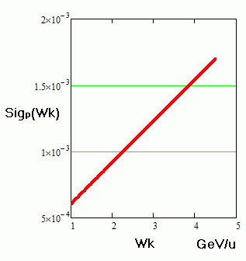
NICA collider parameters
Ring circumference, m | 503,04
Number of bunches | 22
Rms bunch length, m | 0.6
Beta-function in the IP, m | 0.35
Betatron tunes, Qx/Qy | 9.44/9.44
Ring acceptance | 40 π⋅mm⋅mrad
Long. acceptance, Δp/p | ±0.010
Gamma-transition, γ_{tr} | 7.088
Ion energy, GeV/u | 1.0 | 3.0 | 4.5
Ion number per bunch | 2∙10⁸ | 2.4∙10⁹ | 2.3∙10⁹
Rms dp/p, 10⁻³ | 0.55 | 1.15 | 1.5
Rms beam emittance, h/v, (unnormalized), π⋅mm⋅mrad | 1.1/ 0.95 | 1.1/ 0.85 | 1.1/ 0.75
Luminosity, cm⁻²s⁻¹ | 0.66e25 | 1e27 | 1e27
IBS growthe time, sec | 160 | 460 | 2000
R.m.s momentum spread
at equilibrium between IBS and
electron or stochastic cooling
3

Slide 4
Structure scheme of collider rings
4

Slide 5
Beam preparation scheme
Beam storage at the experiment energy
RF barrier bucket system (RF1)
Allowing storage of the required beam intensity at half ring circumference Cring/2. Accumulation efficiency ~ 95%, about 44 - 100 injection pulses (22-50 to each ring) every 5 sec. Total accumulation time is about 6 min.
RF1 can be used for acceleration ions if injection energy is less then energy of experiment RF1 generates accelerating voltage 250-300 V.
1st narrow-band RF system (RF2)
Operating at 22 harmonics of revolution frequency; it provides the beam bunching.
2nd narrow-band RF system (RF3)
Operating at harmonics number 66, that provides the bunch length necessary for collision experiments.
5

Slide 6
Scheme of RF cycle in collider
Barrier RF system (1-st RF)
accumulation
barriers are switched off
coasting beam
2-nd RF system (h=C/23m=22)
1/3
bunching with adiabatic RF increase
Stop at length of 1/3 of bucket
3-d RF system (h=h2x3=66)
rebucketing adiabatic RF increase
bunch has final parameters

Slide 7
Main parameters of RF systems
 | RF1 | RF2 | RF3
Frequency, MHz | BB | 11.48-12.9 | 34.4-38.7
Total voltage amplitude, kV | 5 | 100 | 1000
Voltage per resonator, kV | 5 | 25 | 125
Number of resonators | 1 | 4 | 8
7

Slide 8
Maximal luminosity
Betta function in collision point is minimal
β=0.35 m and β=0.6 m
2. Collision frequency is maximal,
Number of bunches nb =22 to avoid parasitic collisions in IP region with length 23 m
3. Bunch length is minimal
σb=0.6 m to reduce hour-glass effect in collision point, further reduction of bunch length
became to increase of peak current and betatron tune shift
4. Phase density in bunch is maximal Nb/ε
5. Bunch intensity is maximal Nb
8

Slide 9
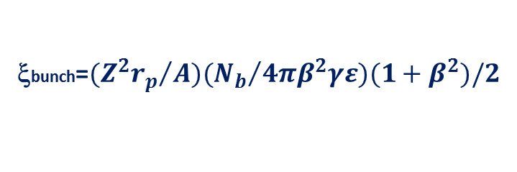
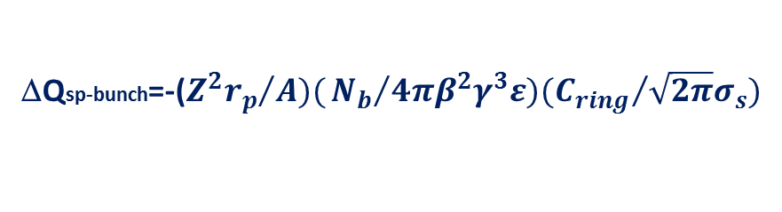


Incoherent betatron tune shift
ΔQtot=ΔQsp+2ξ
tune shift of bunched beam at experiment parameters
ΔQsp-bunch=-(${Z^{2}r_{p}}/{A)(}{N_{b}}/{4πβ^{2}γ^{3}ε)({C_{ring}}/{\sqrt{2π}σ_{s})}}$
ΔQsp-bunch ∝N/(nb$\sqrt{2π}σ)$
ΔQsp-bunch= - 0.035/0.014 at ion energy 1/4.5 GeV/n
Stack beam at maximal storage ion intensity
ΔQsp-stack∝N/(Cring /2)
ΔQsp-stack= -0.013/0.005 at ion energy 1/4.5 GeV/n
ΔQsp-bunch/ΔQsp-stack=(Cring/2)/(nb$\sqrt{2π}σ)=2.74$
Beam- beam parameter of bunched beam et experiment parameters
ξbunch=$({Z^{2}r_{p}}/{A)({N_{b}}/{4πβ^{2}γε)(1+β^{2})/2}}$
ξbunch∝N/nb
ξbunch= 0.004/0.0014 at ion energy 1/4.5 GeV/n
Stack beam at maximal storage ion intensity
ξstack∝N⋅lcol/(Cring /2)
ξbunch/ξstack=(Cring/2lcol)/nb=1
ξstack= 0.004/0.0014 at ion energy 1/4.5 GeV/n
9

Slide 10
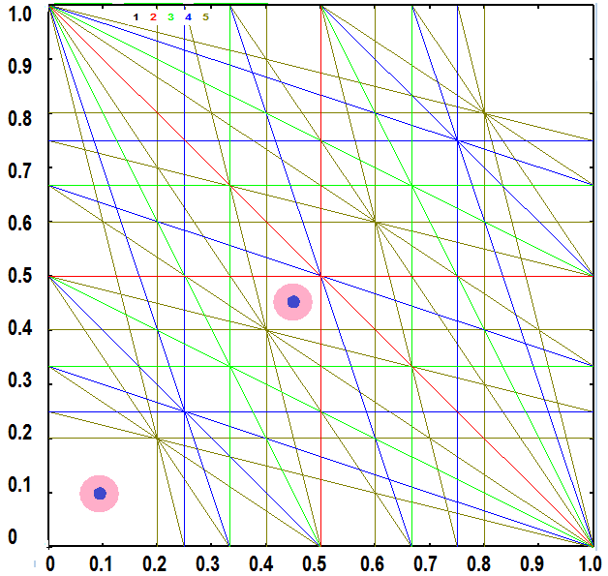
5 order sum resonances
10

Slide 11
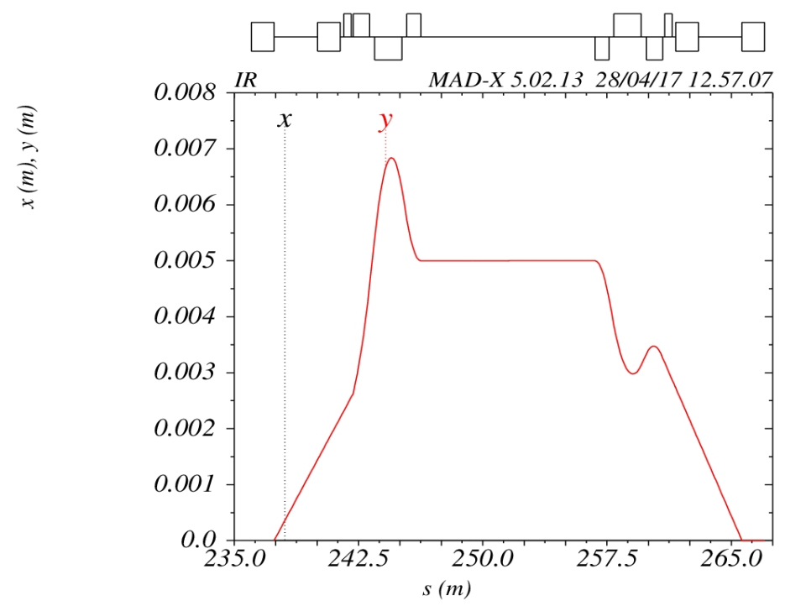
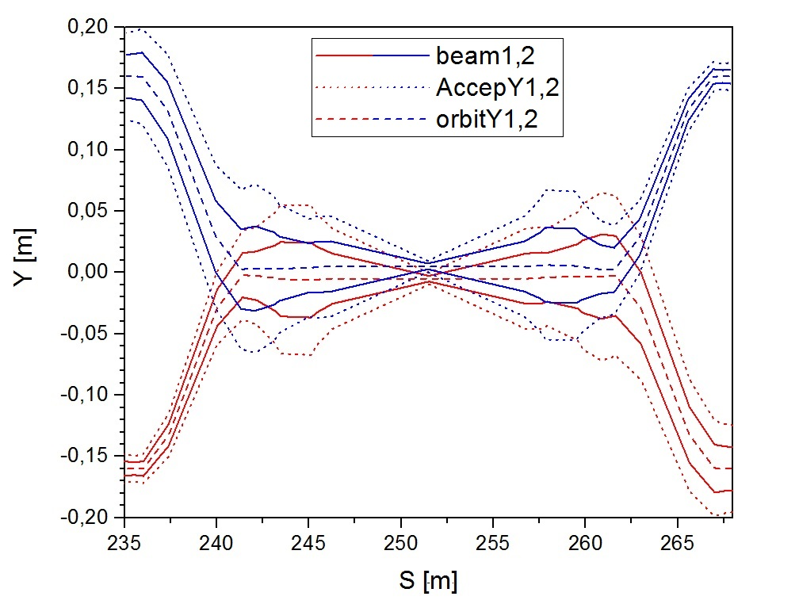
Bumps of ion orbits in collision region at storage of ion beams
O. Kozlov simulations,
β*=0.6m, sigma_x,y, =0.8 mm
Four correctors from each side of colliding region in two rings will be used for correction of ion orbit in colliding region.
At storage of ion beams in collider rings these correctors are planed to used for bump of ion orbits of counter propagating beams in collision region. The correctors provide 1 mrad deflection angle (magnetic field is 0.1 T, corrector length is 30 cm) and vertical displacement of centers gravity of ion beams on distance Δ=10 mm.
Bump of ion orbit in collision region
Counter propagating beams are separated only In collision point.
Ion trajectories at bump of orbits
11

Slide 12
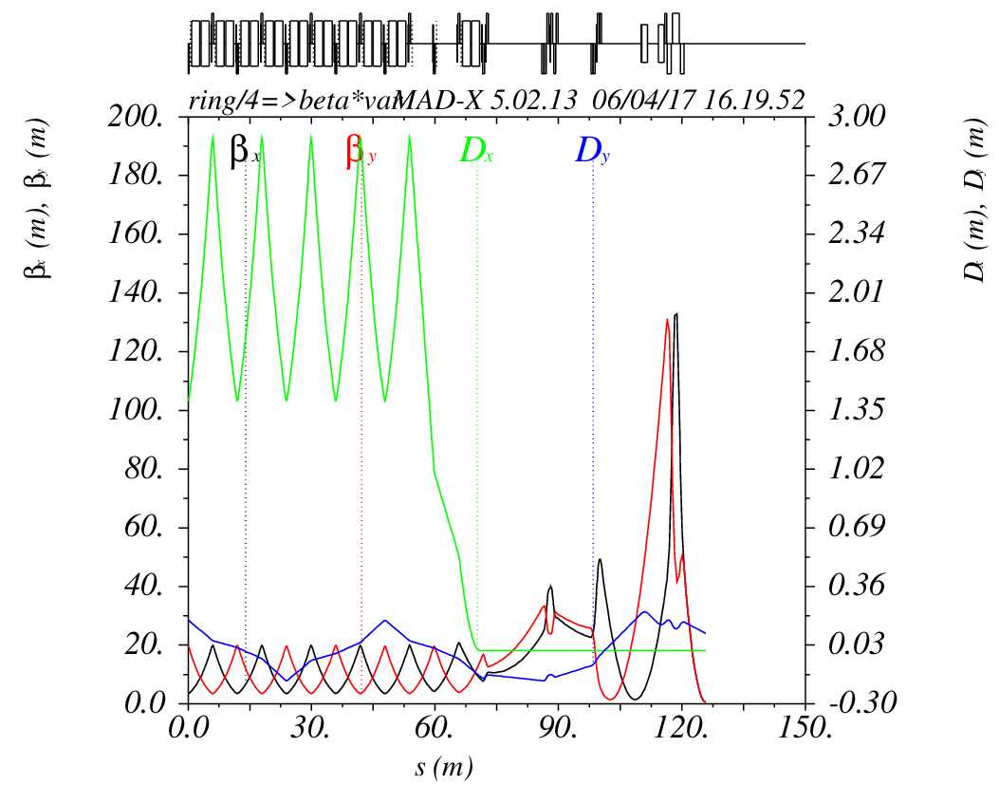
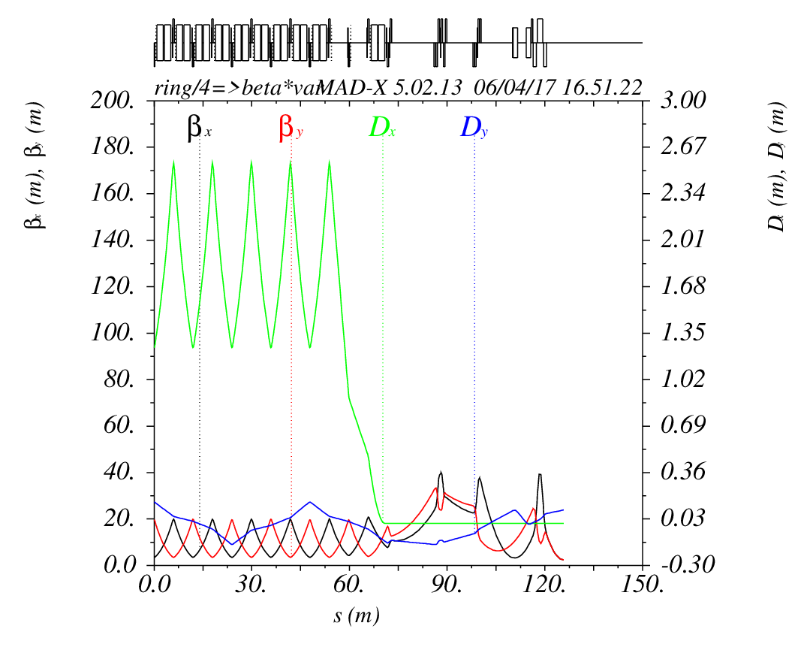
β* Variation at storage of ion beams
Twiss-parameters for a quarter of the ring, β* variation (O. Kozlov)
β*=0.6m
sigma_x,y, =0.8 mm
β*=2.5m
sigma_x,y, =1.65 mm
12

Slide 13
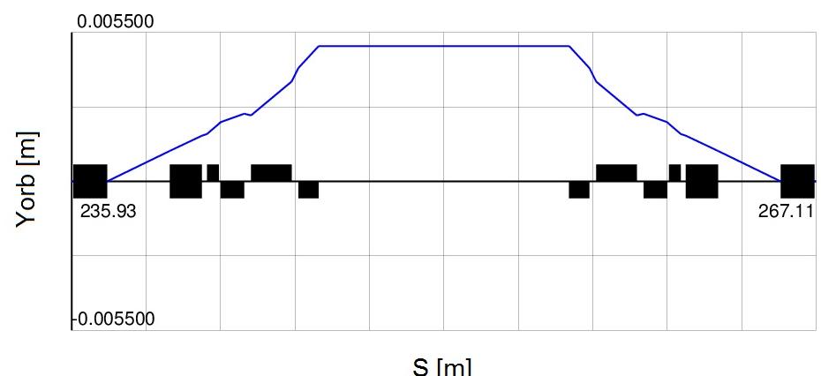
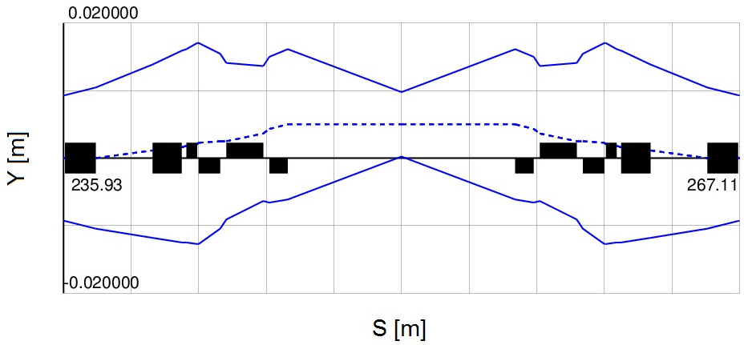
Bump orbit at IP beta function 2.5 m
The correctors provide 0.5 mrad deflection angle (magnetic field is 0.075 T, corrector length is 30 cm) and vertical displacement of centers gravity of ion beams on distance Δ=10 mm.
Beam envelope 6 σ in colliding region at bump orbit
13

Slide 14
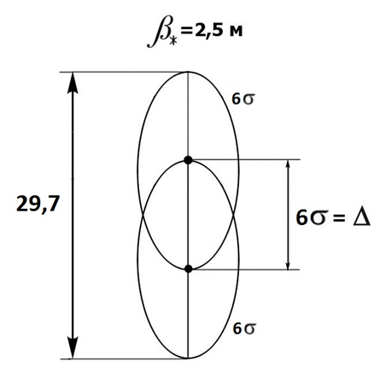
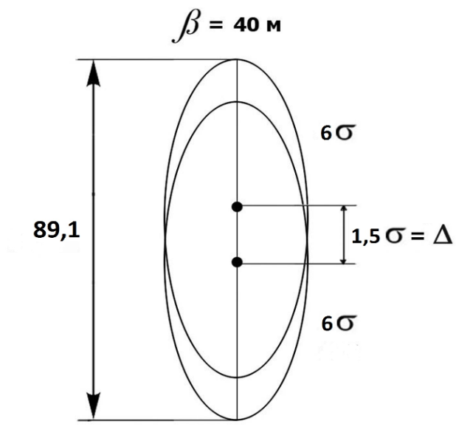
Reduction of parasitic collisions of stored ion beams
IP
β*=2.5m
σx,y, =1.65 mm
This aperture permits to store two counter propagating ion beams with sizes of 6σ. Each beam center gravity is displaced in vertical direction on a distance ±3σ=±5 mm relatively to axis. The distance between beam center gravities is Δ=6σ=10 mm
Lenses of final focus
Δ=10-4.5 mm
σx,y, =3.8-5.1 mm
In the lenses of final focus the counter propagating ion beams
with sizes of 6σ are overlapping. However the centers of gravities for two counter propagating ion beams are displaced in vertical direction on distance of Δ=2.5σ - σ.
It permits to reduce beam-beam parameter ξ by a factor of 4-5 in regime of parasitic collisions, caused by collisions by ion tails, where number of colliding ions is reduced, and reduction of collision length.
14

Slide 15
Parameters of BB RF1 station
E=4.5 GeV/n
Maximal voltage – 5 kV
Rectangular barrier with phase length- π/12
Stack phase zone– π (Nuclotron perimeter 251.5 м).
Kicker pulse=kicker forward front – 100 ns+ plateau – 200 ns+ back front- 410 ns= 710 ns=π-2π/12=5/6π
Injection zone = kicker plateau=200 ns = 0.23 π (59 m>6σ)
Ion storage is realized with four moving barriers. Barriers with voltage 5kV and phase length π/12 capture ions with momentum spread Δp/p=0.01, corresponding to collider acceptance.
15

Slide 16
RF barrier buckets, scheme operation
RF1 generates four pulses of RF voltage during one revolution period. Pulses 1 and 4 are used for stored ions, pulses 2 and 3 -for injected particles.
Particle distribution and
BB positions at ion storage
Ion injection
Injection zone=0.23π (59 m)
Stack zone=π (251.5 m)
b)BB position at bunches merging
Barriers 2 and 3 moved adiabatically in counter directions
to provide equal momentum spread in injection and stack zones Barriers 3and 4 than switch off and injection portion merging with stack.
c)BB start to prepare space
for new injection
d)BB are displaced to initial
injection position, BB 2-3 should be appeared at injection
16

Slide 17
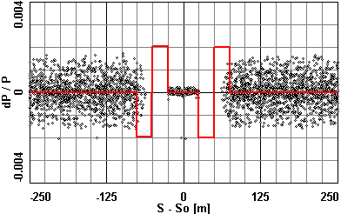
t=233 sec - increasing of stacking region
(A.Smirnov)
17

Slide 18
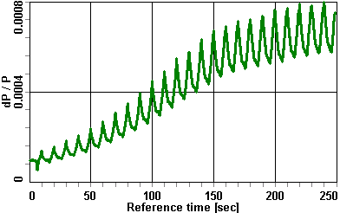
momentum spread evolution
18

Slide 19
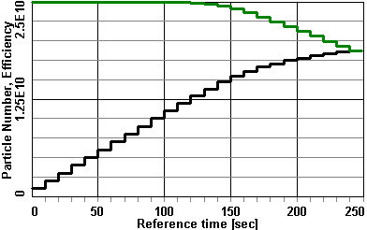
evolution of particle number (black) and accumulation efficiency (green)
19

Slide 20
Parameters of the injected bunch
Ion Energy, GeV/u | 1.0 | 4.5
Particle number, 10⁹ | 1 | 1
RMS bunch length, m | 5.9÷17.5 | 2.5÷6.2
Momentum spread, 10⁻⁴ | 2.8÷0.95 | 2.1÷0.85
Stacking efficiency (%) with moving barriers
Ion energy, GeV/u | 1.5 | 2.5 | 4.5
Barrier height,(Δp/p)×10⁻³ | 0.87 | 1.08 | 2
Electron cooling rates, s⁻¹ | 1.0 | 0.25 | 0.03
Without cooling, % | 68 | 70 | 74
With electron cooling, % | 93 | 91 | 93
20

Slide 21
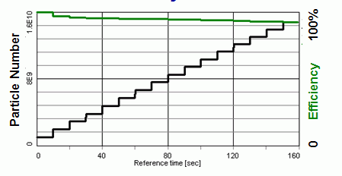
Increase of accumulated particle number on time
BETACOOL simulation (e – cooling). E=1.5 GeV/u. Smirnov A. simulation of stochastic cooling. E= 3.5 GeV/u. T. Katayama
1.5 Gev/u
3.5 Gev/u
Accumulation process and its efficiency
E < 3 GeV/u:
Stacking with Electron cooling
Storage time corresponds to 200 s at ion energy 1-2.5 GeV/n.
E > 3 GeV/u:
stacking with Stochastic cooling
21

Slide 22
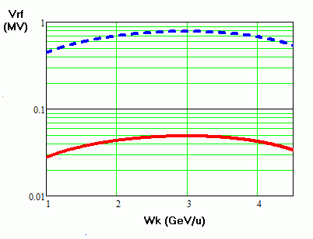
RF2 voltage
  RF2 voltage of 100 kV corresponds to case when longitudinal acceptance is larger than emittance of captured coasting ion beam
  Number of bunches nb =22 to avoid parasitic collisions in IP region with length 23 m
Final emittance is less than starting one (after accumulation) due to cooling.
Preparation of beam for collision occurs in two stages:
1. Adiabatic voltage increase in RF2 (h=22) until time when bunch is placed inside separatrix of 66 harmonic. (Under cooling the bunch shrinks not only in its length but in emittance as well)
  2. Then the bunch length becomes short enough it is intercepted into RF3 (h=66). Adiabatic voltage increase is going on.
The lowest possible RF2 voltage can be limited by 50 kV.
22

Slide 23
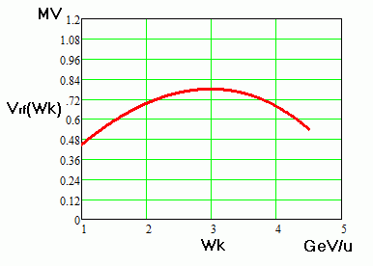

Choice of the RF3 harmonics number
4.5 GeV/u, σ_{p} = 1.7⋅10⁻³
h3/h2 | L _{bucket} in σ_{s} | V _{rf} (kV) | Hbucket in σ_{p}
1 | ±18 | 1723 | ±11.5
2 | ±9 | 861 | ±5.7
3 | ±6 | 574 | ±3.82
4 | ±4.5 | 431 | ±2.9
5 | ±3.6 | 344 | ±2.29
RF3 voltage
Height of bucket in σp at harmonic number more than h3/h2= 3 is less than 3σp. RF voltage is enough large at h3/h2<3. Optimal value h3/h2=3.
Bunching + cooling
RF3 provides formation of required bunch length and momentum
23

Slide 24
Thanks for you attention
24

