Slide 1
Stochastic cooling system: Start-up and project modes
I.Gorelyshev, N.Shurkhno, A.Sidorin
NICA MAC 2017

Slide 2
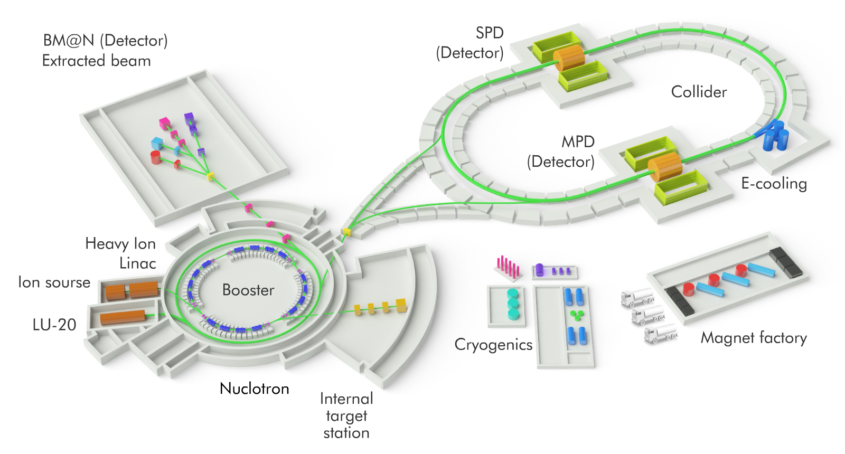
Nuclotron-based Ion Collider fAcility
Stochastic cooling system – one of the crucial elements of NICA project
Tasks:
Beam accumulation(at low intensities)
Longitudinal emittance reduction during the bunching
Luminosity preservation(IBS counteration)

Slide 3
Start-up mode | Project mode
RMS bunch length 1,2 m | RMS bunch length 0,6 m
U_{RF} = 50 kV | U_{RF} < 1000 kV
h = 22 | h = 66
Ions ¹⁷⁹Au₉₇₊
ε⫠_{max}= 1,1 π mm mrad
Energy range 3-4,5 GeV/u
Bandwidth 2-4 GHz
Only longitudinal cooling | 3-D cooling

Slide 4
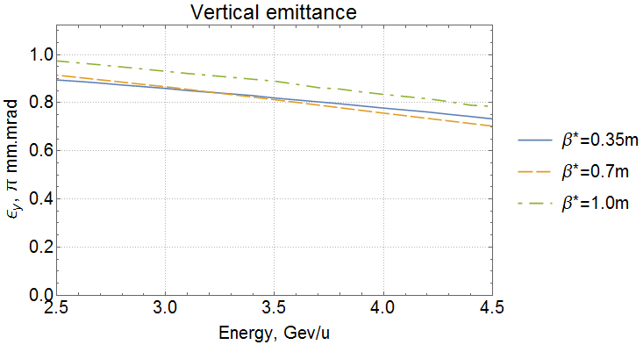
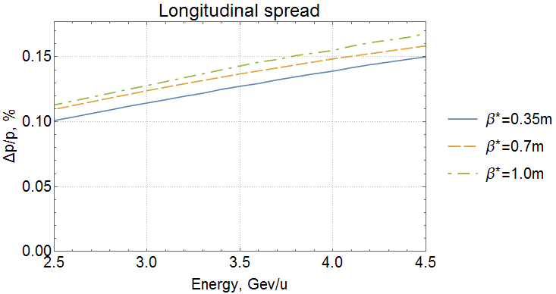
Project mode
IBS calculations: BETACOOL
Structures compared:
3-D cooling
IBS simulation condition
σ_{s} = 60 cm

Slide 5
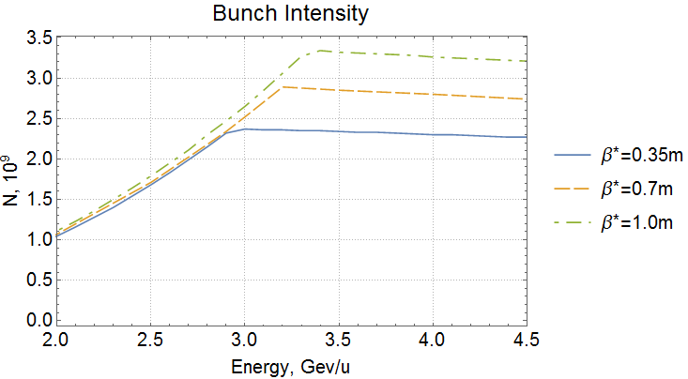
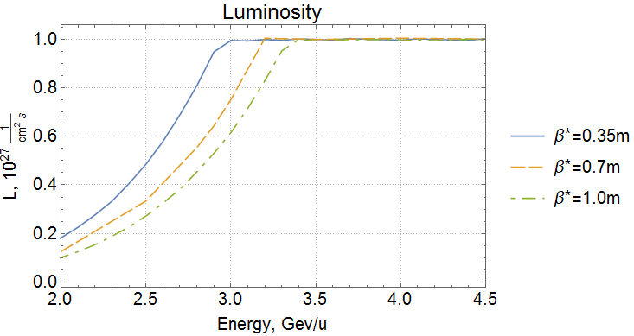
Luminosity
ΔQ = 0,05
L_{max} = 10²⁷сm⁻²s⁻¹
Project luminosity attainment
β^{IP}, m | 0,35 | 0,7 | 1,0
E, GeV/u | 3.0 | 3.2 | 3.4
N, 10⁹ | 2.3 | 2.85 | 3.25

Slide 6
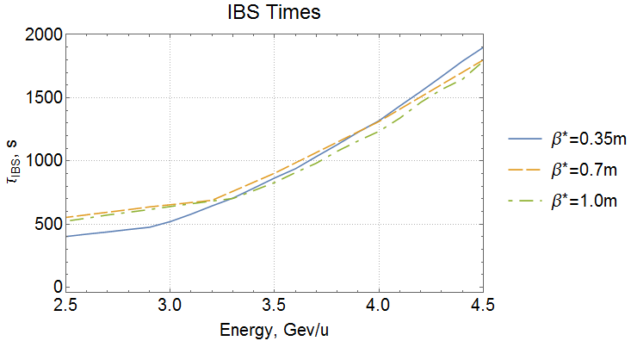
Intrabeam scattering
Requirement: cooling rates has to exceed IBS rates
In the range from 3,3 to 4,5 GeV/u IBS times for compared structures does not significantly depend on β^{IP} and are about (700-1800 s)

Slide 7
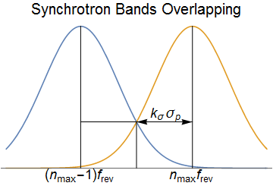
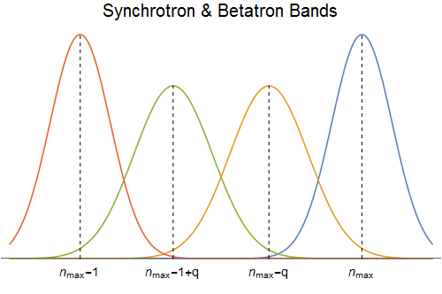
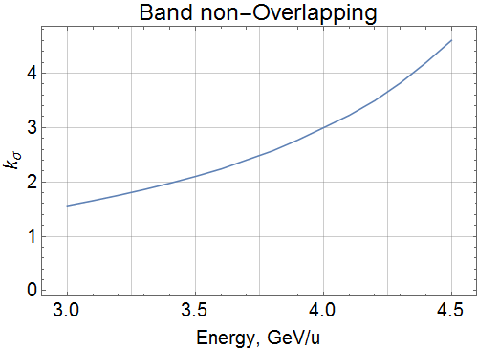
Bandwidth & Working Point
Bandwidth 2-4 GHz
Preferable working point is
Having bandwidth 2 – 4 GHz we have the absence of overlapping 1.5 – 4.6 σ_{p}

Slide 8
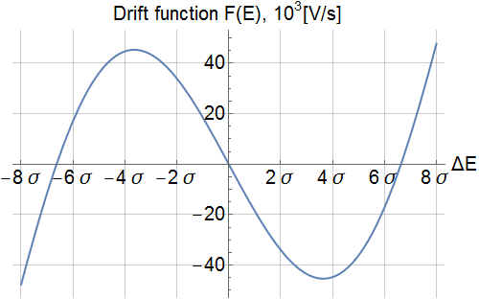
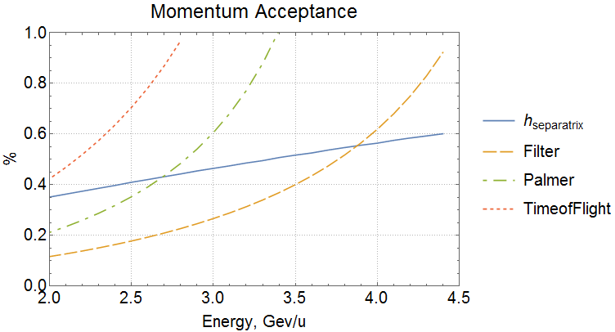
Cooling Acceptance
At energies below 3.9 GeV/u cooling by the filter method does not cover the whole separatrix, which leads to additional beam loss.
The Filter method is rejected for the project mode due to the low acceptance

Slide 9
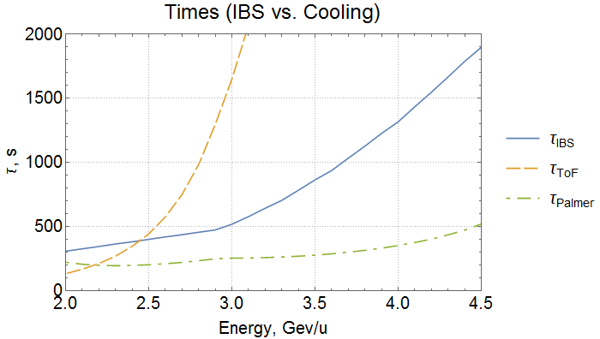
Cooling times(at optimal gain)
Time-of-Flight method does not provide faster cooling tempo than tempo of IBS heating.
Only Palmer method satisfied the requirements and it is chosen for the project mode.

Slide 10
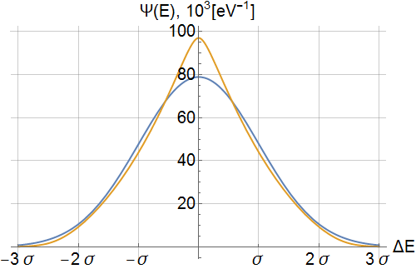
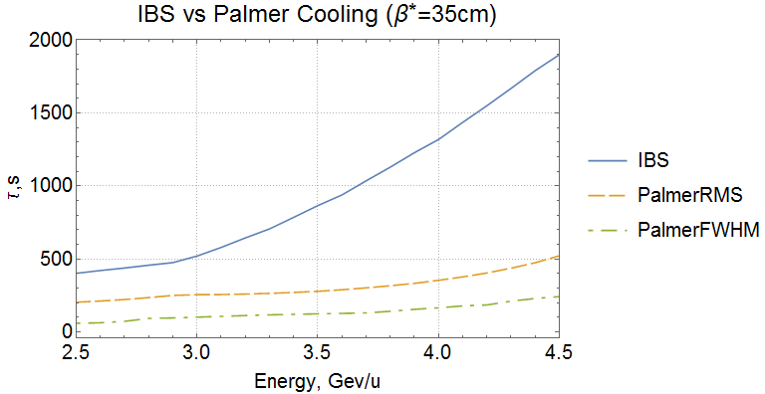
Drift force is not linear
The core is cooled faster than the tail

Slide 11
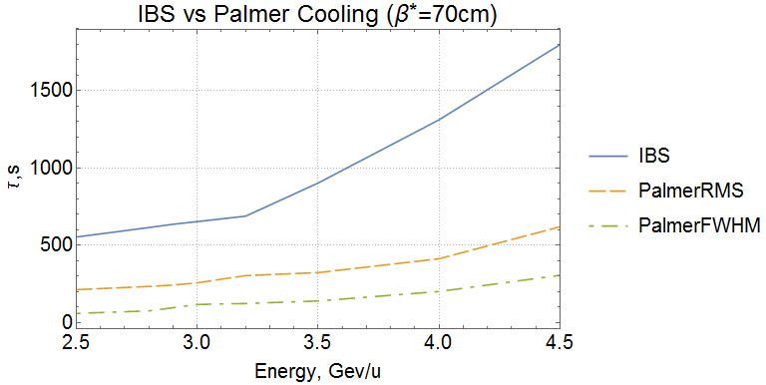
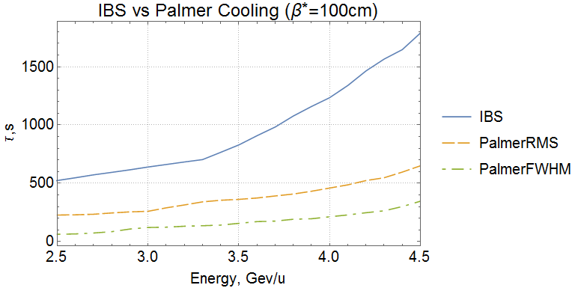
E=3Gev/u | β*=35cm | β*=70cm | β*=100cm
IBS/CoolRMS | 2,034 | 2,543 | 2,464
IBS/CoolFWHM | 5,110 | 5,584 | 5,302
For the project mode the Palmer cooling rates 2-5 times exceed the IBS rates at any discussing choice of β–function in the interaction point

Slide 12
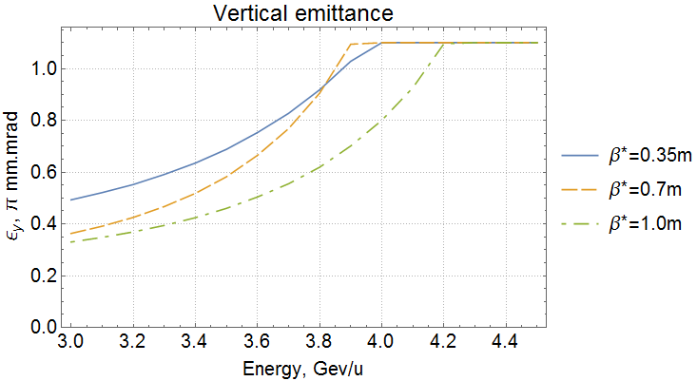
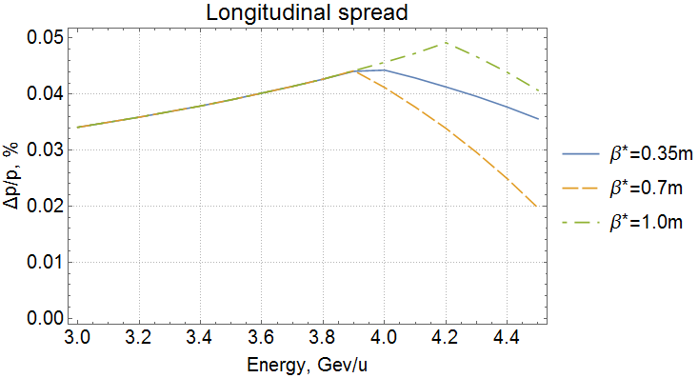
Start-up mode
Longitudinal cooling only
IBS simulation condition
σ_{s} ≤ 120 см

Slide 13
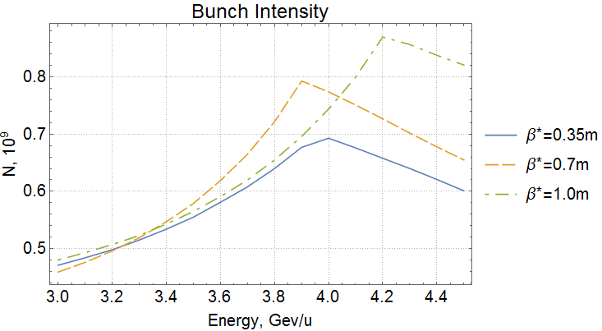
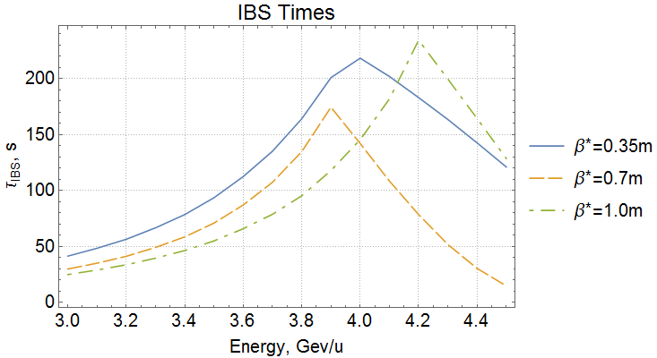
Intrabeam scattering
Required luminosity for start-up mode L = 5∙10²⁵cm⁻²s⁻¹

Slide 14
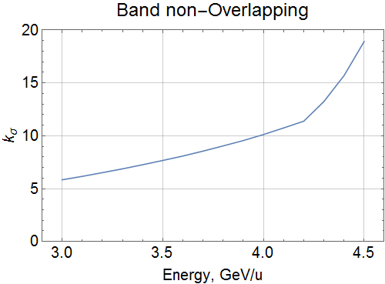
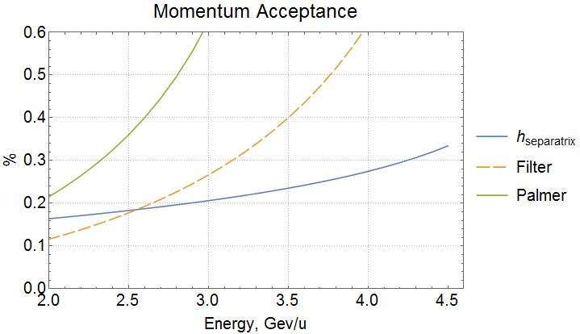
Bandwidth & Cooling Acceptance
Separatrix covered:
Palmer: >1,7 GeV/u
Filter: >2,5 GeV/u
Absence of band overlapping > 6σ_{p}
Palmer and Filter methods are allowed to be implemented by acceptance criterion.
Filter method provides faster cooling rates therefore it is chosen for the start-up mode.

Slide 15
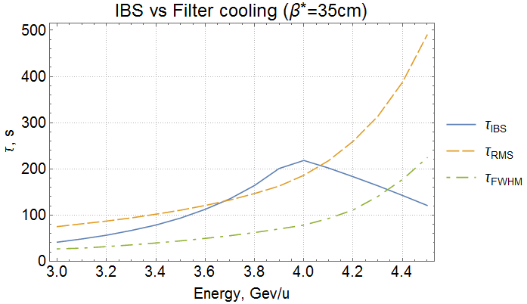
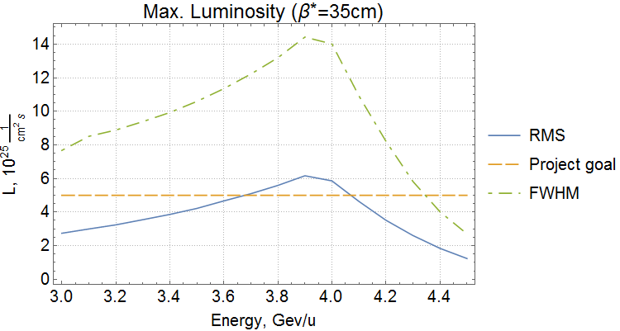
Luminosity (at equal IBS/Cooling rates)
for project luminosity
For the core of the distribution the stochastic cooling system provides the required cooling rates

Slide 16
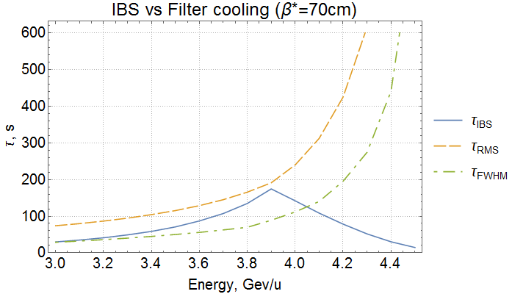
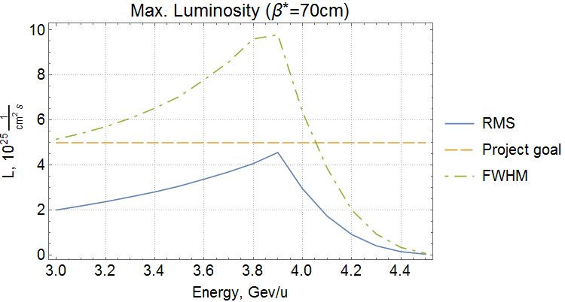
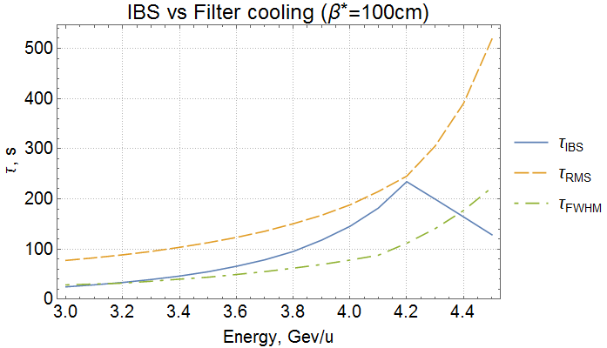
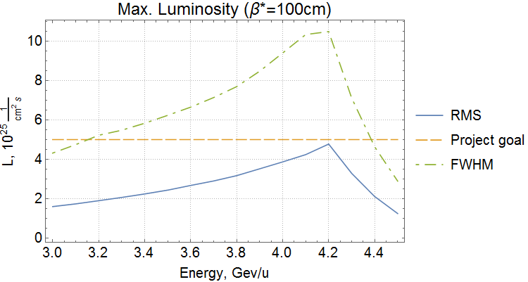

Slide 17
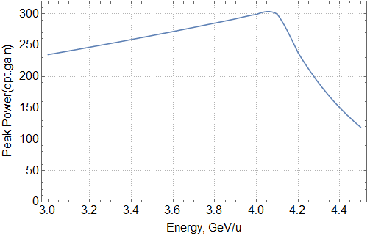
Power & Gain
Mode | Start-up | Project
Long. cool. method | Filter | Palmer
Optimal gain, dB | 69 | 91
Equipment losses, dB | 67 | 37
Total gain, dB | 136 | 128
Output peak power is chosen
500 Watt/channel
Gain is chosen 140 dB

Slide 18
List of Equipment
Low power(<–30dBm): Pickups, Low noise Preamplifiers, Couplers
Medium power: Preamplifiers, Feeder Cable, Optical Comb Filter,
Attenuators, Phase Shifters
High power(>30dBm): Main Amplifiers, Dividers, Kickers

Slide 19
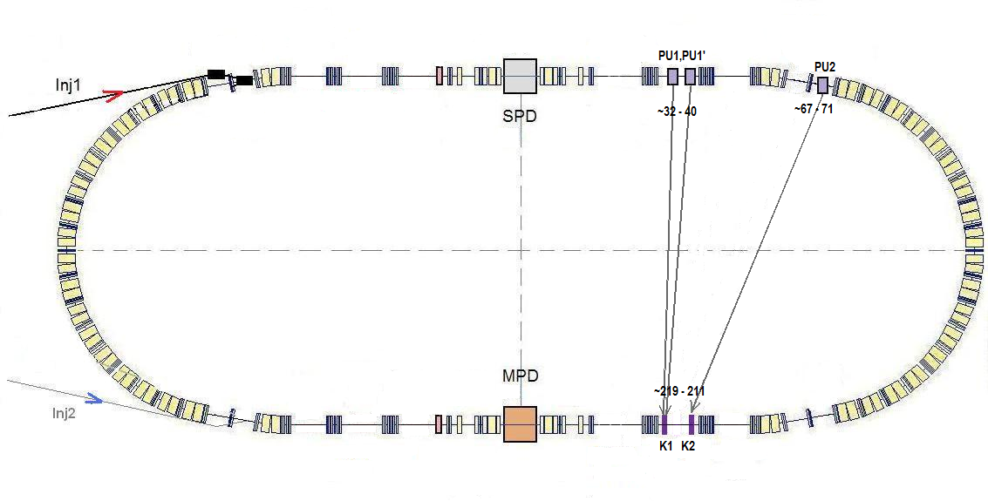
Placement & Delay
Start-up mode:
Longitudinal channel 1
(Equipment own delay 452 ns)
Project mode:
Longitudinal channel 2 (473 ns)
Transverse channels 1, 1’ with combined kicker
(405 ns, 418 ns)
Channel 1’
Channel 1
Channel 2
Min. constant delay:
Channel 1 – 595 ns
Channel 2 – 490ns
+
Variable delay:
Range 32 ns
Precision 1 ps
There is a reserve in delay for all channels and modes

Slide 20
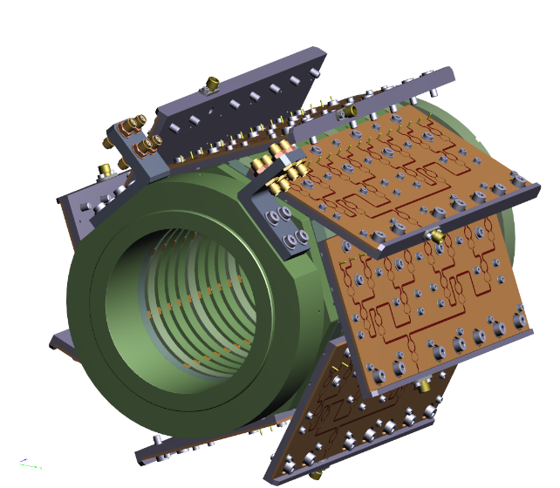
Pickups, Kickers & Main Amplifiers
FZJ Ring-slot couplers are chosen as Pickups & Kickers
Purchase list:
Pickup – 2 basic structures
Kicker – 4 basic structures
6 pickups & 4 kickers in total
16 amplifiers per kicker
100 amplifiers in total
Basic structure – 16 rings
High Impedance
30W amplifier
per each pair of
combiner boards
Kicker dissipates ~ 120 Watt
Negotiations with FZJ concerning pickups & kickers are on the way
Main 30W Amplifiers R&D is in progress (OKB TSP, Minsk)

Slide 21

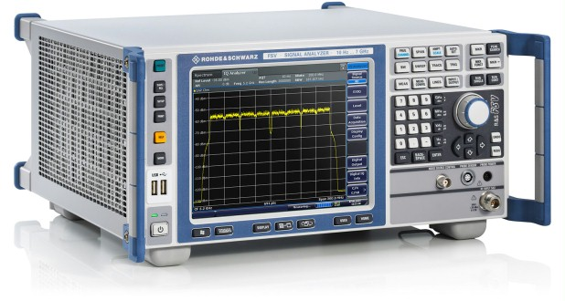
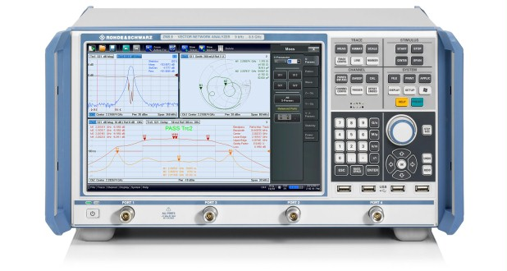
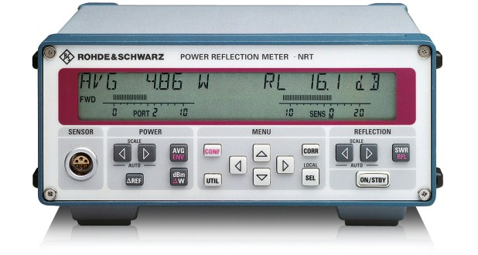
Diagnostics
Signal Spectrum Analyzer
4-channel Vector Network Analyzer
Equipment
is being purchased
Schottky diagnostics
BTF measurements
Power meter

Slide 22
Status & Plans
More detailed plan is in the database
Equipment | Status |  | Plans
Diagnostics | Being Purchased |  | Finished by the end of 2017
Optical Comb Filter | Components being purchased |  | Purchased (III 2017) | Assembled (I 2018)
4 Kickers | Test bench Production | Negotiations (FZJ) | First Tests (III-IV 2017) | Production + Assembly 1 unit/year starting 2018
6 Pickups | Negotiations (FZJ) |  | Production + Assembly 1 unit/year starting 2018
Main amplifiers | R&D |  | R&D finished (end 2017) | 16 units/yr starting 2018
Electronics | Being purchased |  | Purchase + Assembly 1 channel/year starting 2018

Slide 23
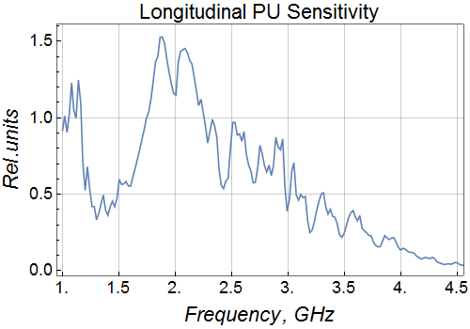
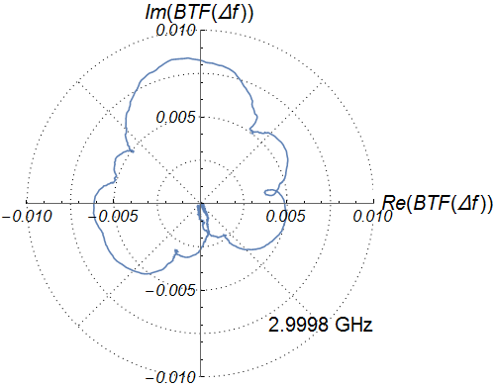
Recent results
Beam Transfer Function:
Nyquist diagrams of
41 harmonics measured

Slide 24
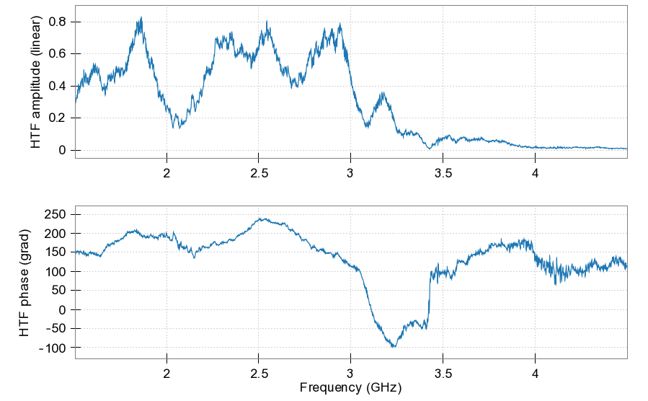
BTF measurements at FZJ

Slide 25
Conclusions
Stochastic cooling system can provide the required luminosity at any discussing beta-function in the interaction point for both Start-up and Project modes.
For longitudinal cooling in the Start-up mode the Filter method is chosen, Palmer method is chosen in the Project mode. Also main parameters are defined.
For the Start-up mode the stochastic cooling system provides the required cooling rates for the core of the distribution. Evolution of the distribution function tails has to be investigated numerically.
Equipment purchasing is started, main amplifiers R&D is in progress, negotiations with FZJ concerning pickups and kickers are on the way.

Slide 26
Thank you for attention

