Slide 1
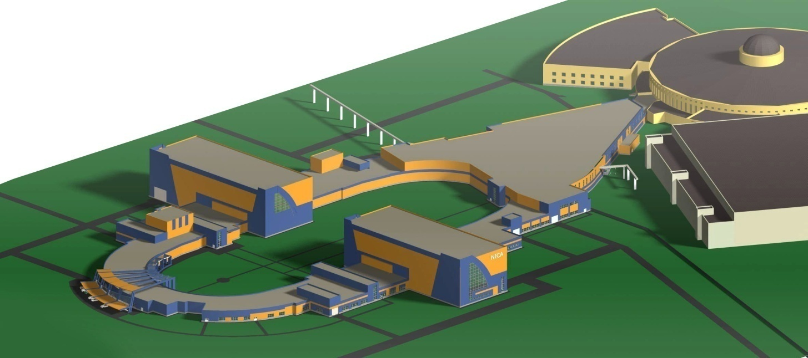
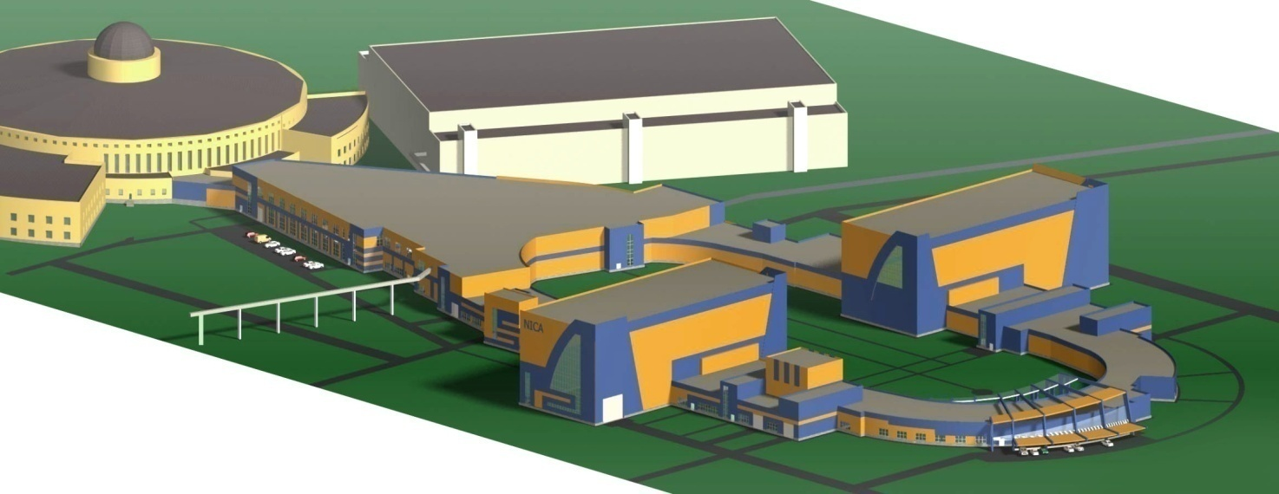
MAC for NICA May 22–23, 2017
RADIATION ENVIRONMENT
AT THE NICA COMPLEX
G. N. Timoshenko
M. Paraipan
A. R. Krylov

Slide 2
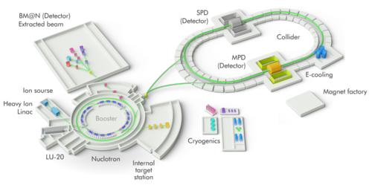
THE PRINCIPAL RADIATION SOURCES: 1) HILAC, LU-20
2) Booster 3) Nuclotron 4) Ion beam transport channels 5) Collider
6) 205 building
Slide 1

Slide 3
The secondary radiation fields are formed at the accelerators due to losses of particles during acceleration process and their interaction with the accelerator components, targets, etc. The hardest radiation environment around the NICA facilities will be connected with acceleration of ¹⁹⁷Au ions to maximum energy.
The main radiation component behind radiation shielding of high-energy accelerators are neutrons with a very wide energy range. When accelerators are stopped the main radiation factor is gamma-rays due to radioactivity induced in accelerator’s equipment.
According to Russian legislation:
effective dose rate at working places of personnel A must be lower than 12 μSv/h;
for personnel B effective dose rate must be lower than 2.4 μSv/h;
for population the annual effective dose must be lower 1 mSv
For new facility (the collider), a reserve factor of 2 must be applied.
Compliance with above mentioned requirements is achieved mainly by the following measures:
biological shielding surrounding the radiation sources;
radiation zoning for restriction of personnel’s radiation exposure duration;
interlocks system, which prevent personnel’s access to dangerous radiation zones;
system of permanent zonal radiation monitoring with danger warning by a sonic and light signaling devices.
Slide 2

Slide 4
For radiation shielding design and NICA radiation situation forecasting the modern MC code GEANT4 for the simulation of radiation transport in matter has been applied.
COLLIDER
The main causes of ion beam losses will be:
residual gas in the vacuum pipe;
intra-beam scattering of ions;
large amplitudes of betatron oscillations;
recombination of ions with electrons from the beam cooling system;
5) beam injection systems.
Catcher
Vacuum pipe
Quadrupole lens or dipol magnet
In order to avoid the beam “halo”, special beam catchers will be mounted in the booster and the collider for the beam aperture restriction.
130
285
400
50
90
A scheme of interaction the secondary hadrons from the catcher with collider equipments
shielding
Slide 3

Slide 5
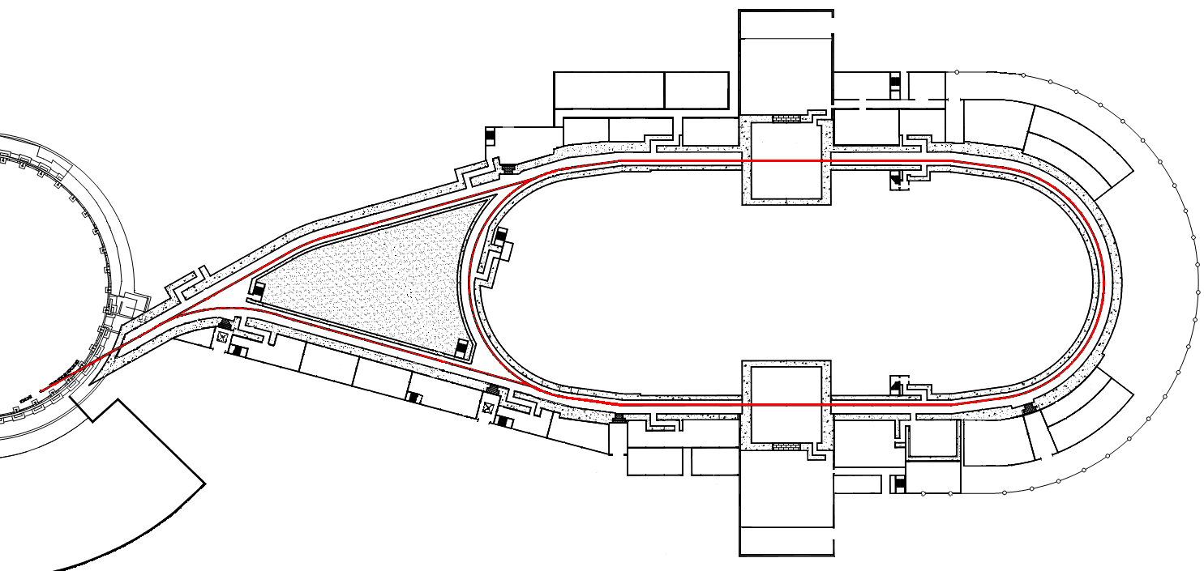
Forbidden area at running
collider
light
fence
11-11′
12-12′
13-13′
14-14′
8-8′
9-9′
15-15′
17-17′
Personnel B
7-7′
18-18′
20 м
6-6′
19-19′
5-5′
20-20′
55 м
4-4′
21-21′
3-3′
2-2′
1-1′
24-24′
23-23′
SEC
border of LHEP site
Population
- beam “halo” catchers (24 catchers in every rings)
MAIN RADIATION SOURCES
Catcher losses (distributed equally);
Uniform beam losses along the rings;
Additional losses in the catchers 1, 2, 3 and 24′, 23′, 22′ owing to ion recombination with SEC electrons – in proportions 50%, 30%, 20% respectively;
Kickers, septum magnets losses − only during injection;
Slide 4
Notes:
This is general plan of the collider with the placement of main radiation sources. The total amount of the catchers in both collider rings are 48 (local sources). The other local sources are kickers and septum magnets in the ion beams inlets to the rings. Additional losses in the catchers 1, 2, 3 and 24 prim, 23 prim, 22 prim will be owing to recombination of ions with SEC electrons – in proportions 50 %, 30 %, 20 % respectively. There are the uniform beam losses along the rings also.
You see here the border of the LHEP with shortest distance from the collider 55 meters. This is the first crucial point at the NICA complex from the point of view of radiation situation. The western arc of the collider will be fenced by light barrier since most part of the ion losses in the collider will be in the region of the arches.

Slide 6
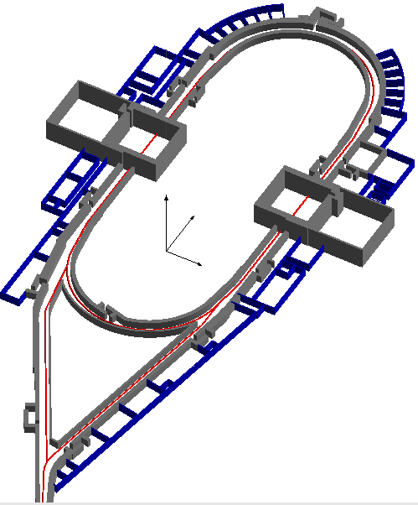
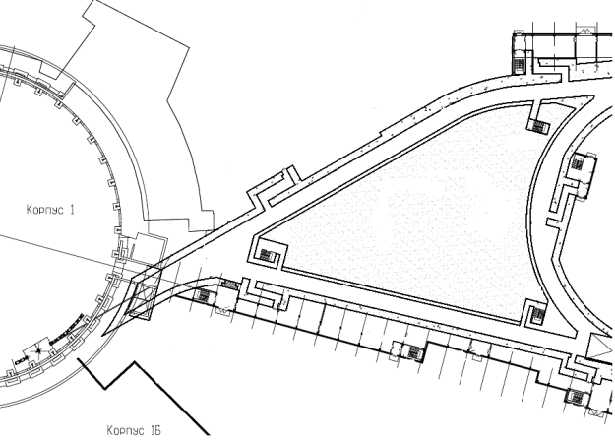
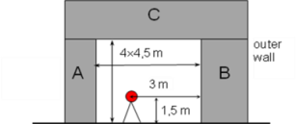
3D simulation geometry of the collider
А-1,5 m, В-2 m, С-2 m
А-2 m, В-3 m, С-2,5 m
Tunnel cross section
А-1,5 m, В-2 m, С-2 m
C
A
4×4,5 m
B
outer
wall
А-1,5 m, В-2 m , С-2 m
3 m
1,5 m
top ring
А-1,5 m, В-2 m, С-2 m
А-2 m, В-1 m, С-2,5 m
А-1 m, В-2 m, С-2 m
low ring
A -1 m, В- 2,5 m, С - 2 m
A- 1 m, В- 2 m, С- 2 m
Shielding material – ordinary concrete ρ= 2,35 g/cm³
Beam transport channels
Slide 5

Slide 7
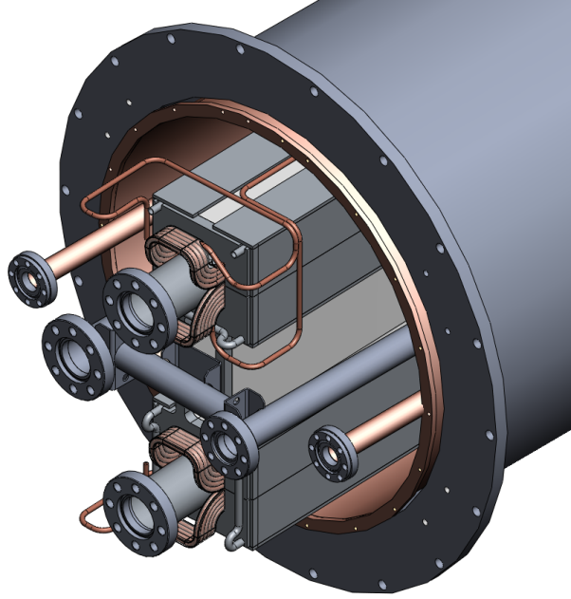
FODO period 11.96 m
С
DM
DM
CM
QL
beam chambers ∅ 56 mm;
wall thickness 3 mm (Fe)
magnet core(Fe);
section 230х230 mm²
320
cryostat ∅ 800 mm;
wall thickness 6 mm (Fe)
dispersed matter (Fe);
ρ =0.223 g/cm³
The detailed design of the collider equipment components and their placement along the rings were taken into account in the calculations
Slide 6

Slide 8
At a large distance from the collider, the radiation fields are formed by neutrons multiply scattered in air and ground (“skyshine” neutrons)
Simulation of the “skyshine”
effect
Dry air
R = 1000 m
Radial distribution of the annual effective dose of “skyshine” neutrons
Dry ground 1 m
Ordinary concrete ρ = 2.34 g/cm³ Ground ρ = 1.7 g/cm³ Air ρ = 0.00012 g/cm³
Element | Mass fraction (%)
H | 0.56
O | 35.73
C | 15.41
Si | 18.74
Ca | 26.85
Mg | 2.71
Element | Mass fraction (%)
Si | 46.64
O | 53.36
Element | Volume (%)
N₂ | 78
O₂ | 21
Ar | 1
Slide 7
Notes:
At large distance from the collider the radiation fields will be formed by multiscattered in air and ground neutrons (so colled “skyshine” neutrons). In order to simulate the "skyshine" effect around the collider by the GEANT4 code the big volume of air around collider was considered. Here are a scheme of the skyshine neutron field forming near the collider and the radial distribution of the annual effective dose of skyshine neutrons.

Slide 9
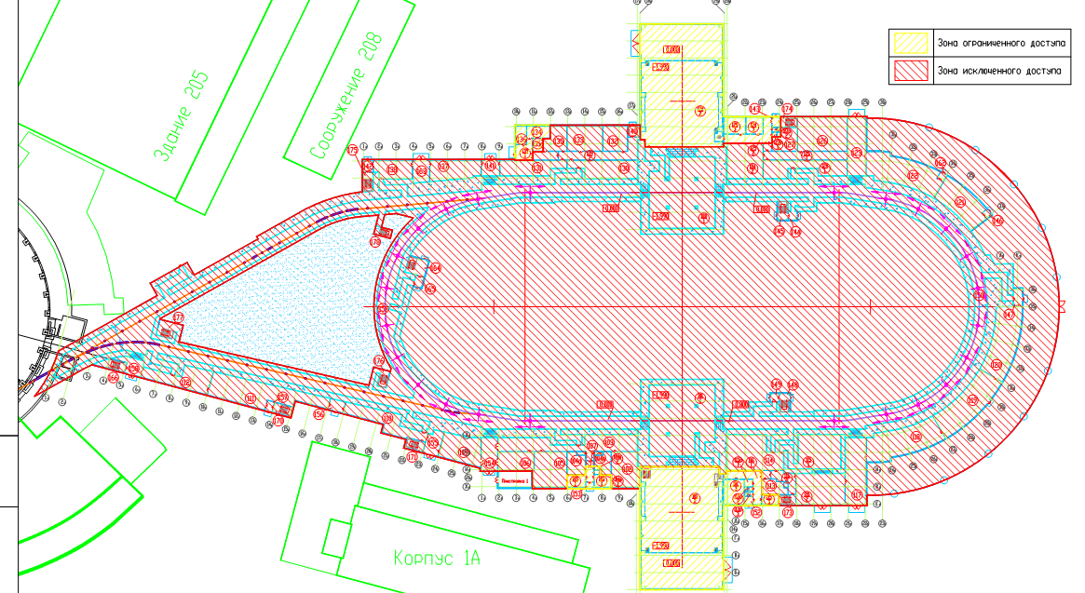
restricted access area
forbidden access area
1,2 µSv/h
(personnel B)
55 m
0.5
mSv/year
(population)
6 μSv/h
(personnel А)
Radiation zoning around the collider will be determined by “skyshine” neutrons
Slide 8

Slide 10
SIMULATED RADIATION ENVIRONMENT AROUND NICA COLLIDER
10
9
8
11-11′
12-12′
13-13′
14-14′
8-8′
9-9′
15-15′
7
7-7′
17-17′
5
18-18′
6
20 m
6-6′
19-19′
5-5′
20-20′
55 m
4-4′
21-21′
3
11
3-3′
2-2′
1-1′
24-24′
23-23′
4
SEC
1
2,3
μSv/h
2
Points of calculation | 1 | 2 | 3 | 4 | 5 | 6 | 7 | 8 | 9 | 10 | 11
Quantity | μSv/h | μSv/h | μSv/h | μSv/h | μSv/h | μSv/y | μSv/h | μSv/h | μSv/h | μSv/h | μSv/y
Beam catchers | 0,19 | 0,04 | 0,25 | 0,07 | 0,19 | 393,5 | 0,25 | 0,071 | 0,19 | 0,043 | 54,4
Ion-electron recombination | 0,14 | 0,02 | 0,05 | 0,02 | 0,013 | 36,8 | 0,011 | 0,006 | 0,001 | 0,0041 | 8,48
Kickers, septum magnets | 1,01·10⁻⁴ | 1,19·10⁻⁴ | 8,55·10⁻⁵ | 8,58·10⁻⁵ | 6,49·10⁻⁵ | 0,5 | 6,39·10⁻⁵ | 8,0·10⁻⁵ | 1,87·10⁻⁵ | 5,03·10⁻⁵ | 0,077
Uniform ring losses | 1,72·10⁻⁴ | 3,83·10⁻⁴ | 2,16·10⁻⁴ | 4,3·10⁻⁴ | 1,46·10⁻⁴ | 1,91 | 2,09·10⁻⁴ | 4,13·10⁻⁴ | 2,17·10⁻⁴ | 4,66·10⁻⁴ | 0,87
Total | 0,33 | 0,07 | 0,3 | 0,07 | 0,21 | 432,7 | 0,26 | 0,08 | 0,19 | 0,05 | 63,8
0,082 μSv/h
0,012 μSv/h
The gamma-ray components of the total doses are not shown in the Table, but they are not more than 5% for the “skyshine” neutron fields and not more than 7% right behind the collider shielding.
Slide 9

Slide 11
Induced activity simulation for the NICA collider
The verification of the GEANT4 code with the unique
data on residual radioactivity in an experiment in which thick stainless steel and copper targets were bombarded with 950 MeV/n ²³⁸U ions shown that the total activities simulated by the GEANT4 code are overestimated up to 1.5 times. It is quite acceptable for the radiation protec-tion purposes as overestimation is preferable to under-estimation in this case.
Predicted levels of induced radioactivity at the catcher
Isotope | Partial specific activity after 1 month, Bq·kg⁻¹ | Partial specific activity after 10 years, Bq·kg⁻¹
³⁵S | 1.4·10⁴ | 2.45·10⁴
³⁸Cl | 1.15·10⁴ | 1.17·10⁴
⁴²K | 1.6·10⁴ | 1.65·10⁴
⁴³K | 1.14·10⁵ | 1.15·10⁵
⁴⁵Ca | 2.3·10³ | 1.1·10⁴
⁴⁷Ca | 1.8·10³ | 4.2·10³
⁴⁶Sc | 8.2·10³ | 3.8·10⁴
⁴⁷Sc | 3.3·10⁴ | 3.3·10⁴
⁴⁸Sc | 1.4·10⁴ | 1.4·10⁴
⁴⁸V | 2.3·10⁵ | 2.3·10⁵
⁵¹Cr | 2.8·10⁵ | 5.7·10⁵
⁵²Mn | 4.5·10⁵ | 4.6·10⁵
⁵⁴Mn | 3.8·10⁴ | 5.5·10⁵
⁵²Fe | 2.55·10⁵ | 2.8·10⁵
⁵⁵Fe | 4.2·10⁴ | 1.5·10⁶
⁵⁹Fe | 4.1·10³ | 1.4·10⁴
⁵⁵Co | 4.9·10⁴ | 5.3·10⁴
⁵⁶Co | 2.4·10⁴ | 7.2·10⁴
⁵⁷Co | 4.6·10³ | 1.9·10⁴
The dynamics of the total residual activity of catcher steel
during the first month and to the end of collider operation
Slide 10

Slide 12
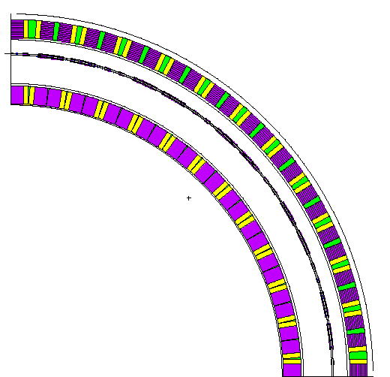
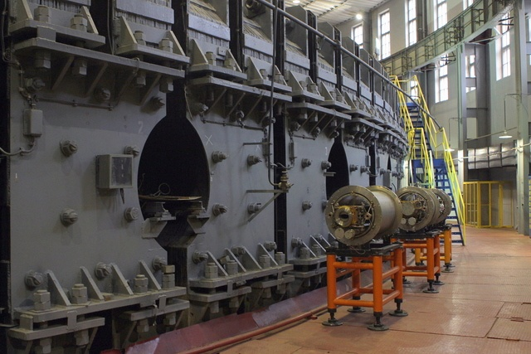
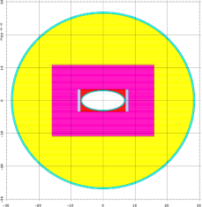
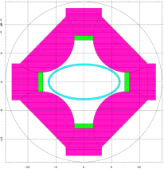
The booster will be arranged within the old magnet yoke of the Synchrophasotron in LHEP Building № 1. Building № 1 was constructed as an ordinary building with relatively thin wall, large window openings and light roof and has no shielding capacity. Unfortunately, the massive magnet yoke of the Synchrophasotron is also not a good radiation shielding for the booster ring because of numerous gaps and open windows.
BOOSTER
gaps
DIP
windows
A mathematical model of the Synchrophasotron ring with gaps and openings was developed.
Calculations show that an magnet yoke with openings would reduce the dose rate only
1.5-2 times compared with the situation
when the yoke is completely absent. It is due to scattered neutrons from the openings.
QL
Slide 11
Notes:
Читать!

Slide 13
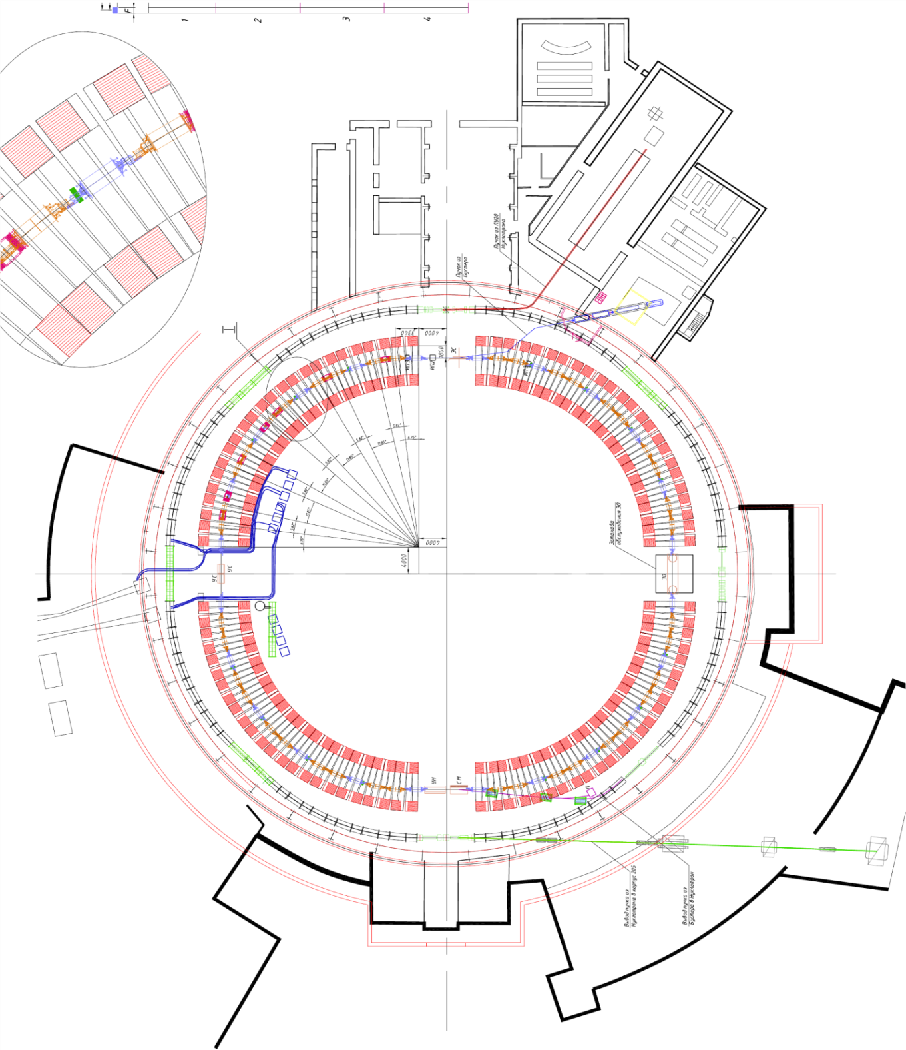
LHEP border
HILAC
113 m
catcher
The main radiation sources of the booster:
beam catchers (4 in each quadrant);
residual gas and intra-beam scattering of ions;
recombination of ions with electrons from the SEC (losses are concentrated in the 4th quadrant catchers );
ion stripping target (in the third linear space);
Booster-Nuclotron thansfer channel;
trap for beam of ions with no-purpose charge state.
1st linear space
light fence
I
IV
2nd linear space
4th linear space
SEC
II
stripping
target
III
3rd linear space
B-N transfer
channel
beam trap
Lambertson
magnet
to 205 Building
8 m concrete shielding
to the collider
Slide 12

Slide 14
Open windows and gaps
It is necessary to shut all openings by concrete plugs and close the linear spaces between the quadrants of the Synchrophasotron ring
Closed windows and gaps
Slide 13

Slide 15
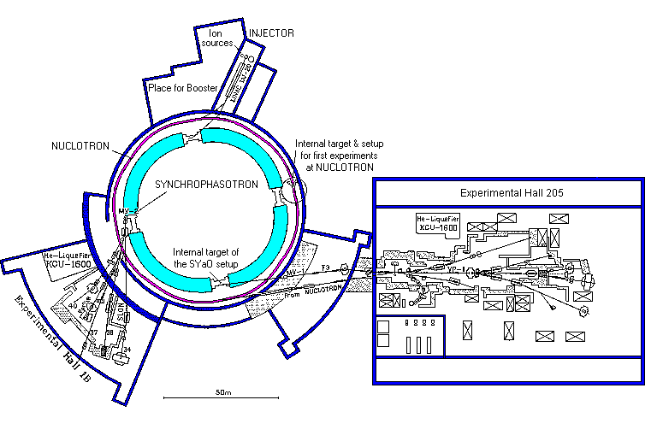
Radiation zoning around LHEP Building № 1 for the running booster
Population
0.15 mSv/y
0.36μSv/h
0.36μSv/h
R
Personnel B
BOOSTER
3.6 μSv/h
Prohibition zone
3.6 μSv/h
Personnel A
0.36μSv/h
Red: prohibited access zone
Green: zone of restricted access for personnel A (controlled zone)
Yellow: access for personnel B
Blue: territory of population access
Slide 14

Slide 16
NUCLOTRON
GEANT4 simulations and rough recalculations of Nuclotron experimental data with deuterons to the NICA conditions show that without upper shielding the annual dose on the LHEP site border will be impermissible (above 5 mSv)
The preliminary estimations of the radiation situation around the Nuclotron show that the thickness of top shielding of the tunnel have to be about 1-2 meters of concrete. The specific thickness of top shielding will depend on the schedule of the complex operation. Radiation zoning for the booster and the Nuclotron will be the same as they are both located in the same building and work at the same time.
Slide 15

Slide 17
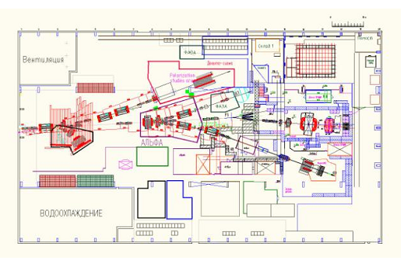
BM@N experiments in the building 205
В
The main radiation source of BM@N installation is ZDC (zero degree calorimeter) that is the massive ion beam stopper. The dose estimations were done for ¹⁹⁷Au ions with energy 4.5 GeV/n and maximum beam intensity 5⋅10⁶ ion/s.
B and A – second and third crucial points, where the effective doses of neutrons and gammas were calculated.
Border of the LHEP site
42,5 m
ZDC
34 m
А
89
67
10,5 m
1
19
10 m
0,5
116 m
С1
С2
Thin target
ZDC
S
8,7 m
The BM@N installation can work near 3000 hours per year (restriction by the point A). During the residual time of the NICA complex operation, the Nuclotron and booster should be turned off between the collider injection cycles.
vacuum tube
4 m
Fe shield 1,1×1,5×1,5 m
Scheme of BM@N shielding
Slide 16

Slide 18
CONCLUSION
For the normal operation of the NICA complex in accordance with the scientific program the radiation safety should be provided for all NICA facilities:
- at the booster by closing all openings with the concrete plugs and by shielding the linear spaces;
- at the Nuclotron by creating the top shielding above the tunnel;
at the collider and beam transport channels by the shielding according to the design project;
at 205 building by the local shielding of the BM@N installation;
at NICA complex as a whole by radiation zoning the territory of the LHEP site and all dwellings of the complex.
The proposed measures will guarantee not exceeding the required dose rate for personnel and annual doses on the border of the LHEP site for population.
Slide 17
Notes:
Читать!

Slide 19
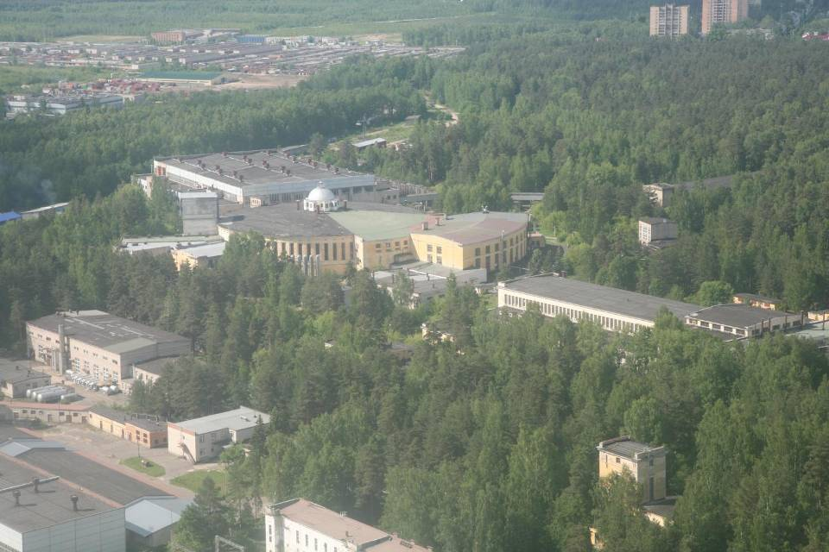
Thank for attention

Slide 20
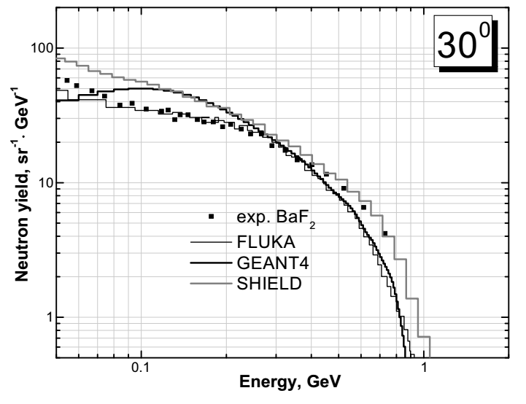
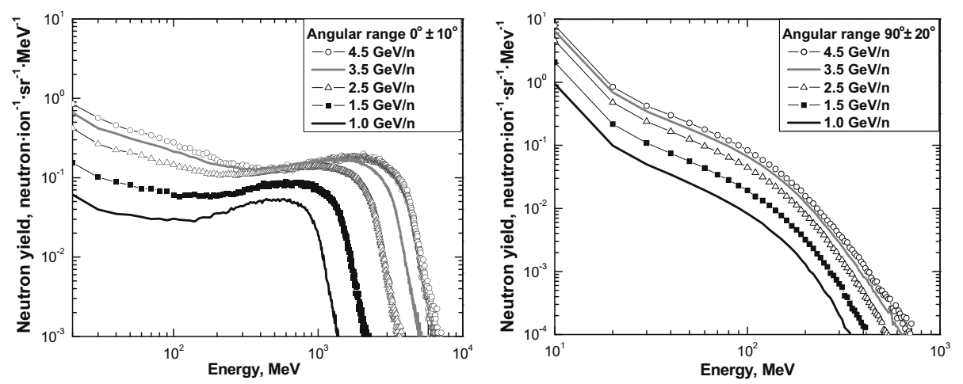
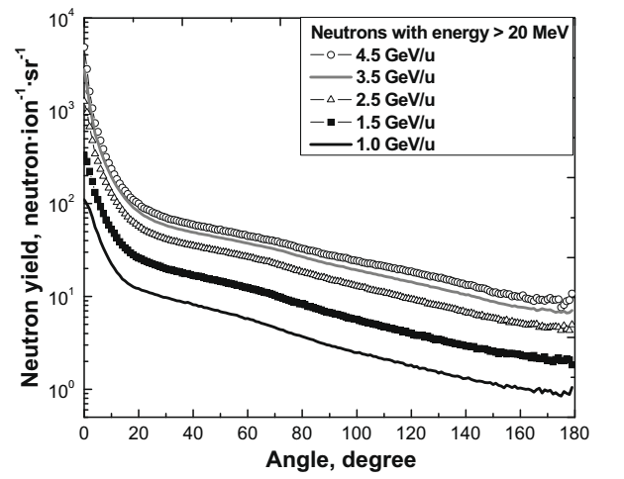
It should be noted that apparently up to now there is a lack of experimental data on the double differen-
tial neutron yields in the interaction of relativistic superheavy nuclei with matter which are so needed for
this project. Here you see the results of GEANT4 comparison with unique experimental data on neutron
yield from thick target bombarded by uranium ion with energy near 1 GeV/nucleon at GSI and our calcula-
tions of the spectra and angular distributions of secondary neutrons depending on the ion energy.
Dependences of the neutron spectra from a thick Fe target on the uranium projectile energy in the forward and lateral directions.
Angular dependences of the yield of neutrons with
energies above 20 MeV from the thick Fe target

Slide 22
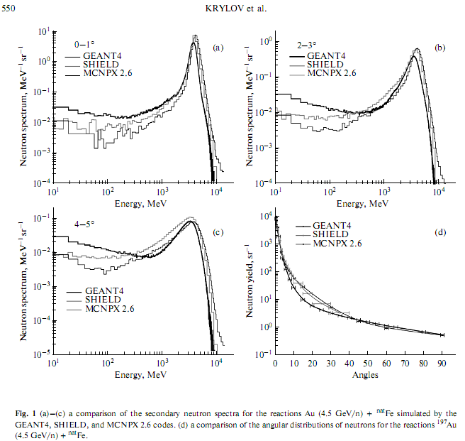

Slide 23
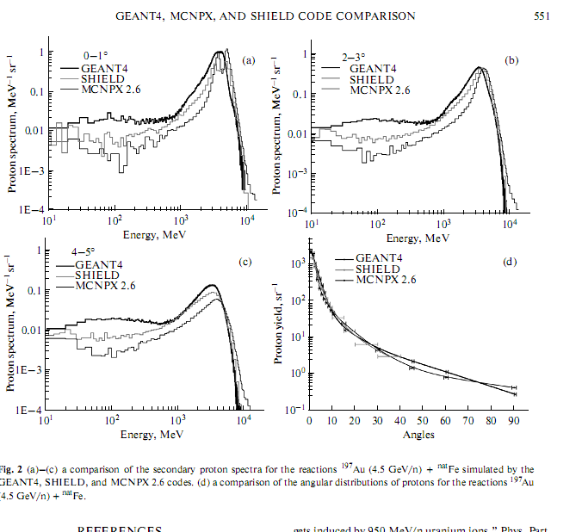

Slide 24
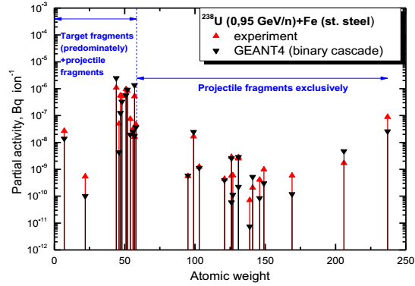
A comparison of total activities of the residual radionuclides (with T_{1/2} > 2 days) in a thick targets simulated by the GEANT4 code with the experiment
Target | Total activity, Bq⋅ion⁻¹
 | Experiment | GEANT4
St. steel | 5.01E-6 | 5.93E-6
Copper | 2.09E-06 | 3.13E-06

Slide 25
The time structure of the collider operation

Slide 26
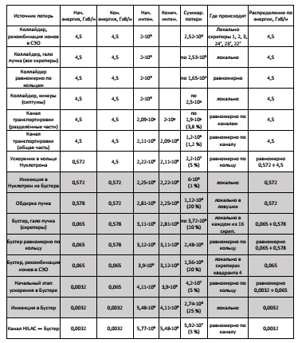

Slide 27
Calculated radial distribution of the "skyshine" neutron effective dose rate depending on the energy of gold ions in the Nuclotron ring
¹⁹⁷Au

