Slide 1
BM@N Project
Elena Kulish
on behalf of BM@N Collaboration
LHEP, JINR

Slide 2
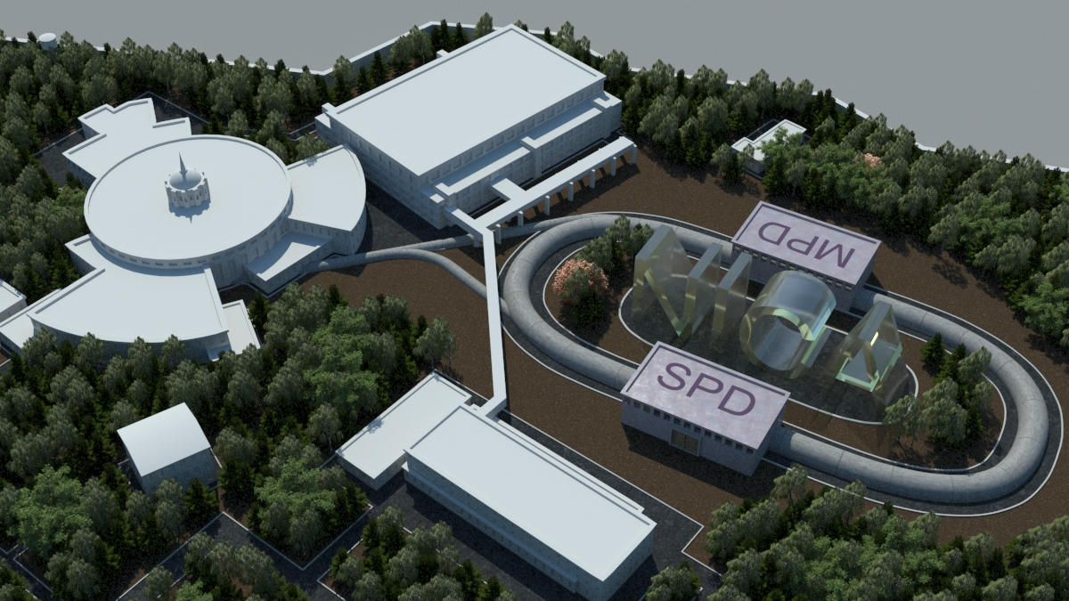

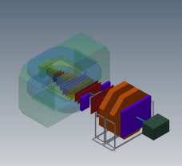




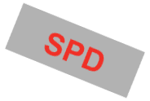


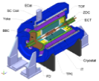
Complex NICA-Nuclotron
Parameters of Nuclotron for BM@N experiment:
E_{beam} = 1-6 GeV/u; beams: from p to Au; Intensity~10⁷ c⁻¹ (Au)
PS and
LU-20 (5MeV/u)
KRION-6T+HILac (3MeV/u)
Accelerator complex LHEP
BM@N
existing
BM@N
In preparation
bld. 205
bld.#1
Collider NICA
(1-4.5 GeV/u, C=503 m)
Booster
(600 MeV/u)
Collider NICA
(1-4.5 GeV/u, C=503 m)
Booster
(600 MeV/u)
NUCLOTRON 0.6-6 GeV/u
√s=4-11 GeV, C=503 m
MultiPurpose
Detector - MPD
MultiPurpose
Detector - MPD
N

Slide 3
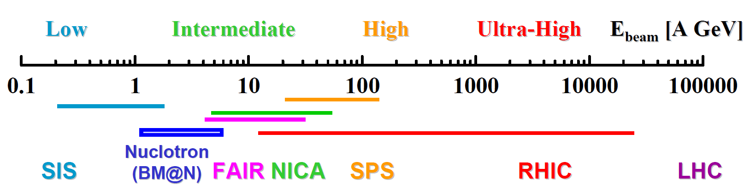
Physics possibilities at the
Nuclotron
Heavy ion collisions experiments
Fixed target experiment
BM@N - Baryonic Matter at Nuclotron
Baryonic matter = Meson and baryon spectroscopy

Slide 4
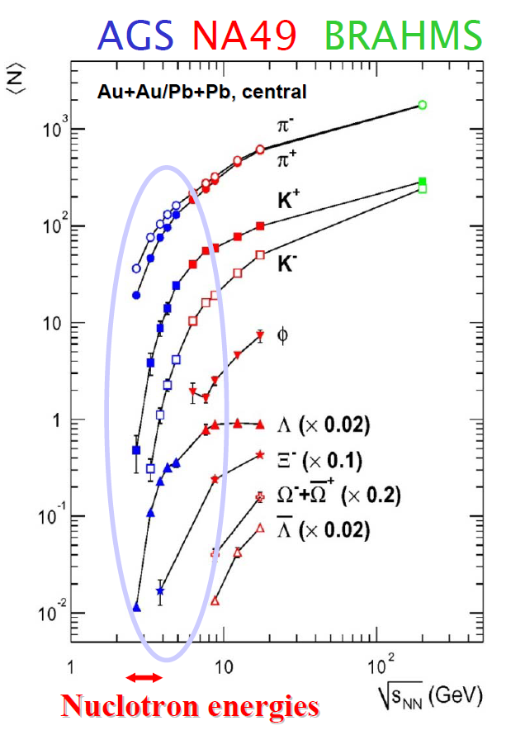
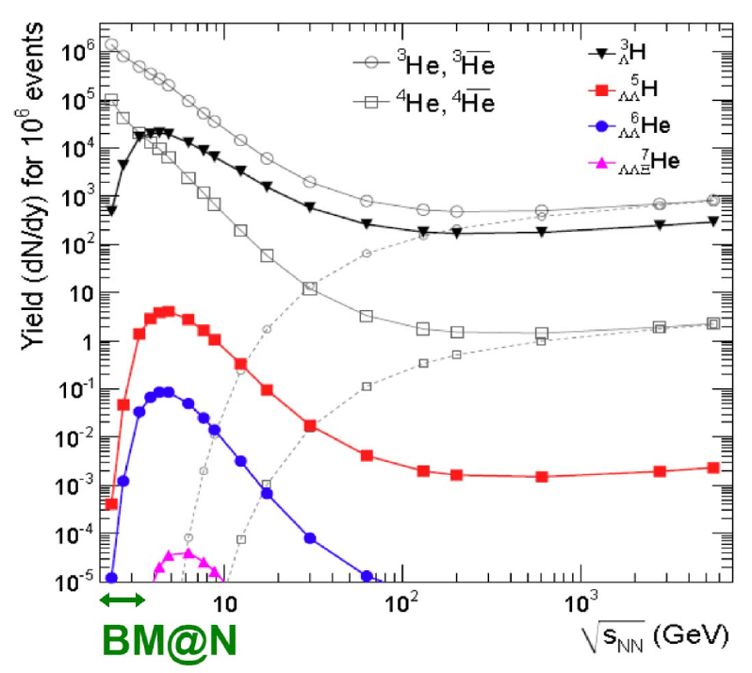
Physics possibilities at the
Nuclotron
In A+A collisions: Opening thresholds for strange and multistrange hyperon production
In heavy-ion reactions: production of hypernuclei through coalescence of Λ
with light fragments enhanced at high baryon densities
Maximal yield predicted for√s=4-5A GeV
√s=2.3-3.5A GeV

Slide 5
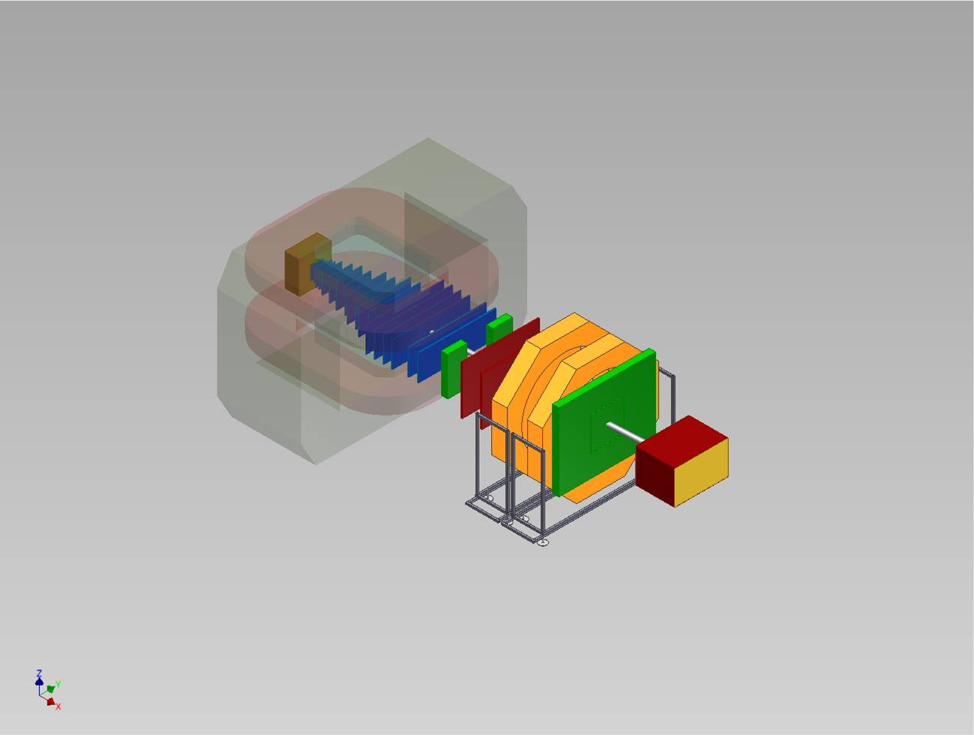
BM@N setup
Target and T0 detectors
SiMS
GEM
DCH
MRPC-2
Analyzing magnet
MRPC-1
ZDC
SiMS – Silicon Micro-strip Sensors, GEM – Gas Electron Multipliers, mRPC – Multi-gap Resistive Plate Chambers, DCH – Drift Chambers, ZDC – Zero Degree Calorimeter

Slide 6
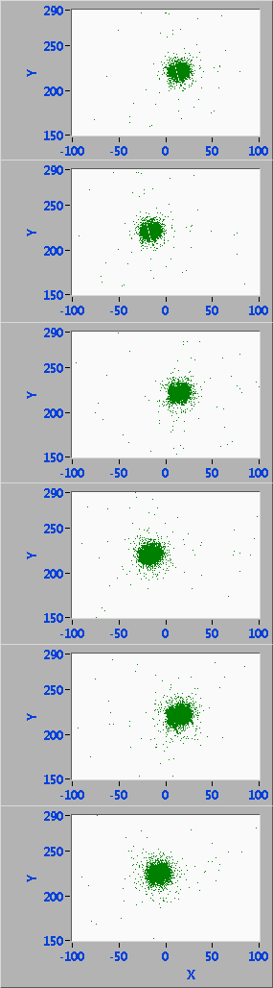
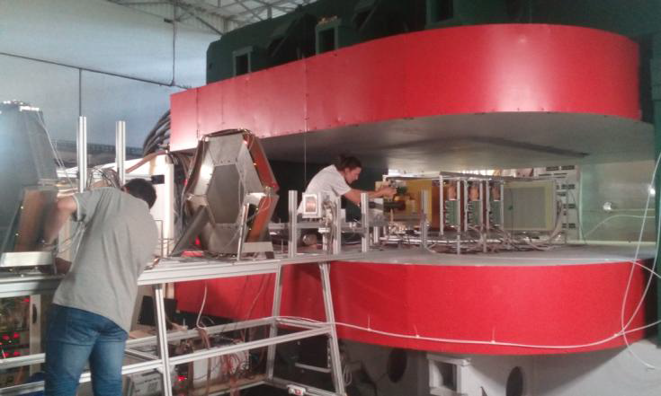
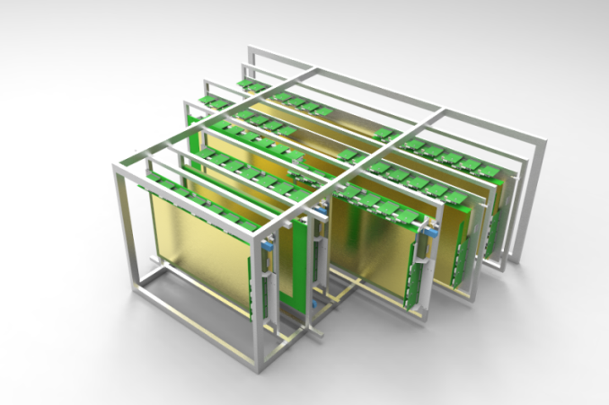
Central tracker:
Gas electron multipliers
BM@N advantage: large aperture magnet (~1 m gap between poles)→ fill aperture with coordinate detectors, which sustain high multiplicities of particles
For tracking in BM@N recent technical runs with deuteron and carbon beams 5 detectors 66 x 41 cm2 and 2 detectors 163 x 45 cm2 were used
Central tracker (GEM+Si) inside analyzing magnet to reconstruct AA interactions:
-implement more GEM planes to improve track momentum reconstruction
-implement Si micro-strip sensors to improve vertex reconstruction

Slide 7
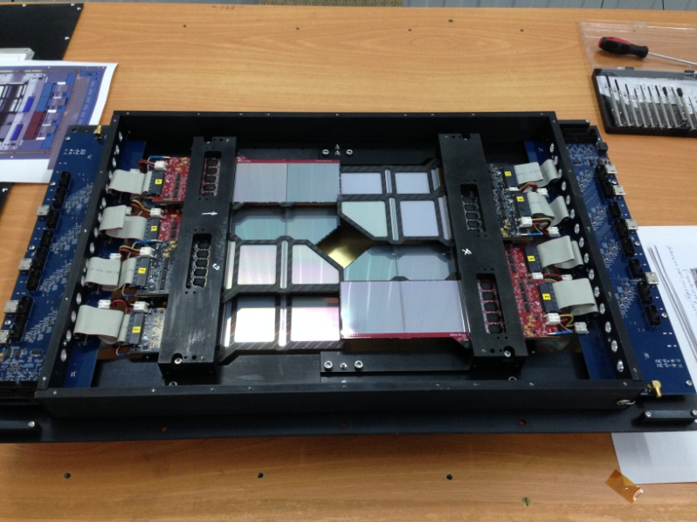
Central tracker:
Silicon micro-strip sensors
2-coordinate Si detector X-X’(±2.5º) with strip pitch of 95/103 μm, full size of 25 x 25 cm² , 10240 strips
Detector combined from 4 sub-detectors arranged around beam, each sub-detector consists of 4 Si modules of 6.3 x 6.3 cm²
One plane installed in front of GEM tracker in December 2016

Slide 8
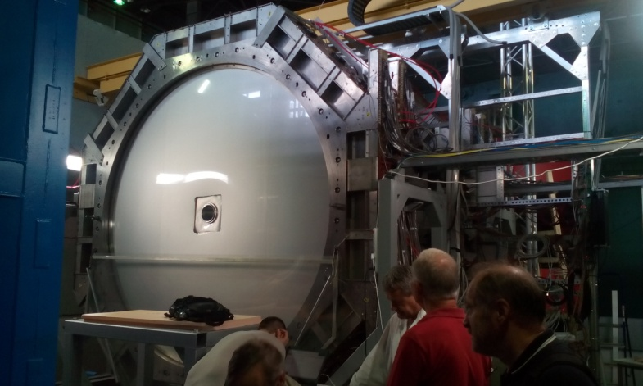
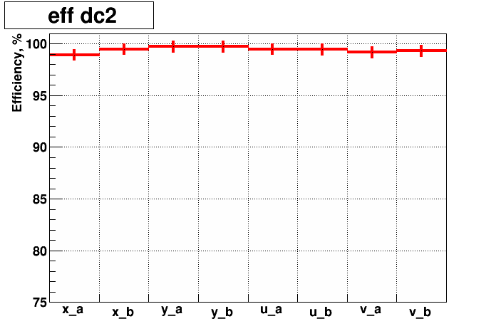
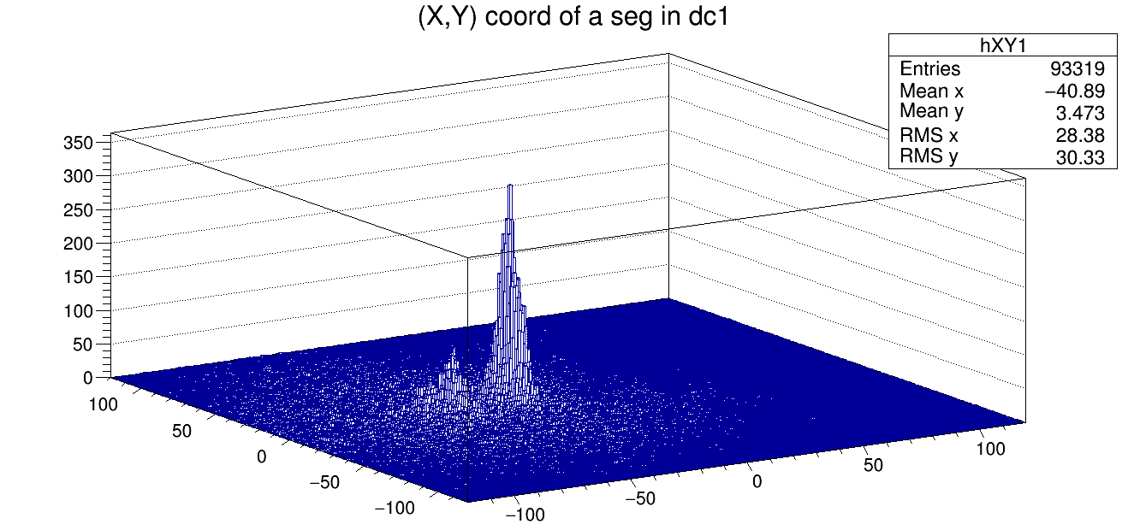
outer tracker: Drift chambers
Reconstructed beam tracks
Averaged Efficiency per
layer = 99.4%
4 double coordinate planes
wire inclination angles of 0, 90, ±45°
wire pitch of 10 mm
outer dimentions of the sensitive area –
Y_{out} ± 1.2 m, X_{out} ± 1.2 m
2048 wires per chamber
(magnetic field)
d
p
Y coor
X coor

Slide 9
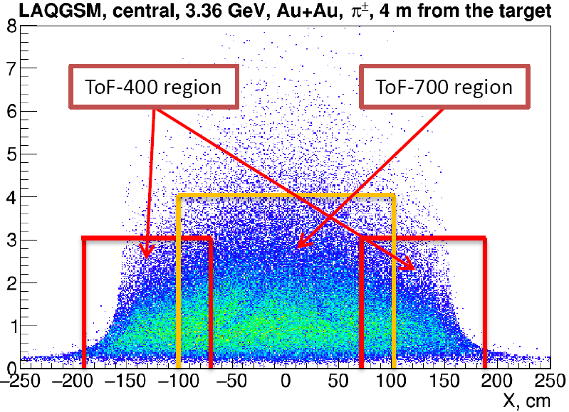
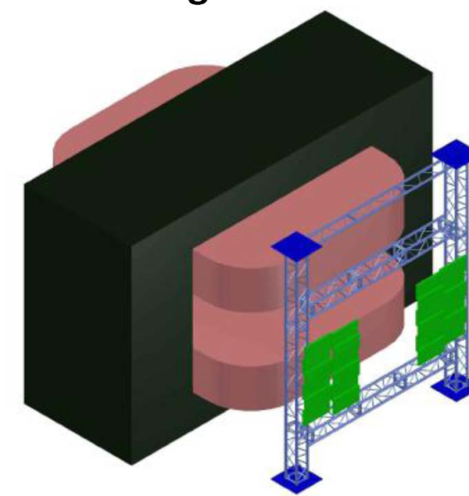
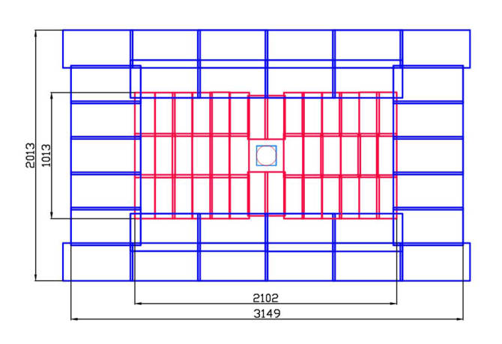
Tof-400 and tof-700
ToF-400 wall
ToF-700 wall
-6 m from the target
-size of 3.2x2.2 m²
-40 warm mRPCs – high time
resolution at rate ~20 KHz/cm²
-30 cold mRPCs – low rate region
-FEE channels 3520
-4 m from the target
-cover about 3 m²
-20 mRPCs
-good rate capability
up to 2 kHz/cm²
-FEE channels 1920
• Time resolution of ToF-700 chamber ~65 ps
• Time resolution of ToF-400 chamber ~53 ps
Distribution of time of flight between ToF-400 and ToF-700, time is in ns.
Time resolution - 85 ps

Slide 10
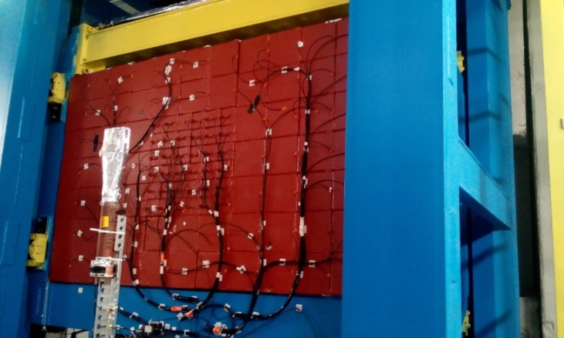
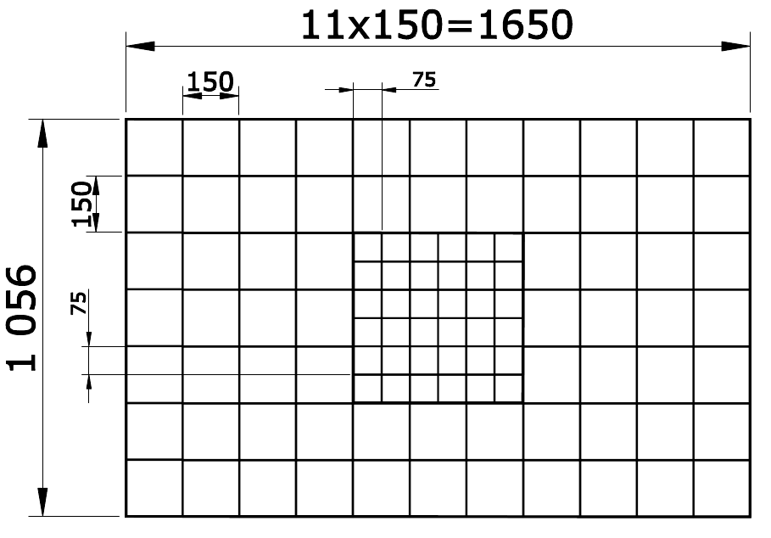
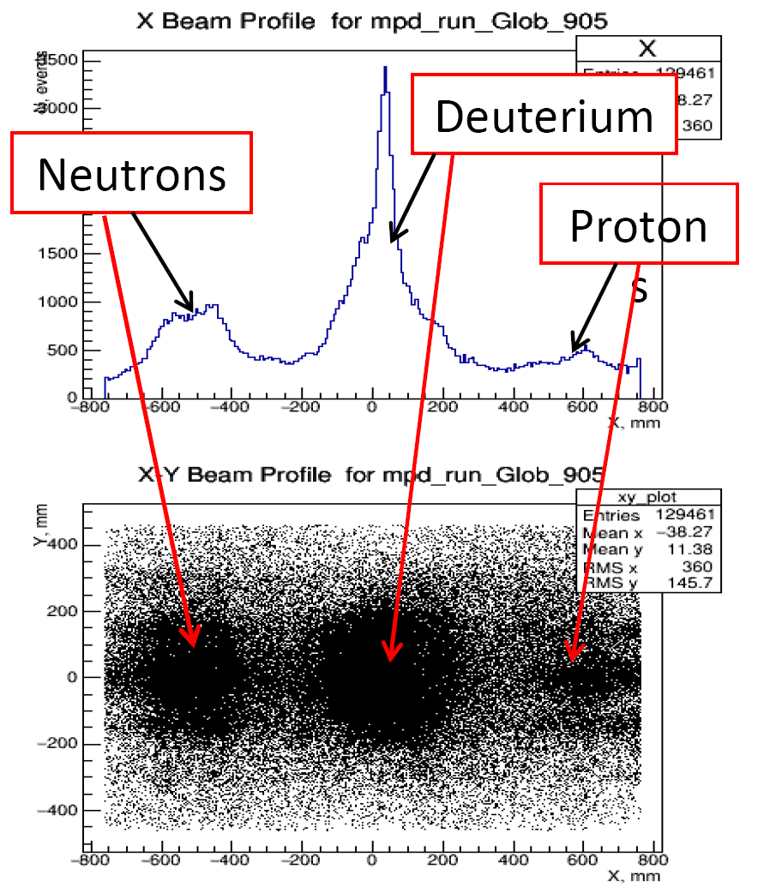
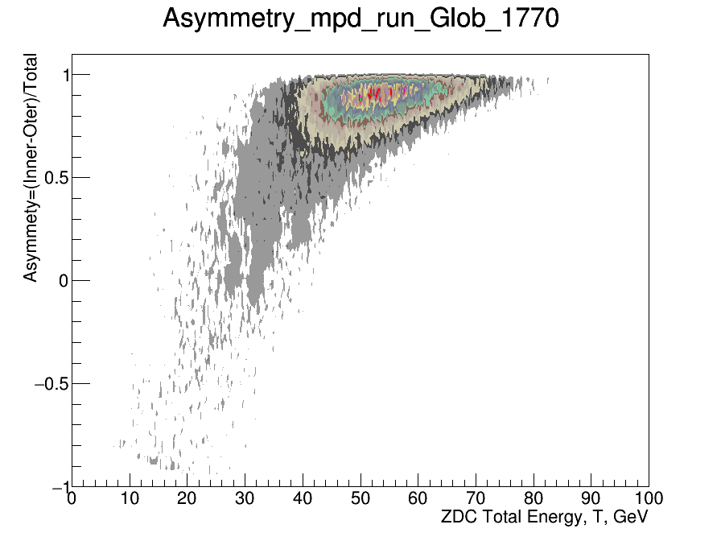
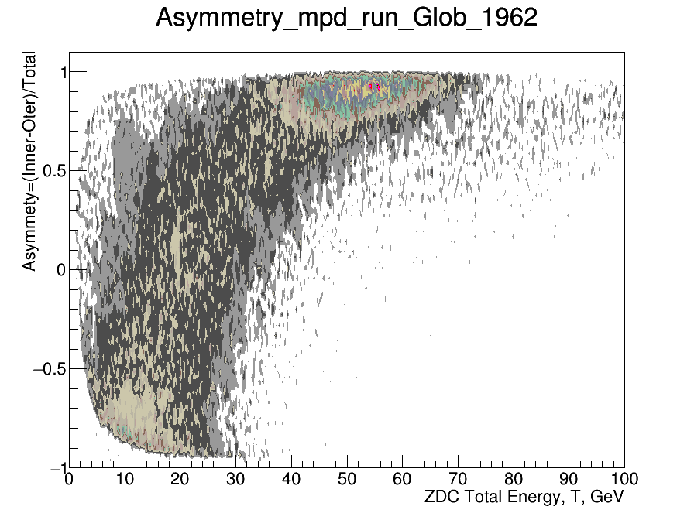
Zero degree calorimeter
ZDC response to deuterons and products of d+CH₂ interactions
Interaction centrality estimation
Asymmetry = (EInner – EOuter)/(EInner + EOuter)
Pb target 9.9 mm thick
without target

Slide 11
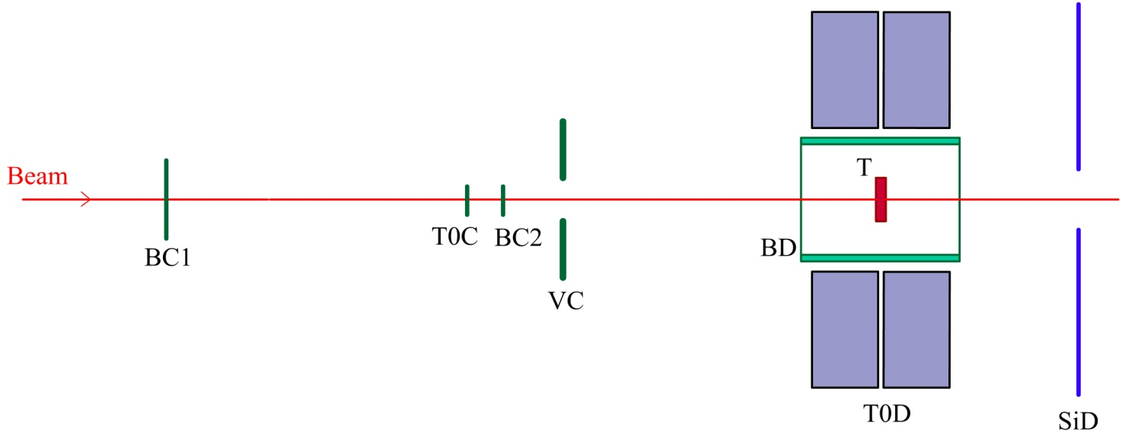
Trigger and t0 detectors
Trigger-T0 detector system on the BM@N beam line (not in scale):
BC1 and BC2 – the scintillation beam counters,
T0C – the T0 counter (Cherenkov or scintillation),
VC – the scintillation veto-counter,
BD – the scintillation-strip barrel detector,
SiD – the forward silicon detector,
T – the target
Effective triggering of nucleus-nucleus collisions in the target
Start signal definition for the ToF detectors with picosecond time resolution
Monitoring of beam characteristics and background, induced by upstream interactions of beam ions with beam line materials

Slide 12
conclusions
BM@N technical runs were performed in December 2016 and March 2017 with deuteron and carbon beams at energies: T0 = 3.5 - 4.6 AGeV
Finally BM@N collected data to check efficiencies of sub-detectors and develop algorithms for event reconstruction and analysis
Major sub-systems are operational, but are still in limited configurations

