Slide 1

54th PAC on Particle Physics
JINR, January 18, 2021
Implementation of recommendations and work towards optimisation
of the research programme
Itzhak Tserruya

Slide 2
Outline
Highlights from the 53rd PAC – PP (June 29, 2020)
Highlights from the 128th SC (September 17, 2020)
Recent developments
Agenda

Slide 3
53rd PAC-PP highlights: NICA
A. Sidorin
Some delays due to the pandemic situation. Nevertheless, the tests of the main Booster systems were completed.
The PAC welcomes the active preparations for the launch of the Booster synchrotron with beam in August 2020.
The PAC expresses its concern with the lack of sufficient manpower for the collider magnet construction and test and urges the JINR management to take the necessary steps to address this issue that otherwise could seriously impact the overall schedule of the NICA project. The PAC requests the Nuclotron-NICA team to ensure that the Nuclotron maximum available energy of 4.5 GeV/n becomes available as soon as possible.
Following recommendation of the NICA Cost & Schedule Review Committee
Establishment of a NICA Project Office
Global planning substantially improved
Preliminary list of milestones prepared

Slide 4
53rd PAC-PP highlights: Infrastructure
N. Agapov
The Committee notes with satisfaction that, despite the difficult pandemic situation, all areas of infrastructure development are advancing without downtime and, basically, at the necessary pace.
February 2020
A

Slide 5
53rd PAC-PP highlights: Infrastructure
N. Agapov
The Committee notes with satisfaction that, despite the difficult pandemic situation, all areas of infrastructure development are advancing without downtime and, basically, at the necessary pace.
February 2020
A

Slide 6
53rd PAC-PP highlights: MPD
Adam Kisiel
The PAC welcomes the steady progress in the assembly and production of most of the MPD detector components foreseen in the first stage configuration
The PAC expresses its concern with the delay in the ECAL construction and the resulting impact on the physics programme, with only half of the coverage foreseen now in the first stage while the second half is expected at a later stage.
The PAC appreciates the admission of new institutions to the MPD Collaboration and encourages the MPD management to increase its efforts in this direction.
The PAC appreciates the ongoing Monte Carlo simulations of the detector and physics processes in preparation for the first beams in MPD and welcomes the plans to intensify this effort.
The PAC recommends extension of the project until the end of 2025 with first priority.
Transportation of MPD magnet yoke parts into the MPD hall
MPD magnet yoke assembly
MPD Hall epoxy floor finished

Slide 7
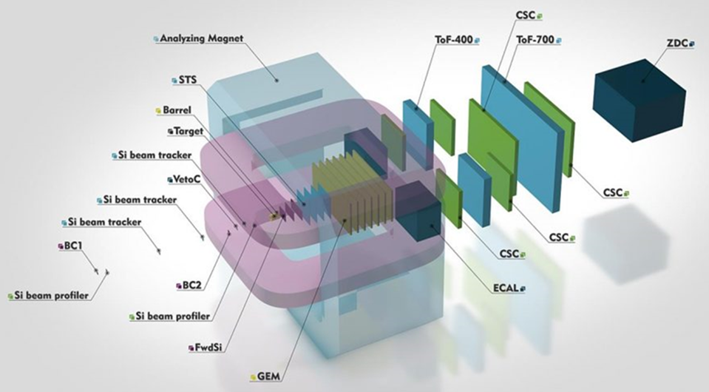
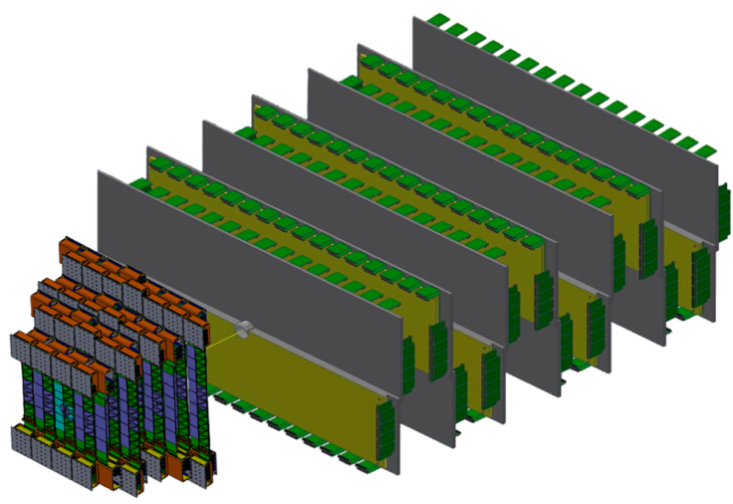
53rd PAC-PP highlights: BM@N
Mikhail Kapishin
The PAC appreciates the efforts towards upgrading the detector for the heavy-ion physics runs planned in 2021 and beyond and on the analysis of the data collected with carbon and argon beams on fixed targets.
The PAC encourages the BM@N team to publish the results obtained with the C and Ar beams as soon as possible.
BM@N upgrade for Au+Au collisions
4 stations double-sided micro-strip silicon sensors
7 GEM stations
Forward Hadron Calorimeter (ZDC)
Vacuum beam pipe from Nuclotron to BM@N
Vacuum target chamber and downstream beam pipe with low material budget

Slide 8
Recommendations on projects approved for completion in 2020 and proposed for continuation
COMPASS-II – A. Nagaytsev
TAIGA – L. Tkatchev
Daya Bay and JUNO – D. Naumov
NOvA / DUNE – A. Olshevskiy
The PAC recommended extension of the COMPASS-II project until the expected end of the project i.e. till the end of 2022, and of the TAIGA, Daya Bay/JUNO and NOvA/DUNE projects till the end of 2023, with first priority.

Slide 9
Recommendations on projects approved for completion in 2020 and proposed for continuation
COMPASS-II – A. Nagaytsev.
The PAC encourages the JINR team to enhance its participation in the data analysis and develop collaborative work for the physics exploitation of the data in order to secure scientific recognition of the group’s two-decade-long work in COMPASS.
By the project completion in 2022, the group should explore new opportunities like e.g., MPD and SPD where its expertise is certainly very much needed.
The PAC recommends extension of the COMPASS-II project until the end of 2022 with first priority.
TAIGA – L. Tkatchev
The PAC notes that the TAIGA project has a solid in-house component with significant international participation. The JINR group is playing an important role in the TAIGA collaboration for the design and production of the IACTs.
The PAC encourages the team, in particular young researchers, to strengthen their participation in the data analysis. Publication of methodological results obtained by the group should be carried out more actively.
The PAC recommends extension of the TAIGA project until the end of 2023 with first priority.

Slide 10
Recommendations on projects approved for completion in 2020 and proposed for continuation
Daya Bay and JUNO – D. Naumov
The PAC notes the high quality of the work performed by the JINR group and recommends continuation of the JUNO project with first priority until the end of 2023.
The PAC encourages the group to ensure that the present personnel overlap with the DUNE project will not lead to future potential conflicts between the two international collaborations.
NOvA / DUNE - A. Olshevskiy
Taking into account the visible role of the JINR group in the NOvA experiment and its solid plans for further advances in forefront neutrino physics research with the DUNE experiment, the PAC recommends continuation of NOvA and approval of DUNE, both until 2023 with first priority.
The PAC encourages the JINR Directorate to provide the necessary resources to the DUNE project in order to guarantee visible participation of the group. In the same line, one could envision JINR’s possible contribution to the LBNF facility, in line with what is done by other major international laboratories. In this context, the JINR group should play the role of bridgehead for the future joining of more groups associated with JINR.

Slide 11
Scientific Council (I)
Excerpts from the Resolutions of the 128th session of the SC held on September 17, 2020:
General considerations relevant to the PAC-PP:
The Scientific Council recognizes recent achievements in implementing and developing JINR’s major facilities, in particular:
the progress achieved in constructing the NICA megascience complex which includes a unique technological accomplishment accompanied by obtaining the first scientific results. The Scientific Council commends the regular functioning of the Supervisory Board of the NICA Complex Project and its Cost and Schedule Review Committee.

Slide 12
Scientific Council (II)
Recommendations in connection with the PAC-PP:
The SC endorsed and supported all recommendations made by the PAC – PP.
In particular:
The Scientific Council is pleased to note that despite the difficult pandemic situation, the Nuclotron-NICA project including the VBLHEP infrastructure developments advanced well and, basically, at the necessary pace. In particular, in spite of a two-month delay, the tests of the main Booster systems were completed and preparation work for launching the Booster synchrotron is started. The Scientific Council seconds the concern of the PAC for Particle Physics with the lack of sufficient manpower for the collider magnet construction and tests and urges the JINR management to take the necessary steps to address this issue that otherwise could seriously impact the overall schedule of the NICA project. The Scientific Council endorses the PAC’s request that the Nuclotron maximum energy of 4.5 GeV/n should be available as soon as possible.
The Scientific Council appreciates the efforts of the BM@N team on upgrading the detector for the heavy-ion physics runs planned for 2021 and beyond and on completion of the analysis of short-range correlations of nucleon pairs in inverse kinematic reactions measured at the Nuclotron.

Slide 13
Scientific Council (III)
Recommendations in connection with the PAC-PP (continuation):
The Scientific Council welcomes the steady progress in the assembly and production of most of the MPD detector components foreseen in the first-stage configuration as well as in the production of the Inner Tracking System. The Scientific Council shares the PAC’s concern regarding the delay in the ECAL construction and the resulting impact on the physics programme, with only half of the coverage foreseen now at the first stage while the second half is expected at a later stage. The Scientific Council appreciates the ongoing Monte Carlo simulations of the detector and physics processes in preparation for the first beams in MPD and welcomes the plans to intensify this effort. The Scientific Council supports the PAC’s recommendation on extension of the MPD project until the end of 2025 with first priority.
The Scientific Council encourages the JINR team in the COMPASS experiment to enhance its participation in the data analysis and develop collaborative work for the physics exploitation of the data in order to secure scientific recognition of the group’s two-decade-long work in COMPASS. By the project completion in 2022, the group should explore new opportunities like e.g. MPD and SPD where its experience is certainly very much needed. The Scientific Council endorses the PAC’s recommendation concerning extension of the COMPASS-II project until the end of 2022 with first priority.
The Scientific Council recognizes that the TAIGA project has a solid in-house component with significant international participation. The JINR group is playing an important role in the TAIGA collaboration for the design and production of the IACTs, but its participation in the data analysis should be strengthened. Publication of the methodological results obtained by the group should be carried out more actively. The Scientific Council shares the PAC’s recommendation on extension of the TAIGA project until the end of 2023 with first priority.

Slide 14
Scientific Council (IV)
Recommendations in connection with the PAC-PP (continuation):
The Scientific Council appreciates the high quality of the work performed by the JINR group in the Daya Bay and JUNO experiments. The contributions of the JINR group to both experiments made in many important systems of the detectors are acknowledged and imprinted in the structure of the collaboration management. The Scientific Council supports the plans of the JINR team in the data analysis of the Daya Bay experiment and in the development, construction and commissioning of the JUNO project. It endorses the PAC’s recommendation to continue the participation in the JUNO project until the end of 2023 with first priority.
The Scientific Council, taking into account the visible role of the JINR group in the NOvA experiment and its solid plans for further advances in forefront neutrino physics research with the DUNE experiment, supports the PAC’s recommendation on continuation of NOvA and approval of the group’s participation in DUNE, both until 2023 with first priority. It supports the PAC's proposal to the JINR Directorate to provide the necessary resources to the DUNE project in order to guarantee visible participation of the JINR group and to encourage the group to play the role of bridgehead for the future joining of more groups associated with JINR.

Slide 15
Recent Developments

Slide 16
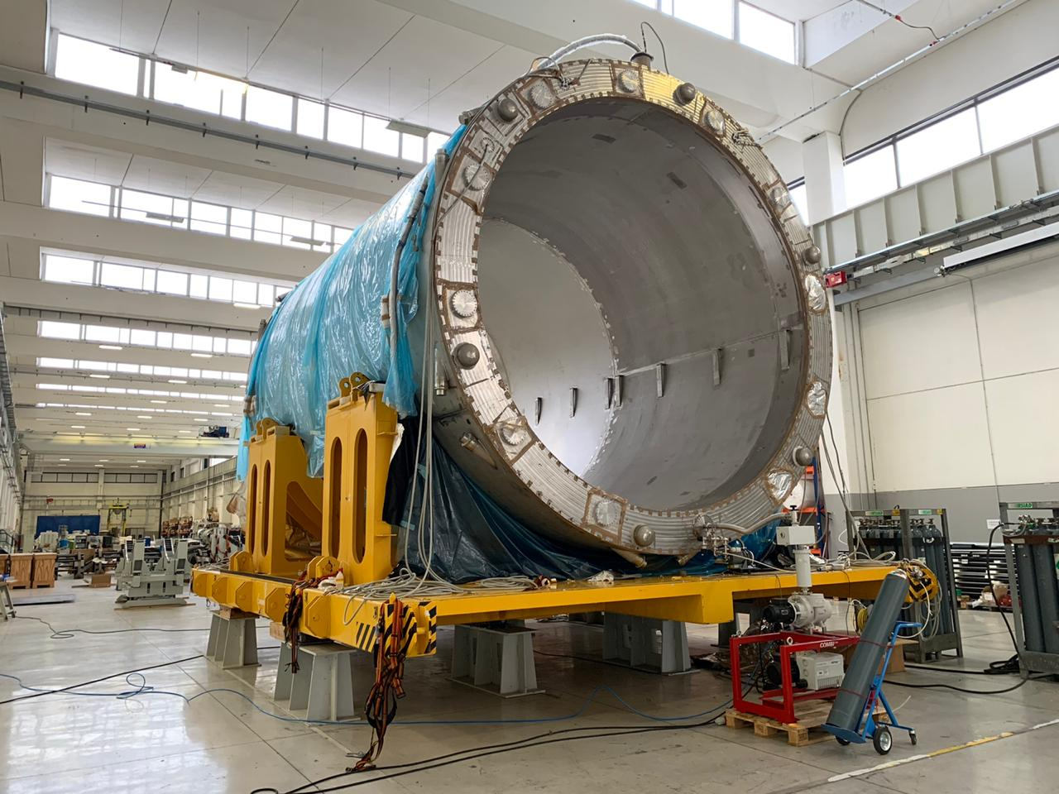
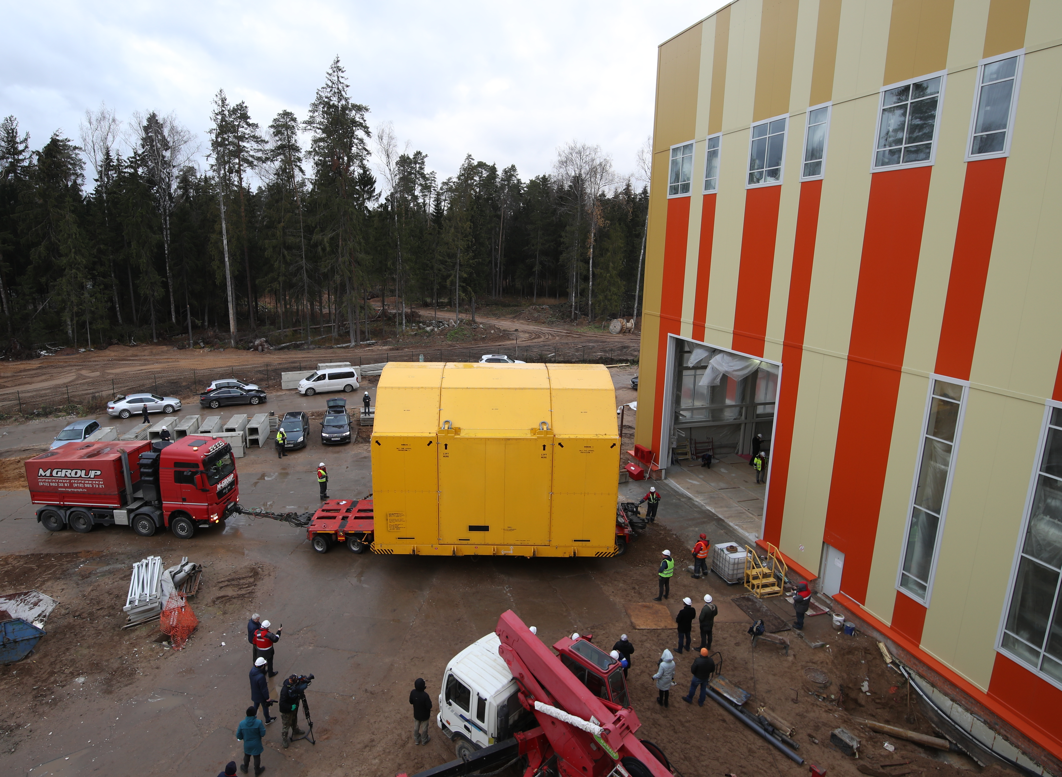
MPD solenoid arrives at JINR- Nov. 6, 2020
Solenoid before shipment at ASG in Italy
Arrival at the MPD Hall
The 120 ton cargo sent from Genoa arrived on October 25 at St. Petersburg and from there to the port of Dubna on Nov. 5, 2020 where it was reloaded on a 680 horsepower truck. The journey by water lasted over a month. The transportation from the Dubna port to the MPD Hall (a distance of less than 3km) took about 3h.

Slide 17
Beam circulated in Booster – December 19, 2020
He⁺ beam 10⁹ ions/turn, 3.2 MeV/u circulated in Booster

Slide 18
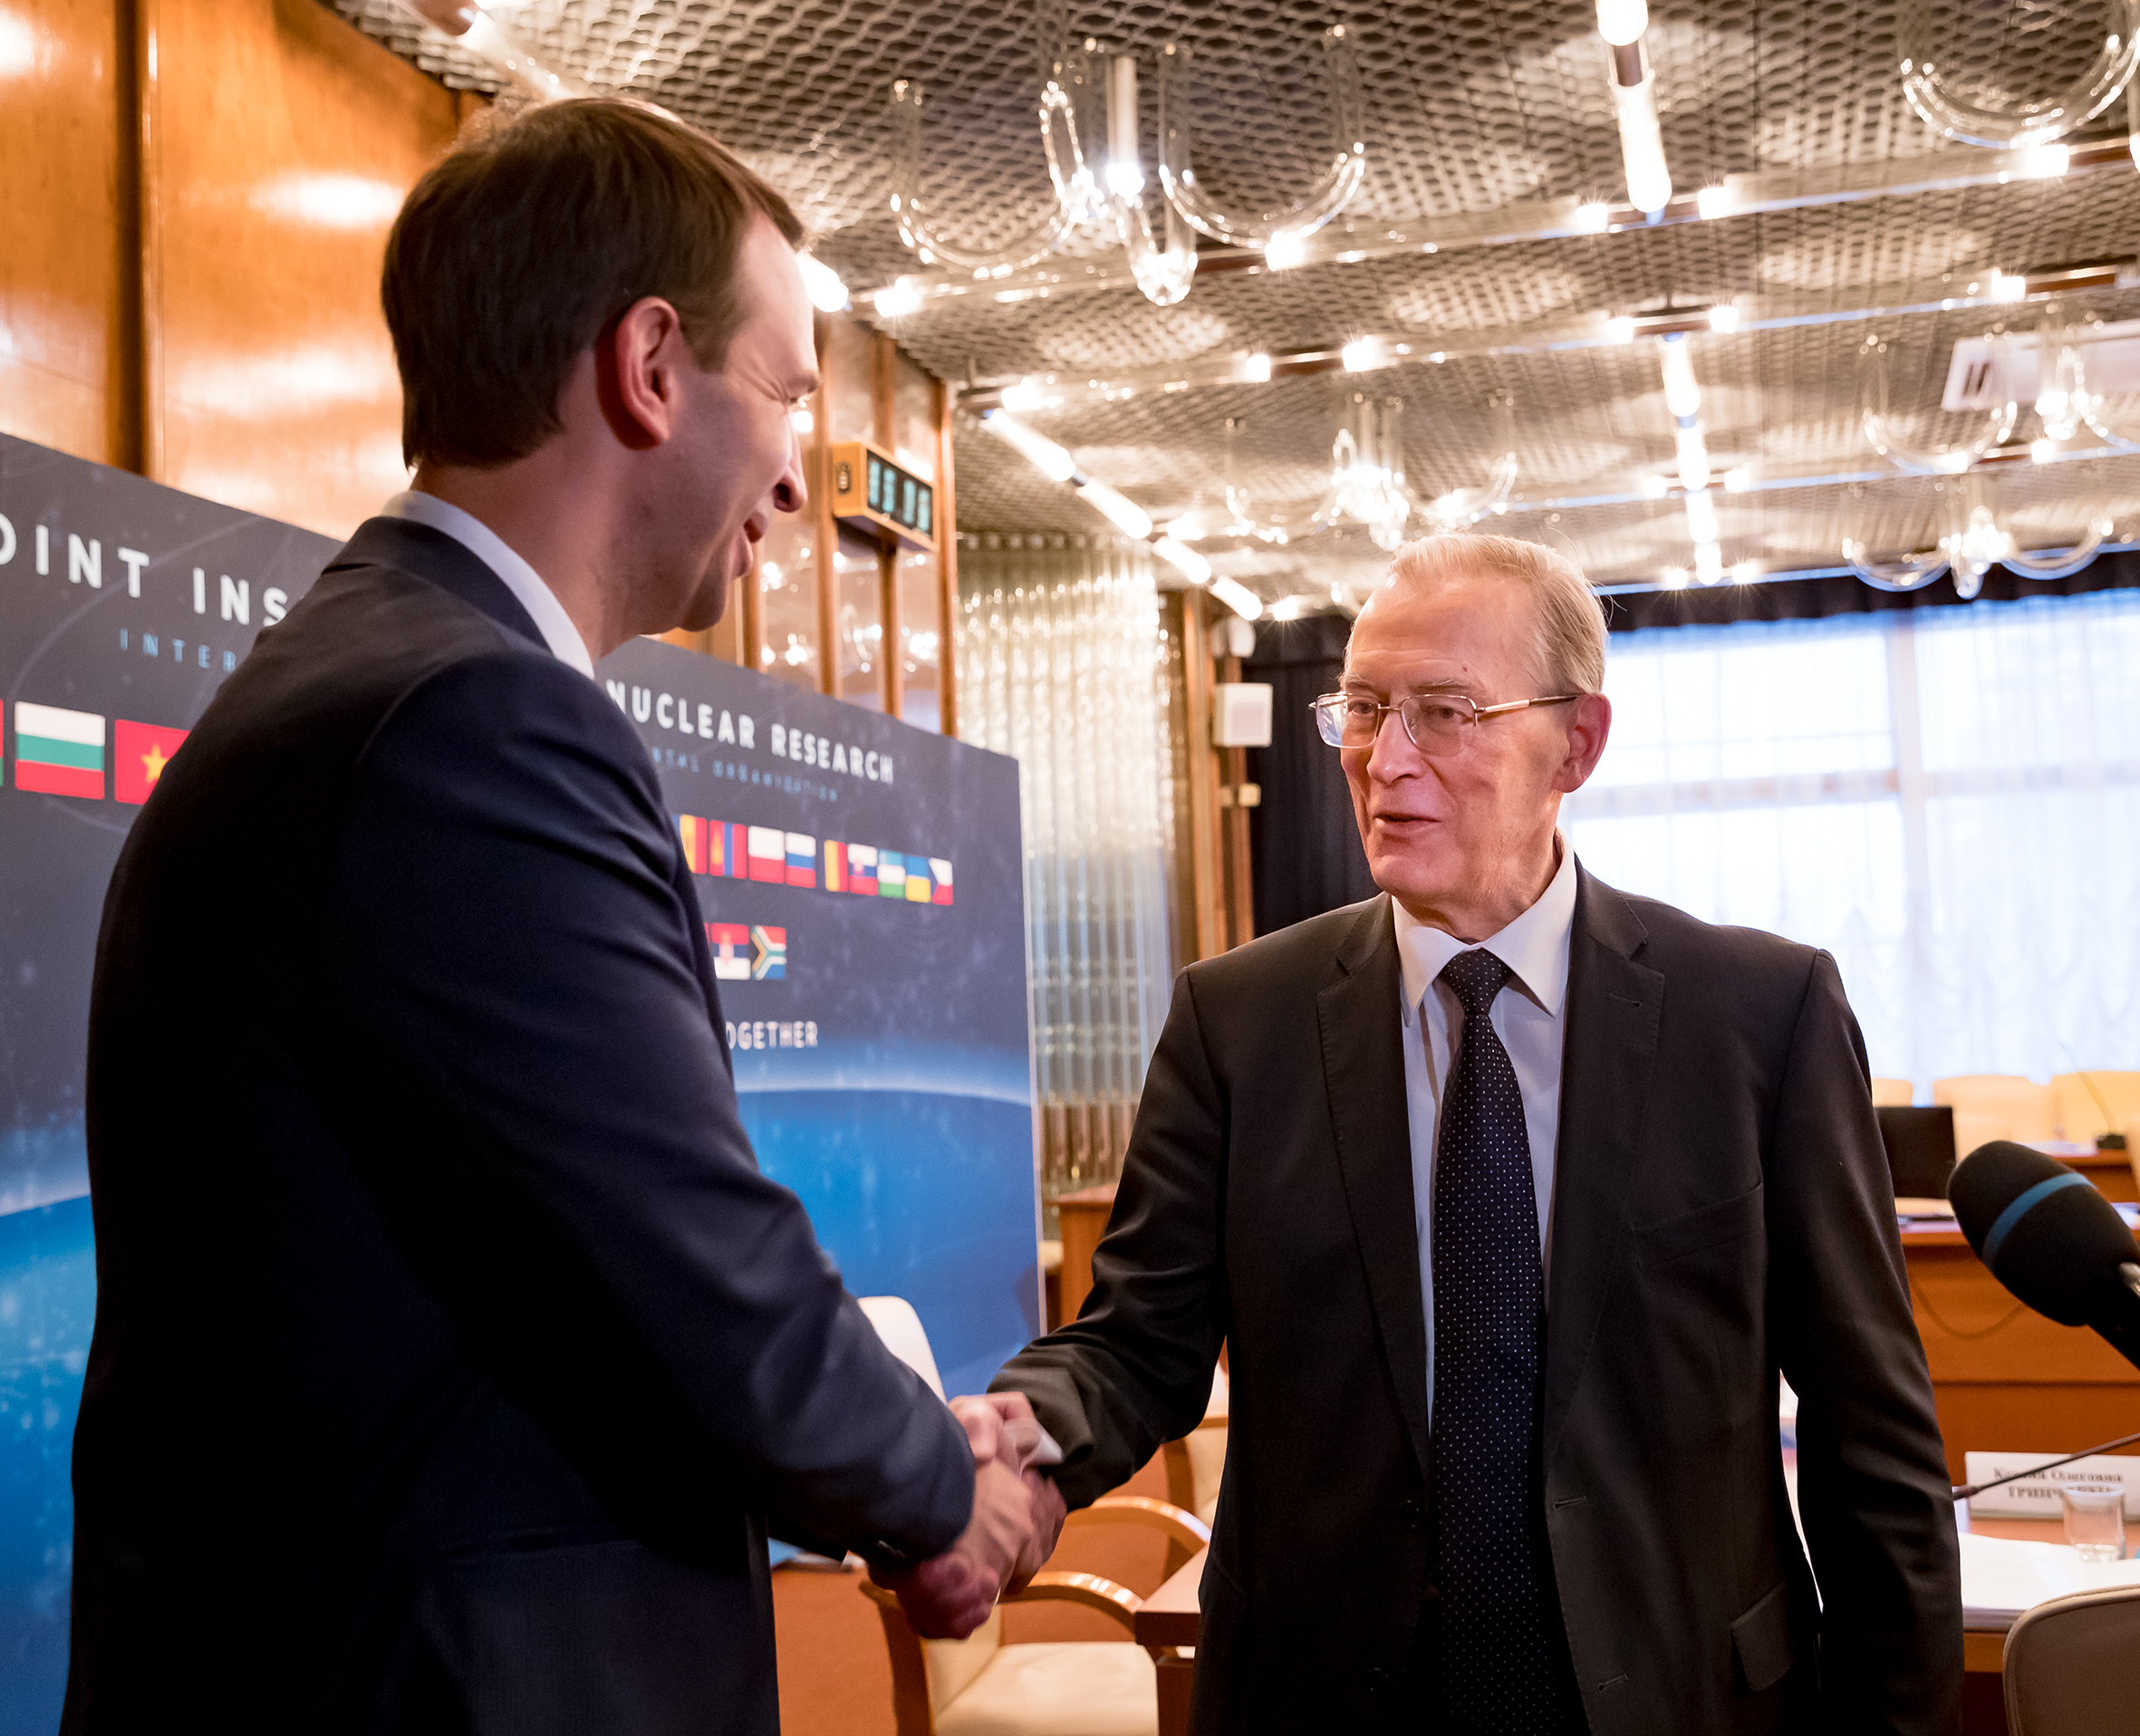
G. Trubnikov JINR Director – Jan. 1, 2021
The Committee of Plenipotentiaries, at its session on November 23, 2020, elected Academician Grigory Trubnikov as a new Director of the Joint Institute, effective January 1, 2021
Best wishes Grigory!
Thank you Victor!

Slide 19
BM@N first results on SRC to be published in Nature Physics
First BM@N paper on Short Range Correlations has recently (January 6, 2021) been accepted for publication in Nature Physics.

Slide 20
54th PAC-PP agenda January 18, 2021
Highlights of today's meeting:
Impact of global pandemic situation on JINR activities
Update reports on NICA, MPD and BM@N
Projects seeking continuation:
NICA
CBM
PANDA
Reports from the LHC experiments

Slide 21
Thank you !

