Slide 1
Design of cooler for collider NICA and the potential of 2.5MV cooler.
Parkhomchuk V.V., Bryzgunov M.I., Bubley A.B., Goncharov A.D., Denisov A.P., Kremnev N.S., Poluhin V.A., Putmakov A.A., Reva V.B.Skorobogatov D.N.
Abstract
Design of electron cooling system for NICA collider are discussed. Aim of using cooler increased luminosity by intensive cooling ion bunches. It will suppressed IBS and beam-beam interactions.

Slide 2
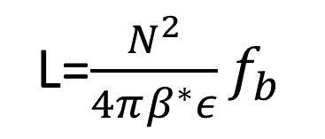
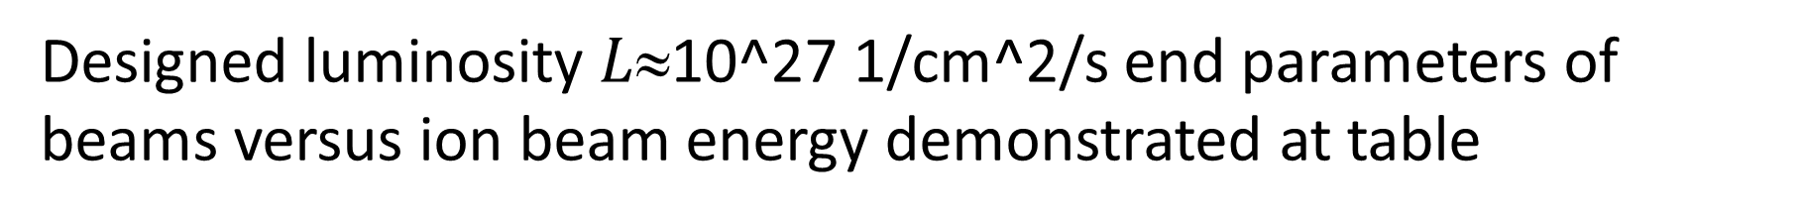
Luminosity of collider NICA will determined ion beams parameters and magnetic optic IP inside detector.
L=$\frac{N^{2}}{4πβ^{∗}ε}f_{b}$
Designed luminosity $L$10^27 1/cm^2/s end parameters of beams versus ion beam energy demonstrated at table
Laslet tune shift

Slide 3
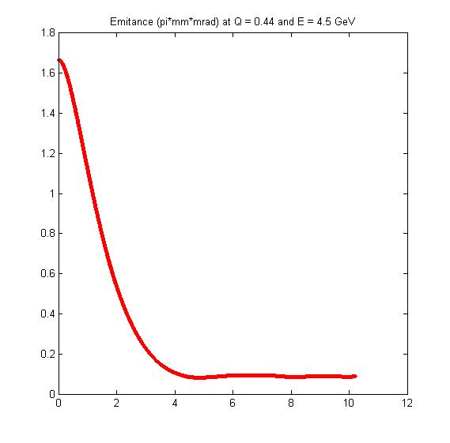
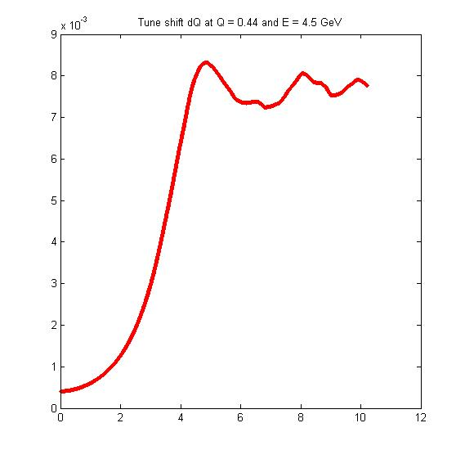
Simple estimation of beam*beam interaction as short lenses (0 bunch length) looks optimistic and electron cooling will shrink beam emittance but increasing Lasslet shift still subject of discussions.
secunds
secunds

Slide 4
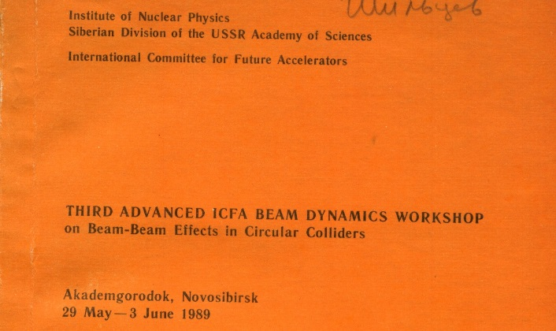
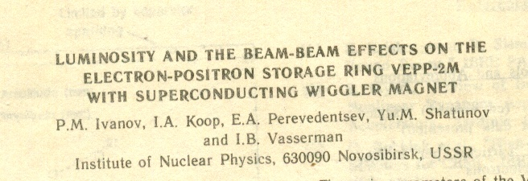
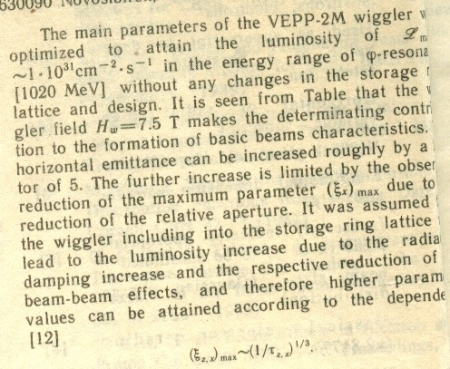
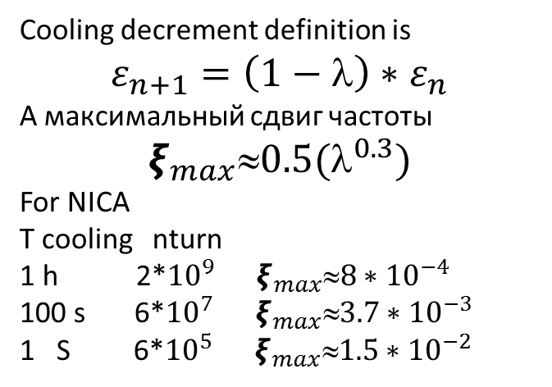
World experience demonstrated that maximal tune increased as decremnts at power 0.3
Cooling decrement definition is
$$ε_{n+1}=\left(1−λ\right)∗ε_{n}$$
А максимальный сдвиг частоты
$$ξ_{max}0.5(^{0.3})$$
For NICA
T cooling nturn
1 h 2*${10}^{9}{ ξ}_{max}8∗{10}^{−4}$
100 s 6*${10}^{7}{ ξ}_{max}3.7∗{10}^{−3}$
1 S 6*${10}^{5}{ ξ}_{max}1.5∗{10}^{−2}$

Slide 5
Basic design for NICA cooler is COSY cooler
Draft of 2 MeV cooler for COSY (proton synchroyron). 1-high voltage vessel with pressed SF6 isolation, 2,3- transport line for electron beam, 4- cooling straight , 5- toroids for connection electron beam and ion beam

Slide 6
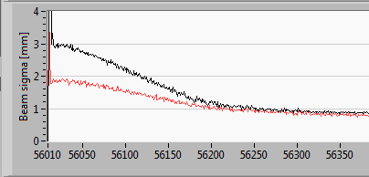
Example of the transverse cooling
Np=3∙10⁸, Je=800 mA, Ee=909 kV,
Experiment time is 22 march 2015 10:45:00
t, s
Horizontal width, mm
Vertical width, mm
Culculeded cooling rate:
102 сек
t, s
t, s
Fitting equation:
is size of the proton beam at t=0
is value of the horizontal or vertical width
is size at t→∞
march 2015

Slide 7
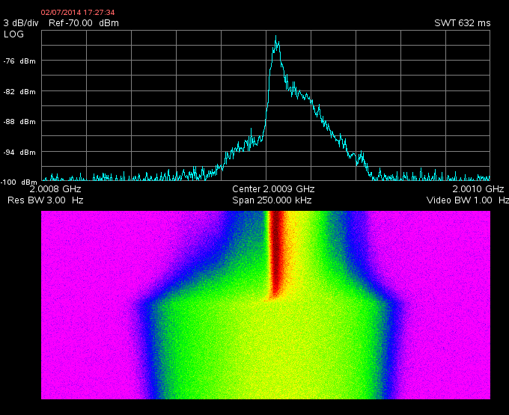
Combine action of stochastic and electron cooling
initial no longitudinal cool, after e-cooling
Only stochastic
Stochastic+e-cooling
Electron energy 908 keV
Proton energy 1.66 Gev
Stochastic cooling vertical and horizontal
E-cool time 120 s
Stochastic cooling time 400 s
Beta function x/y 4m/3m
February 2014

Slide 8
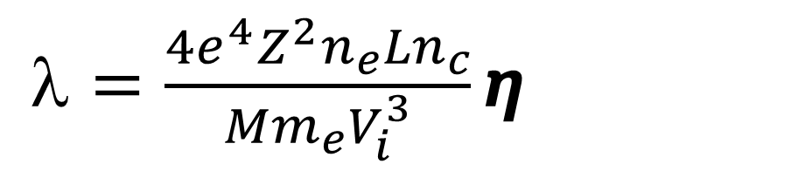

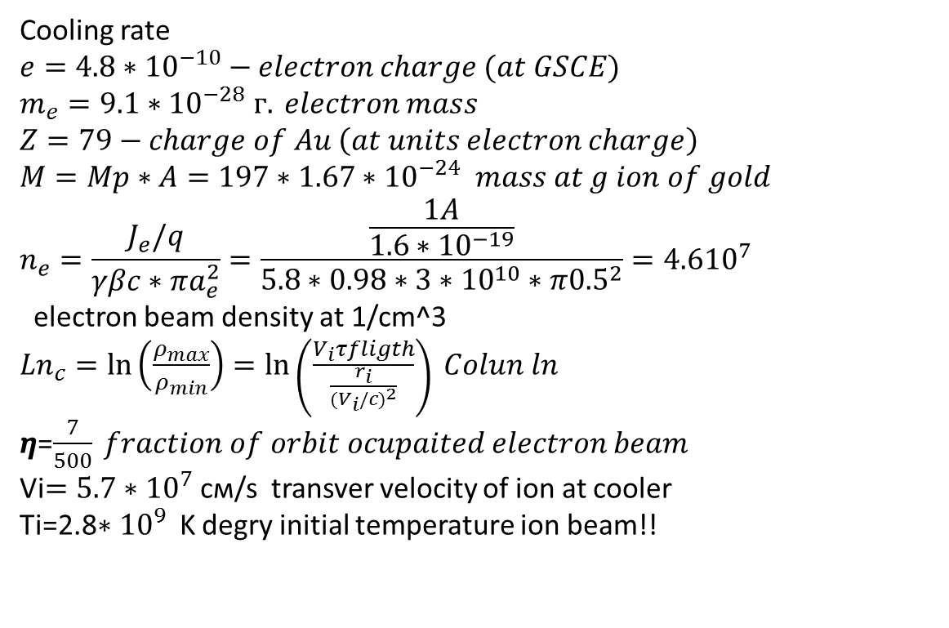
Cooling rate
$$e=4.8∗{10}^{−10}−electron charge (at GSCE)$$
$$m_{e}=9.1∗{10}^{−28} г. electron mass$$
$$Z=79−charge of Au \left(at units electron charge\right)$$
$$M=Mp∗A=197∗1.67∗{10}^{−24} mass at g ion of gold$$
$$n_{e}=\frac{J_{e}/q}{γβc∗πa_{e}^{2}}=\frac{\frac{1A}{1.6∗{10}^{−19}}}{5.8∗0.98∗3∗{10}^{10}∗π{0.5}^{2}}=4.6{10}^{7}$$
electron beam density at 1/cm^3
${Ln}_{c}=\ln\left(\frac{ρ_{max}}{ρ_{min}}\right)=\ln\left(\frac{V_{i}τfligth}{\frac{r_{i}}{{{(V}_{i}/c)}^{2}}}\right) Colun ln$
$η$=$\frac{7}{500} fraction of orbit ocupaited electron beam$
Vi$=5.7∗{10}^{7}$ см/s transver velocity of ion at cooler
Ti=2.8${∗10}^{9}$ K degry initial temperature ion beam!!
$=\frac{4e^{4}Z^{2}n_{e}{Ln}_{c}}{{Mm}_{e}V_{i}^{3}}η$
$$τcool=\frac{γ}{λ}=28 s$$
Ue=2.5 MV
IBS=1100 sec

Slide 9
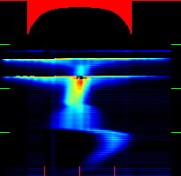
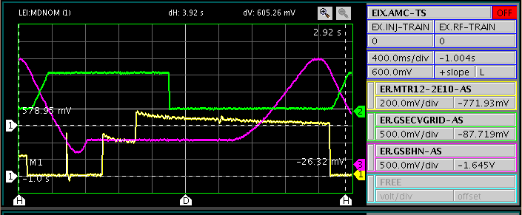
Using electron cooler for heavy ions
Au (+54/197) for LEIR
Initial Gold ion beam diameter 50 mm
Cooled down at 3-5 mm.
Time between injection 0.4 s
Calculated from above equation 0.125 s

Slide 10
Emittance versus versuse electron beam radius (electron beam density )
В минимуме
Размера
Сдвиг
Частоты
Бетатронных
Колебаний
ΔQ=0.14
При уменьшении магнитного
поля в пушке радиус электронного
пучка на участке охлаждения
уменьшался с 1.9 см до 1.35 см

Slide 11
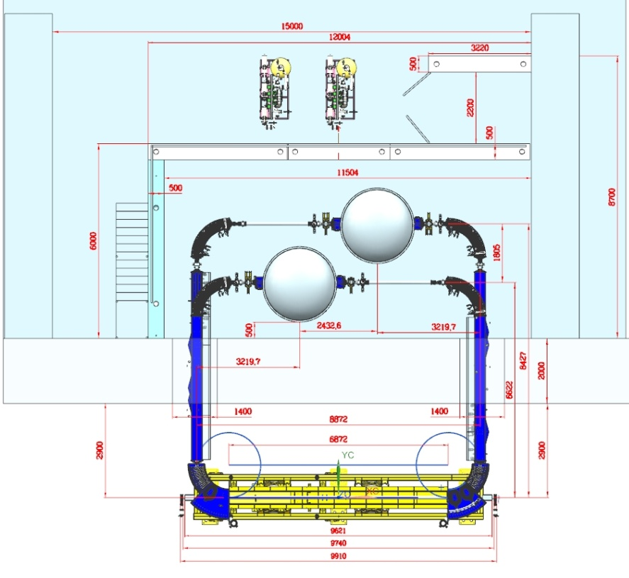
План размещения в зале СЭО НИКА
Draft of cooler for ion collider NICA

Slide 12
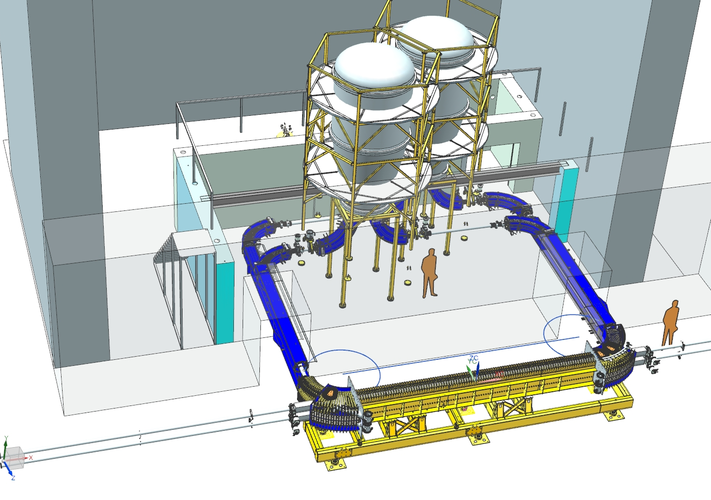
Размещение СЭО
Относительно прямолинейного
Промежутка НИКА
3D model of NICA cooler
Inside hall.

Slide 13
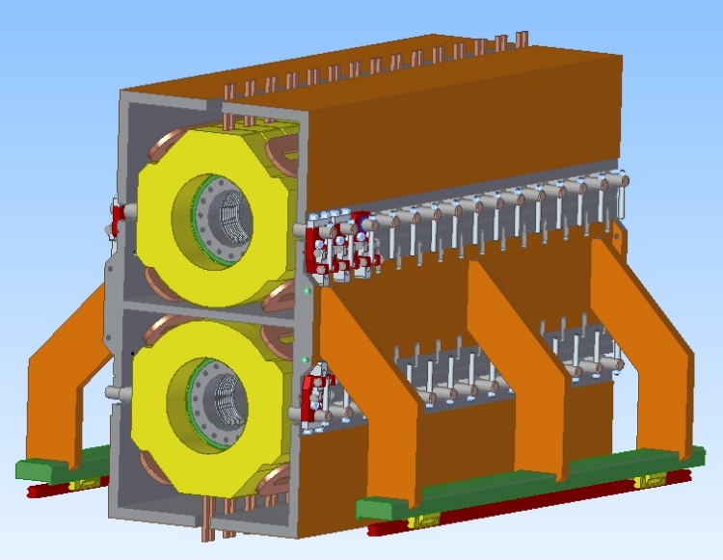
2 windows solenoid for NICA cooler. It is possible to see correction coils and magnetic
field map from correction fields

Slide 14
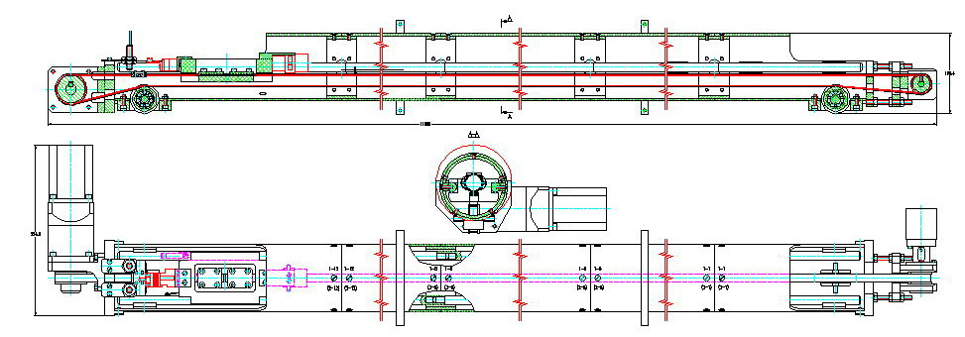
Measuring system with compass for detection strightnees of magnet lines with prescision better 10^(-5)

Slide 15
Измерения «компасом»
Поперечных магнитных полей
На бустере НИКА
Measured of direction magnet field line at buster cooler for NICA.
For details see report Maxim Bryzgunov

Slide 16
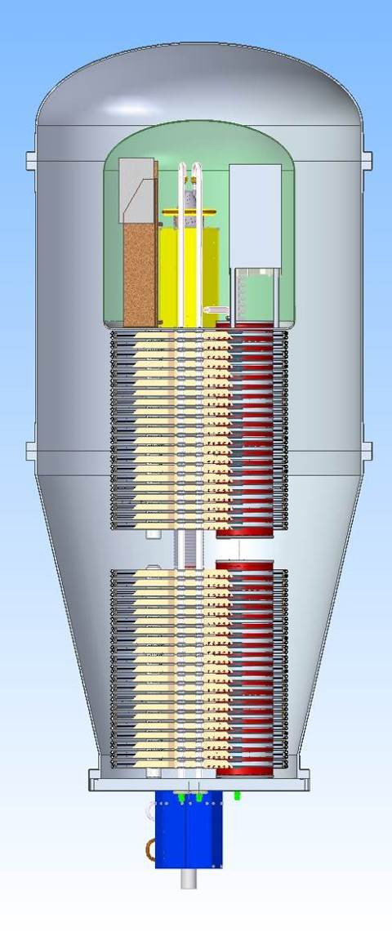
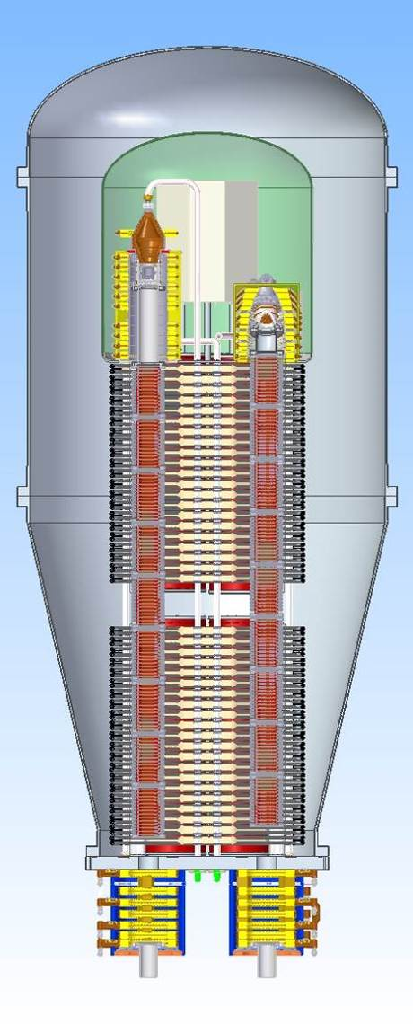
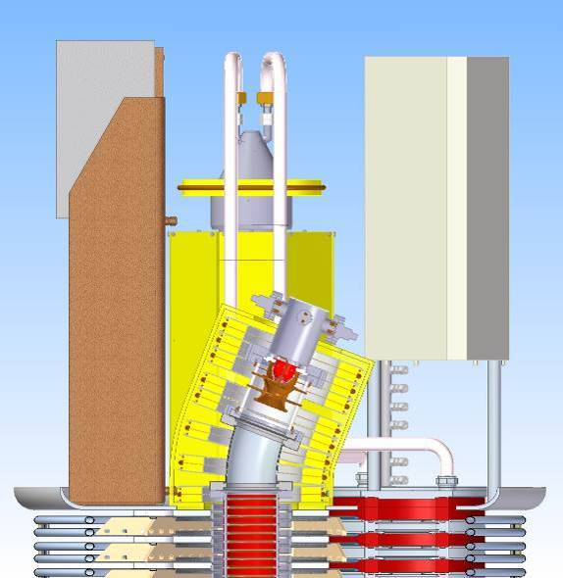
Electron gun shifted from axis for protection cathode from bombarding secondary rest gases ions accelerated at acceleration tube up to 2.5 MV
High voltage vessel NICA cooler. For powering magnet coils along acceleration tube used 2 cascade transformer
High voltage equipment”s inside
vessel with pressed SF6 up
to 10 bars

Slide 17
Circuit connection of two sections. Capasitor used for compensation scattering inductivity that improved power transport. 2 at parallel magnetic ring 280*200*10 mm^3 used nanocrystalic foil 5BDCR.
3D model of cascade transformer for powering magnet and high voltage elements along acceleration tube.

Slide 18
Basic parameters of cascade transformer
Diameter (ØD1- ØD2) 280 mm– 200 mm
Thickness (2 rings 10 mm at parallel) 20 mm
Mass of Fe 4.8 kg
Working Inductions 0.2 T
Power losses for induction 0.2 T 12 Wt/kg
Current at coils up to 70 A
Voltage up to 600 V
Trasfered power up to 40kWt
Lossed power at cascade transformer 7 kWt
Number of turns at coils 28 turns
Mass of copper 230 g (28 turns)
Cros section cooper for coils (Licendrat AWG38) 5.8 mm^2,
Resistivity coils for 0 Hz (28 turn) 0.015 Ohm

Slide 19
Collaboration efforts BINP and JINR open perspective constructed
Very powerfully cooler with magnetized electrons and very fast cooling
for obtain high luminosity at ion*ion collider NICA
Thanks for attention

