Slide 1
Lattice and Dynamic Aperture
of the NICA Collider
O.S. Kozlov, S.A. Kostromin
LHEP, JINR, Dubna
XII Международный семинар по проблемам ускорителей заряженных частиц, г.Алушта, 4 сентября, 2017

Slide 2
Contents
Collider project parameters
Composition of the rings
Dynamic Aperture calculations

Slide 3
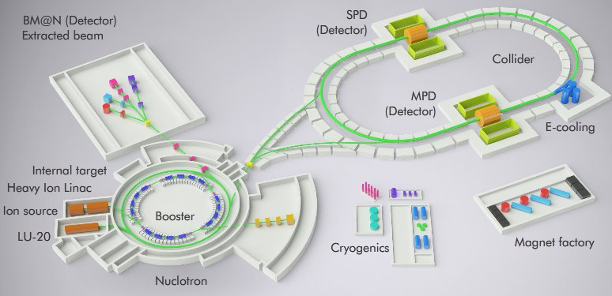
NICA Complex
Beams – p,d(h)..¹⁹⁷Au⁷⁹⁺
Collision energy √s= 4-11 GeV/n (Au), 12-27 (p)
Beam energy (fixed target) - 1-6 GeV/n
Luminosity: 10²⁷ cm⁻²s⁻¹(Au), 10³² (p)
Experiments:
2 Interaction points – MPD and SPD
Fixed target experiment BM@N

Slide 4
NICA structure and operation regimes. (Heavy Ion Mode)
Facility operation scenario
Linac HILac
KRION
Booster (25 Tm)
1(2-3) single-turn injection,
storage of (2 ÷ 4)×10⁹ ions,
acceleration up to 100 MeV/u,
electron cooling, acceleration
up to 578 MeV/u
Ion sources
Linac LU-20
Fixed Target Area
Stripping (80%) ¹⁹⁷Au³¹⁺ => ¹⁹⁷Au⁷⁹⁺
~ 2 x 22 injection cycles
22 bunches per ring
IP-2
Nuclotron (45 Tm)
injection of one bunch
of ≤ 2×10⁹ ions,
acceleration up to
1 - 4.5 GeV/u max.
Two SC
collider rings
IP-1

Slide 5
1. Collider project parameters
Circumference, m | 503.04
Number of bunches | 22
Rms bunch length, m | 0.6
Beta-function at IP, m | 0.35
Betatron tunes, Qx / Qy | 9.44 / 9.44
Chromaticity, Q’x / Q’y | -33 / -28
Ring acceptance, π⋅mm⋅mrad | 40
Long. acceptance, Δp/p | ±0.010
Gamma-transition, _{tr} | 7.088
Ion energy, GeV/u | 1.0 | 3.0 | 4.5
Ion number per bunch | 2.0∙10⁸ | 2.4∙10⁹ | 2.3∙10⁹
Rms Δp/p, 10⁻³ | 0.55 | 1.15 | 1.5
Rms beam emittance, hor/vert, (unnormalized), π⋅mm⋅mrad | 1.1/ 0.95 | 1.1/ 0.85 | 1.1/ 0.75
Luminosity, cm⁻²s⁻¹ | 0.6∙10²⁵ | 1.0∙10²⁷ | 1.0∙10²⁷
IBS growth time, sec | 160 | 460 | 1800
Tune shift, ΔQ_{total} =ΔQ_{SC} +2 | -0.050 | -0.037 | -0.011

Slide 6
Designations and numbering of the Collider elements
1) 1st collider ring - “Red", lower, direction of beam movement - counter-clockwise
2) 2nd collider ring - "blue", the upper, the direction of the beam - clockwise.
Designations and numbering of structural elements:
The collider consists of the eastern (E) and western (W) superperiods. They begin and end at the collision points (MPD-SPD). The super period includes a corresponding arch and two halves of Long Straight sections.
2) The Interaction Region MPD is the "northern“ straight section, the Interaction Region SPD is the "southern“ one.
3) The sequence numbering of the elements starts from the Interaction Points in MPD or SPD in the direction of the beam movement in the corresponding ring.
4) The designation of an element consists of:
a) type designations:
Q is the quadrupole magnet
QT - tuning quadrupole magnet
QFF - quadrupole magnet of final focusing of beams
M - dipole magnet
BV - dipole magnet of the system of vertical reduction / separation of beams
MS - correcting magnet (multipole)
CP - correcting magnet (dipole) + beam position monitor
b) the sequence number of the element
c) an index giving an accessory to the superperiod (W or E)
d) an index giving an accessory to the ring (1 or 2)
For example, Q20E2 is a regular quadrupole magnet in the eastern arch, 20th from the collision point of the beams in the MPD.
The index of the ring (1 or 2) is absent for the elements in the sections common to both beams.
List of elements of the collider (without indexes belonging to the super period and the ring):
Q1 - Q39 - quadrupole magnets (Q8 - Q32 - in the arches)
QT1 - QT10 - Trim Quadrupole Magnets in Straight Gaps
QFF1 - QFF6 - quadrupole magnets of the final focusing of beams
BV1 - BV4 - dipole magnets of vertical reduction / separation of beams
MC1-MC33 - multipole correcting magnets (MC6 - MC28 - in arches)

Slide 7
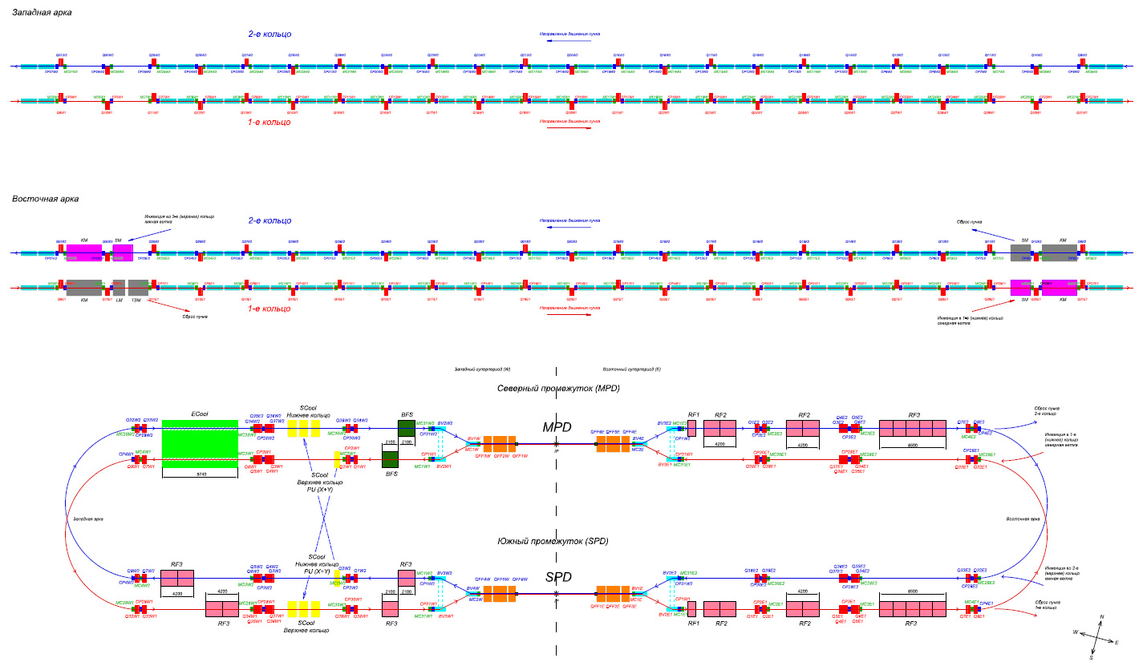
1. Collider rings composition

Slide 8
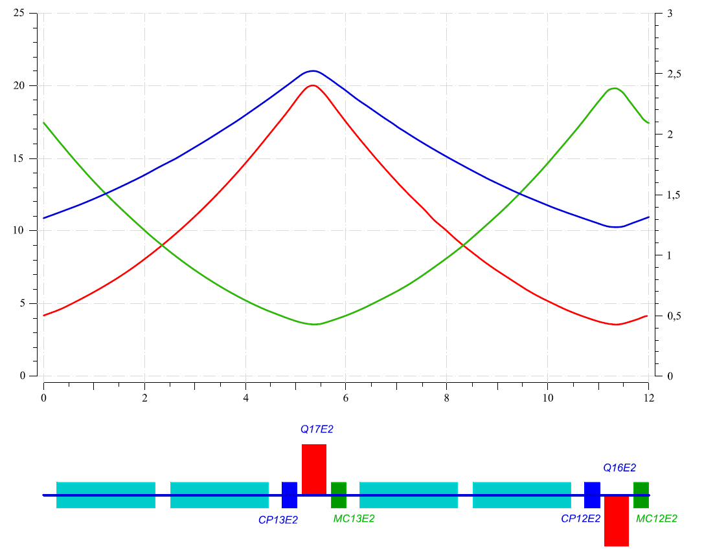
1. Collider ring composition
Arc: FODO periodic Cell
M: horizontal dipole magnet, L=1940mm, Bmax=1.8T oq: space QF/QD-CP, L=100mm
QF, QD: regular quadrupole magnet, L=470mm, Gmax=23T/m odd: space Dipole-Dipole, L=300mm
MC: multipole corrector, L=300mm od: space Dipole-MC, L=265mm
CP: X,Y dipole corrector+Beam PickUp, L=300mm

Slide 9
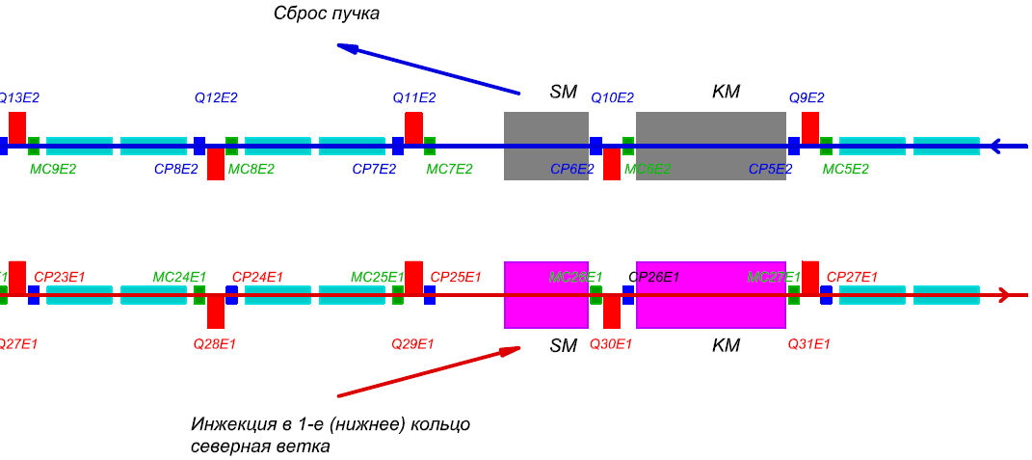
1. Collider rings composition
Arc, missing dipole Cells: – Injection, Dump, Dispersion suppressor.
Lower Ring 1, Upper Ring 2 - East Arc - North side

Slide 10
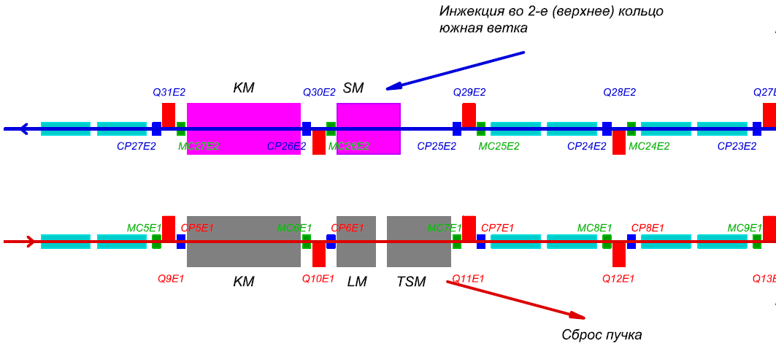
1. Collider rings composition
Arc, missing dipole Cells: – Injection, Dump, Dispersion suppressor.
Lower Ring 1, Upper Ring 2 - East Arc - South side

Slide 11
1. Collider rings composition
Straight sections North: MPD

Slide 12
1. Collider rings composition
Straight sections South: SPD

Slide 13
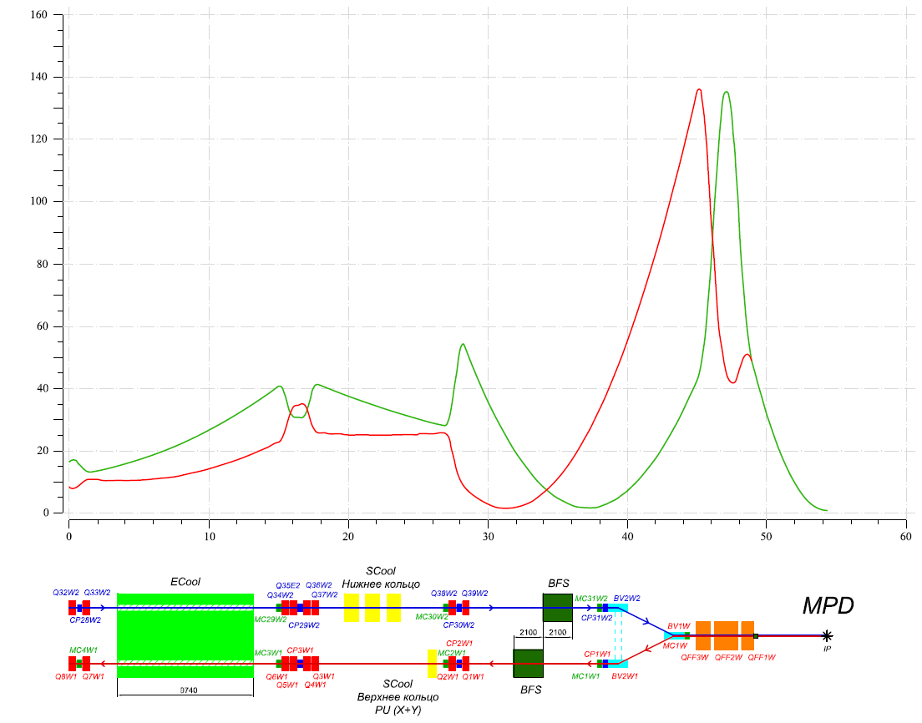
1. Collider ring composition
Beta-functions in Straight section. β* @ IP = 0.6m.

Slide 14
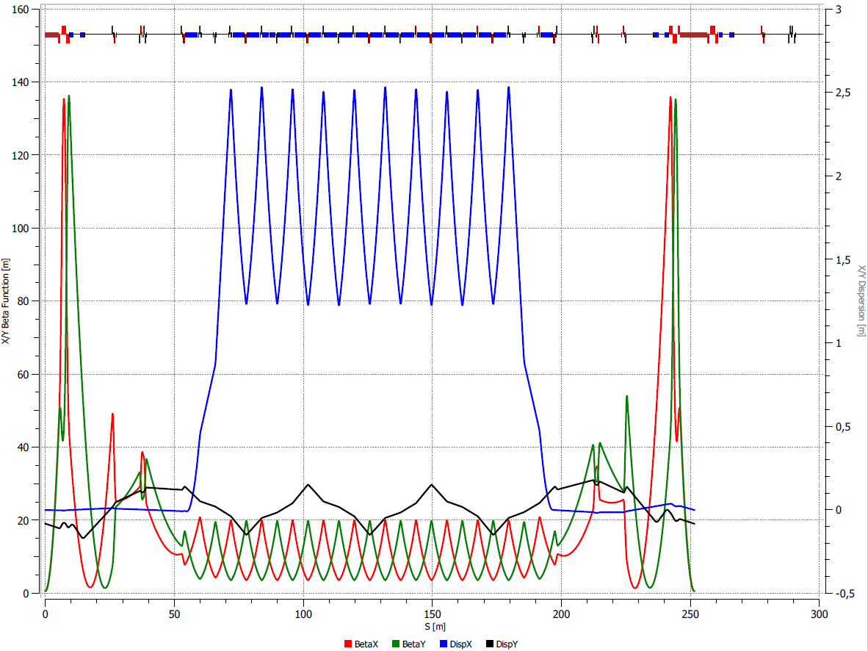
1. Collider ring composition
Twiss-functions in Half of the Ring. Q_{x,y} =9.44/9.44, β*=0.6m.
No coupling correction. Bs_MPD=0.6T, Bs_Ecool=0.2T

Slide 15
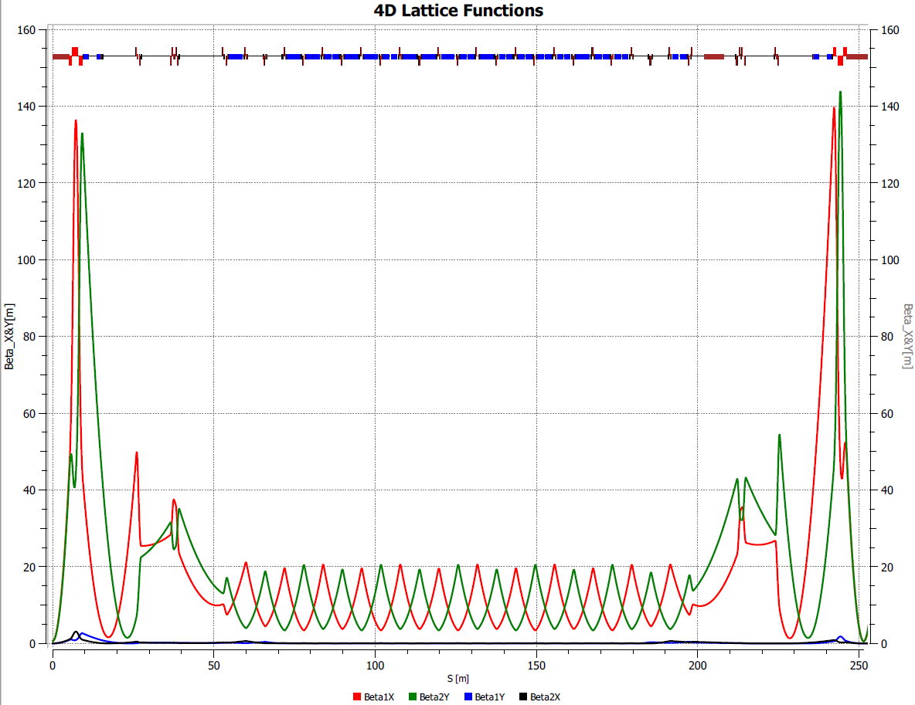
1. Collider ring composition
Beta-functions of the Ring. X/Y-Coupling correction.
4 Families of Skew Quads in Drifts. Gmax=1.8 T/m

Slide 16
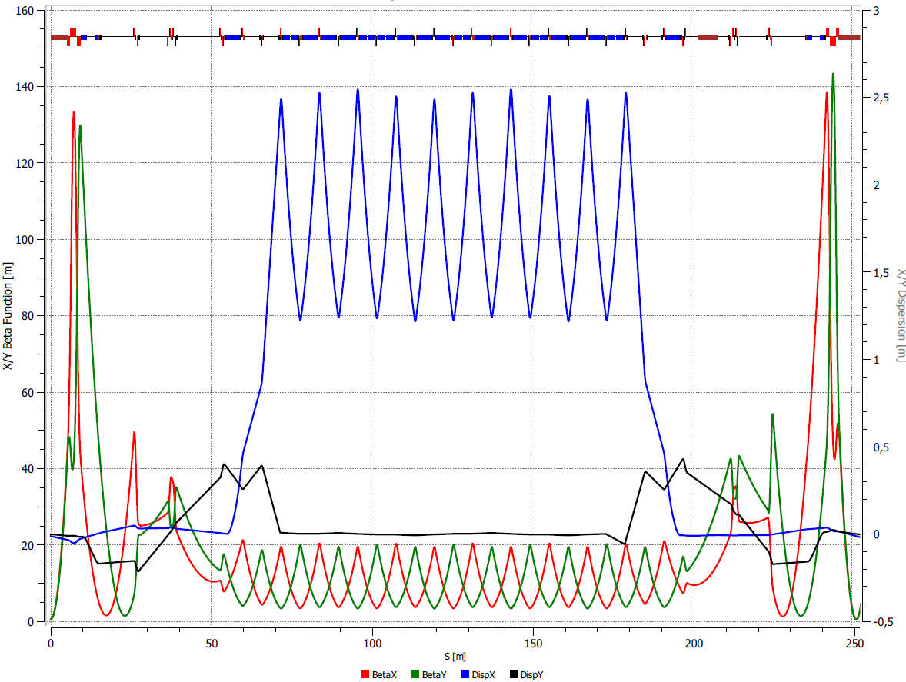
1. Collider ring composition
Dy-Dispertion correction.
2 Families of Skew Quads in arcs. Gmax=4T/m

Slide 17
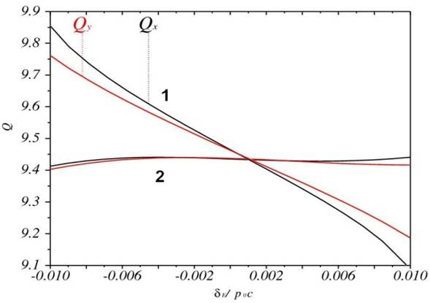
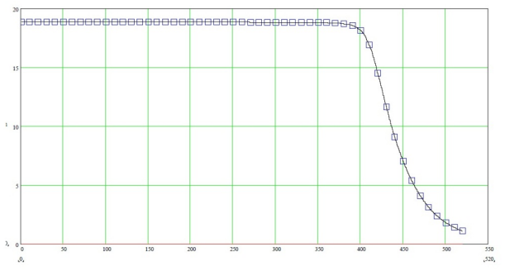
2. Nonlinearities of the magnetic field in Collider
1. Dipole/Quadrupole harmonics
(ΔB/B) _{n} ~ 10⁻⁴ expected values at R_{beam}
2. Chromaticity correction Sextupoles
Tune spread over the momentum acceptance ±4_{p} before (1) and after (2) correction
Natural chromaticities: Q’_{x}=-33, Q’_{y}=-28 (Q’_{x,y}~20 from 2 IPs)
Corrected chromaticities: Q’_{x,y}=0
N_{corr}=24, G’_{max}=150T/m²
3. Fringe Fields, Final Focus Quads in particular
Gradient in QFF1 vs. Longitudinal coor. @ I=10.3kA

Slide 18
2. Nonlinearities: Fringe Fields
Fringe Field effect in quadrupole:
Δθ/θ ~ β² ·k² · L·ε
=> To decrease Fringe Field effect:
- Increase Quadrupole length ⬄ Decrease Quadrupole strength k;
Decrease beta-function in Lense β (or Decrease IP-QFF1 distance) or Increase β* in IP ;
Decrease Emittance ε.
Fringe Fields in ALL elements are taken into account in MADX code

Slide 19
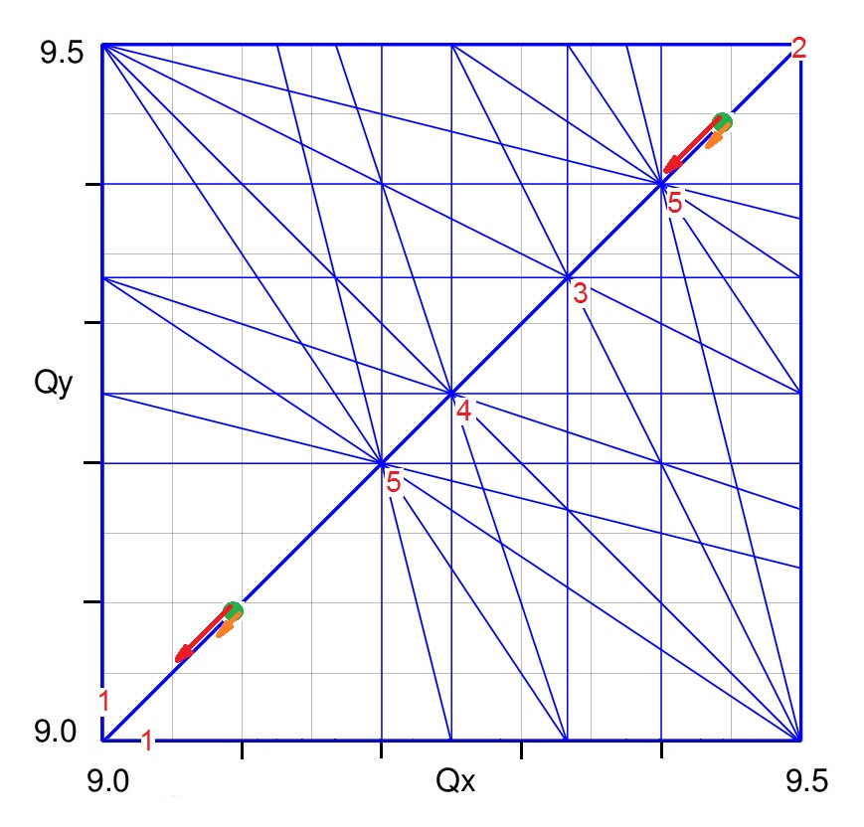
Q-diagram and Resonances
Betatron tunes Qx/Qy regulation: 1. Quadrupole correctors (trim-quads) in long straight sections (tune regulation and matching conditions); 2. Arc quadrupoles (strong change of tune, Q=8÷9.5 ), Imax=11kA;
Nominal Betatron Tunes νx=νy=0.420.44 require for effective Stochastic Cooling in Energy range 34.5 GeV/u;
Qx/Qy=9.10 – second possible working point: ECool up to 3GeV/u, larger DA
Resonance diagram up to 5th order.
Collider Working points and Space Charge Tune Shifts at 1/4.5 GeV/u

Slide 20
3. Dynamic Aperture calculations
Dynamic Aperture: A(x,y)= A_{x,y}(s,N_{turn} )
in optimal collider lattice: A_{x,y}(s)>M_{x,y}(s), M_{x,y}(s) – vacuum chamber
good reserve: A_{x,y}(s)=2M_{x,y}(s);
DA calculation methods:
PTC - Polymorphic Tracking Code, (MAD-X):
Symplectic tracking;
Nonlinearities of magnetic elements (chromaticity sextupoles, systematic/random errors in dipoles/quadrupoles);
Fringe fields of all magnetic elements;
2. Thin-lens tracking, (MAD-X): Symplectic tracking;
Beam-beam interactions in IPs;
Space charge forces.

Slide 21
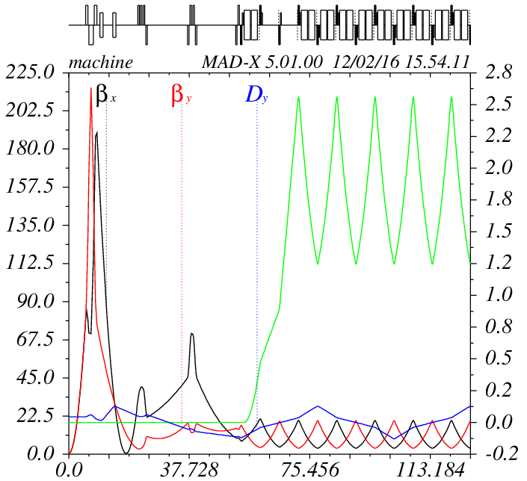
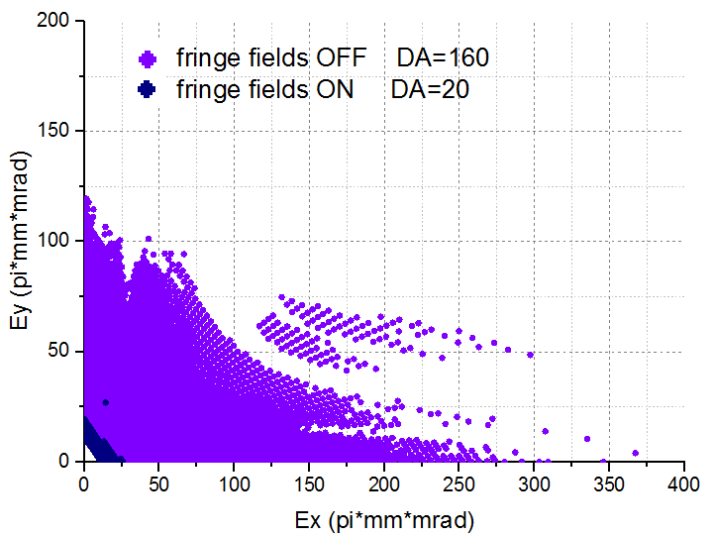
3. Dynamic Aperture calculations
Original Lattice: Q_{x,y} =9.44/9.44, β* =0.35m

Slide 22
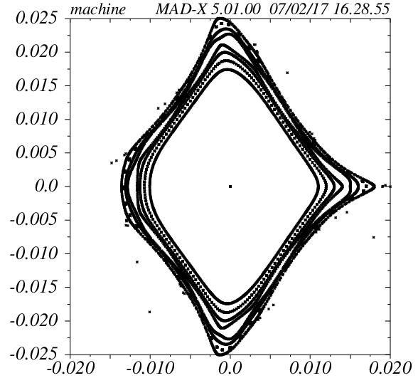
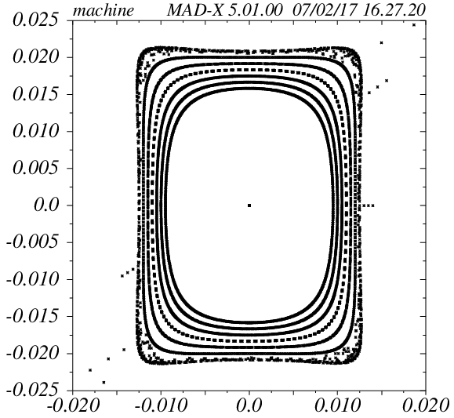
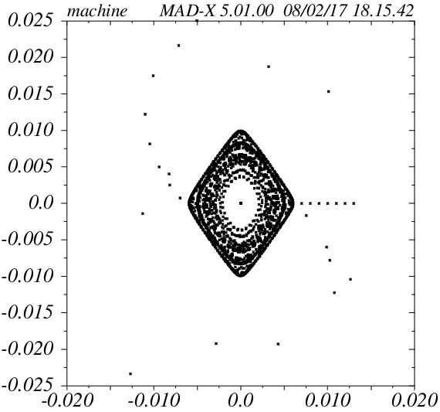
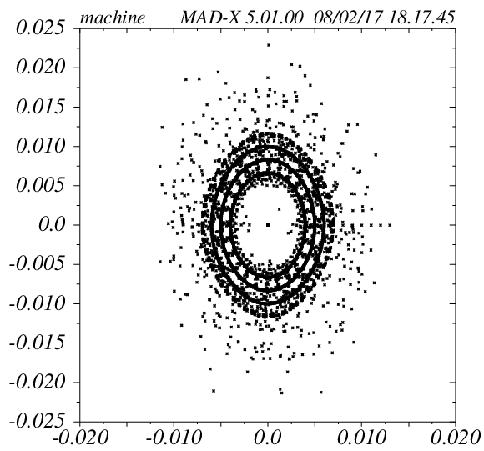
3. Dynamic Aperture calculations
X plane
Y plane
Chrom. Corr. ON
Fringe Field OFF
Chrom. Corr. ON
Fringe Field ON

Slide 23
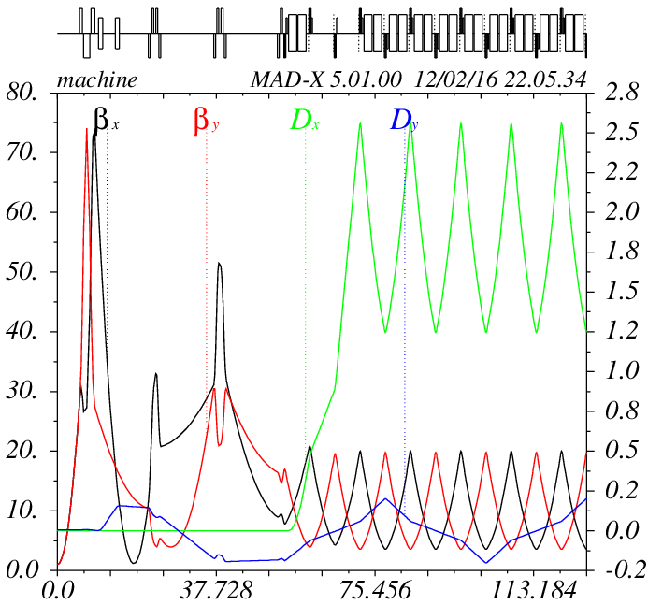
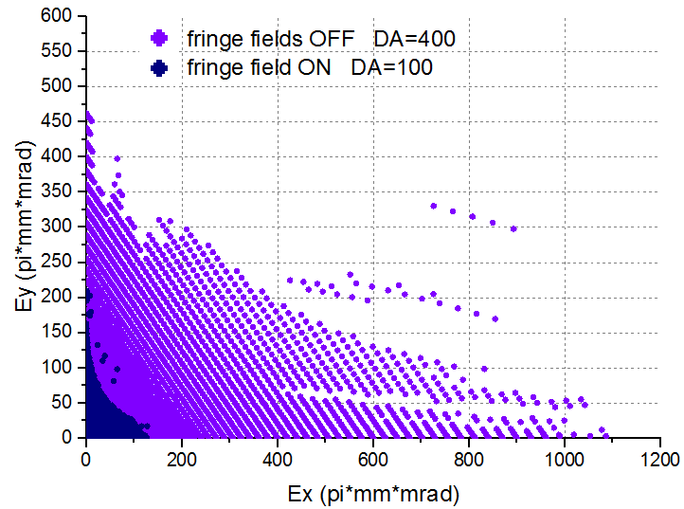
3. Dynamic Aperture calculations
Lattice: Q_{x,y} =9.44/9.44, β* =0.5, 0.6, 0.7, 1.0m
β* = 1.0m

Slide 24
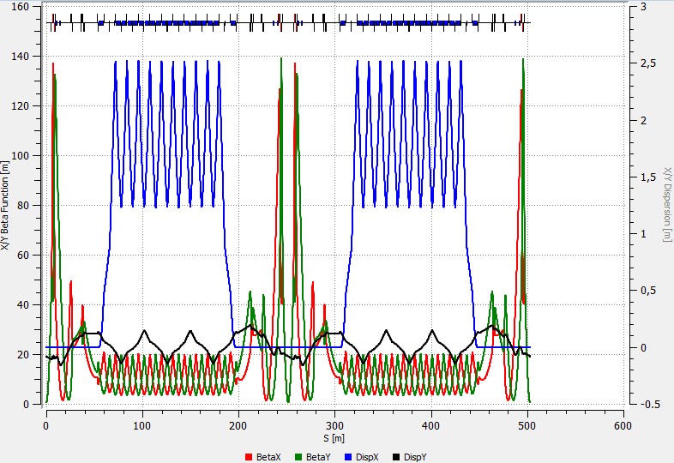
3. Dynamic Aperture calculations
Lattice: Q_{x,y} =9.44/9.44, intermediate β* = 0.6m

Slide 25
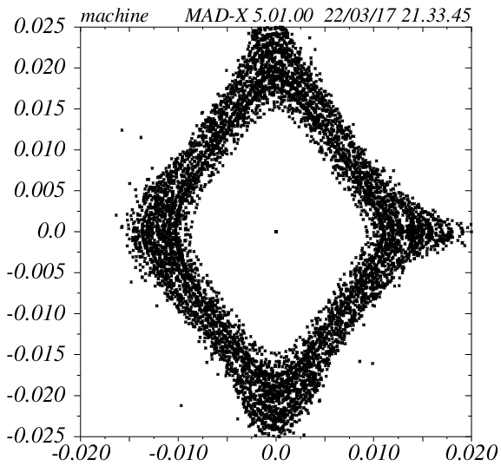
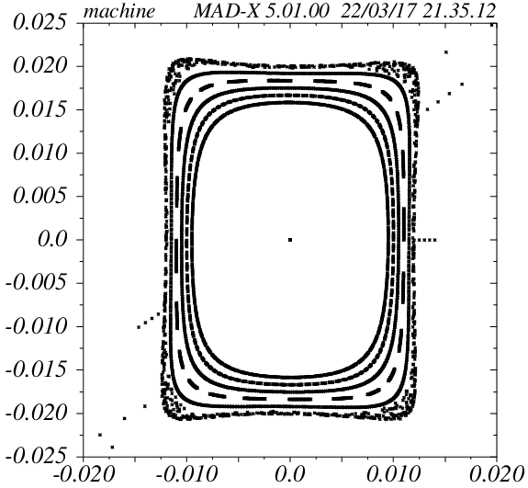
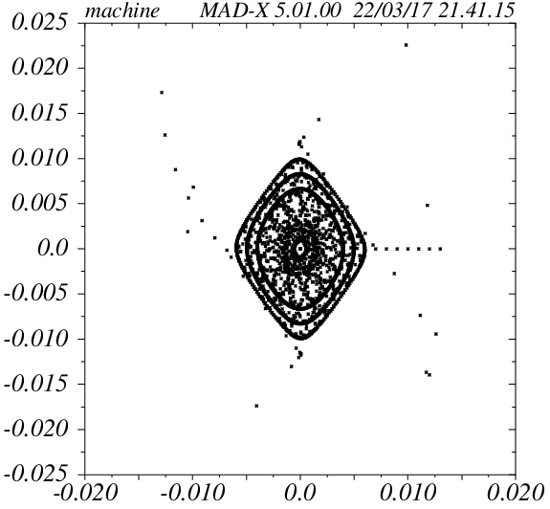
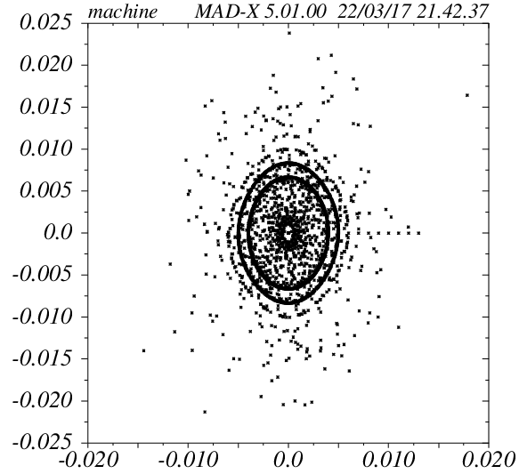
3. Dynamic Aperture calculations
X plane
Y plane
Chrom. Corr. ON
Fringe Field OFF
Chrom. Corr. ON
Fringe Field ON

Slide 26
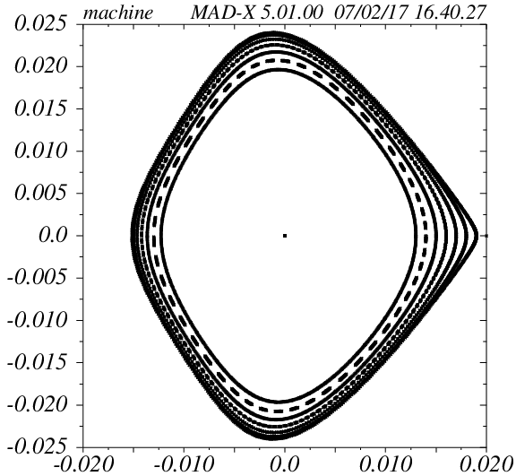
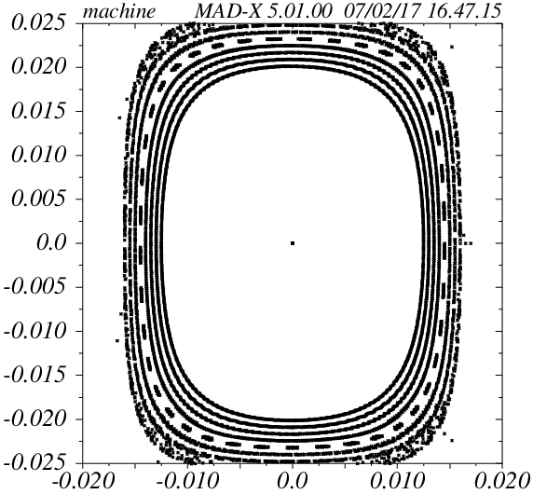
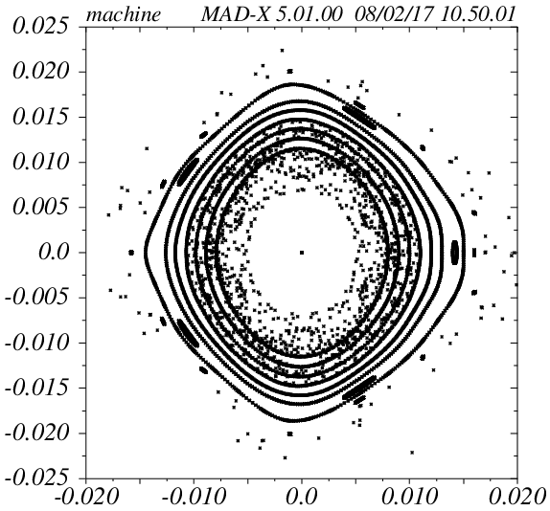
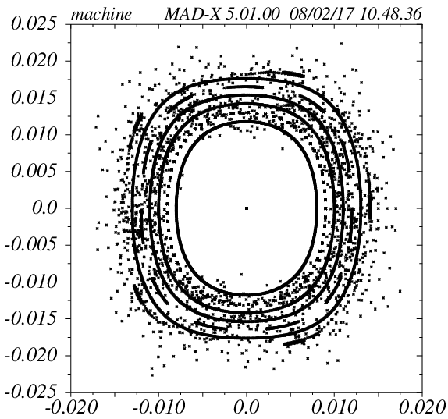
3. Dynamic Aperture calculations
X plane
Q_{x,y} =8.10/10.10
Y plane
Chrom. Corr. ON
Fringe Field OFF
Chrom. Corr. ON
Fringe Field ON

Slide 27
Conclusions 1
Increase β* at IP increase DA: 0.35m DA<GA, 0.6m DA≥GA ;
For β*=0.6m the required luminosity at E_{k} =3÷4.5 GeV/u of L=1•10²⁷ cm⁻²s⁻¹ will be achieved with ~15% higher bunch intensity;
Ring tunes Q_{x,y} =9.44/9.44 chosen as a project base option due to S-Cooling reasons ;
Tunes q_{x,y} =0.10/0.10 (Q_{x,y} =8.10/10.10) show a largest aperture DA>GA

Slide 28
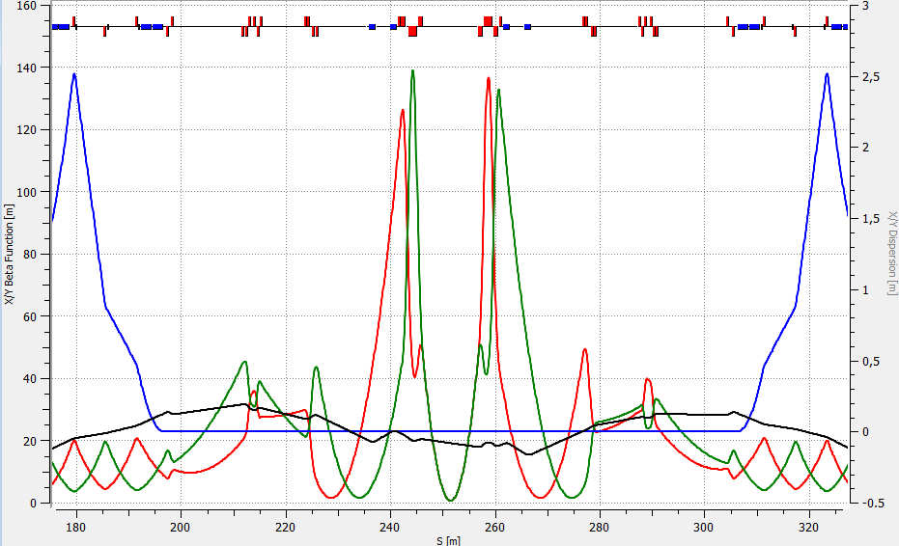
3. Dynamic Aperture calculations (continued)
- Optics for two beams optimization
- Nominal Working point Q_{x,y} =9.44/9.44
Q_{x,y} =9.44/9.44, β* =0.60m

Slide 29
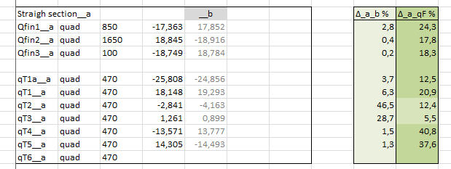
3. Dynamic Aperture calculations (continued)
- Optics for two beams
- Working point Q_{x,y} =9.44/9.44
Quadrupoles in straight sections A and B
Collider optics, MAC 2017

Slide 30
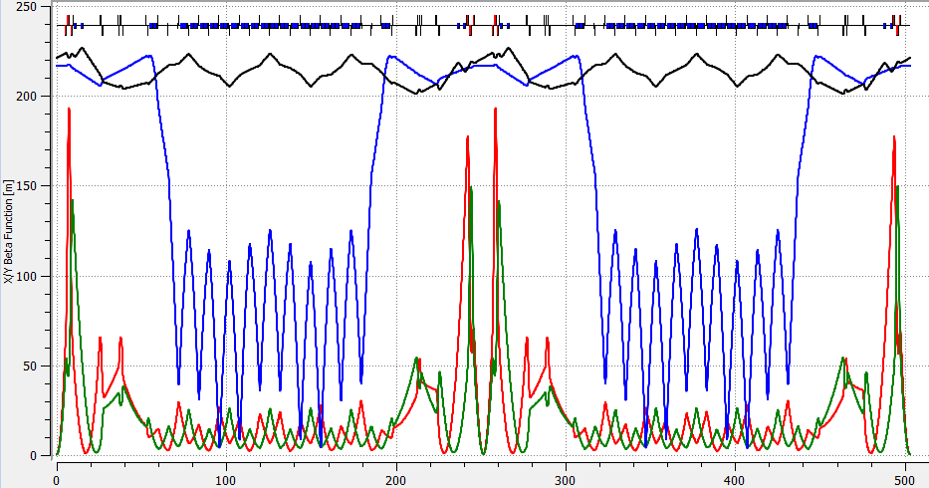
3. Dynamic Aperture calculations (continued)
- Move to Working point Q_{x,y} =9.10/9.10 by qF, qD Quads strength adjustment
Q_{x,y} =9.10/9.10, β* =0.60m

Slide 31
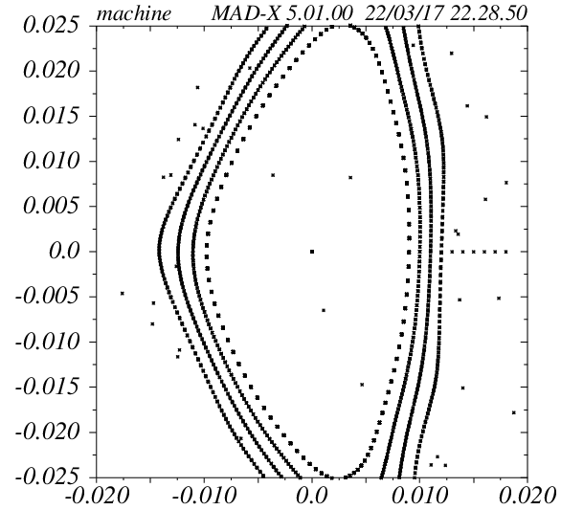
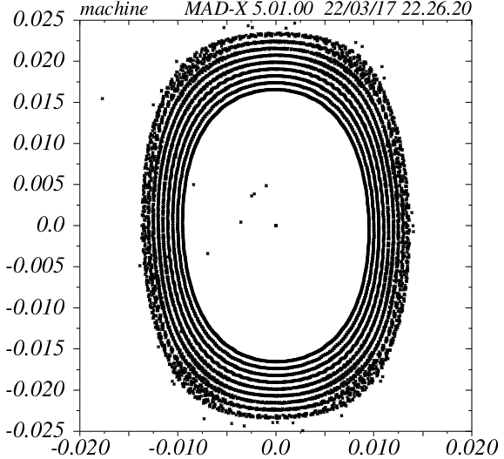
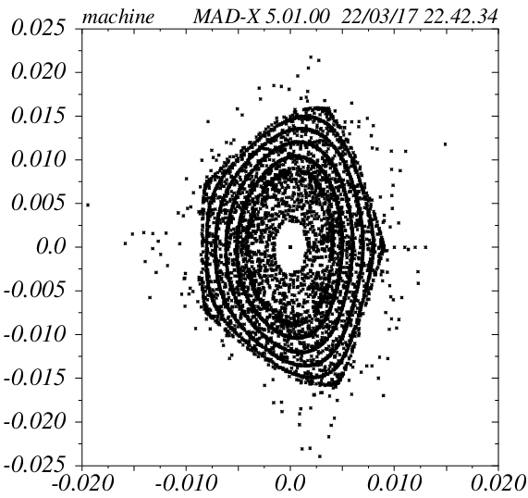
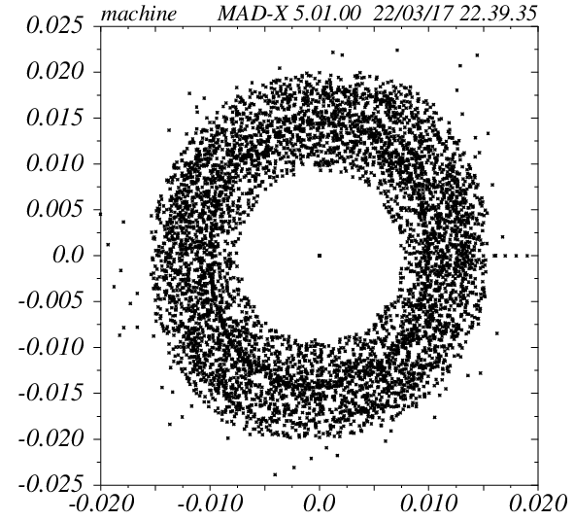
3. Dynamic Aperture calculations
X plane
Q_{x,y} =9.12/9.12
Y plane
Chrom. Corr. ON
Fringe Field OFF
Chrom. Corr. ON
Fringe Field ON

Slide 32
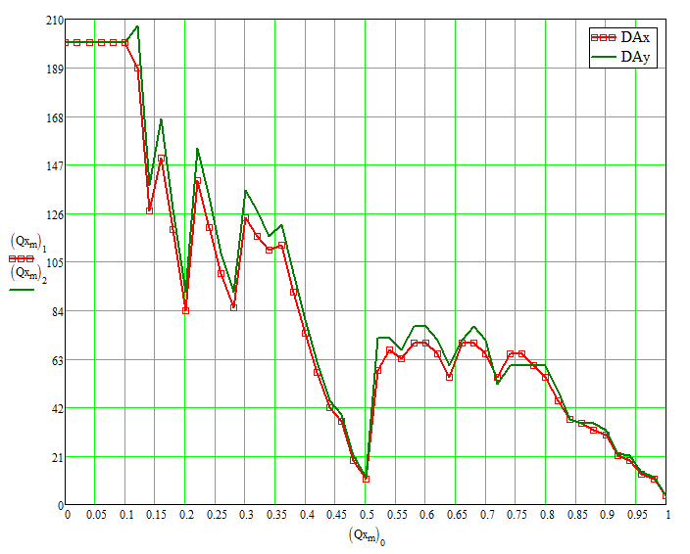
3. Dynamic Aperture calculations
“Artificial” Tune Scan (by the phase advance adjusting matrix) along the coupling resonance.

Slide 33
Conclusions 2
Anti-symmetric optics suitable for both rings compiled;
Designations and numbering of elements of the collider Rings have been introduced;
Half-Ring-A differs from Half-Ring-B in Straight Sections Quads strength ;
Tunes Q_{x,y} =9.10/9.10 produced by 4% decrease of main Quads qF, qD strenght;
Point 9.10/9.10 has largest DA›GA, will be used at StartUp;
Point 9.44/9.44 preferable for S-cooling has a smaller DA

Slide 34
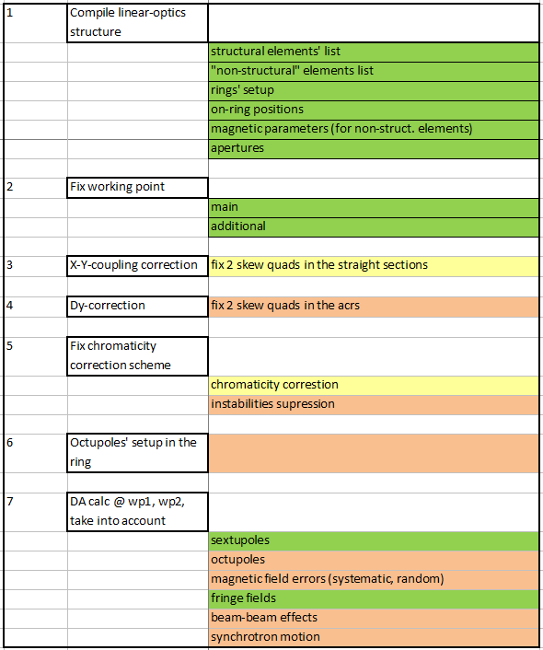
Conclusions 3: Tasks

Slide 35
Thank you for your attention !

