Slide 1

NICA
Heavy Ion Linear Accelerator (HILAC)
commissioning
In collaboration with
“BEVATECH OHG”(Germany), Tomco (Australia)
JINR, INR(Russia).
Levterov К. on behalf of Acceleration Department,
DUBNA, JINR LHEP

Slide 2
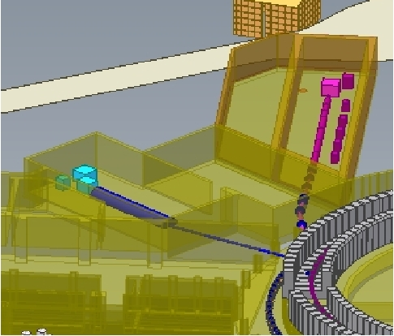
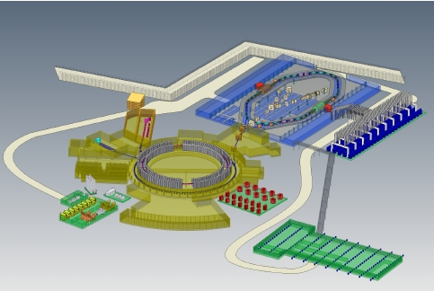
Injection facility NICA
HILAC
(Heavy Ion Linear Accelerator)
3.2 MeV/u
Z/Amin=0.16
LINAC
LU-20
5 MeV/u
Z/Amin=0.33

Slide 3
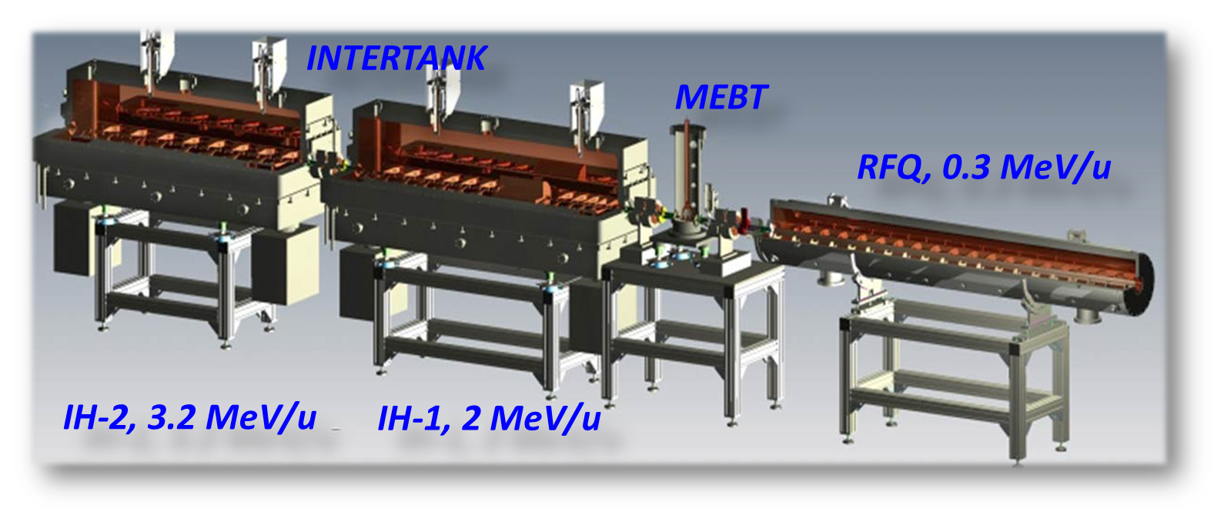
TOPICS
RFQ commissioning results.
Total commissioning RFQ+IH1+IH2.

Slide 4
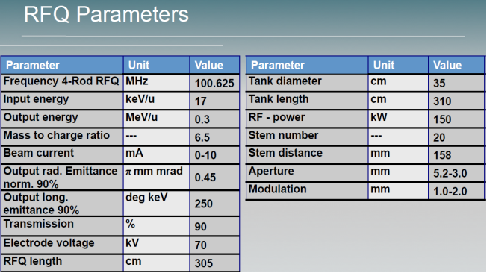
Estimation of output energy and transmission is Goal of RFQ commissioning
4-rod RFQ
Au31+, Ein=17 keV/u Eout=300 keV/u

Slide 5
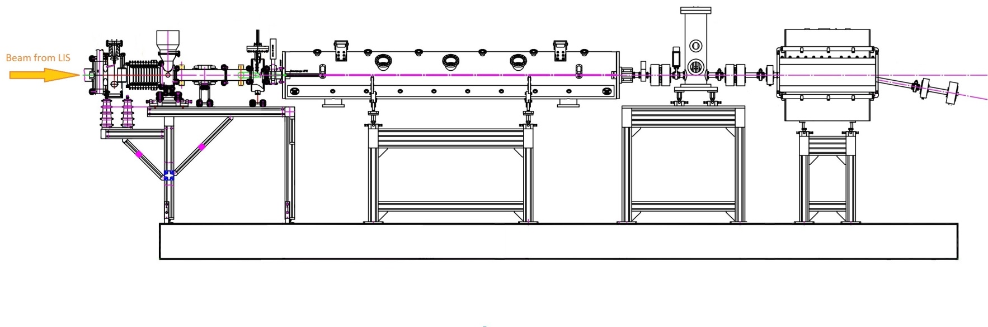
EXPERIMENTAL SETUP
LEBT
RFQ
MEBT
ANALISING MAGNET
Electrodes
Accelerating tube
Focusing
lenses
D1
Buncher
D2
Osciloscope

Slide 6
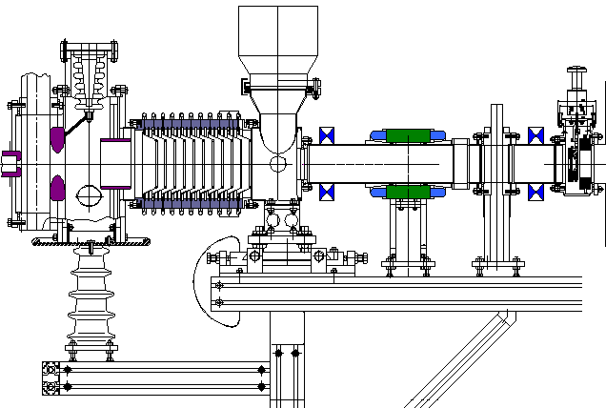
LEBT
Low Energy Beam Transport
Ein=3 keV/u Eout=17 keV/u
Electrodes
Accelerating
tube
RFQ input
Focusing magnet lenses
Steer

Slide 7
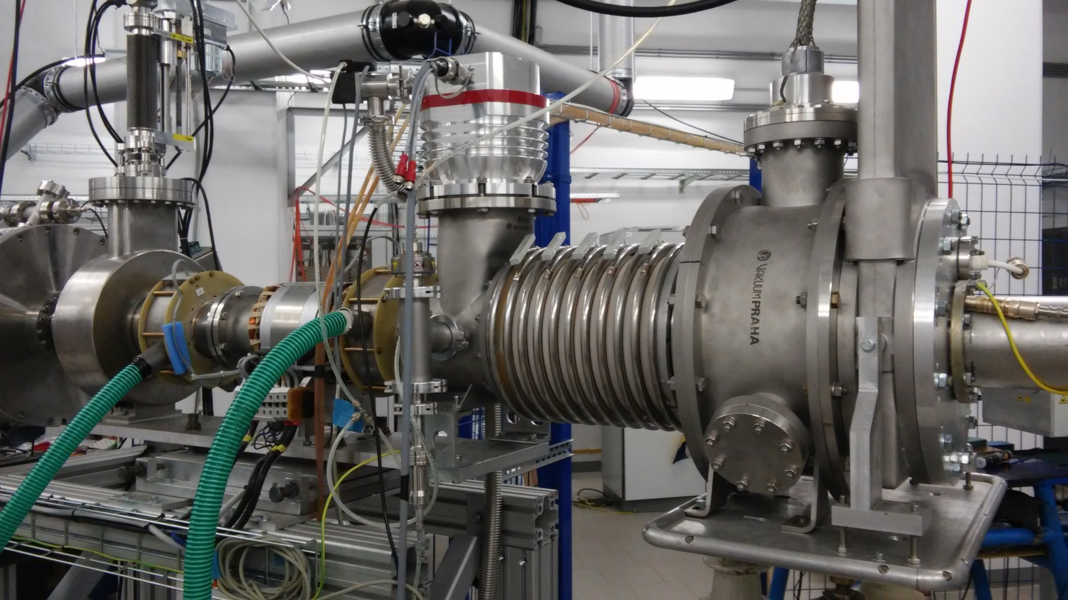
LEBT
Low Energy Beam Transport
Ein=3 keV/u Eout=17 keV/u

Slide 8
OUTPUT ENERGY
E=300 keV/u => β = 0.0253
STEPS :
Experimental searching for R at the given energy
Calculating βacc at the found R
β = [2(e/ mp с²) (Z/A) U]^{1/2}
R= (mpс/e) β (A/Z) 1/B
R= 3,13 β A/Z 1/B

Slide 9
OUTPUT ENERGY searching for R
β = [2(e/ mpс2) (Z/A) U]^{1/2}
R= (mpс/e) β (A/Z) 1/B
R= 3,13 β A/Z 1/B
U=51 kV | Z/A | β | B, G | R, m
C2+ | 1/6 | 0,00430 | 484 | 1,665
C3+ | 1/4 | 0,00520 | 394 | 1,652
C4+ | 1/3 | 0,00603 | 340 | 1,669
<R>=1.662 m (+/-0.5%)

Slide 10
OUTPUT ENERGY
βуск = (e/mpC) (Z/A) BR
βуск = 0,319 Z/A BR
 | I magnet, A | B, kG | Urf p-p, mV | Uinj, kV | β +/_0.5%
C2+ | 88,60 | 2,88 | 823 | 102 | 0,0254
C3+ | 59,50 | 1,95 | 565 | 65 | 0,0258
C4+ | 44,00 | 1,45 | 442 | 49 | 0,0255
C5+ | 35,70 | 1,18 | 340 | 41 | 0,0261
C6+ | 29,70 | 0,97 | 283 | 34 | 0,0257
D+ | 29,70 | 0,97 | 283 | 34 | 0,0257
H+ | 14,50 | 0,48 | 144 | 17 | 0,0256

Slide 11
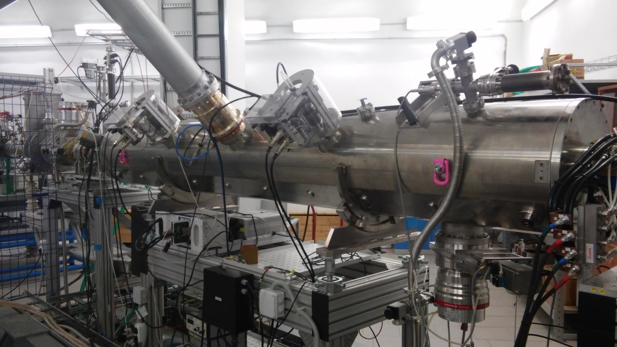
RESULTS OF RFQ COMMISSIONING
OUTPUT ENERGY E~ 300 keV/u, experimentally approved for C6+, C5+, C4+, C3+, C2+, C1+, D+, H+
Transmission for C2+ ~ 80%, C2+ ~ 90% (desirable to be defined more exactly)

Slide 12
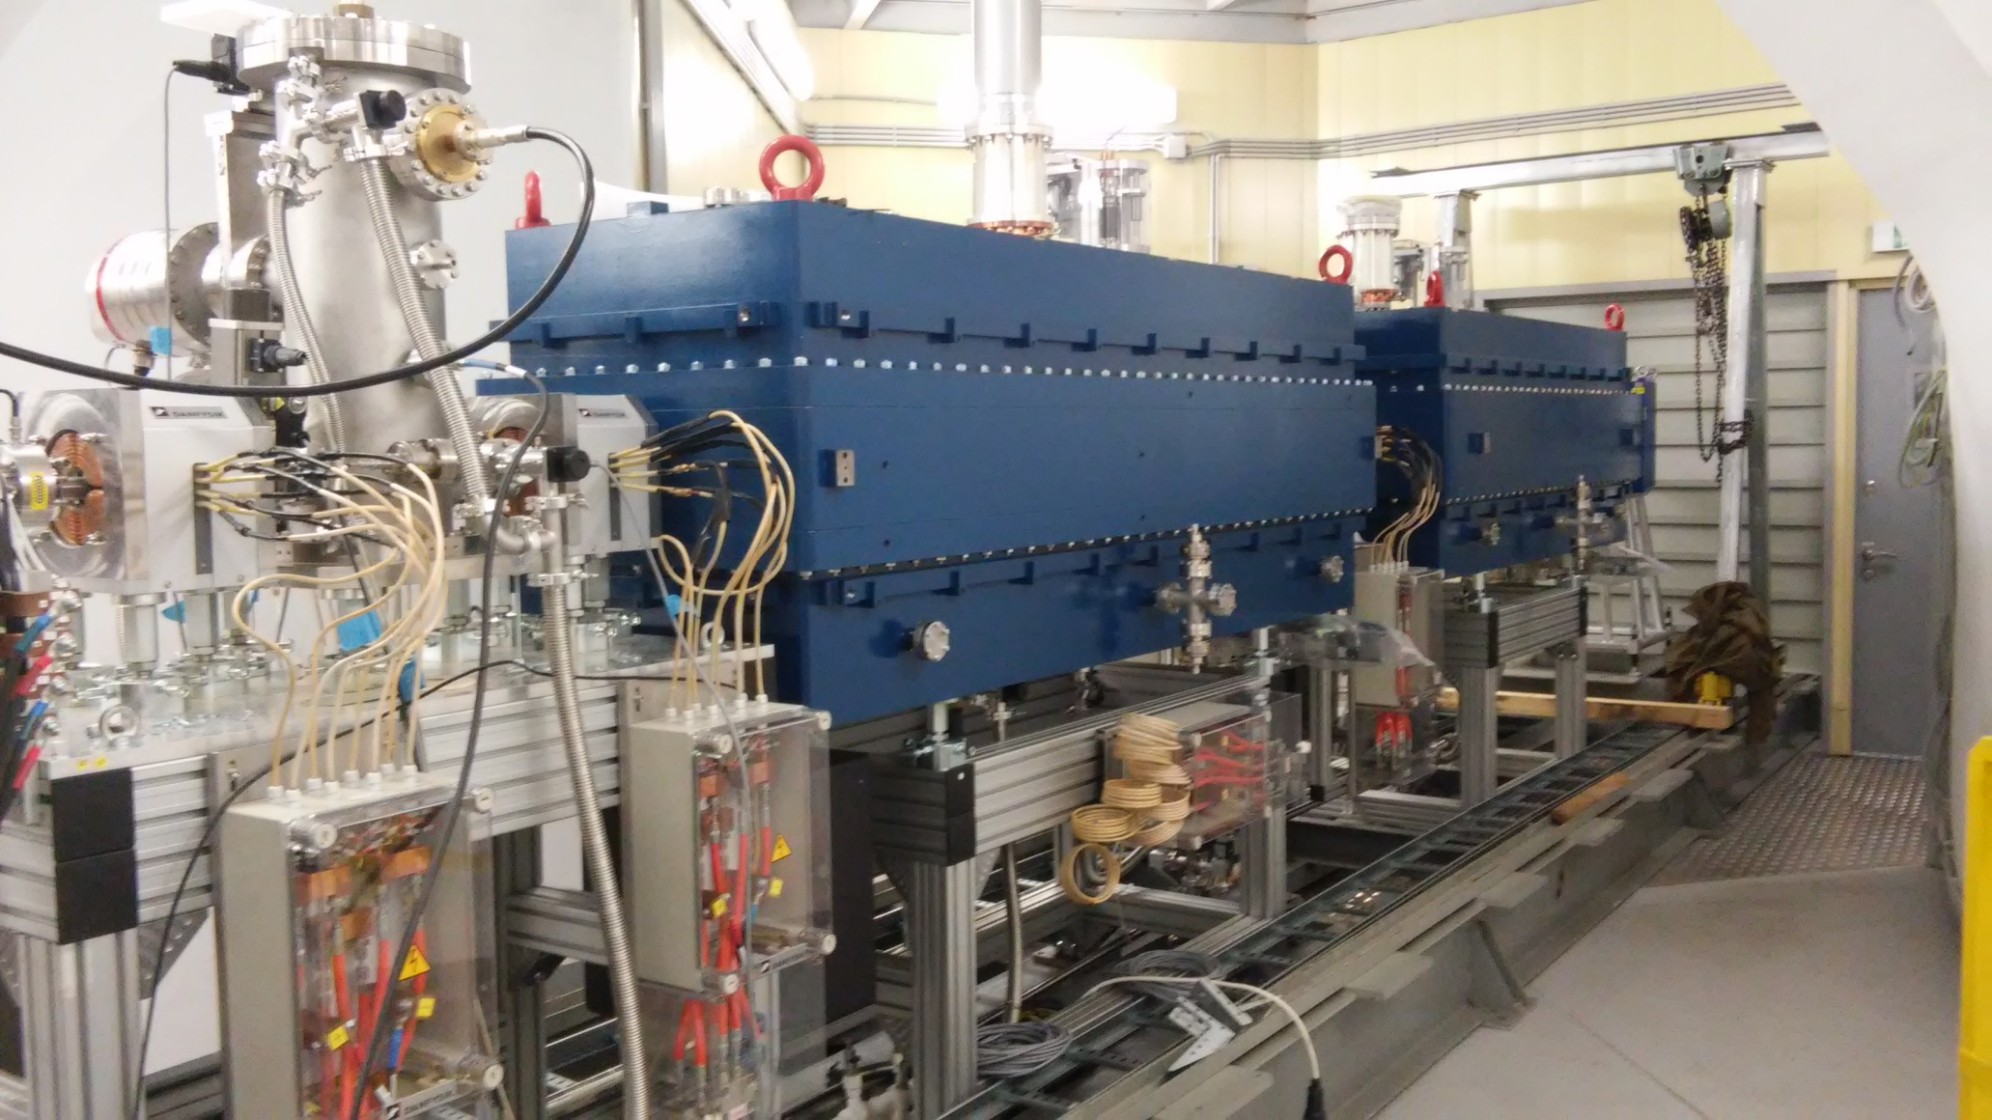
Total commissioning RFQ+IH1+IH2

Slide 13
DTL structure IH1 + IH2
Ein=300 keV/u Eout=3.2 MeV/u
«KONUS» (KOmbinierte NUll grad Struktur–нем.) – combined structure with zero synchronus phase.
IH, βλ/2 , TEM110.
- asynchronous beam injection with a surplus energy into structure with ‘fictional’ 0° synchronous particle, which defines only the drift tube structure
- Each accelerating section is followed by a transversal
focusing element
- At the entrance of each 0° synchronous particle
section the bunch must be longitudinally focused -35º.

Slide 14
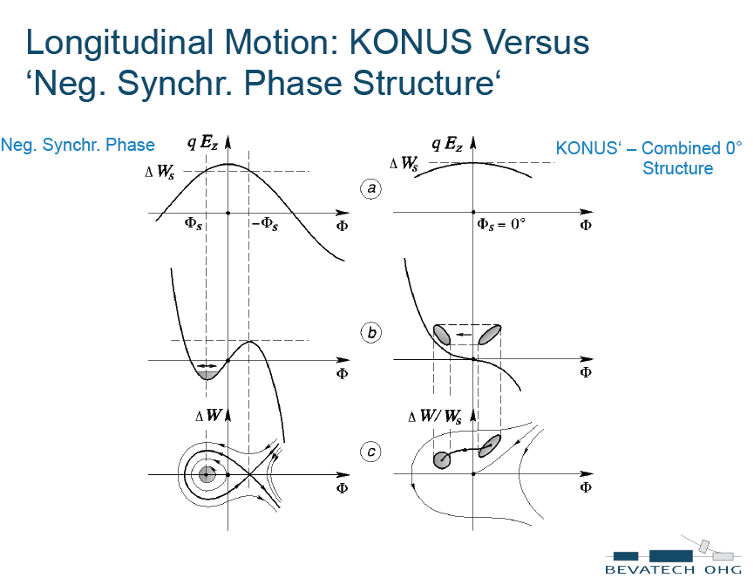
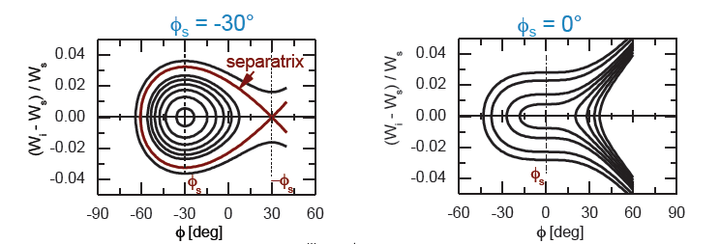

Slide 18
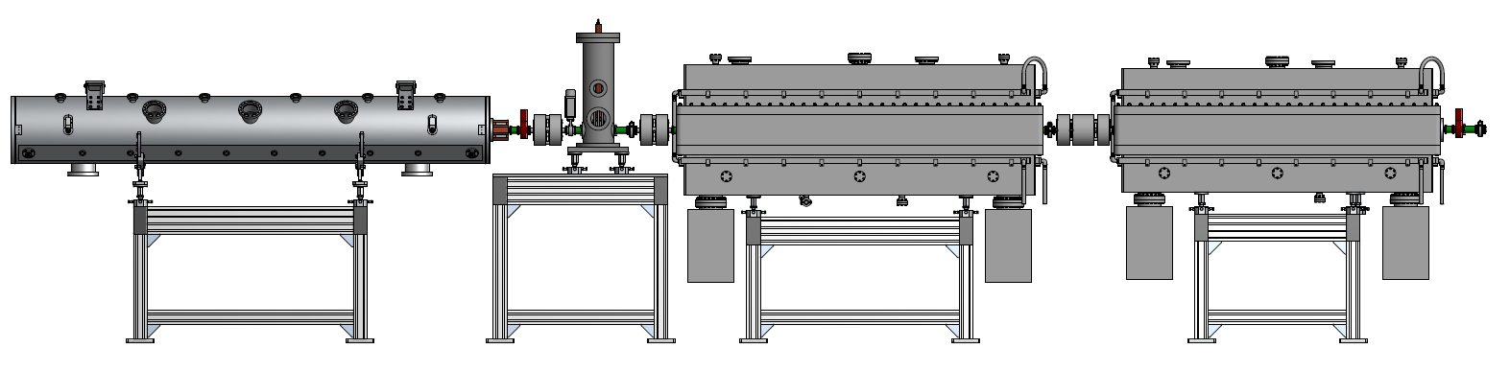
Experimental setup
S- steerer, CT-current transformer, PP-phase probe,
D- doublet, T- triplet, FC- Faraday cup
Experimental Eout= 3.2 MeV
CT1
PP1
PP2
CT2
PP3
FC
FC
Analizing
magnet
S2v, S2h
D1
D2
T1
T2

Slide 19
OUTPUT ENERGY
E=3.2 MeV/u => β = 0.0826
STEPS :
Experimental searching for R at the given energy
Calculating βacc at the found R
β = [2(e/ mp с²) (Z/A) U]^{1/2}
R= (mpс/e) β (A/Z) 1/B
R= 3,13 β A/Z 1/B

Slide 20
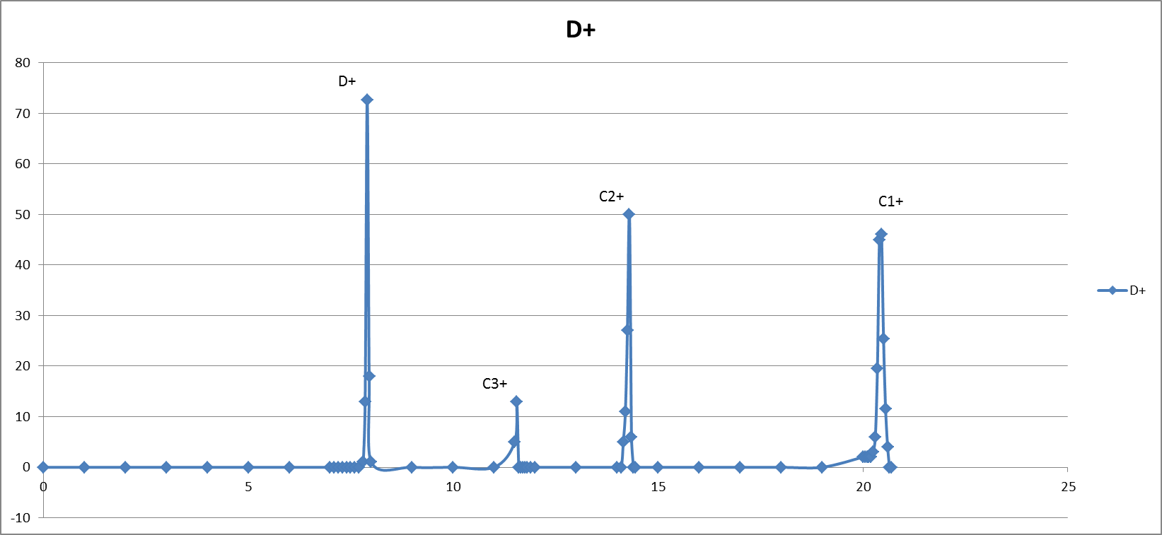
OUTPUT ENERGY searching for R
Uinj=69 kV
β = [2(e/ mpс2) (Z/A) U]^{1/2}
R= (mpс/e) β (A/Z) 1/B
R= 3,13 β A/Z 1/B
U=51 kV | Z/A | β | B, G | R, m
C2+ | 1/6 | 0,00495 | 494 | 1,91
C3+ | 1/4 | 0,00606 | 392 | 1,92
C4+ | 1/3 | 0,00700 | 338 | 1,91
<R>=2.00 m (+/-0.5%)

Slide 21
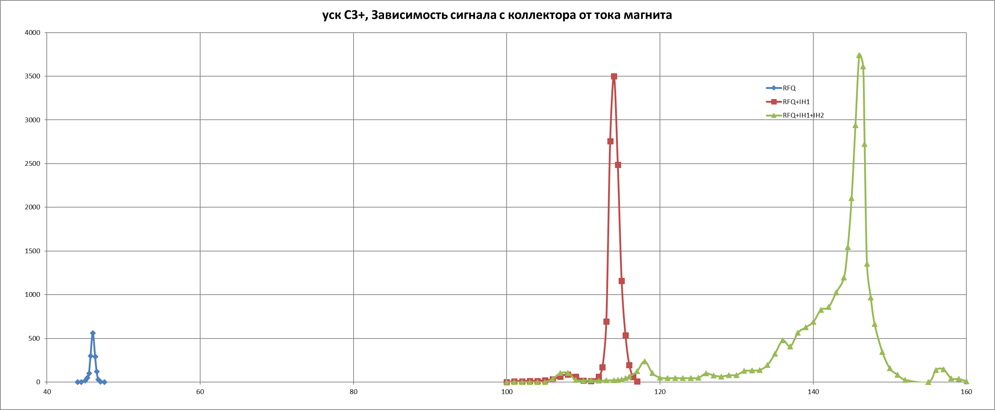
Three stages of C3+ beam acceleration in HILAC

Slide 22
?OUTPUT ENERGY?
βуск = (e/mpC) (Z/A) BR
βуск = 0,319 Z/A BR
Acceleration | E, Mev/n | βexp | βth
RFQ | 0.282 | 0.0245 | 0.0253
RFQ+IH1 | 1.666 | 0.0596 | 0.0626
RFQ+IH+IH2 | 2.698 | 0.0758 | 0.0826

Slide 23


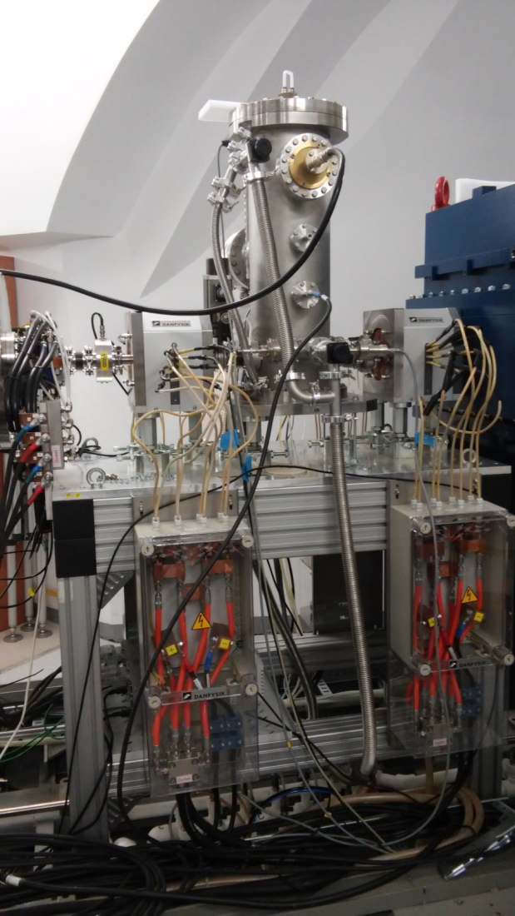
NEXT STEPS
Measurement of transmission.
RF control system.
Beam test with ESIS.

Slide 24
THANKS

