Slide 1
The injection facility of Nuclotron and obtained results of runs #52-54
A. Martynov on behalf of accelerator division.

Slide 2
Table of Contents
Structure and layout of the injection complex
Modernization of foreinjector
Source of polarized Ions
Transportation channel overview
Obtained results during Nuclotron runs 52-54

Slide 3
Layout of the complex

Slide 4
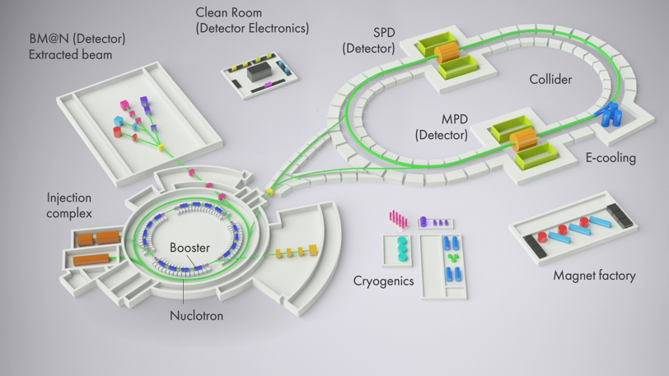
Layout of the complex
LU-20

Slide 5
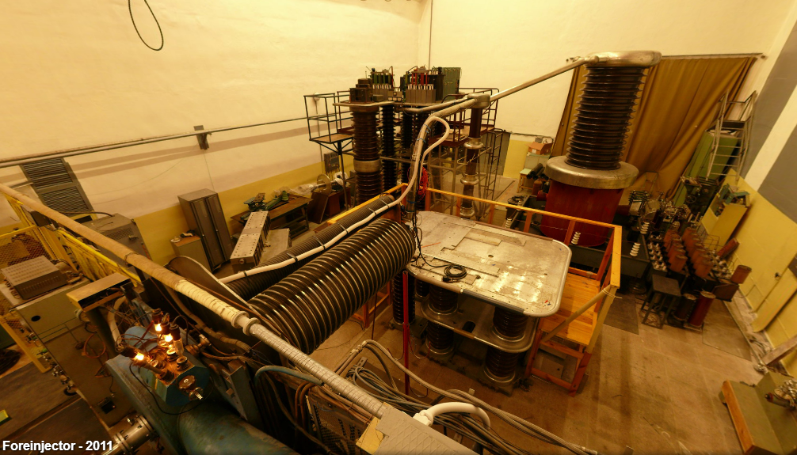
Foreinjector for Alvarez LU-20 before upgrade
Power supply for HV terminal, up to 5 kW
Pulse transformer,
up to 800 kV
Accelerating tube
HV terminal
K. Levterov

Slide 6
Foreinjector for ALVAREZ LU-20
Before upgrade
After upgrade
Ion Source
Pmax = 5 kW
Ion Source
Pmax = 35 kW
HV TERMINAL
U HV terminal ≤ 100 kV
45 kV- protons,
62 kV - Z/A=1/2,
103 kV - Z/A=1/3.
HV TERMINAL
U HV terminal ≥ 300 kV
625 kV- protons,
312.5 kV - Z/A=1/2,
470 kV - Z/A=1/3.
LINAC
RFQ
K. Levterov
LINAC

Slide 7
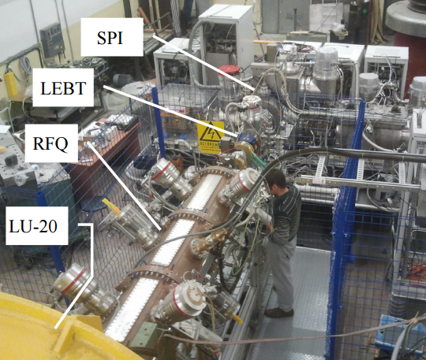
Foreinjector for Alvarez LU-20 after upgrade

Slide 8
Structure of the complex
Transfer to extraction channels
Nuclotron
SPI
RFQ
LU-20
LIS
p↑, d↑, ions z/A>0.3 5 MeV/u
protons 20 MeV/u
Polarized p↑ and d↑ beams, protons and light ions
are accelerated with DTL LU-20

Slide 9
Structure of the complex
Transfer to extraction channels
Source of polarized ions
Nuclotron
SPI
RFQ
LU-20
LIS
p↑, d↑, ions z/A>0.3 5 MeV/u
protons 20 MeV/u
Polarized p↑ and d↑ beams, protons and light ions
are accelerated with DTL LU-20

Slide 10
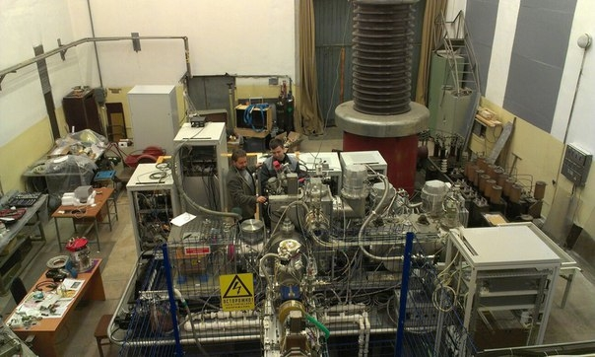
Source of polarized ions (SPI)
The main purpose of the SPI-project is to produce the intensity of the accelerated polarized beams (D+,H+) at the JINR Accelerator Complex up to 10¹⁰ p/pulse
Developers: V.V. Fimushkin (JINR),
A.S. Belov (INR RAN) and others

Slide 11
SPI
3 runs in 2016-2017 (#52-54) with d↑, 1 run (#54) with stable p↑ beam.
 | Polarized deuterons | Polarized protons
Obtained beam current in 2017 (source) | 2 mA | 0.4 mA
Project beam current (source) | 5-6 mA | 5-6 mA
Obtained beam intensity in 2017 (Nuclotron) | 2.2x10⁹ ppc | 1.8x10⁸ ppc
Project beam intensity (Nuclotron) | 1-2x10¹⁰ ppc | 1-2x10¹⁰ ppc
Next steps (since the last Nuclotron run #54):
1) Measure and match beam emittance from SPI to LEBT
2) Install buncher in front of DTL (int. x3)

Slide 12
Structure of the complex
Transfer to extraction channels
Nuclotron
SPI
RFQ
LU-20
LIS
p↑, d↑, ions z/A>0.3 5 MeV/u
protons 20 MeV/u
Laser Ion source
Polarized p↑ and d↑ beams, protons and light ions
are accelerated with DTL LU-20

Slide 13
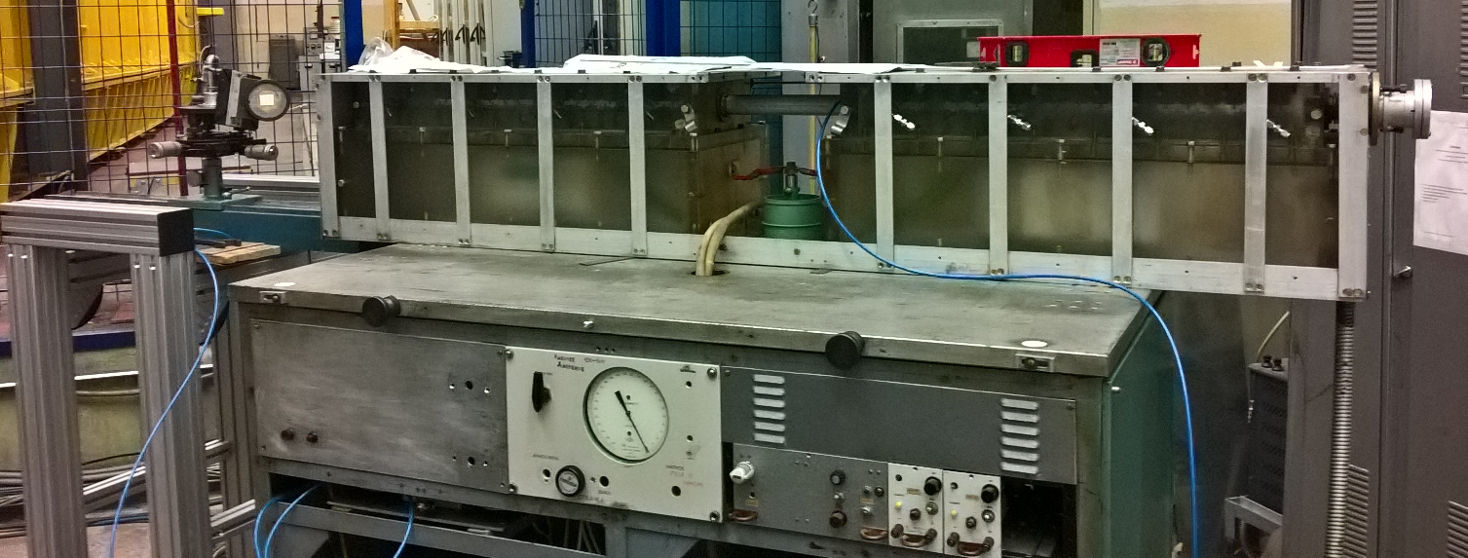
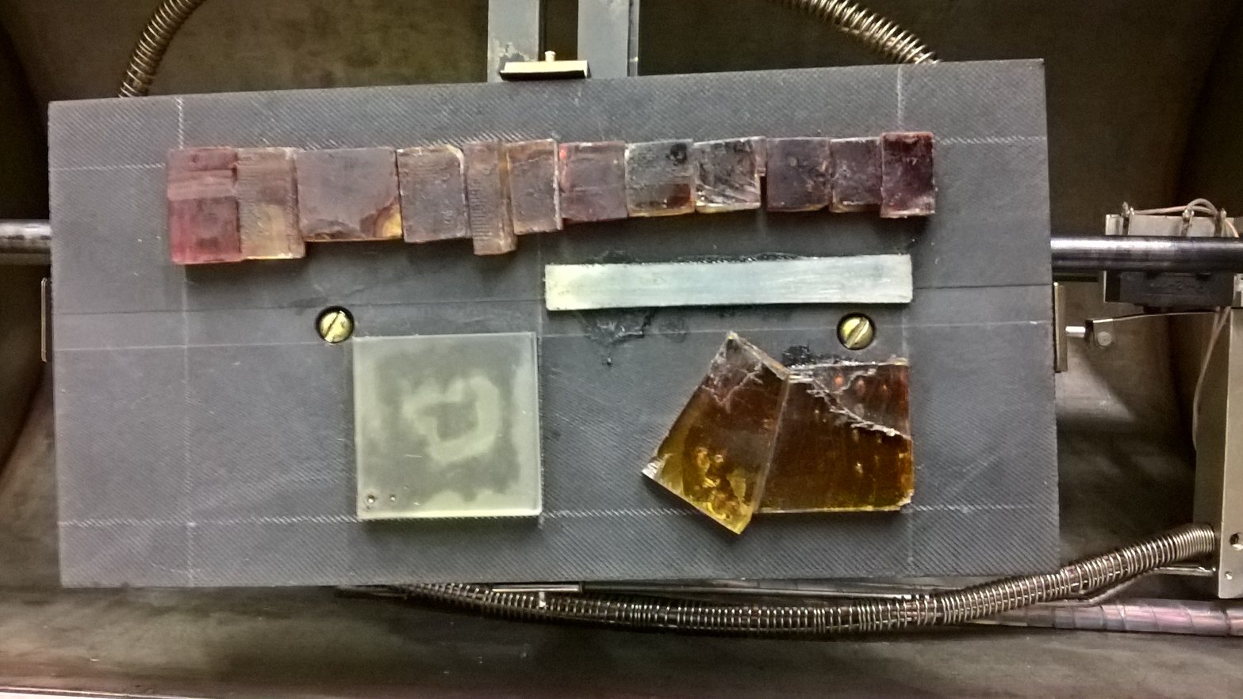
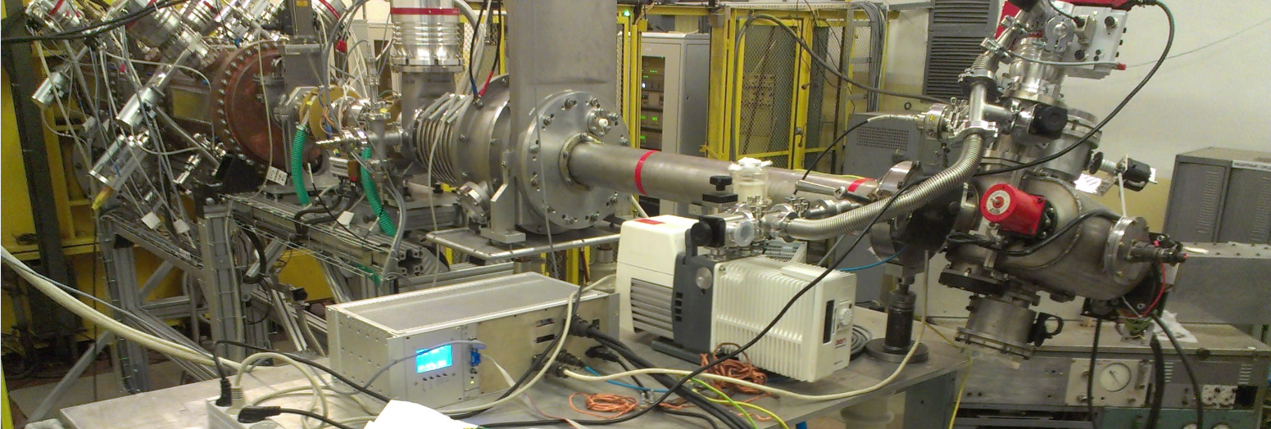
Laser Ion Source (LIS)
LiF
D polyethylene
C+
LiF
CO2 Laser
LiF
LEBT
RFQ
Vacuum chamber

Slide 14
Structure of the complex
Transfer to extraction channels
LU-20 foreinjector
Nuclotron
SPI
RFQ
LU-20
LIS
p↑, d↑, ions z/A>0.3 5 MeV/u
protons 20 MeV/u
Polarized p↑ and d↑ beams, protons and light ions
are accelerated with DTL LU-20

Slide 15
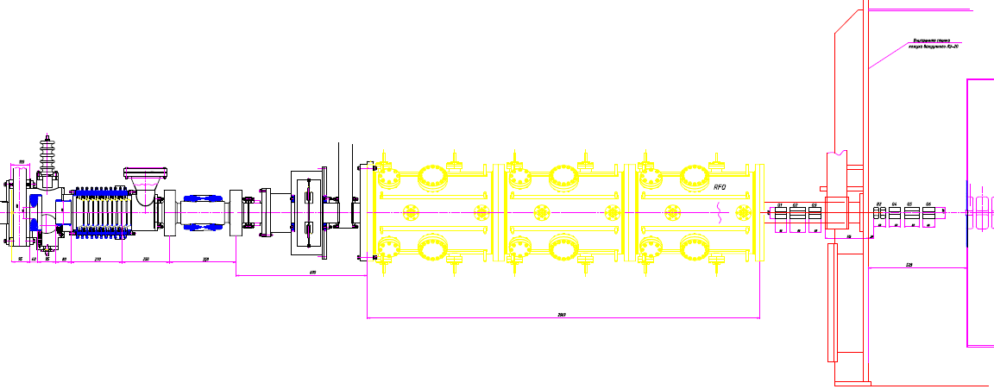
LU-20 injection line
LEBT
RFQ
MEBT
QT + (Bu) +QT
Source
LU-20 (DTL)
10 keV/u(SPI)
0.5 keV/u (LIS)
31 keV/u
156 keV/u
5 MeV/u
62 keV/u
Ion source output
LEBT output
RFQ output
Lu-20 output

Slide 16
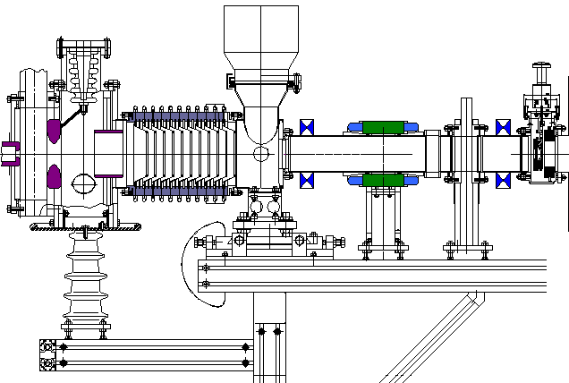
Low energy beam transport
Focusing magnet lenses
RFQ input
Electrodes
Accelerating
tube
Steerer
SPI ions | Z/A | Current mA | ε_{n}(4rms) π sm mrad | Beam energy keV/u
 |  |  |  | From SPI | LEBT output
²D⁺ | 0,5 | 10 | 0.2 | 10 | 62
Developed at JINR

Slide 17
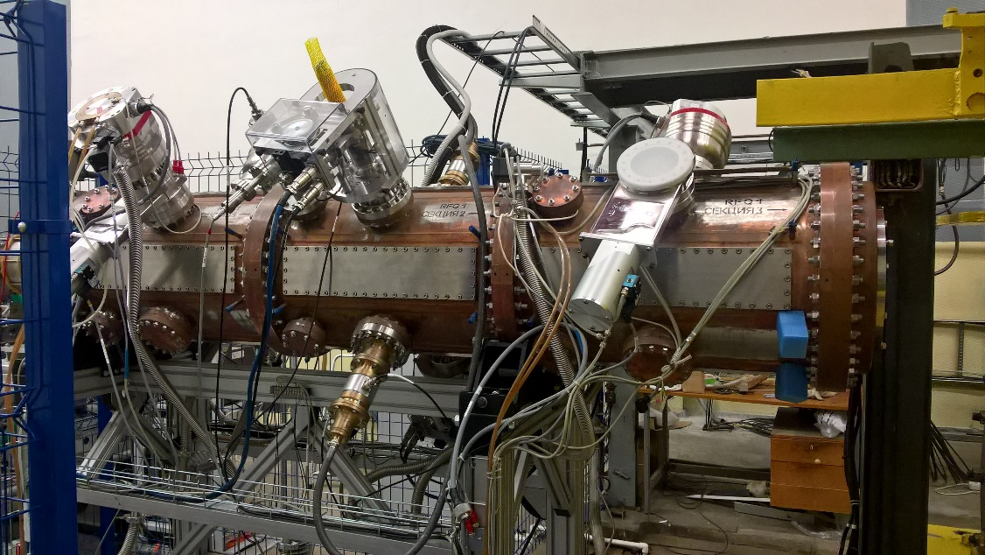
RFQ
Developed by collaboration of JINR, ITEP, VNIITF (Snezhinsk), MEPHi (2016)
q/A | 1.0 | 0.5 | ≥ 0.3
Injection energy, [keV] | 31 | 61.8 | 103
Max current, [mА] | 10 | 20 | 10
Output energy [keV/u] | 156
Norm emittance (output) [π·cm·mrad] | ≤ 0.5
RFQ length, [m] | 2.2
Transmission, % | > 85% | > 89% | > 93%
In LU-20 acceptance with buncher | 70 % | 71 % | 80 %
In LU-20 acceptance without buncher | 15 % | 15 % | 20 %

Slide 18
Structure of the complex
Transfer to extraction channels
Drift-tube linac
Nuclotron
SPI
RFQ
LU-20
LIS
p↑, d↑, ions z/A>0.3 5 MeV/u
Polarized p↑ and d↑ beams, protons and light ions
are accelerated with DTL LU-20

Slide 19
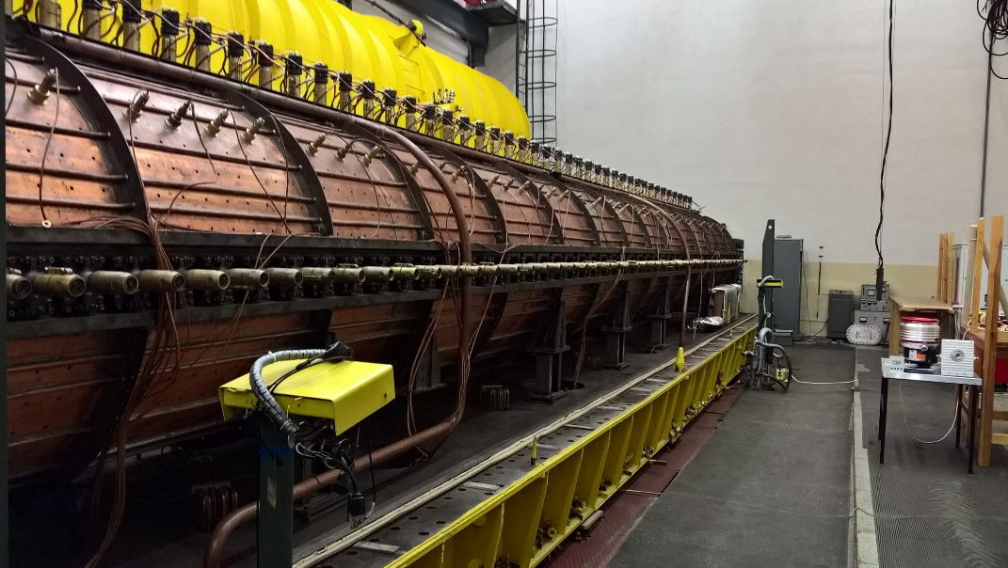
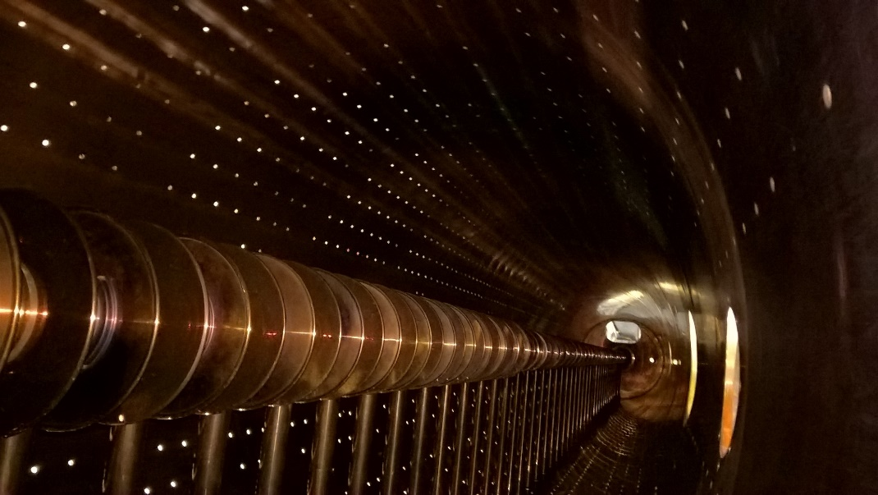
LU-20
q/A | 0.5 | 0.3
Injection energy | 156 keV/u
Output energy | 5 MeV/u
Transmission | ~75% | ~50%
Frequency | 145.2 MHz

Slide 20
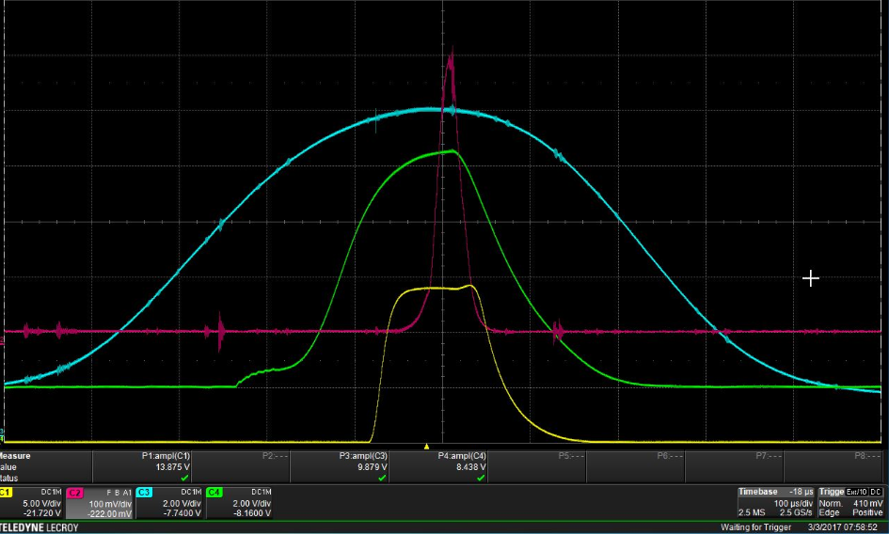
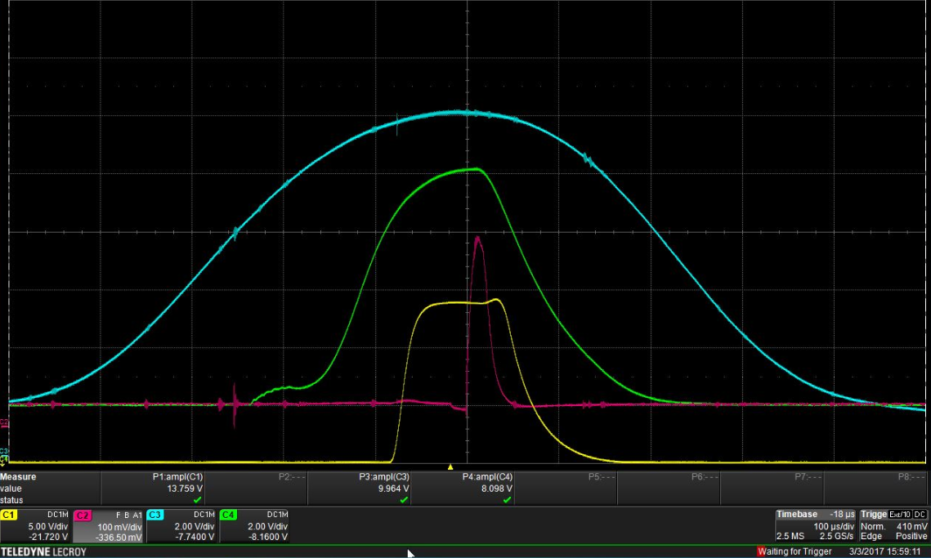
Transportation channel to Nuclotron
CF-1
Proton beam: I = 500 μA. For polarized protons I = 38 μA.
CF-4
Proton beam: I = 300 μA.
For polarized protons I = 30 μA.
Beam loss in channel:
Protons: 40%
Polarized protons: 21%
Beam current
RF of LU-20
RF of RFQ
Accelerating
voltage

Slide 21
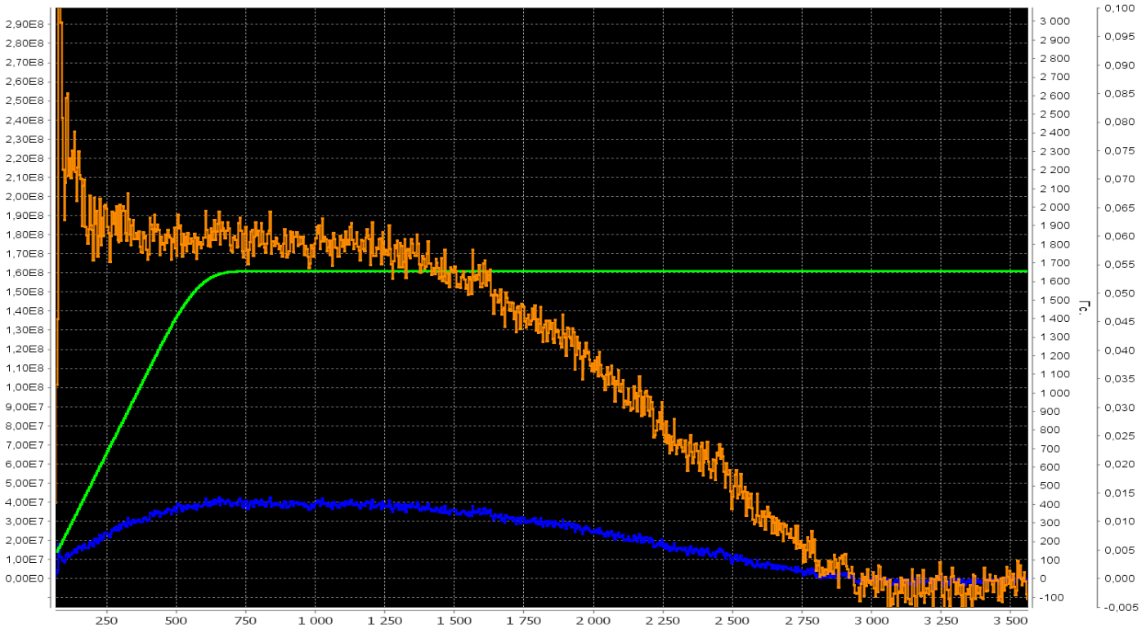
p↑ beam at Nuclotron
1.8 E8
1650
Beam voltage ,U
Beam intensity, particles/sec.
Magnetic field, Gs
Time, ms

Slide 22
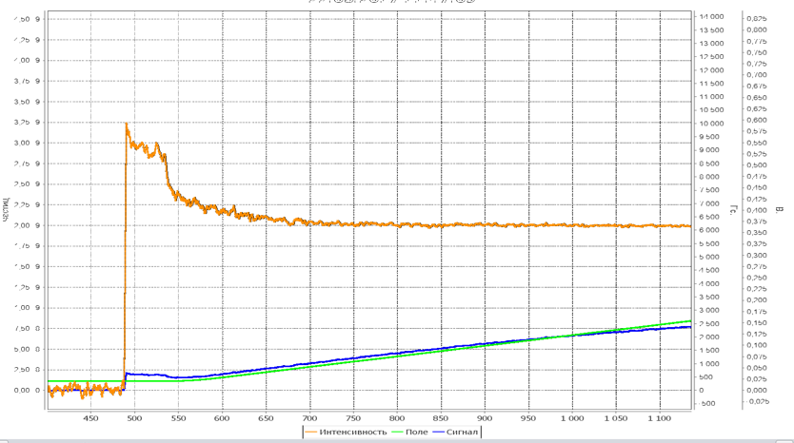
d↑ beam at Nuclotron
2.0 E9
Magnetic field, Gs
Beam voltage ,U
Beam intensity, particles/sec.
2500
Time, ms

Slide 23
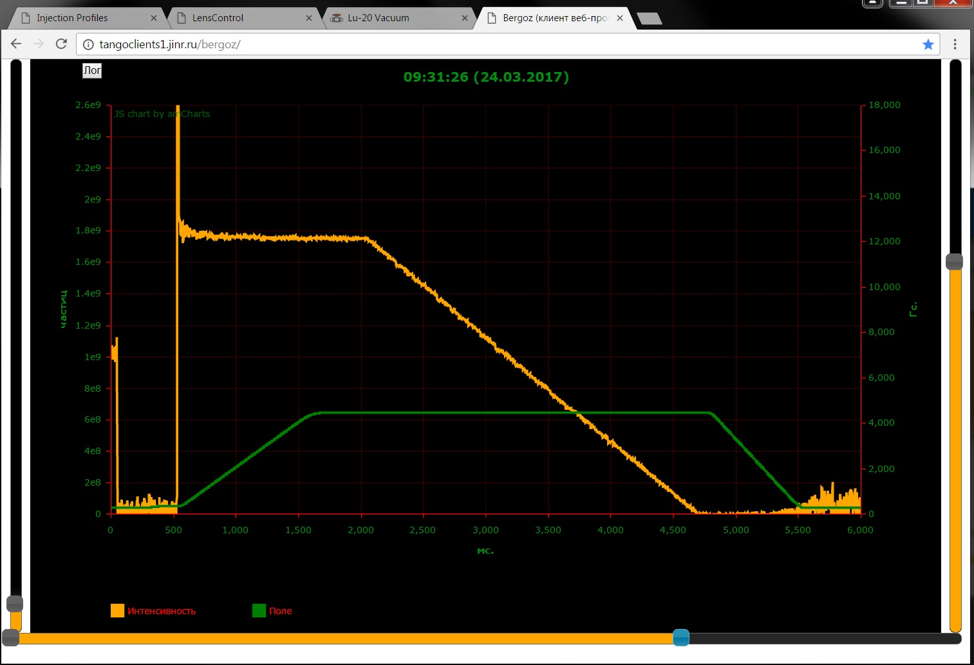
Li beam at Nuclotron
1.8 Е9
Beam intensity, particles/sec.
Magnetic field, Gs

Slide 24
Beam parameters during runs #53-54
Measured parameters of accelerated beam
 | d | d↑ | p(H⁺) | p↑ | Li³⁺ | C⁵⁺/C⁶⁺
I_{RFQ}, μA | 3000 | 2000 | 3600 | 520 | 10000 | 12000
I_{CF-1}, μA | 500 | 500 | 500 | 38 | 430 | 400
I_{CF-4}, μA | 400 | 100 | 420 | 30 | 340 | 320
Intensity, ppc | 8x10⁸ | 2.2x10⁹ | 2x10⁹ | 1.8x10⁸ | 2x10⁹ | 3.5x10⁸

Slide 25
Beam loss overview
Obtained results (run 54)
SPI
LEBT
RFQ
MEBT
LU-20
HEBT
Nuclotron
100%
80%
70%
16%
8-12%
3-10%
Theoretical beam loss (with buncher and channel optomisation)
SPI
LEBT
RFQ
MEBT+ Buncher
LU-20
HEBT
Nuclotron
100%
80%
70%
50%
25-38%
10-32%

Slide 26
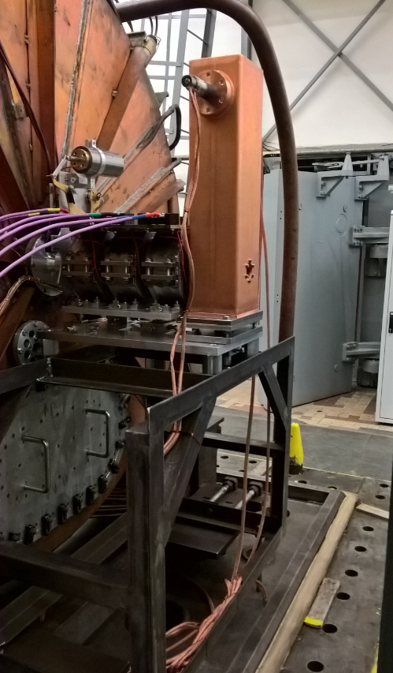
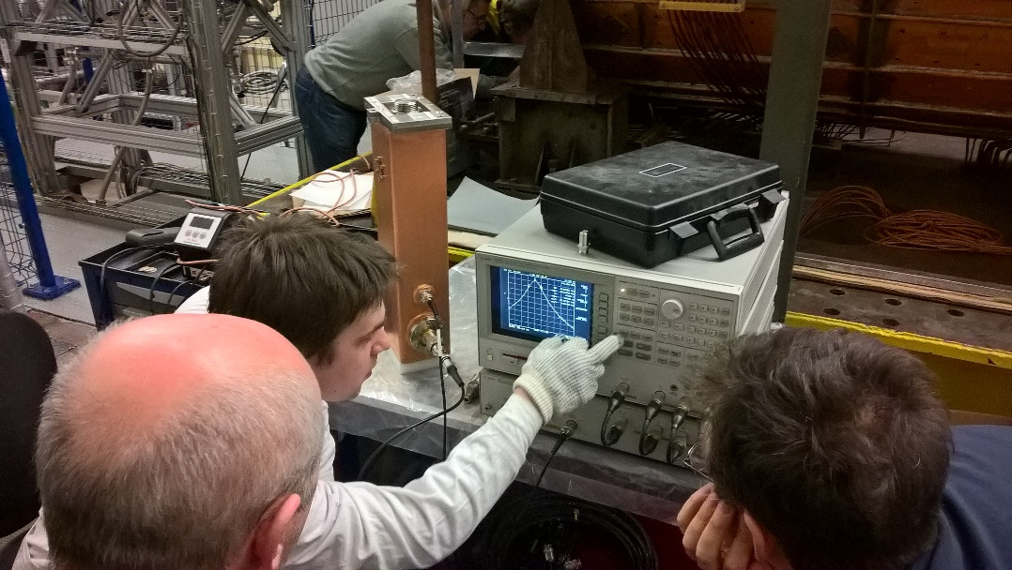
Next steps
Buncher installation in front of LU-20 and MEBT (JINR/ITEP)
Replacement of debuncher at transportation channel from LU-20 to Nuclotron (JINR/INR RAS).
Beam diagnostics.
Replacement of power supplies for elements of transportation channel.
Channel optics optimization.
Buncher tuning and installation (april 2017)

Slide 27
Thank you for attention!

