Slide 1
XII International workshop
“Problems of Charge Particle Accelerators”
to the memory of Prof. V.P. Sarantsev,
September 3-8, 2017, Alushta, Russia
Update of
Super Charm Tau Factory
Project at Budker INP
P.Piminov on behalf the Super-ct-factory team,
BINP SB RAS, Novosibirsk, Russia

Slide 2
Super Charm Tau Team
V.V. Anashin, D.E. Berkaev, E.A. Bekhtenev, V.E. Blinov, A.V. Bogomyagkov, A.E. Bondar, A.V. Bragin, I.N. Churkin, A.M. Dolgov, V.P. Druzhinin, S.I. Eidelman, S.A. Glukhov, S.E. Karnaev, G.V. Karpov, E.K. Kendjebulatov, V.A. Kiselev, V.V. Kolmogorov, I.A. Koop, A.A. Krasnov, V.S. Kuzminykh, G.Ya. Kurkin, A.E. Levichev, E.B. Levichev, P.V. Logachev, O.I. Meshkov, N.A. Mezentsev, N.Yu. Muchnoi, S.A. Nikitin, I.N. Okunev, A.V. Otboev, P.A. Piminov, Yu.A. Pupkov, D.B Senkov, D.N. Shatilov, Yu.M. Shatunov, S.V. Shiyankov, S.V. Sinyatkin, A.N. Skrinsky, V.V. Smaluk, Yu.A. Tikhonov, A.G. Tribendis, P.D. Vobly, A.N. Zhuravlev, K.V. Zolotarev

Slide 3
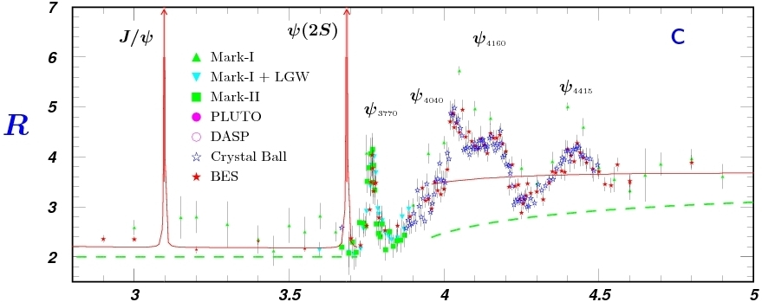
Physics program
D_{s}
τ
D
τ⁺τ⁻
D-Dbar mixing
CP violation searches in charm decays
Rare and forbidden charm decays
Standard Model tests in τ leptons decays
Searches for lepton flavor violation τ→μγ
CP/T violation searches in τ leptons decays
Production of the polarized anti-nucleons @ E=1 GeV (may be with reduced luminosity)

Slide 4
Main requirements & solutions
Beam energy from 1.0 to 2.5 GeV
Luminosity 10³⁵ cm⁻²s⁻¹ at 2 GeV
Longitudinal polarization of electron beam at IP
Beam energy calibration by Compton backscattering
Double ring collider
Crab waist collisions
Beta-function less than 1 mm
Constant beam emittance and damping time (damping wigglers)
High beam current (feedbacks)
5 Siberian Snakes
High intensity source of positron
High intensity source of polarized electron
2.5 GeV linac
50 Hz top-up injection

Slide 5
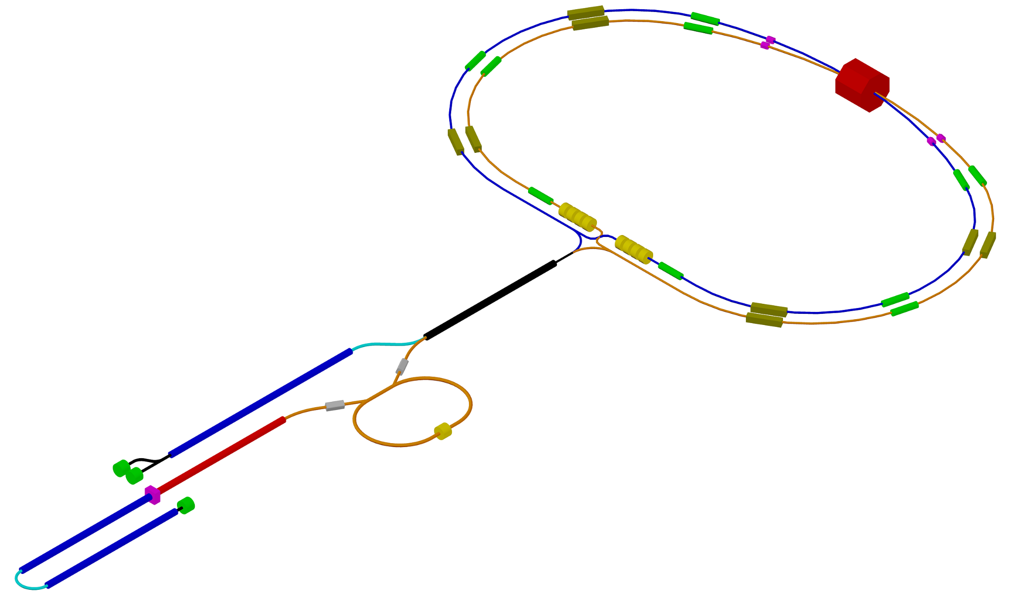
Layout
e– main ring
detector
e+e– linac
e+ main ring
e– injector
e+ damping ring
e+ injector
Major updated relates to the injection facility

Slide 6
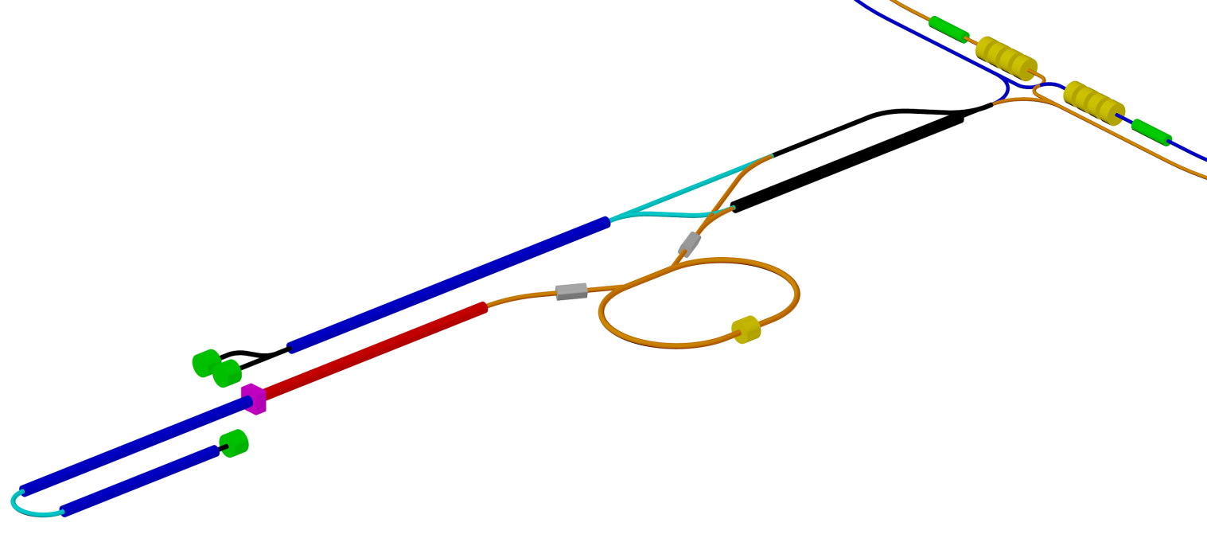
Injector
Accelerating structure: TW, constant impedance (geometry), length is 3 m, quasi-constant electric field distribution, energy gain is 22 MeV/m, beam energy per structure is 66 MeV
Klystron: peak power is 50 MW, repetition rate is 50 Hz, pulse length is up to 5 μs
RF module: 1 klystron, 2 accelerating strictures, electric field amplitude is 27 MV/m, gap between structures is 1 m
RF photogun: beam charge is 1 nC, laser length is 266 nm, laser energy is up to 3 mJ, laser pulse length is not more 10 ps, metallic cathode, beam energy is at least 5 MeV, beam energy spread for total charge is not more 0.5%, rms beam length is about 1 mm (3 ps)
Thermionic gun: pulse length is up to 10 ns, peak current is about 8 A
1.5 GeV Transport channel
e- 1.5 GeV Linac
AS – 24
Klystrons – 12
Length – 96 m
e± 1 GeV Linac
AS – 16
Klystrons – 8
Length – 72 m
Compressor
e- Photogun 1 nC, 3 ps
ΔE/E ~ 0.5% (total charge)
Debuncher
e+ 1.5 GeV Damping Ring
e+ 1.5 GeV Linac
AS – 24
Klystrons – 12
Length – 96 m
Polarized e- Gun
Thermionic
gun
e- 1 GeV + 1.5 Gev Linacs
AS – 16 + 24
Klystron – 8 + 12
Length – 72 m + 96 m
Total number of accelerating structures: 104
Klystron number: 52
Total length of the linacs ~ 440 m

Slide 7
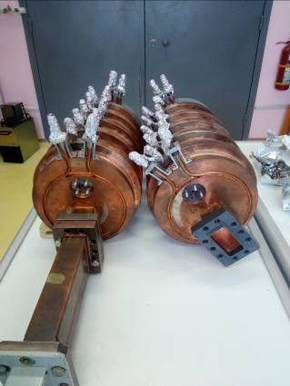
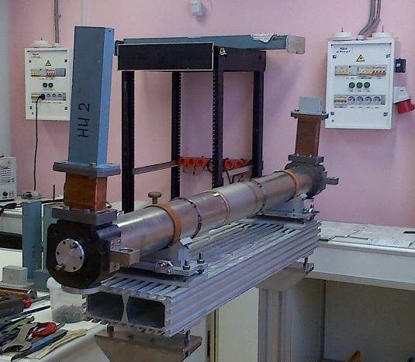
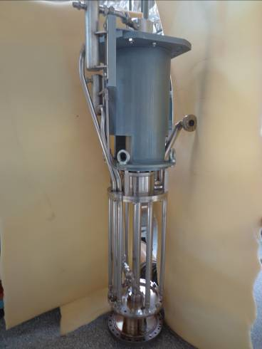
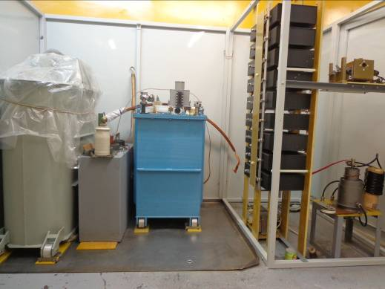
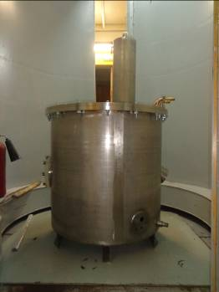
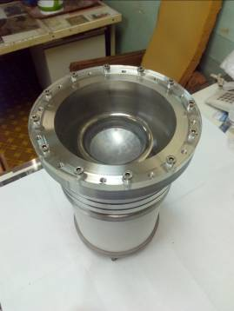
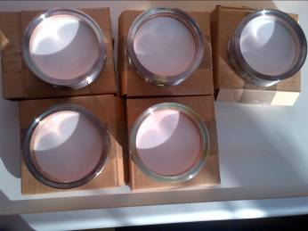
Linac manufacturing by BINP
SLED type power compressor
TW disk loaded accelerating structure
Prototype of the klystron
Modulator
Transformer
Cathode assembly
Vacuum waveguide window
See talk “200 МэВ ускорительный модуль S диапазона” by S.Samoilov (BINP SB RAS) on Thursday

Slide 8
Source of polarized electrons
Polarized electron source produced by BINP for AmPS
Beam polarization...........90%
Cathode voltage..............100 kV
Photocathode type.........AlInGaAS/AlGaAS SL
Laser type........................Ti–Sapphire
Light wavelength.............700–850 nm
Laser energy in a pulse..10 mkJ
Pulse duration...................2 ns
Repetition rate.................50 Hz
No. of e– per a pulse.......3·10¹⁰
Normalized emittance....10÷30 mm·mrad
200 keV polarized electron gun of Nagoya University, Japan

Slide 9
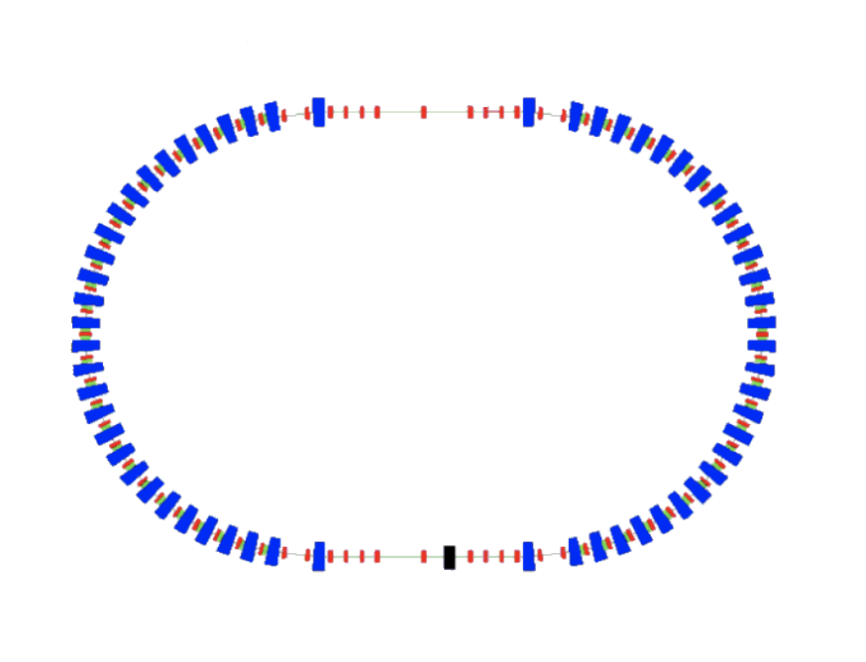
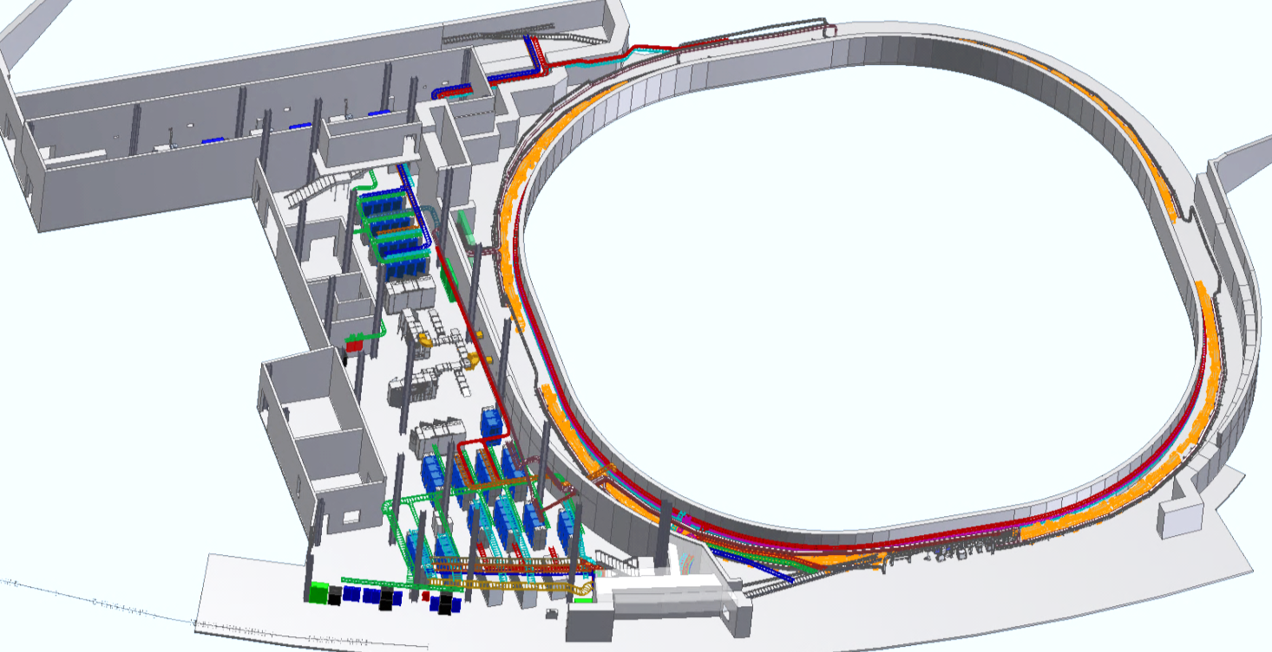
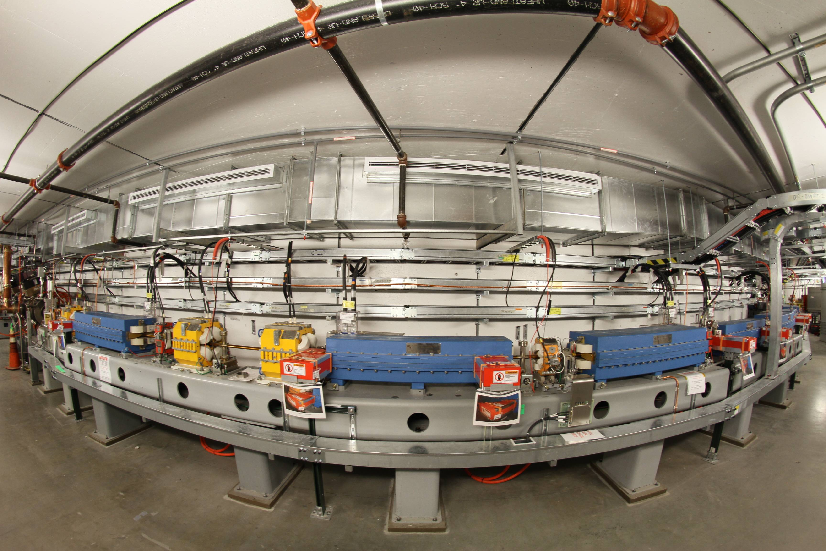
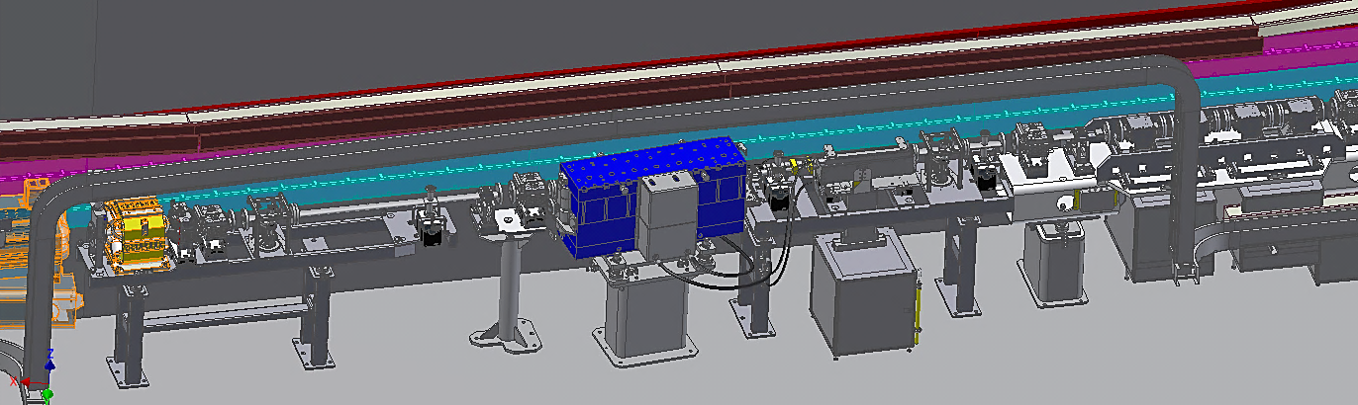
Damping ring
NSLS-II Booster was manufactured by BINP
Energy......................1.5 GeV
Circumference.......132 m
Emittance................10 nm·rad
Bunch length............3 mm
Damping time..........5 msec
RF Frequency..........500 MHz
Injection rate.........50 Hz

Slide 10
Main ring
IP
Siberian
Snake
Siberian
Snake
Damping
Wiggler
Damping
Wiggler
Siberian
Snake
Siberian
Snake
Damping
Wiggler
Damping
Wiggler
Siberian
Snake
RF

Slide 11
Main parameters
Energy | 1.0 GeV | 1.5 GeV | 2.0 GeV | 2.5 GeV
Circumference | 813.1 m
Emittance hor/ver | 8 nm/0.04 nm @ 0.5% coupling
Damping time hor/ver/long | 30/30/15 ms
Bunch length | 18 mm | 12 mm | 10 mm | 10 mm
Energy spread | 11·10⁻⁴ | 11·10⁻⁴ | 9.3·10⁻⁴ | 7.2·10⁻⁴
Momentum compaction | 8.5·10⁻⁴ | 8.8·10⁻⁴ | 8.8·10⁻⁴ | 8.8·10⁻⁴
Synchrotron tune | 0.007 | 0.010 | 0.009 | 0.008
RF frequency | 499.95 MHz
Harmonic number | 1356
Particles in bunch | 7·10¹⁰
Number of bunches | 406(10% gap)
Bunch current | 4.2 mA
Total beam current | 1.7 A
Beam-beam parameter | 0.135 | 0.135 | 0.121 | 0.097
Luminosity | 0.6·10³⁵ | 0.9·10³⁵ | 1.0·10³⁵ | 1.0·10³⁵

Slide 12
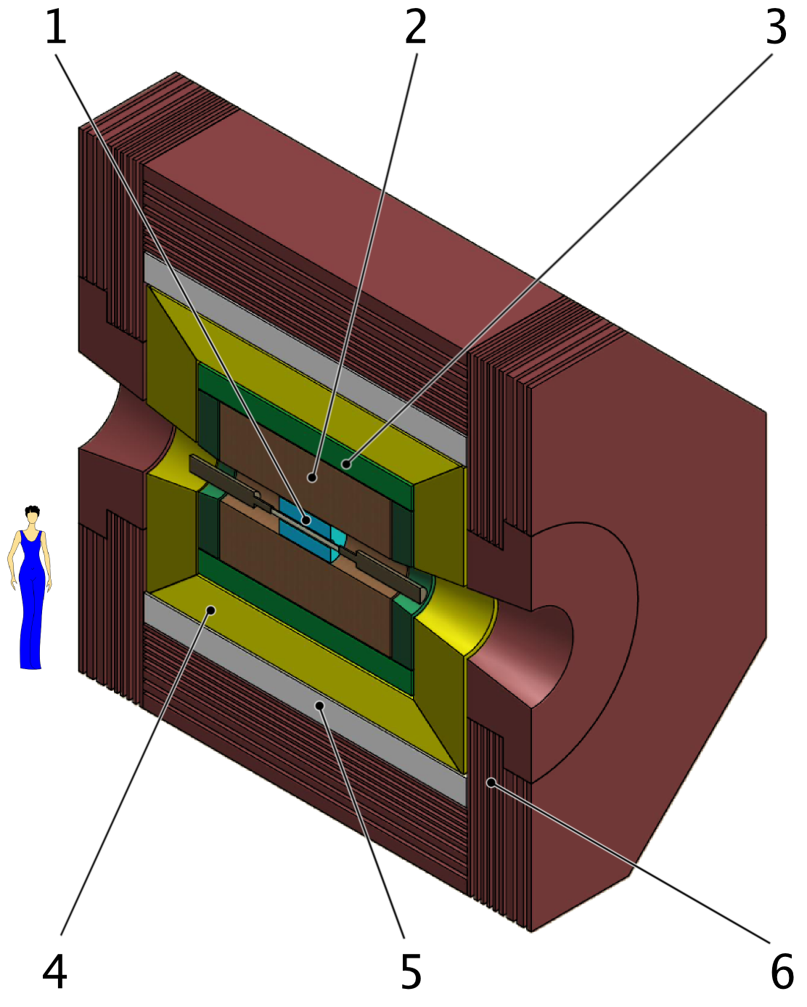
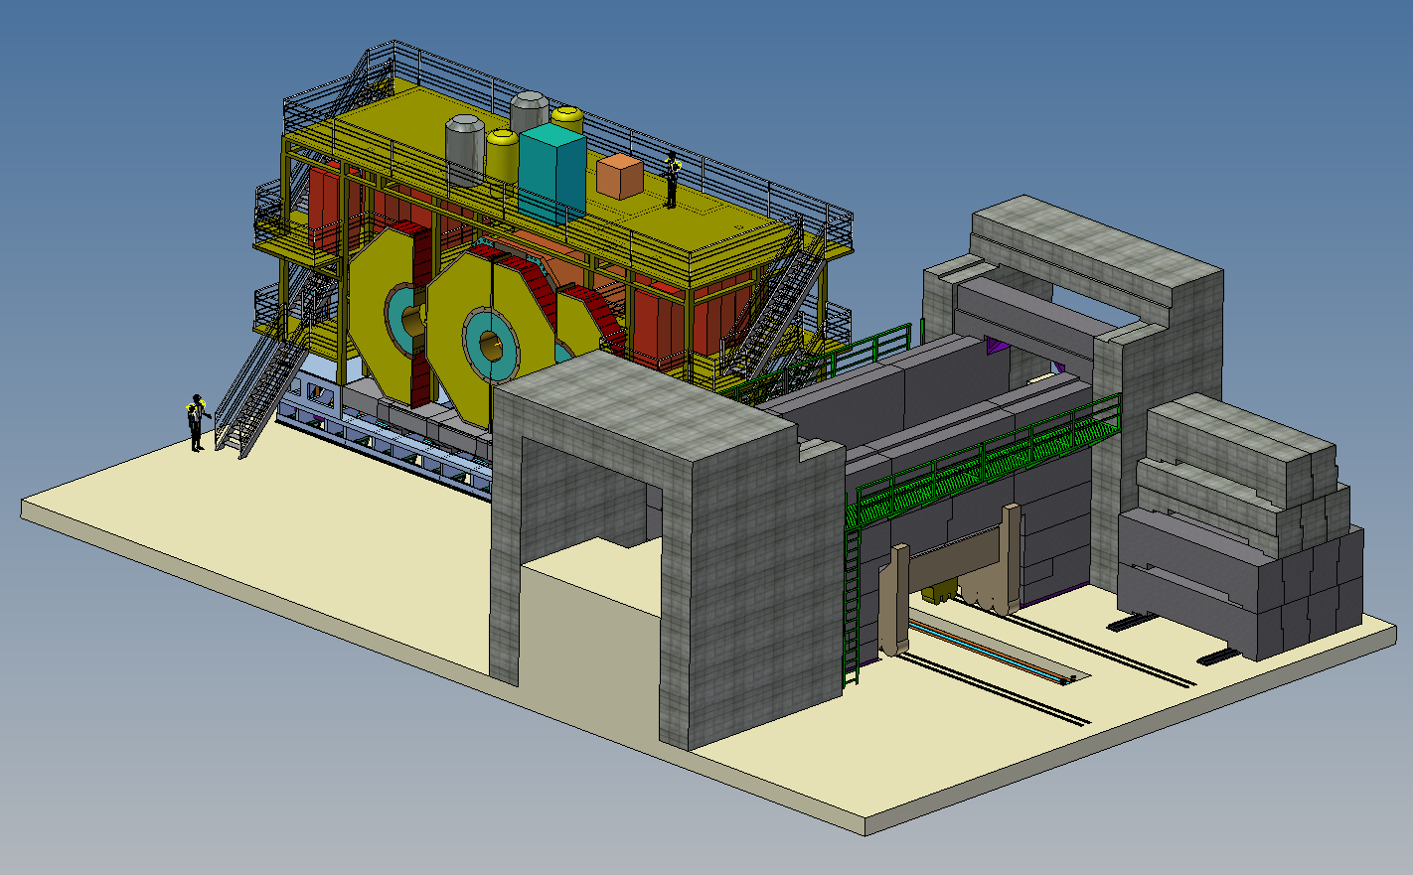
Detector
Universal magnetic detector with 1T longitudinal field
an excellent momentum resolution for charged particles and a good energy resolution for photons;
a particle identification system with nearly record parameters among existing detectors or those under construction;
a digitizing hardware and data acquisition system, which is able to read events at a rate of 300–400 kHz with an average event length of about 30 kB;
a unique trigger, which is able to select physics events and suppress background under a very high detector load.
1 – vertex
2 – drift chamber
3 – FARICH
4 – calorimeter
5 – superconducting coil
6 – yoke with a muon system

Slide 13
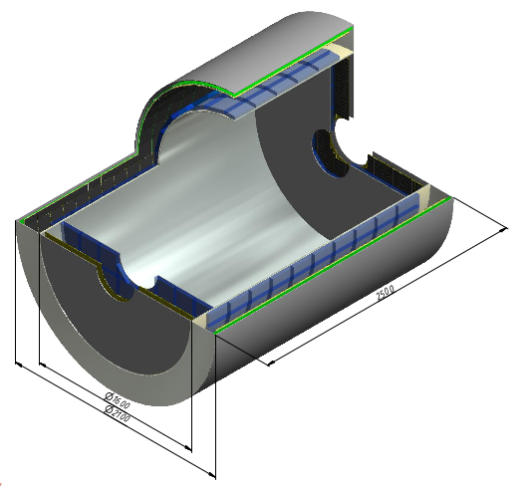
Detector technologies today
Drift chambers
Crystal calorimeters
NaI(Tl) – SND
CsI(Tl) – KEDR
CsI(Tl) – KMD-II
CsI(Tl) – Belle-II
BGO – KMD-3
LSO & GSO
SND KMD-3 KEDR
Computing for Super-ct
Focusing Aerogel Ring Imaging CHerenkov
Superconductiong coil for Panda (FAIR)

Slide 14
Final Focus System
Cryostat
Compensation Sold
Detector Yoke
Anti Sold
e+
e-
QD0
QF1

Slide 15
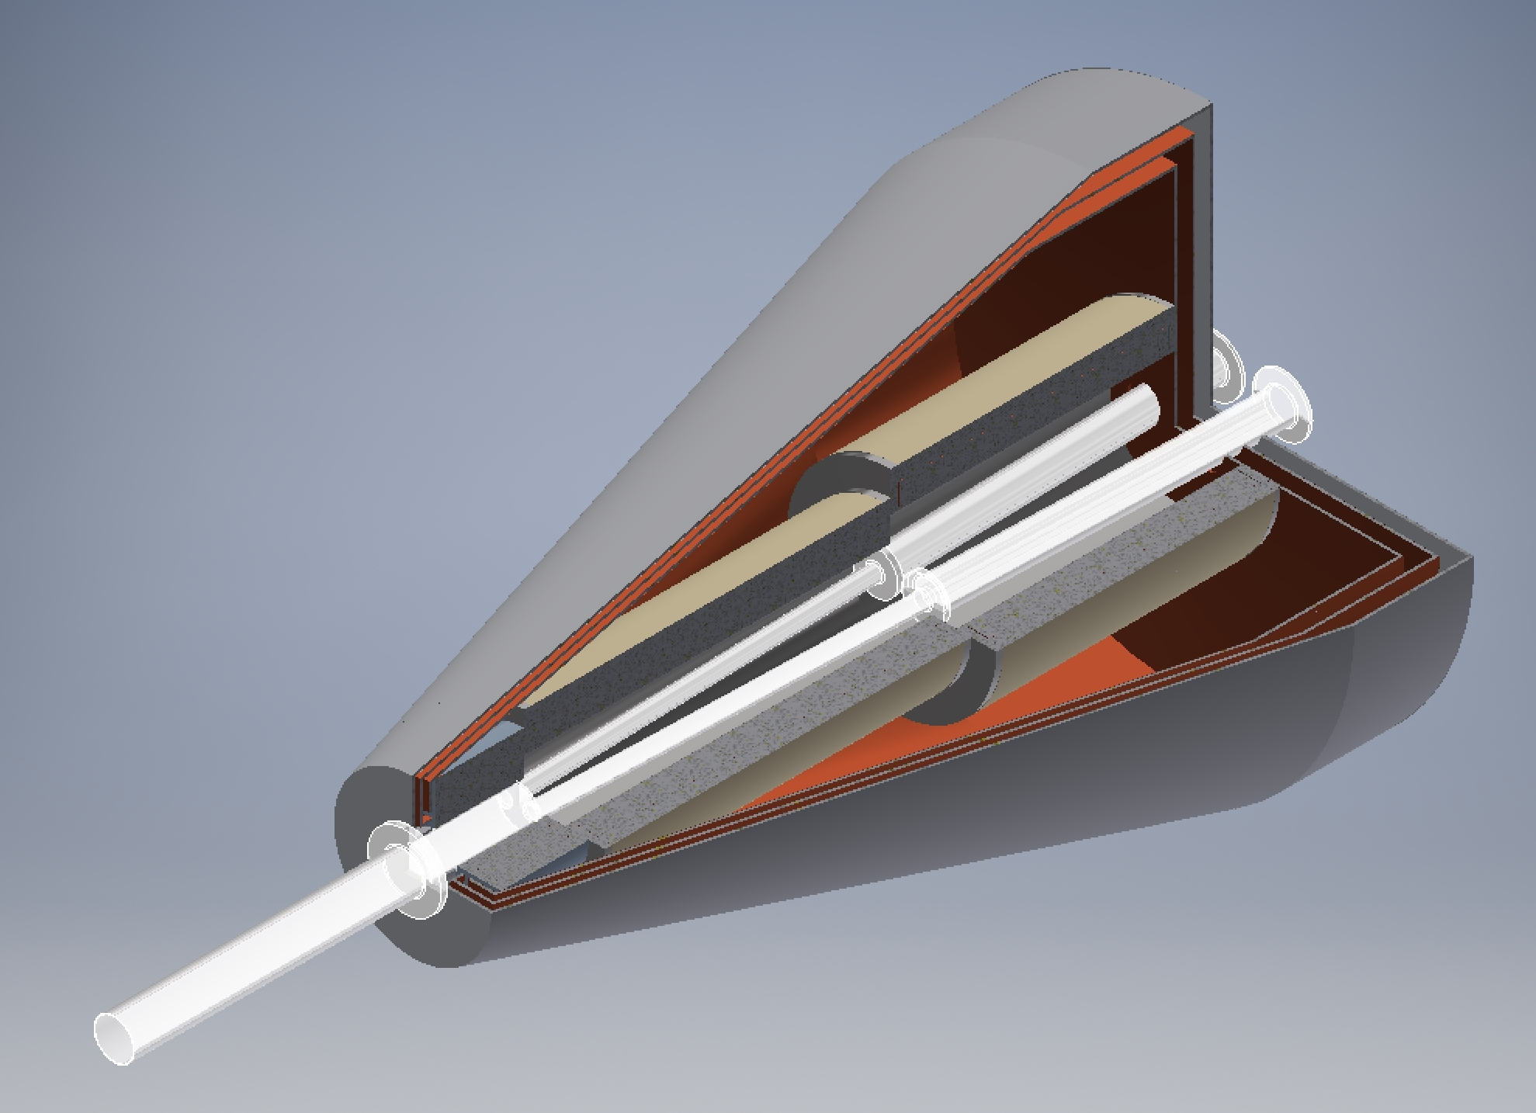
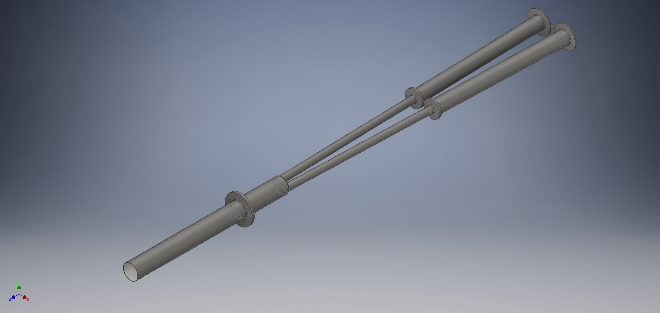
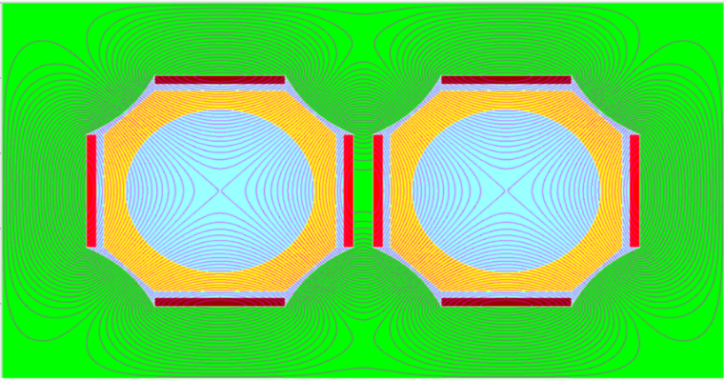
Final Focus
Compensation
Solenoids
QF1
Cryostat
QD0
Vacuum chamber
Anti-Solenoid
26 mm
60 mm
40 mm
100 mm

Slide 16
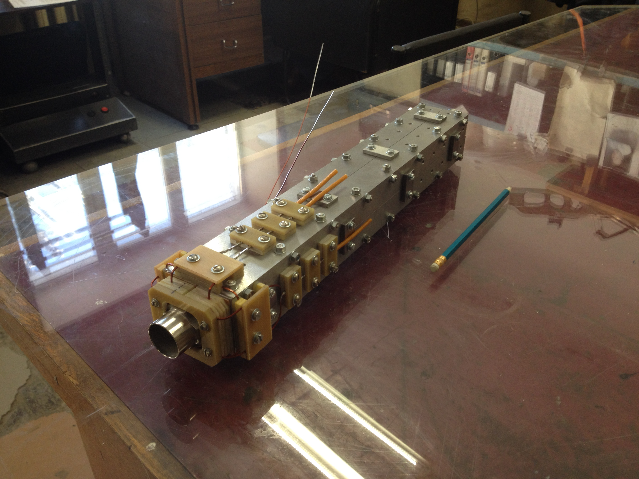
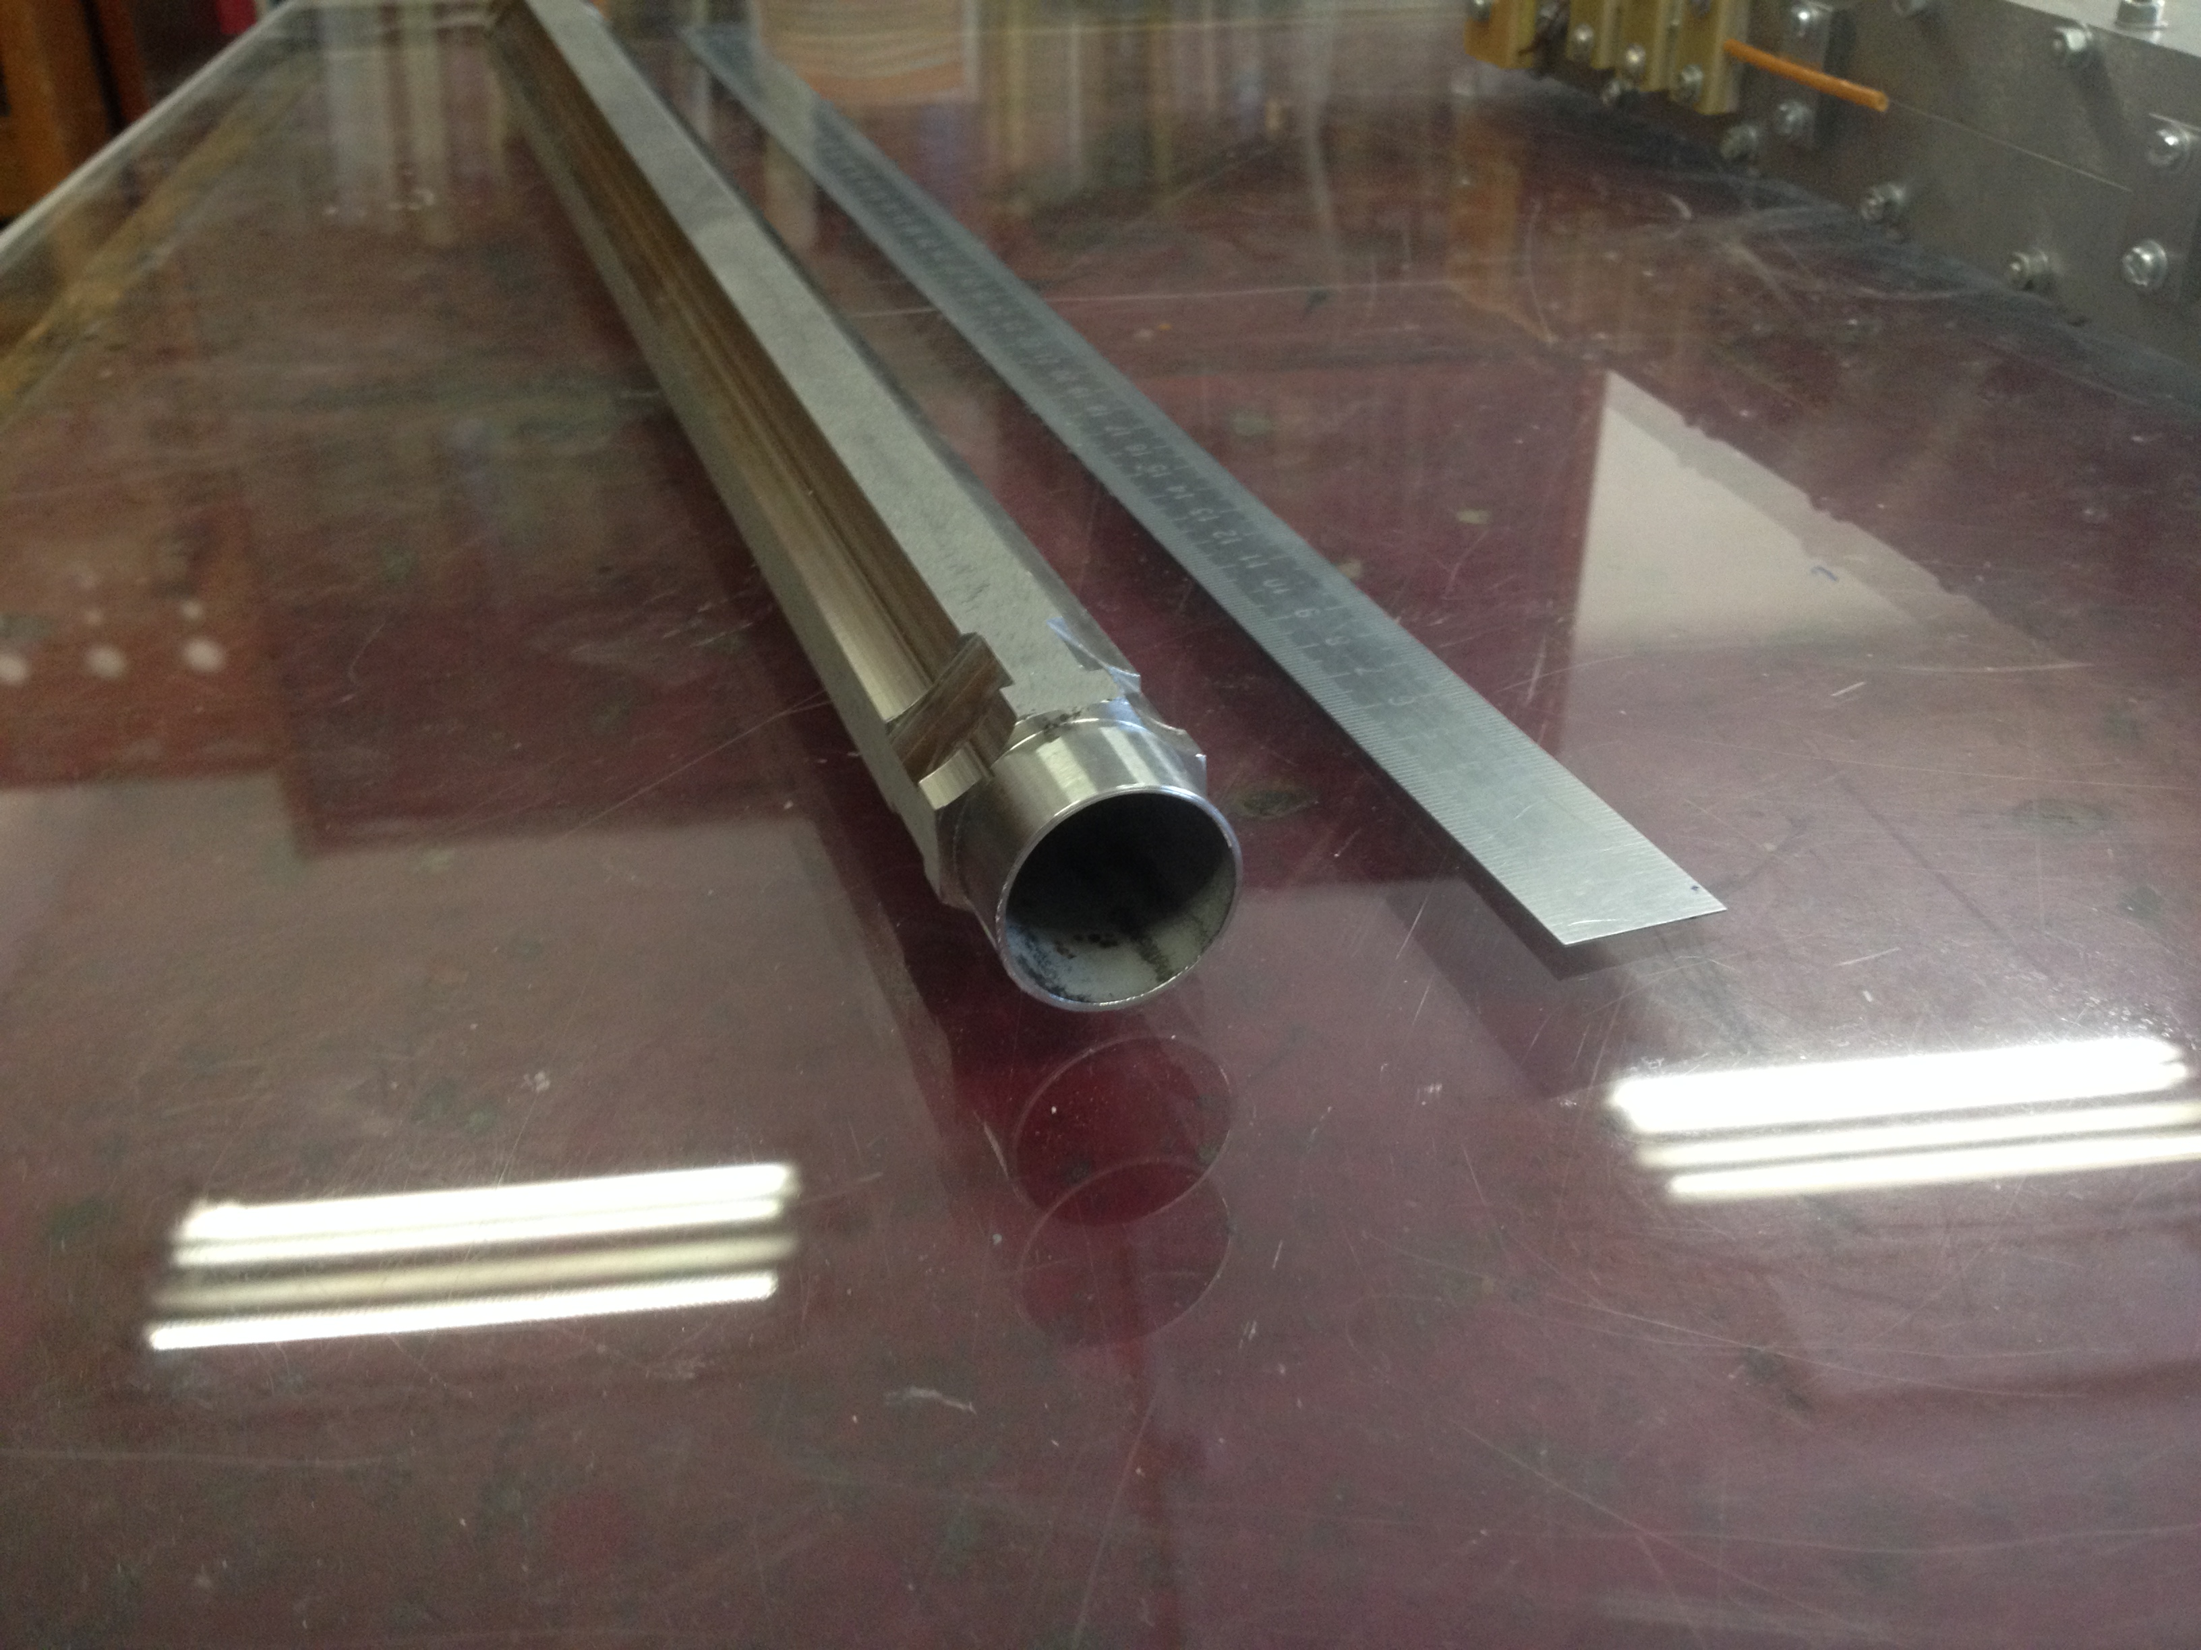
QD0 prototype
SC iron yoke twin aperture magnet
Excitation current 1.15 kA·turns
Single aperture 1 cm
Gradient 10 kGs/cm
Length 40 cm

Slide 17
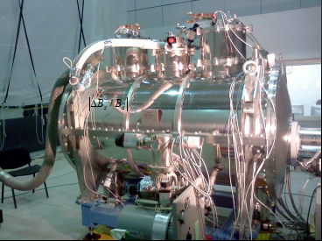

Damping Wigglers
4 damping wigglers (6.2 T, 1.6 m, λ=35 cm) keep the damping time (30 ms) and the horizontal emittance (8 nm) in the energy range 1.0÷2.5 GeV
Superconducting wiggler for LSU CAMP
Number of poles..........15 + 2x3/4 + 2x1/2
Maximum field..............7.5 T
Period length.................20 cm
Pole gap...........................2.52 cm
Stored energy...............850 kJ

Slide 18
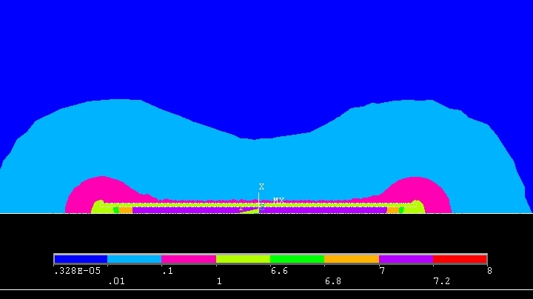
Polarization (5 Siberian Snakes)
Snakes off
Snakes on
Superconducting solenoids
1.85 m, 7.1 T, 220 A, 250 kJ
50000 0.9 mm NbTi
Longitudinal field, T
Distance, m

Slide 19
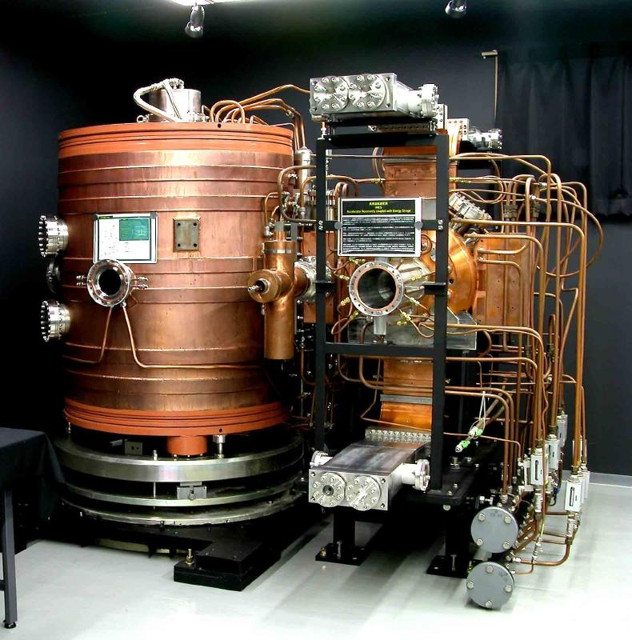
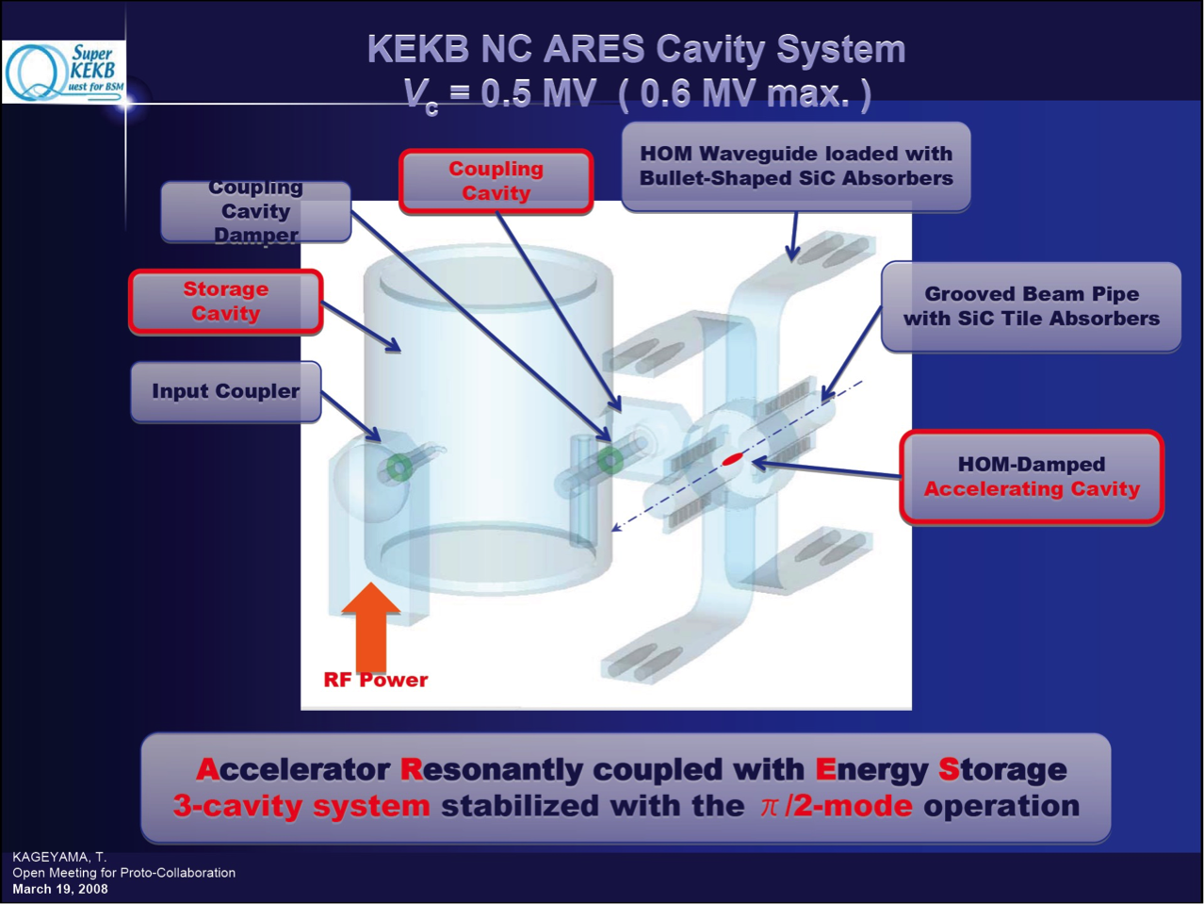
RF system
Accelerating cavities of ARES-type
Parameter | Value
Length | 2.0 m
RF Frequency fRF | 509 MHz
Shunt Impedance Rsh | 0.86 MOhm
Quality factor Q0 | 1.15·10⁵
Charact. Impedance Rsh/Q0 | 7.5 Ohm
Accelerating voltage URF | 0.5 MV
RF power (per cavity) | 350 kW
RF power losses (per cavity) | 150 kW
RF power in beam (per cavity) | 200 kW

Slide 20
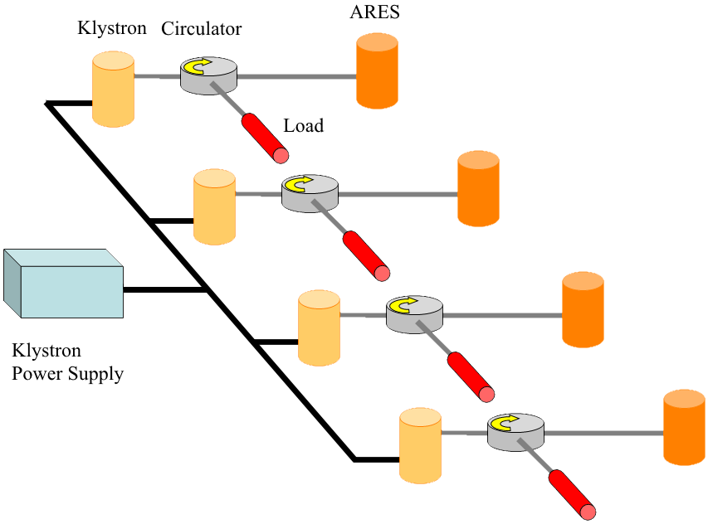
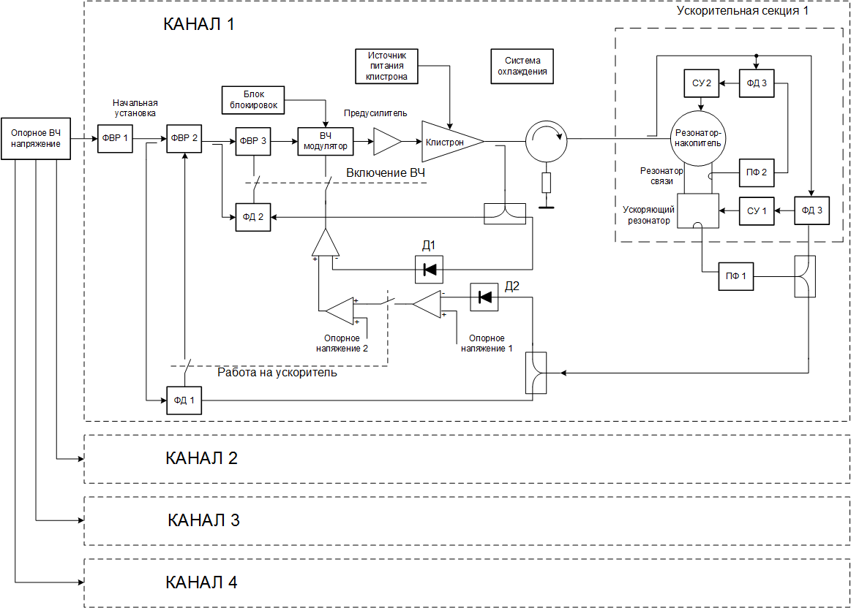
RF system
RF system configuration option (one ring):
common klystrons power supply (~ 2 MW);
THALES TH20536A (500 MHz, 500 kW), 4 things;
ARES, 4 things.
Beam energy | 1.0 | 1.5 | 2.0 | 2.5 | GeV
Beam current | 2.0 |  |  |  | A
Accelerating voltage | 329 | 956 | 1487 | 1192 | kV
Number of ARES | 2 | 4
Accelerating voltage per ARES | 165 | 239 | 372 | 298 | kV
Frequency detuning | -36.2 | -29.4 | -19.2 | -22.5 | kHz
Losses per turn | 190 | 298 | 397 | 497 | kV
Beam power | 380.6 | 596.2 | 794.2 | 994.4 | kW
Power losses | 31.3 | 132.6 | 320.4 | 205.8 | kW
RF power; per ARES | 411.9 | 728.8 | 1115 | 1200 | kW
 | 206 | 182 | 279 | 300 | kW
Feeder line VSWR | 2.25 | 1.06 | 1.7 | 1.0
Generator power | 484 | 729 | 1191 | 1200 | kW
Offset of the meeting point (pp) | 0.30 | 0.17 | 0.11 | 0.15 | mm

Slide 21
Vacuum system for SuperKEKB
BINP produced and tested:
Type-Q 318 chambers
Type-B 108 chamber
Type-S 276 chambers
in total 702 vacuum chambers during 21 months

Slide 22
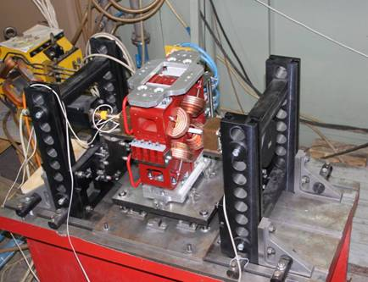
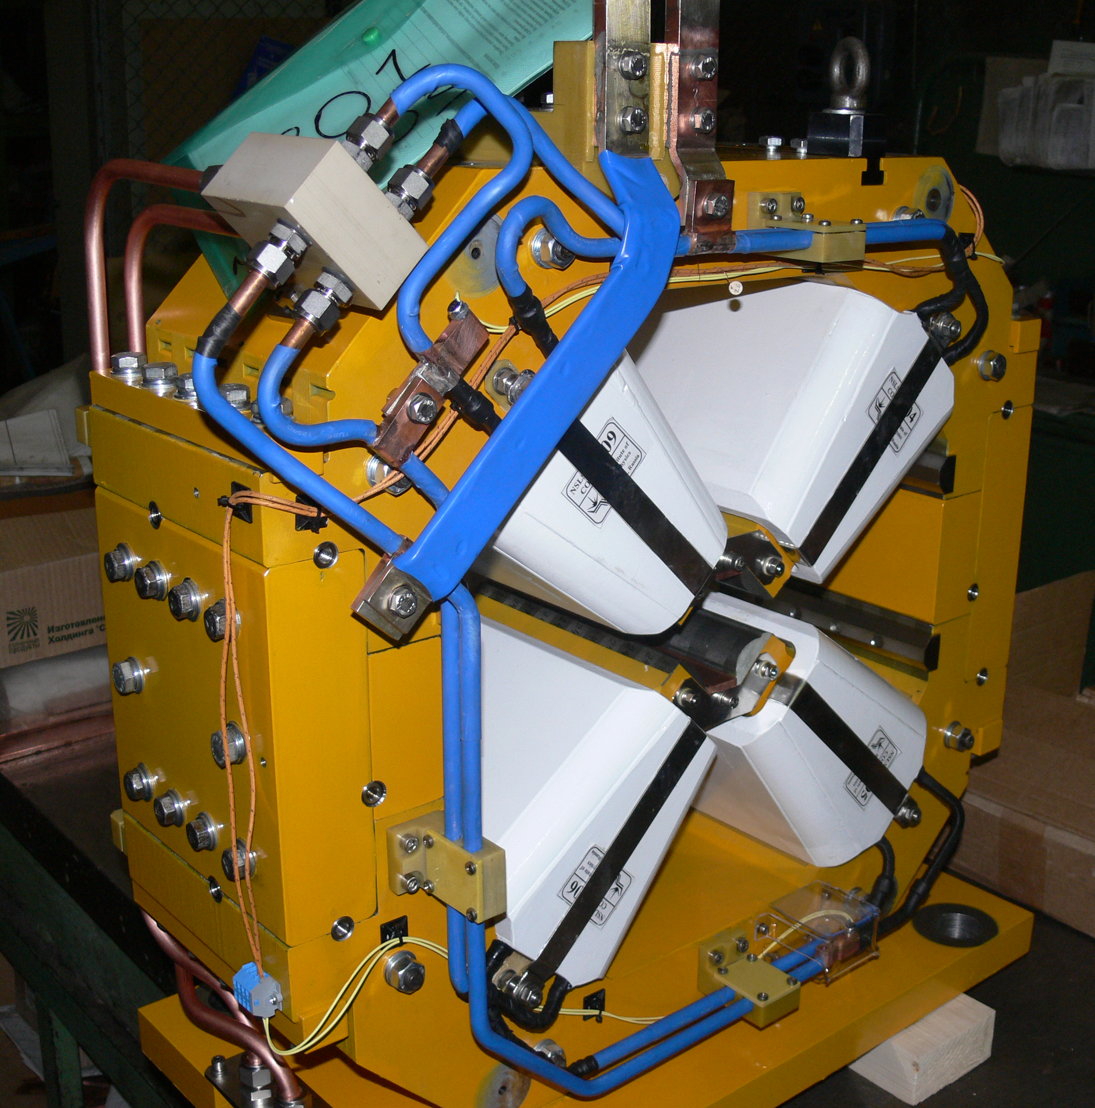
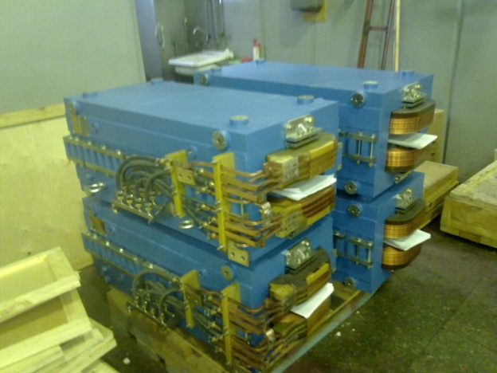
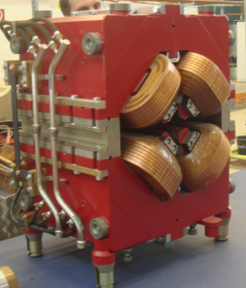
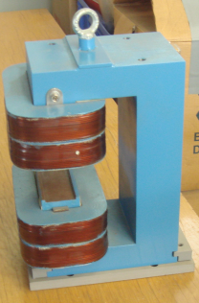
Magnets by BINP
X-FELL
NSLS-II
PETRA-III
SR SAGA, Japan

Slide 23
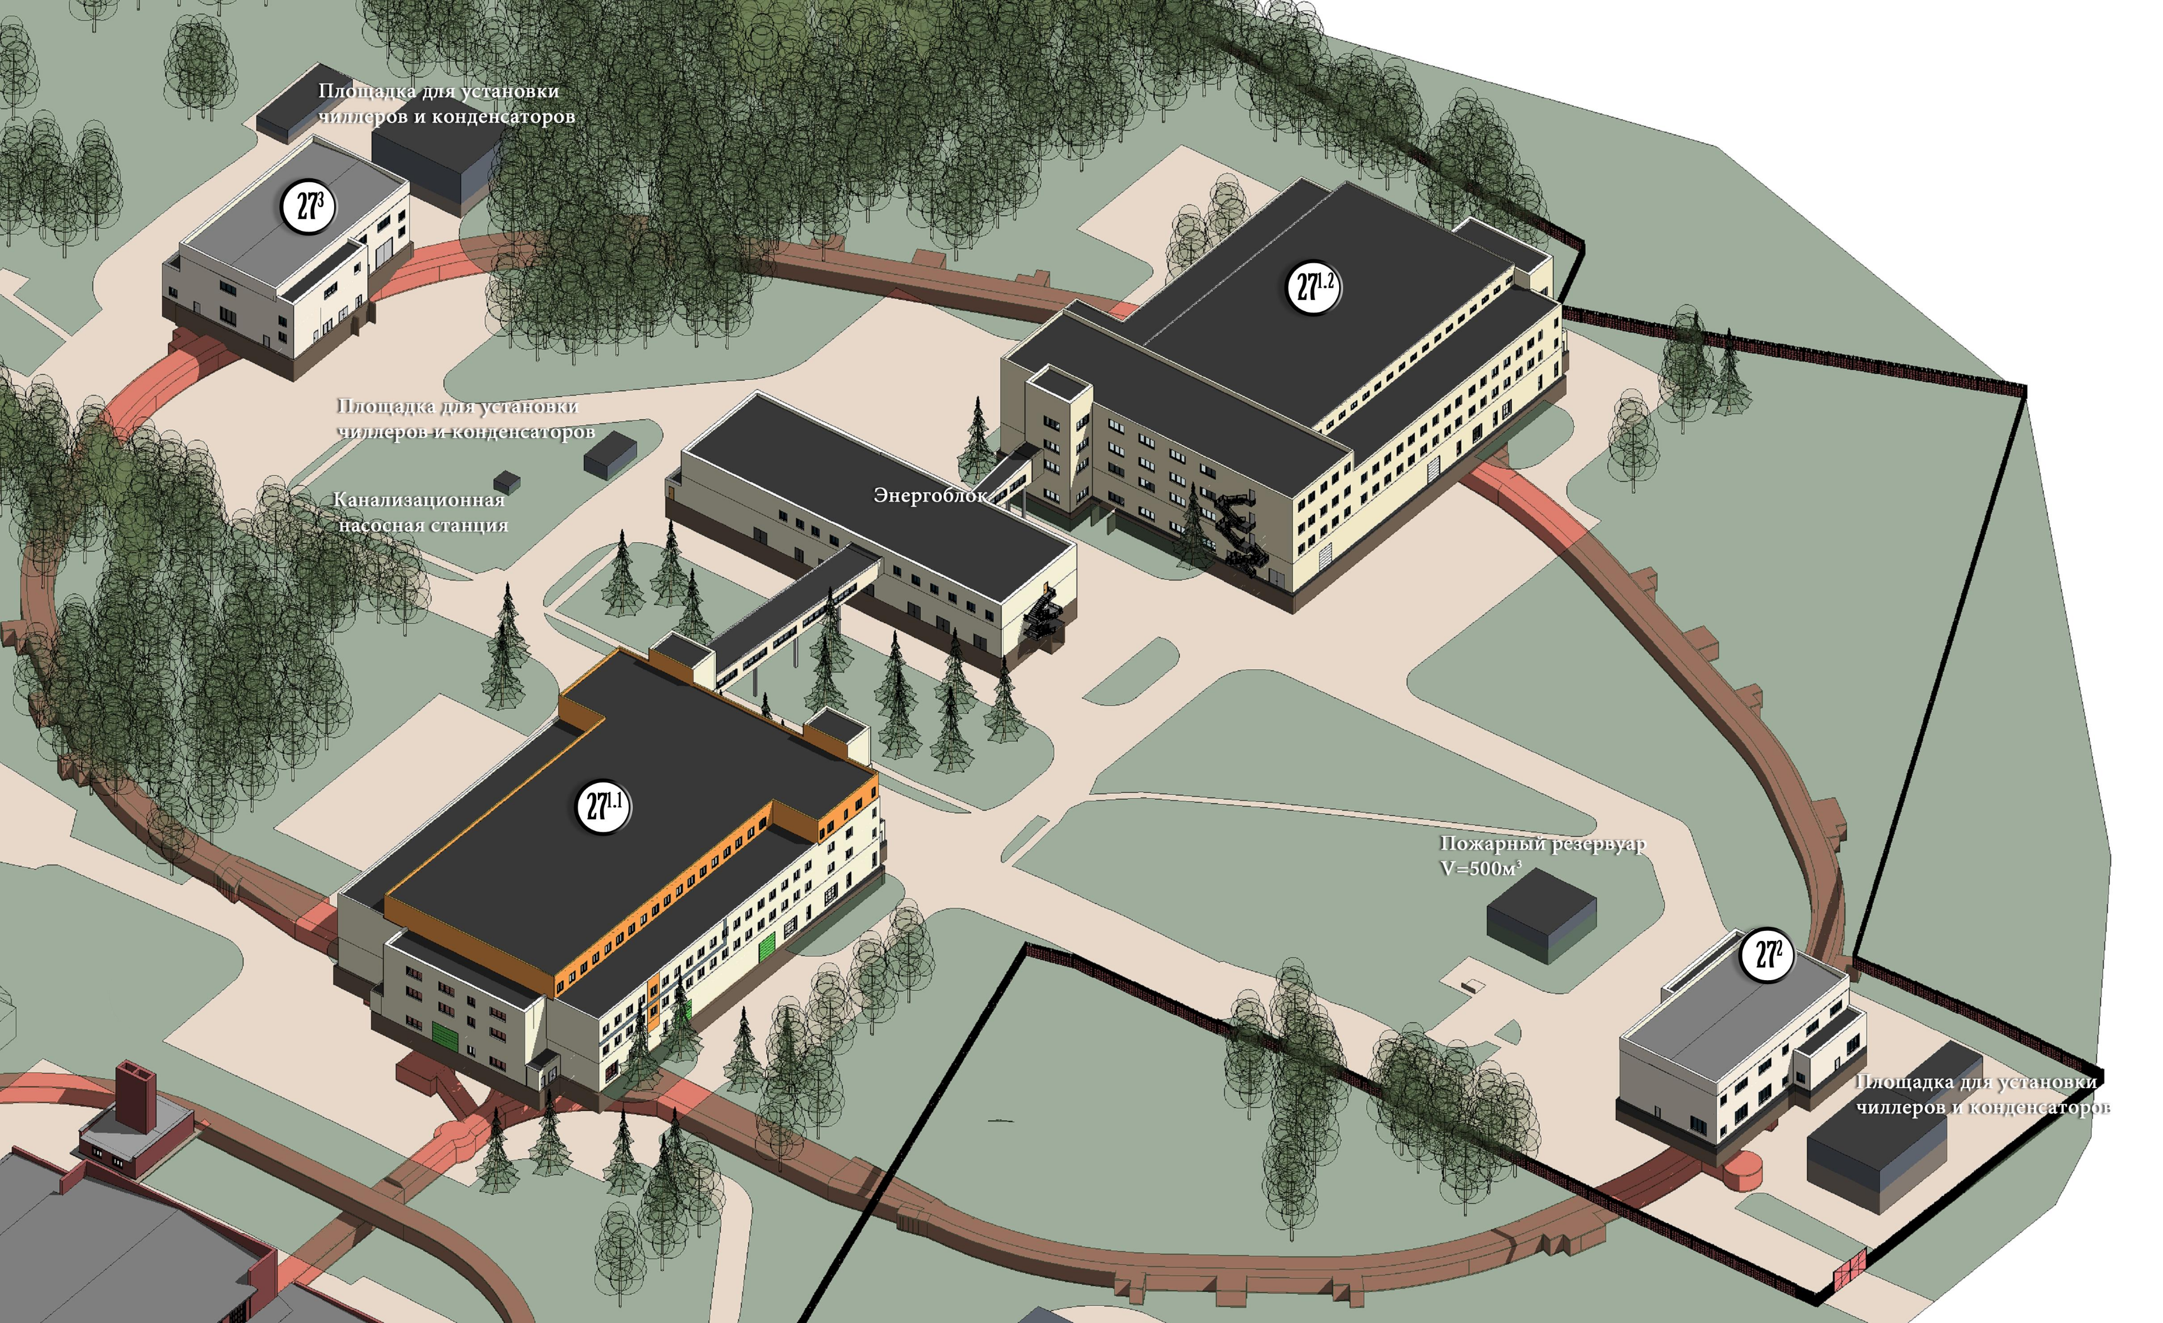
Infrastructure

Slide 24



Roadmap
2010 – Preliminary Design Report
2011 – Conceptual Design Report
2011 – Roadmap
2012 – Building project
(178 pages)
(202 pages)
(112 pages)
(12 volumes)
2017 – Update of CDR
(>250 pages, 2 volumes)

Slide 25
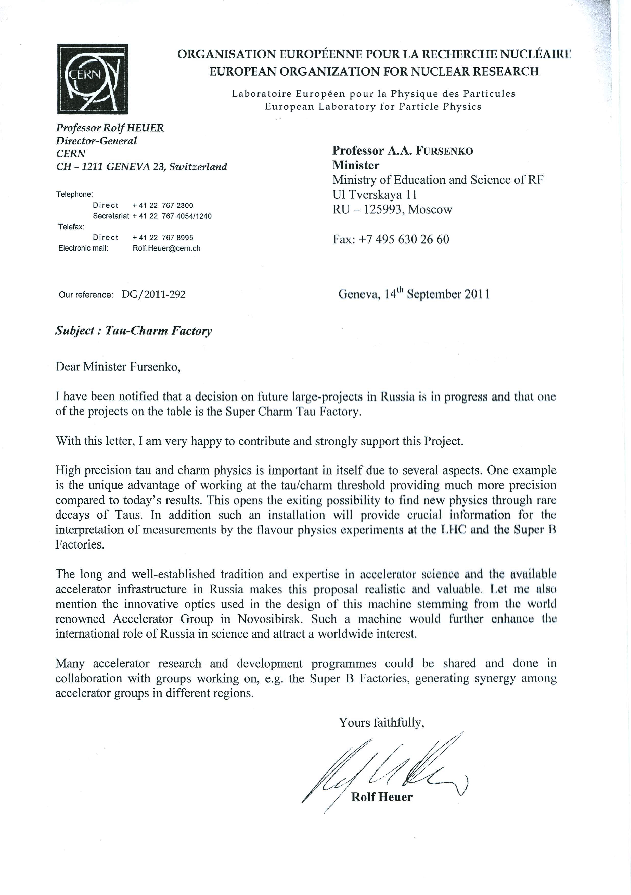
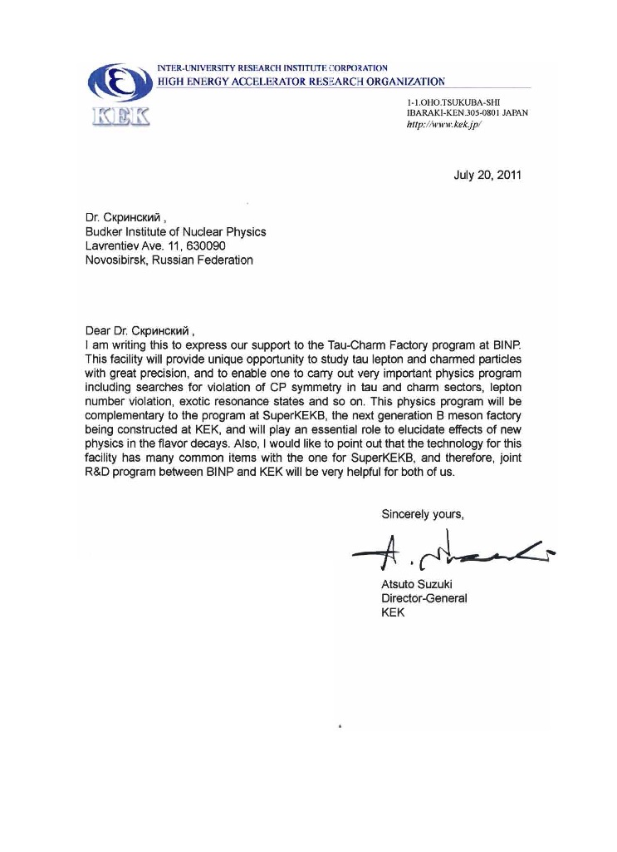
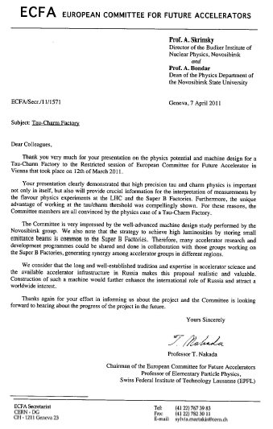
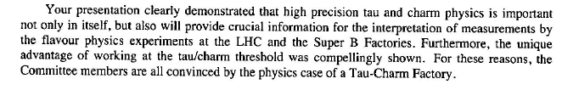
International support & collaboration
Rolf Heuer,
Director of CERN
Atsuto Suzuki,
Director of KEK
European Committee for Future Colliders
…Ваше выступление ясно показало, что прецизионная тау- и чарм-физика не только важны сами по себе, но могут дать важную информацию по интерпретации экспериментов по физике «ароматов» на БАК и СуперВ-фабриках. Более того, уникальные преимущества работы на пороге тау-лептона были отчетливо продемонстрированы. По этим причинам члены Комитета полностью удовлетворены содержанием научной программы тау-чарм фабрики…
Председатель ECFA
Проф.Т.Накада
Martin L. Perl,
Nobel Laureate in Physics

Slide 26
Russian Government Support

Slide 27
Conclusion
Electron-positron collider Super Charm Tau Factory is brilliant facility for high energy physics
New principles of the project allows to rich very high luminosity (two orders higher than existing)
BINP SB RAS has all resources for building of the project (humans, workshop, technologies, …)
Super Charm Tau Factory will be multi disciplinary accelerator center for science and technologies

Slide 28
Thank you very much

