Slide 1
Serial Magnetic Measurements of Quadruple Magnets of NICA Booster
A. Shemchuk on behalf of NICA team

Slide 2
Presentation plan
Introduction
2. Doublet of quadrupole lenses
3. Specification requirements
4. Measurement procedure
5. Design and assembly of the sensor
6. Structure of magnetometric system
7. Results
8. Conclusion

Slide 3
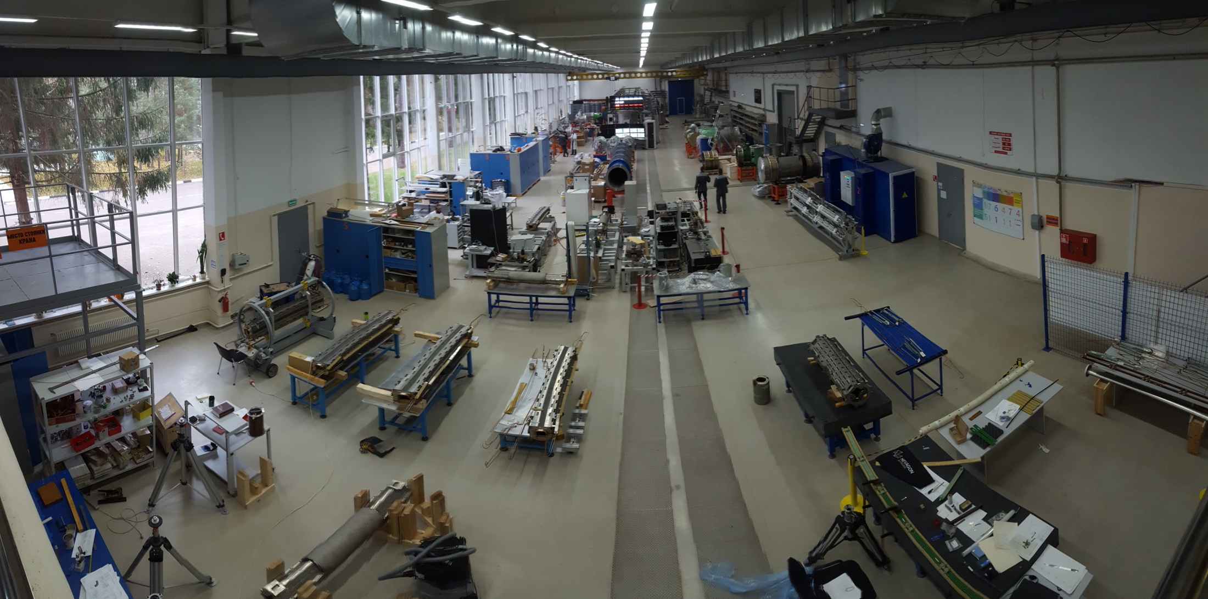
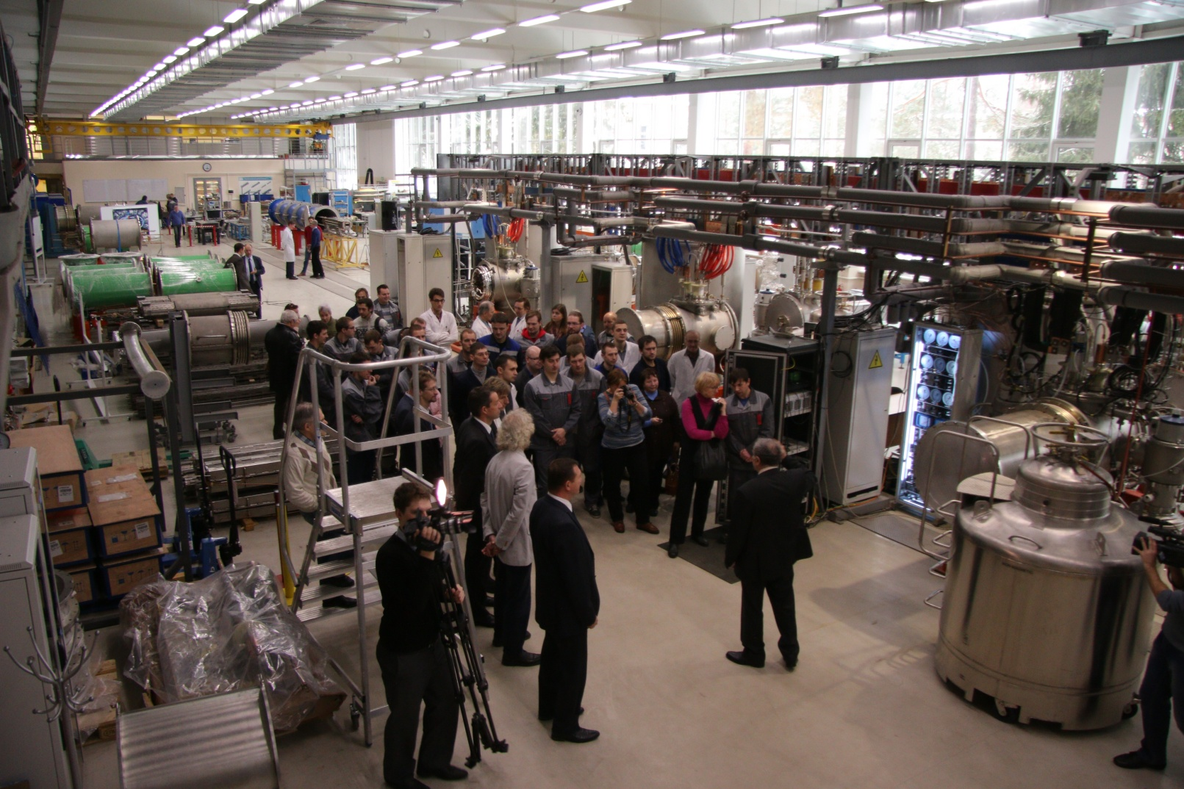
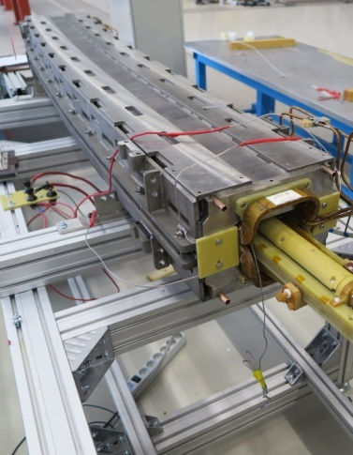
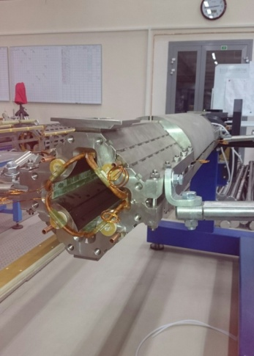
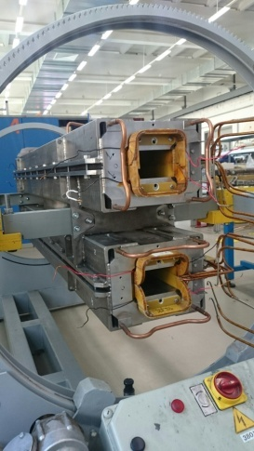
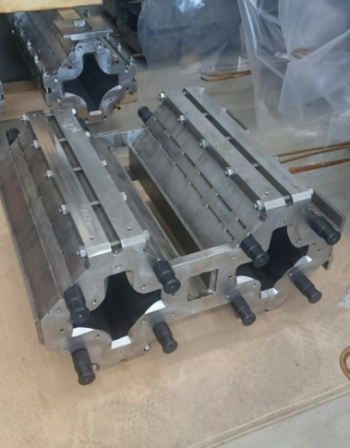
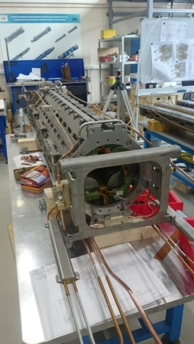
Introduction
- Dipole magnets of NICA booster - 40 шт.
-Quadrupole magnets of NICA booster- 48 шт.
-Dipole magnets of NICA collider– 80 шт.
-Quadrupole magnets of NICA collider– 86 шт.
-Quadrupole magnets of SIS-100 (FAIR project) - 175 шт.
Launch of factory of superconducting magnets, November 28, 2017
Scientific and ex-remental department of production and testing of superconducting magnets.

Slide 4
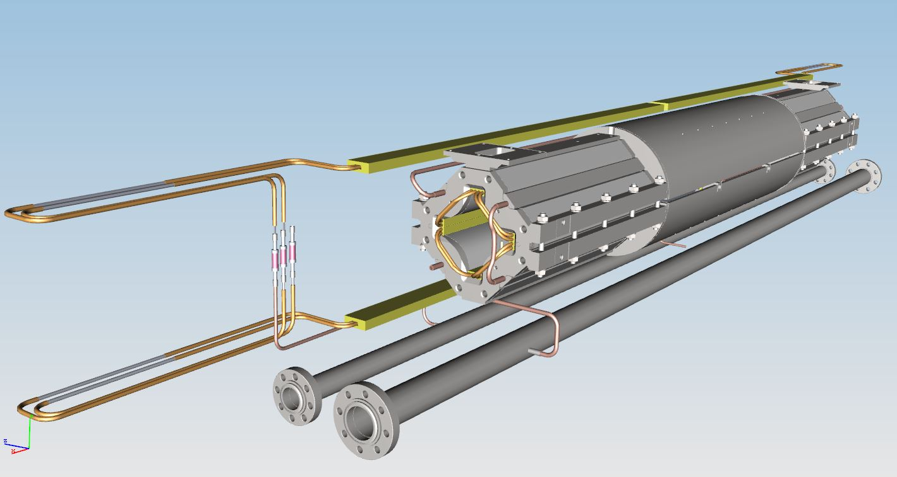
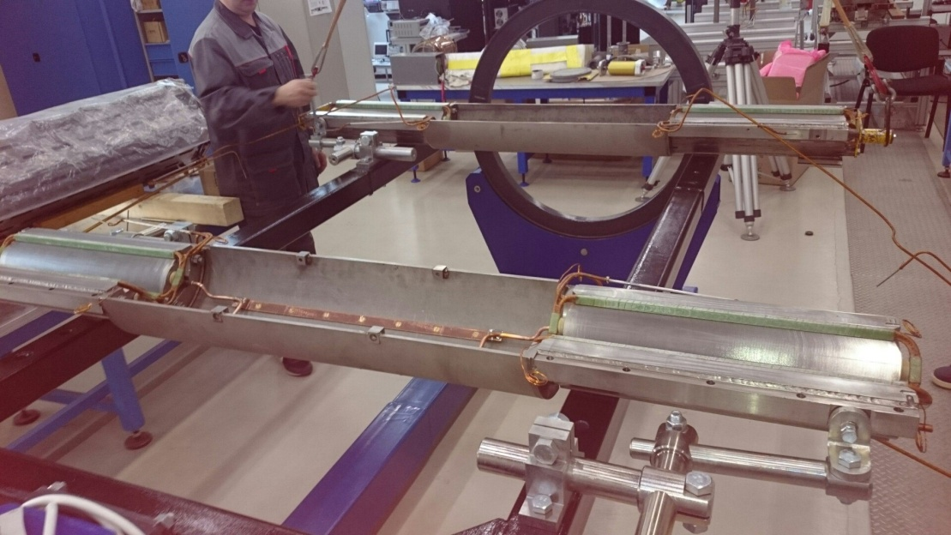
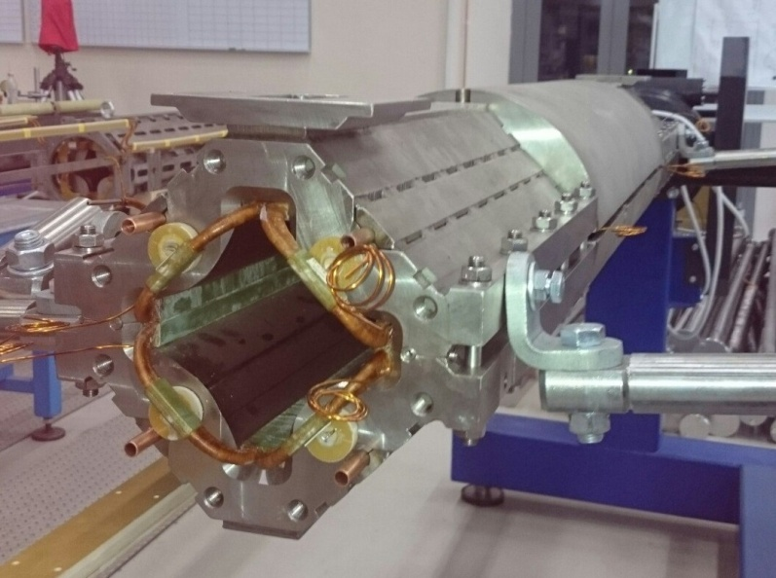
Doublet of quadrupole lenses
Fig. 1 3d view of doublet of quadrupole lenses
Parameter | Unit | Value
Number of magnets | Pc. | 48
Field gradient (inj./max.) | T/m | 1.3 /21.5
Effective magnetic length | m | 0.47
Beam pipe aperture (h/v) | mm | 128 /65
Operating current | kA | 9.68
Ramp rate | T/(m·s) | 14.3
Field error at R= 30 mm |  | ≤ 6⋅10⁻⁴
Pole radius | mm | 47.5
Fig. 2 Installation of a winding in an iron yoke
Tab. 1 Main characteristics of the NICA Booster Magnets
Fig. 3 Magnet, collected and ready to measurements

Slide 5
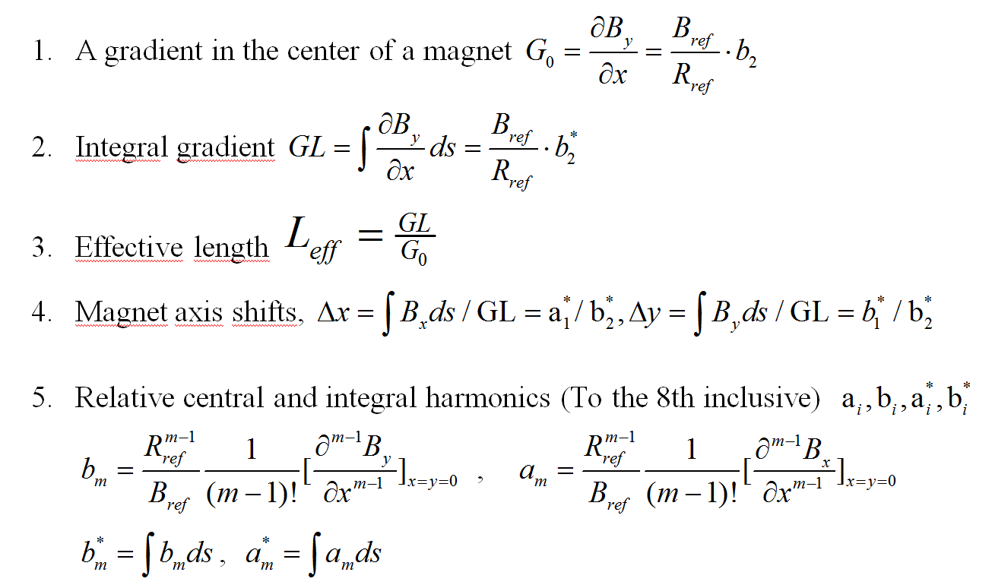
Specification requirements

Slide 6
Specification requirements
 | Parameter | Tolerance | Accuracy
1 | A gradient in the center of a magnet, G₀ | 5*10 | 10
2 | Integral gradient, GL | 5*10 | 10
3 | Effective length L_{eff} | 5*10 | 10
4 | Magnet axis shift Δx | ±0.1 | 0.02 mm
5 | Magnet axis shift Δy | ±0.1 | 0.02 mm
7 | b1, a1 | 3*10 | 10
8 | a2, (b2=1) | 10 | 10
9 | a3, b3 | 10 | 2*10
10 | a4, b4 | 5*10 | 10
- 4
- 4
- 4
- 4
- 4
- 4
- 3
- 4
- 4
- 4
- 4
- 4
- 4
- 4
* Values and precision of definition of harmonics of a magnetic field of bn, an are specified in the relative to the main field (b2 – for a quadrupole magnet) units. These value are defined for rref=30mm radius.

Slide 7
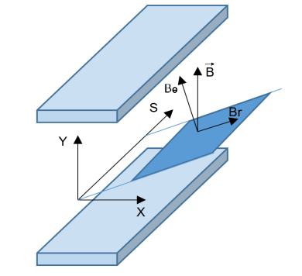
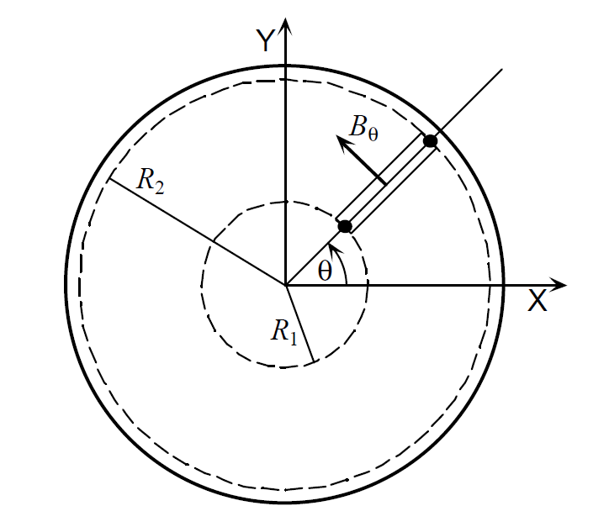
Measurement procedure
2d representation of the magnetic field
$$B\left(𝔃\right)=B_{y}\left(x,y\right)+iB_{x}\left(x,y\right)=\sum_{n=1}^{∞}{ℂ_{n}{\left(\frac{z}{R_{ref}}\right)}^{n−1}}=\sum_{n=1}^{∞}{C(n)e^{−inα_{n}}{\left(\frac{𝓩}{R_{ref}}\right)}^{n−1}}$$
$$𝓩=x+iy=re^{iθ} , C\left(n\right)e^{−inα_{n}}=ℂ_{n}=B_{n}+iA_{n}$$
$$B_{θ}\left(r,θ\right)=\sum_{n=1}^{∞}{C\left(n\right){\left(\frac{r}{R_{ref}}\right)}^{n−1}cos [n(θ−α_{n})]}$$
Flux through the radial coil
$Φ_{radial}\left(θ\right)=NL\int_{R_{1}}^{R_{2}}{B_{θ}\left(r,θ\right)dr=}\sum_{n=1}^{∞}{\frac{NLR_{ref}}{n}\left[{\left(\frac{R_{2}}{R_{ref}}\right)}^{n}− {\left(\frac{R_{1}}{R_{ref}}\right)}^{n}\right]C\left(n\right)cos\left[n\left(θ−α_{n}\right)\right]}$ =
= $\sum_{n=1}^{∞}{\frac{NLR_{ref}}{n}\left[{\left(\frac{R_{2}}{R_{ref}}\right)}^{n}− {\left(\frac{R_{1}}{R_{ref}}\right)}^{n}\right]}$ ($B_{n}\cos\left(nθ\right)−A_{n}$sin($nθ$))
Measured flux harmonics
$$Ψ_{m}= \sum_{p=1}^{P}{Φ (θ_{p})e^{−i2π(m−1)\frac{p−1}{P}}}$$
Ф$\left(θ\right)=\sum_{n=1}^{∞}{\text{(}{ReΨ}_{n}\cos\left(nθ\right)+{ImΨ}_{n}\text{sin}\text{(}nθ\text{))} }$
P – Number of function measurement points
$$Φ_{radial}\left(θ\right)$$
Fig. 4 Harmonic coil measurement procedure

Slide 8
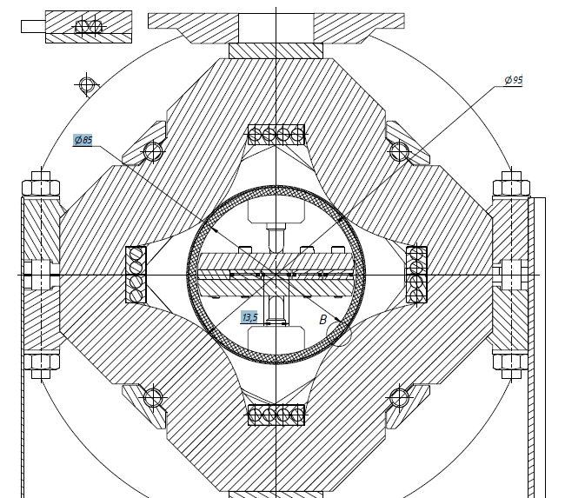
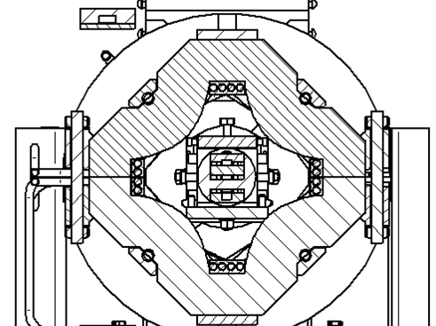
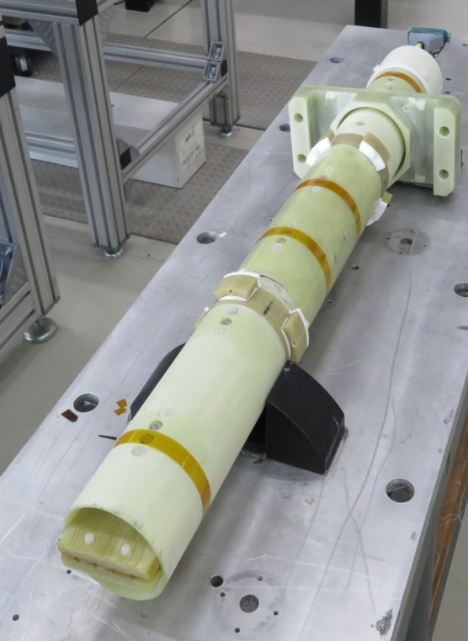
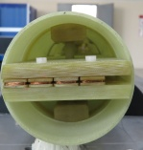
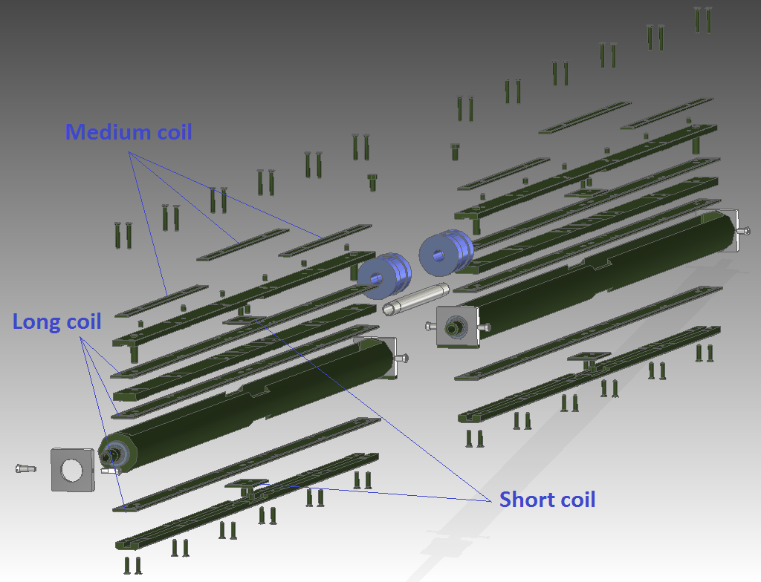
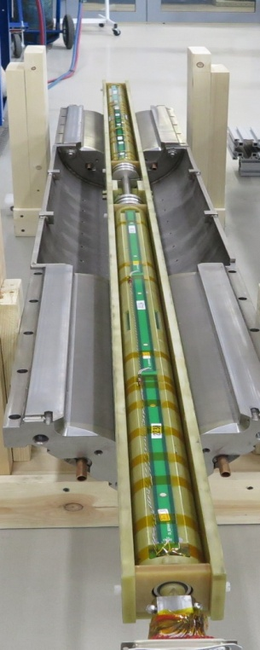
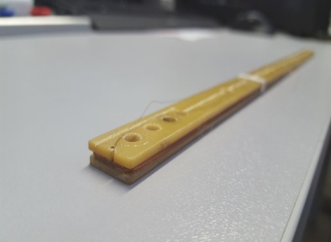
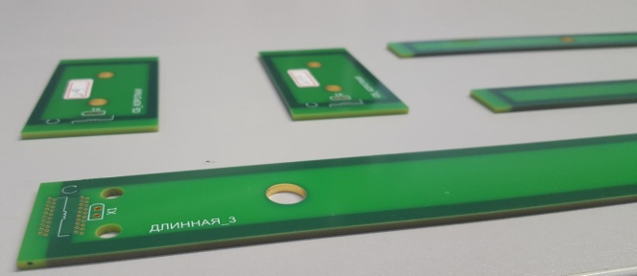
Design and assembly of the sensor
Before creation of the sensor for serial tests two prototypes were created. The first turned on radial coils, the second - tangential.
Creation of prototypes
Fig. 5 Radial probe
Fig. 6 Tangential probe

Slide 9
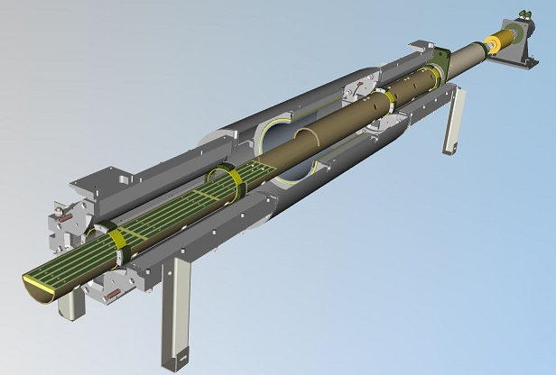
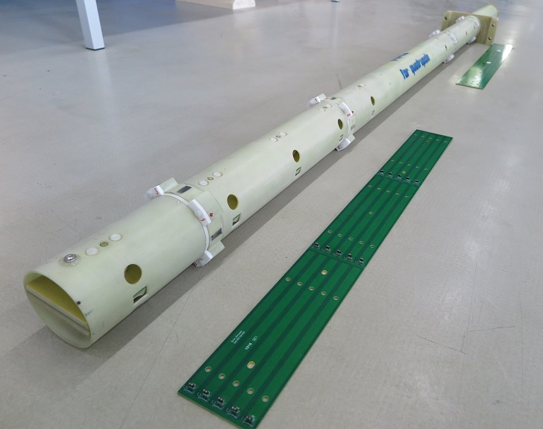
Design and assembly of the sensor
3
2
1
2
3
4
5
1
Fig. 7 The full-size probe for serial measurements

Slide 10
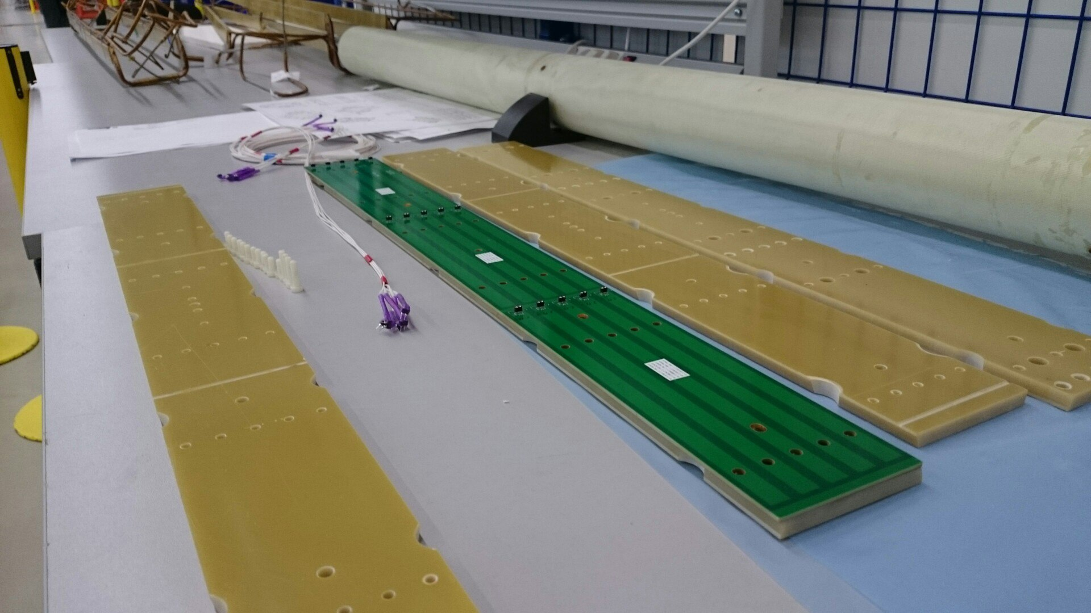
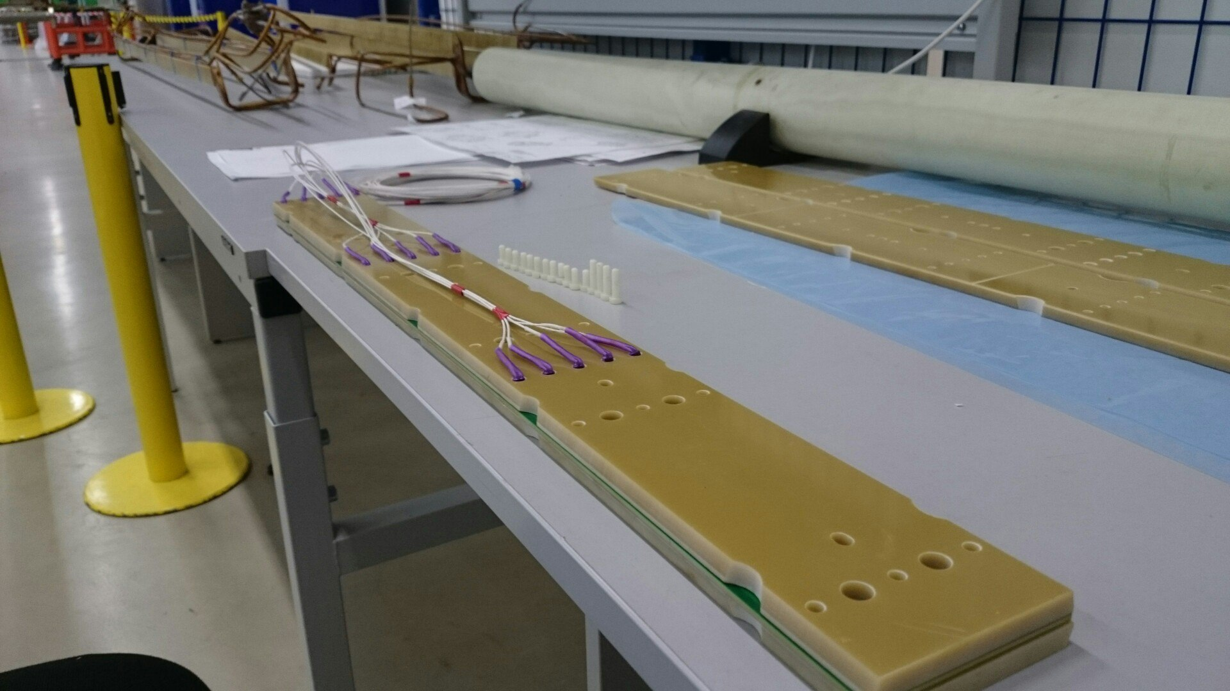
Design and assembly of the sensor
Block of harmonic coils
Fiberglass-laminate tube
Plates for precise positioning
A
A
Fig. 8 Basic elements of the probe with harmonic coils

Slide 11
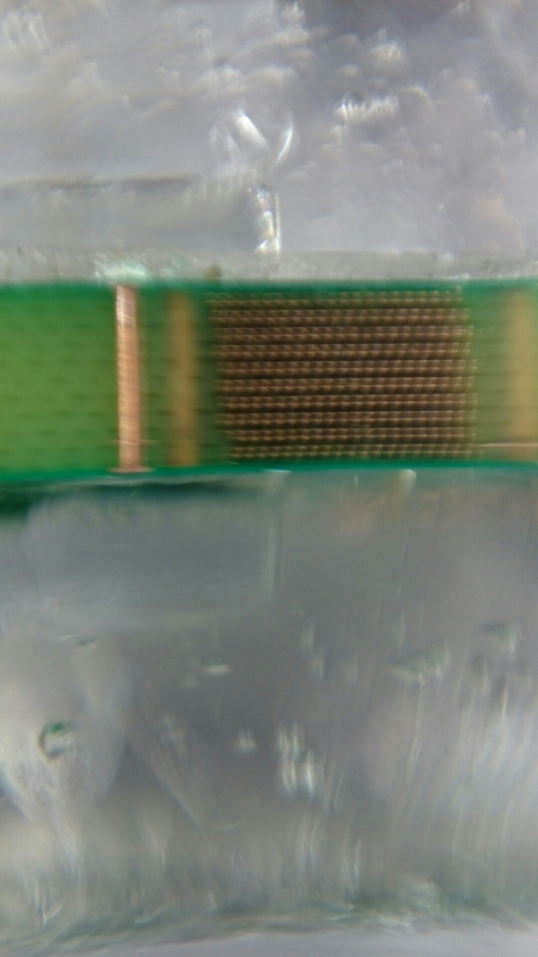
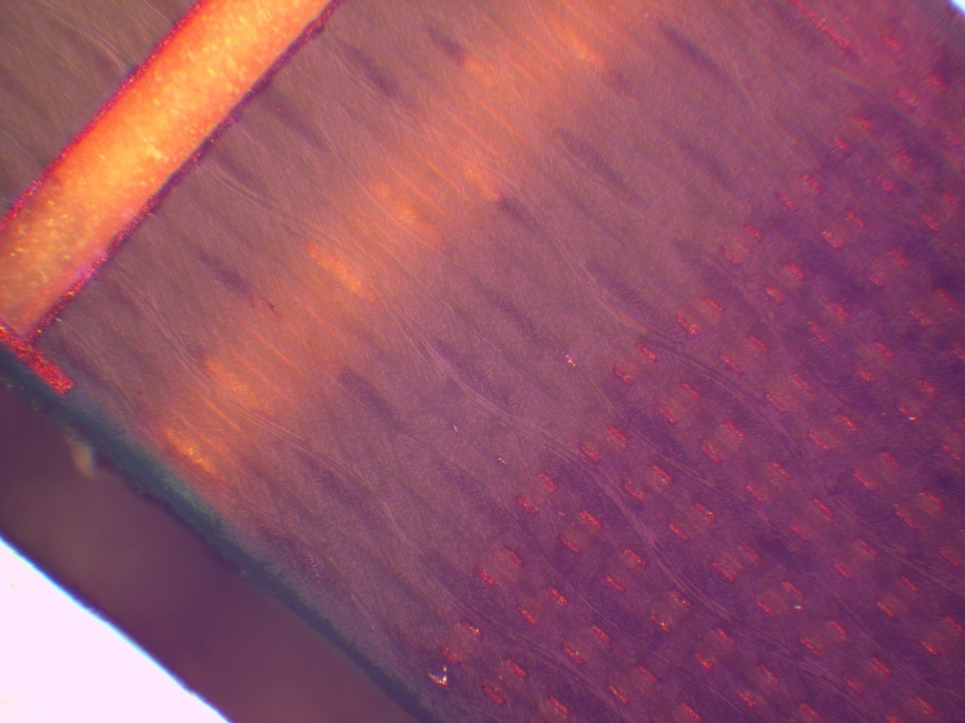
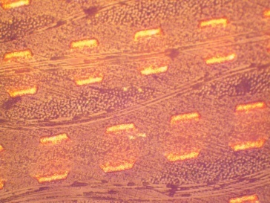
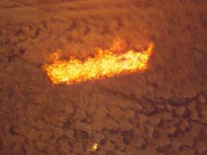
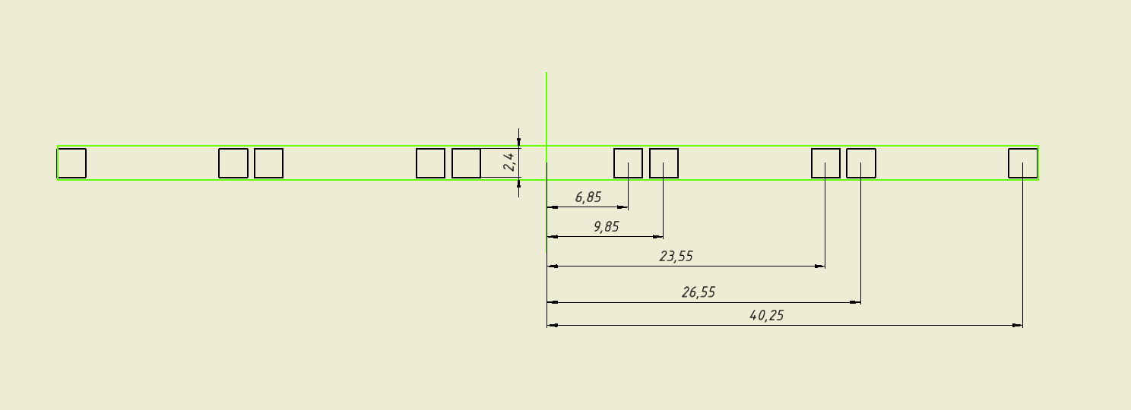
Design and assembly of the sensor
Measuring coils are executed on technology of the multilayer printed circuit board. The printed circuit board contains three blocks on five identical measuring coils.
Coils contain 400 rounds formed by 20 layers on 20 rounds.
Parameter | Value ,mm
R1 | 6,85
R2 | 9,85
R3 | 23,55
R4 | 26,55
R5 | 40,25
L | 400
Main parameter of PCB
Zoomed cross-section sheme PCB coil
Fig. 9 Cross-section of PCB coil
Fig . 10 Cross-section A-A

Slide 12
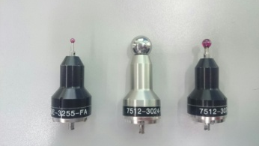
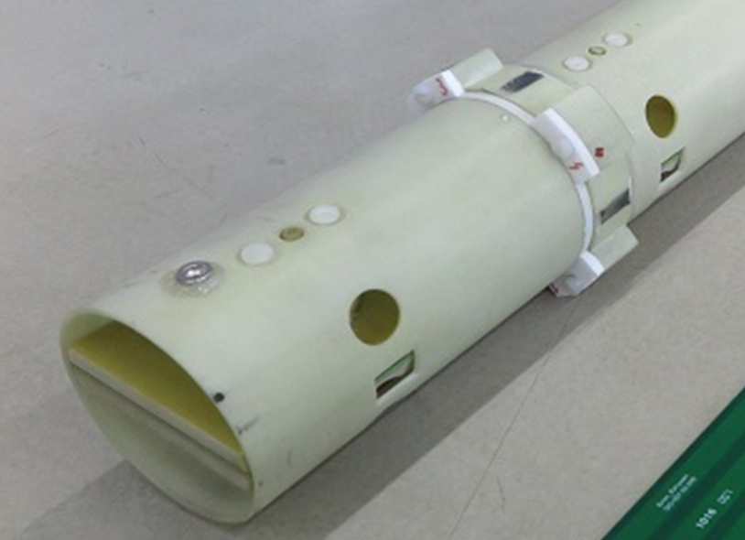
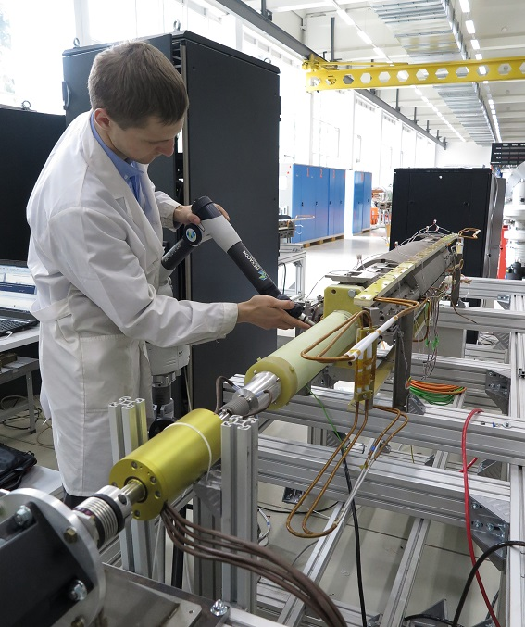
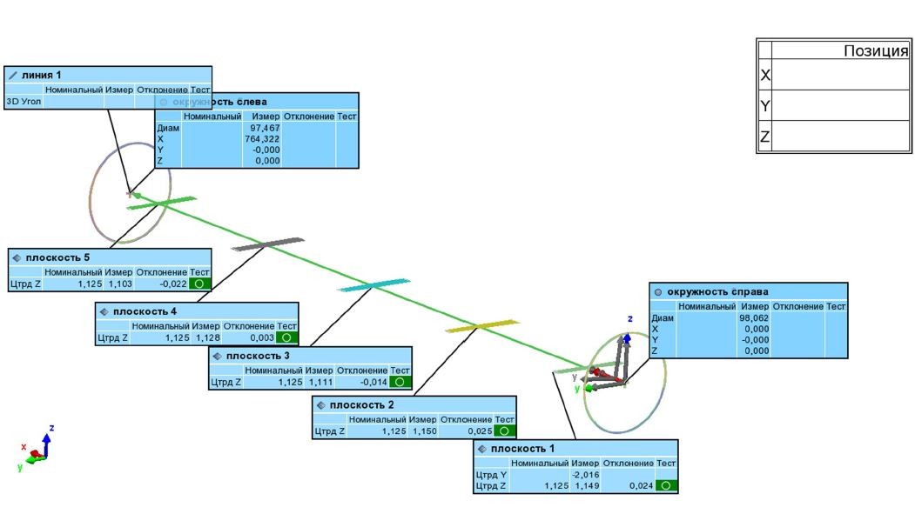
Design and assembly of the sensor
The most important task in assembly - is exact installation of the block of coils relative a rotation axis. Thanks to a measuring arm, the accuracy of installation of coils is about 30 microns.
Fig. 12 Нoles for an adjustment of coils in the sensor
Fig.13 Position of coils concerning a spin axis. Construction is executed in the PolyWorks program
Fig.11 Measurement of coordinates of an axis of the sensor concerning the fiducial platforms of a doublet

Slide 13
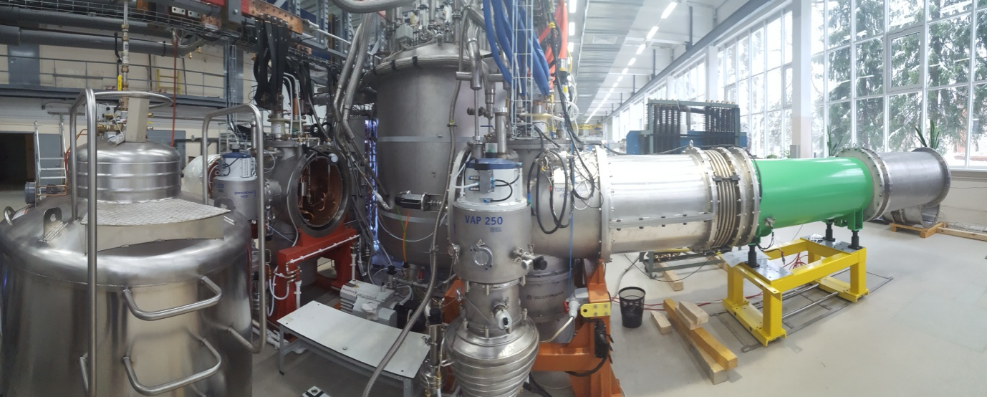
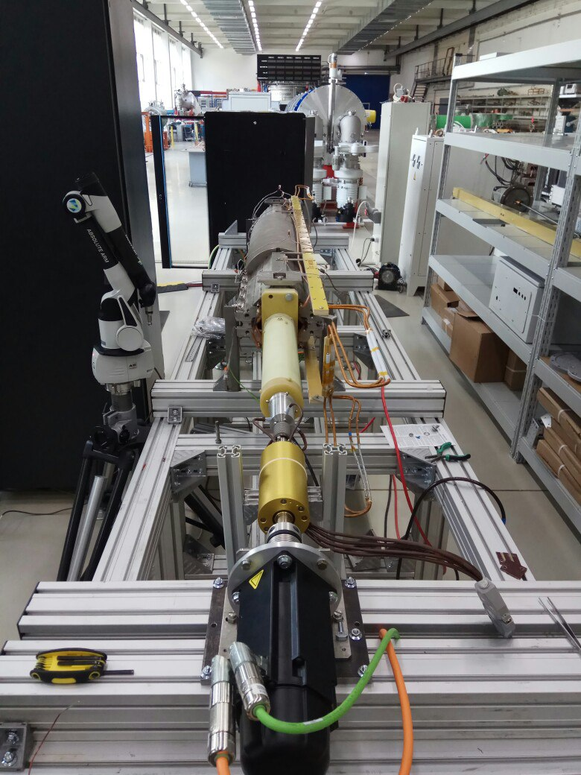
Structure of magnetometric system
Magnetic measurements
«Warm» t= 293 °K
«Cold» t= 4.5 °K
Fig. 14 Cryogenic measurements
Warm magnetic measurements are carried out in order that at an early stage to reject low-quality magnets. Realization of warm measurements allows to save time and costs of cooling of the rejected magnet.
Fig. 13 Warm measurements

Slide 14
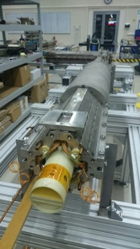
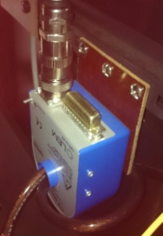
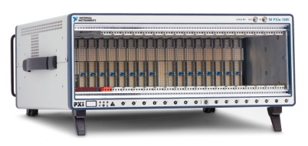
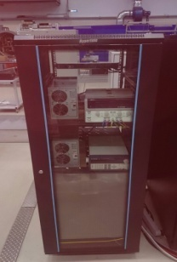
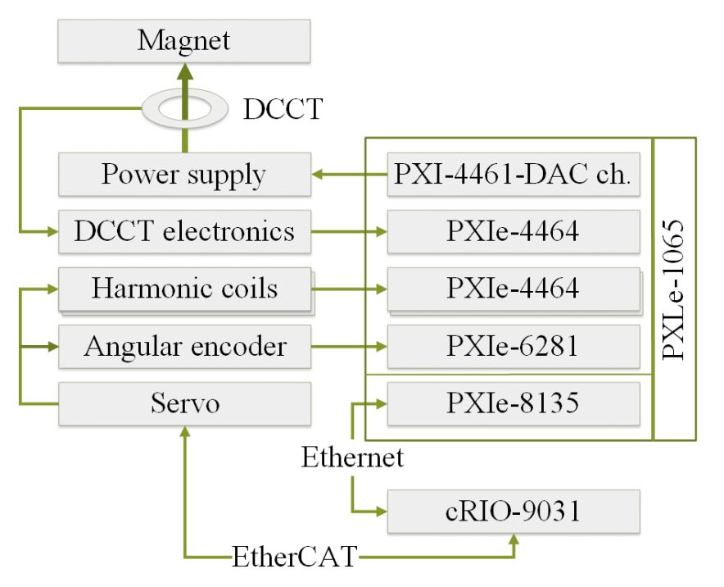
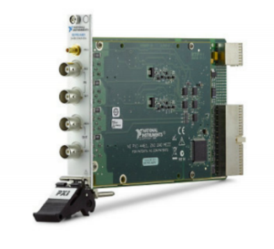
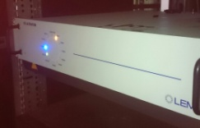
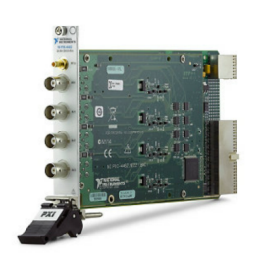
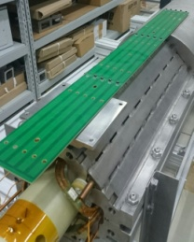
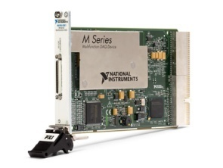
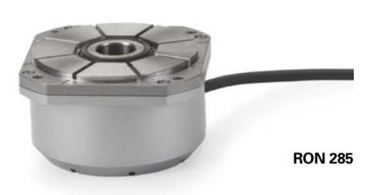
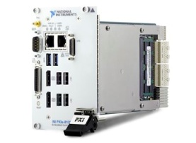
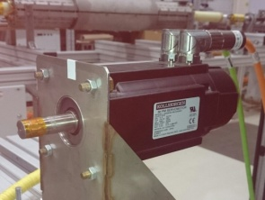
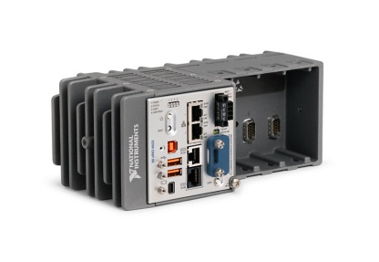
Structure of magnetometric system
Fig. 15 Schematic chart of acquisition and control.

Slide 15
Results
The graph shows the sensitivity of the measuring system to the measured harmonics.
For «D» lens
For «F» lens
Fig.16 Sensitivity for harmonics of measurement system

Slide 16
Results
bn,an ˂ 10⁻⁴ (n=7..31)
For «D» lens
For «F» lens
Fig. 16 Measured harmonics of the serial doublet lens DL 20-04

Slide 17
Results
The difference in effective lengths correlates with the difference in measuring the thickness of the core iron. The difference in measuring the lengths of core iron was 0.33 mm.
∆=0.66 mm
Fig. 17 Effective length for 10 kA. Left – for DL20-04, right – for DL14-14

Slide 18
Results
The table below presents the results of the cryogenic measurements of the two doublets. Values are given for the current 9680 A.
 | Parameter | DL-20-04 |  | DL-14-14 |  | σ
 |  | F | D | F | D
1 | Integral gradient, GL | 21,1914 | 21,1837 | 21.1438 | 21.1525 | 0.001
2 | Effective length L_{eff} | 496,11 | 495,77 | 495.89 | 495.41 | 0.03
3 | Magnet axis shift Δx | -0,24 | -0,20 | 0.38 | 0.35 | 0.01
4 | Magnet axis shift Δy | -0,51 | -0,48 | -0.63 | -0.64 | 0.01
Tab. 2 Measured parameters of the measured parameters of the two doublets at t=4,5°K

Slide 19
Conclusion
Created magnetometric system is able to measure all the quantities listed in the specifications within the specified tolerances, namely:
Variation of effective length – 10⁻⁴
The accuracy of measuring the shift of the magnetic axis of the element relative to its geometrical axis - 0.05 mm
The accuracy of measurement of harmonics - 10⁻⁴
At the moment the magnetic measurements group is working on stand string methods. It will allow to independently measure the offset of the axes of the doublet. Also make work on complete full automation of the measurement process.

Slide 20
Acknowledgements
I want to thank our colleagues from CERN, given the dependence of the thermal compression of the measuring coil. Also thank Karpunin Roman for images under a microscope-section of the coil.
Thank you for
your attention!

Slide 21
Спасибо за внимание!
Желаем успехов во всех Ваших начинаниях!!!

