Slide 1
LOAD CHARACTERISTICS OF SERIES- AND PARALLEL- COUPLED ACCELERATING STRUCTURES
Yu. Chernousov
ICKC, Novosibirsk, Russia

Slide 2
Outline
Motivation
RF feeding schemes
Sequential (serial) feeding schemes
Parallel Coupled Structures (PCS)
Features of PCS
Conclusions

Slide 3
Motivation
Development robust low energy accelerator
Detection features and advantages of parallel feeding
Demonstration advantages of parallel feeding
Parallel Coupled Accelerating Structure – the best decision for low energy accelerator and high-gradient high energy accelerator?

Slide 4
Sequential (serial)
feeding schemes

Slide 5
Sequential
(serial)
feeding
scheme
1947-48
W. Hansen et al., at Stanford,
built the MARK-I disk loaded linac
yielding 4.5 MeV electrons in a 9 ft structure powered by a 0.75 MW, 2.856 GHz magnetron.
RF in
RF out

Slide 6
Sequential
(serial)
feeding
scheme
1964
E.Knapp and D. Nagle
invented the side coupled cavity.
In 1972 E. Knapp et al. successfully operated the 800 MHz side coupled cavity linac(CCL) to produce
800 MeV energy at Los Alamos.

Slide 7
Sequential
(serial)
feeding
scheme
1994, D.Tronc
His proposal: to combine the traveling and standing waves structures
D.Tronc. LINAC ACCELERATING STRUCTURES. Proc. of EPAC1994. p.2164.

Slide 8
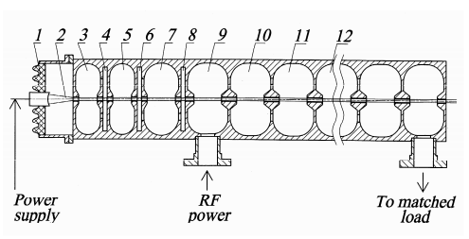
Sequential
(serial)
feeding
scheme
Vitaly M. Pirozhenko_ EFFICIENT TRAVELING-WAVE
ACCELERATING STRUCTURE.
Proc. of EPAC08, p.2746.

Slide 9

Parallel coupled RF feeding
schemes
Parallel
feeding
scheme,
1977,
Cornell,
US
RF input
Coaxial feeding line
Accelerating cells
R.M. Sundelin,
J.L.Kirchgessner, and M.Tiger.
Parallel Coupled Structure.
IEEE Trans.on Nucl.Sci.,
Vol. NS-24, No.3, 1977, p.1686.

Slide 10
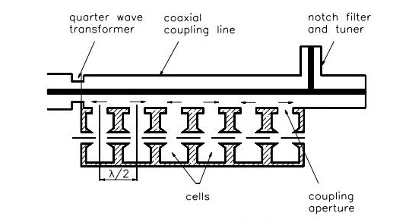
Parallel coupled RF feeding
schemes
Parallel
feeding
scheme
1989,
BINP,
Novosibirsk
V. Akimov et al., in Proc. 11th All-Union Workshop
on Accel. of Charged Part., Dubna, v. 1, 268 (1989).

Slide 11
Parallel coupled RF feeding
schemes
1
2
3
RF
Parallel
feeding
scheme
1986,
ICKC,
Novosibirsk
L
beam
1- accelerating cavity, 2- feeding waveguide, 3-slot
Ivannikov V.I.И., Chernousov Yu.D., Shebolaev I.B. Parallel coupled accelerating structure. Z.T.Ph.,1986, V.56, N12, p.2407.

Slide 12
Parallel coupled RF feeding
schemes
RF
source
Parallel
feeding
schemes
2006,
2010,
2015,
2016.
SLAC
Directional Coupler
Sc = (1 – i + N)^{-1/2}
Load
•
•
•
•
Accelerator
Cavity
N^{th} Accelerator
Cavity
Neilson J., Tantawi S., Dolgashev V. Design of RF Feed System for Standing-wave Accelerator Structures. // Proc. of LINAC. 2010. P. 235.

Slide 13
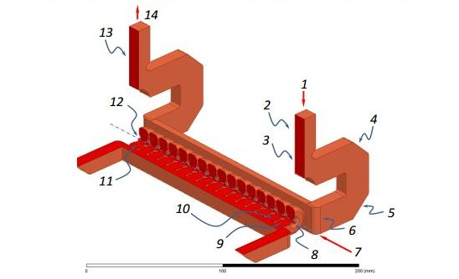
Parallel coupled RF feeding
schemes
Parallel
feeding
schemes
2006,
2010,
2015,
2016.
SLAC
Dolgashev V.A. Traveling Wave Linear Accelerator with RF Power Flow Outside of Accelerating Cavities. US Patent Application №US 2015/0359080 A1.
Pub.date: Dec.10, 2015.

Slide 14
RF feeding schemes: serial feeding, parallel feeding
Accelerating cells
A
Sequential
(serial)
feeding
scheme
Vitaly M. Pirozhenko_ EFFICIENT TRAVELING-WAVE
ACCELERATING STRUCTURE.
Proceedings of EPAC08, p.2746.
RF input
Coaxial feeding line
R.M. Sundelin,
J.L.Kirchgessner, and M.Tiger.
Parallel Coupled Structure.
IEEE Trans.on Nucl.Sci.,
Vol. NS-24, No.3, 1977, p.1686.
Parallel
feeding
scheme
Accelerating cells
Notes:
On the slide are examples of accelerating structures. Top slide - accelerating structure with serial communication. Microwave power from the generator enters the first cavity, and then successively to other resonators. Problems: high level of electric field in the first cavity and breakdown; pulse overheating of first coupling slot; low level of electric field in the accelerating cavity at the end of the structure; high order mode; beam loading effect in TW structure and difficult to overcome this problem;
Parallel feeding scheme was offered at Cornell University in 1977. Accelerating cavity excited in parallel from the coaxial line. Problems:
low level of electric field in the coaxial line.
Можно отметить, что к настоящему времени в ускорительной технике научные разработки во многих направлениях практически завершены и развитие идет только по технологическому совершенствованию ранее предложенных технических решений. Это почти в полной мере касается элементов ЛУЭ - ускоряющих структур, инжекционных систем и систем фокусировки пучка. Так, используются и совершенствуются ускоряющие структуры двух типов – бегущих и стоячих волн ([2] - Зверев Б.В., Собенин Н.П. Электродинамические характеристики ускоряющих резонаторов. М.: Энергоатомиздат, 1993.). Оба эти типа – структуры с последовательной связью, в которых СВЧ энергия подводится к одному из резонаторов структуры, и затем последовательно распространяется из одного резонатора в другой. Для ЛУЭ на таких структурах характерно значительное количество проблем. Это проблемы пробоя в ускоряющих ячейках в области максимального электрического поля и вблизи элементов ввода СВЧ энергии [3], проблемы локального импульсного перегрева и разрушения поверхности в районе элементов связи [4], проблемы возбуждения высших типов колебаний в полосах прозрачности структуры [5], проблемы спада напряженности поля вдоль оси структуры [6] и, соответственно, создания заданного распределения поля (например, нарастающего) при ее значительной длине, проблемы фокусировки ускоряемых частиц при значительных токах пучка [7], особенно на начальной стадии ускорения, проблемы управления импульсными параметрами инжекционного тока [8], проблемы переходных процессов в ускоряющей структуре[9], проблемы нагрузки структуры током пучка[10].
Разработка новых технических решений - устройств и способов, направленных на решение перечисленных проблем и улучшение параметров линейных ускорителей электронов, является актуальной научной и технической задачей.

Slide 15
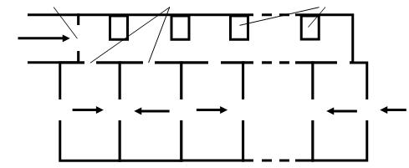
Parallel coupled accelerating structure – conceptual RF scheme
.
Input Diaphragm
Input Slots
Tuning Pins
RF
source
Exciting Cavity
Beam
Accelerating Cavities

Slide 16
Conceptual RF schemes
.
RF
β₀ , β_{B}
Beam
RF
β₀ , β₀₊₁ , β_{B}
Beam

Slide 17
Basic relations, serial feeding
In a stationary mode, the RF power (P) is partially reflected from the resonator, partially dissipated in the walls (P_{W}), and in the presence of the accelerated beam is partially spent on its acceleration (P_{B}). RF power passing into the resonator
,
P_{EXT} – RF power, emitted from the resonator at a generator switch of,
β₀ – coupling coefficient of the accelerating cavity with the feeding waveguide without beam,
χ=P_{B}/P_{W} is the load ratio, the ratio of power required for beam acceleration to the losses in the resonator walls.

Slide 18
Basic relations, serial feeding
β₀>β_{B} ,
If β_{B} = 1,
β₀ = 1+ χ,
η = P_{B}/P = χ /(1+ χ ),
β₀ = 1/(1 - η)
For example, when χ =1, η = 0.5, in the mode of critical coupling we obtain β₀ = 2, i.e., the accelerating cavity in the "cold" mode (without the beam) must be set at "over-coupling" with the feeding line, with the coupling coefficient of 2.

Slide 19
Basic relations, parallel feeding
P_{EXT} – radiated RF power;
P_{W0} +P₀₁ -loss of the first resonator;
P_{W0} - loss in the walls of the first resonator;
P₀₁ = P_{W1} +P_{B} transmitted power; P_{W1} - the power of the loss in the walls of the second resonator;
P_{B} - power for beam acceleration.
β₀ = P_{EXT}/P_{W0} is the coupling coefficient of the first resonator;
β₀₊₁ - input coupling coefficient of the system, beam switch of;
β_{B} - input coupling coefficient of the system, beam switch on;
γ = P₀₁/P_{W0} - load ratio;
- beam load factor.

Slide 20
Basic relations, parallel feeding
β₀ >β_{B} > β₀₊₁

Slide 21
Basic relations, parallel feeding
At critical coupling (β = β_{B} = 1),
The dependence of efficiency η on the load factor χ:
For example, when χ =1, η = 0.4, in the mode of critical coupling in the "cold" mode (without the beam):
β₀ = 5, and β₀₊₁ ≈ 0.5

Slide 22
Serial feeding, parallel feeding, comparison
β₀ >β_{B} > β₀₊₁
β₀>β_{B}

Slide 23
Conclusions
The idea of parallel coupled structure (PCS) has 40-th history.
The presented ratios are the load characteristics of accelerating structures with series- and parallel-coupling: the coupling coefficient and the efficiency of conversion of RF power of the generator into the power of the accelerated beam.
The conventional standing-waves accelerating structure with series-coupling and switch-of is configured into the mode of "overcoupling".
PCS with beam switch-of is set into the mode of "sub-coupling". At beam switch-on, the accelerating cavity is loaded, its quality factor decreases, the coupling between the accelerating and exciting resonators is reduced, the exciting resonator is loaded less, its quality factor and, respectively, the coupling with the feed line grows, and at a certain beam current, a critical mode of coupling is achieved.

Slide 24
Спасибо
за
внимание
RF
Beam

Slide 25
Advantages of PCAS: all due to parallel feeding of the accelerating sells
  Maximizes RF power distribution efficiency
  Minimizes RF power flows via coupling slots
  Localization the RF breakdown in each cell
  Enhanced vacuum pumping conductance
  Built-in PPMFS – Periodic Permanent Magnetic Focusing System
  PCAS + RF-control Gun ⇒ 100% capture
Parallel Coupled Accelerating Structure – the best decision for low-energy accelerator.
Parallel Coupled Accelerating Structure – the best decision for high-energy accelerator.
Notes:
The work of LAPCAS with electron beam in different regimes is demonstrated. Short pulses mode: electron energy – 4 MeV, pulse current – 0.3A, pulse duration -2.5 ns; long pulses mode: electron energy – 2.5 MeV, pulse current – 0.1A, pulse duration - 0.1-4μs. When the electron gun worked in RF-control regime the capture about 100 % was achieved. Beam loading effect in LAPCAS takes place. Method of compensation of energy spread of accelerated electrons by delaying the moment of injection in the LAPCAS gives encouraging results. The equations in the simplified form describing transients allow interpreting the experimental pulse dependences obtained by a method of retarding metallic plates in pulse regime.
Certainly the method of feeding of accelerating sells in parallel from a rectangular waveguide [1] will help to create the robust high gradient accelerating structures [4].

Slide 26
Parallel coupled accelerating structure –design scheme
RF power from a klystron feeds the excitation cavity (6) through inductive coupling iris diaphragm (7). The excitation cavity (6) excites the accelerating cavities (1). The connection of the excitation cavity with the accelerating cavities is provided by RF magnetic field through coupling slots (3). The focusing alternative magnetic field is created along the beam axis by permanent magnets (4,5) with radial magnetization inserted in the iron yoke (4). The copper pins (2) are used to tune the resonance frequency of exiting cavity (6).
1- accelerating
cavity
3- input slots
6- exciting
cavity
7- input
diaphragm
2- tuning pins
4,5 - PPMFS
PPMFS – Periodic Permanent Magnet Focusing System

Slide 27
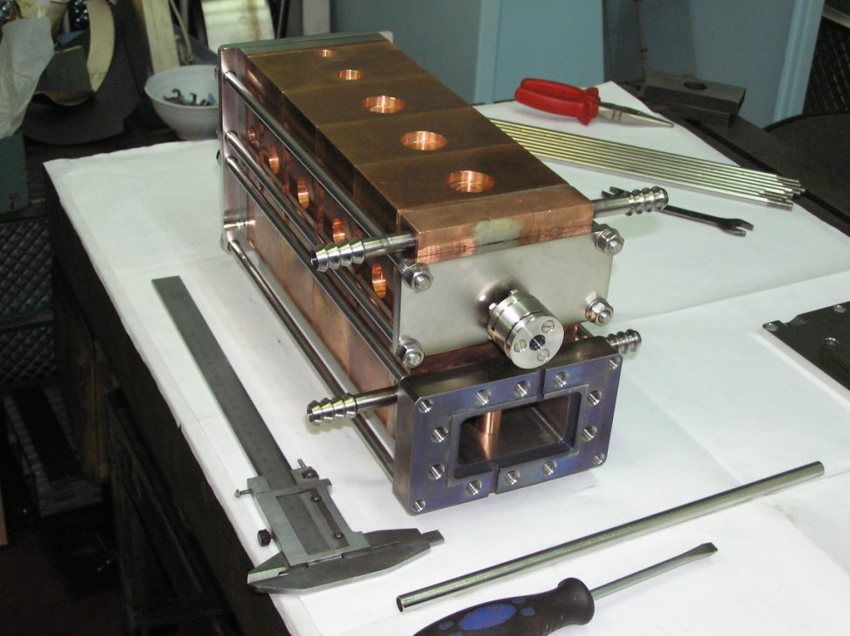
Parallel coupled accelerating structure – 5 cavity model with indium seals
2010-
2012
-first
results
Beam output
RF input

Slide 28
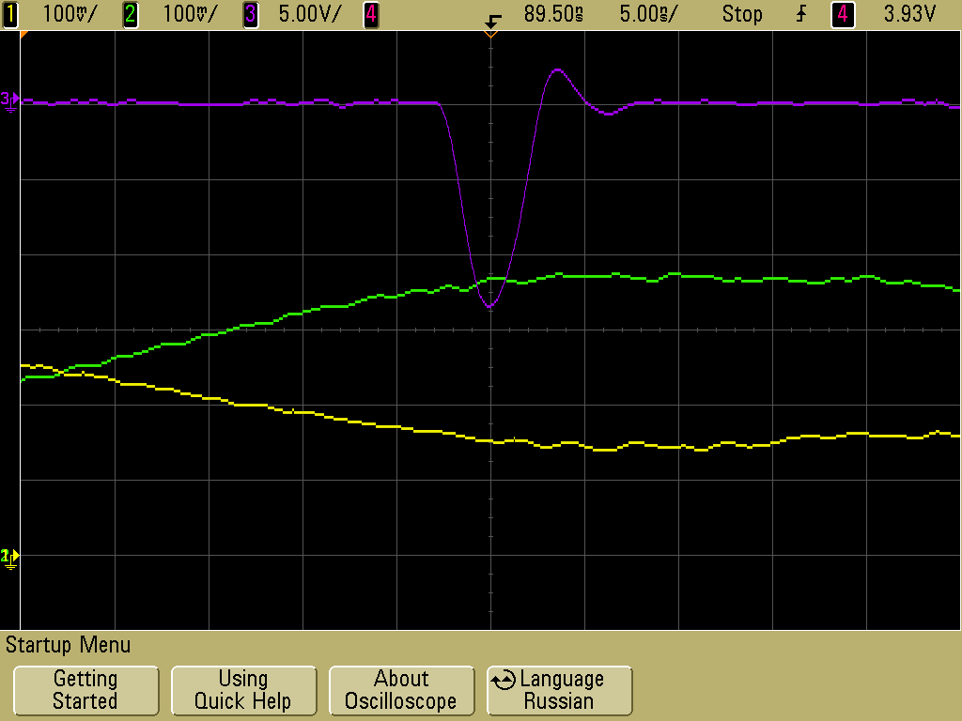
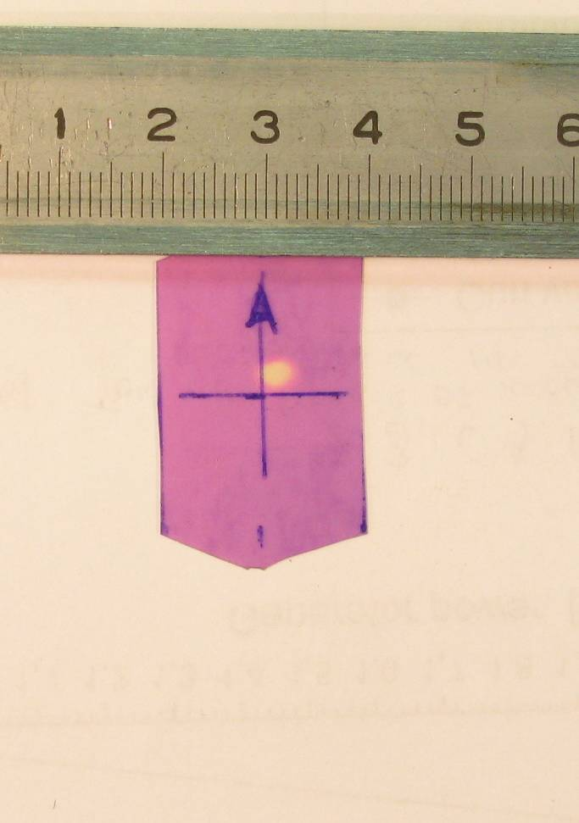
Beam pulse characteristics.
2010-2012-first results.
a
Dependence of output beam current on klystron power
(as a percentage to the input current)
In the RF control regime
the beam capture is about 100 %
Beam current oscilloscope picture (current amplitude is about 270 mA, pulse duration 5 ns)
Cross section of the beam at the exit
of accelerator

Slide 29
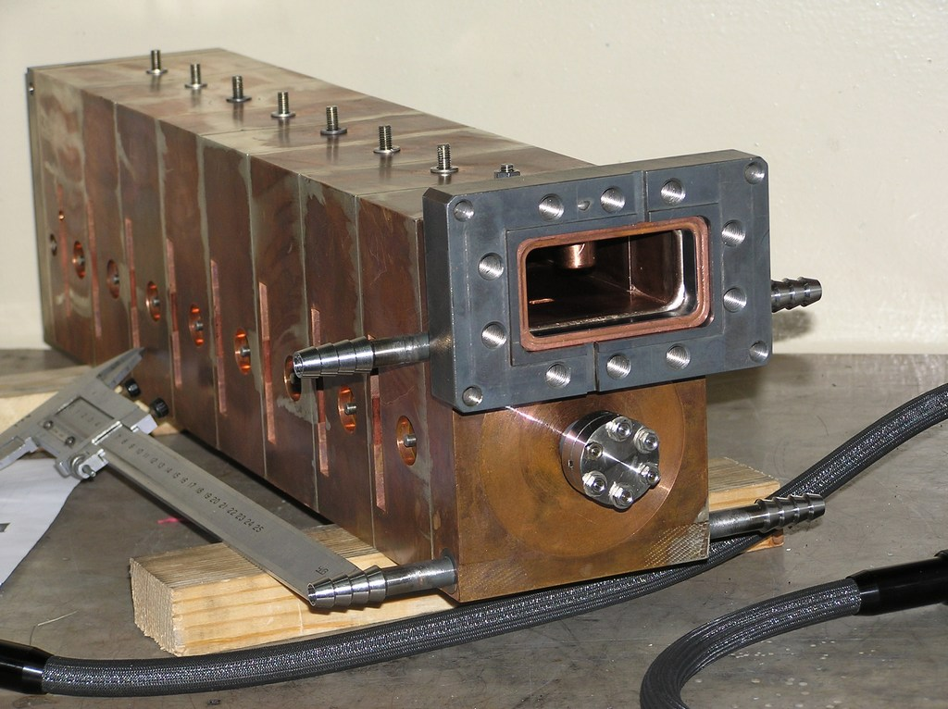
Parallel coupled accelerating structure – 9 cavity brazing model
.

Slide 30
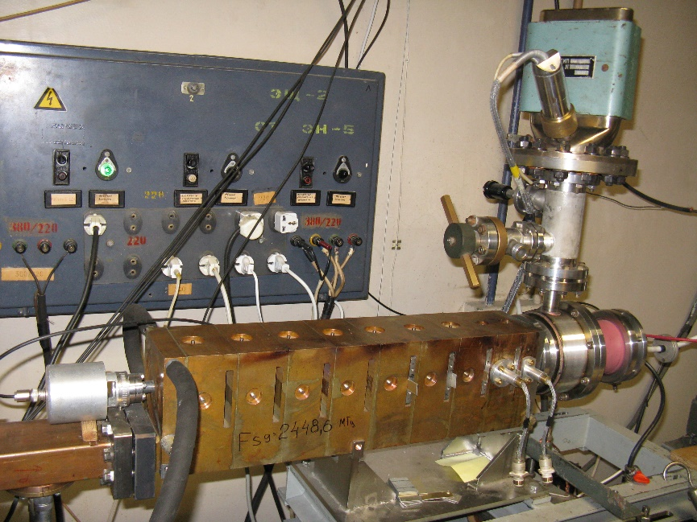
Parallel coupled accelerating structure – working stand. 2016
Beam output
Gun
Magnets
RF input
Structure

Slide 31
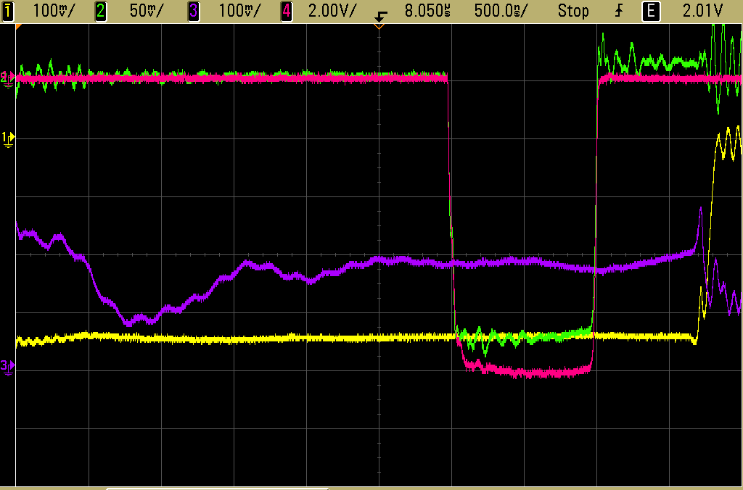
Beam characteristics.
2015-2016 – resent results.
Beam current oscilloscope picture (beam current amplitude 200 mA, pulse duration 1 µs - red)
Beam Capture-Energy characteristics.
Вeam current amplitude is 50 mA

Slide 32
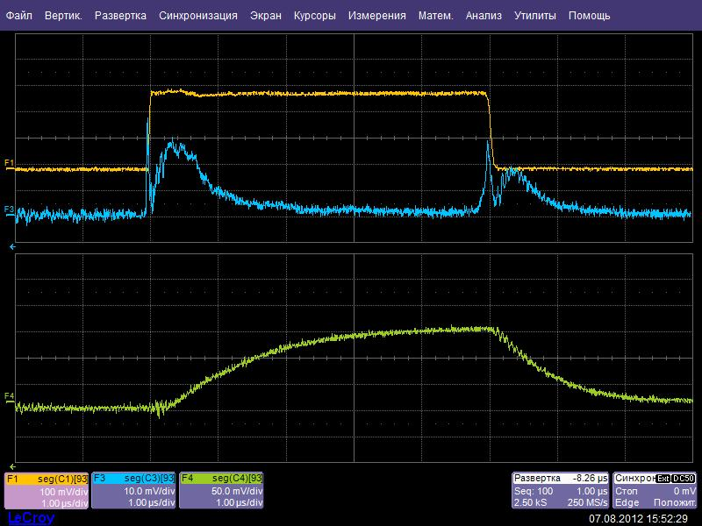
Breakdowns
RF pulse of the klystron.
1.6 MW, 5 μs.
Reflected signal from
the accelerating structure .
Stored RF energy in the
5-th accelerating cavity.
Notes:
Experimental data characterizing the breakdown processes during RF processing are represented in Fig. 3a-3c. Measured value of RF power was 1.6 MW, calculated amplitude of surface electric field reached up to 0.7 MV/cm. Incident, reflected RF power and stored RF energy in the fifth accelerating cavity were measured at the experiments. In Fig.3 one can see signals: incident RF power (F1) – yellow; reflected RF power (F3) – blue; RF signal from fifth accelerating cavity, proportional to stored energy in them (F4) – green. In normal regime (without breakdown) all signals are of the proper form, without any singularity. Incident RF power (F1) has rectangular form. Reflected RF signal (F3) characterizes transients in the system of two coupled cavities – accelerating and exciting cavities. Signal (F4) with exponential form represents stored energy in the fifth cavity.

Slide 33
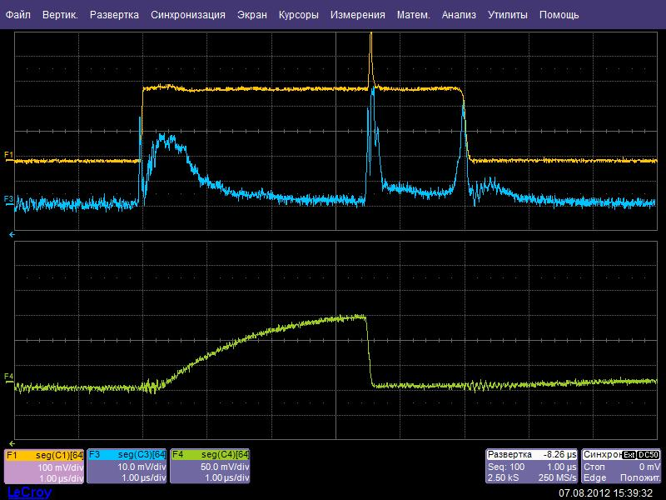
Breakdowns
RF pulse of the klystron.
Reflected
signal.
Breakdown
in the 5-th
accelerating cavity.
The stored energy is
dissipated during
less then 100ns
Notes:
The processes change under breakdown. If a breakdown takes place in the single accelerating cavity, a part of the stored RF energy dissipates in this cavity, some fraction radiates to exciting cavity and then thru Input Diaphragm to external RF Power line. As a result on the reflected signal one can see short pulse burst - Fig.3b, line (F3). Let's note that there are no sizeable reflections from accelerating structure which could affect the RF generator. The stored energy in the 5-th accelerating cavity is dissipated during less then 100ns

Slide 34
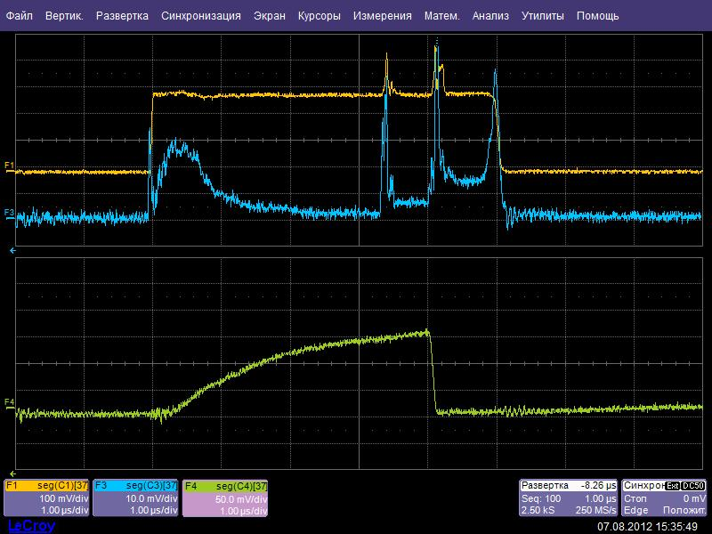
Breakdowns
Breakdown
in the other
accelerating cavity
Breakdown
in the 5-th
accelerating cavity
The 5-th cavity
Almost doesn't
See
Notes:
In Fig.3c behavior of the system when the breakdowns take place almost simultaneously - during one RF pulse in some accelerating cavities – a very rare event is shown. In this case accelerating cavities are disconnected one by one, reflected RF signal increases – Fig.3c, line (F3). So, 5-th accelerating cavity almost doesn't ″notice″ the breakdown in the other separate cavity.

Slide 35
Breakdowns: more detail in the poster
Notes:
Breakdowns occur in the accelerating cavities with sequential RF power feeding violates normal work of the accelerator, destructs the surface of the cells. In the case of PCAS a breakdown does not change acceleration regime in the accelerating structure. RF energy destroying the surface of accelerating cavity of PCAS due to breakdowns, as compared to SW and TW structure with sequential RF power feeding is at least N times less, where N is a quantity of accelerating cavity of the structure. Therefore the damages are alike smaller.

Slide 36
Advantages of PCAS: all due to parallel feeding of the accelerating sells
  Maximizes RF power distribution efficiency
  Minimizes RF power flows via coupling slots
  Localization the RF breakdown in each cell
  Enhanced vacuum pumping conductance
  Built-in PPMFS – Periodic Permanent Magnetic Focusing System
  PCAS + RF-control Gun ⇒ 100% capture
Parallel Coupled Accelerating Structure – the best decision for low-energy accelerator.
Parallel Coupled Accelerating Structure – the best decision for high-energy accelerator.
Notes:
The work of LAPCAS with electron beam in different regimes is demonstrated. Short pulses mode: electron energy – 4 MeV, pulse current – 0.3A, pulse duration -2.5 ns; long pulses mode: electron energy – 2.5 MeV, pulse current – 0.1A, pulse duration - 0.1-4μs. When the electron gun worked in RF-control regime the capture about 100 % was achieved. Beam loading effect in LAPCAS takes place. Method of compensation of energy spread of accelerated electrons by delaying the moment of injection in the LAPCAS gives encouraging results. The equations in the simplified form describing transients allow interpreting the experimental pulse dependences obtained by a method of retarding metallic plates in pulse regime.
Certainly the method of feeding of accelerating sells in parallel from a rectangular waveguide [1] will help to create the robust high gradient accelerating structures [4].

Slide 37
Conclusions
The idea of parallel coupled structure (PCS) has her 40-th history.
The work of new type of PCS with electron beam in different regimes is demonstrated.
Short pulses mode: beam energy – 4MeV; 8 MeV, pulse current – 0.6A, pulse duration -2.5 ns – 5 ns.
Long pulses mode: electron energy – up to 8 MeV, pulse current – up to 0.3A, pulse duration - 0.1-4μs. Capture about 100 % was achieved (pulse current up to 200 mA).
Breakdowns: PSC almost doesn't ″notice″ the breakdown in the separate cavity.
New type of PCS helped to create the robust low-energy accelerator.
New type of PCS will help to create the robust high gradient accelerating structures .

Slide 42
Parallel coupled RF feeding schemes
Rectangular Waveguide
Yu. Chernousov,
V.Ivannikov,
I. Shebolaev.
1986.
Novosibirsk
.
RF Power
Beam
Accelerating Cavities
RF
source
Directional Coupler
Sc = (1 – i + N)^{-1/2}
S. Tantawi,
V. Dolgachev.
2006.
SLAC
Load
•
•
•
•
Accelerator
Cavity
N^{th} Accelerator
Cavity
September 24 - 28, 2012, St.Petersburg, Russia
Notes:
In 1986 we offered new Parallel coupled RF feeding scheme. Structure consists of Accelerating Cavities and exciting Rectangular Waveguide. In 2006 the idea of parallel feeding of accelerating cavity attracted the attention of SLAC accelerator specialists.

Slide 43
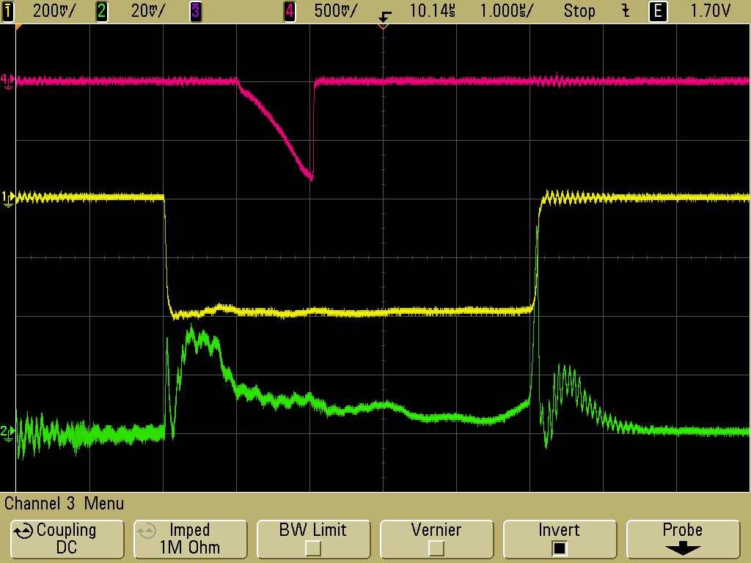
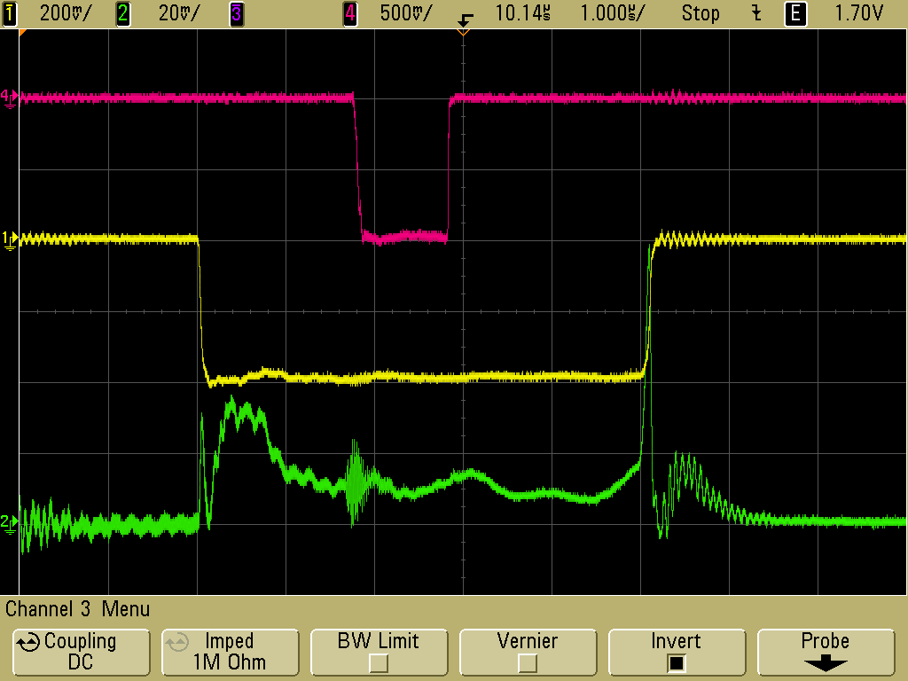
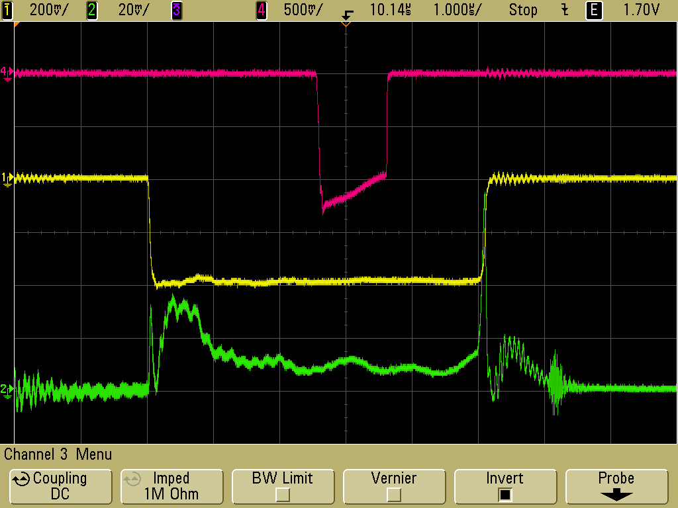
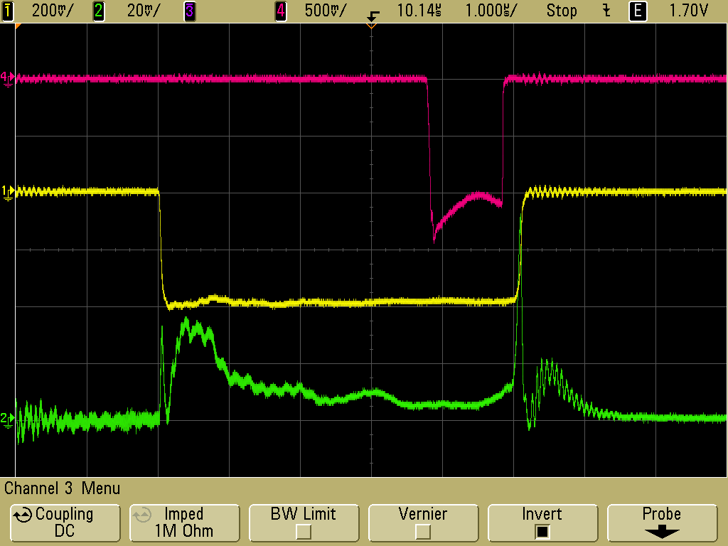
Beam Loading: Experimental Results
The experimental observations of beam loading effect are performed by the following way. Pulsed electron beam of rectangular form with pulse duration of 1 μs (test pulse, red) with constant magnitude of injection current (0.1A) and variable delay time in reference to the klystron pulse (yellow) was injected into the accelerator. A Faraday cap with metal plates in front of them was installed at the exit of the accelerator. Electrons with high energy overcome the metal plates, and those with low energy get stuck in it. Part of accelerated beam overcoming the metal plate of any thickness and electrons passed through the plate fall into the Faraday cap and pulsed current is recorded by oscilloscope.
The dependence of beam energy on time becomes the dependence on time of magnitude of a current from Faraday cap recorded by oscilloscope.
September 24 - 28, 2012, St.Petersburg, Russia
Notes:
Pulse-energy characteristics of the accelerated beam are represented on Figure (A-D, left-right). Electron pulses from injector were of rectangular form. Delay time of beam injection relatively to RF pulse changed from approximately 1μs (oscillogram A) up to 3.8 μs (Oscillogram D). Oscillogram B, Fig.1 represents a point on the time scale where the conditions U_{A} = CONST take place, therefore, the recorded current pulse has a rectangular shape. In this case it means that average energy of accelerated electrons does not depend on time.

Slide 44
Parallel
feeding
scheme
Rectangular Waveguide
RF Power
Beam
Accelerating Cavities
Yu. Chernousov,
V.Ivannikov,
I. Shebolaev.
1986.
Novosibirsk
Parallel
feeding
scheme

