Slide 1

Status of the vepp-4 accelerator facility
XII International workshop “Problems of Charge Particle Accelerators” to the memory of Prof. V.P. Sarantsev, September 3-8, 2017, Alushta, Russia
P.Piminov for VEPP-4 team
Budker Institute of Nuclear Physics SR RAS,
Novosibirsk, Russia

Slide 2
VEPP-4 team
A.Aleshaev, V.Anashin, O.Anchugov, G.Baranov, A.Barnyakov, A.Batrakov, E.Bekhtenev, D.Berkaev, V.Blinov, B.Bobrovnikov, A.Bogomyagkov, D.Bolkhovityanov, D.Burenkov, P.Cheblakov, I.Churkin, A.Dolgov, V.Dorokhov, S.Dutkevich, F.Emanov, V.Erokhov, S.Glukhov, O.Gordeev, S.Gurov, V.Kaminskiy, S.Karnaev, G.Karpov, K.Karyukina, D.Kashtankin, V.Kiselev, V.Kolmogorov, E.Kravchenko, A.Krasnov, G.Kulipanov, K.Kuper, E.Kuper, I.Kuptsov, G.Kurkin, E.Levichev, P.Logachev, A.Medvedko, O.Meshkov, S.Mishnev, I.A.Morozov, I.I.Morozov, N.Muchnoi, A.Murasev, S.Nikitin, I.Nikolaev, D.Nikolenko, I.Okunev, A.Onuchin, V.Oreshonok, P.Piminov, O.Plotnikova, A.Polyanskiy, Yu.Pupkov, I.Rachek, O.Rezanova, E.Rotov, V.Sandurev, A.Shamov, D.Shatilov, D.Shvedov, S.Shiyankov, E.Simonov, S.Sinyatkin, A.Skrinsky, E.Starostina, V.Svischev, D.Sukhanov, Yu.Tikhonov, B.Tolochko, D.Toporkov, A.Tribendis, G.Tumaikin, Fedotov, S.Vasichev, D.Voroshilov, V.Zhilich, A.Zhmaka, A.Zhukov, A.Zhuravlev, K.Zolotarev

Slide 3
physics program
high energy physics at VEPP-4M with detector KEDR
synchrotron radiation at VEPP-3 & VEPP-4M
nuclear physics experiments at VEPP-3 with Deuteron facility
test beam facility at VEPP-4M
accelerator physics activity

Slide 4
УНУ ВЭПП-3/ВЭПП-4М + ВЭПП-2000
 | VEPP-2000 | VEPP-3 | VEPP-4M
Circumference | 24.4 | 74.4 | 366 | m
Energy | 0.1÷1 | 0.3÷2 | 1÷4.7 (5.3) | GeV
Bunches | 1e+x1e– | 2e± | 2e+x2e–, 16e±
Current | 200 | 150 | 15 (40) | mA
Luminosity | 1·10³² |  | 3·10³⁰ (2·10³¹) | cm⁻²·s⁻¹
VEPP-4М
VEPP-3
e+e– Injector
KEDR
e– linac
e– gun
e+ target
Damping Ring
e+ linac
Injector | Old | New
Injection energy | 355 | 400 | MeV
e+ intensity | 10⁸ | 7·10⁸ | s⁻¹
e– intensity | 3·10⁹ | 2·10⁹ | s⁻¹
Repetition rate | 1 | 0.2÷0.5 | Hz
Injected bunch length | 23 | 1 | cm
K-500
VEPP-2000

Slide 5
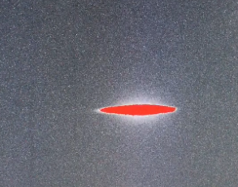
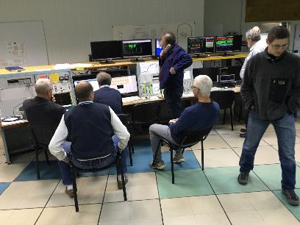
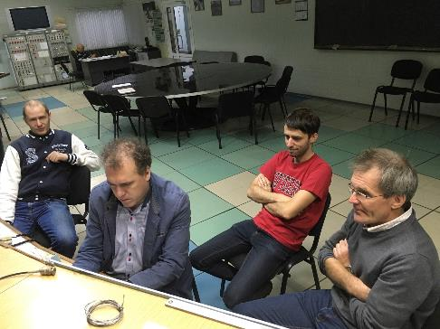
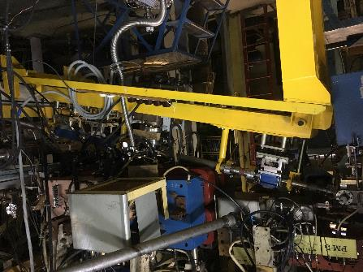
first beam from new injector
1 Sep 2016 – start installation
21 Oct 2016 – e– in VEPP-3
18 Nov 2016 – e– in VEPP-4M
1 Dec 2016 – SR @ VEPP-3
26 Dec 2016 – e+ in VEPP-3
26 Jan 2017 – e+ in VEPP-4M
1 Feb 2017 – luminosity @ VEPP-4M
See next talk “Status and prospects of VEPP-5” by Fedor Emanov (BINP SB RAS)

Slide 6
VEPP-4 layout

Slide 7
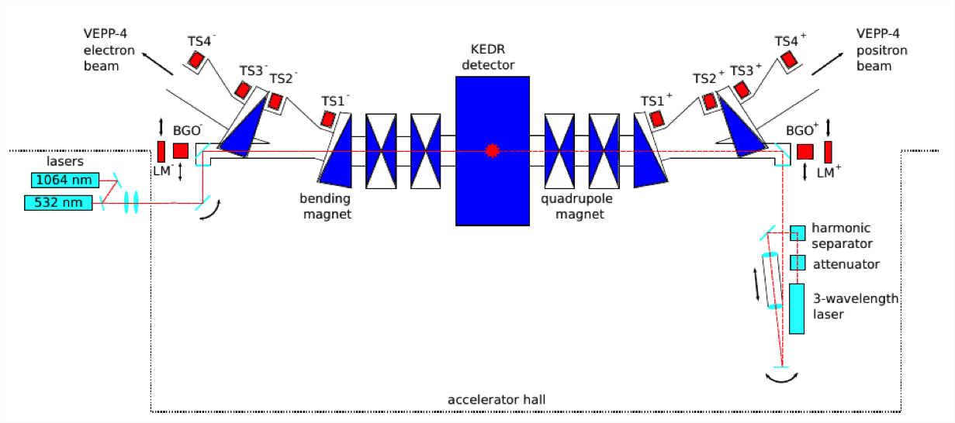
VEPP-4M with KEDR
Universal magnetic detector KEDR
Electron-positron tagging system
Wide energy range 0.9÷5 GeV
Energy spread control
Precision beam energy calibration by resonance depolarization
First collider with beam energy monitoring by Compton backscattering

Slide 8
hep @ KEDR
2001-2017 low energy luminosity run 2x(0.9÷1.9) GeV
  J/ψ, ψ’ , ψ”, ψ(3770) meson masses WR = World Record
  τ lepton mass WR
  D⁰ mesons masses
  D± mesons masses WR
  Search for narrow resonances 1.85÷3.1 GeV WR
  R-scan 1.85÷3.1 GeV WR
  Ruds- and R- scan 3.12÷3.72 GeV WR
  J/ψ → γη_{c} WR
  ψ-mesons, η_{c}, … parameters WR
  …
2017-2020 high energy luminosity run 2x(2÷5.2) GeV
  R-scan 5÷7.5 GeV
  Y(1S), Y(2S), Y(3S), … mass & lepton widths
  γγ-physics (gamma gamma -> adrons)

Slide 9
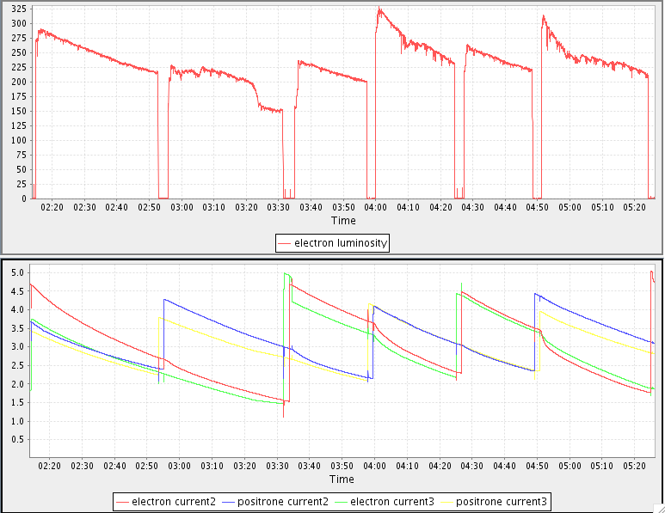
luminosity @ ψ(3770)
luminosity, 10²⁸ cm^{–2}c^{–1}
L = 2·10³⁰ → 3.3·10³⁰ cm⁻²s-¹
bunch current, mA
New injector provides maximal positron and electron bunch current and high injection rate in VEPP-4M
Optics correction (specific luminosity, dyn. aperture, inj. efficiency)
Using transverse 2x2 feedback for beams overlapping

Slide 10
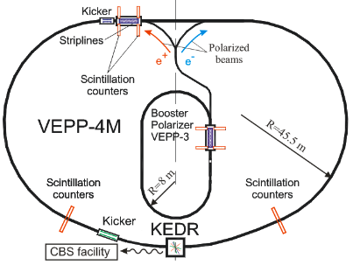
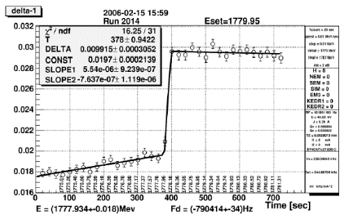
RD energy calibration
Accuracy ~ 10⁻⁶
Needs polarized beam
Up to 2-3 serial measurements possible with the same beam
Polarized beam obtained in ranges E = 1.5÷2 GeV and 3.8÷5 GeV
~ 100 beam energy calibration run in 2016/2017

Slide 11
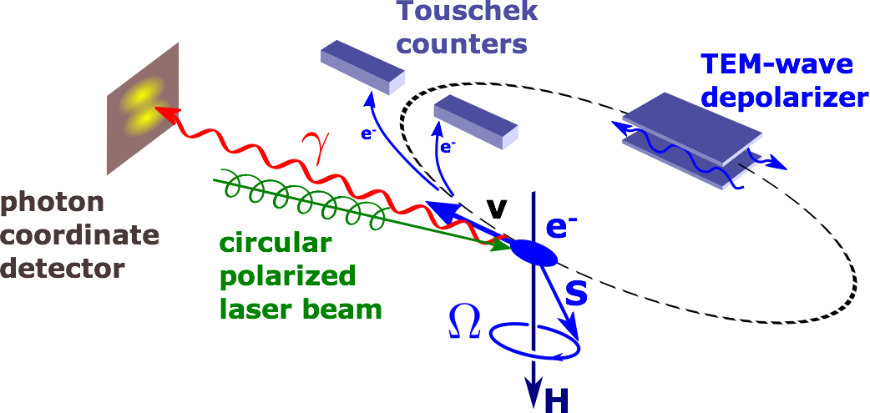
laser polarimeter
E=4062.8 ± 0.6 MeV
14 May 2017
first beam energy calibration at 4.1 GeV by laser polarimeter

Slide 12
deuteron @ VEPP-3
Tensor-polarized deuteron photodisintegration at the VEPP-3 storage ring
The two-body deuteron photodisintegration is one of the most studied process in nuclear physics. Tensor analyzing power T20 reaction will be measured in an unexplored region of the photon energy up to 1.5 GeV.

Slide 13
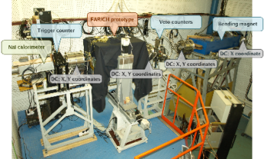
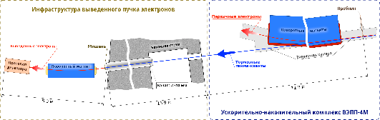
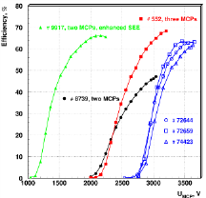
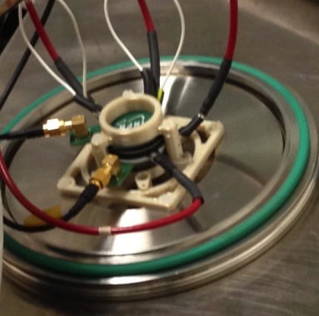
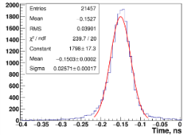
test beam facility @ VEPP-4M
Micro-channel plates in ionization mode as a fast timing device for future hadron colliders
 | e⁻ | γ
Energy | 0.1÷3 | 0.05÷1.5 | GeV
σ_{ΔE/E} | 0.5÷1.5 | ~0.5 | %
Intensity | 10÷100 | ~1000 | Hz

Slide 14
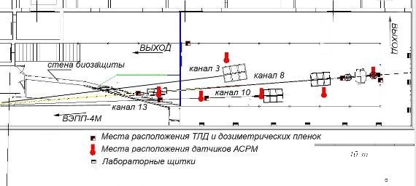
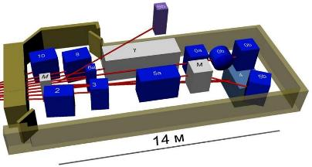
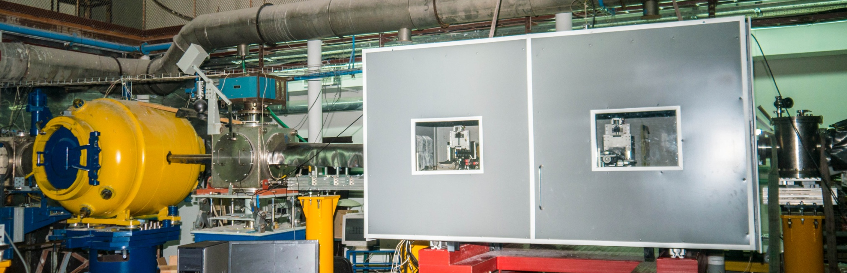
SR @ VEPP-3/VEPP-4M

Slide 15
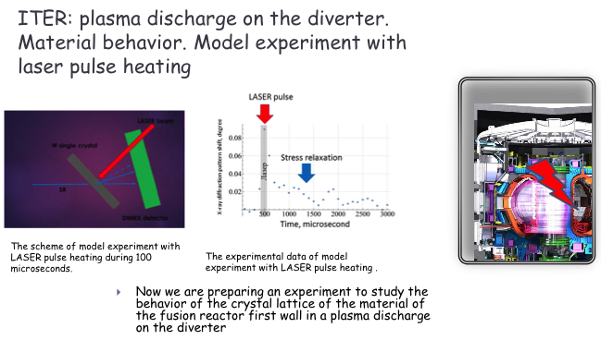
SR experiments

Slide 16
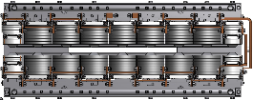
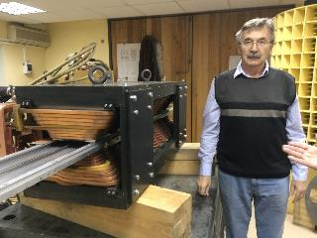
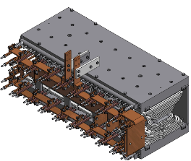
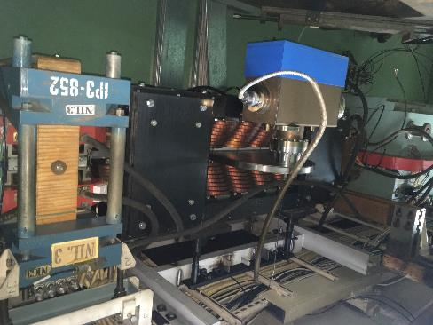
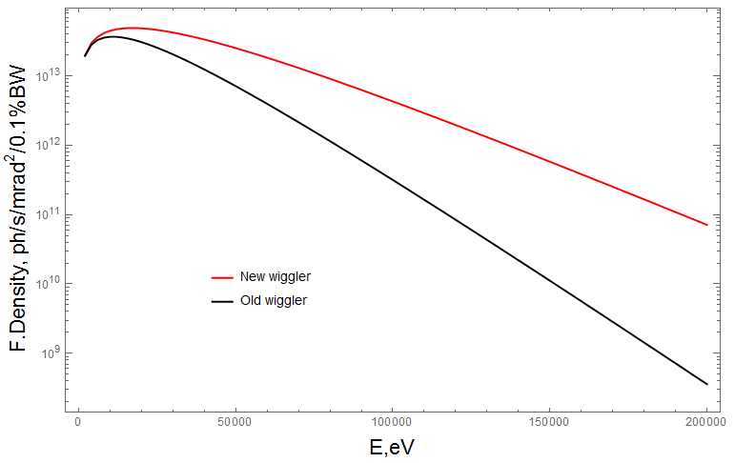
new hybrid 20 kGs wiggler
 | Old | New | Unit
Field | 13 | 20 | kGs
Period | 40 | 28 | cm
Number of poles | 5+2 | 7+2
Gap | 4 | 3 | cm
Current | 1.2 | 2.0 | kA
Voltage | 30 | 60 | V

Slide 17
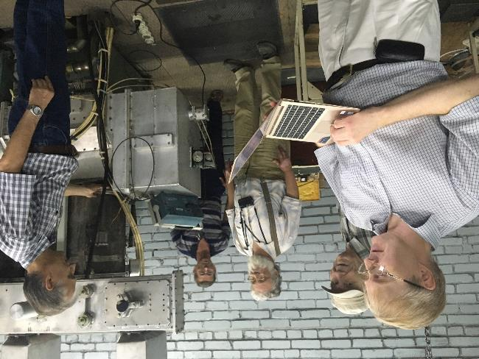
upgrade RF system @ VEPP-4M
ГИ-50
ГУ-101А
ГИ-50
ГУ-92А
4 х ГУ-101А
5 RF Cav
ГИ-50
ГУ-101А
4 х ГУ-101А

Slide 18
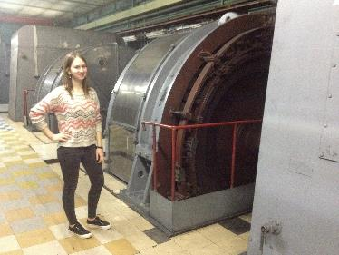
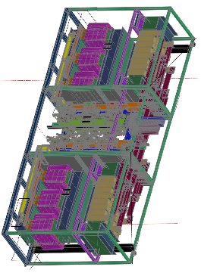
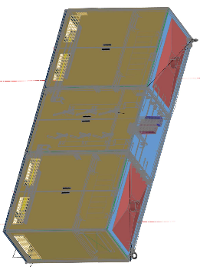
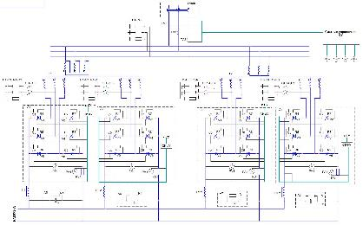
upgrade power supplies @ VEPP-3 & VEPP-4M
main power supply of VEPP-3 ±15kA ±40V 600kW
main power supply of VEPP-4M +7.5kA +70V 525kW
Energy of VEPP-4M will be increased from 4.75 to 5.3 (6.0) GeV!

Slide 19
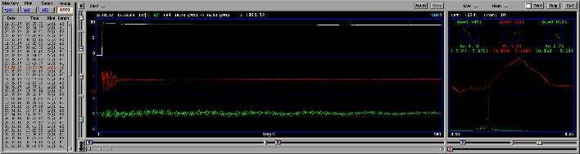
new BPM processor for VEPP-4M
54 processors (3 types – 35,105,210 MHz)
e+e– separation
orbit ~ 5 um
turn-by-turn ~ 20 um
orbit, dispersion, beta measurement
bunch injection
time-back mode
220V power supply
Ethernet
EPICS Control system
35 MHz
210 MHz
See poster “BPM System for VEPP-4M Collider “ by Е. Bekhtenev (BINP SB RAS ) on Tuesday

Slide 20
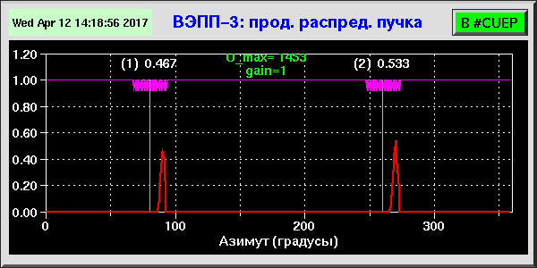
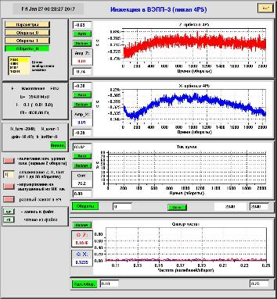
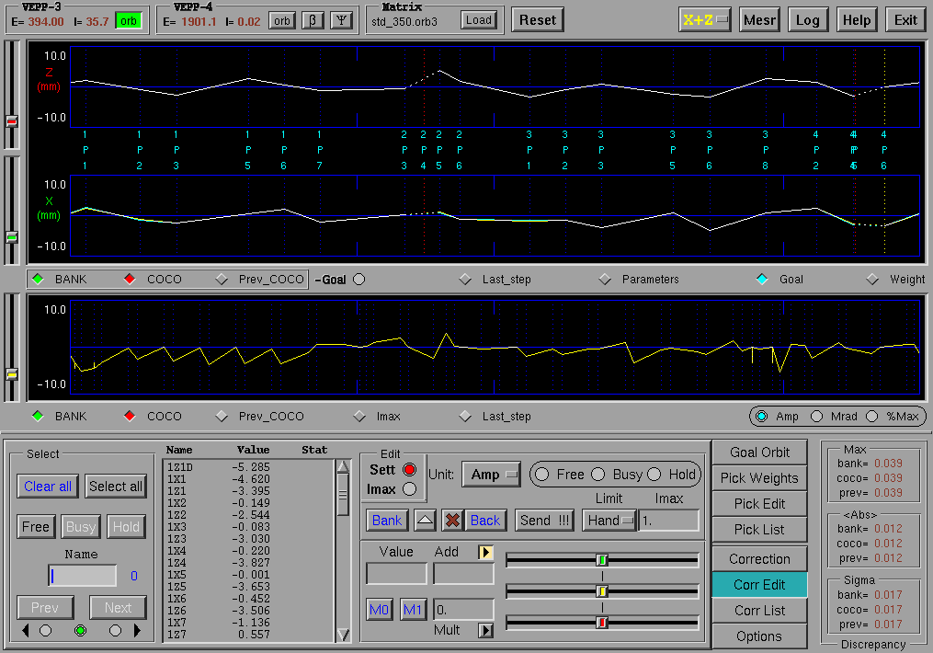
new BPM processor for VEPP-3
18 BPM processor (1 type)
orbit ~ 1 um
turn-by-turn ~ 5 um
orbit measurement ~ 200 Гц
220V power supply
Ethernet
EPICS contron system
See talk “BPM System for Transport Channel Booster–Nuclotron at NICA Complex“ by Е. Bekhtenev (BINP SB RAS ) on Thursday

Slide 21
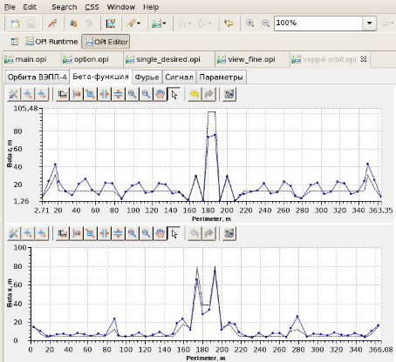
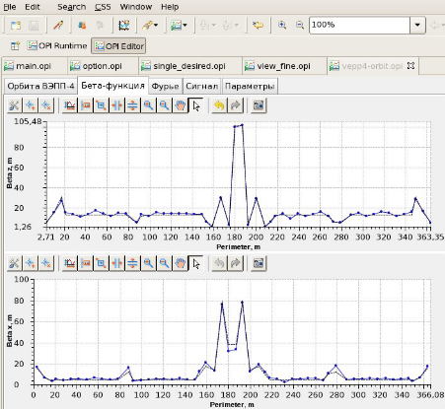
beta-function correction
beta measurement in 54 BPMs by 1 kick ~ 1 sec
beta correction with theoretical response matrix ~ 1 min

Slide 22
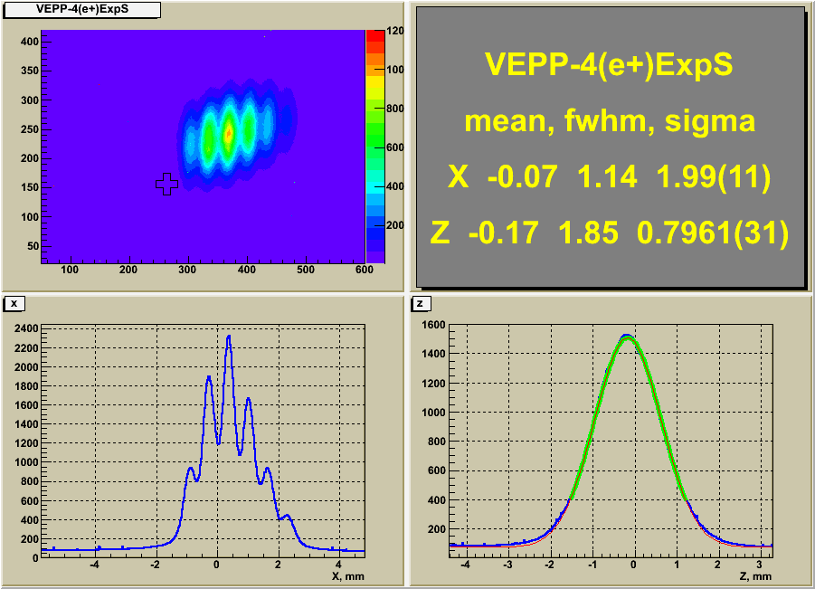
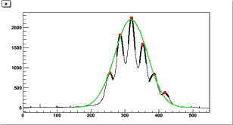
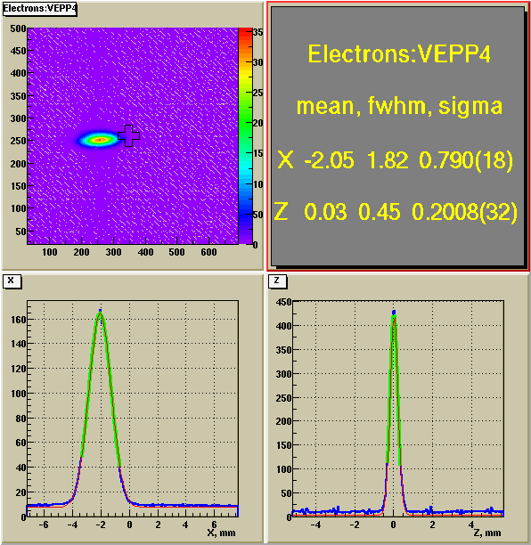
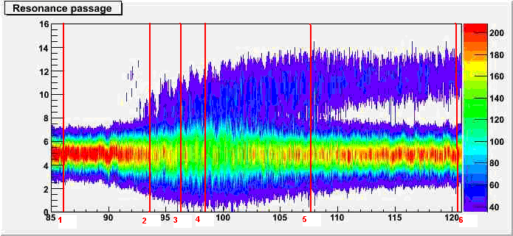
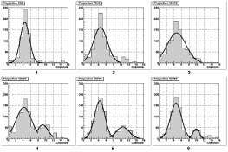
Optical diagnostics
See talk “Optical Diagnostics for Accelerator…” by Oleg Meshkov (BINP SB RAS) on Thursday

Slide 23
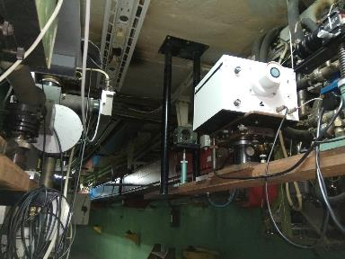
Streak-camera @ VEPP-4M
See poster “Тhe longitudinal broadband impedance and energy spread measurements at the VEPP-4M electron-positron collider“ by O. Meshkov (BINP SB RAS ) on Tuesday

Slide 24
conclusion
VEPP-4 works!
The low energy luminosity run is completed
The high energy luminosity run is started
SR experiments are continued
Nuclear physics at VEPP-3 are continued
VEPP-4 is a test-bench to verify accelerator technologies for future projects (Super-cτ-factory, μμ−tron, etc.)

Slide 25
thank you for your attention

