Slide 1

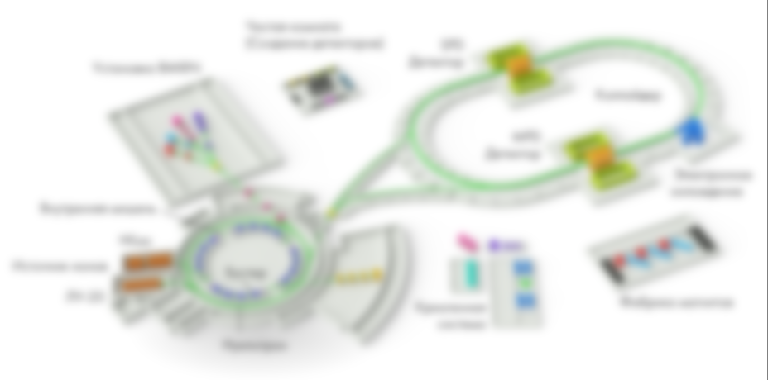

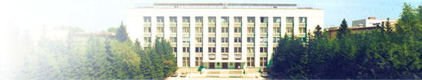
Nuclotron-based
Ion Collider fAcility
RF SYSTEM FOR THE NICA COLLIDER
E.A.Rotov for
Yu.A.Biryuchevsky, V.V.Kozlov, E.K.Kenzhebulatov, A.A.Kondakov, S.A.Krutikhin, Ya.G.Kryuchkov, G.Ya.Kurkin, A.M.Malyshev, N.V.Mityanina, A.A.Murasev, V.N.Osipov, A.M.Pilan, V.M.Petrov, V.V.Tarnetsky, A.G.Tribendis, K.N.Chernov (BINP),
O.I.Brovko, A.V.Eliseev, I.N.Meshkov, E.M.Syresin (JINR)
Budker
Institute
of Nuclear
Physics

Slide 2
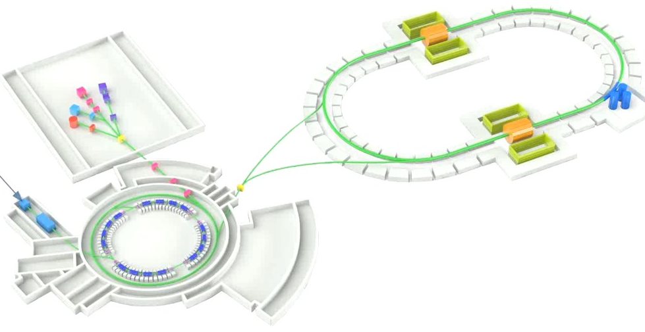
Collider beam parameters
Energy of Au79+, GeV/u | 1 | 4,5
Au beam intensity, ions | 0,6·10¹⁰ | 4,8·10¹⁰
Number of bunches | 22
Rms bunch length, m | 0,6
Nuclotron beam parameters
Energy of Au79+, GeV/u | 1 | 4,5
Au beam intensity, ions/pulse | 1÷1,1·10⁹ | 1÷1,1·10⁹
Rms bunch length, m | 5,9÷17,5 | 2,5÷6,2
Δp/p, 10⁻⁴ | 2,8÷0,95 | 2,1÷0,85
Bunch length (6σ), m | 35,4÷105 | 15÷37,2

Slide 3
NICA COLLIDER RF SYSTEM PROJECT
To provide beam accumulation and bunch formation in the Collider
3 independent RF systems are used.
Parameter |  | RF1
Frequency | kHz | 522÷587
Barrier voltage (amplitude) Pulse width Number of pulse | kV ns | 5 80 4
Accelerating voltage (meander, amplitude) | kV | 0.3
= barrier bucket system
Parameter |  | RF2 | RF3
Harmonic number |  | 22 | 66
Frequency | MHz | 11.484÷12.914 | 34.452÷38.742
Accelerating voltage (amplitude) | kV | 100 | 1000

Slide 4
Scheme of the Collider ring with equipment and insertions.

Slide 5
Barrier bucket system(RF1)
Вeam storage
Вeam Acceleration
2π

Slide 6
Bunch formation in the Collider
All RF systems off
RF2 (h=22)
RF3(h=66)

Slide 7
Barrier bucket system(RF1)
Vacuum chamber
Ceramics
14 Barrier inductors
Two accelerating inductors

Slide 8
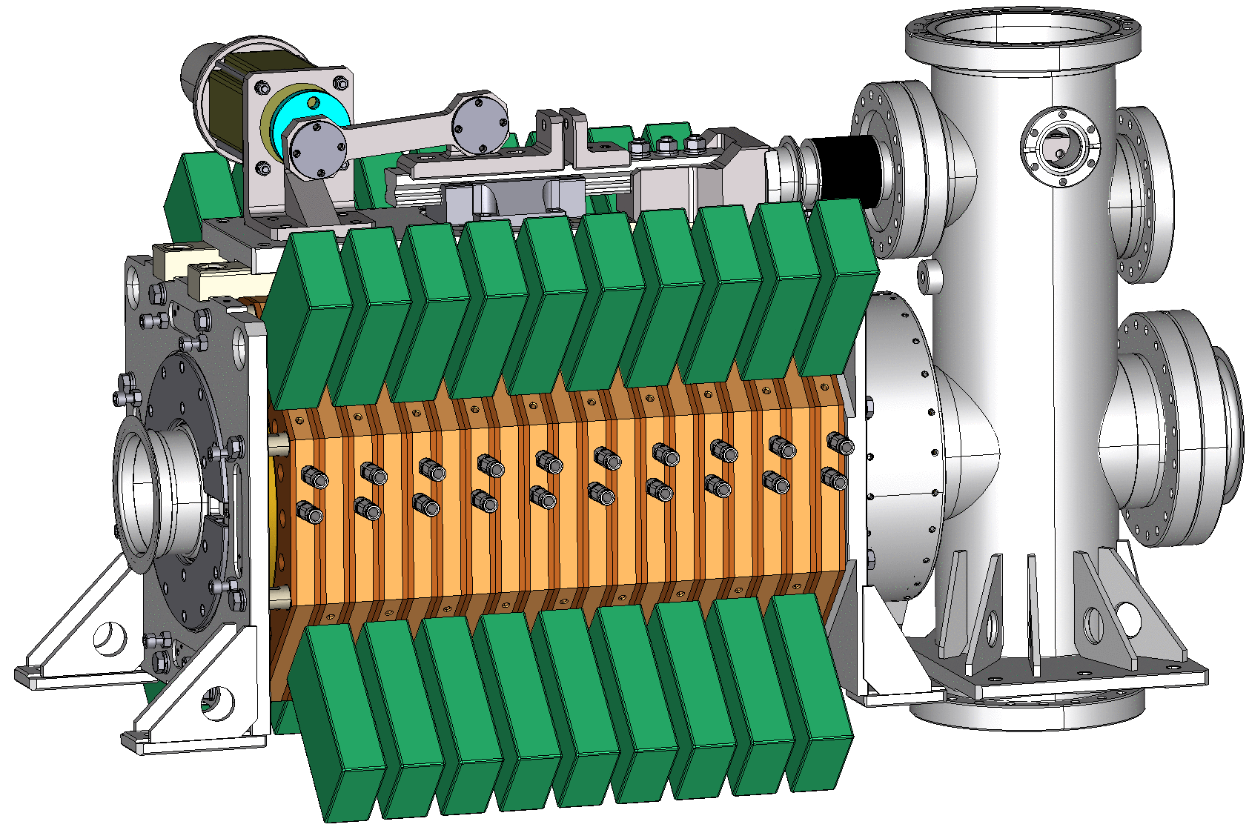
Barrier bucket system (RF1).
Barrier and
accelerating inductors
Pulse generator
Heater
Accelerating gap
Movable short

Slide 9
Concept of RF2 and RF3 cavities.
The cavities should be placed between the rings of the Collider.
∅ 100
270
320
⇒ RF2 and RF3 = capacitevly loaded coaxial cavities
∅ < 540

Slide 10
Concept of RF2 and RF3 cavities.
Tuner (4 segments)
Gap
Dimension, mm |  | RF2 | RF3
L | Cavity length (*) | 1200 | 1000
D | ∅ cavity | 500 | 500
а | ∅ aperture | 100 | 100
g | Accelerating gap | 5 | 20
d | ∅ tuner | 450 | 410
G | Tuner length | 420 | 200
s | Tuner gap | 2.5÷4.1 | 10÷21.1
a
d
D
s
g
G
L
Tuner parameters | RF2 | RF3
Tuning range Δf, MHz | 1.7 | 4.6
Tuner stroke Δs, mm | 1.6 | 11.1
Precision δs, um (adequate Δϕ_{UI} = 5°) | 0.13 | 0.5
Sensitivity ∂f/∂s, MHz/mm | 1.53 | 0.63
* - movable short not accounted

Slide 11
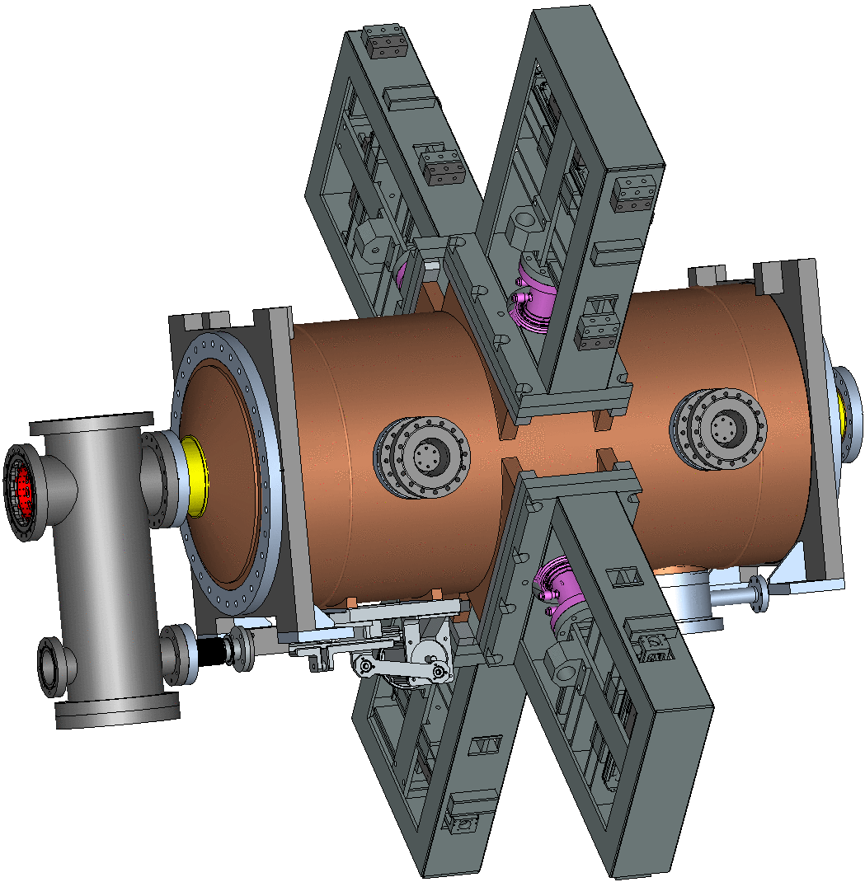
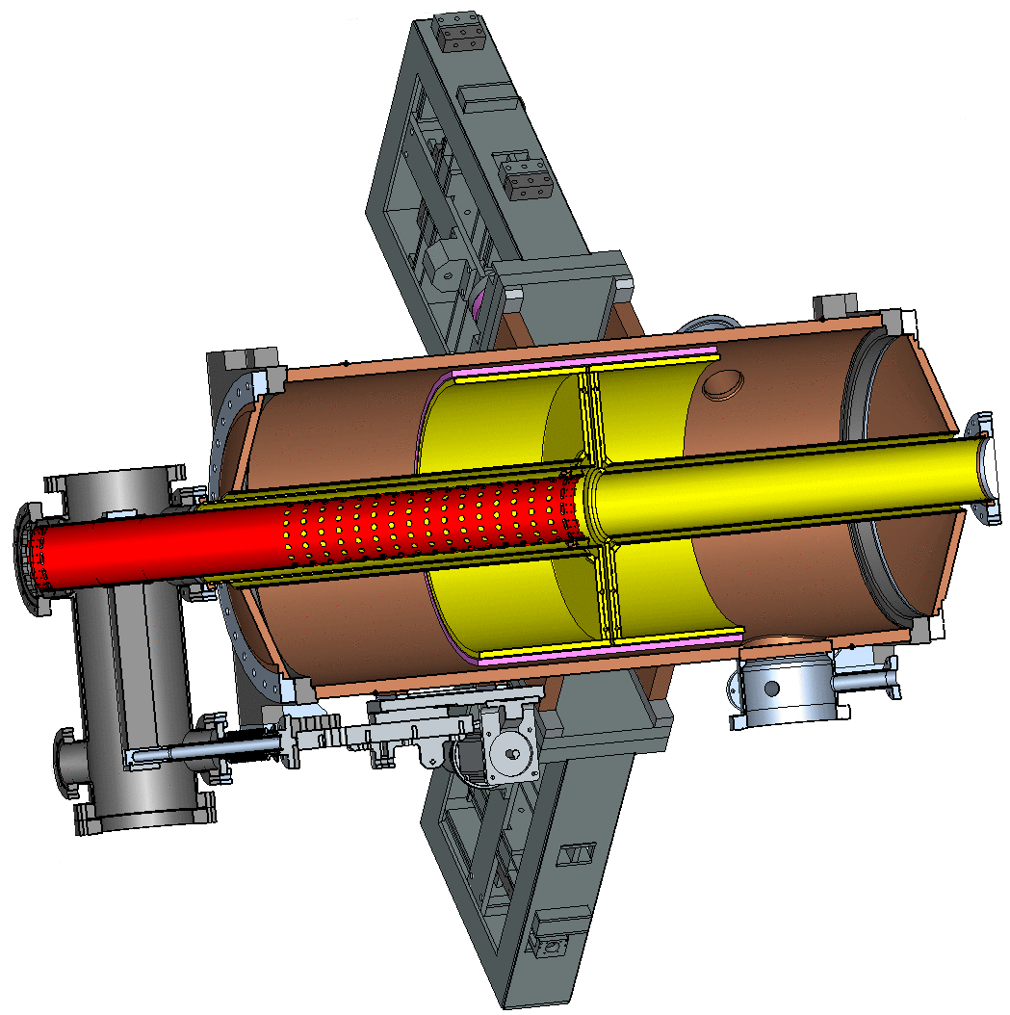
Harmonic stations RF2(RF3)
Power coupler
Tuner
Movable short
Accelerating gap
Tuner actuator

Slide 12
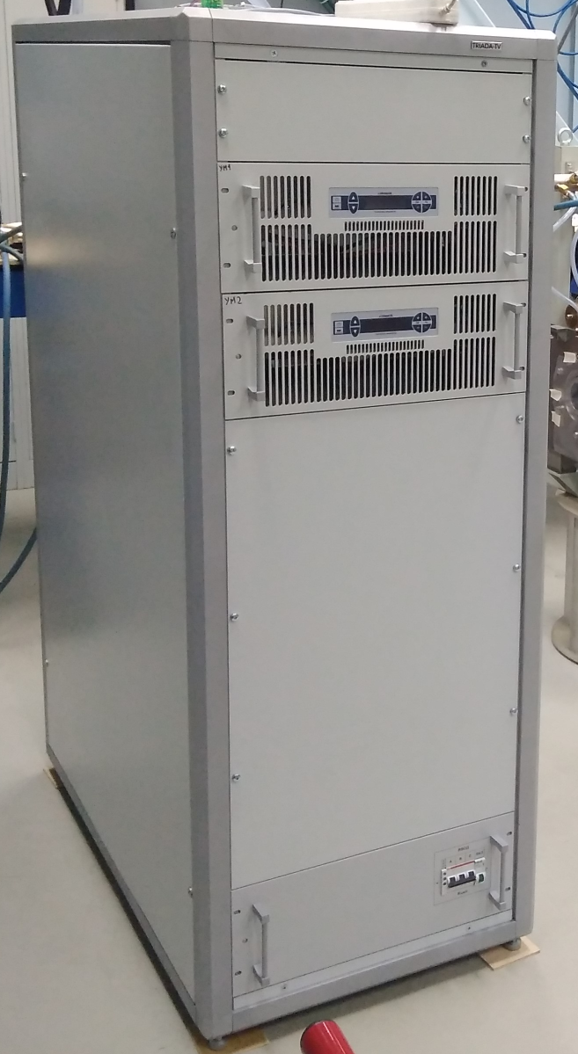
RF power amplifiers for RF2

Slide 13
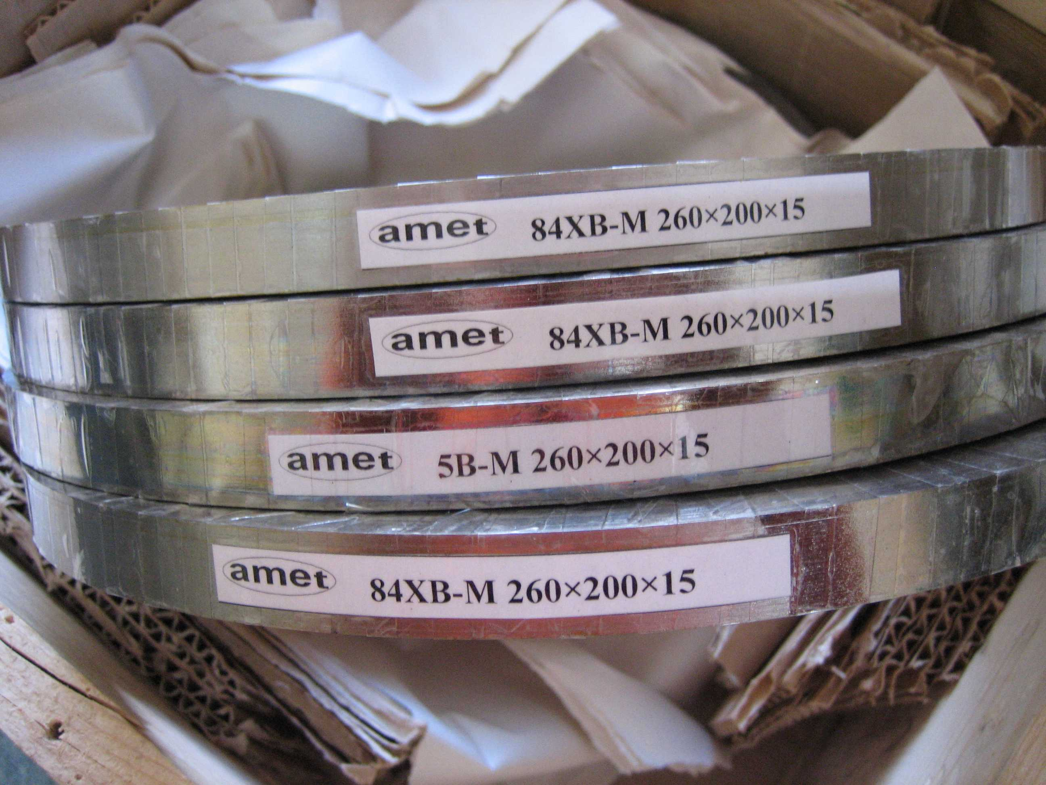
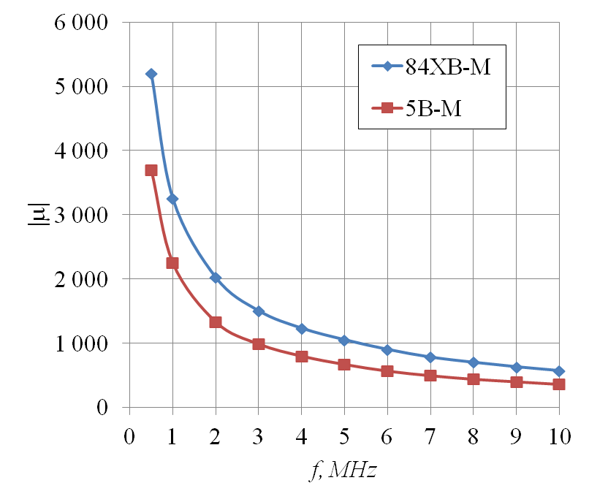
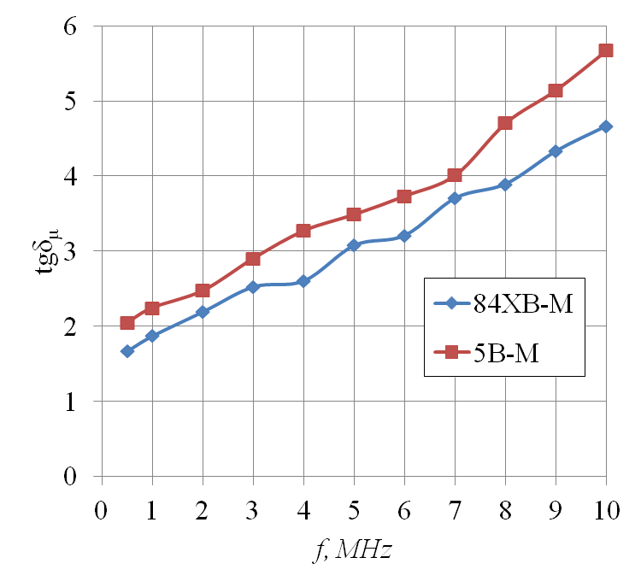
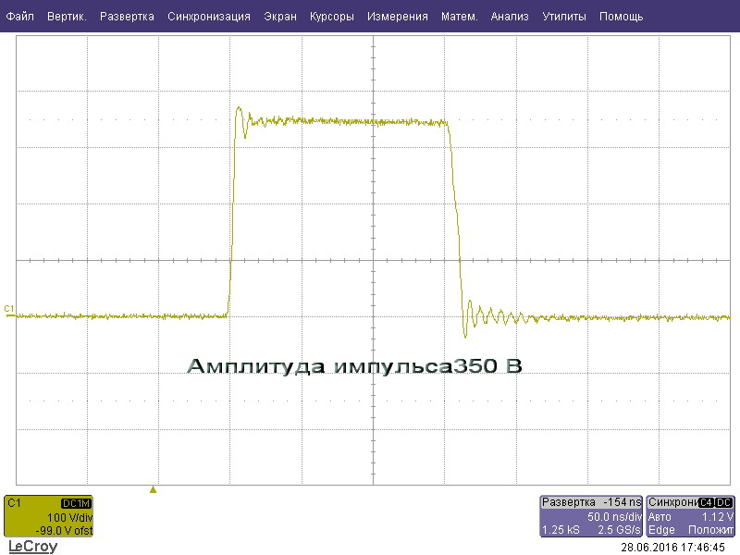

Slide 14
Stand for testing of bellows and contacts
Welded bellows
Elastic contacts

Slide 15
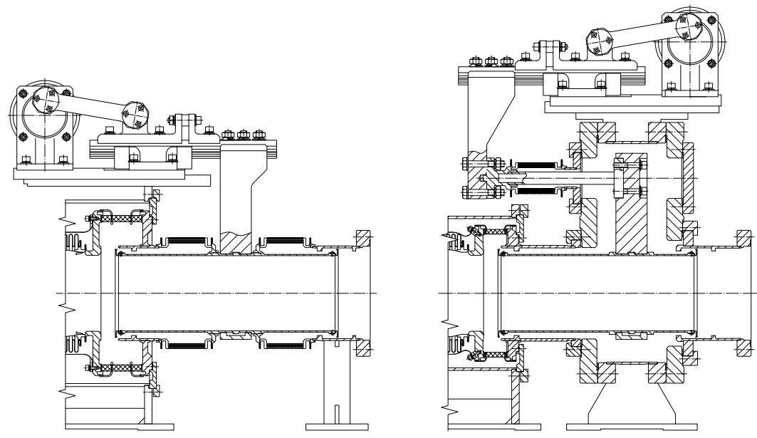

Slide 16
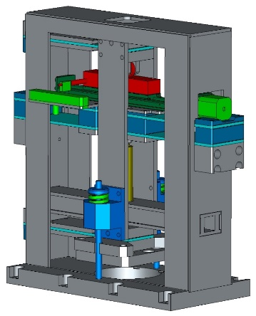
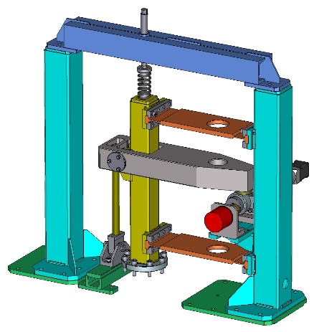
Two versions of tuner actuator
Piezo actuator
Stepper Motor
Piezo actuator
Stepper Motor

Slide 17
Summary
Prototypes of key components of RF stations (RF1 inductors, movable short, tuner) manufactured and successfully tested.
Two stations RF1 prepared for the production at BINP. Stations RF1 are planned to be tested at JINR by December 2018.
Agreement for production at BINP an RF2 full scale prototype is being finalized.
Optimization of the RF3 system is in progress.

Slide 18
Thank you for your attention!

