Slide 1
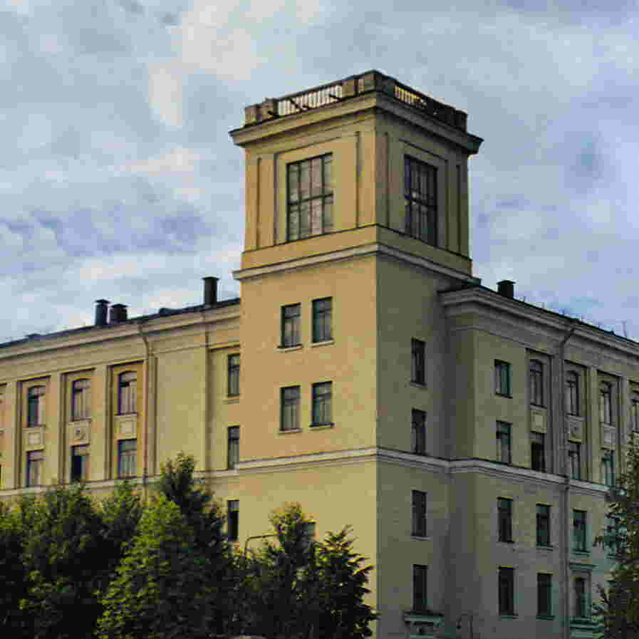
Joint Stock Company
“D.V. Efremov Institute of Electrophysical Apparatus” (JSC “NIIEFA”)
Up-to-Date Cyclotron Systems Designed and Manufactured
in the JSC <NIIEFA>
A.V. Vanin, Yu.N. Gavrish

Slide 2
A series of cyclotrons and cyclotron systems for generation of accelerated proton beams in an energy range from 1 up to 80 МeV has been designed, manufactured in the JCS «NIIEFA» and put into operation.
Main Parameters of Cyclotrons
Cyclotron | Type of ions |  | Energy, E, МeV | Current, I, µA | Beam line | Additional Equipment
 | To be accelerated | To be extracted
СС1 - 3 | H⁻ | H⁺ | 1 - 3 | 20 | available | Analizer: ΔЕ/Е<10⁻³, I = 10 – 100 nА
СС - 12 | H⁻ | H⁺ | 12 | 100 | available | Target system
СС - 18∕9 | H⁻ / D⁻ | H⁺ / D⁺ | 18 / 9 | 100/50 | available | Target system
СС- 18∕9M | H⁻ / D⁻ | H⁺ / D⁺ | 12-18 / 6-9 | 150/50 | available | Target system
СС- 30∕15 | H⁻ / D⁻ | H⁺ / D⁺ | 18-30 / 9-15 | 100/50 | available | Target system
C - 80 | H⁻ | H⁺ | 40 - 80 | 100 | available | The line to form homogeneous beams for therapy of ophtalmic diseases – under designing
2

Slide 3
The СС1-3 Cyclotron System.
Purpose and parameters
Purpose: analytical studies using nuclear-physical methods: X-ray-method for the elemental analysis, spectral gamma-ray analysis and Ruzerford backscattering.
Distinctive features are: high sensitivity and comprehensive express analysis (detection of small concentrations up to 10⁻⁵–10⁻⁷g/g); a possibility for non-contact non-destructive analysis of substances or objects at a remote distance.
Main requirements for beam parameters:
Proton energy range, МeV 1 – 3
Spectrum width, % 0.1
Beam current, nА 10 – 100
3

Slide 4
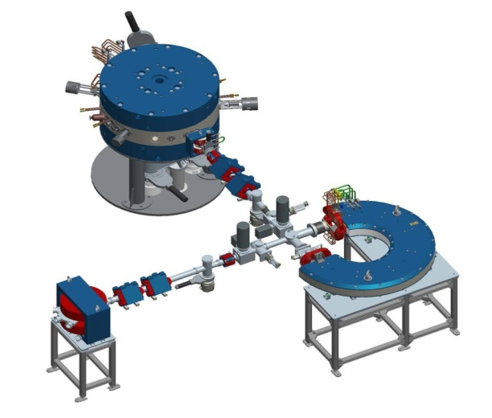
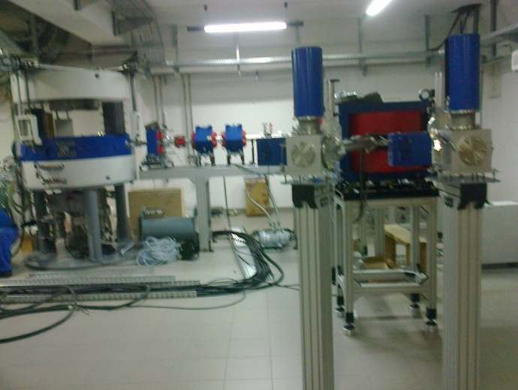
The СС1-3 Cyclotron System. Components
The cyclotron system consists of a compact cyclotron and a system for beam forming and transportation to remote analytical chambers, as well as, power supply, control, vacuum pumping and water cooling systems.
Tests of the whole system with the beam on were carried out for boundary values of the design range of energies (1 and 3 МeV) and an intermediate value of 1.7 МeV. At a max energy of protons and collimator slits width of 2 mm, the beam current of 104 nА was obtained; at min and intermediate energies, a current of 60 нА was fixed, which corresponds to the design current range.
4

Slide 5
Cyclotron Systems of the CC-series
Cyclotrons СС–12, СС-18∕9, СС-18∕9M and MСС-30∕15 are intended for production of radionuclides directly in medical centers. Different parameters of accelerated beams define the expediency of choice of any of the aforementioned models for a particular application.
The СС–12 machine can be installed in a small PET-center with one or several PET-scanners and will provide its demand for short-lived isotopes of carbon (C-11), nitrogen (N-13), oxygen (0-15) and fluorine (F-18).
Cyclotrons СС-18∕9 and СС-18∕9M are intended for operation in regional diagnostic centers. These machines allow the efficiency of production of the aforementioned isotopes to be increased and also produce some short-lived radionuclides, such as Rb-81, I-123, In-111, Tl-201, Ga-67, Yt-87 and others.
The МСС-30/15 cyclotron is intended for application in large radiological centers interested not only in routine production of radionuclides, but also in creation of new promising radiopharmaceuticals. The assortment and yield of single-photon short-lived radionuclides is significantly increased, some long-lived radionuclides are produced, such as Na-22, Co-57,Cd-109 and Ce-139. Also researches are carried out, which make possible fields of application of radionuclide diagnostics to be widened.
5

Slide 6
Specific Features of Cyclotrons of the CC- series
Some common design and engineering solutions were applied in СС – 12, СС - 18∕9, СС - 18∕9М and МСС- 30∕15 cyclotrons, which set them apart from cyclotrons produced by other firms. The main shielding-type magnet was made with the vertical median plane, which gives an easy access to the in-chamber devices by moving apart the movable part of the magnet along the guides. Hydrogen and deuterium ions are accelerated at a fixed frequency ( the 2^{-nd} and 2^{-th} harmonics, respectively). When changing the type of ions to be accelerated, radial distribution of the average magnetic field is corrected without additional coils by moving special shims. Two accelerated ion beams of equal energy can be extracted simultaneously. These cyclotrons are equipped with external injection systems and systems for the extracted beams transport.
6

Slide 7
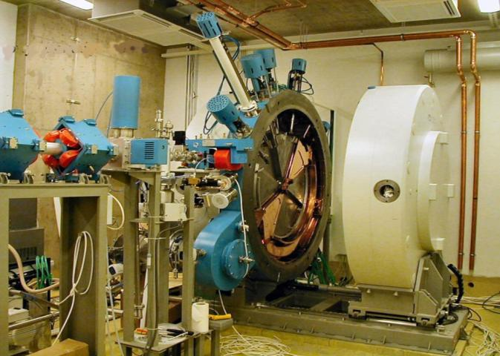
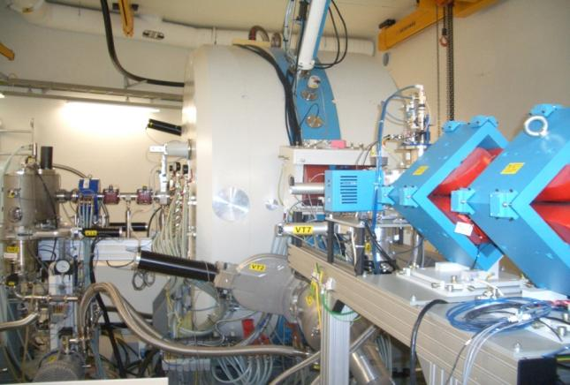
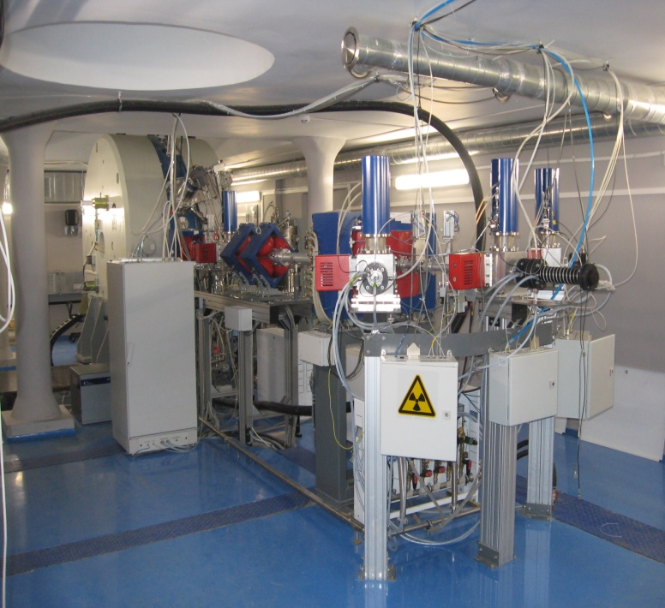
The СС - 18∕9 cyclotron with open vacuum chamber
The CC-30/15 cyclotron, the external injection system on the left
The СС–18/9M cyclotron is equipped with water and gaseous target devices providing production of radionuclides for PET diagnostics
7

Slide 8
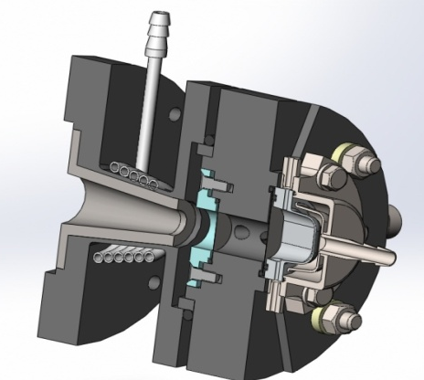
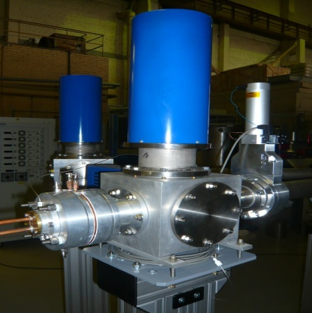
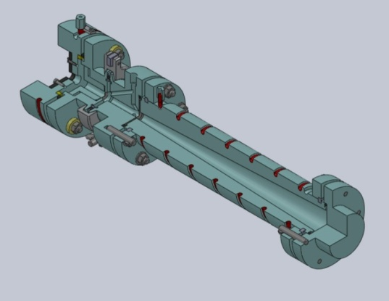
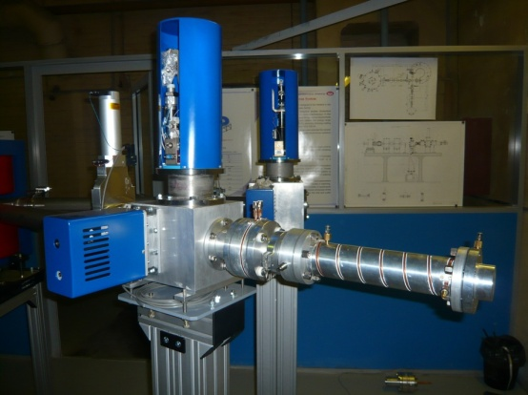
Equipment of the Target System
Target Devices
        Target device for production of F-18 radionuclide
Target Devices
Target device for production of C-11 radionuclide
8

Slide 9
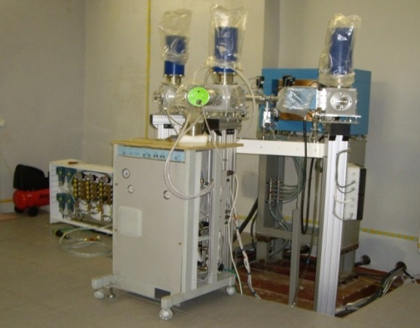
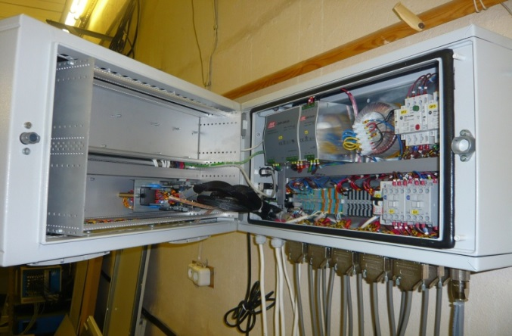
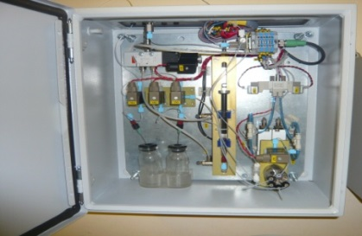
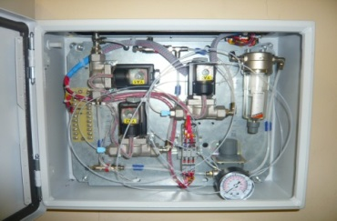
Equipment of the Target System
Cabinet of the target system
Cabinet of controllers of the target system ACS
The target system and its utilities are integrated into the common automated control system of the cyclotron system.
Delivery of a target system or separate targets for cyclotrons produced in NIIEFA or by other firms, which have already been put into operation, is possible. To date, a manipulator for automatic remote replacement of targets has been designed in the JSC “NIIEFA”.
System for targets loading with target materials

Slide 10
The C-80 Cyclotron System
The C-80 cyclotron system intended for production of proton beams with energies from 40 up to 80MeV and current not less than 100 µА has been designed and manufactured according to PNPI performance specification and with active participation of PNPI staff members. Works on designing of the cyclotron system were carried out from September, 2010. The main distinctive feature of the project is that the main electromagnet was designed using a model of the magnet of the synchrocyclotron operating in PNPI. Such a decision allowed the costs to be reduced, on the one hand, however, limited the choice of engineering solutions when designing the machine, on the other hand.
In particular:
• Overall dimensions of the vacuum system and location of hookup elements were specified.
• Parameters of the magnet power supply sources were specified.
• Overall dimensions of the resonance system were partly specified.
• The system for external injection of hydrogen negative ions is placed in a basement directly under the magnet.
• Beams of accelerated protons are extracted through one output port by moving the stripping device to a necessary position.
• The range of energy variation of extracted protons is limited by the mutual location of the stripping device and resonance system.
• To increase the maximum energy of accelerated ions, we were forced to design and manufacture anew pole pieces with sectors of high spirality.
10

Slide 11
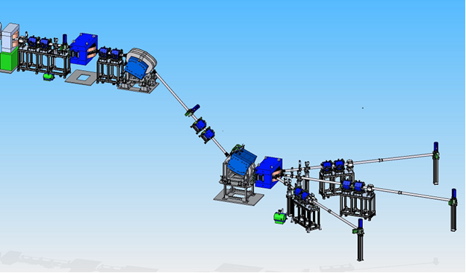
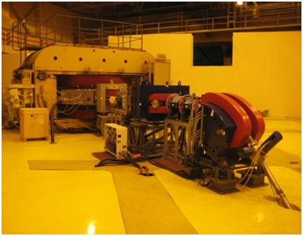
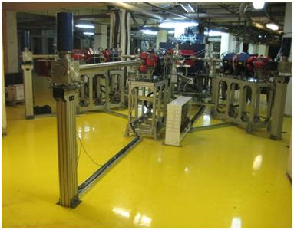
The equipment of the cyclotron system with the transport system of an accelerated proton beam to remote target stations is mounted in the experimental hall of building 2 and in its basement. The equipment of the cyclotron and that of the first section of the beam transport system is located on the first floor; the external injection system, the RF generator and the system for the beam transport to three targets are mounted in the basement.
11

Slide 12
Status of Works on the C–80 Cyclotron System
In June, 2016 physical start-up of the cyclotron was realized. In the course of preliminary acceptance tests, acceleration of negative hydrogen ions and extraction of accelerated proton beams in an energy range of 40-79 MeV were provided. In an energy range of 40-60MeV, the design current of the extracted beam was obtained. The beam with the proton energy of 50 MeV was transported to the final diagnostic device (the Faraday cup) to a distance of ~ 35m.
Purposes for the nearest future are the following: designing, manufacturing and installation of additional local radiation shielding for the cyclotron and electromagnets in the experimental hall to reduce the radiation level (now operation is possible only in the pulse mode); obtaining of the accelerated beam design current of 100 µA in the design range of energies in the continuous mode.
The beams with the mentioned above parameters allow the implementation of the whole range of research and commercial projects, namely:
• final development of the technology for production of a wide assortment of isotopes for medicine, including radiation generators,
• commercial production of isotopes,
• organization of proton therapy of ophtalmic diseases,
• tests of radioelectronic components for radiation resistance using intensive proton and neutron beams,
• experimental studies in fields of nuclear physics and radiation material science.
Production of radioisotopes for medicine was chosen as the main field of the accelerated beam application. Now works have been started on creation of a beam-forming and transport system for proton therapy of ophtalmic diseases.
12

Slide 13
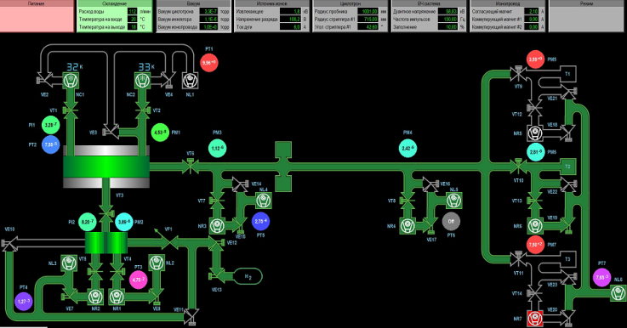
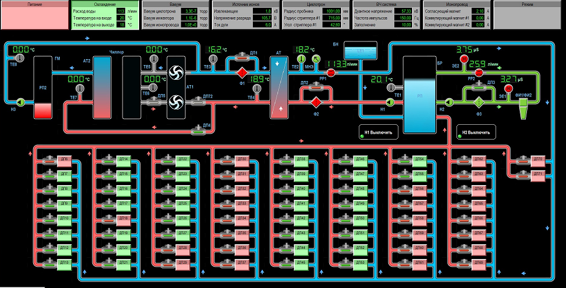
Automated Control Systems
Control of operation of cyclotron systems produced in NIIEFA is carried out by an operator from operator workstation. Distributed automatic control systems (ACS) are used, which consist of controllers and computers, each being responsible for the control of one or several sub-systems of the cyclotron.
The main unit of the control system is an industrial (host) computer, which inquires slave controllers and transmits the information acquired to computers of the operator’s workstation; receives commands from the operator’s workstation and performs their arbitration and distribution.
State and basic parameters of the vacuum system
State and basic parameters of the temperature stabilization system
13

Slide 14
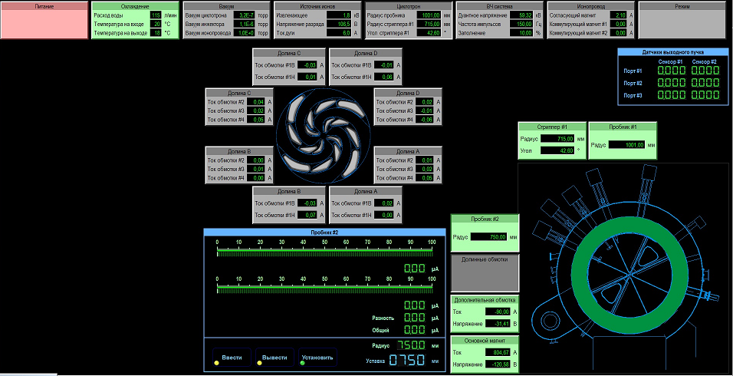
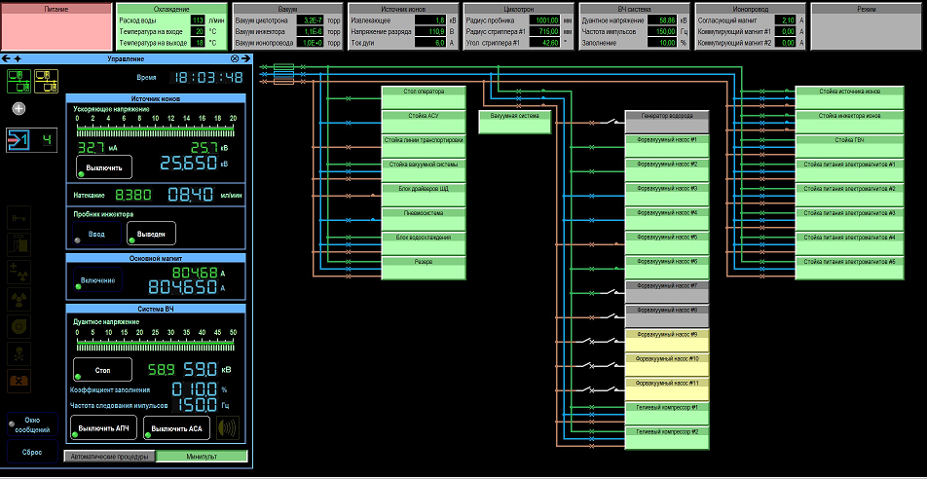
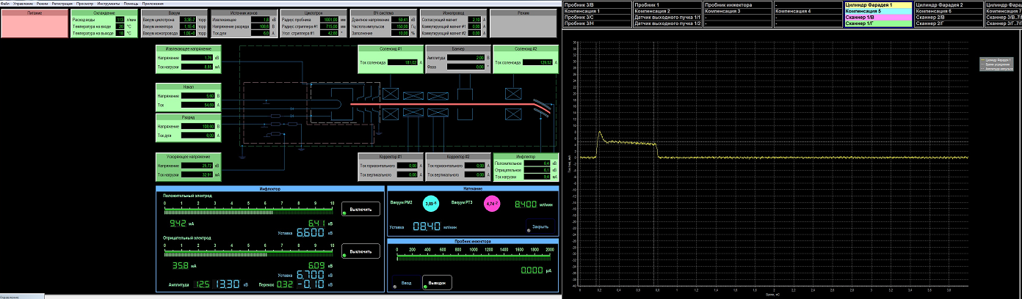
State and basic parameters of the injector
State and basic parameters of the power supply system
14

Slide 15
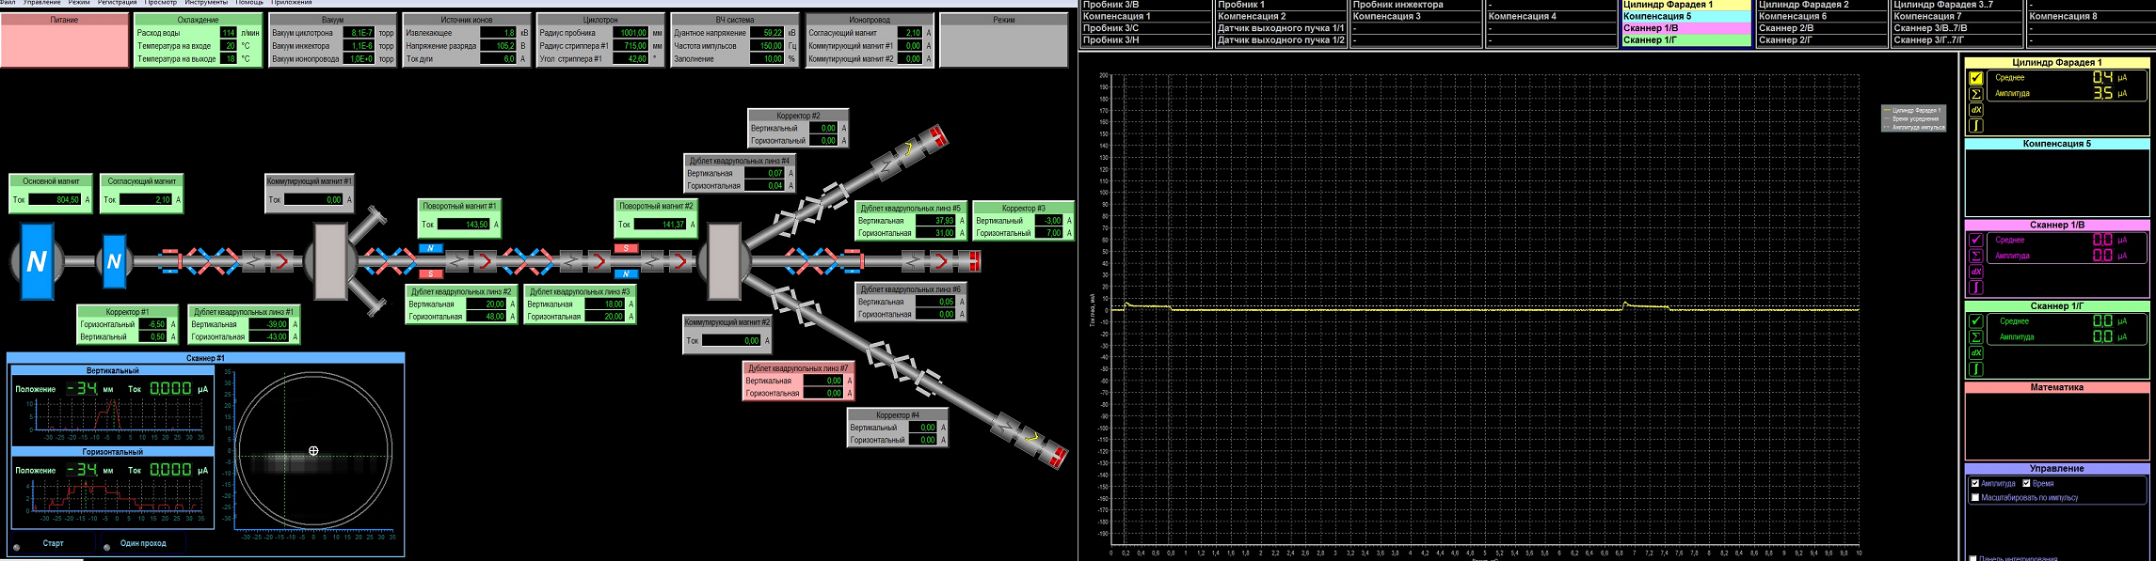
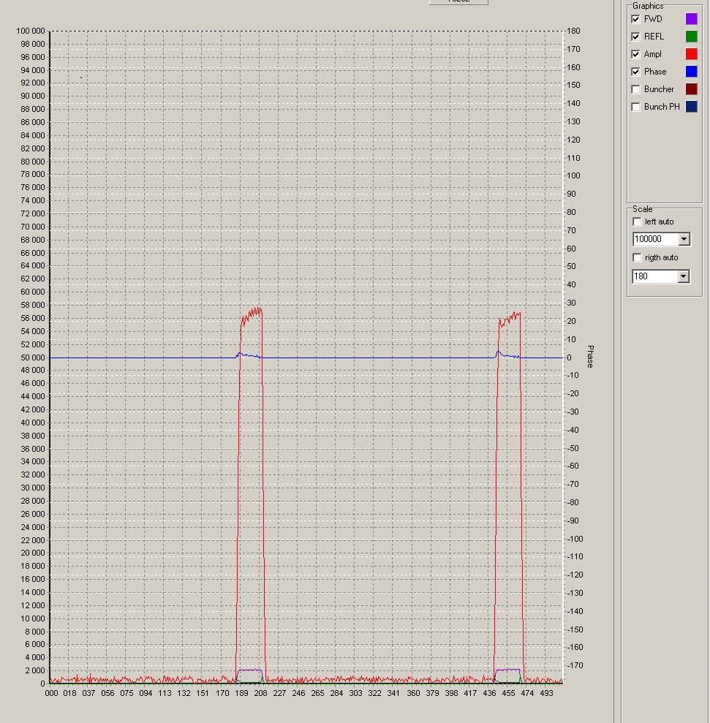
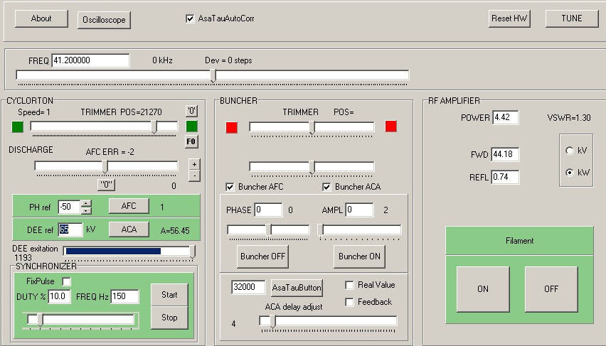
State and basic parameters of the RF - system
State and basic parameters of the beam transport system with control of beam parameters
15

Slide 16
Thank you for attention!

