Slide 1
START-UP THE PROTOTYPE DC-PHOTOINJECTOR (UP TO 400 keV) IN THE PHOTOCATHODE OPERATION MODE TO THE “TRANSMISSION MODE"
N.I.Balalykin¹, V.S.Aleksandrov¹, E.I.Gacheva², J.Huran³, V.V.Zelenogorsky², G.A.Luchinin², V.F.Minashkin^{1,a}, M.A.Nozdrin¹, A.K.Poteomkin², G.D.Shirkov¹, V.G.Shabratov¹
¹Joint Institute for Nuclear Research, Dubna, Russia
²Institute of Applied Physics, RAS, Nizhniy Novgorod, Russia
³Institute of Electrical Engineering, SAS, Bratislava, Slovakia.
XII INTERNATIONAL SEMINAR ON THE PROBLEMS OF ACCELERATED CHARGED PARTICLES

Slide 2
N.I.Balalykin et al.: “START-UP THE PROTOTYPE DC-PHOTOINJECTOR (UP TO 400 keV) IN THE PHOTOCATHODE OPERATION MODE TO THE “TRANSMISSION MODE“”
Contents
Introduction
Scheme of the prototype DC-photoinjector
Laser Driver
Photocathode and Accelerator Structure
High-voltage power supply
The first experimental results
Plans for the future
XII INTERNATIONAL SEMINAR ON THE PROBLEMS OF ACCELERATED CHARGED PARTICLES

Slide 3
N.I.Balalykin et al.: “START-UP THE PROTOTYPE DC-PHOTOINJECTOR (UP TO 400 keV) IN THE PHOTOCATHODE OPERATION MODE TO THE “TRANSMISSION MODE“”
Introduction
JINR works on the development of a prototype DC-photoinjector with an electron energy of up to 400 keV for future electron accelerators (electron-positron colliders and free-electron lasers). The article describes the created injector, the distinguishing feature of which is the use of the photocathode operation mode on the "transmission mode". The photo-injector uses a unique laser system with the ability to synchronize the repetition rate of laser pulses (10 psec, 262 nm wavelength, 1.85 μJ energy) with the frequency of the accelerator RF system. The first experimental results of the DC-photoinjector are presented and further plans for the development of the installation are considered.
XII INTERNATIONAL SEMINAR ON THE PROBLEMS OF ACCELERATED CHARGED PARTICLES

Slide 4
N.I.Balalykin et al.: “START-UP THE PROTOTYPE DC-PHOTOINJECTOR (UP TO 400 keV) IN THE PHOTOCATHODE OPERATION MODE TO THE “TRANSMISSION MODE“”
Scheme of the prototype DC-photoinjector
-
+
-0 ÷ 400kV
Ceramic HV column
Quartz glass
oscilloscope
HV (0-35kV)
Photocathode
Faraday Cup
HV
1
2
3
15
γ
e,γ
Attenuator
Transportation
system
Laser Driver
200MΩ
200MΩ
200MΩ
200MΩ
15 electrodes
Accelerating structure
water cooling
Vacuum post
XII INTERNATIONAL SEMINAR ON THE PROBLEMS OF ACCELERATED CHARGED PARTICLES

Slide 5
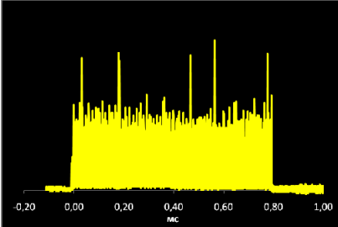
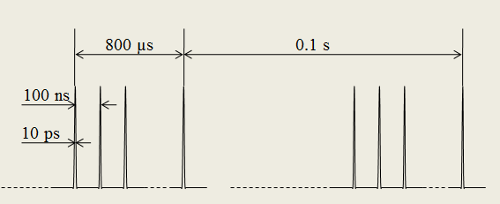
N.I.Balalykin et al.: “START-UP THE PROTOTYPE DC-PHOTOINJECTOR (UP TO 400 keV) IN THE PHOTOCATHODE OPERATION MODE TO THE “TRANSMISSION MODE“”
Laser Driver (JINR & Institute of Applied Physics, RAS, Nizhniy Novgorod, Russia)
Basic parameters of the laser driver
Wavelenth, nm
260-266
micropulse half maximum duration, ps
8-12
Oscillogram of the macroimpulse of radiation in the fourth harmonic
micropulse energy, µJ
1.85
, µs
macropulse duration
800
number of micropulses in a macropulse
8 000
macropulse repetition rate, Hz
10
Time structure of radiation
XII INTERNATIONAL SEMINAR ON THE PROBLEMS OF ACCELERATED CHARGED PARTICLES

Slide 6
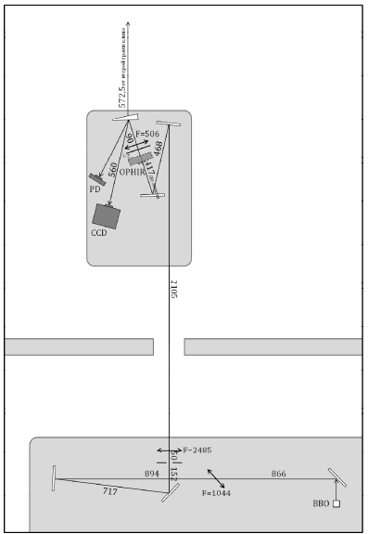
N.I.Balalykin et al.: “START-UP THE PROTOTYPE DC-PHOTOINJECTOR (UP TO 400 keV) IN THE PHOTOCATHODE OPERATION MODE TO THE “TRANSMISSION MODE“”
Laser Driver (Continuation)
The laser beam transport system performs the following functions:
The scheme of the laser beam transport system
Compensates for the divergence of the radiation after the fourth-harmonic crystal oscillator BBO
Transfers the image of a circular diaphragm 5 mm in diameter to the photocathode with a reduction of 1: 5
Turns the linear polarization of radiation (horizontal after VBO) to an arbitrary angle using a half-wave plate
Allows to perform diagnostics of the beam transverse distribution, the shape of the macroimpulse and the power of the UV radiation before the photocathode
XII INTERNATIONAL SEMINAR ON THE PROBLEMS OF ACCELERATED CHARGED PARTICLES

Slide 7
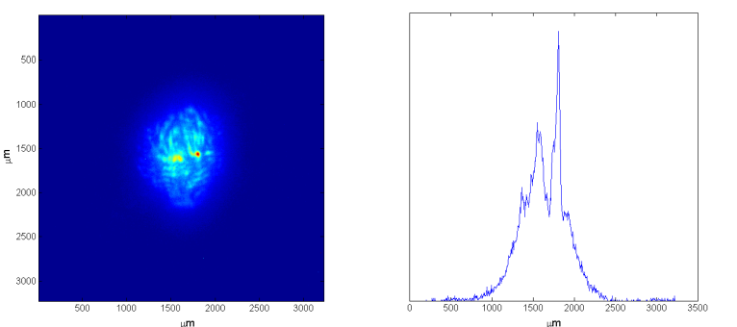
N.I.Balalykin et al.: “START-UP THE PROTOTYPE DC-PHOTOINJECTOR (UP TO 400 keV) IN THE PHOTOCATHODE OPERATION MODE TO THE “TRANSMISSION MODE“”
Laser Driver (Continuation)
Поперечное распределение интенсивности лазерного излучения УФ
The transverse distribution of the intensity of fourth harmonic laser radiation at a virtual cathode
The effective diameters of the beam on the photocathode along the vertical and horizontal lines were 758 μm and 642 μm, respectively.
XII INTERNATIONAL SEMINAR ON THE PROBLEMS OF ACCELERATED CHARGED PARTICLES

Slide 8
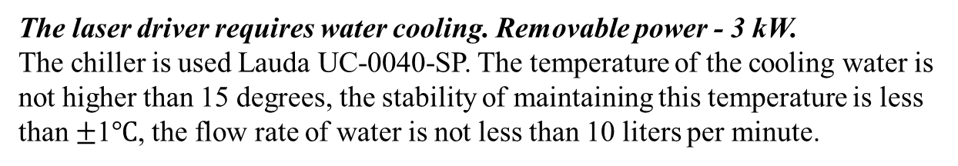
N.I.Balalykin et al.: “START-UP THE PROTOTYPE DC-PHOTOINJECTOR (UP TO 400 keV) IN THE PHOTOCATHODE OPERATION MODE TO THE “TRANSMISSION MODE“”
Laser Driver (Continuation)
Of particular note is the following:
In the laser driver it is possible to synchronize the repetition frequency of microimpulsions with the operating frequency of the accelerator (Or with an external reference frequency signal).
The set of laser driver equipment includes a UV laser attenuator of the company LOTIS TII (VA-266). This device will allow to vary widely the energy of laser radiation without changing the settings of the elements of the laser driver.
The laser driver is located in a special room, which provides air conditioning and filtration. The walls of this room are painted with special paint to reduce reflections of the laser beam.
The laser driver requires water cooling. Removable power - 3 kW.
The chiller is used Lauda UC-0040-SP. The temperature of the cooling water is not higher than 15 degrees, the stability of maintaining this temperature is less than $±$1$℃$, the flow rate of water is not less than 10 liters per minute.
XII INTERNATIONAL SEMINAR ON THE PROBLEMS OF ACCELERATED CHARGED PARTICLES

Slide 9
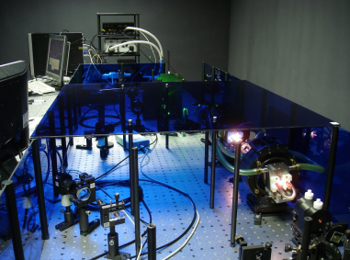
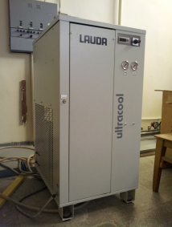
N.I.Balalykin et al.: “START-UP THE PROTOTYPE DC-PHOTOINJECTOR (UP TO 400 keV) IN THE PHOTOCATHODE OPERATION MODE TO THE “TRANSMISSION MODE“”
Laser Driver (Continuation)
Laser Driver
Chiller Lauda UC-0040-SP
XII INTERNATIONAL SEMINAR ON THE PROBLEMS OF ACCELERATED CHARGED PARTICLES

Slide 10
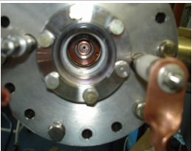
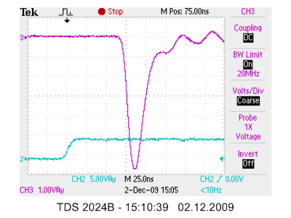
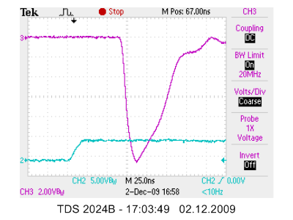
N.I.Balalykin et al.: “START-UP THE PROTOTYPE DC-PHOTOINJECTOR (UP TO 400 keV) IN THE PHOTOCATHODE OPERATION MODE TO THE “TRANSMISSION MODE“”
Photocathode and Accelerator Structure
На Рис.4 представлены типичные осциллограммы импульсов фототока как без (а), так и на фоне термоэмиссии (б) при облучении сфокусированным в разной степени лучом.
Из Рис.4 видно, что при интенсивностях вплоть до 4,2 Мвт/см² термоэмиссия практически отсутствует. Начиная с интенсивности ≈ 4,8 Мвт/см² , процесс идет на фоне термоэмиссии- длительность импульса фототока значительно возрастает.
N.I.Balalykin et al.: “HOLLOW PHOTOCATHODE CONCEPT FOR E-GUN”
and γ
+γ
As an example, two typical oscillograms of the photocurrent pulses are presented both without (a) and on the background of thermoemission (b) under irradiation with a beam focused in different degrees. In this experiment, a laser with a pulse duration of 15 nsec was used.
a)
b)
XII INTERNATIONAL SEMINAR ON THE PROBLEMS OF ACCELERATED CHARGED PARTICLES

Slide 11
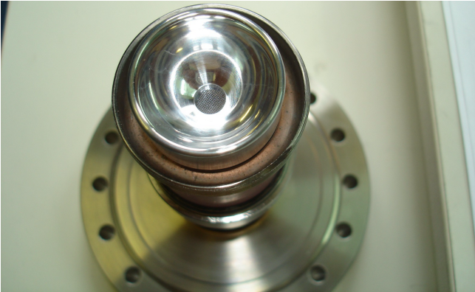
N.I.Balalykin et al.: “START-UP THE PROTOTYPE DC-PHOTOINJECTOR (UP TO 400 keV) IN THE PHOTOCATHODE OPERATION MODE TO THE “TRANSMISSION MODE“”
Photocathode and Accelerator Structure
The cathode node, which was used in the prototype photoinjector in seances in April 2017. A transparent copper cathode was used with a cell size of 40 * 40 μm and a wire diameter of 30 μm.
XII INTERNATIONAL SEMINAR ON THE PROBLEMS OF ACCELERATED CHARGED PARTICLES

Slide 12
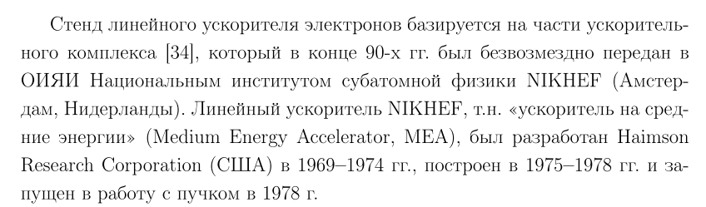
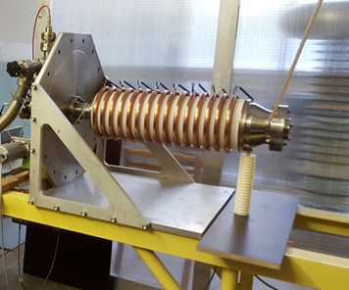
N.I.Balalykin et al.: “START-UP THE PROTOTYPE DC-PHOTOINJECTOR (UP TO 400 keV) IN THE PHOTOCATHODE OPERATION MODE TO THE “TRANSMISSION MODE“”
Photocathode and Accelerator Structure
Accelerating structure is similar to the accelerator structure of the Linac-200 injector (development of Haimson Research Corporation)
Ceramic HV column
Quartz glass
Ускорительная система или ускорительная трубка
Photocathode
Faraday Cup
1
2
3
15
γ
e,γ
200MΩ
200MΩ
200MΩ
200MΩ
15 electrodes
XII INTERNATIONAL SEMINAR ON THE PROBLEMS OF ACCELERATED CHARGED PARTICLES

Slide 13
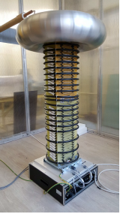
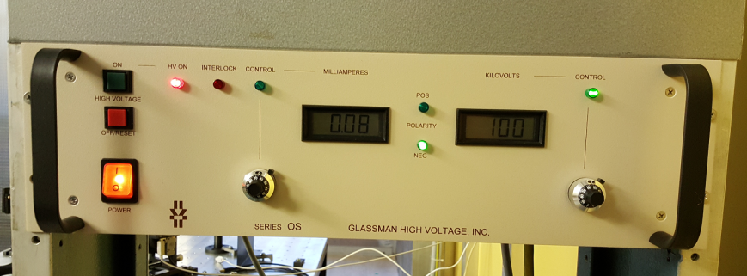
N.I.Balalykin et al.: “START-UP THE PROTOTYPE DC-PHOTOINJECTOR (UP TO 400 keV) IN THE PHOTOCATHODE OPERATION MODE TO THE “TRANSMISSION MODE“”
High-voltage power supply
For high-voltage supply of the photo-injector used the power supply type OS400N3.5 of company GLASSMAN HIGH VOLTAGE INC.
High Voltage Stack and Driver Assembly
Output Voltage – 0-400 kV, Output Current - 0-3.5mA
High Freq. Ripple (P-P) – 200V, Line Freq. Ripple (P-P) – 20V
Input: 198-264 V RMS single phase, 48-63 Hz, 2500 VA maximum at full load
Control Assembly
The unit is located in a special room. The dimensions are determined by the maximum voltage of 400kV. The walls are made of metal mesh (inside) and polycarbonate (outside). The room is hermetically sealed and can be filled with a special gas at an atmospheric pressure (for example, nitrogen) to increase the electrical strength.
XII INTERNATIONAL SEMINAR ON THE PROBLEMS OF ACCELERATED CHARGED PARTICLES

Slide 14
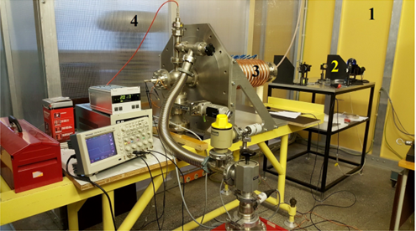
N.I.Balalykin et al.: “START-UP THE PROTOTYPE DC-PHOTOINJECTOR (UP TO 400 keV) IN THE PHOTOCATHODE OPERATION MODE TO THE “TRANSMISSION MODE“”
The first experimental results
General view of the prototype of the photoinjector. 1 - the outer wall of the laser room, 2 - the optical transport line, 3 - the accelerating structure with the photocathode, 4 - the high-voltage source.
2- часть оптической транспортной линии
XII INTERNATIONAL SEMINAR ON THE PROBLEMS OF ACCELERATED CHARGED PARTICLES

Slide 15
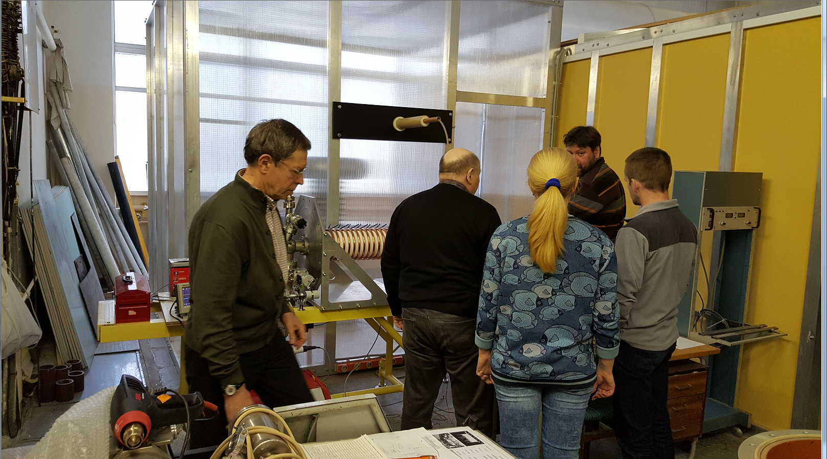
N.I.Balalykin et al.: “START-UP THE PROTOTYPE DC-PHOTOINJECTOR (UP TO 400 keV) IN THE PHOTOCATHODE OPERATION MODE TO THE “TRANSMISSION MODE“”
The first experimental results
XII INTERNATIONAL SEMINAR ON THE PROBLEMS OF ACCELERATED CHARGED PARTICLES

Slide 16
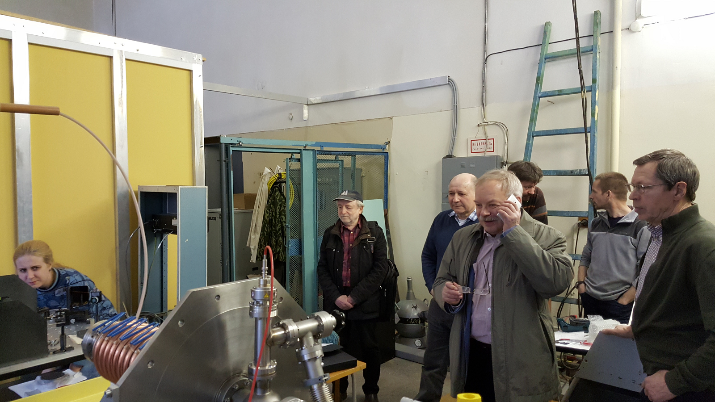
N.I.Balalykin et al.: “START-UP THE PROTOTYPE DC-PHOTOINJECTOR (UP TO 400 keV) IN THE PHOTOCATHODE OPERATION MODE TO THE “TRANSMISSION MODE“”
The first experimental results
XII INTERNATIONAL SEMINAR ON THE PROBLEMS OF ACCELERATED CHARGED PARTICLES

Slide 17
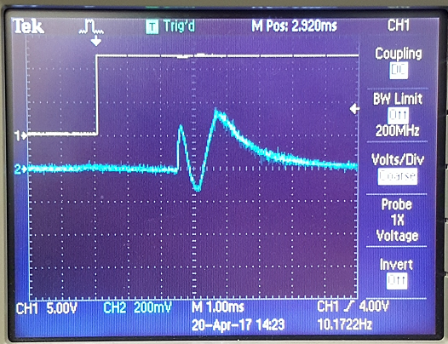
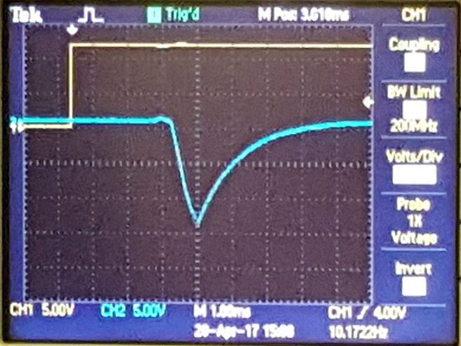
N.I.Balalykin et al.: “START-UP THE PROTOTYPE DC-PHOTOINJECTOR (UP TO 400 keV) IN THE PHOTOCATHODE OPERATION MODE TO THE “TRANSMISSION MODE“”
The first experimental results
Beam charge measurement circuit
Oscillogram of the macroimpulse of radiation UF
-HV
Accelerating
structure
γ
e,γ
Photocathode
Faraday Cup
oscilloscope
C=1nF
R=1 MΩ
synchronization
Oscillogram 1 (V=0kV)
Oscillogram 2 (V= -80kV)
VHV=0 kV
VHV= -80 kV
XII INTERNATIONAL SEMINAR ON THE PROBLEMS OF ACCELERATED CHARGED PARTICLES

Slide 18
N.I.Balalykin et al.: “START-UP THE PROTOTYPE DC-PHOTOINJECTOR (UP TO 400 keV) IN THE PHOTOCATHODE OPERATION MODE TO THE “TRANSMISSION MODE“”
The first experimental results
In April 2017, the first beam of photoelectrons was obtained at the stand. Macro pulses with a charge of 15 nC were registered. This corresponds to a micropulse of 200 mA, a macropulse of 20 μA and an average current of 150 nA at a repetition rate of 10 Hz. The voltage at the cathode was -80 kV. A transparent copper cathode was used with a cell size of 40 * 40 μm and a wire diameter of 30 μm.
The charge of the macroimpulse was measured using a Faraday cylinder at a capacitance of 1 nF. The voltage on the capacitor was recorded by an oscilloscope Tektronix TDS 2024B. Then the charge of the macroimpulse was calculated (Q=C*V).
It should be noted that at this stage photoemission from the Faraday cylinder, secondary emission, and so on was not taken into account.
XII INTERNATIONAL SEMINAR ON THE PROBLEMS OF ACCELERATED CHARGED PARTICLES

Slide 19
N.I.Balalykin et al.: “START-UP THE PROTOTYPE DC-PHOTOINJECTOR (UP TO 400 keV) IN THE PHOTOCATHODE OPERATION MODE TO THE “TRANSMISSION MODE“”
Регулировка напряжения первого электрода.
Блок привязки частоты микроимпульсов лазера
к ВЧ-частоте ускорения.
Plans for the future
An increase in the electron energy up to 400 keV. Source HV - 400 kV, 400 kV cable with connectors, accelerating the structure to be placed in a barrel with SF6 gas.
Operational diagnostics of the laser beam (using a virtual cathode, etc.) and electronic (the shape of micropulse, emittance !, charge, energy distribution, etc.). Separation of the electron beam from the laser beam (foil, rotary magnet, etc.).
Обустроить пульт управления (автоматизация).
Система блокировок и сигнализаций, радиационный контроль.
modernization of the laser driver control system
Thank you for attention
XII INTERNATIONAL SEMINAR ON THE PROBLEMS OF ACCELERATED CHARGED PARTICLES

