Slide 1
Software for Low-Energy Beam Simulation by Particle-in-Cell Algorithm
Boytsov Alexey
JINR, VBLHEP

Slide 2
Contents
- Motivation
- Algorithm
- Workflow, Libraries and Tools
- Tests and Simulation Example
- Future Plans
- Summary

Slide 3
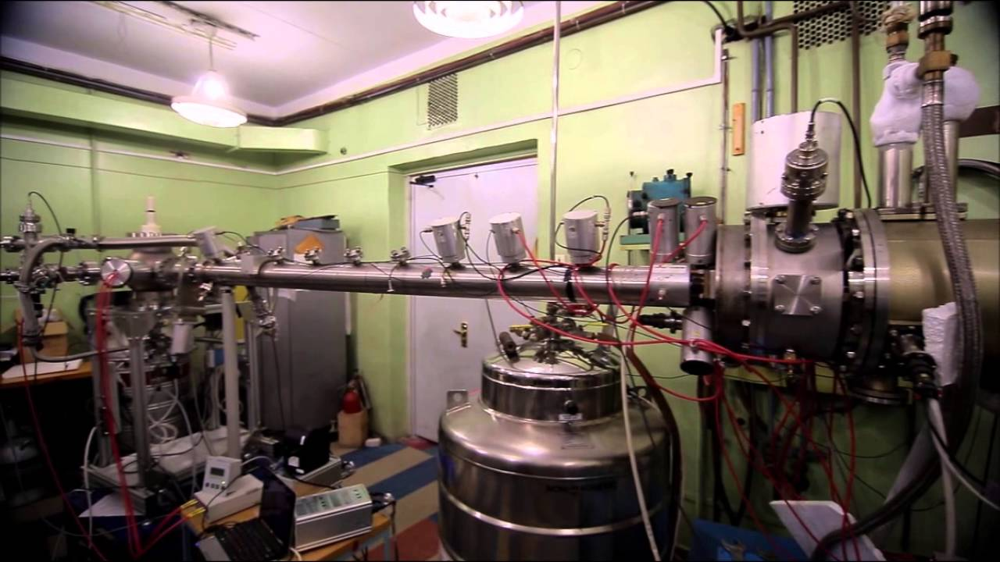
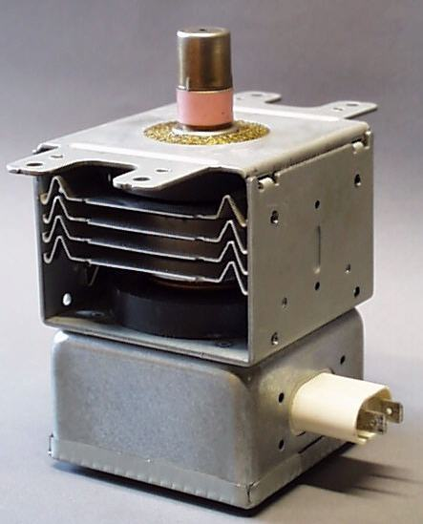
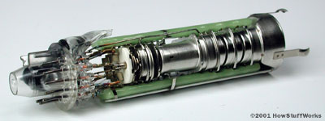
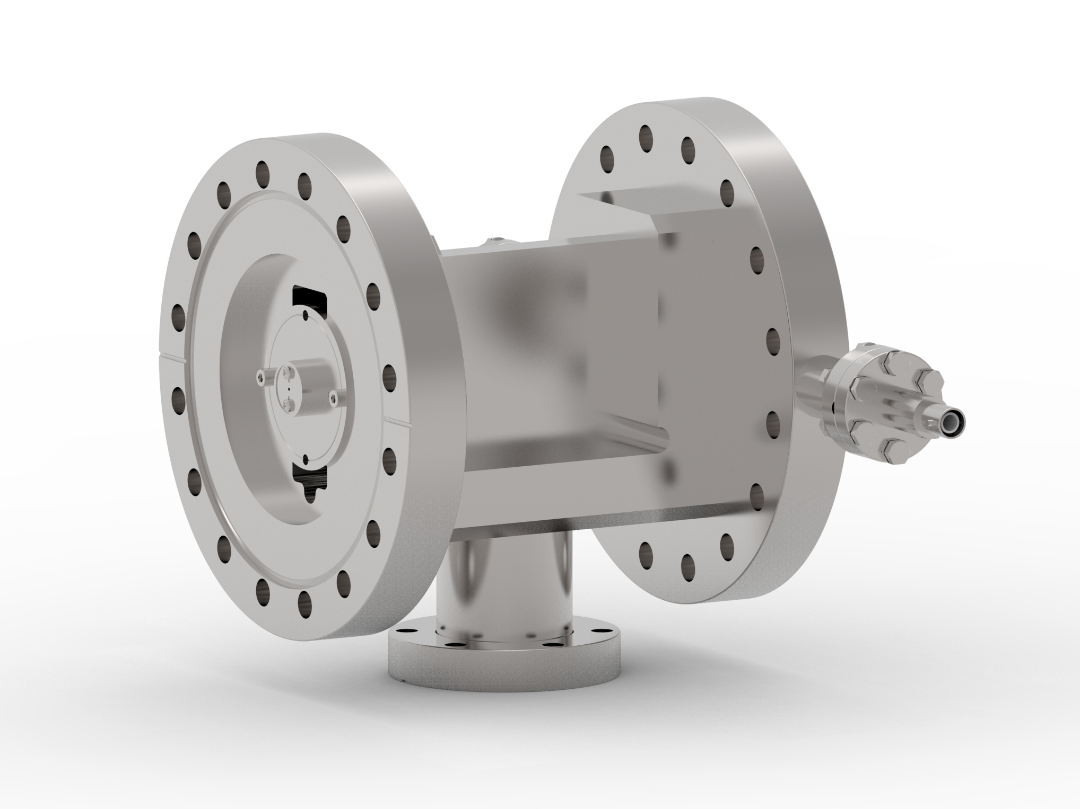
Low-Energy Beam Devices

Slide 4
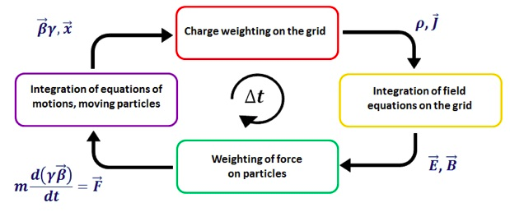
The Particle-in-Cell Method
The Particle-In-Cell Method for Hydrodynamic Calculations.Personal Authors: Evans, Martha W.; Harlow, Francis H.; Bromberg, Eleazer Report Date: 08 NOV 1957
http://gaps.ing2.uniroma1.it/alberto/alberto/PIC_files/PICloop.jpg

Slide 5
Software

Slide 6
Libraries and Tools
Development team:
Bulychev Andrew
Boytsov Alexey
https://www.python.org/
https://github.com/epicf
https://www.hdfgroup.org/
https://www.paraview.org/
http://hlit.jinr.ru/
https://www.freecadweb.org/

Slide 7
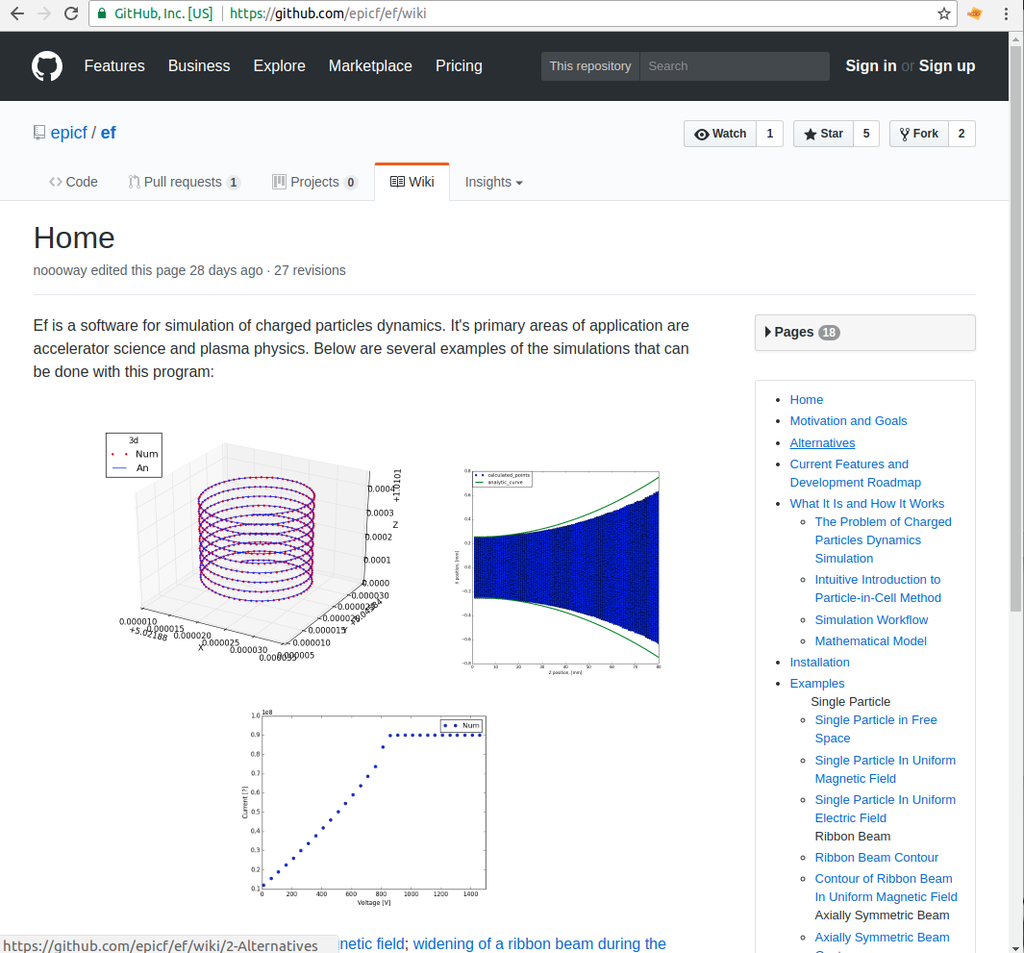
Github.com

Slide 8
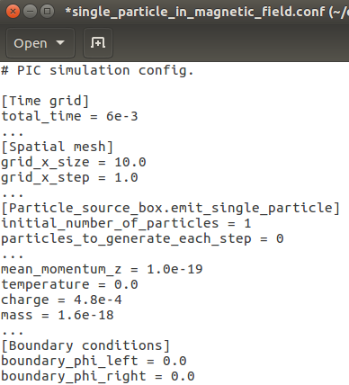
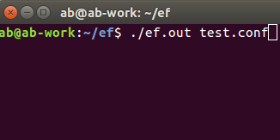
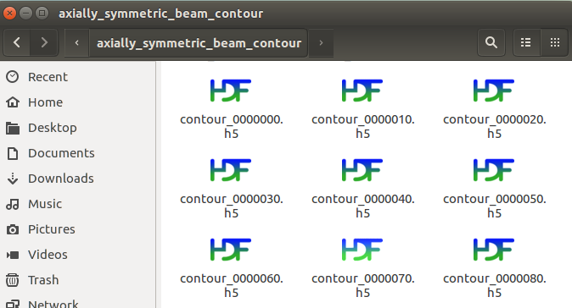
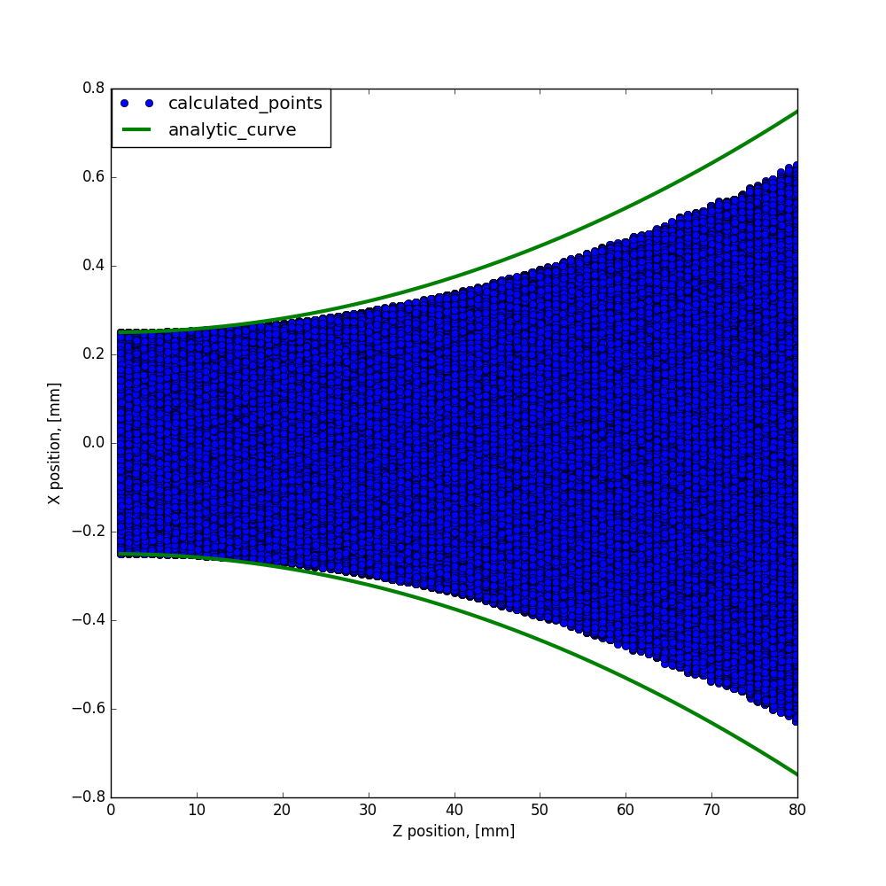
How to do simulation?
2. Run simulation
1.Write config file
3. Obtain results
4. Analyze results

Slide 9
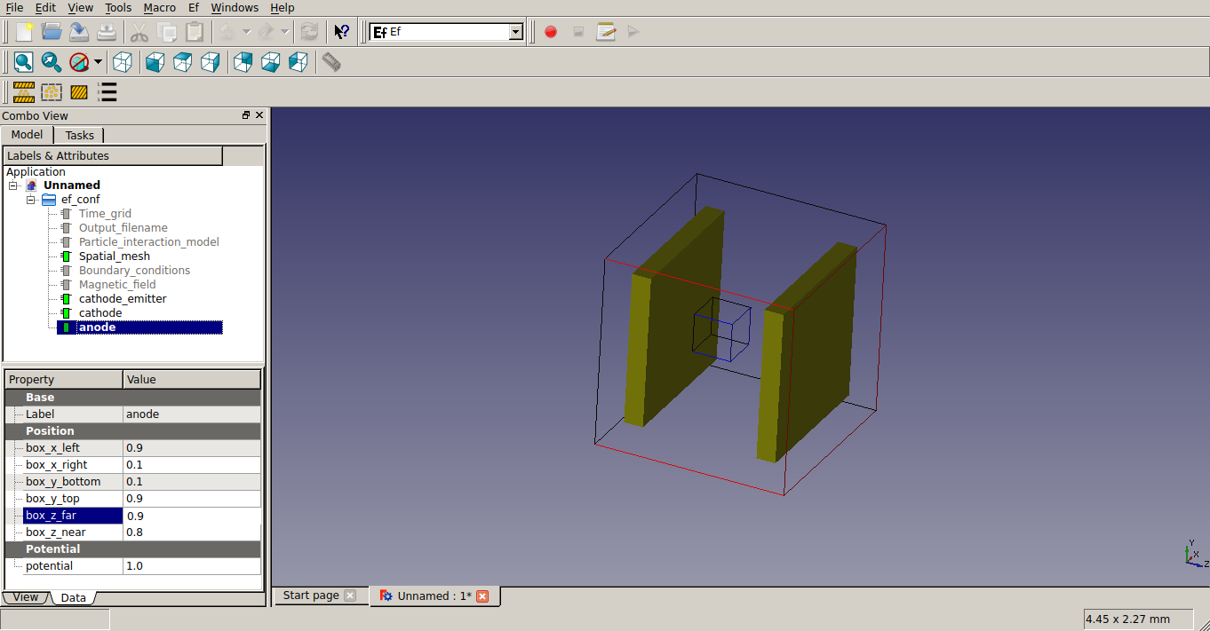
Another way FreeCAD - ParaView (beta version)

Slide 10
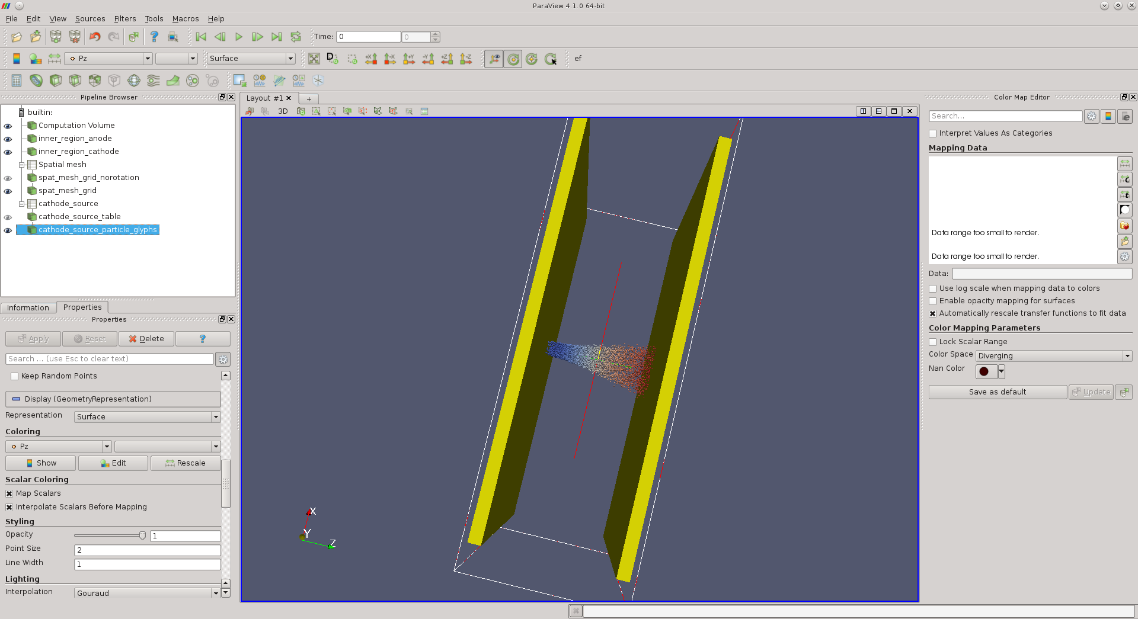
Another way FreeCAD - ParaView (beta version)

Slide 11
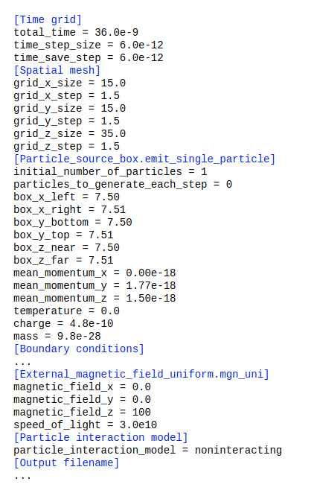
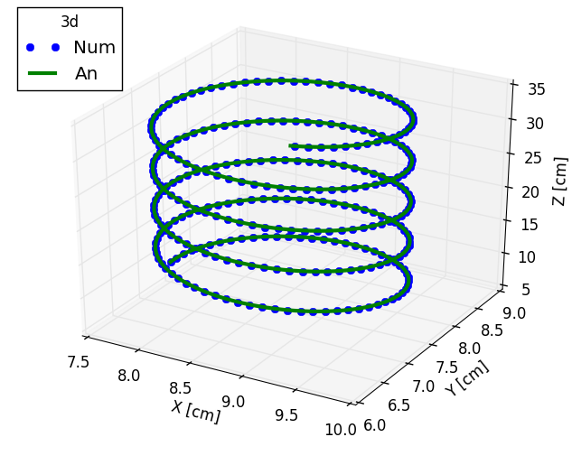
Tests - Helix

Slide 12
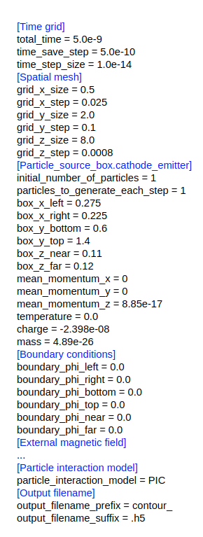
Tests - Ribbon beam

Slide 13
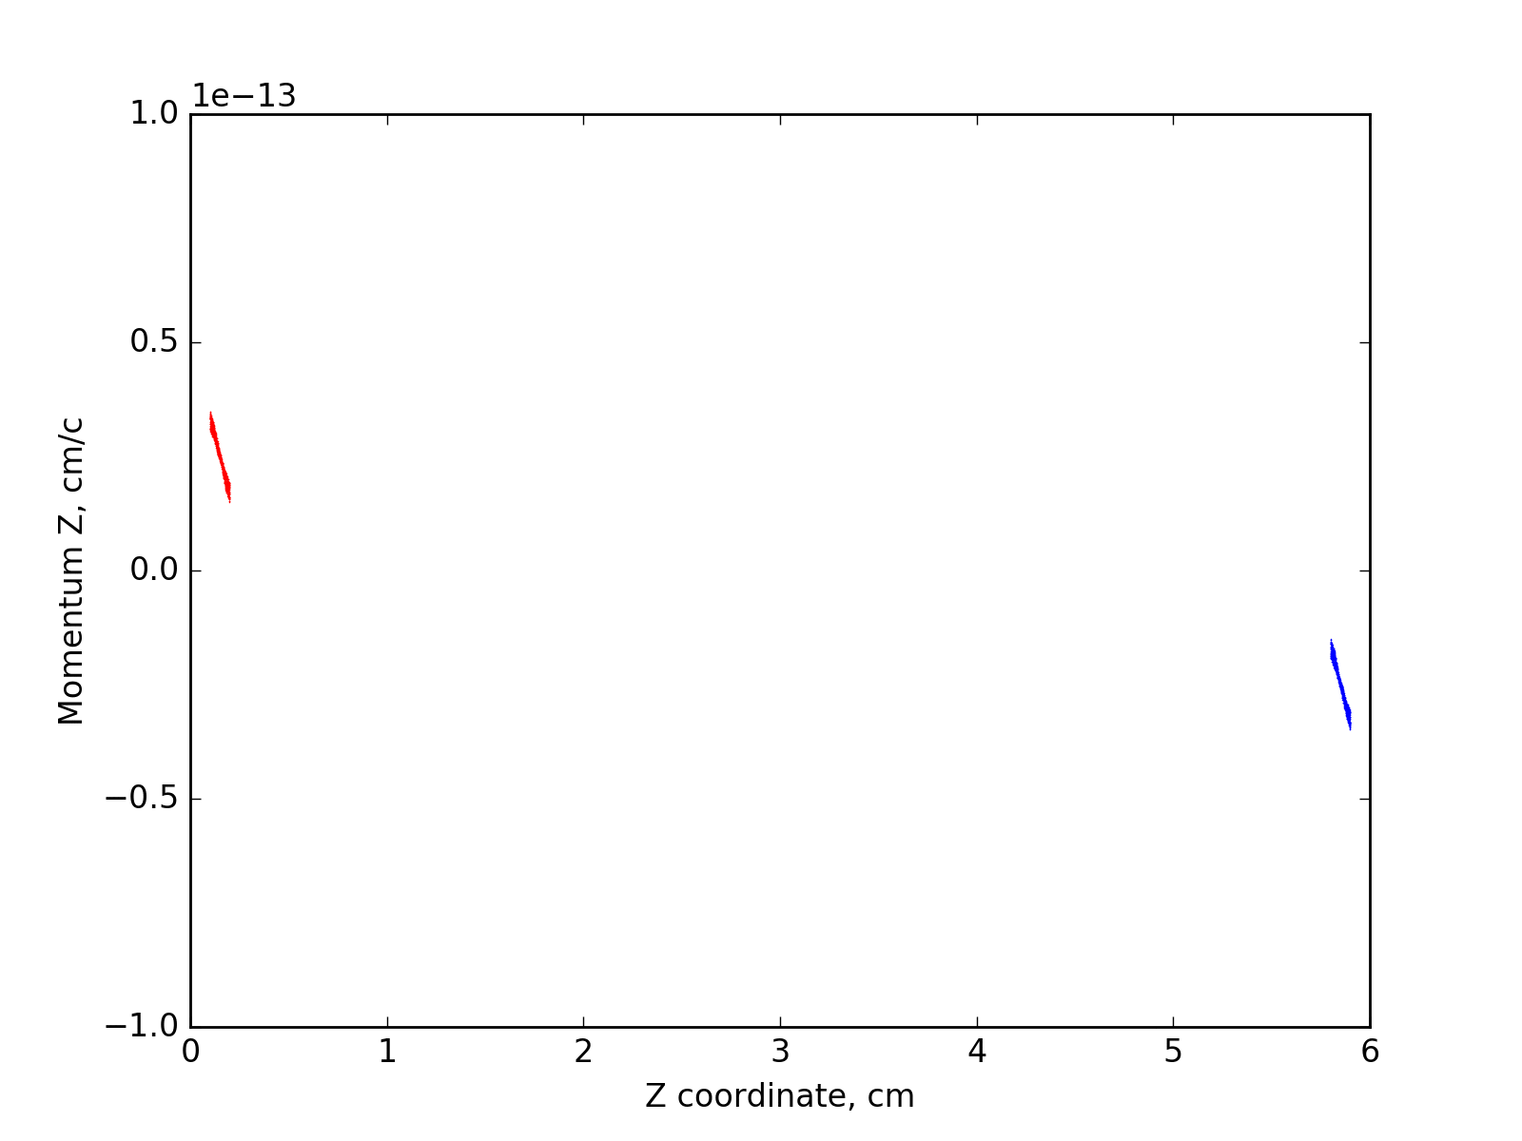
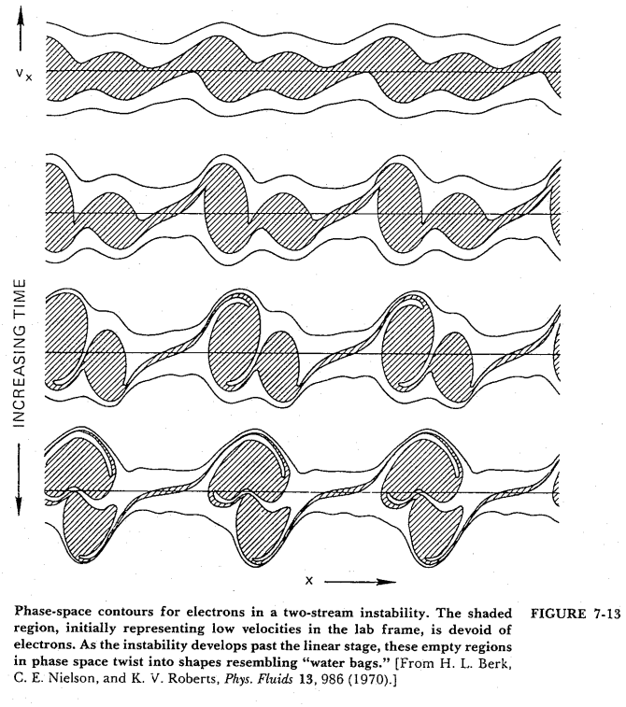
Simulation Example: Two-Stream Instability
Grid 40х40х300
1000 time steps
190000 macroparticles
Simulation time: 20 minutes on single CPU

Slide 14
Future Plans
Programming tools:
MPI-CUDA parallelization
User interface
Analysis tools
CAD models
Physical tools:
Develop emission model of particle source
Add material properties
Collision models
Physical simulations:
Two stream instability of electrons and ions
Reflex mode of operation in Electron beam ion source
Brillouin beam

Slide 15
Summary
1. Basic code for Particle-In-Cell algorithm
has been written.
2. First tests have been performed.
3. Project is hosted at https://github.com/epicf . It is open, please try and enjoy.

Slide 16
Спасибо за внимание

