Slide 1
Semileptonic and nonleptonic decays of B_{c} meson into charmonium states
Issadykov Aidos
in collaboration with: Mikhail A. Ivanov &
Bratislava group

Slide 2
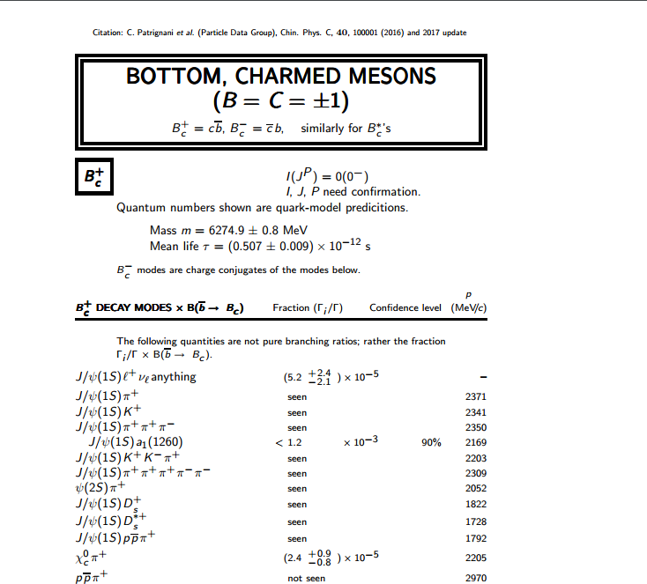
PDG

Slide 3
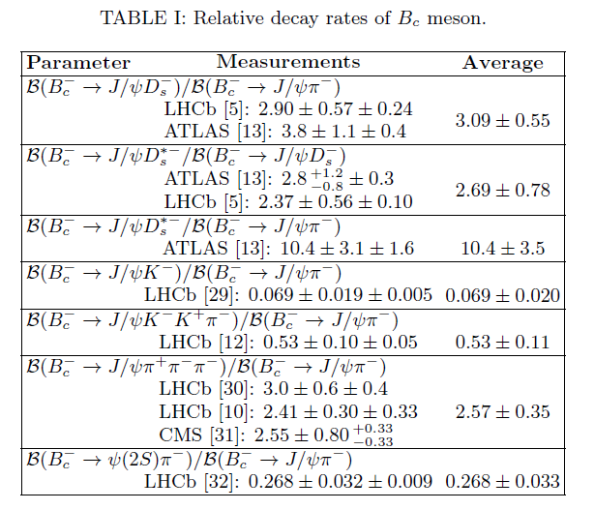
Experimental data

Slide 4
Goal
CDF and D0 collaborations
1998 y. 20 ev.
LHCb collaboration:
2014 y. 839 ev.
LHCb collaboration(nonleptonic):
2013 y. 46 ev.
2016 y.

Slide 5
Goal
CDF and D0 collaborations
1998 y.
LHCb collaboration:
LHCb collaboration:
2014 y.
LHCb collaboration(nonleptonic):
2013 y.
2016 y.

Slide 6
Covariant quark model

Slide 7
Compositeness condition in covariant quark model

Slide 8
Model parameters
The fitted values of the size parameter Λ in GeV

Slide 9
Form factors definition

Slide 10
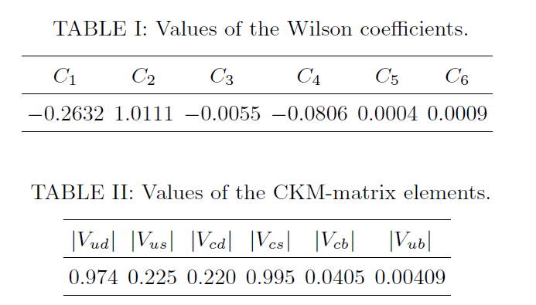
Model parameters

Slide 11
Form factors $B_{c}$ decays

Slide 12
Widths of semileptonic and nonleptonic $\text{decays} ofB_{c}$ meson

Slide 13
Branching ratios of semileptonic $B_{c}$ decays

Slide 14
Branching ratios of nonleptonic $B_{c}$ decays
Old one

Slide 15
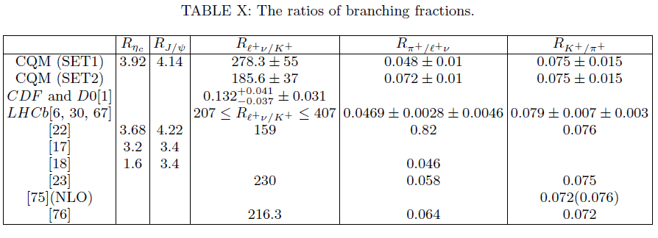
Ratios of $B_{c}$ meson decays

Slide 16
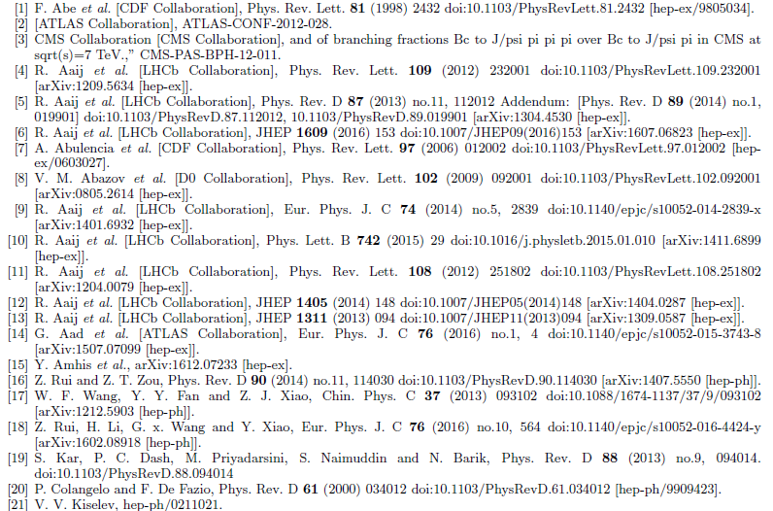
References

Slide 17
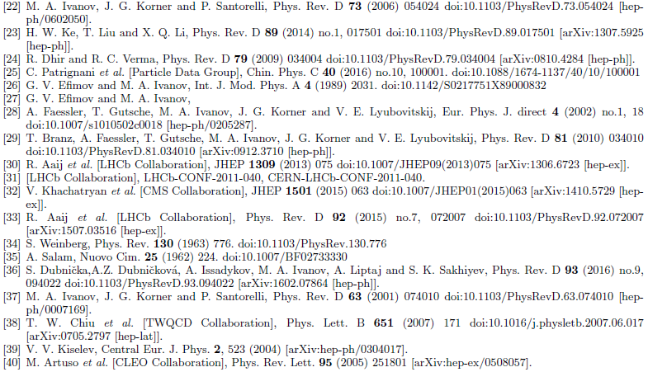
References

Slide 18
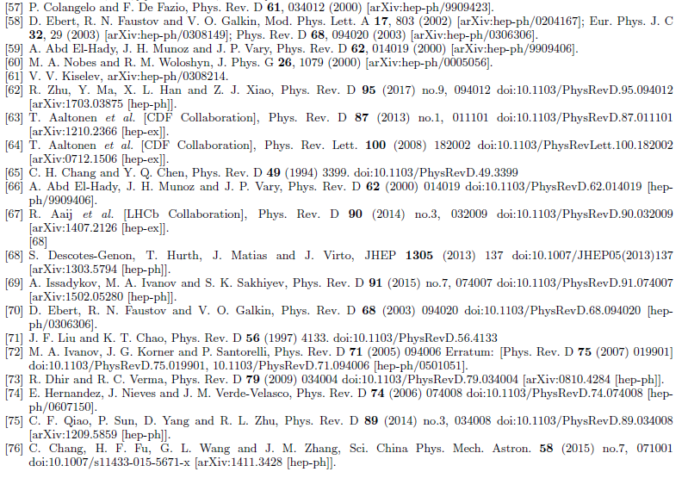
References

Slide 19
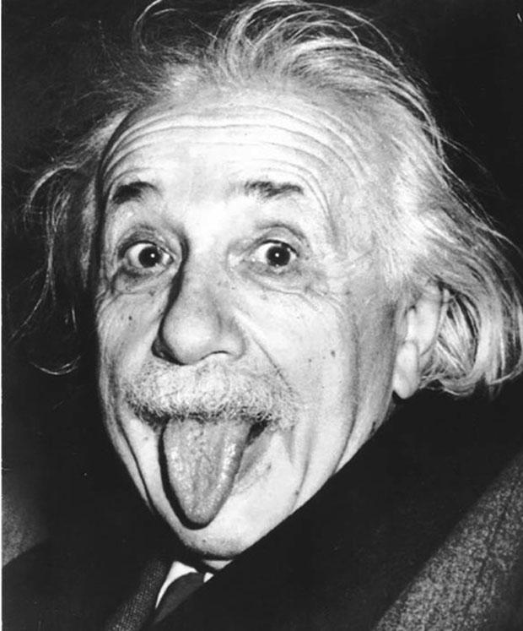
Thank you!

