Slide 1
Technical interchange meeting: Computing models, Software and Data Processing for the future HENP experiments
Markus Schulz
CERN IT
July 2014

Slide 2
Presentations
Data Management in HEP. What Next?
  Predrag Buncic
Federated Storage Systems
  Eygene Ryabinkin
Access Protocols
  Oliver Keeble
EOS Virtual Storage Cloud
  Andreas Peters & Dirk Düllmann
High Performance Computing for HEP
  Danila Oleynik

Slide 3
Disclaimer
I have stolen slides from all but one presentation (without asking)
I probably have not understood all presentations ....
I probably have misunderstood some of the discussions/conclusions ....

Slide 4
  Data Management in HEP. What Next?
  Predrag Buncic
Experience from 15 years of Grid development
  Architecture initially driven by slow, unreliable networks and lack of disks
  Data Grid based on Tiers
    Co-scheduling data and processing
    All knowing, all controlling Resource Broker (problem)
EGEE no paradigm shift
  but fixed many services
WLCG reduced services to bare minimum
  Experiments build their own working grids
    Reliability and performance in experiment layer ( often manually)
  Four different implementations, same principles

Slide 5
WLCG
Distributed infrastructure of 150 computing centers in 40 countries
  300+ k CPU cores (~ 2M HEP-SPEC-06)
  The biggest site with ~50k CPU cores, 12 T2 with 2-30k CPU cores
Distributed data, services and operation infrastructure

Slide 6
Where are we today with data volume?

Slide 7
RAW data volume outlook
Very rough and probably wrong estimates of a new RAW data per year of running using a simple extrapolation of current data volume scaled by the output rates.
  To be added: derived data (ESD, AOD), simulation, user data…

Slide 8


Slide 9
Global Data Federations
Again, several solutions
  FAX – Federated ATLAS Xrootd, AAA – Any Data, Any Time, Anywhere (CMS), AliEn (ALICE)

Slide 10
Does it work?
Technically speaking yes....
Efficiency drops with latency
  hands on experienced by ALICE
  efficiency will be key
Learning from Amazon
  small number of regionally clustered centres

Slide 11

Reducing complexity is the key for illustration only
Virtually joining together the sites based on proximity (latency) and network capacity into Regional Data Clouds
  Each cloud/region provides reliable data management and sufficient processing capability
    Dealing with handful of clouds/regions instead of the individual sites

Slide 12
What to do?
Very little time: Run2 now, Run3 soon
All experiment share the problem
  factor 100 in data
Commissioning of data management products is tough
Base common solution on trusted product
  EOS best candidate for federation
    evolution needed
  EOS proven to scale
Collaborate on building a Federation of Regional Storage Clouds
  and tools needed to exploit them:
  Scalable Global Namespace.........

Slide 13
Predrag
“We should not repeat mistakes from the past ending up with four different solutions for the same problem”

Slide 14
  Federated Storage Systems
  Eygene Ryabinkin
View of the data management landscape from the perspective of a site manager ( Kurchatov )
Comparison of existing solutions
  DPM, dCache, XrootD native, EOS
Impact of federated storage
  performance, operations, policies
Very lively debate ☺

Slide 15
Comparison
DPM
  easy to understand, good for a few PB, many protocols, single points of failure
dCache
  more complex, scales to O(10PB ), one federation (NDGF) , single points of failure
XrootD Native
  scales to 10PB, works well, good architecture, plugins, basic controls, can run with redundant heads
EOS ( “XrootD on steroids”)
  no need for RAID, T0 scale, split instance at CERN, documentation could be better

Slide 16
Federations
Analysis of a balanced system for read/write
Writing: no major difference
Reading: Federation will trigger much more remote reads
  can lead to saturation ( often the Firewall)
  hot spots have to be addressed
    replication or clever distribution in the cloud

Slide 17
Use Case ALICE
Pool nodes have seen high load due to 100s external clients, saturation of node bandwidth
Temporary solution: xrootd limits external access
Link between data and workload scheduler is needed
Long term: Caches, bandwidth reservation etc.
Maybe LHCONE will help (not clear when)
  software defined networks

Slide 18
Cloud Complications
Traceability questions, debugging
  strong cooperation is needed
T1-T2 have different SLAs
  in same cloud??
dependencies between sites
  efficiency on site A depends on site B, C, D
  very difficult to disentangle when doing efficiency analysis

Slide 19
Outcome
Should be a ready-to-use product for WLCG
  based on a protocol (or product)
the set of learned lessons in many areas: which protocols can be used for federations, what software features are useful, what are the requirements for site-level services and inter-site things (networking and others), what are the best practices that were emerged during the project.
Testing ground for other communities
Federations are not only about networks and software!

Slide 20
Access Protocols
Oliver Keeble
List of protocols used at scale
Considerations for selection of protocols:
  Accessibility, Performance, Sustainability, Features, Integration, Security
  Maybe more than one is a good idea
Comparison of HTTP and XrootD
  features and performance (preliminary)

Slide 21
xroot
Highly optimised access protocol
  Used also for transfer
Coupled to high performance server
Advanced federation potential
End-to-end control
  No compromises made to other communities
Proven workhorse in HEP

Slide 22
HTTP
Universal
  Access, transfer, management
Highly accessible
  Although advanced features have patchy support
Performance – good enough
  …but not decisive
Many interesting implementations
  Sustainable
  Support in HEP is maturing
    dCache, DPM, xrd-http
    ROOT/Davix
Attractive to new communities

Slide 23
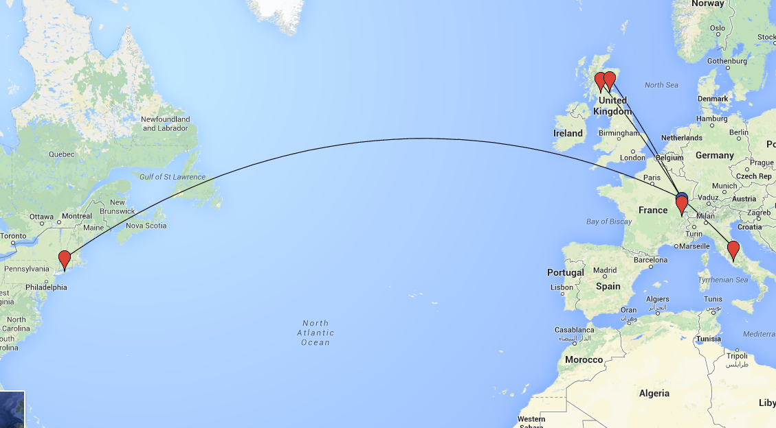
Sites involved

Slide 24
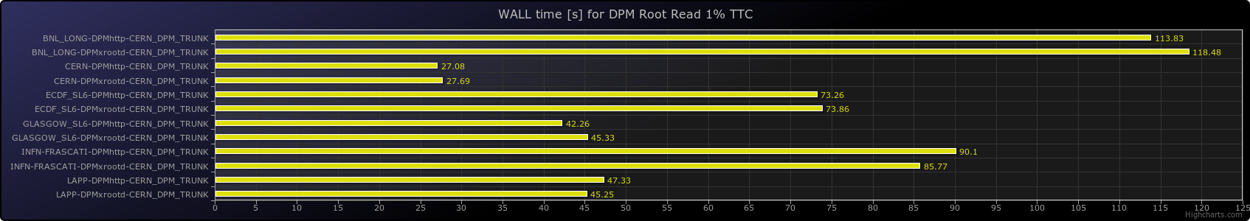
Test results
Client at CERN -> Various WLCG sites, xroot & HTTP
ROOT read of 1% of events
X axis represents seconds to complete the job

Slide 25
Summary
Agreement:
  Xrootd is a must have for our community
  Integration of HTTP and Xrootd opens the door for other communities
    with xrd-http easy, performance very similar
  Dual protocol support ensures that we can follow future trends ( SPDY??)
  Testing will require some effort, but not twice as much
  The T1 in Russia will start with Xrootd and consider HTTP later

Slide 26
EOS Virtual Storage Cloud
Andreas Peters & Dirk Düllmann
Two main parts:
  EOS as a storage solution for large centers
    O(100PB), low latency, CERN runs 5 instances with 3 FTEs, no expensive RAID hardware needed (JBOD)
  EOS based federation and global name space
    Virtual Storage Cloud
      site, cloud, global
    Global Namespace based on RadosFS
EOS team expressed interest in collaboration
  operational experience and development

Slide 27





EOS is the CERN disk-only file storage for [non-] LHC derived data targeting physics analysis use cases.
5 instances - 25.000 disks - 60 PB storage space - 200 Mio files
Service in production since 2012 - 1-year availability including scheduled downtimes 99.5% at CERN.
External instances at
FNAL, SASKE, Subatech, SINICA, RRC Kurchatov, UNAM
Releases
production
version
EOS
Disk Storage @ CERN
Beryl
Citrine
in preparation
Diamond
next generation
storage bundle
27

Slide 28






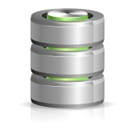

Virtual Storage Cloud
Clients
VST instance
global
CLOUD B
CLOUD A
VST instance
cloud
VST instance
site
Storage access is resolved locally or according to policies to a higher level instance.
28

Slide 29

VSC/VST Realization
XrdCl
VST
Plugin
CEPH/Rados
Scalable Block Storage
RadosFS
Hierarchical View, Authz & Meta Data
Clients distinguish local files
(without CLOUD replication)
and CLOUD files (cross-SE replicated)
XRootDD
Protocol prov. redirection
EOS VST Cloud Service
Placement and Access Scheduler
EOS
VST Adaptor
EOS
VST Adaptor
XRootDD
VST Adaptor
VST Adaptor
XRootDD
XRootDD
XRootDD
dCache
RadosFS
DPM

Slide 30
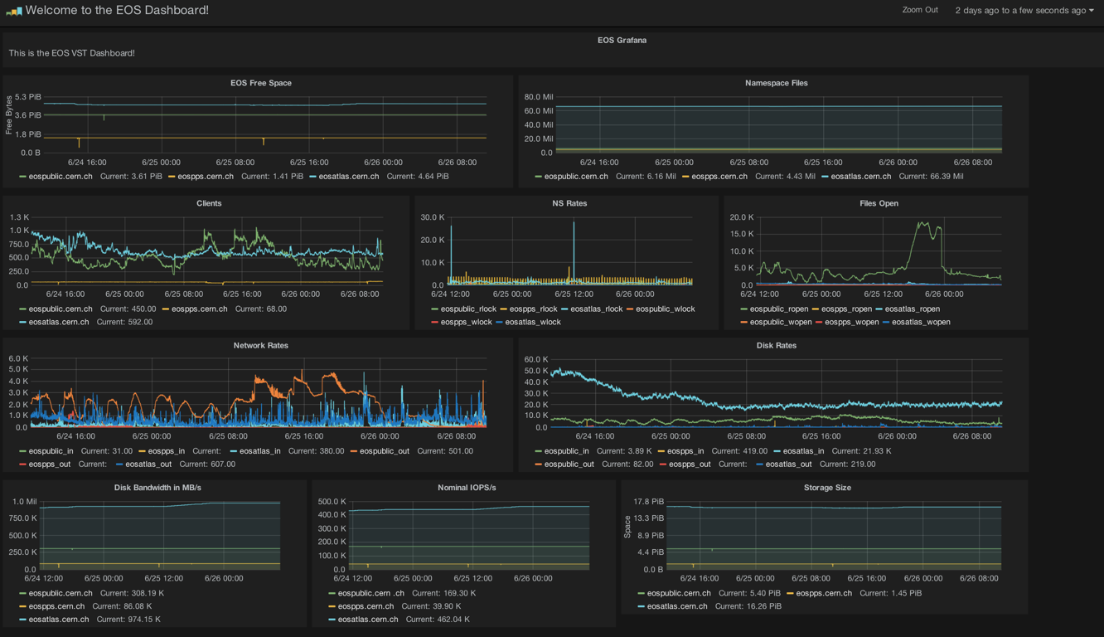
GRAFANA VST Dashboard
Every site can publish VST data into an InfluxDB and configure their customized local dashboard using GRAFANA [open source products]

Slide 31
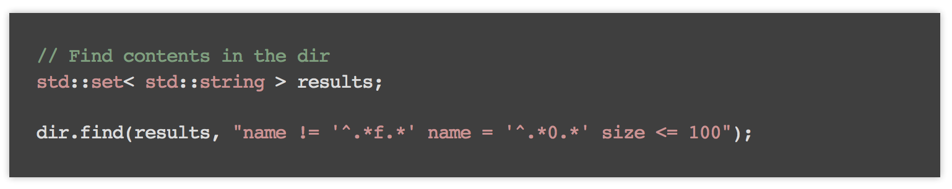

RadosFS
CERN IT-DSS Development
provides back-end meta data catalog with extreme scalability [ scales with number of directories ] stored on Rados [ e.g 1 billion directories - 1 trillion file meta data entries ]
parallel search engine map-reduce-technology
meta data on file entries and directories
very simple C++ API
implementation complete
next hook into XRootD server
can also be used as storage system
running on top of Rados Object Store

Slide 32
Next Steps
VST Adaptor is needed to link native Xrootd T2s ( soon )
Two Phases:
  1) Kurchatov T1 & T2 federated
  2) Evaluate expansion to Russian cloud
    Dubna or Protvino
6 months Alice tests Kurchatov federation
Effort: About 1 FTE

Slide 33
High Performance Computing for HEP
Danila Oleynik
Many different HPC centres offer resources
  direct allocation, backfill
All machines are unique, different approaches needed
  ARC-CE
  HPC-Panda
Restrictions of network and disk storage are serious issues
6% of ATLAS’ resources are HPC based

Slide 34
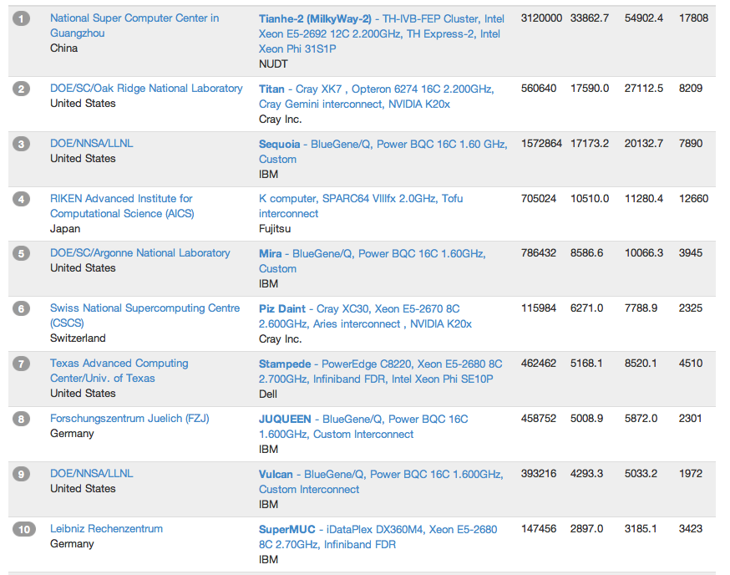
High Performance Computing (Top 10, Nov 2013)
ATLAS has members with access to these machines and to ARCHER, NERSC, …
Already successfully used in ATLAS as part of Nordu Grid and in DE (Abisko, Abel, Triolith, C2PAP, Hydra)

Slide 35
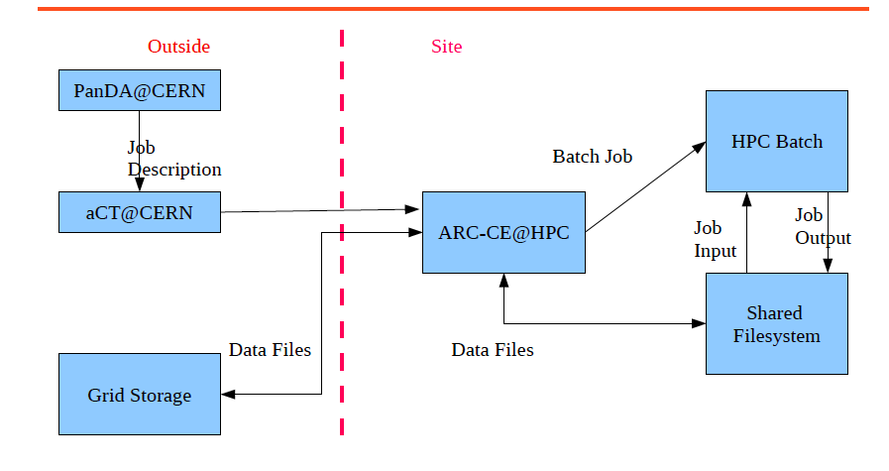
ARC-CE/aCT2

Slide 36
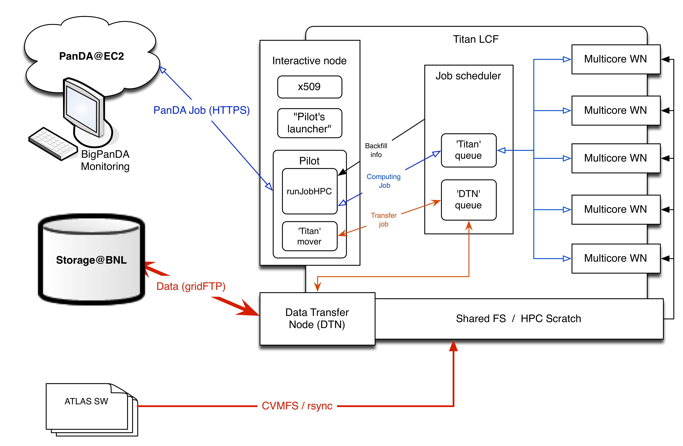
PanDA setup on Titan LCF

Slide 37
Conclusion
Federation of Regional Storage Clouds has several advantages over a “naive” global federation
Support for Xrootd and HTTP is desirable
  and feasible
EOS is an excellent candidate for T1 scale sites
The concept of Storage Clouds will be followed up
  EOS VSC is the clear favourite
  Includes global scalable namespace
There are many opportunities for collaboration
HPC offers opportunities to increase resources by a non trivial amount
  some technical hurdles remain:
  data access, network, diversity

