Slide 1
RECENT DEVELOPMENTS
IN THE CONTRIBUTION OF DFCTI/IFIN-HH
TO THE WLCG COLLABORATION
Mihai Ciubancan, Teodor Ivanoaica, Mihnea Dulea
Department of Computational Physics and Information Technologies (DFCTI)
IFIN-HH, Magurele, Romania
Grid 2014, LIT/JINR, 01.07

Slide 2
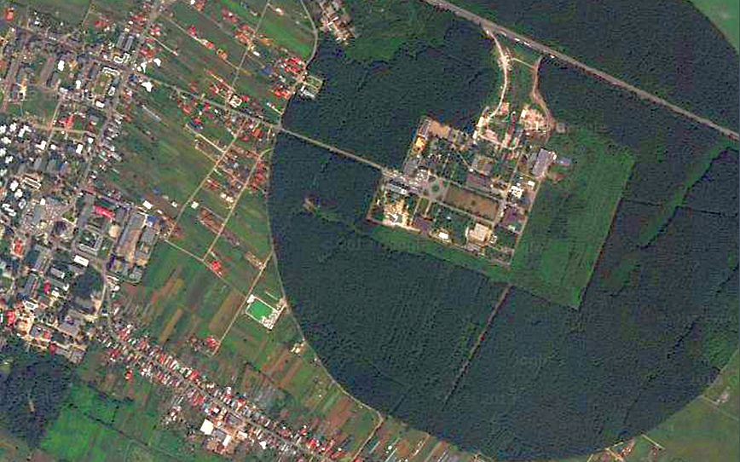
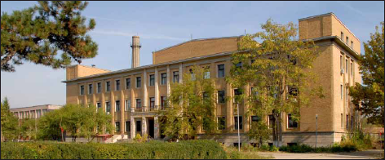
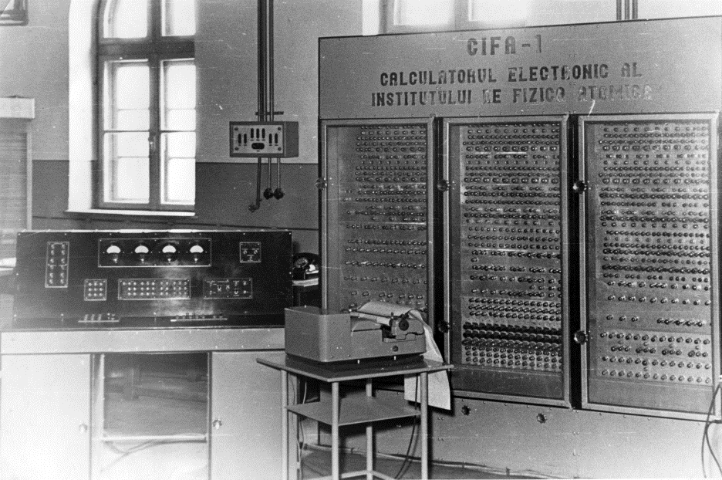
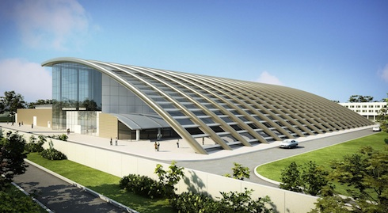
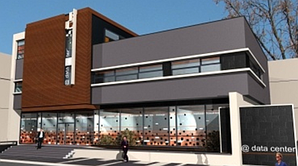
IFIN-HH
VVR-S nuclear reactor (1957)
Group I
First Romanian computer (CIFA-1, 1956)
Group II
ELI-NP (2018)
New computing center (2015)
Grid 2014, LIT/JINR, 01.07

Slide 3
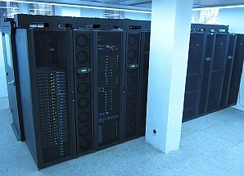
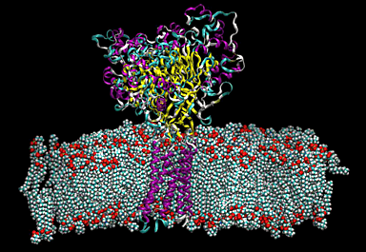
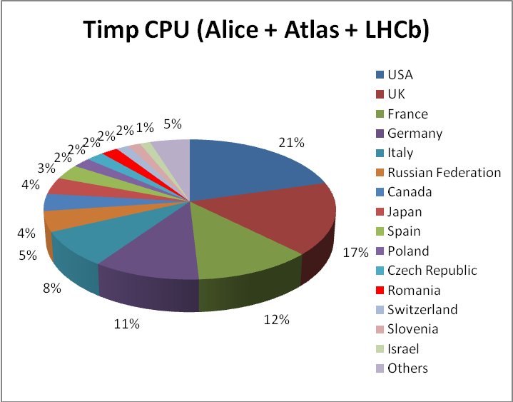
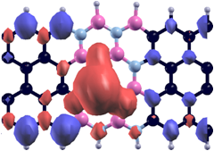
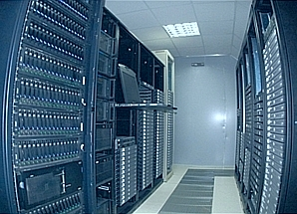
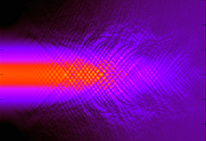
DFCTI
DFCTI hosts, develops and administrates one of the most important e-infrastructures in the country, that includes HPC and Grid computing facilities dedicated to the support of the research community within IFIN-HH and of the large scale international collaborations
DFCTI coordinates the Romanian Tier-2 Federation (RO-LCG), which contribute to the computational support of three of the LHC experiments within the WLCG collaboration.
The technical expertise of the staff includes HPC and grid technologies, algorithm programming and optimization, distributed data access and management, advanced networking, cluster architectures and optimization, parallel computing, symbolic computing, molecular dynamics.
The staff also conducts inter- and multidisciplinary research in areas such as strongly correlated systems, nuclear and sub-nuclear phenomena, condensed matter and biomolecular systems.
Grid 2014, LIT/JINR, 01.07

Slide 4
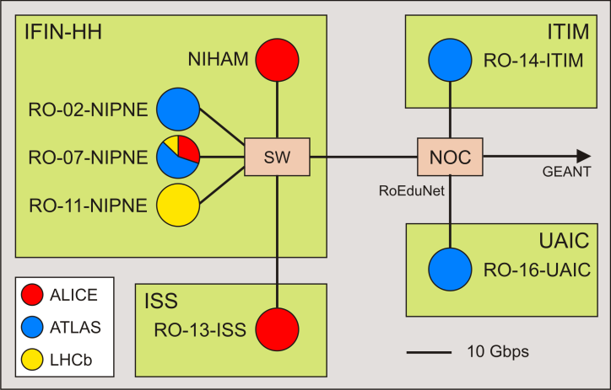
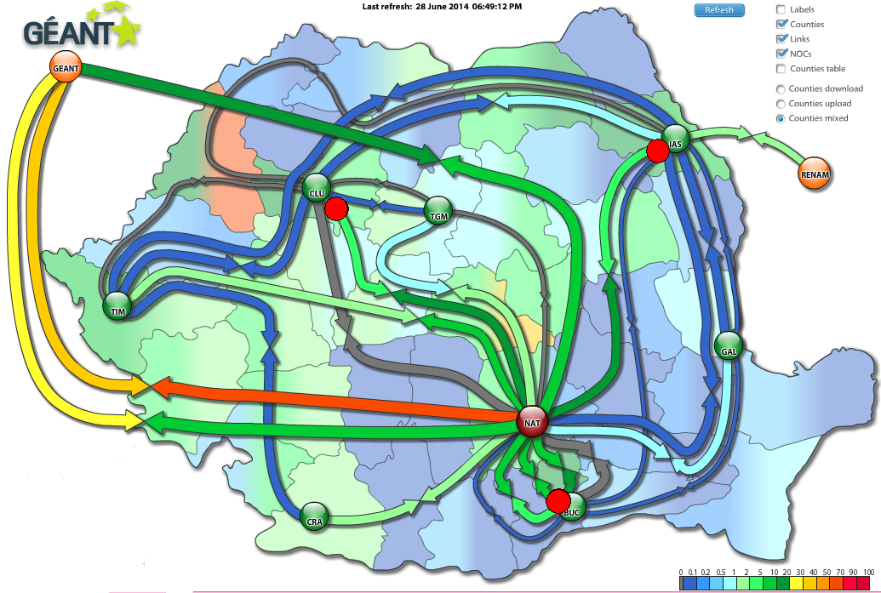
RO-LCG
RO-LCG provides disk storage and computing power for simulations and data analysis required by the ALICE, ATLAS and LHCb experiments at the LHC.
Resource centres
IFIN-HH:
RO-07-NIPNE (alice, atlas, lhcb), @DFCTI
NIHAM (alice)
RO-02-NIPNE (atlas)
RO-11-NIPNE (lhcb), @DFCTI
ISS = Institute of Space Science, Magurele:
RO-13-ISS (alice)
ITIM = Natl. Inst. for R&D in Isotopic &
Molecular Technologies from Cluj-Napoca:
RO-14-ITIM (atlas)
UAIC = 'Alexandru Ioan Cuza' University of Iasi
RO-16-UAIC (atlas)
Network
The centres are connected through 10 Gbps links to the 100 Gbps backbone of the RoEduNet NREN. RoEduNet currently provides a 10 Gbps connection to GEANT.
Grid 2014, LIT/JINR, 01.07

Slide 5
RO-LCG
RO-LCG resources dedicated to WLCG
2.6 PB storage capacity
6800 processing cores
The resources allocated by RO-LCG to the VOs represent 2-10% of the total experiments requests from the Tier2s
Standard software configuration of the sites:
Scientific Linux
EMI 3 middleware. Two ALICE sites (NIHAM & RO-13-ISS) also use AliEn
CEs with CREAM job management service
PBS/TORQUE distributed resource manager
Maui job scheduler;
Disk Pool Manager (DPM) for disk storage
Grid 2014, LIT/JINR, 01.07

Slide 6
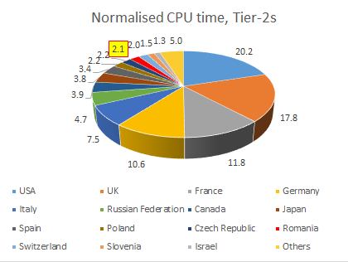
RO-LCG PRODUCTION
Total Grid production on LHC VOs since its beginning (2006):
Total # of run jobs: 44.8 millon
Total CPU time: 489 mega HEPSpec06-hours
Annual production (2013): RO-LCG ranked 12th among all the 36 Tier2 national centers, regarding the cumulated ALICE + ATLAS + LHCb CPU hours, with a share of 2.1% of the total
Grid 2014, LIT/JINR, 01.07

Slide 7
RUN-2
The LHC Long Shutdown (LS1) offered the opportunity to prepare the computational support for the Run-2.
The higher luminosity and the increase of the trigger rates by experiments will generate significantly larger amounts of data to be processed and stored within WLCG.
Solutions for the handling of extra data required changes in the computing models and an overall upgrade of the Grid resources, including those of the Tier2 (federations of) centres.
The transition of LCG from the hierarchical to mesh topology allows direct connections of the Tier2s with multiple Tier1s and other Tier2s within the LHCONE.
The performance of the Tier2 sites will strongly depend on their network capabilities.
DFCTI is preparing the upgrade of the network capacity and the computational support of two initiatives launched by the ATLAS and, respectively, the LHCb experiment:
the planned migration to multi-core queues (to be performed by ATLAS in parallel with its Data Challenge 14);
LHCb’s intention of supporting user analysis on a set of ‘Tier2 with Data’ (T2D) sites endowed with sufficient disk capacity
Grid 2014, LIT/JINR, 01.07

Slide 8
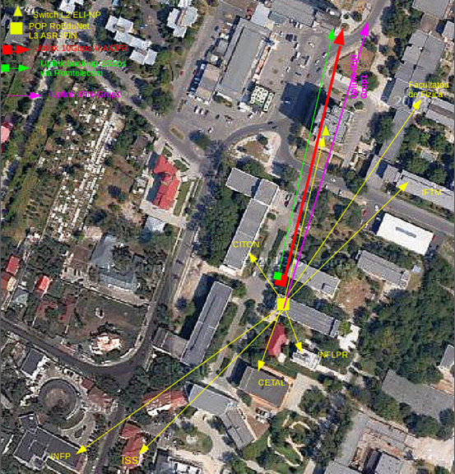
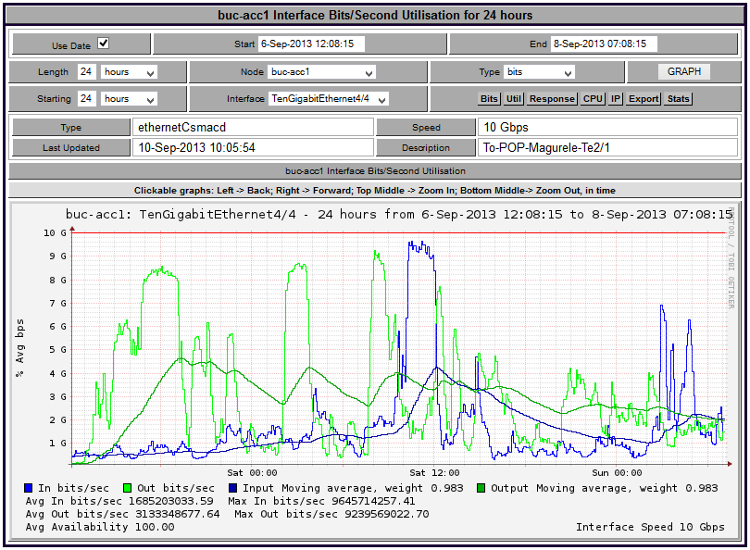
NETWORK INFRASTRUCTURE UPGRADE
DFCTI provides access to RoEduNet for 9 institutions and 5 grid sites located in Magurele.
These grid sites are connected by DFCTI to the NREN’s NOC through a 10 Gbps link and backups.
Since 2013, DFCTI hosts the Magurele PoP (point of presence) of the RoEduNet.
Due to the massive transfer of WLCG data, the in/out traffic is occasionally reaching values close to the bandwidth limit (see below).
DFCTI recently installed a Cisco ASR 9006 router, that allows the increase of the bandwidth to more than 10 Gbps.
A 40 Gbps upgrade of the external link is currently performed, which will be later followed by an upgrade to 100 Gbps.
Grid 2014, LIT/JINR, 01.07

Slide 9
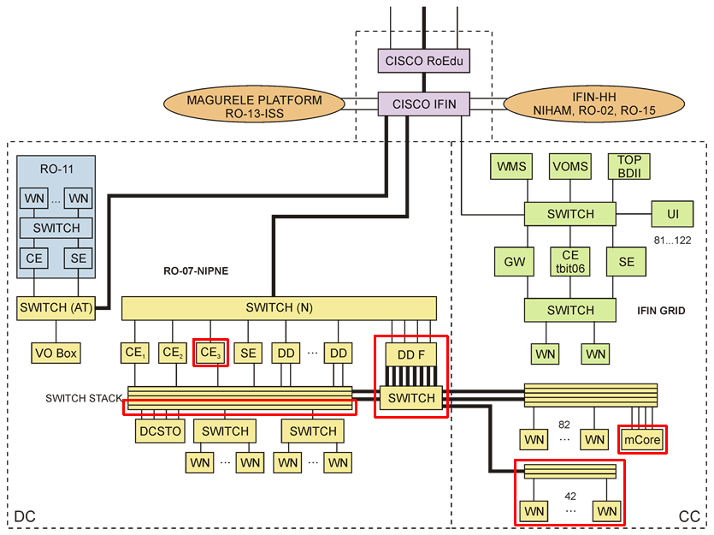
GRID SITES @DFCTI
RO-07-NIPNE, RO-11-NIPNE, IFIN GRID
DD = DPM disk server; mCore = multicore cluster
Thick lines: 10 Gbps; thin lines 1 Gbps
Encircled in red: the last 12 months’ upgrades
Grid 2014, LIT/JINR, 01.07

Slide 10
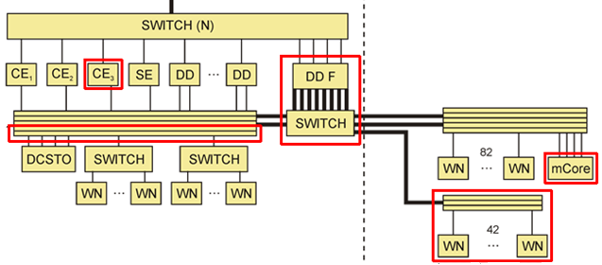
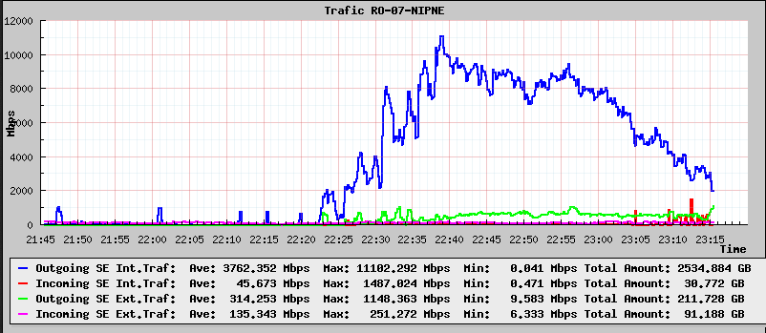
RO-07-NIPNE
RO-07 is a distributed site with scalable architecture.
LHC VOs currently supported:
ALICE production, ATLAS, LHCb
Other VOs supported:
gridifin (general purpose), ifops (monitoring)
Will support soon a new VO dedicated to ELI-NP.
Resources provided to WLCG:
2000 cores
964 TB storage capacity
Problems solved
ATLAS analysis
requires large bandwidth between DPM disk servers and worker nodes, which increases with the number of concurrent jobs.
A number of WNs that share enough bandwidth with the DDs were dedicated to analysis. The analysis queue is managed by a separate CE – tbit03.
‘Computing centre’
‘Data centre’
The concurrent running of 500 analysis jobs generates a maximum traffic of 11 Gbps from the SE to WNs
ATLAS multicore queue
An older HPC cluster, with 8 cores/node, was adapted for the running of AthenaMP (MC production jobs)
LHCb T2D
See slide 12
Grid 2014, LIT/JINR, 01.07

Slide 11
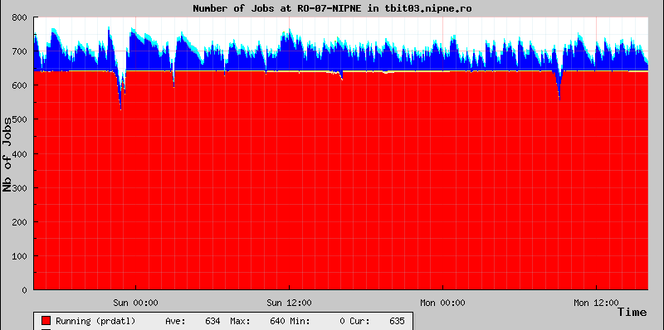
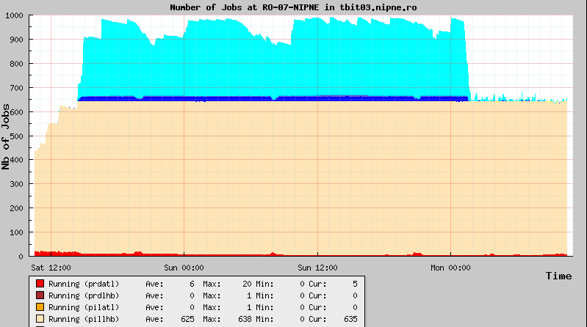
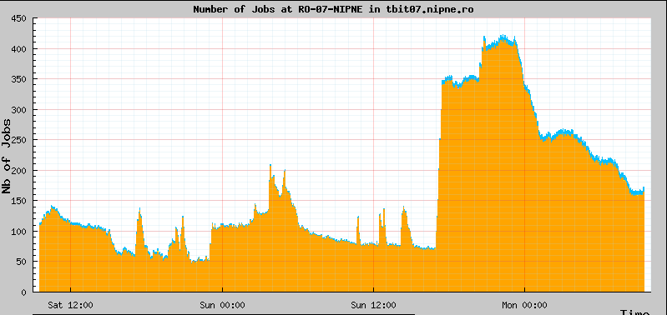
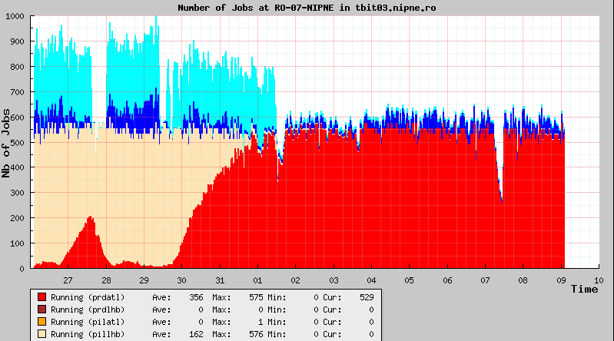
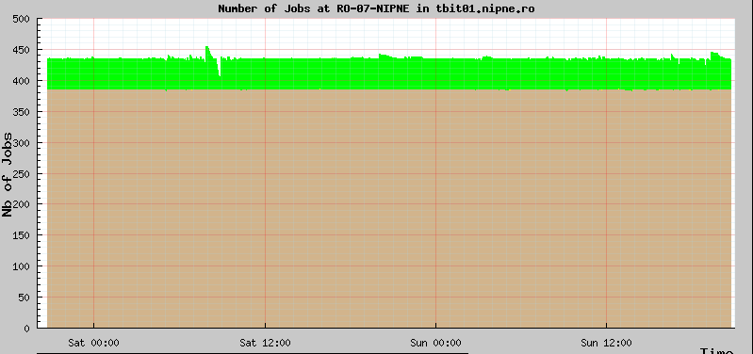
JOB MANAGEMENT
<- ATLAS production regime on tbit03
LHCb regime @tbit03
LHCb -> ATLAS transition
ATLAS analysis jobs @ tbit07
<- ALICE production jobs @ tbit01
Grid 2014, LIT/JINR, 01.07

Slide 12
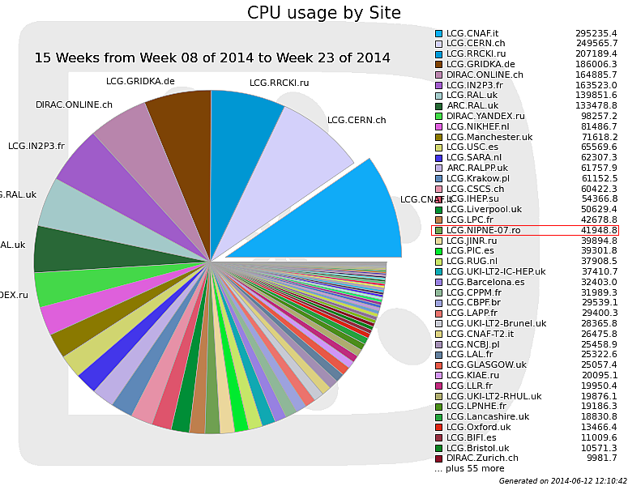
LHCb PRODUCTION
Grid 2014, LIT/JINR, 01.07

Slide 13
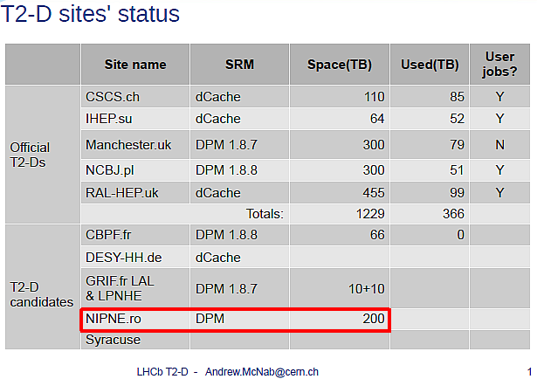
T2D CANDIDATE
The LHCb experiment recently modified the computing model (2013).
T2-D proposal: request some T2 sites to add LHCb storage and pass qualification tests to become “T2-D” sites
Storage to be used for data so can run analysis jobs at T2-Ds, but also available for use in production campaigns
Grid 2014, LIT/JINR, 01.07

Slide 14
JOINING DIRAC 4 EGI COMMUNITY
RO-07-NIPNE has recently its SE registered
See Dr. Andrei Tsaregorodtsev’s presentation
Goal: to integrate the distributed resources @DFCTI: LCG, IFIN GRID, HPC clusters
Grid 2014, LIT/JINR, 01.07

Slide 15
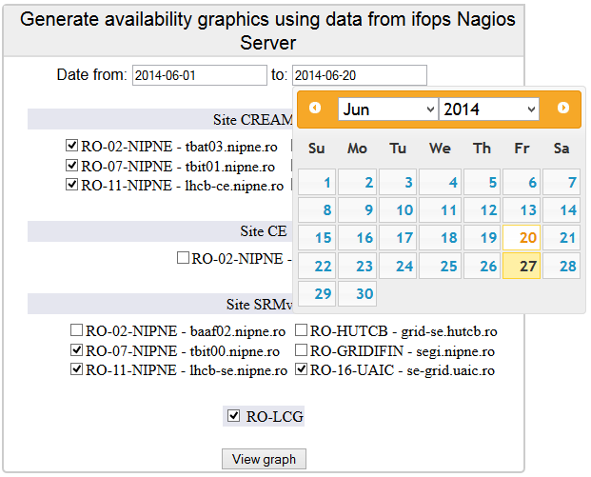
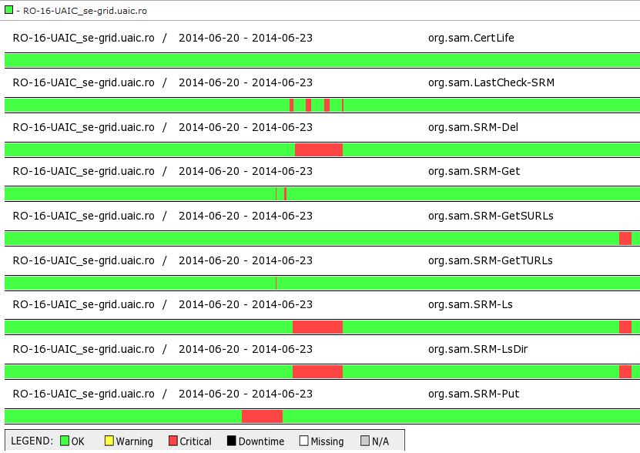
SERVICE AVAILABILITY/RELIABILITY MONITORING
DFCTI provides its own monitoring services for RO-LCG.
OPS availability tests were replaced by CERN with LHC VOs tests, but EGI is still using them.
SAM provided by IFIN GRID infrastructure, through ifops VO, which is dedicated to the monitoring of the sites of National Grid for Physics and Related Fields – GriNFiC (including RO-LCG).
Upgraded for getting more detailed info.
Grid 2014, LIT/JINR, 01.07

Slide 16
RO-LCG 2014 CONFERENCE
You are invited to the RO-LCG Conference, 3-5.11.2014, IFIN-HH, http://rolcg2014.ifin.ro
Grid 2014, LIT/JINR, 01.07

Slide 17
FUNDING/ACKNOWLEDGEMENTS
Most of the funding was provided in 2012-2014 through national projects
National contribution to the development of the LCG computing grid for elementary particle physics, project funded by the Ministry of National Education – RDI, under contract 8EU/2012
CEA - IFA Partnership, R&D project: Efficient Handling and Processing Petabite Scale Data for the Computing Centres within the French Cloud, contract C1-06/2010, co-funded by the National Authority for Scientific Research (ANCS)
Collaboration with LIT-JINR / Dubna in the framework of the Hulubei-Meshcheryakov program, project: Optimization Investigations of the Grid and Parallel Computing Facilities at LIT-JINR and Magurele Campus
Development of Grid and HPC infrastructure for complex systems physics, contract PN09370104, funded by the Ministry of National Education - RDI
Grid 2014, LIT/JINR, 01.07

