Slide 1
ARC-CE: updates and plans
Oxana Smirnova, NeIC/Lund University
1 July 2014
Grid 2014, Dubna
using input from: D. Cameron, A. Filipčič,
J. Kerr Nilsen, B. Kónya

Slide 2
ARC-CE: brief summary
Compute element by NorduGrid
A key component of ARC middleware
  Other components: clients, information services
A key enabler of the Nordic Tier-1
  Along with the distributed dCache storage
Used by all LHC experiments
  Mostly by ATLAS (so far)
    Increasing use by CMS
  The only CE used in Nordic and Baltic countries
  Main CE in Slovenia and Ukraine
  Increasing use in the UK and Germany

Slide 3
ARC-CE instances in GOCDB
cf. CREAM-CE: 566 instances as of today

Slide 4
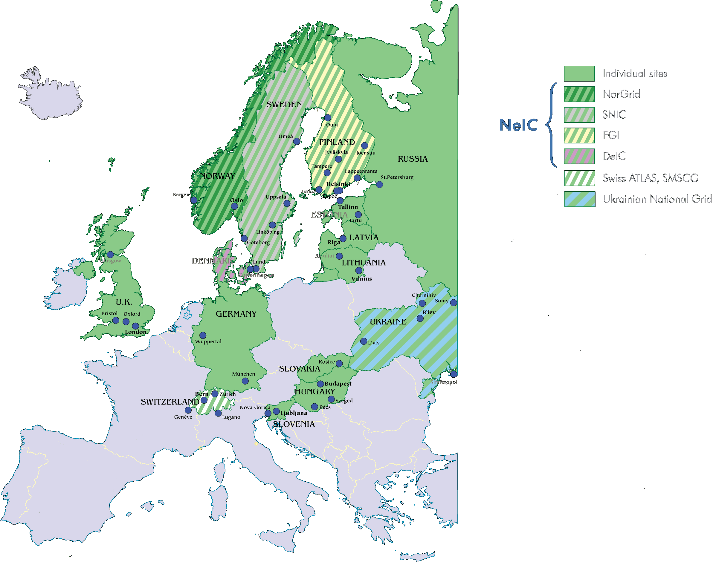
ARC-CE geography
Data as of end-2013

Slide 5
Optimisation for data-intensive jobs
Linux
Cluster
Linux
Cluster
Worker
Node
Worker
Node
Worker
Node
Worker
Node
Storage
cache
ARC-CE
Other CE
ARC-CE can do all the data transfers
Allows to cache frequently used files
Minimizes bandwidth
Maximizes worker nodes usage efficiency
ARC-CE is a rather complex service
Is built of many individual services and tools
Requires high-end storage for cache

Slide 6
ARC-CE components on a (SLURM) cluster
Shared file system
Head Node
Session
directory
Control directory
CA certificates
Cache
infoproviders
DTR
SLURM controller
A-REX
gridftp/http
Runtime env.
ARIS
JURA
users
registration
process
user
mapping
Worker
Node
Legend
(ARC components in orange):
SLURM daemon
files
Worker
Node
processes
SLURM daemon

Slide 7
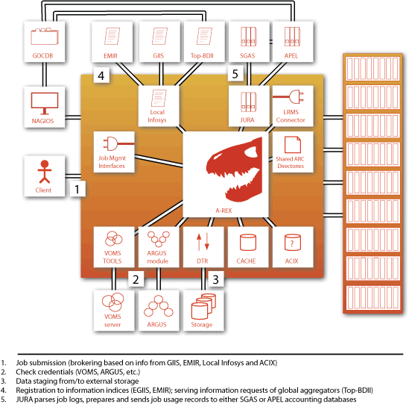
Integration with EGI services

Slide 8
Control tower for pilots: aCT
ARC Control Tower is the layer between ATLAS and ARC
  Picks up job descriptions from Panda
  Converts them to XRSL job description
  Submits and manages jobs on ARC-CEs
  Fetches output, handles common failures and updates Panda
aCT2: based on ARC API
Modular
  ARC actors: submitter, status checker, fetcher, cleaner
  ATLAS actors: autopilot, panda2arc, atlas status checker, validator

Slide 9
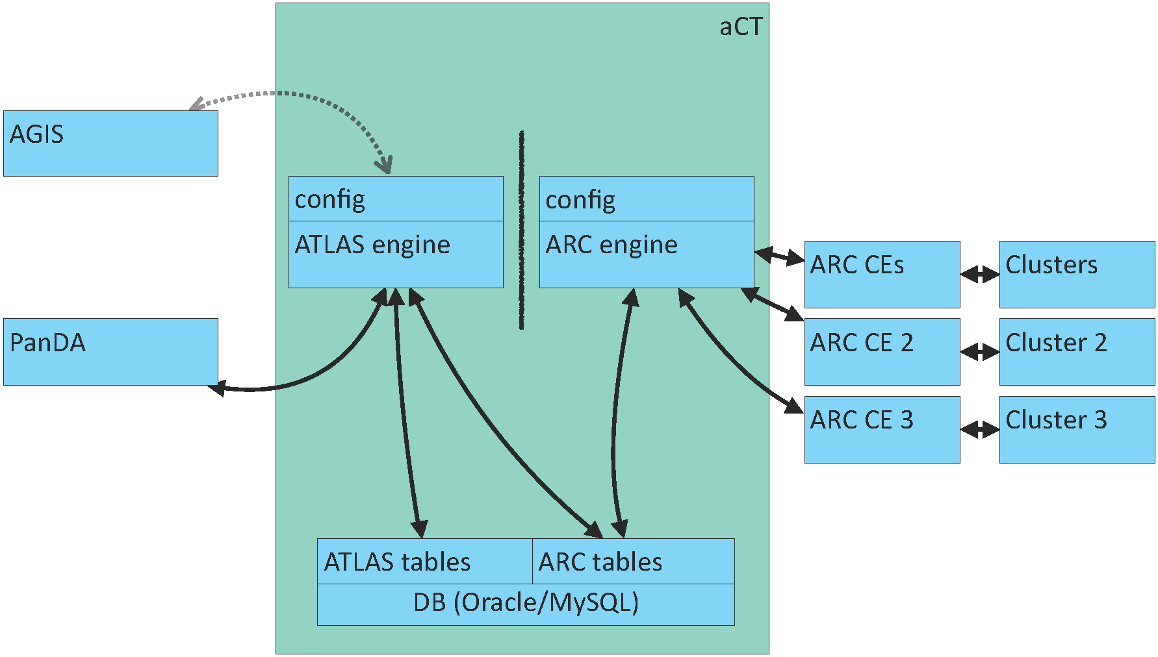
aCT2
Runs on two 24 CPU, 50GB RAM servers at CERN
  Usually one for production, one for testing
  Goal: 1 Mjobs/day
ATLAS part can be replaced by another workflow manager
  Implemented in Python

Slide 10
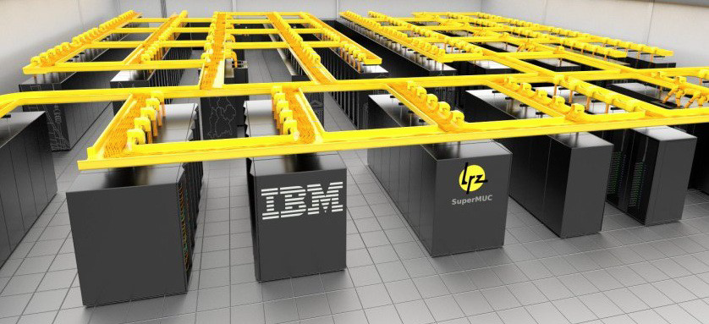
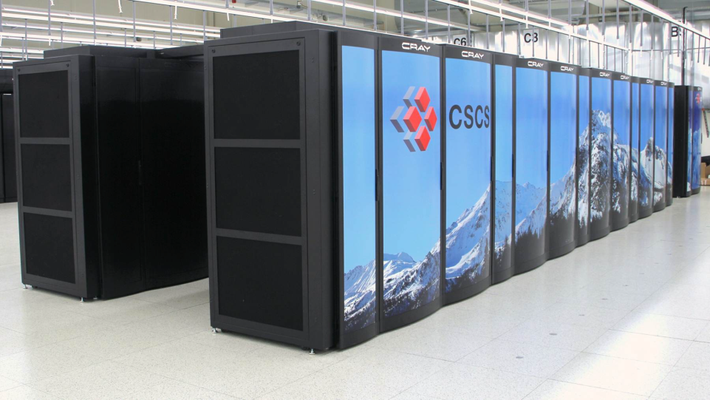
Gateways to supercomputers
ATLAS is pursuing usage of HPC resources
  Long-term funding guaranteed
  Not suitable for all kinds of jobs still
In Europe, ARC is often used as a “gateway”
  C2PAP/SuperMUC, Hydra: via aCT
  Piz Daint: via ARC-CE ssh back-end (testing)
Still, a lot remains to be done on both HEP and HPC sides to make it useable

Slide 11
HPC challenges to overcome
WAN access on nodes is limited or not available
Whole-node, whole-socket, whole-partition scheduling
Shared filesystem might suffer with heavy I/O jobs
Limited access to login/edge nodes
HPC policies and procedures
  Sites are tuned for few classes of massively parallel applications with relatively low I/O
  Limited time slots allocated
  Access via a SSH-login front node

Slide 12
Overcoming the difficulties
Custom ARC-CE service machines:
  Using RHEL6 packages on unsupported OS
  Porting to unsupported OS (SLES11)
User mode services:
  Adapting ARC-CE to run as a non-privileged user
  Limited usability (uid mapped to one batch account)
No WAN access:
  aCT, manual software sync, Parrot, no db access
    Experienced GPFS lock-up due to heavy software area usage (bug fixed by IBM)
Limited connectivity to edge nodes:
  ARC SSH backend in the works

Slide 13
ATLAS@Home: BOINC via ARC
Slide by Wenjing Wu
The scale of volunteer computing:
  At Amazon EC2 price: 1.16USD/hour for a CPU intensive Windows/Linux instance (~1.5GFLOPS)
  All BOINC activities would cost ~ (7.2PetaFLOPS/1.5GFLOPS)*1.16USD=
  =5.56M USD/hour
  Successful Individual projects:
    Einstein@home (280 TeraFLOPS),
    SETI@home (581 TeraFLOPS)
    LHC@home (2TeraFLOPS)

Slide 14
ATLAS@Home
Why use volunteer computing?
  It’s free!
  Public outreach
Considerations
  Low priority jobs with high CPU-I/O ratio
    Non-urgent Monte Carlo simulation
  Need virtualisation for ATLAS sw environment
    CERNVM image and CVMFS
  No grid credentials or access on volunteer hosts
    ARC middleware for data staging
  The resources should look like a regular Panda queue
    ARC Control Tower

Slide 15
ATLAS@Home Architecture
ARC Control Tower
http://atlasathome.cern.ch
Panda Server
Grid Catalogs and Storage
ARC CE
proxy cert
BOINC LRMS Plugin
Session Directory
Volunteer PC
Boinc Client
Shared Directory
Boinc server
VM
DB

Slide 16
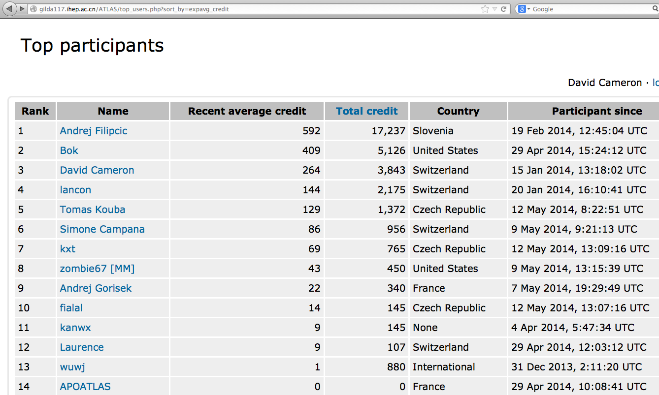
Participants
No idea who they are!

Slide 17
Summary and outlook
ARC-CE is well established beyond Nordics now
  More contributors, too
aCT2 opens up many more possibilities, such as usage of HPC and volunteer computing
  Very new, much optimisation is still needed
  … and also documentation and packaging
Future directions:
  Focus on LHC requirements
  Enhance support of HPC systems, more batch system options
  Develop more user-friendly task schedulers, using aCT2 experience

