Slide 1
ATLAS PanDA: Workload Management System for Big Data on Heterogeneous Distributed Computing Resources
Danila Oleynik (On behalf of ATLAS collaboration)
02.07.2014

Slide 2
What is PanDA?
Production and Distributed Analysis system developed for the ATLAS experiment at the LHC
Deployed on WLCG resources worldwide
Now also used by AMS and LSST experiment
Being evaluated for ALICE, NICA, COMPAS, NA-62 and others
Many international partners: CERN IT, OSG, NorduGrid, European grid projects, Russian grid projects…

Slide 3
What can PanDA do?
PanDA can manage:
Large data volume – hundreds of petabytes
Distributed resources – hundreds of computing centers worldwide
Collaborative – thousands of scientific users
Complex work flows, multiple applications, automated processing chunks, fast turn-around ...

Slide 4
A bit of History
The ATLAS experiment at the LHC
Well known for recent Higgs discovery
Search for new physics continues
PanDA project was started in Fall 2005
Goal: An automated yet flexible workload management system which can optimally make distributed resources accessible to all users
Originally developed for US physicists
Joint project by UTA and BNL
Adopted as the ATLAS wide WMS in 2008
In use for all ATLAS computing applications

Slide 5
PanDA Philosophy
PanDA WMS design goals:
Achieve high level of automation to reduce operational effort for large collaboration
Flexibility in adapting to evolving hardware and network configurations over many decades
Support diverse and changing middleware
Insulate user from hardware, middleware, and all other complexities of the underlying system
Unified system for production and user analysis
Incremental and adaptive software development

Slide 6
PanDA Scope
Key features of PanDA
Central job queue
Unified treatment of distributed resources
SQL DB keeps state of all workloads
Pilot based job execution system
ATLAS work is sent only after pilot execution begins on CE
Minimize latency, reduce error rates
Fairshare or policy driven priorities for thousands of users at hundreds of resources
Automatic error handling and recovery
Extensive monitoring
Modular design

Slide 7
PanDA Components
PanDA server
Database back-end
Brokerage
Dispatcher
PanDA pilot system
Job wrapper
Pilot factory
Dynamic data placement
Information system
Monitoring system

Slide 8
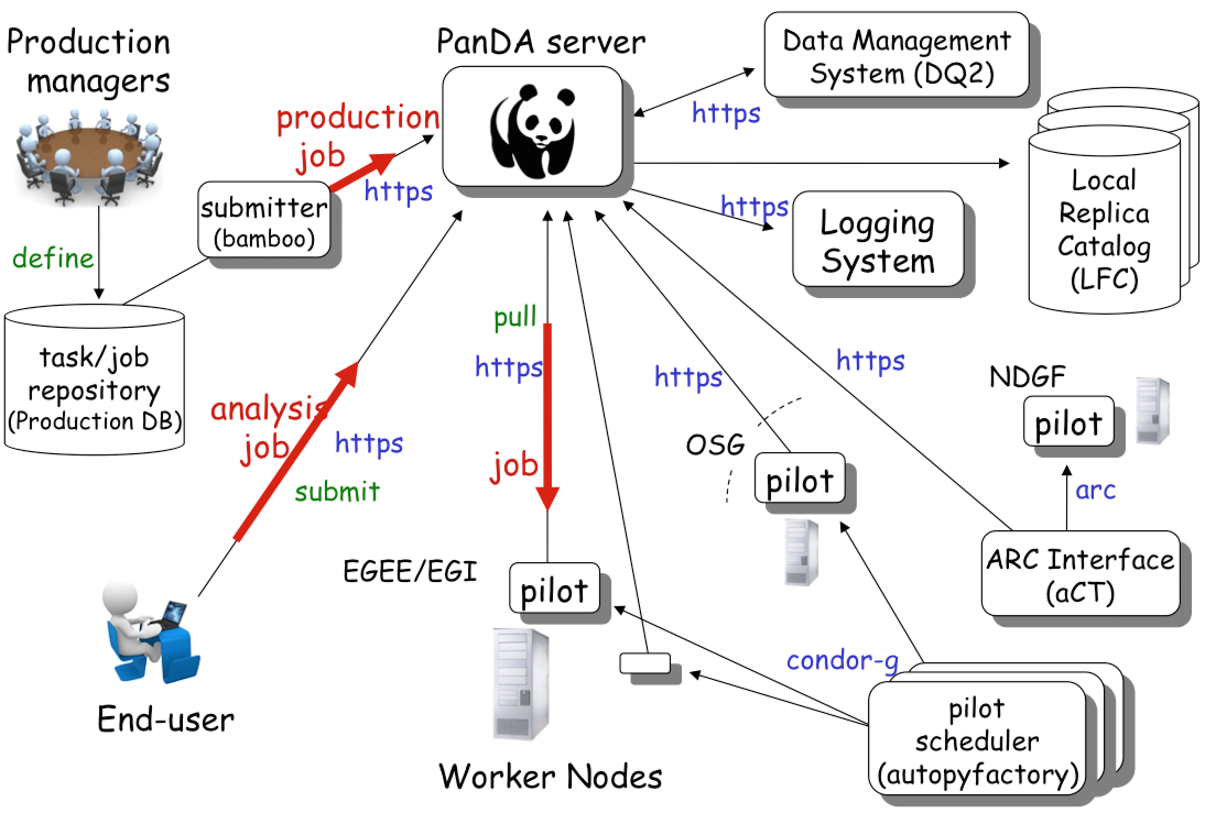
PanDA Workload Management
PanDA server

Slide 9
Jobs/month Completed by PanDA

Slide 10
LHC & ATLAS upgrade – new challenges for computing
The ADC (ATLAS Distributed Computing) software components, and particularly PanDA, managed, with contingency, the challenge of data taking and data processing
But: the increase in trigger rate and luminosity will most likely not be accompanied by an equivalent increase of available resources
One of the way for increasing efficiency of system – involving opportunistic resources: Clouds and HPC

Slide 11
Cloud Computing and PanDA
ATLAS cloud computing project set up a few years ago to exploit virtualization and clouds
To utilize public and private clouds as extra computing resources
Additional mechanism to cope with peak loads on the grid
Excellent progress so far
Commercial clouds – Google Compute Engine, Amazon EC2
Academic clouds – CERN, Canada (Victoria, Edmonton, Quebec and Ottawa), the United States (FutureGrid clouds in San Diego and Chicago), Australia (Melbourne and Queensland) and the United Kingdom
Personal PanDA analysis queues being set up
Mechanism for a user to exploit private cloud resources or purchase additional resources from commercial cloud providers when conventional grid resources are busy and the user has exhausted his/her fair share

Slide 12
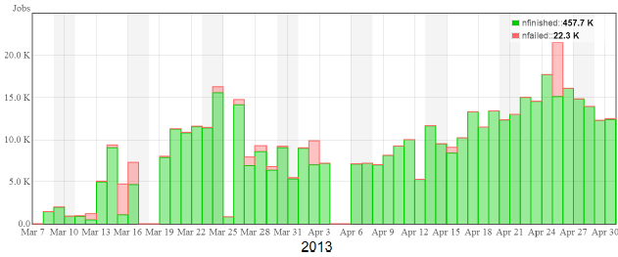
From
Sergey Panitkin

Slide 13
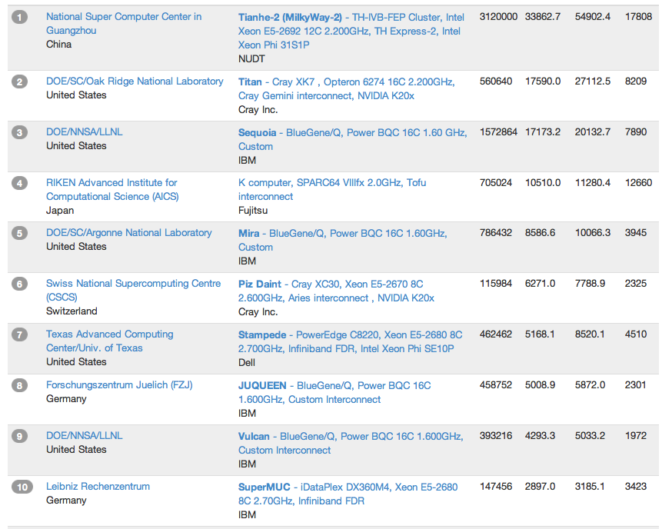
High Performance Computing (Top 10, Nov 2013)
ATLAS has members with access to these machines and to ARCHER, NERSC, …
Already successfully used in ATLAS as part of Nordu Grid and in DE

Slide 14
How to connect HPC to ATLAS Distributed Computing?
Already two solutions:
ARC-CE/aCT2
Nordu Grid based solution, ARC-CE as unified interface
OLCF Titan (Cray)
Modular structure of PanDA Pilot now allow easy integration with different computing facility.

Slide 15
ARC-CE/aCT2
More information: ARC-CE: updates and plans
Dr. Oxana SMIRNOVA on 1 Jul 2014

Slide 16
Titan LCF specialty
Parallel file system shared between nodes.
Access only to interactive nodes (computing nodes have extremely limited connectivity)
One-Time Password Authentication
Internal job management tool: PBS/TORQUE
One job occupy minimum one node
Limitation of number of jobs in scheduler for one user
Special data transfer nodes (high speed stage in/out)

Slide 17
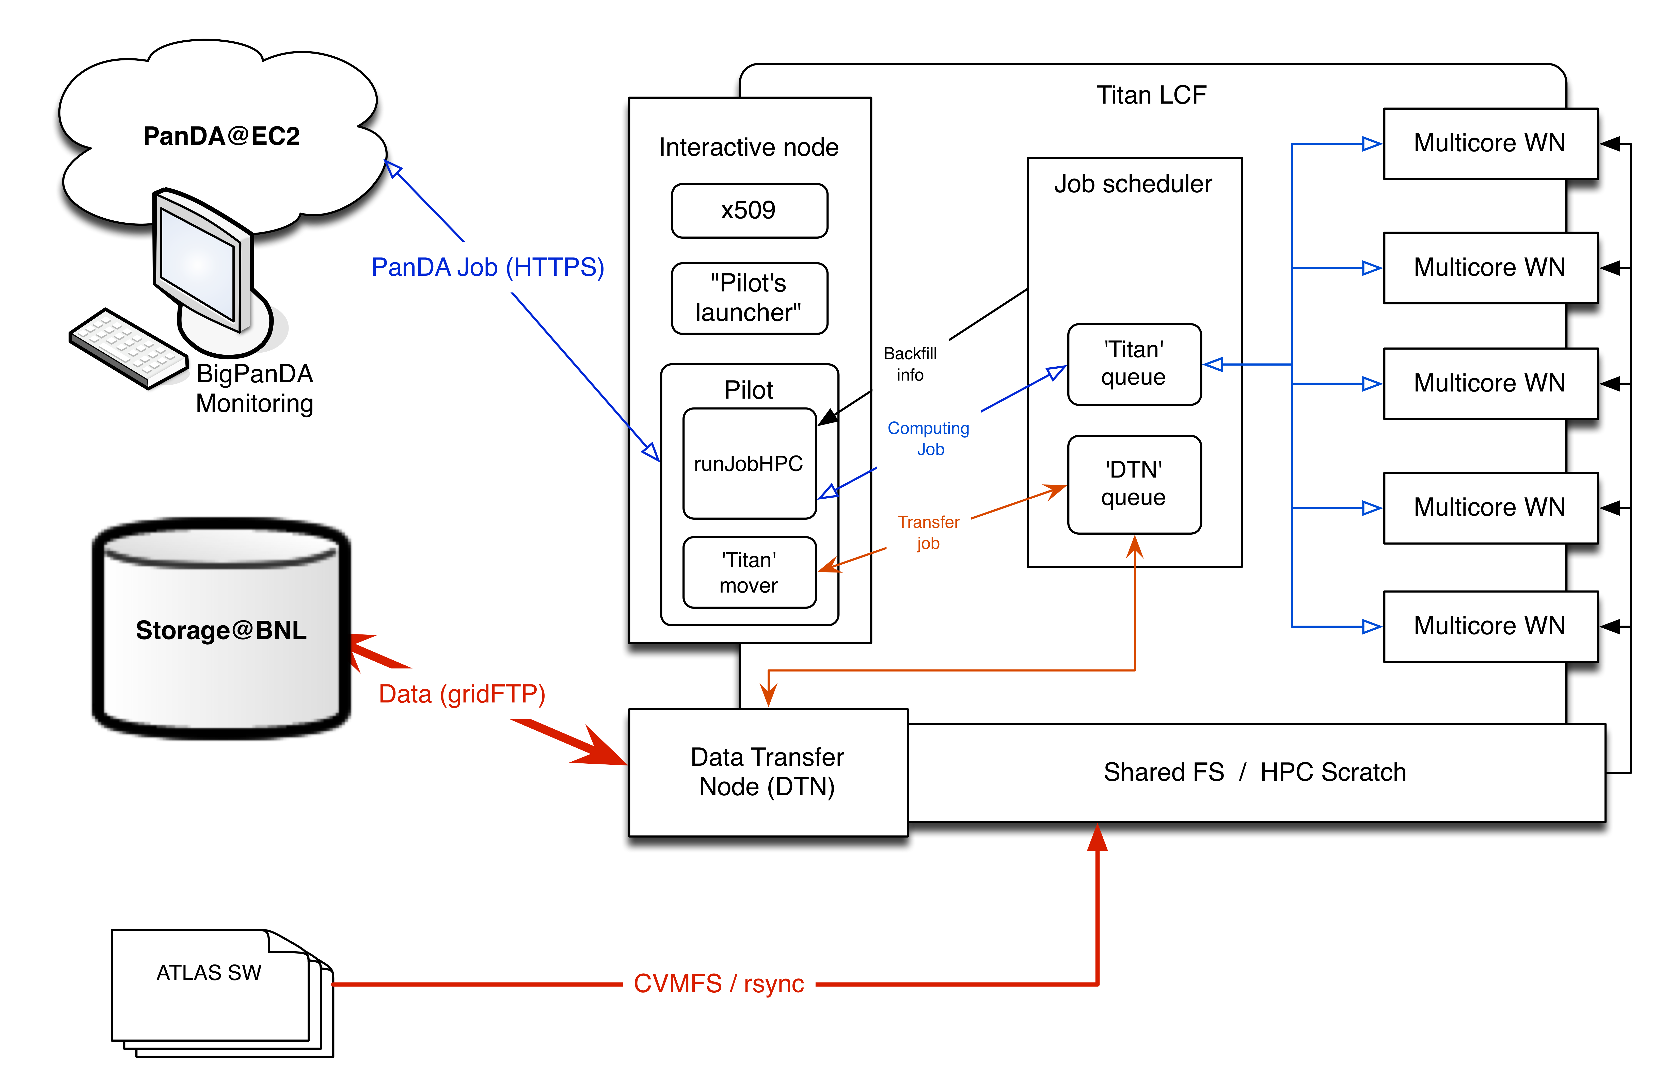
PanDA architecture for Titan
Pilot(s) executes on HPC interactive node
Pilot interact with local job scheduler to manage job
Number of executing pilots = number of available slots in local scheduler

Slide 18
SAGA API - uniform access-layer
SAGA API was chosen for encapsulation of interactions with Titan internal batch system (PBS)
High level job description API
Set of adapters for different job submission systems (SSH and GSISSH; Condor and Condor-G; PBS and Torque; Sun Grid Engine; SLURM, IBM LoadLeveler)
Local and remote intercommunication with job submission systems
API for different data transfers protocols (SFTP/GSIFTP; HTTP/HTTPS; iRODS)
To avoid deployment restrictions, SAGA API modules was directly included in PanDA pilot code
http://saga-project.github.io

Slide 19
Backfill Enabled Pilot
Typical HPC facility is ran on average at ~90% occupancy
On a machine of the scale of Titan that translates into ~300M unused core hours per year
Anything that helps to improve this number is very useful
We added to PanDA Pilot a capability to collect, in near real time, information about current free resources on Titan
Both number of free worker nodes and time of their availability
Based on that information Pilot can define job submission parameters when forming PBS script for Titan, thus tailoring the submission to the available resource.
Takes into account Titan’s scheduling policies
Can also take into account other limitations, such as workload output size, etc

Slide 20
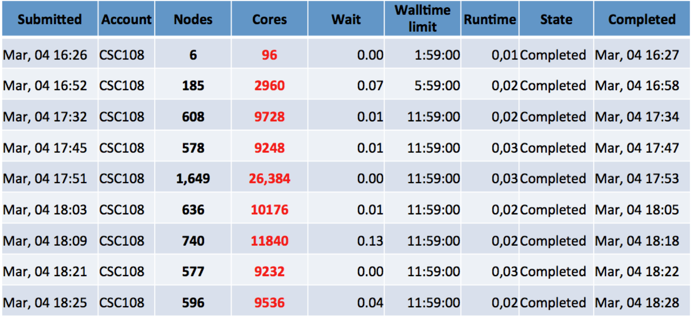
Backfill test (initial)

Slide 21
Backfill tests
Conducted together with Titan engineers
Payload : ATLAS alpgen and ALICE full simulation
Goals for the tests :
Demonstrate that current approach provides real improvement in Titan’s utilization
Demonstrate that PanDA backfill has no negative impact (wait time, IO effects, failure rate…)
Test jobs submission chain and the whole system
24h test results
Stable operations
22k core-hours collected in 24h
Observed encouragingly short job wait time on Titan (few min.)

Slide 22
Next steps
Test ‘Titan’ solution on others HPCs, on first step on other Cray machines: Eos (ORNL), Hopper (NERSC)
Improvement of Pilot for dynamic rearranging of submission parameters (available resources and walltime limit) in case job stuck in local queue
Implementation of new ‘computing backend’ plugin for ALCF

Slide 23
Acknowledgements
D.Benjamin, T.Childers, K.De, A.Filipcic, T.LeCompte, A.Klimentov, T.Maeno, S.Panitkin

Slide 24
BackUP

Slide 25
Volunteer Computing: ATLAS@Home
Goal: to run ATLAS simulation jobs on volunteer computers
Huge potential resources
Conditions:
Volunteer computers need to be virtualized (use CernVM image and CernVM FS to distribute software), so standard software can be used
Volunteer cloud should be integrated into PanDA, i.e. all the volunteer computers should appear as a site. Jobs are created by PanDA
No credentials should be put on volunteer computers
Solution: Use BOINC platform, and a combination of PanDA components and a modified version of the ARC Control Tower (aCT) located between user and PanDA Server
Project status: Successfully demonstrated in February 2014
Client running on a “volunteer” computer downloaded simulation jobs from aCT, payload was executed by PanDA Pilot and results were uploaded back to aCT which put the output files in the proper Storage Element and updated the final job status to PanDA Server

