Slide 1
Tier-1 & Tier-2
for ATLAS, ALICE & LHCb
at Kurchatov Institute (NRC KI).
Current status.
Yury Lazin,
on behalf of the Tier-s team

Slide 2
Index:
1 – Statistical information about our resource centers;
2 – Basic infrastructure of the Tier-1 & 2 centers;
3 – Some words about the future.

Slide 3
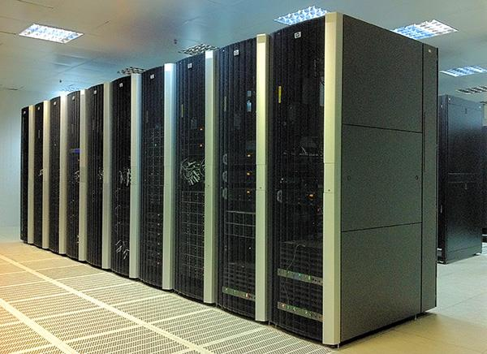
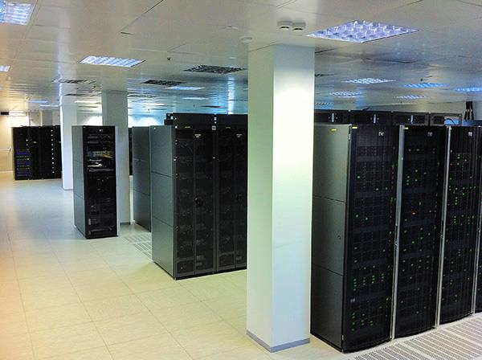
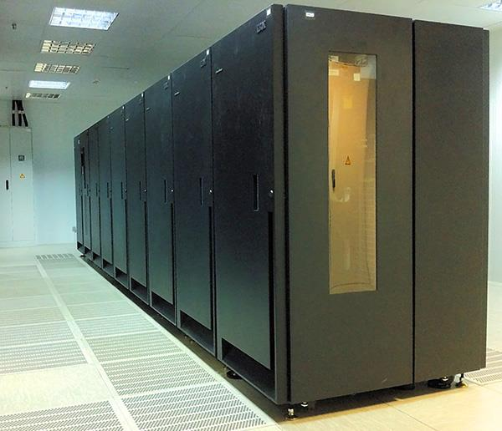
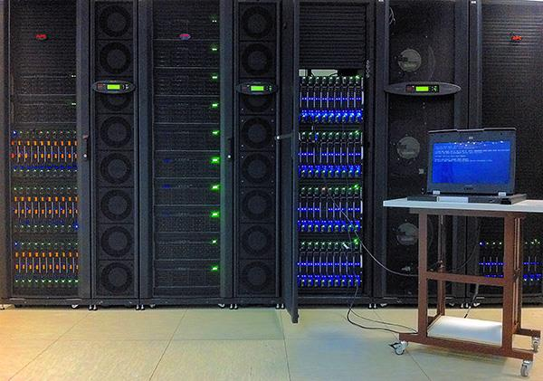
Tier-1&2 at Kurchatov Institute for the LHC experiments. Current status.
RRC-KI-T1
RRC-KI
Computing array
core / HEPSPEC06
2160 / 22700
Computing array
core / HEPSPEC06
1052 / 12540
Disk Storage System
(DSS)
2600 ТB
Tape Storage System
(TSS)
2000 ТB
DSS
636 ТB

Slide 4
Usage statistics of resources of Tier-1 (RRC-KI-T1) for LHC experiments.
This chart shows a summary of the accounting records for this site.
The records are organised according to VO (only information about LHC VOs is returned).

Slide 5
Usage statistics of resources of Tier-2 (RRC-KI) for LHC experiments
This chart shows a summary of the accounting records for this site.
The records are organised according to VO (only information about LHC VOs is returned).

Slide 6
Usage statistics of resources of centers for VO-ALICE.
Name Status Size Used Free Usage No of files Type ADD test
ALICE::RRC_KI_T1::EOS OK 150 TB 23.6% 114.6 TB 35.4 TB 764.7 K FILE OK

Slide 7
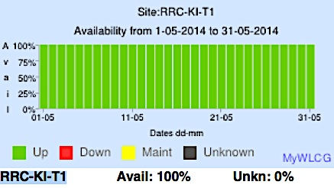
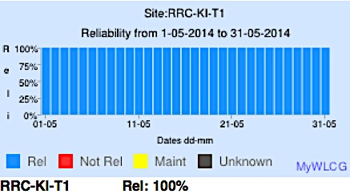
Usage statistics of resources of centers for VO-ATLAS

Slide 8
Usage statistics of resources of centers for VO-LHCb.

Slide 9
Basic infrastructure of the Tier-1&2 centers
Internal monitoring subsystem.
https://orb.t1.grid.kiae.ru/nagios/
Operational management subsystem.
Shifts, resources (Griki-DB, Puppet, e-mails, phone)
Data processing subsystem:
Processor array
2160 / 22700 core / HEPSPEC06
Telecommunications subsystem:
External links;
Internal telecommunications topology
Service subsystem:
EGI services: APEL; Top-BDII; Site-BDII; CREAM CE; ngi-SAM; SRM; VO-BOX
Tier-1 Grid services:
dCache 2.2.24 + Enstore (ATLAS) tape instance dCache 2.2.24 (ATLAS) disk instance dCache 2.6.22 (LHCb) disk instance xrootd - EOS 0.3.19 (Alice) disk instance
Internal services: NAT; DNS; Proxy
Engineering subsystems.
Electricity; Battery cabinets; Motor-generators; Refrigeration.
Storage subsystem:
Disks / Tapes 2600/2000 Terabyte

Slide 10
Operational management subsystem.
Local monitoring:
https://orb.t1.grid.kiae.ru/nagios/, Griki-DB (https://grid.kiae.ru/griki/) mail.grid.kiae.ru
Modernization of the resource center:
Griki-DB; Puppet
Operational management of the resource center.
Remote monitoring:
by means of experiments ALICE, ATLAS, LHCb, WLCG, RDIG, GStat, GOCDB, GGUS:
MonALISA, SSB/Jobs/DDM-Dashboard, SUM Dashboard, Dirac …
https://netstat.cern.ch/monitoring
Team of Rapid Response
Team of System Administrators
Solution of errors:
Griki-DB;
E-Mails; GOCDB.
Protocol:
Griki-DB; E-Mails

Slide 11
Modernization of the Tier-1:
Local monitoring
https://orb.t1.grid.kiae.ru/nagios/
GRIKI-DB:
Hostname; Software; MAC; IP; расположение…
GetHostMacIp.sh
dhcp_conf.sh
dns_conf.sh
commutators.sh
getUnused.sh
CreateNagiosConfigs.sh
Puppet:
Manifests Classes Scenarios
Network box:
DNS, DHCP, Routers, Switchs
Service box:
Storage/Data processing/Service
Team of System Administrators
Protocol:
Griki-DB, E-Mails

Slide 12
Plans by change of resources of Tier-1.
 | Currently | By the beginning of the seance in 2015.
CPU, HEP-SPEC06 | 22700 | 71000
Disks*, TБ | 2600 | 6300
Tapes, TБ | 2000 | 7400
Disks resources include buffer pool for tapes.

Slide 13
Next Steps:
1 – We need to clone GRID-admin specialists;
2 – Expanding the resource base of Tier-1;
3 – We need to sign a Memorandum of Understanding (MoU).

Slide 14
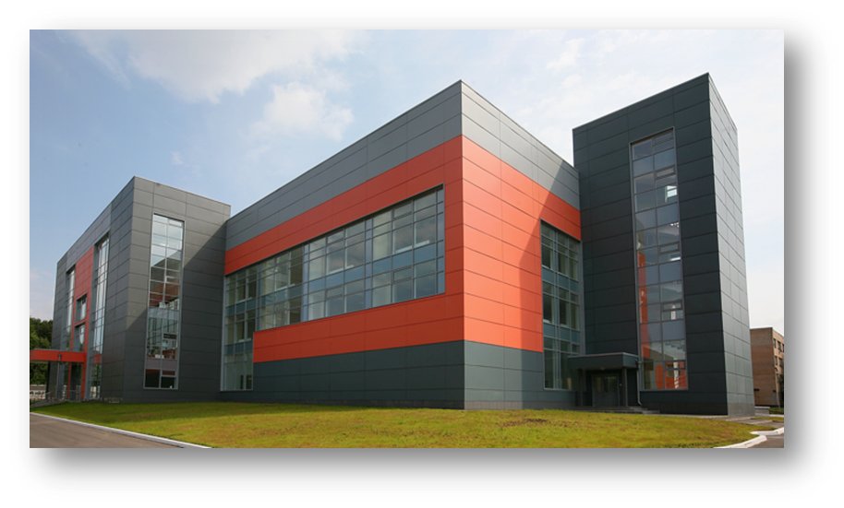
Tier-1&2 at Kurchatov Institute for the LHC experiments. Current status.
Thanks for your attention!

