Slide 1
NetMax@home the project of the voluntary distributed computing ver.4.06
The 6th International Conference "Distributed Computing and Grid-technologies in Science and Education"
Laboratory of Information Technologies (LIT) of the Joint Institute for Nuclear Research (JINR) 30 June - 5 July 2014, Dubna
Ilya Kurochkin
Institute for information transmission problem Russian academy of sciences

Slide 2
Terms
telecommunication network consisting of commutation nodes and communication links of limited capacities
network subscribers’ pairs generate a sequence of flows (requests) which have to be sent from one subscriber(source node) to another (target node)
maximize the number of fulfilled requests with different criteria of routing

Slide 3
Example of the network
Edge capacity
Target node
Source node
Intermediate nodes

Slide 4
One flow in network
Filling flow
Flow capacity

Slide 5
Put in the network several flows

Slide 6
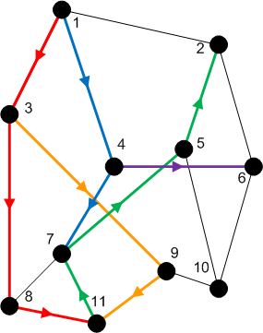
Rational use of network resource
Maximize the numbers and capacity of fulfilled flows(requests)
Increase network total capacity
Use sequential generate of requests
Solve multicommodity problem, because network have many pairs (source-target) of nodes

Slide 7
Tasks
The primary tasks which can be solved:
Check of efficiency of strategy of routing;
Determination of vulnerabilities in a telecommunication network;
Modeling on a failure for determination of reliability of corporate networks;
comparative analysis of various strategies of routing.

Slide 8
Network topology
Stochastic
Wheel
Ring with multicenter
Connected clusters
Modified tree

Slide 9
Stochastic topology

Slide 10
Wheel topology

Slide 11
Ring with multicenter

Slide 12
Rings with multicenter (Rostelecom infrastructure in Sochi 2014)

Slide 13
Connected clusters

Slide 14
Modified tree

Slide 15
Different criteria of routing
The prevailing routing algorithm is the minimum path-length algorithm or Simple algorithm (used for example in RIP routing protocol) or the minimum cost path algorithm where costs are assigned to communication lines in accordance with various criteria:
Delay factor,
Transmission bandwidth,
Reliability and etc.
(used for example in the OSPF routing protocol)

Slide 16
Groups of routing algorithms
Two groups of algorithms will be offered.
One of these is based on the concept that the next path to be developed along the edges with this moment maximum “residual” capacities.
Another group is based on computation of capacities of minimal cuts among all pole pairs on the basis of data about network edge “residual” capacities as well as on acceptance of probability law for requirement distribution among pole pairs

Slide 17
Algorithms of routing
Simple algorithm (minimal length)
Edge group (economy small edges capacity)
Edge algorithm
Suboptimal edge algorithm
Minimal cut group (economy small minimal cuts)
Suboptimal minimal cut algorithm
Additive minimal cut algorithm
Hybrid algorithm

Slide 18
NetMax project use
Routing in SDH/SONET networks;
Management of flows in the distributed systems of storage and data transmission;
Problem of development of a city road network;
Routing and planning in IP-networks for autonomous system or its segments at use MPLS and tunneling;
Management in SDN&NFV
Channel routing with the centralized management.

Slide 19
Use in high-performance computing (HPC)
The toolkit is implemented in the addition (toolbox) to Matlab environment.
For tasks of high computing complexity the versions for usage in multiprocessor systems and the version for the distributed computing (on BOINC platform) is implemented.

Slide 20
Problems of experiments in NetMax@home project
Various time of performance of iterations from several minutes to 1 month
Large volume of input data (~ 2 GB)
and results for one round of experiment (1-5 TB)
The format of the output data didn't allow to work with results of experiments effectively
Lack of an assessment of operating time of each iteration
Social and organizational aspects of the voluntary distributed calculations

Slide 21
Input data
Input file: 60-500 KB for one iteration (work unit)
One network modeling results: 0.1 – 25 MB
Number of iterations: from 20 000 to 100 000 for each round of experiment
Assessment of operating time of each iteration
NetMax@home ver. 4.06

Slide 22
Possible experiments in NetMax@home
Definition of the most suitable algorithm of routing of paths for a set of networks with certain characteristics
Choice of topology of a network on estimated loading
Finding of weak places in a network
Determination of significant parameters at creation of networks with the set properties
Modeling SDN(Software-defined Network)

Slide 23
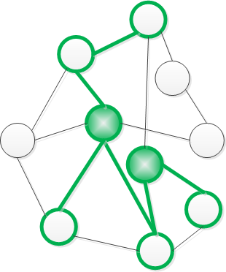
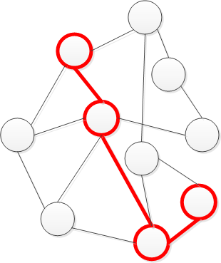
Next step
Add new subgraph
Add new path

Slide 24
Thank you for attention
Institute for information transmission problem Russian academy of sciences (IITP RAS) Centre for distributed computing
web: distributed-computing.ru
e-mail: qurochkin@gmail.com

