Slide 1

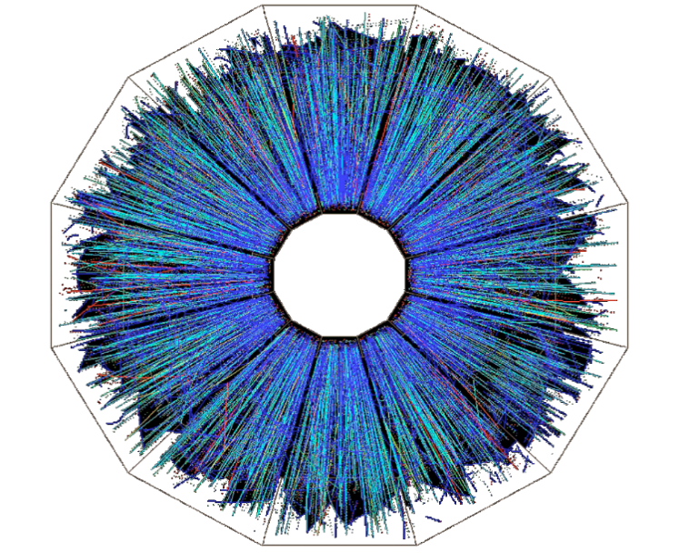

STAR Experiment at RHIC
Investigation of the Properties of Nuclear Matter
and Particle Structure at the Collider of Relativistic Nuclei
and Polarized Protons
Project STAR (JINR Participation)
A. Aitbaev, A.A. Aparin, G.S. Averichev, H.N. Agakishiev, N.A. Balashov, T.G. Dedovich, I.Zh. Bunzarov, N.Y. Chankova-Bunzarova, V.B. Dunin, P. Filip, A.O. Kechechian, O. Kenzhegulov, K.V. Klygina, V.V. Korenkov, A.A. Korobitsyn, R. Lednický, V.V. Lyuboshitz, S.I. Manukhov, V.V. Mitsyn, M.P. Osmachko, G.A. Ososkov, Yu.A. Panebrattsev, S.S. Panyushkina, E.A. Pervyshina, E.V. Potrebenikova, N.E. Sidorov, E. Shakhaliev, S.I. Snigirev, M.V. Tokarev, A. Tutebaeva, N.I. Vorontsova, S.F. Vokal, I. Zborovsky
Leaders: Richard Lednický, Yury Panebrattsev
JINR PAC for Particle Physics, 22 June 2021

Slide 2
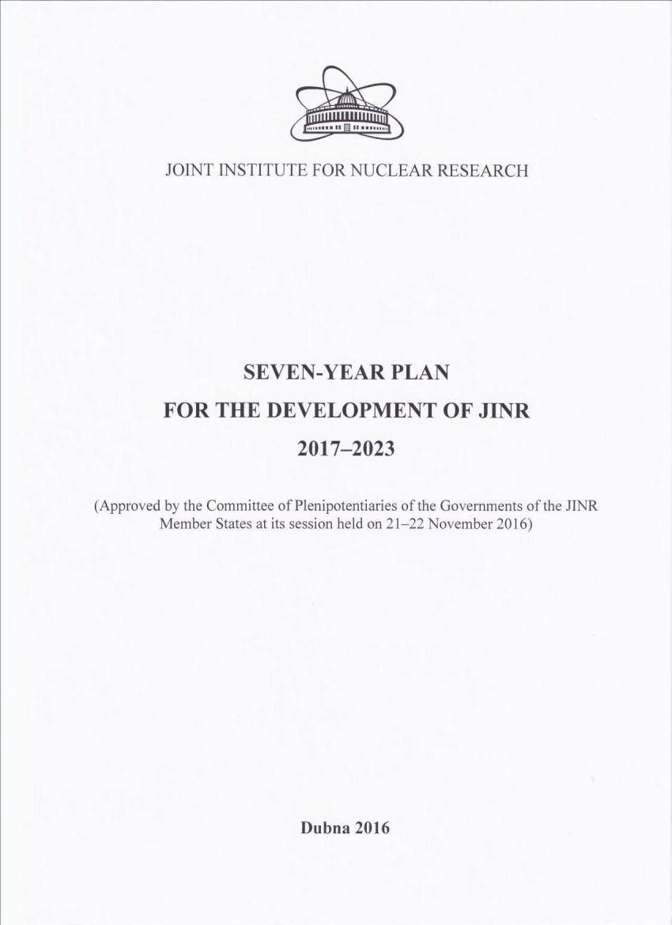
JINR 7-year Plan (2017–2023)
STAR Experiment at RHIC
Search for new fundamental laws of nature
Obtaining new results in the energy scan program in the STAR experiment at RHIC

Slide 3
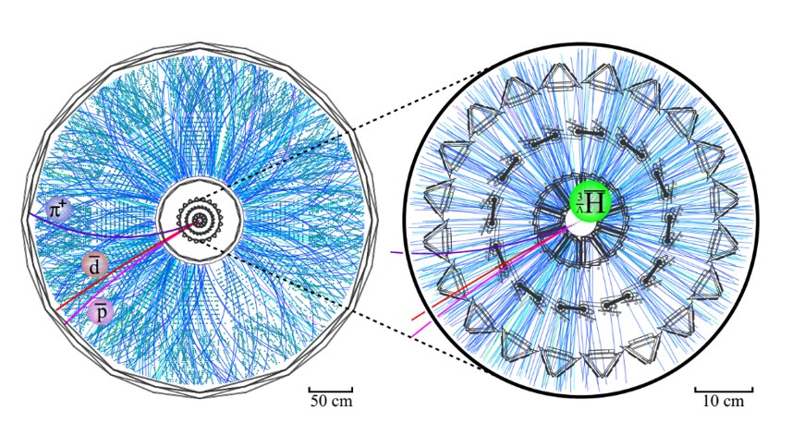
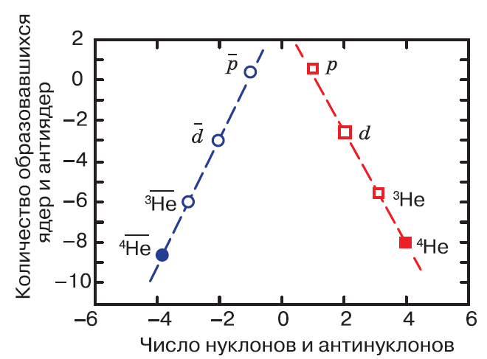
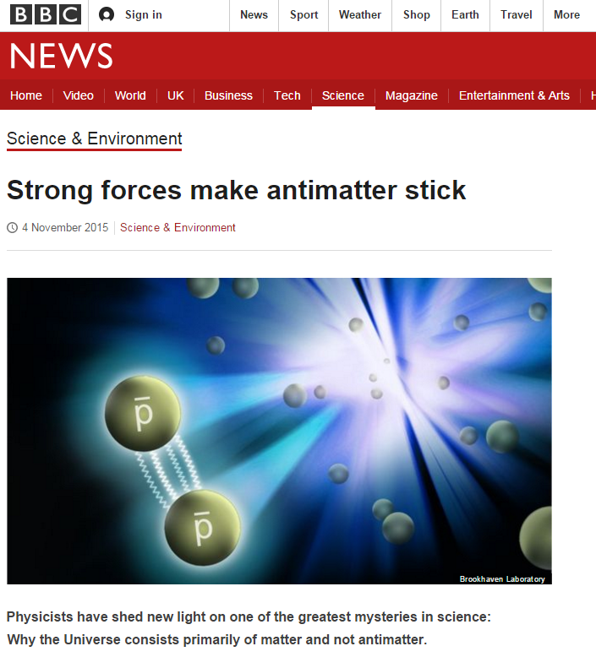
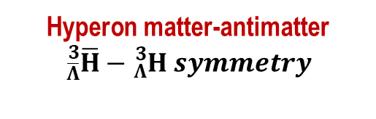


Search for New Fundamental Laws of Nature
No significant mass difference between the matter-antimatter partners explored at RHIC – No evidence of CPT violation.
Science, 328 (2010) 58
Nature, 473 (2011) 353
Nature 527 (2015) 345
Nature Physics, 16 (2020) 409
Proton-antiproton
$$matter=antimatter$$
Antiproton interactions
$$pp \& \overline{p}\overline{p} universality$$
Hyperon matter-antimatter
$${}_{\overline{Λ}}^{3}{\overline{H}}−{}_{Λ}^{3}{H symmetry}$$
Number of produced nuclei
and antinuclei
Number of nucleons and antinucleons

Slide 4
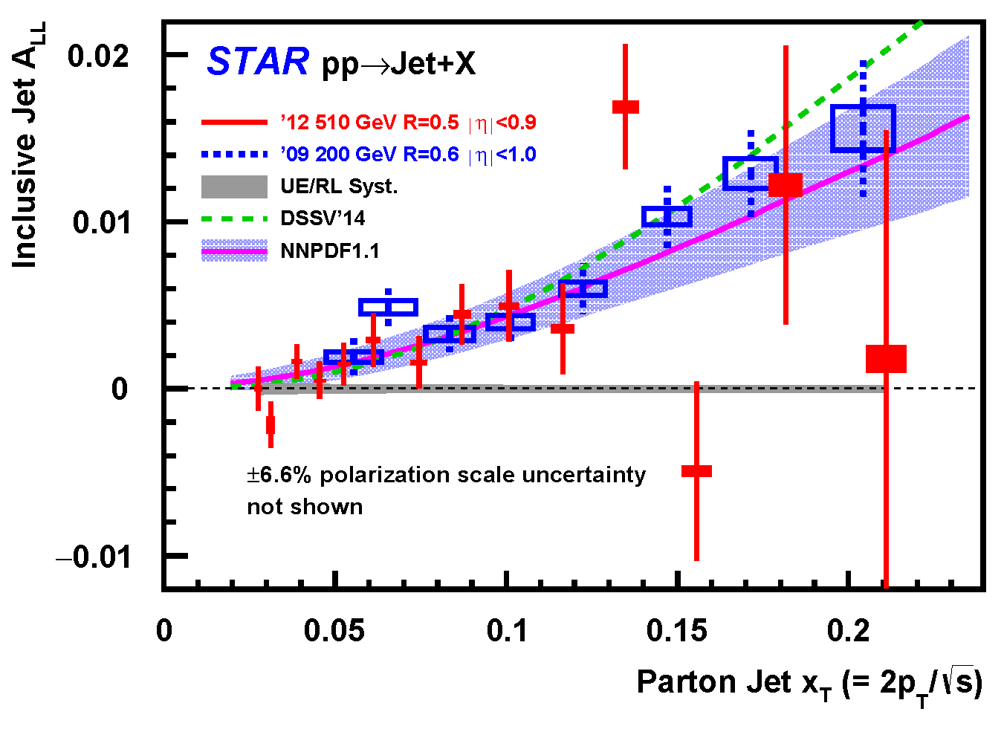


Search for New Fundamental Laws of Nature
Polarization Phenomena
Polarization of the sea quarks
$$∆\overline{d}≠∆\overline{u}$$
Asymmetry of jet production
$$∆G>0$$
Phys. Rev. D 99 (2019) 051102
Phys. Rev. D 100 (2019) 052005
A positive integral contribution of gluons to the proton spin was found (510 GeV, jets).
The asymmetry of spin-dependent sea anti-u and anti-d quark distributions in a proton was found (510 GeV; W, Z bosons).

Slide 5
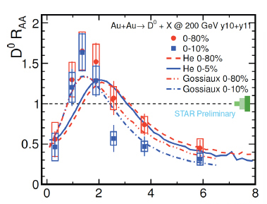



Search for New Fundamental Laws of Nature
Heavy Quarks
Heavy quark suppression
$D^{0}$, $D^{+}$, $D_{s}^{+}$, $Λ_{c}^{+}$, $J/ψ$, $Υ$
Elliptic flow for heavy quarks
$$D^{0}and other hadrons$$
Phys. Rev. C 99 (2019) 034908
PRL 118, 212301 (2017)
A significant suppression of D⁰ meson yields at large transverse momenta was established.

Slide 6
BES-I Result: Net-Protons Number Fluctuations
STAR Collaboration
“Net-proton number fluctuations and the QCD Critical Point”
Phys. Rev. Lett., 126, 92301 (2021)
Event-by-event net-proton number distributions
Cumulants (C_{n}) of the net-proton distributions
$Sσ$ and $κσ^{2}$ as a function of collision energy
The first evidence of a non-monotonic variation in kurtosis × variance of the net-proton number distribution as a function of $\sqrt{s_{NN}}$ with 3.1σ significance, for central Au + Au collisions was found.

Slide 7
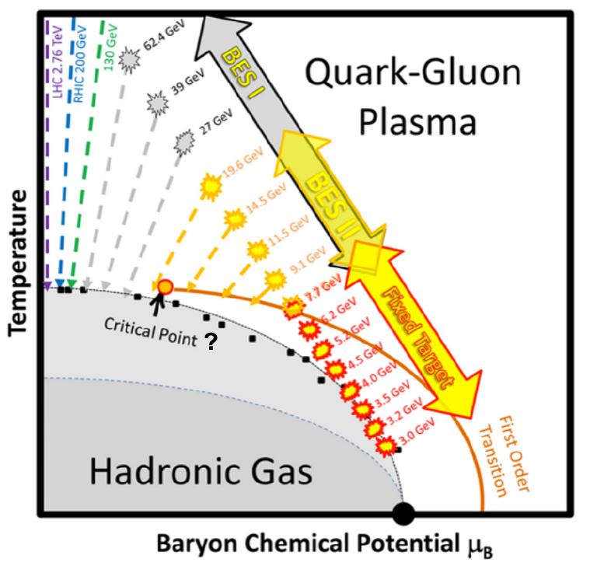

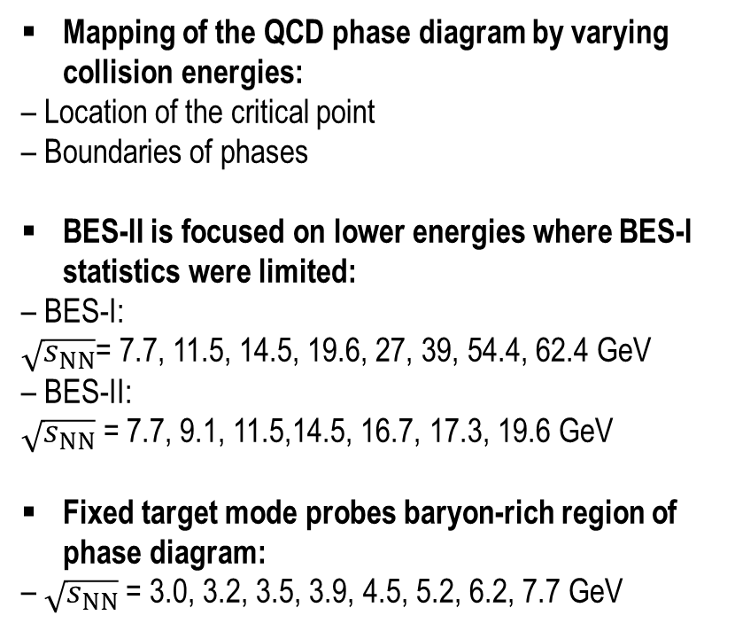
Beam Energy Scan II: 2019–2021
Mapping of the QCD phase diagram by varying collision energies:
– Location of the critical point
– Boundaries of phases
BES-II is focused on lower energies where BES-I statistics were limited:
– BES-I:
$\sqrt{s_{NN}}$= 7.7, 11.5, 14.5, 19.6, 27, 39, 54.4, 62.4 GeV
– BES-II:
$\sqrt{s_{NN}}$ = 7.7, 9.1, 11.5,14.5, 16.7, 17.3, 19.6 GeV
Fixed target mode probes baryon-rich region of phase diagram:
– $\sqrt{s_{NN}}$ = 3.0, 3.2, 3.5, 3.9, 4.5, 5.2, 6.2, 7.7 GeV
Energy range: $\sqrt{s_{NN}}$ = 3.0–200 GeV
Baryon density range : μ_{B} = 25–720 MeV
Temperature range : T_{ch} = 60–166 MeV

Slide 8
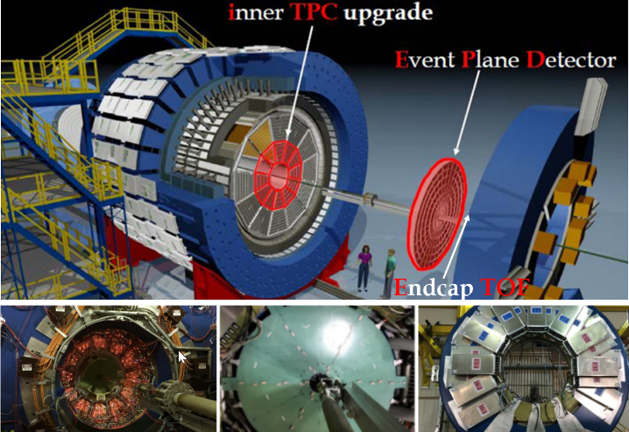
BES-II STAR Detector Configuration
STAR Experiment at RHIC
iTPC upgrade:
Replaces ageing wires;
Sparse pads → cover full area
→ better dE/dx
–1 < η < 1 → –1.7 < η < 1.7
p_{T} > 125 MeV/c → p_{T} > 60 MeV/c
EPD upgrade:
Replaces ageing BBC.
Greatly improved Event Plane info.
Better trigger & b/g reduction.
eTOF upgrade
Z = –270 cm
R_{min} = 110 cm
R_{max} = 220 cm

Slide 9
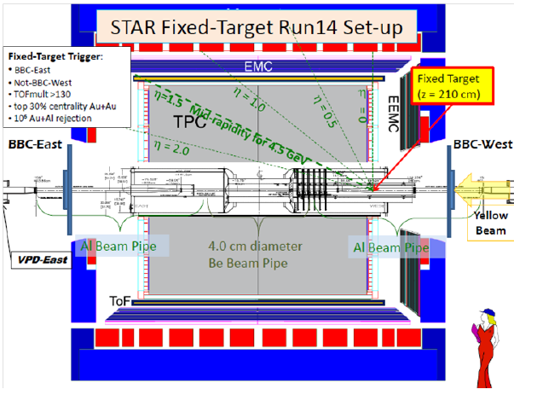
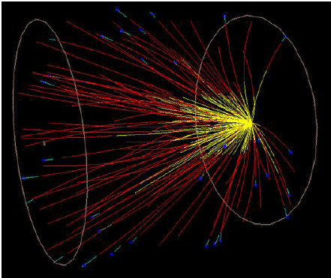
BES-II and Fixed Target Configuration
STAR Experiment at RHIC
Fixed Target Program extends STAR’s physics reach to region of compressed baryonic matter.

Slide 10
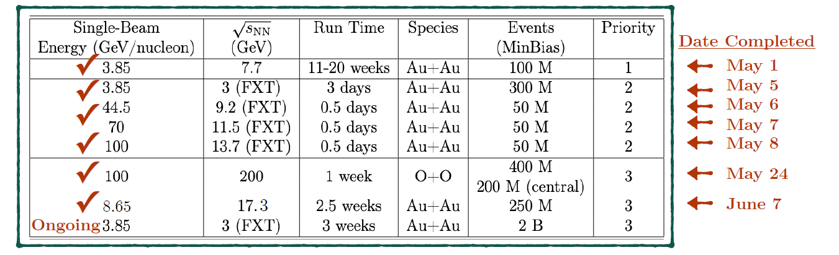
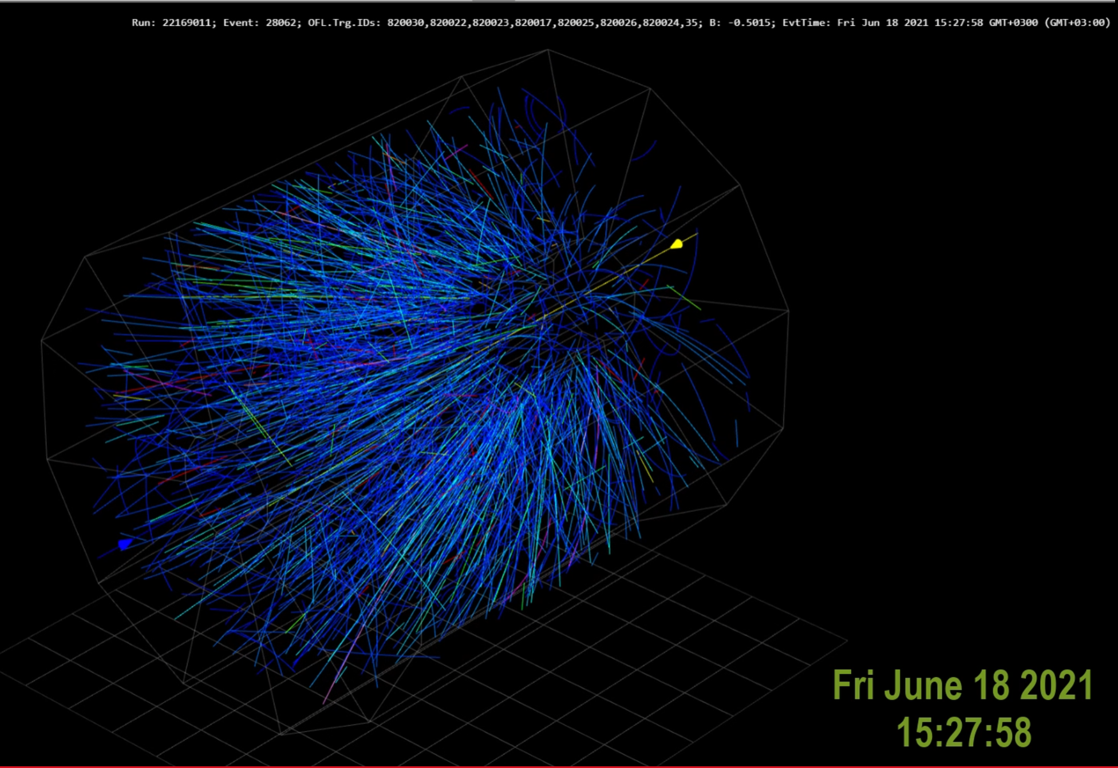
Beam Energy Scan II: RUN’21
STAR has had a very successful run while adopting a safe covid-era shift paradigm.
Running Fixed Target at 3 GeV

Slide 11
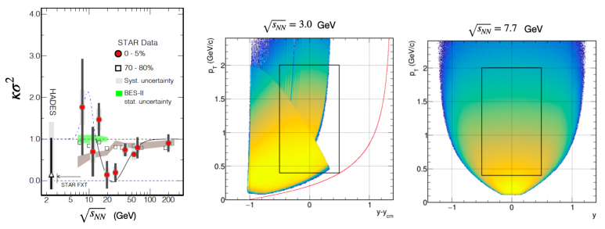
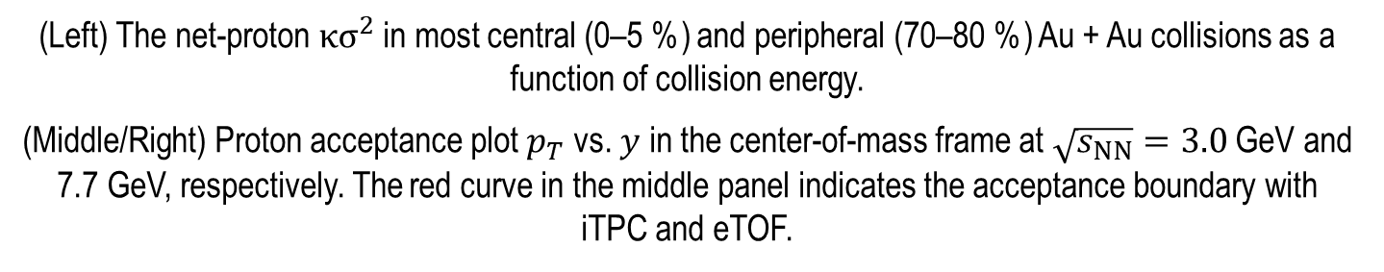
High Moments of Net-Proton Multiplicity Distribution
(Left) The net-proton ${κσ}^{2}$ in most central (0–5 %) and peripheral (70–80 %) Au + Au collisions as a function of collision energy.
(Middle/Right) Proton acceptance plot $p_{T}$ vs. $y$ in the center-of-mass frame at $\sqrt{s_{NN}}=3.0$ GeV and 7.7 GeV, respectively. The red curve in the middle panel indicates the acceptance boundary with iTPC and eTOF.

Slide 12
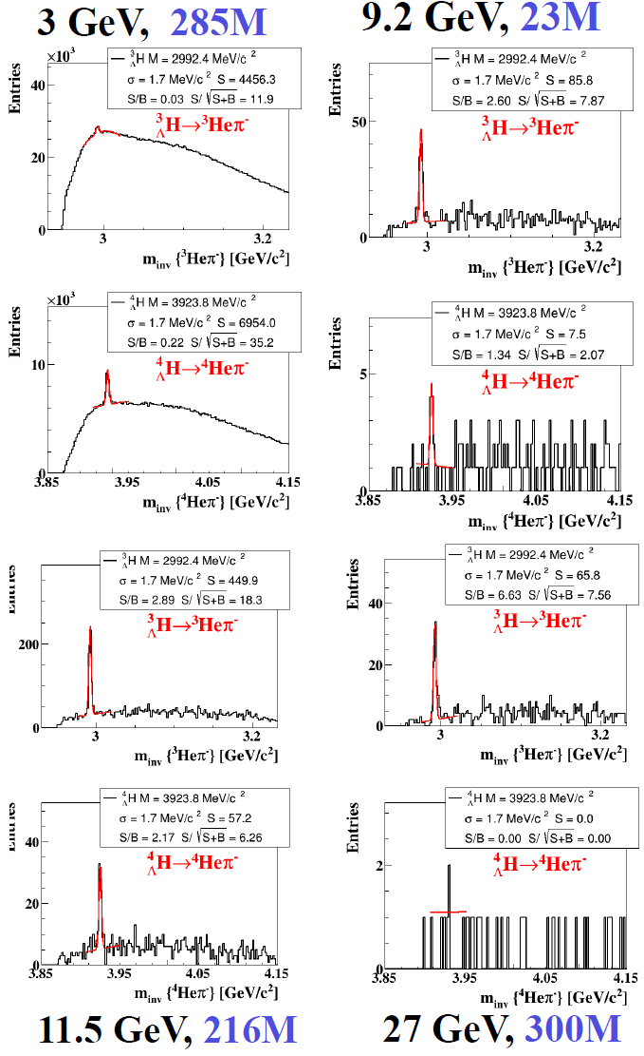
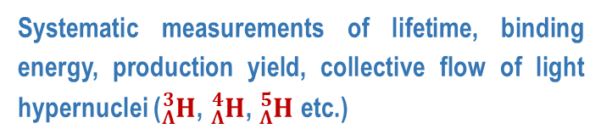
BES-II and Hypernucleus Physics
Theoretical calculations
Systematic measurements of lifetime, binding energy, production yield, collective flow of light hypernuclei (${}_{Λ}^{3}H$, ${}_{Λ}^{4}H$, ${}_{Λ}^{5}H$ etc.)

Slide 13
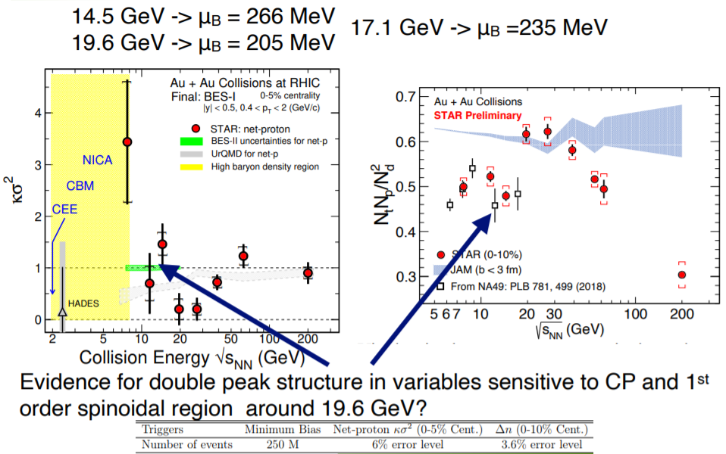

BES-II Additional Measurement at 17.3 GeV
Evidence for double peak structure in variables sensitive to Critical Point and first order spinoidal region around 19.6 GeV?

Slide 14
JINR Group Contribution
STAR Experiment at RHIC

Slide 15
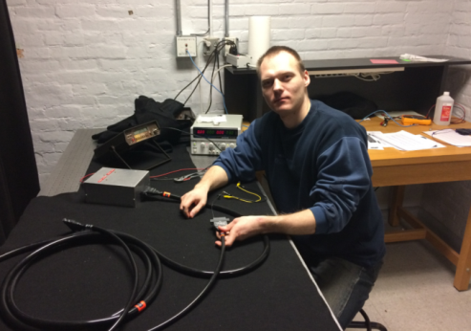
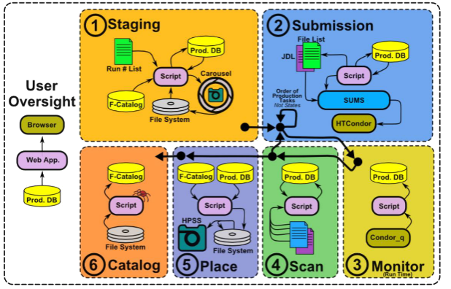

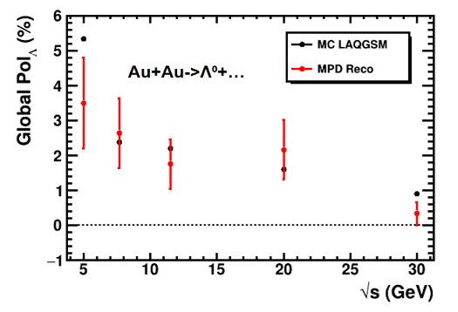
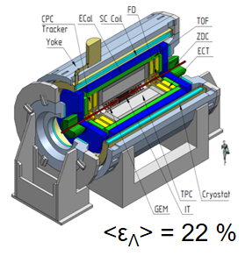
JINR Results
Event Plane Detector
Assembling and testing
JINR GRID Computing
Data processing in Dubna
Data taking and data analysis
STAR for NICA
Simulation of global polarization
Remote participation in shift runs as shift crew and QA shifts
Study of global polarization phenomena
Event-by-event fractal analysis, study of self-similarity and fractal properties of nucleus-nucleus interactions
Development of new particle identification methods for net baryon fluctuations
Implementation of EPD in data analysis
Development of data processing infrastructure
Involving of university students to data analysis (Bachelor and Master theses)

Slide 16
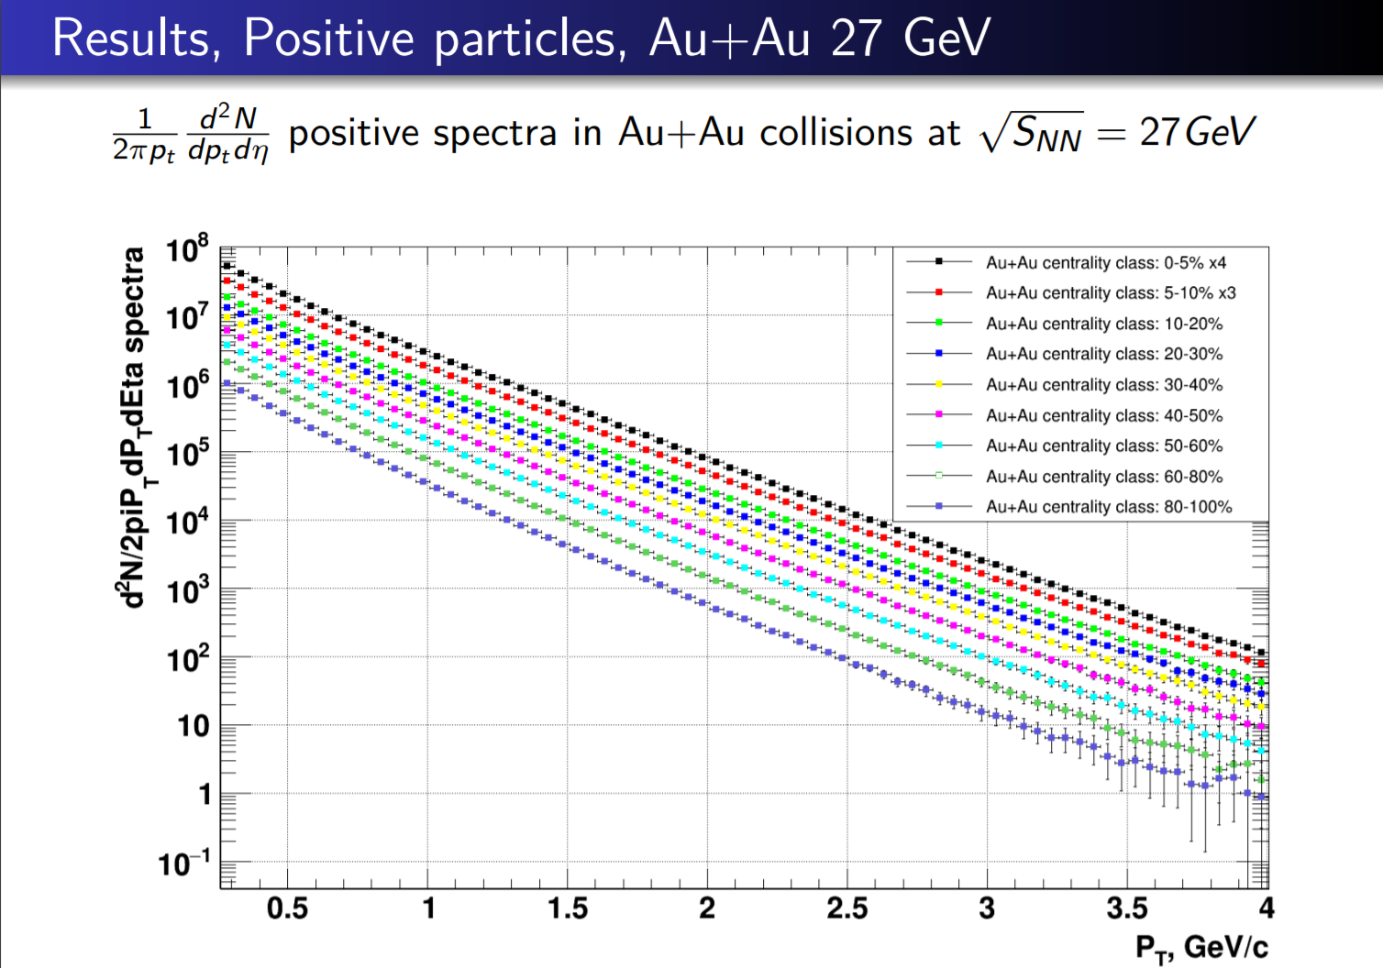
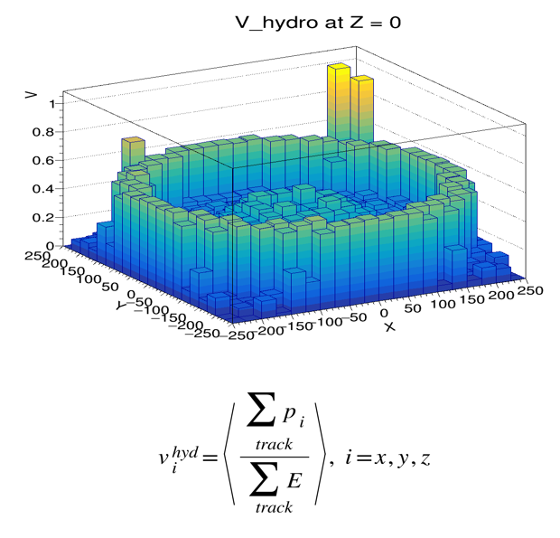
Student Results
S. Manukhov, A. Aitbaev
STAR BES Au + Au spectra at 27 and 54 GeV (STAR Meeting, Mart 3, 2021)
E. Pervyshina
Study of particle multiplicity (UrQMD Au + Au at 9 GeV). Presented at AYSS-2020, published in AIP conference series in 2021
Preliminary
S. Snigirev, S. Panyushkina
Study of vorticity and helicity in heavy ion collisions
A. Korobitsyn
Machine learning for particle identification at STAR and MPD/NICA
A. Tutebayeva, O. Kenzhegulov
Nuclear modification factor in Au + Au collisions in STAR experiment
I. Kirutin
High moment multiplicity distribution and identity method in heavy ion collisions

Slide 17
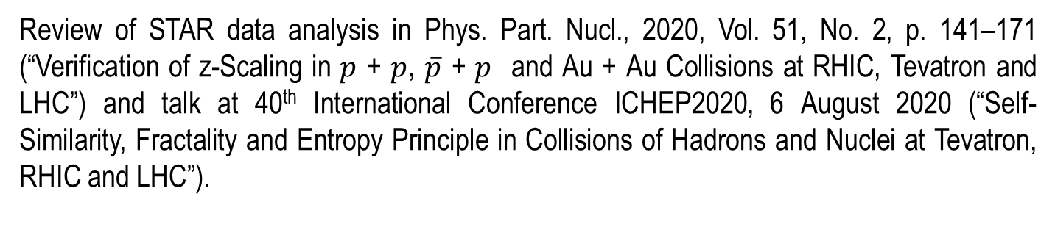
JINR Group Results
STAR Experiment at RHIC
High-p_{T} spectra of negative hadrons in Au + Au collisions at $\sqrt{s_{NN}}$= 7.7, 9.2 GeV
STAR Meeting, September 2020
Constituent level analysis of particle production
Nucl. Phys. A993 (2020) 121646 (47 p.)
Phys. Part. Nucl., 2020, Vol. 51, No. 2, p. 141
Phys. Part. Nucl. Let., 2021, Vol. 18, No. 3, p. 302
Event-by-event study of fractal structure
Phys. Part. Nucl. Lett., 16, 3, 240–250 (2019)
Phys. Part. Nucl. Lett., 18, 1, 113–133 (2021)
STAR Meeting, September 2020
Cumulative production in Au + Au at STAR
Nucl. Phys. A993 (2020) 121646 (47 p.)
Strangeness production in p + p collisions at RHIC
Phys. Part. Nucl. Lett., 2021, v.18, № 3, pp. 302–314
Review of STAR data analysis in Phys. Part. Nucl., 2020, Vol. 51, No. 2, p. 141–171 (“Verification of z-Scaling in $p$ + $p$, $\overline{p}$ + $p$ and Au + Au Collisions at RHIC, Tevatron and LHC”) and talk at 40th International Conference ICHEP2020, 6 August 2020 (“Self-Similarity, Fractality and Entropy Principle in Collisions of Hadrons and Nuclei at Tevatron, RHIC and LHC”).

Slide 18
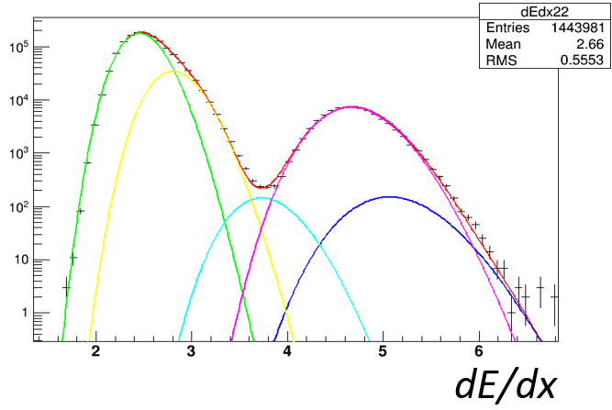
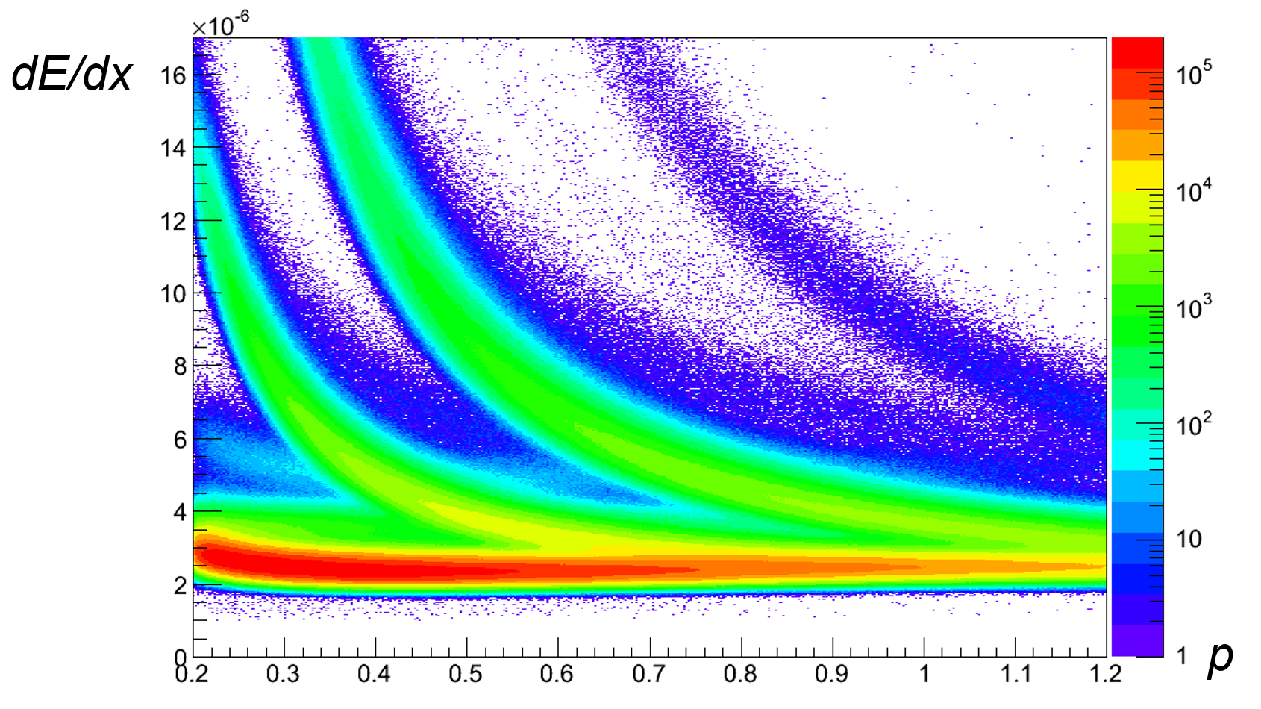
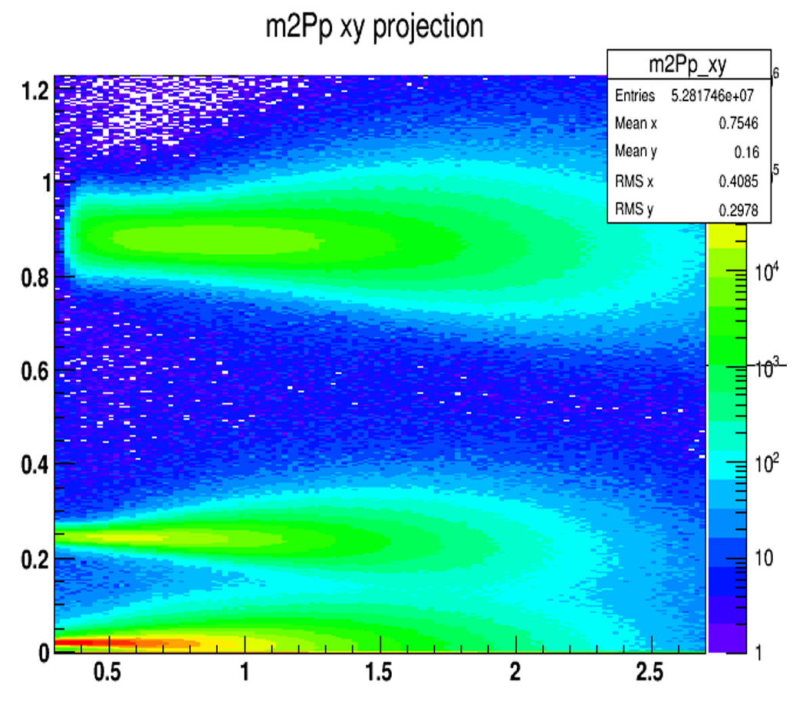
Development of new method of particle identification
STAR Experiment at RHIC
The Statistical Method of PID at STAR (The Identity Method)
Particle identification TPC dE/dx response function by statistical (identity) method
The value of cumulants is very sensitive to purity of selected events and particles.
The purity of particle samples can be skewed due to overlaps in dE/dx and TOF distribution of different spices of particles.
dE/dx distribution for AuAu 39 GeV
Clean sample after identity method
I.G. Agakishiev, A. Aparin
“Moments of net-proton multiplicity distributions at STAR using the identity method”,
STAR collaboration meeting, Krakow, 19–23 August 2019

Slide 19
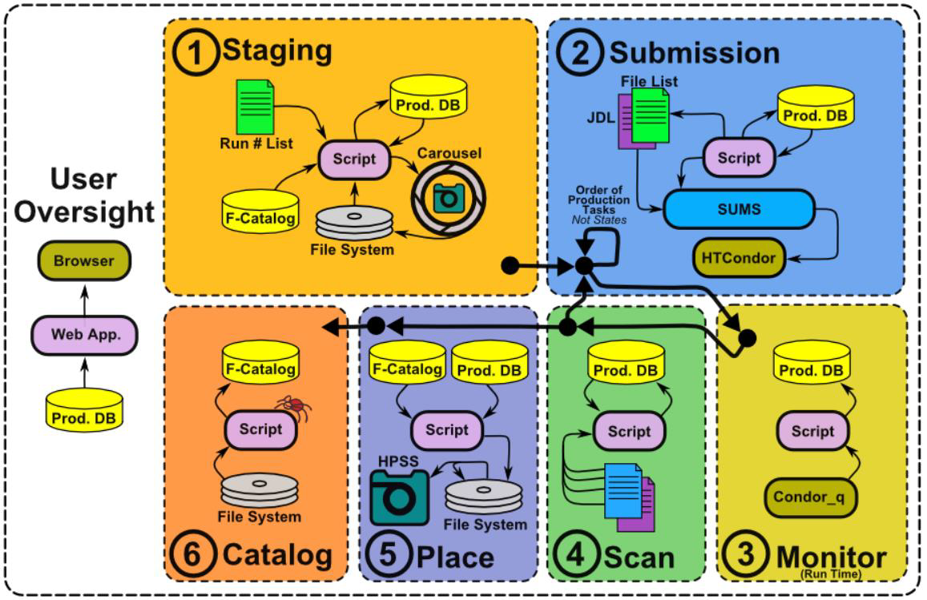
STAR–JINR GRID Computing
STAR Experiment at RHIC
Software development and use of the JINR infrastructure
(GRID, TIER-1) for the STAR data processing at Dubna
V. Korenkov (LIT), V. Mitsyn (LIT), H. Agakishiev, L. Didenko (BNL), L. Hajdu (BNL), J. Lauret (BNL)

Slide 20
Plans for STAR in 2022–2025
STAR Experiment at RHIC

Slide 21


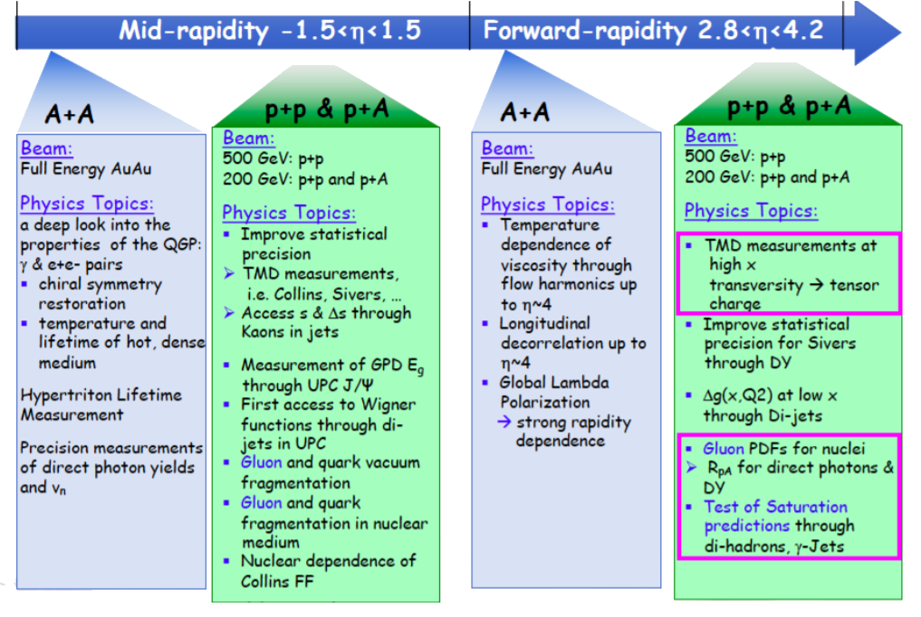
Plans 2022–2025
Forward Hot & Cold
QCD Physics
Notes:
Программа Hot QCD Physics на 2023 и 2025 годы по изучению микроструктуры QGP в золото-золото соударениях при энергии 200 ГэВ направлена на решение двух важнейших задач – детализацию фазовой диаграммы QCD и определение свойств QGP на малых масштабах.

Slide 22
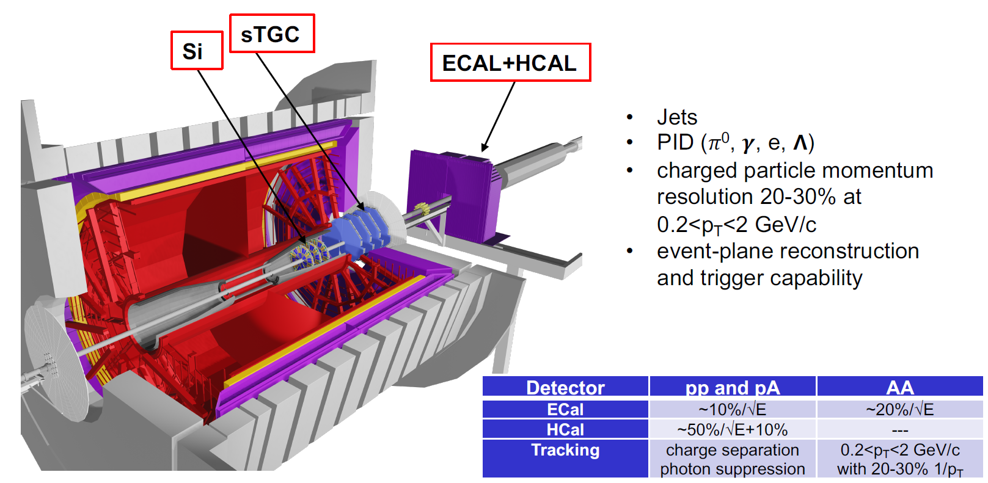
STAR after BES-II
Forward upgrades
2.5 < η < 4
Notes:
22

Slide 23
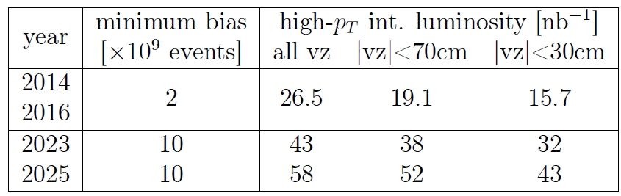
Plans 2023 & 2025
Forward Hot QCD Physics
STAR minimum bias event statistics and high-p_{T} luminosity projections
for the 2023 and 2025 Au + Au runs.
For comparison the 2014/2016 event statistics and luminosities are listed as well.
The study of the QGP microstructure in Au + Au collisions at the energy of 200 GeV
to detail the QCD phase diagram and determine the properties of QGP at small scales.

Slide 24
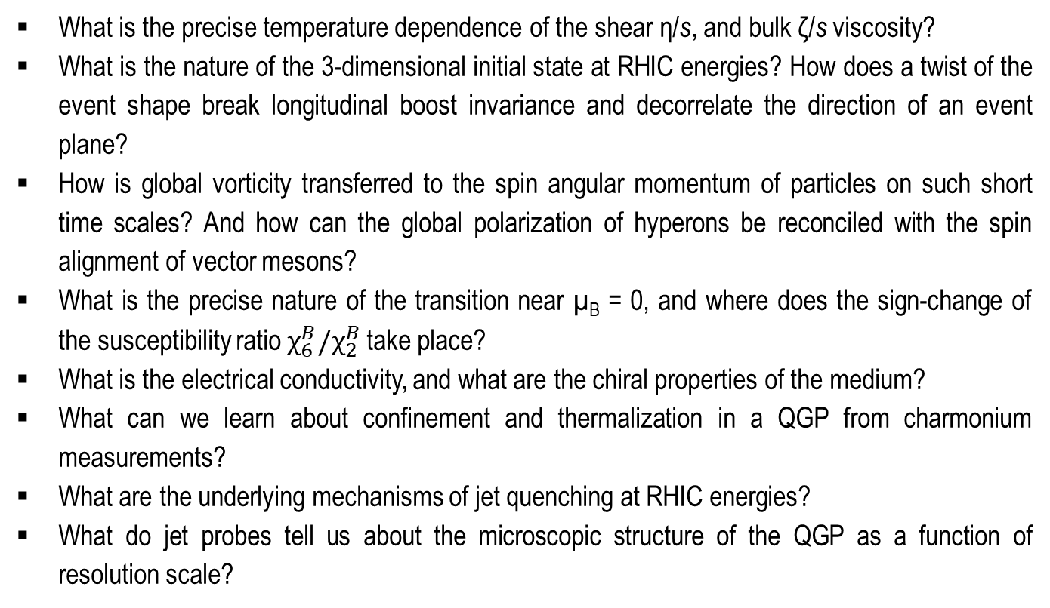
STAR after BES-II
Important QGP questions
What is the precise temperature dependence of the shear η/s, and bulk ζ/s viscosity?
What is the nature of the 3-dimensional initial state at RHIC energies? How does a twist of the event shape break longitudinal boost invariance and decorrelate the direction of an event plane?
How is global vorticity transferred to the spin angular momentum of particles on such short time scales? And how can the global polarization of hyperons be reconciled with the spin alignment of vector mesons?
What is the precise nature of the transition near µ_{B} = 0, and where does the sign-change of the susceptibility ratio $χ_{6}^{B}/χ_{2}^{B}$ take place?
What is the electrical conductivity, and what are the chiral properties of the medium?
What can we learn about confinement and thermalization in a QGP from charmonium measurements?
What are the underlying mechanisms of jet quenching at RHIC energies?
What do jet probes tell us about the microscopic structure of the QGP as a function of resolution scale?
Notes:
24

Slide 25
STAR after BES-II
Run-22 and Run-24:
Transversely polarized proton beams in p↑ + p↑ collisions at 510 and 200 GeV
Wide η range up to 4.2.
Probe down to x ~ 2·10^{–3} for gluons.
Probe down to x ~ 0.5 for valence quarks.
Cold QCD Physics with p↑ + p↑ Collisions at 510 GeV:
  inclusive transverse spin asymmetries at forward rapidities;
  transversity, Collins function and interference fragmentation function;
  Sivers and Efremov-Teryaev-Qiu-Sterman function.
Polarized p↑ + p and p↑ + A collisions at 200 GeV:
  forward transverse spin asymmetries;
  Sivers effect;
  transversity and related quantities.
Notes:
25

Slide 26
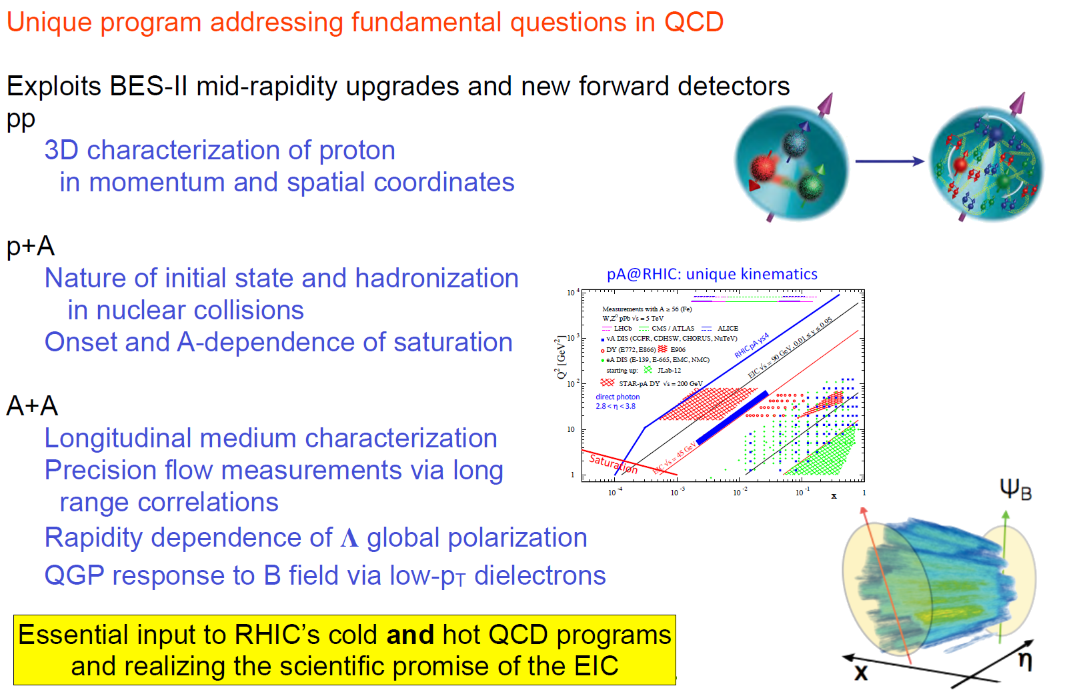
STAR after BES-II
Looking forward to 2023–2025
Notes:
26

Slide 27
Plans for JINR Group in 2022–2025
STAR Experiment at RHIC

Slide 28
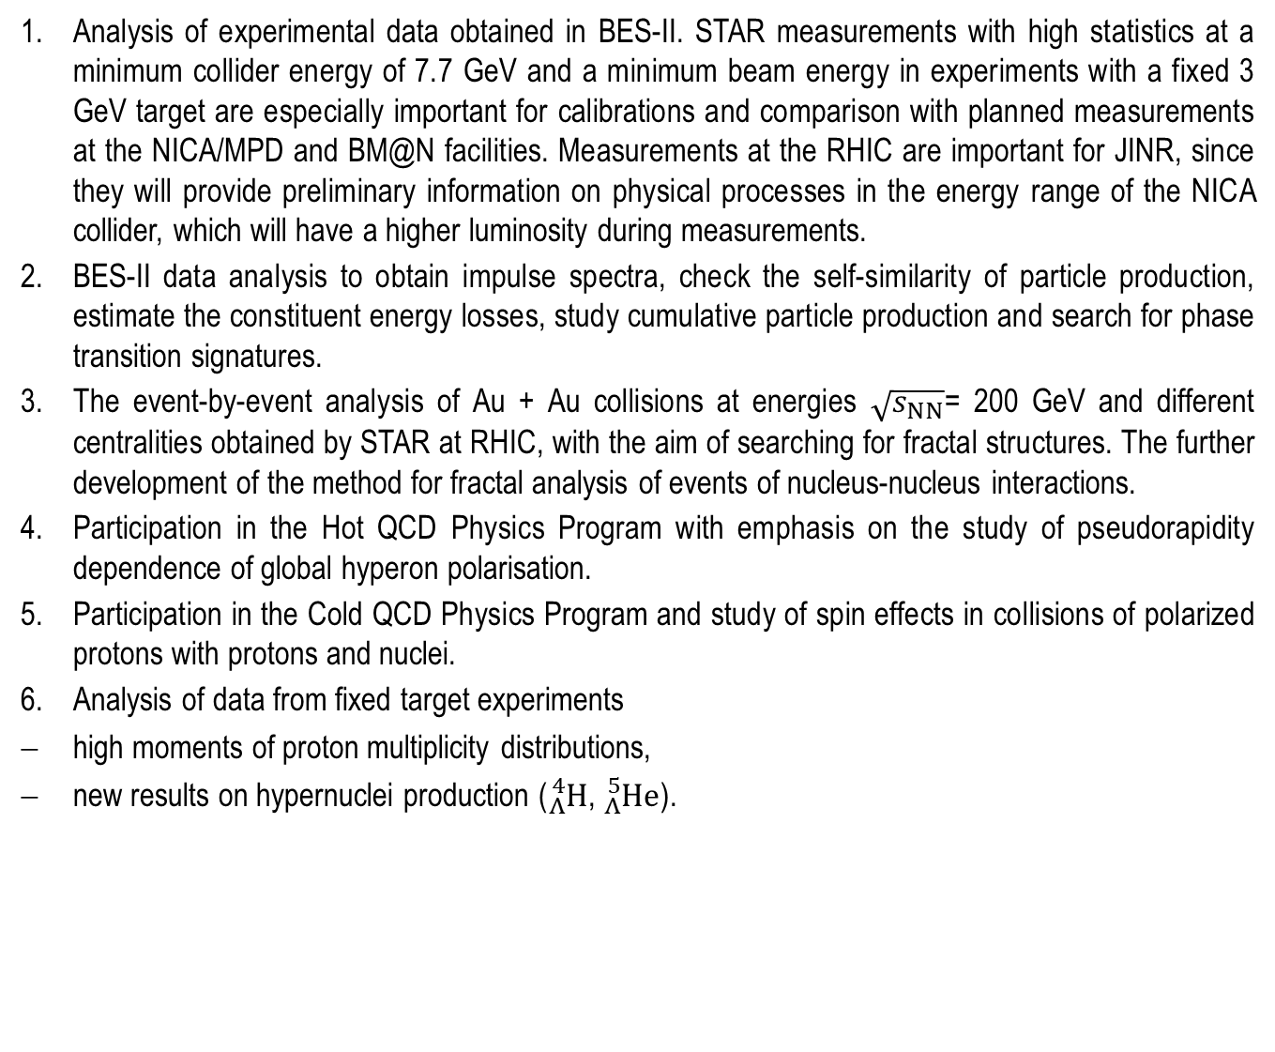
JINR Group Plans and Requests
Analysis of experimental data obtained in BES-II. STAR measurements with high statistics at a minimum collider energy of 7.7 GeV and a minimum beam energy in experiments with a fixed 3 GeV target are especially important for calibrations and comparison with planned measurements at the NICA/MPD and BM@N facilities. Measurements at the RHIC are important for JINR, since they will provide preliminary information on physical processes in the energy range of the NICA collider, which will have a higher luminosity during measurements.
BES-II data analysis to obtain impulse spectra, check the self-similarity of particle production, estimate the constituent energy losses, study cumulative particle production and search for phase transition signatures.
The event-by-event analysis of Au + Au collisions at energies $\sqrt{s_{NN}}$= 200 GeV and different centralities obtained by STAR at RHIC, with the aim of searching for fractal structures. The further development of the method for fractal analysis of events of nucleus-nucleus interactions.
Participation in the Hot QCD Physics Program with emphasis on the study of pseudorapidity dependence of global hyperon polarisation.
Participation in the Cold QCD Physics Program and study of spin effects in collisions of polarized protons with protons and nuclei.
Analysis of data from fixed target experiments
high moments of proton multiplicity distributions,
new results on hypernuclei production (${}_{Λ}^{4}H$, ${}_{Λ}^{5}{He}$).

Slide 29
JINR Group Plans and Requests
There is enhanced interest to the production of light ions, which surprisingly appears to be in agreement with predictions of particle number ratios in both statistical and coalescence models. The first model is unjustified due to a huge difference between the temperature of chemical freeze-out of ~160 MeV and the binding energy of a few MeV. A possibility to distinguish these models has been suggested based on the yields of ⁴Li and ⁴He.
New BES-II net-proton kurtosis and light nuclei yield ratio measurements and their data analysis, including measurement at minimal collider energy 7.7 GeV and additional measurement at 17.3 GeV.
Further development and application of the methods of correlation femtoscopy developed at JINR based on particle momentum and spin correlations due to quantum statistics and final state interaction. It will allow for a systematic study of the space-time picture of particle production and a study of their strong interaction, including the interaction in various combinations of hyperons, kaons and nucleons; the latter being necessary to obtain the equation of state of dense nuclear matter and determine the properties of neutron stars.
Monte Carlo simulation and software development:
– Event-by-event Monte Carlo simulation and comparison with STAR data
– Development of particle identification
– Turning on the event plane detector into data analysis
– Machine learning techniques to data analysis
Software infrastructure for the STAR data processing at JINR. STAR-JINR end-to-end GRID production.

Slide 30
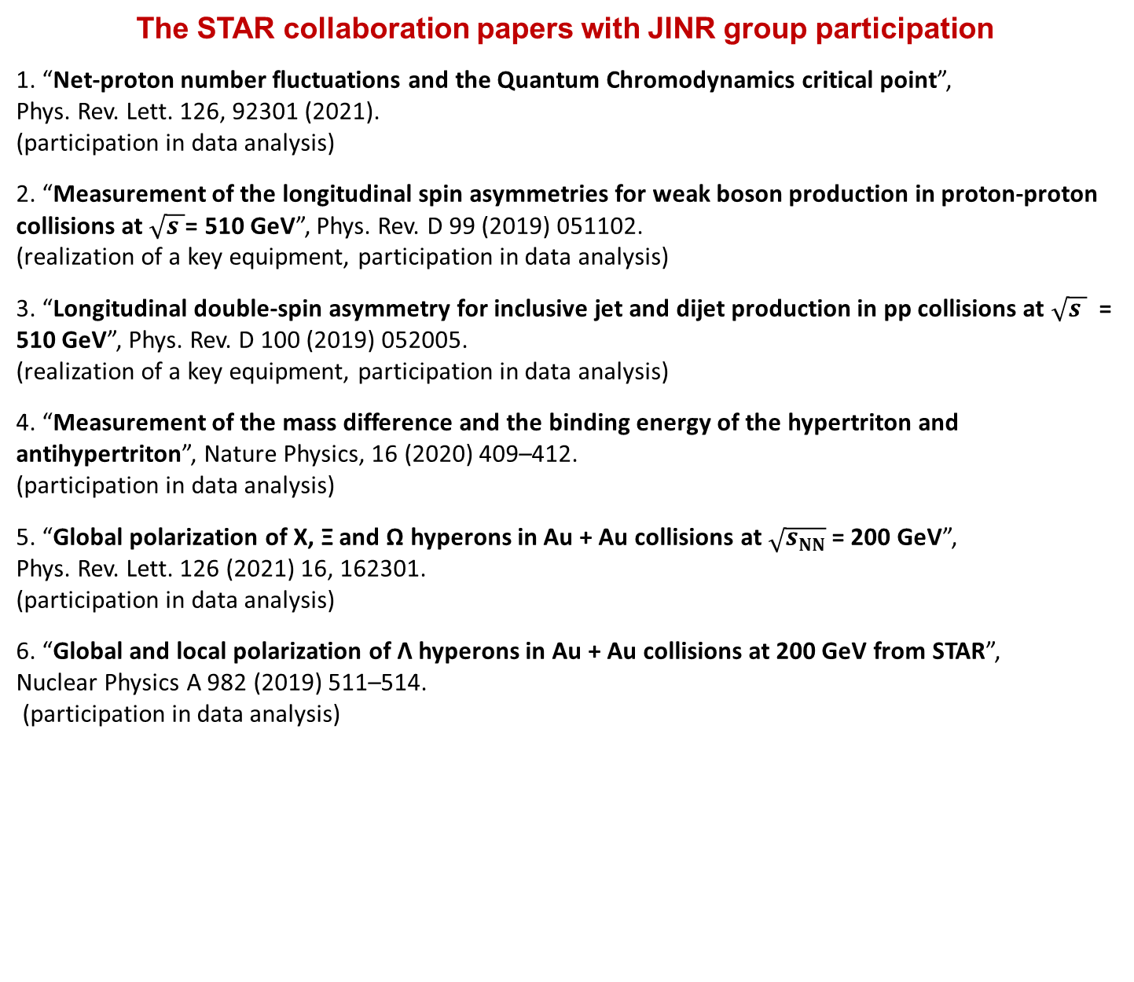
Project Results
STAR Experiment at RHIC
The STAR collaboration papers with JINR group participation
1. “Net-proton number fluctuations and the Quantum Chromodynamics critical point”,
Phys. Rev. Lett. 126, 92301 (2021).
(participation in data analysis)
2. “Measurement of the longitudinal spin asymmetries for weak boson production in proton-proton collisions at $\sqrt{s }$= 510 GeV”, Phys. Rev. D 99 (2019) 051102.
(realization of a key equipment, participation in data analysis)
3. “Longitudinal double-spin asymmetry for inclusive jet and dijet production in pp collisions at $\sqrt{s }$ = 510 GeV”, Phys. Rev. D 100 (2019) 052005.
(realization of a key equipment, participation in data analysis)
4. “Measurement of the mass difference and the binding energy of the hypertriton and antihypertriton”, Nature Physics, 16 (2020) 409–412.
(participation in data analysis)
5. “Global polarization of Χ, Ξ and Ω hyperons in Au + Au collisions at $\sqrt{s_{NN}}$ = 200 GeV”,
Phys. Rev. Lett. 126 (2021) 16, 162301.
(participation in data analysis)
6. “Global and local polarization of Λ hyperons in Au + Au collisions at 200 GeV from STAR”,
Nuclear Physics A 982 (2019) 511–514.
(participation in data analysis)

Slide 31
Project Results
STAR Experiment at RHIC
JINR group publications based on STAR data measurements
1. M.V. Tokarev, I. Zborovsky, A.O. Kechechyan
”Validation of z-scaling for negative particle production in Au + Au collisions from BES-I at STAR”, Nucl. Phys. A993 (2020) 121646 (47 p.).
2. M.V. Tokarev, I. Zborovsky, A.O. Kechechyan, T.G. Dedovich
“z-Scaling in p + p, anti-p + p and Au + Au Collisions at RHIC, Tevatron and LHC”, Physics of Particles and Nuclei, 2020, Vol. 51, No. 2, pp. 141–171.
3. I. Zborovsky , M.V. Tokarev
“Self-Similarity, Fractality and Entropy Principle in Collisions of Hadrons and Nuclei at Tevatron, RHIC and LHC”, Published in Proceedings of 40th International Conference on High Energy physics – ICHEP2020, July 28 – August 6, 2020, Prague, Czech Republic, Proceedings of Science, 2020, PoS (ICHEP2020) 575.
4. M.V. Tokarev, A.O. Kechechyan, I. Zborovský
“Self-Similarity of Negative Particle Production in Au + Au Collisions at STAR”, Physics of Particles and Nuclei Letters, 2019, Vol. 16, No. 5, pp. 510–515.
5. M.V. Tokarev, I. Zborovsky
“Self-Similarity, Fractality and Entropy Principle in Collisions of Hadrons and Nuclei at Tevatron, RHIC and LHC”, Phys. Part. Nucl. Lett., 2021, v.18, № 3, pp. 302–314.

Slide 32
Project Results
STAR Experiment at RHIC
JINR group publications based on STAR data measurements
6. T.G. Dedovich, M.V. Tokarev
” Reconstruction of the Dimension of Complete and Incomplete Fractals“, Physics of Particles and Nuclei Letters, 2019, Vol.16, № 3, pp. 240–250.
7. T.G. Dedovich, M.V. Tokarev
“Criteria of fractal reconstruction and suppression of background events by SePaC method”, Physics of Particles and Nuclei Letters, 2021, Vol. 18, No. 1, pp. 93–106.

Slide 33
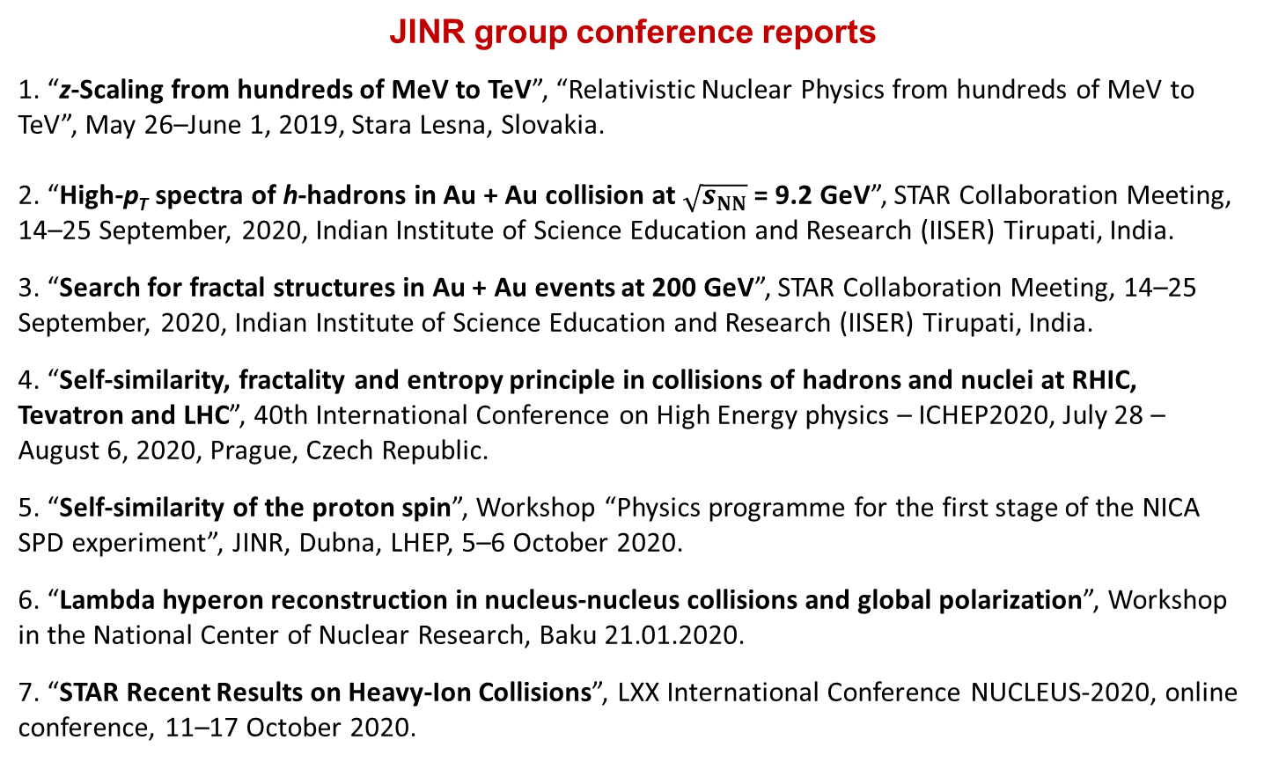
Project Results
STAR Experiment at RHIC
JINR group conference reports
1. “z-Scaling from hundreds of MeV to TeV”, “Relativistic Nuclear Physics from hundreds of MeV to TeV”, May 26–June 1, 2019, Stara Lesna, Slovakia.
2. “High-p_{T} spectra of h-hadrons in Au + Au collision at $\sqrt{s_{NN}}$= 9.2 GeV”, STAR Collaboration Meeting, 14–25 September, 2020, Indian Institute of Science Education and Research (IISER) Tirupati, India.
3. “Search for fractal structures in Au + Au events at 200 GeV”, STAR Collaboration Meeting, 14–25 September, 2020, Indian Institute of Science Education and Research (IISER) Tirupati, India.
4. “Self-similarity, fractality and entropy principle in collisions of hadrons and nuclei at RHIC, Tevatron and LHC”, 40th International Conference on High Energy physics – ICHEP2020, July 28 – August 6, 2020, Prague, Czech Republic.
5. “Self-similarity of the proton spin”, Workshop “Physics programme for the first stage of the NICA SPD experiment”, JINR, Dubna, LHEP, 5–6 October 2020.
6. “Lambda hyperon reconstruction in nucleus-nucleus collisions and global polarization”, Workshop in the National Center of Nuclear Research, Baku 21.01.2020.
7. “STAR Recent Results on Heavy-Ion Collisions”, LXX International Conference NUCLEUS-2020, online conference, 11–17 October 2020.

Slide 34
Schedule of the Project
STAR Experiment at RHIC
No. | Activity | Years
 |  | 2021 | 2022 | 2023 | 2024 | 2025
1 | BES II Data Tacking Runs
2 | BES II Data Analysis
3 | Cold QCD Physics with p↑ + p↑ Collisions at 510 Gev
4 | Cold QCD Physics with p↑ + A Collisions at 200 Gev
5 | Hot QCD Physics
6 | Study of Femtoscopy Correlation, Event Structure, Global Polarization, High p_{T}

Slide 35
Cost Estimate of the Project
STAR Experiment at RHIC
No. | Name | Full Cost (kUSD) | Expenses per Year (kUSD)
 |  |  | 2022 | 2023 | 2024
1 | Materials and Equipment | 45.0 | 15.0 | 15.0 | 15.0
2 | Payments for Agreement Based Research | 45.0 | 15.0 | 15.0 | 15.0
3 | Travel Expenses | 165.0 | 55.0 | 55.0 | 55.0
 | Total direct expenses | 255.0 | 85.0 | 85.0 | 85.0

Slide 36
Project STAR (JINR participation)
STAR Experiment at RHIC
Thank you for attention !!!

Slide 37
JINR–STAR Team
STAR Experiment at RHIC
№ | Name | Position | FTE | Country/Lab
1 | A. Aitbaev | Student | 0.5 | Kazakhstan
2 | A.A. Aparin | Researcher | 1 | LHEP
3 | G.S. Averichev | Researcher | 0.5 | LHEP
4 | H.N. Agakishiev | Researcher | 1 | LHEP
5 | N.A. Balashov | Programmer | 0.1 | LIT
6 | T.G. Dedovich | Researcher | 1 | LHEP
7 | I.Zh. Bunzarov | Researcher | 0.25 | Bulgaria
8 | N.Y. Chankova-Bunzarova | Researcher | 0.25 | Bulgaria
9 | V.B. Dunin | Engineer | 0.5 | LHEP
10 | P. Filip | Researcher | 0.25 | Slovakia
11 | A.O. Kechechyan | Researcher | 1 | LHEP
12 | O. Kenzhegulov | Student | 0.5 | Kazakhstan
13 | K.V. Klygina | Engineer | 1 | LHEP
14 | V.V. Korenkov | Researcher | 0.1 | LIT
15 | A.A. Korobitsyn | Researcher | 1 | LHEP
16 | R. Lednický | Project leader | 0.25 | LHEP
17 | V.V. Lyuboshitz | Researcher | 1 | LHEP
18 | S.I. Manukhov | Student | 0.5 | LHEP
19 | V.V. Mitsyn | Programmer | 0.2 | LIT
20 | M.P. Osmachko | Engineer | 0.5 | LHEP
21 | G.A. Ososkov | Researcher | 0.2 | LIT
22 | Yu.A. Panebrattsev | Project leader | 1 | LHEP
23 | S.S. Panyushkina | Student | 0.5 | LHEP
24 | E.A. Pervyshina | Student | 0.5 | LHEP
25 | E.V. Potrebenikova | Programmer | 1 | LHEP
26 | N.E. Sidorov | Programmer | 0.5 | LHEP
27 | E. Shakhaliev | Researcher | 1 | Azerbaijan
28 | S.I. Snigirev | Student | 0.5 | LHEP
29 | M.V. Tokarev | Researcher | 1 | LHEP
30 | A. Tutebaeva | Student | 0.5 | Kazakhstan
31 | N.I. Vorontsova | Engineer | 0.5 | LHEP
32 | S.F. Vokal | Researcher | 0.5 | Slovakia
33 | I. Zborovsky | Researcher | 0.5 | Czech Republic
At present, the JINR STAR team consists of 18 researchers (13 FTEs), 4 programmers (2 FTEs), 4 engineers (2.5 FTEs) and 7 students
(3.5 FTEs), for a total of 33 members and ~20 FTEs.

Slide 38
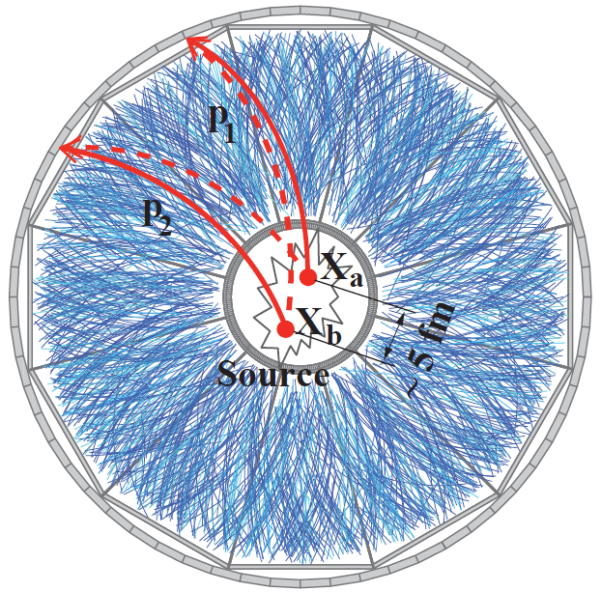
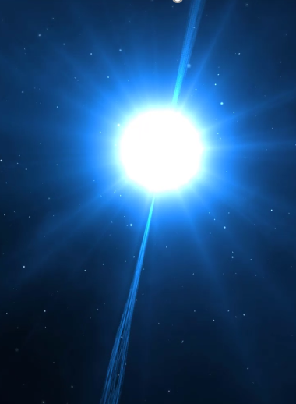







Proposal of Femtoscopic STAR Data Analysis
Particle momentum correlations due to the effects of final state interaction (FSI) and quantum statistics (QS) at small relative momenta in their centre-of-mass system, as well as, particle coalescence due to FSI, allow one to get space-time characteristics of the production processes on a femtometer level. They provide the information on particle strong interaction hardly accessible by other means.
R. Lednicky, Phys. of Atomic Nuclei 67 (2004) 71
$$KK$$
Of particular importance is a systematic study of the production space-time parameters in the beam energy scan, together with the fluctuation characteristics. Correlations in various combinations of pions, kaons, nucleons and hyperons contain a rich complementary information about the production process.
R. Lednicky, Nucl. Phys. B (Proc. Suppl.) 198 (2010) 43
$$ππ$$
$$Kp$$
$$ΛΛ$$
$$ΛK$$
$$πp$$
$$pp$$
The correlation measurement of strong particle interaction at nonzero strangeness is especially up-to-date in connection with the so-called hyperon puzzle in neutron stars. Their radius of 10–15 km and mass of ~1.5–2 sun masses essentially depend on the EoS, which is softened in the presence of hyperons thus leading to a decrease of the maximal neutron star mass. The present knowledge of hyperon-nucleon, hyperon-hyperon, kaon-nucleon and kaon-hyperon interactions is not sufficient for a reliable calculation of nucleon and hyperon fractions and corresponding neutron star EoS.
D. Lonardoni et al., Phys. Rev. Lett. 114 (2015) 092301

Slide 39
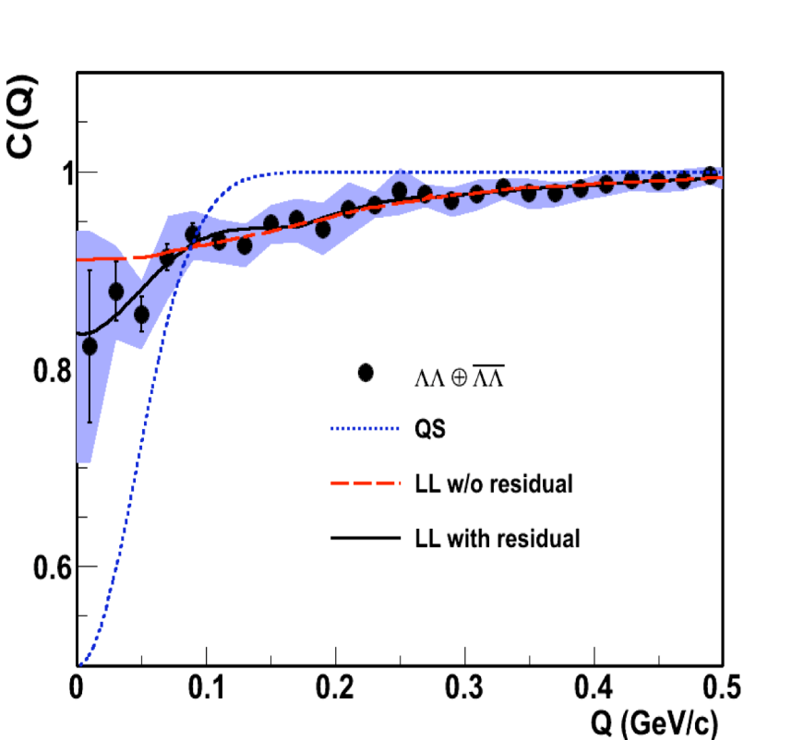
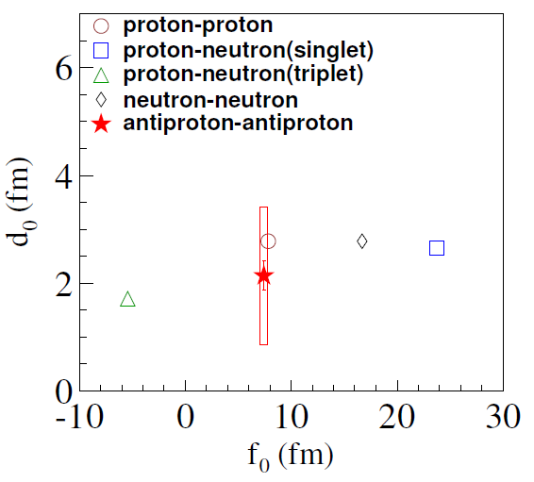
Proposal of Femtoscopic STAR Data Analysis
The measurement of the ΛΛ interaction:
a possible existence of so-called H-dibaryon;
a negative singlet s-wave scattering length f₀ ≈ – 1 fm;
a large positive effective radius d₀ ≈ 8 fm.
Thus excluding both a near threshold s-wave resonance and a ΛΛ bound state (the latter requiring 2d₀/f₀ > –1, i.e., d₀ < 0.5 fm at f₀ ≈ – 1 fm).
A recent ALICE analysis of ΛΛ correlations in p + p and p + Pb collisions is compatible with the existence of a ΛΛ bound state. This discrepancy calls for a new analysis of STAR data with higher statistics and a more refined treatment of residual correlations.
STAR Collab. Phys. Rev. Lett. 114, 022301 (2015)
ALICE Collab. Phys. Lett. B 797 134822 (2019)
The STAR correlation measurement of the proton-proton and antiproton-antiproton scattering parameters is in a good agreement with each other. The two-particle FSI in multiparticle production processes is usually taken into account by substituting the product of plane waves at equal times in pair rest frame (PRF) with the two-particle wave function of the corresponding scattering problem. Obviously, this assumption is not justified at very large temporal particle separation t* in PRF, when the two-particle FSI should vanish. As for the correlations involving pions, the validity check of the equal-time (t* = 0) approximation still remains to be done.
R. Lednicky, Phys. of Atomic Nuclei 67 (2004) 71
STAR Collab. Nature 527 (2015) 345

Slide 40
Proposal of Femtoscopic STAR Data Analysis
The measurement of the ΛΛ spin correlation
The extraction of the ΛΛ singlet scattering parameters with the analysis of Λ spin correlations using as a spin analyser the asymmetric (parity violating) decay Λ → pπ–: the distribution of the cosine of the relative angle θ between the directions of the decay protons in the respective Λ rest frames allows one to determine the triplet fraction of the ΛΛ correlation function. Since the spin correlation method requires no construction of the uncorrelated reference sample, it can serve as an important consistency check of the standard correlation measurements. This technique can be especially useful for the analysis of ΛΛ correlations in p+p or p+A collisions, where the characteristic Gaussian source radius r₀ is rather small (~1–1.5 fm) and the correlation width 1/r₀ ~ 200 MeV/c is sufficiently large for a statistically significant analysis.
R. Lednicky and V. L. Lyuboshitz, Phys. Lett. B 508 (2001) 146

Slide 41
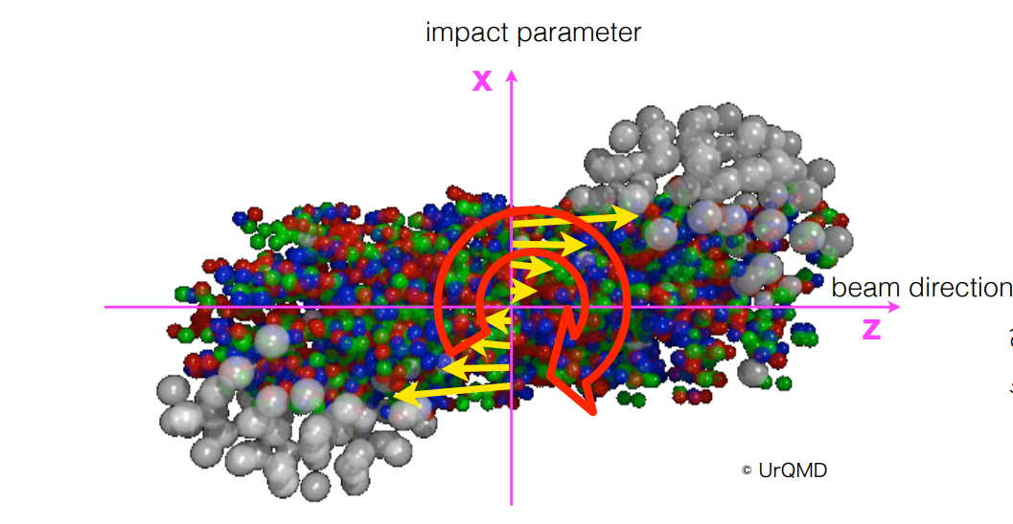

Rotating Nuclear Matter and Global Polarization
STAR Experiment at RHIC
Nature 548 (2017) 62
$$\vec{ω}=\frac{1}{2}\left(∇×\vec{υ}\right)$$
Becattini, Karpenko, Lisa, Upsal, Voloshin, PRC95.054902 (2017)

Slide 42
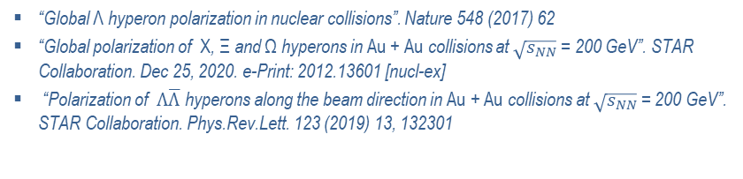
Global Polarization Analysis
STAR Experiment at RHIC
Study of energy dependence for hyperon global polarization
Preliminary results
Preliminary results
“Global Λ hyperon polarization in nuclear collisions”. Nature 548 (2017) 62
“Global polarization of Χ, Ξ and Ω hyperons in Au + Au collisions at $\sqrt{s_{NN}}$ = 200 GeV”. STAR Collaboration. Dec 25, 2020. e-Print: 2012.13601 [nucl-ex]
“Polarization of $Λ\overline{Λ}$ hyperons along the beam direction in Au + Au collisions at $\sqrt{s_{NN}}$ = 200 GeV”. STAR Collaboration. Phys.Rev.Lett. 123 (2019) 13, 132301

Slide 43
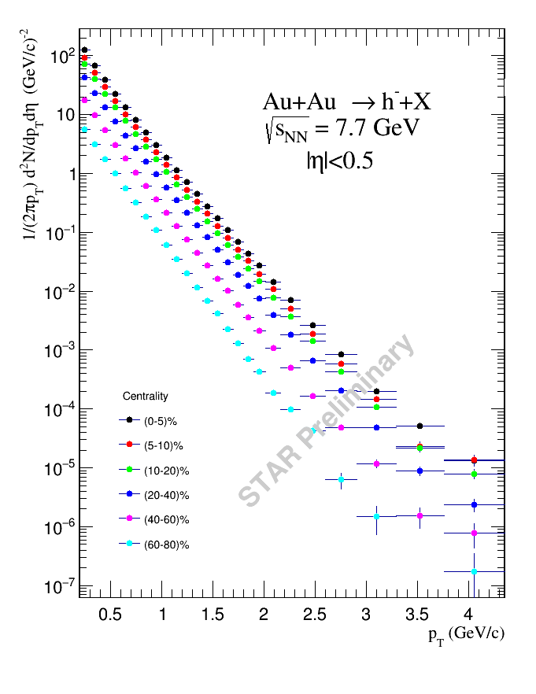
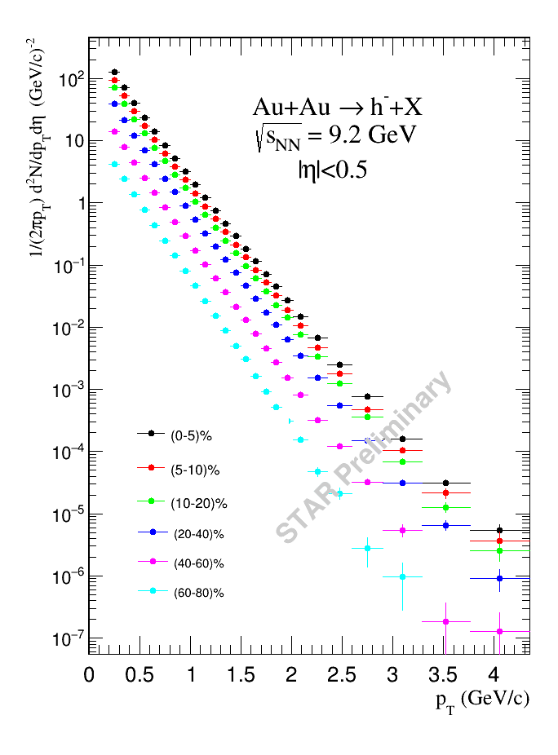
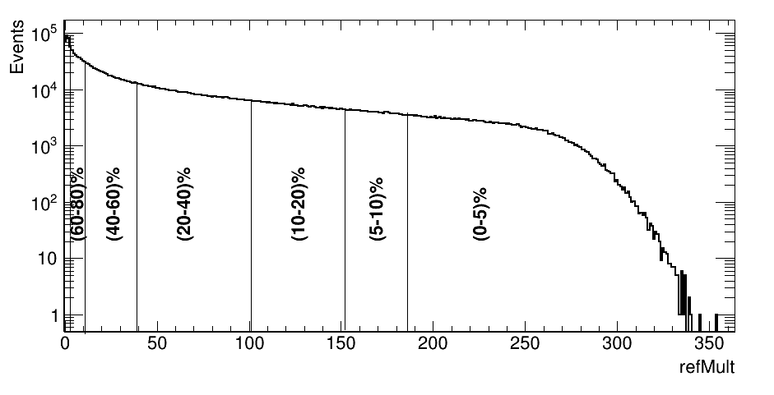


BES-II – Spectrum Analysis
STAR Experiment at RHIC
High-p_{T} spectra of negative hadrons
in Au + Au collisions at $\sqrt{s_{NN}}$= 7.7, 9.2 GeV in STAR
BES-II
9M →162M (recorded)
Multiplicity distribution
Centrality classes
0-5 % | 5-10 % | 10-20 % | 20-40 % | 40-60 % | 60-80 %
186-350 | 152-186 | 101-152 | 49-101 | 11-49 | 3-11
A. Kechechyan, M. Tokarev, I. Zborovský
STAR Meeting, September 2020

Slide 44
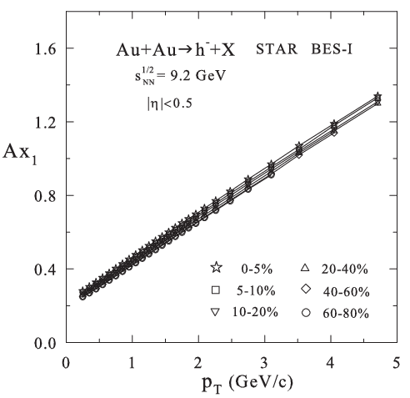
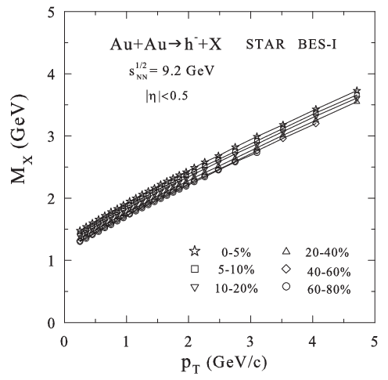

BES-II – Spectrum Analysis
STAR Experiment at RHIC
Constituent level analysis of particle production
Momentum fraction Ax₁
Recoil mass M_{X}
Energy loss ΔE/E ~ (1–y_{a})
BES-II
STAR Preliminary
Momentum fraction
increases with p_{T}
Recoil mass
increases with p_{T}
Energy loss
decreases with p_{T}
High x₁ and p_{T} → compressed matter
Large M_{X} → high density recoil system
High y_{a} → small energy loss, clear PT & CP signatures
A. Kechechyan, M. Tokarev, I. Zborovský
Nucl. Phys. A993 (2020) 121646 (47 p.)
Phys. Part. Nucl., 2020, Vol. 51, No. 2, p. 141
Phys. Part. Nucl. Let., 2021, Vol. 18, No. 3, p. 302

Slide 45


JINR Results
Event-by-event study of fractal structure
Parton shower
Cantor set
Structure of Cantor set
Fractal dimension distribution of Au + Au events (STAR – filled and
Monte Carlo (random) – open areas)
Tatiana Dedovich, Mikhail Tokarev
Phys. Part. Nucl. Lett., 16, 3, 240–250 (2019)
Phys. Part. Nucl. Lett., 18, 1, 113–133 (2021)
STAR Meeting, September 2020
Notes:
45

Slide 46




JINR Results
Cumulative production in Au + Au at STAR
The first results on cumulative hadron production in heavy-ion collisions at collider mode are the data on transverse momentum spectra obtained by the STAR collaboration in Au + Au collisions in central rapidity range at $\sqrt{s_{NN}}$ = 7.7 and 11.5 GeV at the RHIC.
The scaling function ψ(z) and momentum fraction Ax₁ for negative hadrons produced in Au + Au collisions at the energy $\sqrt{s_{NN}}$= 7.7GeV for different centralities.
The solid line is a reference curve for p + p collisions
A. Kechechyan, M. Tokarev, I. Zborovský
Nucl. Phys. A993 (2020) 121646 (47 p.)
Notes:
46

Slide 47


JINR Results
Strangeness production in p + p collisions at RHIC
The scaling properties of strange particle production ($K_{0}^{S},K^{−},K^{∗0},φ,Λ,Λ^{∗},Σ^{∗},Ξ,Ω$) in p + p collisions obtained by STAR collaboration at RHIC energies $\sqrt{s_{NN}}$ = 200 GeV were investigated.
The z-presentation of the transverse momentum spectra and momentum fraction y_{a} of strange hadrons ($K_{0}^{S},K^{−},K^{∗0},φ,Λ,Λ^{∗},Σ^{∗},Ξ,Ω$) produced in pp collisions at $\sqrt{s}$ = 200 GeV and θ_{cms} = 90º.
Physics of Particles and Nuclei, 2020, Vol. 51, No. 2, pp. 141–171
Phys. Part. Nucl. Lett., 2021, v.18, № 3, pp. 302–314
Notes:
47

