Slide 1


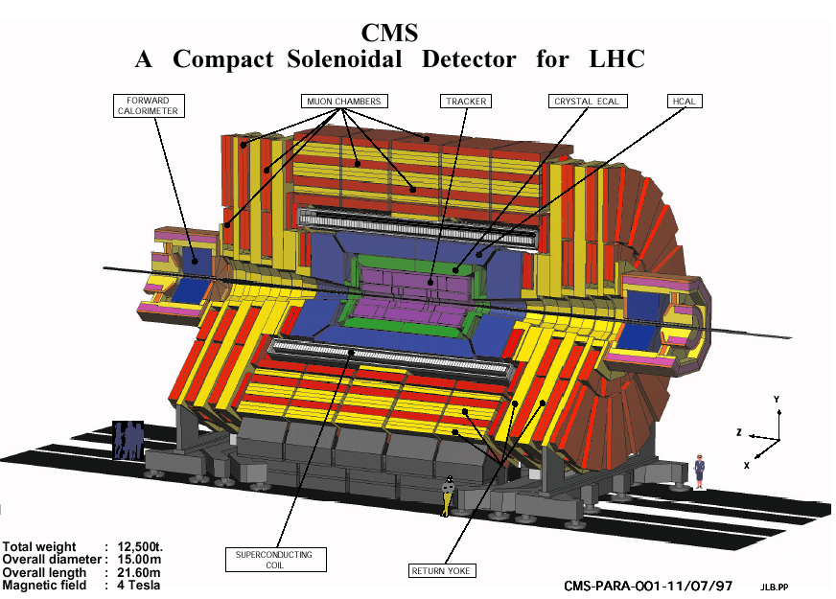
Report on the Scientific Results
JINR Participation in Compact Muon Solenoid at the LHC
Topic 02-0-1083-2009/2022
Maria Savina on behalf of the JINR CMS Group
55th Meeting of the Program Advisory Committee for Particle Physics,
June 22, 2021, JINR, Dubna
70 participants from JINR
92 participants from JINR member states
16 paid authors and 4 unpaid authors
(PhD) from JINR
8 paid authors from JINR member states
33 FTE provided by JINR

Slide 2
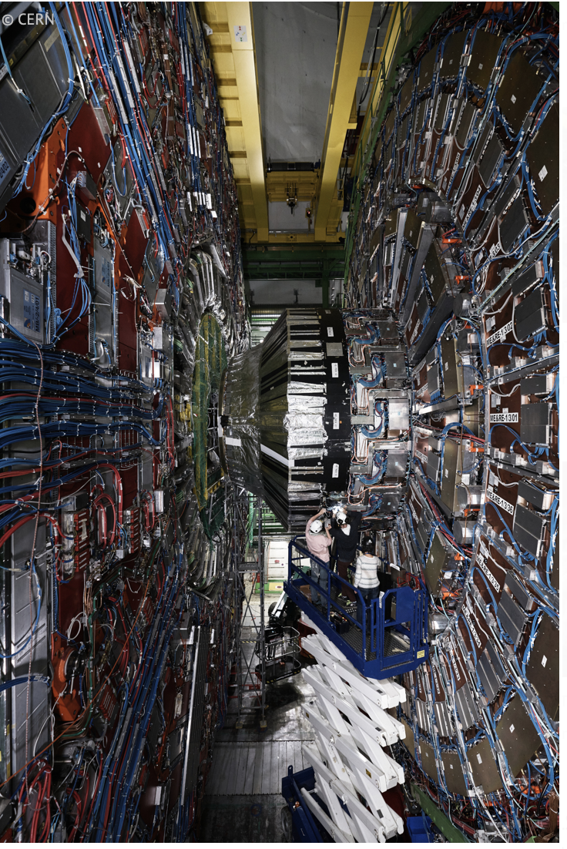
Upgrades, Operation and Service Works
In accordance with Experimental Physics Responsibilities (EPR) each author (paid and free) is required to work on operational, maintenance, upgrade duties, including participation in shifts, at least 4 months (in the calculation of full time equivalent JINR obligations are 91.85 FTE-months in 2021)
In the fist half of 2021, during the long-term technical shutdown of the LHC (Long Stop, LS2), JINR CMS group has contributed to
Hadron Endcap (HE) ngCCMs (new generation modules) modification and took a leadership on ngCCMs replacement
180 MEx/1 CSCs upgraded with new electronics are installed and commissioned including tested with сosmic data
ngCCM installation process
JINR physicists are responsible as conveners for the HCAL Technical Coordination, Muon DQM Coordination, CMS Tier-1/Tier-2 data management
Participation in CMS Author Committee, CMS Analysis Review Committee (ARC) and Institutional Review Procedure
The JINR project “UPGRADE OF THE CMS DETECTOR” aimed to large-scale modernization of the detector systems to ensure feasibility of the HL–LHC physics program was developed and submitted to PAC (talk by V. Karjavin)
Notes:
2

Slide 3
Update of JINR Activity in the CMS Physics Analysis and SW
Activity in CMS Physics Working Group
- Exotica, Higgs, and Standard Model Analysis
- Muon and Jet/MET Physics Object Groups
- Muon and HCAL Detector Performance Group
Human resources
- 18 scientists from JINR (14 from LHEP, 2 from LIT, 2 from
BLTP) and 7 from Dubna Member States (Minsk and Erevan)
- 15.5 FTE from JINR and 5.5 from DMS
- 14 young researchers: 1 PhD from JINR, 4 PhD Students from JINR, 2 PhD Students from DMS, 7 MS Students
Publications and talks in 2021
- 1 CMS Analysis in refereed journal
- 1 CMS Analysis was approved for submission
- 2 CMS Analysis in the CMS Analysis Notes
- 5 papers in refereed journals
- 2 talks were given by JINR physicists at the international conferences by young scientists (Summer Conferences are just started, about 10 talks already selected by Collaboration to be presented there )
The “traditional” JINR studies are:
Beyond the Standard model (SM): searches for signals of extended gauge sector, signals of low-energy gravity at TeV scale (extra dimension models), and dark matter particles in the dilepton final states
SM studies: lepton pair production in Drell–Yan process (cross section, asymmetry, angular coefficients) to test SM at a new energy scale
Jet reconstruction algorithms: measurements of multiplicity in jets for studies of hadronization process, improvement of PDF and QCD coupling precision
New perspectives (RUN3 and HL-LHC) for new physics are:
searches for signals of dark matter and new scalar bosons beyond SM (extra Higgs bosons) produced leptons/b-quarks and missing ET; studies of Higgs boson properties.
studies of lepton-flavour violation processes to search for microscopic black holes, extended gauge sector, RPV SUSY, etc.
JINR physicists contribute to the seven CMS physics analyses; three of them are subject of full JINR responsibility

Slide 4
The list of JINR Physics and SW Tasks (six-month update)
Searches for physics beyond the Standard Model and exploring properties of Higgs boson (12.4 FTE)
  New gauge bosons, extra dimensions, dark matter candidates in dilepton mass spectra in proton-proton collision
  1 Doctor of Sc. and 1 PhD (0.8 FTE), 1 PhD Student (1 FTE), 1 CMS Analysis in journal papers in 2021, 1 journal papers
  Microscopic black holes, dark matter candidates, new higgs states in h₁₂₅ → bbar/Z (μμ + MET); also new states in μμ + b-jets
  1 Doctor of Sc. + 4 PhD (2.4 FTE), 5 PhD/MS Students (4.1 FTE), 1 journal paper and 1 CMS Analysis Note in 2021
  Processes with fermion flavour violation (eμ/μτ/eτ)
  1 Doctor of Sc. + 2 PhD (1.2 FTE), 3 PhD/MS Students (1,4 FTE), analysis is ongoing
  Search for Higgs to bbbar decay in Vector-Boson-Fusion Higgs production process
    1 PhD (0.5 FTE), 1 PhD Student (1 FTE), analysis is ongoing
Small changes from the beginning of 2021
Tests of the Standard Model (6.2 FTE)
  Measurement of the differential Drell-Yan cross section and Drell-Yan radiative corrections
  2 Doctor of Sc. + 3 PhD (1.3 FTE), 1 MS Student (1 FTE), 1 journal paper in 2021
  Forward-backward asymmetry of Drell-Yan lepton pairs in pp collisions
  1 PhD (0.4 FTE), analysis is approval
  Angular coefficients of Z bosons as a function of transverse momentum and rapidity
  1 Doctor of Sc. + 1 PhD (0.5 FTE), 1 PhD Student (1 FTE), analysis is ongoing
  Measurements of the multiplicity in quark and gluon jets and fractions of gluon jets
    1 PhD (1 FTE), 1 PhD Student (1 FTE), 1 CMS Analysis Note and 1 journal paper in 2021
Several Mr and PhD students have joined us
for Dark Matter and LFV searches
Reconstruction and Data Quality (2.3 FTE)
  Development of algorithms for high-p_{T} muons reconstruction; hit reconstruction and segment builder, Muon DQM
  4 PhD (1.8 FTE), 1 PhD Student (0.5 FTE), works are ongoing
Notes:
4

Slide 5
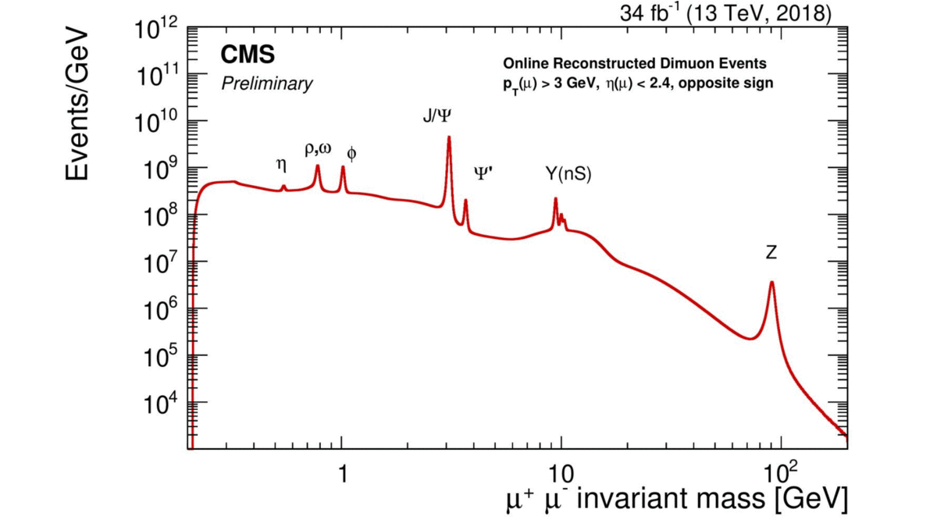
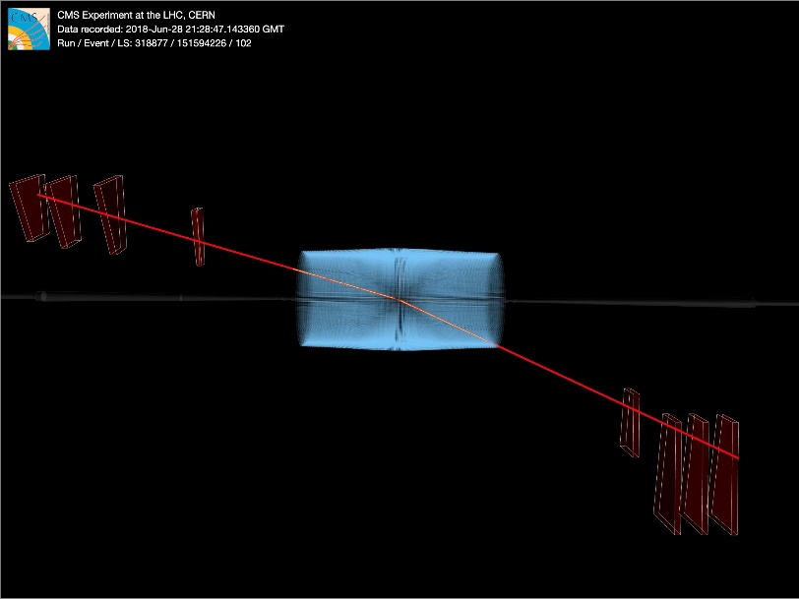
High-mass dileptons @ RUN2
The CMS data at 13 TeV from 2016 to 2018, a total integrated luminosity of up to 140 fb⁻¹
The new physics theories could alter the Drell-Yan mass distribution in two ways:
as a new resonance that decays directly into two leptons → a narrow peak in the distribution
as a broad non-resonant excess or even a deficit of events with respect to the background SM prediction
RUN2 data analysis aimed to New Physics is completed!
World science @ JINR page, 30 April 2021
http://www.jinr.ru/posts/searching-for-new-physics-with-very-high-energy-lepton-pairs/
Precision tests of the Standard Model is going on…
Notes:
5

Slide 6
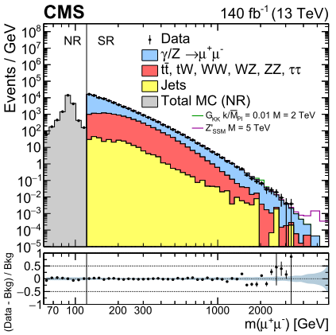
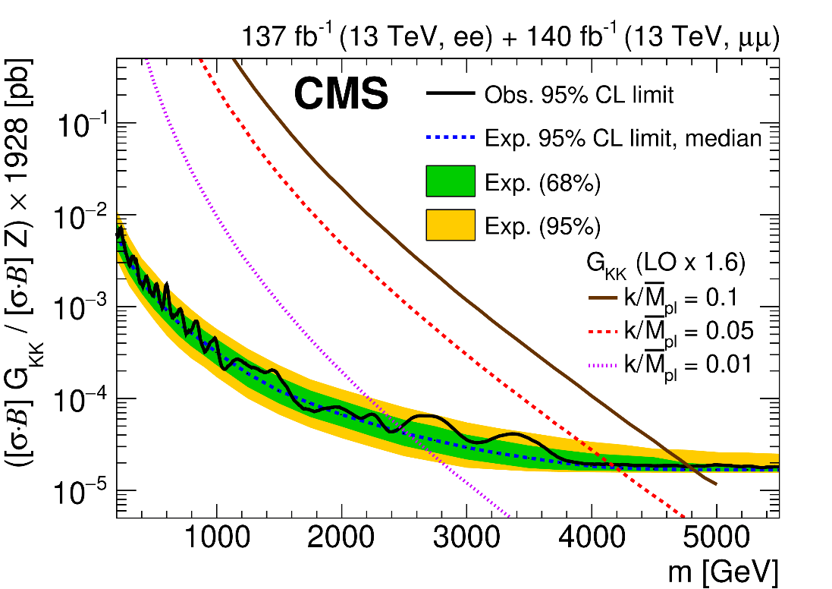
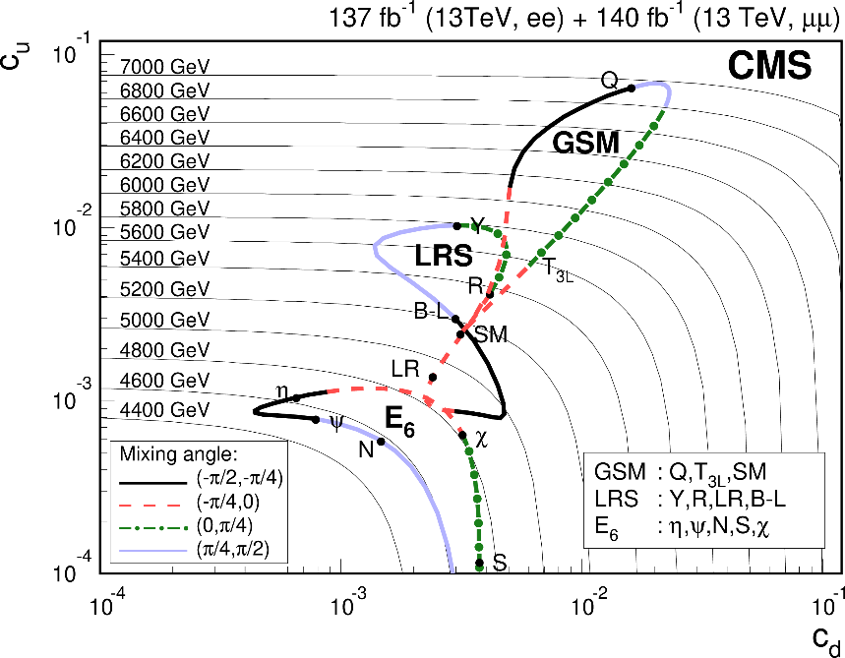
Exploring dileptons: resonances
A new narrow resonance decaying to a pair of electrons/muons
arXiv:2103.02708,
submitted to JHEP
Lower limits on the mass of spin-2 gravitons in RS1 model of 2.47 - 4.81 TeV are set for values of the coupling parameter k/M_{Pl} between 0.01 and 0.1
Lower limits obtained by recasting the combined limit at 95% CL on the Z⁰ boson cross section for narrow resonances from GSM, LRS, and E6 models. The observed mass limits of 4.5 – 7 TeV are set.
limit exceeds 4.5 TeV for all models considered and reaches close to 7 TeV in the GSM class of
models.
No significant deviation from
the Standard Model
Upper limits (95% CL) on the ratio of the product of production cross section and branching ratio of a new narrow dilepton resonance to that of the Z boson
Notes:
6

Slide 7
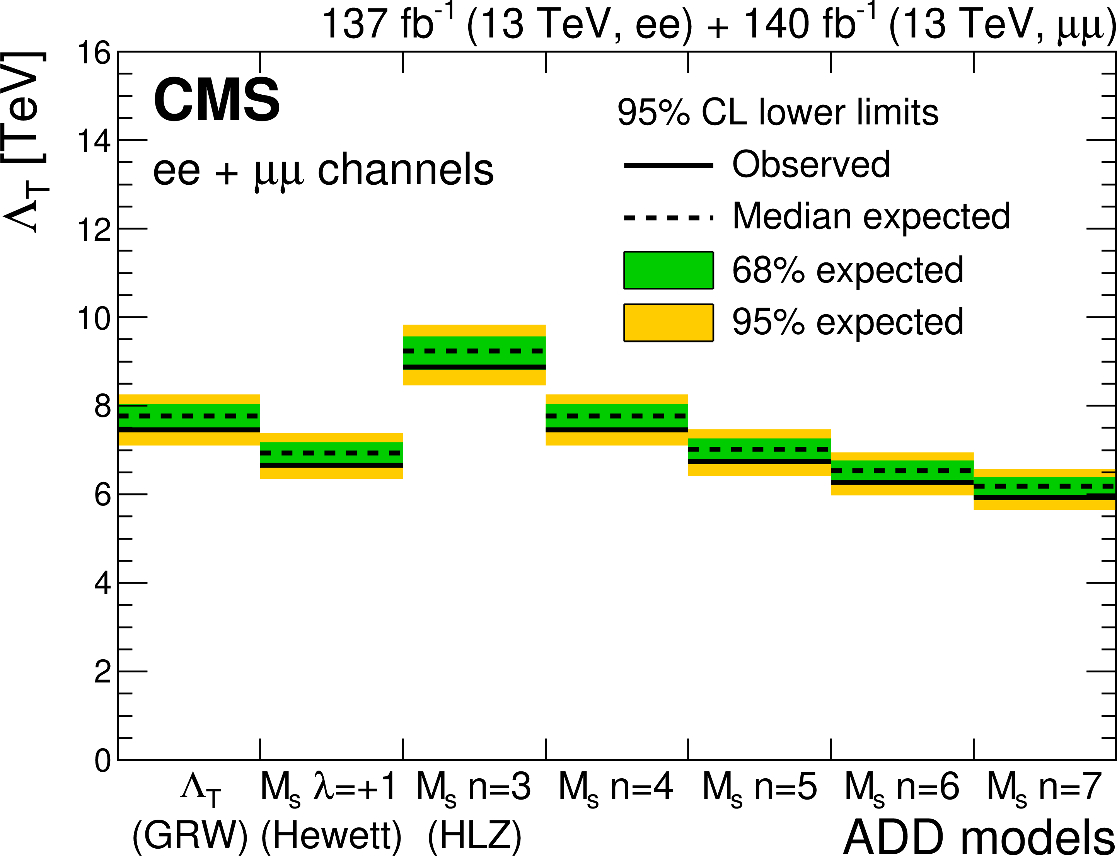
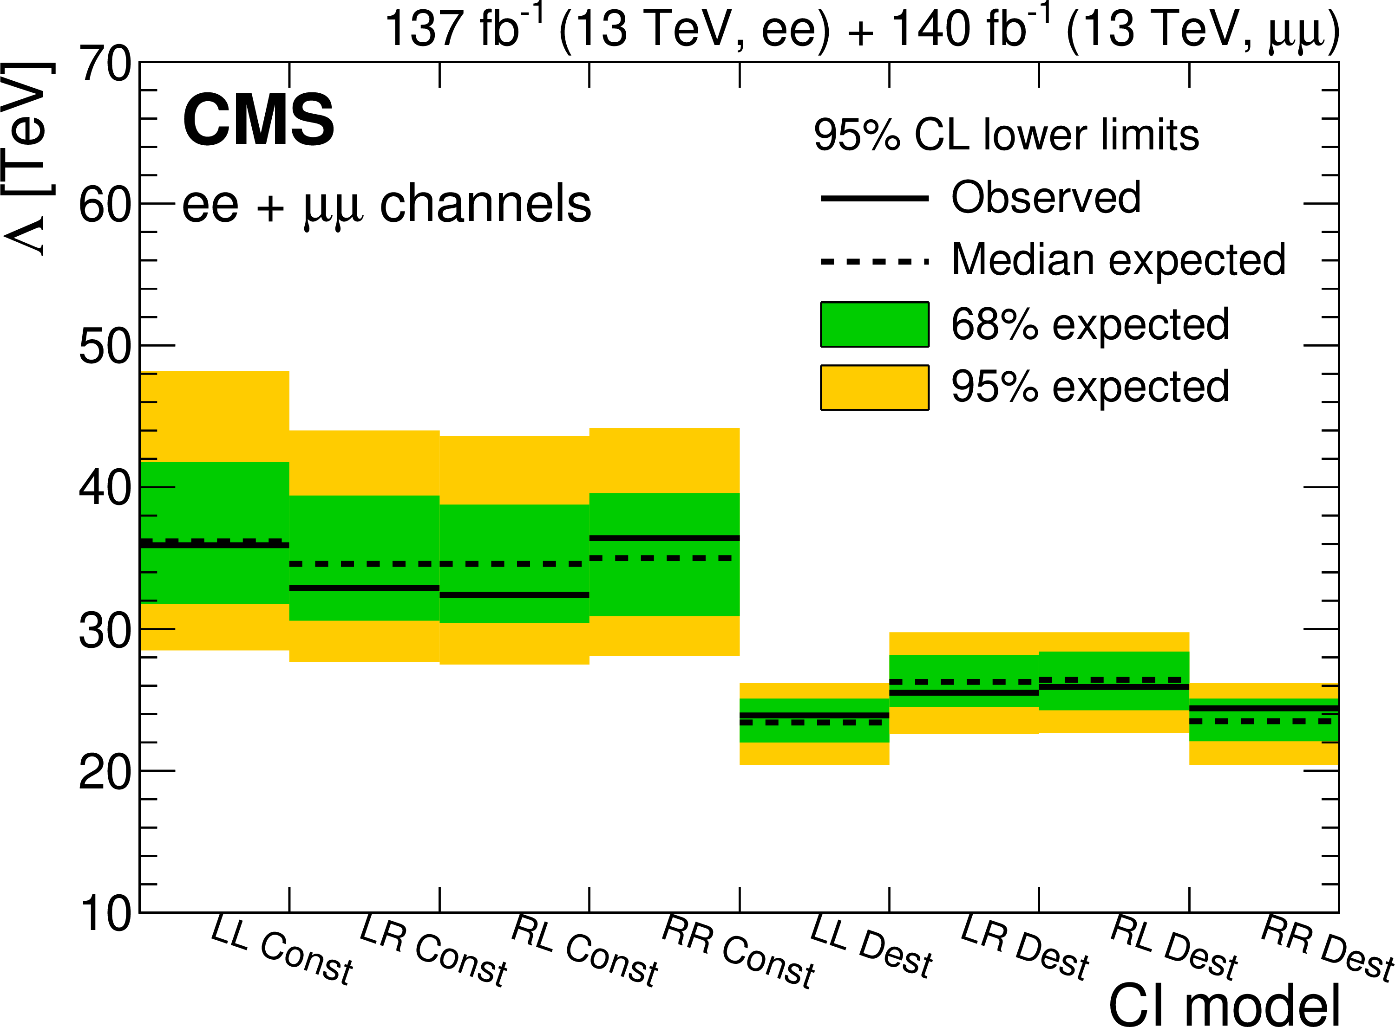
Exploring dileptons: non-resonant signals
In the Arkani-Hamed, Dimopoulos, and Dvali model of large extra dimensions, lower limits on the fundamental multidimensional gravity scale M_{s} ranging from 5.9 to 8.9 TeV are set, depending on the parameter definition
In the case of a four-fermion contact interaction, lower limits on the UV cutoff parameter Λ range from 23.6 to 36.6 TeV depending on the helicity structure of the interaction and the sign of its interference with the SM DY background
arXiv:2103.02708, submitted to JHEP
Notes:
7

Slide 8
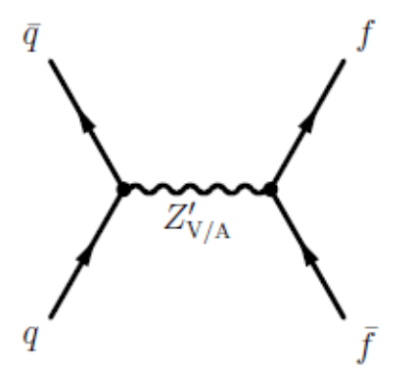


Exploring dileptons: dark matter interpretation
The simplest dark matter model: one DM particle, one mediator, plus the SM content
The (axial) vector mediator model
A cross section as a function of model parameters (5 only for the SDM): M_{med}, g_{q}, g_{l}, m_{DM}, g_{DM} – the first 3 ones are the case for mediator production in a visible mode.
m_{DM}=1 GeV
limits on g_{l} from DY: g_{l} ≤ 0.1
Universal quark coupling:
$$Γ_{med}=\frac{3{\left(g_{q}^{′}\right)}^{2}M_{med}}{2π}≃$$
$$\frac{(18g_{q}^{2}+1)M_{med}}{12π}$$
M_{med}
g_{q}
g_{q,l}
$$g_{q}^{′}=\frac{g_{B}}{6}$$
Notes:
8

Slide 9
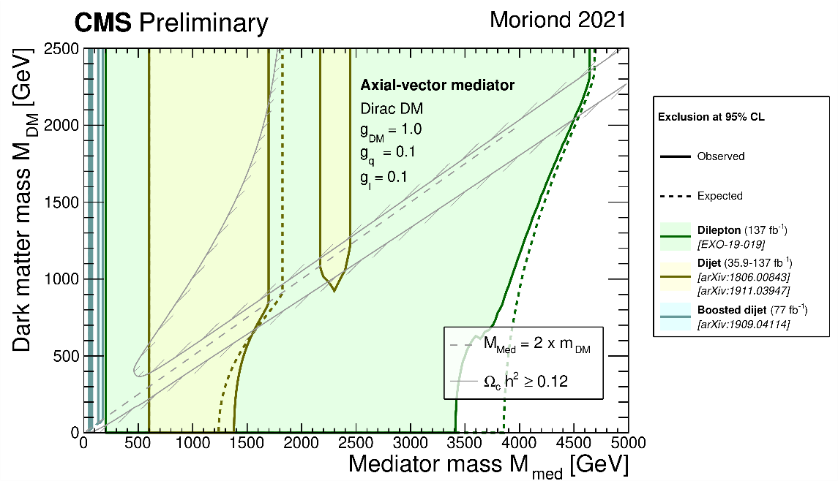
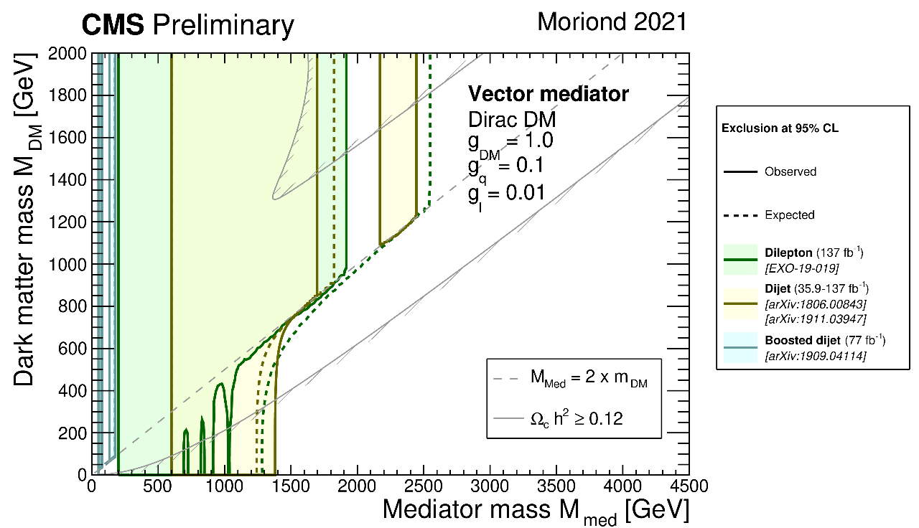
DM mediator search with dileptons and dijets (combined)
Channels with dileptons and dijets were were combined to increase statistics
95% CL observed and expected exclusion regions in m_{Med}-m_{DM} plane for dijet and di-lepton searches from CMS in the Axial-vector and the Vector SDM
Moriond 2021 plots
The exclusions are computed for a universal quark coupling of g_{q} = 0.1, lepton coupling g_{l} = 0.1 (0.01), and for a DM coupling of g_{DM} = 1.0
https://twiki.cern.ch/twiki/bin/view/CMSPublic/SummaryPlotsEXO13TeV#Moriond_LHCP_20 21
Notes:
9

Slide 10
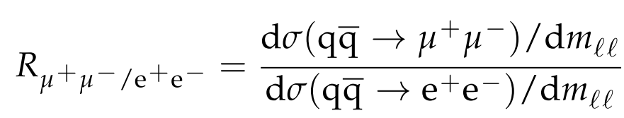
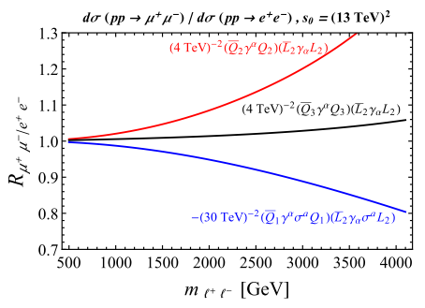
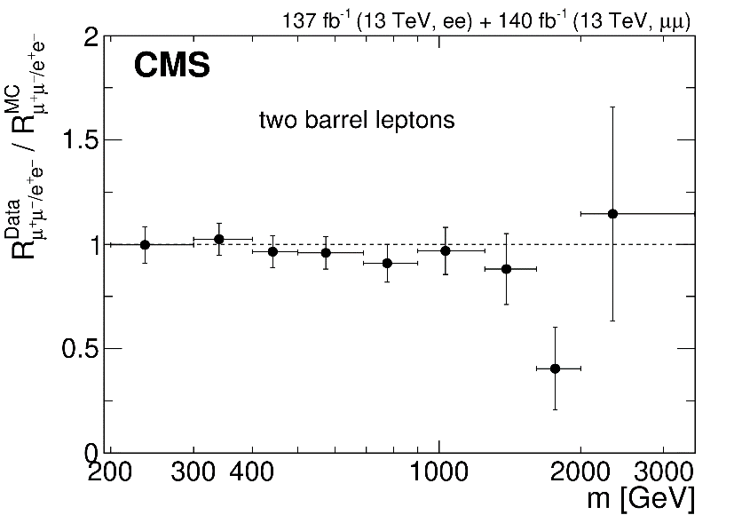
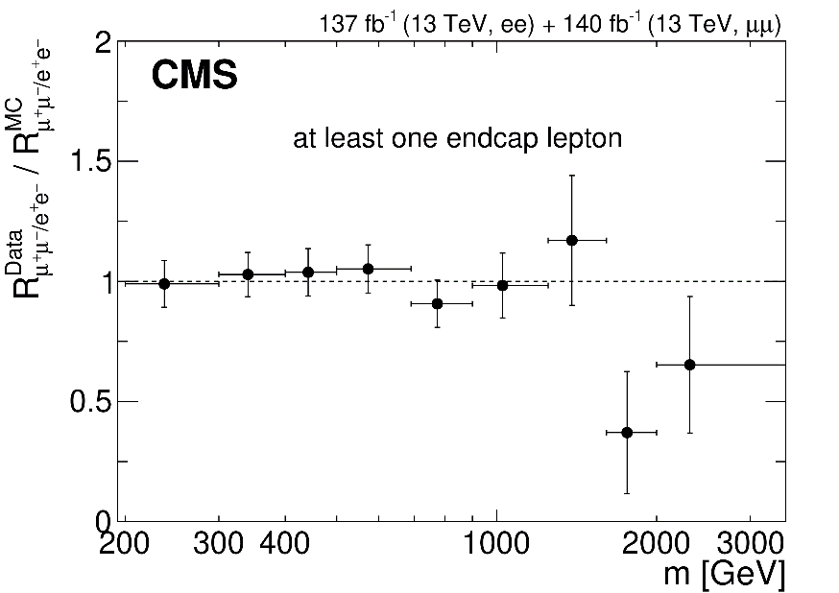
Test of the SM lepton ﬂavour universality in DY
Standard model: lepton ﬂavour universality (LFU), the same couplings
Motivations for LFU violation:
several recent measurements reported by the LHCb, together with other ﬂavor anomalies in B-meson decays (hints)
a new physics (the high-mass tail effects) that give the signiﬁcant deviation from unity of the R (heavy neutral gauge bosons or leptoquarks etc.)
LFU violation in DY: deviation from unity of the ratio of the dimuon to dielectron differential cross section as a function of dilepton mass m_{ll}
A. Greljo and D. Marzocca,
EPJ C77 1287 (2017) 548.
Good agreement with SM expectation
is observed up to 1.5 TeV
arXiv:2103.02708,
submitted to JHEP
Notes:
10

Slide 11
Beyond dileptons: RUN3 and HL-LHC perspectives
Live after RUN2 – move forward using all the previous experience
Preparation for RUN3 (2022-2024):
selection of the theoretical scenarios
choice of the region of parameter space
signal/bckgr. simulation
Monte-Carlo mass production incl. detector response, wide scan of the parameter space
trigger requirements
l⁺l⁻
dilepton
l⁺l⁻ (l^{+/-}) + MET
the pair/single lepton + MET
μ⁺e⁻ (μτ/eτ)
the different flavour
lepton pair (LFV)
l⁺l⁺/ l⁻l⁻
the same-sign lepton pair
A wide field of possibilities for both data reconstruction and processing methods, as well as for physics analysis
new algorithms, methods, triggers, reconstruction efficiency…
models of new physics, data interpretation and reinterpretation, physics generators…
Notes:
11

Slide 12



Beyond dileptons: a single/pair leptons + MET
Extended simplified DM: 2HDM-based DM; Dark portal, t-channel VFC SDM… (primary area of interest during RUN3 period and beyond)
The simplified vs the simplest DM:
SM → extended higgs/gauge sector: extra states = extra graphs
One DM particle/mediator + SM
f, χ
$$h(b\overset{̿}{b})/Z(ll)$$
V/VA
VBC
2HDM+$Z_{V}^{′}$
Z_{VFC}
g_{q}
g_{q,χ}
new couplings
new states
flavour violation
$$\overset{̿}{f},\overset{̿}{χ}$$
“powerful”/specific signatures: one for many models / specific for the selected theoretical scenario
not only s-channel processes
single/pair leptons in FS plus the missing transverse energy
Complementary signatures:
Z → lepton pair + MET
and
h₁₂₅ → bbar + MET
JINR
JINR + Erevan
Notes:
12

Slide 13
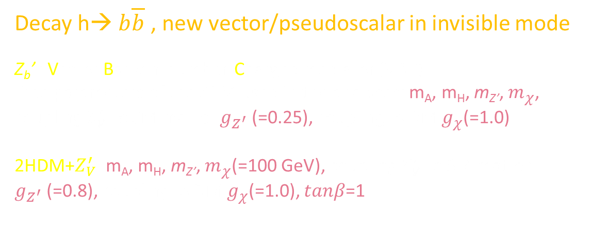
Mono h($b\overline{b}$) + $E_{T}^{mis}$, SDM interpretation
Decay h→ $b\overline{b}$ , new vector/pseudoscalar in invisible mode
Z_{b}’ : Vector Baryon-number-Charged mediator (VBC)
Free parameters of the SDM used in the analyses: m_{A}, m_{H}, m_{Z’}, $m_{χ}$, coupling $Z_{V}^{′}$ to SM matter $g_{Z^{′}}$ (=0.25), coupling to DM $g_{χ}$(=1.0)
2HDM+$Z_{V}^{′}:$m_{A}, m_{H}, m_{Z’}, $m_{χ}$(=100 GeV), coupling $Z_{V}^{′}$ to SM matter $g_{Z^{′}}$(=0.8), coupling to DM $g_{χ}$(=1.0), $tanβ$=1
Z_{b}’
Z_{b}’
EPJC 79 (2019) 280
RUN3 analyses is in preparation… (JINR + Erevan)
Notes:
13

Slide 14
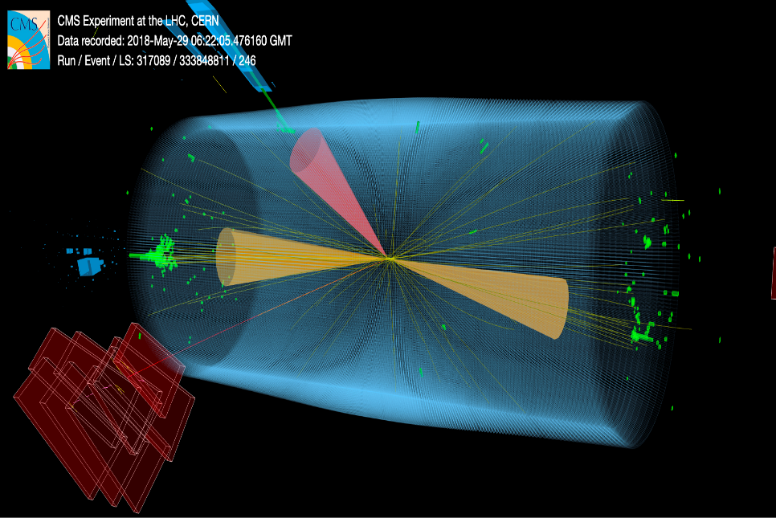
Beyond dileptons: different flavour lepton pairs
Models: microscopic “quantum” black holes (QBH), RPV SUSY, LFV EGM, Flavorful
higgs model… (arbitrary mass of a lepton pair)
Flavorful higgs model
RUN2 analyses on full statistics
of up to 140 fb⁻¹ is going on
μτ
RUN 3 analyses is in preparation
(JINR + Minsk)
Notes:
14

Slide 15
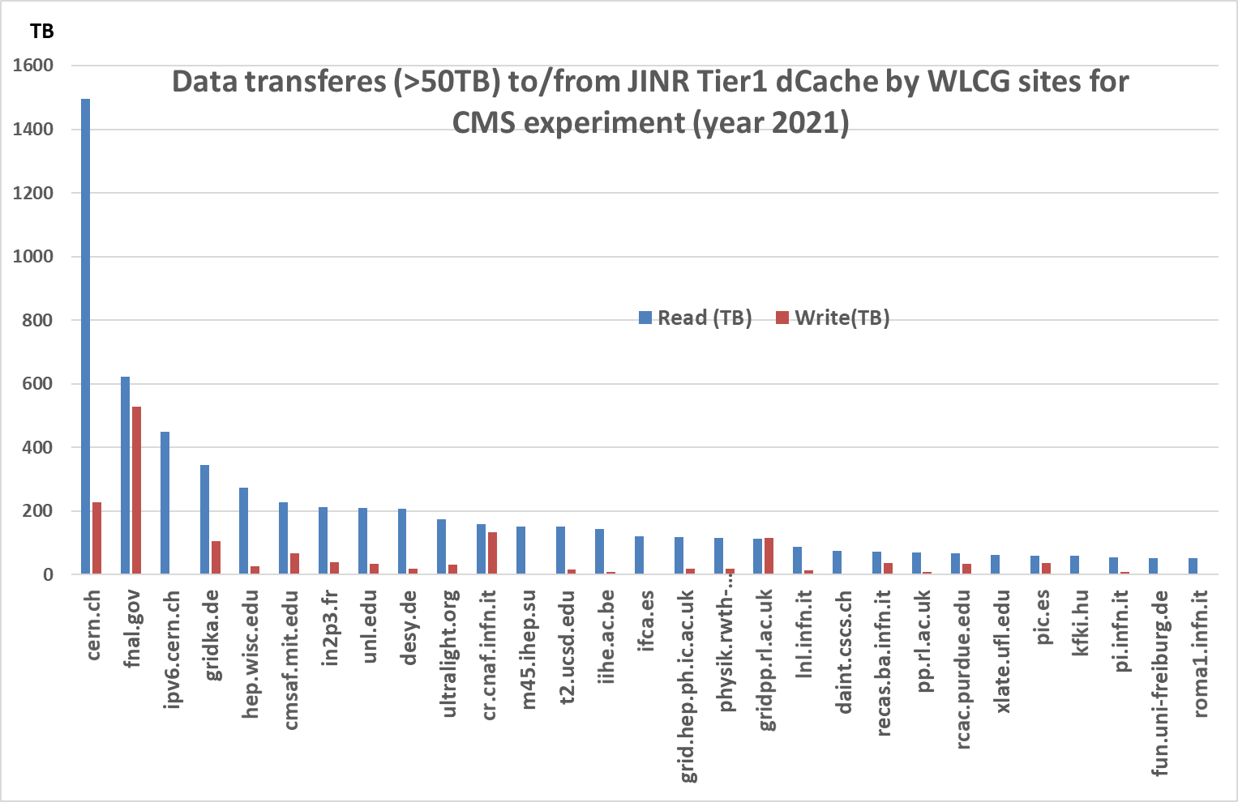
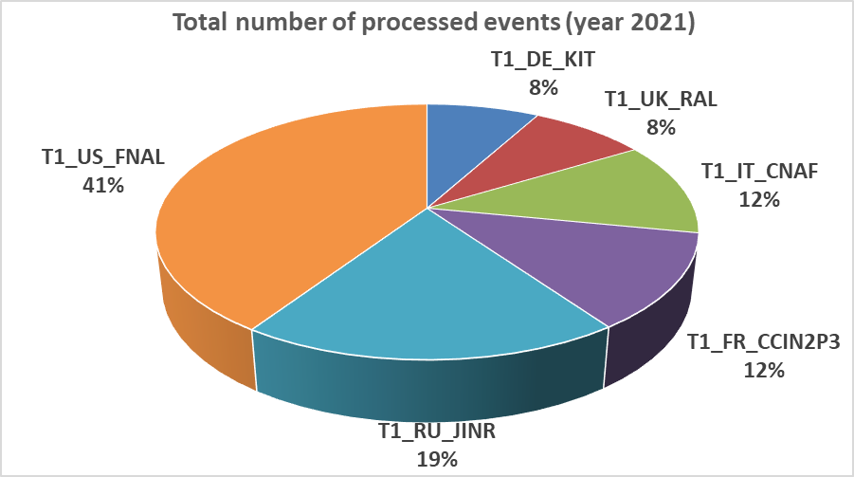
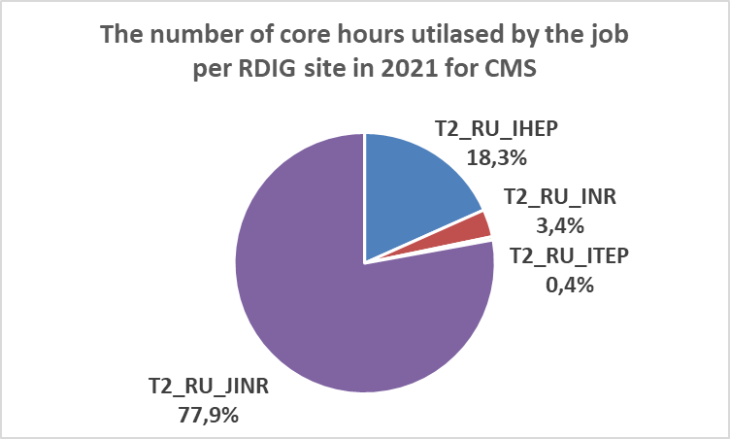
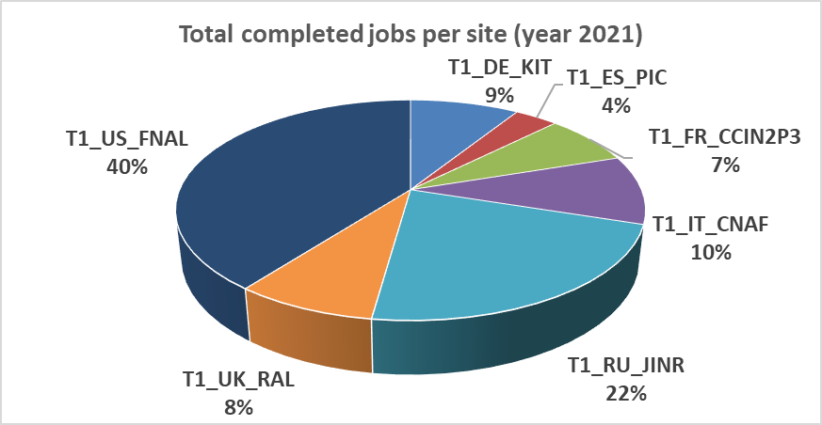
JINR Grid-Infrastructure for CMS computing
JINR grid infrastructure for CMS computing is represented by the Tier1 level center for the CMS experiment and the Tier2 level center, which are components of the LIT MICC and provides data processing for the CMS collaboration.
In terms of performance (number of events processed, jobs per site, etc.) JINR Tier1 ranks second among other world Tier1 centers (FNAL, JINR, CCIN2P, KIT, CNAF, RAL, PIC) for the CMS experiment
JINR Tier1 is a key site for WLCG infrastructure
Tier2 play a leading role within RDIG community
JINR’s Tier2 site is the most productive in the Russian RDIG Consortium (Russian Data Intensive Grid) for CMS data processing. More than 77% of the total CPU time in the RDIG is used for calculations on our Tier2.
8.5 PB of data from more than 180 grid sites have been transferred to Tier1, and more than 10 PB of data have been downloaded.
The JINR Tier1 site is equipped with novel high-performance computing elements, which gives us the possibility to process massive production jobs with a high speed and throughput.
.
RUN3 preparation require JINR sites further improvement with JINR directorate support.

Slide 16
Plans for 2021 (reminder and status)
Physics analysis, RUN2 completion
In 2021, it is planned to continue searching for new physics with dileptons (done) and b-jets using all the LHC RUN2 statistics (partially done)
Study of the Standard model with the Drell-Yan process: the DY cross sections and angular coefficients is measured in triple differential mode for the first time, the DY cross section measurement is extended to lower invariant masses (partially done);
AFB will be measured on full RUN2 available statistics (in approval)
Measurements of the charged particle multiplicities in quark and gluon jets for RUN1 and RUN2 (partially done)
Physics analysis, RUN3 preparation
Searches for signals of dark matter and new scalar bosons beyond SM (extra Higgs bosons) with (di)leptons/b-quarks plus MET; studies of observed Higgs boson properties (in progress/preparation)
Studies of lepton-flavour violating processes to search for FV higgs models, quantum black holes, RPV SUSY, etc. (in progress)
Upgrades, operation and service works
Preparation and submission of the JINR project “UPGRADE OF THE CMS DETECTOR” for LHC Phase 2 (done)
Studying the aging effects of the ME1/1 CSC will be continued at GIF ++ setup. With the SPS muon beams, it is planned to study the characteristics of the CSC with background conditions corresponding to the HL LHC operating mode. The new segment builder algorithm to be studied with GIF++ muon beam data. A study of new CSC gas mixtures will be carried out taking into account the requirement to limit the use of greenhouse gases at CERN (partially done)
In 2021, the JINR group plans to continue research on the temperature measurements for the HB readout box, as well as test and install modified clock&control modules and commissioning of Hadron Endcap Calorimeters, completion of work on the installation of modernized low voltage power supplies and HF migration to multimode control links (partially done)

Slide 17
Summary
During the long-term technical shutdown of the LHC (Long Stop, LS2) the JINR team successfully participated in
  Physics program
    JINR physicists are involved in the seven CMS Physics Analysis (three of them are subject of the full responsibility) within the Exotica/Higgs/SM Working Groups
    1 CMS paper, 5 papers in referred journal, 2 CMS AN Notes are already published in 2021
    young physicists are involved actively (11 young researcher < 35), 2 talks in 2021 were presented by them (10 talks already selected by Collaboration to be presented at the summer conferences)
    the results are recognized and included in PDG reviews
  Detailed plans of participation in physics analysis during the LHC RUN3 (up to 2023). Preparation for RUN3 data analysis is in progress
  Upgrade, operation and service works
    Works in the framework of the LS2 program are ongoing, JINR CMS group has contributed to
        Hadron Endcap (HE) ngCCMs (new generation modules) modification and replacement
        upgrade of MEx/1 CSCs with new electronics
    Works M&O_B (maintenance and operation of detector systems, computing, software development) and EPR (Experimental Physics Responsibilities) obligations for 2021 are ongoing
  The JINR project “UPGRADE OF THE CMS DETECTOR” has been developed and submitted to PAC aimed to large-scale modernization of the detector systems to ensure feasibility of the HL–LHC physics program

Slide 18
Thank you for your attention!

Slide 19
JINR Publications in 2021
CMS papers in refereed journals
CMS Collaboration [Albert M Sirunyan et al.], "Search for resonant and nonresonant new phenomena in high-mass dilepton final states at 13 TeV”, arXiv: 2103.02708, submitted to JHEP.
Refereed journals
I. A. Zhizhin, A. V. Lanyov, S. V. Shmatov, “Search for new physics in deilepton channel with the CMS Experiment at the LHC”, Phys. Atom. Nucl. 84 (2021) 184
M. V. Savina, D. Seitova, “Program of searches with the CMS detector for signals from multidimensional low-energy gravity at the LHC”, Phys. Atom. Nucl. 84 (2021) 149
V. V. Shalaev, S. V. Shmatov, "Electroweak Physics with the CMS Experiment", Phys. Atom. Nucl. 84 (2021) 37
V. Zykunov, Phys. Atom. Nucl. 84 № 4 (2021)
S. Shulha, D. Budkouski. PEPAN Letters, 2021, Vol. 18, No. 2, pp. 239–243
CMS Notes
Daniele Barducci at al., “Search for mu+ mu- plus b-jet event excess at the dimuon mass of 28 GeV in pp collisions at 13 TeV using full Run II data”, CMS AN-2021/089, CMS preprint, 2021.
S. Shulha, D. Budkouski, “Measurement of mean charged-particle multiplicities in gluon and quark jets produced in pp-collisions at 8 TeV and 13 TeV with the CMS detector”, CMS AN-2021/024, CMS preprint, 2021.

Slide 20
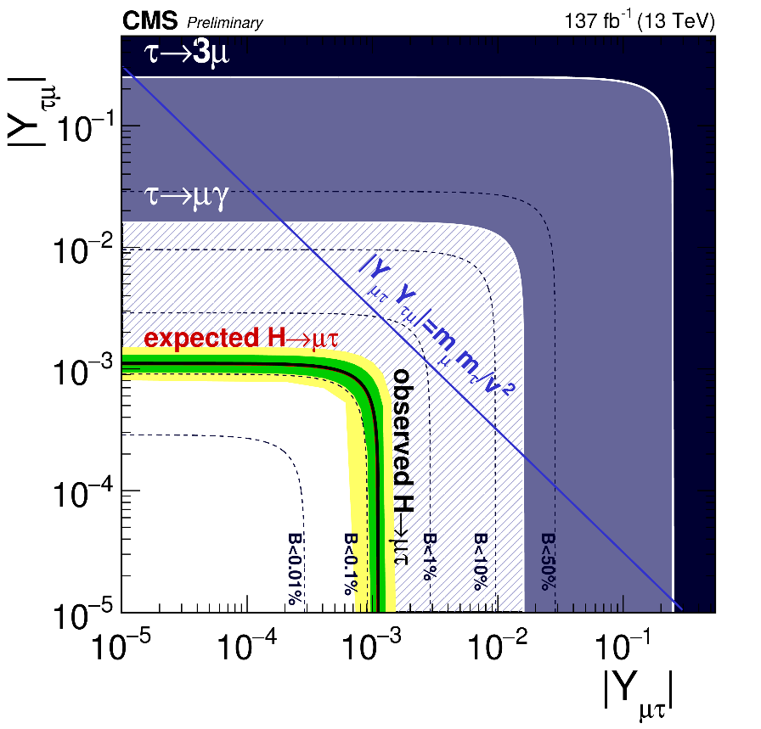
Beyond dileptons: different flavour lepton pairs
The h₁₂₅ decay what allows for FV; the full RUN2 statistics
A test of a Higgs boson “standardness” – invariant dilepton mass must be a mass of the h₁₂₅
Upper limits on non-diagonal Yukawa matrix elements (V_{μτ}/V_{τμ}, V_{eτ}/V_{τe})
arXiv:2105.03007,
submitted to JHEP
http://cms-results.web.cern.ch/cms-results/public-results/superseded/HIG-20-009/CMS-PAS-HIG-20-009_Figure_007-a.png
Preparation for RUN3 is going on
Notes:
20

