Slide 1
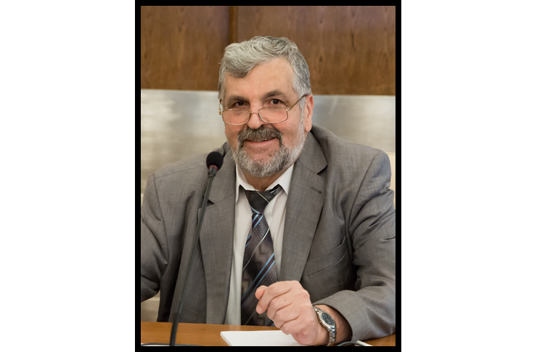
Valeriu Kantser
5 February 1955 – 2 April 2017
Outstanding Moldovan scientist , Full member of the Academy of Sciences of Moldova, Chairman of the JINR Programme Advisory Committee for Condensed Matter Physics (2008–2017)

