Slide 1
Report on the concluding theme
“Investigations of Condensed Matter by Modern Neutron Scattering Methods”
for the period 2015-2017
Theme Leaders: D.P. Kozlenko, V.L.Aksenov, А.М.Balagurov

Slide 2
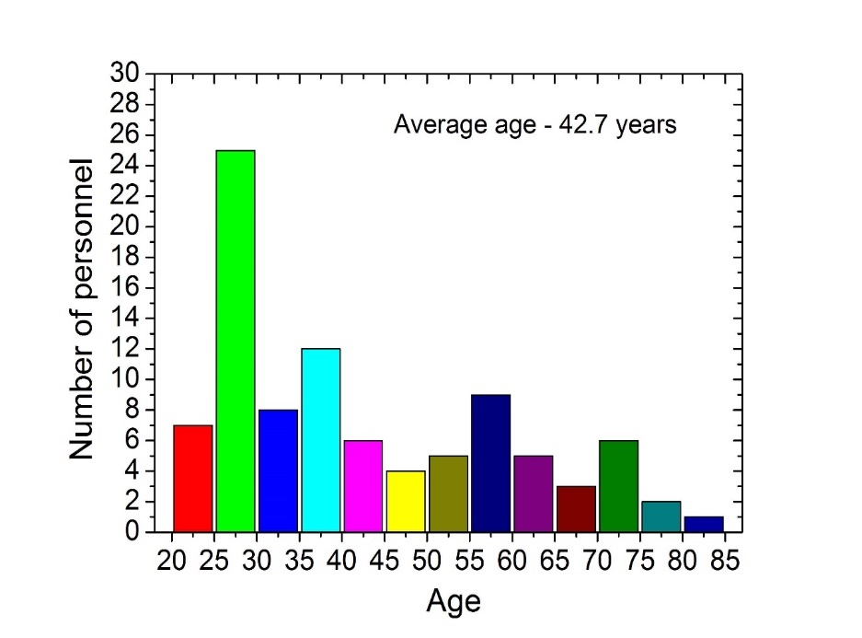
Department of Neutron Investigations of Condensed Matter
Sector 1 - Diffraction
Sector 2 – Neutron Optics
Group 1 – HRFD/FSD
Group 2 – DN-2
Group 3 – DN-12
Group 4 - SKAT
Group 1 – REMUR
Group 2 – REFLEX
Group 3 – GRAINS
Group YuMO
Group NERA
Staff number: 105
Main Staff: 47
Staff from Member states: 39
Part occupancy staff: 19
40 % of staff – younger than 35 years old

Slide 3
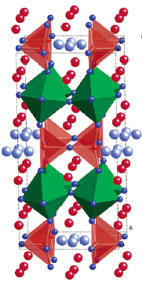
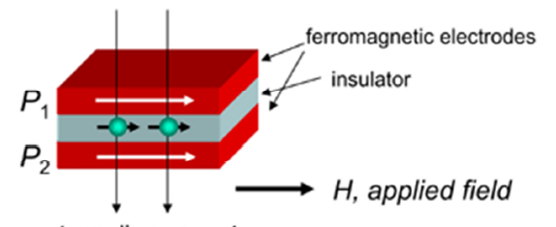
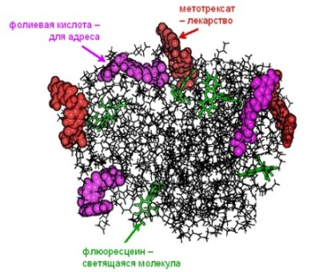
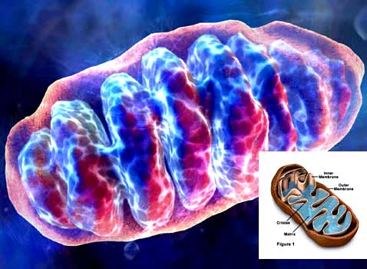
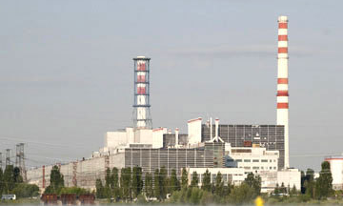
The priority directions of scientific research :
Physics and Chemistry of Novel Functional Materials;
Physics of Nanosystems and Nanoscale Phenomena;
Physics and Chemistry of Complex Liquids and Polymers;
Molecular Biology and Pharmacology;
Materials and Engineering Sciences.

Slide 4
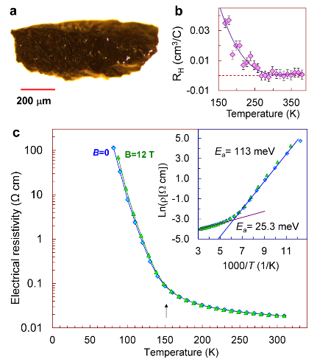
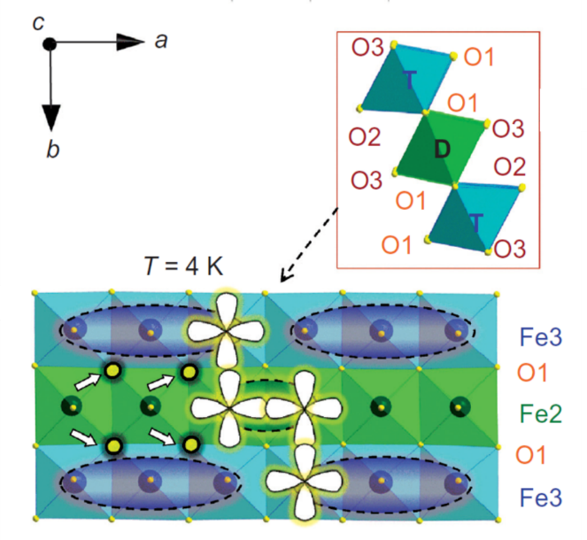
Novel type of the charge ordering state in iron oxide Fe₄O₅ involving competing dimer and trimer formation
Previously known: Fe₃O₄, Fe₂O₃, FeO
A new one: Fe₄O₅
Crystal structure of Fe₄O₅ (a), neutron diffraction patterns, measured at different temperatures and processed by the Rietveld method (b), magnetic structures at Т = 150 К (c), and Т = 10 К (d).
Formation mechanism of the dimeric and trimeric states
S.V.Ovsyannikov,.., D.P.Kozlenko, et al., Nature Chemistry (2016)

Slide 5
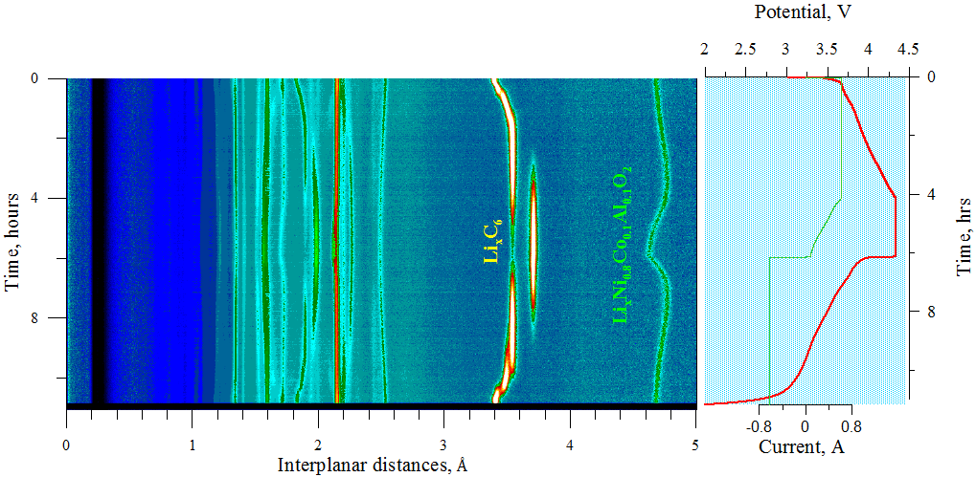
Evolution of the crystal structure of the cathode material LiNi_{0.8}Co_{0.1}Al_{0.1}O₂ in the process of electrochemical cycling
Neutron diffraction patterns of LiNi_{0.8}Co_{0.1}Al_{0.1}O₂ obtained in operando regime. The charging-discharging curve of the reloaded electrical current source during the experiment is shown on the right.

Slide 6
Crystal and Magnetic Structure of Cr₂O₃ at Ultrahigh Pressures
Cr₂O₃ (eskolaite) – one of the first discovered magnetoelectric materials with ferroelectric polarization induced by external magnetic field, T_{N} = 307 K
Crystal and magnetic structures of Cr₂O₃
Neutron diffraction patterns of Cr₂O₃ measured at ultrahigh pressures up to 35 GPa at with DN-6 diffractometer
D.P.Kozlenko et al., Journal of Alloys and Compounds, accepted for publication (2017)
Normalized magnetic moments and Neel temperature at high pressure

Slide 7
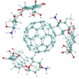
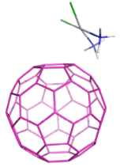
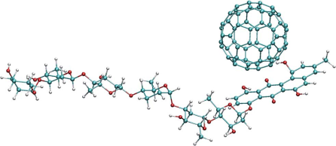
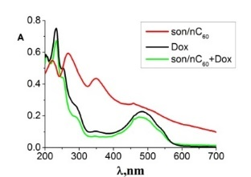
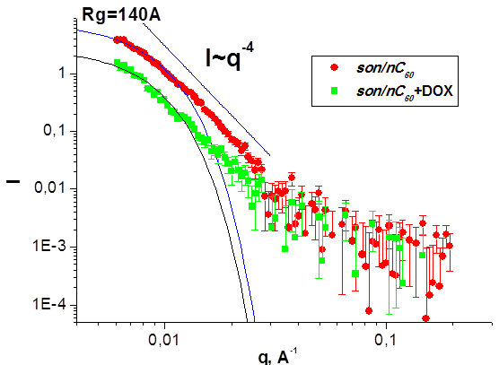
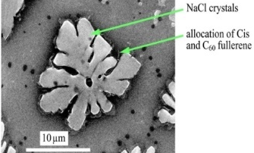
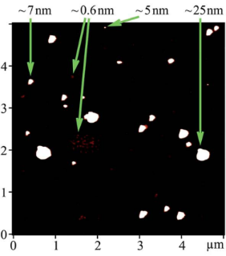
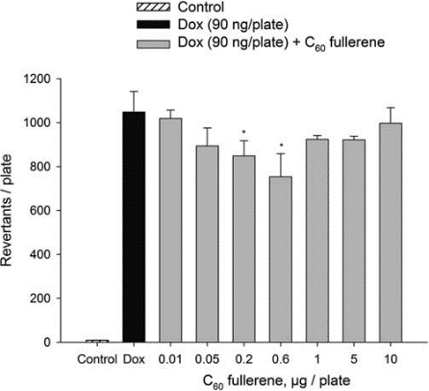
Fullerenes complexation with antitumor drugs
(FLNP JINR – Biological and Physics Department KNU)
Doxorubicin
ζ = -22 mV C₆₀
ζ = +45 mV C₆₀+Dox.
ζ = 0 mV Dox
Cisplatin
ζ = -22 mV C₆₀;
ζ = -17,6 mV C₆₀+Cis
UV-Vis
SEM
NaCl crystals
C60+Cis
Landomycin
ζ = -22 mV C₆₀
ζ =-10 mV C₆₀+LA
SAXS
AFM
SAXS
Biological tests
Mutagenic activity in Salmonella typhimurium
SANS
S.Prylutska, et al. Nano Res. (2017) accepted.
Yu.I.Prylutskyy, et al. RSC Adv. (2016).

Slide 8
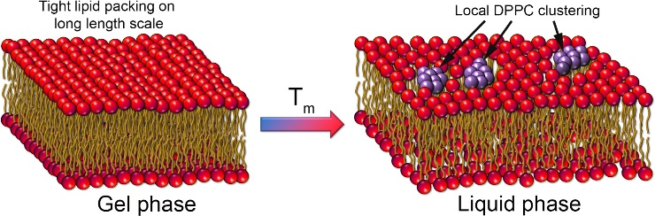
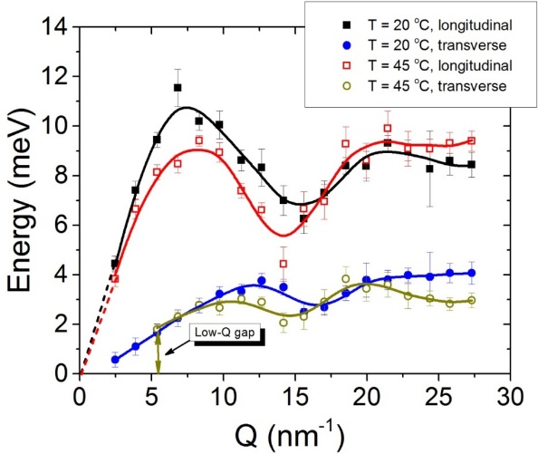
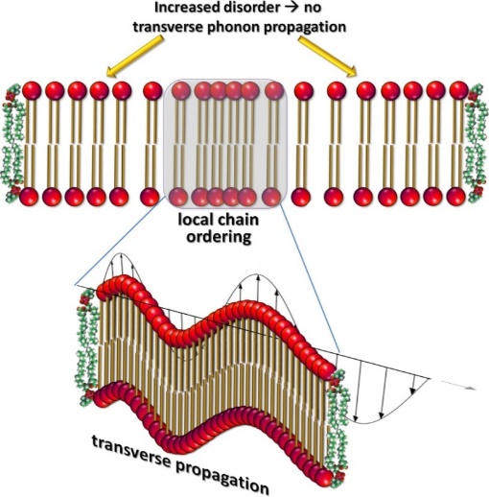
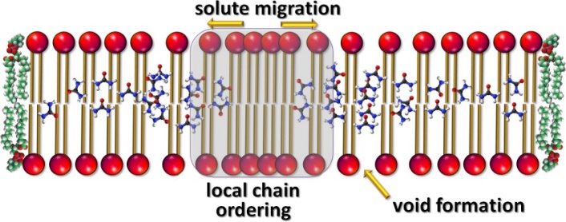
The Mechanism of Passive Transport in Lipid Bilayers
Low-Q phononic gap
No phonon propagation
at Q < Q_{gap}
Phonon-mediated nm-scale clustering
Characteristic length-scale
d_{gap} = 2π/Q_{gap} of a local “order”
(no phonons at smaller Q → more disorder on long scale! )
The cut-off value Q_{gap}
(at which gap occurs)
NO phononic gap
Low-Q phononic gap
Q_{gap}
We observe:
nm-scaled short-lived molecular clusters → local chain ordering, or density fluctuations
Increased disorder beyond the cluster size → indication of the transient voids formation
Size and the life time of the clusters agrees well with the theory prediction
the cluster size d_{gap} = 2π/Q_{gap} is ~ 1.1-1.6 nm
Lifetime: ~1 ps (agrees well with common
assumptions – a few ps)
M.Zhernenkov, .., D.Soloviov, et al. Nat. Commun. (2016)

Slide 9
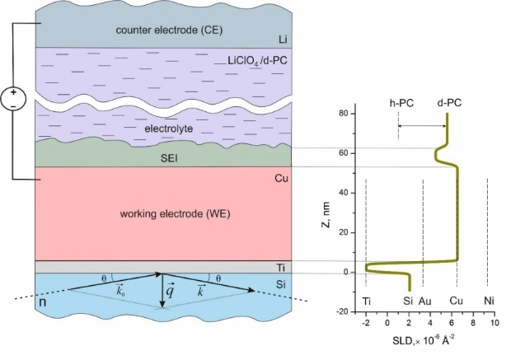
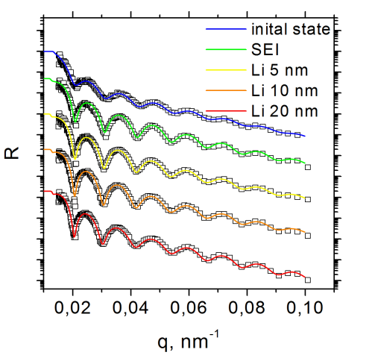
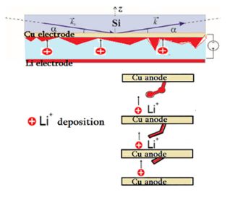
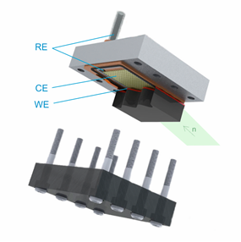
Monitoring of electrochemical processes at the interface metal electrode/liquid electrolyte by neutron reflectometry (FLNP JINR – Dep. Chem. MSU)
Electrochemical interface with a metal electrode and lithium-containing liquid electrolyte
Experimental NR curves and fitting results
Electrochemical cell for NR experiments
SLD profiles
Working electrode (WE)
Counter electrode (CE)
Reference electrode (RE)
M.V.Avdeev, et al. Appl. Surf. Sci. (2016) submitted.

Slide 10
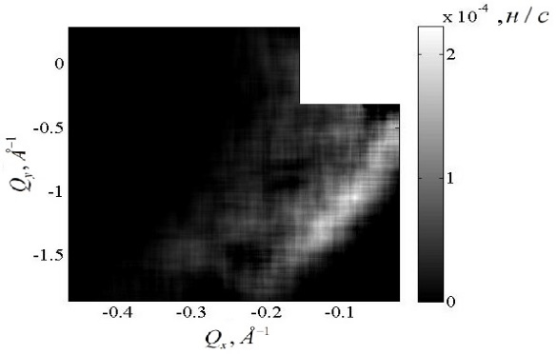
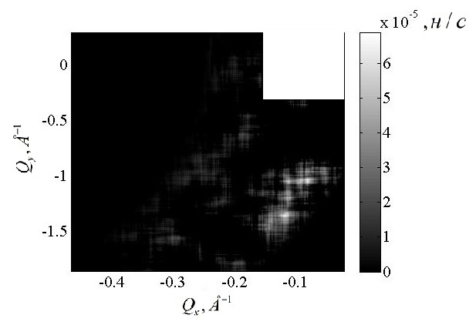
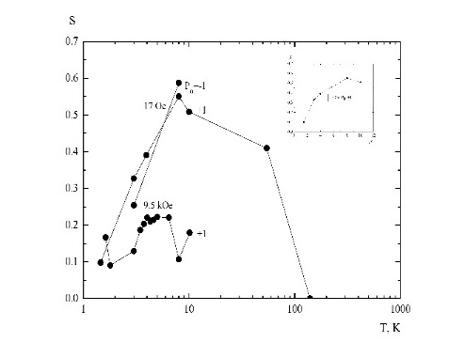
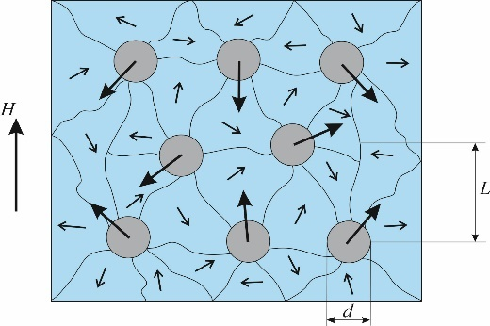
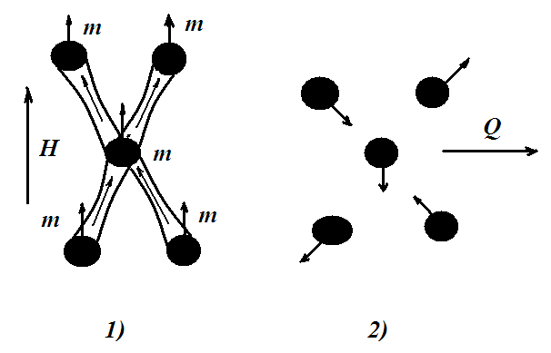
Observation of cryptoferromagnetic domain state in layered structure
V(150nm)/Fe(7%)+V+Nb)(20nm)/Nb(150nm)
Scattering at 10K, 2. Scattering at 1.5K, 3. Decreasing of scattering in range 1.5K-150K,
4. Transformation of cluster structure from 8K to 1.5 K at H=0
5. Structure at T=1.5K and H=1 kOe – Clusters and Domains (cryptoferromagnetism)

Slide 11
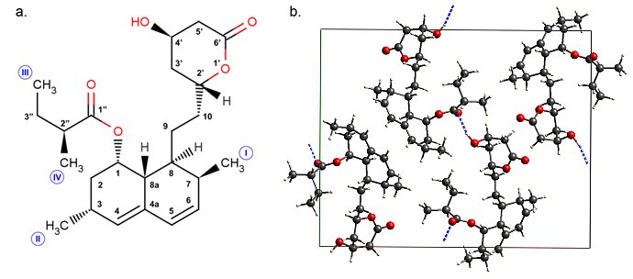
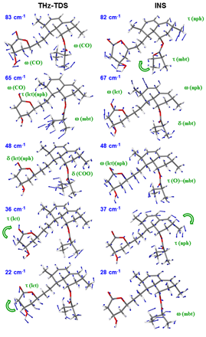
A study of structure and dynamics of lovastatine
С.
d.
Molecular (left) and crystal (right) structures of lovastatine (LOV; (1S,3R,7S,8S,8aR)-8-{2-[(2R,4R)-4-Hydroxy-6-oxooxan-2-yl]ethyl}-3,7-dimethyl-1,2,3,7,8,8a-hexahydronaphthalen-1-yl (2S)-2-methylbutanoate) (b).
Theoretical (harmonic DFPT PBE-TS approach) and experimental vibrational spectra of lovastatine according to inelastic incoherent and terahertz spectroscopy (с). The most important vibrational modes are visualized (d).

Slide 12
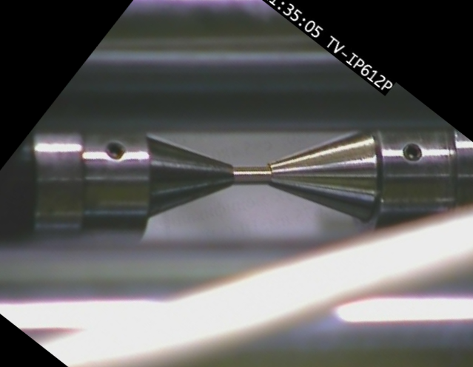
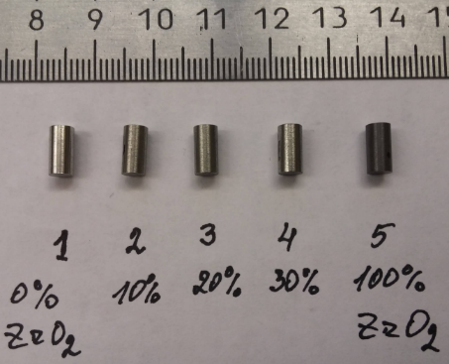
FSD-2016: TRIP steels (in collaboration with IMF of TU Bergakademie Freiberg)
Typical image from camera
Image profile analysis: changes in sample dimensions
4 phases: austenite, α- and ε-martensite, ZrO₂ (amorphous)
Phase contents vs. plastic deformation
Changes in diffraction pattern vs. plastic deformation
Studied samples

Slide 13


Deformation inside a paleosubduction channel – Insights from microstructures and crystallographic preferred orientations of eclogites and metasediments from the Tauern Window, Austria.
Microstructural observations
Geological location
Crystallographic preferred
Orientation (texture)
Keppler et al. (2016) J. Struct. Geol. 82, 60-79.
[doi: 10.1016/j.jsg.2015.11.006]

Slide 14
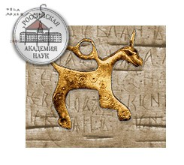
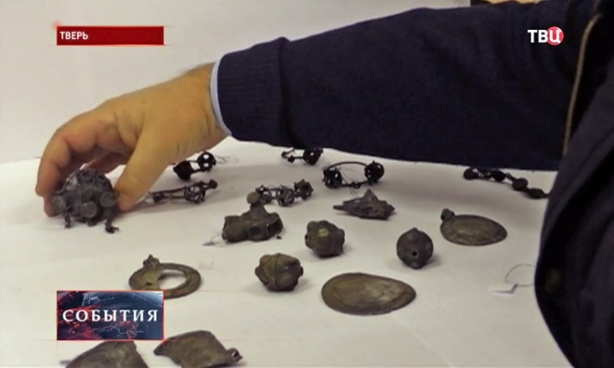
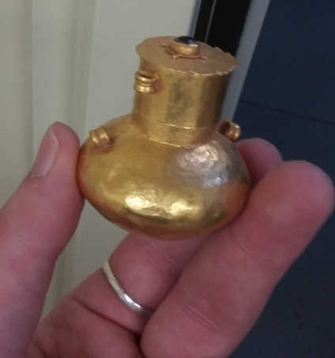
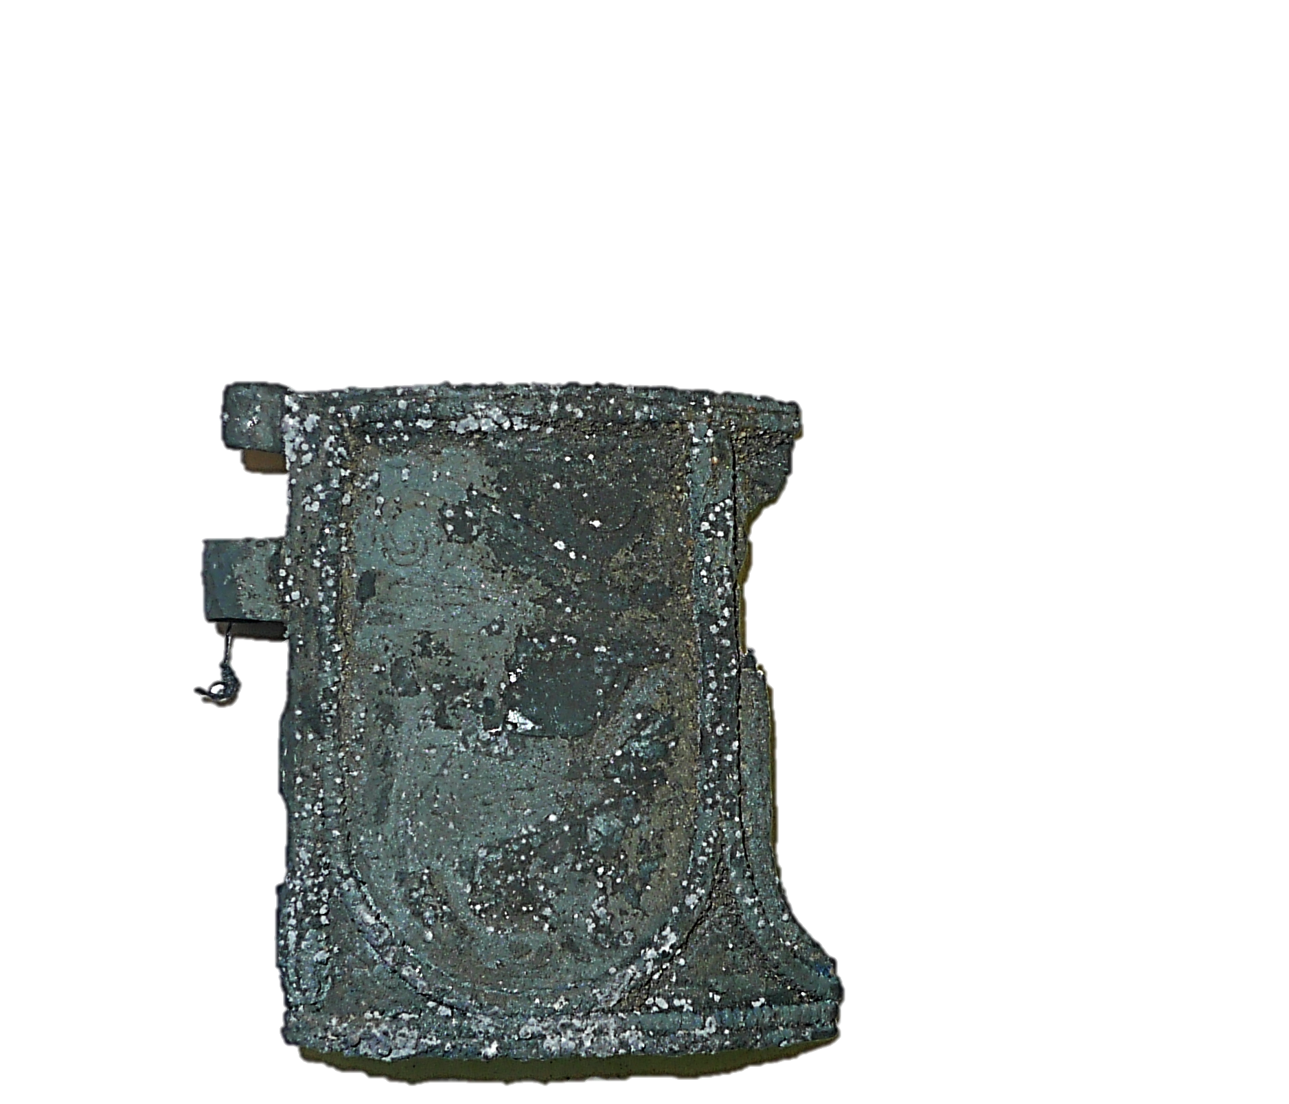
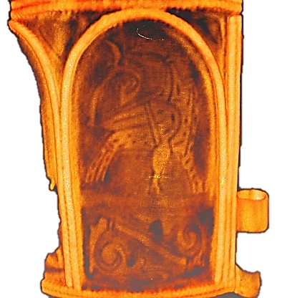
Neutron radiography and tomography facility: cultural heritage studies
Institute of Archaeology of Russian Academy of Science
«Tver’ treasure» was found in 2014
Gold Scythian jar (left) and neutron tomography reconstruction (right)
The part of Old-Russian ancient bracelet dated to XIV century (left) and neutron tomography reconstruction (right).

Slide 15

2014 – 163 proposals; 150 accepted; 17 countries; 59 visiting users from 12 countries
2015 – 197 proposals; 174 accepted; 19 countries; 67 visiting users from 14 countries
2016 – 238 proposals; 208 accepted; 19 countries; 102 visiting users from 11 countries
2014
2015
2016
3.7%
26%
47%
5.5%
6.7%
9.8%

Slide 16
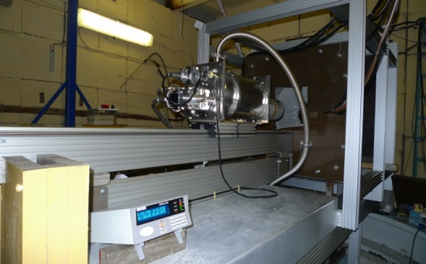
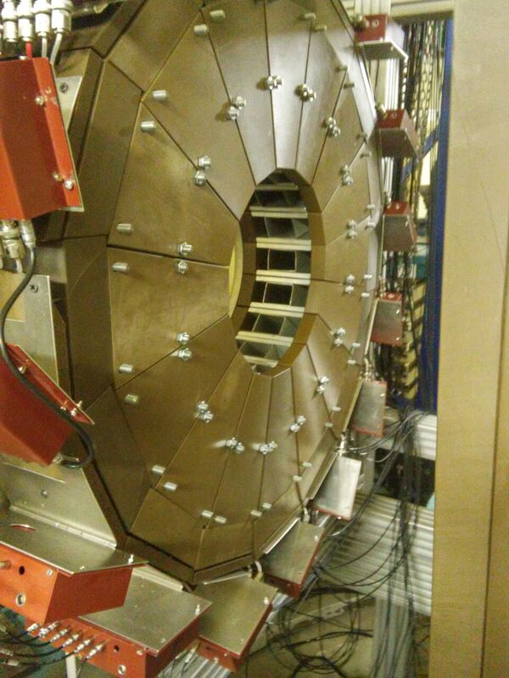
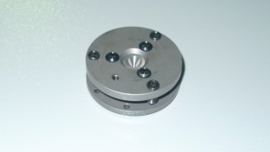
Development of IBR-2 Spectrometer Complex
Two detector system was put into operation at DN-6 diffractometer
Second circular detector of DN-6, consisting of 96 separate ³Не counters
Neutron diffraction patterns of LiMn₂TeO₆, measured at scattering angles 2θ = 45° (left) и 90° (right) for 10 min.

Slide 17
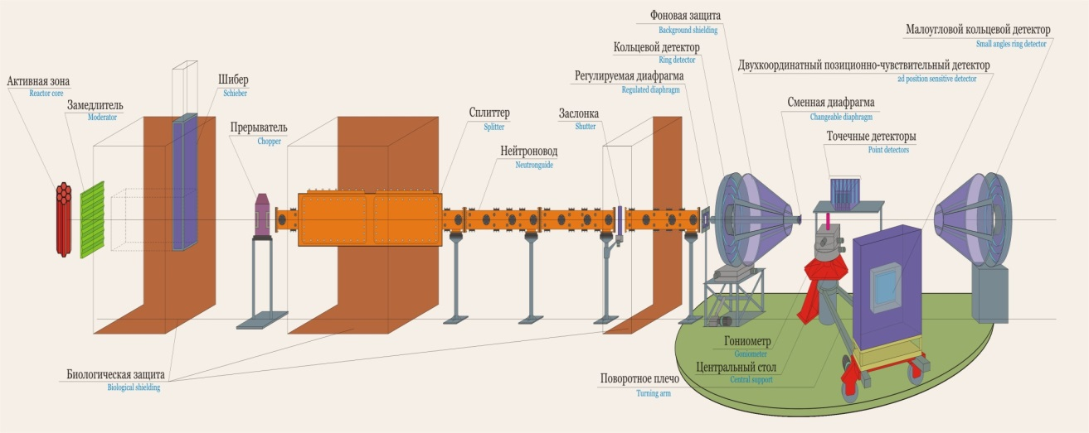
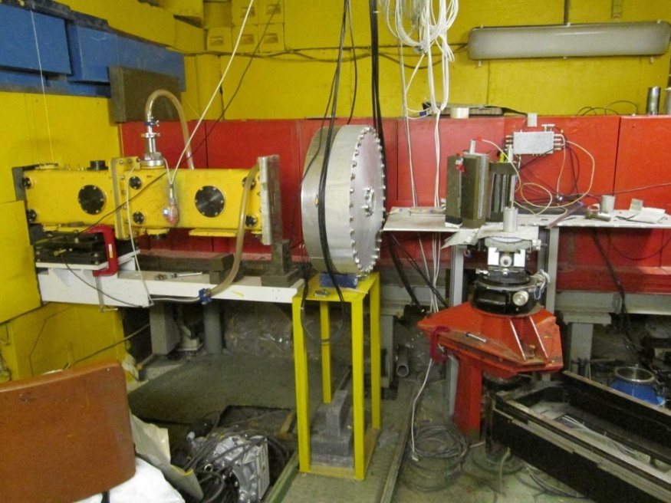
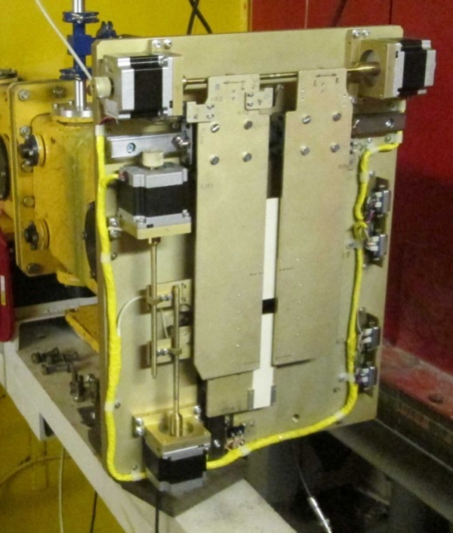
Reconstruction of the DN-2 into Real Time Diffractometer (RTD)
Ring-shaped helium backscattering
detector on the RTD diffractometer
Adjustable neutron beam
diaphragm for the RTD diffractometer 20x105mm

Slide 18
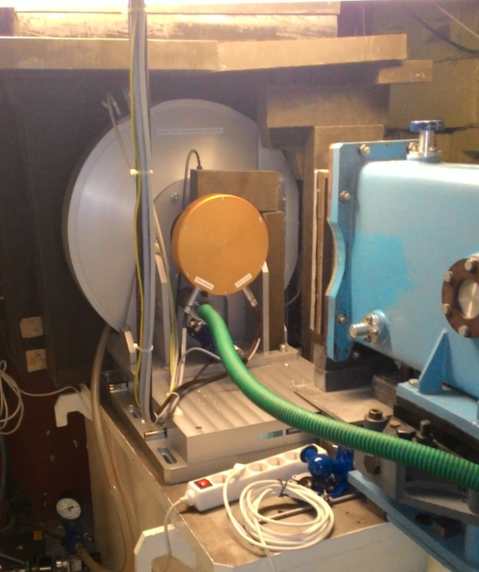
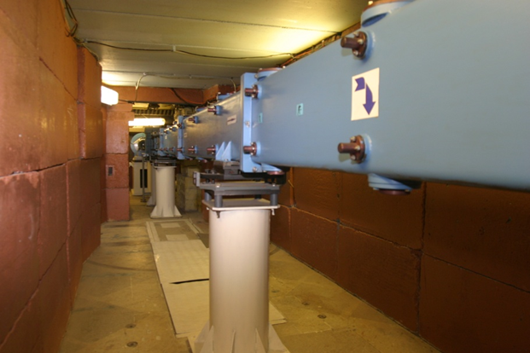
Global modernization of the HRFD diffractometer
New Fourier chopper in work position.
Comparison of the old (V-14-10) и new (V-16-10) incident neutron spectra measured using vanadium sample (a). The gain factor of neutron intensity as function of neutron wavelength measured using the standard Al2O3 sample (b).
Neutron guide with vertical parabolic focusing. New mirrors were mounted in old vacuum casing.

Slide 19
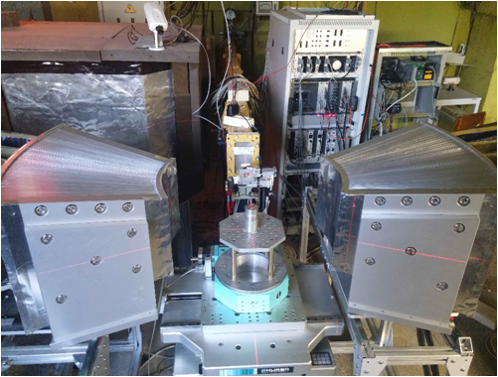
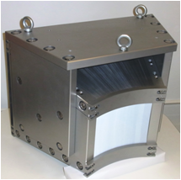
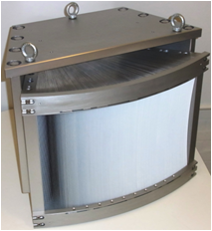


FSD-2016: NEW radial collimators (G.V.=1.8 mm)
Beam profiles:
analytical calculations and Monte Carlo simulation
Radial collimators on FSD for gauge volume definition in bulk sample during stress measurements
Two radial collimators
by JJ X-Ray (Denmark)
Two strain components can be measured simultaneously using both collimators
Webcam for sample control:
top view of sample position
with radial collimators

Slide 20

Reconstruction of the Reflex reflectometer into the SESANS spectrometer
End part of a new neutron guide assembled at the 9th beamline.
Incident neutron wavelength distribution spectra on 9th beamline at the previous instrument configuration (black) and with a new neutron guide (red). Long wavelength limit is shifted by 11 Å, due to the move of the background chopper to the new position closer to the source.

Slide 21

Installation of the Fourier Stress Spectrometer Components at 13 beamline of IBR-2 and first test experiments
The main elements of the FSS spectrometer and the infrastructure of the 13 beamline (left). The measured spectrum of the iron sample by different detector elements (right).

Slide 22


Complementary laboratory equipment
Raman spectrometer Horiba HR Evolution
X-ray diffractometer PANalytical Empyrean

Slide 23
Publications – 287
Conference reports – 324
Patents - 1
International prizes
Prize of the Romanian Academy of Sciences “Stefan Procopiu”, 2015, D.P.Kozlenko.
JINR Prizes
2015
Scientific and technical applied research:
I prize
M.V. Avdeev, V.L.Aksеnov, O.I. Ivankov, A.V. Rogachev, O.V. Tomchuk, L.A. Bulavin, L. Rosta, V.M. Garamus, N.N. Rozhkova, E. Osawa. “Structure diagnostics and investigations of powders and liquid suspensions of detonation nanodiamonds by small angle scattering of thermal neutrons”
2016
Experimental Physics Research
I prize
D. Kozlenko, E. Lukin, S. Kichanov, A. Rutkauskas, B. Savenko, E. Burzo, P. Vlaic, Dang Ngoac Toan. “Magnetic phenomena in intermetallic compounds RCo2: studies of the limits of the itinerant electron metamagnetism concept”.

Slide 24
Financial report (theme budget)
Planned | 2015, kUSD | 2016, kUSD | 2017, kUSD
Materials | 421.6 | 450 | 531.2
Equipment | 632.4 | 675 | 796.8
Research contracts | 20.0 | 20.0 | 20.0
International cooperation | 158.7 | 158.7 | 158.7
Total | 1232.7 | 1303.7 | 1506.7
Fact: | 75 % | 65 %
Additional financial sources – 900 kUSD per year, including:
Grants of PP of Poland, Slovak Republic, Czech Republic, Romania, Bulgaria, Belarus,
BMBF-JINR Agreement,
RSA-JINR Agreement,
ARE-JINR Agreement,
State contracts of RF Ministry of Science and Education,
RFBR grants,
IAEA grants.

Slide 25
Proposal for the extension of the theme
“Investigations of Condensed Matter by Modern Neutron Scattering Methods”
for the period 2018-2020
Theme Leaders: D.P. Kozlenko, V.L.Aksenov, А.М.Balagurov

Slide 26
The priority fundamental and applied research directions of the theme:
Physics and Chemistry of Novel Functional Materials;
Physics of Nanosystems and Nanoscale Phenomena;
Physics and Chemistry of Complex Liquids and Polymers;
Molecular Biology and Pharmacology;
Materials and Engineering Sciences.

Slide 27
Main scientific topics within priority research directions:
1.1 A study of structure and properties of novel functional materials,
1.2 A study of structure and properties of materials under extreme conditions,
1.3 A study of fundamental regularities of real time processes in condensed matter,
1.4 Computer modeling of physical and chemical properties of novel crystalline and nanostructured materials;
2.1 A study of magnetic properties of layered nanostructures;
2.2 A study of structural characteristics of carbon and silicon based nanomaterials,
2.3 A study of molecular dynamics of nanomaterials;
3.1 A study of magnetic colloid systems at bulk and interface state,
3.2 Structural characterization of polymer nanodispersed materials;
4.1 A study of structural characteristics and functional properties of biological materials,
4.2 A study of structure and properties of lipid membranes and lipid complexes,
5.1 A study of texture and physical properties of Earth’s rocks, minerals, and constructional materials,
5.2 Non-destructive control of residual stresses in industrial products and constructional materials,
5.3 Neutron imaging of internal structure of industrial products, constructional materials, cultural and natural heritage objects,
5.4 A study of radiation damage effects in condensed matted by X-ray spectroscopy.

Slide 28
Expected Scientific Results:
Determination of the parameters of atomic and magnetic structure of bulk and nanostructured functional materials, including oxides and intermetallics, demonstrating interesting physical phenomena or prospective for technological applications.
Determination of the parameters of the atomic and magnetic structure of novel forms of materials, appeared under extreme conditions.
Determination of microscopic mechanisms of magnetoelectric effect formation in complex multiferroic oxides.
Determination of the electrode microstructure effects on charging/discharging processes in compact power sources.
Operando analysis of the processes of deposition of electrically active ions from liquid electrolytes on electrochemical interfaces.
Revealing of proximity effects in magnetic layered nanostructures and analysis of magnetic properties in time independent and dependent magnetic fields.
Determination of the structural stability of colloid systems, including medical and biological solvents, in bulk and at interfaces.
Determination of the structural characteristics of nanosystems based on compositional C- and Si-containing materials, including fullerens, nanodiamonds and their bioactive derivatives.
Determination of structural characteristics of magnetic elastomers and carbosilane dendrimers, prospective for technological applications.
Determination of atomic structure and vibrational spectra of molecular complexes: ionic-molecular inclusive materials and complexes with electric charge transfer, structural and dynamical parameters of hydrogen bonding in bioactive materials.
Clarification of the molecular mechanisms of protein interactions, dimerization and functional characteristics of supramolecular structures and complexes.
Determination of structural characteristics of lipid nanosystems for understanding of the transport mechanisms of pharmacological drugs through the skin.

Slide 29
Expected Scientific Results (continued):
13. Analysis of metamorphic, geodynamic and evolution processes in the lithosphere
using the data about the texture of deep and near-surface earth rocks.
14. Determination of residual stresses and microdeformations in industrial products and
modern constructional materials, induced by various technological processes (metallic and
thermic treatment, welding, etc.).
15. Determination of the relationship between the microstructure and thermomechanical
properties of the prospective functional and constructional matrials (steels, alloys,
composites, metalloceramics, etc.).
16. Elaboration of the 3D models of internal arrangement of the cultural and natural heritage
objects, industrial materials and products using neutron tomography method.
17. Clarification of radiation damage mechanisms of solid-state materials, obtaining of long-life
operating data on radiation resistance of materials.

Slide 30
Methodical activities
Development of the instrumentation of the IBR-2 spectrometer complex.
Development of neutron scattering methods for interdisciplinary studies of nanosystems and materials.
Projects
Isotope-identifying neutron reflectometry at the IBR-2 facility (2015-2018).
A system for neutron operando monitoring and diagnostics of materials and interfaces for electrochemical energy storage devices at the IBR-2 reactor (2018-2020).

Slide 31
Expected methodical results:
Extension of the experimental capabilities and improvement of the technical parameters of the new DN-6 diffractometer for studies of microsamples (development and fabrication of the neutron focusing device, detector system elements, high pressure cells and infrastructure).
Improvement of the technical parameters and extension of the experimental capabilities of the multifunctional reflectometer GRAINS (installation of the polarizing system, development and fabrication of electrochemical and liquid-containing cells for experiments).
Modernization of the operational IBR-2 spectrometers (HRFD, RTD, DN-12, YuMO, FSD, REFLEX, REMUR, NERA, SKAT, EPSILON, DIN-2PI) aimed at improving their instrumental parameters (neutron counting rate, background conditions, and extension of experimental opportunities).
Creation of the test configuration of the small-angle spin-echo spectrometer on IBR-2 beamline 9.
Development of the concept of the modernization of the inelastic neutron scattering spectrometer NERA and start of its realization.
Improvement of the technical parameters of the neutron radiography and tomography spectrometer on IBR-2 beamline 14 (spatial resolution, radiation stability of the detector system).
Adaptation of the correlation spectrometer FSS on IBR-2 beamline 13 and improvement of the technical parameters. Further development of the correlation RTOF-method.
Development and fabrication of the elements of basic configuration of the small angle scattering and imaging spectrometer (bender, biological schielding, collimation system).
Development and testing of neutron scattering methods for condensed matter research including spin-echo, radiography, tomography, etc.
Development of the neutron scattering methods for in-operando monitoring and studies of electrochemical materials and interfaces.

Slide 32

User Programme at IBR-2M Spectrometer Complex
Web-submission system: http://ibr-2.jinr.ru
Next proposal call: 1 September – 15 October 2017

Slide 33
Azerbaijan – IP ANAS (Baku)
Belarus – BSU, INP BSU, JISSSP NASB, NC PHEP BSU, PMI NASB, RIPChP BSU (Minsk )
Bulgaria - IMS BAS, INRNE BAS, ISSP BAS, IE BAS (Sofia)
Czech Republic – CTU, GPI ASCR, IG ASCR, IMMC ASCR, IP ASCR (Prague), NPI ASCR (Rez)
Arab Republic of Egypt – EAEA, CU (Cairo)
Finland - TRC (Espoo)
France - IBS, ILL (Grenoble), LAL (Orsay), LLB (Saclay)
Germany - HZB (Berlin), Univ. (Bayreuth), RUB (Bochum), TU (Darmstadt), TU (Dortmund), IZFP (Dresden), TU BAF (Freiburg), Univ. (Goettingen), MLU (Halle), DESY (Hamburg), FZJ (Julich), KIT (Karlsruhe), CAU, IFM-GEOMAR (Kiel), Univ. (Leipzig), Univ. (Rostock), MPI-FKF (Stuttgart)
Hungary – Wigner RCP (Budapest), US (Szeged)
Kazakhstan – INP (Almaty), RII (Rudny)
Japan – Shinshu Univ. (Nagano), Keio Univ. (Minato)
India - Amity U. (Pancheyon)
Latvia – ISSP UL, IPE (Riga)
Moldova – IC ASM (Chisinau)
Mongolia – IPT MAS (UlaanBaator)
Poland - INCT (Warsaw), FC JU, NINP PAS, AGH (Cracow), IP MCSU (Lublin), UWM (Olsztyn), IP AMU (Poznan), ICh SUT, IP SUT (Szczecin), IPTCH WUT, UW (Wroclaw), UNCH (Siedlce), WPUT (Szczecin)
Romania - IFIN-HH, INCDIE ICPE-CA, INFM, ISS, UB (Bucharest), I.N.C.D.T.I.M., RA BC-N, UBB (Cluj-Napoca), UOC (Constanta), NIRDTP, UAIC (Iasi), SCN (Pitesti), LMF CFATR, UPT, UVT (Timisoara)
Russia - GС RAS, IC RAS, IGIC RAS, IMET RAS, IPCE RAS, ITEP, MEPhI, MITHT, MSU, NIKIET, PFUR, NRC KI, SINP MSU, VNIINM (Moscow), VNIISIMS (Alexandrov), ISSP RAS (Chernogolovka), RIAR (Dimitrovgrad), PNPI RAS (Gatchina), IP SB RAS (Krasnoyarsk), NNSU (Nizhny Novgorod), IPPE (Obninsk), GIDROPRESS (Podolsk), RIP RSU (Rostov-on-Don), IPTI RAS (St. Petersburg), SSPI (Sterlitamak), NPI TPU (Tomsk), HPPI RAS, INR RAS (Troitsk), TSU (Tula), IMP UB RAS (Yekaterinburg)
Serbia – INS “Vinca” (Belgrade), UNS (Novi Sad)
Republic of South Africa – NECSA (Pretoria)
Slovak Republic – CU (Bratislava), IEP (Kosice)
Switzerland - PSI (Villigen), ETH (Zurich)
Taiwan – NSRRC (Hsinchu)
Ukraine - IPMS NASU, NTSU (Kiev), IAP NASU (Sumy)
United Kingdom – RAL (Didcot)
Uzbekistan - INP UAS (Tashkent)

Slide 34
Planned budget of the theme
(as included in the 7-year plan of the JINR strategic development for 2017-2023)
Activities | Expenses, kUSD
 | 2018 | 2019 | 2020
1. Development of the new spectrometers and improvement of their parameters (DN-6, GRAINS, tomography and radiography, FSS, SESANS). | 450 | 400 | 400
2. Modernization and reconstruction of the operational spectrometers (HRFD, YuMO, RTD, DN-12, FSD, NERA, REMUR, SKAT, EPSILON, DIN-2PI). | 750 | 850 | 850
3. Development and fabrication of the basic configuration of the new small angle scattering and imaging spectrometer. | 300 | 350 | 450
4. Development of neutron scattering methods for studies of condensed matter | 70 | 80 | 100
Total: | 1570 | 1680 | 1800

Slide 35


Referee reports
Prof. P.A.Alekseev
(RNC KI, Moscow)
Prof. V.A.Osipov (BLTP JINR)
Prof. V.A.Skuratov (FLNR JINR)

Slide 36
Thank You for Your Attention!

