Slide 1


EXPERIMENT TECHNOLOGY DEVELOPMENT AND APPLIED RESEARCH WITH SLOW MONOCHROMATIC POSITRON BEAMS [project pas]
46th meeting of the PAC for Condensed Matter Physics
29-30 June 2017, Dubna
Scientific leader
i.n. meshkov
Project leaders
A.g. kobets, P. horodek
Main researchers
E.V. Ahmanova, M.K. Eseev, O.S. Orlov, A.Yu. Rudakov, A.A. Sidorin, K. Siemek, L.V. Soboleva,
T.A. Stepanova, V.I. Hilinov, S.L. Yakovenko, M. Drobin, V.V. Seleznev

Slide 2
List of contents
Introduction
What does Positron Annihilation Spectroscopy mean?
What do we have?
What do we do?
What do we want to do?
Summary

Slide 3
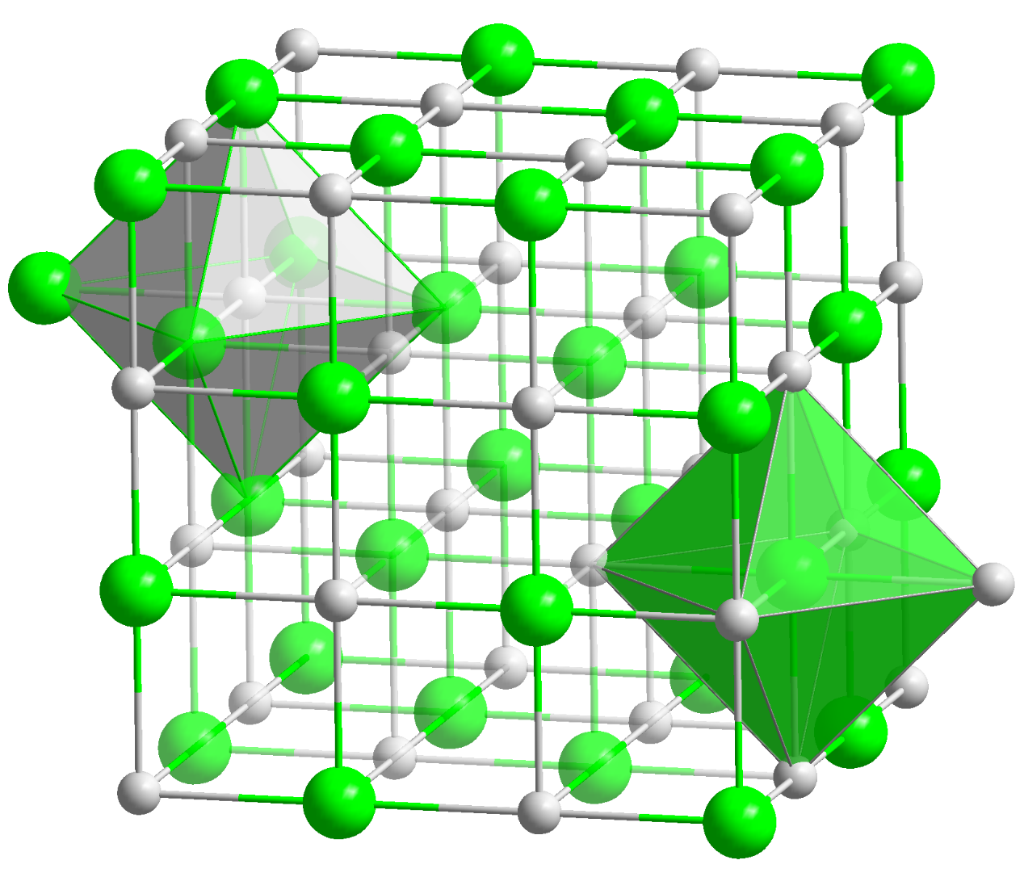
INTRODUCTION
Material properties vs defects
residual resistivity, conductivity in semiconductors, diffusion of impurity atoms, most mechanical properties around plastic deformation, optical and optoelectronic properties
reliability of products, lifetimes of minority carriers in semiconductors, and lifetime of products, electromigration, cracks in steel, hydrogen embrittlement

Slide 4
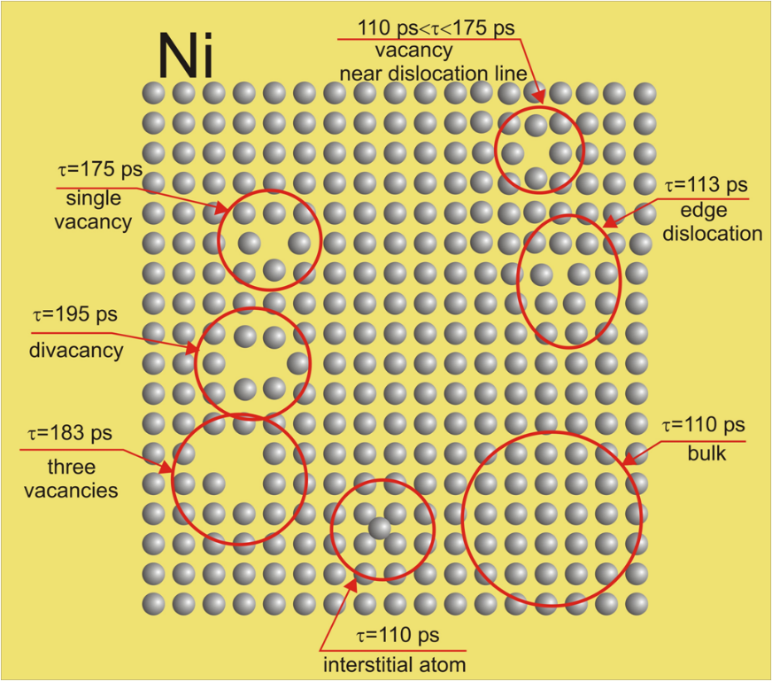
What is PAS?
PAS techniques:
angular correlations of gamma quanta
Doppler spectroscopy (DB)
positron lifetime spectroscopy (LT)
Possibilities:
evaluation of defect concentration
determination of defect concentration profile
detection of the kind and size of defects
Applications:
solid body physics
material and surface engineering
metals, semiconductors, thin layers
Positron lifetimes in different defects of Ni structure
* http://www.ifj.edu.pl/~mdryzek/

Slide 5
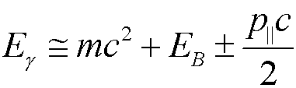
What do we have?
Doppler spectroscopy
The change of photon energy by relativistic Doppler effect in the laboratory system
S parameter
ratio of area under the central part of 511 keV line to whole area below this line
defines the participation of e⁺e⁻ pairs with low momentum
the bigger value the bigger concentration
of such defects as vacancies
where E_{B} is binding energy e⁺e⁻ in the pair surrounding, p|| – momentum of annihilating pair, m – electron mass, c - speed of light in the vacuum.
W parameter
defines the participation of pairs e⁺e⁻ with high momentum
together with S parameter gives information about kind of defects

Slide 6
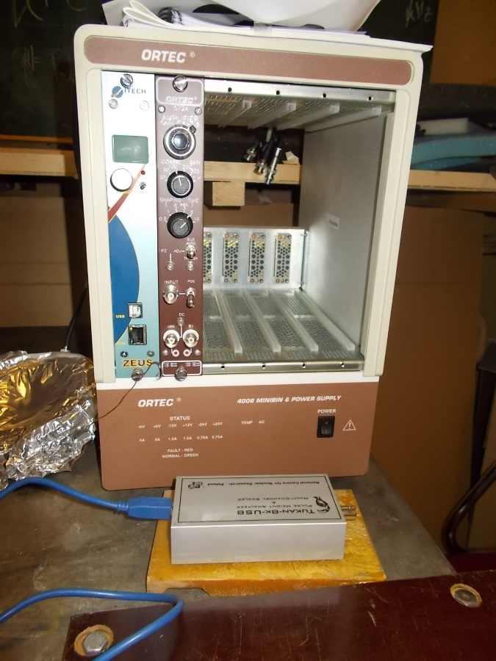
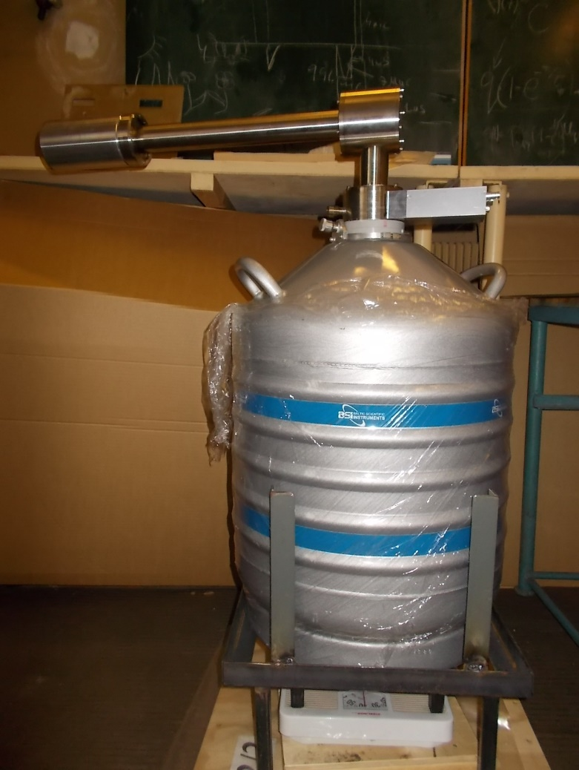
What do we have?
Doppler spectroscopy
gamma ≈ 511 keV
HpGe detector
preamplifier
amplifier
MC analyzer
PC computer
The energy resolution of DB spectrometer at LEPTA project is 1.2 keV at 511 keV.

Slide 7
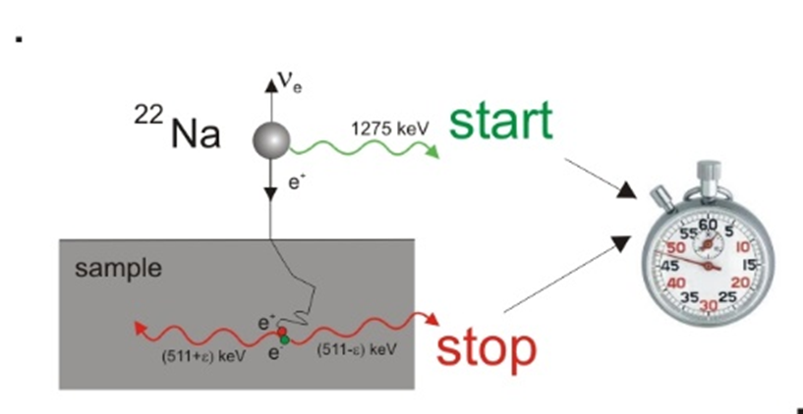
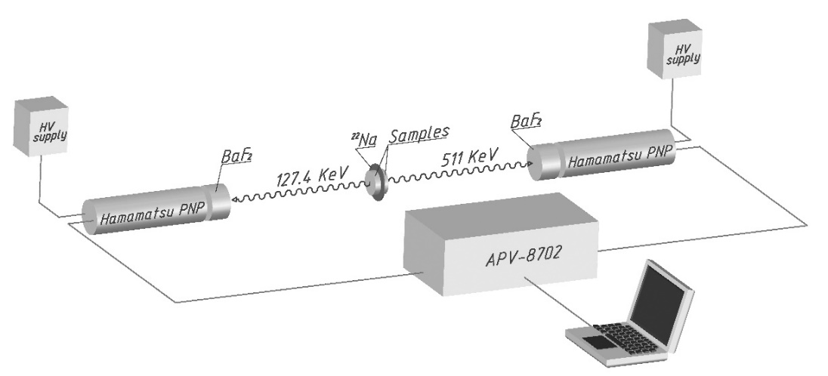
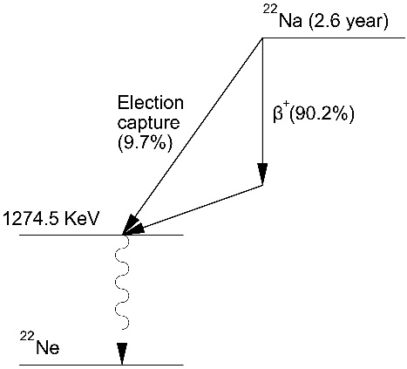
What do we have?
LT spectroscopy
The annihilation rate λ
the reciprocal value of mean positron lifetime
r₀ – electron radius, c – speed of light
electron density inside the defect is lower in comparison
to bulk area what finds a reflect in the mean positron lifetime
e.g. for pure Fe τ = 110 ps in nondefected structure
while positron trapped inside vacancy lives τ = 174 ps

Slide 8
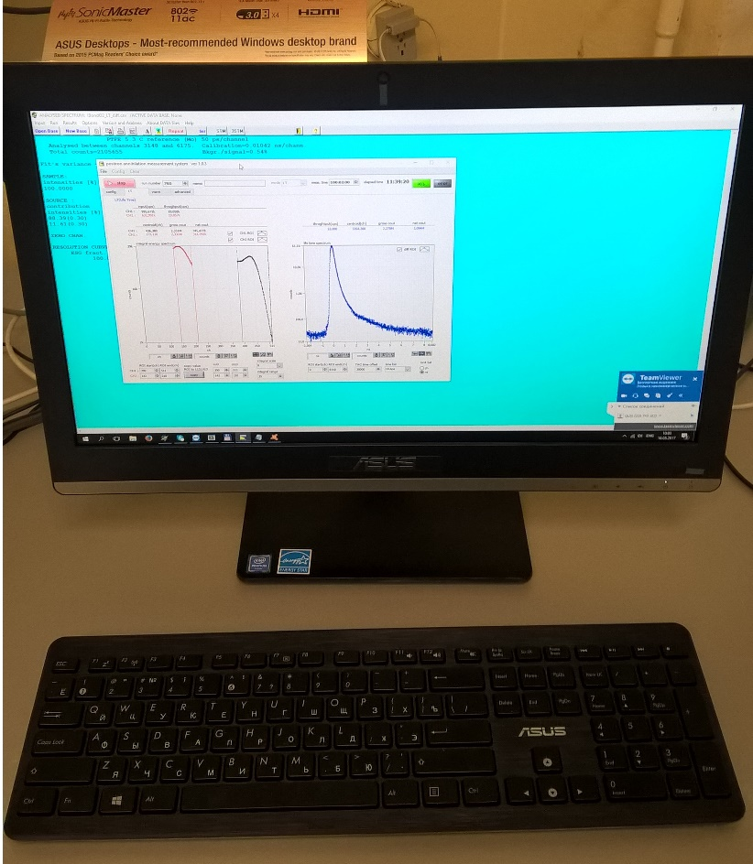
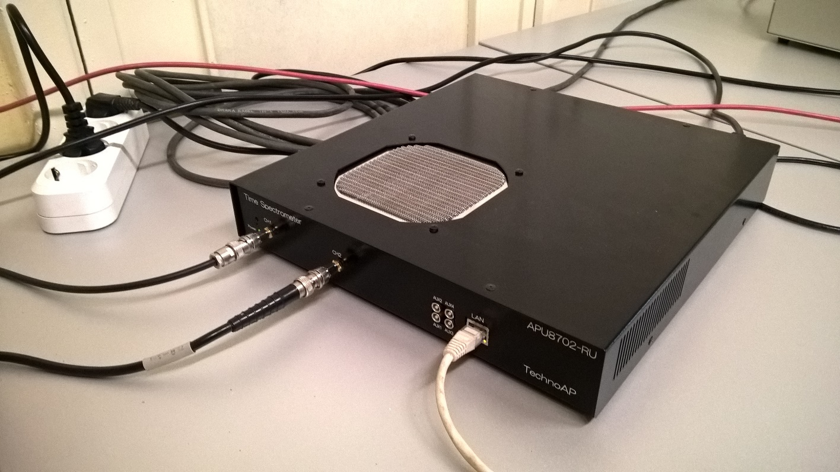
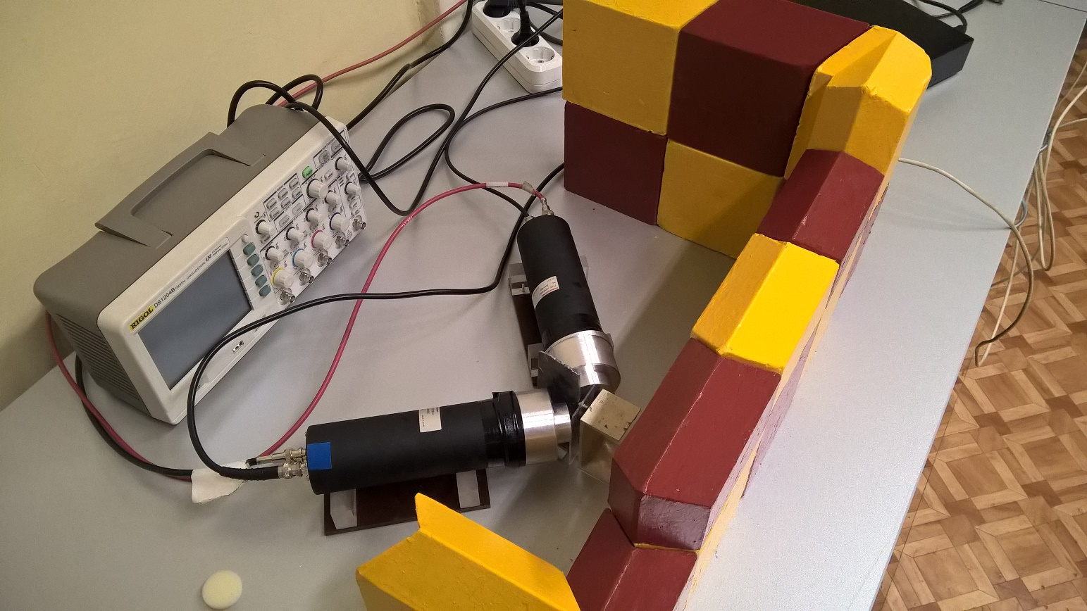
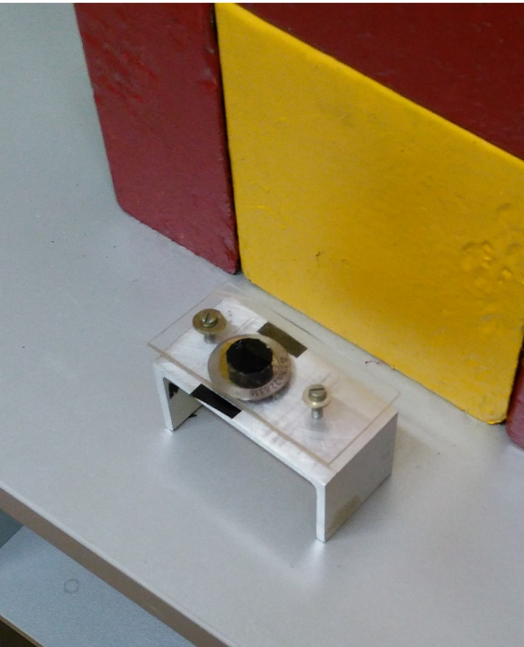
What do we have?
LT spectroscopy

Slide 9
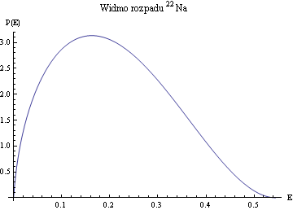
What do we have?
Positron sources
²²Na energy spectrum
Disadvantages of experiment are a long range of positron implantation and a lack of possibility to locate positrons precisely on the given depth

Slide 10

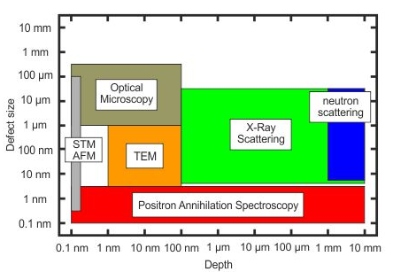
What do we have?
Positron beam
There are some areas i.e. thin layers, ion implantation, semiconductors where the application of conventional PAS experiments is strongly limited
HERE EXPERIMENTS WITH SLOW POSITRONS ARE REQUIRED !!
https://www.hzdr.de/db/Cms?pNid=3581

Slide 11
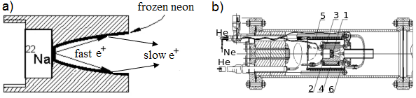
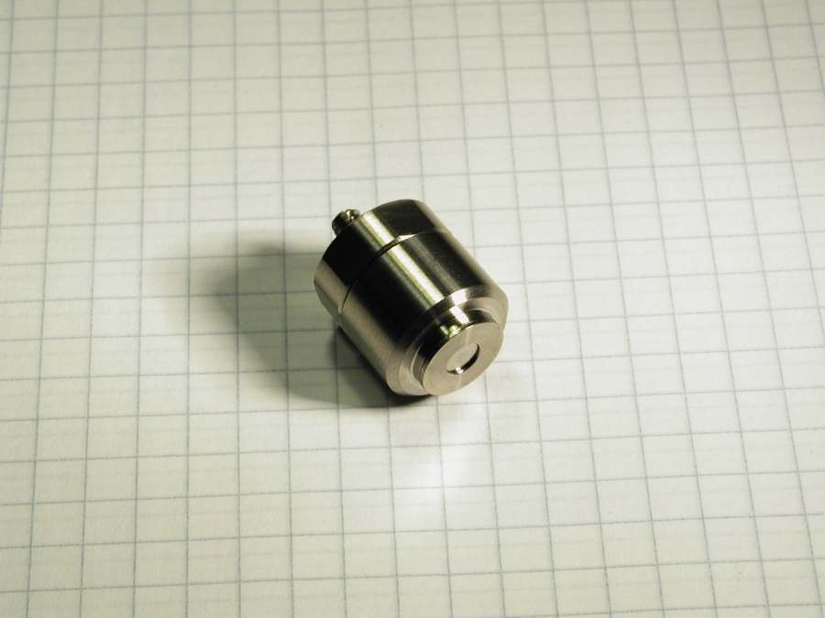
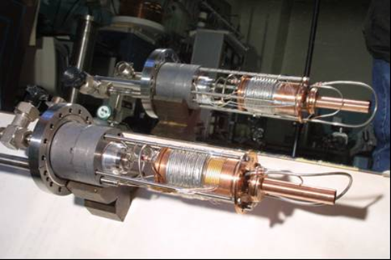
What do we have?
Positron beam
from iThemba LABS (RSA)

Slide 12
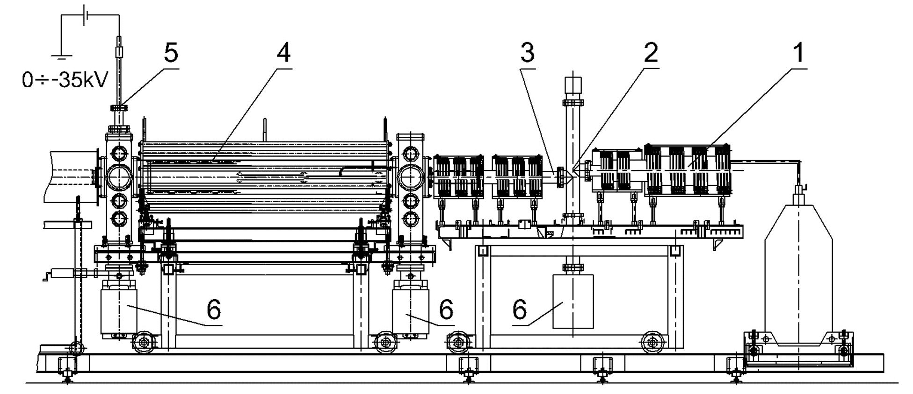
What do we have?
Positron beam

Slide 13
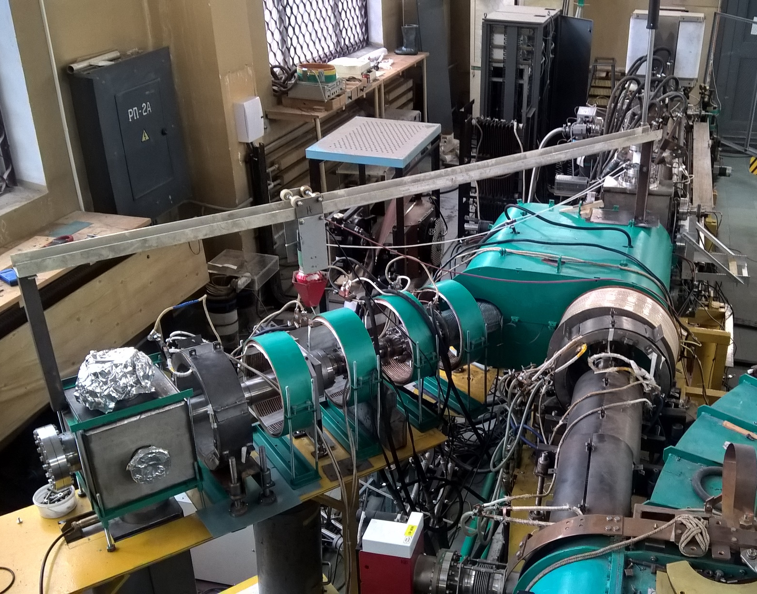
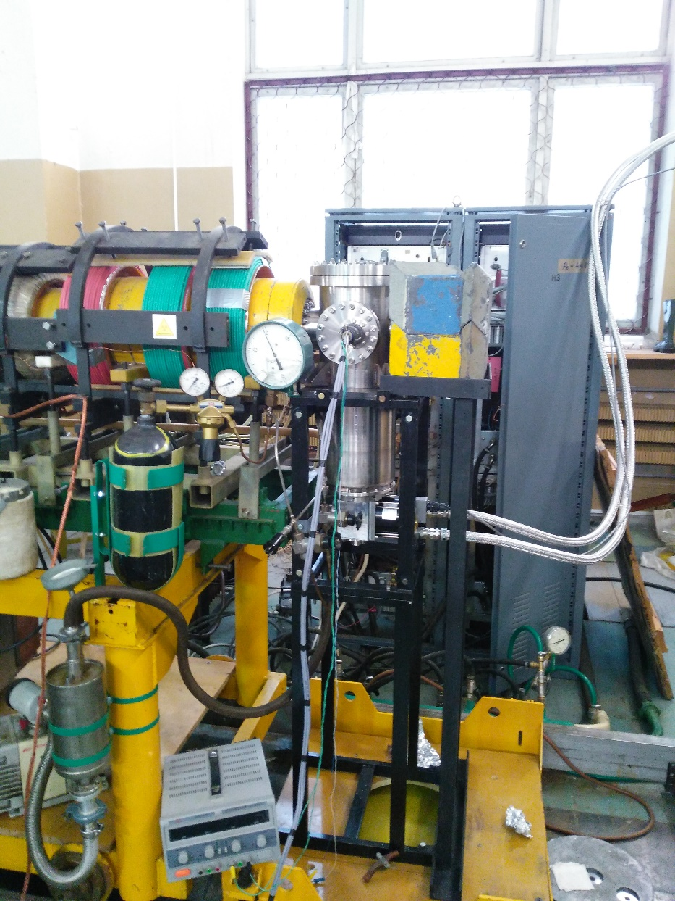
What do we have?
Positron beam

Slide 14
What do we have?
Positron beam
Feature | Value
activity of ²²Na isotope | ~30 mCi
moderator | frozen Ne (7K)
magnetic field | 100 Gs
vacuum conditions | 10⁻⁹ Torr
intensity | ~10⁶ e⁺/s
energy range | 50 eV ÷ 35 keV
diameter of the flux | 5 mm

Slide 15
What we have?
Positron beam

Slide 16
What do we do?
corrosion
P. Horodek, et al. Appl. Surf. Sci. 333 (2015) 96–103.

Slide 17
What do we do?
tribology
blasting
angle
P. Horodek et al., Tribol Lett (2017) 65:30.

Slide 18
What do we do?
Heavy ion implantation
P. Horodek et al., Surf. Coat. Technol. 296 (2016) 65–68.

Slide 19
What do we do?
Heavy ion implantation
P. Horodek et al., Vacuum 138 (2017) 15–21.

Slide 20
What do we do?
THE Long range effect
P. Horodek et al., Rad. Phys. Chem. 122 (2016)60–65.

Slide 21
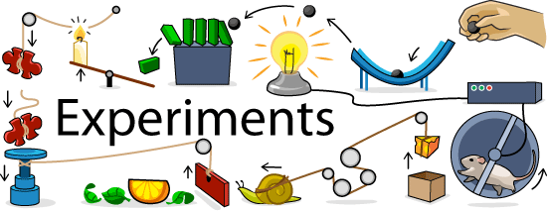
What do we want to do?
https://askabiologist.asu.edu/activities/experiments

Slide 22
What do we want to do?
The order positron beam

Slide 23
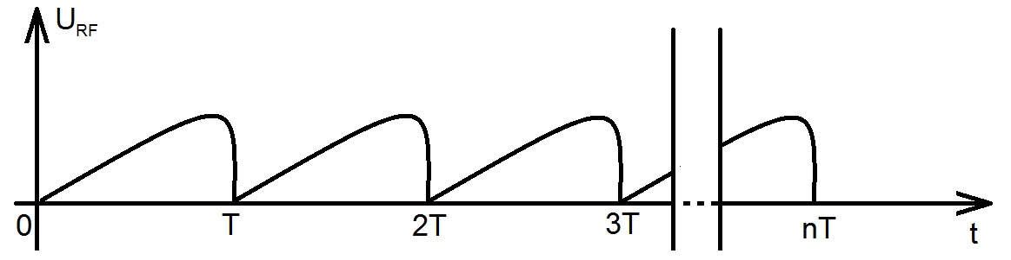
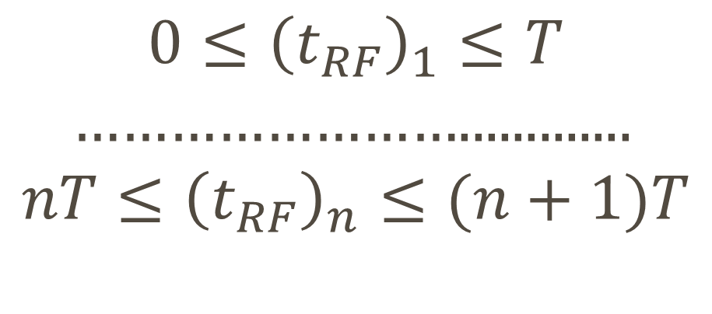
What do we want to do?
The order positron beam
$$0≤{\left(t_{RF}\right)}_{1}≤T$$
…………………….............
$$nT≤{\left(t_{RF}\right)}_{n}≤(n+1)T$$

Slide 24
SUMMARY
PAS is a sensitive method for detecting structural defects in solids
this method is implemented at our facility
in the frame of project the PAS studies of materials will be provided along with apparatus development
PAC’s agreement on the project will be highly appreciated

Slide 25
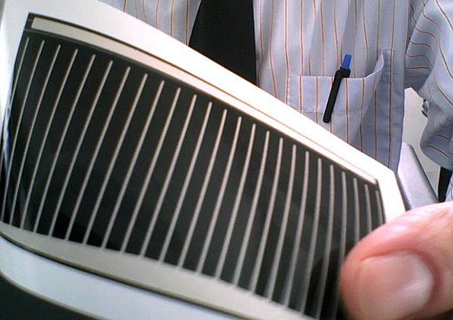
A copper indium gallium selenide solar cell (or CIGS cell, sometimes CI(G)S or CIS cell) is a thin-film solar cell used to convert sunlight into electric power. It is manufactured by depositing a thin layer of copper, indium, gallium and selenide on glass or plastic backing, along with electrodes on the front and back to collect current. Because the material has a high absorption coefficient and strongly absorbs sunlight, a much thinner film is required than of other semiconductor materials.

Slide 26
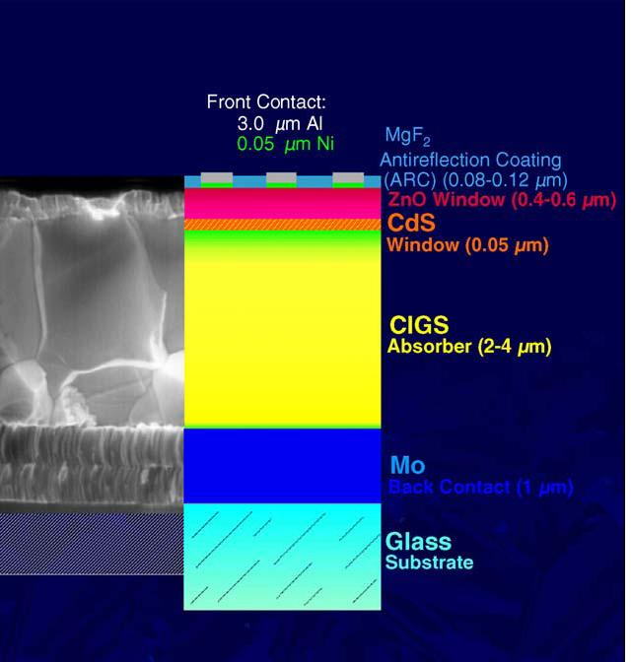

Slide 27
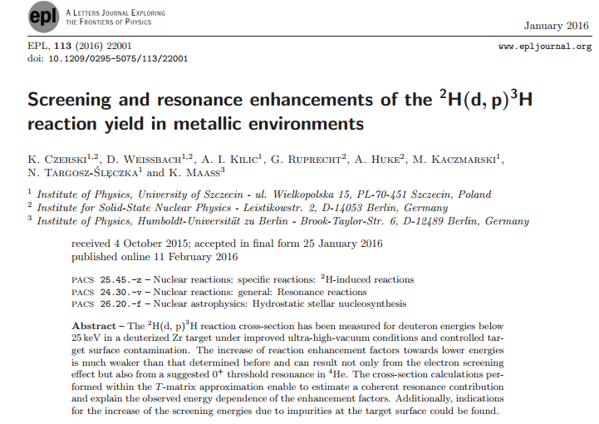

Slide 29
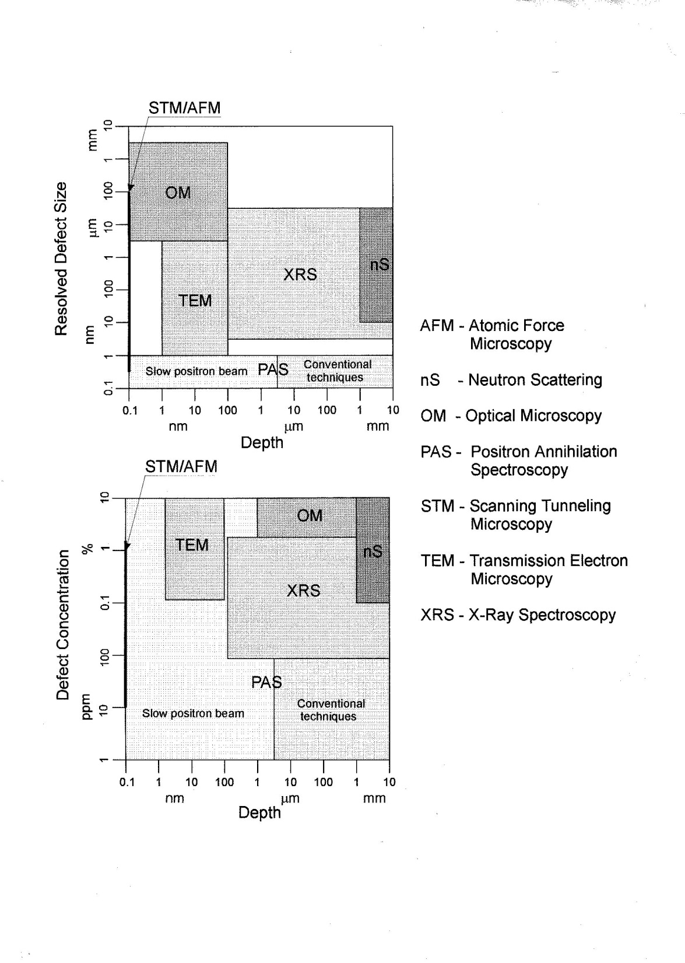

Slide 30
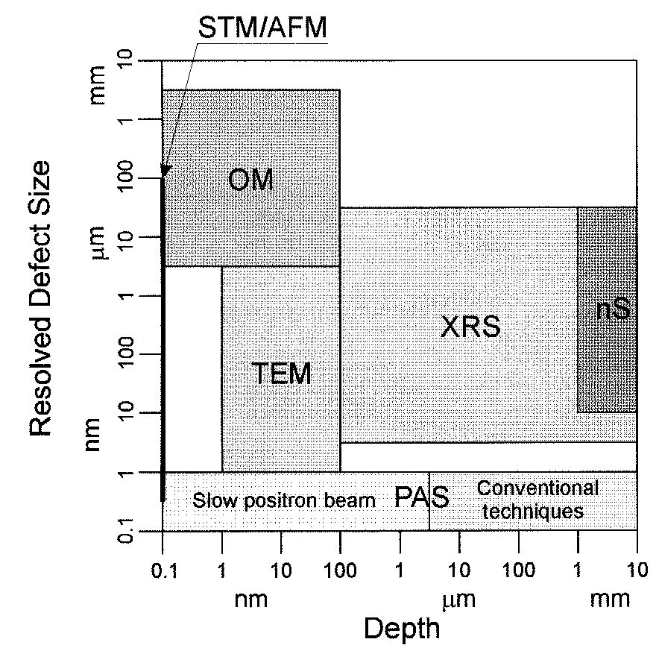

Slide 31
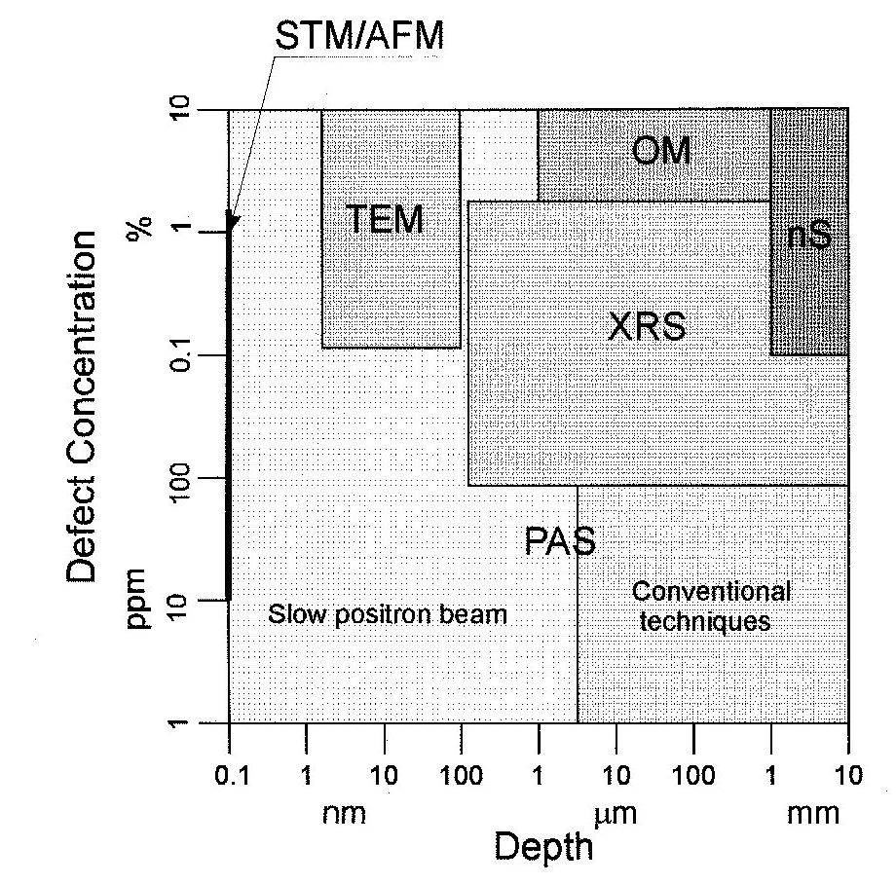

Slide 32
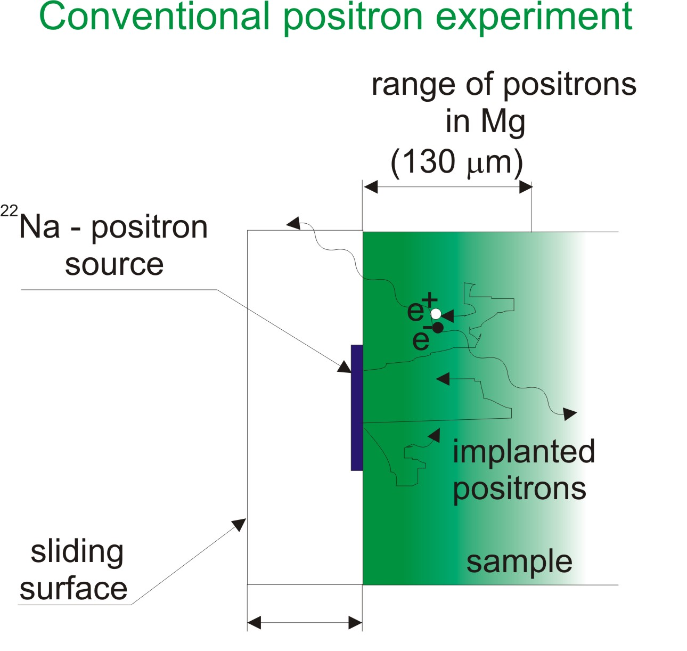

Slide 33
