Slide 1
46th PAC on
Condensed Matter Physics
Simulation of damage threshold and structure in swift heavy ion tracks in Al₂O₃
R. A. Rymzhanov¹, N.A. Medvedev², J.H. O’Connel³,
V.A. Skuratov¹, A.E.Volkov^{1,4,5}
¹ FLNR, JINR, Dubna, Russia
²Institute of Physics, Czech Academy of Sciences, Prague 8, Czech Republic
³CHRTEM, NMMU, Port Elizabeth, South Africa
⁴NRC”Kurchatov Institute”, Moscow, Russia
⁵LPI of the Russian Academy of Sciences, Moscow, Russia

Slide 2
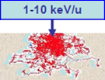
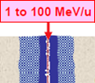
Swift heavy ions (SHI)
Е > 0.5 MeV/nucl, M > 4m_{p}
S_{nucl}/S_{el} < 0.01 - Lose energy to electronic stopping
Simulate the influence of fission fragments and cosmic rays on material properties

Slide 3
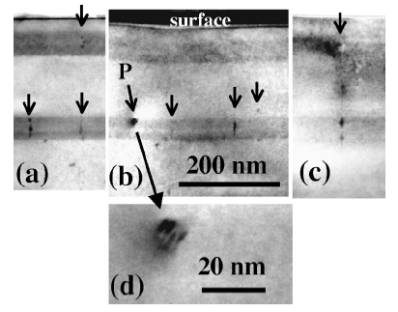
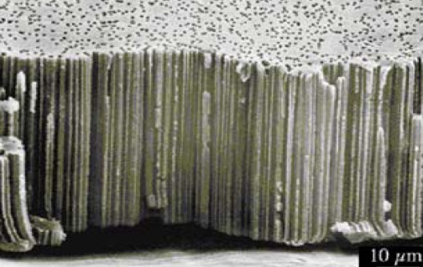
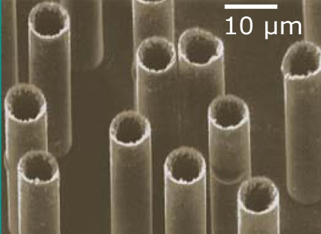
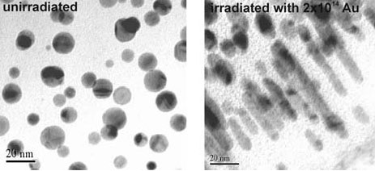
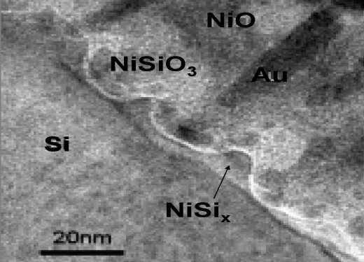
Practical application of SHI
Interlayer transitions
Quantum dots
P. Gaiduk et al., Phys. Rev. B66 045316 (2002)
200 MeV Au
B. Canut et al., NIMB 245 (2006) 327)
1.3 GeV U
Si_{x}Ge_{1-x}
Membranes and nanowires
Modification of nanoclusters
GSI, Darmstadt
GSI, Darmstadt
Kluth et al, REI-2007, Au in SiO₂
Nanostructuring
W.Bolse

Slide 4
Fundamental interest
Nanometric spatial and femto-picosecond temporal scales
Extremely high level of material excitation
Marek Skupinski (Uppsala)
SHI
electrons
lattice
10⁻¹⁶ 10⁻¹⁵ 10⁻¹⁴ 10⁻¹³ 10⁻¹² 10⁻¹¹ 10⁻¹⁰ 10⁻⁹ t (sec)
The relaxation of excitation induced by SHI cannot be described within macroscopic approaches

Slide 5
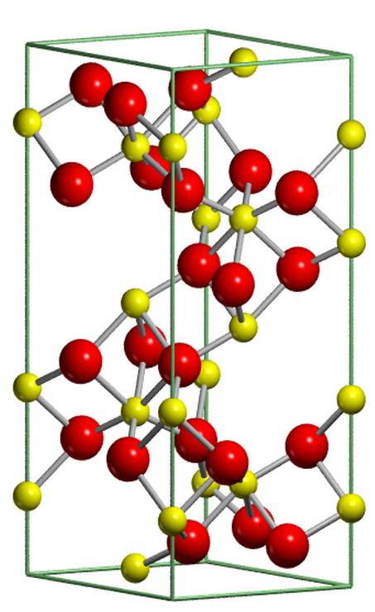
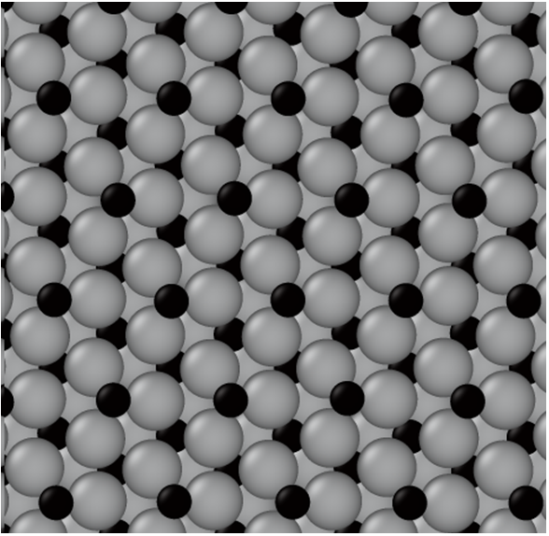
Why Al₂O₃?
Good material for modelling
Radiation resistant material (Perspective for applications in nuclear energetics)
Y-[120]
[010]
X-[100]

Slide 6
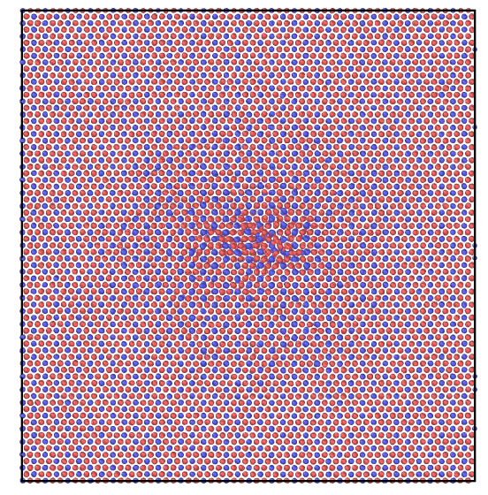
Combined experimental and numerical investigation
Theoretical
Experimental
Monte-Carlo model of
electron subsystem excitation
Irradiation by Xe, Bi ions
(FLNR, Dubna: IC-100, U-400M)
Energy transfer to the lattice
P.N. Terekhin, R.A. Rymzhanov et al.
NIMB 254 (2015) 200–204
TEM microscopy and analysis
(CHRTEM, SA)
Molecular Dynamics simulation
(LAMMPS code)
Verification of the model
Explanation of observed results

Slide 7
TREKIS: Monte-Carlo model
Time-Resolved Electron Kinetics in SHI Irradiated Solids
Collective response of a material is taken into account
1. SHI passage and generation of primary δ-electrons and holes ~10⁻¹⁷ s
2. Spreading of electrons and secondary electron cascading ~10⁻¹⁶ - 10⁻¹⁴ s
3. Auger and radiative decays of core holes ~10⁻¹⁵ s
4. Mobility of valence holes ~10⁻¹³s

Slide 8
TREKIS: Verification of model
Electronic energy loss of ions and inelastic mean free paths of electrons
Good coincidence with SRIM, CasP and NIST database

Slide 9
TREKIS: Results
Excitation of target lattice
100 fs
Mobility of valence holes play an important role for energy transfer to the lattice

Slide 10
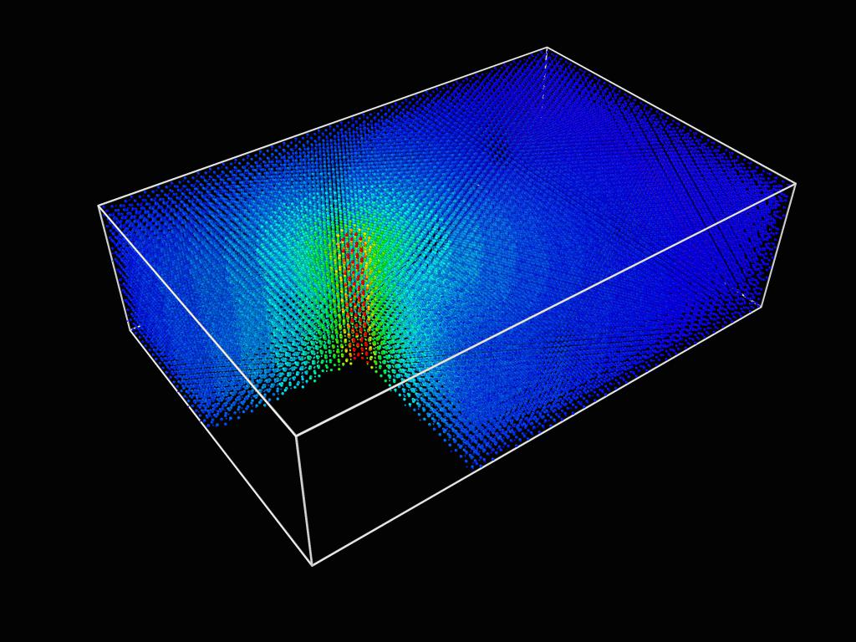
MD simulation
MD code
LAMMPS
Xe 167 MeV
5.25 nm
Z
X
Y
18.8 nm
12.2 nm

Slide 11
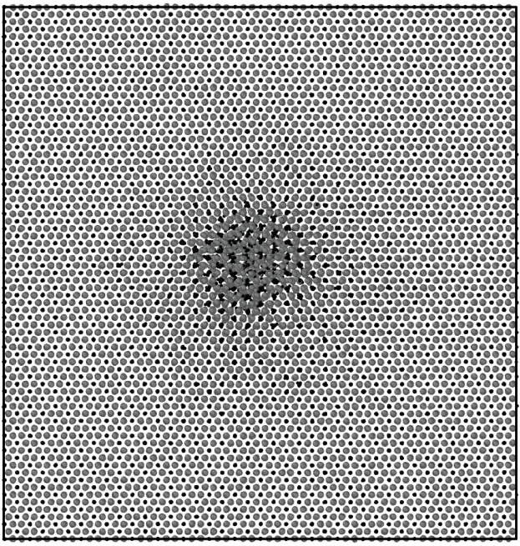
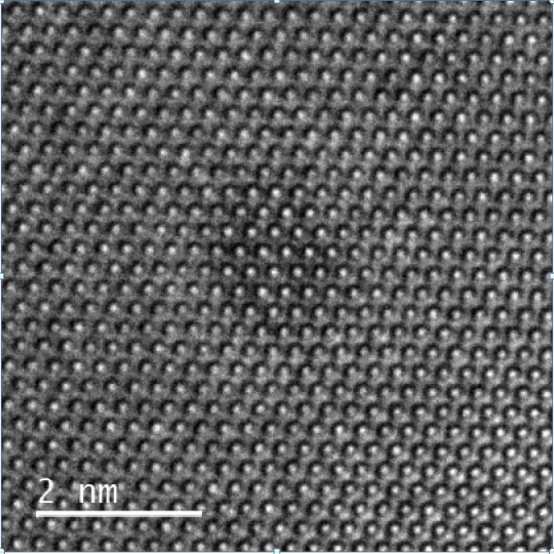
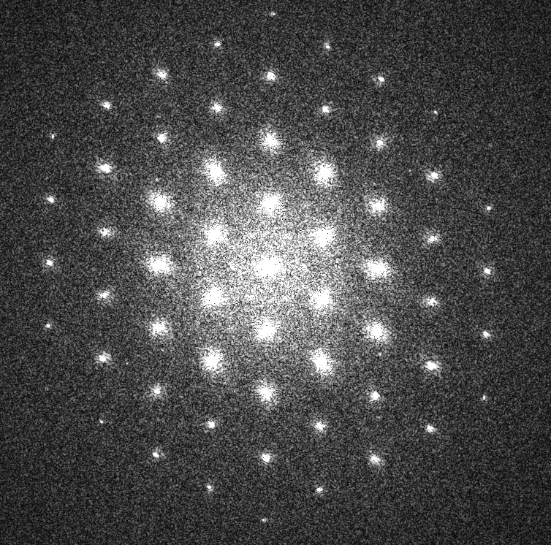
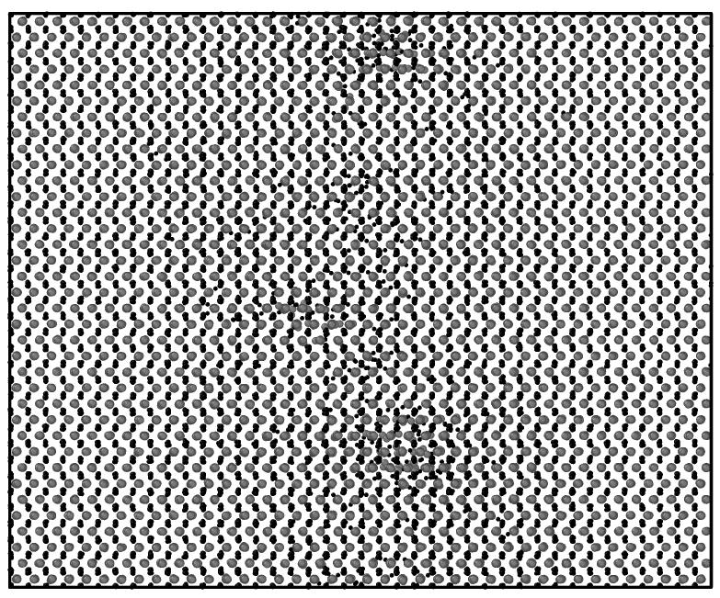
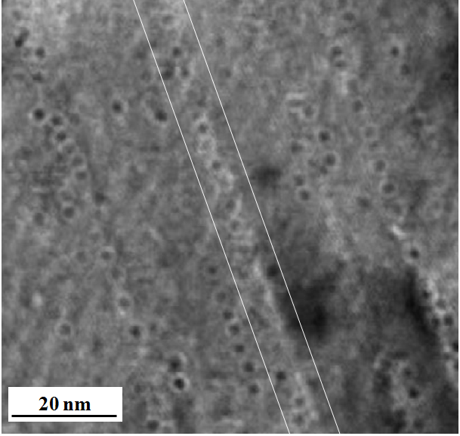
Xe 167 MeV
а)
c)
9.8 nm
~1.8 nm
Y
Z
X
b)
d)
Z
Y
- Al
- O
X
V.A. Skuratov, J. O’Connell et al. NIMB 326 (2014) 223–227

Slide 12
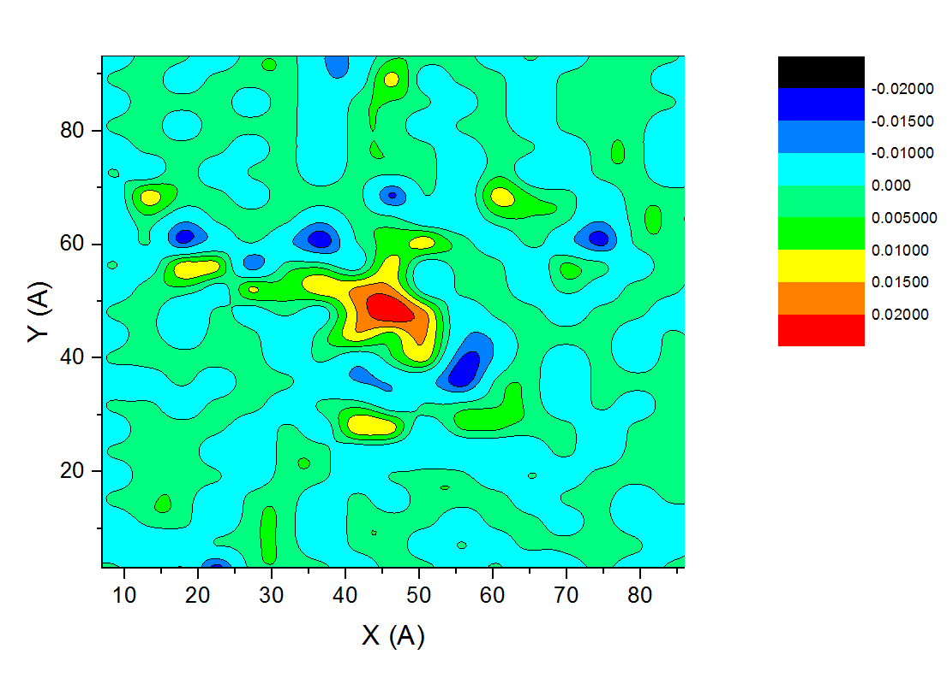
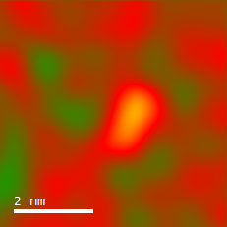
Xe 167 MeV
Lattice deformation:
Radial density of Al₂O₃
Simulation
Experiment
5%
0
-5%

Slide 13
Xe 167 MeV
Simulation of X-ray powder diffraction
Aluminum sublattice is damaged stronger than oxygen sublattice

Slide 14
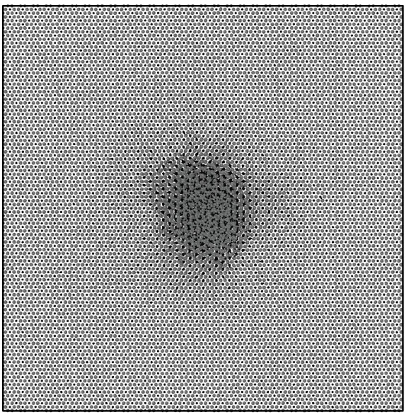
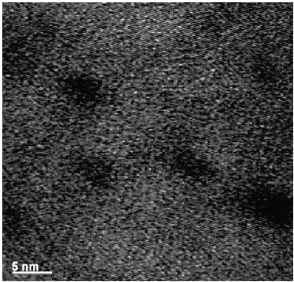
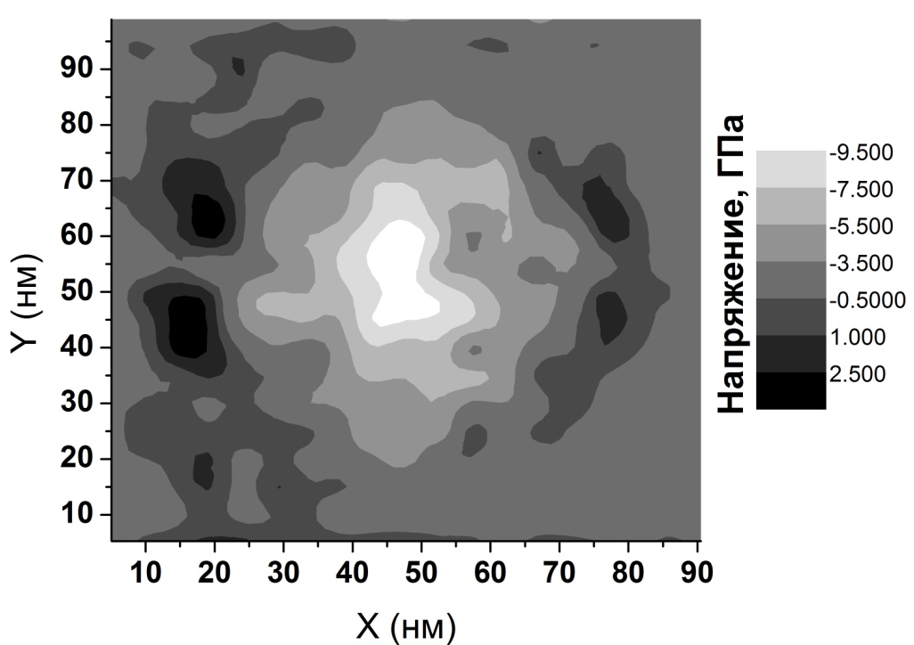
Bi 700 MeV (44 keV/nm)
~3.4 nm
Y
Z
X
- Al
- O
Residual stress around ion trajectory
Track structure: underdense core is surrounded by overdense shell

Slide 15
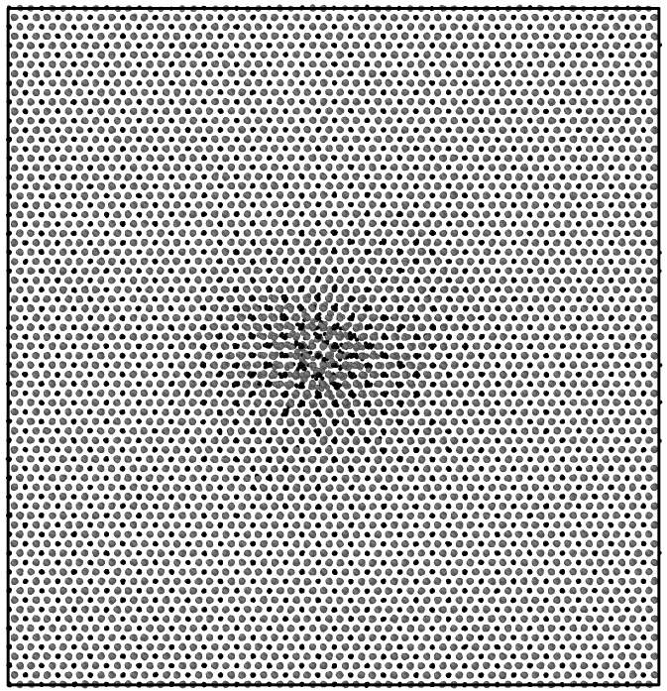
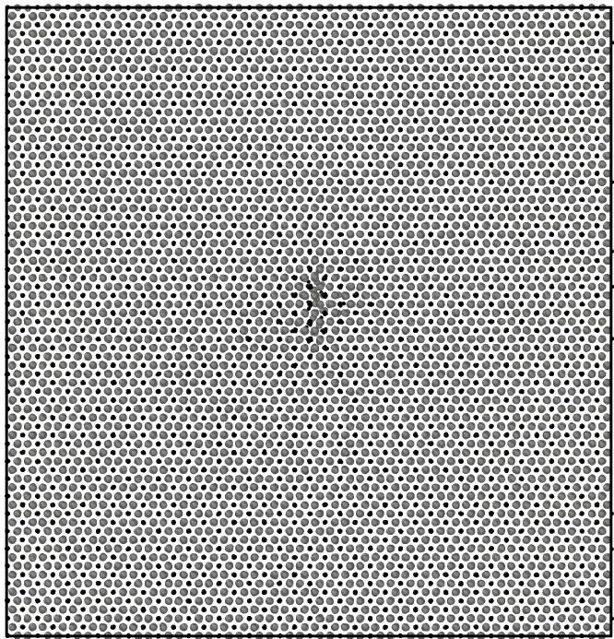
Kr and Fe ions
Kr 107 MeV Fe 22.5 MeV
dE/dx = 16 keV/nm dE/dx = 10 keV/nm
а)
b)
~0.5 nm
~1.25 nm

Slide 16
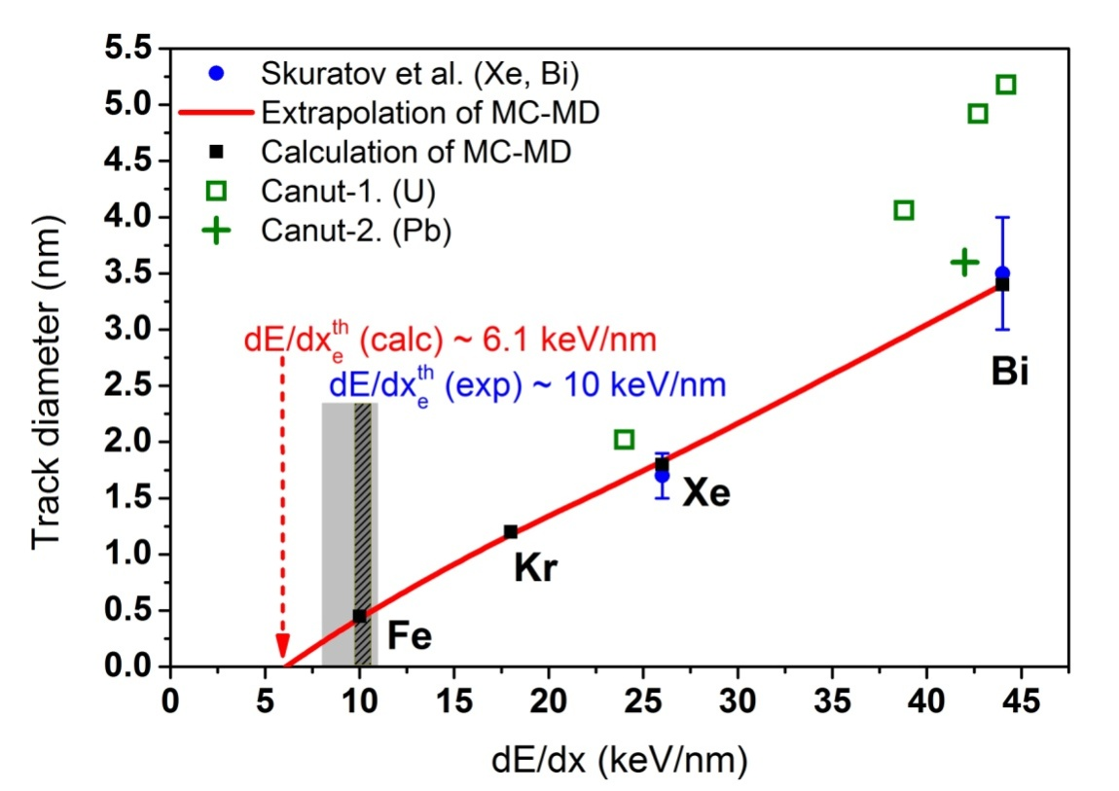
Track formation threshold
Calculated threshold value is dE/dx^{th} ~ 6.1 keV/nm

Slide 17
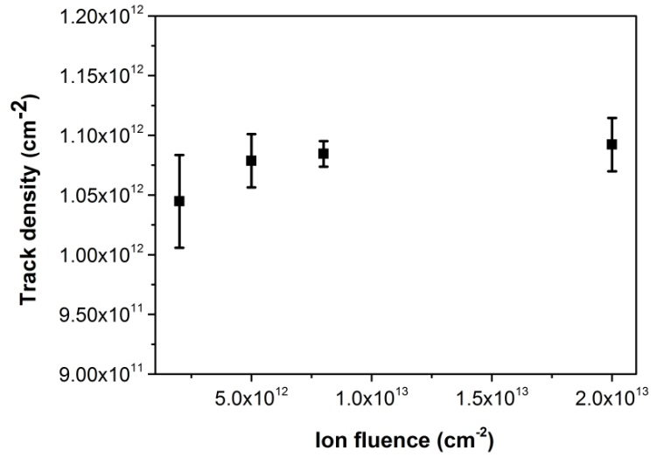
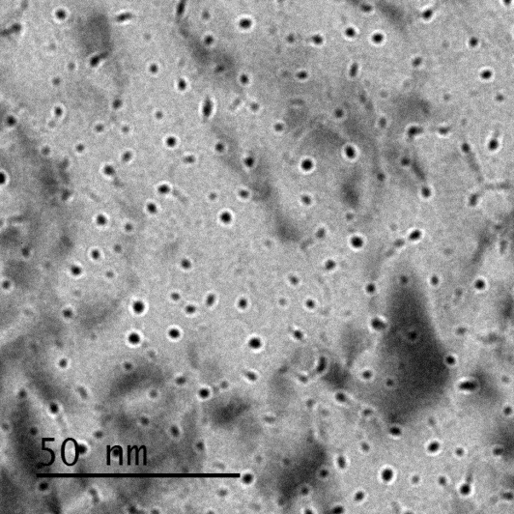
Track density
  The number of ion tracks saturates at fluence of
  ~ 1.1 x 10¹² cm⁻²
  Effective radius of SHI track ~ 5.4 nm
J. O’Connell et al. VITT 2015

Slide 18
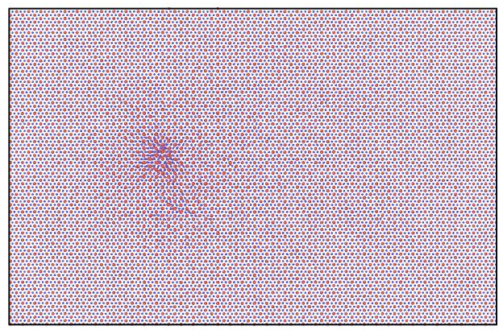
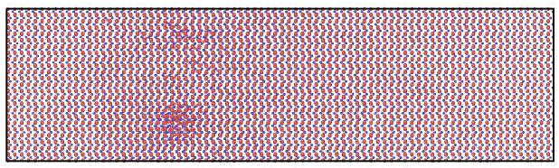
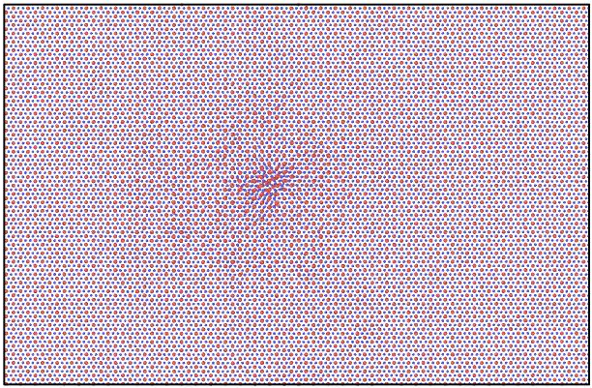
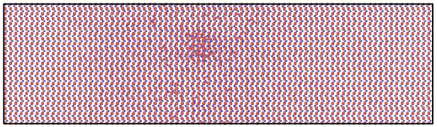
Overlapping of SHI tracks. Xe 167 MeV
2.8 nm
Z-projection
Box size 12.2 x 18.8 x 5.2 нм³
Xe 167 MeV ion
Passage of the second ion causes annealing of the defects created by the first one
Is the healing of tracks the probable mechanism of observed saturation?
Y-proj.
Z-projection
Y-proj.

Slide 19
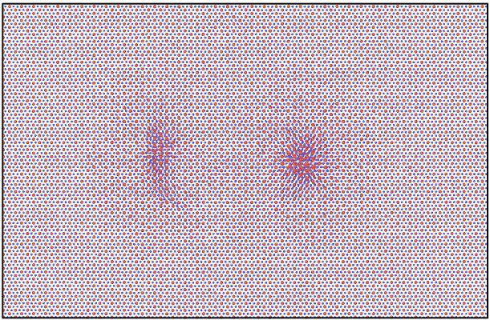
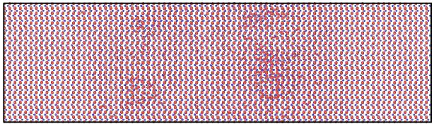
Overlapping of SHI tracks. Xe 167 MeV
Passage of the ion at longer distances from older tracks causes partial annealing of the defects
Effective radius of recovery is ~6.5 nm (experimental ~5.4 nm) and corresponding track density is ~2.7×10¹² см⁻²
6.5 nm
Z-projection
Y-proj.
Z-projection
Y-proj.

Slide 20
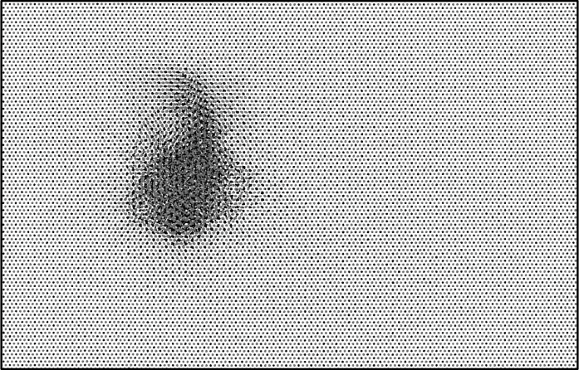
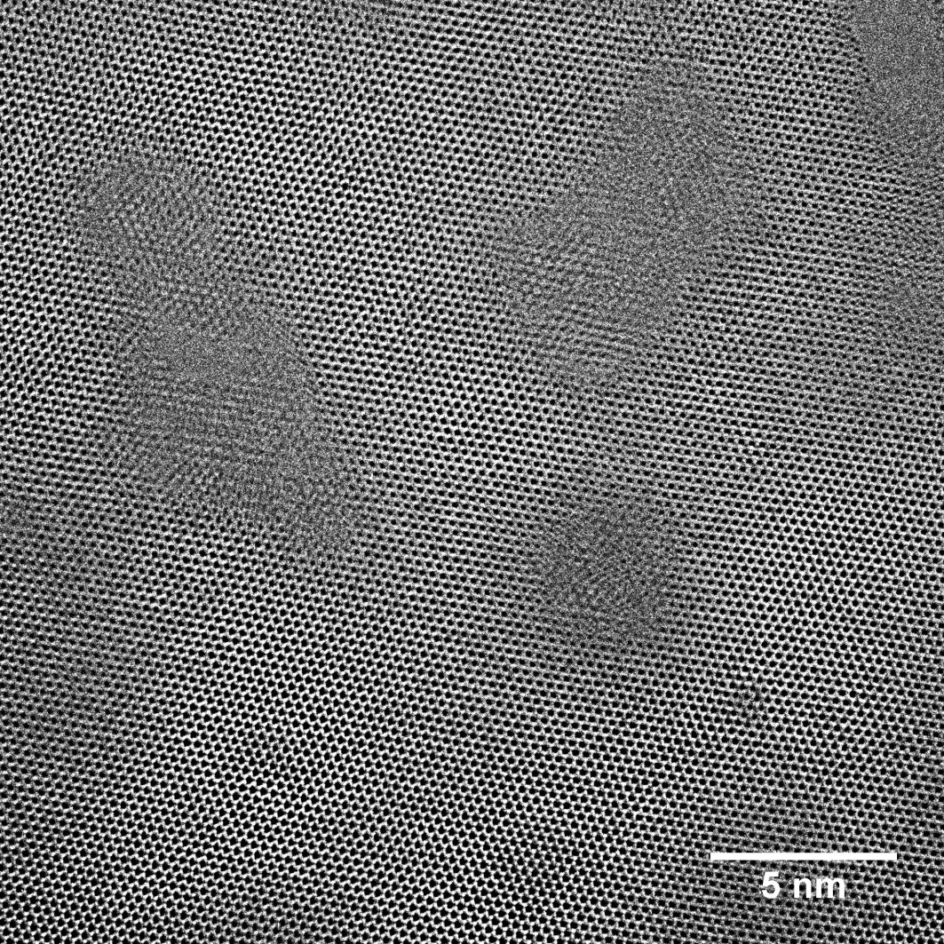
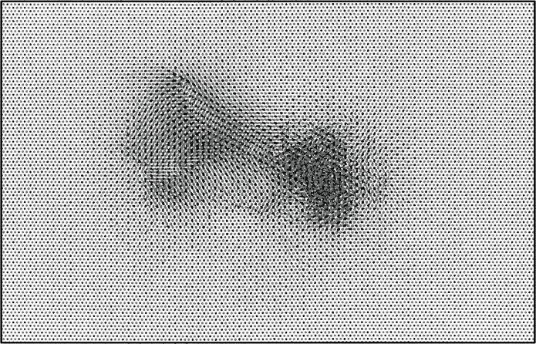
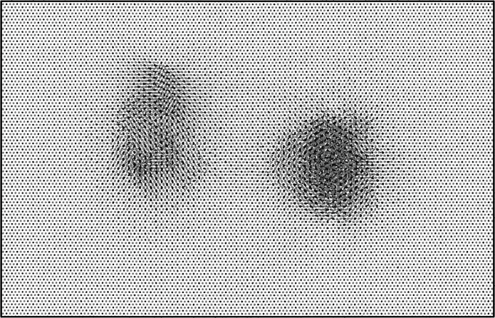
Overlapping of SHI tracks. Bi 700 MeV
Bi 700 MeV ion tracks causes partial recovery of older tracks
6.5 nm
8 nm

Slide 21

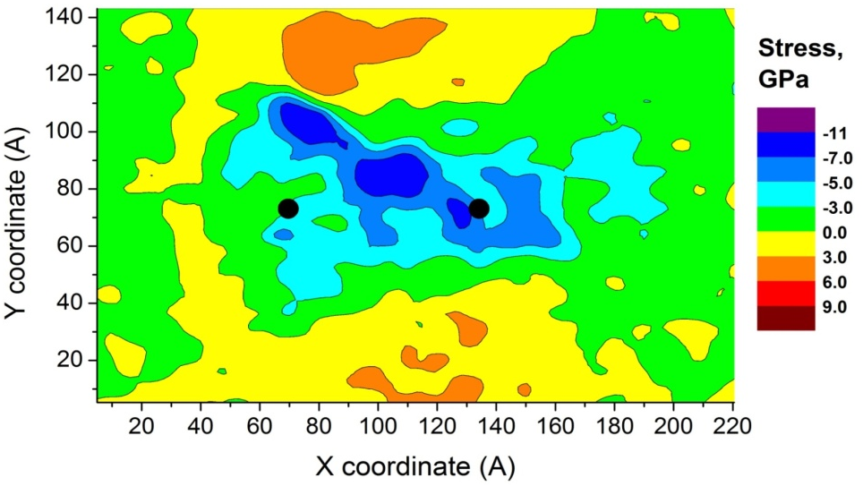

Overlapping of SHI tracks. Bi 700 MeV
Stress field of overlapped tracks
6.5 nm
TEM image of double Bi 700 MeV
Color coding of displacements: X, Y, Z
  Closely spaced tracks are “connected” with defect structure aligned along atomic planes

Slide 22
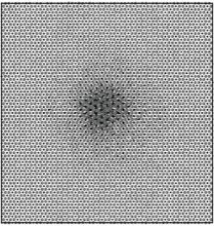
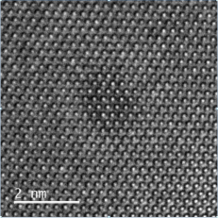
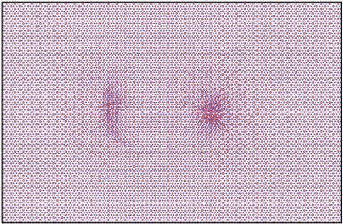
Conclusions
The relaxation of excess lattice energy in Al₂O₃ irradiated by SHI is studied using original MC model and classical MD
The estimation of track size is in a good agreement with recent TEM data. The energy loss threshold of track formation in Al₂O₃ is determined (dE/dx~ 7 keV/nm).
Simulation of X-ray powder diffraction patterns of irradiated crystal revealed that the Al sublattice is damaged stronger than O sublattice
The effect of recovery of overlapping tracks in Al₂O₃ is investigated. The effective distance of recovery is ~5.4 nm (TEM) - 6.5 nm (MD) for Xe 167 MeV ion.
Overlapping of Bi tracks causes only partial recovery of existing track forming defect connections between tracks.

Slide 23
46th PAC on
Condensed Matter Physics
Thank you for your attention

Slide 24
Interatomic forces
Buckingham-type potential
C_{ij}, A_{ij}, ρ_{ij} from
M. Matsui, Geophys. Res. Lett (1996)
Verification of potential
Elastic constants | Experimental, GPa | Calculated, GPa
C₁₁ | 498 | 473.6
C₁₂ | 163 | 181.7
C₁₃ | 117 | 150.8
C₁₄ | -23 | -19.2
C₃₃ | 502 | 520.5
C₄₄ | 147 | 115.7
C₆₆ | 167 | 146.3
T_{m}(exp) = 2345 K

Slide 25
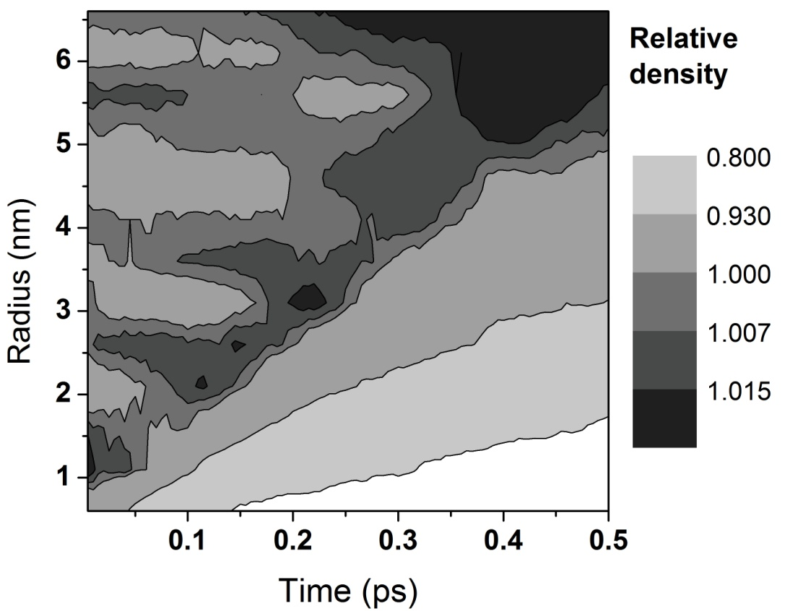
Track relaxation kinetics
Radial and temporal dependence of the Al₂O₃ density near Xe 167 MeV ion trajectory
Propagation of elastic waves with frequency of ν ~ 0.5 THz

Slide 26
Dose of fast fission fragment irradiation is ~10¹⁶ cm⁻² per year

