Slide 1
47th PAC on Particle Physics
JINR, June 26-27, 2017
Implementation of recommendations and work towards optimisation of the research programme
Itzhak Tserruya
Weizmann Institute of Science

Slide 2
Outline
Highlights of the Recommendations from the 46th PAC – PP
121th Scientific Council meeting (February 23-24, 2017)
Agenda

Slide 3
Highlights from the 46th PAC-PP
NICA:
Successful commissioning of the linear accelerator for heavy ions HILAC.
Preparations for the Booster construction.
Record duration of the 53rd Nuclotron run.
Successful acceleration of a polarized deuteron beam with a polarization up to 60% and an intensity up to 7·10⁸ ions.
Official start of the assembly and testing line for superconducting magnets.
We are looking forward to the progress reports on Nuclotron-NICA, BM@N and MPD projects.
MPD:
Progress on the preparation of TDR for the different sub-systems of day 1.
Progress in attracting outside collaborators.
BM@N:
First successful run with a set-up that included all subsystems.
The PAC is concerned by the half-a-year delay in the project realization that resulted from the low availability of beam test and the lengthy internal tendering procedures.
The DACs for MPD and for BM@N had working meetings on January 17-18.

Slide 4
Scientific Council (I)
Excerpts from the Resolutions of the 121th session of the Scientific Council held on February 23-24, 2017 :
General considerations:
The Scientific Council appreciates the approval by the Committee of Plenipotentiaries of the Seven-year plan for the development of JINR for 2017–2023.
The Scientific Council wishes the Directorate and staff of JINR success in realizing
the ambitious plans aimed at constructing unique basic facilities (NICA, SHE
Factory, Baikal-GVD)…
The Scientific Council is pleased to note the establishment of a Supervisory Board of the NICA project.
The Scientific Council congratulates the JINR Directorate for the successful realization of the idea of an All-Russia Open Lesson on the NICA Project on 8 February 2017 and suggests its wider distribution.

Slide 5
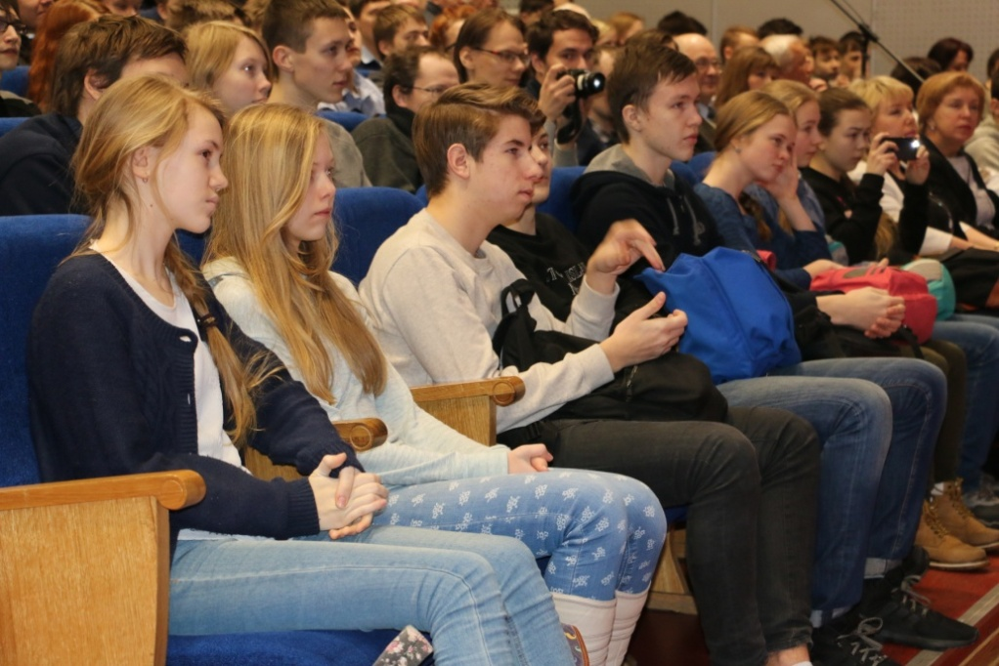
Open Lessons: “NICA – Universe in the Laboratory”
In all schools of Russia at the Day of Russian Science on 8 February, 2017
Video in 7 parts (35 min): http://nica.jinr.ru/lesson
1. Introduction
2. Our Universe had a beginning
3. What is Quark Gluon Plasma
4. Instruments to look in depth of matter
5. Accelerator complex NICA
6. NICA and technical progress
7. Discoveries at collider NICA are waiting you!
Presented by Gregory Trubnikov
First testing at the Petrozavodsk State Univ. (120 school children)

Slide 6
Scientific Council (II)
Recommendations on the NICA project:
The Scientific Council joins the PAC for Particle Physics in appreciating:
- the progress towards realization of the Nuclotron-NICA project, including the successful commissioning of the linear accelerator of heavy ions HILac, the preparations for the Booster construction, the official start of the assembly and testing line for superconducting magnets, the progress in the civil construction work of the collider building.
- and the significant achievements in the Nuclotron operation during the 53rd run, with a record duration of stable operation. A beam of polarized deuterium nuclei was accelerated for the first time after a hiatus of 15 years and was delivered to the experiments with a polarization up to 60% and an intensity up to 7·10⁸ ions.
- Based on the reported FAIR schedule by Deputy Director Boris Sherkov, the Scientific Council emphasizes the need for a timely and successful completion of the NICA project with broad international cooperation.
The Scientific Council notes the ongoing efforts of the MPD team on the preparation of the technical design reports and mass production of detector elements. It congratulates the MPD management for the progress in attracting new outside collaborators.
The Scientific Council congratulates the BM@N team for the first successful run with a set-up that included all subsystems. The Scientific Council takes note of the PAC’s concern by the six-month delay in the project realization that resulted also from the low availability of beam test.
The Scientific Council appreciates the work accomplished by the Detector Advisory Committees of the MPD and BM@N experiments in assisting the realization of the detectors.

Slide 7
Scientific Council (III)
Recommendations in connection with the PAC-PP:
The Scientific Council appreciates the progress towards the development of the COMET experiment, which is under preparation at the J-PARC accelerator and is aimed at searching for muon-to-electron conversion. The participants from JINR have made important technical contributions by constructing a straw-tube detector and by supplying and testing scintillating crystals for the COMET calorimeter. The Scientific Council recommends continuation of this project until the end of 2019 and encourages the team to take active roles in physics analysis.
The Scientific Council takes note of the new project on JINR’s participation in the fixed target NA64 experiment at the CERN SPS. The proposed contribution of JINR to NA64, an interesting project with high scientific potential, is the delivery and operation of a straw-tube tracking detector, with modest resources requested for the next three years. The Scientific Council recommends approval of this project until the end of 2019.
In brief, I am very pleased to report that the SC endorsed all the recommendations of the PAC-PP.

Slide 8
Scientific Council (IV)
Regulations for the JINR PACs
The Scientific Council appreciates the participation of the PACs in updating the governing regulations of the PACs and the evaluation procedures of projects submitted to the PACs. As a general comment, the Scientific Council is pleased with the increased interaction and coordination between the three PACs and the Directorate.
The Scientific Council takes note of the amendments to the “Regulation for the JINR Programme Advisory Committees” presented in detail by Chief Scientific Secretary N. Russakovich. An updated version of the Regulation provides an extended description of the PAC functions, enabling the PACs to establish their operating procedures and develop specific methods of the evaluation of projects. The revised Regulation also encourages the PACs to appoint one or two of its members to perform continuous monitoring of a specific project, allows the PAC members to carry out the evaluation of projects by means of electronic communications and includes a number of minor corrections suggested by the JINR Directorate and PACs. The Scientific Council approves the amended text of this document (Appendix 1).

Slide 9
47th PAC-PP agenda June 26-27, 2017
Highlights of today's meeting:
Update reports on NICA, MPD and BM@N
Addition to BM@N program: short range correlations
Report on the 2017 Nuclotron runs
Projects seeking continuation

Slide 10
Thank you !

