Slide 1
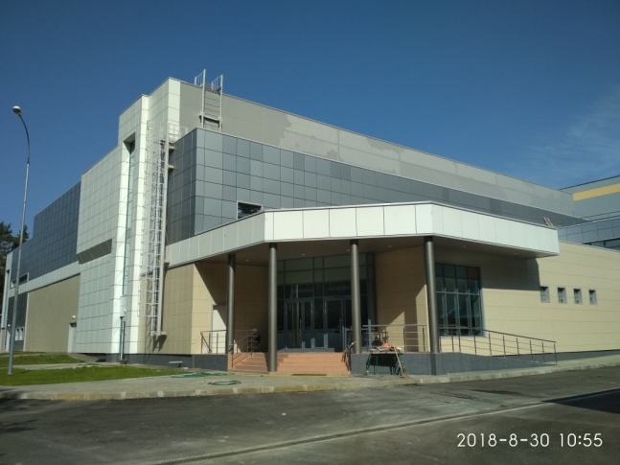
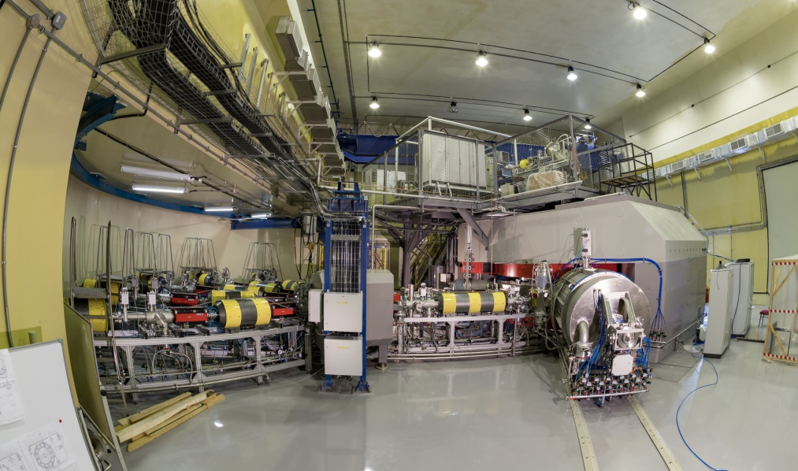
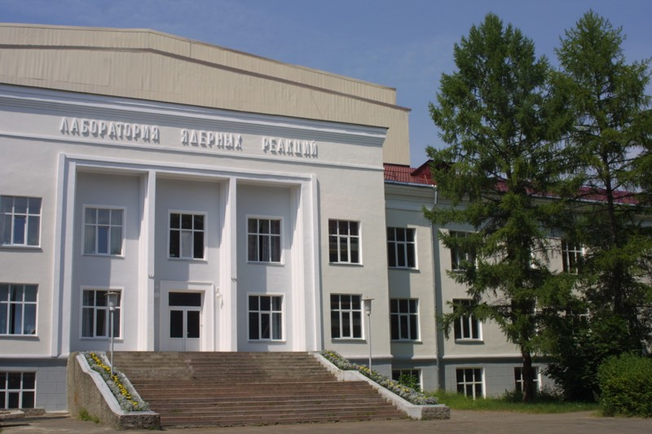
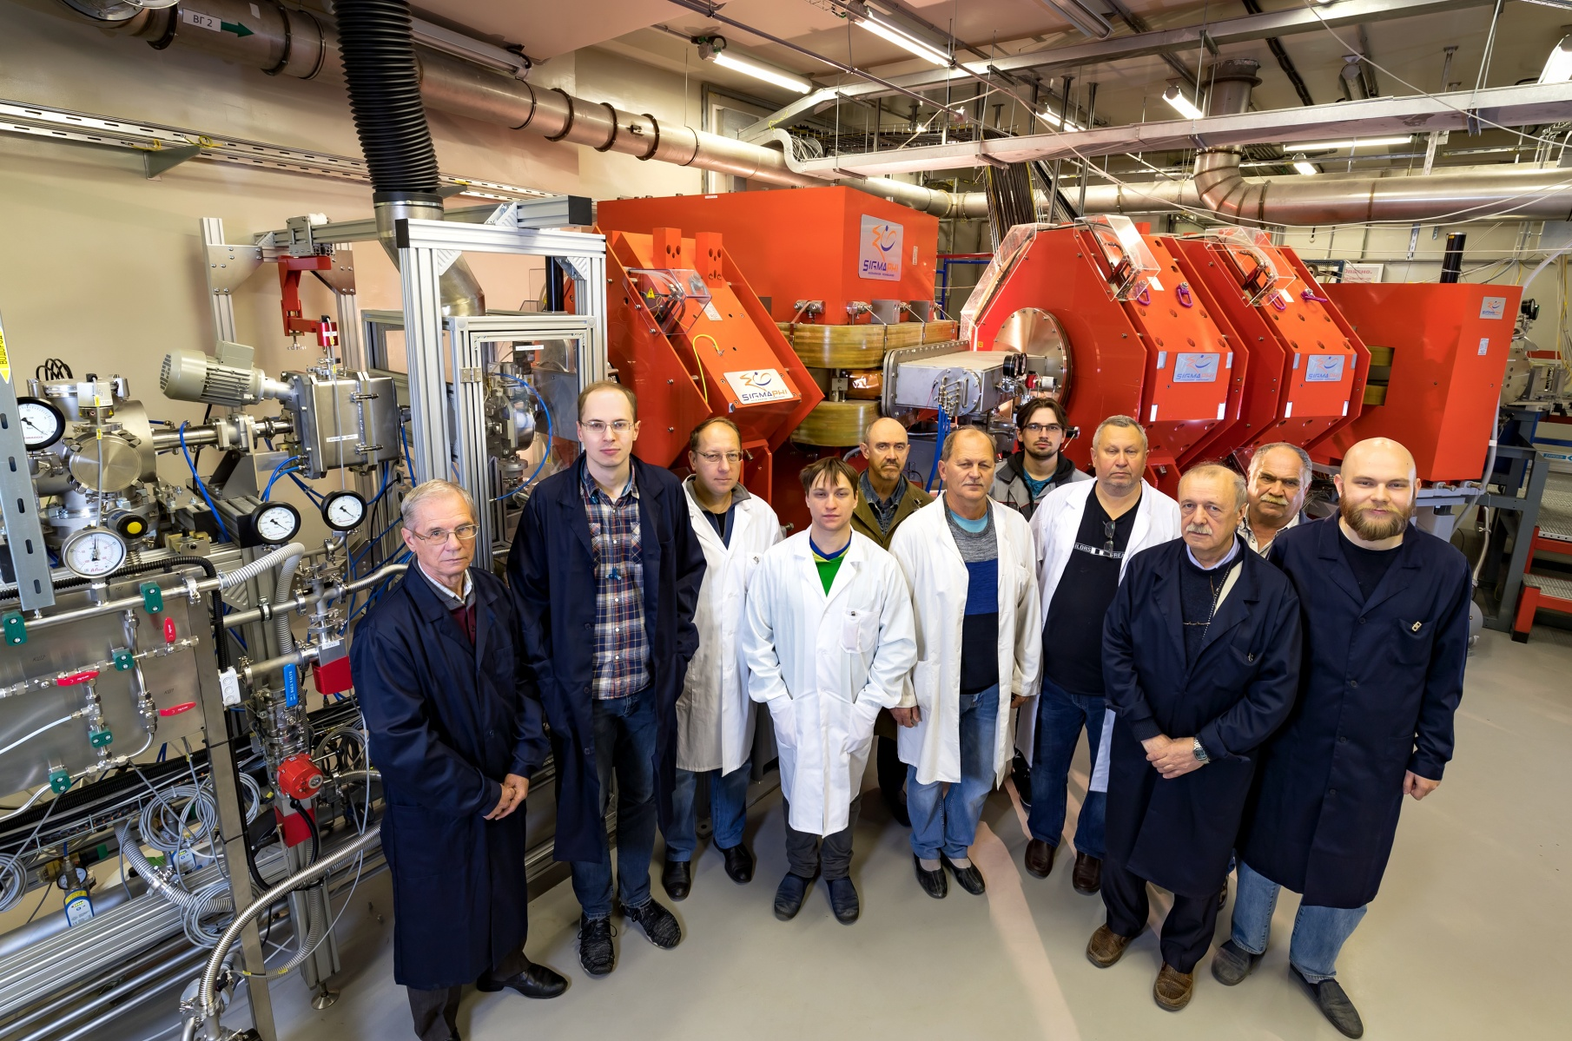
New data on experiments at the SHE Factory
N. Kovrizhnykh
Flerov Laboratory of Nuclear Reactions JINR
DC280
DGFRS-2
55th meeting of the PAC for Nuclear Physics
27 January 2021

Slide 2
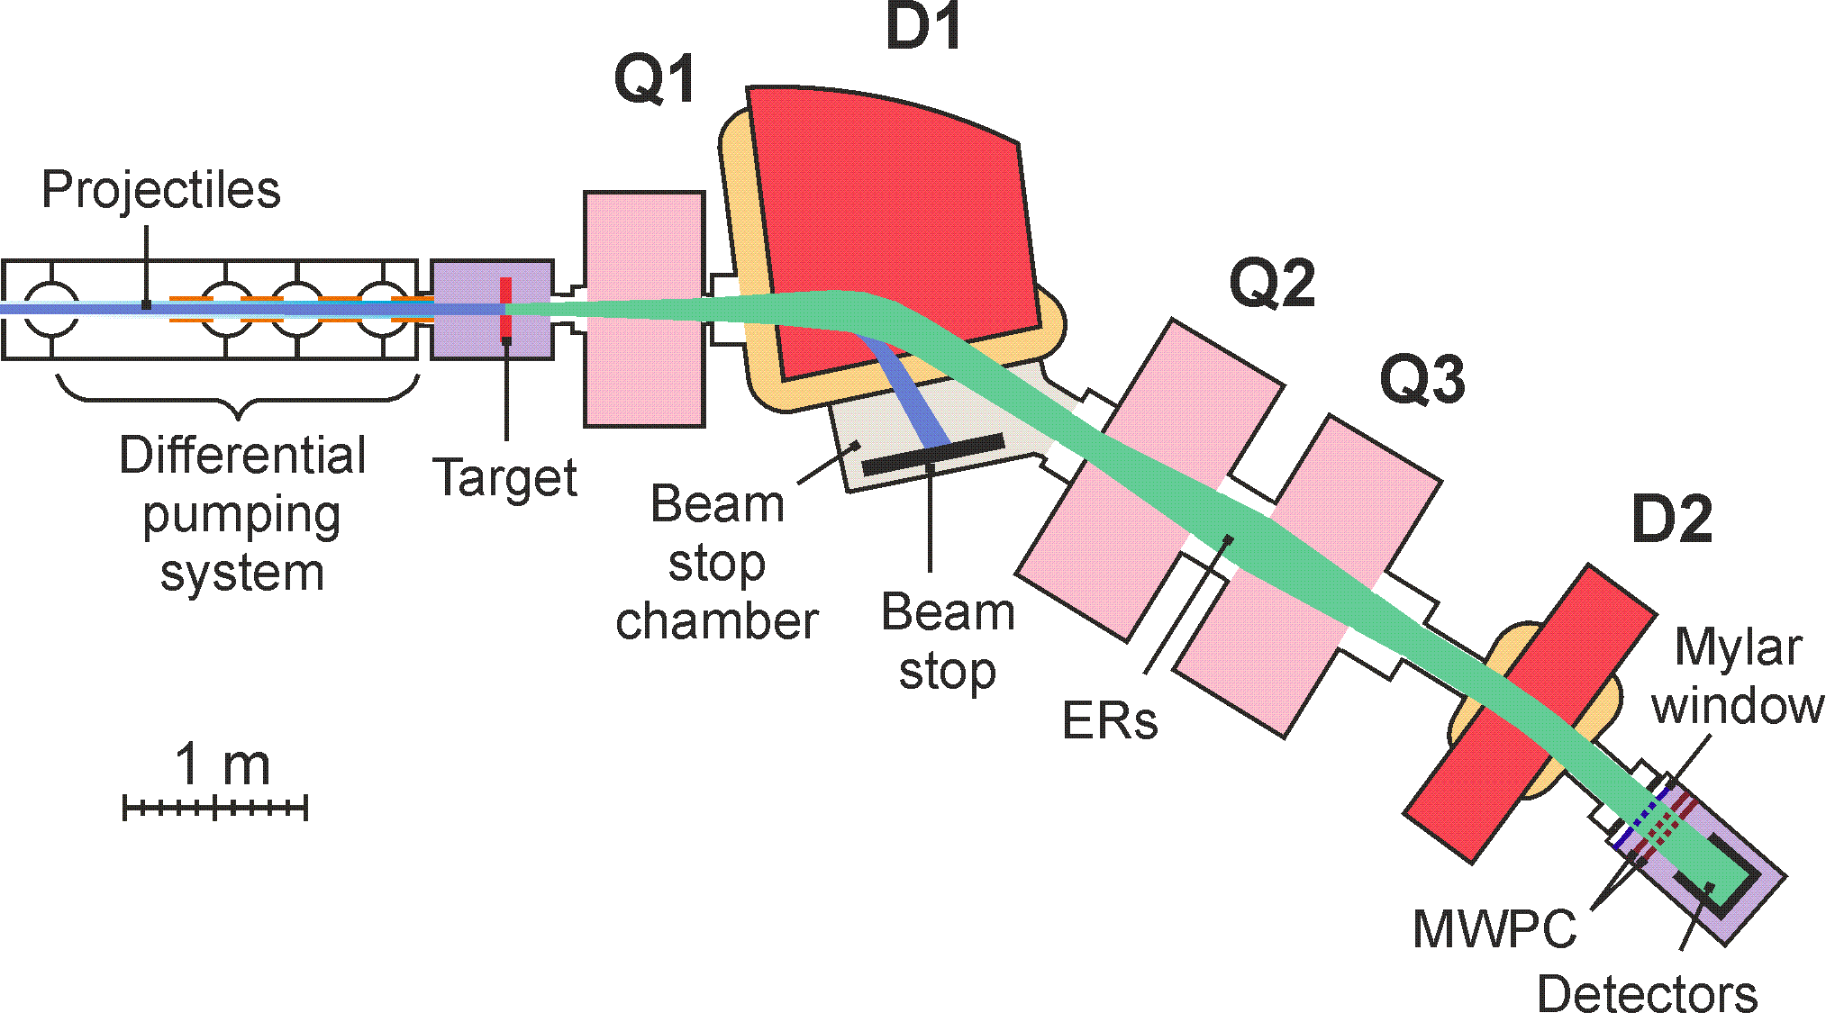
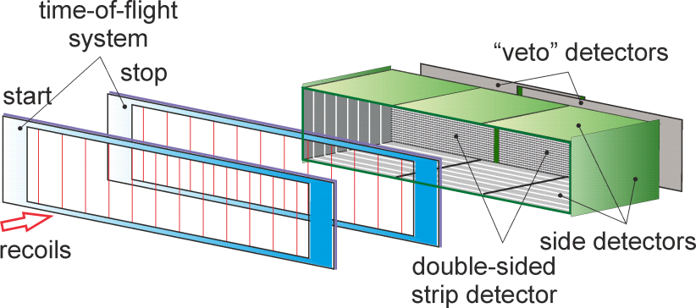
At the end of 2020
Testing of the DGFRS-2 separator has been completed
Optimal parameters of Q1, D1, Q2, Q3, D2
The widths of X and Y distributions
Optimal gas pressure
Dispersions of D1 and D2
Transmission
Background particle suppression factors
Systematics of charges
Programs for calculation of the
DGFRS-2 transmission
Beginning of experiments on the synthesis of
Mc (Z=115) isotopes in the
²⁴³Am+⁴⁸Ca reaction
DGFRS-2
48×220 mm DSSD & 60×120 mm SSSD

Slide 3
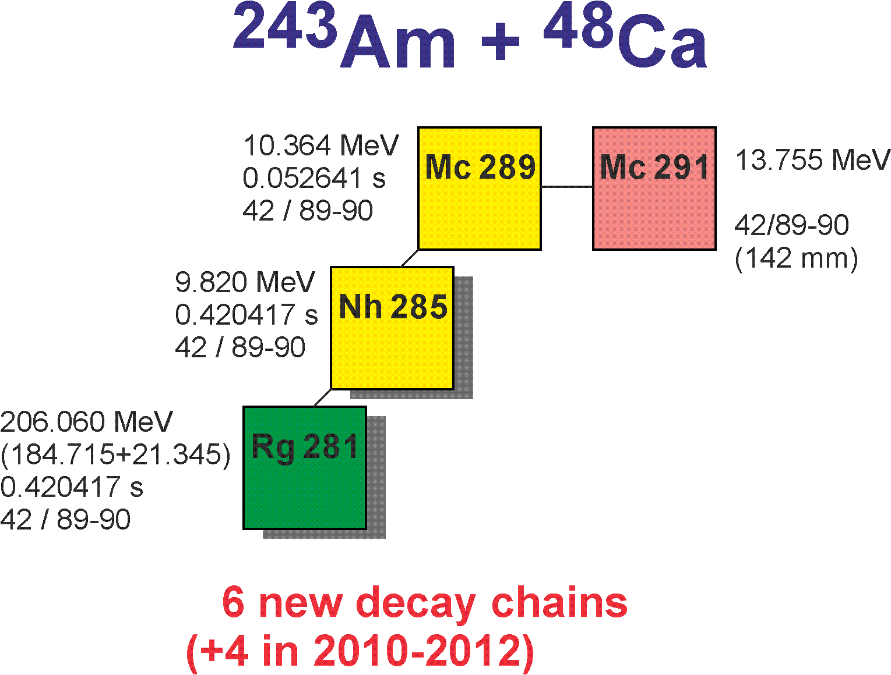
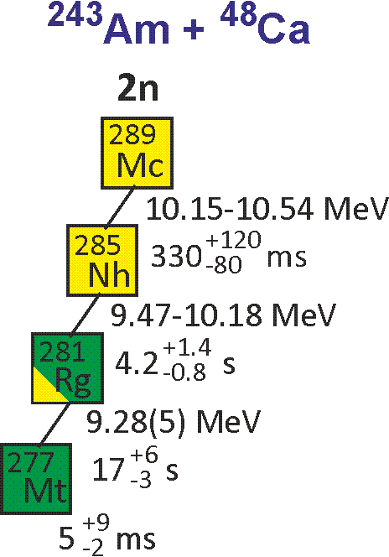
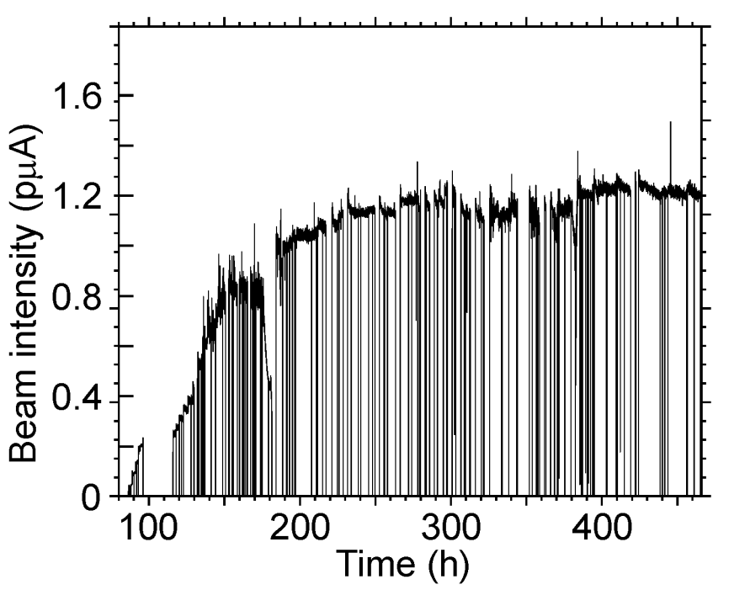
Results of the first experiment
E (MeV) | 243,9 | 240,9 | 239,1
Dose *10¹⁸ | 8,1 | 2,3 | 2,4
N ²⁸⁸Mc/²⁸⁹Mc | 30 / 5 | 16 /1 | 9 / 0
I = 1.2-1.3 pμA 15-cm target
²⁹³Ts: 16 (DGFRS)+2 (TASCA)
2+2 α of ²⁸¹Rg
Comparison of results at the same ⁴⁸Ca energy
Important technical questions:
Transmission
Image size on detector
Background
Systematics of charge states
Test of digital and analog data acquisition systems
Excitation function for the 2n-evaporation channel
- Observation of α decay of ²⁸¹Rg
 | DGFRS-1 | DGFRS-2
Target thickness (mg/cm²) | 0.37 | 0.36
Beam dose 10¹⁸ | 3.3 | 8.0
No of decay chains of ²⁸⁸Мс | 6 | 30
No of decay chains of ²⁸⁹Мс | 0 | 5
Yield of nuclei | 1 | 2.3±0.2
²⁸⁹Mc :14
DGFRS, TASCA, BGS
no α of ²⁸¹Rg

Slide 4
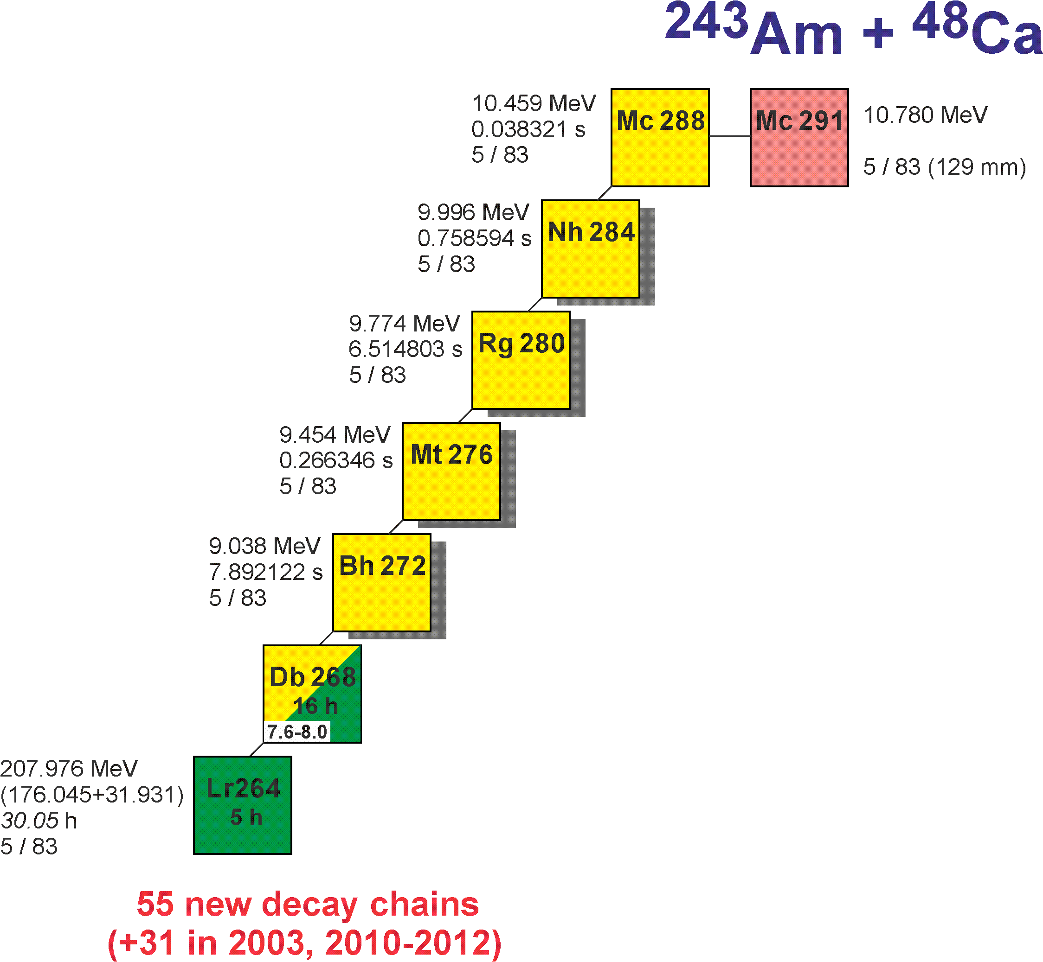
Results of the first experiment
E (MeV) | 243,9 | 240,9 | 239,1
Dose *10¹⁸ | 8,1 | 2,3 | 2,4
N ²⁸⁸Mc/²⁸⁹Mc | 30 / 5 | 16 /1 | 9 / 0
I = 1.2-1.3 pμA 15-cm target
- Excitation function for the 3n-evaporation channel
- Level of cross section for the pxn channel
- Level of EC branch for ²⁸⁸Mc and ²⁸⁴Nh
- Two decay times of ²⁷⁶Mt
- α decay of ²⁶⁸Db !

Slide 5
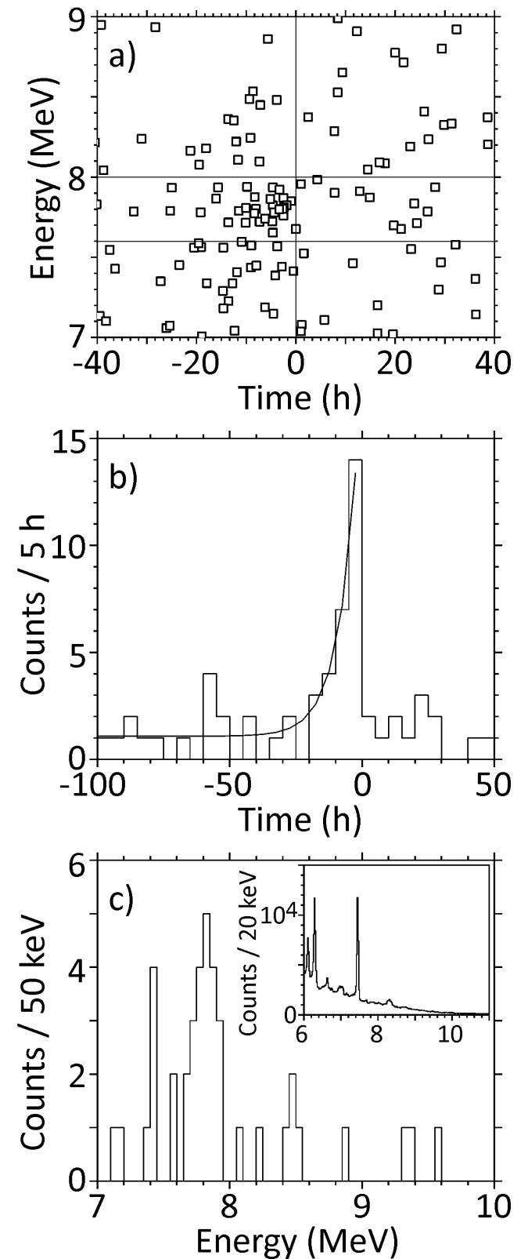
α-like events:
E_{α} vs t of SF
First observation of
α decay of ²⁶⁸Db and new isotope ²⁶⁴Lr
Time distribution
α-like events
E_{α} = 7.6-8.0 MeV
T_{1/2} (²⁶⁴Lr, SF) = 4.9 h
b_{α} (²⁶⁸Db) = 55 %
T_{1/2} (²⁶⁸Db) = 16 h
+2.1
−1.3
+20
−15
+6
−4
Energy distribution
α-like events
T = 5 h

Slide 6
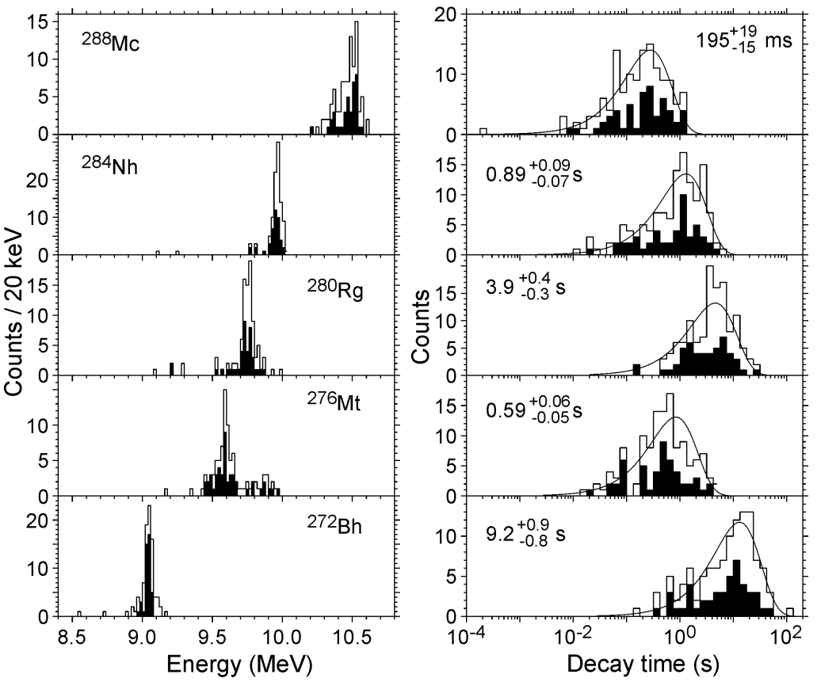
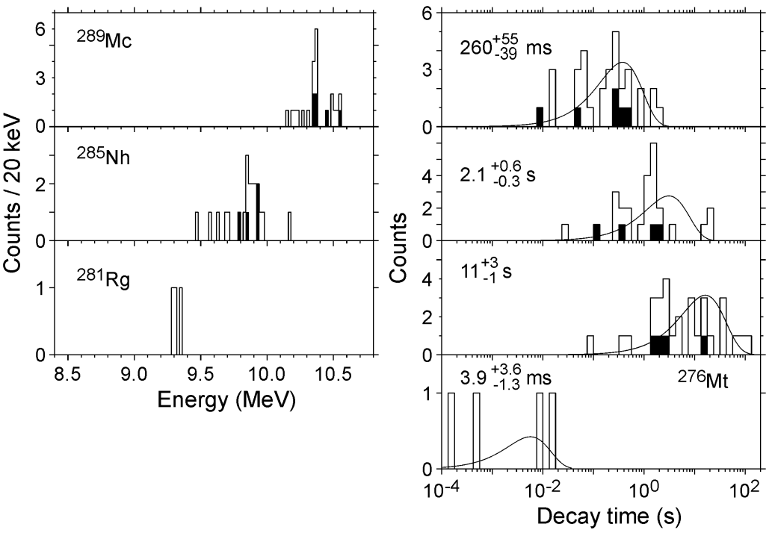
Reaction ²⁴³Am(⁴⁸Ca,2-3n)^{288,289}Mc
Decay properties of 9 isotopes

Slide 7
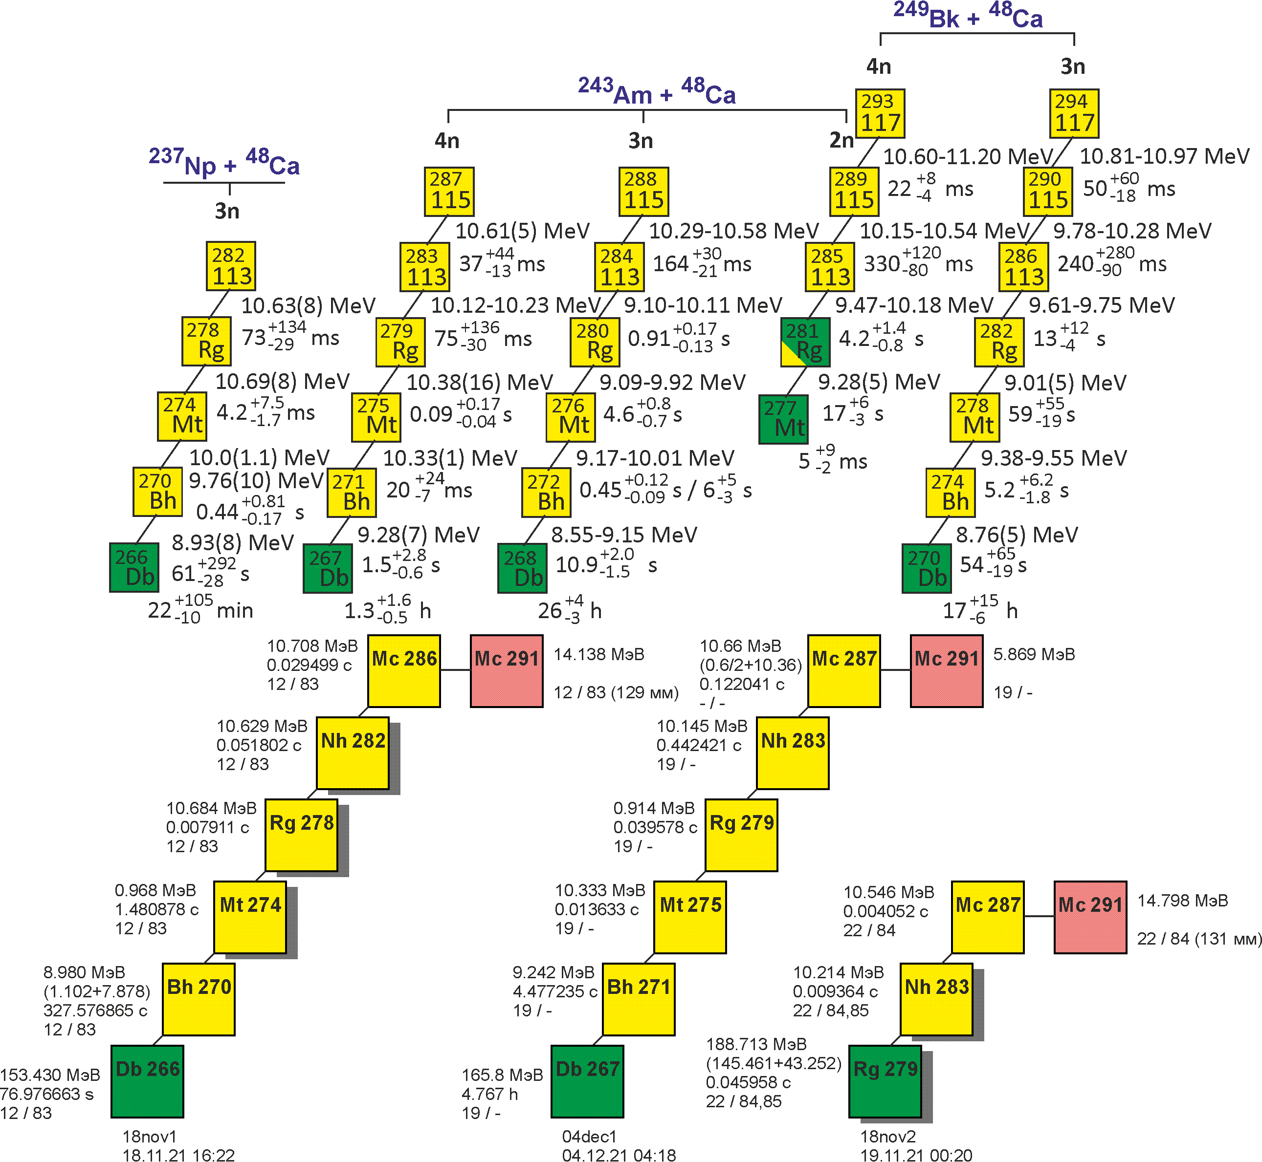
Reaction ²⁴³Am(⁴⁸Ca,4-5n)^{286,287}Mc
New isotope ²⁸⁶Мс
First observation of SF of ²⁷⁹Rg
Decay properties of nuclei
Excitation functions
E (MeV) | 251 | 259
Dose *10¹⁸ | 2,0 | 5,0
²⁸⁶Mc ²⁸⁷Mc ²⁸⁸Mc | 0 1 0 | 1 1 3
2 (DGFRS-1, ²⁸²Nh) + 1
2 (DGFRS-1) + 1 (TASCA) + 2

Slide 8
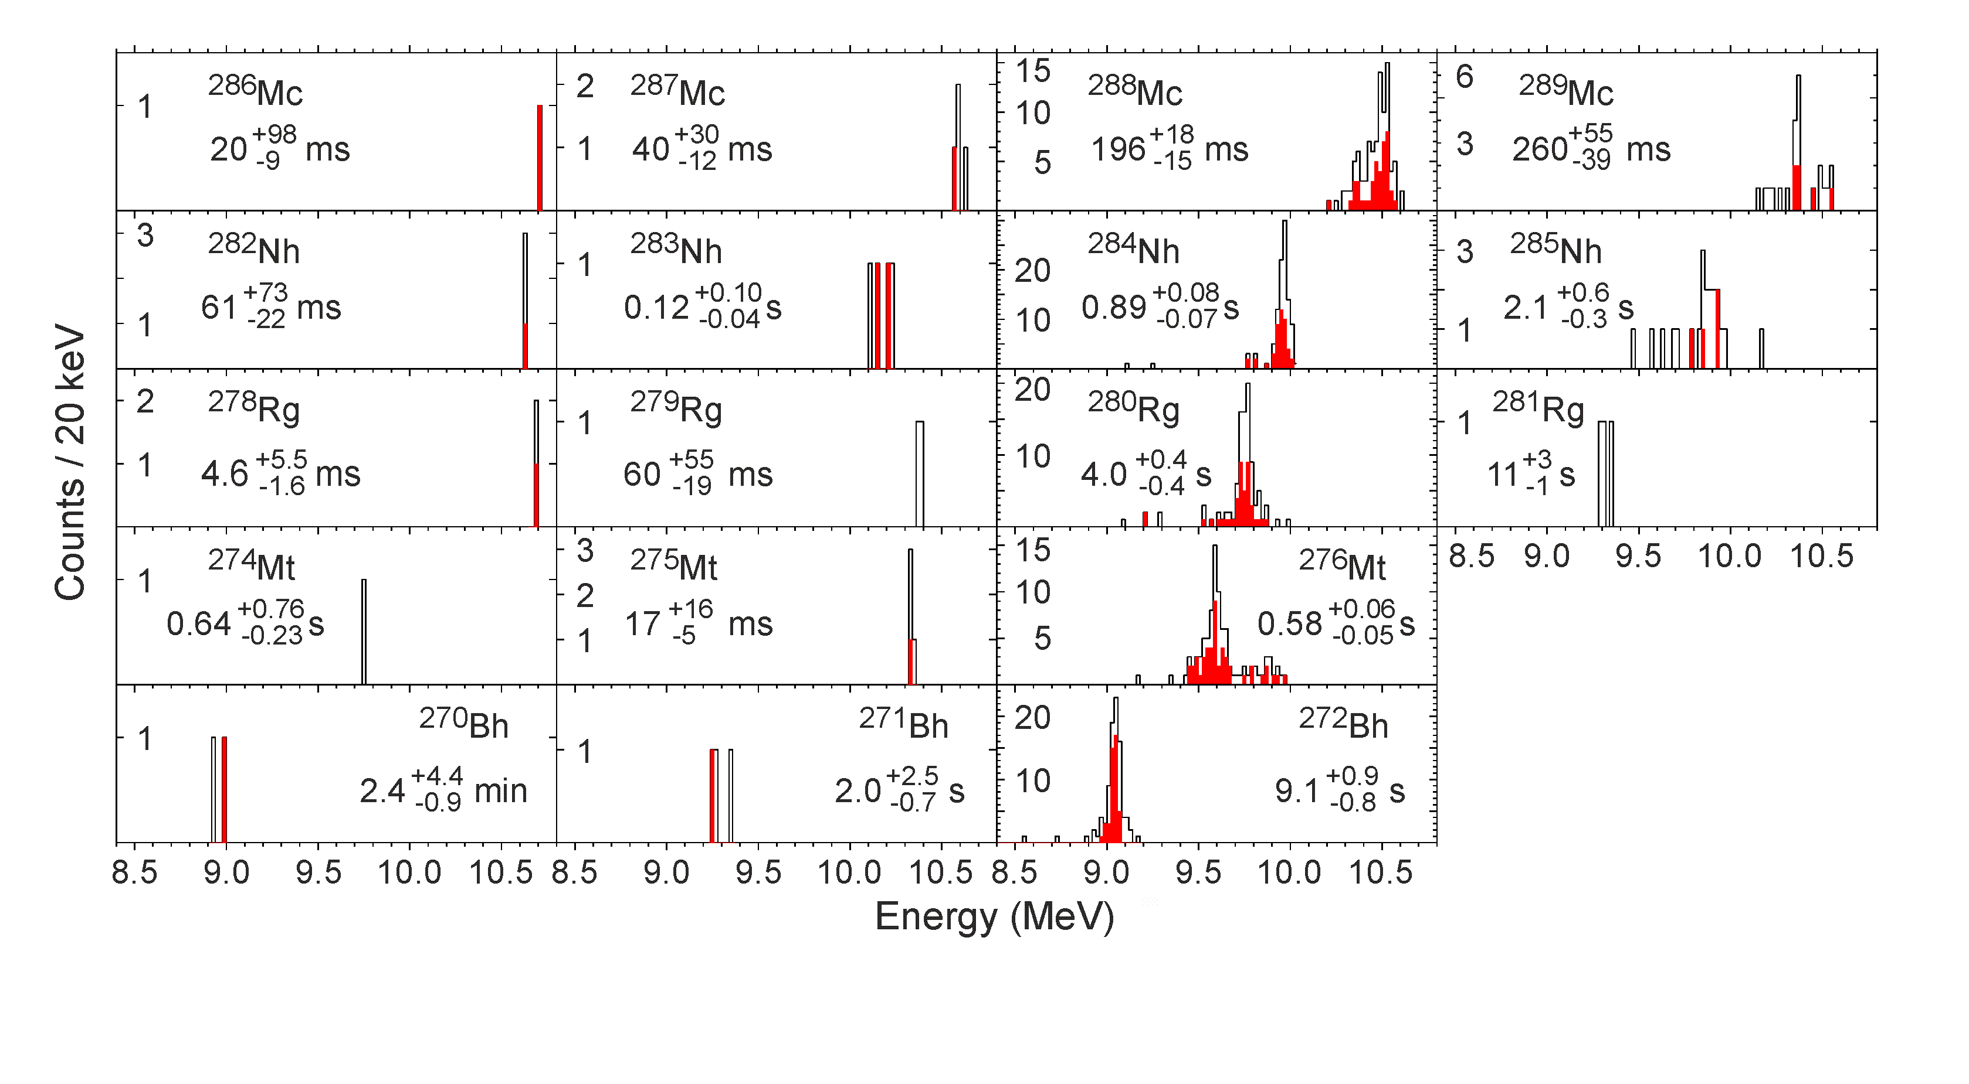
Reaction ²⁴³Am(⁴⁸Ca,2-5n)²⁸⁶⁻²⁸⁹Mc
67 decay chains
Decay properties of 22 isotopes

Slide 9
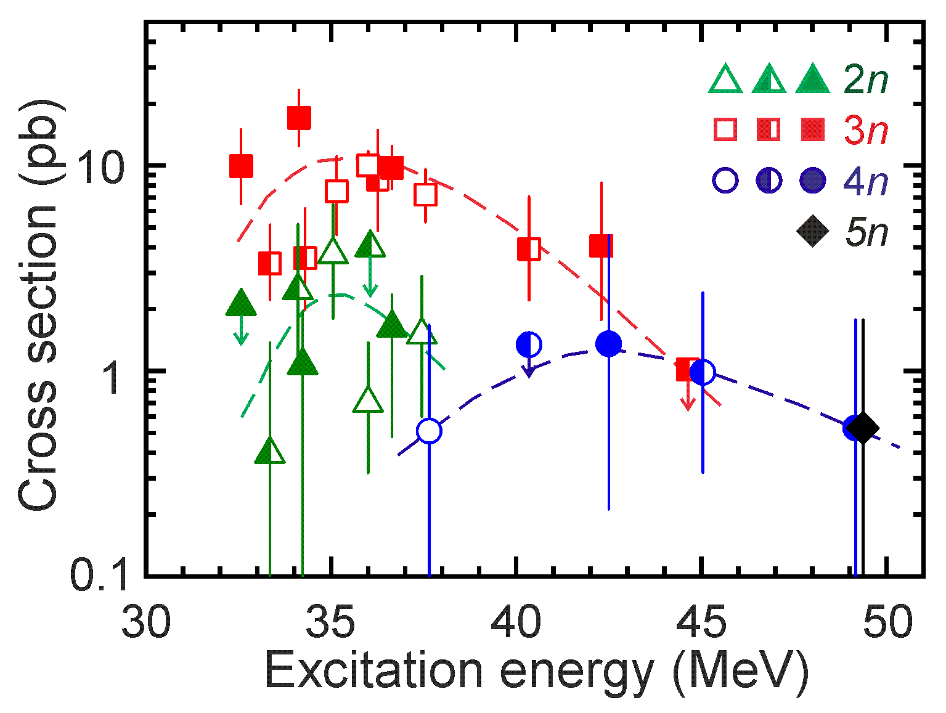
Reaction ²⁴³Am(⁴⁸Ca,2-5n)²⁸⁶⁻²⁸⁹Mc
Excitation functions
Two times larger cross section of the 3n channel
Observation of the 5n channel

Slide 10
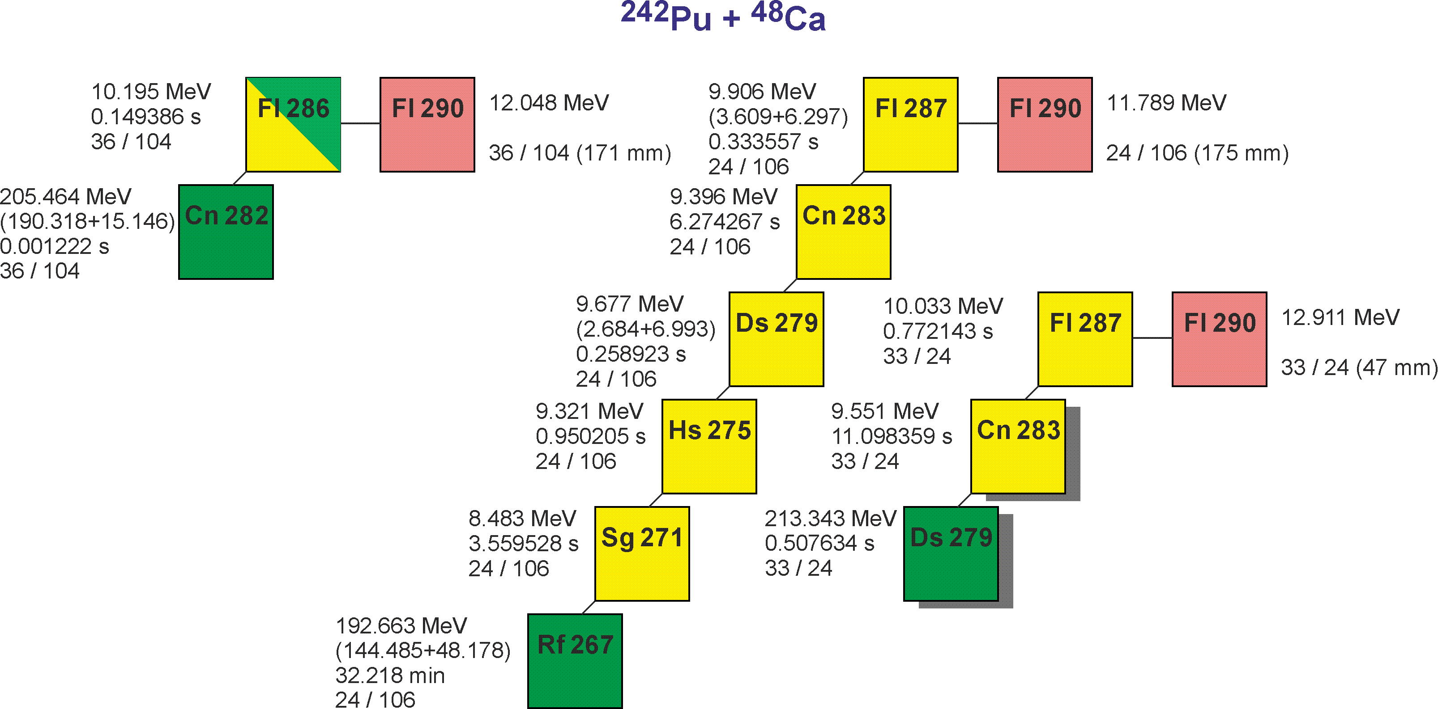
Results of the first experiment ²⁴²Pu+⁴⁸Ca
Target thickness (mg/cm²) | E_{lab} (MeV) | E* (MeV) | Beam dose ×10¹⁸ | No. of chains 3n / 4n | s_{3n} (pb) | s_{4n} (pb)
²⁴²Pu 10×0.76, 0.56, 0.35 | 242.5 | 37.1-40.7 | 11.2 | 65 / 11 | 10.4 | 1.8
 | 247.5 | 41.3-44.8 | 5.0 | 4 / 14 | 1.2 | 4.8
I = 0.05, 0.1 … 1, 1.5, 2.0, 2.5, 3 (1 week) pμA 24-cm target
25
Important technical questions:
Transmission
Image size on detector
Background
Systematics of charge states
Test of digital and analog data acquisition systems
60
3 (DGFRS-1)+1(SHIP) + 9

Slide 11
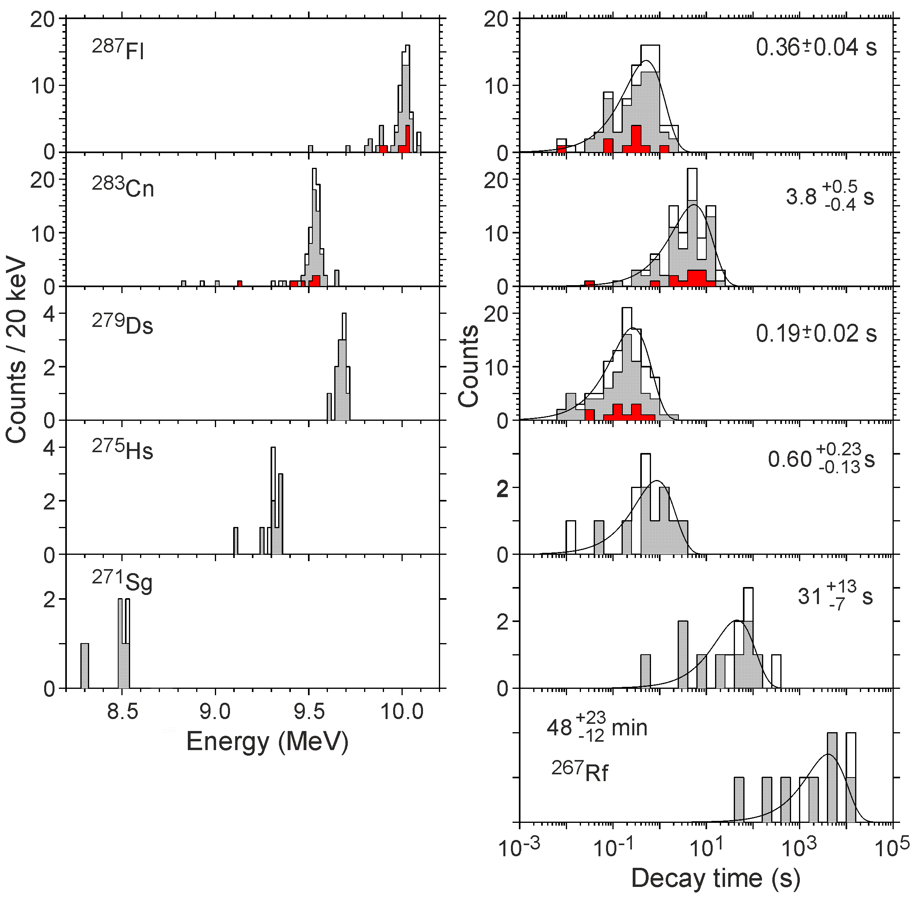
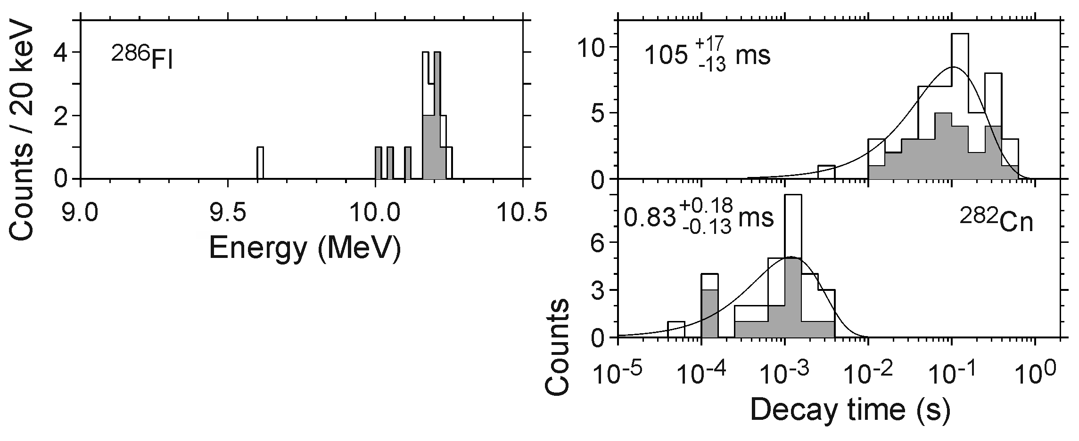
Reaction ²⁴²Pu(⁴⁸Ca,3-4n)^{286,287}Fl
Decay properties of 8 isotopes
Dependence of decay properties of ²⁸⁷Fl, ²⁸³Cn, and ²⁷⁹Ds on level structure (?)
Non-observation of 9.6-MeV α line for ²⁸⁶Fl
Decays through isomeric states for ²⁸⁶Fl and ²⁸²Cn (?)

Slide 12
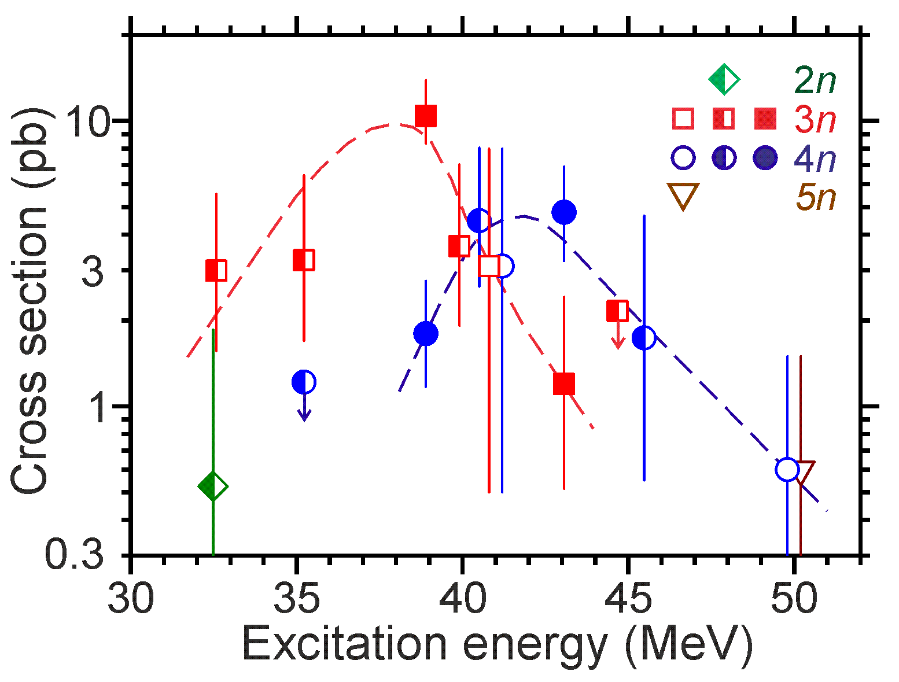
Reaction ²⁴²Pu(⁴⁸Ca,3-4n)^{286,287}Fl
94 decay chains
2-3 times larger cross section of the 3n channel

Slide 13
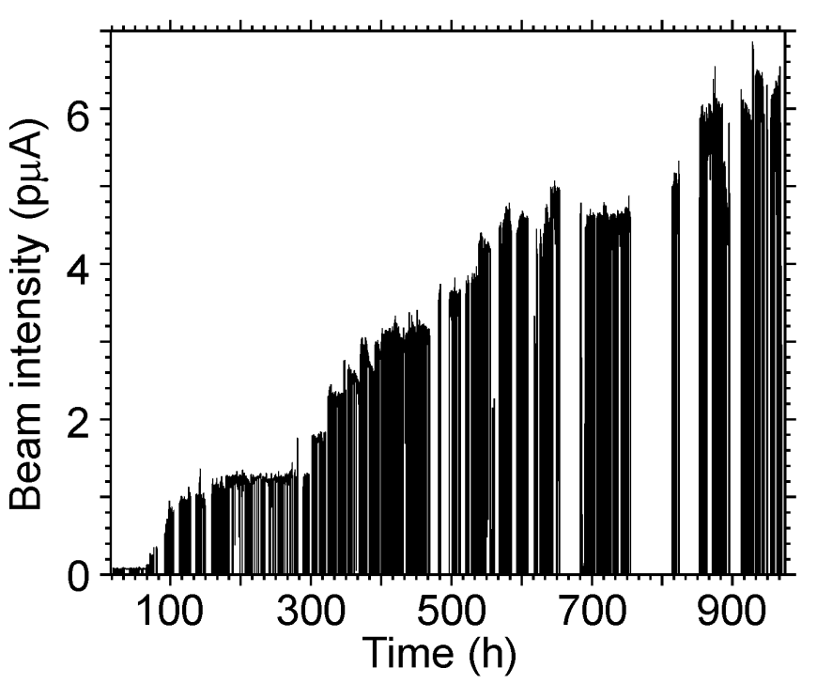
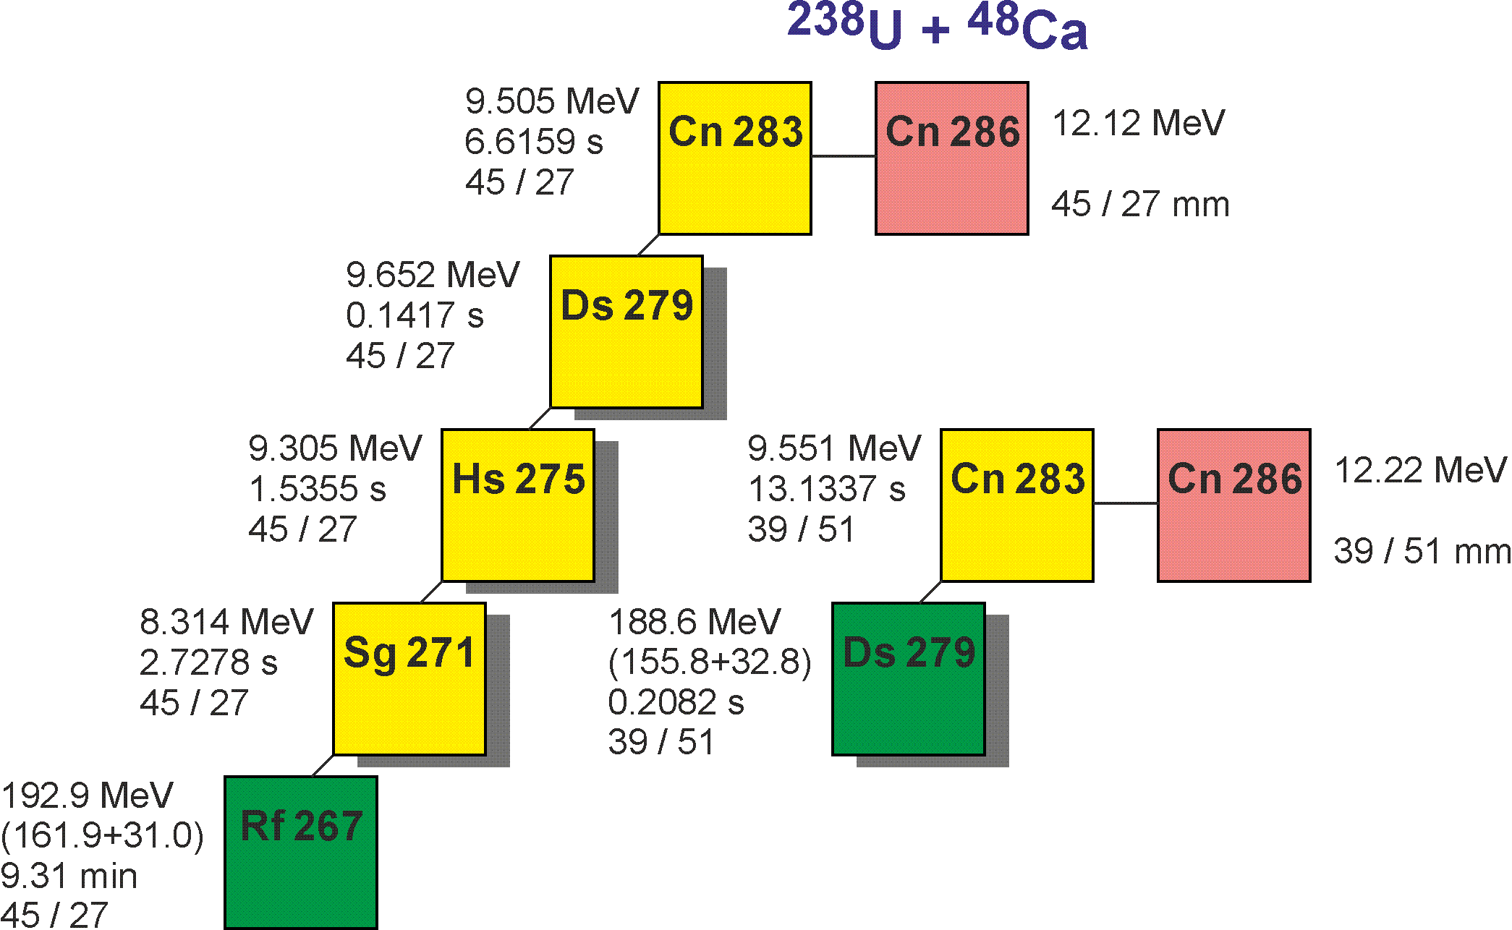
Reaction ²³⁸U(⁴⁸Ca,3n)²⁸³Cn
16 decay chains
Dependence of decay properties of ²⁸³Cn and ²⁷⁹Ds on level structure (?)
I = 0.5, 1, … 6.5 pμA 24-cm target
Small holes appeared in the target but
~97% of ²³⁸U was preserved
on Ti backing
14
3 (DGFRS-1)+1(SHIP) + 9 (²⁴²Pu) + 2

Slide 14
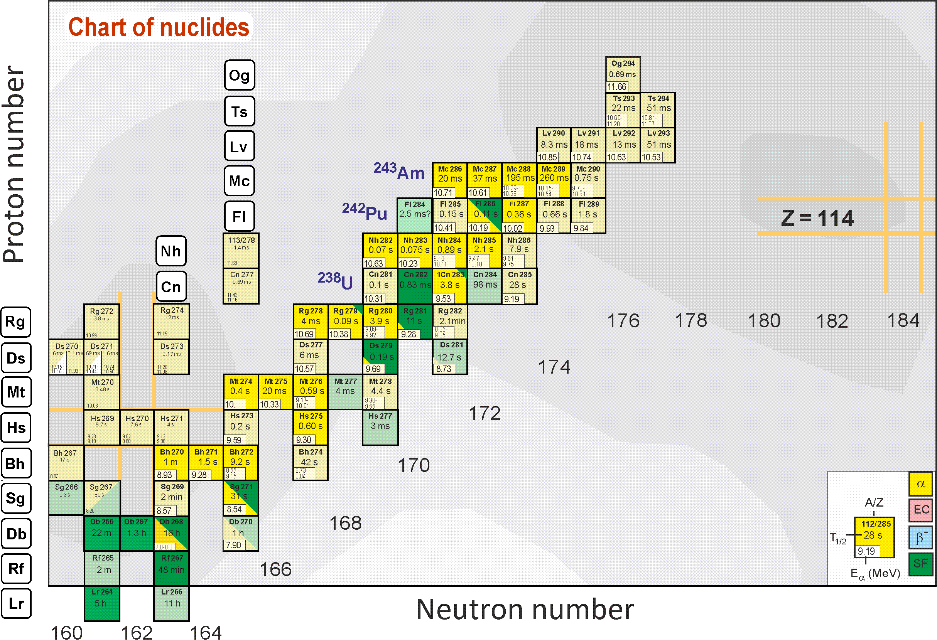
New data on experiments at the SHE Factory
Chart of nuclei. The isotopes produced in the shown reactions in 2021
are highlighted in bright yellow (α decay) and green (spontaneous fission) colors

Slide 15
CONCLUSIONS
²⁴³Am+⁴⁸Ca
New decay chains of ²⁸⁹Mc (6), ²⁸⁸Mc (58), and ²⁸⁷Mc (2)
For the first time:
α decay of ²⁶⁸Db
New spontaneously fissioning isotope ²⁶⁴Lr
New isotope ²⁸⁶Mc
Spontaneous fission of ²⁷⁹Rg
Cross section of the 5n-evaporation channel
Decay properties of 22 isotopes
Two times larger cross section of the ²⁴³Am(⁴⁸Ca,3n)²⁸⁸Mc reaction
Transmission of DGFRS-2 was found to be about twice that of DGFRS-1

Slide 16
CONCLUSIONS
²⁴²Pu+⁴⁸Ca and ²³⁸U+⁴⁸Ca
New decay chains of ²⁸⁶Fl (25), ²⁸⁷Fl (69), and ²⁸³Cn (16)
Decay properties of 8 isotopes
2-3 times larger cross section of the ²⁴²Pu(⁴⁸Ca,3n)²⁸⁷Fl reaction
Stability of ²³⁸U target at 6.5 pmA and a beam dose of 2.6×10¹⁹
97% of the substance was preserved on Ti backing
Decays though different energy levels of ²⁸⁷Fl and ²⁸³Cn lead to
α decay or SF of ²⁷⁹Ds
Existence of isomeric states in the ²⁸⁶Fl consecutive α decays

Slide 17
Thank you for attention!

Slide 18
DC280
Smooth variation of the beam energy in a wide range
Stability of the beam energy
Beam intensity of up to 6.5 pµA was obtained
Stability of the beam intensity

Slide 19
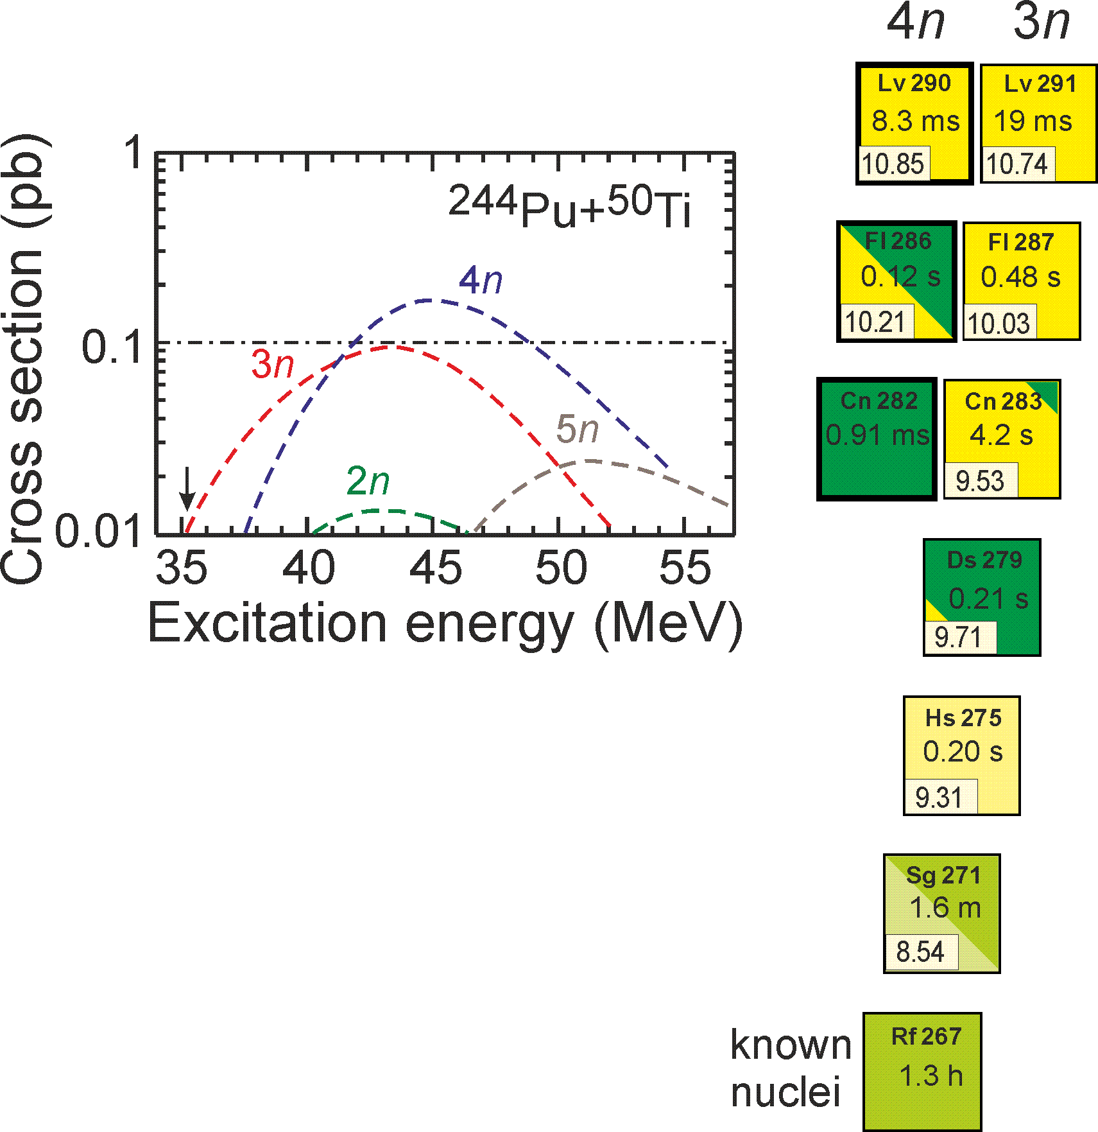
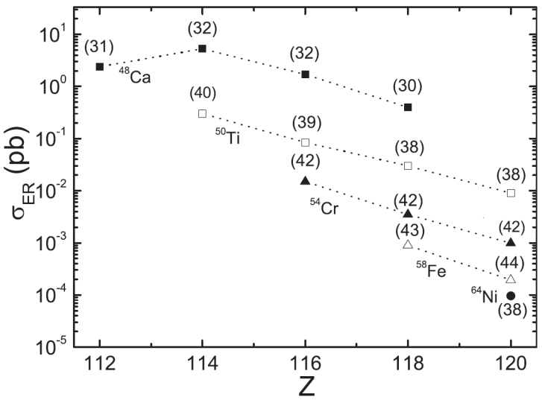
Plans for 2022
Availability of the target material and possibility of use
Unknown cross sections for production of elements 119 and 120
From ⁴⁸Ca to ⁵⁰Ti
Test reactions:
²³⁸U+⁵⁰Ti ²⁸⁸Fl* ²⁴⁴Pu+⁵⁰Ti ²⁹⁴Lv*
V. Zagrebaev and W. Greiner
0.2-0.3 pb
G. Adamian et al.
0.1 pb
G. Adamian et al.
0.3 pb
σ=0.2 pb, h_{t}=0.4 mg/cm², ε_{coll}=0.6, I_{beam}=3 pμA → ≈3 events per 25 days
σ=0.2 pb, h_{t}=0.2 mg/cm², ε_{coll}=0.6, I_{beam}=3 pμA → ≈3 events per 50 days

Slide 20
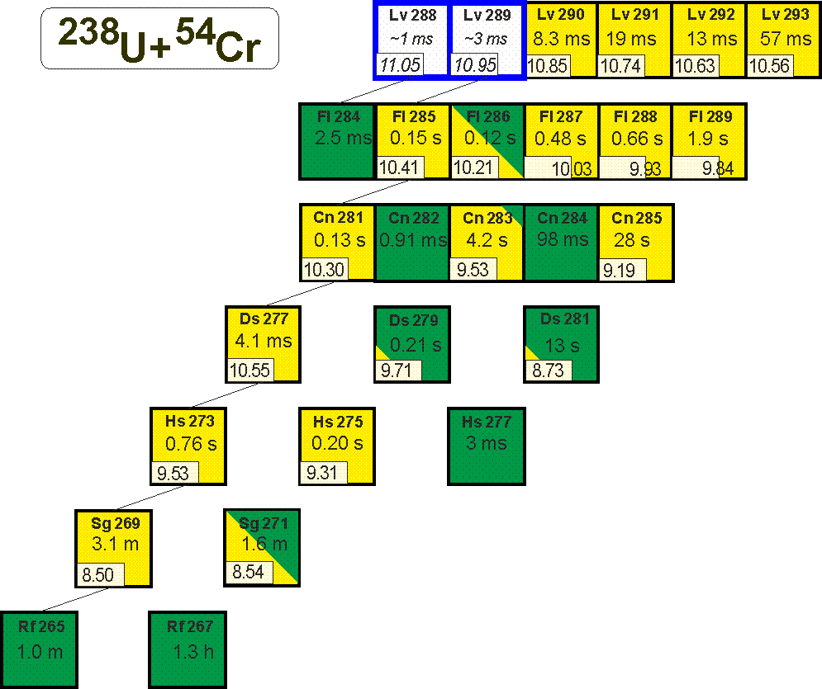
Plans for 2022
Availability of the target material and possibility of use
Unknown cross sections for production of elements 119 and 120
From ⁴⁸Ca to ⁵⁴Cr
Test reaction: ²³⁸U+⁵⁴Cr ²⁹²Lv*
G. Adamian et al.
0.015 pb !
σ=0.015 pb, h_{t}=0.6 mg/cm², ε_{coll}=0.5, I_{beam}=5 pμA → ≈3 events per 5 months

Slide 21
DC280
Beam intensity of up to 6.5 pµA
Stability of the beam intensity
1.25 pμA
Beam intensity (rel. units)
Beam intensity (pμA)
Time (h)
Time (h)

Slide 22
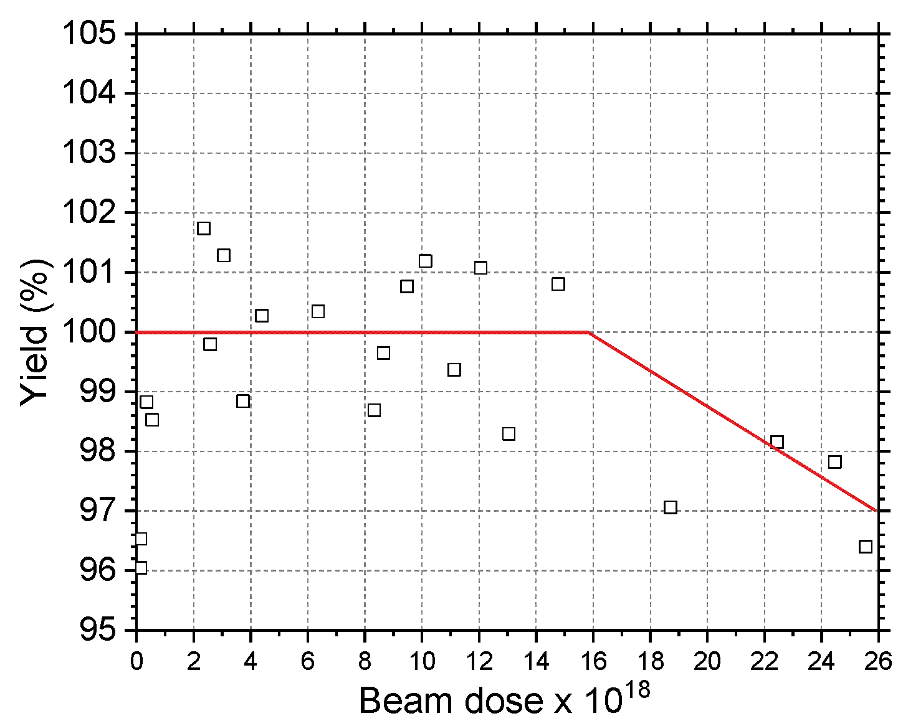
Stability of target
²⁴²Pu
Beam intensity of up to 3 pμA
Loss of material was not observed
²³⁸U
Beam intensity of up to 6.5 pμA
Possible loss of 3% at a beam dose of 2.6x10¹⁹

Slide 23
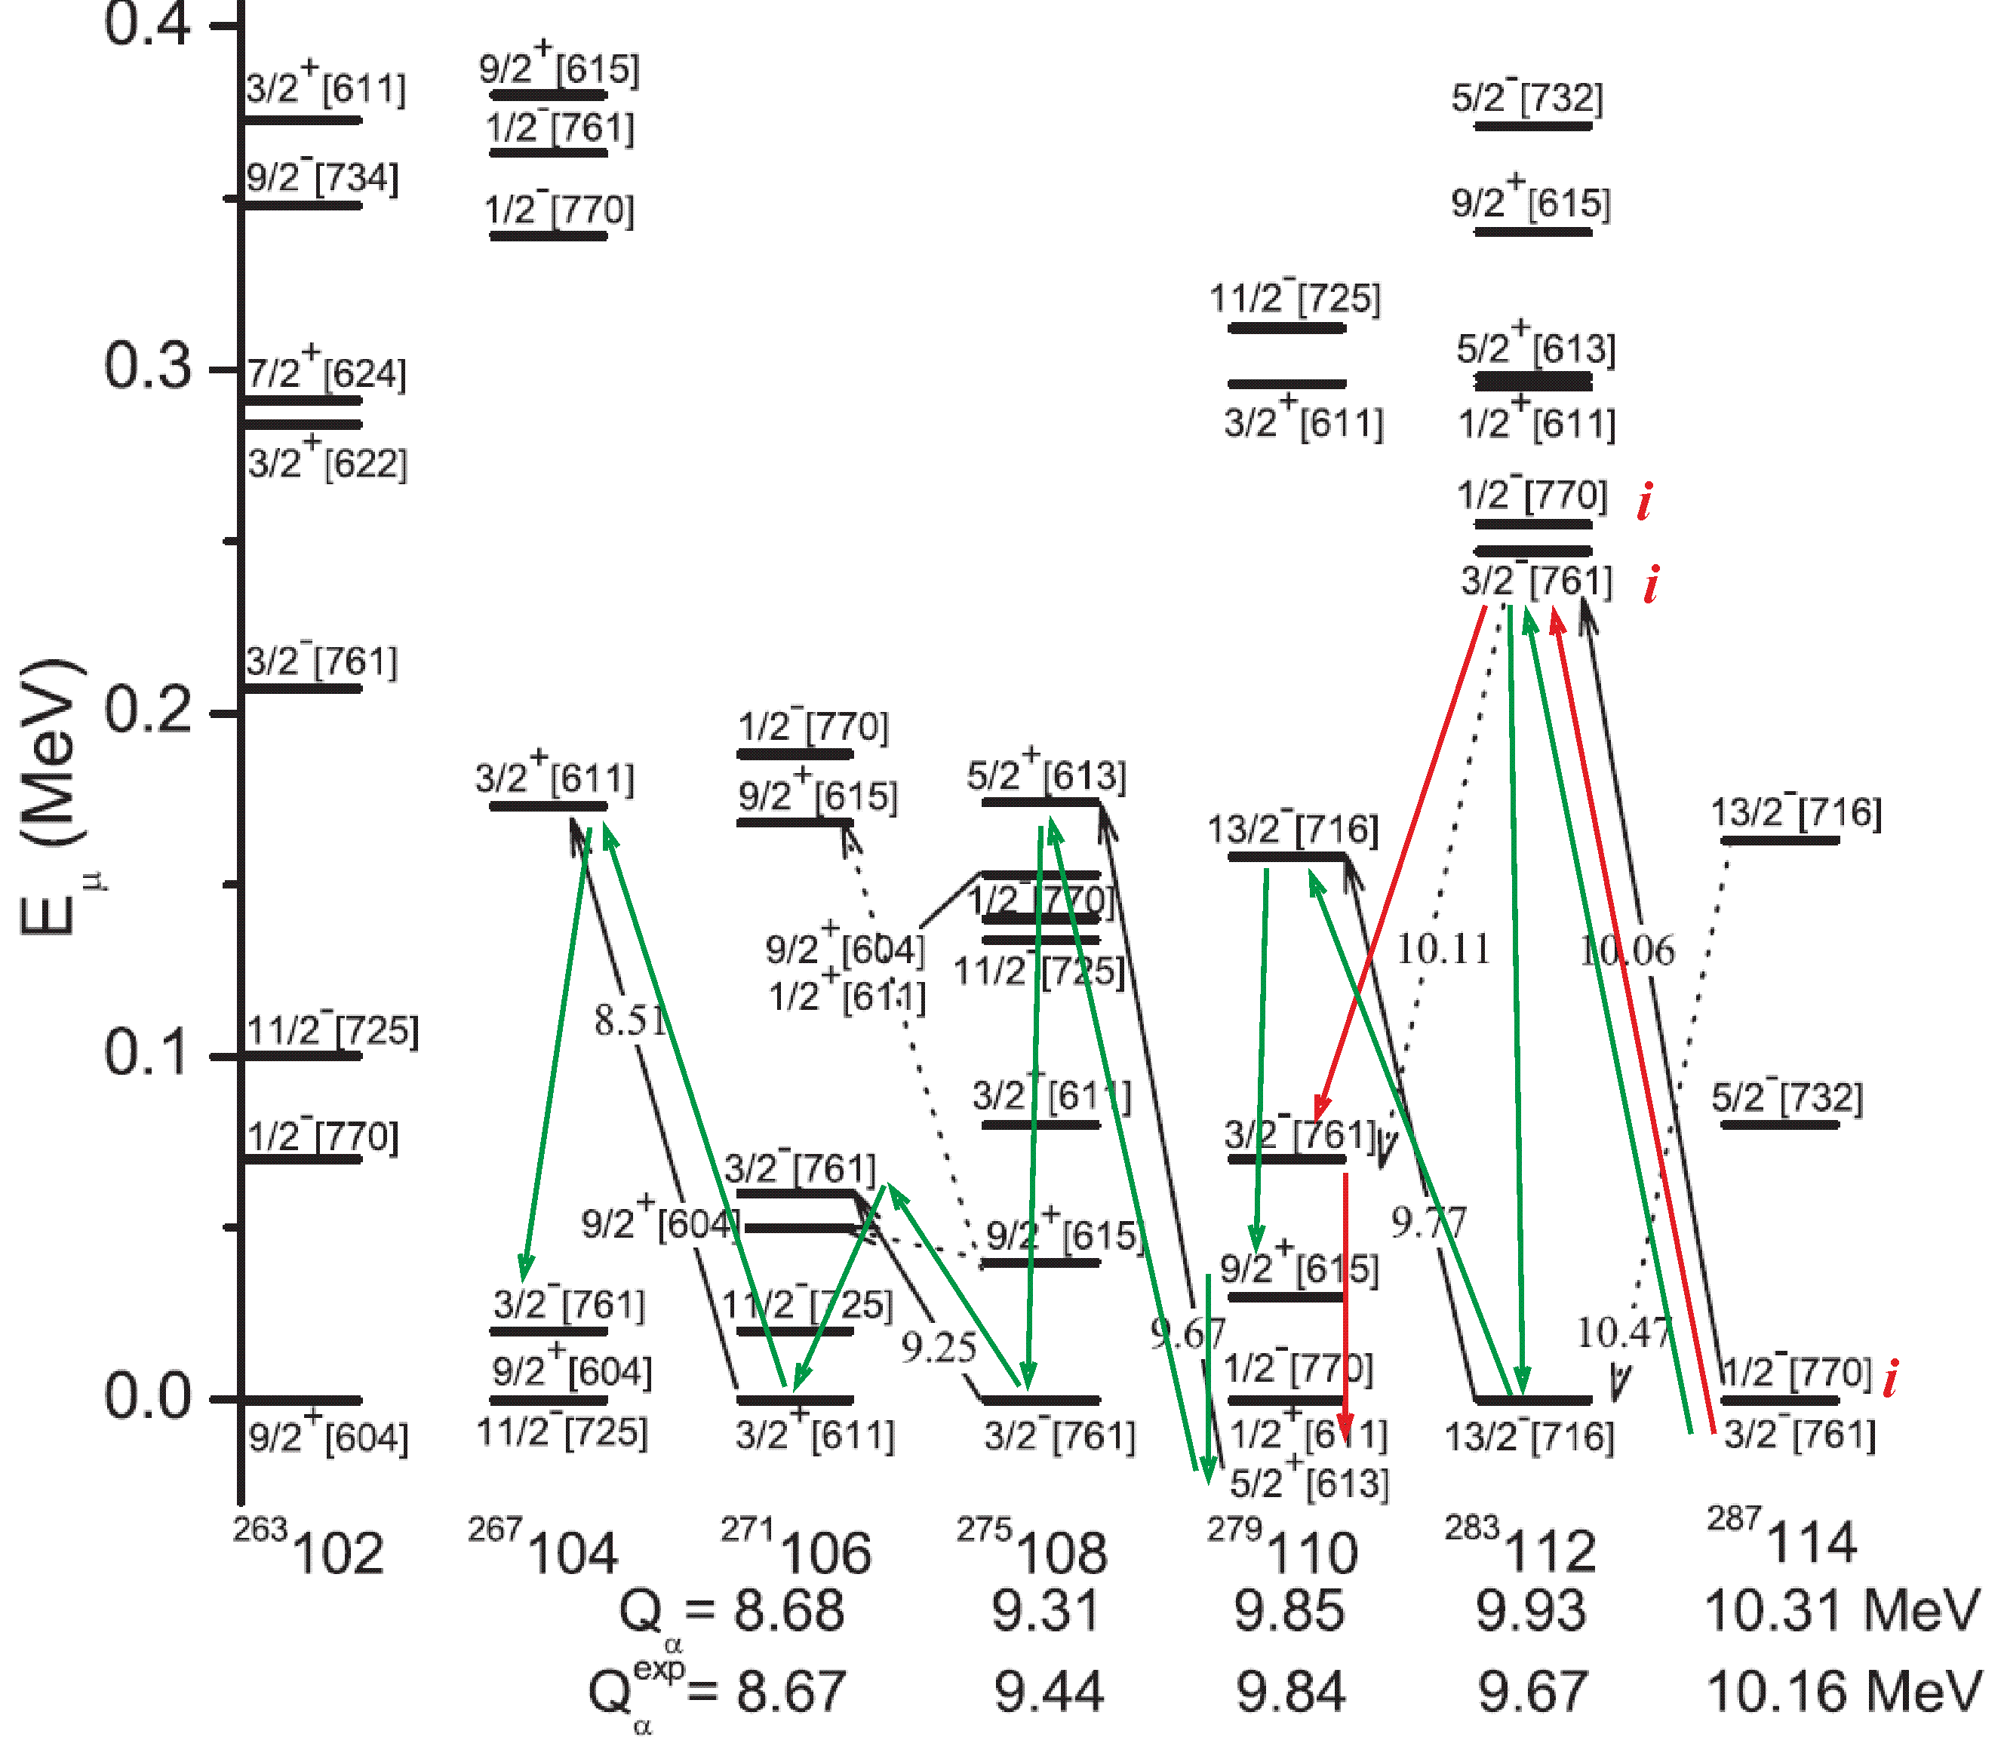
Reaction ²⁴²Pu(⁴⁸Ca,3-4n)^{286,287}Fl
Dependence of decay properties of ²⁸⁷Fl, ²⁸³Cn, and ²⁷⁹Ds on level structure (?)
²⁷⁹Ds: SF / α
A.N. Kuzmina, G.G. Adamian, N.V. Antonenko
Role of quasiparticle structure in α decays of the heaviest nuclei,
Phys. Rev. C 85, 027308 (2012)

