Slide 1
The new muon segment building algorithm in Cathode Strip Chambers Nikolay Voytishin JINR (Dubna)
Alushta
2014

Slide 2
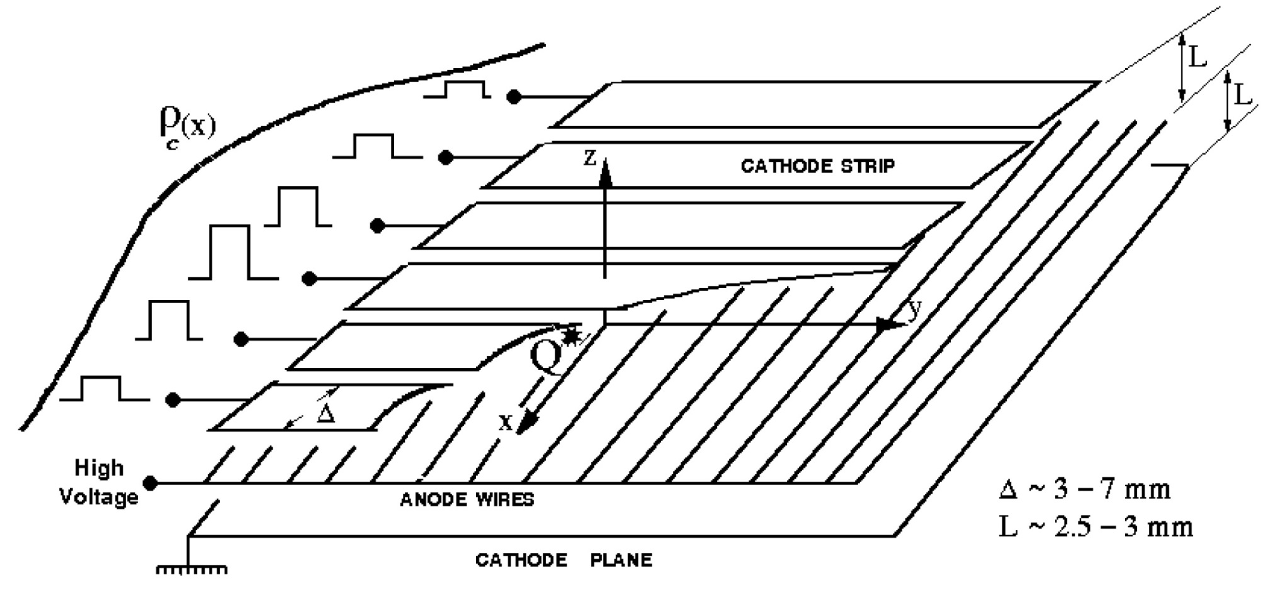
Cathode Strip Chambers (CSC)
CSCs are multiwire proportional chambers (MWPC)
The principle of work of cathode strip chambers

Slide 3
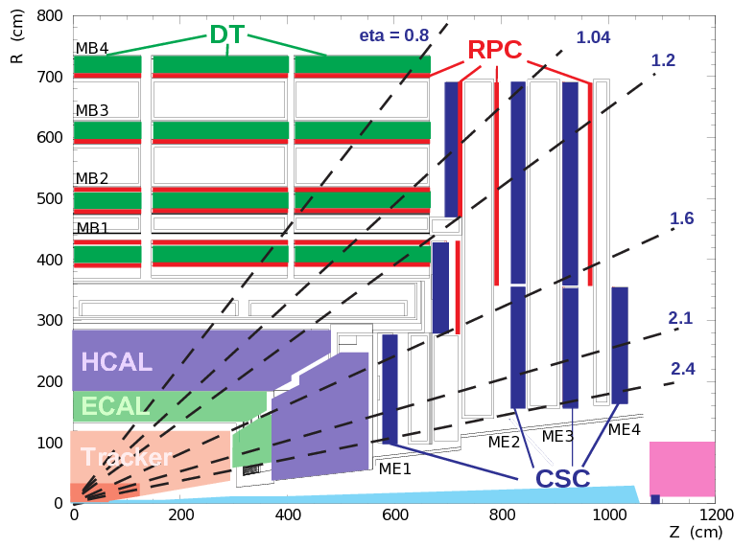
Cathode Strip Chambers (CSC)
An example of CSC placement in an experimental setup in a collider

Slide 4
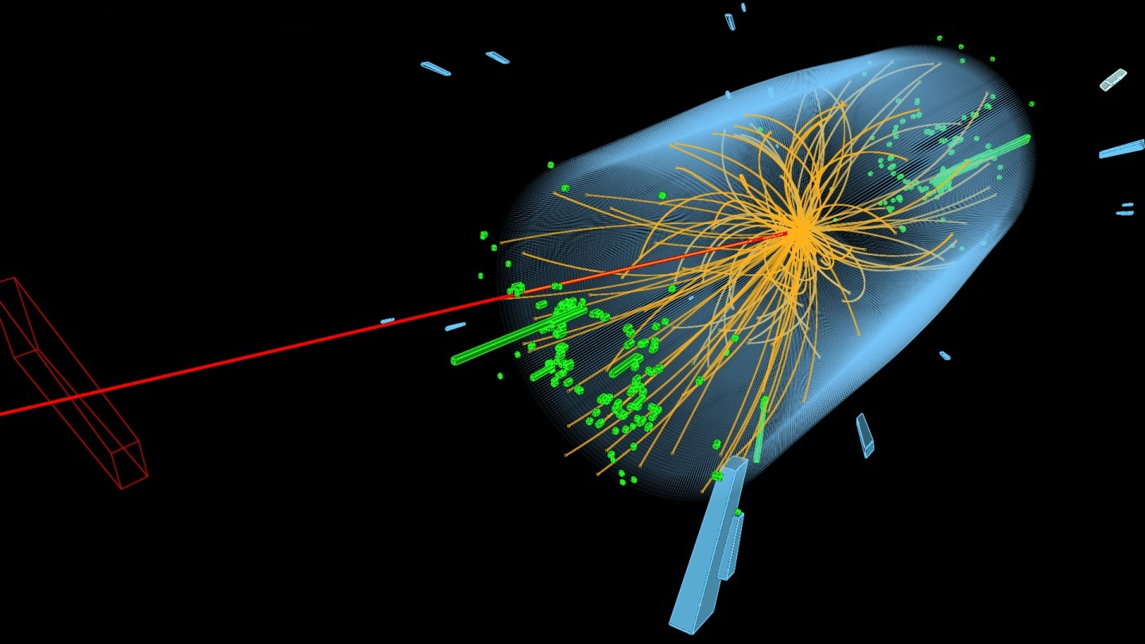
Single Global Muon

Slide 5
Algorithms
Data
Monte Carlo (MC) single muon
pt = 10GeV; 100GeV; 1000GeV;
pt = p/cos($θ^{°}$)
Spanning Tree (ST)
Modified Spanning Tree (newST)
BaseRoad
BaseRoad+Baseline

Slide 6
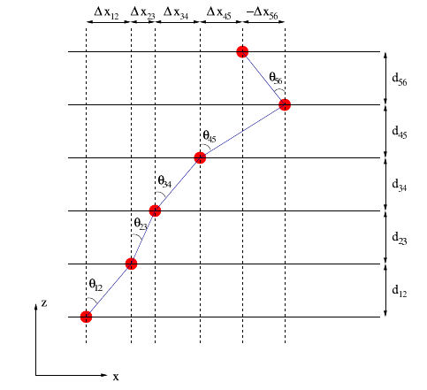
Algorithms
Spanning Tree (ST)
(1)
(2)
(3)

Slide 7
Algorithms
Modified Spanning Tree (newST) – quasiWireGroups (qWG):
Stn | MaxSlope |  | qWG_max, cm | MinSlope |  | qWG_min, cm | maxWG_width, cm
 | η | θ^{ο} |  | η | θ^{ο}
11a | 2,13 | 13,55418 | 0,53 | 2,47 | 9,669694 | 0,37 | 9.25, 3.14
11b | 1,61 | 22,60748 | 0,92 | 2,13 | 13,55418 | 0,53 | 3.14, 10.75
12 | 1,2 | 33,52399 | 1,68 | 1,6 | 22,82875 | 1,07 | 4,1
13 | 0,9 | 44,25033 | 2,47 | 1,1 | 36,82222 | 1,90 | 5,69
21 | 1,6 | 22,82875 | 1,07 | 2,4 | 10,36713 | 0,46 | 2,49
22 | 1 | 40,39506 | 2,16 | 1,5 | 25,15674 | 1,19 | 5,06
31 | 1,75 | 19,71614 | 0,91 | 2,4 | 10,36713 | 0,46 | 2,49
32 | 1,1 | 36,82222 | 1,90 | 1,6 | 22,82875 | 1,07 | 5,06
41 | 1,85 | 17,87173 | 0,82 | 2,4 | 10,36713 | 0,46 | 1,87
42 | 1,2 | 33,52399 | 1,68 | 1,9 | 17,01318 | 0,78 | 5,06
𝑙𝑜𝑤𝑒𝑟_𝑏𝑜𝑢𝑛𝑑= 𝑞𝑊𝐺_𝑚𝑖𝑛−1.5∗max𝑊𝐺_𝑤𝑖dtℎ
𝑢𝑝𝑝𝑒𝑟_𝑏𝑜𝑢𝑛𝑑= 𝑞𝑊𝐺_𝑚𝑎𝑥+1.5∗max𝑊𝐺_𝑤𝑖𝑑𝑡ℎ

Slide 8
New Algorithms
Qwg for rough coordinates
BaseRoad – qwg for precise coordinates:
The first two hits from the same chamber that are the most distant from each other in terms of z-coordinate(in outer layers) are chosen
A straight line is traced through these hits
In the road formed along this line new hits from the inner layers are added to the segment
BaseRoad+Baseline:
- min($\sum_{i}{|d_{i}|}$)

Slide 9
Good RecHit (GRH)
|R_of_RecHit – R_of_SimHit| < 4*Wire_group_widths
|Phi_of_RecHit – Phi_of_SimHit| < $\left\{\begin{aligned}\frac{3}{8}∗ strip width , ME13 \\ \frac{strip width}{2}, other stations\end{aligned}\right.$
If there are two or more candidates that satisfy the first two criteria, as a Good RecHit is considered the candidate that is the closest to the simulated hit in the current layer.

Slide 10
Segment Efficiency

Slide 11
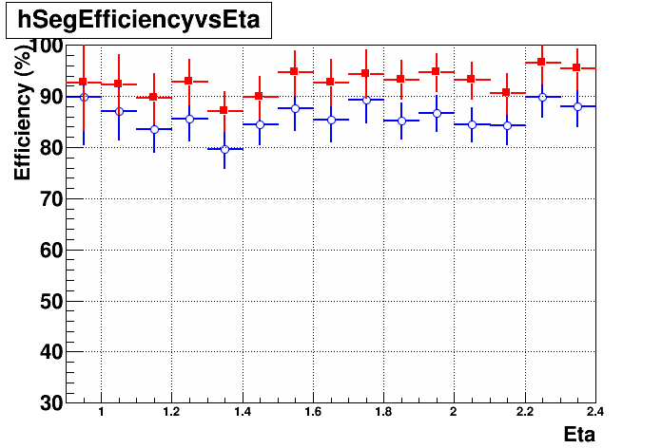
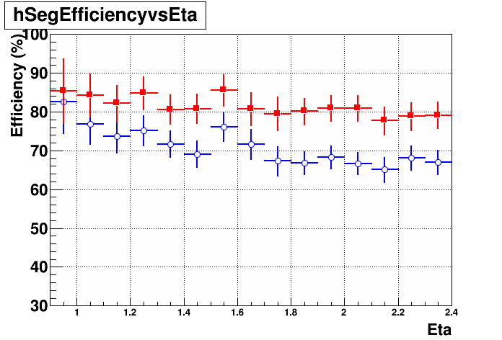
Segment Efficiency vs. η
pt = 10GeV
pt = 1000GeV
blue – standard ST; red – BaseRoad+Baseline.

Slide 12
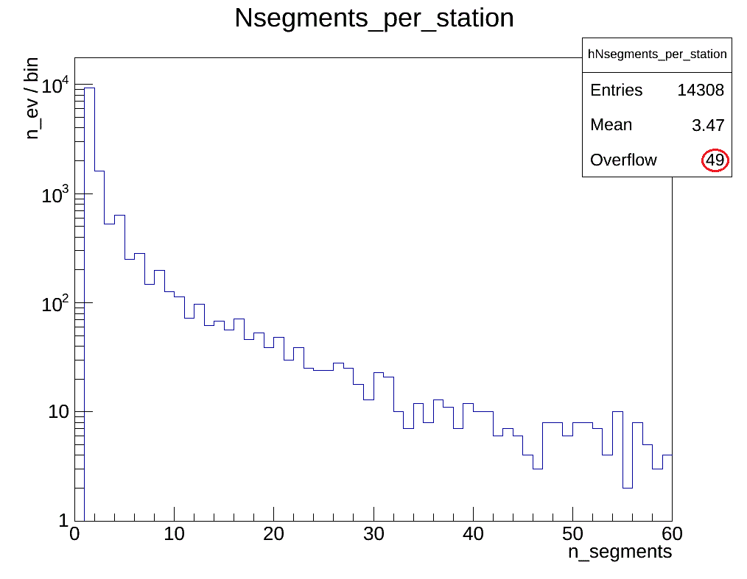
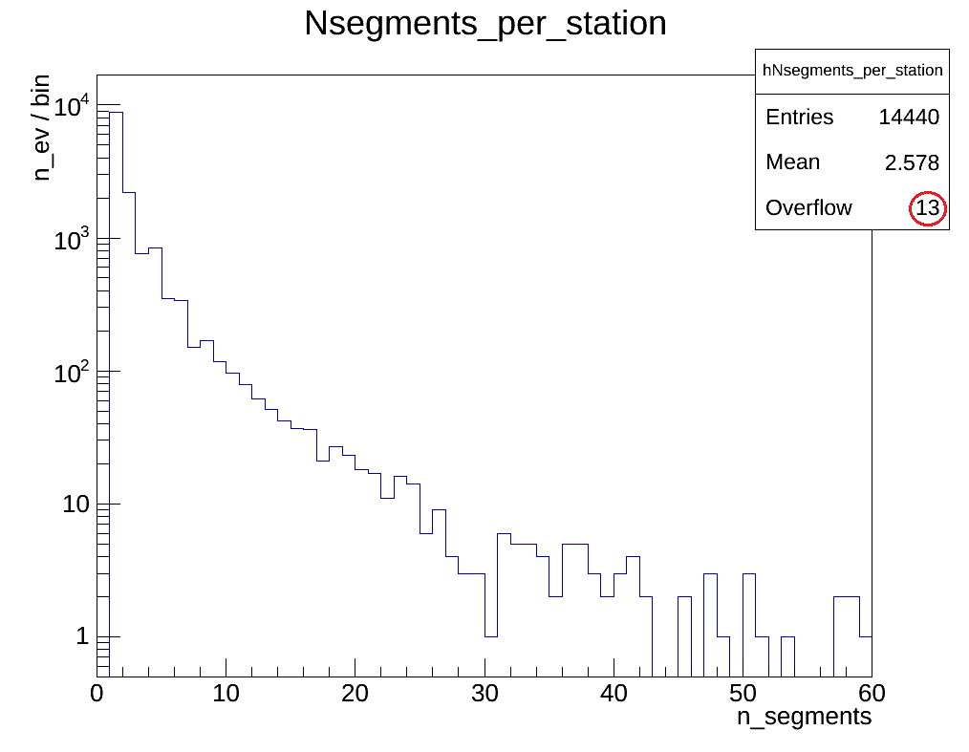
Segment multiplicity
Standard Algorithm
New Algorithm
Number of reconstructed muon segments per station
pt = 1000GeV.

Slide 13
Total number of 3-point segments
The percentage of 3-point segments out of the total number of reconstructed segments

Slide 14
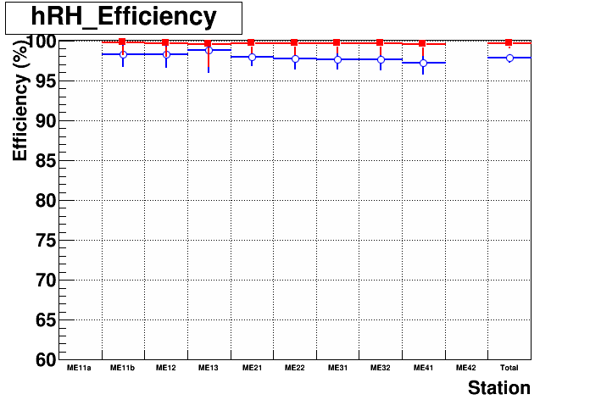
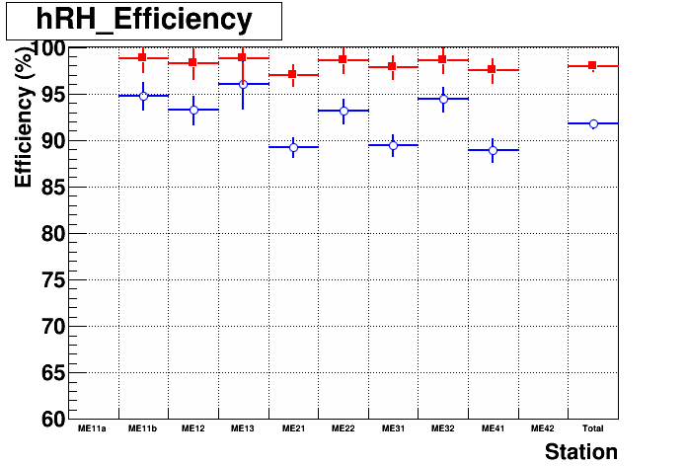
RecHit Efficiency by station
pt = 10GeV
pt = 1000GeV
blue – standard ST; red – BaseRoad+Baseline.

Slide 15
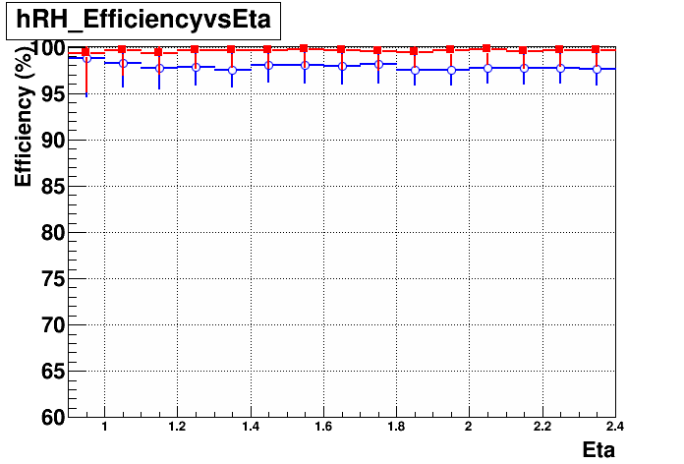
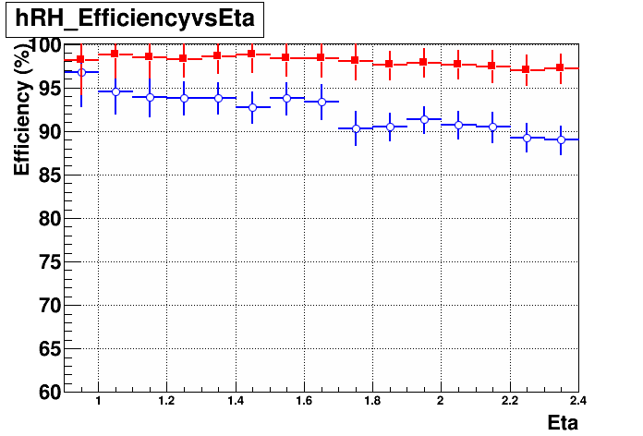
RecHit Efficiency vs. η
pt = 10GeV
pt = 1000GeV
blue – standard ST; red – BaseRoad+Baseline.

Slide 16
Summary
The work is still in progress.
The Spanning Tree algorithm is modified and the new BaseRoad algorithm is implemented.
The notion of a Good RecHit is introduced for the evaluation of the segments’ quality.
The BaseRoad algorithm gives an increase in segment building efficiency of 8% for pt = 10GeV and an increase of 12% for pt = 1000GeV in comparison with the standard algorithm.
The building efficiency decreases with η for the standard algorithm and almost remains constant for the BaseRoad algorithm.
The new algorithm decreases the multiplicity of reconstructed segments per station.
The new algorithm decreases the multiplicity of 3-point reconstructed segments to 7%.
RecHit efficiency is almost the same for both algorithms for pt = 10GeV and is essentially improved for pt = 1000GeV.
There is an decrease in RecHit efficiency with η for the standard algorithm and it is constant for the BaseRoad algorithm.

Slide 17
To-do List
Track-segment building
Spatial resolution (improvement)
Direction resolution (ϕ, η)
Add timebins
Muon reconstruction
SA muons & Global muons efficiency and pt, ϕ, η – resolution
Real data 2012

Slide 18
Thank you for your attention!

Slide 19
Back up tables
 | Segment efficiency
pt, GeV | std_ST |  | new_ST |  | baseroad |  | baseroad+baseline
 | seg_eff, % | GRHs -SegRHs, lost hits | seg_eff, % | GRHs - SegRHs, lost hits | seg_eff, % | GRHs - SegRHs, lost hits | seg_eff, % | GRHs - SegRHs, lost hits
10 | 85.83 | 1772 | 91.42 | 907 | 93.16 | 177 | 92.77 | 314
100 | 81.63 | 2875 | 88.15 | 1909 | 91.15 | 369 | 90.42 | 599
1000 | 69.86 | 6354 | 76.44 | 5186 | 81.96 | 1189 | 80.96 | 1503
best segment size / % out of total
std_ST |  |  |  |  | new_ST
3p_seg, seg-s / % | 4p_seg, seg-s/ % | 5p_seg, seg-s/ % | 6p_seg, seg-s/ % | nr. of seg tot | 3p_seg, seg-s / % | 4p_seg, seg-s/ % | 5p_seg, seg-s/ % | 6p_seg, seg-s/ % | nr. of seg tot
194 // 1.4 | 496 // 3.5 | 2093 // 14.7 | 11456 // 80.5 | 14239 | 89 // 0.6 | 546 // 3.8 | 1143 // 8 | 12467 // 87.5 | 14245
176 // 1.3 | 524 // 3.8 | 2463 // 17.7 | 10775 // 77.3 | 13938 | 105 // 0.8 | 544 // 3.9 | 1343 // 9.6 | 11959 // 85.7 | 13951
375 // 2.9 | 610 // 4.7 | 2724 // 21 | 9287 // 71.5 | 12996 | 145 // 1.1 | 787 // 6.1 | 1575 // 12.1 | 10473 // 80.7 | 12980
BaseRoad |  |  |  |  | BaseRoad+Baseline
3p_seg, seg-s / % | 4p_seg, seg-s/ % | 5p_seg, seg-s/ % | 6p_seg, seg-s/ % | nr. of seg tot | 3p_seg, seg-s / % | 4p_seg, seg-s/ % | 5p_seg, seg-s/ % | 6p_seg, seg-s/ % | nr. of seg tot
69 // 0.5 | 545 // 3.8 | 955 // 6.6 | 12811 // 89.1 | 14380 | 119 // 0.8 | 579 // 4 | 1197 // 8.3 | 12454 // 86.8 | 14349
52 // 0.4 | 514 // 3.6 | 1121 // 7.9 | 12531 // 88.1 | 14218 | 100 // 0.7 | 582 // 4.1 | 1467 // 10.4 | 12007 // 84.8 | 14156
61 // 0.4 | 697 // 5 | 1395 // 10.1 | 11664 // 84.4 | 13817 | 143 // 1 | 795 // 5.8 | 1786 // 13 | 10988 // 80.1 | 13712

Slide 20
Back up

