Slide 1
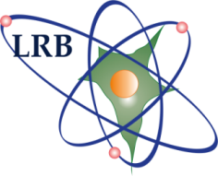

Laboratory of Radiation Biology
Joint Institute for Nuclear Research
Neurochemical alterations
in central nervous system of rodents
after exposure to different radiation modalities
Ksenia Belokopytova
Laboratory of Radiation Biology, Joint Institute for Nuclear Research, Dubna
Academy of Sciences of Moldova, Chișinău
Dubna, 2017
Notes:
Dear members of the scientific council, dear colleges. Let me present my talk, which is focused on study of neurochemical alterations in rat brains after exposure to different radiations modalities.

Slide 2
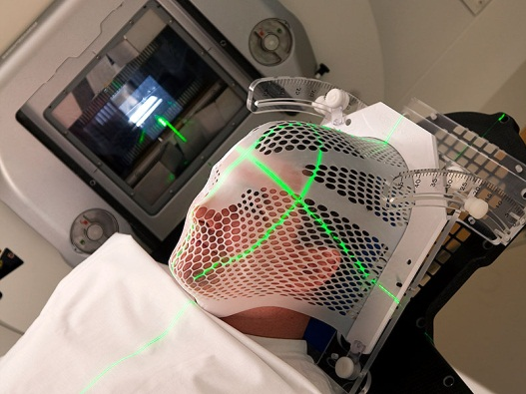
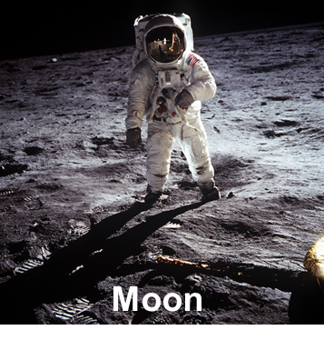
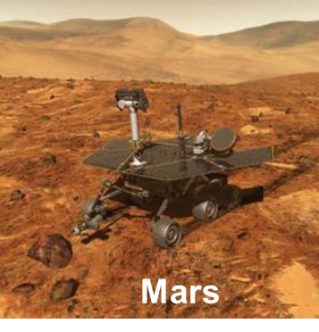
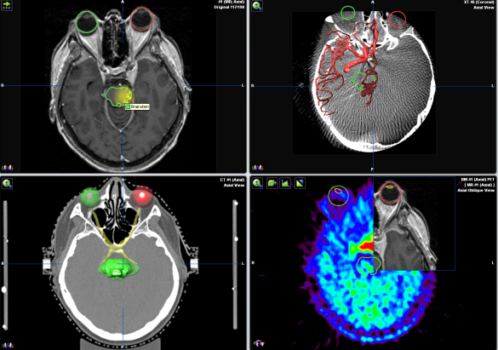
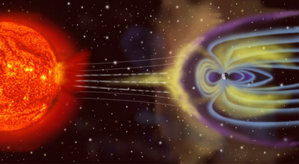
Introduction
Study of radiation damage to the central
nervous system
Cranial radiation therapy
Space
radiobiology
Notes:
This study refers to the problem of radiation damage to the CNS – central nervous system. Why this study is of great interest in present days? First of all, the problem of radiation damage to CNS is important for cranial radiotherapy, when different parts of the brain are exposed to medical beams. In this case we need to know and we need to predict possible side effects of disexposure. It means that we need to know how different brain structures react on irradiations. The second point, why this study is important is connected with the problems of so called space radiobiology when we need to predict neurophysiology effects of space radiation in astronauts.

Slide 3
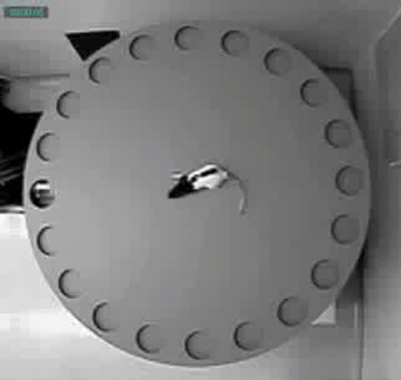
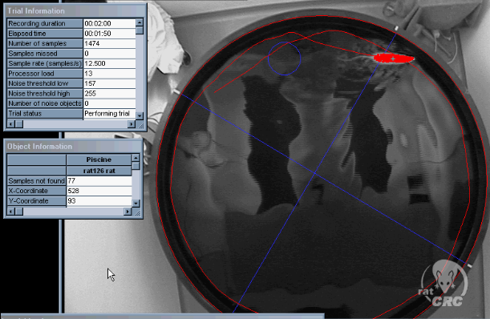
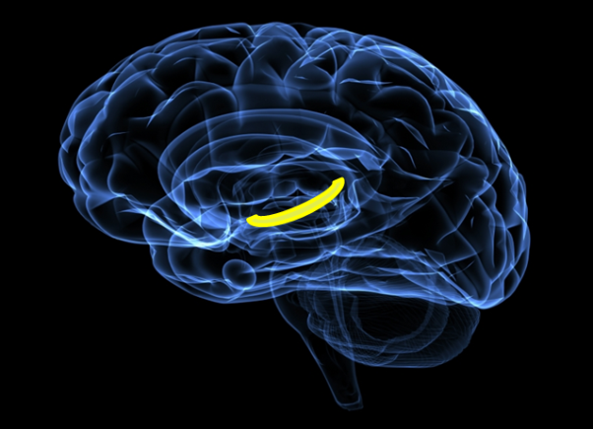
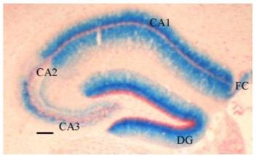
What we know about radiation damage to CNS?
Ground-based experiments with rodents have revealed
Prolonged deficit in hippocampal-dependent learning
and memory.
Impairment in the striatum-dependent operant response.
Electrophysiological alterations in the hippocampus.
Changes in the adult neurogenesis in the hippocampus.
Hippocampus
Notes:
What we know about radiation damage to CNS now: there are a number of neurological alterations that are reviled last years in ground base experiments. And this slide shows us examples of such outcomes. For instance, we know about memory and learning disabilities, locomotor damage, cognitive impairments end other. However to date the molecular mechanisms underlying these changes as well as the most relevant brain regions responsible for the observed disorder haven’t beеn clearly identified.

Slide 4
Aim
To evaluate differences in neurochemical responses of rat brains to irradiation with
170 MeV protons and 500 MeV/u carbon ions by investigating parameters of monoamine metabolism in early and late periods after exposure.
Notes:
In these regards the aim of this study was to contribute to clarified neurochemical mechanisms of radiation exposure through the evaluation of monoamine metabolism following different types of irradiation. As a testy model we use young rats to study these effects.

Slide 5
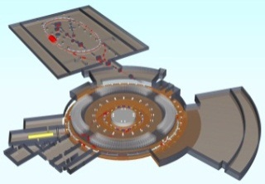
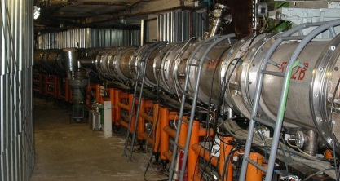
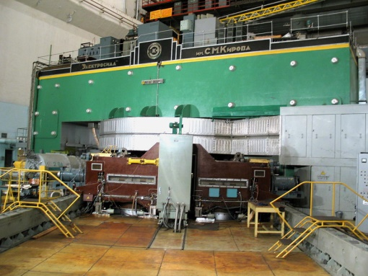
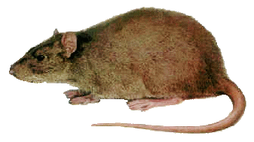
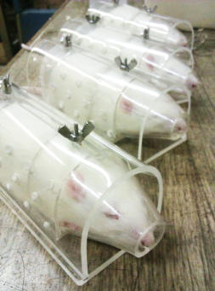
Animals and irradiation
  Different groups of Wistar and Sprague Dawley rats weighting at the average 180-200 g were whole-body exposed to ¹²C ion and proton beams
¹²C ions
Protons
Nuclotron
Veksler and Baldin Laboratory of High Energy Physics, JINR
Phasotron
Dzhelepov Laboratory of Nuclear Problems, JINR
Ion beam
Proton
beam
4x4 cm
  Particle: ¹²C
  Energy: 500 MeV/u
  Particle fluence: 10⁷ particles/cm²
  Absorbed dose: 1 Gy
  Dose rate: 0.03 Gy/min
  LET: 10.5 keV/μm
  Particle: ¹H
  Energy: 170 MeV
  Absorbed dose: 1 Gy
  Dose rate: 1 Gy/min
  LET: 0.2 keV/μm
Notes:
Next slide show us the experiment design seens we perform a comparative study of different exposures we used 2 types of radiations: first one is accelerated carbon ions produced by Nuclotron facility of Veksler-Baldin laboratory of high energy physics; second one is protons available at the Phazatron facility of Dzelepov laboratory of nuclear problems, this is a beam which is currently used for treatments of patients. We exposured all the rats to the same dose of one gray and made neurochemical tests 24 hours, 30 and 90 day after irradiation.

Slide 6
Time scale of experiment
  1-day
  analysis
  30-day
  analysis
  90-day
  analysis
  Irradiation
  24
  hours
  Day 30
  Day 90
  Day 0
2 months
Notes:
It means that the longest time gap between two tests was two months.

Slide 7
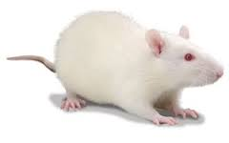
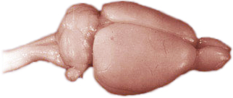
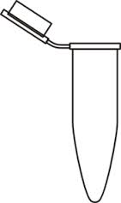
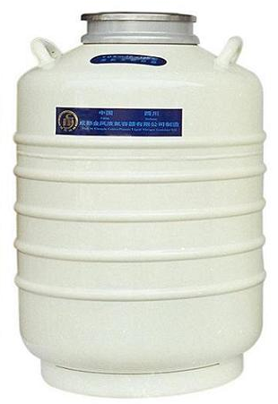
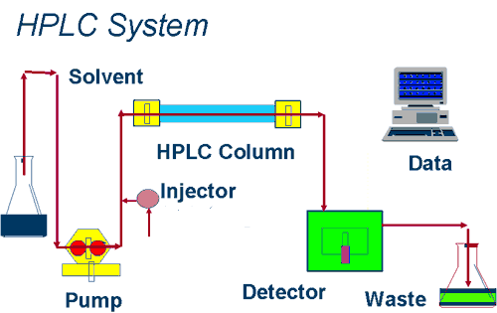
Neurochemical studies
Hippocampus
Prefrontal cortex
Striatum
Nucleus accumbens
Hypothalamus
High-power liquid chromatography (HPLC)
with electrochemical detection
Liquid nitrogen
Concentrations of monoamines and their metabolites
LC-304T chromatograph
Notes:
Here you can see as sketch that demonstrate the full procedure of neurochemical study. First we made a dissection of the brain, we extracted five brain regions namely: hippocampus, striatum, nucleus accumbens, prefrontal cortex, hypothalamus. After rapid freezing this brain structure in liquid nitrogen we used hire performants liquid chromatography to evaluate the levels of monoamines metabolism and their metabolites in the tissues of this brain structures.

Slide 8
Monoamines and their metabolites
  Noradrenaline (NA).
  Dopamine (DA) and its metabolites
      3,4-doxyphenylacetic acid (DOPAC),
      homovanillic acid (HVA),
      3-methoxytyramine (3-MT).
  Serotonin (5-HT) and its metabolite
    5-hydroxyindoleacetic acid (5-HIAA).
Alertness
Concentration
Energy
Obsession
Compulsion
Memory
Anxiety
Impulse
Irritability
Noradrenaline
Serotonin
Mood
Cognitive
function
Appetite
Aggression
Sex
Attention
Dopamine
Reward
Motivation
    Ratios characterizing the monoamine turnover:
    DOPAC/DA
    HVA/DA
    5-HIAA/5-HT
Notes:
With this technic we measured concentrations of the following substances namely: noradrenalin, serotonin, dopamine. And couple of their products of their metabolism.

Slide 9
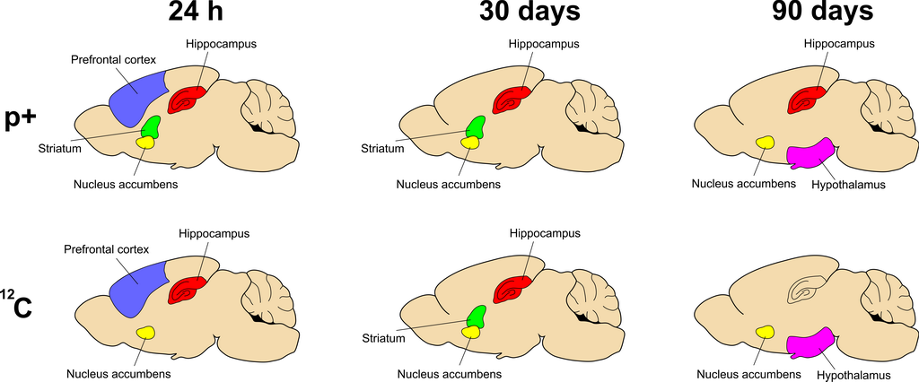
Results
The overall map of brain neurotransmitter alterations observed after exposure to 170 MeV protons and 500 MeV/u ¹²C particles at the dose of 1 Gy. Each particular figure depicts the brain regions where statistically significant changes were observed.
Notes:
Now, let me show the most important results of this study. First of all, what we did, we obtained and overall map of neurochemical alterations in rodent brains following proton and carbon ion exposures.
It means that we identified the most sensitive brain regions which show changes in monoamine metabolism.
So, 24 hours after exposure to protons, we obtained changes in 4 brain structures including the hippocampus, striatum, nucleus accumbens, prefrontal cortex. At the same time period exposure to carbon ions induced alterations in near the same brain regions excluding striatum. In the striatum we didn’t observed any significant alterations. That was the measured differents between protons and carbon ions in this period. Than 30 days after irradiation we observed that the same brain structures were affected by bought radiation modalities. 90 days, after exposure we saw very important different between proton and carbon ion exposures. We observed a pronounced change in hippocampus metabolism following proton irradiation, but not following exposure to carbon ions.
A very important remark concerning all this results. Although, in some cases we see that the some structures are affected by bought radiations, alterations in particulars metabolic indices where consequently different.
And now, I would like to illustrate the differences with couple of the slide.

Slide 10
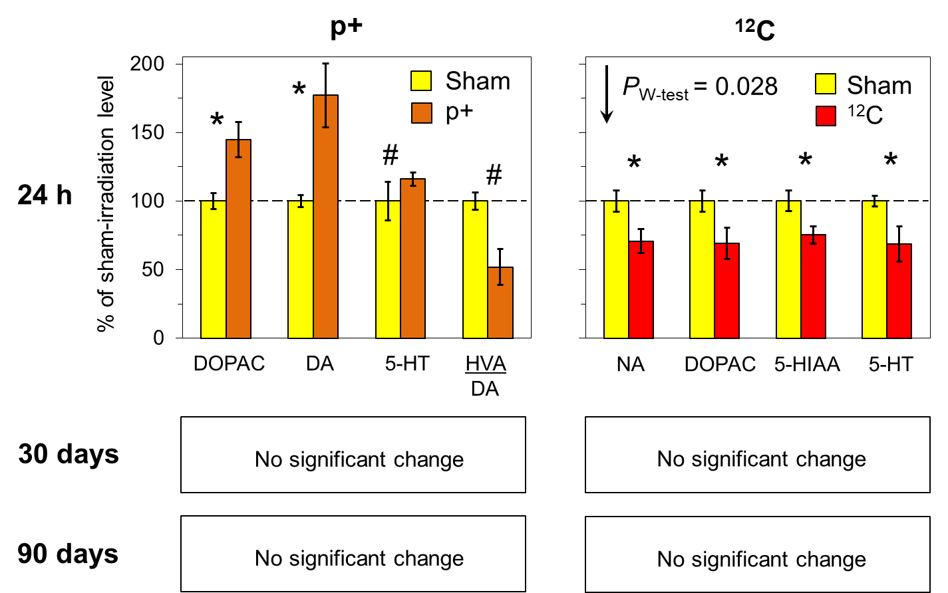
Prefrontal cortex
Effects of 170 MeV protons and 500 MeV/u ¹²C particles on the monoamine metabolism in the rat prefrontal cortex, as measured 24 h, 30 days and 90 days post-irradiation
(*) p < 0.05 and (#) p < 0.1 between the exposed and sham-irradiated rats. “P_{W-test}” indicates the statistical significance of differences between sets of neurotransmitter indices measured in irradiated and control animals (according to the Wilcoxon matched pairs test).
Notes:
In the p.c. exposure to carbon ions induced overall decrease in four indices, which are mention in this slide. At the same time, protons induced increase in several of this indices, moreover, there was a differences in particular indices modified by protons and carbon ions.
This are the measure differences between effects of protons and carbon ions in this brain structures.
Here is a couple of additional illustrations of differences between effects of protons and carbon ions.
The error bars represent the standard errors of the mean. (*) p < 0.05 and (#) p < 0.1 between the exposed and sham-irradiated rats. “PW-test” indicates the statistical significance of differences between sets of neurotransmitter indices measured in irradiated and control animals (according to the Wilcoxon matched pairs test).

Slide 11
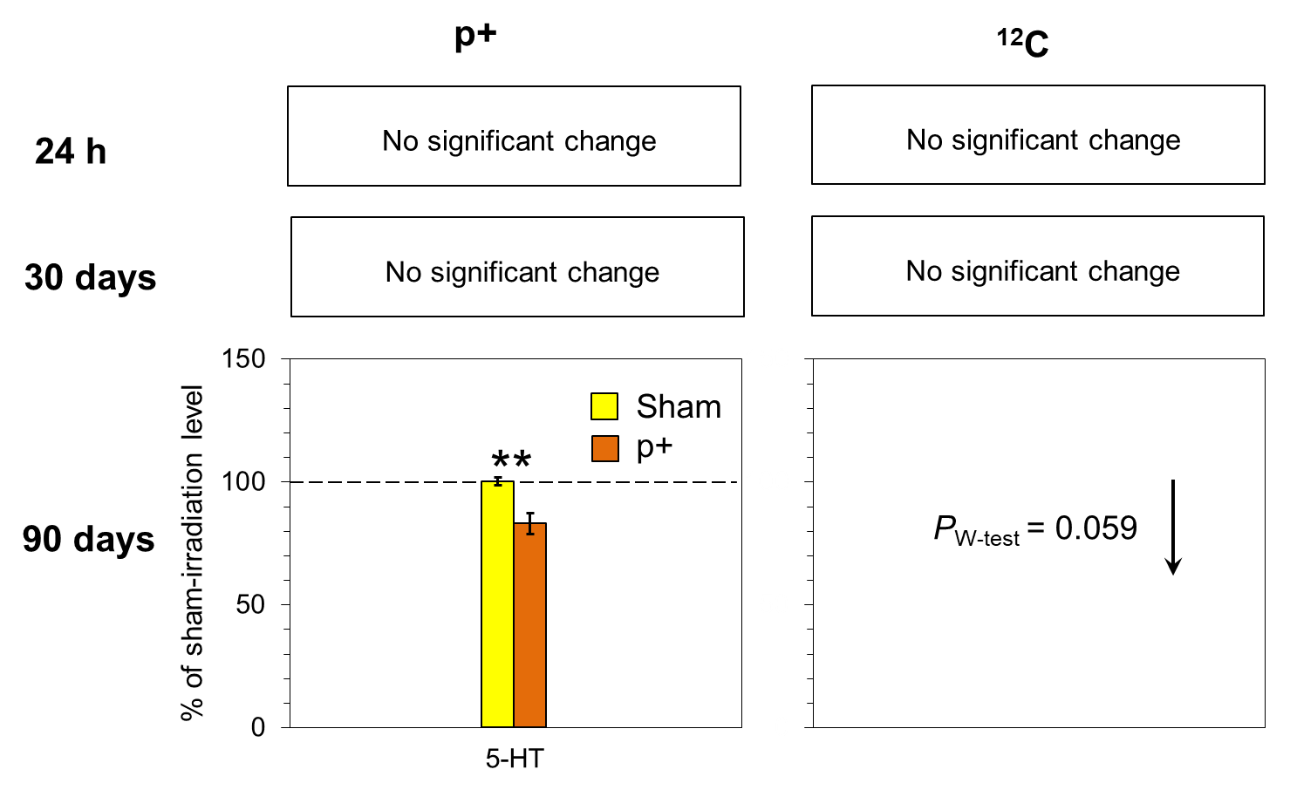
Hypothalamus
Effects of 170 MeV protons and 500 MeV/u ¹²C particles on the monoamine metabolism in the rat hypothalamus, as measured 24 h, 30 days and 90 days post-irradiation.
P_{W-test} = 0.045
DA, DOPAC,
5-HIAA, HVA,
5-HT, 5-HIAA/5-HT,
DOPAC/DA,
HVA/DA
NA
increase
decrease
(**) p < 0.01 between the exposed and sham-irradiated rats. “P_{W-test}” indicates the statistical significance of differences between sets of neurotransmitter indices measured in irradiated and control animals (according to the Wilcoxon matched pairs test).
Notes:
Very interesting results are observed in hypothalamus and hippocampus. Following exposure to protons we see just alterations in particular indices. Only in one of them. On the other hand, after exposure in carbon ions we see an overall decreased in most of the metabolic parameters.

Slide 12
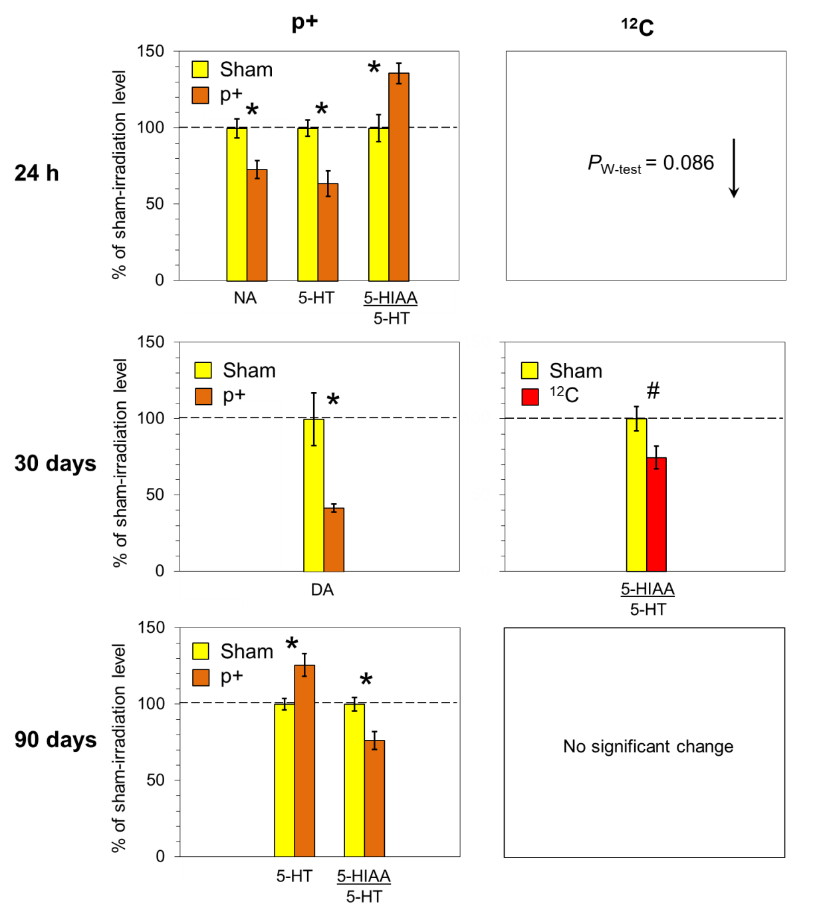
Hippocampus
P_{W-test} = 0.038
Effects of 170 MeV protons and 500 MeV/u ¹²C particles on the monoamine metabolism in the rat hippocampus, as measured 24 h, 30 days and 90 days post-irradiation
NA, DA, DOPAC,
5-HIAA, HVA, 5-HT,
5-HIAA/5-HT
DOPAC/DA,
HVA/DA
increase
decrease
(*) p < 0.05 and (#) p < 0.1 between the exposed and sham-irradiated rats. “P_{W-test}” indicates the statistical significance of differences between sets of neurotransmitter indices measured in irradiated and control animals (according to the Wilcoxon matched pairs test).
Notes:
A similar situations we in the hippocampus at list 24 hours after exposure. Protons induced only a change in 3 particular metabolic indices, however carbon ions induced in overall decreased in hippocampus monoamine metabolism. And again, for other periods of time, we see the more pronounced alterations after exposure to protons compared to carbon ions. That was again an important differences between the effects of this to radiation modalities.

Slide 13
Conclusions
In summary, the reported findings suggest that there is a difference between neurotransmitter metabolism alterations induced by protons and ¹²C ions.
It is shown that in most of the brain structures, proton irradiation impairs only particular metabolic indices while exposure to ¹²C ions leads to an overall change in the monoamine metabolism process.
It is suggested that proton irradiation induces permanent impairment of brain functions starting from mid-term periods of about 30 days, unlike exposure to ¹²C ions leads presumably to late effects firstly detected at 90 days postirradiation.
The presence of neurochemical alterations after proton irradiation and absence of them following the exposure to ¹²C particles is likely caused by hyper-activation of feedback mechanisms by heavy ions, that blur metabolic deviations.

Slide 14
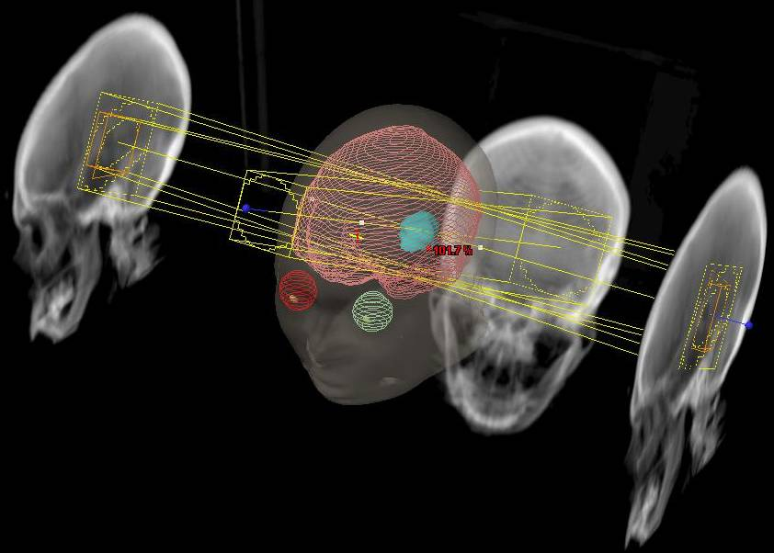
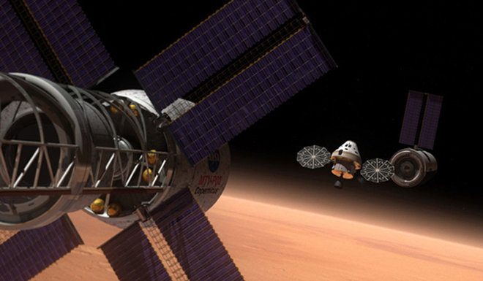
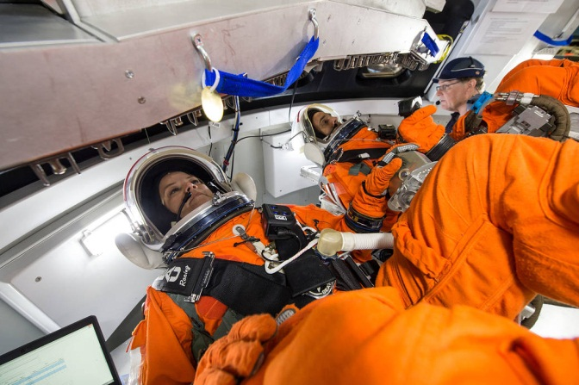
Conclusions
The reported observations are of importance for prediction of possible side effects of the brain radiotherapy where the data on reaction of a particular brain structure under irradiation should constantly be taken into account.
In the deep-space travel, different flight phases imply exposure of a crew to different radiation modalities.
Considering the reported data, this fact may additionally contribute to the variability of the astronauts’ CNS state together with other stressing space-travel factors.

Slide 15
Publications
K.V. Belokopytova, O.V. Belov, V.N. Gaevsky, et al. Neuromediator Exchange Dynamics in Rats at Late Periods after Exposure to ⁶⁰Co γ-Rays // Medical Radiology and Radiation Safety. 2017. 2:5–12.
O. Belov, K. Belokopytova, A. Bazyan, et al. Exposure to ¹²C particles alters the normal dynamics of brain monoamine metabolism and behaviour in rats // Physica Medica. 2016. 32:1088–1094.
K.V. Belokopytova, O.V. Belov, V.S. Kudrin, et al. The Dynamics of monoamine metabolism in rat brain structures in the late period after exposure to accelerated carbon ions // Neurochemical Journal, 2016. 10(2):137–143.
K.V. Belokopytova, O.V. Belov, V.S. Kudrin, et al. The Distribution of Monoamines and Their Metabolites in the Brain Structures of Rats at Later Periods after Exposure to ¹²C Ions // Neurochemical Journal, 2015. 9(3): 214–220.
The study was supported by the RFBR grant 17-29-01005 OFI_M.

Slide 16
Thank you for your attention

