Slide 1
Programme Advisory Committee
for Condensed Matter Physics
(46th meeting, 19–20 June 2017)
Dénes Lajos Nagy
122nd Session of the JINR Scientific Council
Dubna, 18–19 September 2017

Slide 2
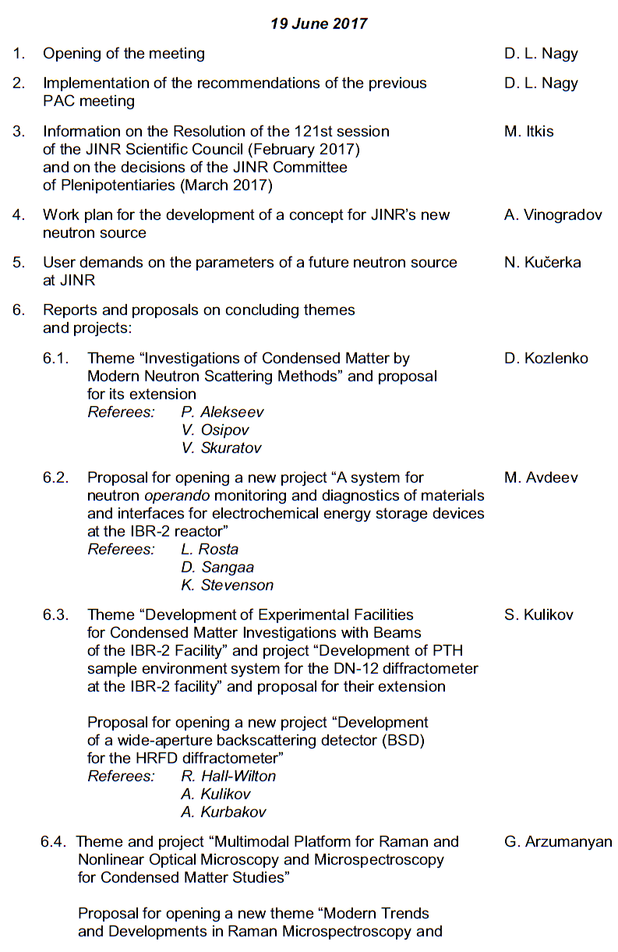
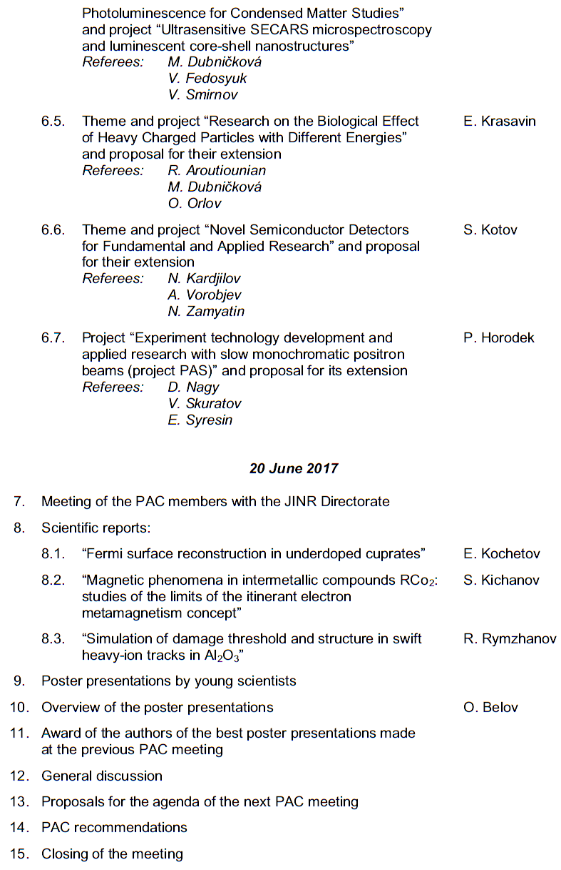
Agenda of the PAC meeting
Highlights of the 46th PAC-CMP meeting:
Plans for the preparation of a concept for JINR’s new neutron source
Reports and proposals on themes and projects
Scientific and technical achievements within concluding themes and projects

Slide 3
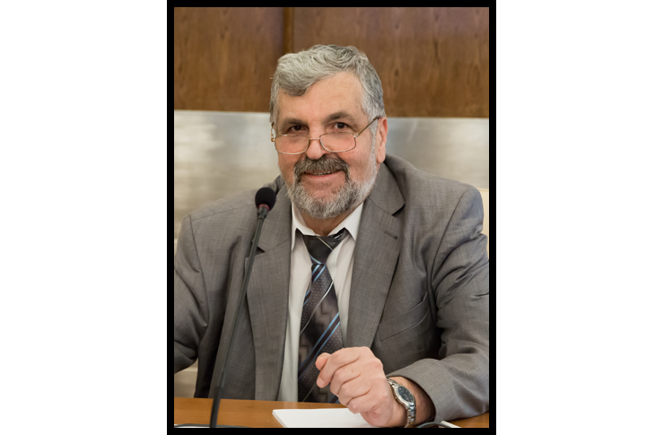
Valeriu Kantser
5 February 1955 – 2 April 2017
Outstanding Moldovan scientist ,
Full member of the Academy of Sciences of Moldova,
Chairman of the JINR Programme Advisory Committee for Condensed Matter Physics (2008–2017)

Slide 4
Work plan on the development of a new neutron source at JINR
A. Vinogradov
One of the tasks of the Seven-Year Plan for the Development of JINR for the period until 2023 is to develop a concept of creation and use of a new neutron source after reaching the end of service life of the basic technological equipment and nuclear fuel of the IBR-2 facility. The IBR-2 design service life for reactor vessel, for burn-up depth of fuel assemblies is rated up to 2042.
A substantiated concept of creation of a new neutron source should be presented for consideration to the scientific community and governing bodies of the Institute. If approved and supported, the work on the creation of a highly competitive world-class neutron source for the period until 2037 may become a top-priority project within the framework of the JINR long-term strategic development program.

Slide 5
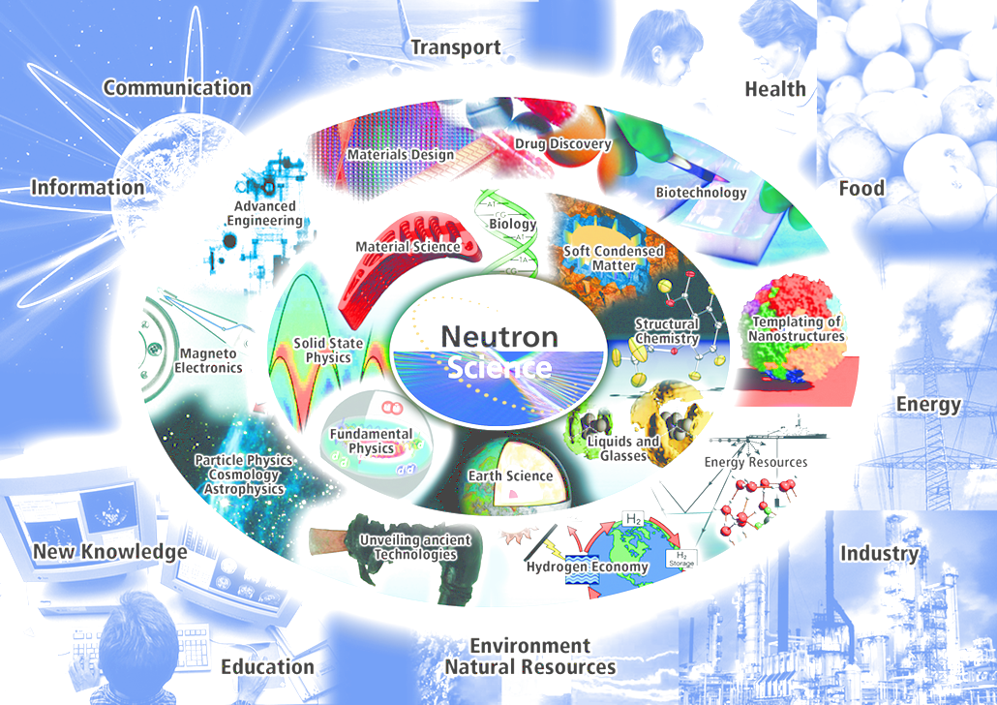
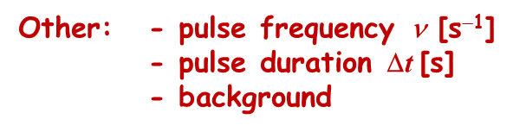


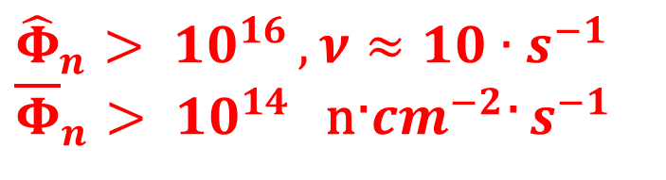



The main parameter among users demands
is neutron flux density
Soft Matter
Life Matter
Soft Matter
Nucleus
New Physics

Slide 6
Within the program of the concept of a new source development in FLNP calculations of various models have been executed. In particular, extreme parameters of a source on the basis of fission reaction: PROTON ACCELERATOR & MULTIPLYING TARGET ⃰ , are received. Results are shown on the next slide.
Reference characteristics of the accelerator: E_{p} ≈ 0.6 ÷ 1 GeV mean proton current I ≈ 0.1 mA proton pulse duration Δ t 10 ÷ 100 μs pulse frequency ѵ = 10 s ⁻¹ (30 s ⁻¹ for Np booster ⃰ ⃰ ) | Target: with different nuclear materials use: Pu, Np cascade composition… with reactivity modulation, so called, super-booster mode W ≥ 10 MW
⃰⃰ Aksenov V.L. (2017) JINR E3-2017-12
⃰⃰⃰⃰⃰⃰ ⃰Aksenov V.L., Ananiev V.D., Komyshev G.G., Rogov A.D., Shabalin E.P. (2016) JINR P3-2016-90

Slide 7
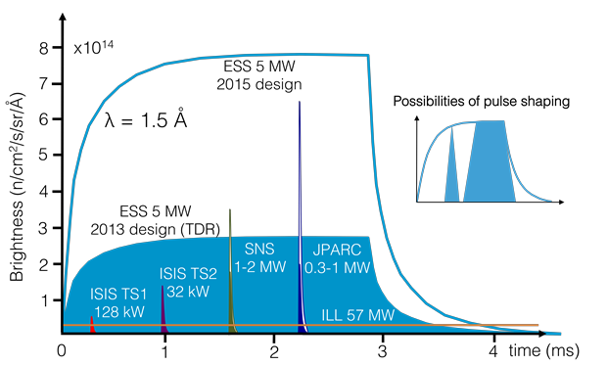

Dubna Neutron Source of fourth generation
(DNS-IV) vs. other sources
130
DNS-IV
25 MW (for Pu super-booster)
Brightness,
peak × 10¹⁴
Flux
density,
time aver.
Flux
density,
peak
IBR-2 9 0.1 58
10 MEu
ESS 8 2 75
2000 MEu
PIK 2 10 10
200 MEu
DNS-IV 130 3 800
100÷900 MEu
Single-pulse source brightness as a function of time at wavelenght of 1.5 A at ESS, ILL, SNS, J-PARC and ISIS Target Stations 1 and 2.
In each case, the thermal moderator with the highest peak brightness shown. (Source: ESS)
Aksenov V.L., Ananiev V.D., Komyshev G.G., Rogov A.D., Shabalin E.P. (2016) JINR P3-2016-90

Slide 8
The PAC notes the growing need for neutrons in modern sciences due to the unique properties of neutron when interacting with matter.
At the same time, the number of neutron sources constantly decreases worldwide since obsolete reactors are being shut down.
In this regard, the PAC considers starting the strategic planning of a possible project for JINR’s new neutron source replacing IBR-2 after reactor shut-down to be an important task and takes note of the presented plan for its implementation.

Slide 9
User demands on the parameters
of a future neutron source at JINR
N. Kučerka
Neutron Users
The European user community is the largest and most diverse in the world by far, numbering over 6000 scientists and engineers from academia, national and international research laboratories and institutes, as well as from industry, all of whom use neutrons as an essential tool in an increasingly wide range of research fields. ESFRI Scripta Volume I, Neutron Landscape Group, June 2016

Slide 10
User demands on the parameters
of a future neutron source at JINR
N. Kučerka
Parameters in Focus
vs. ~10 μs
Diff.+SANS+Refl. Inelastic
flux@sample [n/cm²/s¹] >10⁸
background <5-10%
frequency 5-10 Hz
wavelengths 1-20 Å
resolution <5%
pulse width 200-400 μs
DNS-IV IBR-2 ILL NRU SNS ANSTO
~10⁷ ~10⁸ ~10⁹ ~10⁹ ~10⁸

Slide 11
User demands on the parameters
of a future neutron source at JINR
N. Kučerka
The niche of neutrons is in the studies of magnetic materials and those rich in hydrogen.
Pulsed source at JINR fits within the neutron source landscape geographically and historically.
Narrow pulse width is important for high-resolution configurations, while longer pulse is preferable for high-intensity setups.
The optimization must be done in a source-instrument complex manner.
The PAC appreciates that already in the preliminary design phase attention is being given to the needs of the scientific community regarding principal parameters of the new source.

Slide 12
Recommendations
The PAC recommends that the JINR Directorate starts the strategic planning process of a potential new neutron source at JINR after the decommissioning of the reactor.
The necessary first step of the planning process should be a comprehensive paper containing a clear science case and identifying the specific added value of the future JINR neutron source within the global and the European neutron source landscape as well as the realistic user needs.
The PAC offers its involved contribution to preparing this document.
A prerequisite to a new neutron source is the continued successful operation of the IBR-2 User Programme and enhancement of its performance through instrumentation upgrades.
Common issue: The PAC acknowledges the high level of the implementation of the IBR-2 User Programme which has made this basic JINR facility one of the world's leading open-access neutron sources.

Slide 13
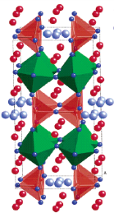
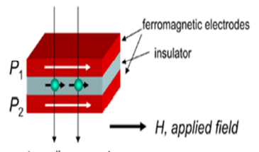
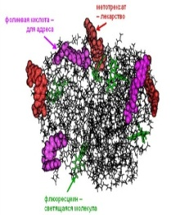
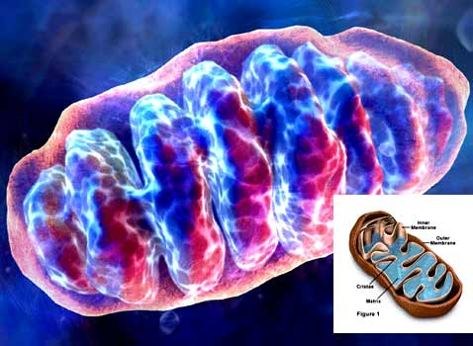
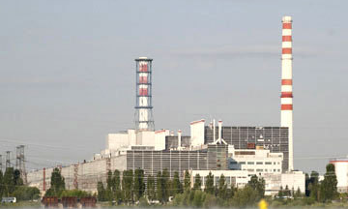
Recommendations on themes and projects
Investigations of Condensed Matter by Modern Neutron Scattering Methods
D. Kozlenko
The priority directions of scientific research :
Physics and Chemistry of Novel Functional Materials;
Physics of Nanosystems and Nanoscale Phenomena;
Physics and Chemistry of Complex Liquids and Polymers;
Molecular Biology and Pharmacology;
Materials and Engineering Sciences.
Notes:
A very good poin of this activity

Slide 14
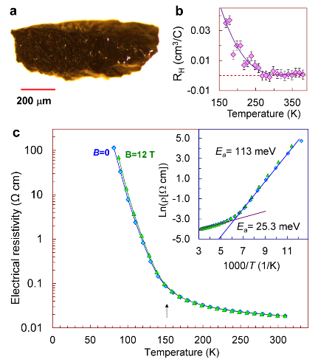
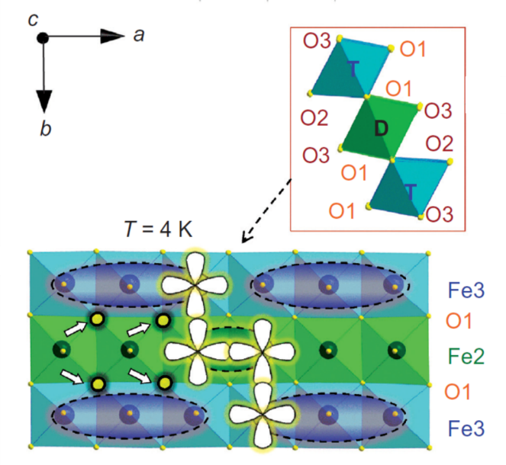
Investigations of Condensed Matter by Modern Neutron Scattering Methods
Novel type of the charge ordering state in iron oxide Fe₄O₅ involving competing dimer and trimer formation
Previously known: Fe₃O₄, Fe₂O₃, FeO
A new one: Fe₄O₅
Formation mechanism of the dimeric and trimeric states
Crystal structure of Fe₄O₅ (a), neutron diffraction patterns, measured at different temperatures and processed by the Rietveld method (b), magnetic structures at Т = 150 К (c), and Т = 10 К (d).
S.V.Ovsyannikov,.., D.P.Kozlenko, et al., Nature Chemistry (2016)

Slide 15
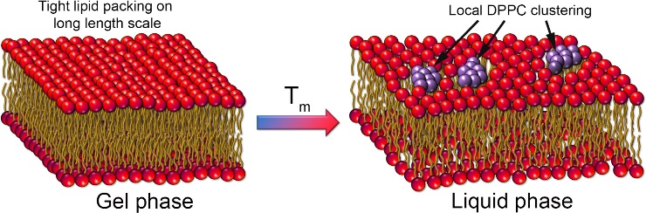
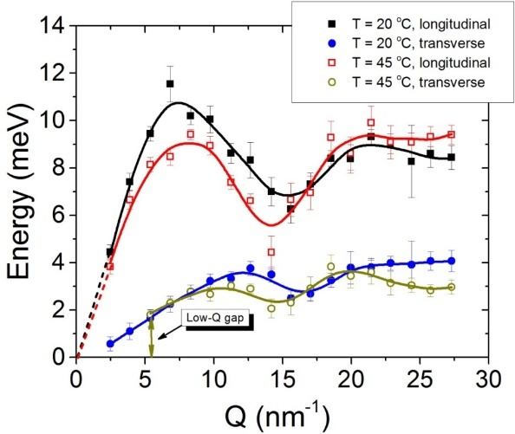
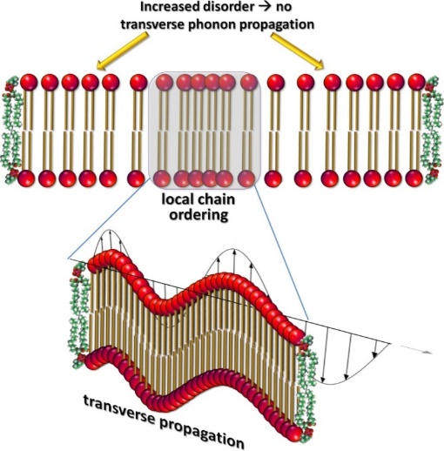
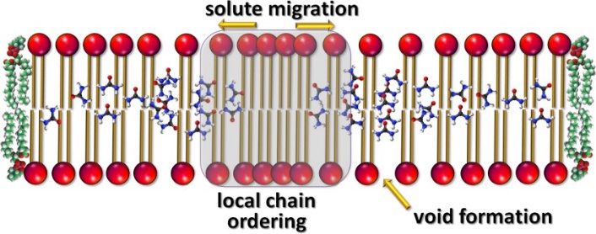
Investigations of Condensed Matter by Modern Neutron Scattering Methods
The Mechanism of Passive Transport in Lipid Bilayers
Low-Q phononic gap
No phonon propagation
at Q < Q_{gap}
Phonon-mediated nm-scale clustering
Characteristic length-scale
d_{gap} = 2π/Q_{gap} of a local “order”
(no phonons at smaller Q → more disorder on long scale! )
NO phononic gap
Low-Q phononic gap
The cut-off value Q_{gap}
(at which gap occurs)
Q_{gap}
We observe:
nm-scaled short-lived molecular clusters → local chain ordering, or density fluctuations
Increased disorder beyond the cluster size → indication of the transient voids formation
Size and the life time of the clusters agrees well with the theory prediction
the cluster size d_{gap} = 2π/Q_{gap} is ~ 1.1-1.6 nm
Lifetime: ~1 ps (agrees well with common
assumptions – a few ps)
M.Zhernenkov, .., D.Soloviov, et al. Nat. Commun. (2016)

Slide 16
Investigations of Condensed Matter by Modern Neutron Scattering Methods
The PAC appreciates the high quality of the obtained scientific results, the significant progress achieved in the development of the IBR-2 spectrometer complex, and the broad cooperation with Member States in the realization of the theme. Implementation of the User Programme was also a very important activity of the theme.
Recommendation. The PAC recommends extension of the theme “Investigations of Condensed Matter by Modern Neutron Scattering Methods” until the end of 2020. The PAC reiterates the importance of the continuous upgrade of the IBR-2 spectrometers and their experimental environment that will lead to considerably increasing their performance.

Slide 17
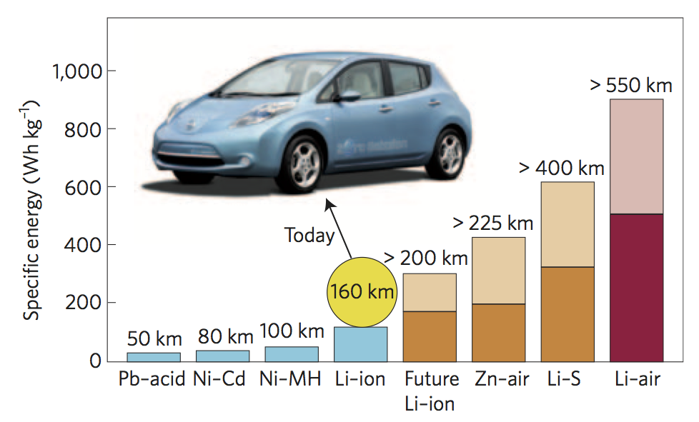
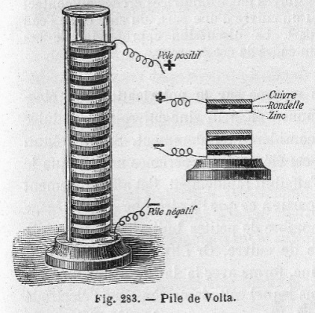
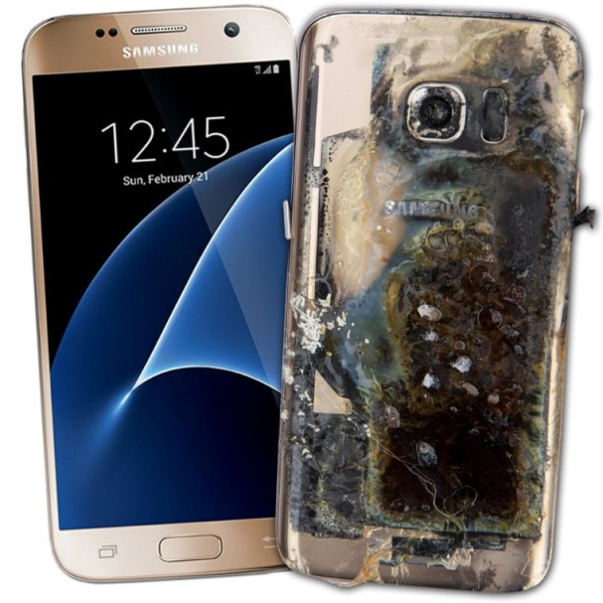
New project “A system for neutron operando monitoring and diagnostics of materials and interfaces for electrochemical energy storage devices at the IBR-2 reactor”
M. Avdeev
Electrochemical energy storage devices: current challenge
Volta’s pile, 1800
Oct. 14, 2016
1900
2000
???
Project objectives:
Development of common approaches to the effective use of neutron scattering methods in the analysis of the structural evolution of various types of electrodes and interfaces for electrochemical energy storage devices during operation (operando mode).
Design and development of specialized electrochemical cells and sample environment systems for operando research in neutron scattering experiments.
Samsung Galaxy Note 7 banned on all U.S. flights due to fire hazard!

Slide 18

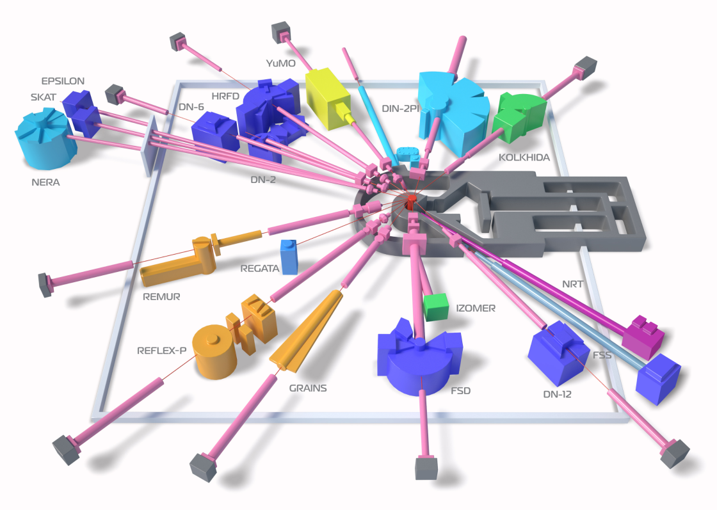
New project “A system for neutron operando monitoring and diagnostics of materials and interfaces for electrochemical energy storage devices at the IBR-2 reactor”
M. Avdeev
Involved methods and instruments
HRFD, RTD (ND)
YuMO (SANS)
IBR-2 pulsed reactor, FLNP JINR
Neutron Diffraction (ND):
HRFD, RTD
Neutron Reflectometry (NR):
GRAINS
Small-Angle Neutron Scattering (SANS):
YuMO
GRAINS (NR)

Slide 19
New project “A system for neutron operando monitoring and diagnostics of materials and interfaces for electrochemical energy storage devices at the IBR-2 reactor”
M. Avdeev
Recommendations
The PAC supports the opening of the project “A system for neutron operando monitoring and diagnostics of materials and interfaces for electrochemical energy storage devices at the IBR-2 reactor” for the period 2018–2020 and encourages cooperation with manufacturers.
Furthermore, the PAC endorses the implementation of additional sample environment facilities at the IBR-2 reactor.

Slide 20
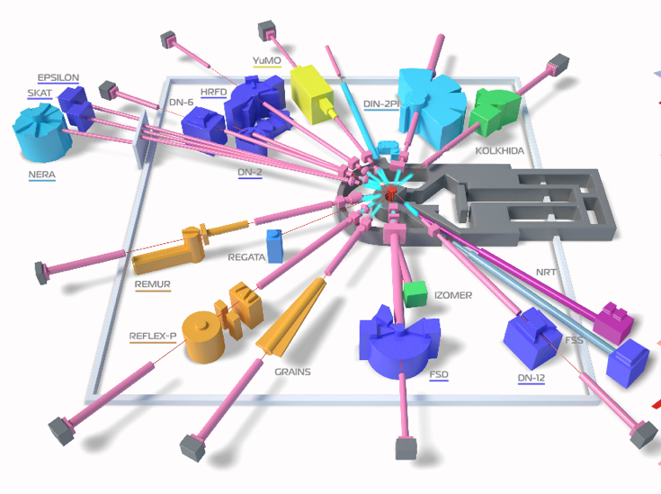
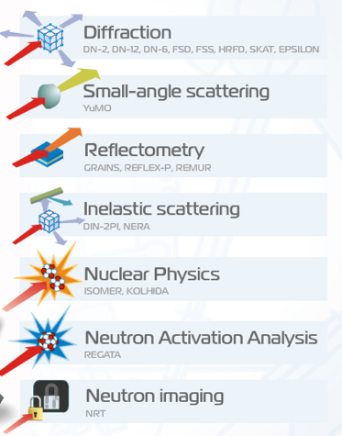
Concluding theme “Development of Experimental Facilities for Condensed Matter Investigations with Beams of the IBR-2 Facility” and project “Development of PTH sample environment system for the DN-12 diffractometer at the IBR-2 facility”
S. Kulikov
Complex of moderators of the IBR-2 reactor
(cold moderators and ambient temperature water moderators)
Cold
Cold
Cold
Cold+
Therm
Therm
Cold
Cold
Cold
Cold
Cold
Therm

Slide 21
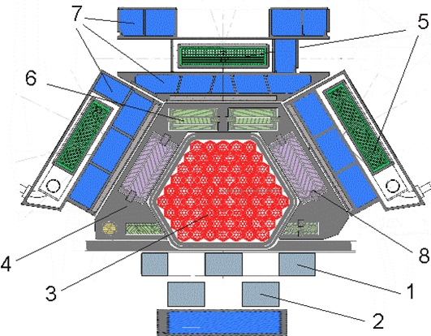
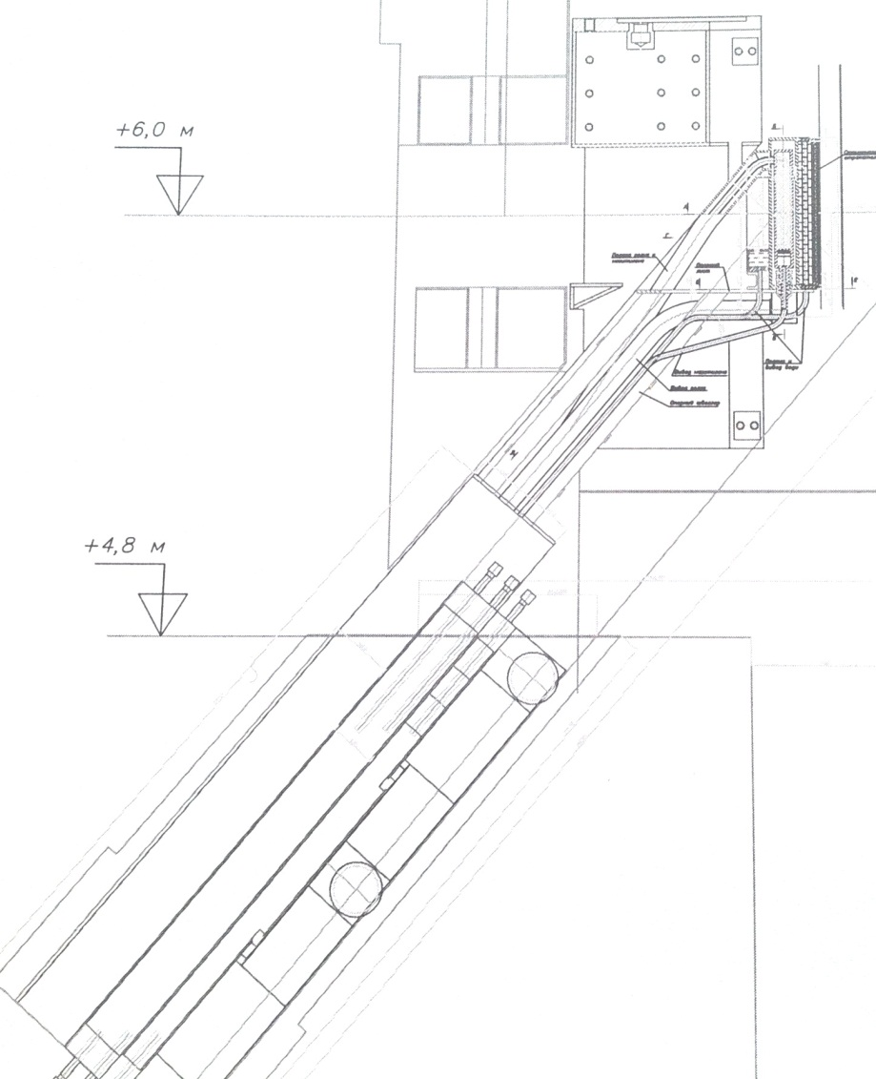
Concluding theme “Development of Experimental Facilities for Condensed Matter Investigations with Beams of the IBR-2 Facility” and project “Development of PTH sample environment system for the DN-12 diffractometer at the IBR-2 facility”
S. Kulikov
Cold moderator for beams 1, 4, 5, 6, 9
(6 instruments)
To lift beads on ~4 m height with inclination angle of 50 degrees

Slide 22
The PAC notes that all the work planned within the framework of the theme has been performed and highly appreciates the results obtained.
At the same time, the report points out that during the pre-commissioning period and tests of the magnet developed under the PTH project, a discrepancy between the technical characteristics of the high-temperature superconducting tape and the characteristics specified in the Manufacturer's Certificate has been revealed, which has not made it possible to achieve the design parameters of the magnet.
At present, negotiations are being held with the supplier to replace the tape.
In this regard, it seems reasonable to extend this project together with the theme in order to resolve the situation with the supplier and to complete the project.
Recommendation. The PAC recommends extension of the theme and project until the end of 2020.

Slide 23
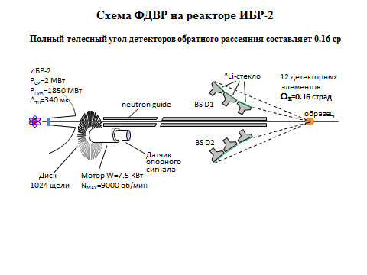
New project “Development of a wide-aperture backscattering detector (BSD) for the HRFD diffractometer”
S. Kulikov
Diffractometer HRFD
Layout of HRFD at the IBR-2 reactor
Disadvantages of the current backscattering detector:
current solid angle of detector ~0.16 sr;
a high sensitivity to γ-background (⁶Li glasses).
As a result the diffraction spectrum obtained with the TOF diffractometer POWGEN3 (SNS/ORNL, Δd/d ≈ 0.001) due to a large-area ZnS(Ag)-based detector (solid angle 1.5 sr) will have a low background and ~10 times better statistics than the spectrum from the same sample measured using HRFD.

Slide 24
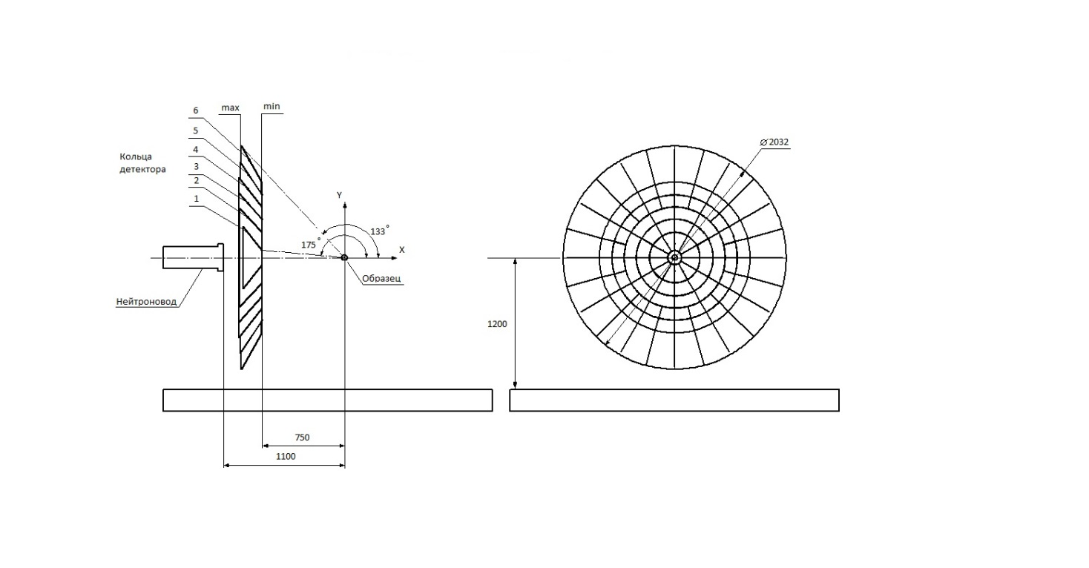
New project “Development of a wide-aperture backscattering detector (BSD) for the HRFD diffractometer”
Wide-aperture backscattering detector (BSD)
The new detector covers the scattering angle interval 2ϴ=(133-175)° with the corresponding total solid angle of approximately Ω_{Q}≈2.0 sr. The technological and technical solutions used at the present time in the Laboratory make it possible to almost completely eliminate event losses due to the detector design for this solid angle. Thus, as compared to the existing detector at HRFD, the solid angle will increase by a factor of ~12.5.
To ensure high and ultra-high resolution, the detector is designed on the basis of a thin 0.42-mm-thick ZnS(Ag)/⁶LiF scintillation screen. The collection and transmission of light from scintillation screens to photomultipliers are done using optical wavelength shifting fibers.
Detector consists of 216 elements

Slide 25
New project “Development of a wide-aperture backscattering detector (BSD) for the HRFD diffractometer”
This project increases the HFRD detector solid angle coverage by more than an order of magnitude, as well as enhancing its capabilities and improves gamma/neutron discrimination.
The detector upgrade additionally has the potential to enhance in-house capacity in detector construction, and involve students in the process.
The PAC notes that this is a well-targeted and effective investment in improving the performance of instrumentation at IBR-2.
Recommendation. The PAC recommends opening this new project for 2018–2020 within the framework of the theme “Development of Experimental Facilities for Condensed Matter Investigations with Beams of the IBR-2 Facility”.

Slide 26
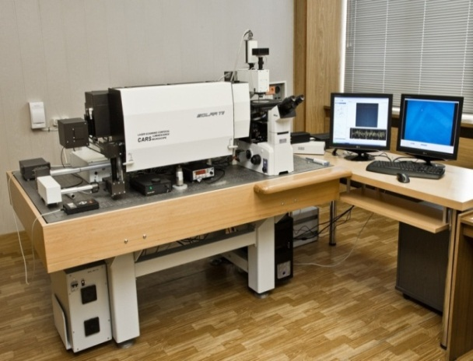
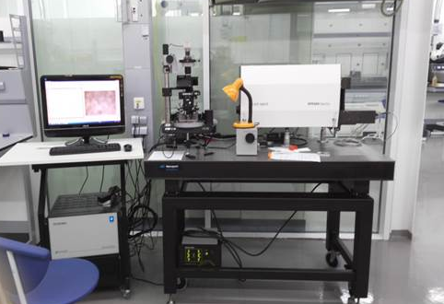
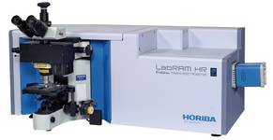
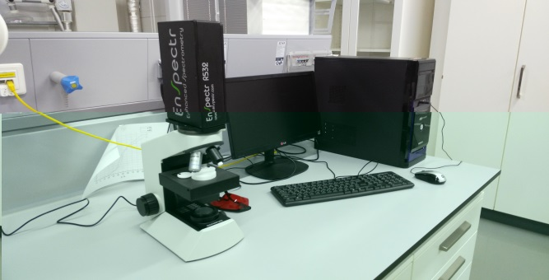
Concluding theme “Multimodal Platform for Raman and Nonlinear Optical Microscopy and Microspectroscopy for Condensed Matter Studies”
and proposals for opening a new theme
“Modern Trends and Developments in Raman Microspectroscopy and Photoluminescence for Condensed Matter Studies”
G. Arzumanyan
RAMAN SPECTROSCOPY at JINR
FLNP
JINR’s Nanocentre
“CARS” microspectrometer
Raman spectrometer coupled to AFM
LabRAM HR Evolution, Horiba
microRaman “EnSpectr”

Slide 27

Raman Spectroscopy
New major options of the upgraded platform
  Polarization-sensitive CARS microscopy (P-CARS)
  Second Order Nonlinear Imaging of Chiral Crystals (SONICC)
  Launch of SERS studies and photoluminescence (PL) along with upconversion luminescence
  Installation of two new laser sources for Raman and PL: green laser (532nm) and NIR laser (785nm) with corresponding optics at the platform
As a result of the upgrade programme, FLNP’s optical platform on the basis of the “CARS” microscope is presently the only Raman and photoluminescence multimodal facility in Russia and CIS countries by its unique characteristics and functionality.

Slide 28
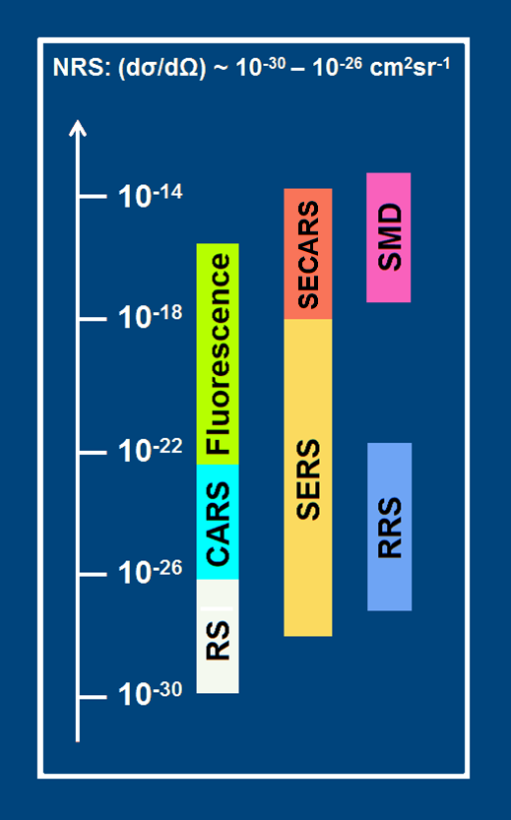
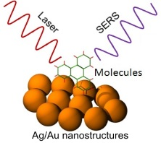

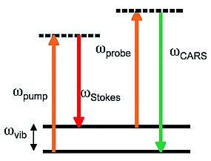
New project “Ultrasensitive SECARS microspectroscopy and luminescent core-shell nanostuctures”
Modern challenges in Raman scattering and microscopy
RS – Raman scattering (spontaneous)
CARS – coherent anti-Stokes Raman scat.
RRS – resonance Raman scattering
SERS – surface-enhanced Raman scattering
SECARS – surface-enhanced CARS
(start in 2017, to be fully implemented in 2020)
TERS – tip-enhanced Raman spectroscopy
SMD – single molecule
detection (10⁻¹⁵)
SERS
CARS

Slide 29
Raman Spectroscopy
The PAC notes the significant progress in the development of this theme both in the field of scientific research with a number of publications in high-impact journals and in the upgrade of trends in Raman spectroscopy, concretely of the SECARS microspectrometer modality based on four-waves mixing at plasmonic materials, currently operating at a world-class competitive level with respect to similar spectral analytical devices.
The PAC welcomes the proposal of theme leaders aimed at realization of Raman microscopy of single molecules as well as at studies of rare-earth element luminescence on the basis of promising core-shell nanostructures.
Recommendation. The PAC recommends opening the new theme “Modern Trends and Developments in Raman Microspectroscopy and Photoluminescence for Condensed Matter Studies” and the project “Ultrasensitive SECARS microspectroscopy and luminescent core-shell nanostuctures” for 2018–2020.

Slide 30
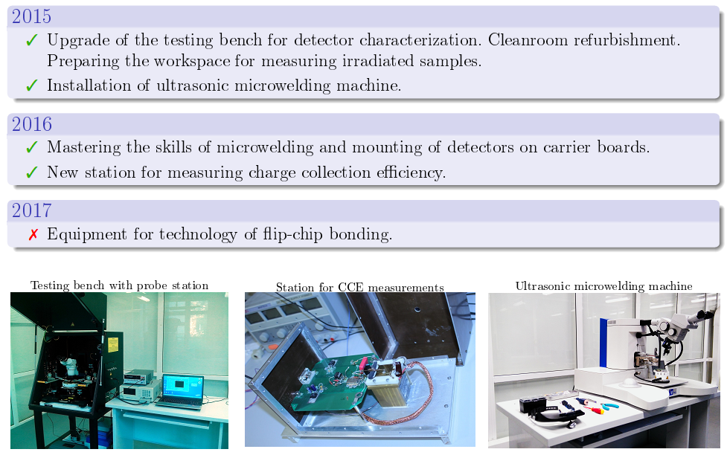
Concluding theme and project “Novel semiconductor detectors for fundamental and applied research”
S. Kotov
Project implementation

Slide 31
Concluding theme and project “Novel semiconductor detectors for fundamental and applied research”
The PAC highly appreciates the successful implementation of the project and, in particular, welcomes JINR’s membership in the Medipix collaboration.
The PAC considers the proposal for extending the theme and project for the next three years to be well motivated, based on previous achievements and aimed at the applied use of products of fundamental research. The funding request is reasonable.
Recommendation. The PAC recommends extension of the theme and project “Novel semiconductor detectors for fundamental and applied research” until the end of 2020.

Slide 32
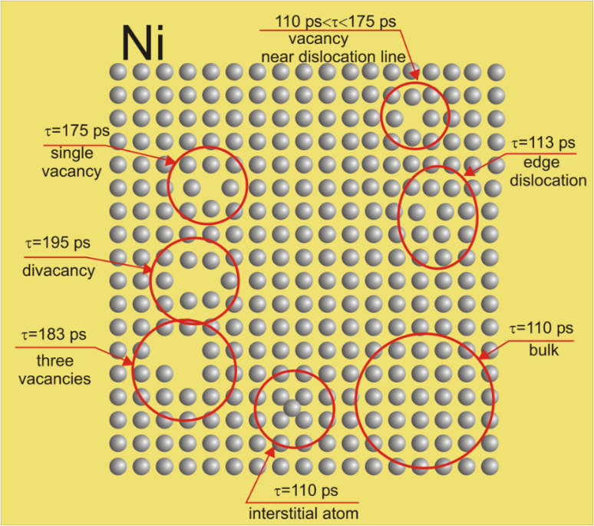
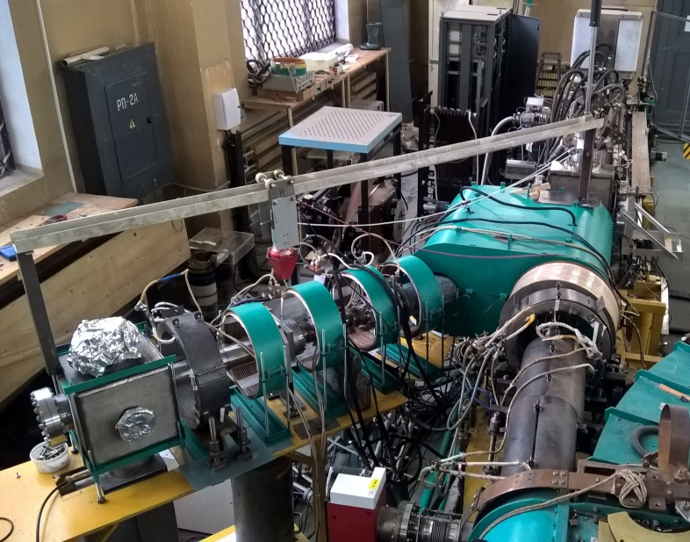
Project PAS and a proposal for its extension
P. Horodek
PAS techniques:
angular correlation of annihilation gamma quanta
Doppler spectroscopy (DB)
positron lifetime spectroscopy (LT)
Possibilities:
evaluation of defect concentration
determination of defect concentration profile
detection of the kind and size of defects
Positron lifetimes in different defects of Ni structure
Positron beam
Applications:
solid-state physics
materials and surface engineering
metals, semiconductors, thin layers

Slide 33
Project PAS and a proposal for its extension
P. Horodek
The PAC notes with satisfaction the progress in the development of the PAS method at the LEPTA facility at DLNP including construction of a specialized channel of slow monochromatic positrons (SCSMP) and the elaboration of a proposal for the formation of the ordering flux of positrons based on SCSMP which allows one to implement in the near future the positron annihilation lifetime spectroscopy.
The implementation of the programme presented in this project will bring the facility to a qualitatively new level opening new opportunities for experimental research in condensed matter physics and materials science.
Recommendation. The PAC recommends extension of the PAS project until the end of 2020 for its implementation under the theme “Novel Semiconductor Detectors for Fundamental and Applied Research”.

Slide 34
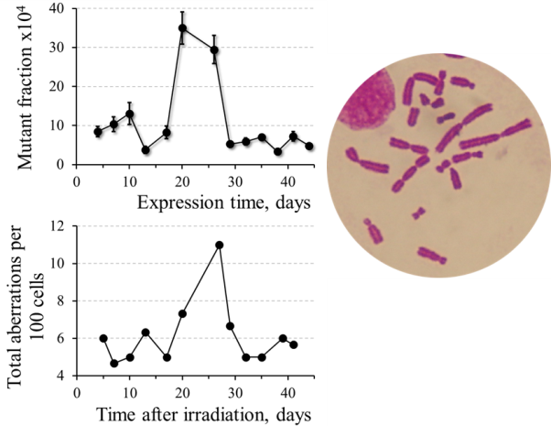
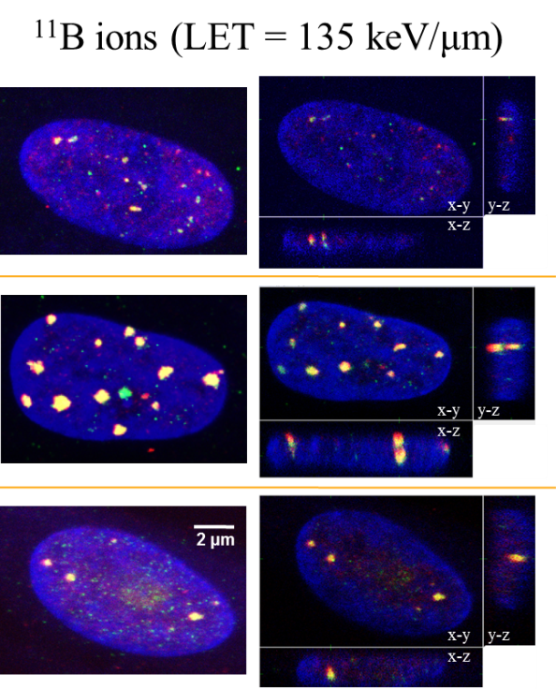
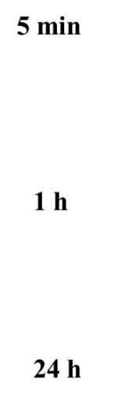
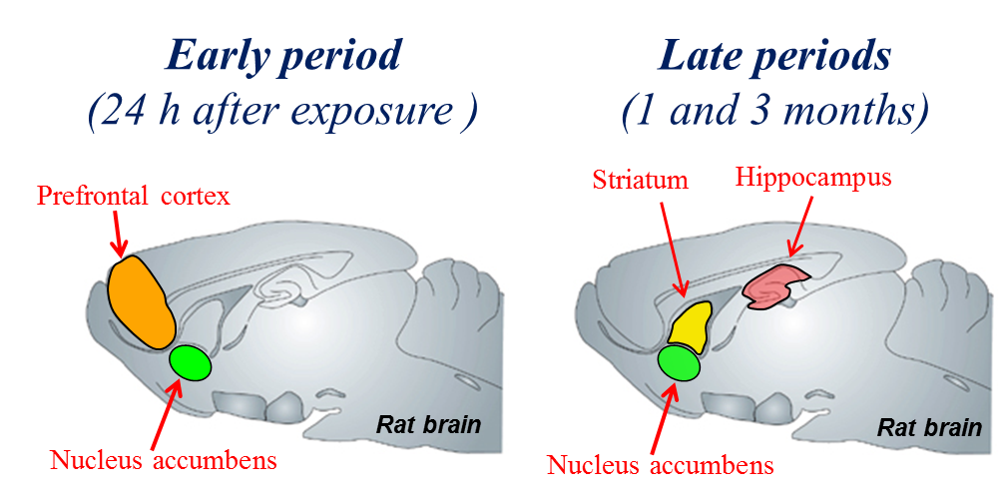
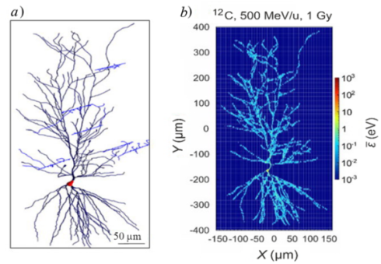

Concluding theme and project “Research on the Biological Effect of Heavy Charged Particles with Different Energies”
and of the proposal for its extension
E. Krasavin
This Theme continues the studies completed within Theme 04-9-1077-2015/2017 "Research on the Biological Effect of Heavy Charged Particles with Different Energies." Throughout this period, the main aim was to study genetic disorders in cells of different origin and to do radiation physiology research.
Main fields of research within the frameworks of the Theme 2018-2020:
- Molecular Radiobiology
- Radiation Genetics
- Radiation Physiology
- Mathematical modeling
- Radiation Research

Slide 35
Concluding the theme and project “Research on the Biological Effect of Heavy Charged Particles with Different Energies”
and of the proposal for its extension
The PAC notes that addressing the fundamental and practical problems urgently requires that the regularities and mechanisms of the heavy charged particle effects be studied in detail at the molecular, cellular, tissue and organismal levels of biological models.
The approaches developed at LRB to the problem and studies of chromosomal instability in mammalian and human cell during their responses to exposure of different types of ionizing radiation at low doses will allow clearing up the mechanisms behind these reactions and evaluating the contribution of physicochemical processes and inducible repair mechanisms to their realization.
In turn, these studies will allow the assessment of the system’s integrity violation manifesting as cognitive and behavioural disorders.
Recommendation. The PAC finds the presented proposal well-formulated and recommends extension of the theme and project “Research on the Biological Effect of Heavy Charged Particles with Different Energies” until the end of 2020.

Slide 36
Scientific reports
The PAC heard with interest the following scientific reports in condensed matter physics and related fields:
“Fermi surface reconstruction in underdoped cuprates”
E. Kochetov
“Magnetic phenomena in intermetallic compounds RCo₂: studies of the limits of the itinerant electron metamagnetism concept”
S. Kichanov
“Simulation of damage threshold and structure in swift heavy-ion tracks in Al₂O₃”
R. Rymzhanov

Slide 37
Poster presentations
The PAC was pleased with the poster presentations by young scientists in the field of radiation biology and with the summarizing report by
O. Belov.
The best poster:
“Neurochemical alterations in central nervous system of rodents after exposure to different radiation modalities” by K. Belokopytova.
The PAC also noted two other high-quality posters:
“Structure induction and repair of DNA double-strand breaks in hippocampal neurons of mice of different age after exposure to ⁶⁰Co γ-rays in vivo and in vitro” by R. Kozhina
“Microfossils in carbonaceous meteorites” by A. Ryumin.

Slide 38
Next meeting of the PAC
The next meeting of the PAC for Condensed Matter Physics will be held
on 22–23 January 2018.
Its tentative agenda will include:
information by the PAC Chairman on the report at the next session of the Scientific Council, and the implementation of the recommendations of the current PAC meeting;
information by the JINR Directorate on the sessions of the Scientific Council
(September 2017) and of the Committee of Plenipotentiaries (November 2017);
reports and recommendations on themes and projects to be completed in 2018 and status reports about ongoing themes;
discussion of the progress of the scientific case for JINR’s new neutron source including the landscape of relevant scientific facilities;
information on the new cooperation between JINR and the SOLARIS synchrotron source in Kraków (Poland);
IBR-2 scientific and technical report including the progress in the FLNP User Programme;
status reports on the upgrades of FLNP instruments and in the context of the JINR Seven-year plan;
information about scientific meetings;
scientific reports;
poster session.

Slide 39
Thank you for your attention

