Slide 1
Integrated Detector Electronics AS
(IDEAS)
2017-09-07
Dirk Meier, Research Director
Dirk.meier@ideas.no,

Slide 2
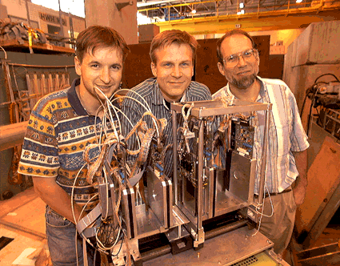
Introduction about Myself
From Left: Colleague, myself,
my Professor Harris P. Kagan (Ohio State University)
I am with IDEAS since 2002.
Year 1998,
CERN West Hall,
many experiments,
and ATLAS detector R&D
Beam
Source: CERN Bulletin 29/98; 13 July 1998
Beam Telescope with silicon strip detectors read out by IDEAS integrated circuits.

Slide 3

Integrated Detector Electronics AS (IDEAS)
IDEAS is a privately owned Norwegian company.
History
  Founded in 1992 as a spin-off from Norway’s high-energy physics activities at CERN.
Purpose
  To develop integrated circuits for image sensors
  (x-rays, gamma rays, charged particles, IR, thermal).
IDEAS products are used in commercial/industrial and scientific applications including space missions.
Resellers in China, Russia, South Korea
HQ: Gjerdrums vei 19, 0484 Oslo, Norway

Slide 4
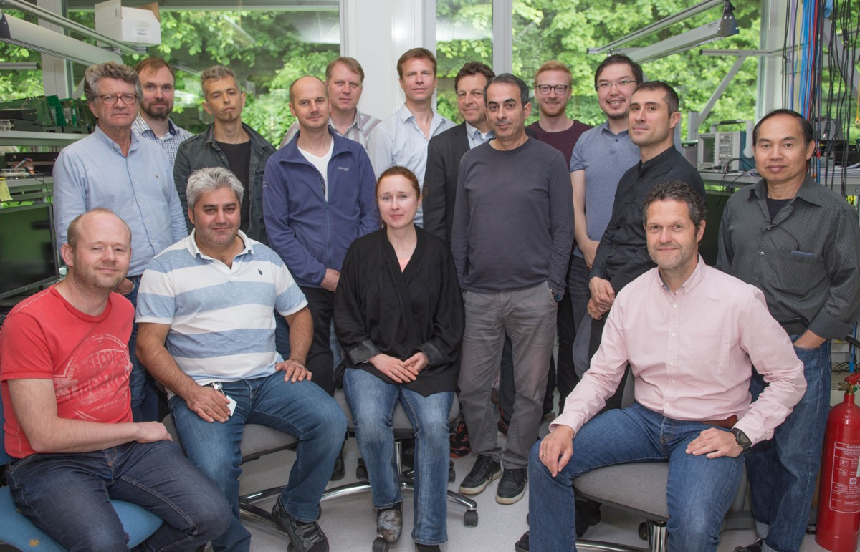
IDEAS Engineers
IDEAS engineers develop advanced integrated circuits
that enable our customers to do cutting edge science.

Slide 5
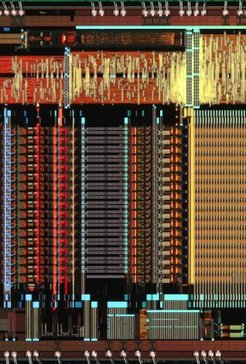
Mission
To innovate
Hybrid Image Sensor Systems
for special operations
and environments

Slide 6
IDEAS Products and Services
Camera Systems
Sensor and
Detector Modules
Readout ICs
and ASICs
Further information at http://www.ideas.no -> Products

Slide 7

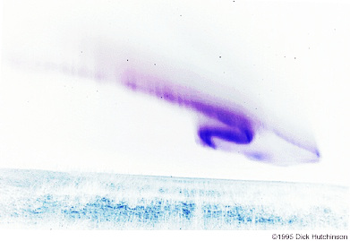
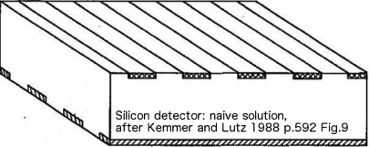
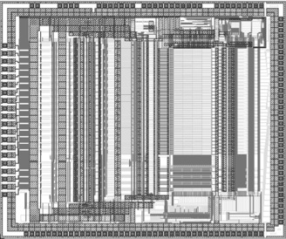
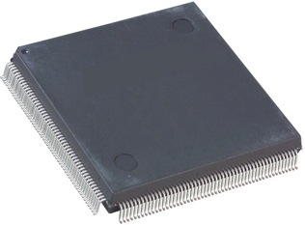

Example of Radiation Sensor
Charged particles
or x-rays or gamma rays or photons
Charges generated in radiation sensor, e.g., silicon
Electrical interconnect between sensor and readout electronics
Readout integrated circuit, ASIC
. . .
Electrical interconnect between ROIC and system
ADC, FPGA, uC

Slide 8
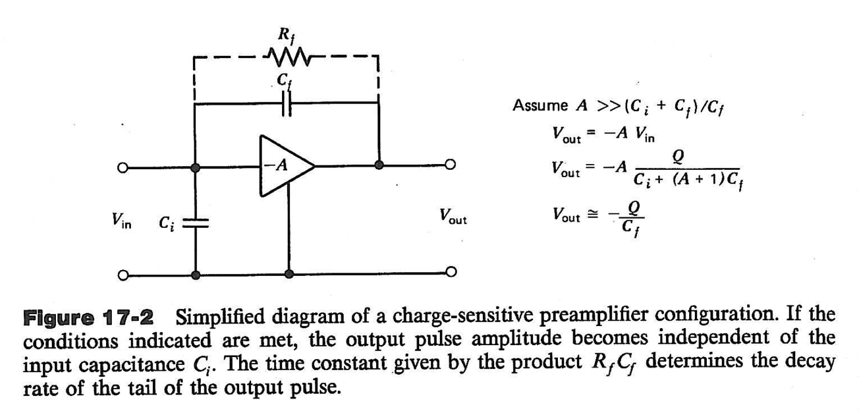
Simplified Charge Sensitive Amplifier
Q
Source: G.F. Knoll, Radiation Detection and Measurement
The detailed specifications of input stage depend on the system requirements.

Slide 9
Field of Applications and Product Categories
Environment
Hot Spot Locator
Healthcare
Nuclear Medicine
Science
Nuclear and particle physics
Security
Space
Industry
Radiation Awareness
Radiology with x-rays
Neutron facilities
Screening and portal imaging
Nuclear proliferation mitigation
Radiation Monitoring
Dosimetry in Radiotherapy
Fundamental physics
Imaging for science and Earth observation
Process and flow tomography
Food processing for safety and quality assurance

Slide 10
Readout Integrated Circuits (RO IC/ASIC)
IDEAS designs integrated circuits for the readout and control of radiation detectors and imaging arrays. The circuits have been developed for specific technologies and applications; the specifications might also meet other than the original requirements. The circuits are available as bare dice or packaged chips and can be sold from stock or can be manufactured within a short time. The sale of some circuits might be restricted (footnote 1). A development kit can be delivered for all integrated circuits. The digital object identifier (DOI, see www.doi.org) provides a link to information about the circuit and an application.
VA – Viking ASICs
VATA and CA – Triggers and Counters
IR – Infrared ASICs
Pre-amplifiers and shapers
Pre-amplifiers, shapers, comparators, counters
LNA, ADC, Micro-controller
Further information at http://ideas.no/ideas-ic-products/

Slide 11
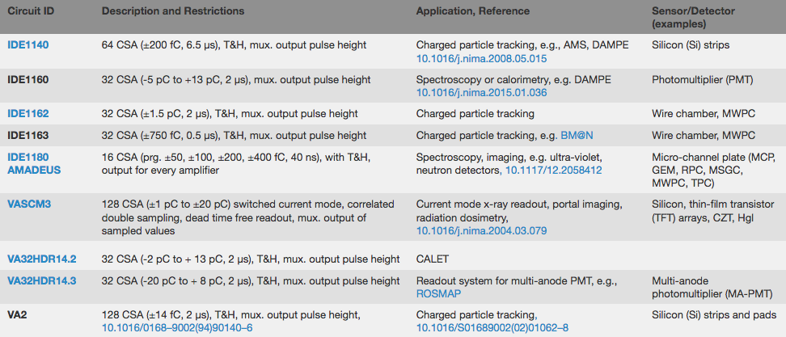
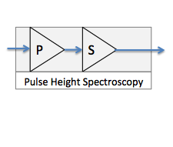
Charge Sensitive Amplifiers without Triggers
These ICs have a number of charge sensitive amplifiers (CSA) followed by track-and-hold (T&H) and multiplexed output (mux).
Source: http://ideas.no/ideas-ic-products/

Slide 12
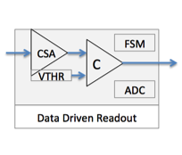
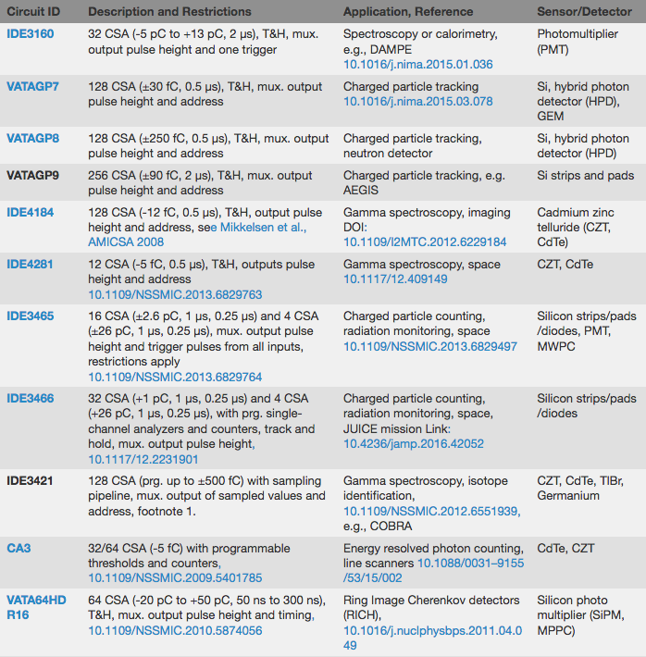
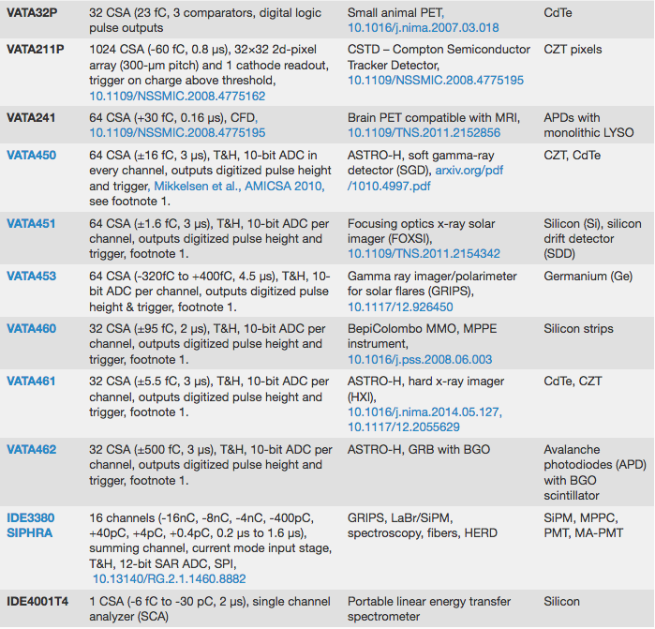
Charge Sensitive Amplifiers with Triggers
These ICs have a number of CSA followed by T&H and comparators to generate a trigger. The trigger signal can be used for timing, counting or to starting the readout of charge values.
Source: http://ideas.no/ideas-ic-products/

Slide 13
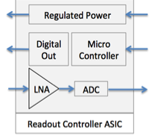
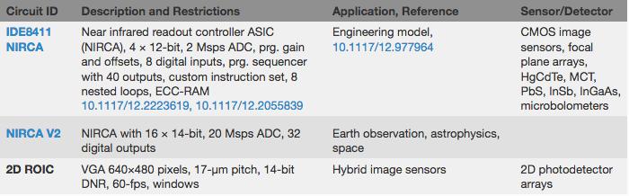
Readout and Controller Integrated Circuits for Large Area Imaging Arrays
The following ICs have been designed for the readout and control or large area imaging arrays. These circuits have a micro-controller for the control of the imaging array, and a number of low-noise voltage amplifiers and data converters (ADCs and DACs).
Source: http://ideas.no/ideas-ic-products/

Slide 14
ASIC Building Blocks (IP)
Analogue processing
Converters & Power
Digital
Full-Custom Digital
  Rad-Hard
  Triple-Redundant
  Parity Check
Rad-Hard by Design
  SEL immune
  SEU tolerant
Rad-Hard by Process
  TID tolerant
Extended Temp Range
  Cryo on Request
Charge Sensitive Amplifiers (CSA)
Analogue-to-Digital Converters (ADC)
Custom Microcontroller (μC)
Shaping Amplifiers
Pre-Amplifiers
Digital-to-Analogue Converters (DAC)
Buffer Amplifiers
Static RAM (SRAM) with EDAC
Current Conveyor
Time-to-Digital Converters (TDC)
Programmable Trigger Coincidence Logic
Fast Trigger Generators
Fast Mono-Stable Multivibrators
External Control Interfaces (SPI, etc.)
Trigger Processing
Low-Dropout Regulators (LDO)
Custom High-Speed Serial Data Links
Sampling Pipeline
Reference and Bias Generators
Data Encoders
(8b/10b etc.)

Slide 15
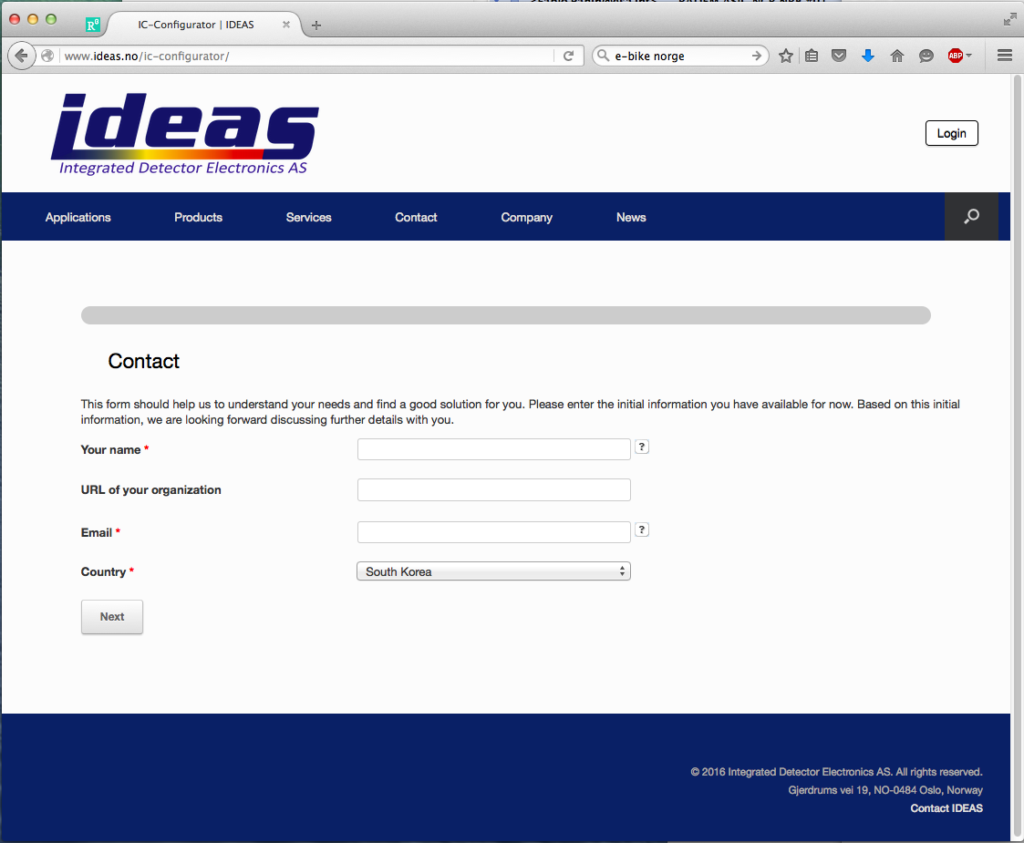
IC Configurator
http://www.ideas.no/ic-configurator/
This form helps us to understand your needs and find a good solution for you.
Please enter the information you have available; leave unknowns open.
Based on this information, we are looking forward discussing further details with you.

Slide 16
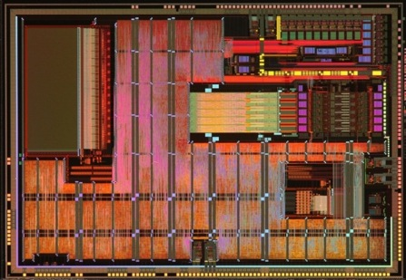
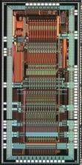
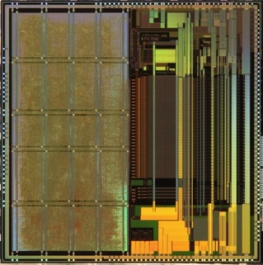
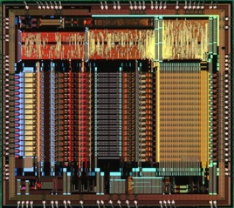
Recently Completed ASIC Design Projects
Readout and counters for space radiation sensors in RADEM instrument for ESA JUICE space mission.
Readout for CZT for gamma and x-ray spectroscopy
Cryogenic operation readout and controller system-on-chip for MCT infrared focal plane array.
SiPM photosensor readout for spectrometers

Slide 17
New ASIC Design Projects
Line | Projects 2017/2018
1 | Design of ASIC for focal plane array controller readout with many on-chip pipeline ADC (14-bit, 20Msps)
2 | Design of ASIC array of low-noise amplifiers for cryogenic readout of MCT
3 | Design of thermal image sensor readout integrated circuit (ROIC)
4 | Design of optical photo sensor readout ASIC for scientific use
 | ...in progress

Slide 18
ASIC Design and Development
Ideas
Needs, wishes
Engineering Process
ECSS-Q-ST-60-02 ASIC/FPGA development standard
Requirements
Budgets
Constraints
Solution
Review milestones
Payment milestones
Documents
Chips (samples, LAT, wafers, KGD)
OEM modules/systems

Slide 19
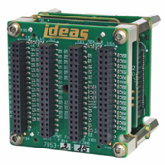
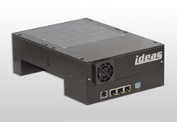
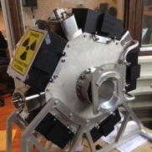
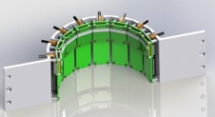
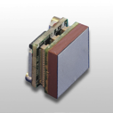
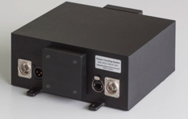

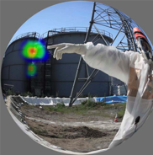
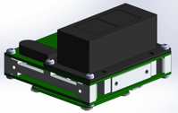
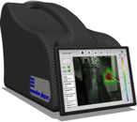
Recent IDEAS System Products using IDEAS ASICs
Sensor Modules
Camera Systems
Applications
Flow Tomography
Nuclear Safety/Decom.
Science

Slide 20
Thank You
Questions?
Technical and Business
Contact: Dirk.meier@ideas.no

Slide 21
ASIC Heritage Relevant for BM@N
Year | Deliveries | Note
1999 | VA32HDR2 | 1.2um CMOS, out-of-stock
2002 | VA32HDR12 AMS-1 and AM-2 TRD | 0.8um CMOS, out-of-stock
2009 | VA32HDR11, TA32CG2 | MONICA
2012 | Samples of VA32HDR11, VA32HDR14.2, TA32CG2
2012 | NRE process migration VA32HDR12 to IDE1162, delivery of many IDE1162 | NICA MPD
2013 | TA32CG and IDE1162 bare dice
2014 | Samples of VATAGP7.1
2015 | More samples of IDE1162 | BM@N Triple GEM
2015 | Samples of IDE1180
2016 | NRE for IDE1163, derived from IDE1162, delivery of samples IDE1163
2017 | Many chips of IDE1163 | BM@N Triple GEM
2017 | Many chips of VATAGP7.1 | BM@N central tracker double-sided Si-microstrips

Slide 22
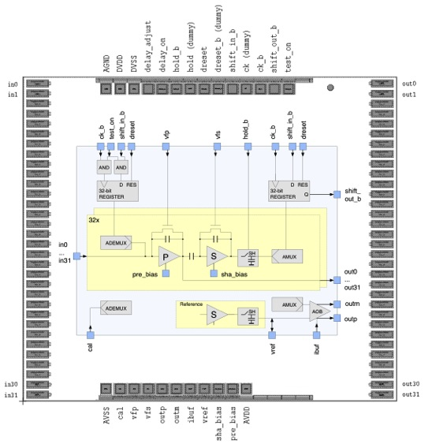
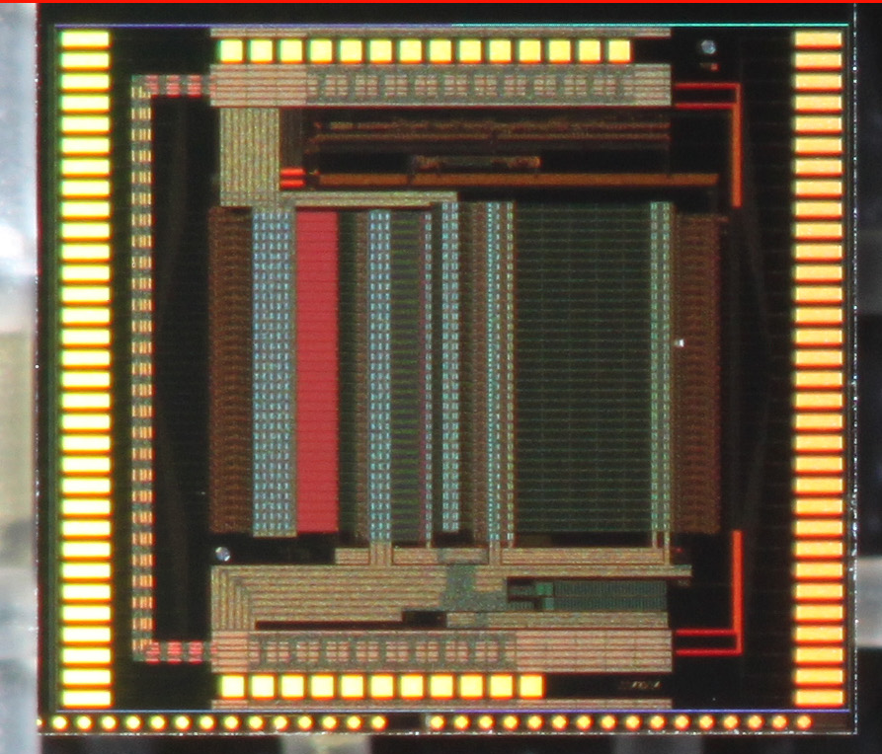
IDE1162 and IDE1163 (same footprint)
3240um x 3735um

Slide 23
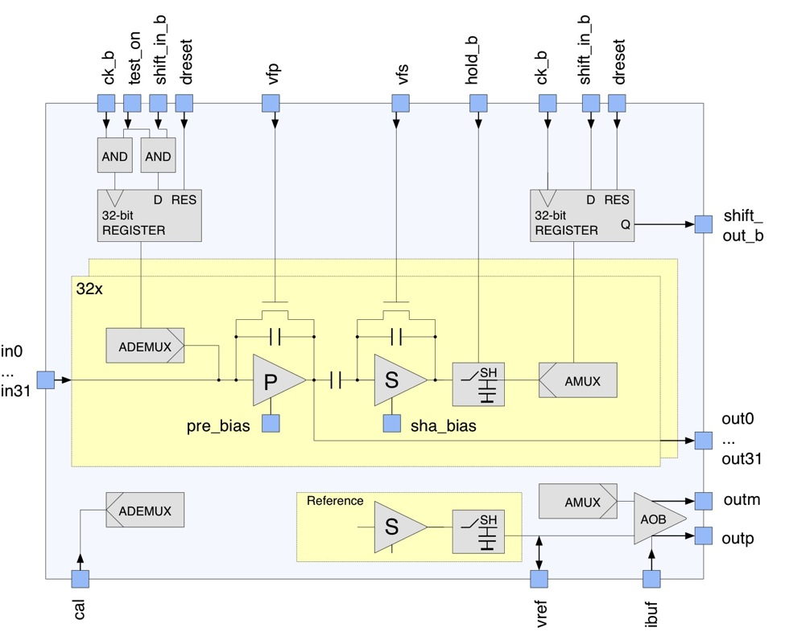
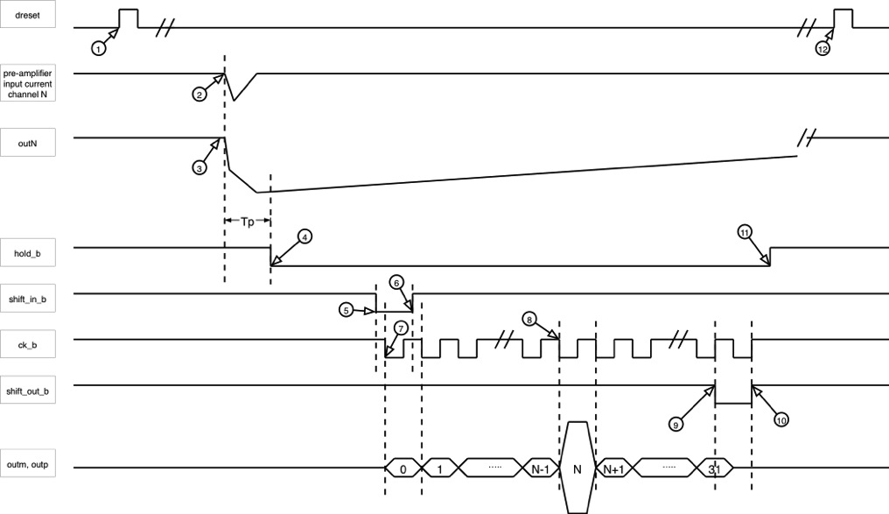
IDE1162 IDE1163 Functions and Readout

Slide 24
IDE1162/IDE1163 Comparison
Parameter | IDE1162 | IDE1163
Number of input channels | 32 | 32
Number of analog mux output | 1 | 1
Input charge range | -1500fC to +1500fC | -750fC to +750fC
Shaping time | 2us | 0.5us
ENC | 2000e at 50pF | 1797e at 120pF
Power | 66mW | 77mW

Slide 25
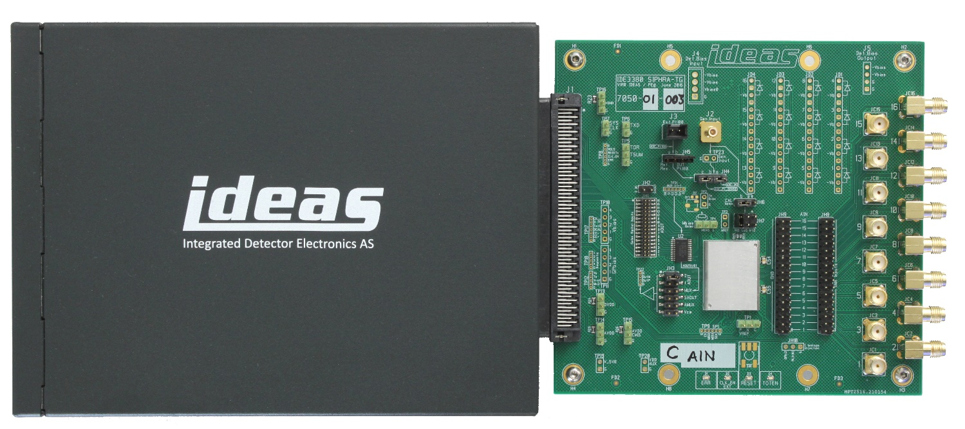
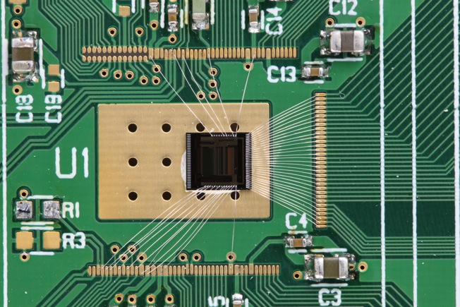
Galao ROIC Development Kit
IDE1163 wire-bonded for tests
The Galao ROIC Development Kit
Readout system made by IDEAS for accessing and working with IDEAS ROICs
Kit consisting of all the hardware and software needed for ROIC control and readout
Galao ROIC Development Kit with IDE1163 Test Card

Slide 26
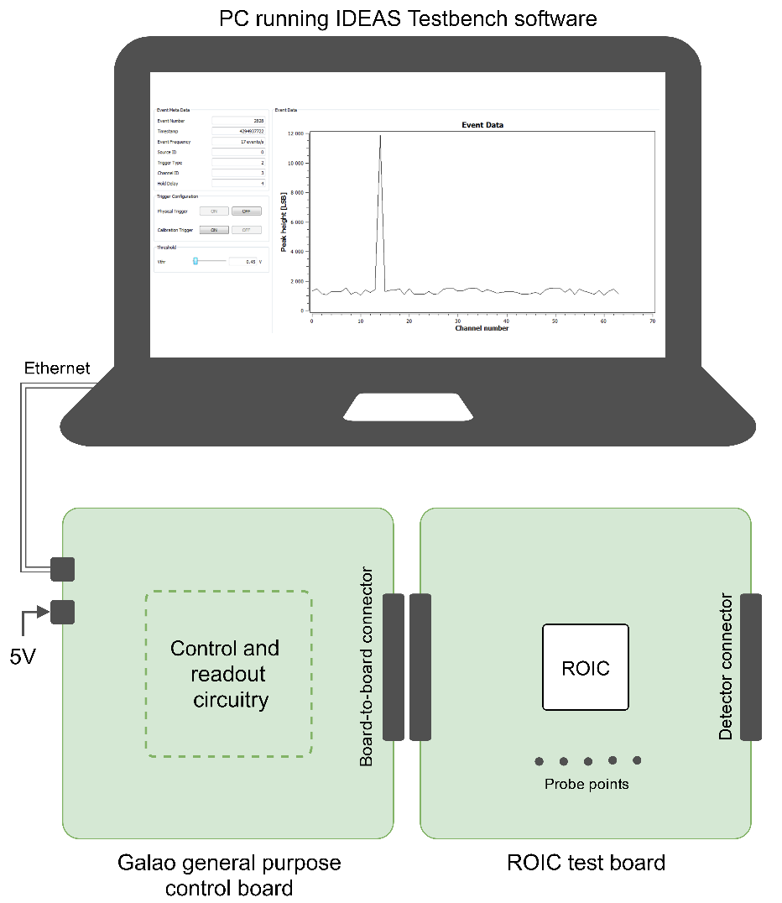
Galao ROIC Development Kit
Galao board
General purpose board with control circuitry
ROIC test board
Interchangeable ROIC-specific board
IDEAS Testbench
Software for performing readouts

Slide 27
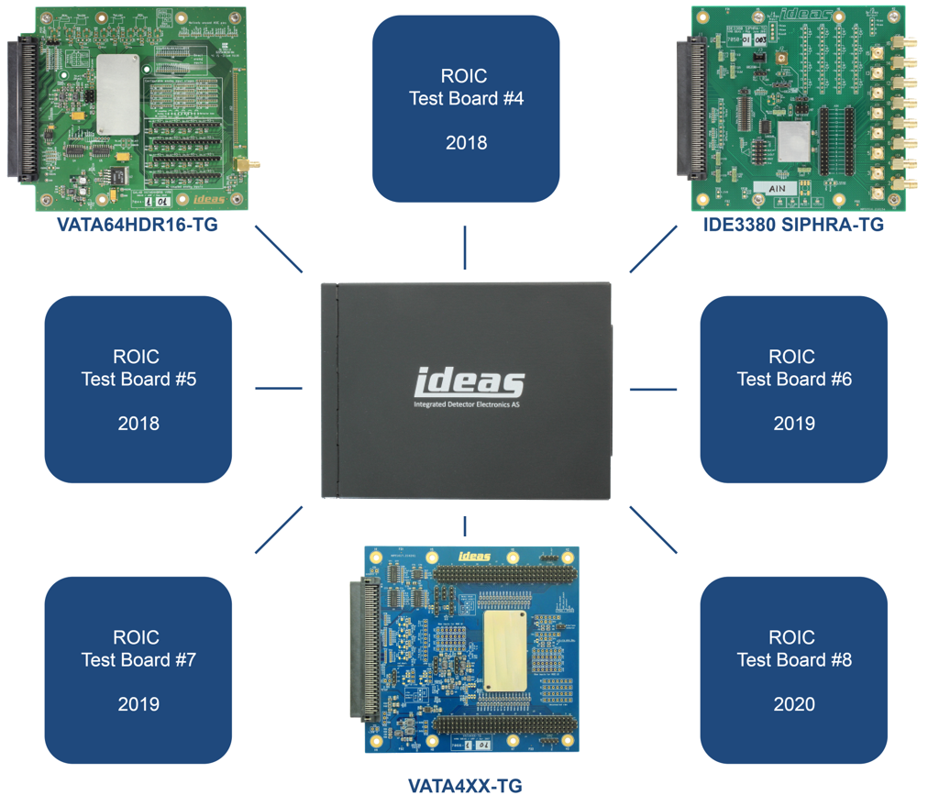
Galao ASIC Testcard Family
VATA64HDR16
SiPM/PMT Readout
ASIC
IDE3380
SIPHRA – SiPM/PMT
Readout ASIC
VATA450/460

Slide 28
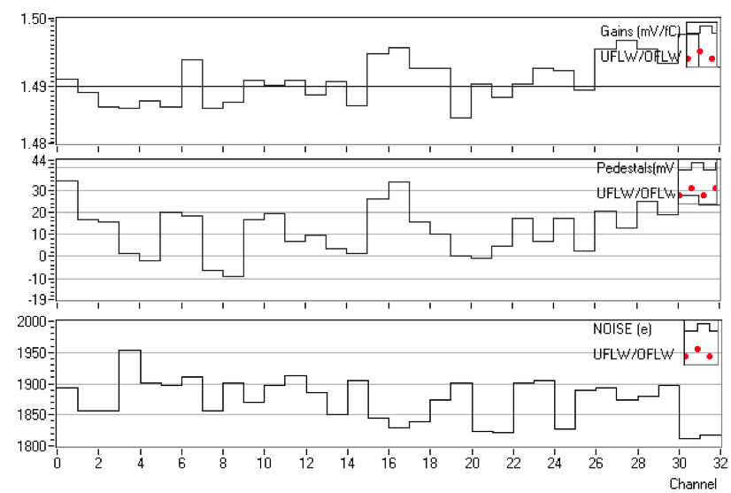
IDE1162
Gains [mV/fC]
Pedestals [mV]
ENC [e]

Slide 29
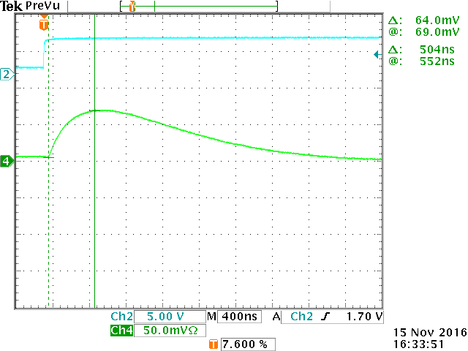
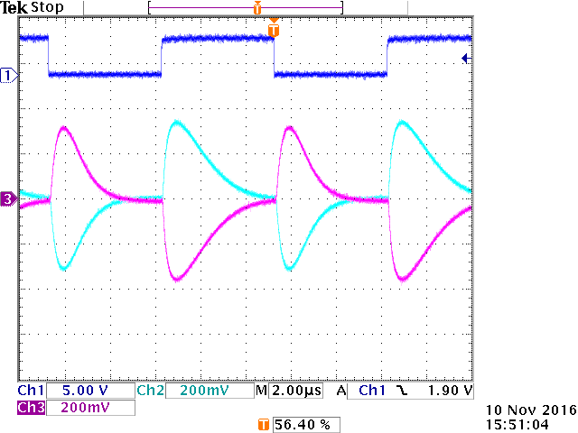
IDE1163 Tests
500ns peaking time

Slide 30
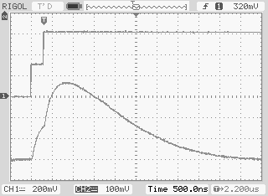
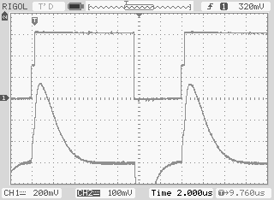
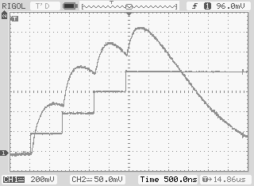
IDE1163 Pileup Tests
Twice 300fC, 300ns apart | Twice 300fC, 300ns apart at 71kHz | Four times 200fC, 800ns apart

Slide 31
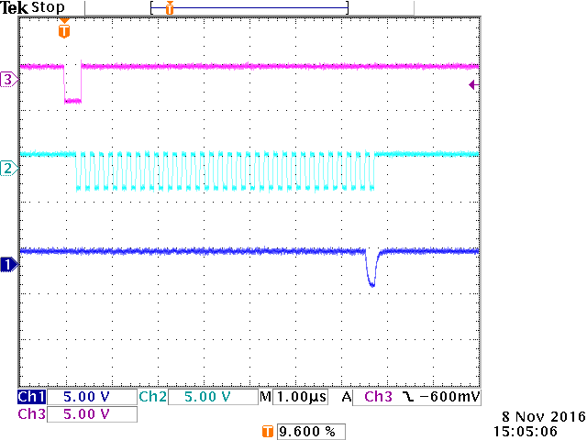
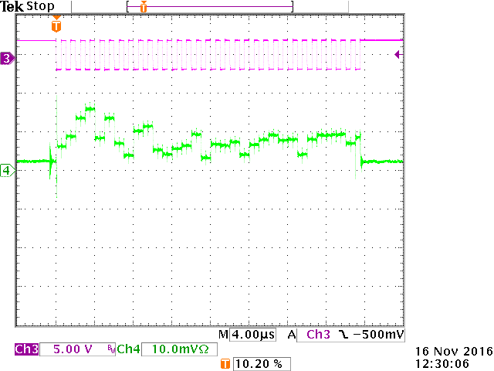
IDE1163 Analog Mux Readout
Digital clock for the analog multiplexer
Pedestals

Slide 32
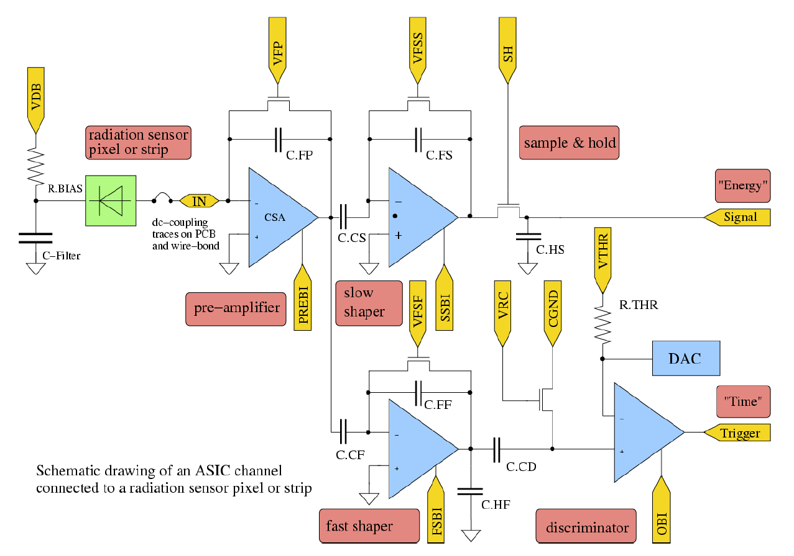
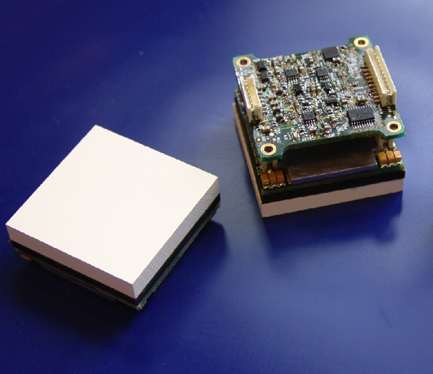
VATAGP Example
ROIC | Description | Application, Reference | Detector
VATAGP7.1 | 128 CSA (±30 fC), S&H, mux. output pulse height and address | Charged particle tracking DOI: 10.1016/j.nima.2015.03.078 | Silicon pads, strips, photodiode arrays
CsI/Si Diode Array Modules for Clinical SPECT Prototype

Slide 33
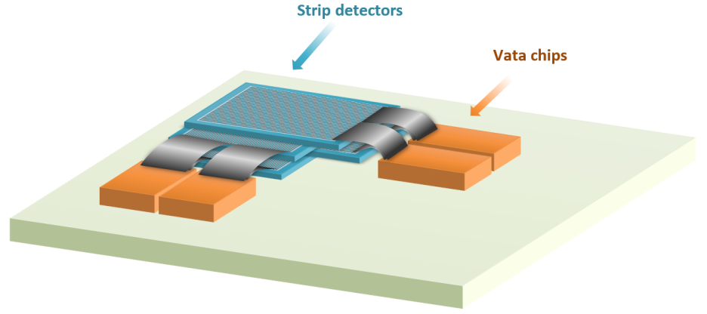
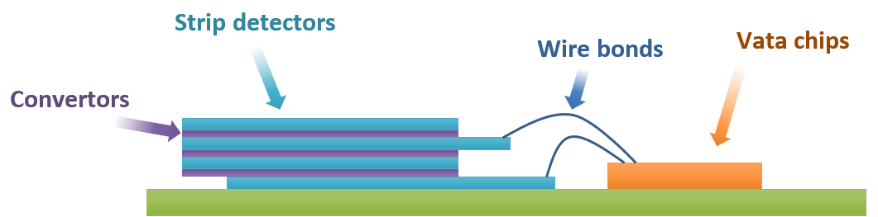
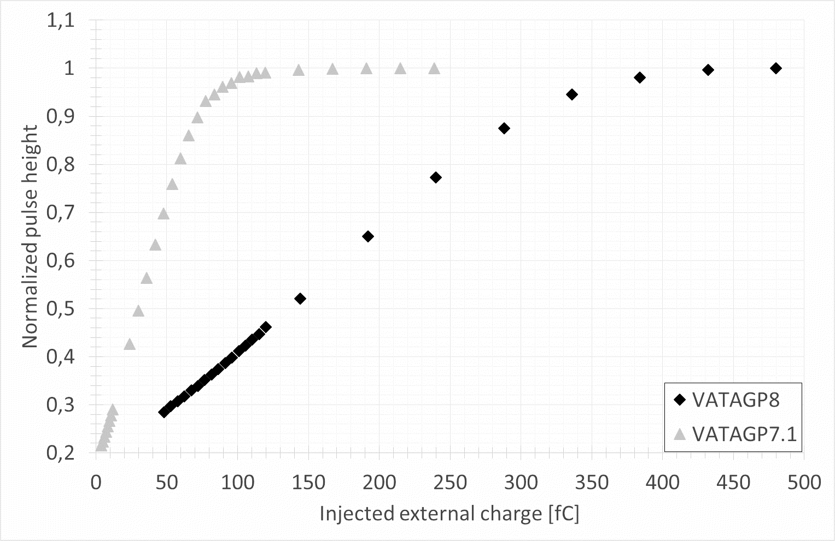

VATAGP8 Example
Nuclear reaction | ⁶Li(n,α)³H |  | ¹⁰B(n,α)⁷Li
Cross-section (for neutron kinetic energy 25 meV) | 945 barns |  | 3813 barns
Reaction energy | 4.78 MeV |  | 2.79 MeV
Distribution of reaction energy to reaction products | ⁴α | ³H | ⁴α | ⁷Li
 | 2.05 MeV | 2.73 MeV | 1.775 MeV 1.470 MeV* | 1.015 MeV 0.84 MeV*
Ranges of reaction products in conversion material | ⁴α | ³H | ⁴α | ⁷Li
 | ~ 6 μm | ~ 32 μm | ~ 3.6 μm* | ~ 1.6 μm*
http://ad-bang.utef.cvut.cz

Slide 34
VATAGP7.1, VATAGP8, VATAGP9
 | VATAGP7.1 | VATAGP8 | VATAGP9
Number of input channels | 128 | 128 | 256
Charge range | Linear: +/- 30fC Usable: +/-50fC | Linear: +/-250fC Usable: +/-450fC | Linear: +/- 30fC
Pre-amplifier feedback capacitance | 0.15pF | 1.25pF | 0.15pF
Output | Amplitude proportional to the charge input and digital address
3 readout modes | All channels, only triggered channels, triggers with neighbors
Triggers from every channel | +/-0.12fC min. threshold at 0 load | +/-0.8fC min. threshold at 0 load | +/-0.16fC min. threshold at 0 load
ENC | 70e+12e/pF | 447e + 27e/pF | 70e+8e/pF
Internal calibration |  | +/-9fC to +/-261fC in steps of 18fC, with 4-bit DAC
Shaping time | 500ns (slow shaper) and 50ns (fast shaper) |  | 2us (slow), 300ns (fast)
Power | 280mW, or 2.2mW/channel |  | 570mW

Slide 35


VATAGP7.1, VATAGP8, VATAGP9
8090um x 6075um
8180um x 6075um
15000um x 6115um

Slide 36


Readout of DSSD with VATAGP7.1
Options
Chosen method
Source: Y.Kovalev et al. INST-2017

Slide 37



JUICE Radiation Monitor Sensor Readout ASIC
For the RADEM Team:
Dirk Meier, dirk.meier@ideas.no
Timo A. Stein, timo.stein@ideas.no
ESA-ESTEC Final Presentation Days,
Noordwijk, Tuesday May 23, 2017

Slide 38

ESA JUICE Mission Expected Outcomes
Source: Alessandra Menicucci/ESA,
https://indico.esa.int/indico/event/45/material/slides/9.pdf
Exploring the emergence of habitable worlds around gas giants.
JUICE to answer the questions from ESA Cosmic Vision program (2015-2025):
What are the conditions for planet formation and emergence of life?
How does the Solar System work?

Slide 39
RADEM Radiation Monitor for JUICE
Features and Responsibilities
Main contractor - EFACEC
Electron Telescope 300 keV - 40 MeV (PSI)
Proton Telescope: 5 MeV – 250 MeV (PSI)
Directionality Detector; E > 300 keV (LIP)
Heavy Ions Stack Detector (PSI)
Novel rad-hard ASICs, built-in logic (IDEAS)
Features
Radiation-hard design
22cm x 16cm x 10cm envelope
<5kg mass incl. shielding
4 W power
-30C to +50C operating temperature
100bps data link
1min integration time
Reference: Wojtek Hajdas (PSI), Patrícia Gonçalves (LIP),
presented at ESA TEC-EEC FPD, 24-25 October 2016

Slide 40




IDE3465 ASIC used in NGRM is Predecessor of the IDE3466 ASIC used in RADEM
Meier et al. Proc. IEEE NSS 2013

Slide 41

The Purpose of the RADEM ASIC is Charged Particle Counting
36x charge-sensitive input channels (p-side Si sensors)
Pulse-height spectroscopy, voltage output
Progr. threshold triggers
Progr. pattern recognition (coincidence)
36x 22-bit pattern counters
SPI interface for readout
External microcontroller sufficient
Low-power (typical: 150 mW), small form factor (256 mm², CubeSat)
Rad-hard for RADEM@JUICE (SEU: 50 MeV·cm²/mg, SEL immune)
Latch-up detection unit
Operating temperature range: -40 °C to 60 °C
Only two supply voltages (1.8 V, 3.3 V) required
Engineering/project name VATA466
Product name IDE3466

Slide 42




RADEM ASIC Heritage and Roadmap
VA64TAP3
VATA464/465
VATA466/IDE3466
POLAR
NGRM
RADEM
IDE3467
Spallation Source ESS
IDE-XXXX
Proof of Concept for RADEM
IDEAS developed VA64TAP3 for POLAR and IDE3465 for the NGRM. Both chips require an external FPGA.
Feasibility study for RADEM concluded that modifications to the IDE3465 were necessary and most external digital logic to be included into a new ASIC, the IDEAS IDE3466.
The resulting ASIC can easily be
connected and operated with
microcontroller only
(no FPGA needed).
ASICs offer
Lower
Mass
Volume
Power
Price
More
Functions
Performance

Slide 43


Principle of Operation - Counting of Coincident Triggers from Silicon Diodes
Charged particle
Absorbers
Diodes
masks M_{i}, and veto bits V_{i}
D1
68-bit
Input
pattern Q_{i}
A1
D2
A2
D3
A3
D4
A4
D5
A5
A6
D6
A7
D7
Coincidence time
Evaluation
D8
High energy – many diodes trigger
Low energy – no or few diodes trigger
Programmed 68-bit pairs M_{i}, V_{i}

Slide 44


RADEM ASIC Block Diagram
Front-end readout IC for silicon detectors to be used in space radiation monitoring.
Purpose is charge particle counting
High degree of miniaturization by including (anti-)coincidence counter logic, latch-up detection and on-chip calibration.
T.A. Stein et al., IDEAS IDE3466 ASIC for RADEM, Proc. SPIE Astro., Edinburgh, 2016.

Slide 45





RADEM ASIC Floorplan, Padframe, Package
CQFP208
15980 µm
Testcard
450 µm thick die
15980 µm

Slide 46




NGRM ASIC versus RADEM ASIC
New in RADEM ASIC: More channels, pattern and coincidence units, counters, pulse height voltage output, latch-up detection unit, SPI

Slide 47


RADEM ASIC Features

Slide 48



Timing Diagram: Channel and Mux.

Slide 49



Trigger, Shaped Pulse, and Pulse Height versus Input Charge

Slide 50

Range, Gain, Noise (ENC)

Slide 51


Coincidence Counting
Input charge rate capability
22-bit Gray counters incrementing,
Log₂ (4194304) = 22

Slide 52


On-Chip Latch-Up Detection Unit
2x latchup detection units (LU1/2).
Voltage drop over ext. shunt resistor (0.2 Ohm) measured.
1x global OR (GLU).
5-bit program. Current threshold: 0.14 A – 2.10 A @ 0.2 Ohm.

Slide 53



Preliminary Single Event Effects
0.35µm AMS CMOS
SEE tests at UCL HIF
Pahlsson et al., SPIE DSS IR Technology,
http://dx.doi.org/10.1117/12.2180439
Radiation tests with RADEM ASIC are in progress.

Slide 54
Space Radiation Monitor ASIC Articles by IDEAS
Meier, D., et al.: “Development of an ASIC for charged particle counting with silicon radiation detectors”, IEEE Nucl. Sci. Symp. 2013, DOI: 10.1109/NSSMIC.2013.6829764.
Stein, T. A., et al.: "Front-end readout ASIC for charged particle counting with the RADEM instrument on the ESA JUICE mission." SPIE Astronomical Telescopes+ Instrumentation. International Society for Optics and Photonics, 2016.
Stein, T. A. et al.: “Characterisation of an ASIC for Small Satellite Space Radiation Monitors” (in progress).

Slide 55


SIPHRA 16-Channel SiPM Readout ASIC
For the IDEAS Team:
Dirk Meier, dirk.meier@ideas.no
NDIP 2017, Tour, France,
3-7 July 2017.

Slide 56

SIPHRA Designed for Gamma Ray Spectroscopy in Space
Background
  Future high-energy astrophysics missions and gamma-ray observatories
  High performance requirements
  Large scintillators (LaBr) with thousands of SiPMs
  ESA ongoing activity in LaBr+SiPM for space

Slide 57


State-of-the-Art MA-PMT Readout for Gamma Ray Spectroscopy
ROSMAP by IDEAS
  ReadOut System for Multi-Anode Photomultiplier Tubes, Hamamatsu H5800C, H12700, Photonis Planacon XP85012
However, compared with MA-PMT, some application require
No or lower detector supply voltage
More sensors, and less power
Smaller/thinner sensor
Less mass
Insensitive to magnetic fields
Lower cost
Faster photon response
Better uniformity, less cross talk
SiPM arrays can meet these requirements, and
Hence, need for readout of SiPM arrays.

Slide 58


Detector Module: LaBr Scintillator & SiPMs
Source: UCD
Ulyanov et al., “Study of silicon photomultipliers for the readout of scintillator
crystals in the proposed GRIPS gamma-ray astronomy mission”,
Proc. of Science, arXiv:1302.5786v1

Slide 59
Photo Sensor Array Readout
Input data, e.g., flux of events and background, #/s/sensor area
Sensor*
Sensor Readout
Data conversion
Data reduction/discrimination
Interface between sensor and system
Output data, e.g., bit/s
*E.g., SiPM array, 1D or 2D

Slide 60

Block Diagram of System Components
Detector module
(SiPM)
Notes:
In a system application the SIPHRA ASIC sits between the detector module, and a host system. The SiPM pulse signal goes into the analog front-end, the ASIC can then either output the integrated or shaped analog signal from each channel, or the pulse height can be digitized directly with an onchip 12-bit ADC, and sent to the host read-out system via a serial output. The many options of SIPHRA allow many possibilities for the host readout system.

Slide 61







SiPM - Silicon Photomultiplier
600pC $≈\frac{100mV ∗100ns}{16Ω}$
Array of SiPM, each SiPM has
Large electrical charge – many pC
Large capacitance – many nF
Dark counts – kHz

Slide 62


How to Connect an SiPM to a SIPHRA Analog Input
SIPHRA has 16 inputs, each with a Current Mode Input Stage (CMIS)

Slide 63
CMIS - Current Mode Input Stage
CMIS main functions and performance:
stable programmable input voltage at AIN.
to scale down the detector current
Designed for large negative charge
  Saturation: ‑16 nC, ‑8 nC, ‑4 nC, ‑0.4 nC
Programmable gain attenuation:
1/10, 1/100, 1/200, and 1/400
Large capacitive load up to several nF,
Large leakage current up to ‑100 µA.
Input voltage is regulated to a stable bias
voltage set via an 8-bit DAC
over the range of 1 V.
Input impedance 5..30 Ohm below 10 MHz. Above 10 MHz, input impedance becomes reactive and peaks with a few 100 Ohm at 250 MHz.
Common-gate input (regulates DC bias)
  Input voltage is regulated to a stable bias voltage set via an 8-bit DAC
  over the range of 1 V.
Bias current 0-20µA.
  Needed to keep current mirror ready for fast transients.
Notes:
The CMIS – The Current mode input stage – features a low input impedance, and a programmable bias voltage for the SiPM, which can help to counter gain variation among SiPMs. The CMIS input accomodates large negative charges up to -16 nC, as well as large detector leakage currents, and large detector capacitance up to several nF. There are four attenuation settings so you can also use this input stage with for smaller maximum signals down to -400 pC

Slide 64
SIPHRA Features and
Block Diagram
IDE3380 SIPHRA Features
16 channels for SiPM/PMT readout 16 current sensitive inputs (≤ 16 nC) 1 summing channel
Programmable attenuation to handle charge up to -16 nC, -8 nC, -4 nC, -400 pC at AIN inputs, or +40 pC, +4 pC, +0.4 pC at FIN inputs
Programmable shaping time 200 ns, 400 ns, 800 ns, 1600 ns
16 inputs (AIN) with programmable offset voltage
Pulse height spectroscopy 16 shapers followed by track-and-hold Programmable hold timing 12-bit SAR ADC digital and/or analog readout 3 ksps/channel max.
Trigger generation Internal from charge discriminator via programmable threshold in every channel External (trigger on input, trigger on sum)
Power 15 mW without CMIS, 30 mW with CMIS active Flexible power down scheme of channels or functions
SEL/SEU radiation hardened
SPI Interface

Slide 65







Current Integrator and Shaper
Current Integrator
Shaper
Notes:
This slide shows in very simple steps how signal acquistion works in the front-end of the ASIC. Since the charge event from the SiPM may be very large charge – we might see charge up to 16nC in a few ns, or currents are up to 75mA – therefore we need to attenuate the signal. We do this with a current mirror with a regulated input voltage. The next step is the current integrator, which converts the charge input signal to a voltage step, and the final step is the shaper which acts a band-pass filter.

Slide 66

SIPHRA Architecture
Notes:
The SIPHRA channel architecture is slightly complicated and I’ll try to keep my explanation short. The current mirror input stage provides multiple copies of the input signal, one path goes through the current integrator, shaper, and track and hold circuit, each channel has an analog output buffer where you can monitor one of these three outputs. There are two comparators per channel – the current mirror input stage feeds directly into a current comparator, providing a very fast trigger which is good to avoid time-walk when creating the sampling signal. The charge comparator is used to discriminate between events based on the charge. Within the readout controller you may select to always read out a channel, or only if the charge was over the threshold. You can also use the analog output for digital signals. The ASIC offers a monostable pulse for counting, or you could look at the comparator outputs directly which might be suitable for event timing or time over threshold. The summing channel is very similar to the normal channel, except it receives a scaled down sum of all the input currents. The intended use is to discriminate between small events that occur in only one or a few of the channels. The other analog parts of the ASIC includes a calibration circuit, the 12b ADC, a multiplexed analog output buffer, and two extra inputs for the ADC, one for general use or calibration, and one to interface to a PT100 element. There is also a trigger or output. On the digital side the SIPHRA ASIC is programmed via SPI. There are NN configuration registers implmeneted with SEU tolerant flip-flops. Additionally the registers keep track of the parity, so in the unlikely event that there is a flip, it will be signaled on a parity error output.

Slide 67


SIPHRA Floorplan and Pad Frame
Chip active area: 7.6 mm×6.8 mm, 103 (119¹⁾) Pins
Planned Packaging Options: Plastic PQFP120, Bare-Die
¹⁾ Normally either 16 AIN or 16 FIN inputs will be bonded, not both.
Notes:
Here you can see the pinout and floorplan for the SIPHRA ASIC. Analog inputs connect at the left middle, go through the channel, and outputs are at the right. The ASIC normally has up to 103 bonded pins, and we plan to deliver plastic PQFP package and bare-die.

Slide 68



Development System with SiPM/LaBr

Slide 69




IDE3380 Development System
Block diagram of the ASIC design validation and test system.
IDEAS Galao development kit to interface to TOIC test PCB. The Galao development kit is based on the Xilinx Zynq-7000 with custom firmware for the SIPHRA ASIC readout and control. The system is controlled via Ethernet (GbE) from a computer. The SIPHRA ASIC is located on the ROIC test board, which allows one to connect to the detector array.
Software
(Python Scripting,
LabView API)
Notes:
The SIPHRA ASIC will be tested with our Galao development kit with a custom test board for the ASIC. The test board will have several options to interface detectors including several connector options to interface to existing detectors and modules. The Galao board features a Zynq FPGA, so test scripts can be written in python, and custom firmware interfaces to the ASIC. We will likely provide this kit, soon after we have tested the ASIC. The ASIC was taped out a few weeks ago and we expected to receive packaged ASICs at the end of July.

Slide 70


Results - Gamma Ray Spectroscopy with SIPHRA LaBr/SiPM
Na-22
For comparison: same LaBr/SiPM, discrete readout
A.Ulyanov et al., Nucl. Instr. Meth. A 810 (2016)
4% FWHM
511 keV

Slide 71


Dynamic Range, Trigger Range
CMIS gain | Trigger threshold charge range
 | Minimum | Maximum
1/10 | -4 pC | -560 pC
1/100 | -43 pC | -5.4 nC
1/200 | -87 pC | -10.8 nC
1/400 | -175 pC | -20.9 nC

Slide 72
Dynamic Range, Noise
 |  | Simulation |  |  | Measurement
CMIS gain | Shaping time [ns] | Saturation charge [pC] | ENC [pC] at 3.3 nF load | Dynamic range | Saturation charge [pC] | ENC [pC] at 0 load | ENC [pF] at 3.3 nF load
1/10 | 200 | -510 | 0.24 | 2125 | -525 | 0.11 | 0.21
 | 400 |  | 0.28 | 1821 |  | 0.10 | 0.21
 | 800 |  | 0.28 | 1821 |  | 0.11 | 0.20
 | 1600 |  | 0.28 | 1821 |  | 0.12 | 0.19
1/100 | 200 | -4980 | 0.83 | 6000 | -5000 | 1.05 | 1.05
 | 400 |  | 0.73 | 6822 |  | 0.97 | 0.96
 | 800 |  | 0.67 | 7433 |  | 0.93 | 0.92
 | 1600 |  | 0.63 | 7904 |  | 0.90 | 0.88
1/200 | 200 | -9830 | 1.62 | 6068 | -10000 | 2.09 | 2.06
 | 400 |  | 1.40 | 7021 |  | 1.92 | 1.89
 | 800 |  | 1.28 | 7680 |  | 1.84 | 1.79
 | 1600 |  | 1.18 | 8331 |  | 1.78 | 1.73
1/400 | 200 | -19500 | 3.27 | 5963 | -20000 | 4.30 | 4.22
 | 400 |  | 2.80 | 6964 |  | 3.92 | 3.86
 | 800 |  | 2.56 | 7617 |  | 3.78 | 3.78
 | 1600 |  | 2.37 | 8228 |  | 3.62 | 3.87
Analog readout:
  Dynamic range 65 dB – 78 dB (simulation)
Digital readout:
  10.8 bit – 11.5 bit (ADC limit)
Cross-talk 0.1%
  Post-Layout simulation (Ideal supply, Excl. package bonds, leads.)

Slide 73



12-bit ADC
50+ ksps
^{[1]} Standby mode is when the ADC and its reference buffers are subjected to intermediate wake ups, in order to be able to wake up within one clock cycle (given Tclk > 1 us).

Slide 74



IDEAS Radiation Tolerant Standard Cell Libray
0.35µm AMS CMOS
Small Library (<50 cells)
Synthesis and Implementation with Cadence tools
SEE tests at UCL HIF
  SEU LET_{th} 50 MeVcm²/mg
  SEL LET_{th} ≥ 135 MeVcm²/mg
Pahlsson et al., SPIE DSS IR Technology,
http://dx.doi.org/10.1117/12.2180439

Slide 75

SIPRA ASIC Roadmap
VA32HDR14.2 and .3
VATA64HDR16
CALET
RICH (SPIDER)
IDE3380 SIPHRA
TBD
IDE-XXXX
Pending user
Feedback! E.g.
More channels
ADC/TDC
Lower Power
IDEAS has tested various SiPM since 2003, and has developed readout ASICs for MAPMT, APD arrays, and SiPM arrays
VA32HDR14.2 and VA32HDR14.3 used in CALET
VATA64HDR16.2 used in RICH/SPIDER
The IDE3380 SIPHRA is for
gamma ray spectroscopy with
LaBr/SiPM arrays, and can
easily be connected and
operated with micro-
controller only
(no FPGA).
Lower
Mass
Volume
Power
Cost
More
Functions
Channels
Performance

Slide 76


Next Steps
Monolithic LaBr/SiPM, Image Univ. College Dublin, SensL SiPM array 16 SiPMs, and IDE3380 Readout System
Radiation (SEE, TID) qualification
Testing by interested scientists and engineers
Raise the TRL beyond 4 and/or optimize functions or performance, e.g., more channels, lower power, include time-to-digital converter TDC.

Slide 77
Next - SIPHRA for Prototyping Applications
N | Feature in SIPHRA | Technology/Application | Comment
1 | Only power-up the channels needed, others are power-down. On-chip ADC powers up only when needed. Sleep otherwise. | Wearable gamma-ray spectrometer/dosimeter with SiPM+scintillator | Low-power. One single or summing channel might be sufficient. Histogramming off-chip.
2 | Timed digital trigger output from every channel of SIPHRA | PET – Positron Emission Tomography | Time stamp requires external time-to-digital converter (TDC), for example, in FGPGA.
3 | Time-over-threshold (TOT) from every channel
4 | Analogue waveform output from every channels, either after integrator or shaper | Continuous waveform sampling, high-dynamic range spectroscopy | Requires external fast sampling ADC for every channel.
5 | Digital trigger from any channel, individually programmable threshold | X-ray counting, energy resolved | Requires external counters, for example, in FPGA.
You are welcome to explore these SIPHRA features.

Slide 78
References
Meier, D., et al. (IDEAS), An ASIC for SiPM/MPPC readout, Nuclear Science Symposium Conference Record (NSS/MIC), 2010 IEEE (2010).
Meier et al. (IDEAS), SIPHRA 16-Channel Silicon Photomultiplier Readout ASIC, Proc. ESA AMICSA workshop, Gothenburg, 2016, https://indico.esa.int/indico/event/102/session/8/contribution/6
Ulianov A., et al., Using the SIPHRA ASIC with an SiPM array and scintillators for gamma spectroscopy, accepted at IEEE NSS 2017.

Slide 79
Summary
SiPM Readout ASIC development, completed, and wafers have been manufactured. Bare chips available from IDEAS.
Electronic characterization (design validation) completed.
Engineering samples bare chips and test hardware
delivered to ESA.
Possible follow-up activities and prototyping/demonstrations:
  Nuclear Medicine: PET, SPECT
  Science: gamma ray spectroscopy, calorimetry, dosimetry
  Space: Fiber calorimetry, gamma ray spectroscopy, CubeSats
  Industrial: X-ray counting, pipe flow-tomography

