Slide 1
Planar graphene tunnel field-effect transistor: effect of edge vacancies on performance.
Katkov V.L.
Bogoliubov Laboratory of Theoretical Physics

Slide 2
Why graphene holds great promise for replacing conventional
semiconductor materials such as silicon in applications ranging from high-speed
computer chips to biochemical sensors?
(+) In graphene, the vibrating atoms at room temperature produce a resistivity of about 1.0 microOhm*cm. This is about 35 percent less than the resistivity of copper.
(+) The limit to mobility of electrons in graphene is set by thermal vibration of the atoms and is about 200,000 cm²/Vs at room temperature, compared to about 1,400 cm²/Vs in silicon, and 77,000 cm²/Vs in indium antimonide, the highest mobility conventional semiconductor known. (Mobility determines the speed at which an electronic device (for instance, a field-effect transistor, which forms the basis of modern computer chips) can turn on and off. The very high mobility makes graphene promising for applications in which transistors much switch extremely fast, such as in processing extremely high frequency signals. Mobility can also be expressed as the conductivity of a material per electronic charge carrier, and so high mobility is also advantageous for chemical or bio-chemical sensing applications in which a charge signal from, for instance, a molecule adsorbed on the device, is translated into an electrical signal by changing the conductivity of the device).
(-) tunnel barriers inside graphene are transparent for electrons that are incident on them at a right angle (Klein paradox). This fact makes the control of the current in graphene by the external electrostatic field difficult
(-) Mobility and Energy gap have inverse relationship m ~ 1/E_{g}^{3/2} (TB model)
2

Slide 3
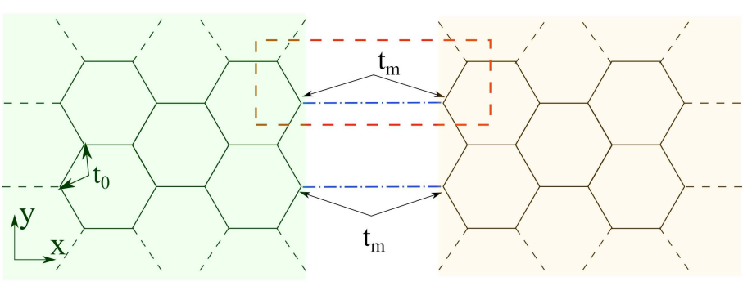
List of papers:
3
Туннельный контакт на базе графена В.Л. Катков. В.А. Осипов, Письма в ЖЭТФ, 98 782 (2013)
Planar graphene tunnel field-effect transistor V.L. Katkov and V.A. Osipov, Applied Physics Letters, 104 053102 (2014)
ТУННЕЛЬНЫЙ ПОЛЕВОЙ ТРАНЗИСТОР НА ОСНОВЕ ГРАФЕНА (Патент на изобретение № 2554694) В.Л. Катков, В.А. Осипов, Официальный бюллетень «Изобретения. Полезные модели», 18, 2 554 694 (2015)
Effect of edge vacancies on localized states in semi-infinite zigzag graphene sheet A.A. Glebov, V.L. Katkov, and V.A. Osipov, JETP Letters, 104 842 (2016)
Effect of edge vacancies on performance of planar graphene tunnel field-effect transistor A.A. Glebov, V.L. Katkov, and V.A. Osipov, Europhysics Letters, 118 27003 (2017)
Tunneling-based graphene electronics: Methods and examples V.L. Katkov and V.A. Osipov, Journal of Vacuum Science and Technology B, 35, 050801 (2017)

Slide 4
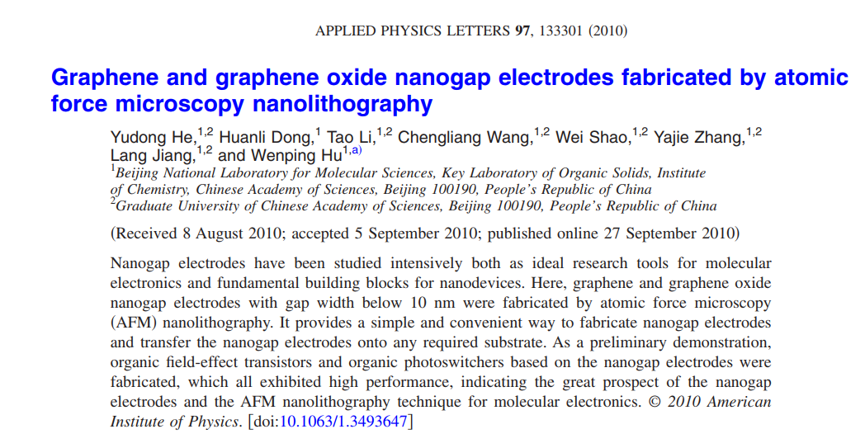
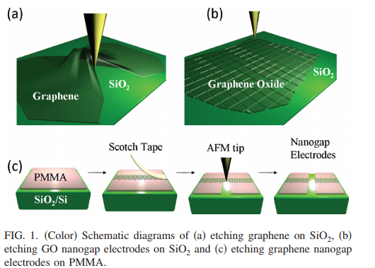
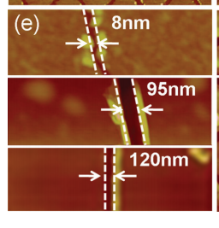
Experiments:
4
2010 г. – 100 nm
2010 г. – 10 nm
2010 г.
АСМ-литография

Slide 5
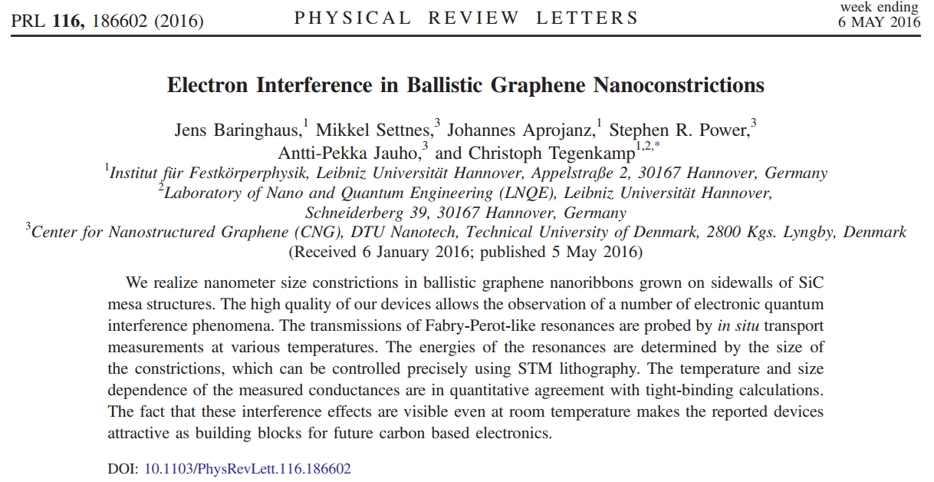
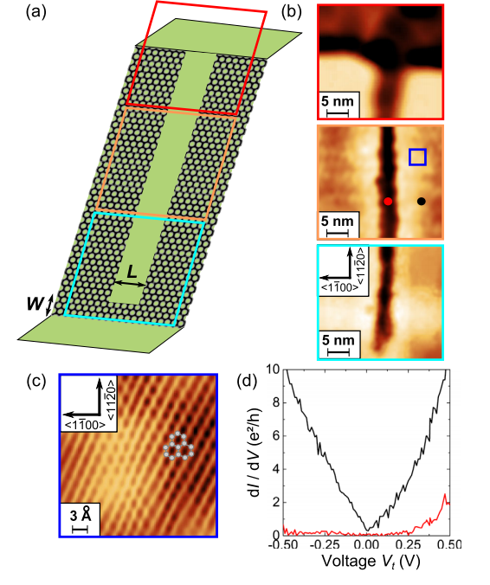
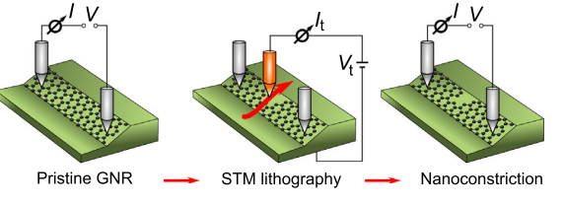
Experiments:
5
2016 г. – 1…6 nm
STM lithography

Slide 6
6

Slide 7
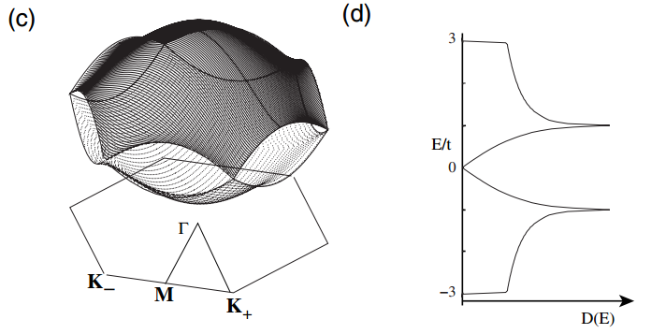
Energy spectrum for bulk graphene:
«armchair» ribbon, M-Г-M
7
«zig-zag» ribbon, K-Г-K
The edge states are topologically protected in the sense that their existence is based on a topological property and remain robust to weak external perturbations.

Slide 8
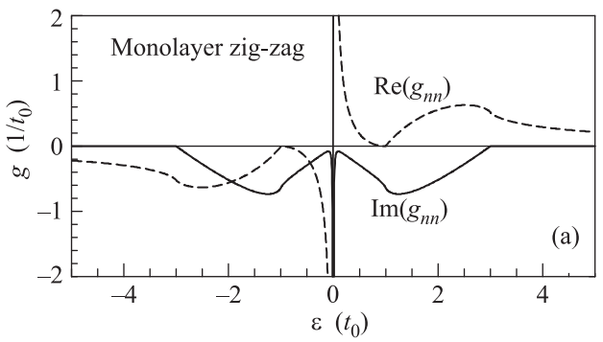
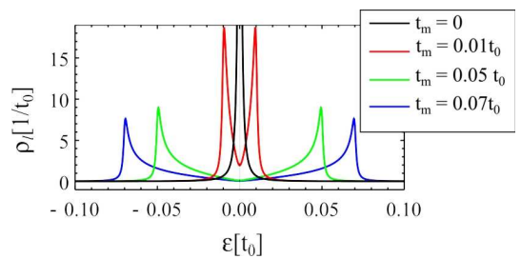
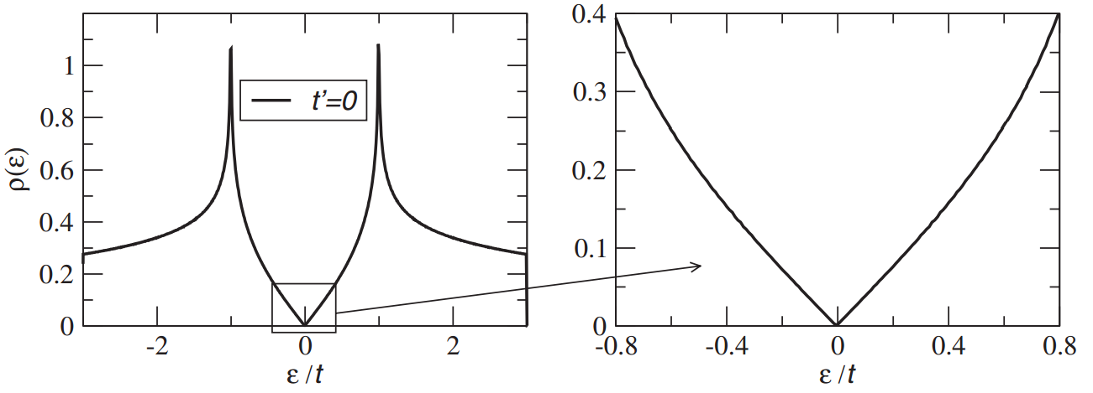
8
DOS for bulk graphene.
Rev. Mod. Phys. 81, 109 (2009)
H. Castro Neto, F. Guinea,
N. M. R. Peres, K. S. Novoselov, and A. K. Geim

Slide 9
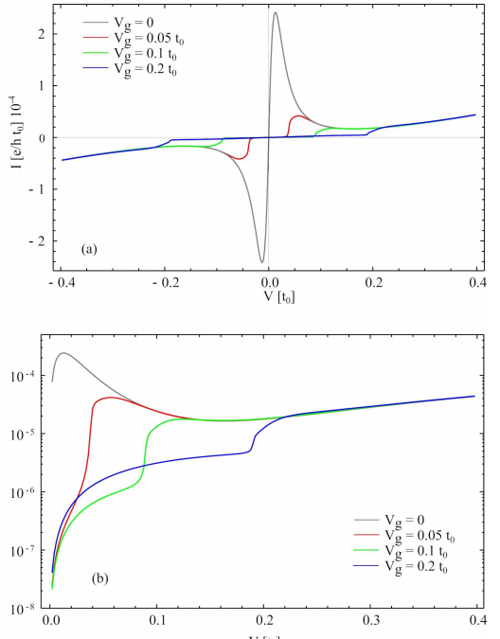
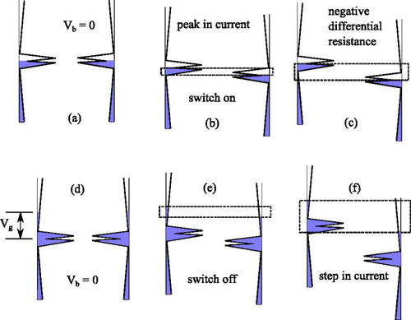
9

Slide 10
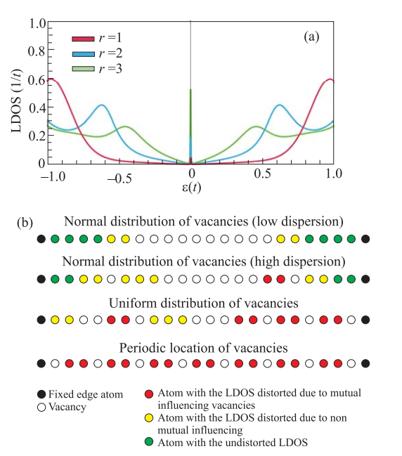
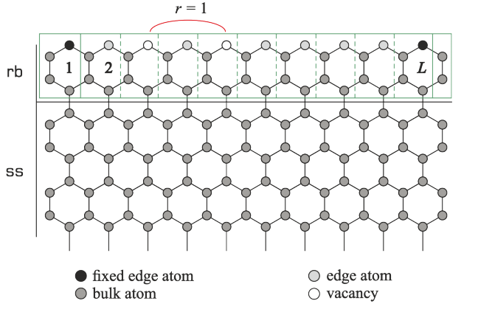
Effect of edge vacancies on localized states in a semi-infinite zigzag graphene sheet.
Glebov, A.A., Katkov, V.L. & Osipov, V.A. Jetp Lett. (2016)
At the same time, graphene electrodes can accommodate different kinds of defects. The most important of them are edge vacancies that can change the density of electronic states (DOS) at the edges. The existence of the edge states depends on both concentration and distribution of defects. Obviously, vacancies will affect the tunnel current through the edge states which are the working basis of the TFET. The aim of work was to study the influence of both the concentration and different distribution (normal, uniform, periodic) of vacancy defects on the operation of the planar graphene tunnel field-effect transistor.
.
10
When vacancies are located at a distance of one or two atoms, their mutual influence leads to the appearance of subpeaks in the LDOS. The edge state turns out to be destroyed most effectively when vacancies are located at a distance not exceeding the characteristic range of mutual influence.
The results of our study may be summarized as follows: (i) when vacancies are located according to the normal distribution, the edge state is degraded at high concentration of defects (more than 70 %); (ii) for the uniform distribution, the edge state is found to disappear at smaller but nevertheless quite large concentrations exceeding 50 %; (iii) the edge state disappears for single vacancies distributed with the period of one and two atoms, this corresponds to a 30% vacancy concentration and higher.

Slide 11
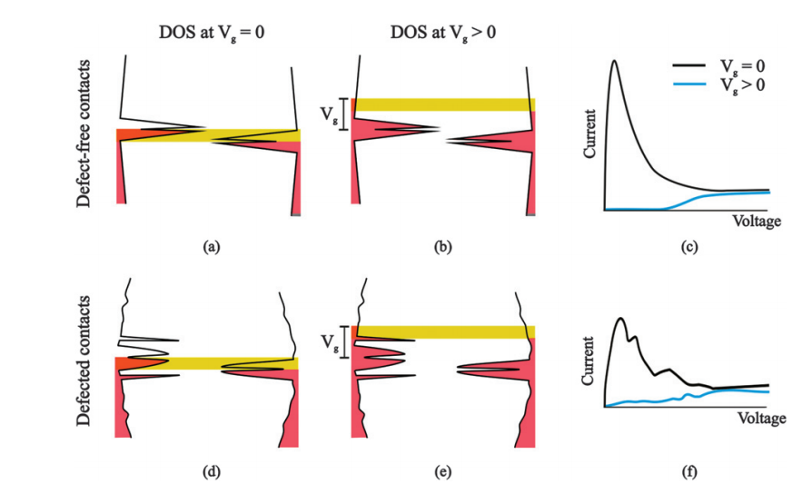
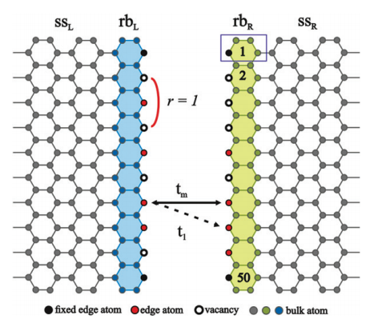
Effect of edge vacancies on performance of planar graphene tunnel field-effect transistor
11
Effect of edge vacancies on performance of planar graphene tunnel field-effect transistor A.A. Glebov, V.L. Katkov, and V.A. Osipov, Europhysics Letters, 118 27003 (2017)

Slide 12
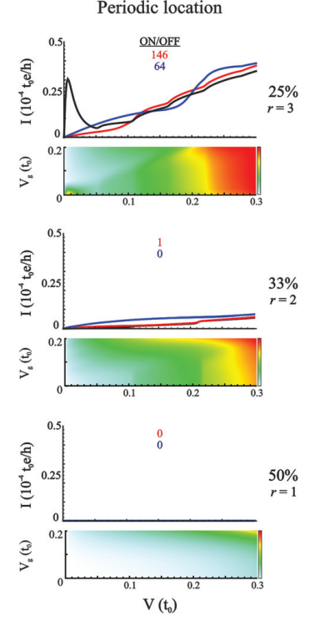
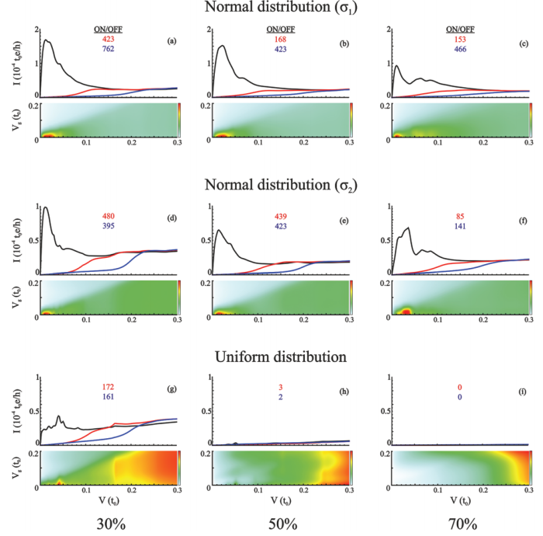
σ1 = L/4
12
σ1 = 3L/4
Gate voltage
Vg = 0 (black),
0.1 (red),
0.2 (blue)
Vacancies concentration

Slide 13
13
Performance of the planar graphene TFET at different distributions and concentrations of edge vacancies:
high performance (green), low performance (yellow), and the device does not work (red).
1. We found that edge vacancies can destroy edge electronic states at some critical concentrations whose values depend on the type of distribution. It can be stated that the critical defect concentrations are above 70, 50, and 30 percent for normal, uniform, and periodic distribution, respectively.
2. The reduction of the split central peak and the appearance of additional subpeaks in DOS as a result of the mutual influence of edge vacancies. This reduces the ON and increases the OFF current thereby worsening the switching performance of the device.

Slide 14
Thank you for your attention!

