Slide 1
TATIANA IVANKINA
Frank Laboratory of Neutron Physics
CMR@IBR-2
International Conference
Condensed Matter Research
at the IBR-2
9-12 October 2017
JINR, Dubna, Russia
23-Jan-2018
47th Meeting of the PAC for the Condensed Matter Physics

Slide 2
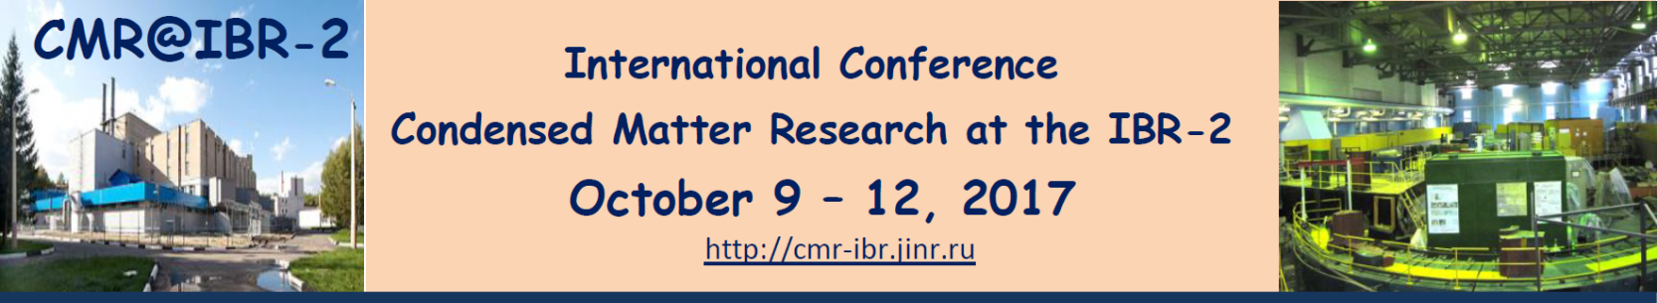
The aim of the regular Conferences on Condensed Matter Research at the IBR-2 reactor, playing the role of user meetings, is to bring together the users of IBR-2 for discussion of recent experimental results, prospects of future research and development of IBR-2 instruments
The Conference was dedicated to the 60th anniversary of the Frank Laboratory of Neutron Physics
The year 2017 marks the 25th anniversary of the start of operation of the first-in-the-world Fourier diffractometer at the IBR-2 pulsed neutron reactor. A special item of the Conference has been dedicated to a powerful experimental method – correlation Fourier diffractometry
GENERAL INFORMATION
23-Jan-2018
47th Meeting of the PAC for the Condensed Matter Physics

Slide 3
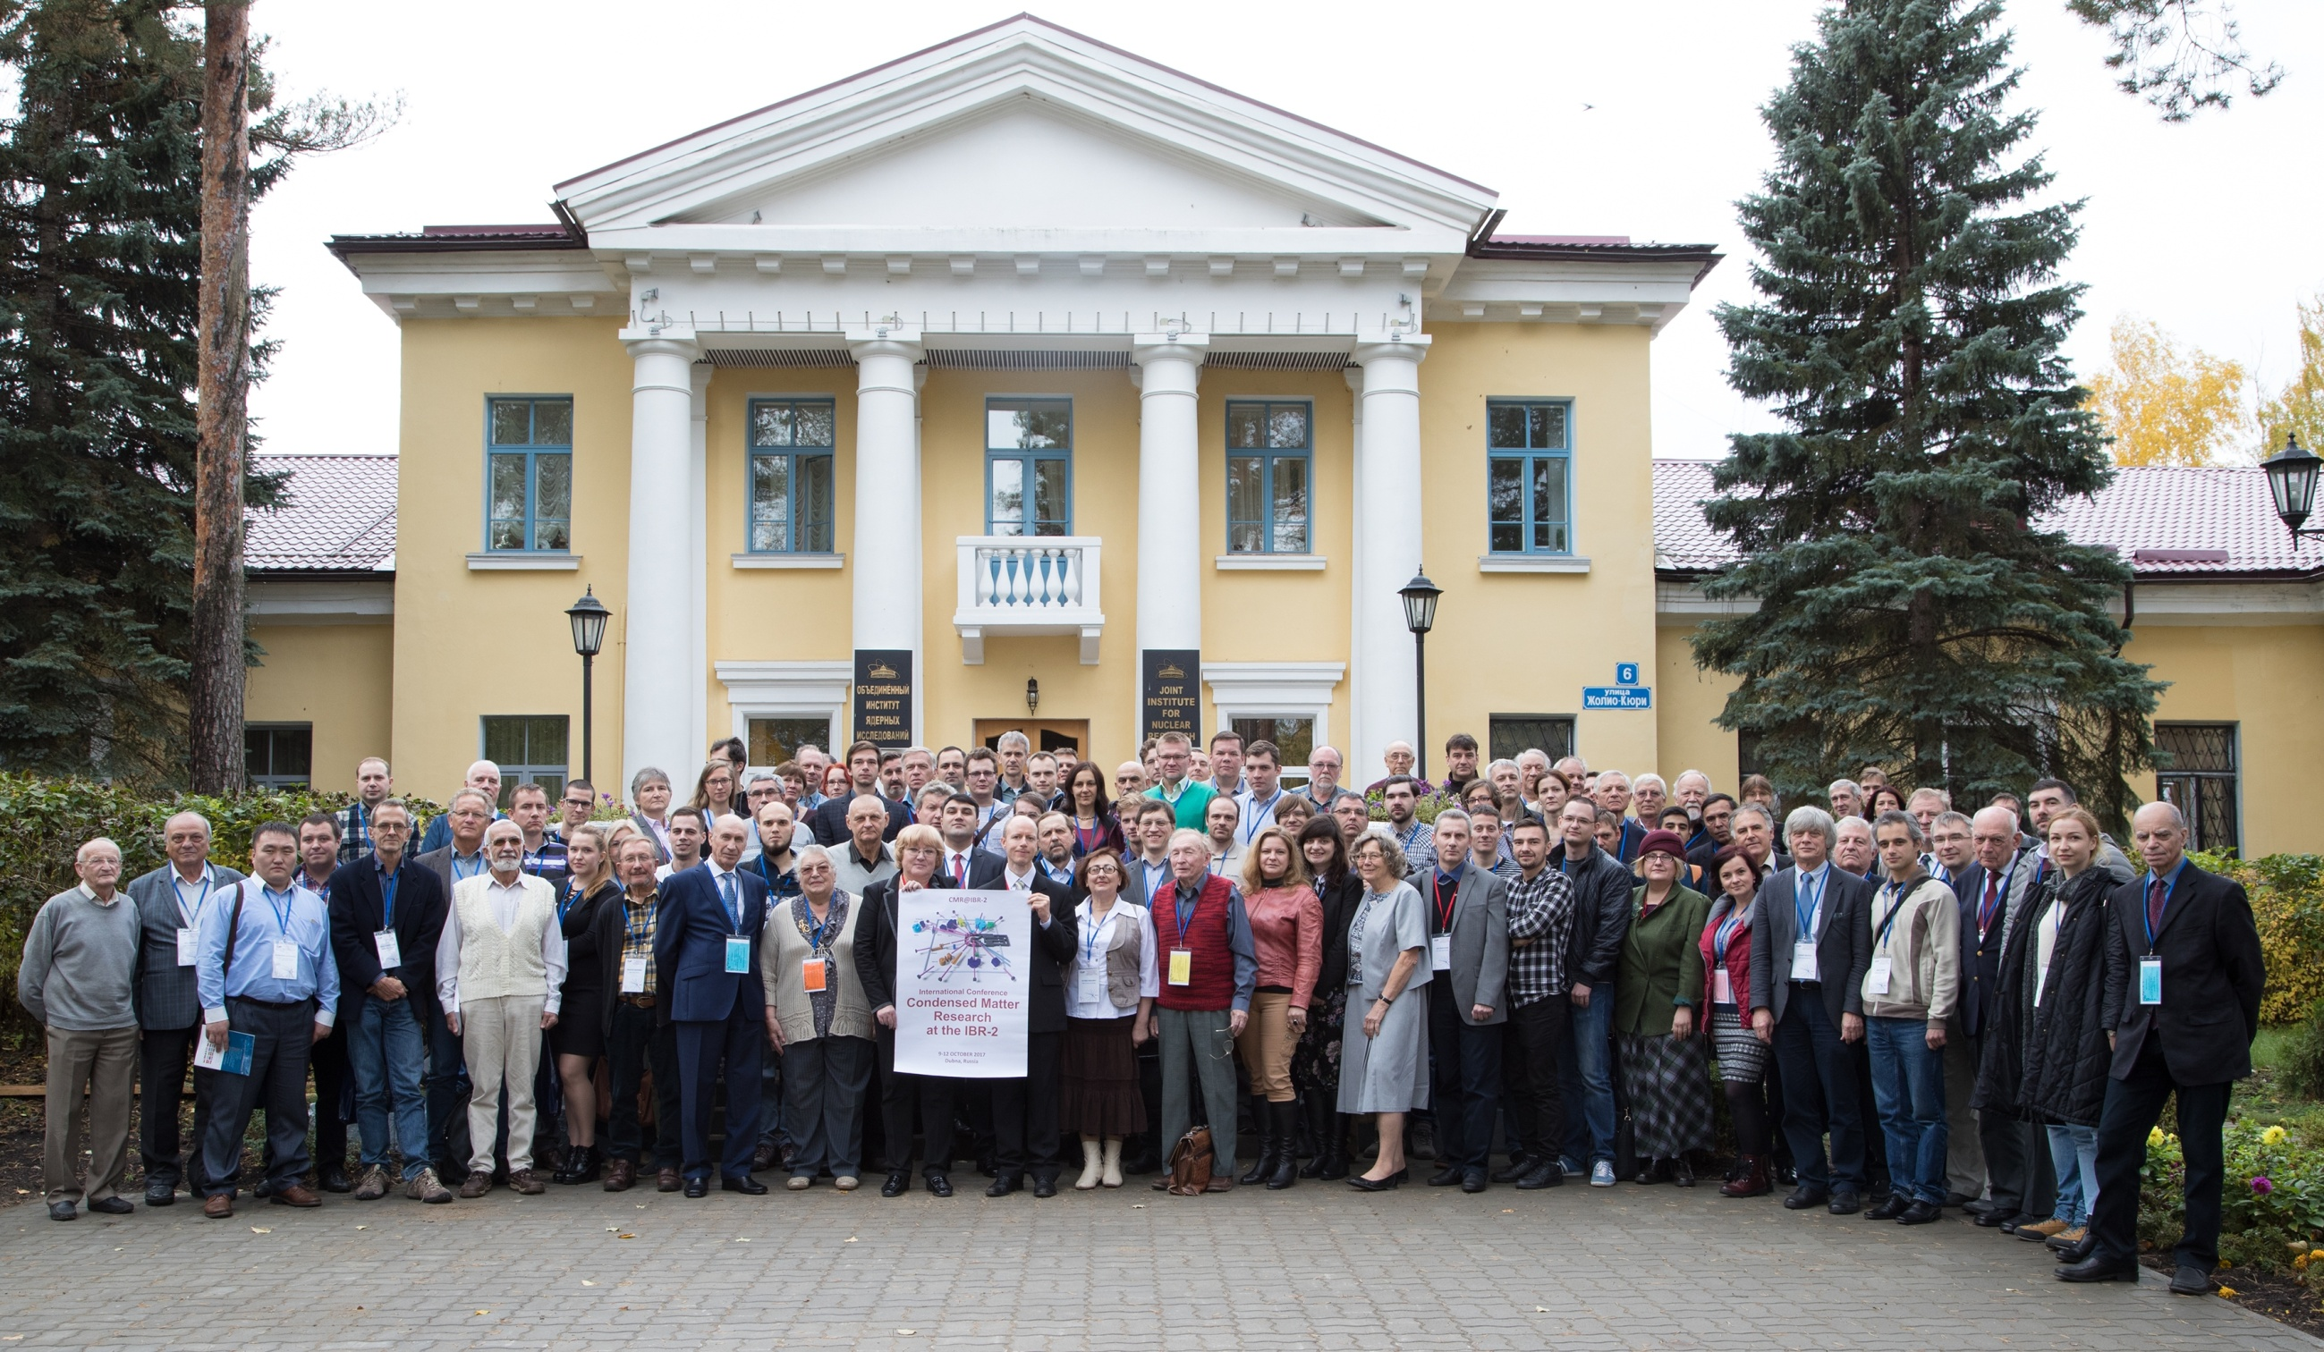
23-Jan-2018
47th Meeting of the PAC for the Condensed Matter Physics

Slide 4
JINR | 66
Russia | 42
Germany | 10
Romania | 7
Slovakia | 6
Poland | 5
Bulgaria | 5
Estonia | 1
Moldova | 1
Total | 143
23-Jan-2018
47th Meeting of the PAC for the Condensed Matter Physics

Slide 5
105
 | 2014 | 2015 | 2017
AZERBAIJAN | 2 | 2 | -
BELARUS | - | 5 | -
BULGARIA | 2 | 1 | 5
CZECH REP. | 1 | - | -
ESTONIA | - | - | 1
GERMANY | - | 2 | 10
ITALY | 1 | - | -
KAZAKHSTAN | 3 | - | -
LATVIA | 2 | 2 | -
MOLDOVA | 1 | 1 | 1
MONGOLIA | 1 | 1 | -
POLAND | 3 | 4 | 5
ROMANIA | 5 | 1 | 7
RUSSIA | 74 | 82 | 108
SERBIA | - | 2 | -
SLOVAKIA | 2 | 8 | 6
UKRAINE | 4 | 7 | -
VIETNAM | 1 | 2 | -
TOTAL | 105 | 120 | 143
2014 year
CMR@IBR-2
143
2017 year
120
2015 year
108
23-Jan-2018
47th Meeting of the PAC for the Condensed Matter Physics

Slide 6
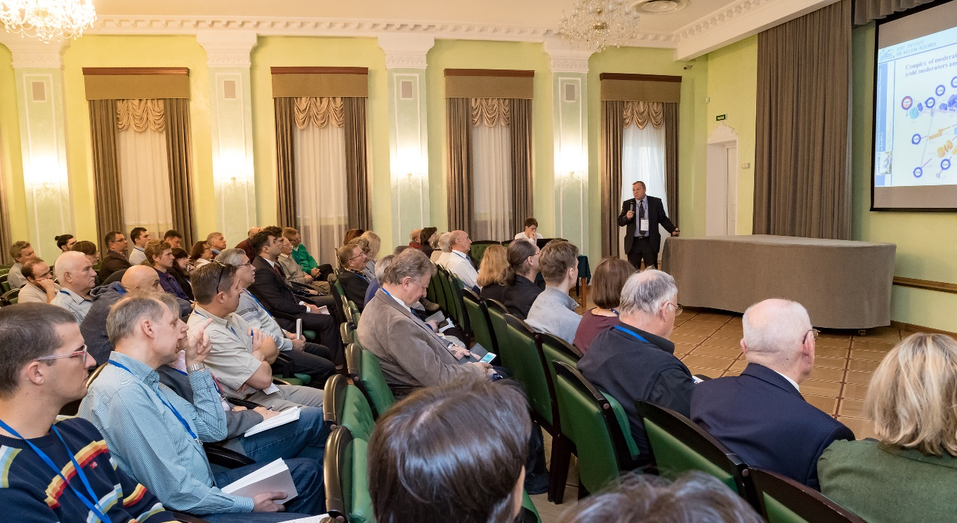
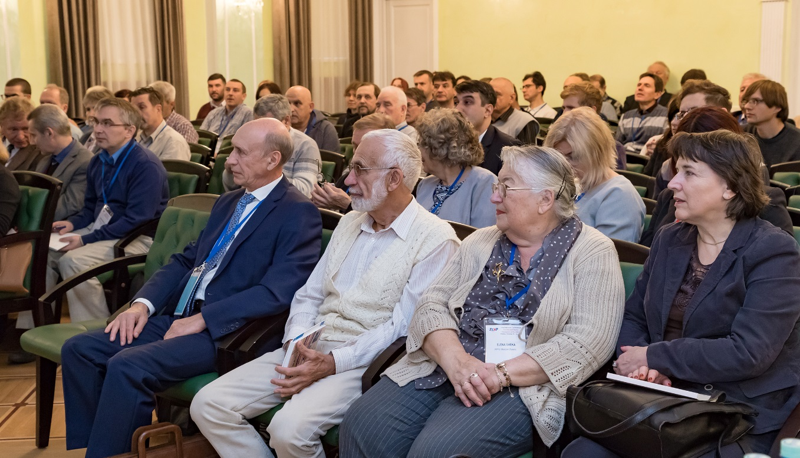
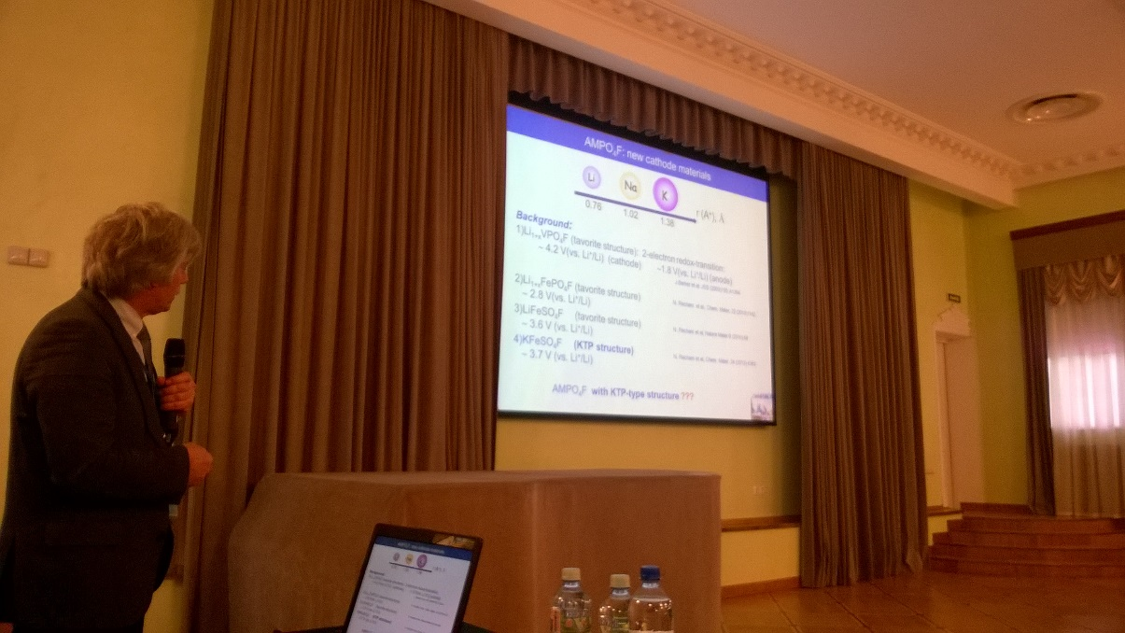
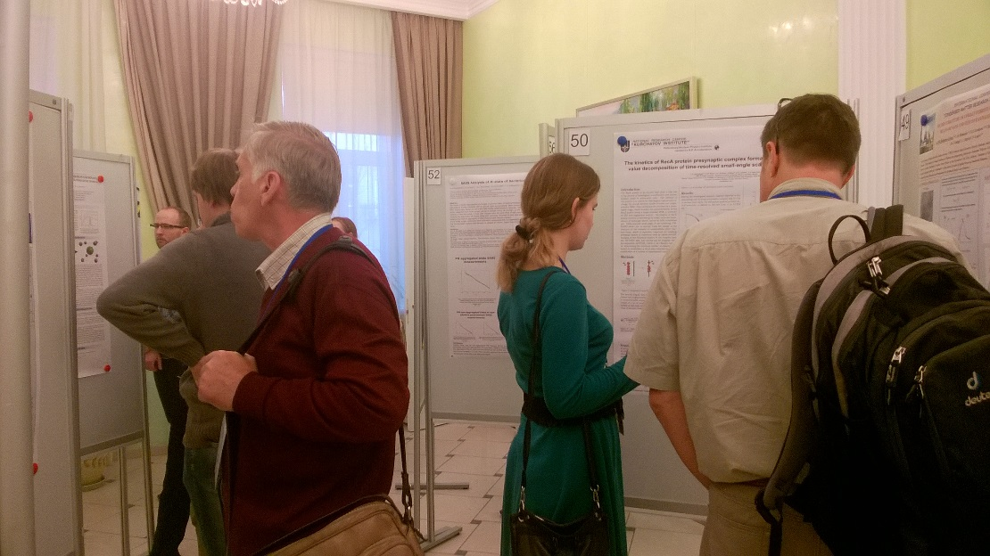
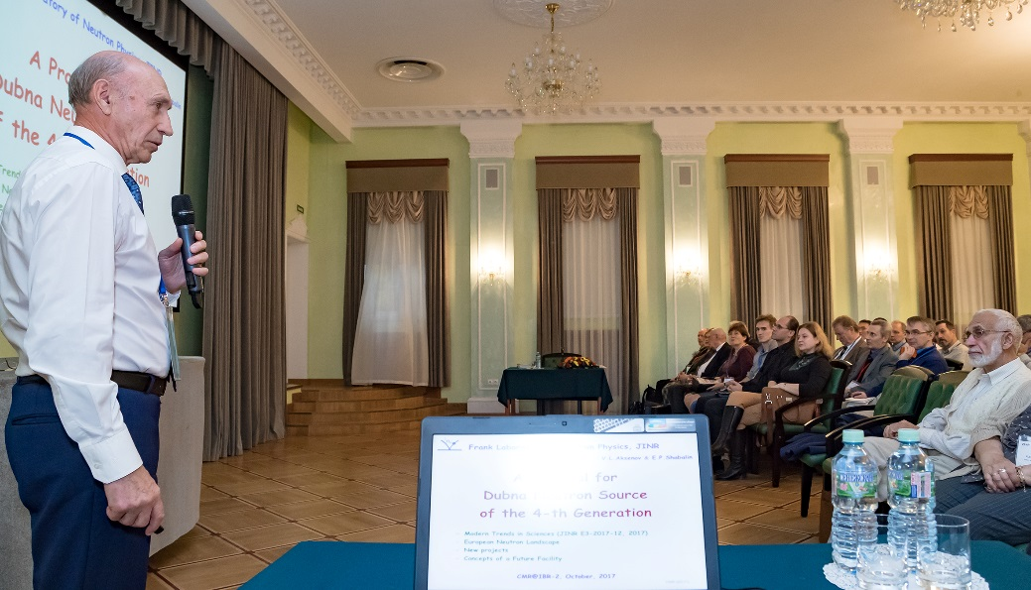
CMR@IBR2 SCIENTIFIC PROGRAMME
INVITED SPEAKER - 11
PLENARY TALK – 53
POSTER - 69
23-Jan-2018
47th Meeting of the PAC for the Condensed Matter Physics

Slide 7
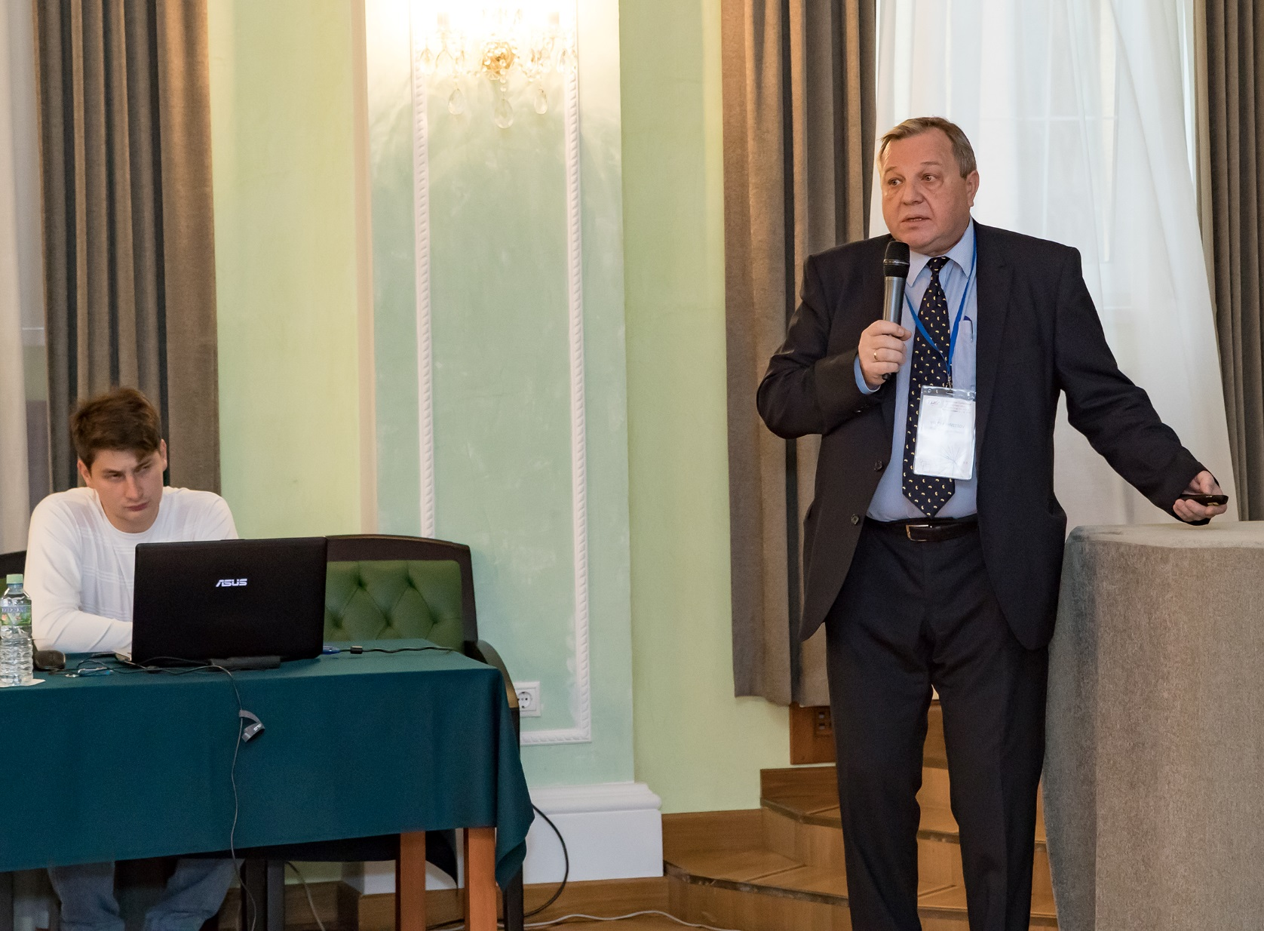
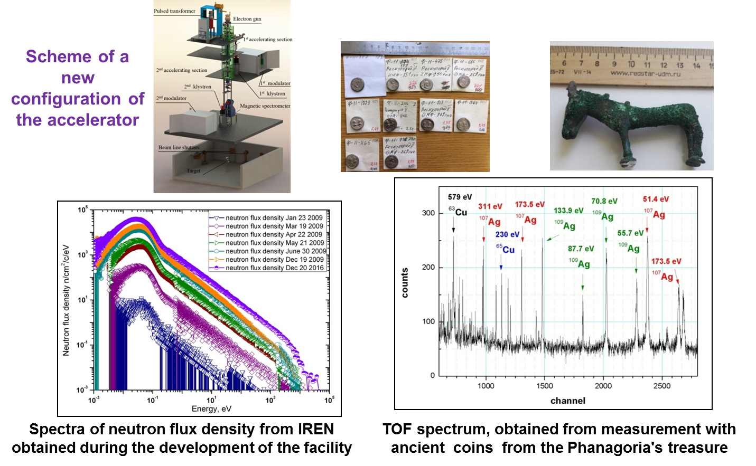
INTRODUCTORY SESSION: Shvetsov V. (FLNP JINR, Dubna). Neutron physics at FLNP JINR
Development of the IREN facility
23-Jan-2018
47th Meeting of the PAC for the Condensed Matter Physics

Slide 8
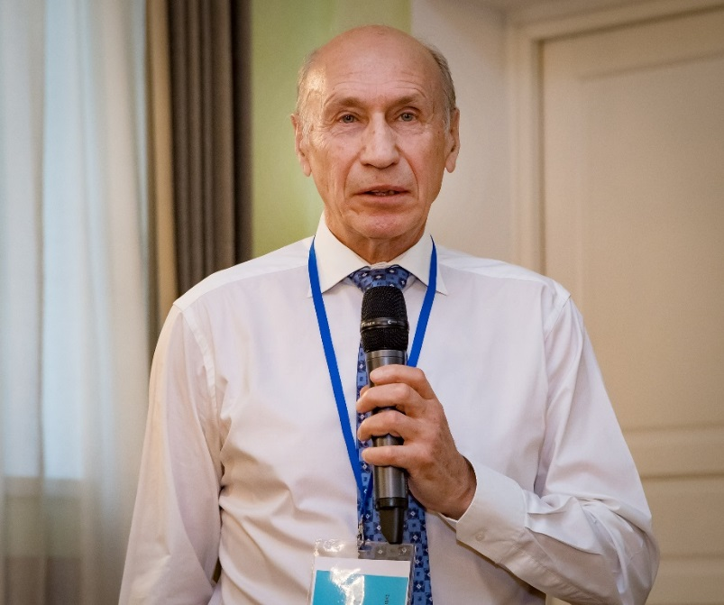
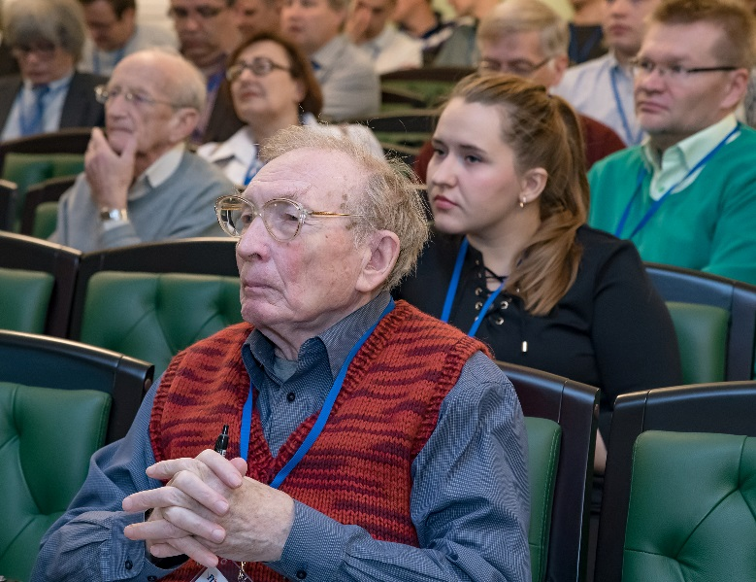
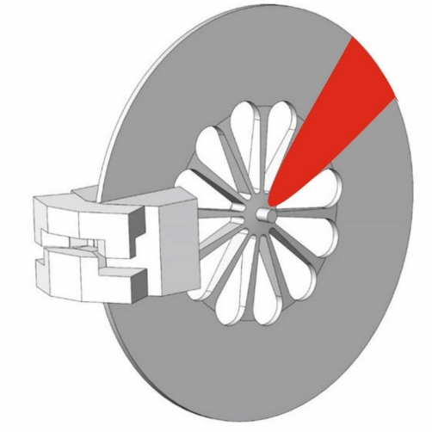
INTRODUCTORY SESSION:
Aksenov V. (FLNP JINR, Dubna). A proposal for Dubna neutron sources of the 4th generation.
DNS-IV
15 MW
Brightness,
peak × 10¹⁴
Linear 1 GeV p-Accelerator
with Variable Pulse Duration +
Multiplying Target Station
100÷600 MEu
Why Neptunium–237 ?
23-Jan-2018
47th Meeting of the PAC for the Condensed Matter Physics
Linear 1 GeV p-Accelerator
with Variable Pulse Duration +
Multiplying Target Station

Slide 9
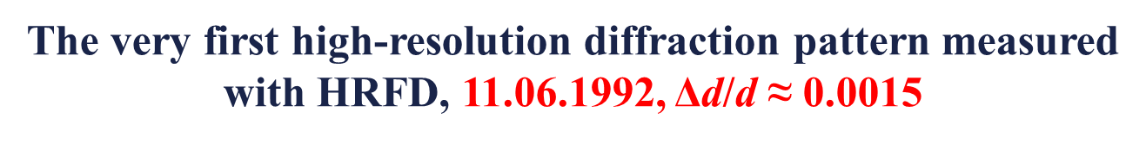
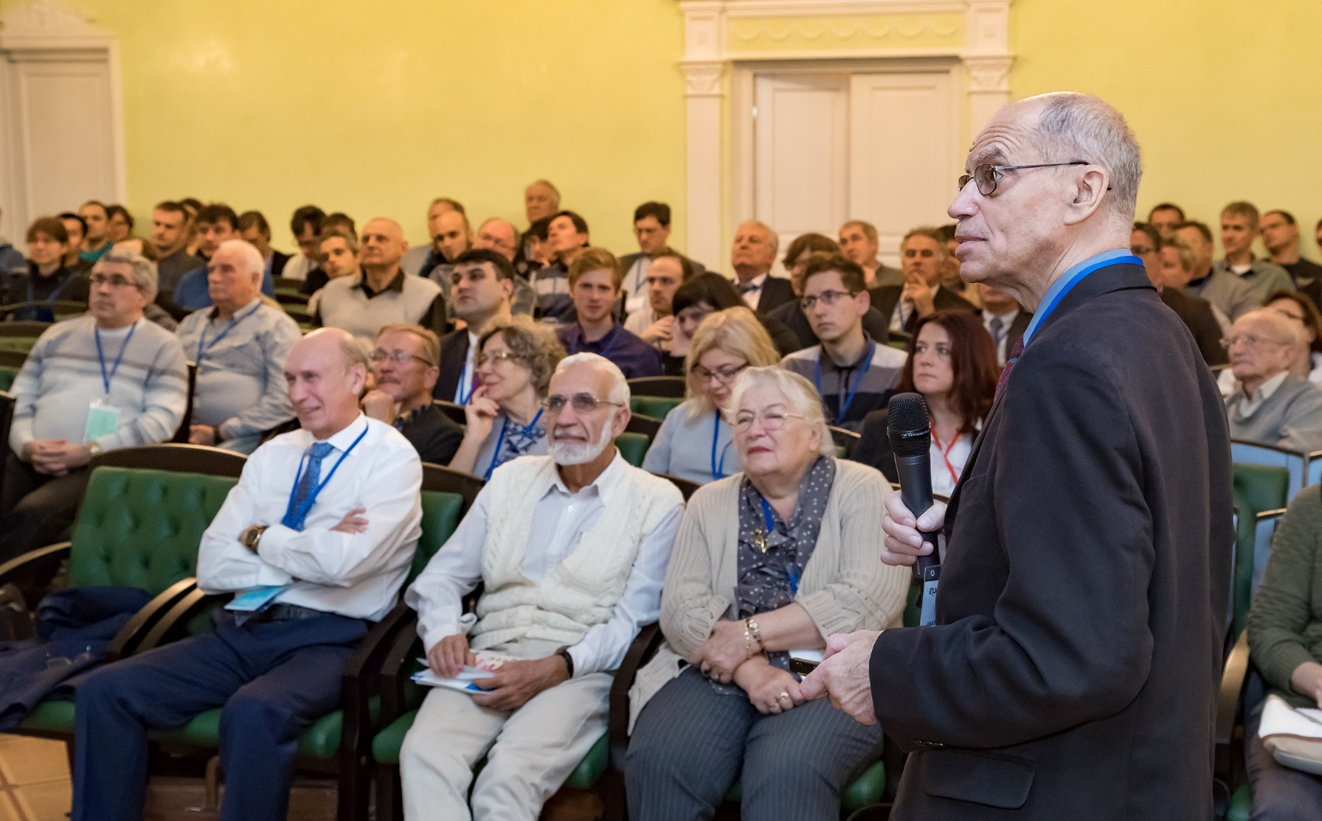
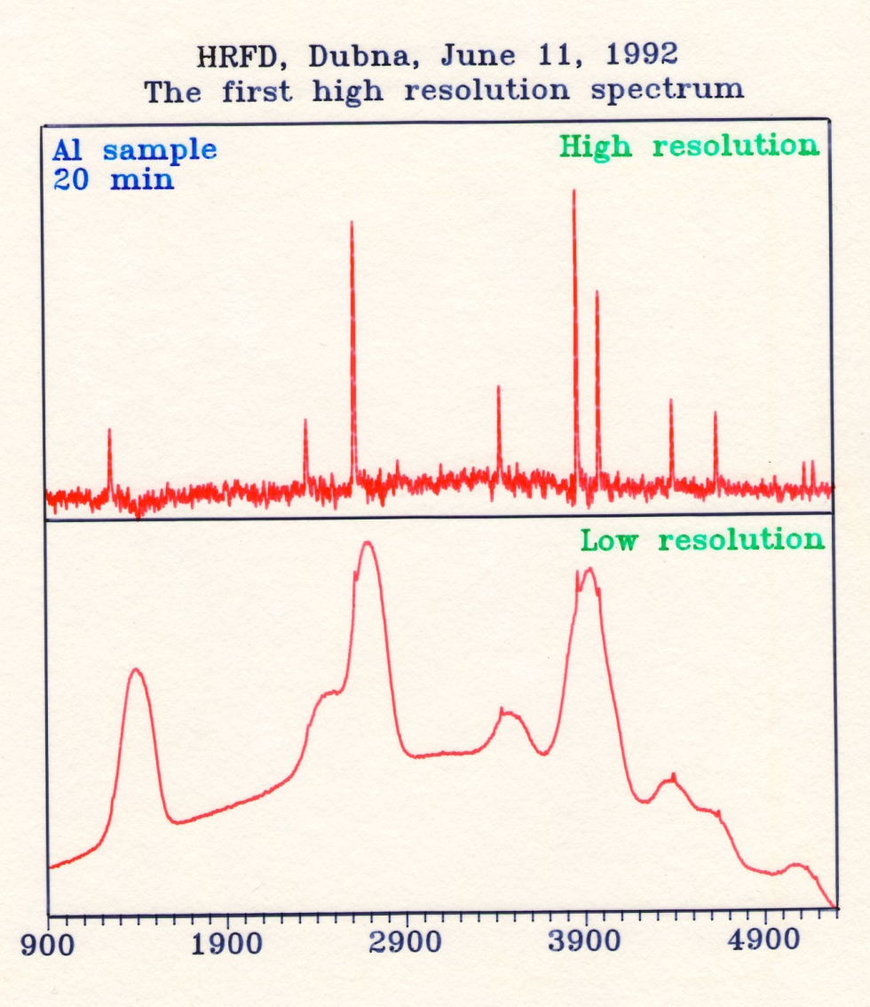
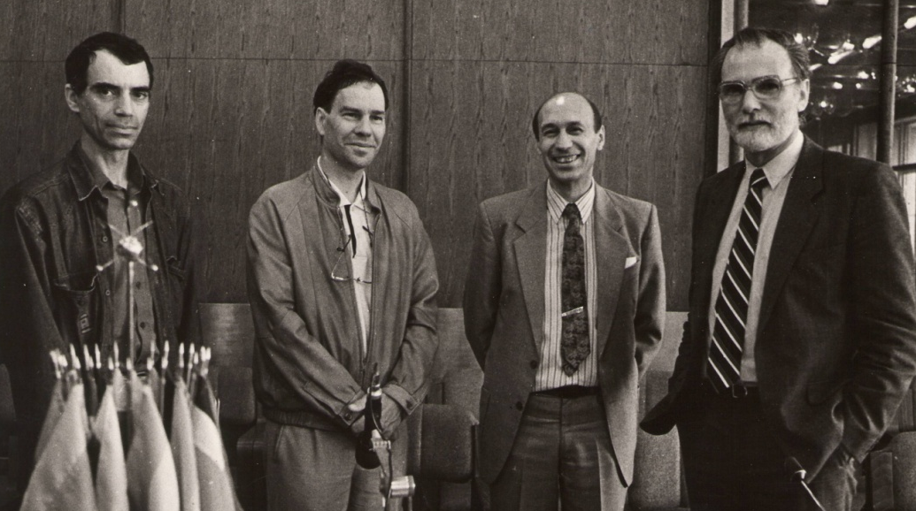

INTRODUCTORY SESSION:
Balagurov A. (FLNP JINR, Dubna). Correlation Fourier diffractometry at long-pulse neutron sources:
the 25th anniversary of the technique at the IBR-2 reactor
Vladimir Kadyshevsky (JINR Director), Victor Aksenov (FLNP Director), Pekka Hiismäki (VTT), Anatoly Balagurov (FLNP).
23-Jan-2018
47th Meeting of the PAC for the Condensed Matter Physics

Slide 10
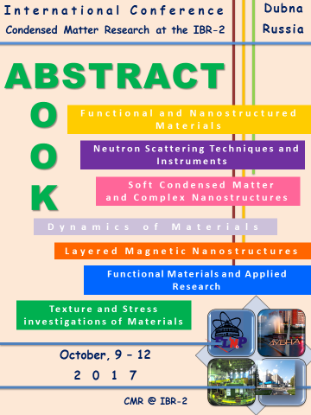
Functional Materials and Applied Research
Techniques and Instruments
- Oral (53)
- Poster (69)
23-Jan-2018
47th Meeting of the PAC for the Condensed Matter Physics

Slide 11
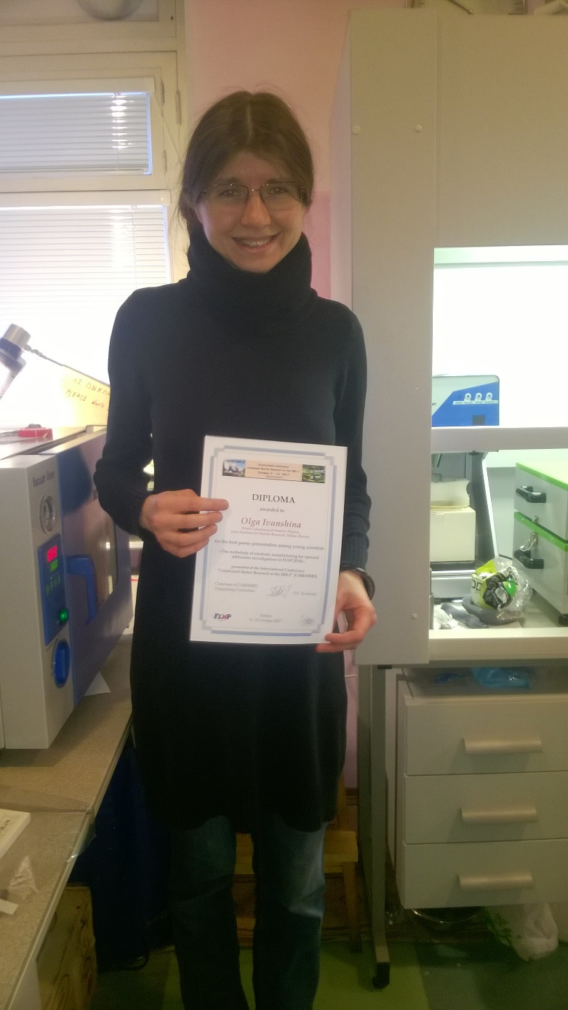
The best poster presentation
among young scientists:
Siposova Katerina (Institute of Experimental Physics SAS, Kosice, Slovakia). Structural study of protein amyloid fibrils upon interaction with fullerene aqueous solutions using small angle scattering
Ivanshina Olga ( Frank Laboratory of Neutron Physics, Joint Institute for Nuclear Research, Dubna, Russia). The metholody of electrode manufacturing for operand diffraction investigations in FLNP JINR.
Serebrennikov Dmitry (I. Kant Baltic Federal University, Kaliningrad, Russia). Investigation of anomalous phonon softening in GdB6, TbB6 ANDDyB6 using the superatom model.
23-Jan-2018
47th Meeting of the PAC for the Condensed Matter Physics

Slide 12
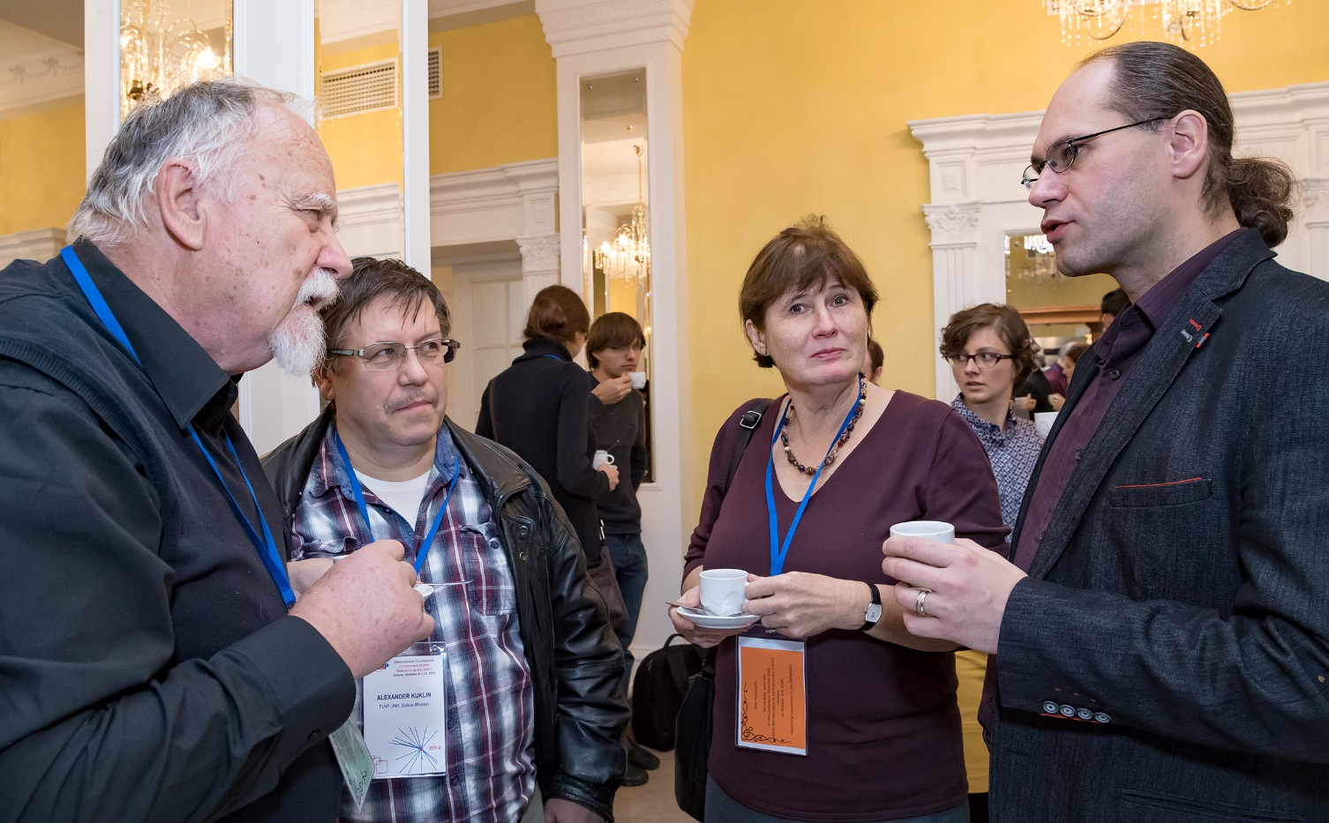
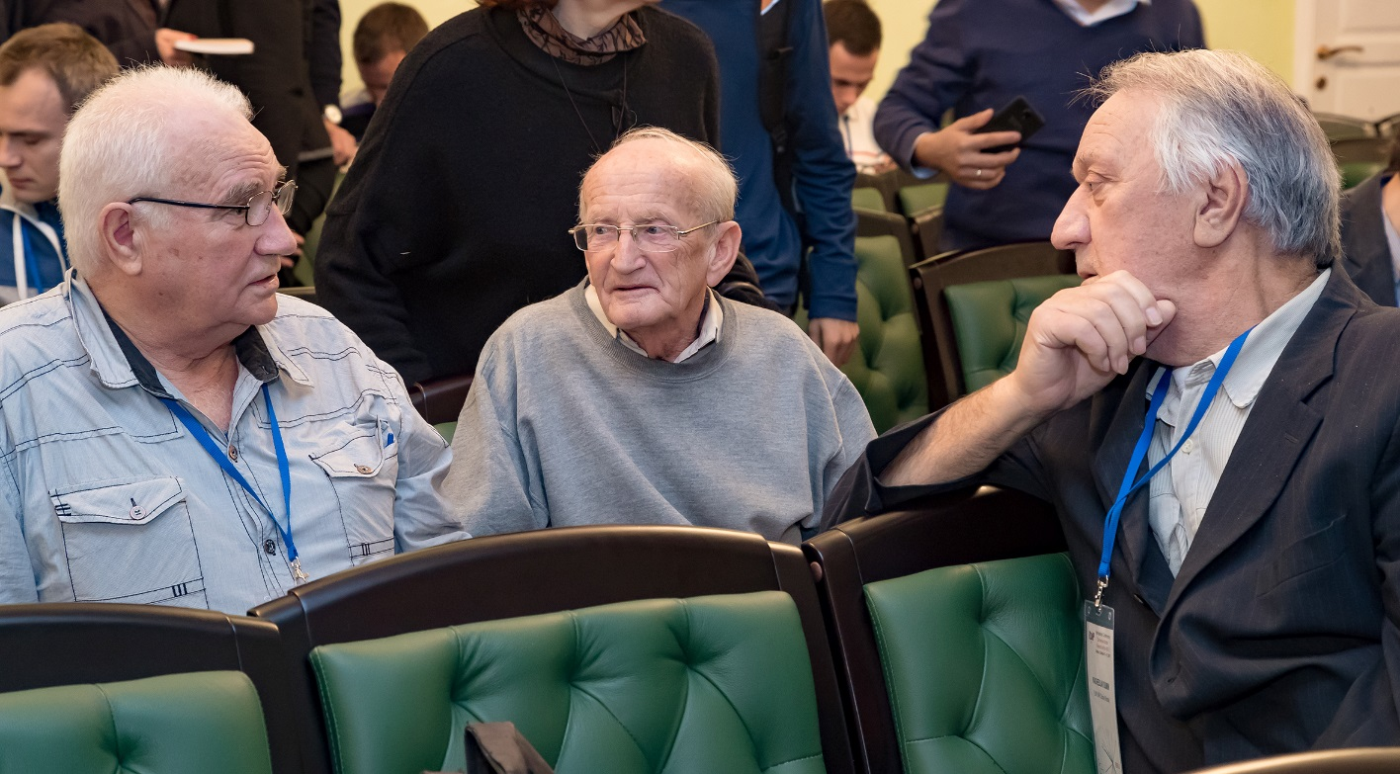
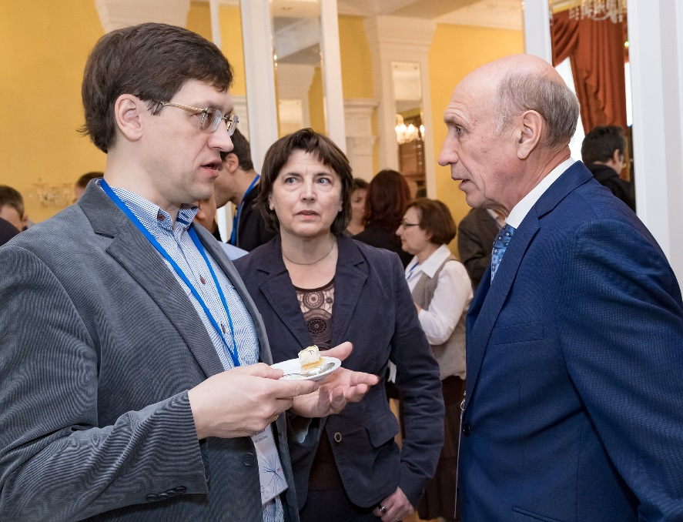
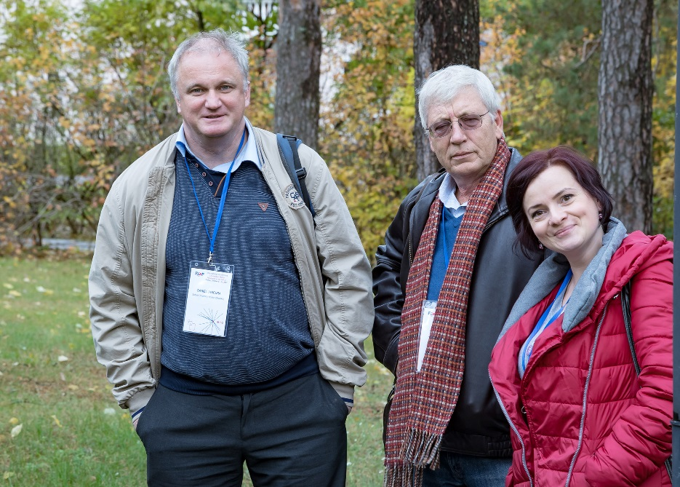
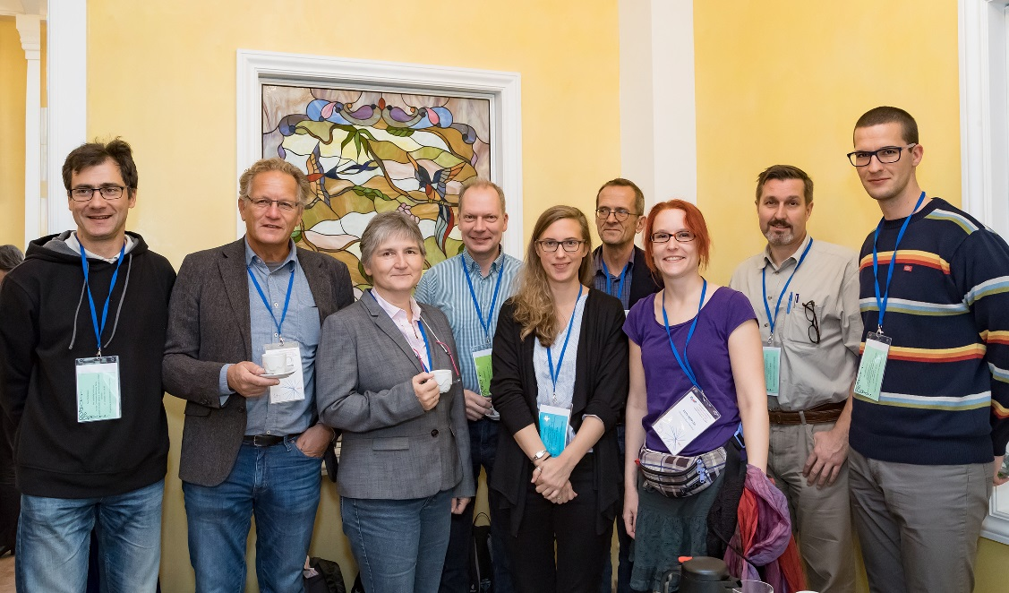
CMR@IBR-2: Recording Moments…
23-Jan-2018
47th Meeting of the PAC for the Condensed Matter Physics

Slide 13

PRESS ABOUT CMR@IBR-2
…“The conference with more than 150 participants
was excellent event not only to introduce with
recent research performed at individual
Spectrometers at the IBR reactor but also
to meet colleagues, to exchange scientific idea
or to find a new international collaboration.
I, personally, thank the Organizing
Committee for these 4 fruitful days of interesting
scientific program and warm hospitality
in friendly ambiance of Scientific club of JINR”
Daniela Uhrikova, Professor of Comenius
University , Slovakia
23-Jan-2018
47th Meeting of the PAC for the Condensed Matter Physics

Slide 14
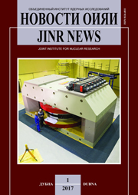
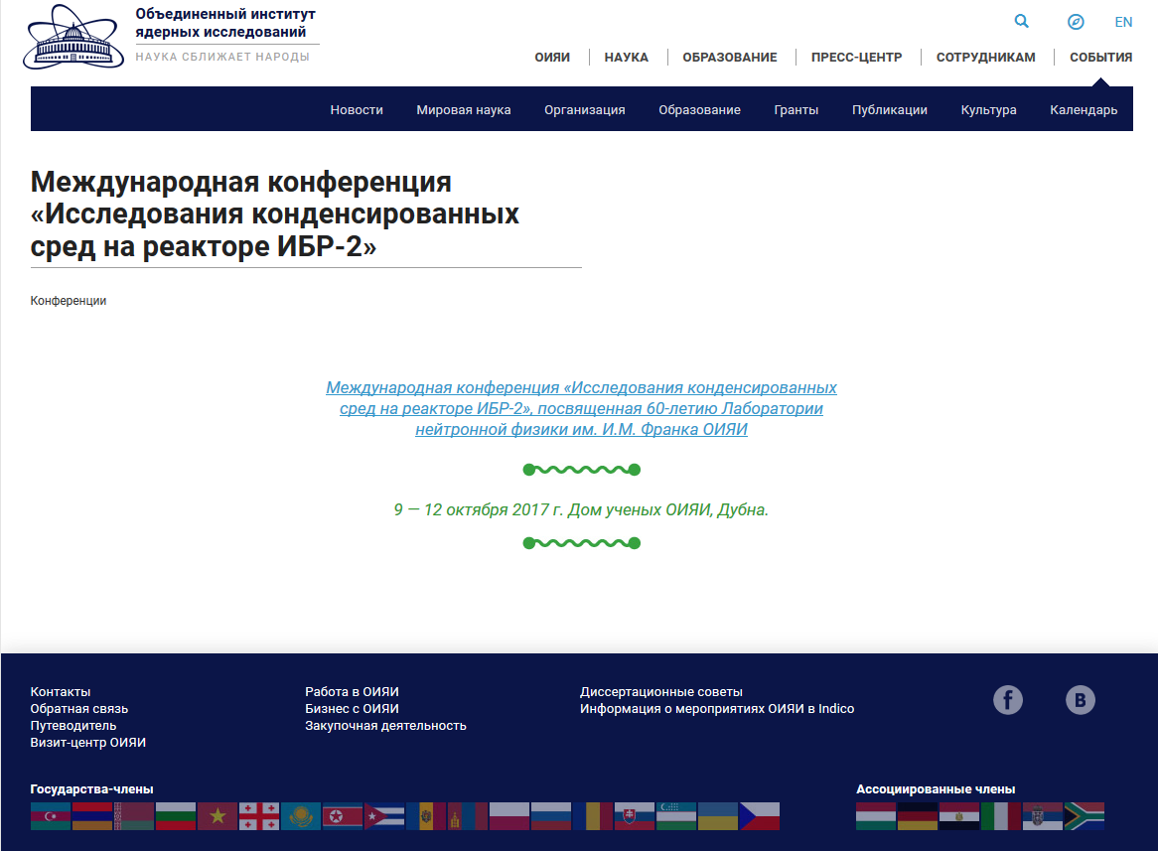
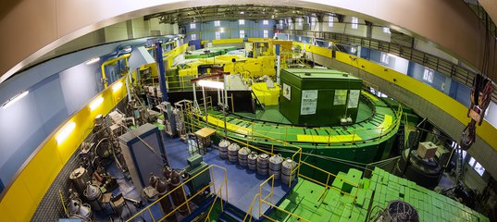
PRESS ABOUT CMR@IBR-2
9 октября 2017 г. начинает свою работу
международная конференция «Исследования
конденсированных сред на реакторе ИБР-2»,
посвященная 60-летию Лаборатории нейтронной
физики им. И.М. Франка ОИЯИ.
Исследования на реакторе ИБР-2 в ОИЯИ, http://science-tv.jinr.ru/
Читайте также статью Еженедельника ОИЯИ о прошедшей конференции
23-Jan-2018
47th Meeting of the PAC for the Condensed Matter Physics

Slide 15
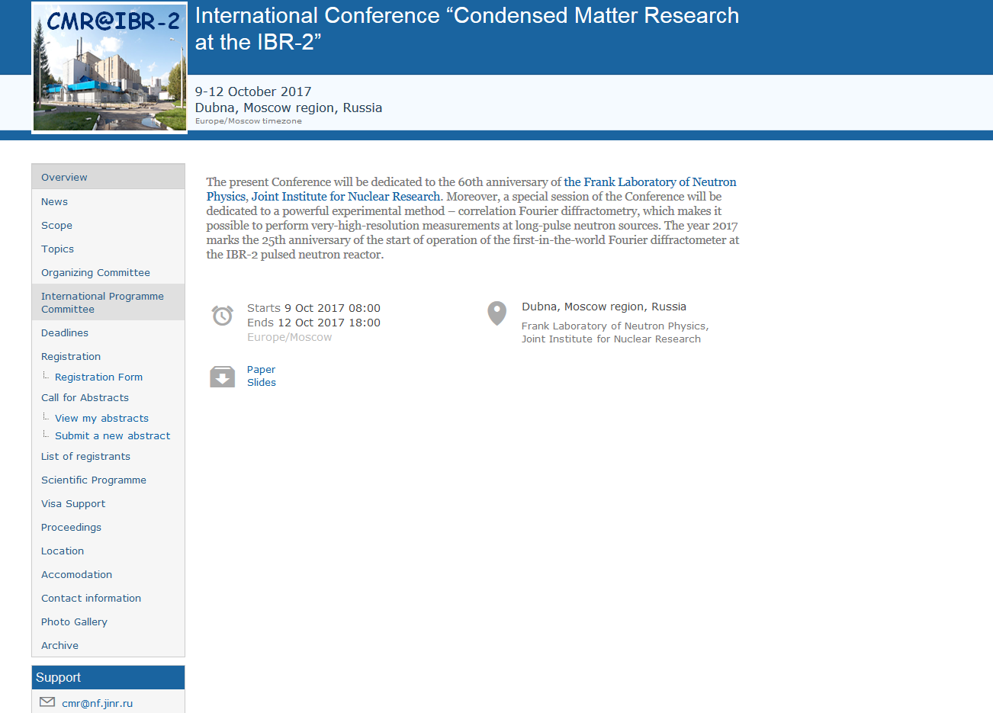

23-Jan-2018
47th Meeting of the PAC for the Condensed Matter Physics

Slide 16
International Programme Committee Prof. V.L. Aksenov (Russia) Prof. P.A. Alekseev (Russia) Prof. A.M. Balagurov (Russia) Prof. P. Balgavý (Slovak Republic) Prof. A.V. Belushkin (Russia) Prof. E. Burzo (Romania) Prof. V.T. Em (Russia) Prof. V.G. Kantser (Moldova) Prof. P. Kopcansky (Slovak Republic) Prof. D. Nagy (Hungary) Prof. W. Nawrocik (Poland) Prof. P. Petrov (Bulgaria) Prof. D. Sangaa (Mongolia) Dr. A. Senyshyn (Germany) Prof. S. Vratislav (Czech Republic) Prof. J. Wasicki (Poland)
Local Organizing Committee Prof. D.P. Kozlenko – Chairman Dr. M. Balasoiu Dr. M.V. Avdeev Dr. G.D. Bokuchava Dr. D.M. Chudoba Mrs. T.S. Donskova – Secretary Mrs. Yu.E. Gorshkova Dr. T.I. Ivankina - Scientific Secretary Mr. S.V. Kozenkov Dr. B.N. Savenko
23-Jan-2018
47th Meeting of the PAC for the Condensed Matter Physics

Slide 17
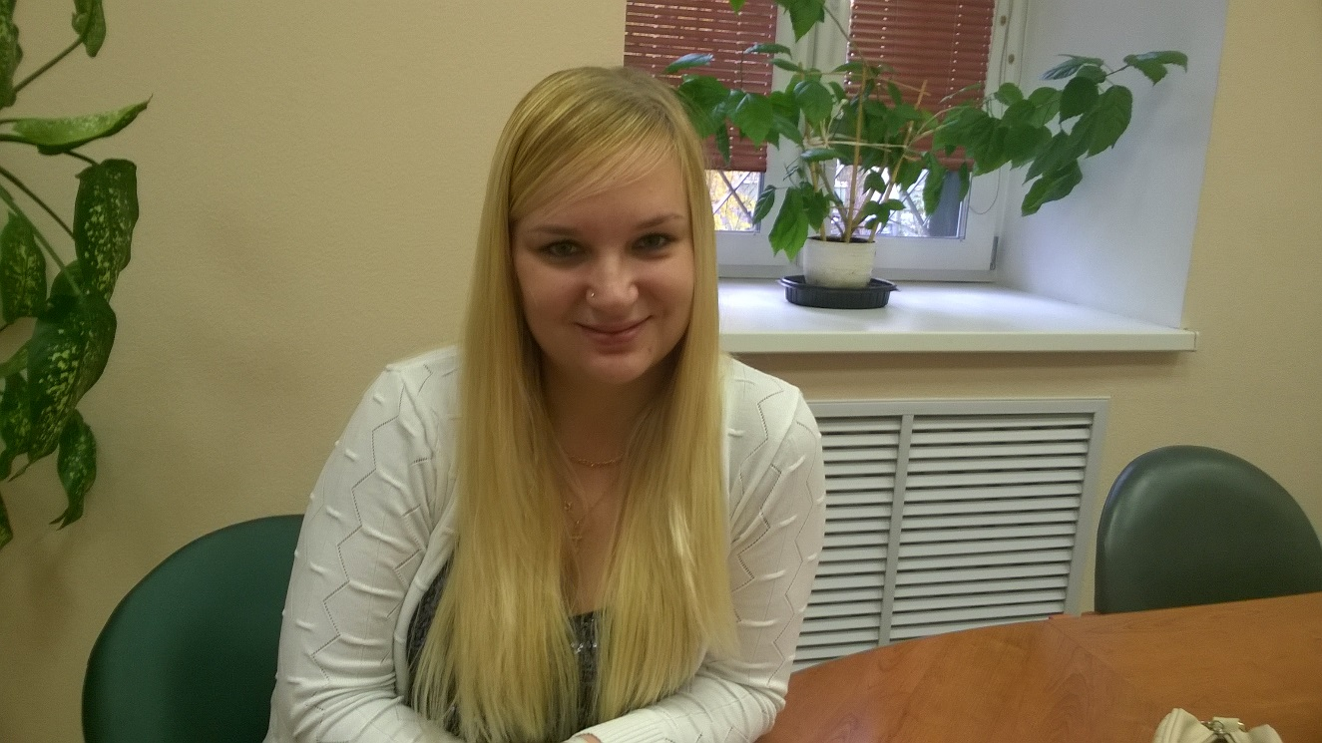
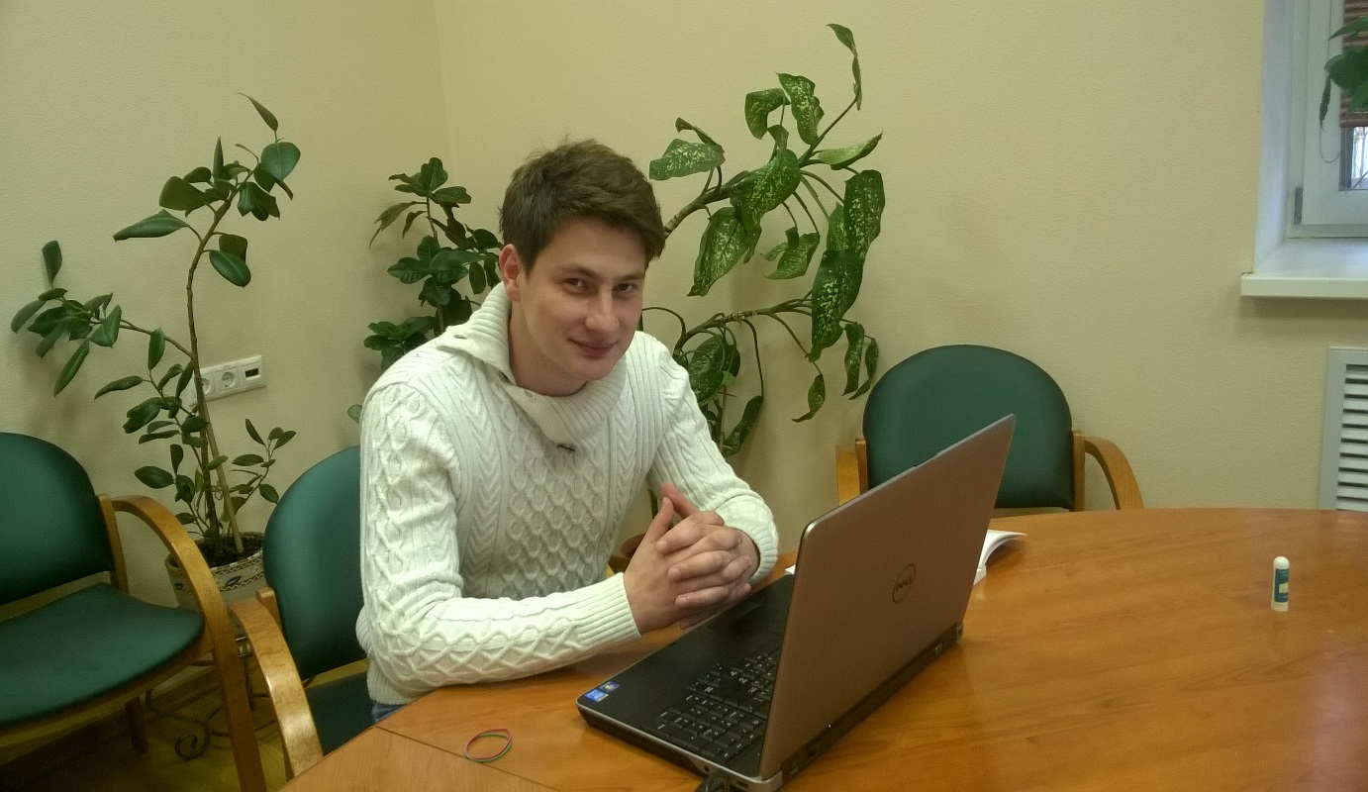
ACKNOWLEDGEMENTS
Valentina Alferjeva
Anton Rutkauskas
23-Jan-2018
47th Meeting of the PAC for the Condensed Matter Physics

Slide 18
Thank you for your attention!
23-Jan-2018
47th Meeting of the PAC for the Condensed Matter Physics

