Slide 1
Programme Advisory Committee
for Condensed Matter Physics
46th meeting
Follow-up
Dénes Lajos Nagy

Slide 2
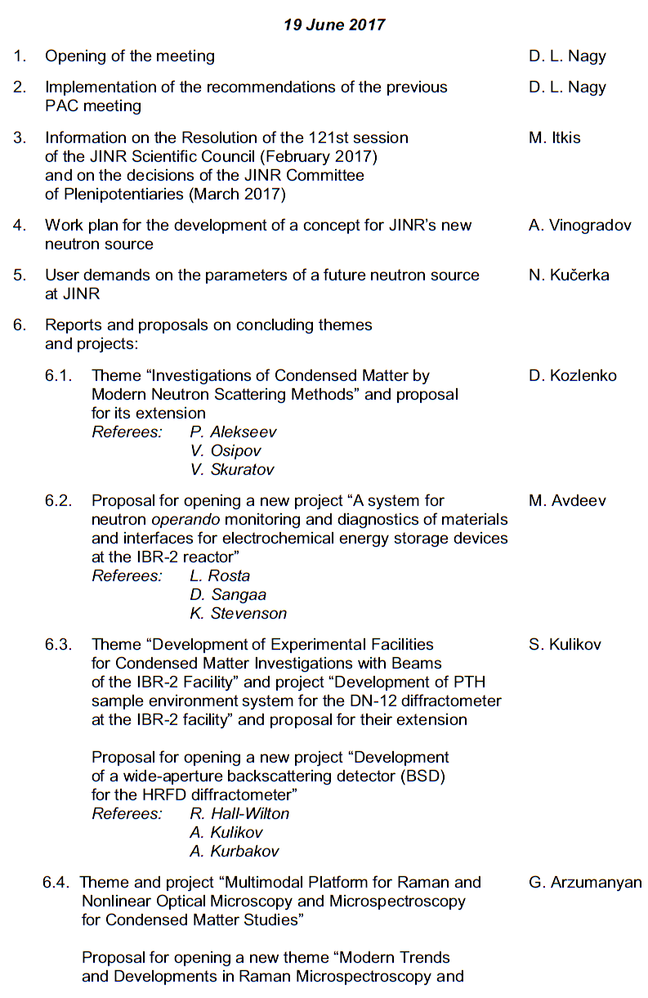
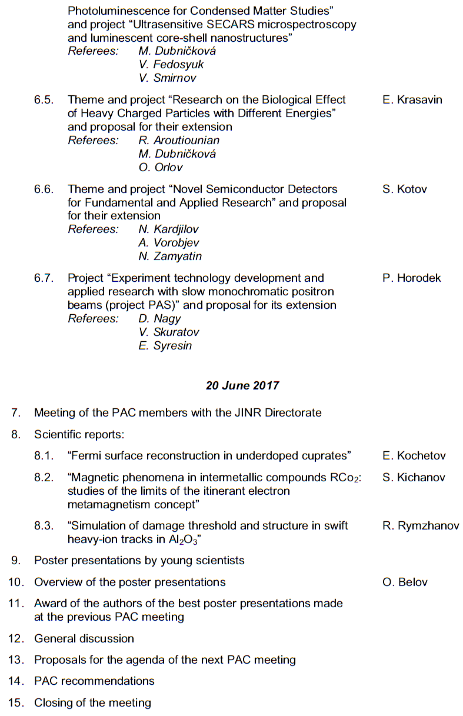
Recalling the agenda of the 46th PAC meeting
Highlights of the previous PAC-CMP meeting:
Plans for the preparation of a concept for JINR’s new neutron source
Reports and proposals on themes and projects
Scientific and technical achievements within concluding themes and projects

Slide 3
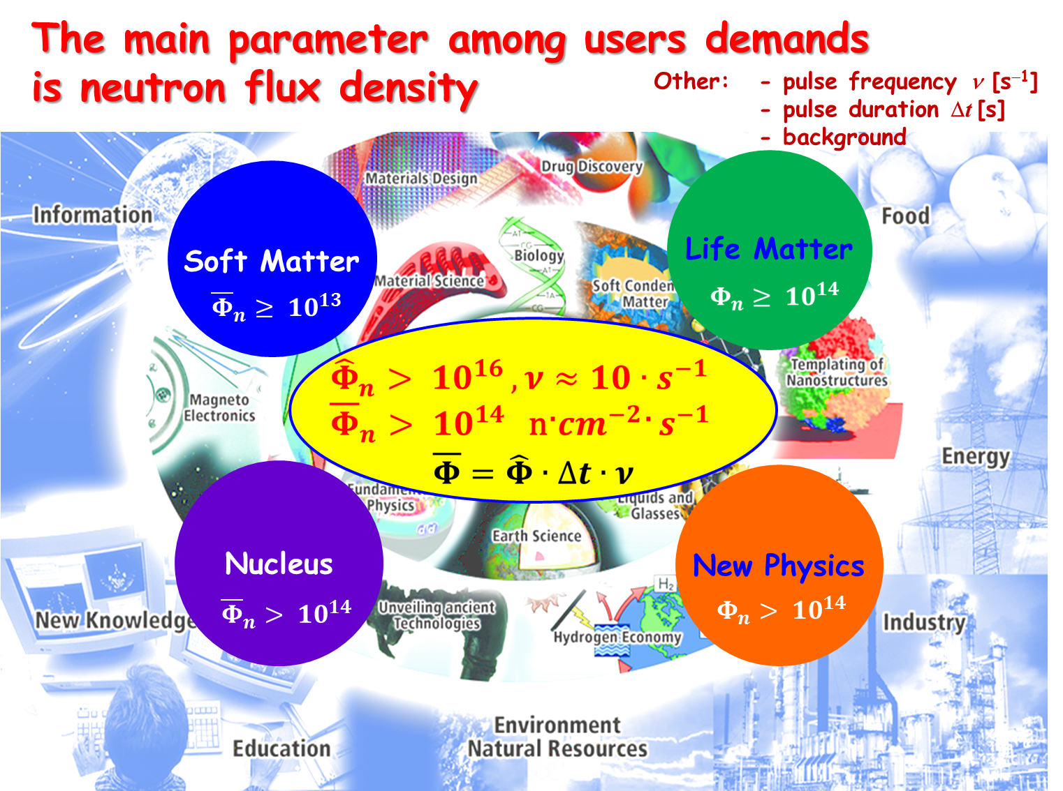
PAC recommendation about the development
of a concept for a new neutron source at JINR
The PAC heard with interest two reports on plans for the preparation of a concept for JINR’s new neutron source and user demands to its parameters presented by A. Vinogradov and N. Kučerka.
The PAC noted the growing need for neutrons in modern sciences due to the unique properties of a neutron in its interaction with matter.
At the same time, the number of neutron sources constantly decreases worldwide since obsolete reactors are
being shut down.
In this regard, the PAC considered
starting the strategic planning of
a possible project for JINR’s new
neutron source replacing IBR-2 after
reactor shut-down to be an important
task and takes note of the presented
plan for its implementation.

Slide 4
Scientific Council resolution about the development
of a concept for a new neutron source at JINR
The Scientific Council took note of the results of the discussion, held at the meeting of the PAC for Condensed Matter Physics, of plans for the preparation of a concept for JINR’s new neutron source replacing IBR-2 after the decommissioning of the reactor.
The Scientific Council agreed that starting the strategic planning of a possible project for a new source is an important task and welcomes further follow-up of this activity by the PAC.

Slide 5
Scientific Council resolution about the development
of a concept for a new neutron source at JINR
The first step in the planning process should be a comprehensive paper containing a clear science case and identifying the specific added value of the future JINR neutron source within the global and the European neutron source landscapes as well as the realistic user needs.
The Scientific Council appreciated the intention of the PAC to be involved in preparing this document, noting that, regarding the principal parameters of the new facility, already in the preliminary design phase attention should be paid to the needs of the scientific community.

Slide 6
Implementation of recommendations by FLNP
The preparation of science case paper for the new source of neutrons at JINR has been started.
It will identify the future opportunities in various directions of condensed matter research and nuclear sciences, while taking advantage of specifics not available to other neutron sources.
A group of experts experienced in long-term strategic planning has been established to guide the work.

Slide 7
At this meeting:
we will hear two reports on further progress in development of a concept of a new neutron source;
we will have a series of discussions.
In particular, we shall certainly need to discuss in details the timeline of ex-ante evaluation process, the milestones of which will be
establishing an international expert group;
publishing a short paper on the idea of the new
facility;
elaborating and publishing a detailed scientific case;
elaborating a detailed technical design report;
elaborating the administrative and financial model for the
construction, commissioning, operation and decommissioning
phases;
decision on the construction of the new facility.

Slide 8
Scientific Council resolution on the PAC recommendations concerning FLNP User Programme
The Scientific Council acknowledged the high quality of the implementation of the IBR-2 User Programme that made this basic JINR facility one of the world's leading open-access neutron sources.
The successful operation of the IBR-2 User Programme and the enhancement of its performance through instrumentation upgrades is a prerequisite to a new JINR neutron source.
Today we will have a report and discussion about statistics of User Programme implementation and organization of the proposal assessment

Slide 9
Scientific Council resolution on evaluated
themes and projects
The Scientific Council supported the PAC’s recommendations on the continuation of ongoing activities and the opening of new themes and projects in condensed matter physics and related fields, appreciating the scientific and technical results obtained.
In particular:

Slide 10
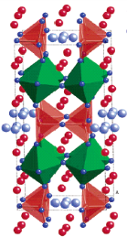
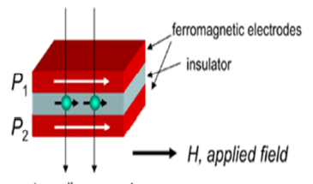
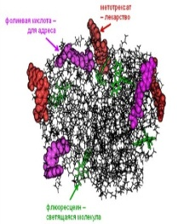
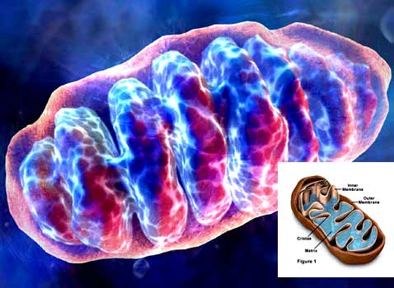
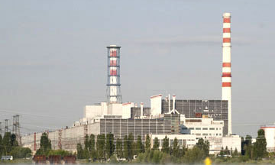
Investigations of Condensed Matter by Modern Neutron Scattering Methods
D. Kozlenko
The PAC appreciated the high quality of the obtained scientific results, the significant progress achieved in the development of the IBR-2 spectrometer complex, and the broad cooperation with Member States in the realization of the theme. Implementation of the User Programme was also a very important activity of the theme.
Recommendation. The PAC recommended
extension of the theme “Investigations of
Condensed Matter by Modern Neutron
Scattering Methods” until the end of 2020. The PAC reiterated the importance of the continuous upgrade
of the IBR-2 spectrometers and their experimental
environment that will lead to considerably increasing
their performance.
Notes:
A very good point of this activity

Slide 11
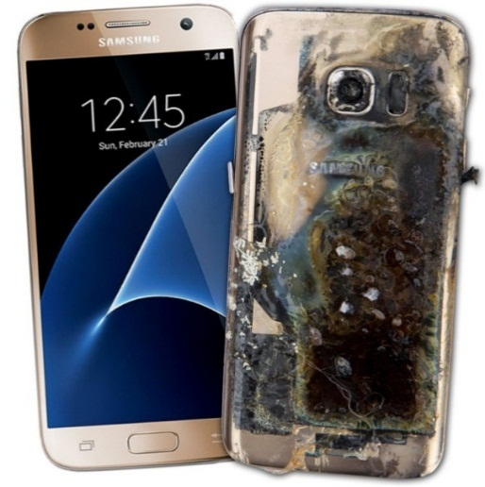
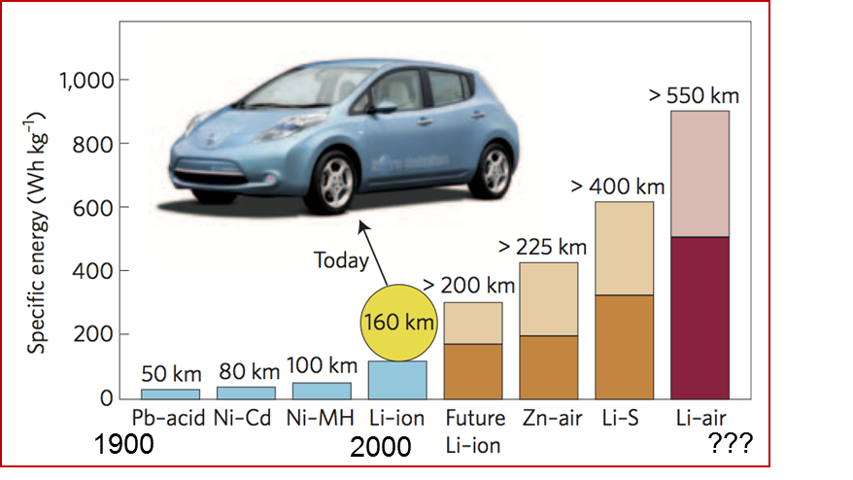
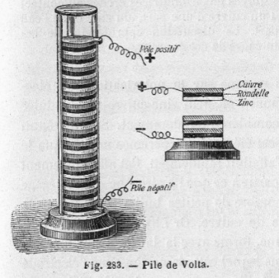
New project “A system for neutron operando monitoring and diagnostics of materials and interfaces for electrochemical energy storage devices at the IBR-2 reactor”
M. Avdeev
The PAC supported the opening of the project “A system for neutron operando monitoring and diagnostics of materials and interfaces for electrochemical energy storage devices at the IBR-2 reactor” for the period 2018–2020 and encourages cooperation with manufacturers.
Furthermore, the PAC endorsed the implementation of additional sample environment facilities at the IBR-2 reactor.
Electrochemical energy storage devices: current challenge
Volta’s pile, 1800
Oct. 14, 2016
Samsung Galaxy Note 7 banned on all U.S. flights due to fire hazard!

Slide 12
Concluding theme “Development of Experimental Facilities for Condensed Matter Investigations with Beams of the IBR-2 Facility” and project “Development of PTH sample environment system for the DN-12 diffractometer at the IBR-2 facility”
S. Kulikov
The PAC noted that all the work planned within the framework of the theme has been performed and highly appreciates the results obtained.
At the same time, the report points out that during the pre-commissioning period and tests of the magnet developed under the PTH project, a discrepancy between the technical characteristics of the high-temperature superconducting tape and the characteristics specified in the Manufacturer's Certificate has been revealed, which has not made it possible to achieve the design parameters of the magnet.

Slide 13
Concluding theme “Development of Experimental Facilities for Condensed Matter Investigations with Beams of the IBR-2 Facility” and project “Development of PTH sample environment system for the DN-12 diffractometer at the IBR-2 facility”
S. Kulikov
At present, negotiations are being held with the supplier to replace the tape.
In this regard, it seems reasonable to extend this project together with the theme in order to resolve the situation with the supplier and to complete the project.
Recommendation. The PAC recommended extension of the theme and project until the end of 2020.

Slide 14
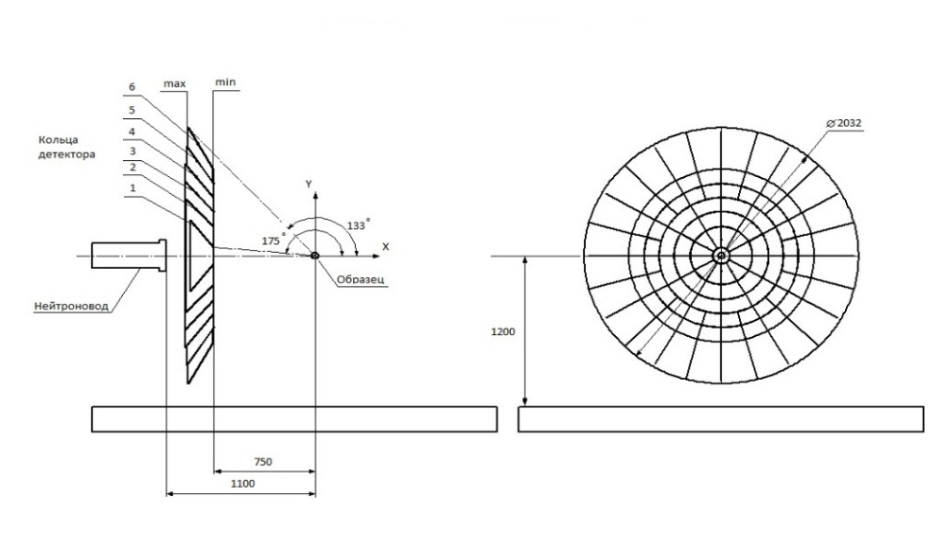
New project “Development of a wide-aperture backscattering detector (BSD) for the HRFD diffractometer”
S. Kulikov
Wide-aperture backscattering detector (BSD) for Diffractometer HRFD
This project increases the HFRD
detector solid angle coverage by
more than an order of magnitude,
as well as enhancing its capabilities
and improves gamma/neutron
discrimination.
The detector upgrade additionally has
the potential to enhance in-house capacity in detector construction, and involve students in the process.
The PAC noted that this is a well-targeted and effective investment in improving the performance of instrumentation at IBR-2.
Recommendation. The PAC recommended opening this new project for 2018–2020 within the framework of the theme “Development of Experimental Facilities for Condensed Matter Investigations with Beams of the IBR-2 Facility”.

Slide 15
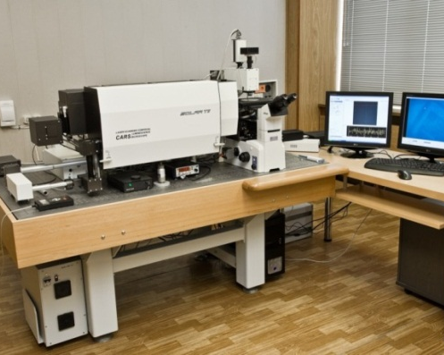
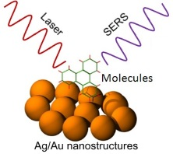
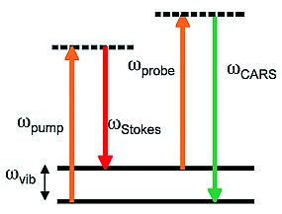
Concluding theme and new project in Raman Spectroscopy
The PAC noted the significant progress in the development of this theme both in the field of scientific research with a number of publications in high-impact journals and in the upgrade of trends in Raman spectroscopy, concretely of the SECARS microspectrometer modality based on four-waves mixing at plasmonic materials, currently operating at a world-class competitive level with respect to similar spectral analytical devices.
The PAC welcomed the proposal of theme leaders aimed at realization of Raman microscopy of single molecules as well as at studies of rare-earth element luminescence on the basis of promising core-shell nanostructures.
Recommendation. The PAC recommended opening the new theme “Modern Trends and Developments in Raman Microspectroscopy and Photoluminescence for Condensed Matter Studies” and the project “Ultrasensitive SECARS microspectroscopy and luminescent core-shell nanostuctures” for 2018–2020.
SERS
CARS

Slide 16
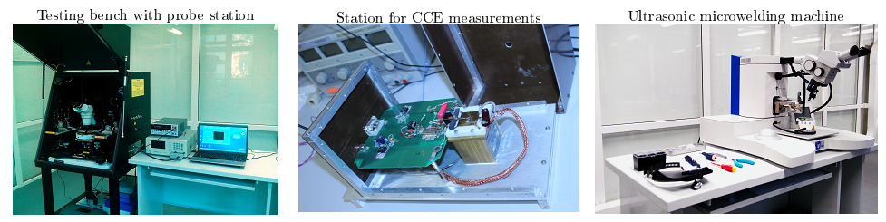
Concluding theme and project “Novel semiconductor detectors for fundamental and applied research”
S. Kotov
The PAC highly appreciated the successful implementation of the project and, in particular, welcomes JINR’s membership in the Medipix collaboration.
The PAC considered the proposal for extending the theme and project for the next three years to be well motivated, based on previous achievements and aimed at the applied use of products of fundamental research. The funding request is reasonable.
Recommendation. The PAC recommended extension of the theme and project “Novel semiconductor detectors for fundamental and applied research” until the end of 2020.

Slide 17
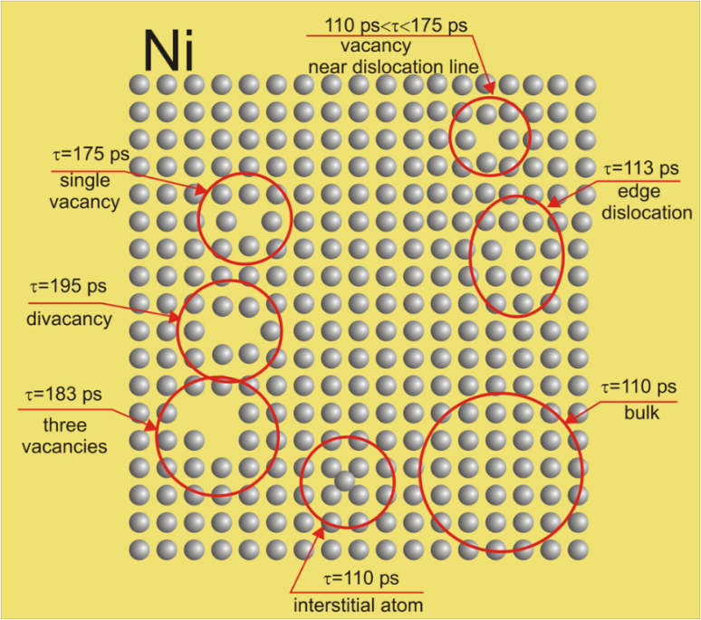
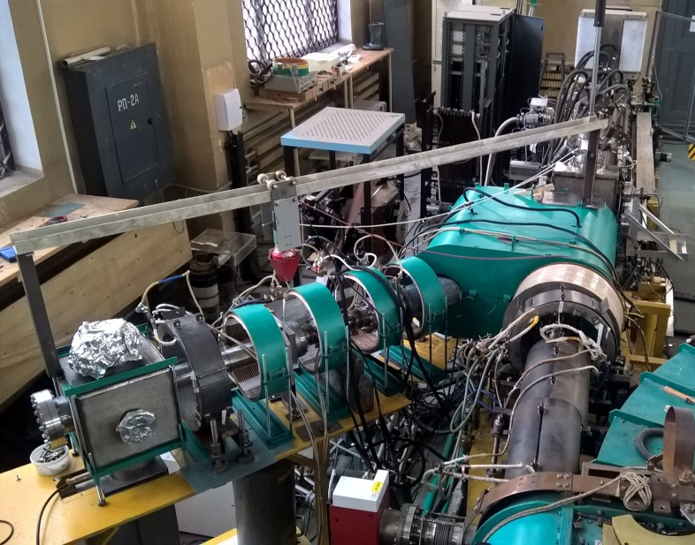
Project PAS
P. Horodek
The PAC notes with satisfaction the progress in the development of the PAS method at the LEPTA facility at DLNP including construction of a specialized channel of slow monochromatic positrons (SCSMP) and the elaboration of a proposal for the formation of the ordering flux of positrons based on SCSMP which allows one to implement in the near future the positron annihilation lifetime spectroscopy.
The implementation of the programme presented in this project will bring the facility to a qualitatively new level opening new opportunities for experimental research in condensed matter physics and materials science.
Positron lifetimes in different defects of Ni structure
Positron beam
Recommendation. The PAC recommends extension of the PAS project until the end of 2020 for its implementation under the theme “Novel Semiconductor Detectors for Fundamental and Applied Research”.

Slide 18
Concluding the theme and project “Research on the Biological Effect of Heavy Charged Particles with Different Energies”
and of the proposal for its extension
E. Krasavin
The PAC notes that addressing the fundamental and practical problems urgently requires that the regularities and mechanisms of the heavy charged particle effects be studied in detail at the molecular, cellular, tissue and organismal levels of biological models.
The approaches developed at LRB to the problem and studies of chromosomal instability in mammalian and human cell during their responses to exposure of different types of ionizing radiation at low doses will allow clearing up the mechanisms behind these reactions and evaluating the contribution of physicochemical processes and inducible repair mechanisms to their realization.
In turn, these studies will allow the assessment of the system’s integrity violation manifesting as cognitive and behavioural disorders.
Recommendation. The PAC finds the presented proposal well-formulated and recommends extension of the theme and project “Research on the Biological Effect of Heavy Charged Particles with Different Energies” until the end of 2020.

Slide 19
Agenda suggested last June for today meeting
Information by the PAC Chairman on the report at the next session of the Scientific Council, and the implementation of the recommendations of the current PAC meeting;
Information by the JINR Directorate on the sessions of the Scientific Council (September 2017) and of the Committee of Plenipotentiaries (November 2017);
Reports and recommendations on themes and projects to be completed in 2018 and status reports about ongoing themes;
Discussion of the progress of the scientific case for JINR’s new neutron source including the landscape of relevant scientific facilities;
Information on the new cooperation between JINR and the SOLARIS synchrotron source in Kraków (Poland);
IBR-2 scientific and technical report including the progress in the FLNP User Programme;
Status reports on the upgrades of FLNP instruments and in the context of the JINR Seven-year plan;
Information about scientific meetings;
Scientific reports;
Poster session.

Slide 20
Thank you for your attention

