Slide 1
Programme Advisory Committee for Nuclear Physics
46-th meeting
Follow-up
14–15 June 2017
Marek Lewitowicz

Slide 2
14 June 2017
15 June 2017
 | 1. | Opening of the meeting | M. Lewitowicz
 | 2. | Implementation of the recommendations of the previous PAC meeting | M. Lewitowicz
 | 3. | Information on the Resolution of the 121st session of the JINR Scientific Council (February 2017) and on the decisions of the JINR Committee of Plenipotentiaries (March 2017) | M. Itkis
 | 4. | Status of the Factory of Superheavy Elements:
 |  | 4.1. Cyclotron DC-280 | I. Kalagin
 |  | 4.2. Ion source | S. Bogomolov
 |  | 4.3. Separator, target and detection units | A. Popeko
 | 5. | Commissioning of the ACCULINNA-2 fragment separator and its first day experiments | A. Fomichev
 | 6. | Visit to FLNR (SHE Factory) | S. Dmitriev N. Skobelev
 | 7. | Proposal for the extension of the project “Design and development of the tagged neutron method for determination of the elemental structure of materials and nuclear reaction studies (project TANGRA)” | Yu. Kopatch
 | 8. | Proposal for the extension of the project: “Study of deeply subcritical electronuclear systems and possibilities of their application for energy production, transmutation of radioactive waste and research in the field of radiation material science. Part III. Quasi infinite target (project E&T&RM)” | V. Wagner
 | 9. | Written reports on the scientific results obtained in the completed projects under the theme “Physics of Light Mesons”:
 |  | 9.1. Project PEN-MEG | N. Khomutov
 |  | 9.2. Project TRITON | D. Demin
 |  | 9.3. Project PAINUC | G. Pontecorvo
 | 10. | Scientific reports:
 |  | 10.1. “Dipole toroidal resonance: vortical properties, anomalous deformation splitting, relation to pygmy mode” | V. Nesterenko
 |  | 10.2. “Search for spatial parity violation effects in reactions of cold polarized neutrons with lightest nuclei” | P. Sedyshev
 | 11. | General discussion
 | 12. | Meeting of the PAC members with the JINR Directorate (closed session)
 | 13. | Poster presentations by young scientists
 |  | General conclusion on the poster presentations
 |  | Closed session:
 | 14. | PAC recommendations
 | 15. | Proposals for the agenda of the next PAC meeting
 | 16. | Presentation of the PAC recommendations
 | 17. | Closing of the meeting

Slide 3
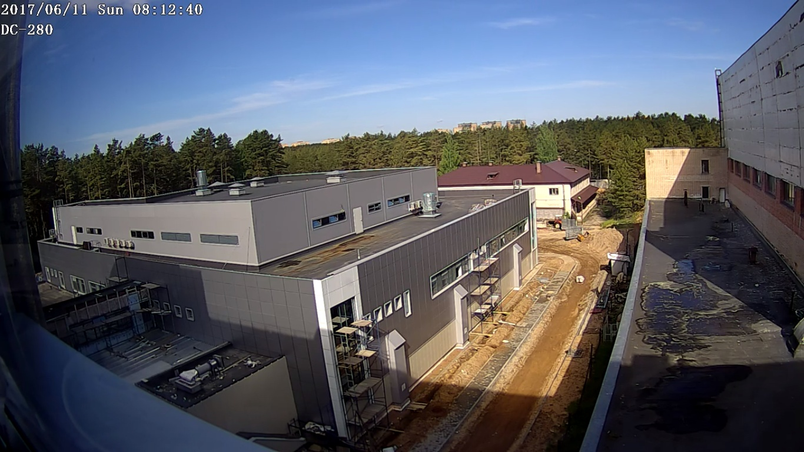
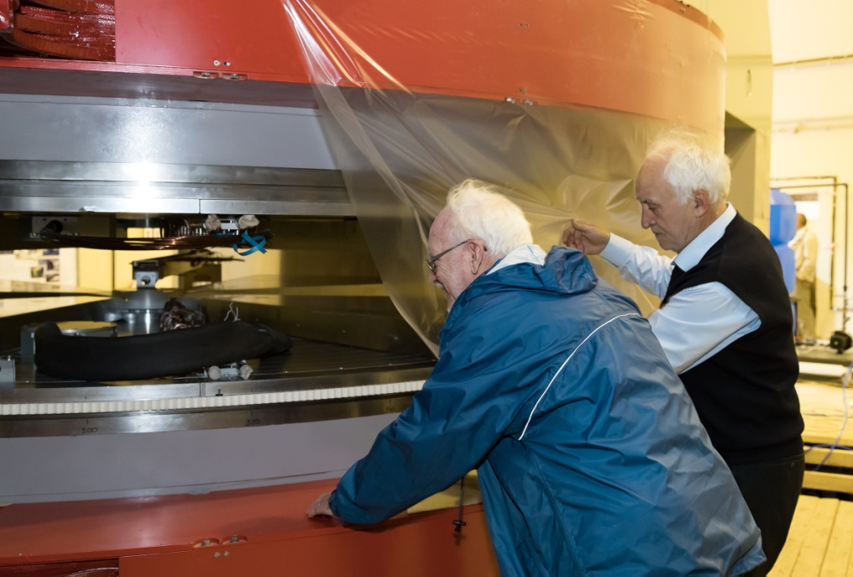
I. Status of the Factory of Superheavy Elements
(SHE Factory)
!
The PAC
heard reports on the status of the Factory of Superheavy Elements presented by Igor Kalagin, Sergey Bogomolov, and Andrey Popeko;
appreciates the high pace of the installation and commissioning work of their subsystems;
The building of the SHE factory June 2017

Slide 4
The PAC recommendation
Status of the Factory of Superheavy Elements
The JINR and FLNR Directorates ensure coordinated implementation of the schedule of civil construction, installation and commissioning work for the accelerator, separator, target and detector systems.
A careful quality control to be ensured during the installation and commissioning of all mentioned SHE Factory components in order to guarantee the reliable operation of the facility at its optimal performance.
The FLNR Directorate focus on the preparation of day-one experiment. Special attention should be given to the timely provision of the SHE Factory complex with engineering and technical personnel.
Note: The PAC for NP members were appointed for a regular follow-up of the construction and commissioning of the SHE Factory

Slide 5
The Scientific Council recommendation
Status of the Factory of Superheavy Elements
The Scientific Council is pleased to note that Phase 1 of construction of the SHE Factory has entered its final stage. Civil construction is planned to be completed at the end of 2017.
A complete range of installation work for the DC-280 cyclotron, the new ECR-ion source, and for the engineering systems is planned to be finished in December 2017. The installation and adjustment of the new gas-filled recoil separator GFS-2 is to be completed during November 2017–June 2018. First experiments are planned for the second half of 2018.
Given the high priority of the research work on the synthesis of superheavy elements and study of their properties, the Scientific Council recommends that the JINR and FLNR Directorates ensure the implementation of programmes on the further development of the SHE Factory (construction of new and upgrade of the existing physics instruments for the studies of chemical and nuclear properties of superheavy elements).

Slide 6
The Scientific Council recommendation
Status of the Factory of Superheavy Elements
In order to meet the deadlines of the start-up and putting into operation of the SHE Factory, the PAC recommends that the JINR and FLNR Directorates ensure coordinated implementation of the schedule of civil construction, installation and commissioning work for the accelerator, separator, target and detector systems. The FLNR Directorate should focus on the preparation of day-one experiment, with special attention to be given to the timely provision of the SHE Factory complex with engineering and technical personnel.
The Scientific Council also recommends that a careful quality control be ensured during the installation and commissioning of all SHE Factory components in order to guarantee the reliable operation of the facility at its optimal performance.
Today we will hear a report on the progress in
the construction of the SHE factory

Slide 7
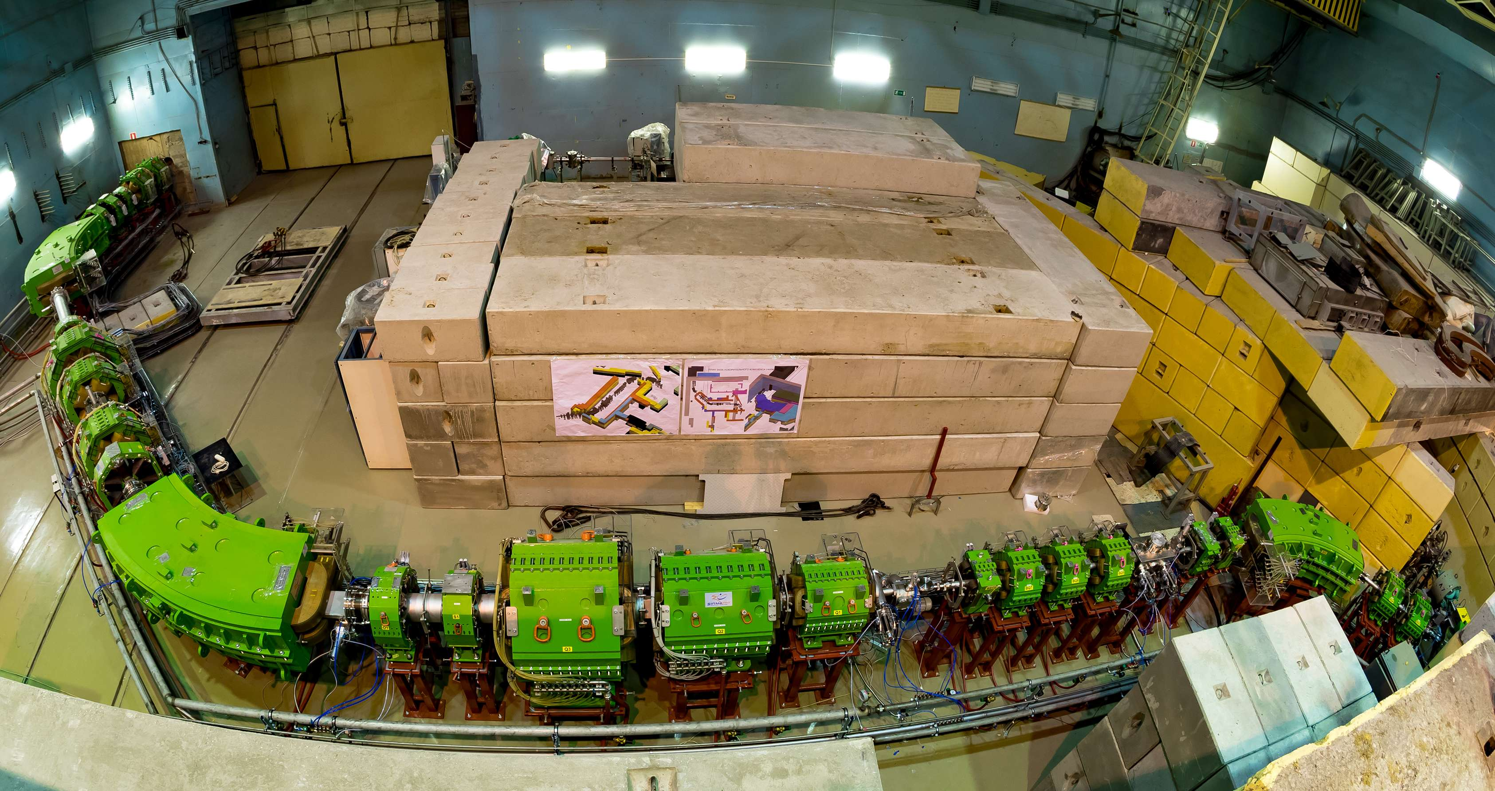
The PAC recommendation
Status of ACCULINNA-2
The PAC endorses the presented programme of the first experiments at the ACCULINNA-2 fragment-separator and looks forward to a report on their results at future meetings of the PAC.
ACCULINNA-2
status
total length F0-F5 ~53m
39 magnetic elements

Slide 8
The Scientific Council recommendation
Status of ACCULINNA-2
The Scientific Council is pleased with the start-up of the new fragment-separator ACCULINNA-2 and welcomes the programme of first experiments to investigate ⁷H, ¹³Li, ¹⁷Ne and ²⁶S decaying via 3n, 4n and 2p emissions.
Today we will hear also a report on the progress in ACCULINNA-2

Slide 9
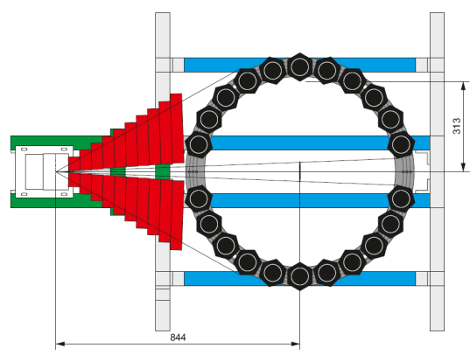
Project TANGRA
(TAgged Neutrons & Gamma-Rays)
The project is aimed at developing the tagged neutron method and its application for basic nuclear physics research, as well as for applied studies.
The PAC notes the successful realization of the first stage of the project during 2014–2016, the expansion of the list of its participants, as well as the balanced research programme for 2017–2019.
Recommendation. The PAC recommends extension of the TANGRA project until the end of 2019 with full allocation of the requested funding, according to the presented schedule of work.
3
4
d + t → ⁴He (3.5МeV) + n (14.1МeV)
2
Main components:
Neutron generator with a position sensitive detector of α-particles
Shielding
Detectors of γ-rays / neutrons
Sample
1

Slide 10
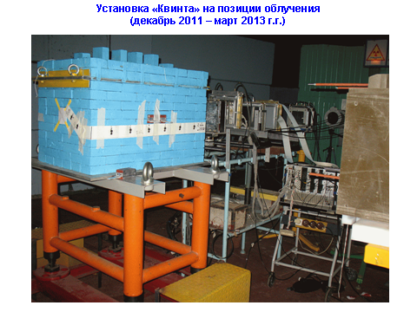
Project E&T&RM
The PAC notes the large amount of work carried out by the authors of the project to develop methods for studying the main nuclear physics parameters of the uranium assembly “Quinta” (the neutron field, the plutonium production time, the energy yield of the assembly, the transmutation rates of minor actinides).
Recommendation. The PAC recommends extending the work on this project until the end of 2019. More detailed recommendations on this topic will be formulated at the next (47th) PAC meeting
Assembly “Quinta””

Slide 11
The Scientific Council recommendation
TANGRA and E&T&RM projects
The Scientific Council supports the recommendations of the PAC for Nuclear Physics on extension of the TANGRA project “Design and development of the tagged neutron method for determination of the elemental structure of materials and nuclear reaction studies” and of the Е&T&RM project “Study of deeply subcritical electronuclear systems and possibilities of their application for energy production, transmutation of radioactive waste and research in the field of radiation material science” until the end of 2019.

Slide 12
The PAC recommendations
Scientific results obtained in the projects of the theme
“Physics of Light Mesons”
PEN-MEG
The PAC recommends continuation of the processing of the data analysis in the PEN experiment on the radiative decay of a pion that will allow improvement of the previous results and to extract a new experimental value of the ratio R^{π}_{e/μ}. The PEN goal is ΔR/R ≈ 5·10⁻⁴.
The PAC supports participation in the MEG-II project. As a result of the MEG (MEG-II) experiment in 2018-2020, a new upper limit on the branching ratio of the μ⁺ → e⁺γ decay of (4-5) × 10⁻¹⁴ will be reached.
PAINUC
The PAC hopes that the PAINUC collaboration will successfully complete the analysis of all the existing data as well as extraction of pion beams and launch a new project as soon as possible.
The PAC encourages the PAINUC collaboration to have a more aggressive strategy for publication.

Slide 13
The PAC recommendations
Scientific results obtained in the projects of the theme
“Physics of Light Mesons”
TRITON
Taking into account the new data on previously not observed pt-fusion channels with the emission of an electron-positron pair and gamma-quantum pair, as well as the complexity of the method of investigation, the PAC recommends continuation of the activity in the TRITON experiment in order to carry out in particular:
– modeling of kinetics of mesoatomic and mesomolecular processes in the target;
– calibration of detectors on an electron beam with an energy up to 20 MeV;
– development of a technique for modeling the channel registration process with the emission of two gamma quanta from the pt-fusion reaction in the TRITON installation;
– in-depth analysis of the experimental data obtained, as well as the decommissioning of the TRITON installation from operation by 2020.

Slide 14
The Scientific Council recommendation
Scientific results obtained in the projects of the theme
“Physics of Light Mesons”
The Scientific Council notes the endorsement by the PAC of the final reports on the results obtained in the MEG-PEN, TRITON, and PAINUC experiments on the theme “Physics of Light Mesons” and supports the PAC recommendation on the continuation of the participation in the upgraded MEG-II frontier experiment in the search for lepton flavour violation.

Slide 15
THANKS FOR YOUR ATTENTION!

Slide 16
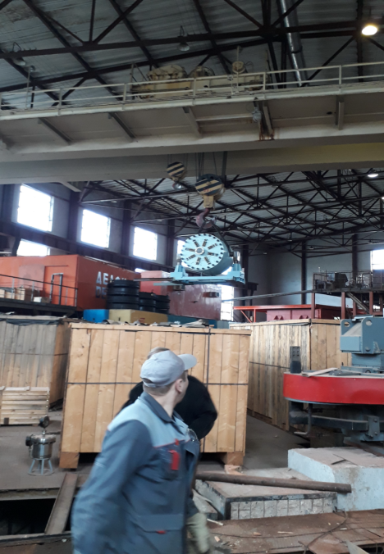
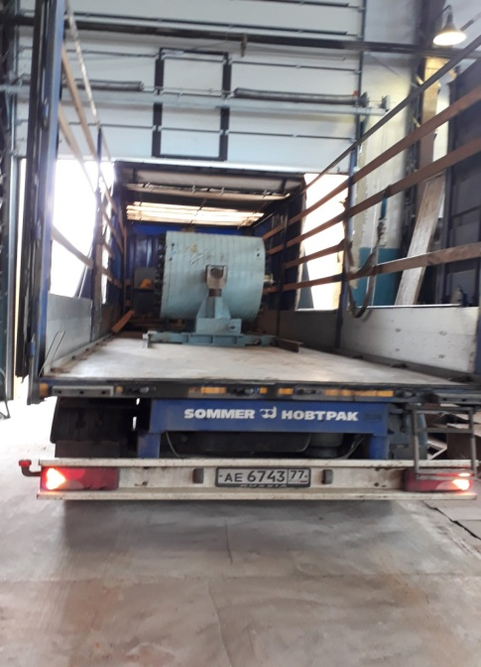
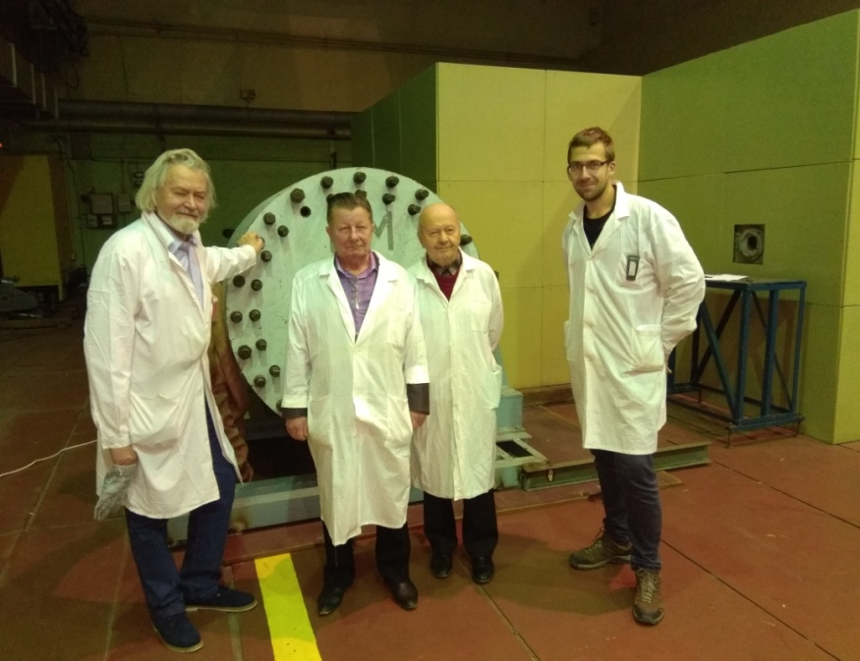
Realization of BURT transportation from VBLHEP to DLNP September 2017, JINR, Dubna
Project Report «E&T»
Our project started in 2017 at the Laboratory of High Energy Physics, topic 1107.
We participated in the First Research Coordination Meeting on Accelerator Driven Systems (ADS) Applications and Use of Low Enriched Uranium in ADS
24 to 29 September 2017 and reported the current results.
Background measurements, DNLP Phasotron, January 2018

Slide 17
The project E&T&RM started in 2018 at the Laboratory of high energy Physics and the topic “Development and Construction of the Prototype of Complex for Radiotherapy and Applied Research…..at the Nuclotron-M”(02-1-1107-2011/2019).
In September, we reported our results at the meeting from 24 to 29 September, the IAEA .In accordance with the work plan of a large target transported and then installed at the DLNP Phasotron. Currently, there is documentation of the work on the proton beam. Also carried out the measurement of the background radiation from depleted uranium

Slide 18
BACKUP SLIDES

Slide 19
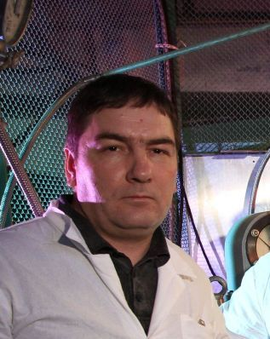
TRITON
The PAC heard a report on the results obtained in the TRITON experiment presented by Dmitry Demin.
The PAC notes that the measured rates of the nuclear reaction p + t in the channels with the output of gamma quantum and muon conversion confirm the results of the only PSI experiment (1993 y) and are in substantial contradiction with the modern theory.
Dmitry Demin
Registration of e⁺e⁻ pairs and pairs of gamma quanta from pt-fusion
For the first time the channel of pt-reaction with electron-positron pair output
ptμ → ⁴Heμ + e⁺+e⁻ + 18.79 MeV
was observed. The general statistics collected on the TRITON installation in 2016 is about 15 thousand events.
Also the reaction channel with output of two gamma quanta
ptμ → ⁴Heμ + 2γ + 19.82 MeV (E_{γ1} + E_{γ2} ≥ 19.77 MeV)
was registered. The general statistics is about 3 thousand registered double events that satisfy the selection criteria for gamma quanta simultaneously recorded in each of two gamma detectors.

Slide 20
The Scientific Council is impressed with the progress of work for the DC-280 cyclotron (Dubna cyclotron, K-factor 280), which is the central device of the Factory of Superheavy Elements. The cyclotron and all its subsystems are in the installation phase. The main cyclotron magnet has been mounted and magnetic measurements are completed.
The ECR-type ion source (DECRIS-PM) is ready to be installed at the SHE Factory.

Slide 21
The manufacturing of the new gas-filled separator GFS-2 is under completion. Documentation for the new target unit designed for GFS-2 has been prepared, and a detection system for recording rare events of formation of superheavy elements with a high position and energy resolution is under development.
The Scientific Council looks forward to the completion of all installation work on schedule (December 2017) and to the commissioning of the cyclotron in the period from January to April 2018.

Slide 22
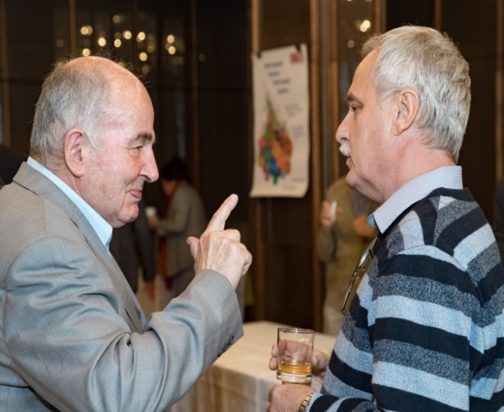
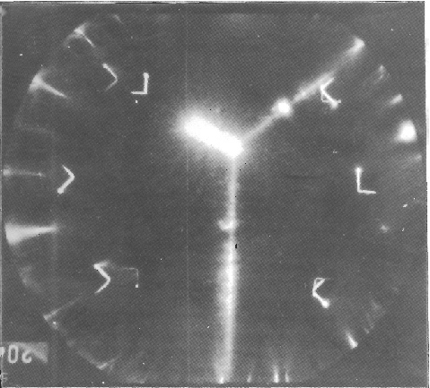
PAINUC
The PAC heard a report presented by Gil Pontecorvo on the results obtained in the study of π^{± 4}He-interactions at beam energy lower than the Delta resonance in the PAINUC project.
The research was conducted using DLNP’s self-shunted streamer chamber placed in a magnetic field.
About 20% of the available raw data has been analysed. A significant part of the events of negative pion interaction with helium are shown to involve two deuterons in the final state.
The PAC hopes that the PAINUC collaboration will successfully complete the analysis of all the existing data as well as extraction of pion beams and launch a new project as soon as possible.
The PAC encourages the PAINUC collaboration to have a more aggressive strategy for publication.
Gil Pontecorvo

Slide 23
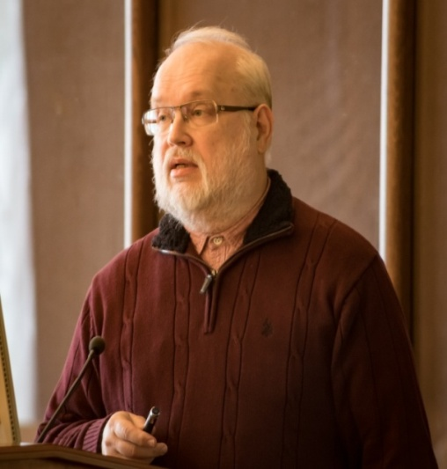
PEN-MEG
The PAC heard a report on the results obtained in the PEN-MEG experiment presented by Nikolay Chomutov.
The PAC recognizes the world-class results produced in implementing this project.
The PEN experiment accumulated some 2.3·10⁷ π⁺→e⁺ν and more than 1.5·10⁸ π→μ→e decays as well as significant numbers of pion and muon radiative decays.
The PAC recommends continuation of the processing of the data analysis in the PEN experiment on the radiative decay of a pion that will allow improvement of the previous results and to extract a new experimental value of the ratio R^{π}_{e/μ}. The PEN goal is ΔR/R ≈ 5·10⁻⁴.
The MEG experiment: a new upper limit on the branching ratio of this decay of B (μ⁺→e⁺γ) < 4.2·10⁻¹³ (90% CL) was established, which represents the most stringent limit on the existence of this decay to date.
The PAC supports participation in the MEG-II project. As a result of the MEG (MEG-II) experiment in 2018-2020, a new upper limit on the branching ratio of the μ⁺ → e⁺γ decay of (4-5) × 10⁻¹⁴ will be reached.
Nikolay Chomutov

Slide 24
Programme for the years 2017-2019
Conditions:
Phasotron should work at least next two years
Nuclotron should be closed (works connected to NICA project)
Nuclotron will start work after 2 – 3 years
PhD students on theme
5) Very good spectroscopy laboratory and also other equipment (clover detector)
6) Good collaboration with Czech universities (Czech direct financial support)
Plans:
Setup Quinta – important additional measurements on Phasotron beam;
Simulation of hybrid nuclear reactor on the basis of a deep subcritical assembly of natural uranium, excited by a beam of high-energy ions. Research possibility of transmutation of radioactive waste under the influence of radiation.
Measurements of important cross-sections and systematic review analysis of up to date results;
Setup “Big uranium target - BURAN" – to be irradiated with extracted beam from Phasotron (DLNP);
Later: Setup Quinta and BURAN – irradiation with Nuclotron extracted beam (205 VBLHEP building) – depends on start of Nuclotron operation.
Recommendation. The PAC recommends extending the work on this project until the end of 2019. More detailed recommendations on this topic will be formulated at the next PAC meeting

Slide 25
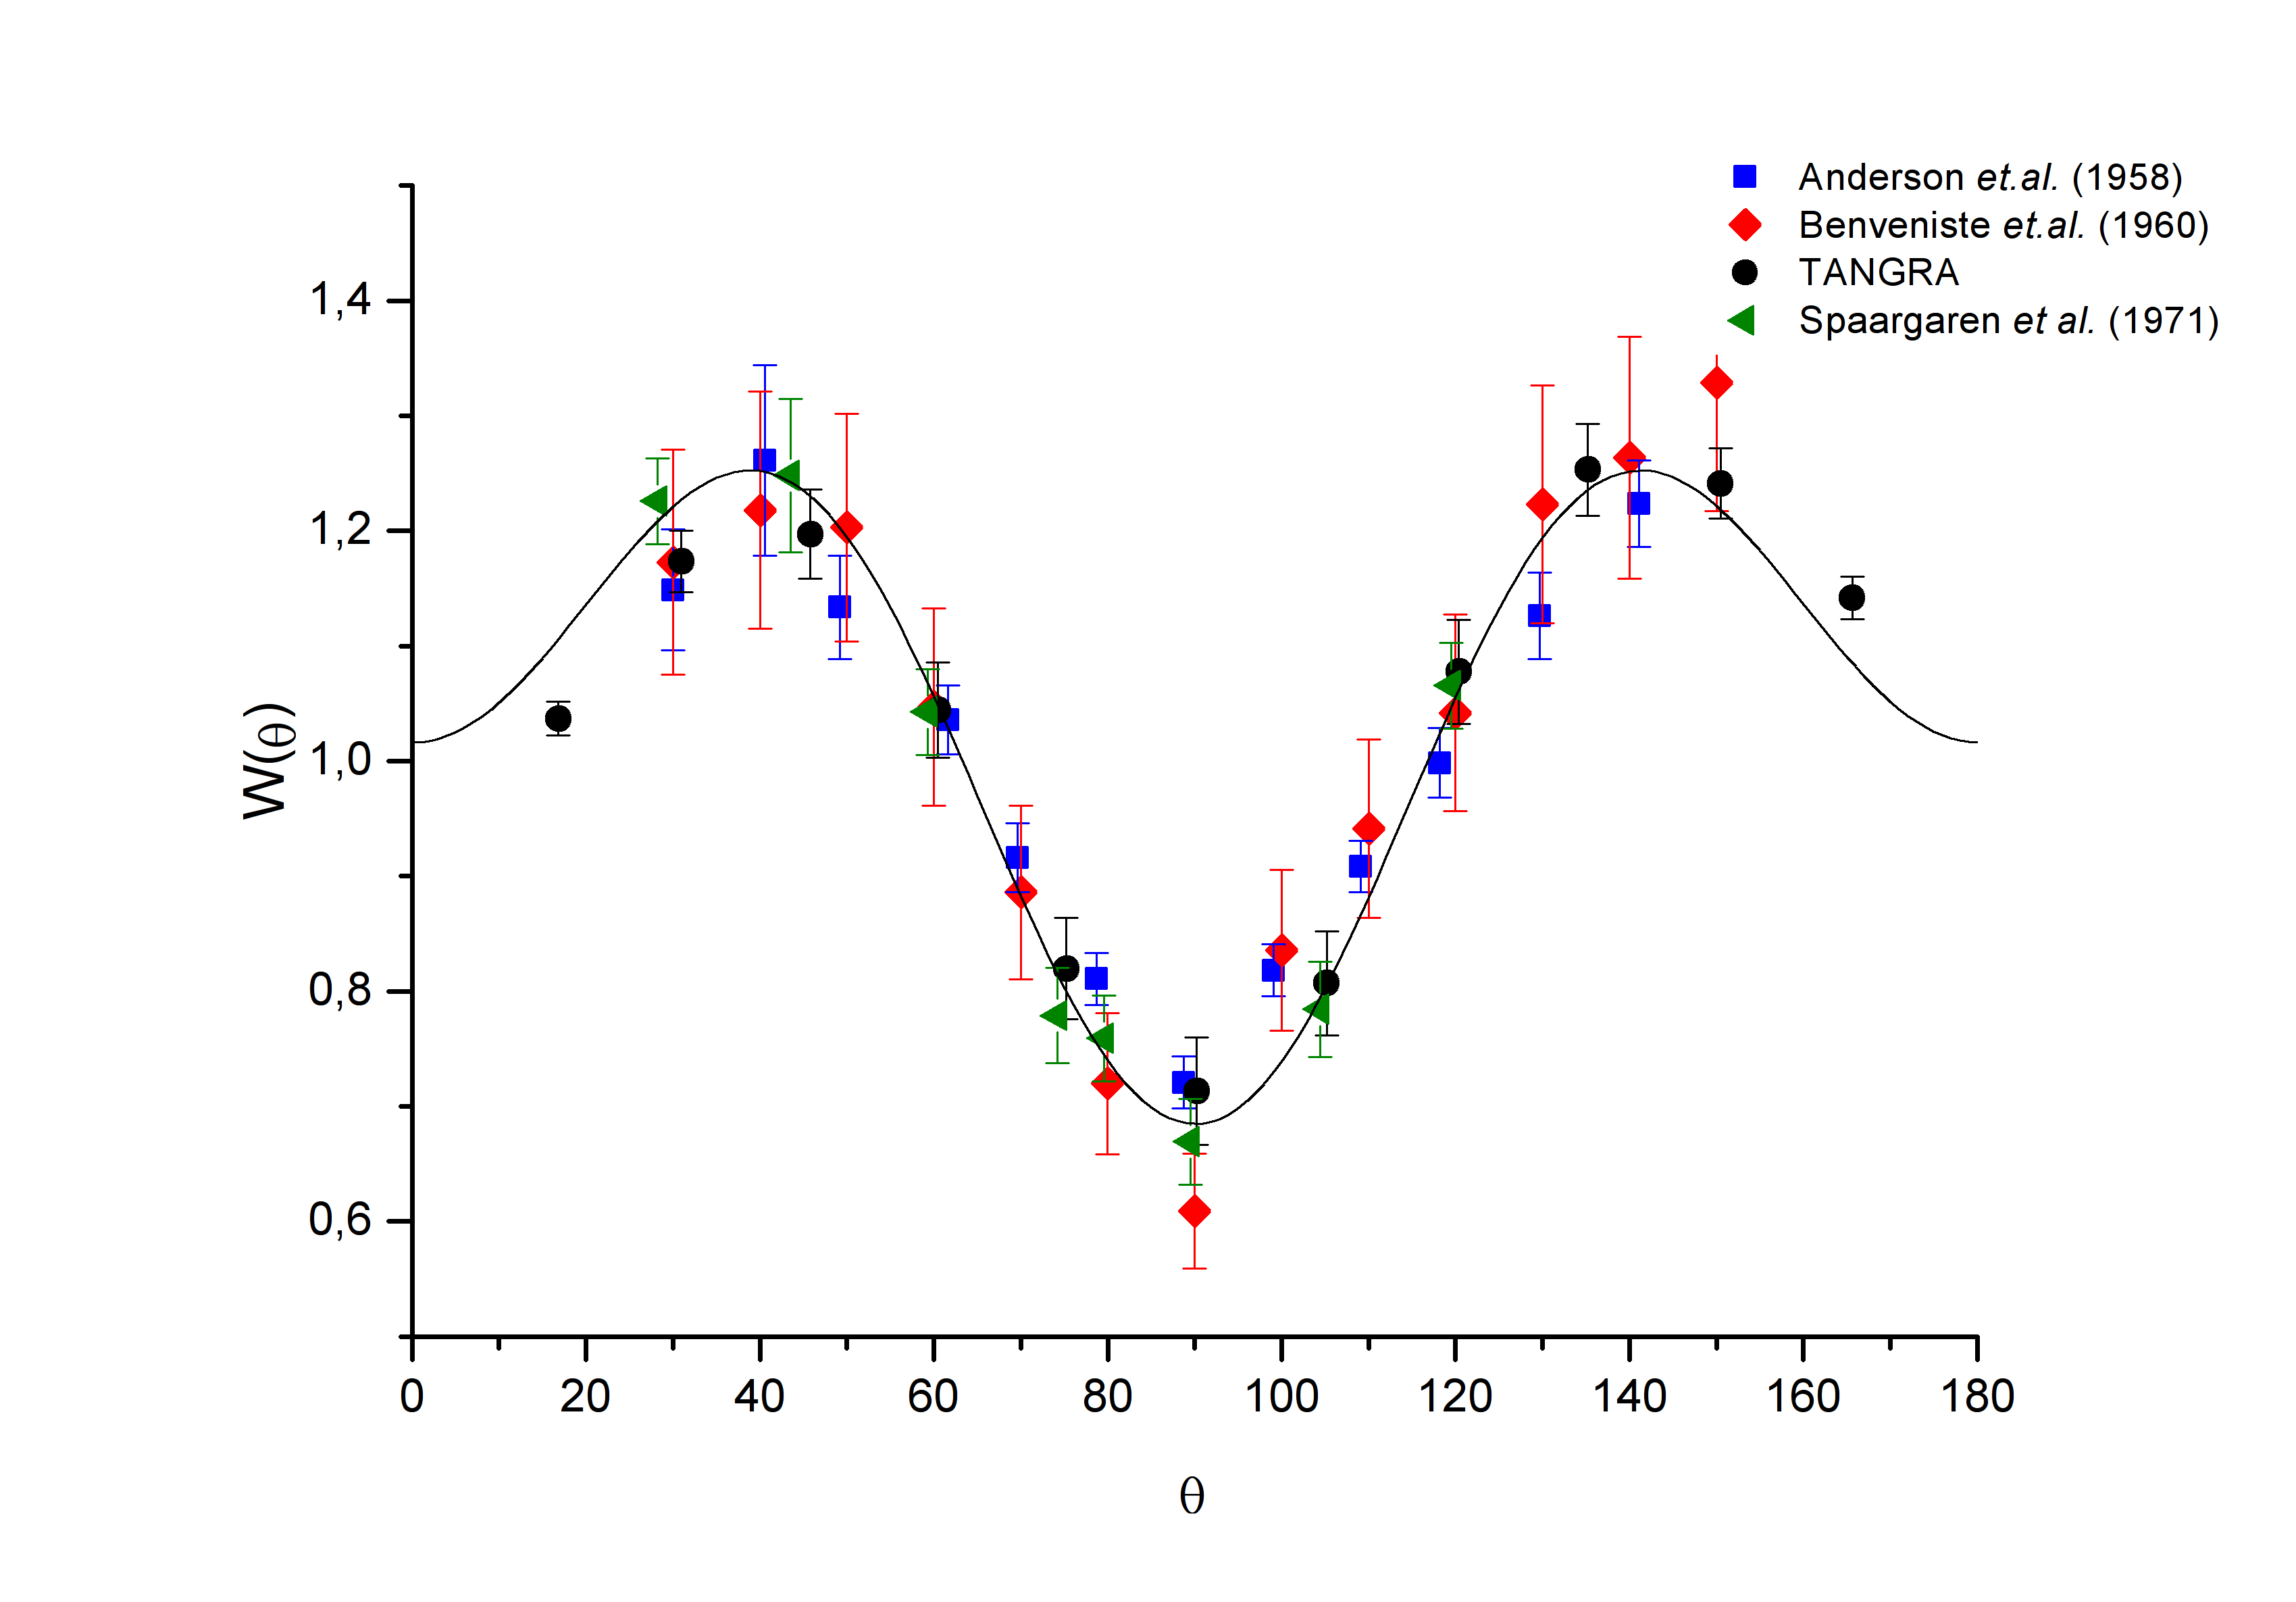
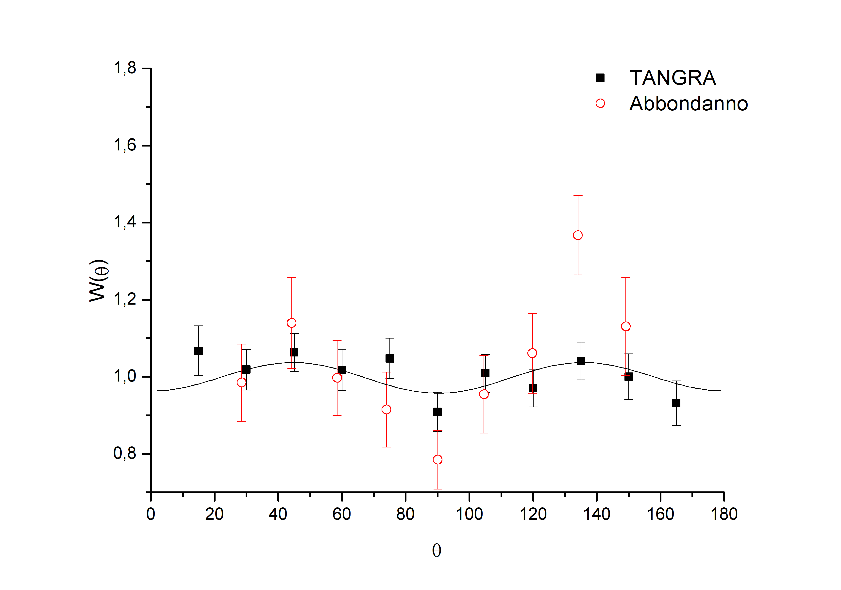
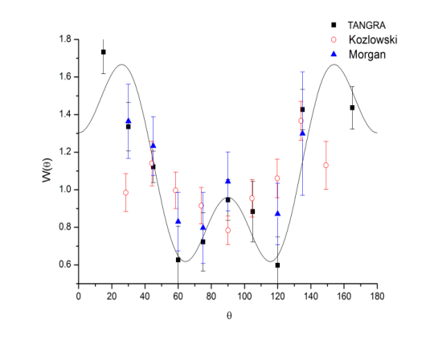
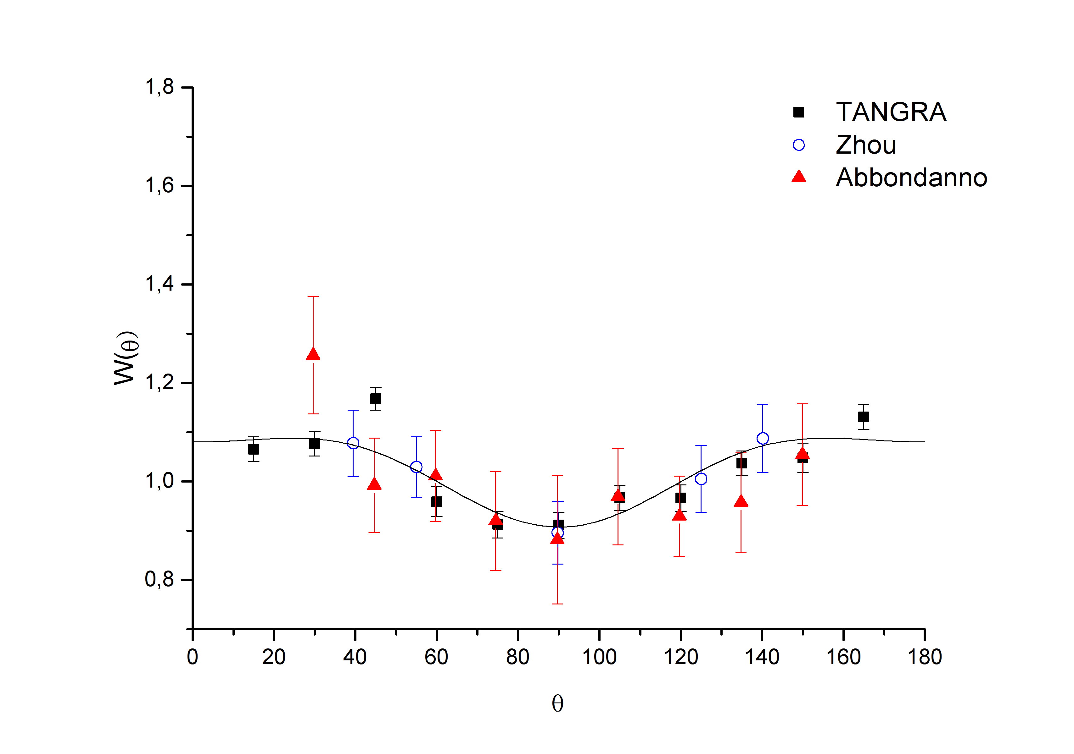
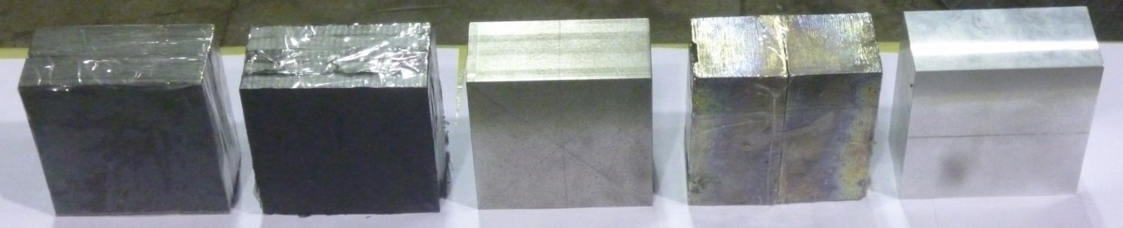
Measurements of differential cross sections of the inelastic scattering of 14.1 MeV neutrons on different materials
Angular distributions of gamma-rays: preliminary results obtained with NaI detectors
¹²C, E_{γ} = 4.4 MeV
²⁴Mg, E_{γ} = 1.4 MeV
¹⁶O, E_{γ} = 6.1 MeV
²⁸Si, E_{γ} = 1.8 MeV
Plans for 2017-2019
²⁰⁸Pb
¹²C
⁵⁶Fe
²⁰⁹Bi
²⁷Al
New samples

Slide 26
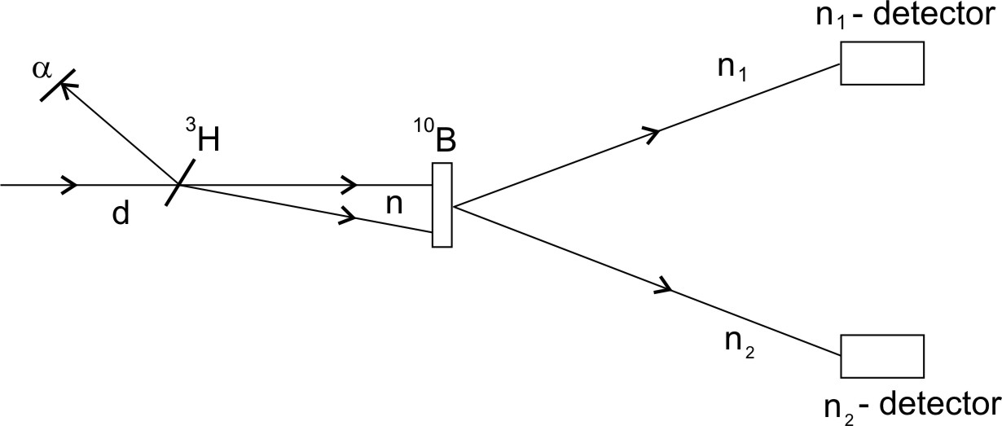
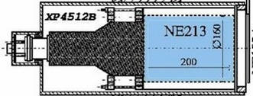
Investigation of the (n,2n`) and (n,n`) – reactions using the tagged neutron method
Plans for 2017-2019
Using high efficiency DEMON detectors with n-gamma separation capability
Investigation of the reaction ¹⁰B(n,2n)⁹B → p + ⁸Be.
Aim: Obtaining information about the low-lying levels of the unstable nucleus ⁹B
Method: Measurement of the energies of two neutrons using time of flight and calculation of missing-mass spectrum for ⁹B.
Recommendation. The PAC recommends extension of the TANGRA project until the end of 2019 with full allocation of the requested funding, according to the presented schedule of work.

Slide 27
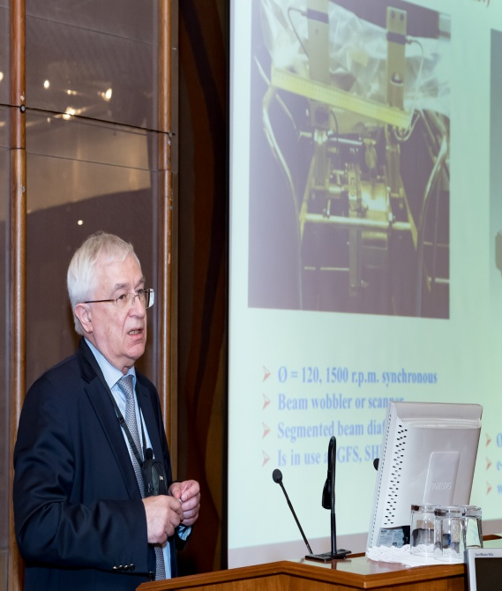
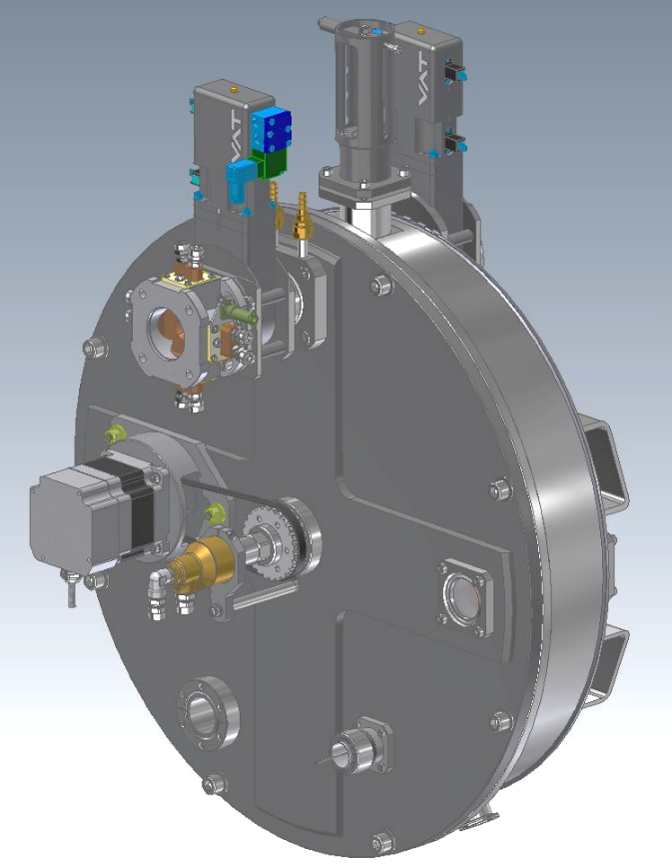
Target, Separator and Detection units
Target unit
New design for the target unit designed for the gas-filled separator has been developed.
The contract on the construction of the target unit will be signed in the coming few months and the system is expected to be operational for the first experiments in 2018.
Andrey Popeko
Ø = 480, 1500 r.p.m. synchronous,
e-beam & optical diagnostic,
water cooling

Slide 28
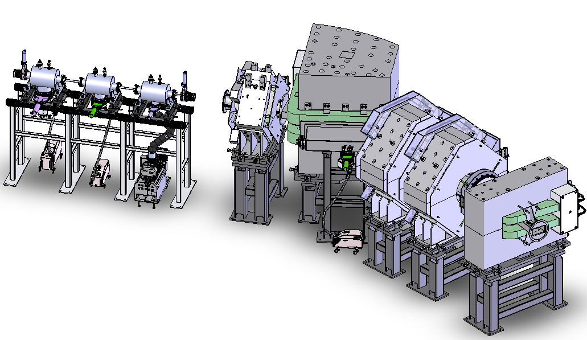
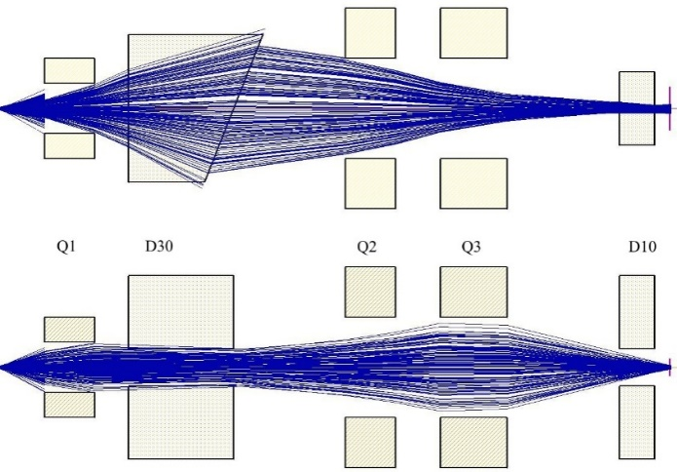
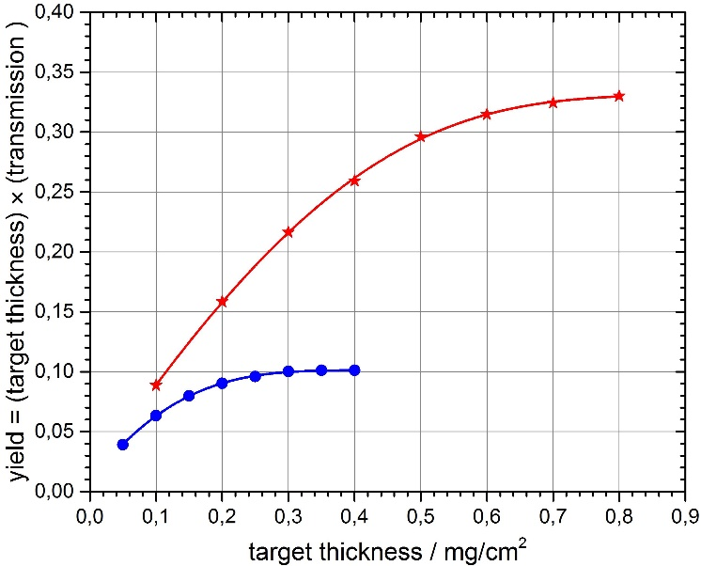

New gas-filled separator GFS-2
The manufacturing of the GFS-2 is ongoing and the initial testing of several components is being conducted.
The separator should be delivered to Dubna and mounted on channel 3 in October 2017.
The design of a pre-separator for studying the chemical properties of superheavy elements is in progress.

Slide 29
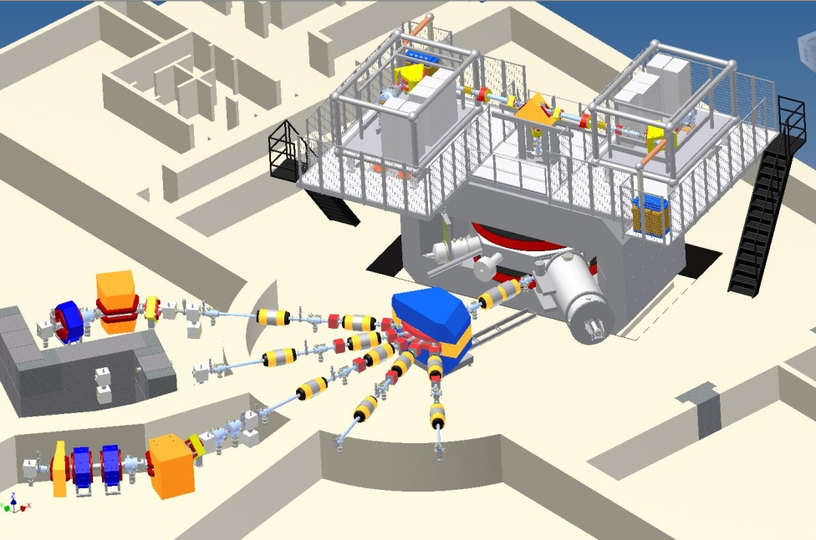

Cyclotron DC-280 (Dubna Сyclotron, K-factor 280) – central device of the new SHE Factory
The cyclotron and all its subsystems are in the installation phase.
The high-voltage platform on which the ion source will be located is being currently mounted.
The mounting of the axial injection system is in progress.
The main cyclotron magnet has been mounted and magnetic measurements are completed.
Completion of the installation work is planned for December 2017.
The commissioning of the cyclotron is now planned from January to April 2018.
SHE Factory layout
Igor Kalagin

Slide 30
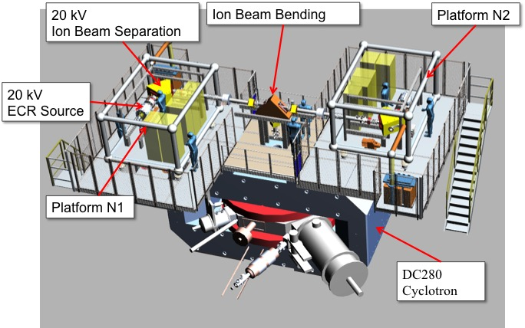
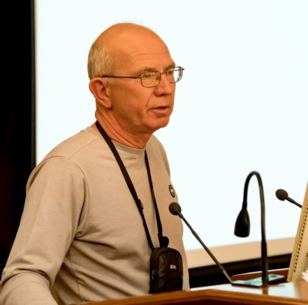
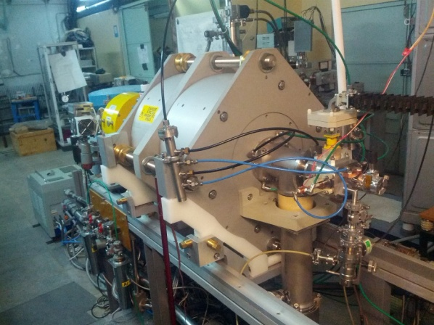
ECR sources
The new 14 GHz ECR-type ion source (DECRIS-PM) was constructed on permanent magnets.
The first results obtained with the DECRIS-PM for Ar, Kr, Xe, Ca, Mg and Fe manifested the design intensities of the produced ions.
The test with Ca ions confirmed that the design specifications of the source were reached in terms of the ion-beam intensity (210 eµA for ⁴⁰Ca⁹⁺) and of the low consumption of the calcium material.
The source is ready for installation at the SHE Factory.
DECRIS-PM at the test bench
Sergey Bogomolov

Slide 31
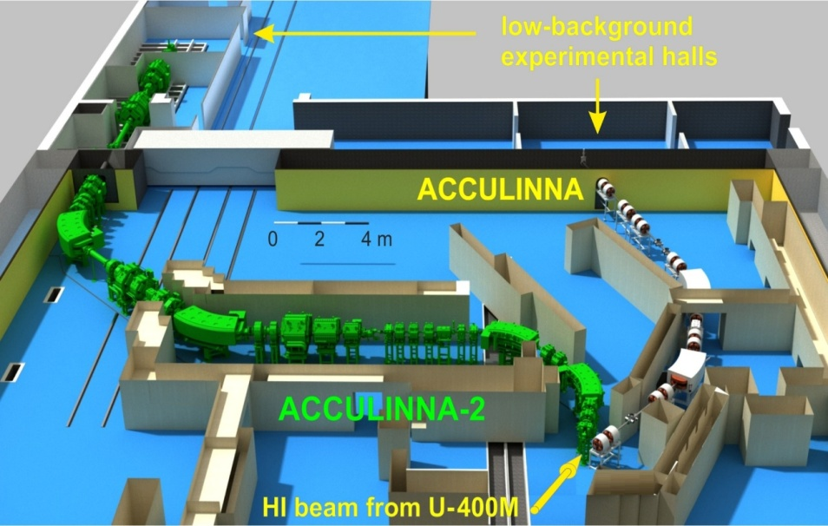
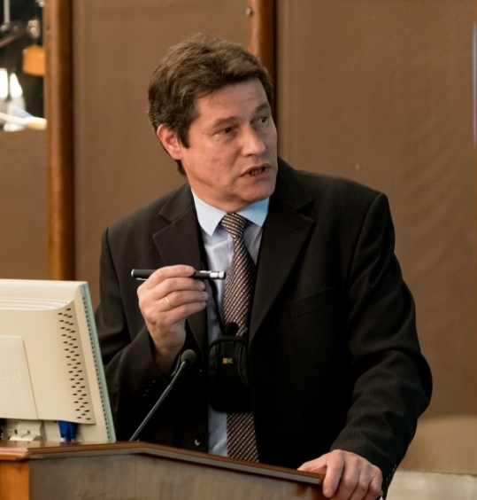
II. New fragment-separator ACCULINNA-2 and its day-one experiments
The PAC heard a report on the progress in commissioning and preparing day-one experiments at the new fragment-separator ACCULINNA-2 presented by Andrey Fomichev.
The start-up of this fragment-separator was carried out in March 2017.
The design parameters of the set-up were experimentally confirmed.
The measured intensities of the secondary beams exceeded the values obtained at the existing fragment-separator ACCULINNA-1 by a factor of 25.
The collaboration proposed that the first experiments would investigate ⁷H, ¹³Li, ¹⁷Ne and ²⁶S decaying via the 3n, 4n and 2p emission.
Andrey Fomichev

Slide 32
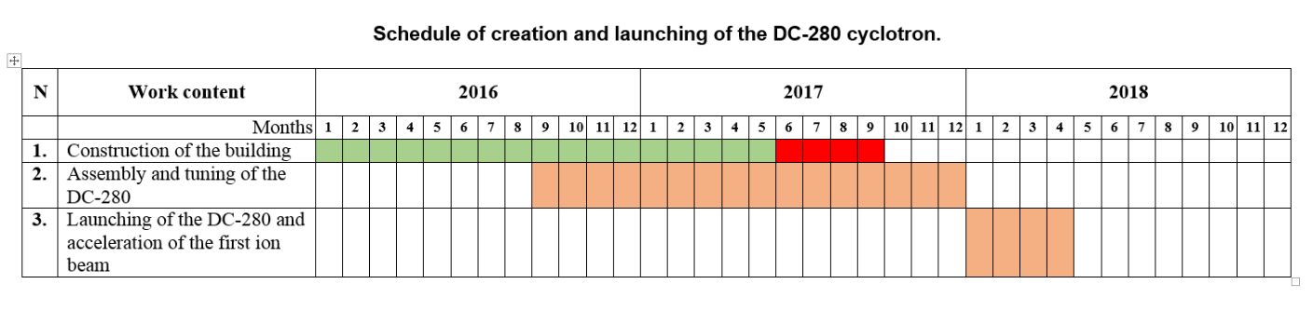
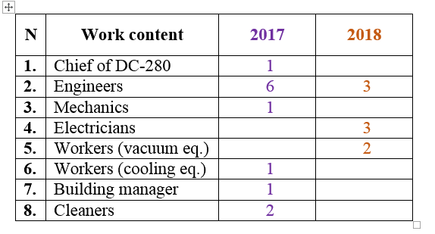
Schedule
Increasing of the FLNR staff for the SHE Factory

Slide 33
VI. Scientific reports
The PAC heard with interest the report “Dipole toroidal resonance: vortical properties, anomalous deformation splitting, relation to pygmy mode” presented by Valentin Nesterenko.
Theoretical models which describe well and give a deep interpretation of the experimental results were widely discussed. The models are also able to predict new results that lowest toroidal and compression states can exist the ²⁴Mg nucleus. The results are very interesting and should be published very soon.
The PAC heard with interest the report “Search for spatial parity violation effects in reactions of cold polarized neutrons with lightest nuclei” presented by Pavel Sedyshev.
The scientific goal of the experiment ¹⁰B(n,α)⁷Li is to determine the value of the weak π-meson-nucleon exchange constant f_{π} and reported f_{π} ≤ 0.6·10⁻⁷.

Slide 34
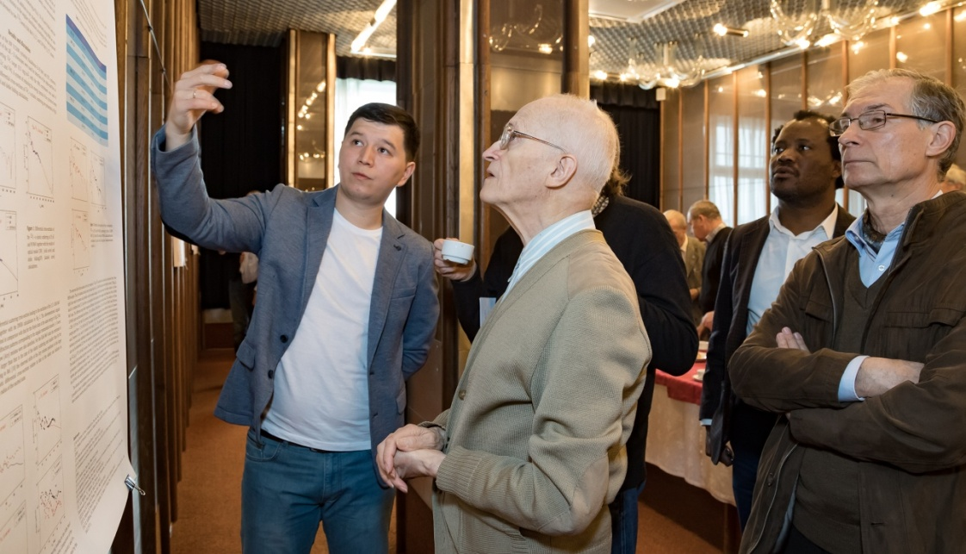
VII. Poster session
The PAC appreciated the high quality of presentations of new results and proposals by young scientists in the field of nuclear physics research.
The best posters selected are:
  “Investigation of exotic states in light nuclei” presented by Danijar Janseitov
  “Impact of tensor interaction on β-delayed neutron emission in neutron-rich Ni isotopes” presented by Evgeny Sushenok.
The PAC recommends the poster “Investigation of exotic states in light nuclei” for presentation at the session of the Scientific Council in September 2017.

Slide 35
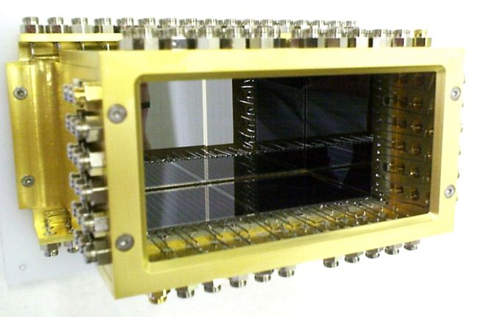
Focal plane DSS-Detectors
(Micron Semiconductors, UK)
A detection system for recording rare events of formation of superheavy elements with a high position and energy resolution at GFS-2 is under development.
First tests of the focal plane double-sided Si strip detector have demonstrated its excellent energy resolution.
A combination of the existing digital and analog electronics is proposed to be used in the first experiments at the SHE Factory.
Detector box

Slide 36
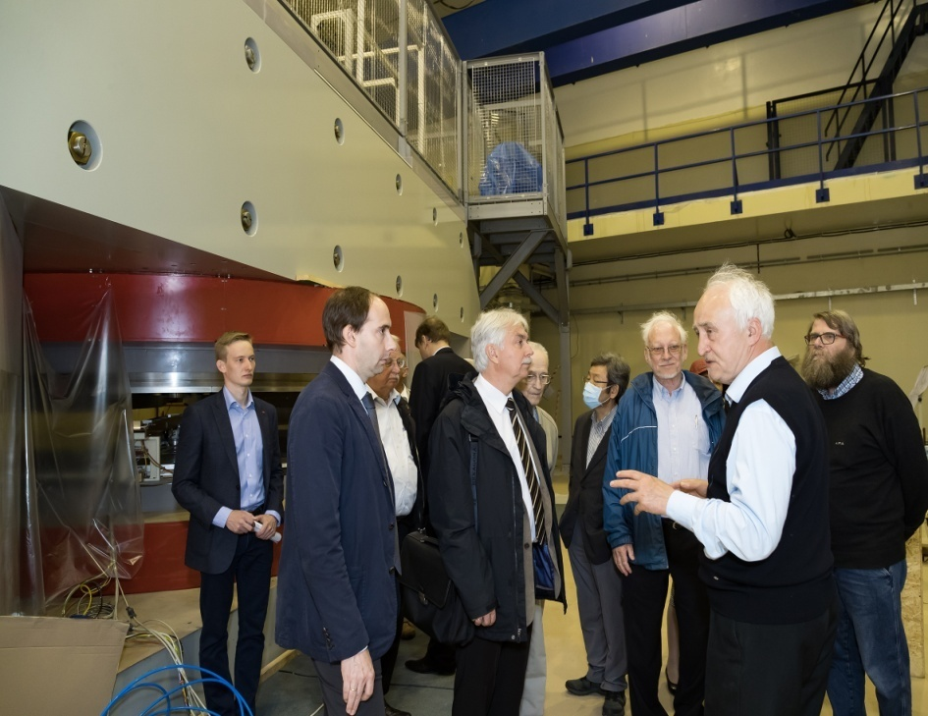
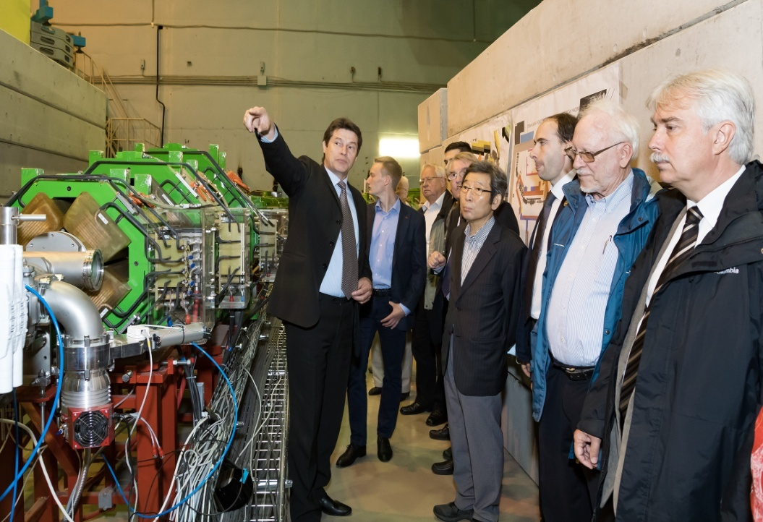
VIII. Visit to FLNR
The members of the PAC thank the Directorate of the Flerov Laboratory of Nuclear Reactions for the organization of the visit to this laboratory to get acquainted with the progress of construction of the Factory of Superheavy Elements and the ACCULINNA-2 fragment separator .

Slide 37
Expected beam parameters of the DC-280
ION | Z | Beam Intensity from ECR |  | HV platform N | Efficiency of acceleration | Expected beam intensities of (4÷8) MeV/n ions on targets pps
 |  | eμA | pps
20Ne | 3 | 150 | 3.10¹⁴ | 1 | 50% | 1.5·10¹⁴
40Ar | 7 | 300 | 3.10¹⁴ | 1 | 50% | 1.5·10¹⁴
48Са | 7/8 | 160 | 1.10¹⁴ | 1 | 50% | 6.2·10¹³
⁵⁰Ti | 8/9 | 75 | 5.10¹³ | 1 | 50% | 2.6.10¹³
⁵⁴Cr | 9 | 125 | 8.10¹³ | 1 | 50% | 4.10¹³
58Fe | 9/10 | 125 | 8.10¹³ | 1 | 50% | 4·10¹³
64Ni | 10/11 | 125 | 8.10¹³ | 1 | 50% | 4·10¹³
70Zn | 11/12 | 100 | 5.10¹³ | 1 | 50% | 2,5.10¹³
136Хе | 22/23 | 150 | 4.10¹³ | 1 | 50% | 2·10¹³
209Bi | 34/35 | 15 | 2,2.10¹² | 2 | 60% | 1·10¹²
238U | 39/40 | 1 | 1,5.10¹¹ | 2 | 60% | 1.10¹¹

Slide 38
Main design parameters of the DC-280
Ion sources | DECRIS-PM - 14 GHz on the 1-st HV platform Superconducting ECR on the 2-nd HV platform (development stage)
Injection energy | Up to 80 keV/Z
A/Z range | 4÷7.5
Energy | 4÷8 MeV/n
Magnetic field level | 0.6÷1.35 T
K factor | 280
Dee voltage | 2x130 kV
RF power consumption | 2x30 kW
Flat-top dee voltage | 2x13 kV
Flat-top power consumption | 2x2 kW

