Slide 1
NICA grant program,
formation of the MPD and BM@N Collaborations
and MAC changes
V. Kekelidze
48th meeting of the PAC for Particle Physics

Slide 2
The first call for the submission of grant applications
in the framework of a newly established grant program
for research conducted at the NICA facility is in preparation
The program aims at encouraging and supporting research proposals performed in the MPD, BM@N or SPD experiments at the NICA project.
Proposals will be evaluated by a peer review system
and grants will be awarded on a competitive basis
to individual researchers according
to the scientific merit of the proposal,
regardless of the specific topic or institute affiliation.

Slide 3
General Information
Applications shall be made solely online through a dedicated JINR website, that will be announced soon.
Applications should be written in English.
The principal investigator(s) (PI) must be a member of the MPD or BM@N or SPD Collaboration prior to submission of the application.
Applications should provide sufficient information to demonstrate to members of the scientific community
who will review the application,
that the proposed research represents a sound approach
to the investigation of an important scientific issue.

Slide 4
The evaluation will rely on a dual review scheme based on a combination of
peer review;
deliberations of a professional review committee.
This combined process is well accepted in leading competitive founding agencies worldwide. It ensures a comprehensive evaluation and allows selection of the best research proposals.
Review Committee
The committee bases its decisions on peer review and
for that it refers each proposal to suitable professional reviewers.

Slide 5
The kick-off meeting on formation of
the MPD and BM@N Collaborations
11-13 April, 2018
Detailed information about the meeting can be found at:
https://indico.jinr.ru/conferenceDisplay.py?confId=385
Those who might be interested in participating in the NICA project could join the meeting.
The registration is now open.
drafts of MoU and By-low are under consideration and edition;
must satisfy to framework
of Provision on collaboration adopted at JINR;
will be approved by the Institutional Board of the Collaborations.

Slide 6
Tentative agenda of the meeting
Wednesday | Thursday | Friday
9:00 – 10:30 Welcome 15’ NICA Physics -theory 30’ Event Generators – 30’ | 9:00 – 10:30 Visit to detector labs | 9:00 – 10:30 BM@N: Inner tracker, Outer tracker, TOF
10:30–11:00 Coffee break | 10:30 – 11:00 Coffee break | 10:30 – 11:00 Coffee break
11:00 -12:30 Overview talks: NICA, MPD, BM@N | 11:30 -13:00 MPD: TPC, TOF, ECAL | 11:00 -12:40 BM@N: ECAL, ZDC, DAQ
12:30 – 14:00 Lunch | 13:00 – 14:30 Lunch | 12:40 – 14:00 Lunch
14:00 – 15:30 Visit to NICA site | 14:30 – 16:00 MPD: FHCAL, FFD, DAQ | 14:00 – 15:30 BM@N track rec., particle id, detector performance
15:30 – 16:00 Coffee break | 16:00 – 16:30 Coffee break | 15:30 – 16:00 Coffee break
16:00 - 17: 30 Collaboration: Discussion 1 | 16:30 – 18:00 MPD: track rec., particle id and detector performance | 16:00 – 17:30 Collaboration: Discussion 2
19:00 Reception | 19:00 Dinner | 19:00 Collaboration Dinner

Slide 7
Machine Advisory Committee
for NICA Accelerator Complex
1. Alexei FEDOTOV BNL, USA
2. Alexander FESHCHENKO INR RAS, RF
3. Sergei IVANOV IHEP, RF
4. Takeshi KATAYAMA Nihon Univ., Japan
5. Valery LEBADEV Fermilab, USA
6. Evgeny LEVICHEV Budker INP, RF
7. Yuri SENICHEV MEPI, RF
8. Rolf STASSEN FZJ, Germany
9. Markus STECK - chairman GSI, Germany
10. Andrei SERY J.Adams Institute, GB
11. Pavel ZENKEVICH ITEP, RF

Slide 8
NICA MAC: Retirements and Appointment
Retirements:
B. Sharkov retired from MAC Chairman position;
attends the MAC sessions as JINR Directorate representative
2. Н. Walker DESY, Germany
V. Yarba FNAL, USA
S. Nagaitsev FNAL, USA
A. Zlobin FNAL, USA
T. Rozer BNL, USA
P. Beloshitsky CERN, Switzerland
L. Zorndahl CERN, Switzerland
New member to be invited:
Ivan A. Arkharov, Doctor of science, Professor, expert in cryogenics,
Bauman Moscow State Technical University, RF
PAC thanks all the colleagues to be retired for their useful contribution to the NICA Accelerator project
and endorses the invitation of Prof. I. Arkharov
to membership in the NICA MAC.

Slide 9
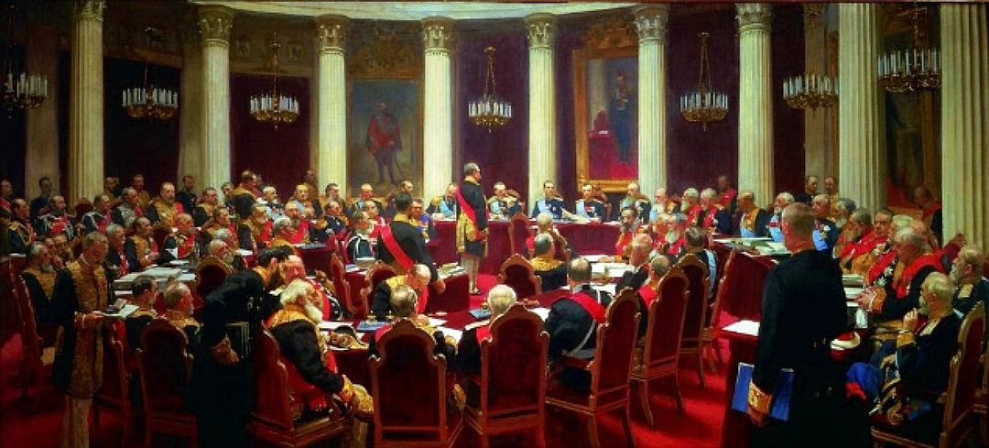
“The right decision is the wrong decision if it's made too late.”
Lee Iacocca
Thank you

