Slide 1
Progress towards the realization
of the MPD project
Within the JINR theme 02-0-1065-2007/2019
Vadim Kolesnikov
(VBLHEP)
On behalf of the MPD team
Programme Advisory Committee for Particle Physics
48th Meeting
January 31 - February 1, 2018

Slide 2
Outline
Introduction
Progress in MPD project realization:
MPD DAC and status of the MPD TDRs
Progress in preparation to MPD mass-production
MPD simulation: recent developments
Conclusions

Slide 3
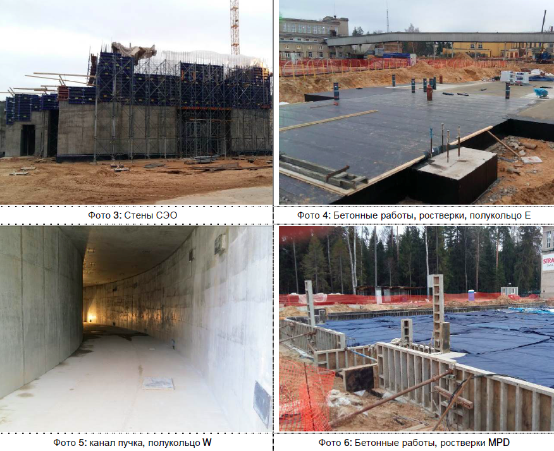
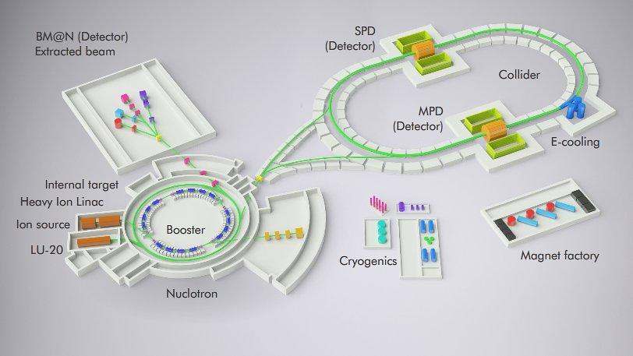
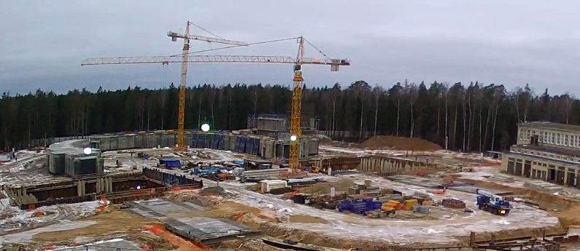
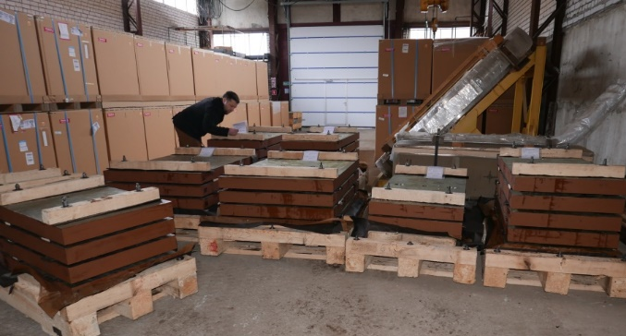
Beams – p,d(h)..¹⁹⁷Au⁷⁹⁺
Collision energy (collider) – 4-11 GeV
(fixed target) - 1-6A GeV
Luminosity: 10²⁷ cm⁻²s⁻¹(Au), 10³² (p)
NICA Complex
MPD Hall concrete works
MPD Hall base plates
The general contractor STRABAG

Slide 4
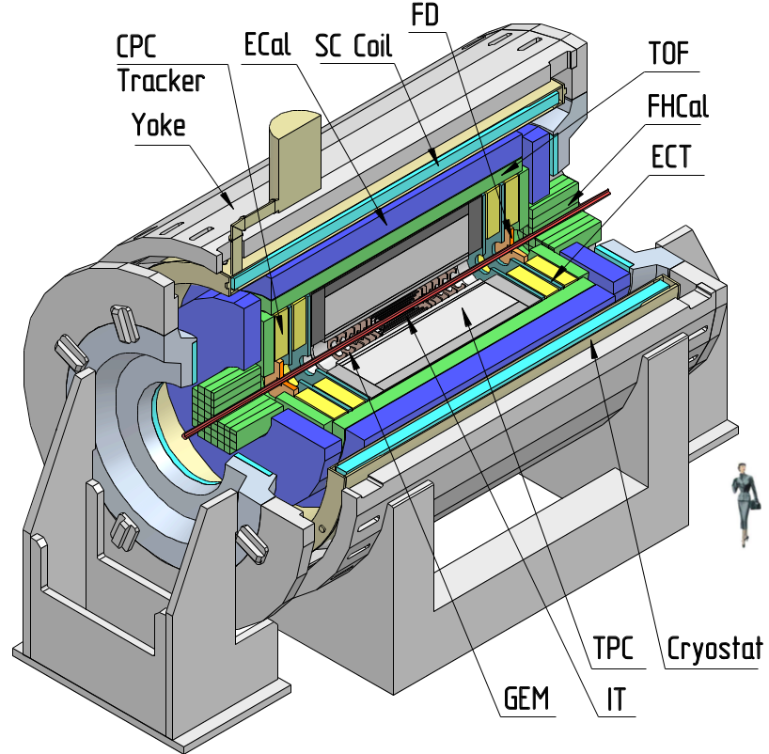
MultiPurpose Detector (MPD)
Heavy-ion physics program aims in the study of the QCD phase diagram in the region of the maximum net baryonic density
MPD Collaboration:
>150 physicists and engineers
from ~20 Universities
First MPD collaboration
meeting - April 2018
Notes:
The MPD will be the fist detector operated at the Collider. Main target is …..
The collaboration is permanently growing.

Slide 5
Status of MPD TDRs
http://indico.jinr.ru/Projects/NICA/Detectors/DetectorAdvisoryCommitee
MPD DAC: H. Gutbrod, I. Tserruya, H.-R. Schmidt, Nu Xu, L. Musa
MPD system | Date of recent evaluation | Comments
TPC | 30.01.2018 | Recent DAC recommendations and TDR status were discussed
TOF | 30.01.2018 | Implemented recommendations from DAC were discussed, ready for green light
FFD | 22.07.2017 | Got green light (22/06/2016)
ECAL | 30.01.2018 | Update version of the ECAL TDR presented on 01.02.2018, still progressing
FHCAL | 22.07.2017 | Recommendations from DAC implemented, ready for green light
Recent MPD DAC meeting – 30/01/2018

Slide 6
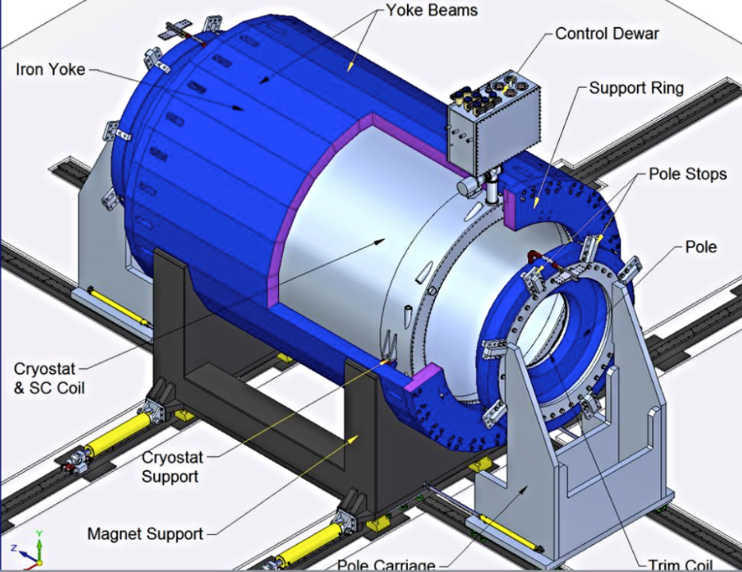
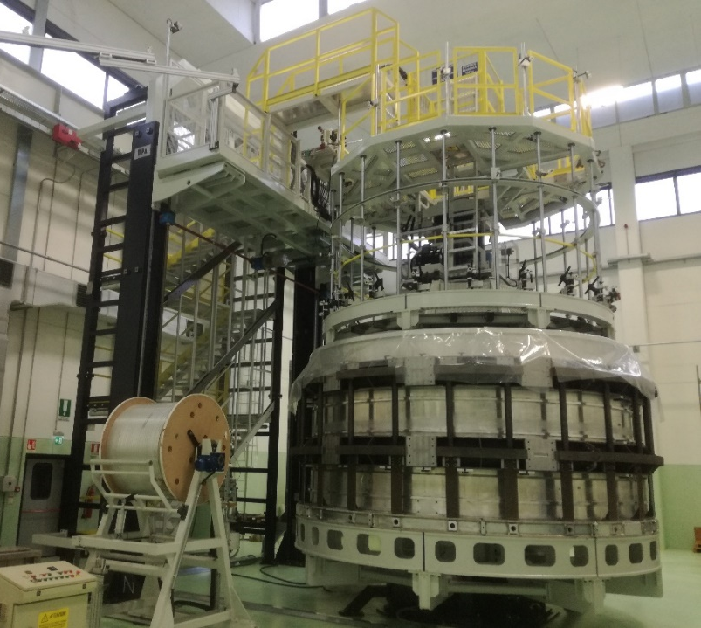
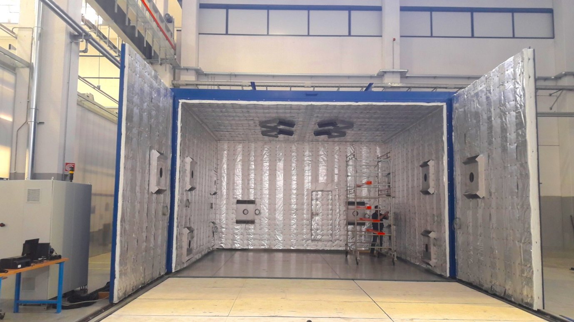
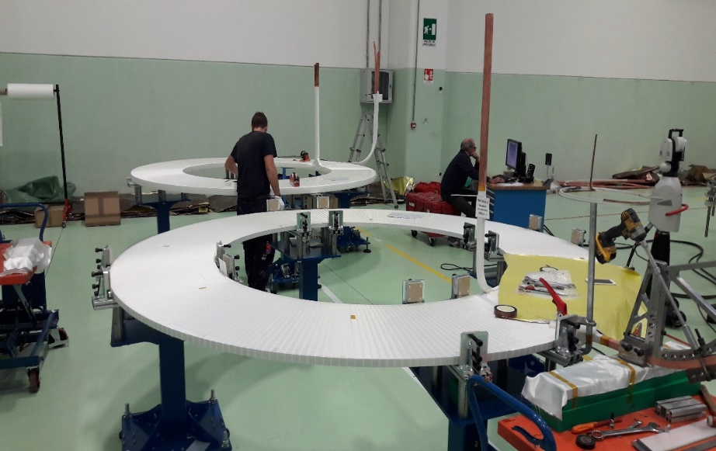
MPD superconducting solenoid: progress
B₀=0.5 T
Weight ~ 900 t
B inhomogeneity ~ 3.10⁻⁴
Coordinator: N. Emel’yanov
Winding machine for SC cable
Solenoid cylinder
End of production - November 2018
Delivery to JINR – April-May 2019
ASG superconductors (Genova, Italy): General responsibility
Vacuum kiln for coil compounding
Trim coils production

Slide 7
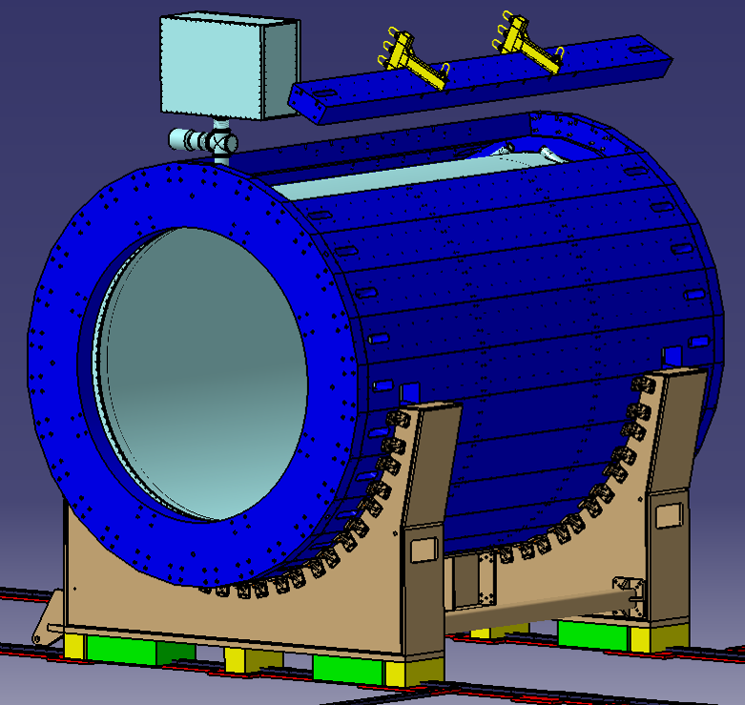
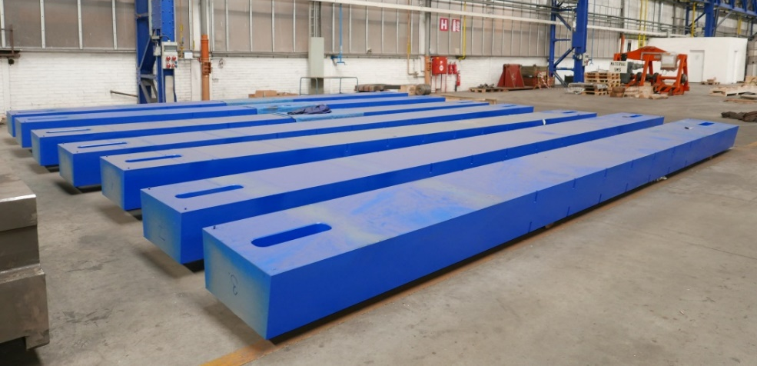
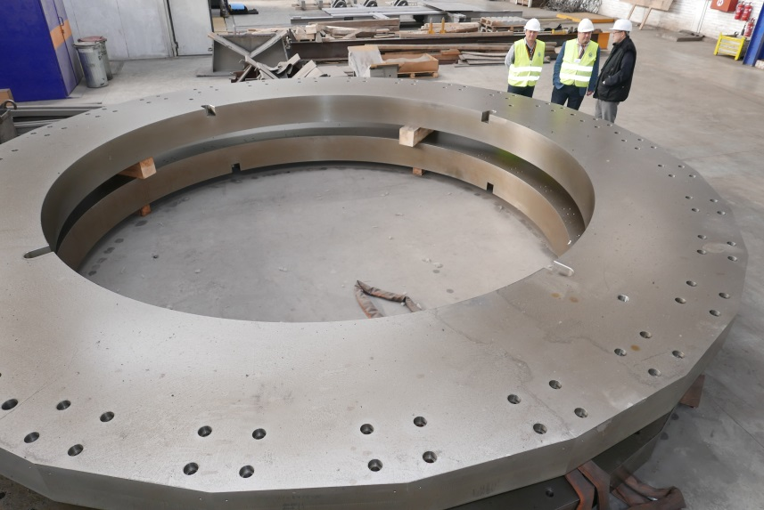
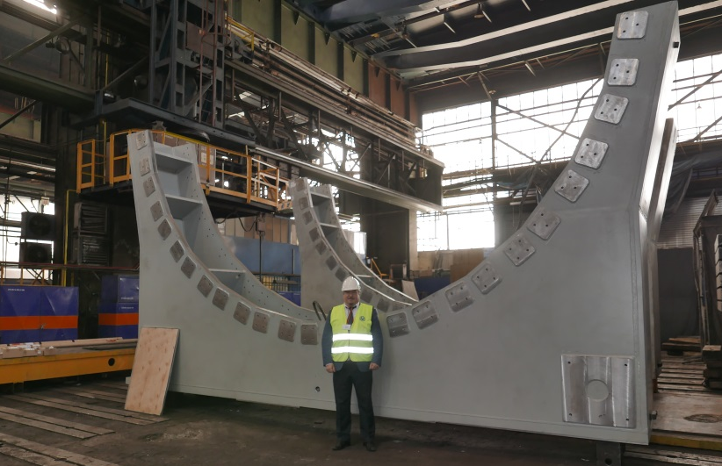
MPD Magnet Yoke: construction status
Leader: N. Topilin
28 plates (16 t each) – 26 ready
2 support rings (42.5 t each) - ready
Lodgment (Yoke support): 70 t, ordinary steel St.3 (Fe 360) – in progress
Plates
Rings
Lodgment
Notes:
The Company in Vitkovice has prepared the place for Control assembling of Magnet Yoke

Slide 8
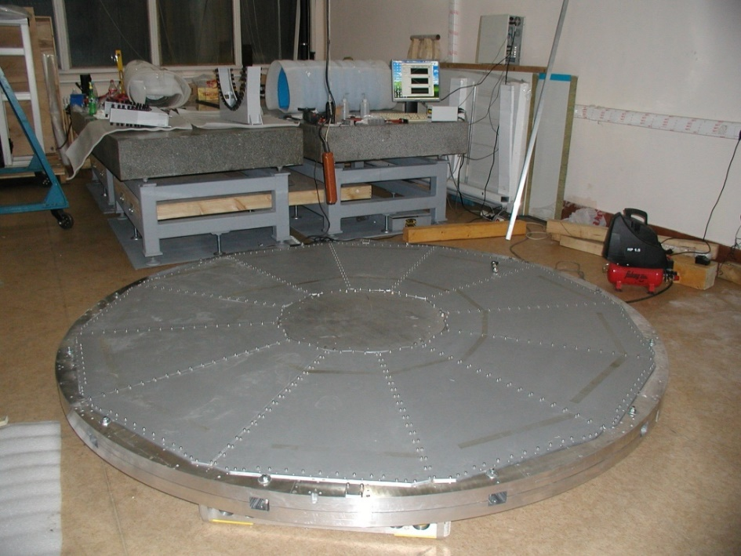
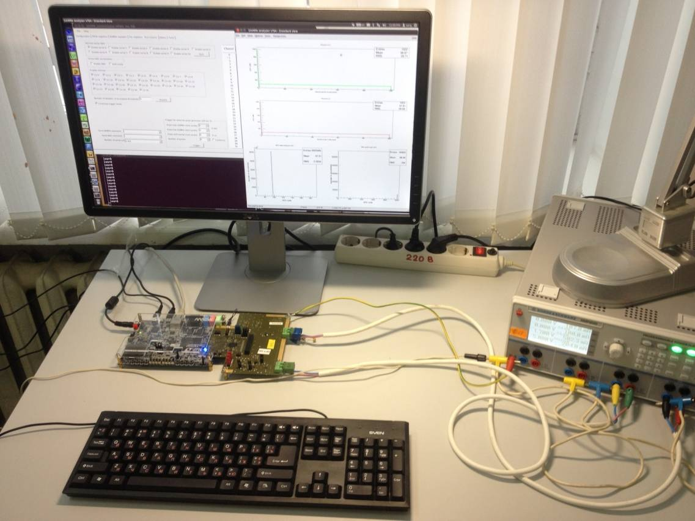
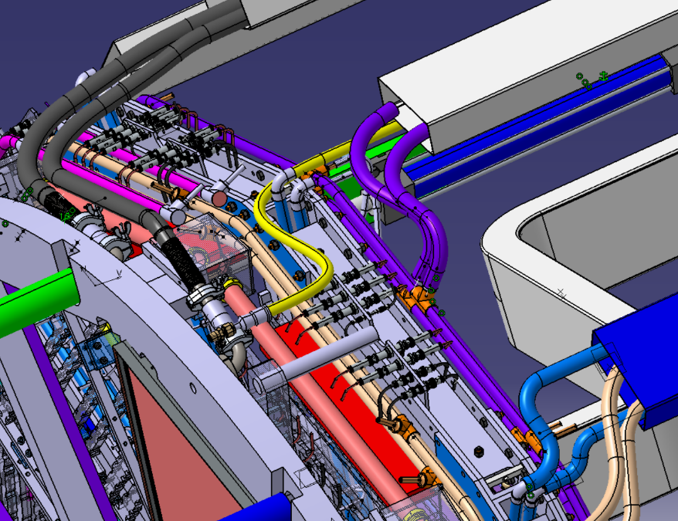
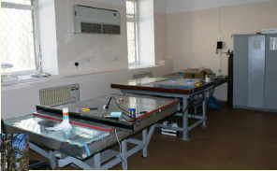
Time Projection Chamber (TPC): progress
Setup for TPC flanges leak tests
Leader: S. Movchan
Clean room and tooling - ready and tested
TPC manipulators – under production (Briansk, Russia)
TPC flanges – ready, under tests
ROC chambers: 1 - tested, 20 – ready for assembling
FEE – designing and final tests. FEC64SAM (SAMPA rev.4)
Gas system – delivered
Cooling – components purchased; a prototype will be delivered to JINR in Feb 2018
Laser calibration system – designed, 2 lasers delivered
Integration - progressing
Stand for SAMPA chip testing
TPC integration (example)
ROC chamber assembly facility

Slide 9
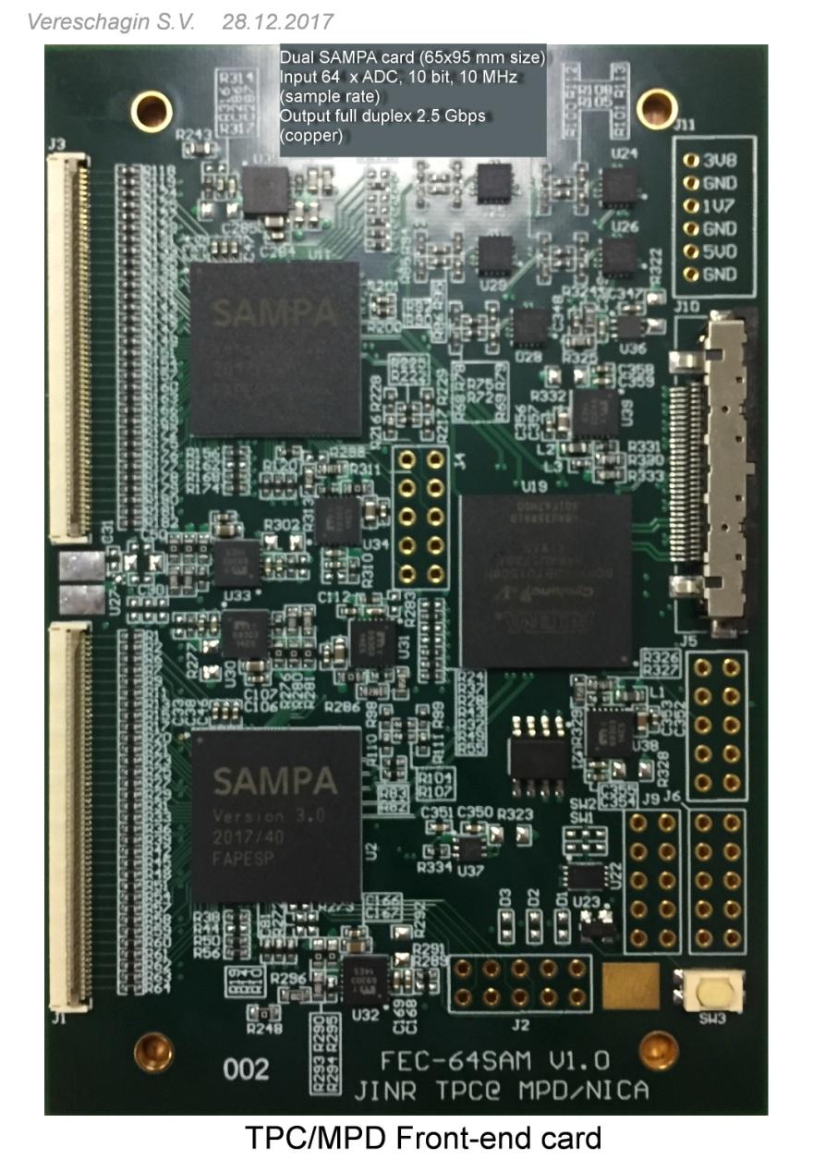
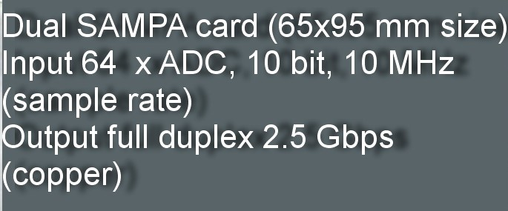
MPD TPC FEE: FEC64SAM v1.0 based on SAMPA rev.3
SAMPAs-FPGA communication – ok!
Trigger and synch – ok!
Plans:
- data transmission
from FPGA to kit – in progress
- board parameters study – will be done

Slide 10
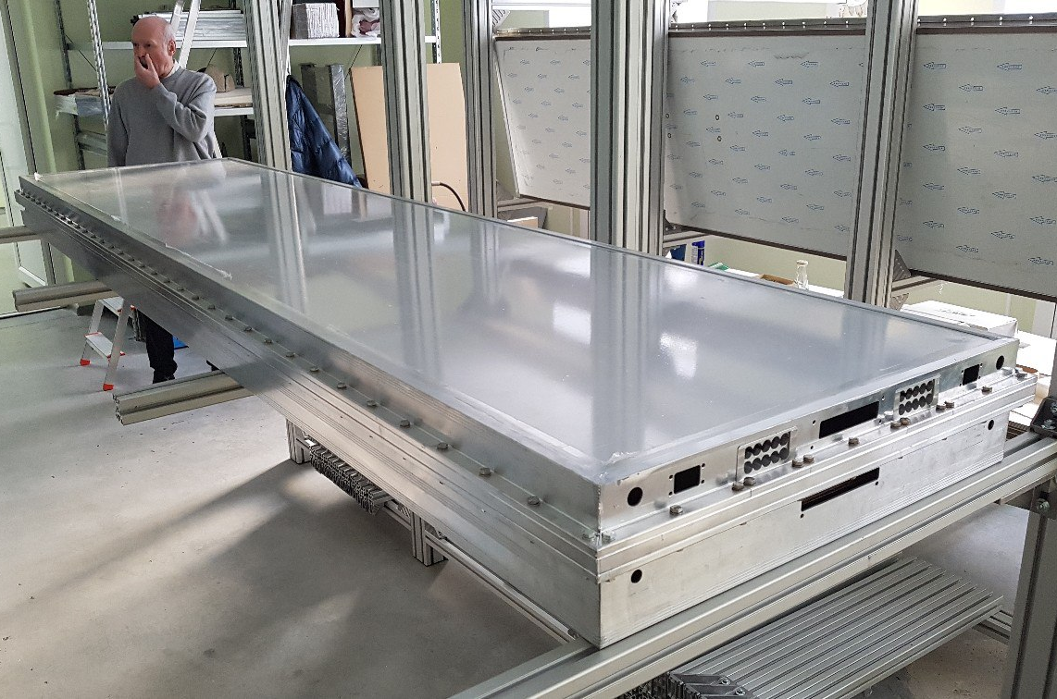
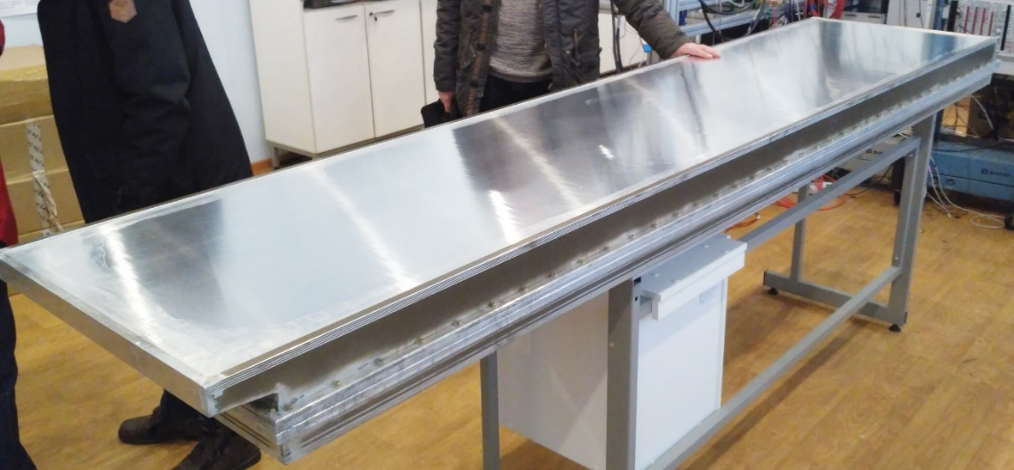
Time-of-Flight (TOF) system: progress in 2017
Leader: V. Golovatyuk
TOF TDR: close to the final version (under evaluation)
All materials are purchased; the equipment for mass production of TOF modules is ready
Front-end electronics and readout TDCs under production (20% of FEE ready)
Production of boxes for the TOF modules has started, two of them made of extruded aluminum profile were produced in December’17
Tooling for TOF installation inside MPD is under construction

Slide 11
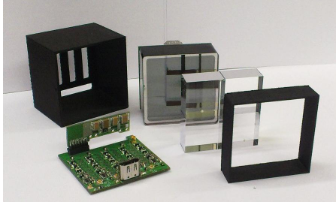
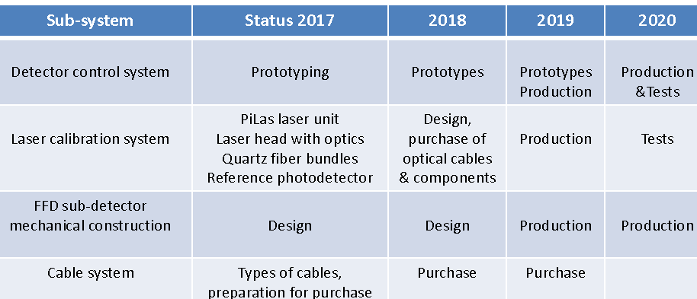
MPD FFD: progress in 2017
Leader: V. Yurevich
TDR FFD ready, got green light from MPD DAC, production status
Special two-room laboratory with needed equipment for FFD production and tests – ready
All MCP-PMTs XP85012/A1 (Photonics) for FFD modules are produced and delivered
Final design of FEE and mechanics - finished
Purchasing of FFD required equipment: 2 NIM crates (delivered), Laser system( laser with optical unit, bundles of optical fibers, and MCP-PMT of reference detector are delivered), HV system (in production, delivery in 2018), CAEN digitizer modules (in production, delivery in 2018).
Beam tests at BM&N (FEE, magnetic field, etc.) ongoing
Yurevich V. I., et al. “Development of trigger and start detectors for experiments with high-energy heavy ions at JINR”, The 2017 International Conference on Applications of Nuclear Techniques, Crete, Greece June 11-17, 2017, Intern. Journal of Modern Physics: Conference Series.
Yurevich V. I., et al. “Cherenkov and scintillation detectors with MCP-PMT and SiPM readout for MPD and BM@N experiments at JINR”, The International Conference on New Developments In Photodetection – NDIP 17, 3 – 7 July 2017, Tours, France.

Slide 12
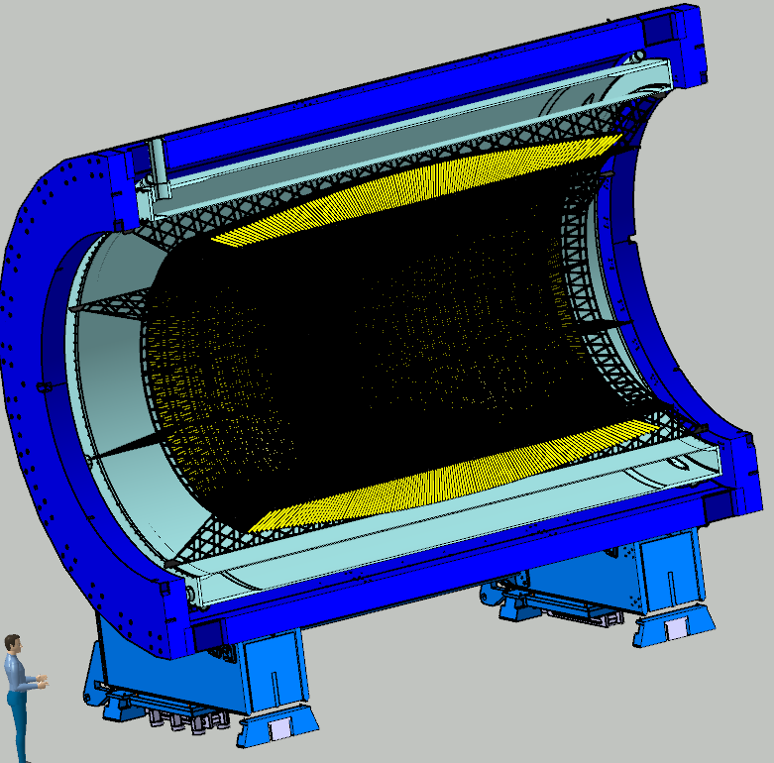
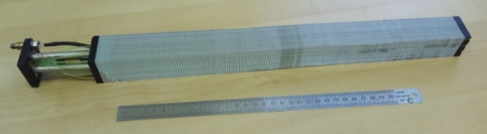
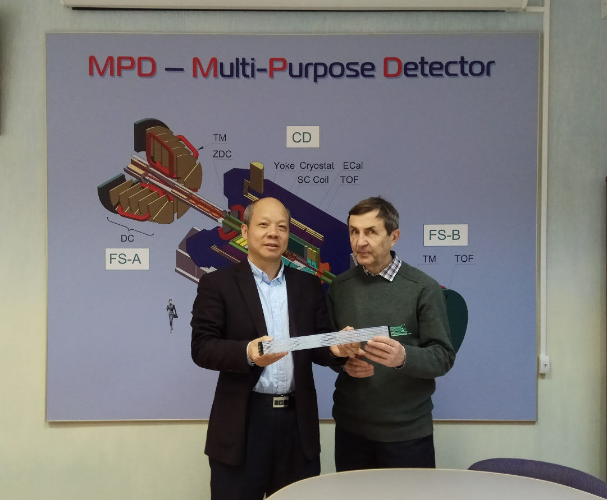
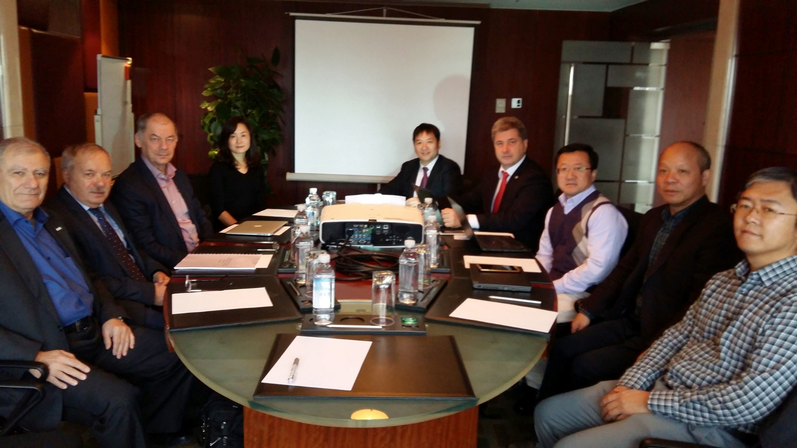
MPD ECAL: progress
I.Tyapkin (JINR), Yi Wang (Tsinghua, China)
Workshop for ECAL module mass-production at JINR – in progress
Construction and testing of prototype modules – done
Workshop for mass-production in Tsinghua (China) under financing
support from Ministry of Science & Technology – in progress
ECAL design&integration and simulation - ongoing
Barrel ECAL ~ 43000 units
Working group NICA-China cooperation
(meeting in October 2017)
Tsinghua-JINR workshop on MPD ECAL
(VBLHEP, December 2017)
Notes:
One of the unique high-tech projects within the framework of the MPD experiment is the large scale electromagnetic calorimeter of the shashlik type with projection geometry. This is a joint project with Tsinghua University (Beijing). It is required to produce more than 40 thousand modules and assemble them into a single cylindrical system, calibrate and put into operation.

Slide 13
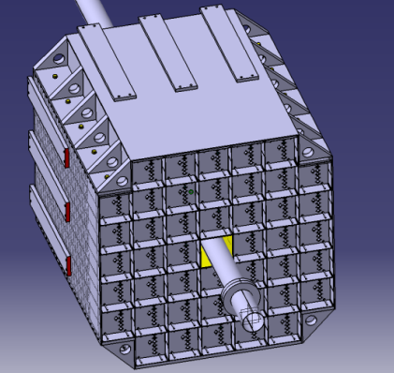
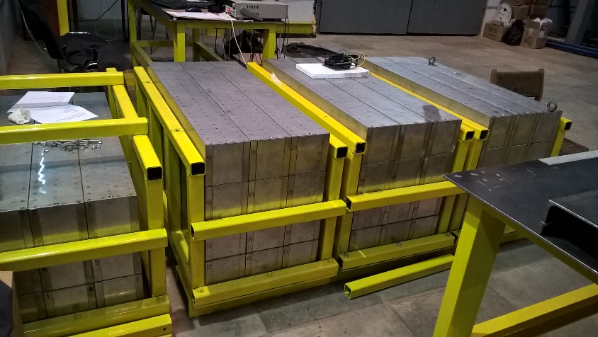
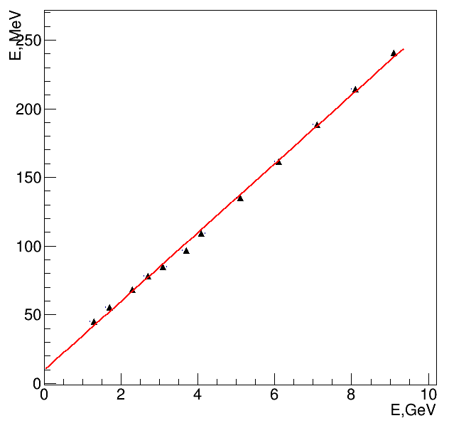
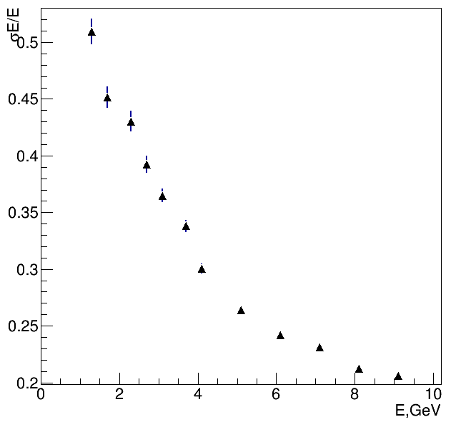
MPD FHCAL : progress in 2017
Leaders: A.Ivashkin, F.Guber (INR, Troitsk)
FHCAL for centrality & event
plane determination
FHCAL TDR – ready. Recent progress follows the MPD DAC recommendations (simulation & beam tests at NICA energies).
According to the agreement with INR RAS about 1/3 of 90 FHCal modules
are produced and tested with cosmic rays.
All the components for the whole FHCAL (lead plates, scintillators,
WLS fibers and structure elements) are delivered; FEE boards under production.
Beam tests in the NICA energy range with a prototype (CERN, end of 2017).
Preliminary (protons)
Good linearity in the NICA energy range
Requested energy resolution can be achieved
Analysis in progress

Slide 14
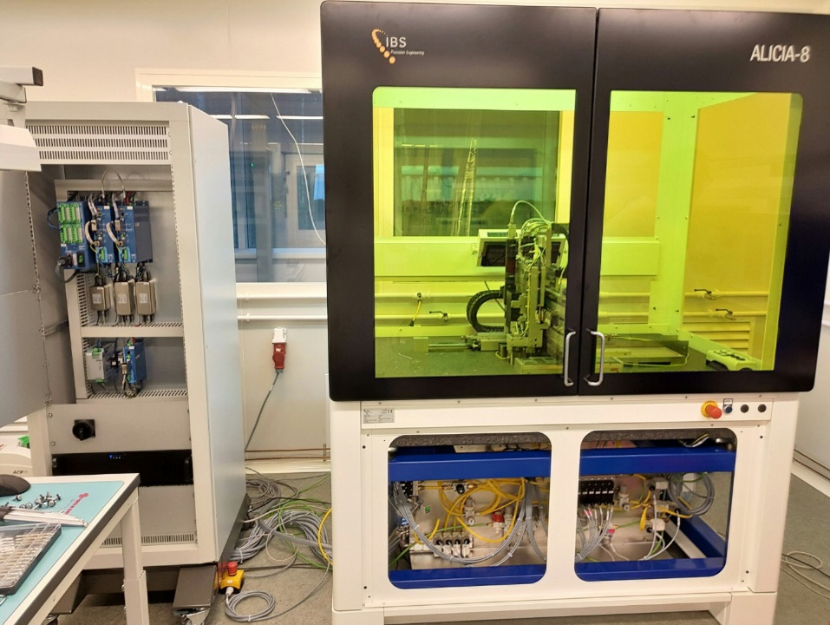
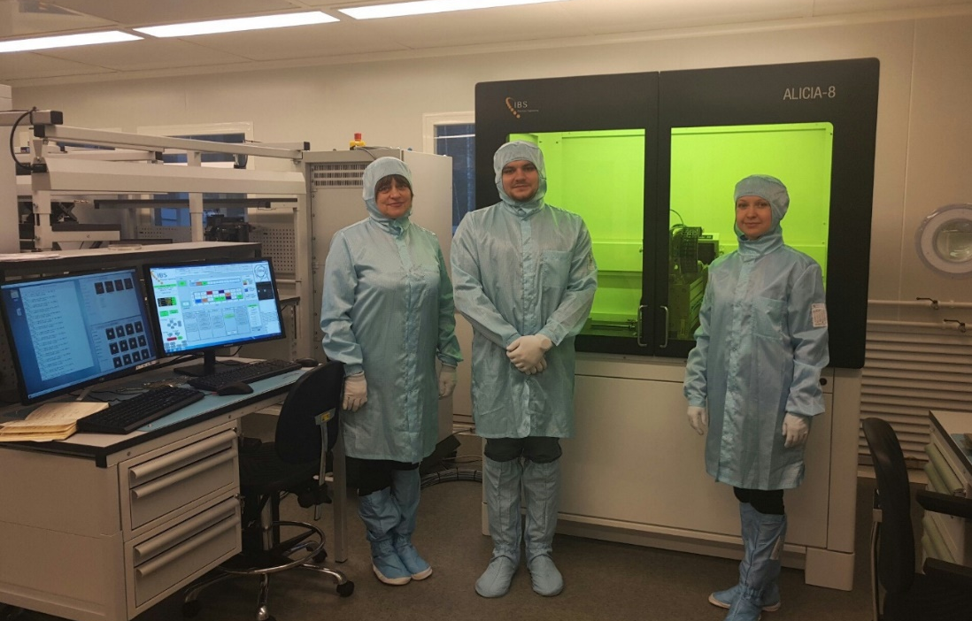
MPD ITS: recent progress
Leader: Yu. Murin
An ALICIA-8 chip “pick&place robot” has installed and commissioned in October - November 2017.
The software for ALICIA was configured in co-operation with Dr. Antonio Di Mauro (CERN) and now connected to the CERN database .
The Contract with IBS PE (Eindhoven) covers 3 years of guarantee service and training of the personal. Start working with ALICIA-8 in the house - Spring 2018.
Positioning actual accuracy of the MAPS on work chuck is better than +/-5μm.
International cooperation with CBM/FAIR (ladders for ITS detectors at NICA and FAIR) and ALICE/CERN (MAPS sensors).
Consortium of several Institutions from Poland – to participate in the NICA experiments

Slide 15
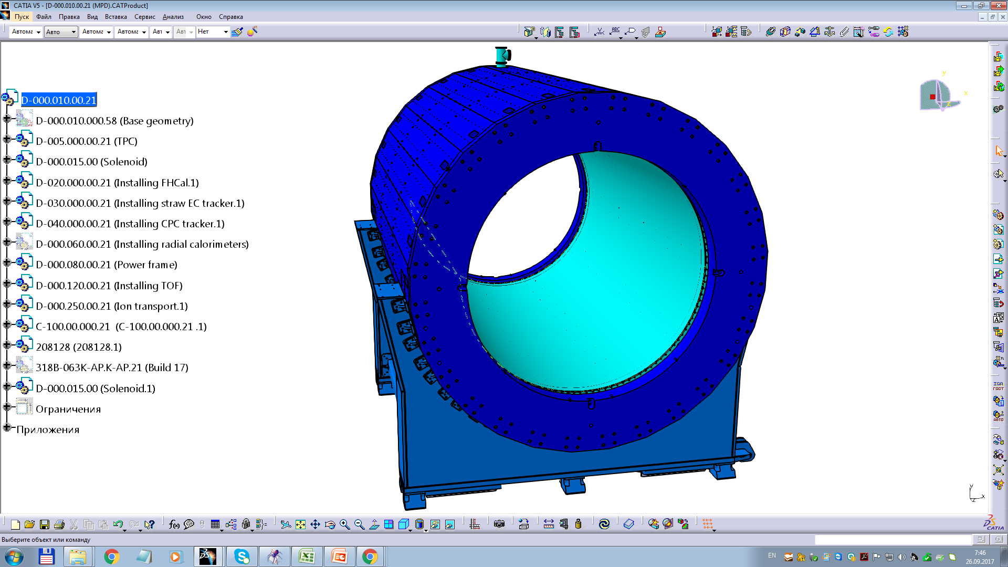
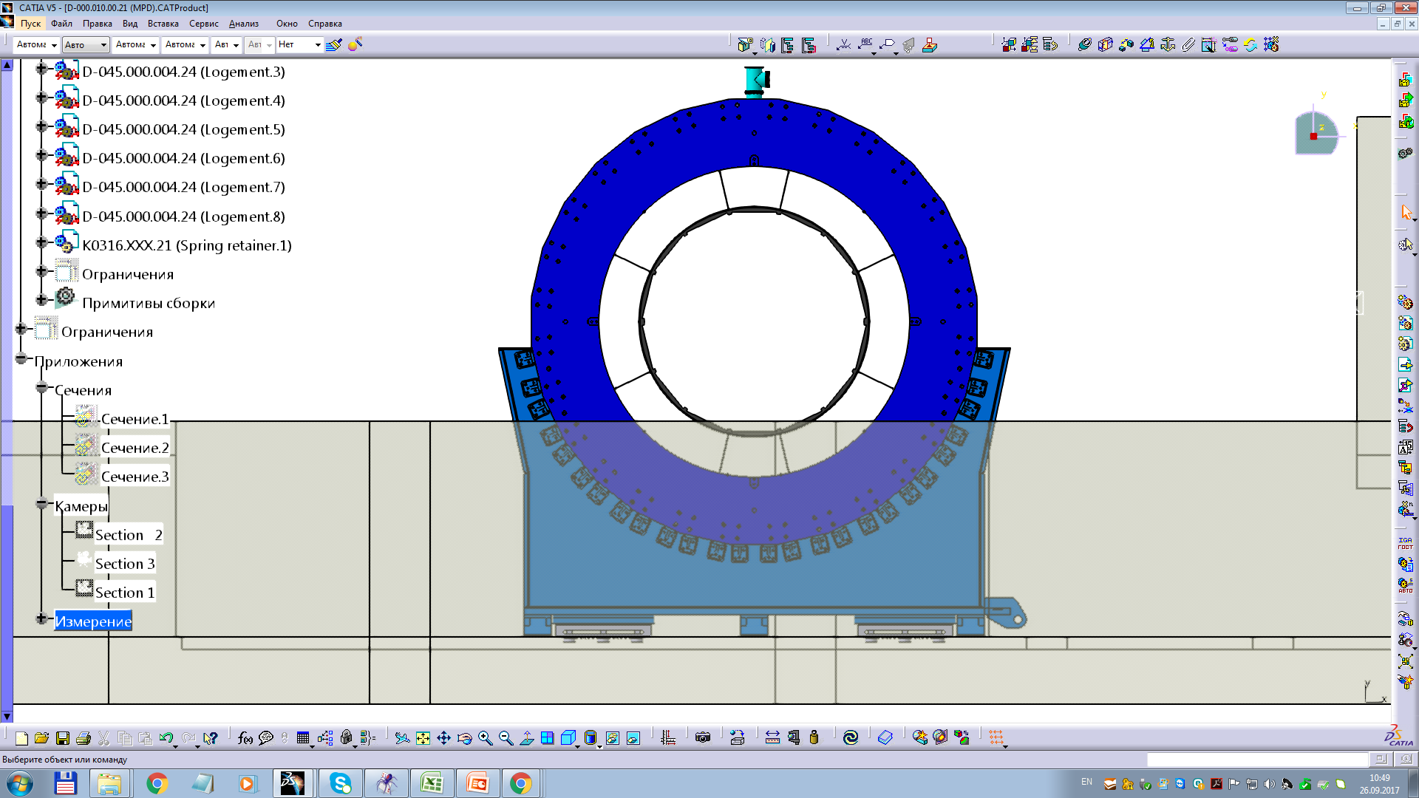
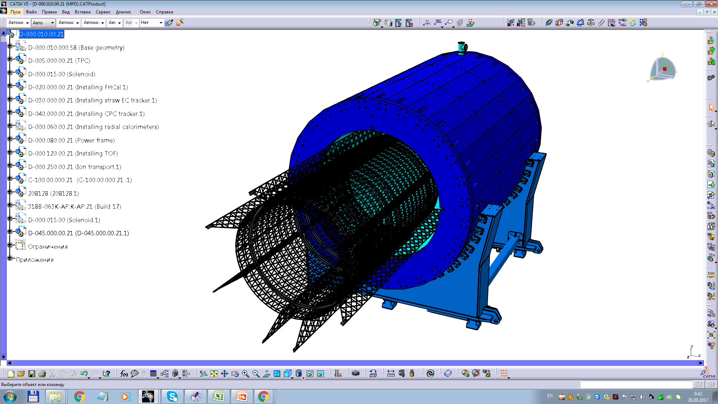
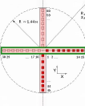
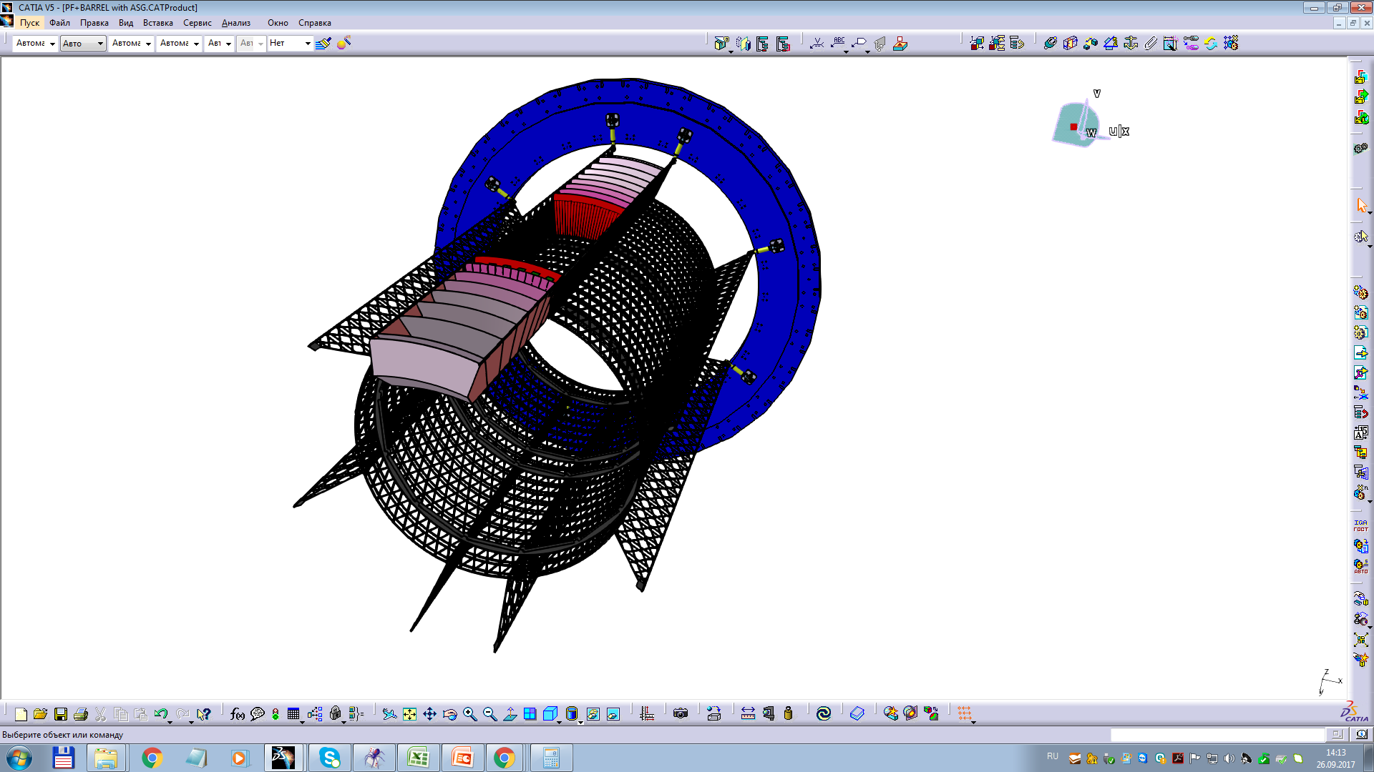
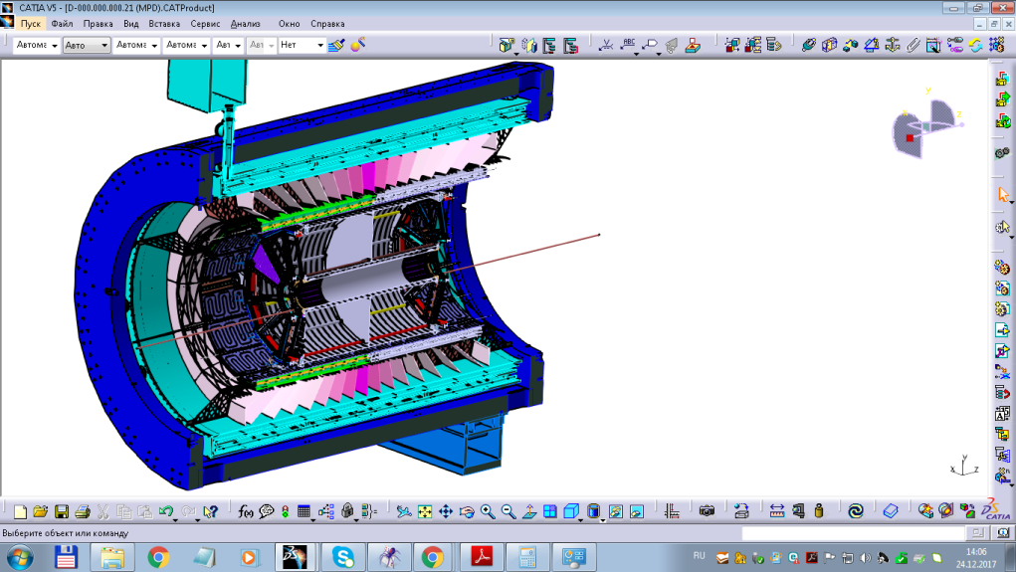
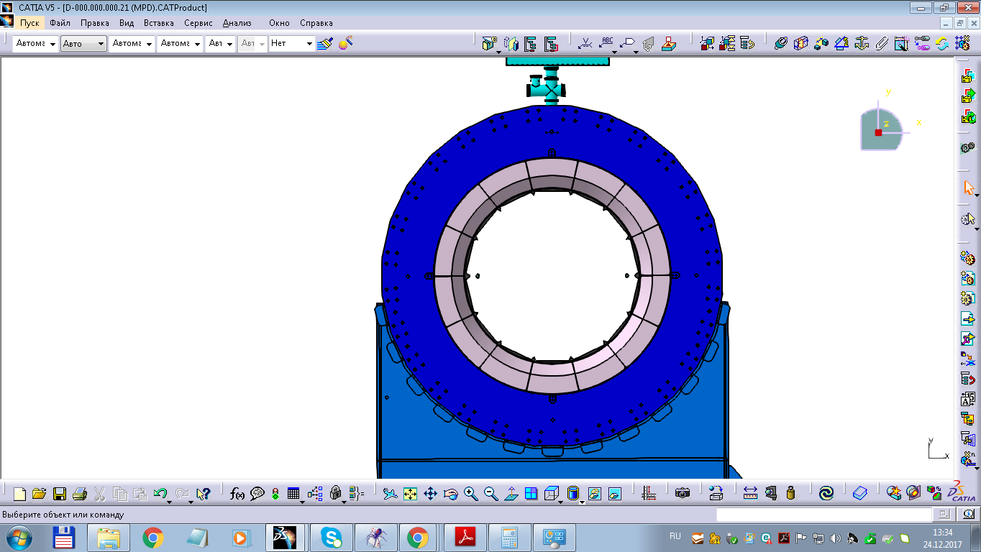
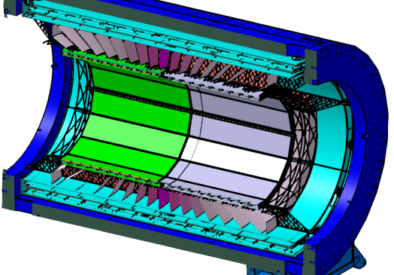
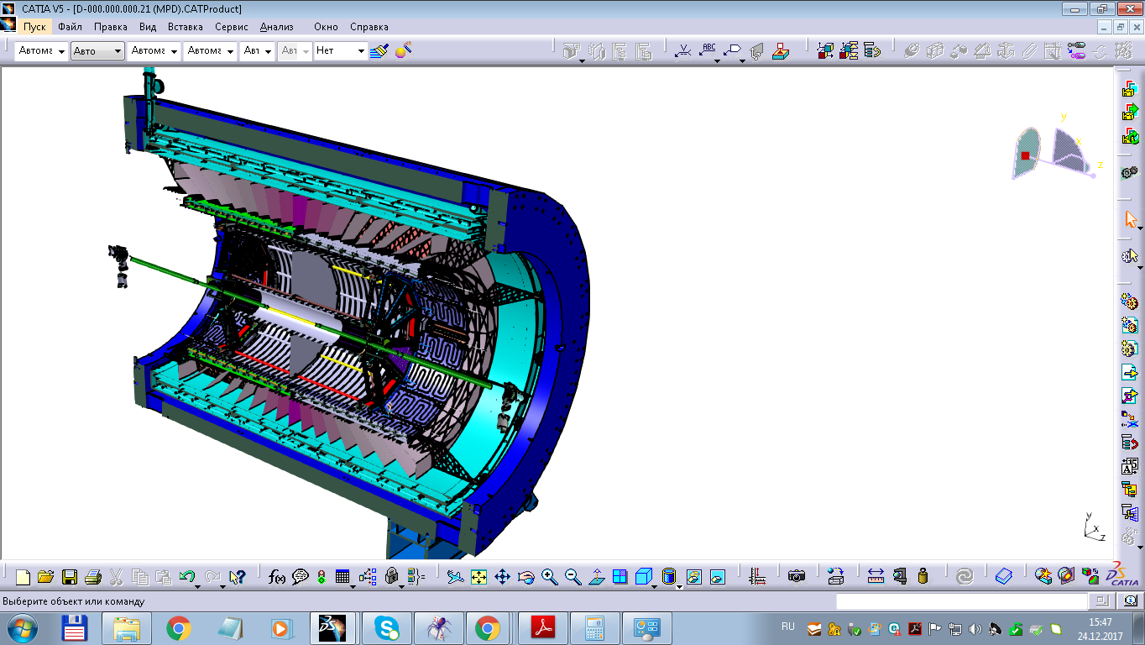
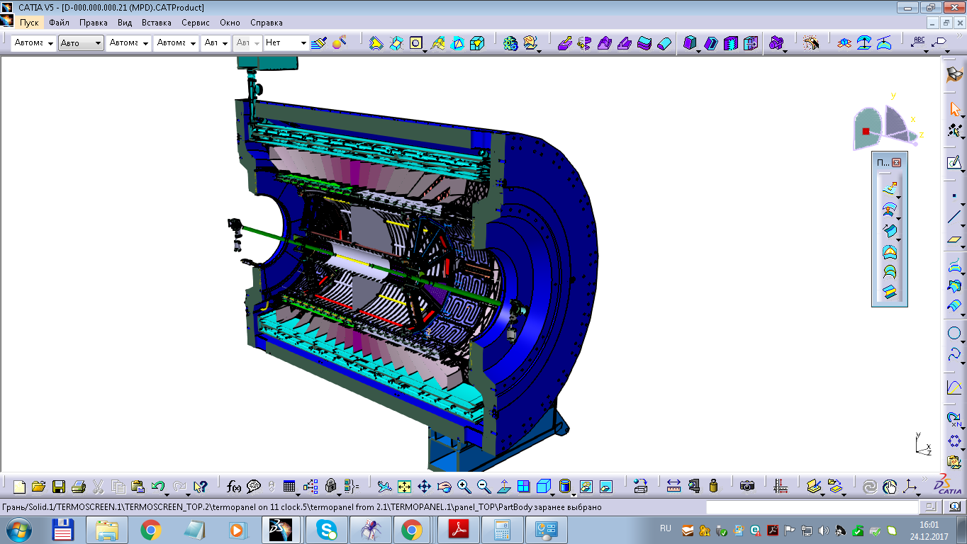
Integration of the Multipurpose Detector
1st stage. Assembly of the magnetic core
with superconducting coil.
Leader: N. Topilin
3rd stage. Conducting magnetic
measurements.
2nd stage. Installation of the power
skeleton.
4th stage. Installation of
"baskets" with
electromagnetic
calorimeters.
5-th stage. Conducting magnetic
measurements
(if necessary)
7th stage. Installing TPC.
6th stage. Installation of
TOF modules.
8th stage. Installing the
vacuum chamber
with FFD and ITS
detectors.
9th stage. Installation of poles
magnet.

Slide 16
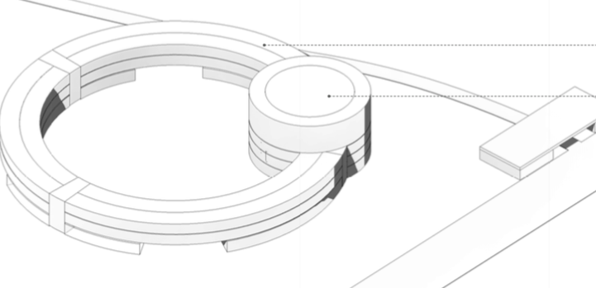
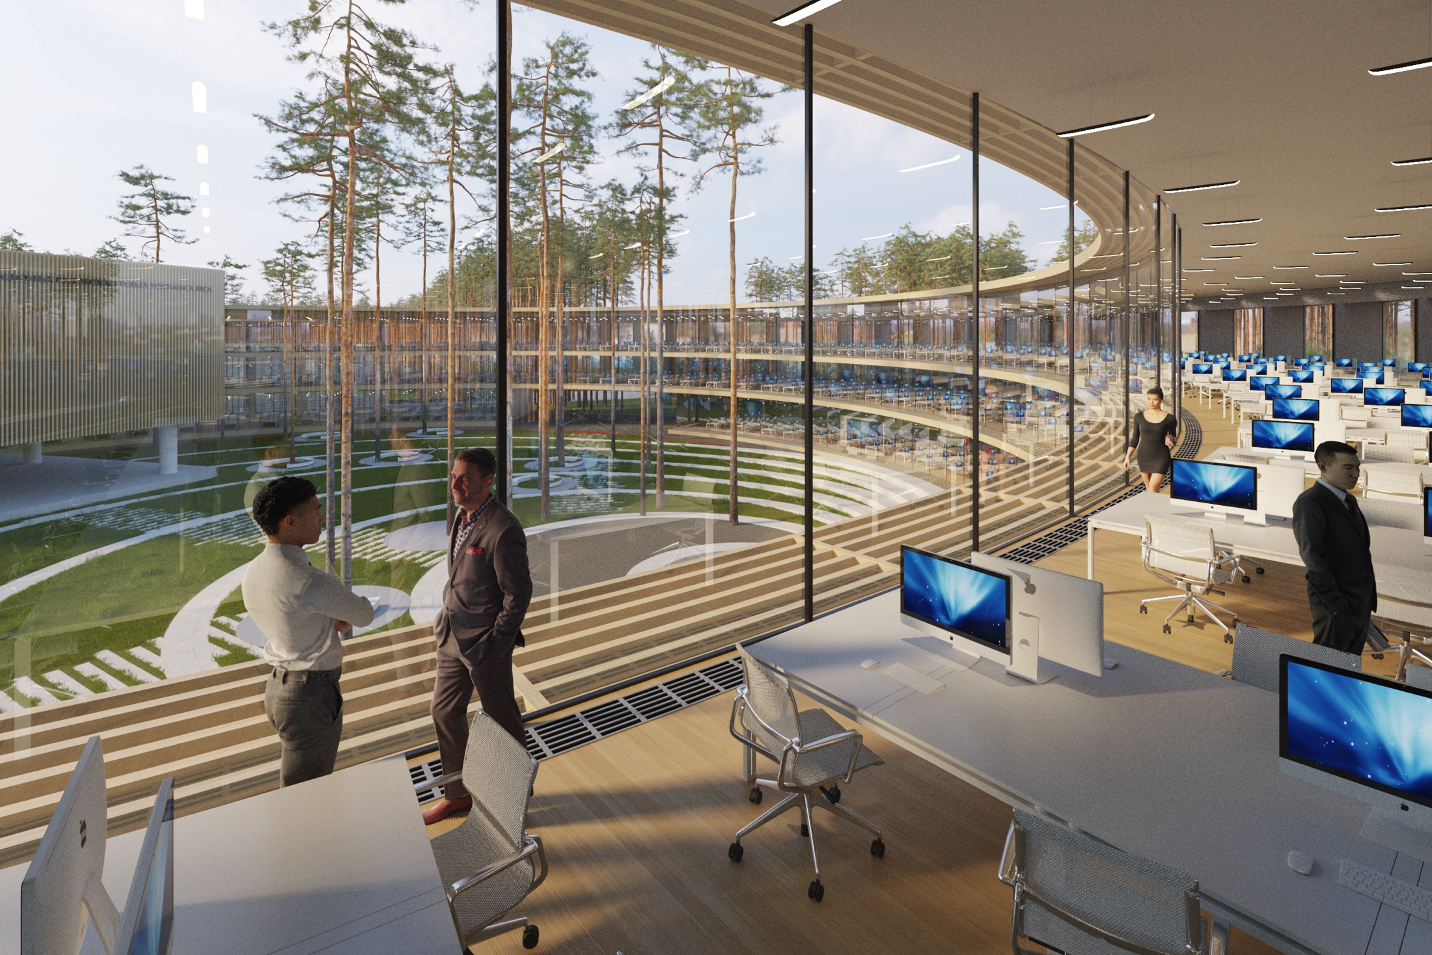
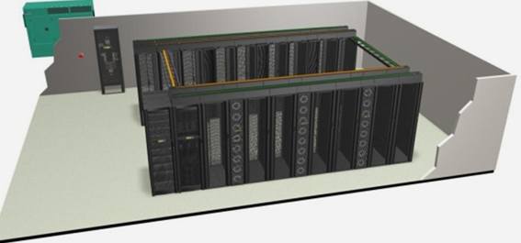
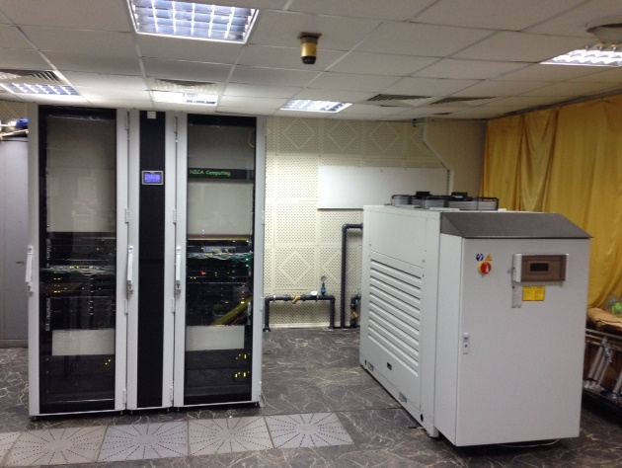
Computer infrastructure for NICA, MPD and BM@N
Leaders: A.Dolbilov, Yu.Potrebenikov
NICA Center
Will be located in the NICA Center + LIT data storage resources
Expected overall data rate ~10¹⁶ bytes/year
3 on-line and 3 off-line clusters over a 100 Gb/s backbone
In construction and tests from 2015: at present contains 576 CPU cores,
9ТB RAM, 7 TB Flash memory, 140 ТB discs
Off-line VBLHEP cluster (project)
Off-line VBLHEP
cluster (prototype)

Slide 17
Progress in MPD MC: realistic TPC simulation
Leader: A.Zinchenko
TPC Simulation procedure (digitization)
1.Primary ionization (ionization clusters)
2.Drift and diffusion of ionization electrons
3.Gas gain fluctuations (Polya distribution)
4.Pad response (charge distribution on pad plane)
5.Electronics shaping
6.Signal digitization (ADC overflow)
Space resolution
Double-hit resolution
Au+Au collsion

Slide 18
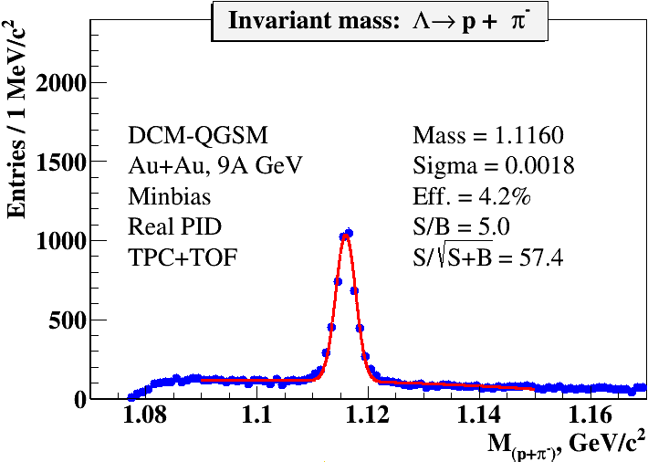
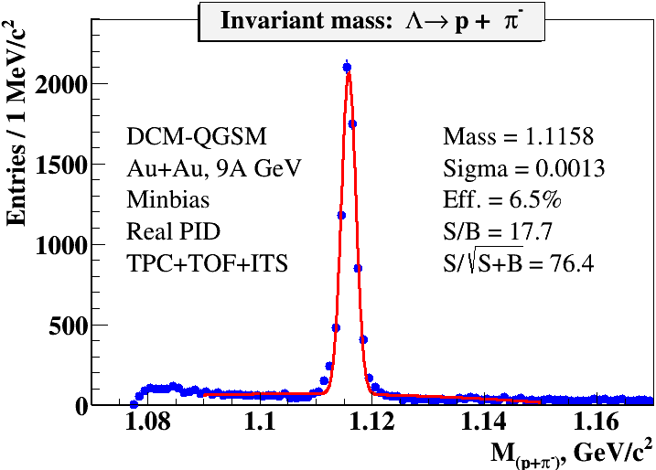
MPD simulation: selected new results
A.Zinchenko, V.Vasendina, K.Shtejer
MPD performance in p+p collisions
ITS detector for strangeness studies
ITS: 5 layers-MAPs+strip detectors
Limited material (no cables and supports); realistic response
Secondary vertex technique
w/o ITS
p+p
p+p
Invariant mass spectrum of (p,𝜋-) pair
Higher efficiency and better
performance
with ITS
Good performance in vertex and track reconstruction in p+p
Reconstruction of strange hyperons from p+p collisions in the MPD detector is possible by combining charged tracks reconstructed in the TPC. A weak combinatorial background due to the low multiplicity from p+p.
w ITS

Slide 19

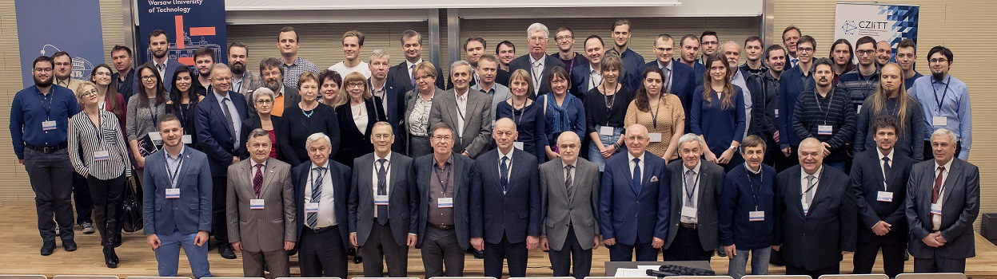
NICA and JINR member states: international activity
M.Peryt, J.Pluta, A.Kisel
This conference brings together experts, scientists, engineers and students interested in aspects of design and construction of equipment for NICA .
Topics:
Heavy-Ion Collisions and QCD Phase Diagram at NICA energies
World experiments and theoretical models related to NICA
Scientific program of JINR and Laboratory of High Energy Physics
NICA acceleration and experimental complex
Physics program of NICA experiments
New technologies, methods and devices developed for NICA
Basic equipment for NICA detectors
Managing system, slow control and Databases
Slow Control System, Managing SCS and Databases, automation
International collaboration
Opportunities for juniors

Slide 20
Summary
Substantial progress in MPD project realization in 2017 (Magnet, TPC,
TOF, FFD, FHCAL)
Evaluation by the MPD DAC all Stage’1 sub-systems carry out regularly,
recent meeting on 30/01/2018
Steady progress in MPD magnet fabrication, however its delivery to JINR
delayed by ~½ year
The (final) choice for the TPC FEE based on SAMPA chip becoming real
MPD Collaboration → toward the formal foundation
Thank you for your attention!

Slide 21
Spares

Slide 22
Mexican group at MPD-NICA: first results
Participant Institutions: BUAP, CINVESTAV (Fisica), UAS, UNISON, UNAM (II, FC & ICN)
Theory: QCD phase diagram at finite T and μB, CEP signatures, chiral symmetry restoration mechanism
Experiment: inclusion of a detector that allows to MPD increase its pseudo-rapidity acceptance, optimization of event plane resolution, multiplicity reference estimator, trigger system and beam monitoring
Proposal: Beam Monitor Detector (BMD) system will consists of two parts located at 2 meters away from the MPD center, Each half is composed by an array of 80 cells made of plastic scintillator arranged in 5 rings.
MC simulations of BMD performance:
Event plane reconstruction
Timing performance
Centrality determination
Trigger efficiencies
Luminosity control
Background rejection
* In July-August 2018 two summer students from Mexico worked on these tasks.
1.7 < |η| < 4.4
Steady progress in Mexico towards the design of the BMD prototype.
Well defined design, building the prototype to test in a beam test
Searching for extra funds (Mexico, JINR?)

