Slide 1

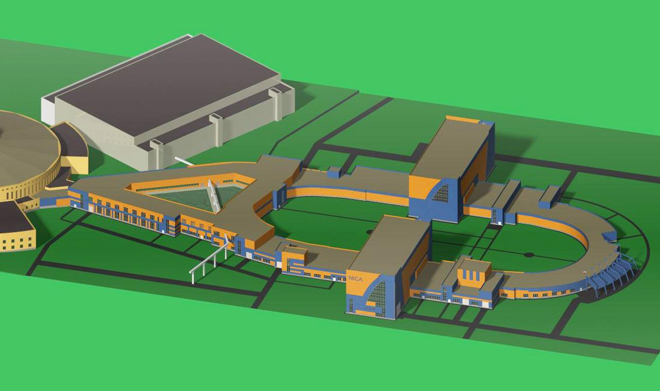
Status of the NICA project
Andrey Butenko on behalf of the team
Veksler and Baldin laboratory for high energy physics
Joint Institute for Nuclear Research
NEW TRENDS
IN HIGH ENERGY PHYSICS
NICA: Nuclotron based Ion Collider fAcility

Slide 2


General information
NICA is an international project
realizing by international intergovernmental organization –
the Joint Institute for Nuclear Research
and brings the efforts of 18 member states and 6 associated countries.
Project NICA started as a part of the JINR Roadmap for 2009-2016
was described in the 7-years Program.
It was approved by Scientific Council and
the Committee of Plenipotentiaries of JINR in 2009.
In 2016 between RF and JINR was signed a contract
about support of the basic configuration of the NICA complex.
In 2017 the project was included into ESFRI road map.
Project web-site: http://nica.jinr.ru/

Slide 3
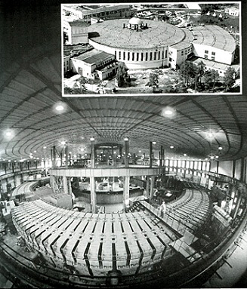
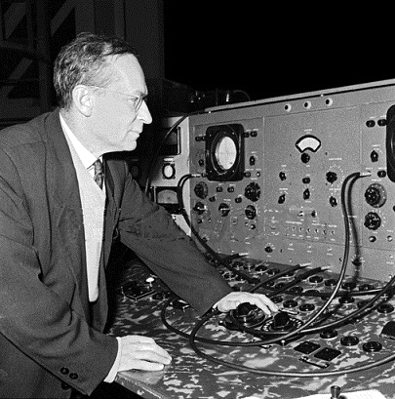
Relativistic nuclear physics
End of 60-th – acceleration of ions
70-th – observation of nuclear cumulative effect
V.I. Veksler
A.M.Baldin

Slide 4
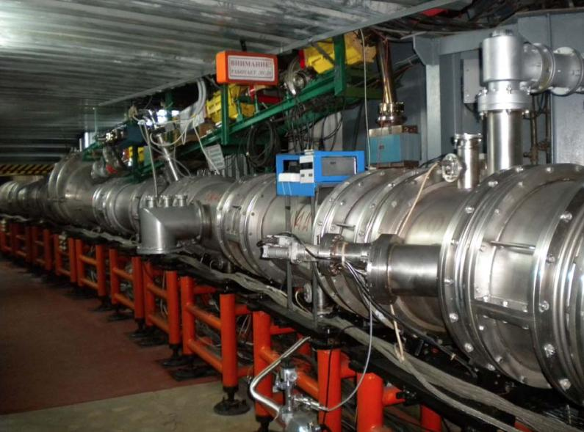
Nuclotron –
superconducting synchrotron
Circumference 251,2m, Br<45 Tm
The project approved
in 1986 year
Commissioning &
fist beam
March 1993 year
Slow extraction
2000 year
The last RUN #55
Feb. - April 2018
Accelerated:
Ions from p to Xe (C, Mg, Fe, Ar, Kr)
Polarized p & d beams
Proton energy max 12 GeV
Light ions, A/z=0.5 max 6 GeV/u
Heavy ions, A/z=0.3 max 4.5 GeV/u

Slide 5
Nuclotron –
Nuclotron – superconducting synchrotron
superconducting synchrotron
Nuclotron-N
preparation of the ring for NICA project
Development of the
KRION ESIS
+
Injector modernization
Energy evacuation system
Heavy ions
Quench protection system
Energy 6 Gev/n
(for Z/A = 1/2)
Field ~ 2T,
B’< 0,8 T/s
Slow extraction at HE
Nuclotron-N
Vacuum improvement
Intensity >10^7 ppc
(with KRION-2)
Control, diagnostics, RF
Cryogenics modernization
Stable, safe,
long operation
Power supply system modernization
Radiation safety

Slide 6

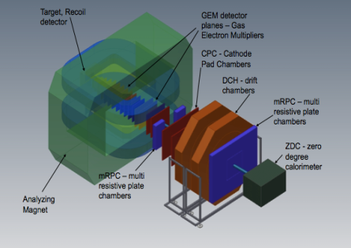

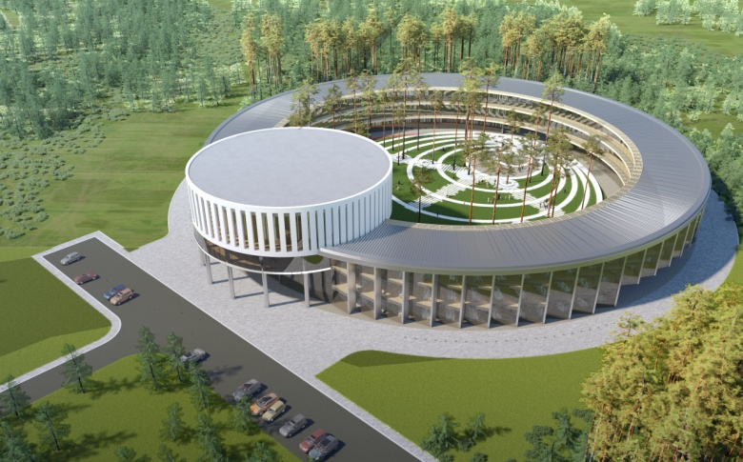
Basic Facility
2 major milestones in 2018
BM@N
the first
physical run
Center NICA
Booster assembling
- Set of accelerators providing the particle beams for fixed target and collider,
- Experimental facilities,
- Line for assembling and cryogenic testing of SC-magnets,
- Workshops for construction of the detector elements,
- NICA innovation center,
- Required infrastructure.
Notes:
This is a view of major NICA facilities. The Nuclotron – supercoducting synchrotron with circumference of 250 meters was put in operation 24 years ago. The beams from Nuclotron are extracted to the experimental hall, where the first experiment of NICA program BM@N is located. The plan is to put in operation a booster in 2019, and collider - in 2020 simultaneously with the MPD.

Slide 7
Stages of the experimental program realization
Stage I
Fixed target experiment with heavy ions
Stage II
Basic configuration of the collider and detector
Full configuration, heavy ion collisions
Collisions of heavy ions with light ions (protons)
Stage III
Spin physics program

Slide 8
Structure of the injector complex
Transfer to collider rings
or fixed targets
Nuclotron
magnetic rigidity of about 42 T·m
SPI
LILAc - after 2022y
LIS
RFQ
LU-20
p↑, d↑, ions z/A>0.3 5 MeV/u
DP
HILAc
Booster
ESIS
RFQ
IH1
IH2
Au³¹⁺ 3.2 MeV/u
Polarized p↑ and d↑ beams, protons and light ions are planned to accelerate with existing Linac LU-20, and after full upgrade 2022 with new LILAc.
Heavy ions: HILac + Booster

Slide 9
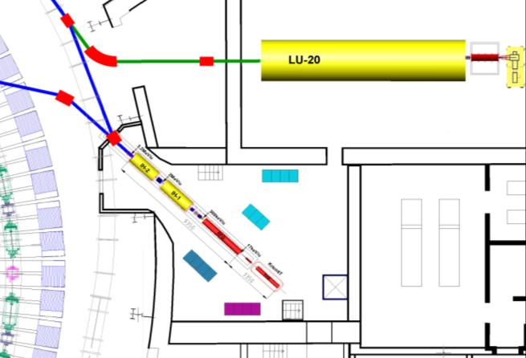
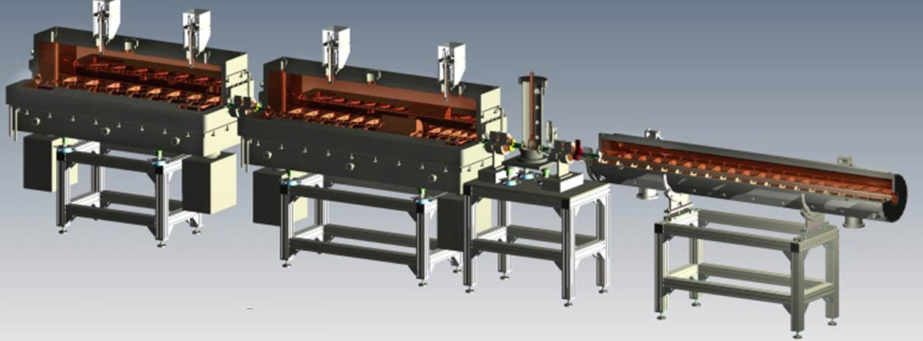
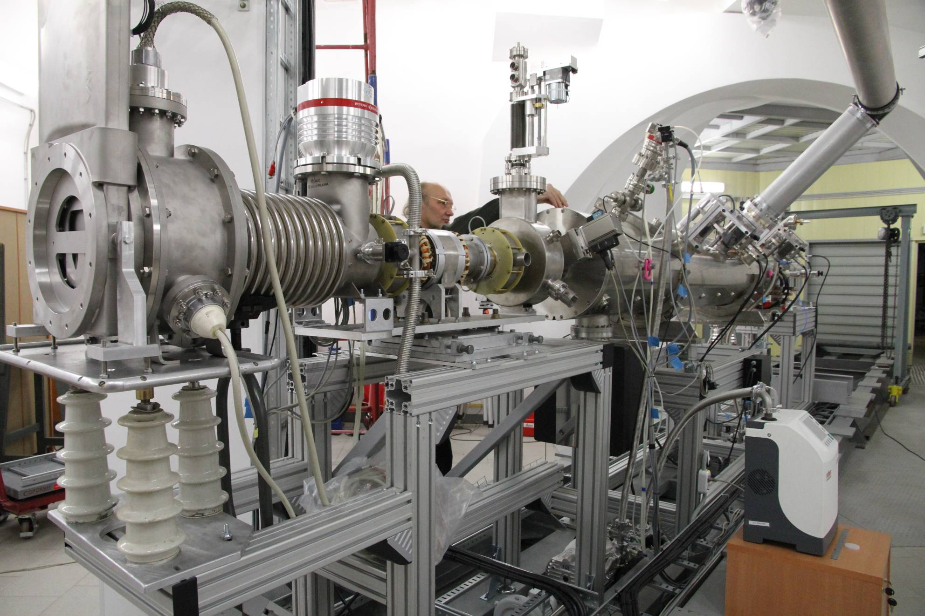
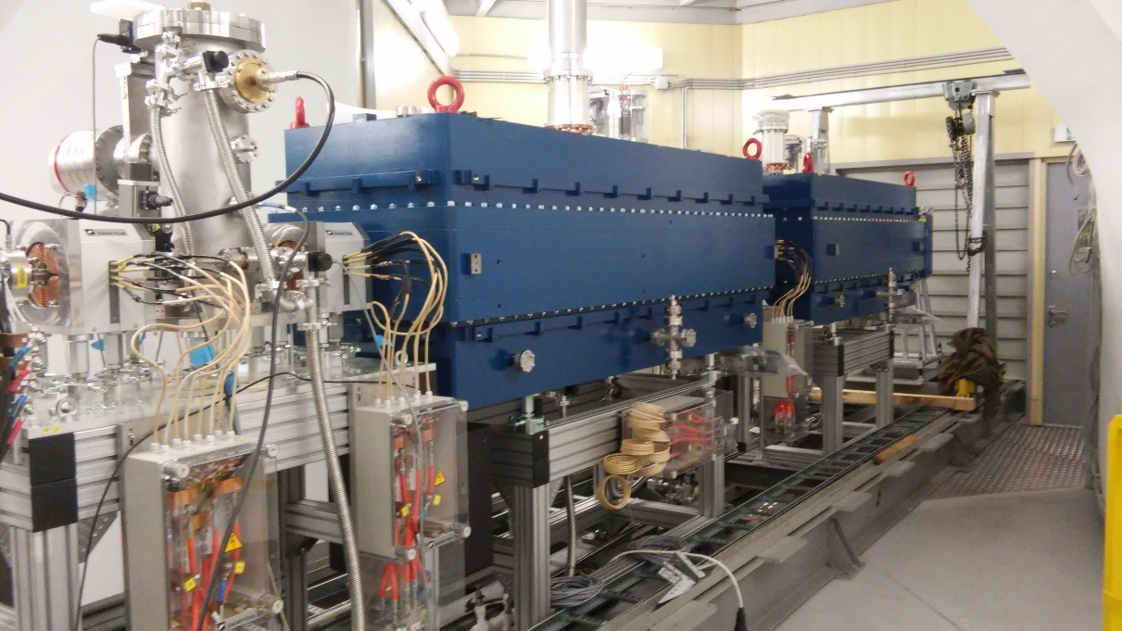
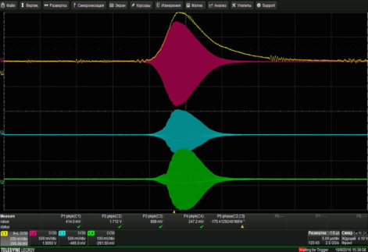
Heavy Ion Linear Accelerator HILAc
high current (10 mA), the first Linac with solid state RF amplifiers
MEBT
IH-1
IH-2
RFQ
Commissioned: Oct. ‘16
Notes:
A new heavy ion linac fabricated by BEVATEC was fully commissioned and put in operation last year.

Slide 10
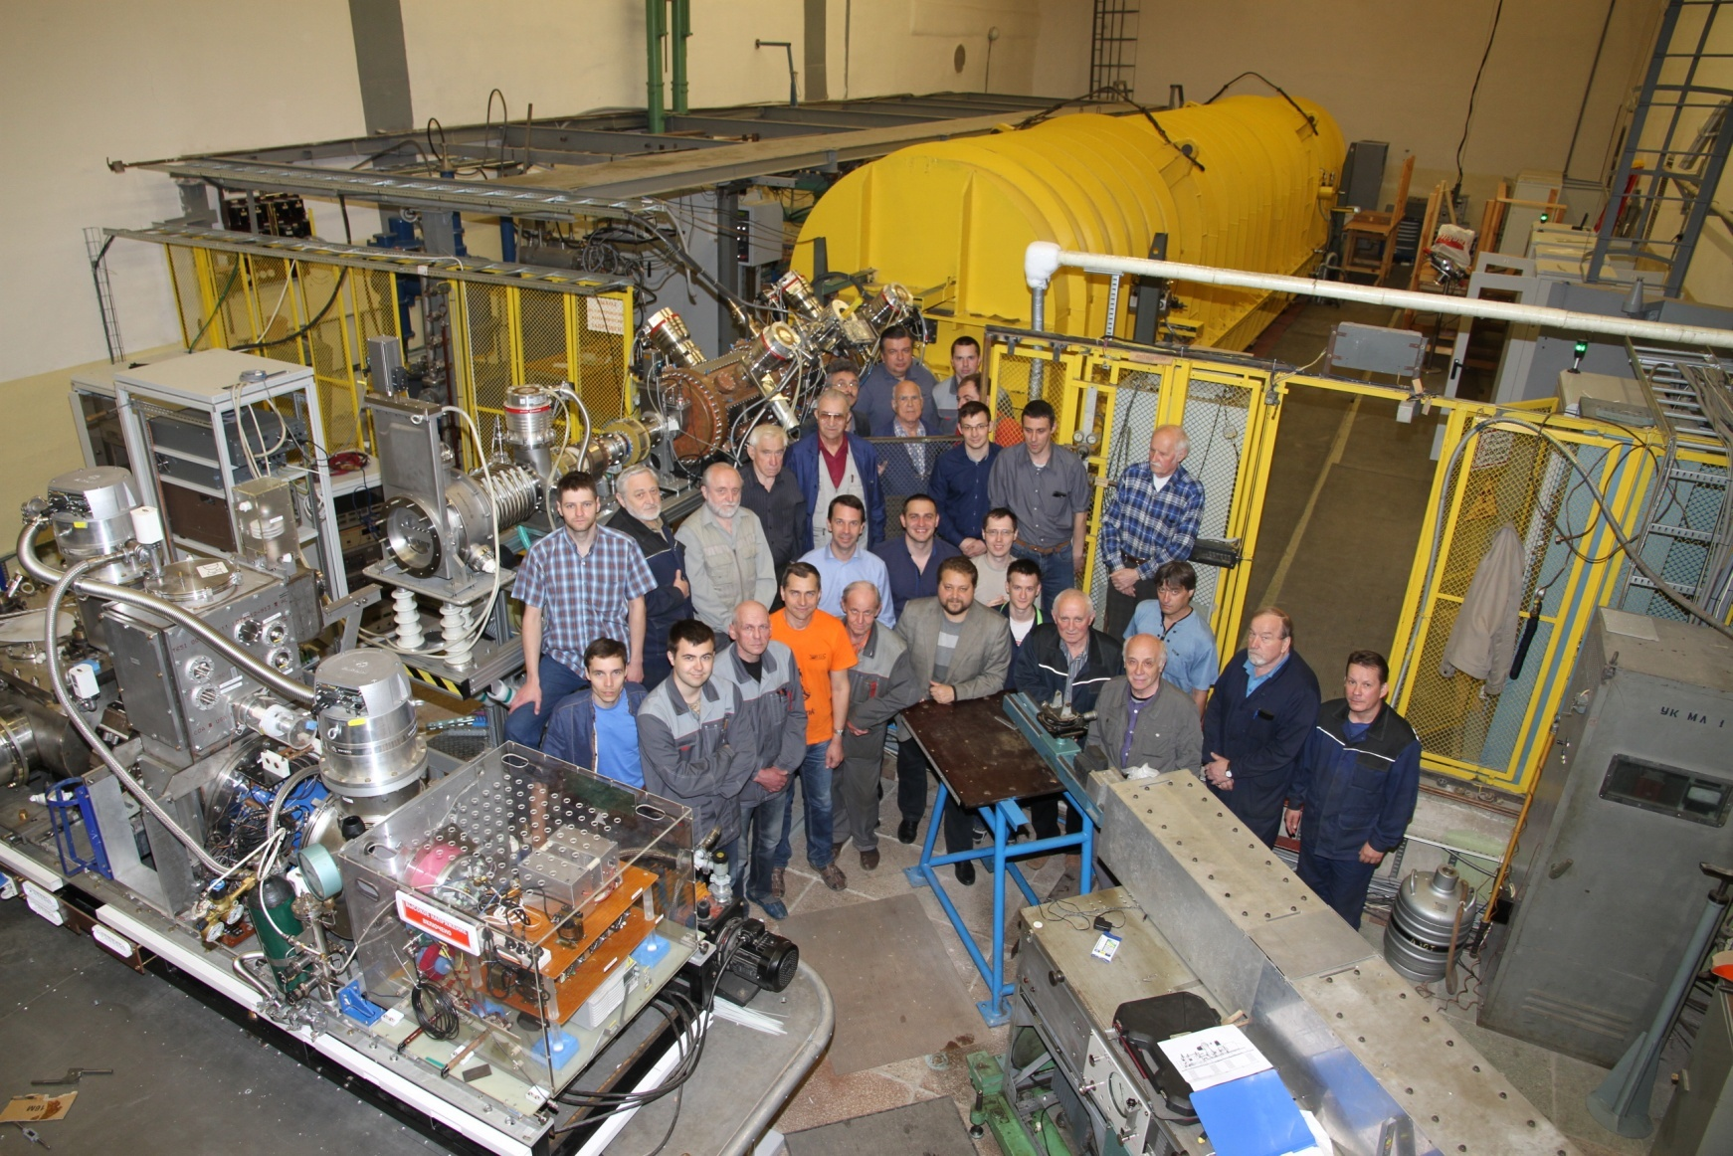
Light Ion Linear Injector LU-20
Injection chain for light ions
LU20
LU-20 – new for-injector:
JINR, INR, ITEP, MEPI
RFQ
SPI
LIS
commissioning: May ‘16

Slide 11
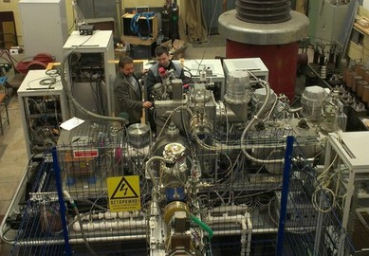
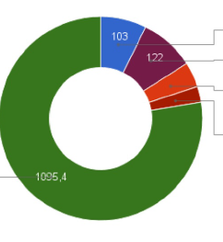
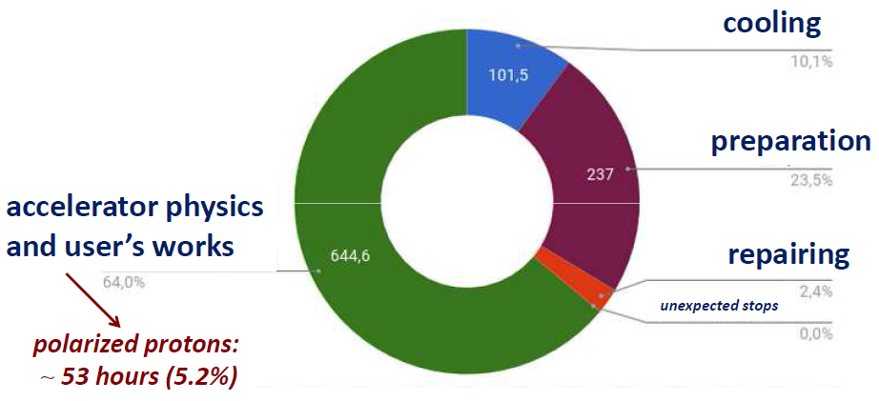
Polarized program at Nuclotron
Run #53, 1450 h, autumn’16
SPI beams
Longest run
Cooling, 7.3%
Tuning, 8.7%
Repairs, 4%
Unexpected losses, 2.5%
77.6%
Run #54, 1150 h, spring’17
Experiments
Polarized, unpolarized deuterons,
maximum energy of extracted beam
4.6 GeV/u

Slide 12
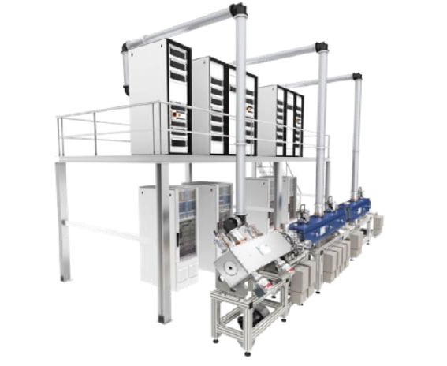
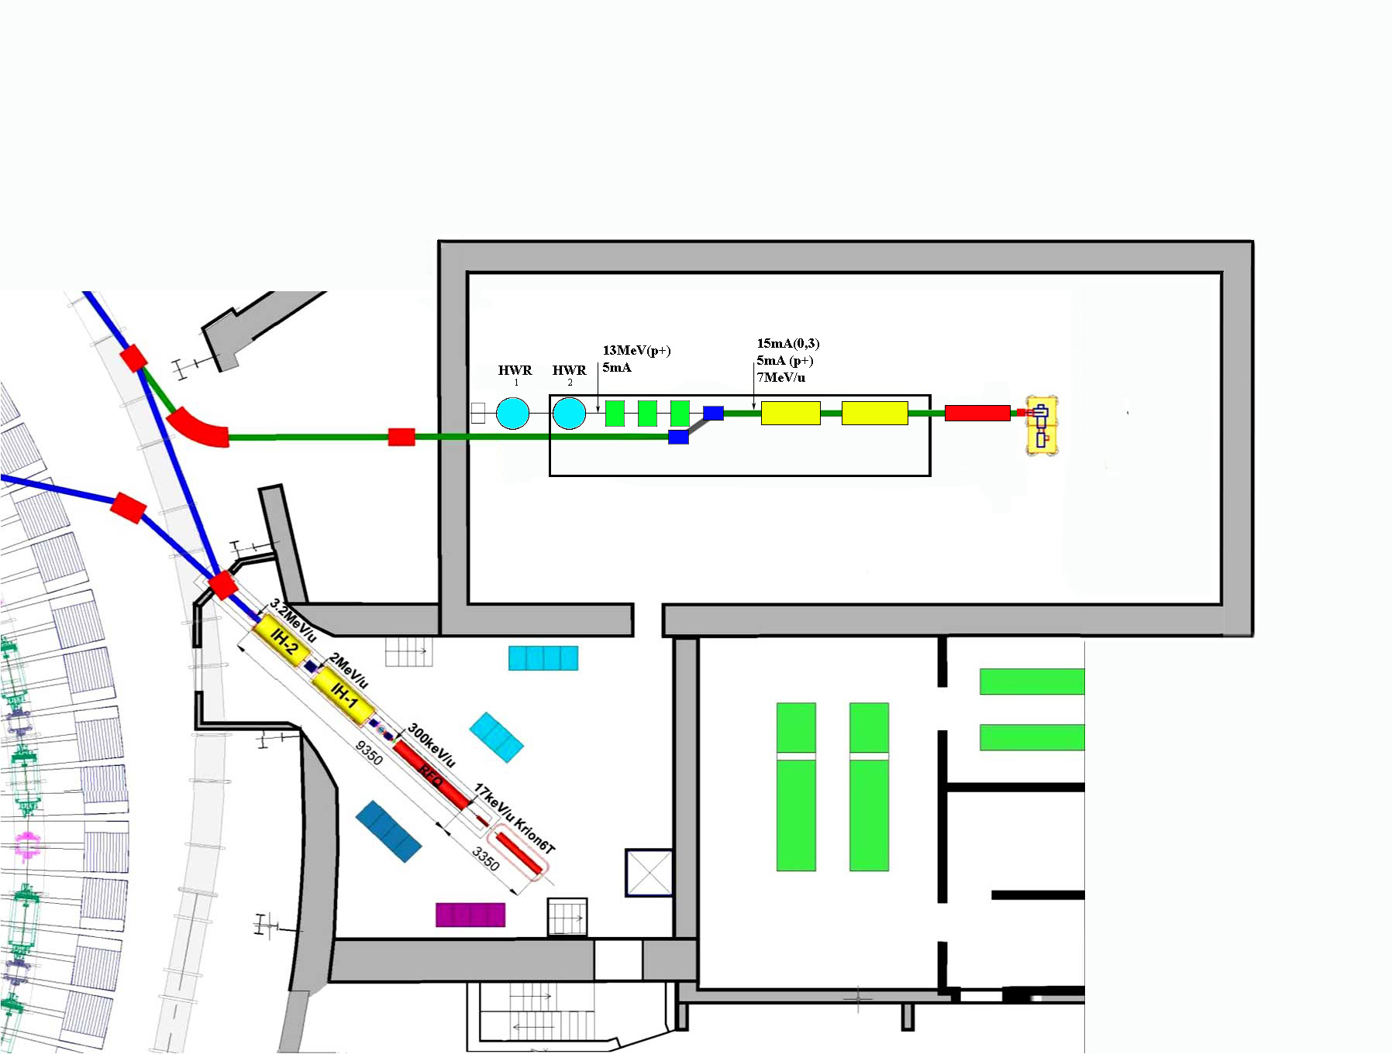
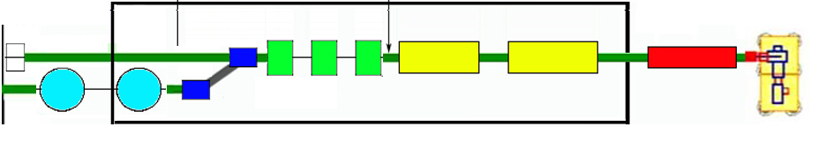
New Light Ion Linac “LILAc”
Injector for the Nuclotron ring.
Future plans for the new injector
Summer 2021: commissioning at the test bench with beam.
SC section
Meddle energy section
First LINac 7 MeV/u section
LU-20 Hall
New linac – 3 sections:
1st sect. from BEVATECH
7MeV/u for ions Z/A>1/3
2nd sect. warm resonators
for p+ up to 13 MeV
3rd for SC res. testing & applied research up to 20MeV
HILAc

Slide 13

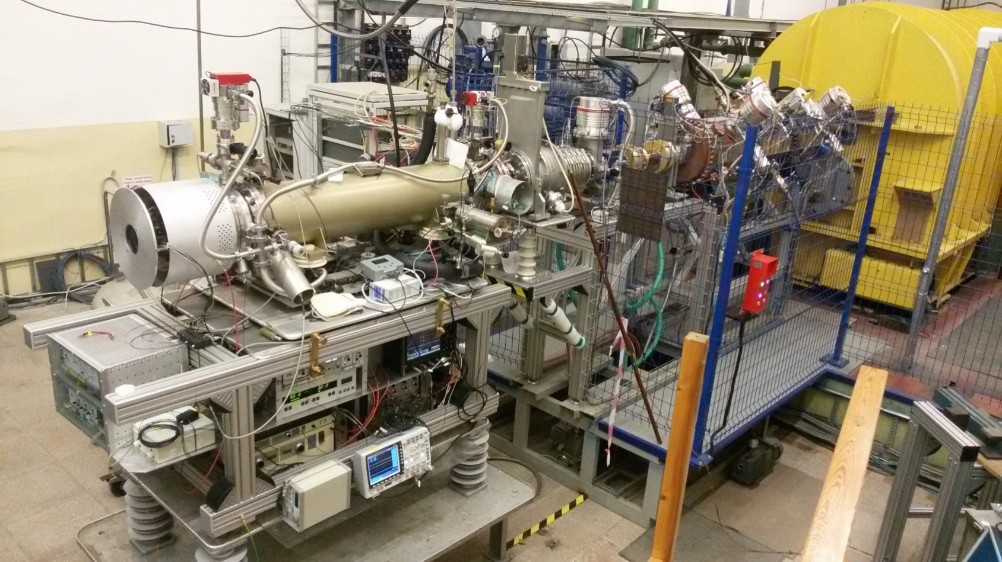
Nuclotron RUN #55, spring 2018
KRION 6T – heavy ion source was used during Nuclotron RUN #55 for SRC & BM@N experiments
Usage of the buncher permitted to increase the Ar beam intensity
at the entrance of the Nuclotron by about 5 times

Slide 14
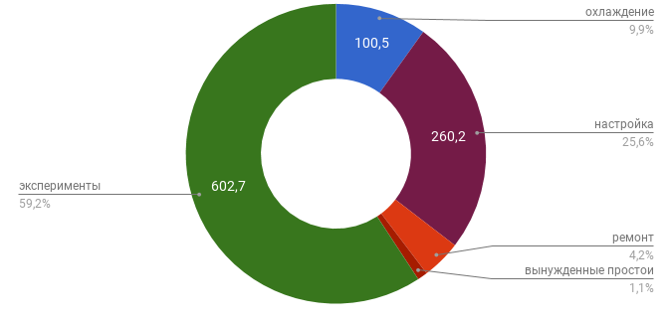
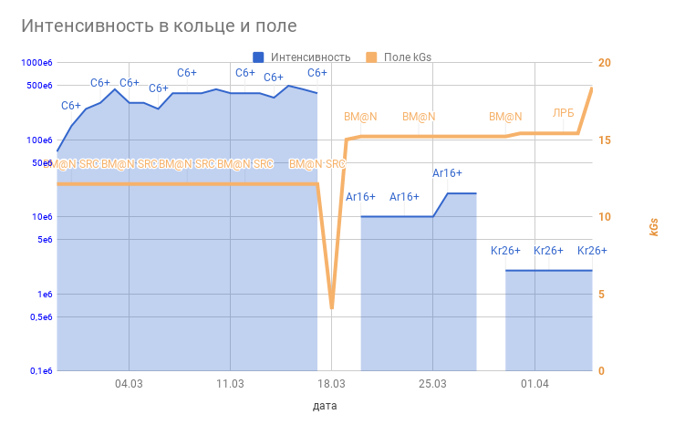
Nuclotron RUN #55, spring 2018
milestone I: BM@N first results
Run 55: February – April 2018
the first run with startup configuration of BM@N
experiment BM@N SRC
¹²C BM@N & SRC
⁴⁰Ar BM@N ⁷⁸Kr BM@N
03.04

Slide 15
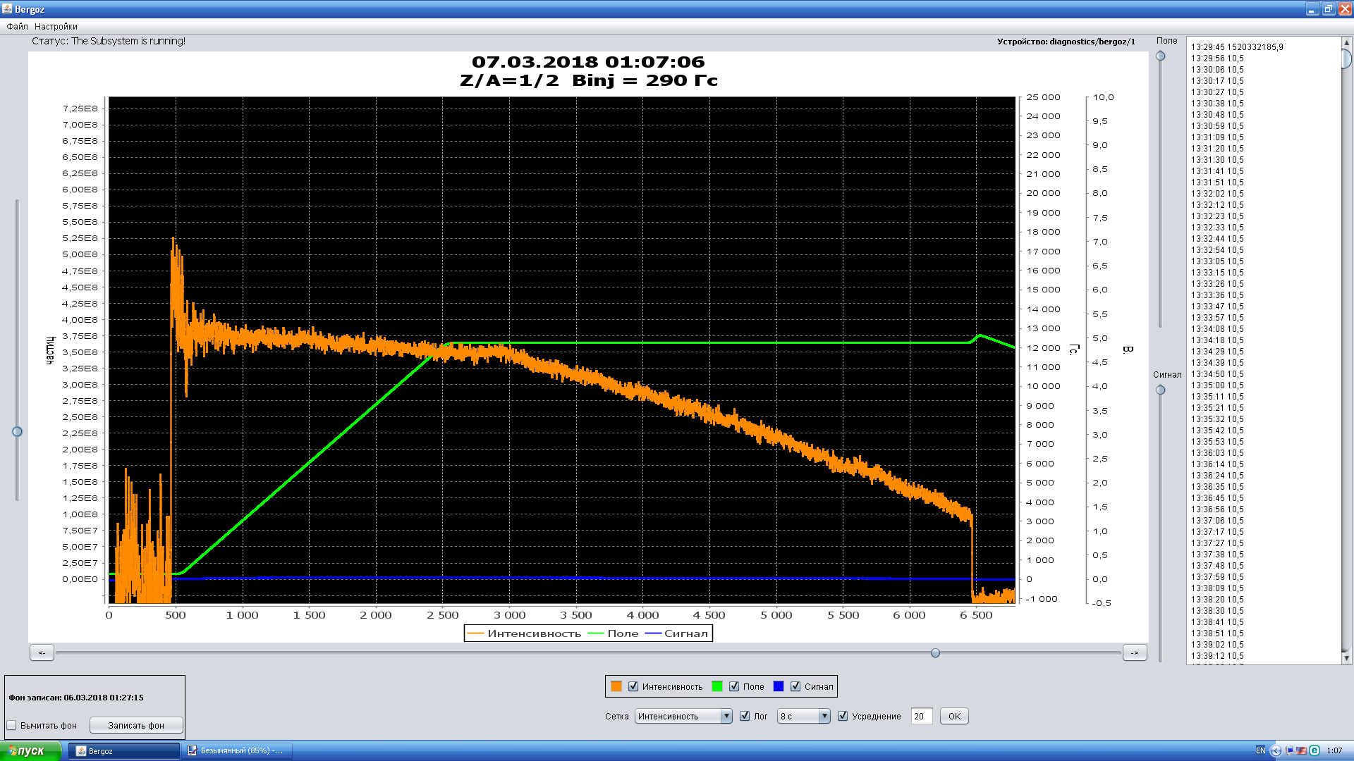
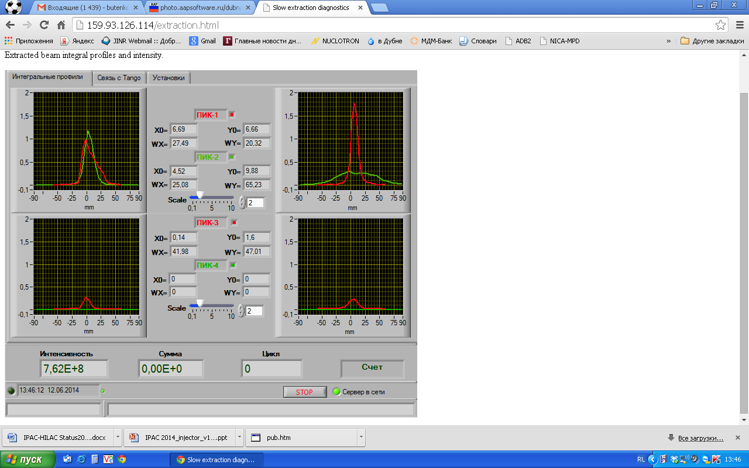
Nuclotron: ion acceleration
¹²C⁺⁶ beam acceleration (3,5 GeV/u) RUN #55
¹²C⁺⁶ Intensity 5*10⁸
Run #54, carbon beam was accelerated up to 5.2 GeV/u, V_{ESS} = 145 kV

Slide 16
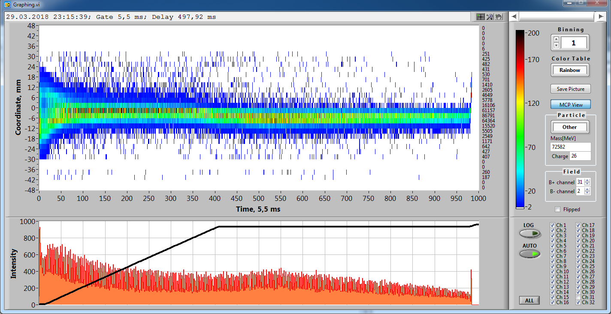
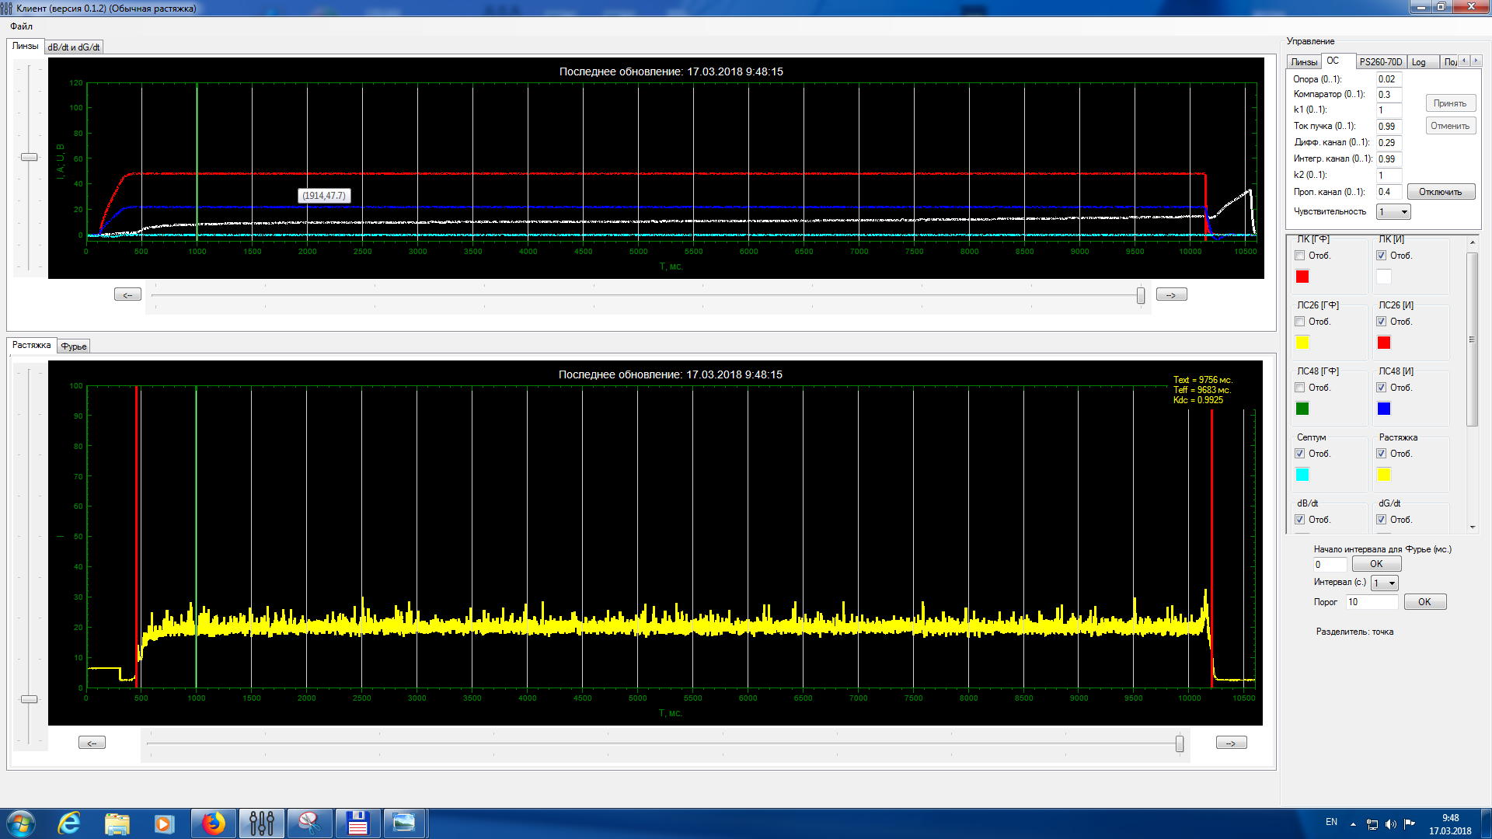
Nuclotron: ion acceleration
⁷⁸Kr⁺²⁶ beam acceleration (3,2 GeV/u) RUN #55
⁷⁸Kr beam spill, 2*10⁵ ppp, T_{spill} = 10s, k_{dc}>99%

Slide 17
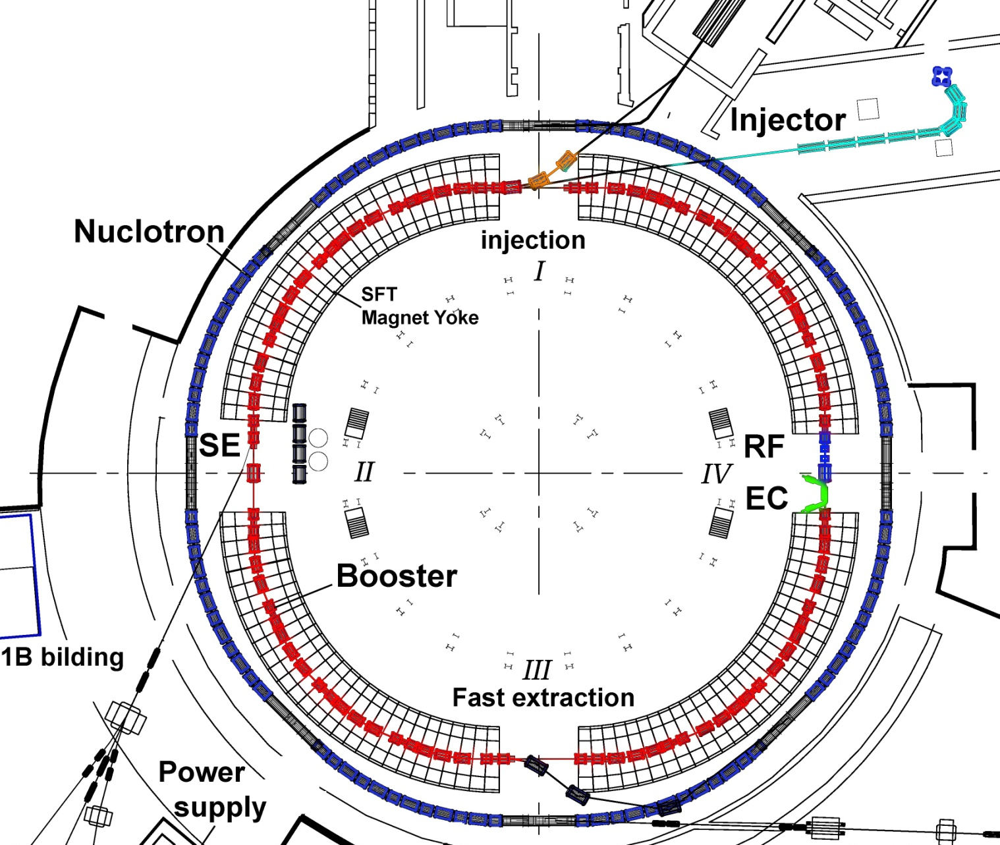
Booster of the Nuclotron
milestone II:
Assemblies | # | tested / ready %
dipoles | 40 | 100/30
qdr doublets | 24 | 80/5
BPM stations | 24 | 80/0
magn.joint kits | 45 | 100/50
bypass for coolant liquid | 2 | 60/0
warm sect. | 4 | 70/50
refererence magnet sec. | 2 | 90/50
feed box | 2 | 10/0
vac. station (cryostat) | 26 | 50/50
vac. station (beam pipe) | 24 | 90/30
ref. mag. sec.
Booster
PS
RF
Ecool

Slide 18
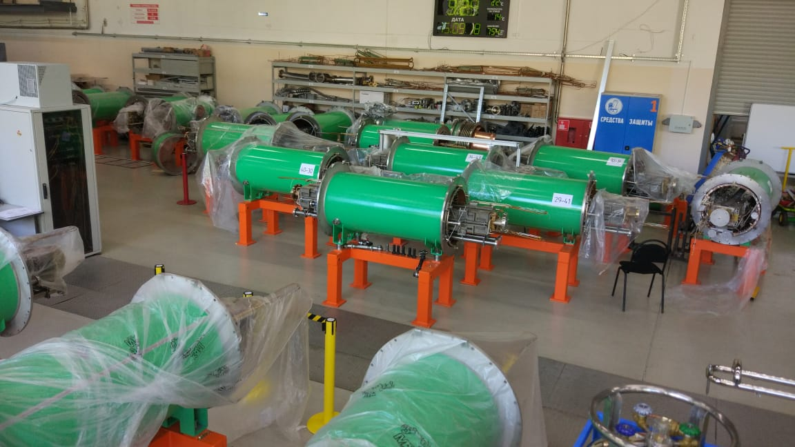
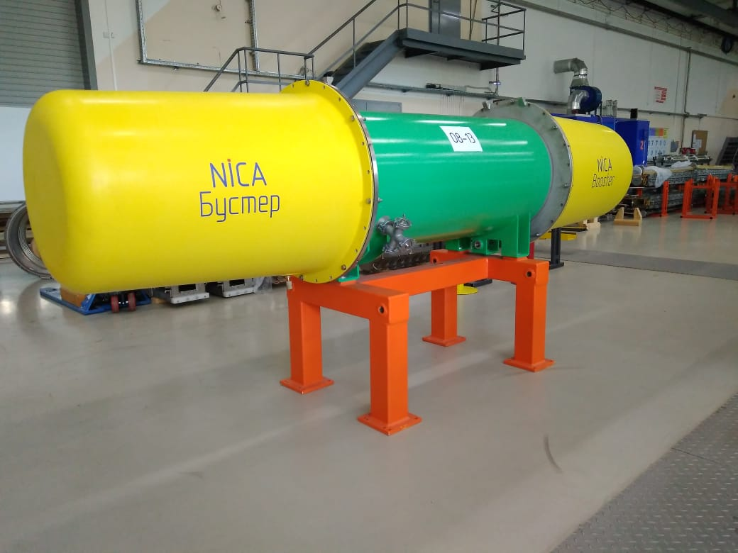
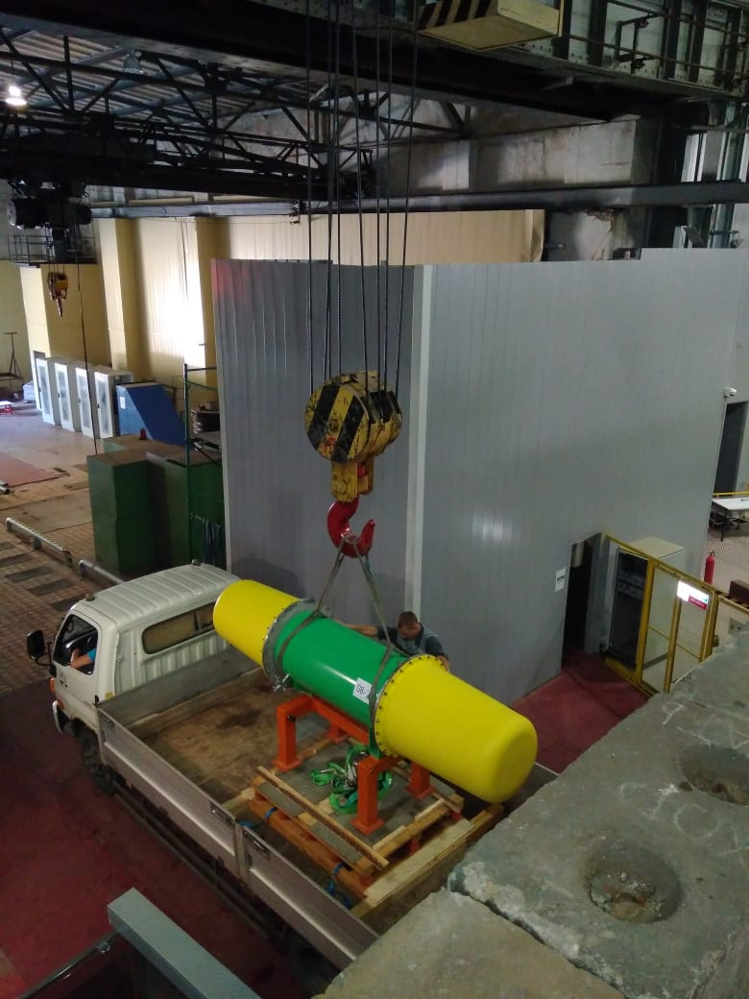
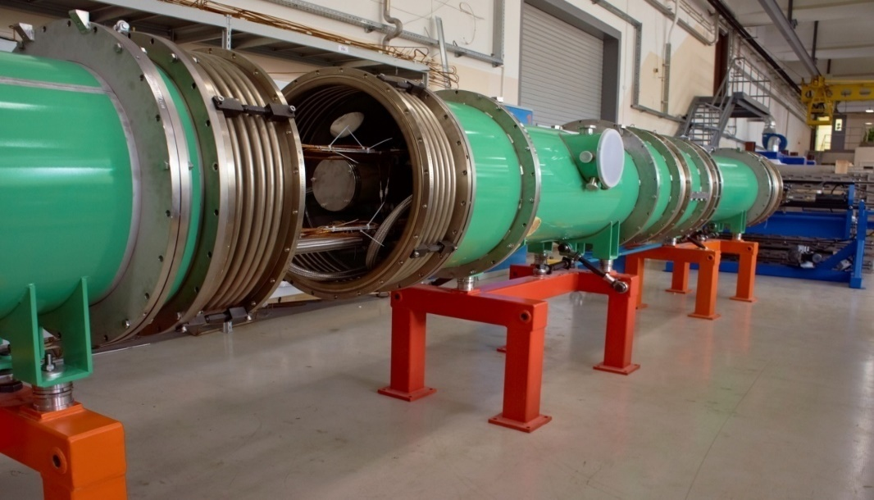
Dipole magnets are transporting to Booster site
the first magnet was transported to the tunnel on 19 Sept. 2018 !
Test assembly of 4 Booster magnets

Slide 19
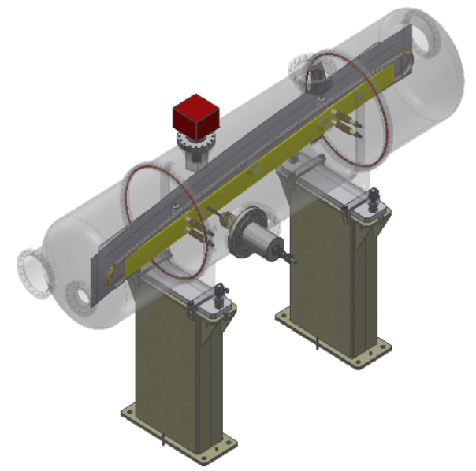
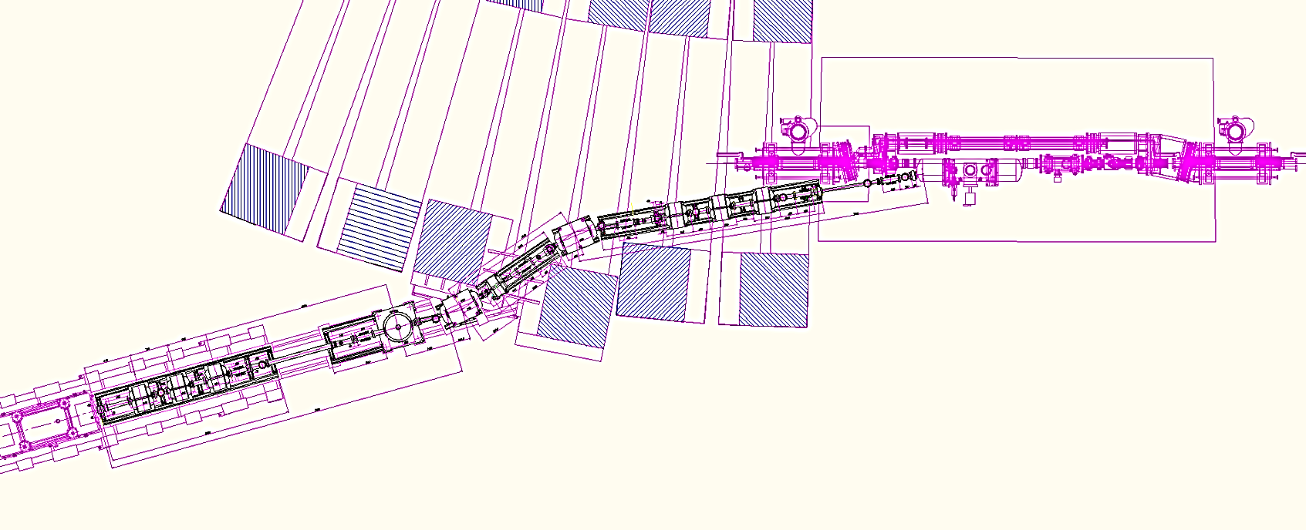
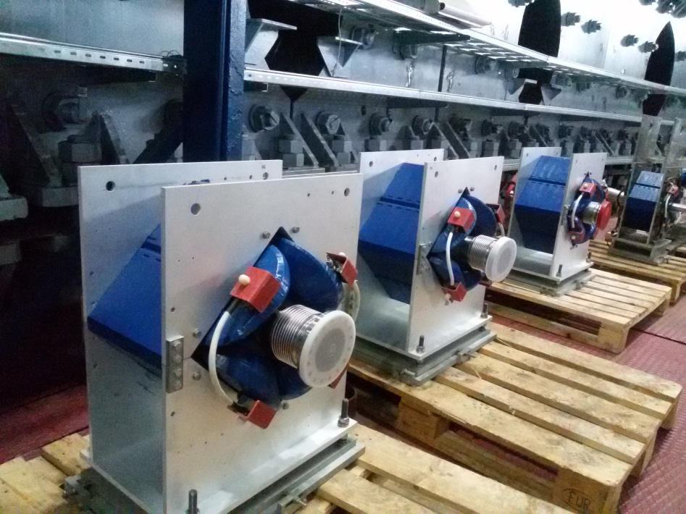
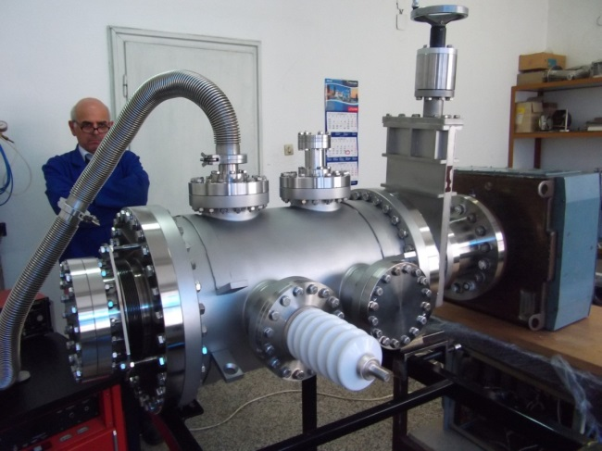
Injection to the Booster
Septum is ready on 70%
“Cryosystems”, UK.
beam
Beam transfer channel from HILAc to the Booster
prototype of
electrostatic
deflector
was tested;
contract for the plates is in progress.
all magnets are ready for installation

Slide 20
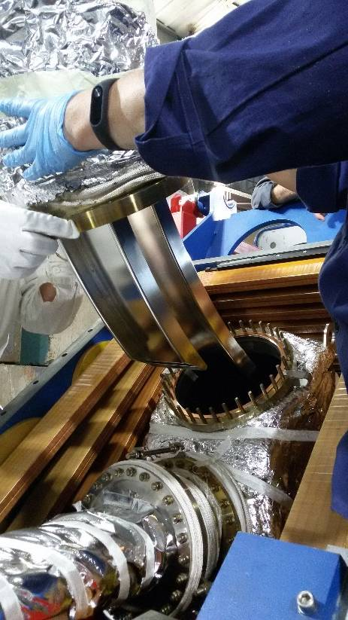
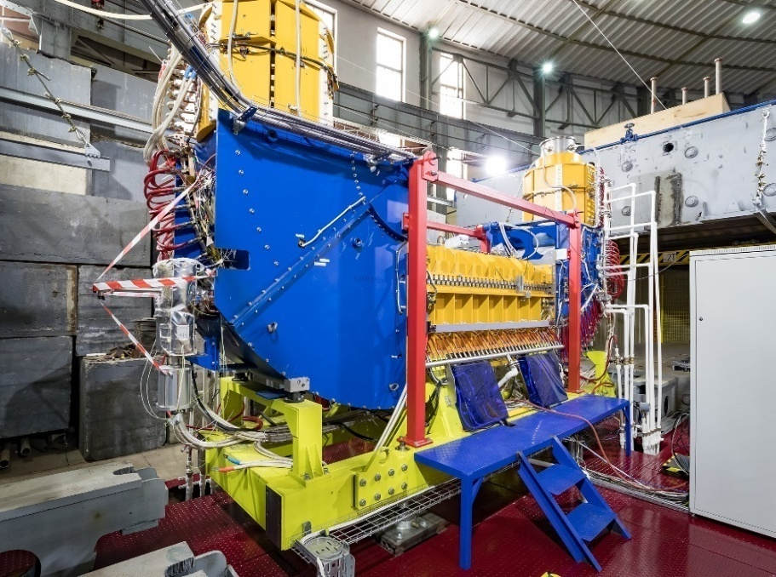
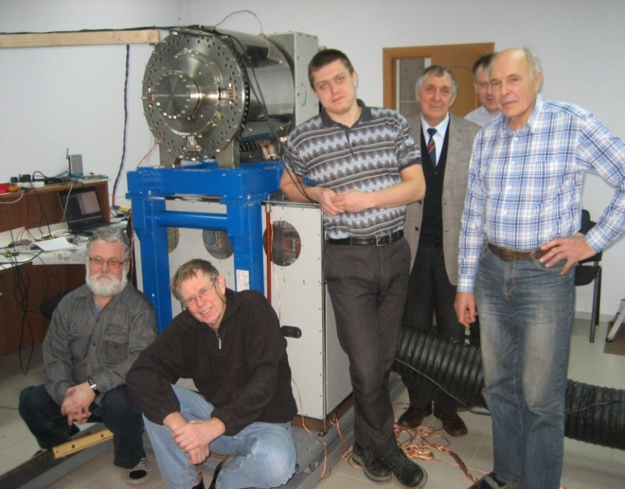
Electron Cooling & RF Systems:
final stage of commissioning
rms(B_{x})=1,6 10⁻⁵
parameters | value
Electron energy, keV | 2
Electron current, mA | 170
Magnetic field, kGs | 1
Filed homogeneity | 2×10⁻⁵
Vacuum pressure, Pa | 3×10⁻⁹
Total power, kW | 120
rms(B_{Y})= 2,0 10⁻⁵
Ecooler is ready
RF is ready
Notes:
Проведены геодезические работы (юстировка) для установки СЭО относительно
оси бустера. Юстировка производилась трекером Leica AT4101.
Точность юстировки составила 0.1 мм.
Смонтирована и подключена по временной схеме
для работы с магнитным полем до 1 кГс при потребляемой мощность 120 кВт
система питания соленоидов, состоящая из 4 шкафов ИСТ
совместно с их трансформаторами.
Максимальное проектное поле составляет 2 кГс,
и для его возбуждения требуется полная мощность питания примерно 400 кВт,
что будет возможно применить после введения в строй новой подстанции.
Создана система водоснабжения замкнутого контура для охлаждения СЭО
с рабочим давлением в системе от 3-х до 6-и Атм.
Проведены измерения однородности и настройка магнитного поля
центрального соленоида. Для измерения однородности магнитных полей
в СЭО использовался метод «компаса», разработанный в ИЯФ им Будкера.
В итоге при настройке секции охлаждения СЭО бустера
достигнута среднеквадратичная неоднородность магнитного поля ΔB/B=2×10⁻⁵
(при проектной величине ΔB/B<10⁻⁴) в широком диапазоне значений
магнитного поля при пропорциональной перестройке магнитных полей.
- Осуществлена сборка вакуумной системы. После проведения магнитных измерений магнитная система СЭО была полностью разобрана за исключением центрального соленоида. Далее сборка вакуумной системы осуществлялась поэтапно совместно с магнитной системой. После сборки части вакуумной камеры и части магнитной системы осуществлялся контроль герметичности собранных вакуумных соединений. Только после этого переходили к следующему этапу сборки вакуумной и магнитной систем.
- Для получения необходимого вакуума в течение 3-х дней была проведена процедура прогрева и через пару недель после прогрева достигнуто значение вакуума 2.5×10⁻⁹ мбар, что соответствует необходимым вакуумным условиям в бустере. В ходе процедуры прогрева были проведены следующие работы: монтаж системы прогрева, дегазация титановых насосов TSP, активация нераспыляемых геттеров NEG, активация катода электронной пушки, включение ионных насосов, подключение UHV вакуумметров, включение титановых распылителей.
- Смонтированы высоковольтные коммуникации, масляная система охлаждения коллектора электронов и проведено тестирование всех высоковольтных источников.

Slide 21
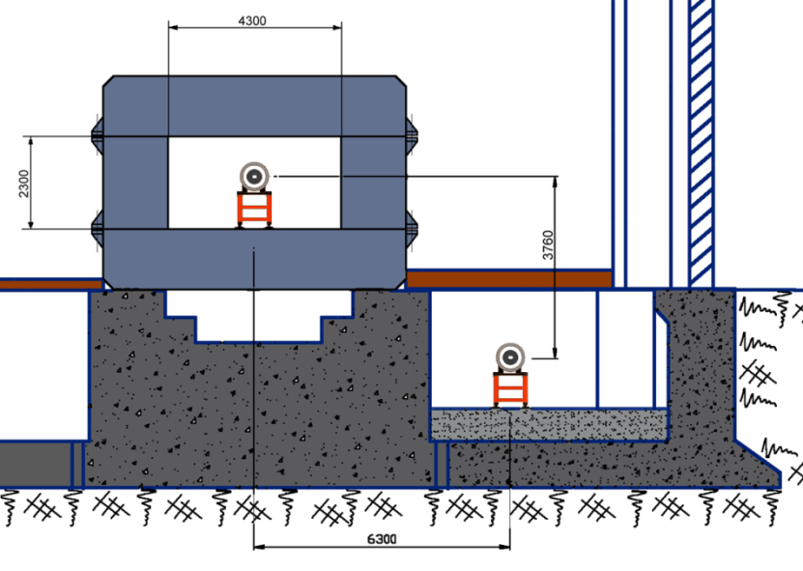
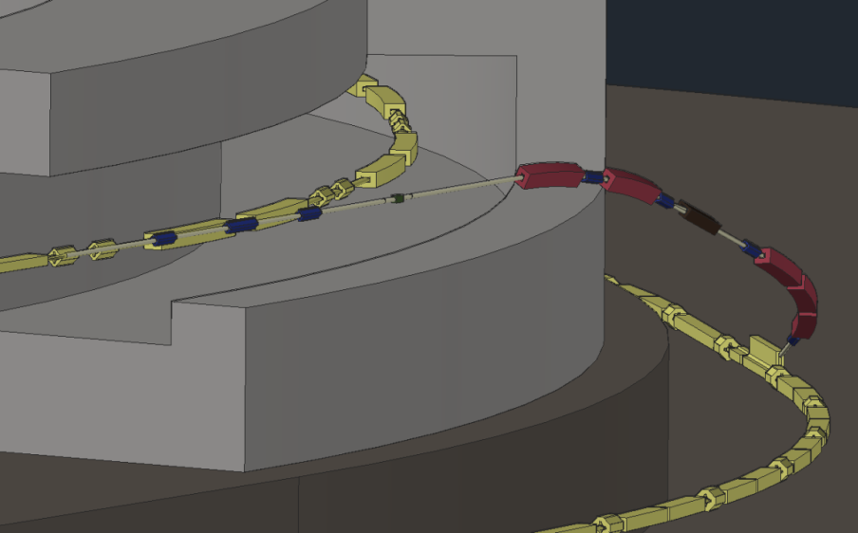
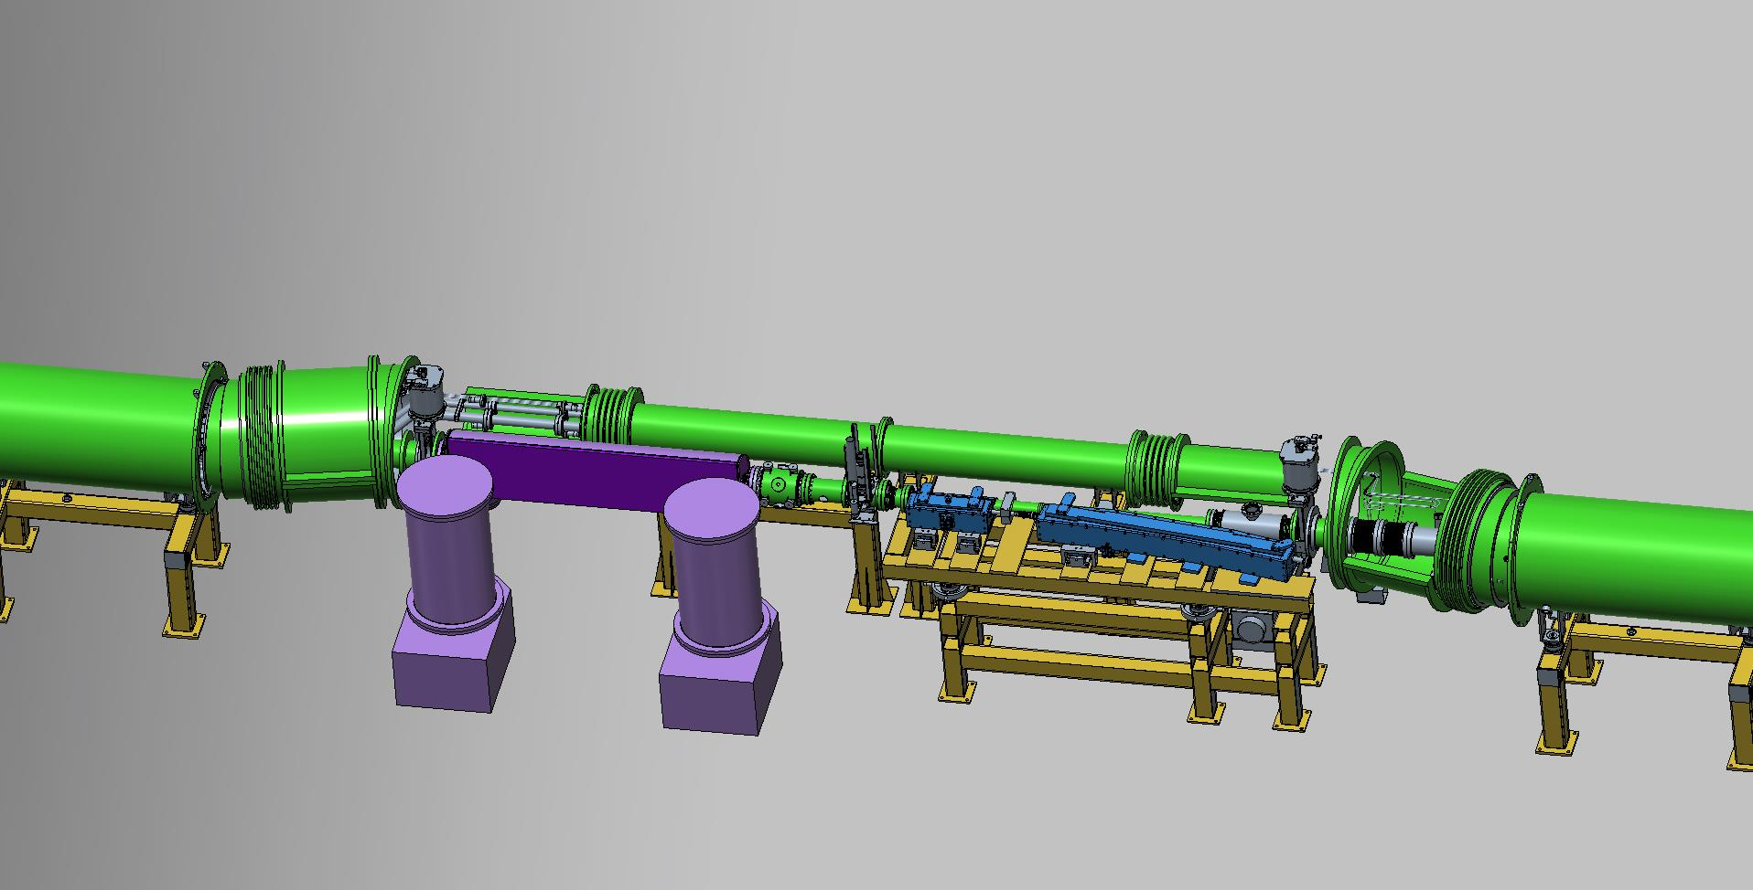
Beam transfer from Booster to Nuclotron
BINP is start production of the beam fast extraction kicker and septa;
magnets for the channel are manufacturing;
Lambertson magnet for Nuclotron injection system is under design;
The prototype of the injection kicker is manufactured and tested; design of a kicker for Nuclotron injection system is being developed;
commissioning – December 2019
Booster
Nuclotron
Common view of beam extraction systems

Slide 22
Booster assembling time-schedule
Booster assembly |  | 2018 |  |  |  |  |  |  |  | 2019
 |  | V | VI | VII | VIII | IX | X | XI | XII | I | II | III | IV | V | VI | VII | VIII | IX | X | XI
“Cold” sections
 | Quadrant 1
 | Quadrant 2
 | Quadrant 3
 | Quadrant 4
 | bypasses and ends
 | reference magnets
 | “Warm” sections
 | E-cooling |  |  |  | commissioned
 | injection section
 | beam extraction section
 | RF system
Systems
 | vacuum system
 | power supply
 | cryogenic system
 | thermometry system
technological commissioning
commissioning
with beam

Slide 23
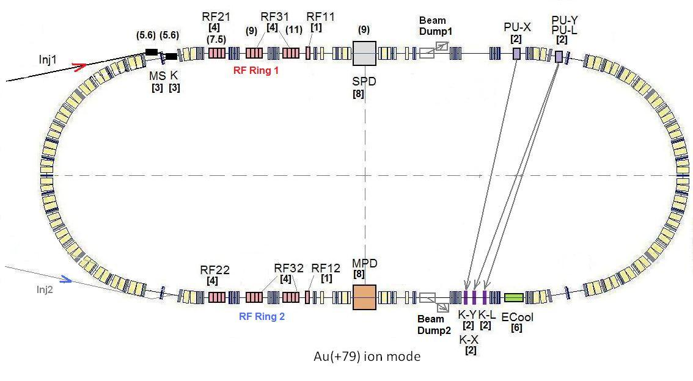
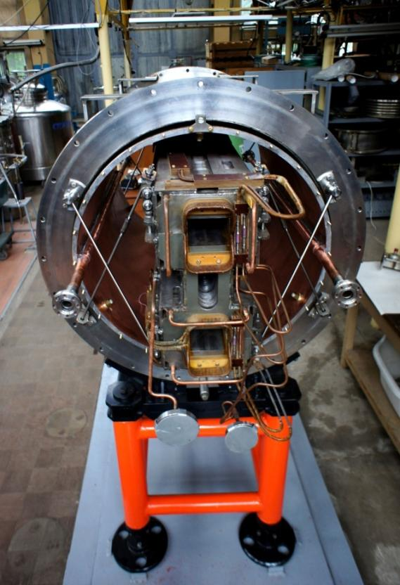
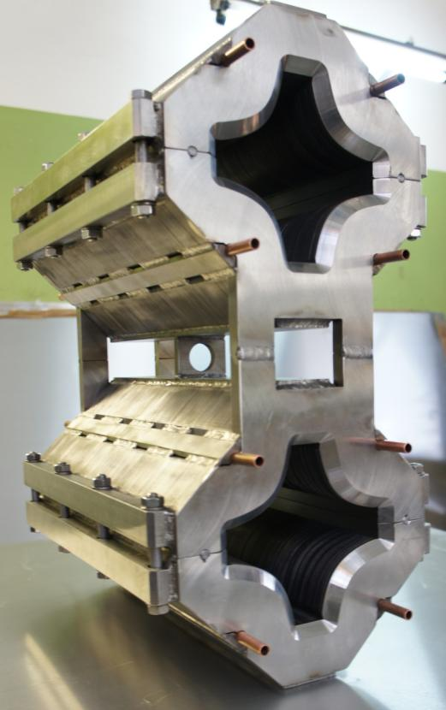
Collider ring
45 T*m, 4.5 GeV/u for Au⁷⁹⁺
SPD
Ring circumference, m | 503,04
Number of bunches | 22
r.m.s. bunch length, m | 0,6
β, m | 0,35
max. int. Energy, Gev/u | 11,0
r.m.s. Δp/p, 10-3 | 1,6
IBS growth time, s | 2080
Luminosity, cm⁻² s⁻¹ | 1x10²⁷
MPD
Double aperture magnets:
dipole & quadrupole
prototypes
Notes:
The lattice design and prototyping of most collider elements are completed. The ring circumference is twice as one of the Nuclotron. For the gold beam a Luminosity at the energy above 10 GeV per nucleon will be 10 to the 27

Slide 24
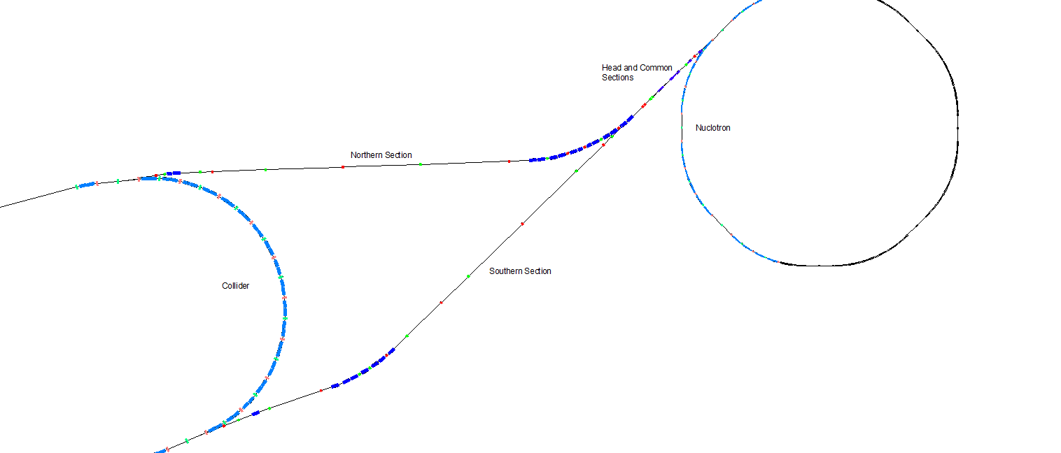
Beam transfer from Nuclotron to Collider
Total length ~ 350 m

Slide 25
Beam transfer from Nuclotron to Collider
Magnets of the Nuclotron-Collider channel are in development by SigmaPhi.
A prototype of a pulse septum is manufactured and tested. Now design of a septum for Collider injection system is being developed.
Commissioning – 2020

Slide 26
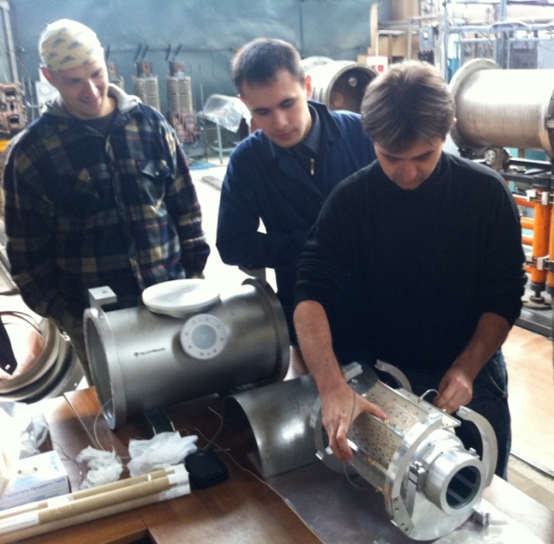
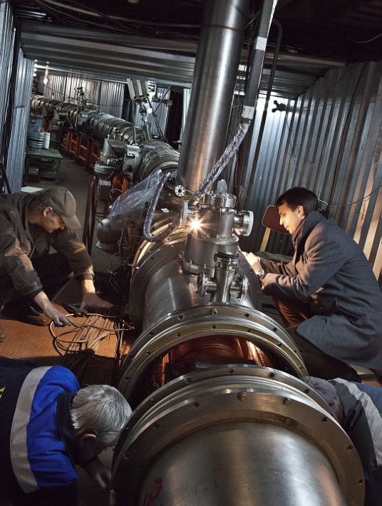
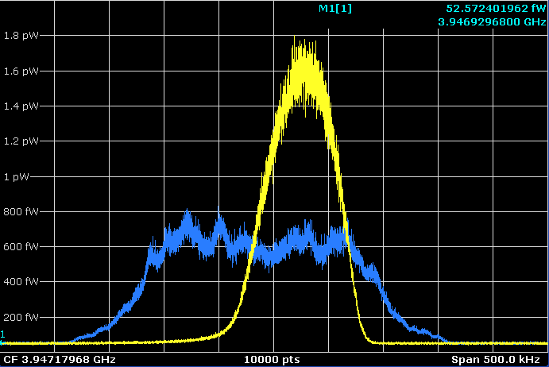
Stohastic cooling system
Collider
Stochastic cooling system
Successive tested at the Nuclotron

Slide 27
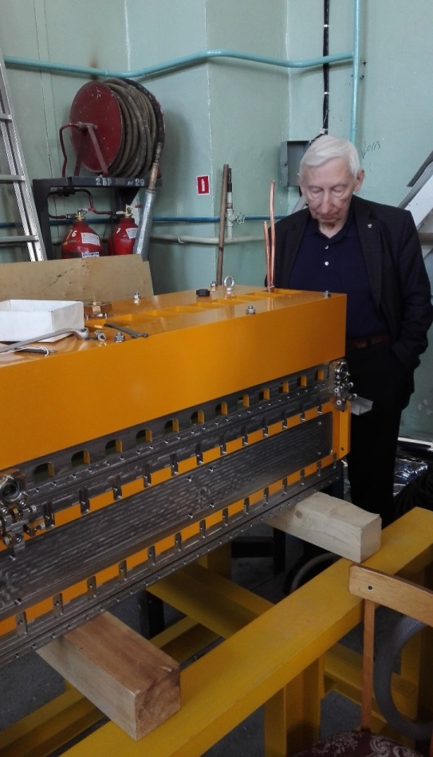
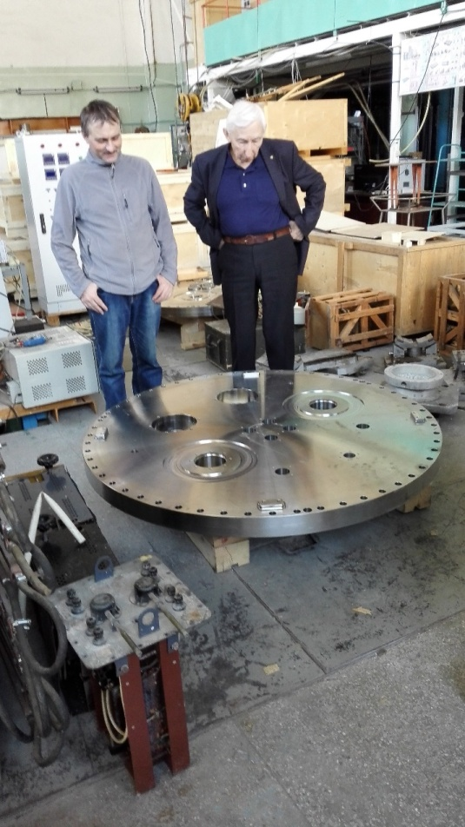
Electron cooling system
Electron cooling system of the collider
Electron energy 2.5 MeV
Construction was started in 2016

Slide 28
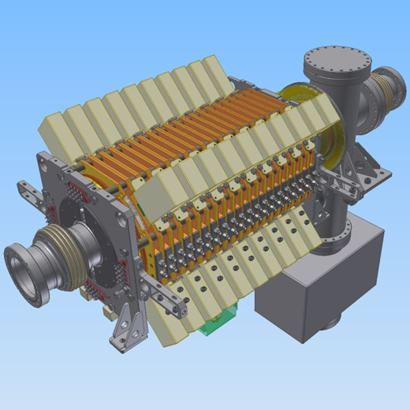


RF systems of the collider
BINP, Novosibirsk
Three types of RF resonators:
RF-1, BB for injection
RF-2, 22 harmonic
RF-3, 66 harmonic
Barrier-bucket RF (injection)
RF-2 22 harmonic
Technical projects of RF resonators are finished.
Manufacturing started this year.
For the base configuration
4 RF-1, 8 RF 22 harmonic is needed.
For the full configuration additionally 20 RF-3, 66 harmonic will be install in 2022y
RF-3 66 harmonic

Slide 29

Line for assembling and cryogenic testing of SC-magnets
Main production areas:
Incoming inspection zone
SC cable production hall
SC coils production hall
Area for assembling the magnets
Area for the magnetic measurements under the room temperature
Leakage test area
Area for mounting the SC-magnets inside cryostats
Cryogenic tests bench
450 magnets for NICA and FAIR projects

Slide 30

Official start up
28 November 2016

Slide 31





New helium liquefier (1000 l/h)
Cryogenic facility
Finally the cooling power
should be doubled
from 4 kW to 8 kW @ 4.5K
Largest in Russia
Commissioned in May 2016
Notes:
He liquefier …..

Slide 32

Civil Construction, bld.17
September 2018
SPD
Hall
Western
Arc
MPD
Hall
readiness for equipment installation in the MPD Hall - 2019

Slide 33

Thank you

