Slide 1





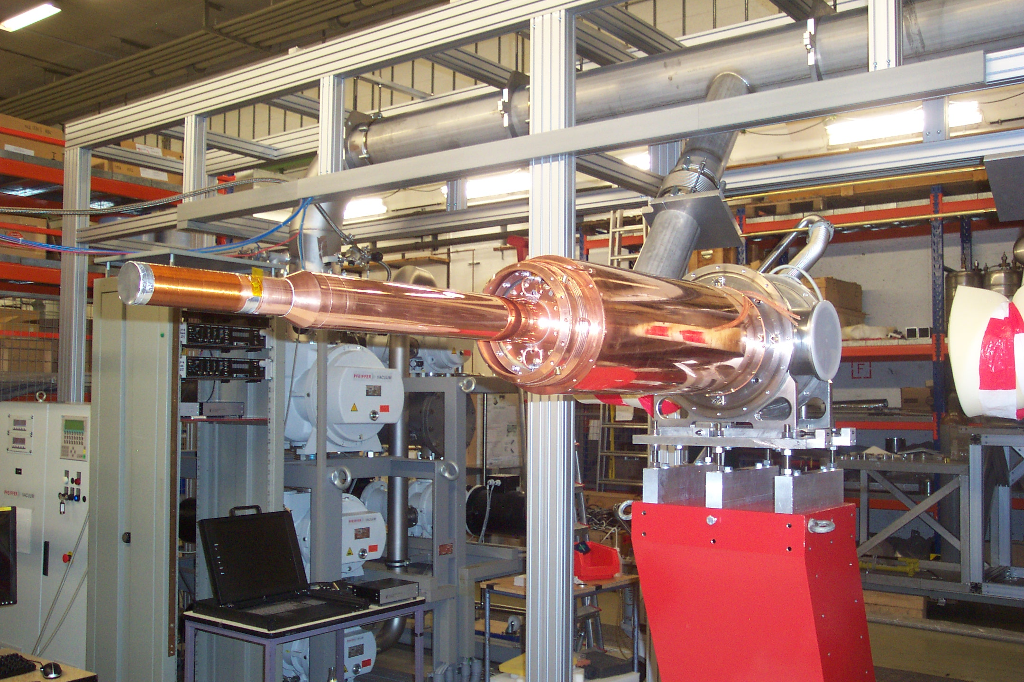
Institut
für Kernphysik
First use of an active polarized Frozen Spin Target in a 4 π detector - Detection of particles under cryogenic conditions below 1 Kelvin
1.-Introduction Physics topics: Excitation of Nucleons and Polarizabilities
2.-Experimental setup: γ- beam and detector - Tagger + Crystal Ball@MAMI
Frozen Spin Target
3.-Active Target developement
New Trends in High energy Physics
Budva
September 24th - 30th , 2018
Andreas Thomas
for the A2 Collaboration

Slide 2
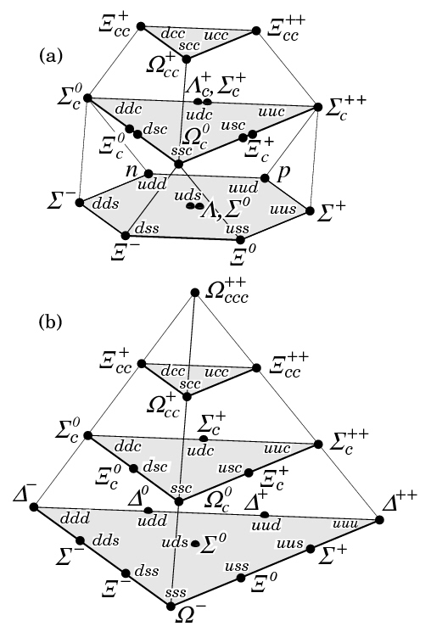
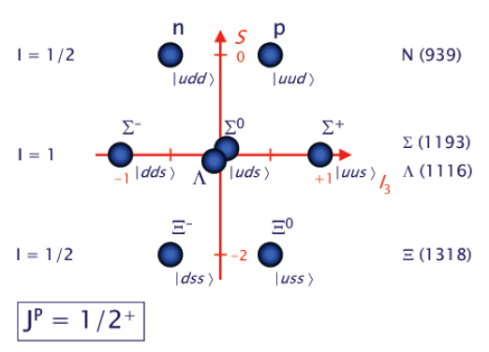
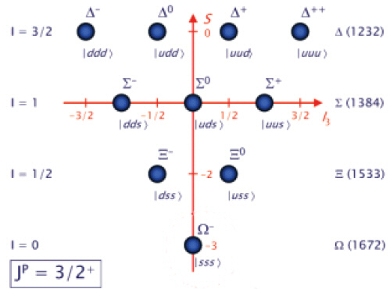
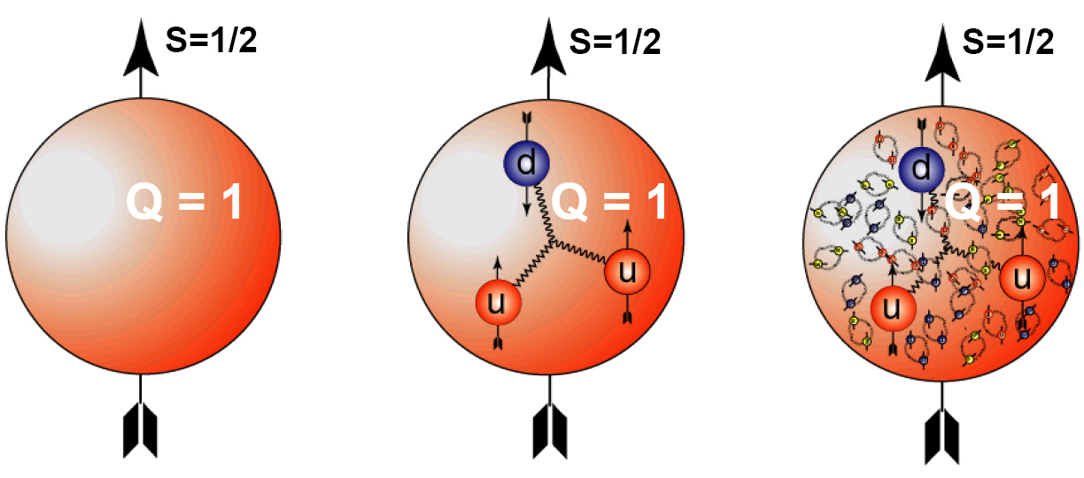
Introduction Physics:
Quark Model
Classification of Baryons
qqq; only uds
Oktett
Dekuplett
Simple Constituent quark picture:
Proton p(938): |uud> ~ |hhi> Spin 1/2
Delta Δ(1232): |uud> ~ |hhh> Spin 3/2
M1-Transition
(Small 2.5% E2)

Slide 3
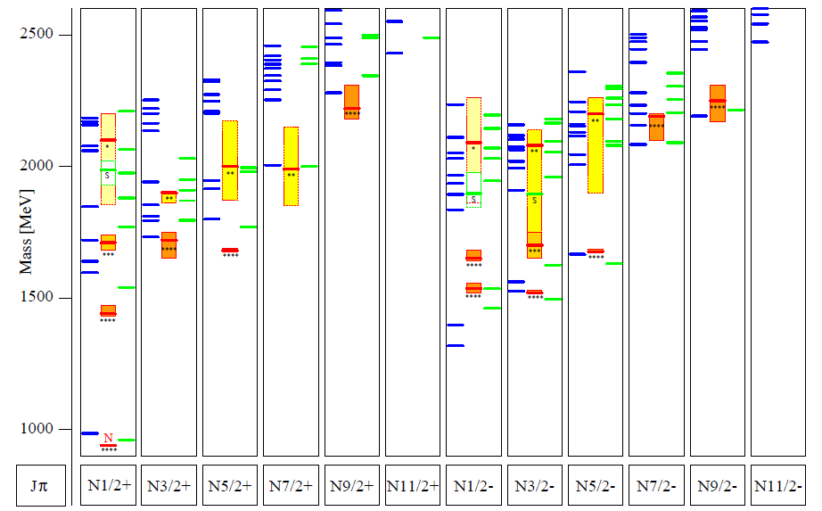
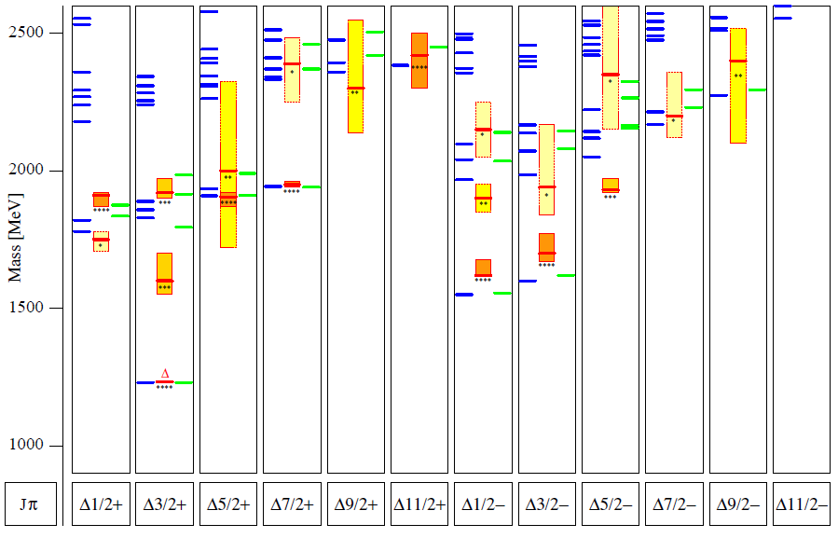
Introduction: Excitation Spectrum of the Nucleon
H
He
Hg
Löhrig, Metsch, Petry, Eur.Phys.J. A10 (2001) 395-446
Atom
Nucleon
The light baryon spectrum in a relativistic quark model

Slide 4
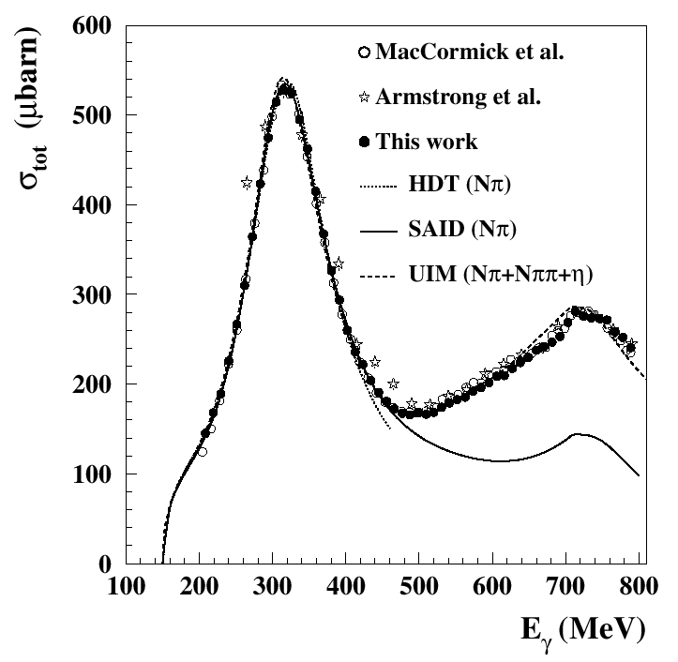

What is the nature of the Nucleon Resonances?
-Excitation inner deg. of freedom
-Molecule
-Quark – Diquark Structure
-Dynamical Generation
- …….?
Unpolarised total photoabsorption cross section
Phys. Rev. Lett. 87, 022003 (2001)
Phys. Rev. Lett. 84, 5950 (2000)
Nucl. Phys. A642, 561 (1998)
Phys. Rev. C 53, 430 (1996); SP01
Nucl. Phys. A645, 145 (1999)

Slide 5
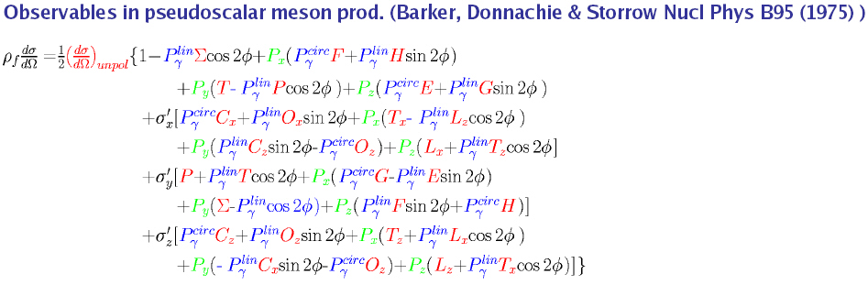
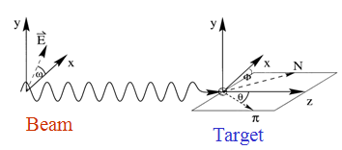
Nature and Properties of nucleon resonances
Polarisation observables used to disentangle broad, overlapping resonances.
Beam
γ
P
lin
P
lin
P
circ
unpol
γ
γ
γ
⎛
π
⎞
⎛
+
π
−
π
⎞
Target
⎜
0
,
⎟
⎜
,
⎟
⎝
2
⎠
⎝
4
4
⎠
⎛
d
σ
⎞
Σ
P
unpol
⎜
⎟
-
-
⎝
d
Ω
⎠
Beam
P
x
-
-
H
F
Target
P
T
P
-
-
y
P
z
-
-
G
E

Slide 6
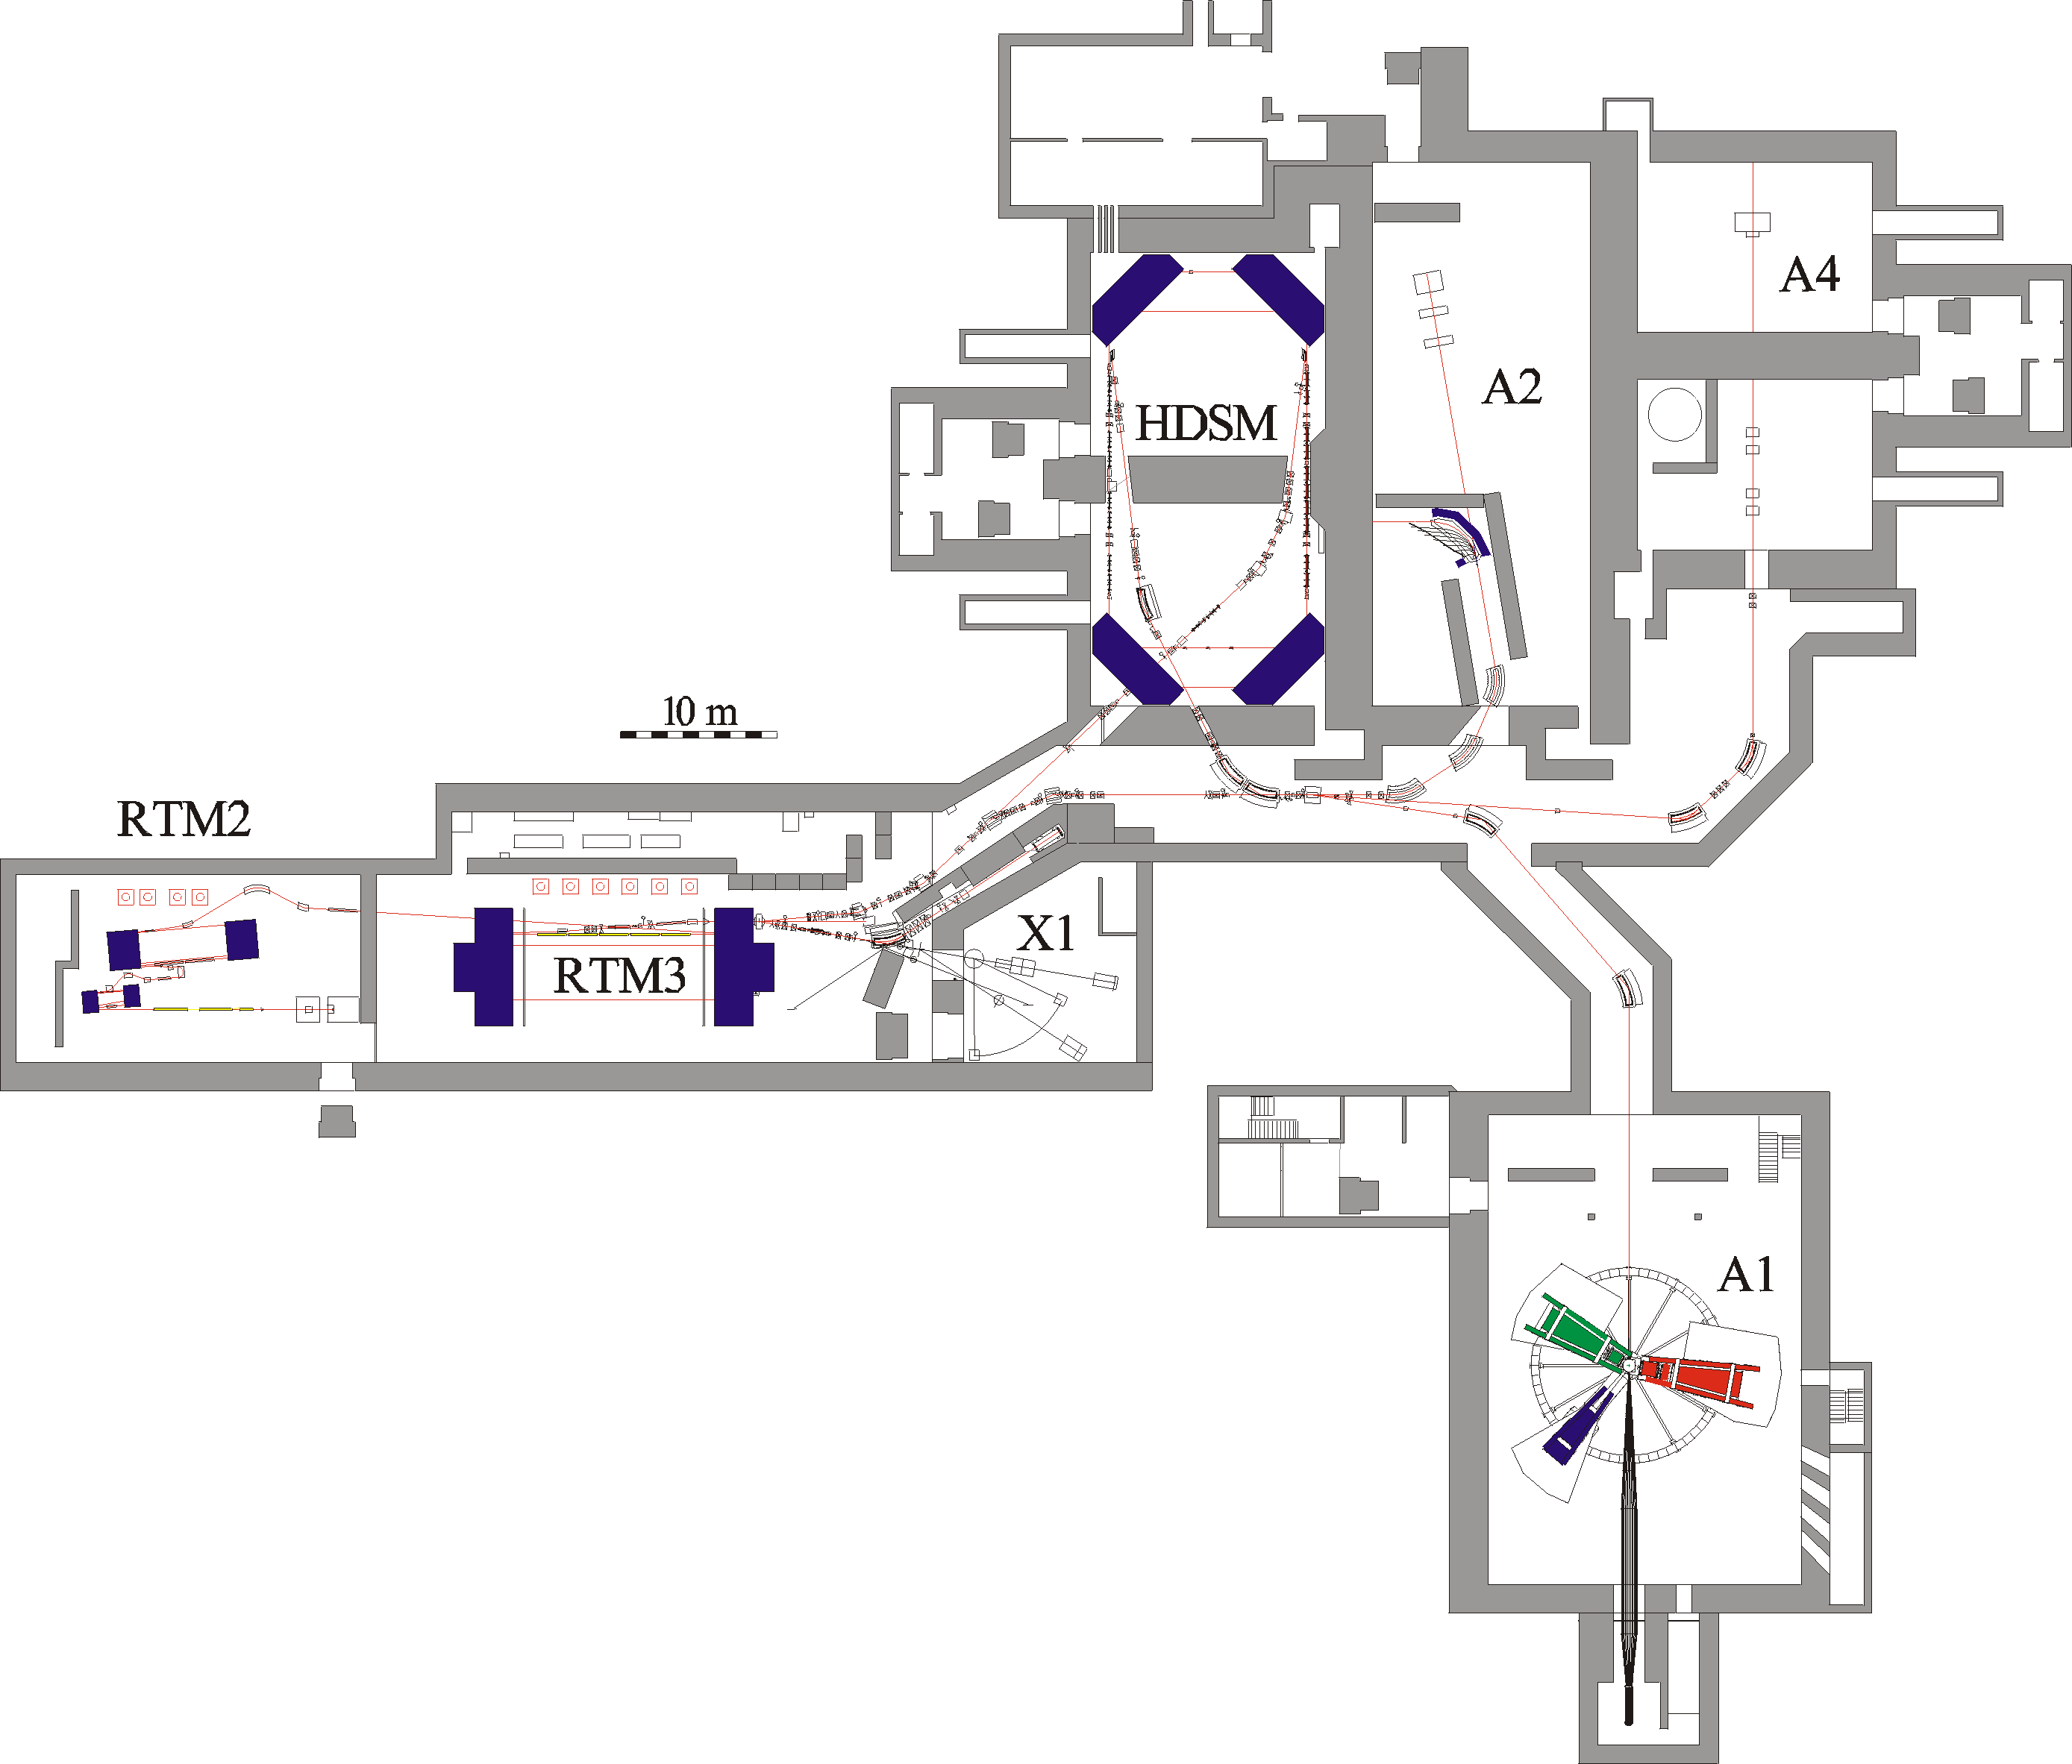
Parameter
1604MeV, σ_{E}=0.100MeV
max. 40μA polarised
ε_{h}=9 nm rad, ε_{v}=0.5 nm rad
~6500h/year as MAMI B !

Slide 7
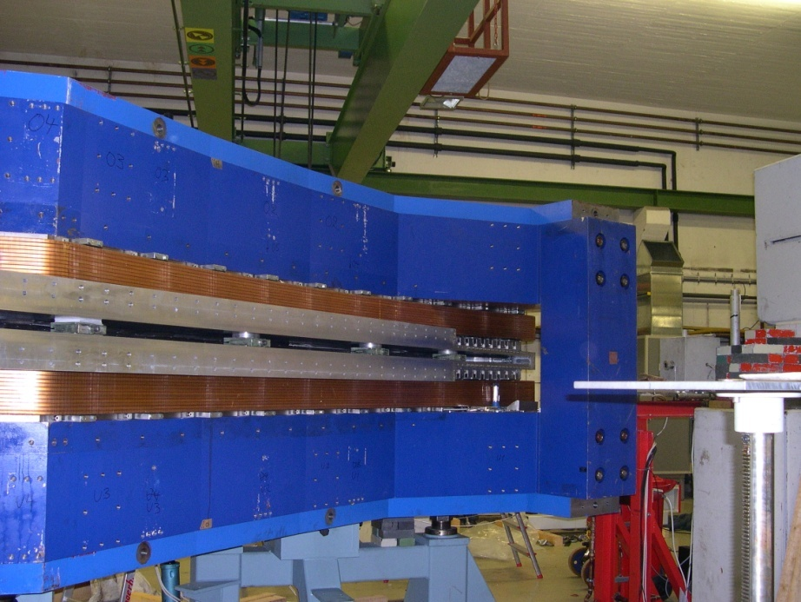
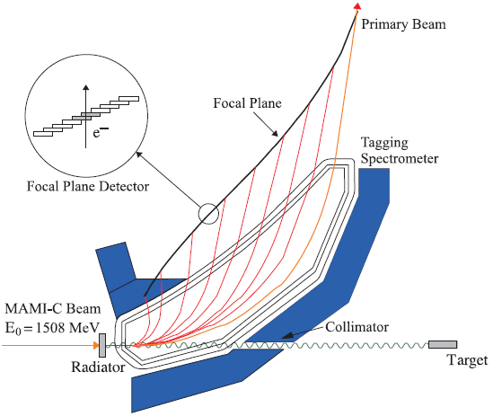
A2 Tagging system (Glasgow, Mainz)
1.
Production and energy measurement of the Bremsstrahlung photons.
Glasgow Tagging Spectrometer
EPJ A 37, 129 (2008)
2.
Determination of the degree of polarization of
the electron beam (Moeller Polarimeter).
Circularly pol. photons.
3.
Coherent production of linearly polarized
photons on a diamond radiator

Slide 8
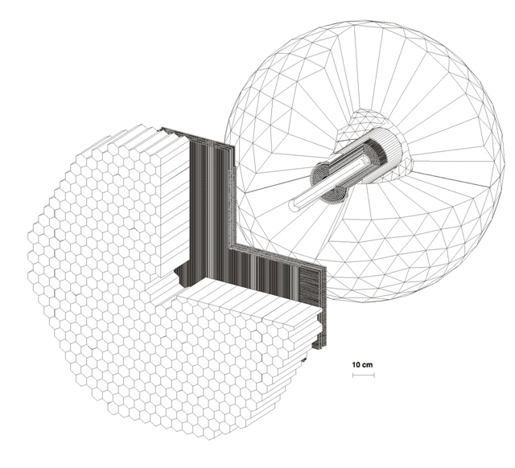
4π photon Spectrometer @ MAMI
TAPS:
366 BaF₂ detectors
72 PbWO₄ detectors
Max. kin. energy:
π⁺⁻ : 180 MeV
K⁺⁻ : 280 MeV
P : 360 MeV
Crystal Ball:
672 NaJ detectors
Max. kin. energy:
μ⁺⁻ : 233MeV
π⁺⁻ : 240 MeV
K⁺⁻ : 341 MeV
P : 425 MeV
Vertex detector:
2 Cylindr. MWPCs
480 wires, 320stripes
PID detector:
24 thin plastic detectors
γp ◊ S11 ◊ pη
π⁰π⁰π⁰
γγγγγγ

Slide 9
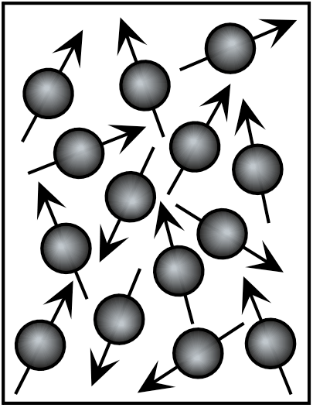
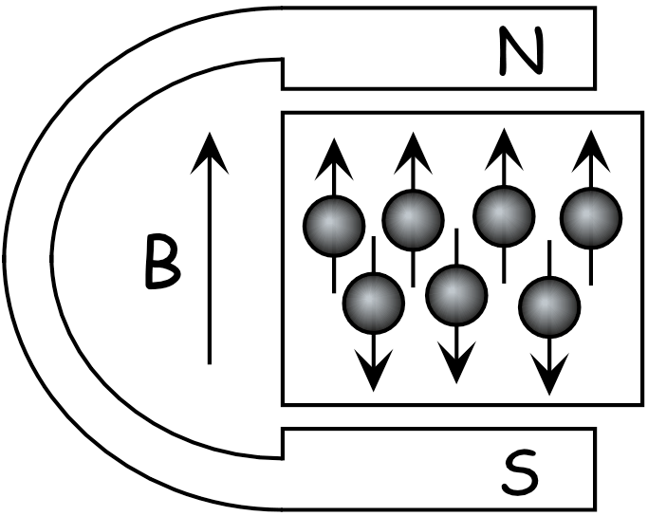
Polarized Target
Polarization = Orientation of Spins in a magnetic field
Ideally: All spins in field direction
P=100%
Complicated interplay between
Polarising force ~ magnetic field B
and
Depolarising force ~ thermal motion of spin particles
(temperature T – relaxation)

Slide 10
Magnetic moment in magnetic field:
ΔE
B=0T
B=2.5T
B=0T
B=2.5T
electron
proton
Thermal equilibrium
Boltzmann distribution
B [Tesla] | T [mK] | e⁻ [%] | p [%] | d [%]
2,5 | 100 | 99,8 | 0,51 | 0,10
 | 1000 | 93,3 | 0,25 | 0,05
5,0 | 100 | 100,0 | 5,09 | 1,05
 | 1000 | 99,8 | 1,28 | 0,11
Trick: Transfer of the high electron polarization to the nucleon via
μ-wave irradiation (DNP)

Slide 11
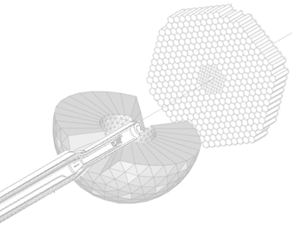
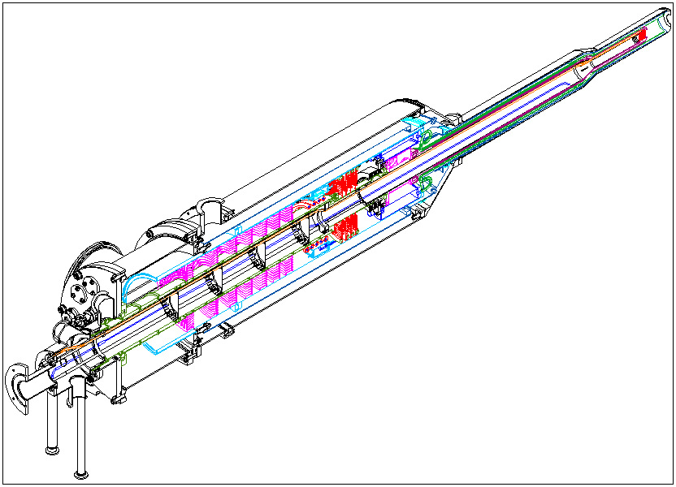
Mainz/Dubna Dilution refrigerator
Mixing chamber(25mK)
Still (0.7K)
Evaporator (1.5Kelvin)
Separator (4.2Kelvin)

Slide 12
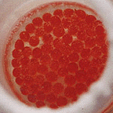
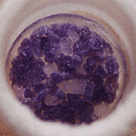
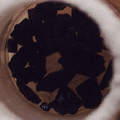
Target material
Saturated electrons of target material not polarized (Pauli principle)
Free electrons
Radicals in material by
chemical or
radiative doping
30mm
Butanol
Ammonia
LiD
N
Dilution factor (e.g. f_{Butanol}=10/74)
determines quality of target material
CH₃
CH₃
Tempo
CH₃
N
CH₃
H
H
O
H

Slide 13
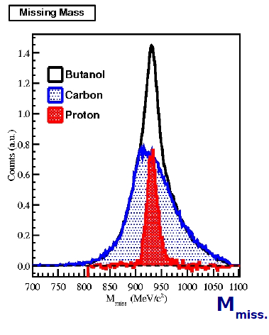
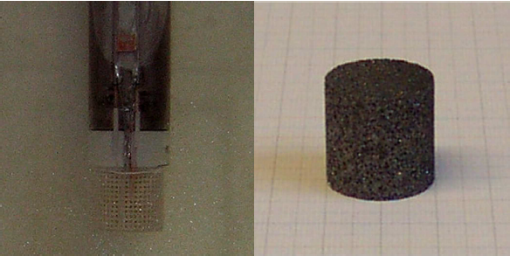
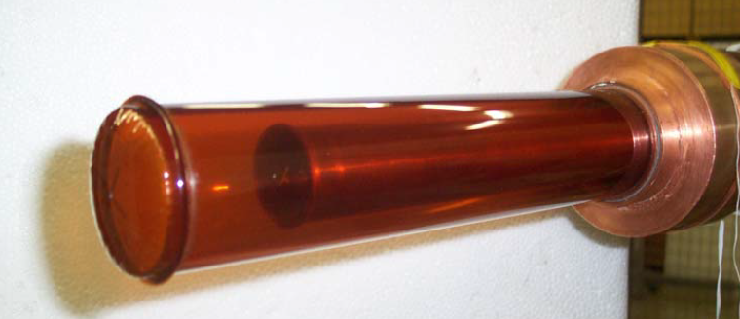
Additional challenges for the analysis of experiments with Frozen Spin Target → Dilution Factor.
Butanol
Carbon
Hydrogen

Slide 14
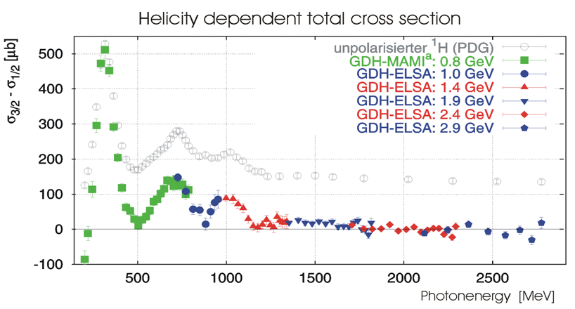
Helicity Dependence E of Meson Photoproduction on the Proton and Neutron
1998-
2003
Mainz and Bonn
2010-
2016
New
Mainz
Exp.
with CBall
Gerasimov-Drell-Hearn sum rule (GDH)
New Measurement of transverse asymmetries at Bonn ELSA 2017-2019.

Slide 15
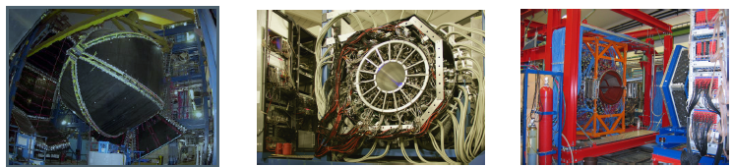
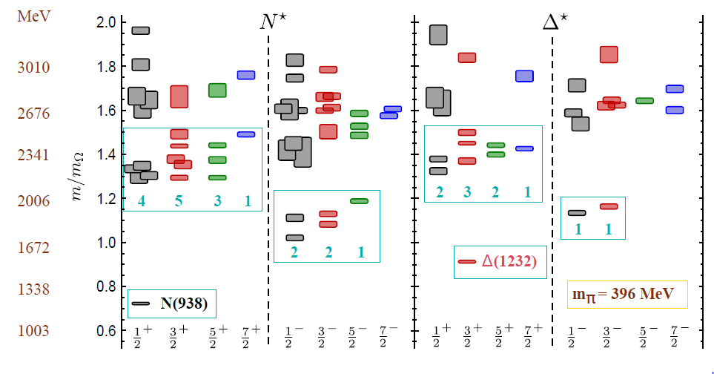
New double polarization data from several facilities
CLAS, Jlab Crystal Barrel, ELSA Crystal Ball, MAMI
With a variety of new measurements of spin observables it comes to a convergence of the multipoles in the region of leading resonances using PWA.
Excited baryons
from Lattice QCD:
R.Edwards et al.,
Phys. Rev. D84
(2011) 074508

Slide 16
Proton Polarizabilities
− − − − − − − − − − − − −
π+
π+
π+
Pion
cloud
π+
π+
π+
π+
π+
+ + + + + + + + + + + + +
Electric polarizability: proton between charged parallel plates

Slide 17
Proton magnetic polarizability
S S S S S S S S S S S
π+
π+
Diamagnetic + Paramagnetic
pion cloud
u
u
π+
d
π+
Paramagnetic
Δ(1232)
N N N N N N N N N
Magnetic polarizability: proton between poles of a magnetic

Slide 18
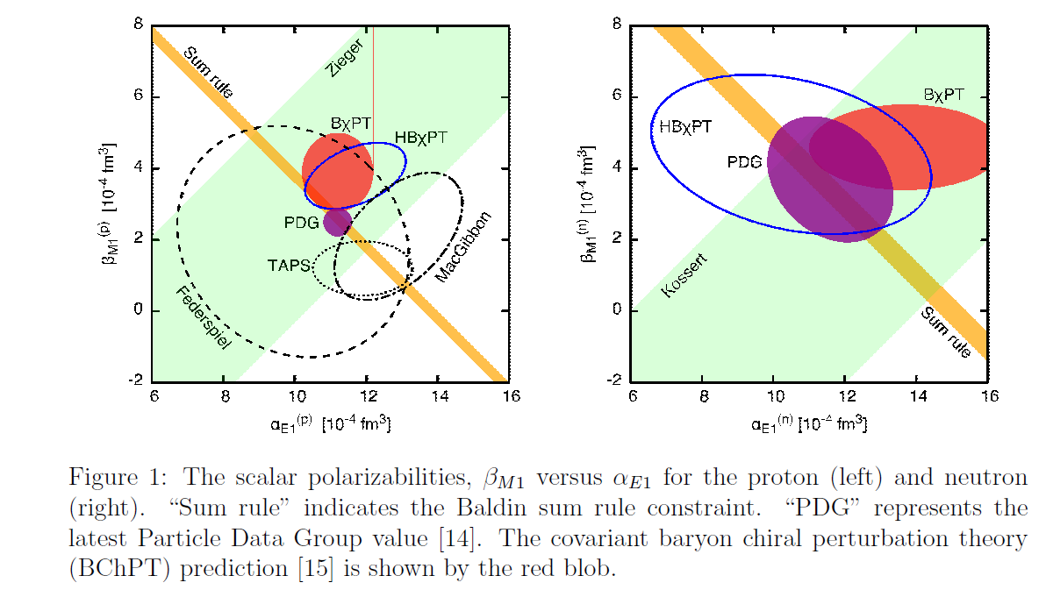
Proton Polarizabilities
New measurement of the Proton Scalar Polarisabilities via beamasymmetry in Compton process finished in July 2018.
[PhD E.Mornacchi]

Slide 19
Spin Polarizabilities
Spin Vector polarizabilities describe spin response to an incident photon
Four vector pol. (γ_{E1E1} γ_{M1M1} γ_{E1M2} γ_{M1E2}) appear at 3rd order in eff. Hamiltonian
Only two linear combinations of vector polarizabilities measured:
The Forward S.P. γ₀ was determined in GDH-Experiment at ELSA and MAMI (DAPHNE) :
The Backward S.P. γ_{π} was determined from dispersive analysis of backward angle Compton scattering. [B. Pasquini et al., Proton Spin Polarizabilities from Polarized Compton Scattering (2007).]

Slide 20
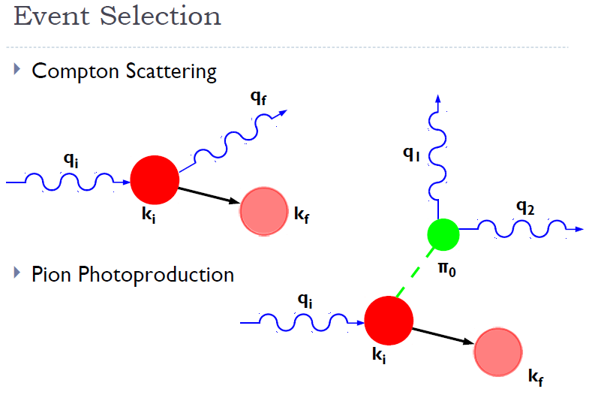
Pion photoproduction off of a proton is 75-100 times more likely than Compton (in the 240-280 MeV range) →
Kinematic overdetermination used for cuts (missing mass, proton angle, …).
Test with ‘substraction target’.
Measurements of the Proton Spin-Polarizabilities with Double-Polarized Compton Scattering
P.P.Martel et al., PRL 114 (2015) 112501
Main problems:
Low energetic recoil protons do not escape from the target and do not reach the detector.
Events are produced on the background nuclei (Carbon, coherent, incoherent, κ~13%). ).
Σ_{2x} 300 hours measurement
Σ_{2x} 300 hours measurement
Curves from:-
B. Pasquini, D. Drechsel, M. Vanderhaeghen,
Phys. Rev. C 76 015203 (2007)
B. Pasquini, D. Drechsel, M. Vanderhaeghen,
Phys. Rept. 378 99 (2003)

Slide 21
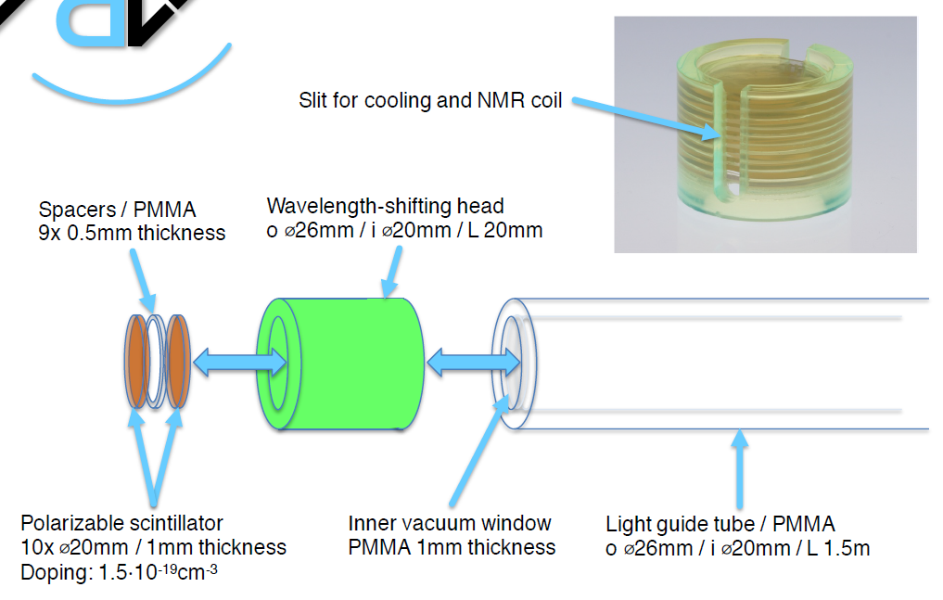
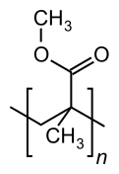
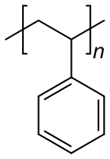
New Developement:
Active Polarized Target

Slide 22
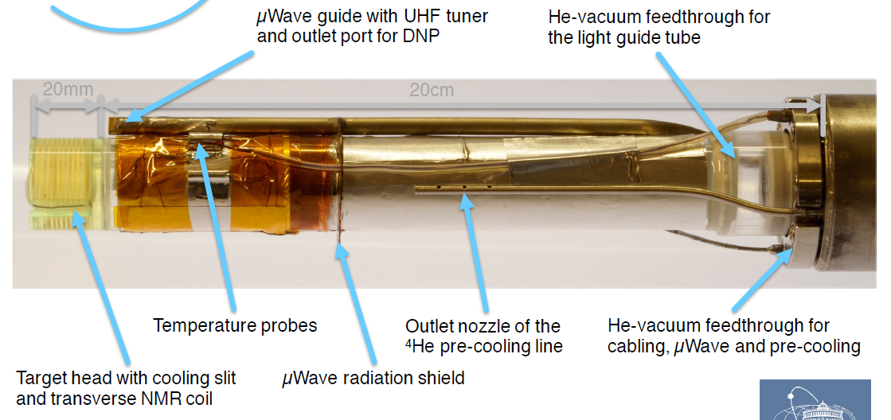
Active Polarized Target
T=45mKelvin after 5 days by ³He/⁴He mixture ← ←Vacuum in beampipe

Slide 23
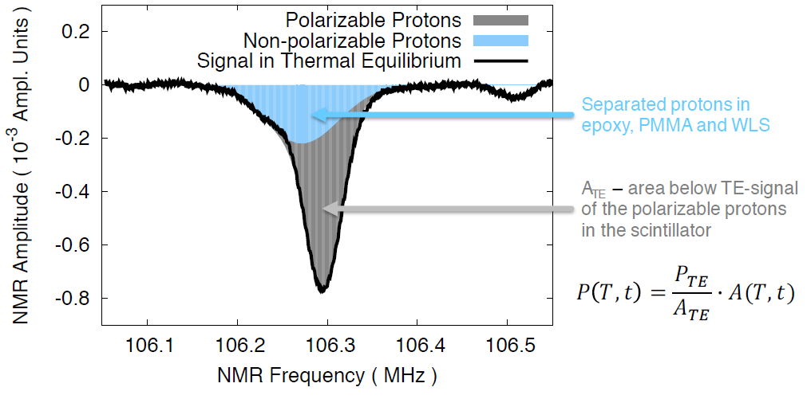
Measurement of P via NMR
[G.Reicherz, Bochum]

Slide 24
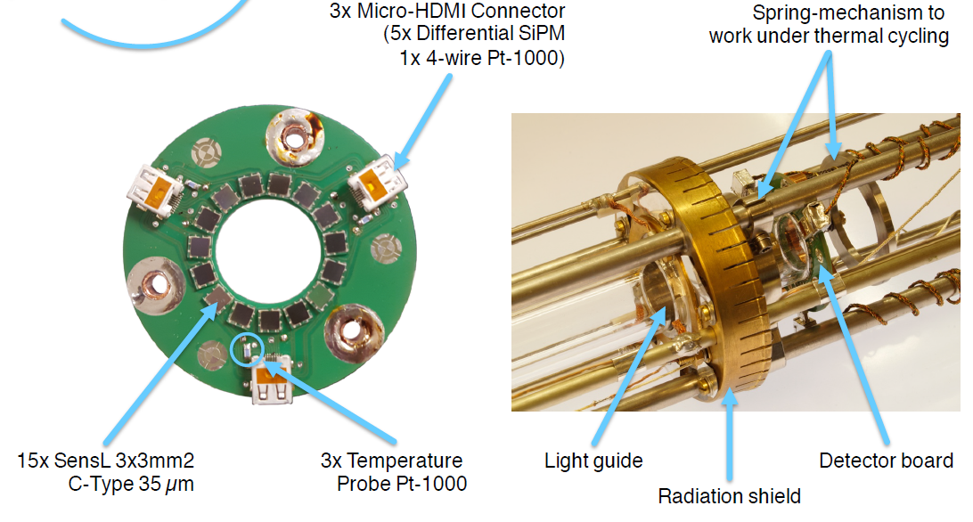
Detector
Electronics
at 150Kelvin
[M.Biroth et al., IEEE Transaction on Nuclear Science,
Vol. 64, Issue 6, June 2017]
SiPMs gain depends strongly from the temperature ~1% K-1. Therefore it is necessary to control the 25V bias voltage to ~10mV and to have a stable temperature. [PhD M.Biroth, Mainz]

Slide 25
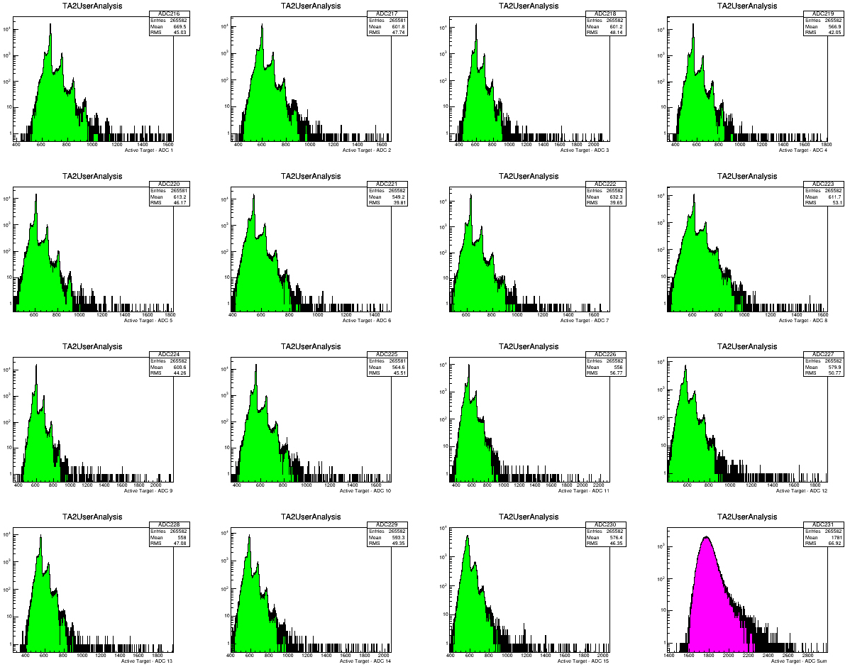
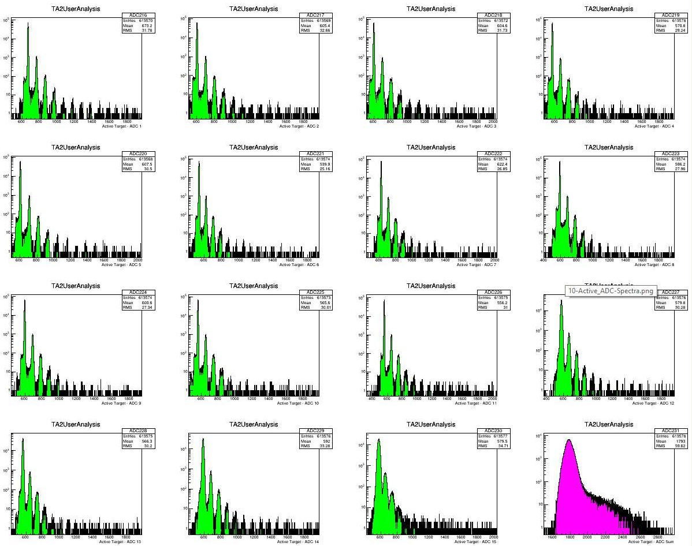
QDC Spectra
at 300Kelvin
QDC Spectra
at 150Kelvin
Clear Separation:
Pedestal,
1 photon,
2 photon, ….

Slide 26
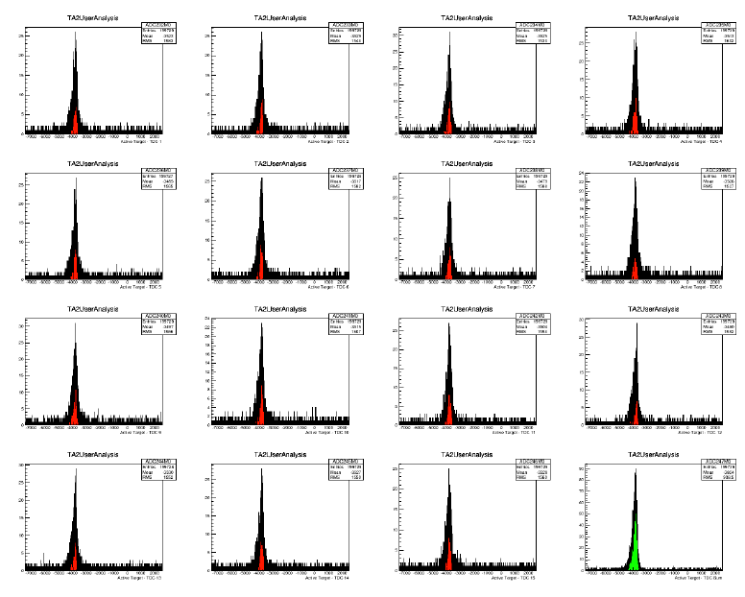
TDC Spectra show the coincidence with Crystal Ball

Slide 27
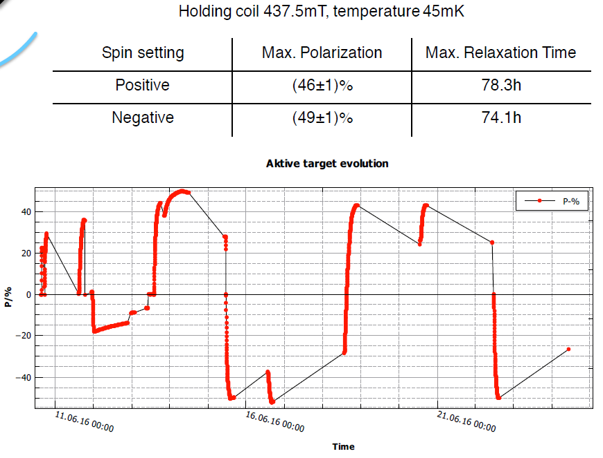
Run
June 2016

Slide 28
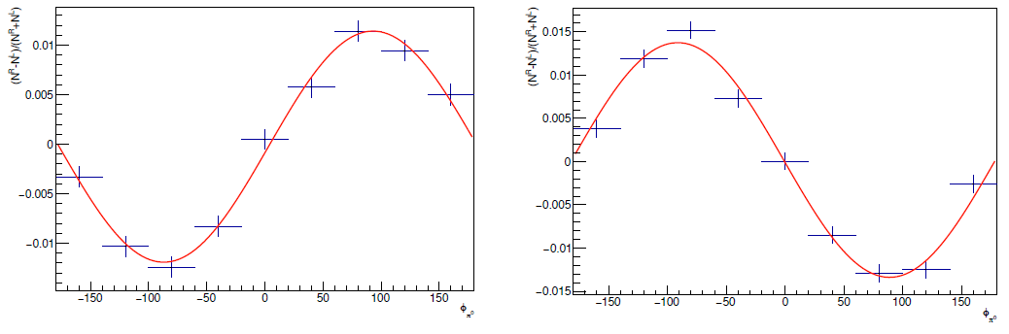
First count rate asymmetries from June 2016
φ distribution for π⁰ production
Target +
Target -

Slide 29
Investigation of dilution factor for π⁰ production
Proton 𝜋⁰ photo production
Recoil proton
Background reactions by scattering on ¹²C or heavy nuclei
Coherent 𝜋⁰
Recoil proton
Recoil nucleus

Slide 31
Recoil protons from scattering on H and
a broad distribution from incoherent scattering on ¹²C

Slide 32
M. Biroth, P. Achenbach, E. Downie, and A. Thomas, “Silicon photomultiplier
properties at cryogenic temperatures,” Nucl. Instrum. Methods
Phys. Res. A, vol. 787, pp. 68–71, Jul. 2015.
P. Achenbach, M. Biroth, E. Downie, and A. Thomas, “On the operation
of silicon photomultipliers at temperatures of 1–4 kelvin,” Nucl. Instrum.
Methods Phys. Res. A, vol. 824, pp. 74–75, Jul. 2016.
M. Biroth, P. Achenbach, E. Downie, and A. Thomas, “A low-noise
and fast pre-amplifier and readout system for SiPMs,” Nucl. Instrum.
Methods Phys. Res. A, vol. 787, pp. 185–188, Jul. 2015.

Slide 33
Conclusions
Data taking with CBall TAPS detector system started 2010 at MAMI C.
All directions of polarization were measured for protons and deuterons in Butanol. Analysis is ongoing.
The active polarised proton target was in operation in our 4π detector system in 2016.
Outlook
R&D for polarised active szintillator target for threshold production and Compton will continue. Analysis of first data is on the way.
New active target insert with better light transport system, fibers,
Scintillating target container with Butanol.
Measurement of 4 Vector Spin Polarisabilities in Compton process.
Neutron Scalar Polarisabilities with active helium gas target 2019.
New Measurement of transverse asymmetries at Bonn ELSA 2017/19.

Slide 34
Thank You!

Slide 35
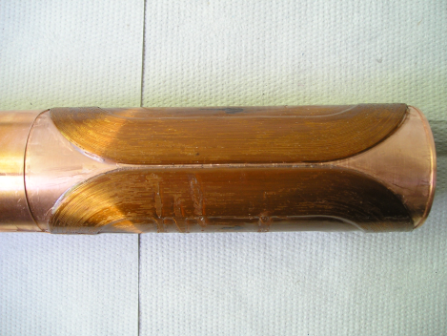
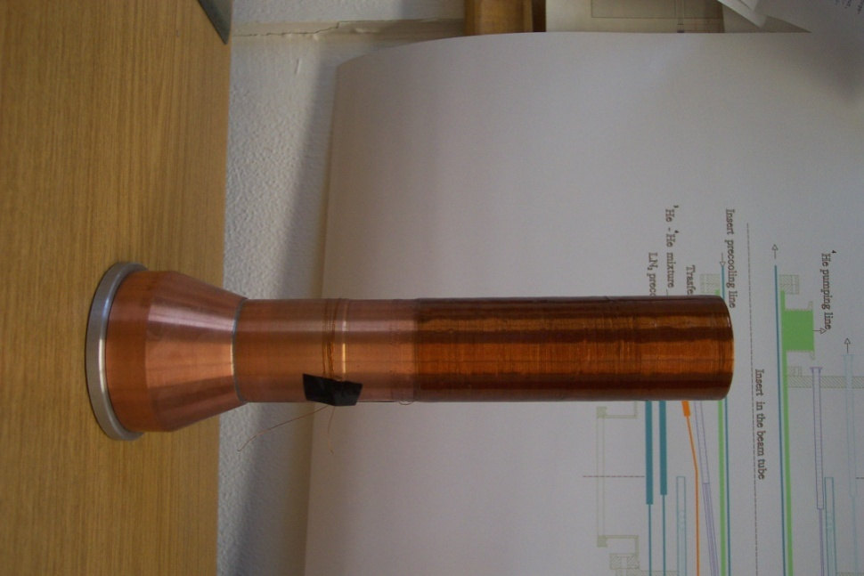
Magnet Technology
DNP at 200mK and 2.5T with 70GHz microwaves.
Frozen spin target (25mKelvin, 0.6T).
Secondary particles punch through holding coil.
All directions of polarization.
Transverse (Saddle coil)
and
Longitudinal (Solenoid)
Internal
Holding Field (1.2K, 0.6T)

Slide 36
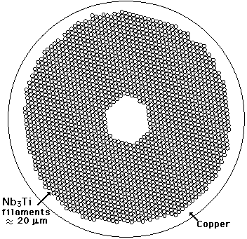
Internal holding coils
Copper/scandium wire with 54 Nb-Ti filaments embedded in it.
Cu:Sc=1.35:1
Alloy composition: Nb47wt.%Ti
Diameter=0.222mm
It achieves currents up to 50A at 4.2K and 1T.

Slide 37
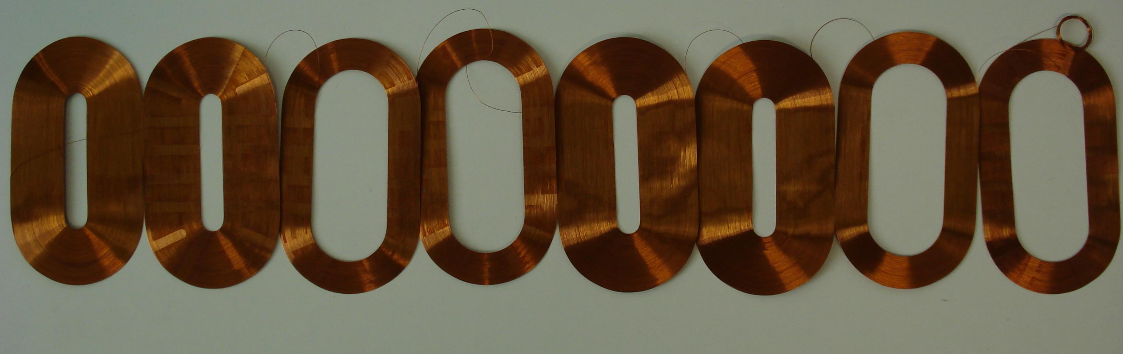
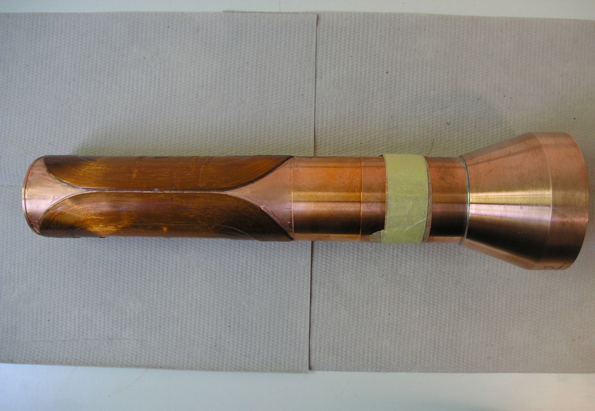
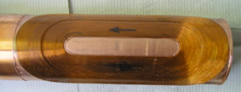
4-layer dipole:
N1=N2=138
N3=N4=78
150mm

