Slide 1
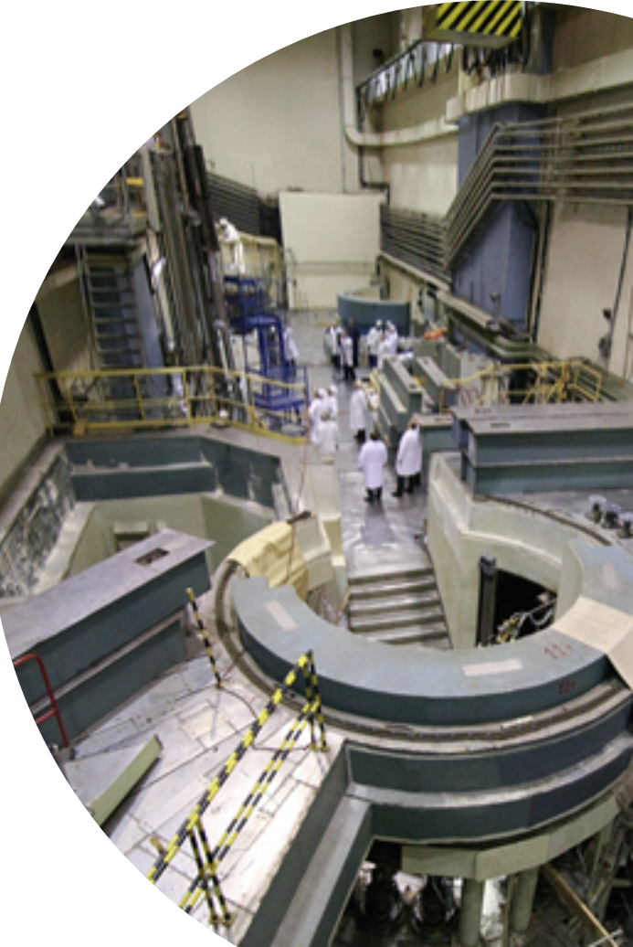
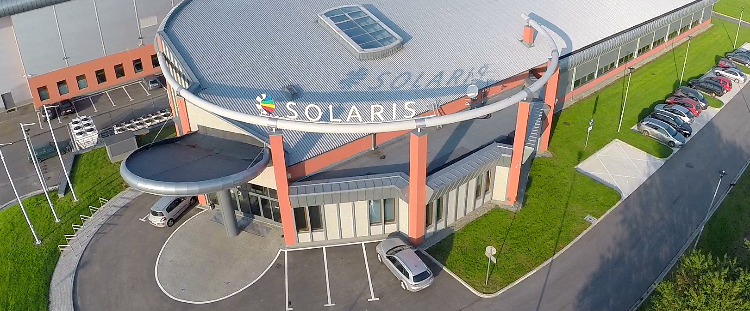
Complementarity between neutron and synchrotron X-ray scattering, the potential of the synergy between IBR-2 and SOLARIS
V.Shvetsov

Slide 2
Main features of the
X-ray NEUTRON
High brilliance of the SR sources;
  Small sample volume;
  High pressure (100-200 Gpa);
Cross-section ∼ Z;
  Low sensitivity for light atoms;
  Small penetration depth;
In case of strong chemical bonds – distortion in atom’s position;
Poor ability for measurements magnetic structure;
Comparatively low brilliance;
Deep penetration depth;
Scattering lengths variation much smaller;
Precise determination of the nucleus position;
Isotopic dependence (especially in case of H and D);
Magnetic structure;

Slide 3
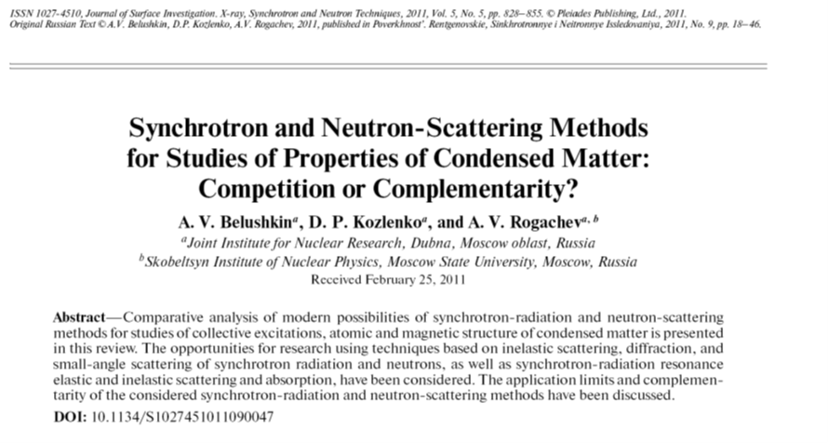
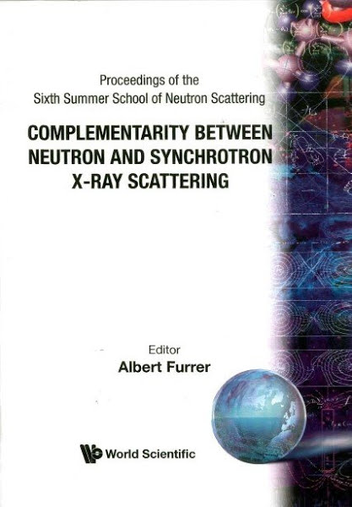
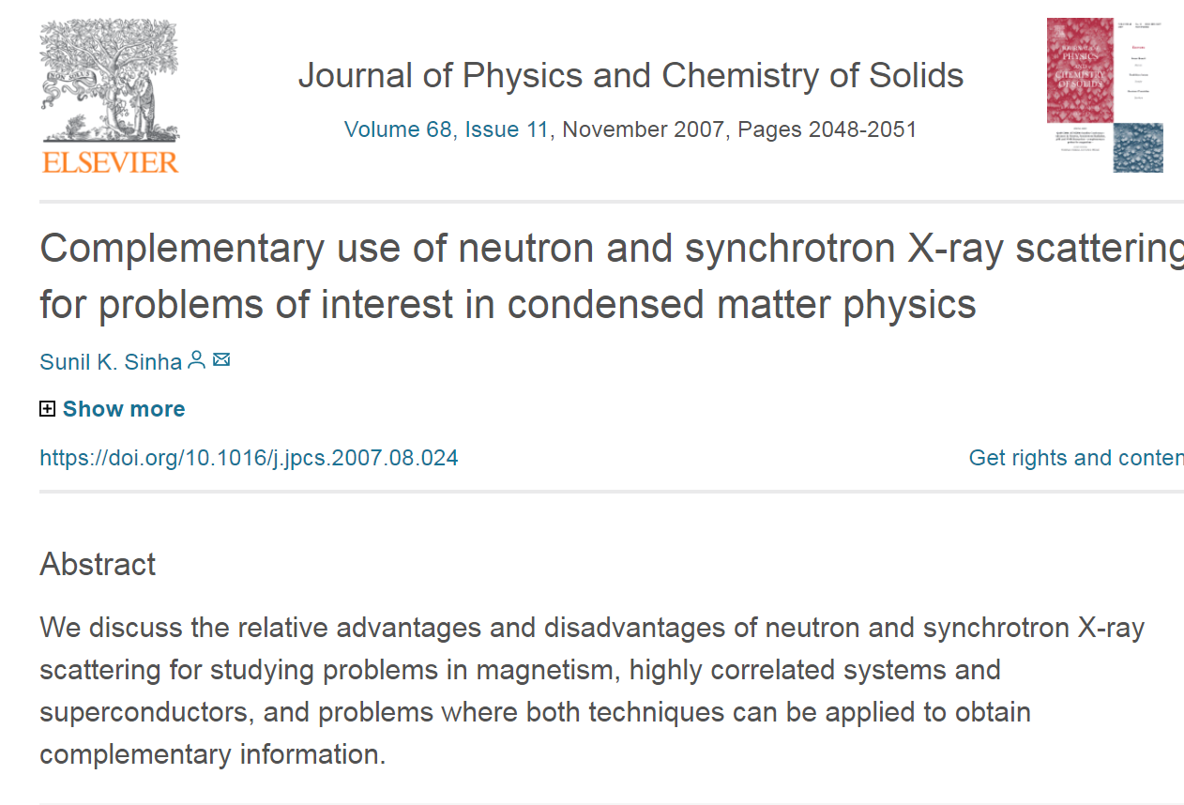

Slide 4
Real Time Experiments

Slide 5
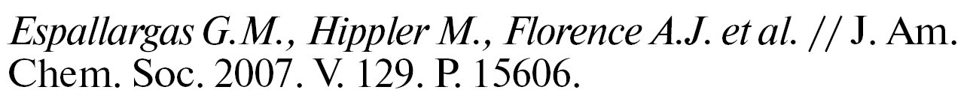
Reversible Gas Uptake by a Nonporous Crystalline Solid
Involving Multiple Changes in Covalent Bonding

Slide 6
Real-time Crystal Growth Visualization and Quantification by Energy-Resolved Neutron Imaging

Slide 7
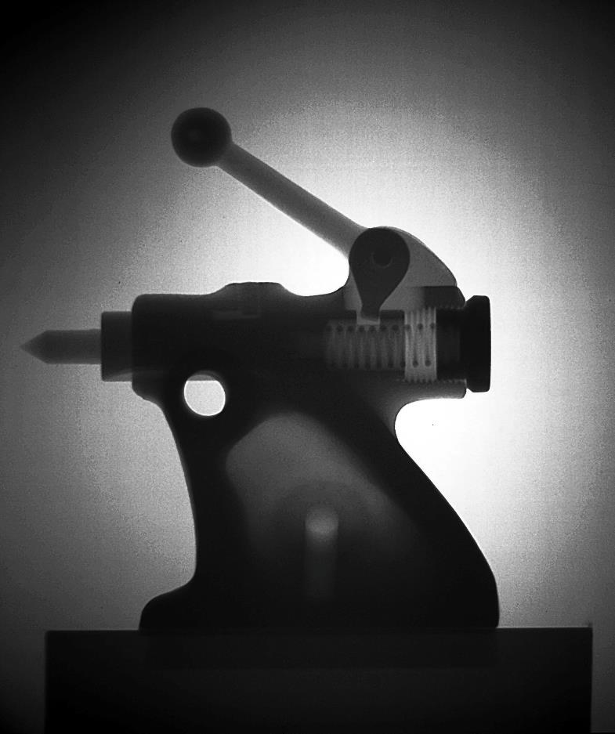
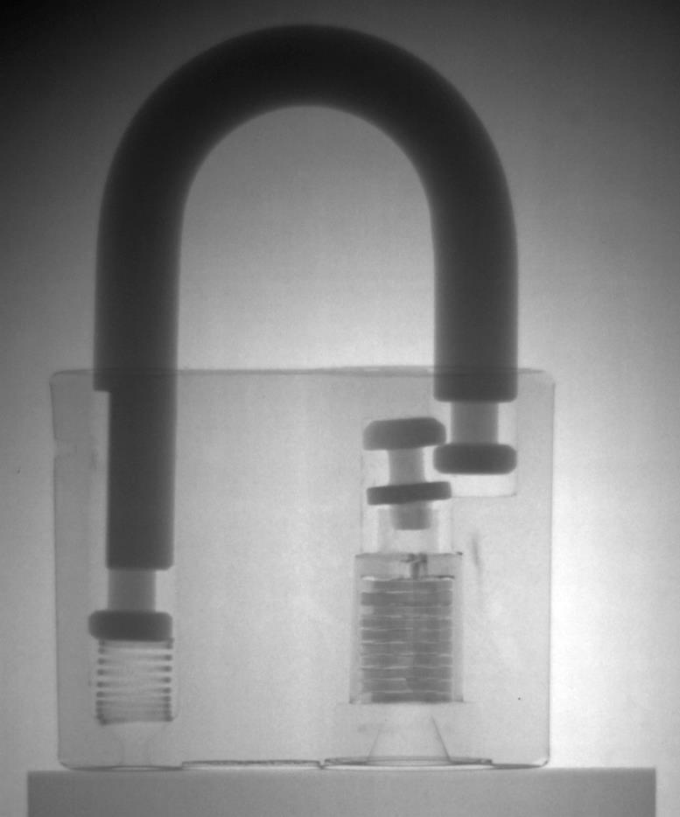
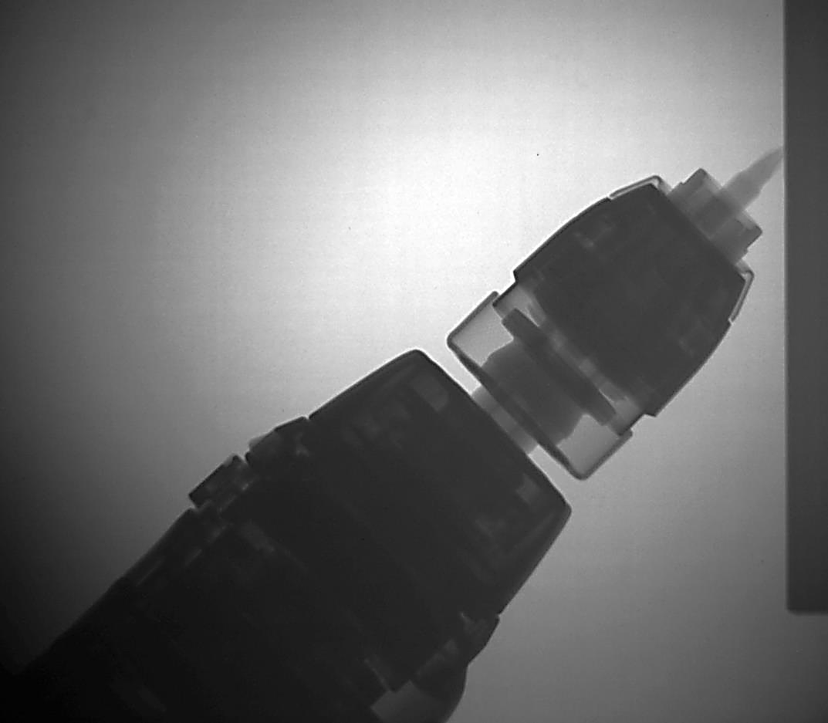

Slide 8
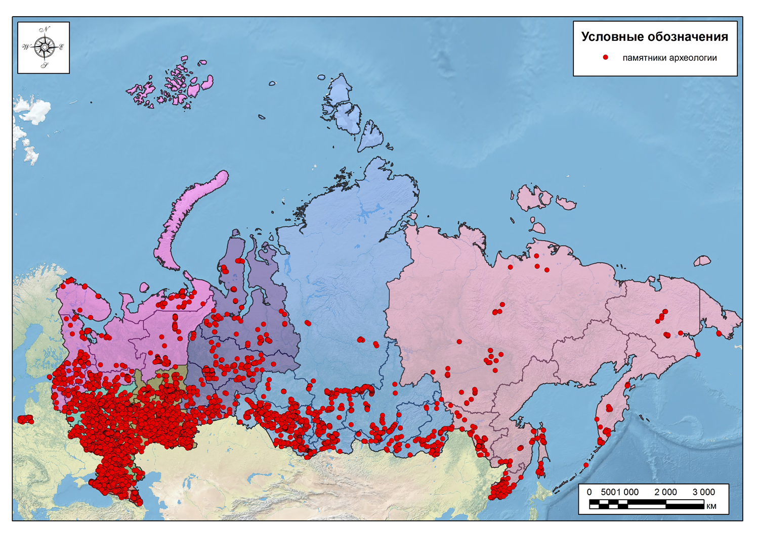
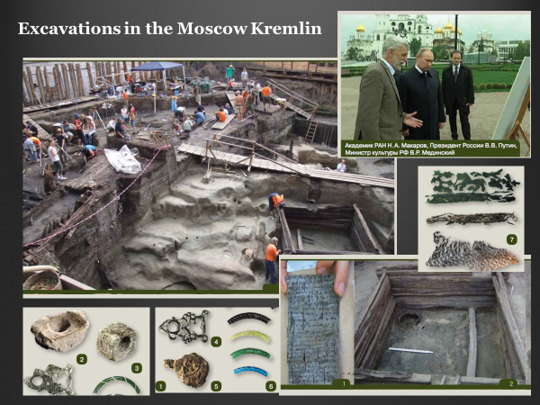
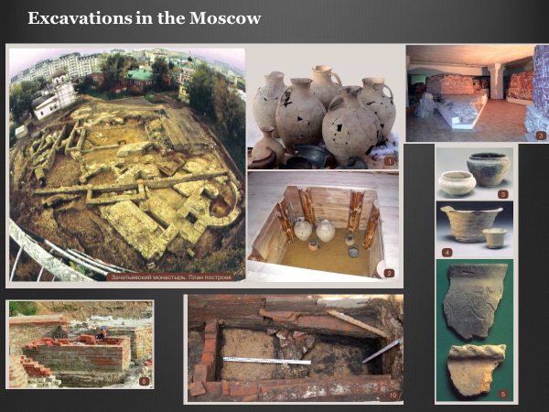
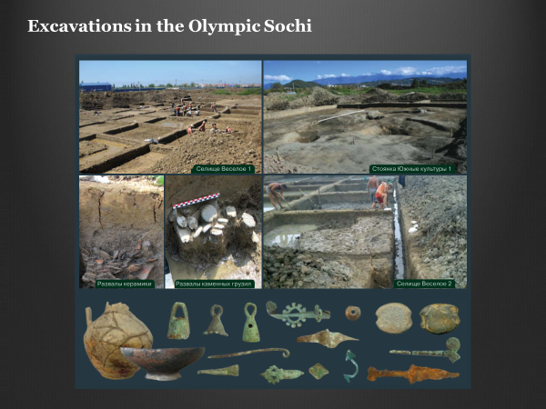
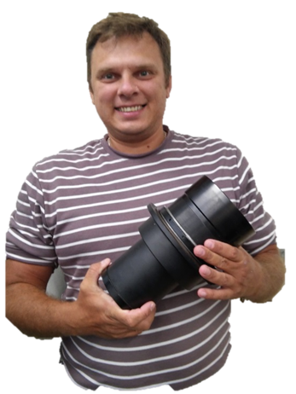
Neutron radiography and tomography at the Beam #14 are used to study archeological objects, especially metallic artifacts
S. Kichanov

Slide 9
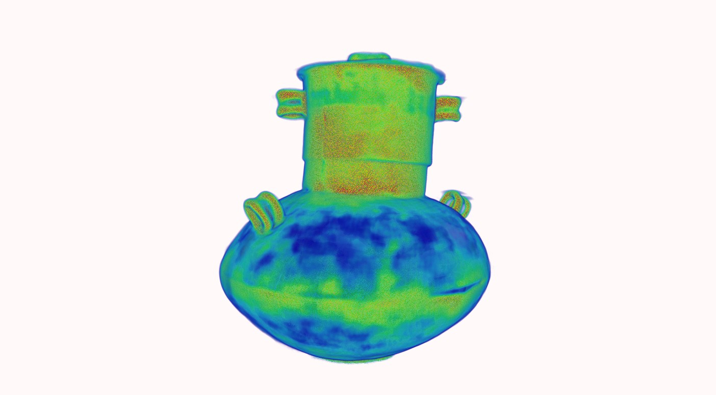
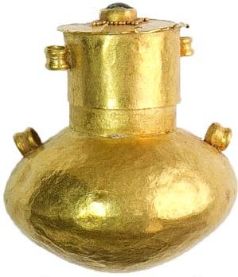

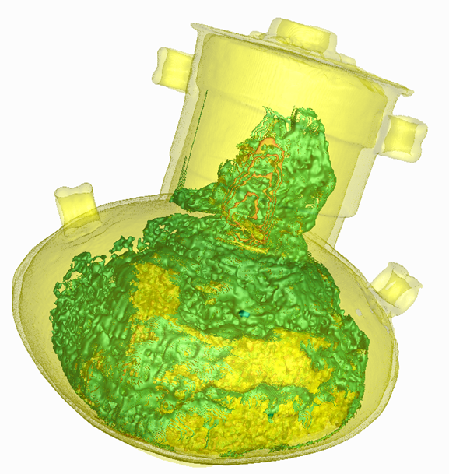
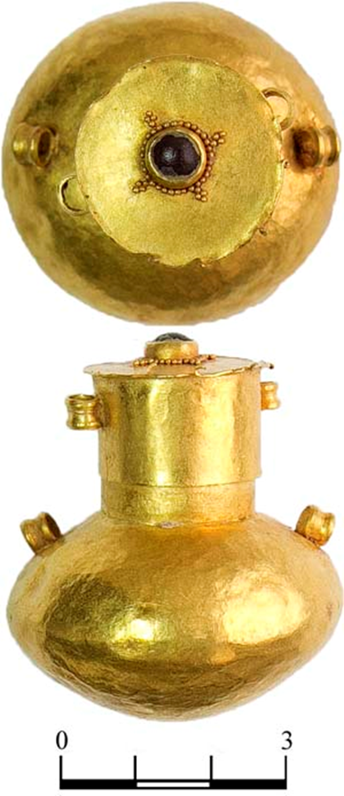
Areas with other composition of gold
traces of concealment
of a joint
Site of dispersed
joint
Site of dispersed
joint

Slide 10
Atomic structure for polycrystalline materials – refinement of the positions of the light atoms by means of neutron scattering

Slide 11
Synthesis and crystal structure of Li₄BH₄(NH₂)₃

Slide 12
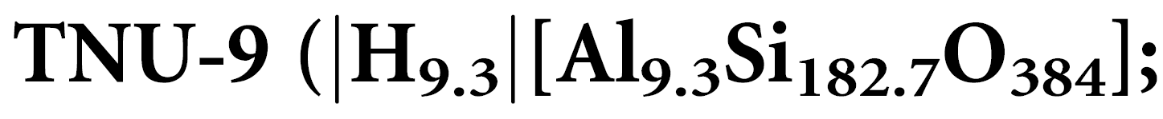
Complex zeolite structure solved by combining powder diffraction and electron microscopy

Slide 13
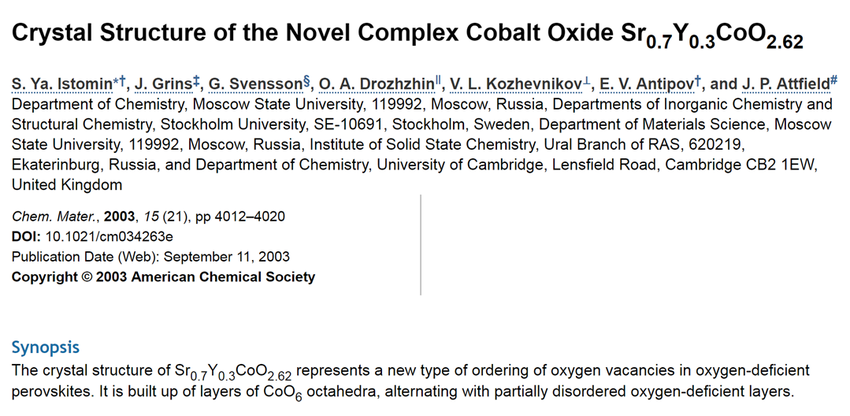
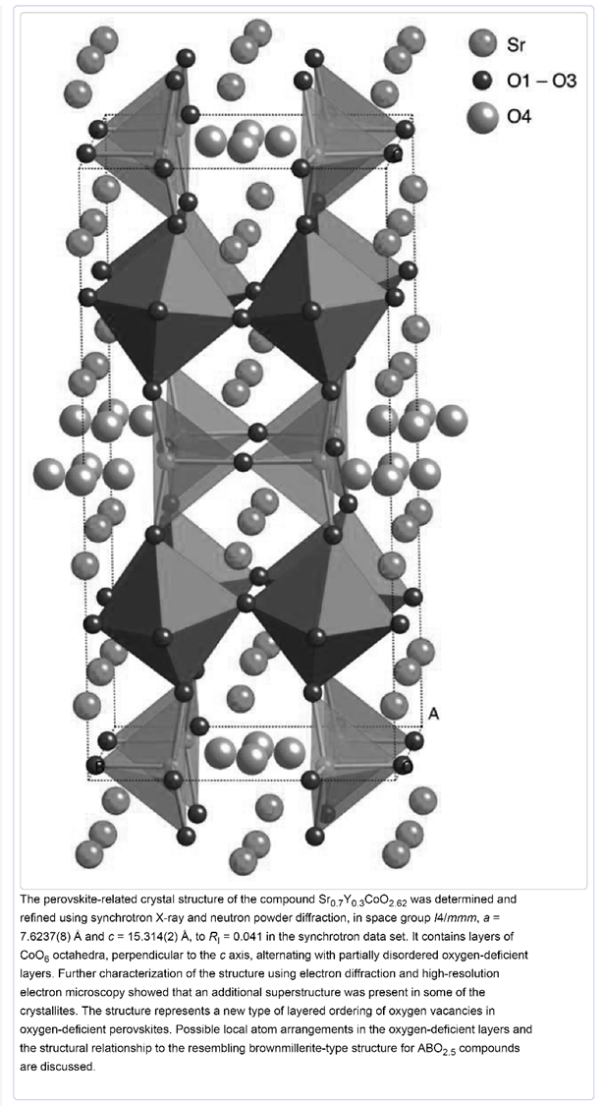

Slide 14
COMPLEMENTARY USE OF METHODS
OF SMALL-ANGLE SCATTERING
OF NEUTRONS AND SYNCHOTRON
RADIATION FOR STUDYING NANOSYSTEMS

Slide 19
Anomalous lattice compression and magnetic ordering in CuO at high pressures: A structural study and first-principles calculations
The structural and magnetic properties of multiferroic CuO have been studied by means of neutron and x-ray powder diffraction at pressures up to 11 and 38 GPa, respectively, and by first-principles theoretical calculations. Anomalous lattice compression is observed, with enlargement of the lattice parameter a, reaching a maximum at P = 13 GPa, followed by its reduction at higher pressures. The lattice distortion of the monoclinic structure at high pressures is accompanied by a progressive change of the oxygen coordination around Cu atoms from the square fourfold towards the octahedral sixfold coordination. The pressure-induced evolution of the structural properties and electronic structure of CuO was successfully elucidated in the framework of full-electronic density functional theory calculations with range-separated HSE06, and meta–generalized gradient approximation hybrid M06 functionals. The antiferromagnetic (AFM) ground state with a propagation vector q = (0.5,0, − 0.5) remains stable in the studied pressure range. From the obtained structural parameters, the pressure dependencies of the principal superexchange magnetic interactions were analyzed, and the pressure behavior of the N´eel temperature as well as the magnetic transition temperature from the intermediate incommensurate AFM multiferroic state to the commensurate AFM ground state were evaluated. The estimated upper limit of the N´eel temperature at P = 38 GPa is about 260 K, not supporting the previously predicted existence of the multiferroic phase at room temperature and high pressure.

Slide 22
Further Development of DN-6: Installation of Neutron Parabolic Focusing Device (7 m length)
Neutron flux at sample position: 3⋅10⁷ n/cm²/s (with focusing device)
Resolution at d = 2 Å, 2θ =90⁰: Δd/d = 0.025
D-spacing range: 0.8 - 12 Å
Pressure range: 0 – 50 GPa
Temperature range: 4 – 300 K
Top level among relevant class of instruments, achievable pressure range comparable with SNAP (SNS)
The replacement of the remaining tail part of the mirror neutron guide (17 m) from m = 1 to m = 2 is planned. The expected additional intensity gain is ~ 2 times
The averaged incident neutron flux gain is ~ 6 times.
Multiplication factor compared to DN-12: 35 times

Slide 23
Conclusion
Year 2017 – only at ESRF and SPRING-8 we spent 228 man-days, didn’t check other sources;
Not all our requests for beamtime were fulfilled;
JINR lab at SOLARIS which is much closer and guaranties 50% of beam time available – very good synergy with our neutron scattering instruments at IBR-2;

Slide 24
Thank you for your attention

