Slide 1

PAC on Particle Physics
48th Meeting
Report to Scientific Council
JINR, February 22, 2018
Itzhak Tserruya

Slide 2
48th PAC-PP agenda Jan.31 – Feb. 1, 2018
Highlights of the 48th PAC-PP meeting:
Update reports on NICA, MPD and BM@N
Nuclotron report
Formation of the BM@N and MPD Collaborations and NICA grant program
Projects seeking continuation

Slide 3
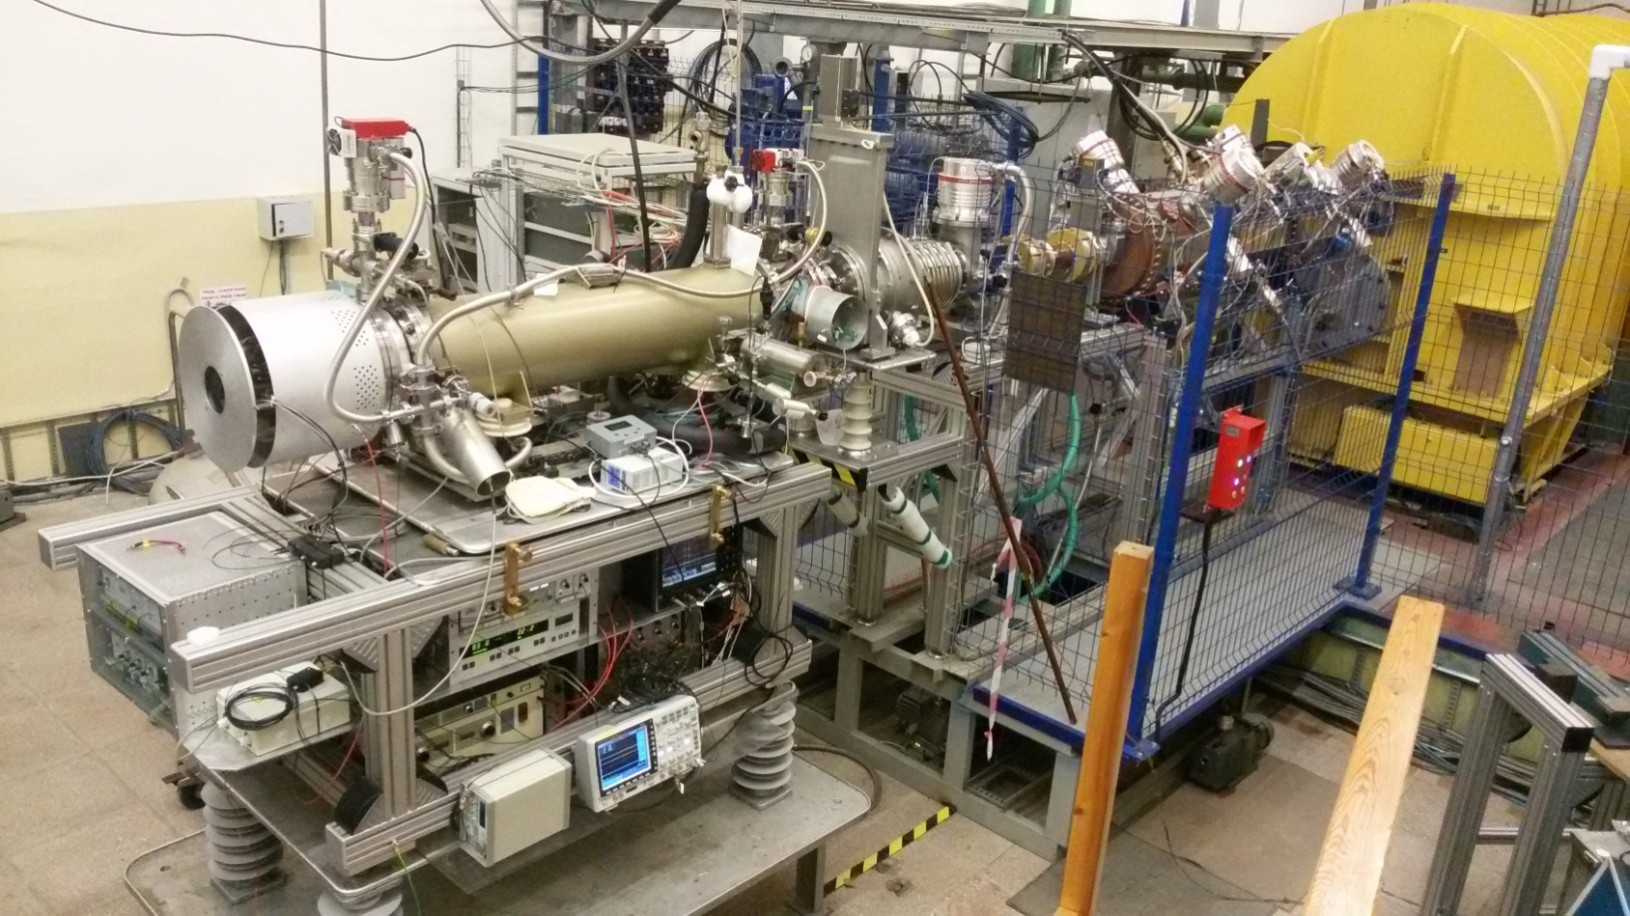
Report on the Nuclotron-NICA project
A. Sidorin
The PAC appreciates the steady progress in developing the accelerator complex.
The PAC congratulates the Laboratory’s staff on the successful preparation of the KRION-6T heavy-ion source.
The PAC appreciates the regular commissioning of new equipment and supports the programme of timely modernization of existing elements of the accelerator complex, in particular, the upgrade of LU-20 and the associated substantial increase in beam intensity.
Injector complex
Notes:
Booster installation to start after run 55 with first tests at the end of 2018

Slide 4
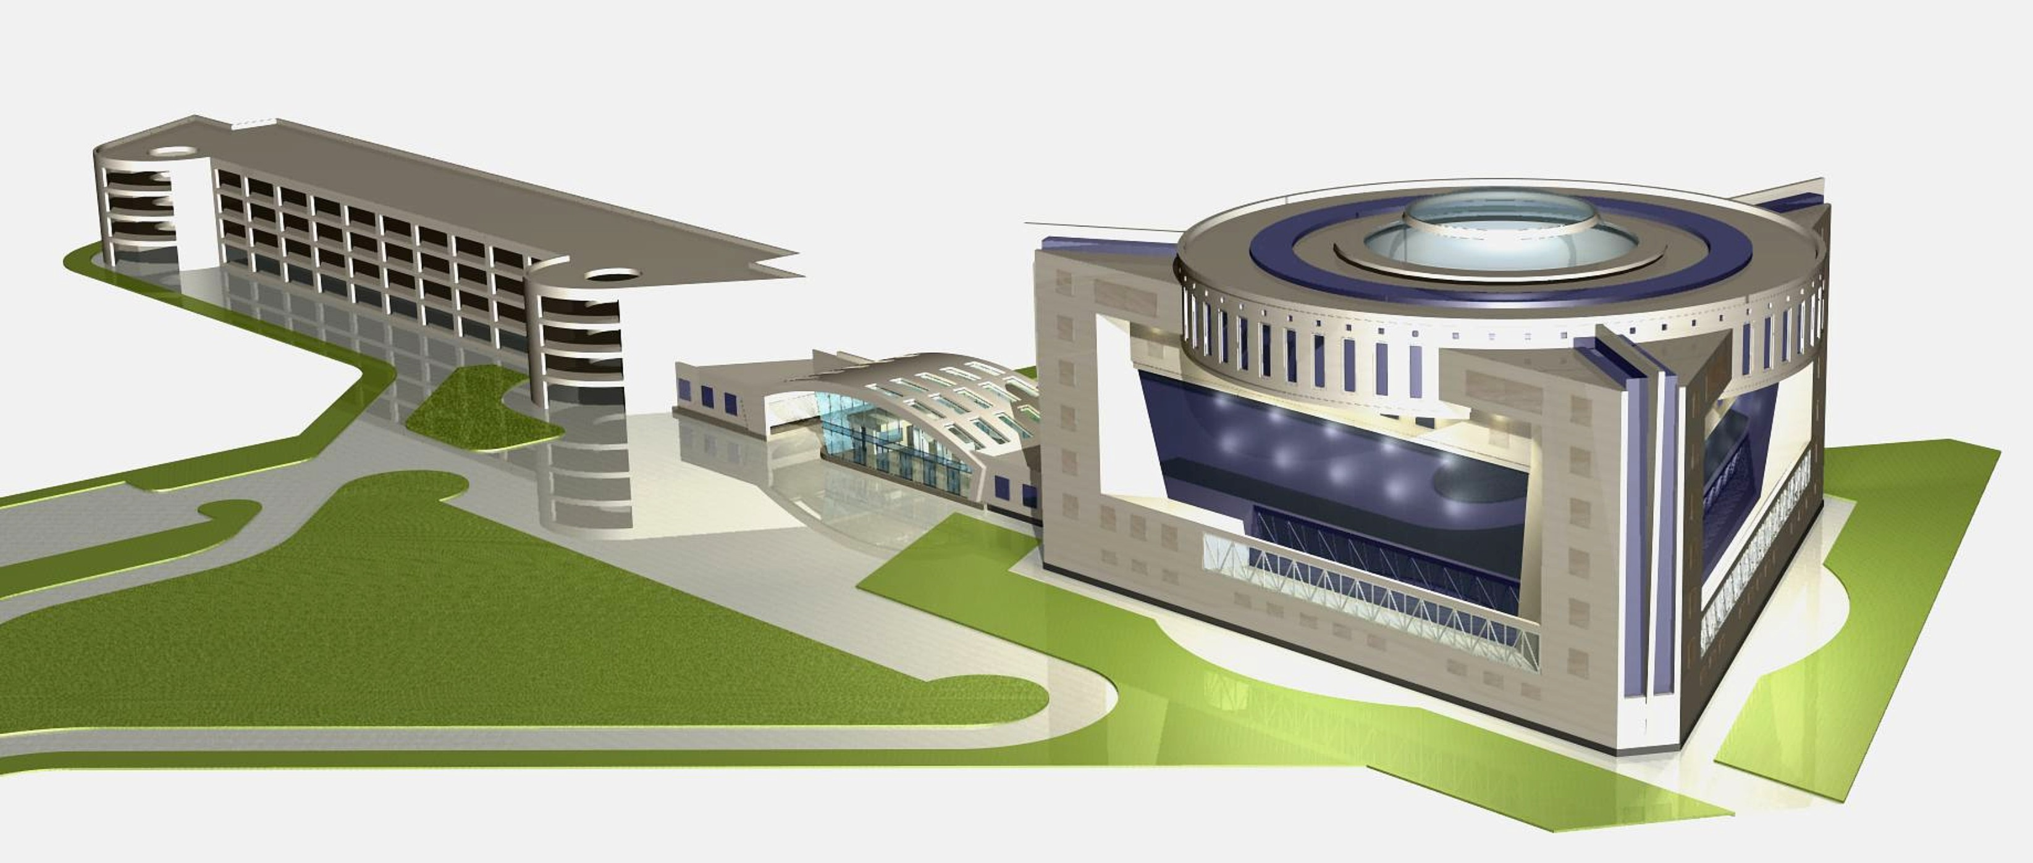
Infrastructure Developments
N. Agapov
The PAC recognizes the steady progress in the development of key infrastructure elements including the upgrade of the power supply system of beam channels, the launch of the new Nuclotron control system, the commissioning of the new helium liquefier, the progress in upgrading the existing cryogenic complex, the preparations for the installation of the booster synchrotron, and the work carried out for the preparation of the collider magnet system.
The PAC is pleased with the progress achieved in the civil construction of the collider complex and with the roadmap for the construction of the NICA Center building.
NICA Center
Design Institute “ARENA”

Slide 5
Nuclotron beam use – Run 55
H. Khodzhibagayan
The PAC heard the report about the forced interruption of Run 55 of the Nuclotron on November 3, 2017 due to a failure of the cooling system of the superconducting magnets.
The PAC notes with satisfaction the successful and rapid completion of the repair work and appreciates the measures taken by the project management to prevent recurrence of similar accidents in the future.
Run 55 was rescheduled for February 5 – March 23, 2018. Beams of C, Ar¹⁶⁺, Kr²⁶⁺ from the KRION source will be used by SRC and BM@N.
The Booster installation will start after completion of the run. First technical run of the Booster by the end of 2018.

Slide 6
Recent Developments
V. Kekelidze
Official launching of the MPD and BM@N Collaborations
The PAC welcomes the plans to hold a three-day meeting at JINR on April 11-13, 2018 to officially launch the MPD and BM@N International Collaborations.
Announcement of the meeting and invitations were sent on December 21, 2017.
Status Feb. 19: About 107 registrants from 11 countries and 23 institutions.
NICA research grant program
JINR is establishing a research grant program to encourage and support research carried out in the MPD, BM@N or SPD experiments.
The proposal is to award research grants to groups (mainly to support students and post-docs) for a 3 y period through a competitive process according to the scientific merit of submitted proposals.
Notes:
Graph of registrations

Slide 7
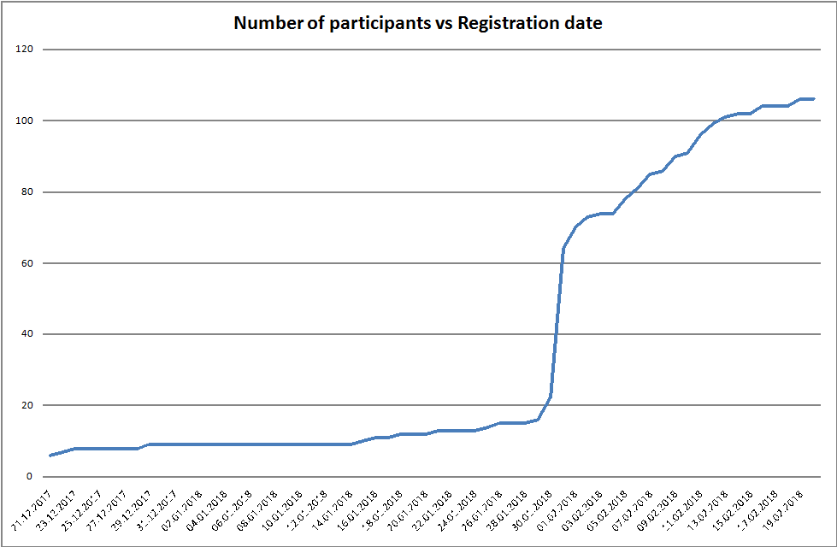
Recent Developments
V. Kekelidze
100
80
60
Nr of registrants
40
20
21.12 31.12 10.1 20.1 30.1 10.2
Registration Date
Notes:
Graph of registrations

Slide 8
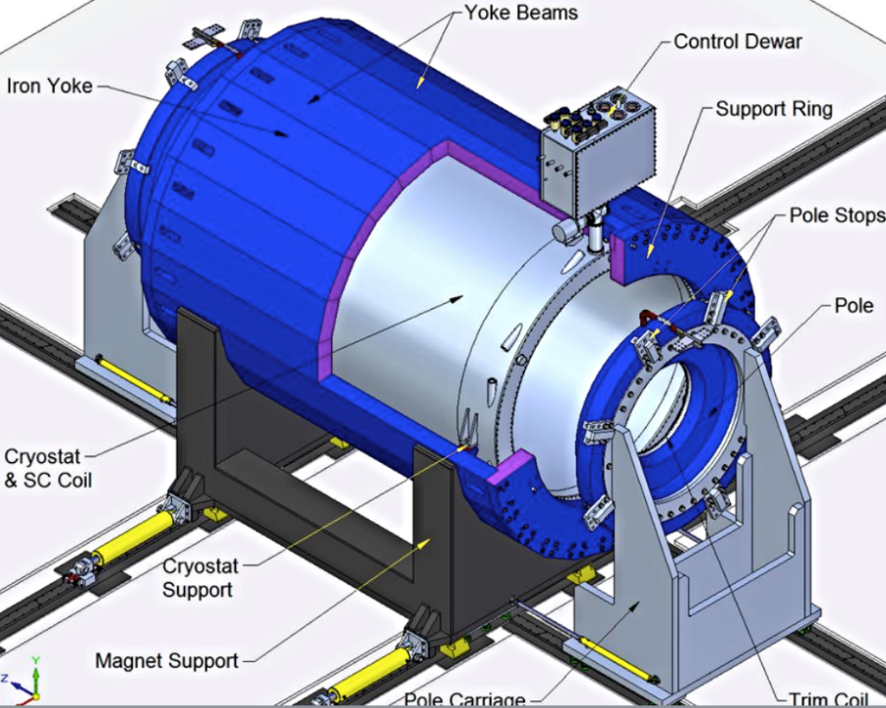
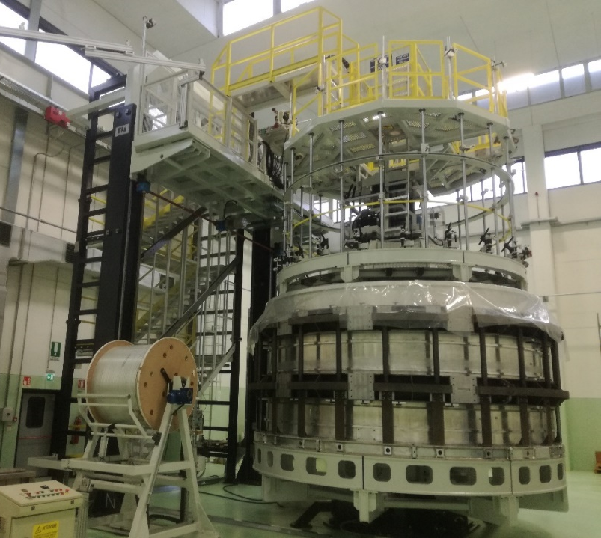
MPD
Vadim Kolesnikov
The PAC appreciates the recent advance in the MPD magnet construction but is concerned about the delay in the magnet delivery to JINR. The Committee urges the team to ensure timely and successful completion of the contract avoiding any further delay.
The PAC is pleased to note that the SAMPA chip has been finally chosen for the TPC front-end electronics and encourages the TPC team to complete the remaining design and prototype work.
It acknowledges the efforts undertaken by the JINR and Laboratory managements to strengthen the participation of Chinese groups in the construction of the MPD electromagnetic calorimeter. The PAC encourages the ECAL team to focus on the optimization of the detector specifications and design in view of finalizing the ECAL TDR.
End of production - November 2018
Delivery to JINR – April-May 2019

Slide 9
BM@N
Mikhail Kapishin
The PAC appreciates the report on the progress towards realization of BM@N
It welcomes the commissioning of new equipment and the first use of the large-area GEM tracking detectors.
The PAC reiterates its concern about the lack of manpower for in-depth analysis of data collected in recent runs.
The Committee looks forward to a report on the detector operation during Run55 with the KRION heavy-ion source and on the study of SRC.
Central tracker in March 2018 run (Ar, Kr)
7 planes of GEM detectors (5 of them big size)
3 planes of Si detector in front of GEMs.

Slide 10
Update on the SPD project
R. Tsenov
The PAC takes note of the report on the progress towards realization of the SPD project.
The PAC endorses the proposed plan for the preparation of the Conceptual Design Report of the SPD detector, backed by local theoretical support, which will be submitted to this PAC in January 2019, and for the formal establishment of the SPD Collaboration.

Slide 11
Recommendations on projects approved for completion in 2018 and proposed for continuation
Upgrade of the ATLAS detector – A. Cheplakov
The Committee is pleased to hear about the commissioning of the Micromegas chamber production site at JINR. It appreciates the realization of a second workshop dedicated to the production of smaller-size muon chambers for domestic projects.
The PAC is satisfied with the progress achieved by the JINR team in the detector modernizations, and recommends continuation of JINR’s participation in the ATLAS upgrade project until the end of 2020.
Upgrade of the CMS detector – A. Zarubin
The Committee appreciates the progress achieved by the JINR group in the CMS Phase-I detector upgrade and R&D work for the HL-LHC.
The PAC recommends continuation of JINR’s participation in the project until the end of 2020.

Slide 12
Recommendations on projects approved for completion in 2018 and proposed for continuation
Borexino/SOX/DarkSide 20k - D. Naumov
The Committee appreciates the broad spectrum of important results obtained in the Borexino experiment.
However, the PAC also notes that Borexino, SOX and Dark Side are three distinct experiments with rather diversified physics goals and timelines.
Borexino: Given the interest in the continuation of the Borexino programme it is recommended that the group carries on the data analysis until the end of 2019.
SOX: due to the issues put forward by the proponents about potential delays, the PAC proposes that a detailed status report be presented at the next PAC meeting in order to decide on a possible recommendation.
DarkSide 20k: the PAC notes the scientific interest of the dark matter DarkSide 20k project. However, considering the different scientific scope with respect to Borexino, and given the scale and the complexity of the experiment, the PAC recommends that the proponents and the JINR management first establish a global strategy to be presented to the PAC at the next meeting in order to allow a thorough evaluation of all aspects of the project related to science, contributions and consistency of the group, investments and timeline.

Slide 13
Scientific Reports
The PAC heard the report:
“Factorization theorem and duality: from low-energy to high-energy regimes ” presented by I. Anikin
and thanked the speaker for his presentation.

Slide 14
Presentations by young scientists
The PAC reviewed 30 poster presentations in particle physics by young scientists from DLNP, LIT and VBLHEP Laboratories.
The PAC selected the poster “Limit on the effective magnetic moment of solar neutrinos using Borexino data” presented by A. Vishneva to be reported at this session of the Scientific Council.
The PAC reiterates its recommendation that the posters should focus on the actual work of the young scientists

Slide 15
Next PAC-PP Meeting – June 18-19, 2018
The next meeting of the PAC-PP will be held on June 18 - 19, 2018
The following items are proposed to be included in the agenda:
  Follow-up on the to-do-list from this PAC meeting
  Consideration of new projects
  Reports and recommendations on the projects to be completed in 2018
  Status Report on the Nuclotron-NICA project
  Status Report on infrastructure issues including Nuclotron
  Report from the Coordinator of the Nuclotron experimental programme
  Status report on the MPD project including simulation results
  Status report on the BM@N project including simulation results and first beam test of the SRC programme
  Posters from young physicists

Slide 16
Thank you!

