Slide 1


SELF-SIMILARITY APPROACH FOR PREDICTION AND ANALYSIS OF EXPERIMENTS AT THE ACCELERATOR COMPLEX NICA
Elina G. Baldina
Joint Institute For Nuclear Research, Dubna, Russia
Institute for Advanced Studies "OMEGA", Dubna, Russia
September 18, 2018 ISHEPP XXIV, Dubna, Russia

Slide 2
Self-similarity
Self-similarity is a special symmetry of solutions, when a change in scales of independent variables can be compensated by a self-similarity transformation of other dynamical variables.
The main idea of application of the self-similarity approach in physics (and science in general) is to reduce the number of variables in a physical law.

Slide 3
General concepts of the self-similarity approach (dimensionality theory)
Defining parameters:
Defined parameter:
Expression of part of variables in terms of independent variables

Slide 4
General concepts of the self-similarity approach (dimensionality theory)
Transition to dimensionless
parameters:

Slide 5
General concepts of the self-similarity approach (dimensionality theory)
Finally, a self-similar solution is sought in the form:

Slide 6
Methods for constructing self-similarity solutions
Determination of the space of parameters describing the problem;
Finding/guessing the symmetry of this space, which allows one to determine the invariants of this space;
Representation of physical laws/dependences as correlations between these invariants. Here, the hypothesis of an analytical character of physical laws is used;
Application of additional principles, such as the correlation depletion principle, the intermediate asymptotic, etc., depending on a particular problem analyzed.

Slide 7
General self-similarity solution for relativistic interacting particles
The relationship between X₁ and X₂ is described by the conservation laws written in the form
Essentially, we are using the correlation depletion principle in the relative four-velocity space which enables us to neglect the relative motion of not detected particles, namely the quantity
in the right-hand side of the above equation.

Slide 8
General self-similarity solution for relativistic interacting particles
In the case of production of antiparticle with mass M₃, the mass M₄ is equal to M₃ as a consequence of conservation of quantum numbers. In studying the production of protons and nuclear fragments
M₄ = −M₃ as far as the minimum value of Π corresponds to the case that no other additional particles are produced. The values of X₁ and X₂ obtained from the minimum Π are used to construct a universal description of the A-dependencies.

Slide 9
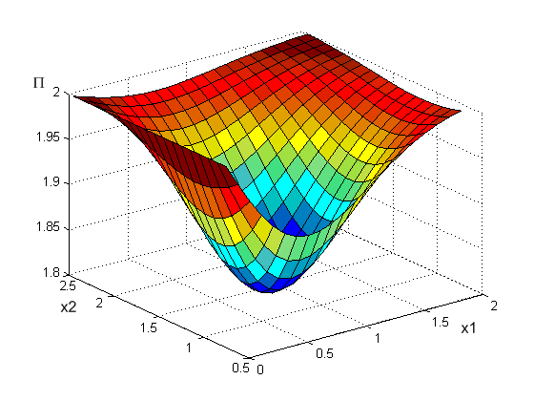
General self-similarity solution for relativistic interacting particles

Slide 10
S1/2 versus energy - reminder

Slide 11
Φ meson production in 2 GeV (S^{1/2}=6 GeV) and 5 GeV (S^{1/2} = 12 GeV) p-p collisions

Slide 12
Φ meson production in 5 GeV p-p collisions (S^{1/2} = 12 GeV)

Slide 13
Φ meson production in 7 GeV p-p collisions (S^{1/2} = 16 GeV)

Slide 14
Φ meson production in 2 GeV Au-Au (S^{1/2} = 6 GeV) and 7 GeV Au-Au (S^{1/2} = 16 GeV) collisions

Slide 15
Φ meson production in 2 GeV Au-Au (S^{1/2} = 6 GeV) and 7 GeV Au-Au (S^{1/2} = 16 GeV) collisions

Slide 16
φ meson production in heavy ion collisions

Slide 17
φ meson production in heavy ion collisions

Slide 18
J/ψ production in heavy ion collisions

Slide 19
J/ψ production in heavy ion collisions

Slide 20
J/ψ production in 2 GeV Au-Au (S^{1/2} = 6 GeV) and 7 GeV Au-Au (S^{1/2} = 16 GeV) collisions

Slide 21
J/ψ production in 2 GeV Au-Au (S^{1/2} = 6 GeV) and 7 GeV Au-Au (S^{1/2} = 16 GeV) collisions

Slide 22
D+(D-) meson production in 2 GeV Au-Au (S^{1/2} = 6 GeV) and 7 GeV Au-Au (S^{1/2} = 16 GeV) collisions

Slide 23
D+(D-) meson production in Au-Au collisions for different collision energies (invariant cross section in mb·GeV⁻² ·c³ ·sr⁻¹ , zero angle)

Slide 24
D+(D-) meson production in 4 GeV/c (S1/2=9.875 GeV)
Au-Au collisions at 0, 45, and 90°

Slide 25
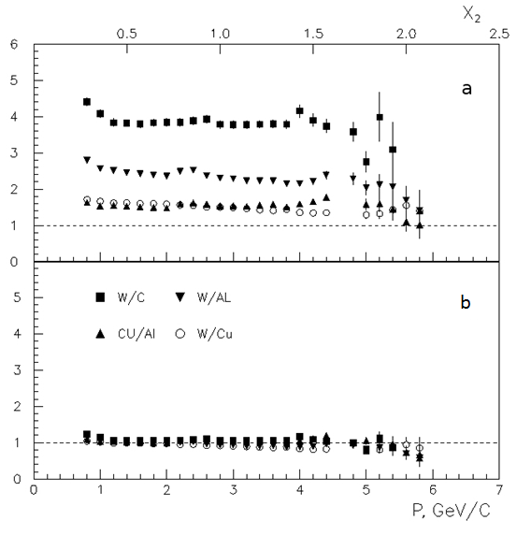
High-PT region
The А-dependence of the form
well describes the dynamic dependence of the cross sections on X2, while it fails to describe a stronger dependence on the mass number of the nucleus observed in this experiment.
Figure. Ratio of cross sections of negative pion production on different nuclei multiplied by inverse А-dependence.
(a) (b)
V. V. Ammosov, et al., Phys. At. Nucl. 76, 1213 (2013).

Slide 27
Conclusions
The above functional self-similarity solution quantitatively describes angular, energy and A-dependences of inclusive production cross sections of all hadrons with transverse momentum up to 1GeV/c.
Higher transverse momenta require an additional mechanism to account for momentum dependence in the invariant cross section.
Interaction of very heavy nuclei (Au, Pb, etc.) may “entangle” the experimental picture
of the reaction and complicate theoretical interpretation. Collective effects can be observed
already for light and intermediate nuclei, although with lower multiplicity and
combinatorial background.
Collective phenomena become extinct with increasing collision energy. Therefore, the
energy range from hundreds MeV to tens of GeV is optimal for experimental observation of
collective effects in nuclear collisions. Of interest is the study of the whole energy range
available at the NICA collider, toward the lowest possible energies.

