Slide 1



Energy and system size dependence of multi-particle production in pp, p-Pb, Xe-Xe and Pb-Pb collisions in ALICE at the LHC
Grigory FEOFILOV
Saint-Petersburg State University
(for the ALICE Collaboration)
25 years at LHC !
Report at the XXIVth International Baldin Seminar on High Energy Physics Problems "Relativistic Nuclear Physics and Quantum Chromodynamics”, JINR, September 17 to 22, 2018, Dubna, Russia.
http://relnp.jinr.ru/ishepp/

Slide 2

Space-time stages of nucleus-nucleus collision
Some details:
Pre-equilibrium phase
τ_{eq}< 0.5 fm/c
QGP
Mixed phase
Chemical freeze-out
Particle composition is fixed
T_{ch} ~ 155 MeV
Thermal freeze-out
Particle p_{T} spectra are fixed
T_{tfo} ~ 100 MeV
Investigations of:
Multiplicity and Spectra
Particle content and ratios
Flows
Correlations
Jet- medium interactions and high-p_{T} supression
Time
π, K, p, Λ,Ξ,Ω,…d,He3,He4…
z
Colliding
nuclei
Grigory Feofilov (for ALICE Collaboration),
XXIVth International Baldin Seminar ,
JINR, Dubna, September 17-22, 2018

Slide 3
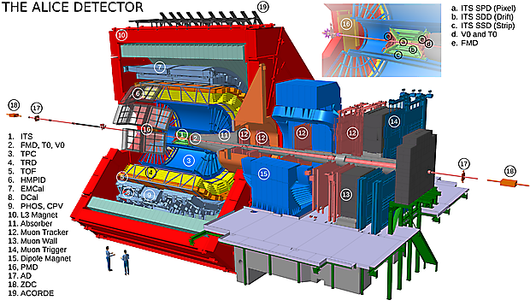
The ALICE detector
ALICE
is optimized for
Heavy-Ion Physics:
dn/dy in Pb-Pb: up to 2000
  PID:
  p_{T} > 0.2 GeV/c
.
Notes:
TPC dE/dx as a function of momentum with superimposed Bethe-Bloch lines for various particle species for RUN2 Pb-Pb low interaction rate runs.
two neutron Zero Degree Calorimeters (ZDC) positioned at ±114 m from the interaction point are used in the offline event selection.

Slide 4
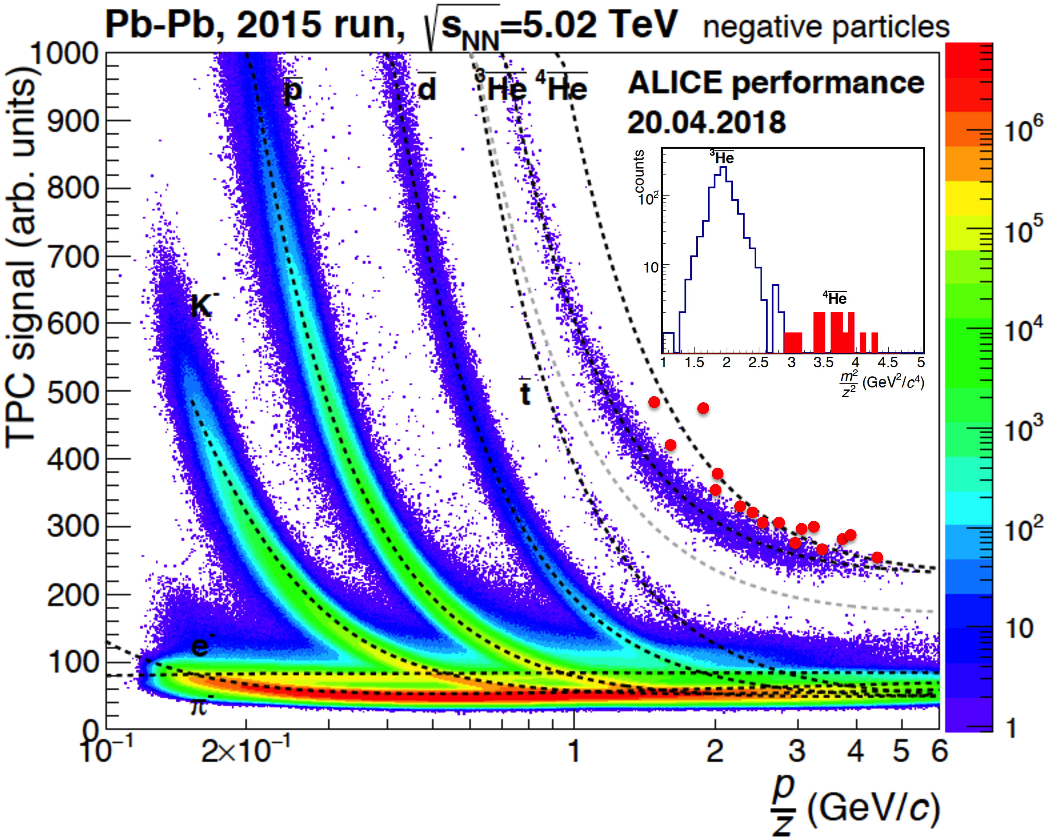
Example of PID performance of TPC : dE/dx vs. rigidity
.
Notes:
TPC dE/dx vs Rigidity distribution for all events passing the offline trigger selection of events with at least one Z>1 track candidate. ONLY NEGATIVELY CHARGED PARTICLES ARE SHOWN. 16 anti-alpha candidates are indicated in this plot.

Slide 5
ALICE Data accumulated since 2009
Run 1 (2009-2013 | Run 2 (2015-now)
Pb-Pb@ 2.76 TeV | Pb-Pb@ 5.02 TeV, (~ 250 μb⁻¹ ) ~ 130 million MB events By end of 2018 -Pb-Pb@ 5.02 TeV, (~ 1 nb⁻¹ is expected)
p-Pb@ 5.02 TeV | p-Pb@ 5.02 TeV , (~3nb⁻¹), 8.16 TeV (~25nb⁻¹)
pp@ 0.9, 2.76, 7, 8 TeV | pp@ 5.02 (~1.3 pb⁻¹) 13 TeV (~25pb⁻¹)
 | Some recent results of 2017: Xe-Xe@ 5.44 TeV, (~ 0.3 μb⁻¹)

Slide 6
Multi-particle production in pp, p-Pb and A-A collisions
Energy and system size dependence
.

Slide 7
pp collisions: energy dependence of pseudorapidity distributions
New data
At 2.76
Soft and hard interactions of hadrons at LHC energies
“Soft” Pomeron as a Regge trajectory with t = 0 intercept:
α_{P}(0) = 1 + Δ > 1
dN/dy ~ dN/dη~ s^{Δ} - under some assumptions
(including the non-interacting Pomerons)
Results from the data fit:
    S^{0.102± 0.003} -for INEL
    S^{0.114± 0.003} -for NSD
    S^{0.114± 0.001} -for INEL>0
Eur. Phys. J. C 77 (2017) 33
Notes:
Charged-particle multiplicity distributions over a wide pseudorapidity range in proton-proton collisions at s√=s=0.9, 7 and 8 TeV
Article reference: Eur. Phys. J. C 77 (2017) 852 Publication link arXiv HEP Data
System: p-p Energy: 900 GeV , 7 TeV , 8 TeV Publication date: 9 December, 2017
Eur. Phys. J. C 77 (2017) 852
==arxiv: 1708.01435 (0.9, 7 and 8 TeV pp)
Eur. Phys. J. C 77 (2017) 33
https://arxiv.org/abs/1509.07541v2
(0.9, 2.36, 7 and 8 TeV pp)

Slide 8
pp collisions: Multiplicity distributions in comparison with models
From low to high energies in pp collisions: What is the main mechanism for changing the mulitplicity distributions -- ?
MPI -?
QGP-?
Color string fusion -?
Eur. Phys. J. C 77 (2017) 33
Remarkable change of high multiplicity distributions tails
MC event generators fail
A reference for heavy-ion collisions at the LHC.
Grigory Feofilov (for ALICE Collaboration),
XXIVth International Baldin Seminar ,
JINR, Dubna, September 17-22, 2018

Slide 9
pp collisions
KNO variable: multiplicity scaled by mean multiplicity
KNO-scaled distributions vs. the KNO variable at 0.9, 2.76, 7 and 8 TeV
Eur. Phys. J. C 77 (2017) 33
KNO scaling: Z. Koba, H.B. Nielsen and P. Olesen, Nucl.Phys. B40 (1972) 317–334.
Violation of the shape of the KNO scaling --fast increase of the high-multiplicity tail of the distribution:
  with increasing energy and
  with increasing pseudorapidity interval
  … more on the high–multiplicity events
  in pp collisions →
Grigory Feofilov (for ALICE Collaboration),
XXIVth International Baldin Seminar ,
JINR, Dubna, September 17-22, 2018
Notes:
Fig. 19: KNO-scaled distribution hNchiP(Nch) versus the KNO variable Nch/hNchi atps = 0.9, 2.76, 7 and 8 TeV, for three pseudorapidity intervals: |⌘| < 0.5 (top), 1.0 (middle) and 1.5 (bottom). In each case, ratios to the distribution at ps = 0.9 TeV are shown, on the right-hand side parts of the figures. As Nch/hNchi takes di↵erent values at di↵erent centre-of-mass energies, ratios were obtained by interpolating the KNO-scaled distributions, and uncertainties were taken from the nearest data point. Bands represent the total uncertainties.

Slide 10
pp collisions: Mean sphericity vs. multiplicity
Eur. Phys. J. C (2012) 72:2124
The transverse sphericity is defined in terms of the eigenvalues: λ₁ > λ₂ of the transverse momentum matrix:
where (p_{x} _{i} , p_{y i} ) are the projections
of the transverse momentum of the particle i.
The transverse sphericity S_{T} :
  The high –multiplicity events
  are more isotropic
  Models fail at high multiplicity
Indications on collectivity in small systems --?
Grigory Feofilov (for ALICE Collaboration),
XXIVth International Baldin Seminar ,
JINR, Dubna, September 17-22, 2018
Notes:
Fig. 5: Mean transverse sphericity as a function of charged particle multiplicity. The ALICE data are compared with five m√odels: PHOJET, PYTHIA6 (tunes: ATLAS-CSC, PERUGIA-0 and PERUGIA-2011) and PYTHIA8. Results at s = 0.9 and 7 TeV are shown in the top and bottom rows, respectively. Different event classes are pre- sented: (left) “soft”, (middle) “hard” and (right) “all” (see text for definitions). The statistical errors are displayed as error bars and the systematic uncertainties as the shaded area. The horizontal error bars indicate the bin widths. Symbols for data points and model predictions are presented in the legend.
arXiv 1205.3963v2, Apr.2017, Eur. Phys. J. C (2012) 72:2124

Slide 11
From pp to p-Pb and Pb-Pb collisions: multiplicity density and total multiplicity per ⟨N_{part} ⟩ vs ⟨N_{part}⟩
arXiv:1805.04432
New data:
dN_{ch}/dη in Xe–Xe at √s_{NN} = 5.44TeV
Similar trends in pp, pA collisions
and those of the mid-sized Cu-Cu, Xe–Xe
and the large Pb–Pb and Au-Au systems.
General violation of ⟨N_{part}⟩-scaling
⟨N_{part}⟩-scaling violation
for very central Xe–Xe collisions - ?
Grigory Feofilov (for ALICE Collaboration),
XXIVth International Baldin Seminar ,
JINR, Dubna, September 17-22, 2018
Notes:
arXiv:1805.04432
Fig. 3: The
2 ⟨Npart ⟩
⟨dNch /dη ⟩ (top) and
2 ⟨Npart ⟩
N tot (bottom) for Xe–Xe collisions at √sNN = 5.44 TeV as a function ch
of ⟨Npart⟩. The error bars indicate the point-to-point centrality-dependent uncertainties whereas the shaded band √
shows the correlated contributions. Also shown in the figure is the result from inelastic pp at s = 5.02 TeV as well as non-single diffractive p–Pb collisions and Pb–Pb collisions at √sNN = 5.02 TeV [7, 8]. Data from lower energies at √sNN = 2.76 TeV [6, 9, 29], and 200 GeV [3] are shown for comparison.

Slide 12
Strangeness yields in pp, p-Pb and Pb-Pb collisions
.

Slide 13
_ _ _
Spectra of K⁰_{s} , Λ, Ξ⁻, Ω⁻, Λ, Ξ⁺, Ω⁺ in Pb-Pb at 5.02 TeV
Hardening of spectra : from peripheral to central bins is more pronounced for heavier particles
.

Slide 14
p_{T}-differential yields of K⁰_{s},Λ,Ξ and Ω in pp collisions at 7 TeV
(DOI:10.1038/NPHYS/4111)
NB! The data are scaled by different factors
to improve the visibility
Some observations:
hardening of p_{T} spectra with increasing multiplicity
the hardening of p_{T} spectra is more pronounced for higher-mass particles
the appearance of collective behaviour at high multiplicity - ?
particle emission from a collectively expanding thermal source - ?
U.Heinz, https://inspirehep.net/record/714564
Notes:
\pt-differential yields of \pKzero, $\pLambda+\apLambda$, $\pXi+\apXi$ and $\pOmega+\apOmega$ measured in \yless{0.5} for a selection of event classes, indicated by roman numbers in brackets (see Table~\ref{tab:multi}). The data are scaled by different factors to improve the visibility. The dashed curves represent Tsallis-L\'evy fits to each individual distribution to extract integrated yields.
Detail description:
\pt-differential yields of \pKzero, $\pLambda+\apLambda$, $\pXi+\apXi$ and $\pOmega+\apOmega$ measured in \yless{0.5} for a selection of event classes, indicated by roman numbers in brackets (see Table~\ref{tab:multi}). The data are scaled by different factors to improve the visibility. The dashed curves represent Tsallis-L\'evy fits to each individual distribution to extract integrated yields.

Slide 15
p_{T}-integrated yield ratios to pions as a function of the <dN_{ch}/dη>
A significant enhancement of strange to non-strange hadron production with increasing <dN_{ch}/dη>
Smooth behavior of particle ratios with the <dN_{ch}/dη> regardless of colliding system and energy
DIPSY rope hadronization model [1,2]
is providing the best description
PYTHIA8 [3] fails completely
[1] C.Bierlich, G.Gustafson, L.Lonnblad, A.Tarasov, https://inspirehep.net/record/1335149 (2015)
[2] Bierlich, C. & Christiansen, J. R. Phys. Rev. D 92, 094010 (2015).
[3] Sjöstrand, T., Mrenna, S. & Skands, P. Z. Comput. Phys. Commun. 178, 852–867 (2008).
[4] EPOS LHC:T. Pierog et al., Phys. Rev. C 92, 034906 (2015).
DOI:10.1038/NPHYS/4111
Notes:
The total systematic uncertainty on the pT-integrated yields amounts to 5(9)%, 7(12)%, 6(14)% and 9(18)% for KS0, lyambda,ksi and omega respectively.
Figure Caption:
(color online) \pt-integrated yield ratios of strange and multi-strange hadrons to ($\pPiplus+\pPiminus$) as a function of \average{\dnchdeta} measured in the rapidity interval \yless{0.5}. The empty and dark-shaded boxes show the total systematic uncertainty and the contribution uncorrelated across multiplicity bins, respectively. The values are compared to calculations from MC models~\cite{Sjostrand:2007gs,Pierog:2013ria,Flensburg:2011kk,Bierlich:2014xba,Bierlich:2015rha} and to results obtained in \PbPb and \pPb collisions at the LHC~\cite{ABELEV:2013zaa,Adam:2015vsf}.
Detail description:
(color online) \pt-integrated yield ratios of strange and multi-strange hadrons to ($\pPiplus+\pPiminus$) as a function of \average{\dnchdeta} measured in the rapidity interval \yless{0.5}. The empty and dark-shaded boxes show the total systematic uncertainty and the contribution uncorrelated across multiplicity bins, respectively. The values are compared to calculations from MC models~\cite{Sjostrand:2007gs,Pierog:2013ria,Flensburg:2011kk,Bierlich:2014xba,Bierlich:2015rha} and to results obtained in \PbPb and \pPb collisions at the LHC~\cite{ABELEV:2013zaa,Adam:2015vsf}.

Slide 16
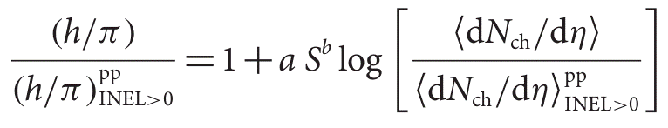
The strange hadron hierarchy in pp and p-Pb collisions
(DOI:10.1038/NPHYS/4111)
S is the number of strange or anti-strange valence quarks
a and b are free parameters:
a = 0.083 ± 0.006,
b=1.67±0.09
No enhancement with the <dN_{ch}/dη> is observed for particles without no strangeness
Enhancement with the <dN_{ch}/dη> depends on strange quark content
Notes:
Parent Group: Physics Working Group PWG-LF: Light Flavour Spectra
The yields of strange (${\rm K}^{0}_{S}$, $\Lambda$, $\overline{\Lambda}$) and multi-strange ($\Xi^{-}$, $\overline{\Xi}^{+}$, $\Omega^{-}$, $\overline{\Omega}^{+}$) hadrons are measured at midrapidity in proton-proton (pp) collisions at $\sqrt{s}$~=~7 TeV as a function of the charged-particle multiplicity density (${\rm d}N_{\rm ch}/{\rm d}\eta$). The production rate of strange particles increases faster than that of non-strange hadrons, leading to an enhancement of strange particles relative to pions, similar to that found in nucleus-nucleus collisions as well as in proton-nucleus collisions at the LHC. This is the first observation of an enhanced production of strange particles in high-multiplicity pp collisions. The magnitude of this strangeness enhancement increases with the event activity, quantified by ${\rm d}N_{\rm ch}/{\rm d}\eta$, and with hadron strangeness. It reaches almost a factor of two for the $\Omega$ at the highest multiplicity presented. No enhancement is observed for particles with no strange quark content, demonstrating that the observed effect is strangeness rather than mass related. The results are not reproduced by any of the Monte Carlo models commonly used at the LHC, suggesting that further developments are needed for a complete microscopic understanding of strangeness production and indicating the presence of a phenomenon novel in high-multiplicity pp collisions.

Slide 17
Mass dependence of particle ratios?
DOI:10.1038/NPHYS/4111
Data shows practically no changes with multiplicity for proton/pion ratio
None of the MC models can describe all particle ratios simultaneously.
For example DIPSY [1] fails in describing p/π ratio in its original formulation, but qualitatively describes Λ/K⁰_{s}
EPOS[2] that uses Core/Corona model-- is OK for p/π ratio , PYTHIA8 [3] fails completely
[1] C.Bierlich, G.Gustafson, L.Lonnblad, A.Tarasov, https://inspirehep.net/record/1335149 (2015);
Bierlich, C. & Christiansen, J. R. Phys. Rev. D 92, 094010 (2015);
[2] Pierog,et al.,Phys. Rev. C 92, 034906 (2015).
[3] Sjöstrand, T., Mrenna, S. & Skands, P. Z. Comput. Phys. Commun. 178, 852–867 (2008).
Notes:
Figure 3 shows that the yield ratios ⇤/KS0 = (⇤ + ⇤)/2KS0 and p/⇡ = (p + p)/(⇡ + + ⇡ ) do not change significantly with multi- plicity, demonstrating that the observed enhanced production rates of strange hadrons with respect to pions is not due to the dierence in the hadron masses.

Slide 18
Hyperon-to-pion ratios as a function of <N_{part}>, for A-A and pp collisions at LHC and RHIC energies.
General smooth increase of ratio with system size (centrality)
Flattening after <N_{part}>~150
Ratios are similar at RHIC and LHC
Increase in h/π ratios with energy is noticeable for pp collisions
Lines – predictions of thermal statistical models based on a grand canonical approach [1],[2]
[1] A. Andronic , P. Braun-Munzinger J. Stachel Phys. Lett. B 673 (2009), p. 142
[2] J. Cleymans, I. Kraus, H. Oeschler, K. Redlich, S.Wheaton, Phys. Rev. C,74 (2006) 03490
Phys. Lett. B 728 (2014) 216-227
170 MeV
164 MeV
Notes:
Hyperon-to-pion ratios as a function of <Npart>, for A-A and pp collisions at LHC and RHIC energies.
The lines mark the thermal model predictions for T=164 MeV (full line) and T=170 MeV (dashed line).
Also shown are the predictions for the hyperon-to-pion ratios at the LHC from the thermal models, based on a grand canonical approach, described in [55] (full line, with a chemical freeze-out temperature parameter T = 164 MeV) and [56] (dashed line, with T = 170 MeV).

Slide 19
Some theoretical approaches: string fusion in DIPSY[1]
DOI:10.1038/NPHYS/4111
Data are bringing new constraints and new questions to the models
DIPSY:
Strings close in space
can fuse to form “the colour ropes”
New type of particle emitting sources
-- strings with higher tension
Increased production of strange particles
and baryons
Pre-Equilibrium Phase for QGP formation - ?
A reminiscent of a thermal system - ?
[1] C.Bierlich, J. R.Christiansen, Effects of Colour Reconnection on Hadron Flavour Observables, arxiv:1507.02091; Christian Bierlich et al., arXiv:1412.6259
[2] String fusion model: M.Braun,C.Pajares, Phys. Lett. B 287, (1992) 154-158
Notes:
Illustration of strings from a pp event at √s = 7 TeV in (⃗b⊥, Y )-space before hadroniza- tion. Notice that the string radius is set at 0.1 fm – an order of magnitude less than in the calculation – in order to improve readability of the figure.

Slide 20
Some theoretical approaches:
Multi-Pomeron Exchange Model with string fusion[1]
Schwinger mechanism of production of particles species of type ν production mass m_{ν}, momentum p_{t} and spin - S_{ν},
Here,
n - number of Pomerons,
t- string tension,
β – model collective parameter
Large set of hadron resonances with cascade decays
The model qualitatively describes the data
[1]G.Feofilov,V.Kovalenko, A.Puchkov
arxiv: 1710.08895 [hep-ph](2017)
DOI:10.1038/NPHYS/4111
.

Slide 21
Some theoretical approaches:
Multi-Pomeron Exchange Model with string fusion[1]
DOI:10.1038/NPHYS/4111
[1] G.Feofilov,V.Kovalenkro, A.Puchkov
arxiv: 1710.08895 [hep-ph](2017)
The model qualitatively describes the data
.

Slide 22
Λ_{c}⁺/D⁰ ratio compared to Λ/K⁰_{S} and p/π ratios
(pp collisions at 7 TeV and p-Pb at 5.02 TeV)
New results: The baryon-to-meson ratios Λ⁺_{c} /D⁰ were measured in pp and
p–Pb collisions
Ratios are obtained and compared for the same systems
Ratios are compatible within their statistical and systematic uncertainties.
Charm and light flavour sectors show similar results
The input for theoretical pQCD models
Test for different hadronization approaches

Slide 23
  Flow of different particles
.

Slide 24
Flow in hadron collisions
Anisotropy in spatial space in A-A collision is converted
to the momentum anisotropy
This motivated the fluid-like collectivity approach
Fourier transform of azimuthal momentum distribution
with anisotropic flow coefficients v_{n}
v_{n} -- Fourier coefficients
ϕ – azimuthal angle
Ψ_{n} -- Event plane angle of the n-th harmonics

Slide 25
Elliptic flow of identified hadrons in p-Pb
arXiv:1807.04538 [nucl-ex]
∆η gap is introduced between the correlated particles to eliminate short-range contribution
Non-flow subtracted using pp measurements
For p_{T} ≤ 2.5 GeV/c, a clear mass ordering of v₂(pT) for p-Pb collisions is observed similar to the previous results for Pb-Pb
Aproximate NCQ and KE_{T} scaling is observed NCQ -number of constituent quarks n_{q}
An indication on the presence of collective behavior on the partonic level
Grigory Feofilov (for ALICE Collaboration),
XXIVth International Baldin Seminar ,
JINR, Dubna, September 17-22, 2018
Notes:
Elliptic flow of identified hadrons in small collisional systems measured with ALICE arXiv:1807.04538 [nucl-ex]
mass ordering of v2(pT) is observed, which is an indication of strong radial expansion with common velocity pushing heavier particles towards higher momenta.

Slide 26
Elliptic flow and multi-particle correlations for different systems
Investigation of anisotropic flow using multi-particle correlations
in pp, p-Pb, Xe-Xe and Pb-Pb collisions
New results:
system size dependence of v₂{m}
on multiplicity of charged particles is measured
Collective behavior is observed
in multi-particle cumulants
even in the smallest pp and p-Pb systems.
Multi-particle cumulants suppress two-particle (non-flow) correlations
Grigory Feofilov (for ALICE Collaboration),
XXIVth International Baldin Seminar ,
JINR, Dubna, September 17-22, 2018
Notes:
Multiplicity dependence of $v_2\{4\}$, $v_2\{6\}$ and $v_2\{8\}$ with standard, 2-subevent or 3-subevent method in 13 TeV pp, 5.02 TeV p-Pb, 5.44 TeV Xe-Xe and 5.02 TeV Pb-Pb collisions.
Multi-particle cumulants in pp, pPb, Xe-Xe and Pb-Pb

Slide 27
Elliptic flow of D⁰, D⁺, D^{∗+} and D⁺_{s} in Pb-Pb collisions
Phys. Rev. Lett. 120, 102301 (2018)
D-meson v₂ is similar to that of pions
Theoretical calculations include:
a hydrodynamical model for the QGP expansion
hadronization via quark recombination, + independent fragmentation (except BAMPS)
The BAMPS-el, POWLANG and TAMU
-- include only elastic interactions
BAMPS-el+rad, LBT, MC@sHQ and PHSD
--- include energy loss via gluon radiation
Low-momentum charm quarks take part in the collective motion of the QGP
Both collisional interaction processes and recombination of charm and light quarks contribute to the observed v₂
Grigory Feofilov (for ALICE Collaboration),
XXIVth International Baldin Seminar ,
JINR, Dubna, September 17-22, 2018
Notes:
Phys. Rev. Lett. 120, 102301 (2018)
arXiv:1707.01005
Elliptic flow of identified hadrons in small collisional systems measured with ALICE arXiv:1807.04538 [nucl-ex]
Measurement of azimuthal correlations of D mesons and charged particles in pp collisions at s√=7
TeV and p-Pb collisions at sNN‾‾‾‾√=5.02
TeV
http://dx.doi.org/10.1140/epjc/s10052-017-4779-8
http://arxiv.org/abs/1605.06963
arXiv:1707.01005
Figure 2: Average of D0, D+ and D∗+ v2 as a function of pT at √sNN = 5.02 TeV, compared with the same measurementat√sNN =2.76TeV[34]andtotheπ± v2 measuredwiththeEPmethod[63,64]andwiththescalar production (SP) method [65].
Figure 3: Average of D0, D+ and D∗+ v2 as a function of pT, compared with model calculations [39,43–47].
Phys.Rev.Lett.111(10):102301 (2013)

Slide 28
Elliptic flow of heavy-flavour decay electrons and flow of D⁰ in p-Pb collisions
ALICE Preliminary, p-Pb,√s_{NN} = 5.02 TeV.
Positive v₂ (5 sigma significance)
Right: v₂ of prompt D0 in p-Pb Collisions
at √s_{NN} = 8.16 TeV,
as measured by CMS (see arXiv://1807.04362)
CMS, arXiv://1807.04362
v₂ for D0 are smaller then for the strange hadrons
NCQ and KE_{T} scaling is not followed by D0 in p-Pb - ?
A weaker coupling of charm quarks to small systems -?
Grigory Feofilov (for ALICE Collaboration),
XXIVth International Baldin Seminar ,
JINR, Dubna, September 17-22, 2018
Notes:
Elliptic flow of identified hadrons in small collisional systems measured with ALICE arXiv:1807.04538 [nucl-ex]
Measurement of azimuthal correlations of D mesons and charged particles in pp collisions at s√=7
TeV and p-Pb collisions at sNN‾‾‾‾√=5.02
TeV
D⁰ elliptic flow in p-Pb collisions may be used to study the strength of charm quarks coupling to small systems which demonstrate hydrodynamic properties.
http://dx.doi.org/10.1140/epjc/s10052-017-4779-8
http://arxiv.org/abs/1605.06963
arXiv:1707.01005
Figure 2: Average of D0, D+ and D∗+ v2 as a function of pT at √sNN = 5.02 TeV, compared with the same measurementat√sNN =2.76TeV[34]andtotheπ± v2 measuredwiththeEPmethod[63,64]andwiththescalar production (SP) method [65].
Figure 3: Average of D0, D+ and D∗+ v2 as a function of pT, compared with model calculations [39,43–47].
Phys.Rev.Lett.111(10):102301 (2013)

Slide 29
  Production of light nuclei in Pb–Pb collisions at √s_{NN} = 2.76 TeV.
  Exotic states of some hypernuclei
.

Slide 30
Precision measurement of the mass difference between light nuclei and anti-nuclei
Nature Phys. 11 (2015) 811.
anti-²D
anti-⁴He
Loosely bound states such as the deuteron and hypertriton and their anti-particles have been observedin Pb–Pb collisions
at a centre-of-mass energy
per nucleon pair of 2.76 TeV.
Direct measurement
confirm CPT invariance
in systems bound by nuclear forces.
The values of the mass- over-charge and binding energy are identical for nuclei and anti-nuclei
The yields of nuclei and of the hypertriton are quantitatively reproduced within a thermal model calculations
Notes:
Fig. 3: The ALICE measurements for d-d and 3He-3He mass-over-charge ratio differences compared with CPT invariance expectation (dotted lines) and existing mass measurements MAS65[26], DOR65[27] and ANT71[28] (left panel). The inset shows the ALICE results on a finer ∆(m/z)/(m/z) scale. The right panel shows our deter- mination of the binding energy differences compared with direct measurements from DEN71[29] and KES99[30]. Error bars represent the sum in quadrature of the statistical and systematic uncertainties (standard deviations).
in Pb–Pb collisions at a centre-of-mass energy per nucleon pair of 2.76 TeV.

Slide 31
Production of ⁴He and anti-⁴He
in Pb–Pb collisions at √s_{NN} = 2.76 TeV
Nucl. Phys. A 971 (2018) 1-20
Velocity β as a function of the rigidity p/z.
Phys. Lett. B 752 (2016) 267–277
Yields agree with the thermal model
Decrease by roughly a factor 300 per extra baryon
The yield of exotic Λ􏰌n and Λ􏰌Λ􏰌 should be also predicted by thermal model and with a high yield (?)
…see the experimental data →
Λ􏰀Λ ~ uuddss
ALICE results do not support the existence of the H-dibaryon and the ∧􏰌n bound state.
Notes:
Fig. 1: Velocity β measured with the TOF detector as a function of the rigidity p/z. For this figure a selection band of -1.5 to 3σ around the mean of the TPC specific energy-loss distribution is required. Negatively (positively) charged particles are shown on the left (right) side, with positive tracks in blue and negative tracks in green. The dashed vertical line represents the cut on the rigidity p/z = 2 GeV/c (applied only for positively charged particles). The insert shows the m2/z2 distributions obtained from the data points shown in the main figure. For details, see text. Nucl. Phys. A 971 (2018) 1-20

Slide 32
(anti-)deuteron production in pp, p-Pb and Pb-Pb
The coalescence parameter B_{A}:
Deuteron coalescence parameter B₂
as function of p_{T}/A in Pb-Pb
-- anti-²D
d/p ratio as a function of the charged particle multiplicity in different collision systems (pp, p-Pb and Pb-Pb) at different energies is in qualitative agreement with the expectation from the coalescence model
(anti-)deuteron formation mechanism is not fully understood
Grigory Feofilov (for ALICE Collaboration),
XXIVth International Baldin Seminar ,
JINR, Dubna, September 17-22, 2018
Notes:
Anti-)deuteron production as a function of charged particle multiplicity in pp collisions at $\sqrt{s}$ = 13 TeV [QM18]
production mechanism of light (anti-)nuclei in ultra-relativistic collisions, which is an open question in high-energy physics.

Slide 33
Future studies of rare processes in Run 3
.

Slide 34

Future: LHC Schedule and upgrades
PHASE I Upgrade
ALICE, LHCb major upgrade
ATLAS, CMS ‚minor‘ upgrade
Heavy Ion Luminosity from 10²⁷ to 7 x10²⁷
PHASE II Upgrade
ATLAS, CMS major upgrade
HL-LHC, pp luminosity
from 10³⁴ (peak) to 5 x10³⁴ (levelled)

Slide 35
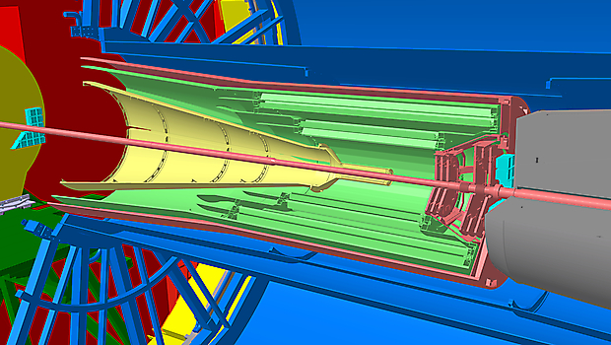
Upgrade of the ALICE
Inner Tracking System for RUN3
  New, high-resolution, low-material ITS
Production of heavy flavours and study of early stages of heavy-ion collisions
Probe for study thermalization of QGP
Understanding of charmonium production

Slide 36


Slide 37
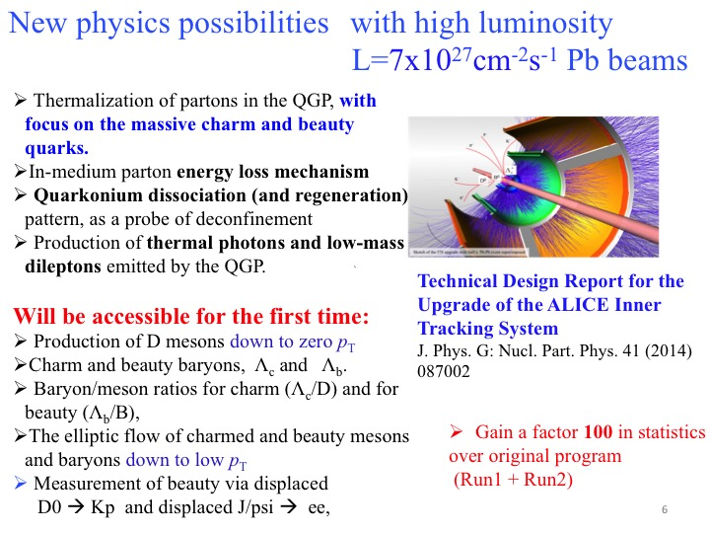
.
.
Acces to the larger hyper-nuclei (which have a larger radius and can be used to further probe the baryon formation mechanism )
Notes:
the large event sample also gives acces to the larger hyper-nuclei (which have a larger radius and can be used to further probe the baryon formation mechanism

Slide 38
Summary
The main observations in multi-particle production in hadron collisions:
Mass dependent hardening of particle spectra with centrality.
Enhanced production rates of strange hadrons with respect to pions.
Smooth behavior of particle ratios vs. <dN_{ch}/dη> regardless of colliding system and energy.
Indications for collectivity effects in small systems similar to nucleus-nucleus collisions
Measurements of strange and multi-strange baryon production confirm the strangeness enhancements in heavy-ion collisions at the LHC with respect to the smaller systems.
However, the microscopic origin of enhanced strangeness production and collectivity in small systems is still not known.
Results on nuclei and hypernuclei production, measured in Pb-Pb collisions at √s_{NN} = 5.02 TeV and pp collisions at √s = 13 TeV, could be described by thermal (Pb-Pb, p-Pb) and coalescence (pp, p-Pb) models.
However, the production mechanism of light (anti-)nuclei in ultra-relativistic collisions is an open question in high-energy physics.
The ALICE upgrade preparations are well on-track for new high-precision studies after 2020.

Slide 39

Thank you!
.

Slide 40
The ALICE detector
ALICE
is optimized for
Heavy-Ion Physics:
dn/dy in Pb-Pb: up to 2000
  PID:
  p_{T} > 0.2 GeV/c
Inner Tracking System (ITS) |η|<0.9
Time Projection Chamber (TPC)|η|<0.8
TOF-- |η|<0.9, Δϕ: 45º-135º
HMPID -- |η|<0.6, Δϕ=100º,
  TRD -- |η|<0.84; MUON -- 2.5<η<4
V0 detector -- 2.8<η<5.1, -3.7<η<-1.7
Calorimeters:
PHOS – (|η|<0.12, Δϕ=100º): γ (0.5-10 GeV/c), π⁰(1-10 GeV/c) , η(2-10 GeV/c)
  EMCAL – |η|<0.7, Δϕ=107º:
  jets, γ, π⁰ (<30 GeV/c)
ZDC – the event selection
.
Notes:
TPC dE/dx as a function of momentum with superimposed Bethe-Bloch lines for various particle species for RUN2 Pb-Pb low interaction rate runs.
two neutron Zero Degree Calorimeters (ZDC) positioned at ±114 m from the interaction point are used in the offline event selection.

Slide 41
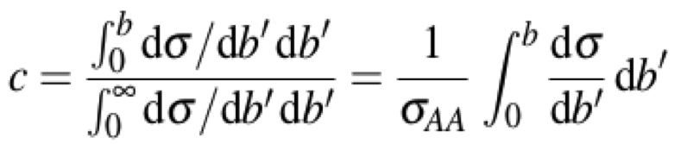
Determination of event collision centrality and the initial conditions
N_{part} – nucleons- participants
N_{part} – nucleons- participants
N_{coll} -- # of nn collisions
Impact parameter
The Glauber Monte Carlo independent emitters:
^{N}_{ancestors} ^{= f · N}_{part} ^{+ (1 − f ) · N}_{coll}
b --
Centrality
ALICE Centrality Estimators:
Multiplicity—in VO
Energy of Spectators -- in ZDC
^{ALICE-PUBLIC-2018-003}
N_{part,} N_{coll}
Notes:
ig. 1: Upper panel: Distribution of the sum of amplitudes in the V0 scintillators. The distribution is fitted with the NBD-Glauber model, shown as a line. A few centrality class examples are indicated in the figure. The inset shows a zoom of the most peripheral region. Lower panel: Ratio of the V0M data distribution by the distribution obtained from the NBD fit.
We remove from the fit the most peripheral 90-100% class

Slide 42
Λ_{c} in pp collisions at 7 TeV and p-Pb, collisions at 5.02 TeV
arXiv:1712.09581
Λ⁺_{c} /D⁰ ratio is sensitive to the c-quark hadronisation mechanism
GM-VFNS perturbative QCD calculations underpredict the measured values by a factor of 2.5.
PYTHIA with CR – in a better agreement to the data
DIPSY and HERWIG -- significantly lower values
Notes:
Fig. 9: Prompt Λ+c baryon pT-differential cross section (average among different decay modes and analyses) in pp √
collisions at s = 7 TeV in the transverse momentum interval 1 < pT < 8 GeV/c (left) and in p–Pb collisions at √sNN = 5.02 TeV in the transverse momentum interval 2 < pT < 12 GeV/c (right). The statistical uncertainties are shown as error bars and the systematic uncertainties are shown as boxes. See text for details of the procedure to average the different decay channel measurements reported in Fig. 8. Comparisons with GM-VFNS calculations [1, 2], POWHEG event generator [9] and with Lansberg and Shao predictions [94] for p–Pb (see text for details) are also shown.
The POWHEG BOX is a general computer framework for implementing NLO calculations in shower Monte Carlo programs according to the POWHEG method. It is also a library, where previously included processes are made available to the users. It can be interfaced with all modern shower Monte Carlo programs that support the Les Houches Interface for User Generated Processes.
Herwig provides significantly improved and extended physics capabilities when compared to both its predecessors, HERWIG 6 and Herwig++ 2, while keeping the key model motivations such as coherent parton showers (including angular-ordered and dipole-based evolution), the cluster hadronization model, an eikonal multiple-interaction model, highly flexible BSM capabilities and improved perturbative input using next-to-leading order QCD.
General mass Variable Flavor Number scheme (GM-VFNS).

Slide 43
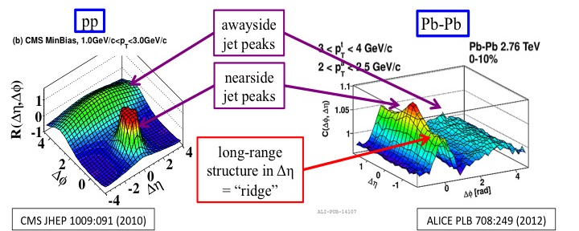
Topology of two-particle correlations in pp, p-Pb and Pb-Pb collisions
Particle momentum anisotropy in directions transverse to the beam
Fourier components Vn􏰀 ≡ ⟨cos(n􏰀φ)⟩ are extracted from the long-range azimuthal correlation functions
∆η gap may be introduced between the correlated particles to eliminate the role
of short-range contribution (e.g. in studies of flow of particles)

Slide 44
Search for weakly decaying 􏰌Λn and 􏰌􏰌 ΛΛ exotic bound states in central Pb–Pb collisions at √sNN = 2.76 TeV
Phys.Lett. B 752 (2016) 267-277
Invariant mass distributions
for dπ⁺ and for Λpπ⁻
Search for decays:
Λn → dπ⁺
H-dibaryon → 􏰌Λpπ−
H-dibaryon (􏰀􏰀Λ􏰀Λ is a hypothetical bound state of uuddss
R.L. Jaffe, “Perhaps a stable dihyperon”, Phys. Rev. Lett. 38 (1977) 195, Erratum,
Phys. Rev. Lett. 38 (1977) 617.
􏰌
Grigory Feofilov (for ALICE Collaboration),
HSQCD'2018, Gatchina, 09.08.2018
Notes:
A search is reported for the existence of loosely bound strange dibaryons 􏰌􏰌
tFig. 2. Invariant mass distribution for anti-dπ+
for Pb-Pb data (19.3x10^6 events) The arrpw = sum of the mass of constituents anti (􏰌lyambda n) of the assumed bound state. A signal for the bound state is expected
in the region below this sum. The dashed line represents an exponential fit outside the expected signal region to estimate the background.
Fig. 3. Invariant mass distribution for 􏰌pπ− for the Pb–Pb data corresponding to 19.3 × 106 central events. The left arrow indicates the sum of the masses of the constituents (􏰌􏰌) of the possible bound state. A signal for the bound state is ex- pected in the region below this sum. For the speculated resonant state a signal is expected between the 􏰌􏰌 and the 􏰎p (indicated by the right arrow) thresholds. The dashed line is an exponential fit to estimate the background.

Slide 45
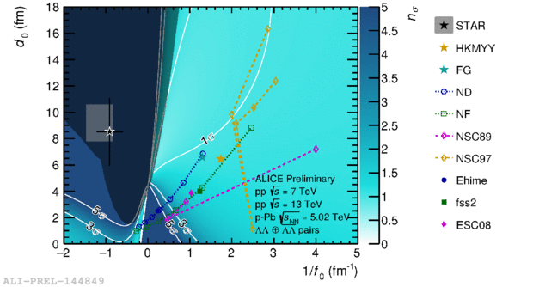
Upper limits of dN/dy for􏰌 Λn and H-dibaryon
Physics Letters B 752 (2016) 267–277
The upper limits are obtained
for different lifetimes.
The values are well below
the model predictions with realistic
assumed branching ratios and
Reasonable lifetimes
Thus, ALICE results do not support
the existence of the H-dibaryon
and the ∧􏰌n bound state.
Measurements of the baryon-baryon correlations that are also sensitive to the binding potential disfavor the ∧∧-baryon
Grigory Feofilov (for ALICE Collaboration),
HSQCD'2018, Gatchina, 09.08.2018
Notes:
Fig. 4. Upper limit of the rapidity density as function of the decay length shown for the 􏰌n bound state in the upper panel and for the H-dibaryon in the lower panel. Here a branching ratio of 64% was used for the H-dibaryon and a branching ratio of 54% for the 􏰌n bound state. The horizontal (dashed) lines indicate the expectation of the thermal model with a temperature of 156 MeV. The vertical line shows the lifetime of the free 􏰌 baryon. (For interpretation of the references to colour in this figure, the reader is referred to the web version of this article.)
Figure (Right): Number of standard deviations of the correlation function modeled using the Lednicky model for a given set of scattering parameters with respect to the data measured in pp collisions at 7 and 13 TeV and p-Pb at 5.02 TeV, together with various model calculations and measurements.

Slide 46
Talk layout
Introduction
Multi-particle production in pp, p-Pb and A-A collisions
  Indications on collectivity in small systems
  Strangeness yields in pp, p-Pb and Pb-Pb collisions
  Flow of different particles
Production of light nuclei and exotic states of some hypernuclei
Future studies of rare processes of heavy flavour formation

