Slide 1
XXIV International Baldin Seminar on High Energy Physics Problems "Relativistic Nuclear Physics and Quantum Chromodynamics

Slide 2
SYMMETRY UND KINEMATIC HIERARCHY FOR PARTICLE REACTIONS
M.P. Chavleishvili
University Dubna

Slide 3
GENERAL SPIN PARTICLE FORMALISM BASED ON SYMMETRY PROPERTIES AND SOME RESULTS FOR BINARY PROCESSES

Slide 4
Symmetry means harmony, beauty, order.

Slide 5
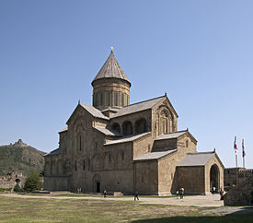

Slide 6
We consider approach in particle physics which is based on the application of the similarity laws, symmetry and other methods, not resting upon the Lagrange functions, to the construction of models starting from the first principles.

Slide 7
GENERAL SPIN PARTICLE FORMALISM BASED ON SYMMETRY PROPERTIES AND KINEMATIC HIERARCHY IN PARTICLE REACTIONS
M. P. Chavleishvili

Slide 8
We consider the general spin particle formalism based on symmetry properties, including requirements of angular momentum conservation in the t-channel. In such "a dynamic amplitude" approach obligatory kinematic factors arise in helicity amplitudes and consequently in expressions of all observable quantities.

Slide 9
FORMALISM FOR HELICITY AMPLITHDES FOR ANY MASSES AND ARBITRARY SPIN
2 PARTICLE --- 2 JETS
2PARTICLE --- N PARTICLE REACTIONS
A lot of diagrams …
Helisity approach …
Small parameters at asymptotic energies we have in two approaches …

Slide 10
We discuss pp elastic scattering at high energies and large fixed angle. This is the region of hard collisions where perturbative QCD must work. PQCD predicts "the helicity conservation" which gives a zero polarization and the value 1/3 for asymmetry parameter which are in contradiction with the experiment.

Slide 11
These spin structures give small parameters in the considered region. These parameters supress contributions of definite helicity amplitudes in observables. This "kinematic hierarchy" gives the nonzero polarisation and is closer to the esperimental value for than QCD.

Slide 12
We will consider a general binary reaction with particles
of any spin $s_{k}$ , masses $m_{k}$ and helicities $λ_{k}$
a($m_{1} , s_{1}$,$λ_{1}$) + b($m_{2} , s_{2}$,$λ_{2}$) → c($m_{3} , s_{3}$,$λ_{3}$) + d($m_{4} , s_{4}$,$λ_{4}$).
Spins of massive particles have 2s+1 projection, so
the total number of helicity (or other) amplitudes for scattering
of massive particles with definite spins is
N=(2$s_{1}$+1)(2$s_{2}$+1)(2$s_{3}$+1)(2$s_{4}$+1).

Slide 13
For particles with a zero spin the binary process is described
by one amplitude, A(s,t). This amplitude is decomposed in
polynomials of both invariant variables. For particles with nonzero spin, the process (1) can bedescribed by Jacob and Wick helicity amplitudes

Slide 14
The helicity amplitudes have clear physical meaning, the same dimensions, observables (polarization, cross sections, asymmetries, etc.) are simply expressed via them.

Slide 15
Asymmetry parameters, such as P, $A_{nn}$, $A_{ll}$ and $A_{ss}$
in terms of the helicity amplitudes have the form
̴$\frac{\sum{}C_{mn}f_{m}{f_{n}^{∗}}_{ }}{\sum{{|f_{m}|}^{2}}}$
Here m and n represent sets of helicity indices

Slide 16
These equations are quite simple,
but helicity amplitudes contain kinematic singularities and the
conservation laws are not guaranteed to fulfil (and these laws are not fulfilled automatically), thus kinematics and dynamics are not separated.

Slide 17
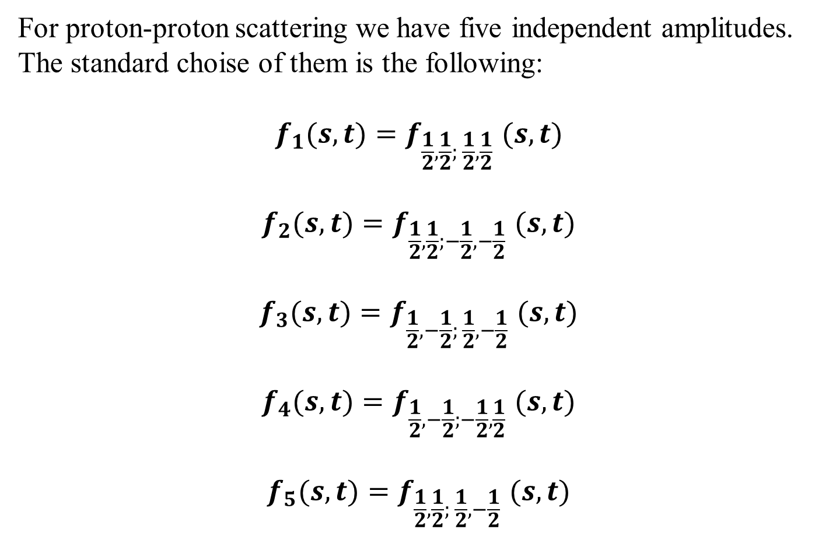
For proton-proton scattering we have five independent amplitudes.
The standard choise of them is the following:
$$f_{1}(s,t){=f}_{\frac{1}{2},\frac{1}{2}; \frac{1}{2},\frac{1}{2}}(s,t)$$
$$f_{2}(s,t){=f}_{\frac{1}{2},\frac{1}{2};−\frac{1}{2},−\frac{1}{2}}(s,t)$$
$$f_{3}(s,t){=f}_{\frac{1}{2},−\frac{1}{2}; \frac{1}{2},−\frac{1}{2}}(s,t)$$
$$f_{4}(s,t){=f}_{\frac{1}{2},−\frac{1}{2};−\frac{1}{2},\frac{1}{2}}(s,t)$$
$$f_{5}(s,t){=f}_{\frac{1}{2},\frac{1}{2}; \frac{1}{2},−\frac{1}{2}}(s,t)$$

Slide 18
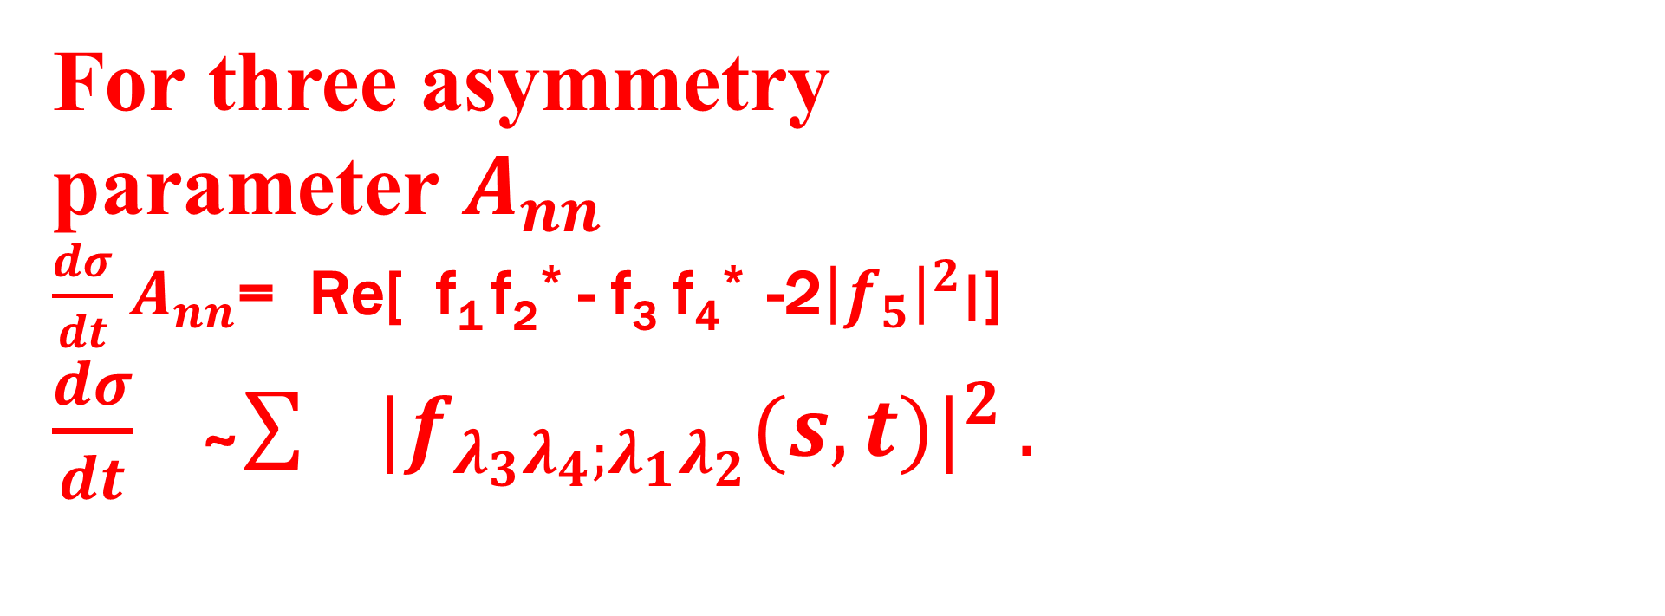
For three asymmetry
рarameter $A_{nn}$
$\frac{dσ}{dt}$ $A_{nn}$= Re[ f₁ f₂* - f₃ f₄* -2${\left|f_{5}\right|}^{2}$׀]
$\frac{dσ}{dt}$ ̴ $\sum{ {|f_{λ_{3}λ_{4};λ_{1}λ_{2}}(s,t)|}^{2}}.$

Slide 19
We can consider the problem of separating the kinematic singularities using symmetries and consequences of conservation laws.

Slide 20
Using crossing relations we can separate kinematical part from helicity amplitudes defining the Dynamic amplitudes
For any binary reactions with arbitrary masses and spins.
{It may be strange. Any physicist study definite process !!!}
For elastic scattering of equal mass spin-particles we can determine dynamic amplitudes by the following equation:

Slide 21
$$f_{λ_{3}λ_{4};λ_{1}λ_{2}}\left(s,t\right)={(\frac{\sqrt{−t}}{m})}^{[λ−µ]}{(\frac{\sqrt{s+t−4m^{2}}}{m})}^{[λ+µ]}{(\frac{s−4m^{2}}{m^{2}})}^{−2J}{(\frac{\sqrt{s}}{m})}^{K}D_{λ_{3}λ_{4};λ_{1}λ_{2}}\left(s,t\right)$$
Where K = $\frac{1−{(−1)}^{\sum{ }λ }}{2}$.

Slide 22
Kinematic hierarchy and proton-proton scattering
At high energies it was often assumed that spin effects are died out, and consequently, the helicity amplitudes do not depend on spin. However, this cannot be assumed
directly. Simplifications like that are not correct, as the obligatory kinematic conditions are not taken into account. One cannot neglect the kinematic factors or consider them to be all equal.

Slide 23
Quantum Chromodynamics

Slide 24
FUNDAMTNTAL CONTRIBUTION IN QCD …
M.Gell-Mann
H.Fritzsch
S.Brodsky …

Slide 25
QCD: ales ist in ordnung …
Only: Prodlems with Spin
“Spin crisis” Krish Effect

Slide 26
PERPURBATIVE QCD AND HARD PROTON-PROTON SCATTERING
There exists contradiction between the perturbative QCD and experiment.
This is connected with proton-proton scattering at high energies and large fixed angles. This is just the region where PQCD must work. But one can say that "the naive PQCD" has some difficulty here.

Slide 27
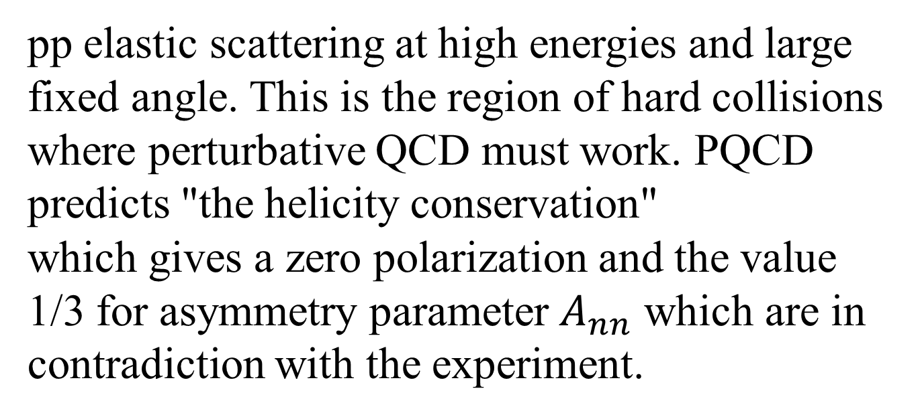
pp elastic scattering at high energies and large fixed angle. This is the region of hard collisions where perturbative QCD must work. PQCD predicts "the helicity conservation"
which gives a zero polarization and the value 1/3 for asymmetry parameter $A_{nn}$ which are in contradiction with the experiment.

Slide 28
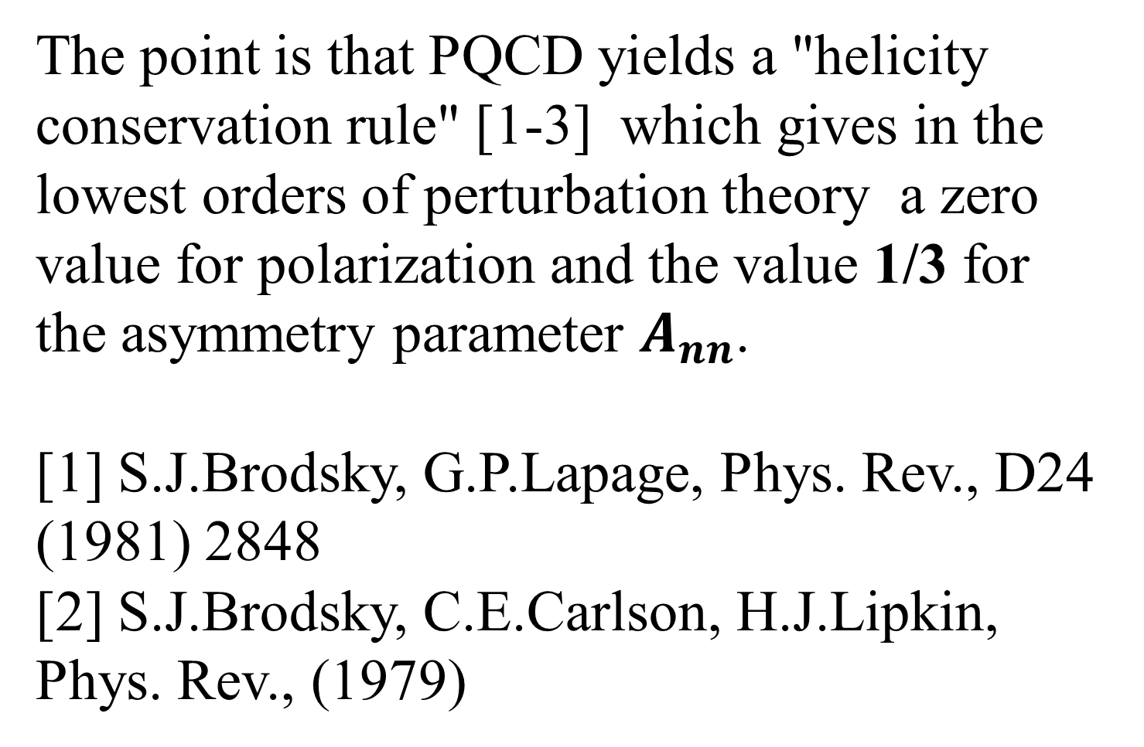
The point is that PQCD yields a "helicity conservation rule" [1-3] which gives in the lowest orders of perturbation theory a zero value for polarization and the value 1/3 for the asymmetry parameter $A_{nn}$.
[1] S.J.Brodsky, G.P.Lapage, Phys. Rev., D24 (1981) 2848
[2] S.J.Brodsky, C.E.Carlson, H.J.Lipkin, Phys. Rev., (1979)

Slide 29
A.D.Krish
Spin crisis
A(3,56) = 0,26
A(4,79) = 0,52
A(5,56) = 0,59

Slide 30
The use of perturbative QCD for this reaction is based on the
following assumptions:
--- Factorization property. The quark subprocess is separable.
--- A simple connection between quark and proton helicities.
The proton helicity is just the sum of quark helicities.

Slide 31
PUZZLE OF HIGH ENERGY PP-SCATTERING.
HELICITY CONSERVATION FROM PERTURBATIVE QCD
OR KINEMATIC HIERARCHY?

Slide 32
What is Small parameter ?

Slide 33
Small parameter in QCD
ASYMPTOTIC FREEDOM

Slide 34
In our approach obligatory kinematic factors are small parameters in the considered region. These parameters supress contributions of definite helicity amplitudes in observables. This "kinematic hierarchy" gives the nonzero polarisation and is closer to the esperimental value for $A_{nn}$ than QCD.

Slide 35
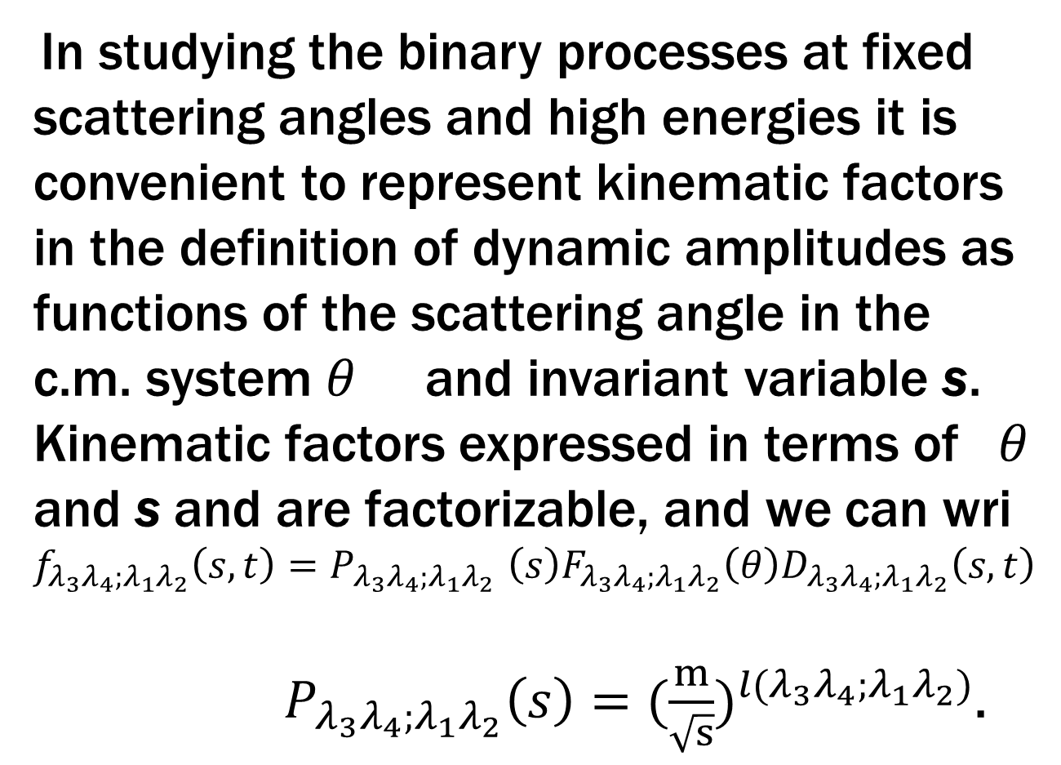
In studying the binary processes at fixed scattering angles and high energies it is convenient to represent kinematic factors in the definition of dynamic amplitudes as functions of the scattering angle in the c.m. system $θ$ and invariant variable s. Kinematic factors expressed in terms of $θ$ and s and are factorizable, and we can wri
$$f_{λ_{3}λ_{4};λ_{1}λ_{2}}\left(s,t\right){=P}_{λ_{3}λ_{4};λ_{1}λ_{2}}\left(s\right)F_{λ_{3}λ_{4};λ_{1}λ_{2}}\left(θ\right)D_{λ_{3}λ_{4};λ_{1}λ_{2}}\left(s,t\right)$$
${ P}_{λ_{3}λ_{4};λ_{1}λ_{2}}\left(s\right)=({\frac{m}{\sqrt{s}})}^{{l(λ}_{3}λ_{4};λ_{1}λ_{2})}$.

Slide 36
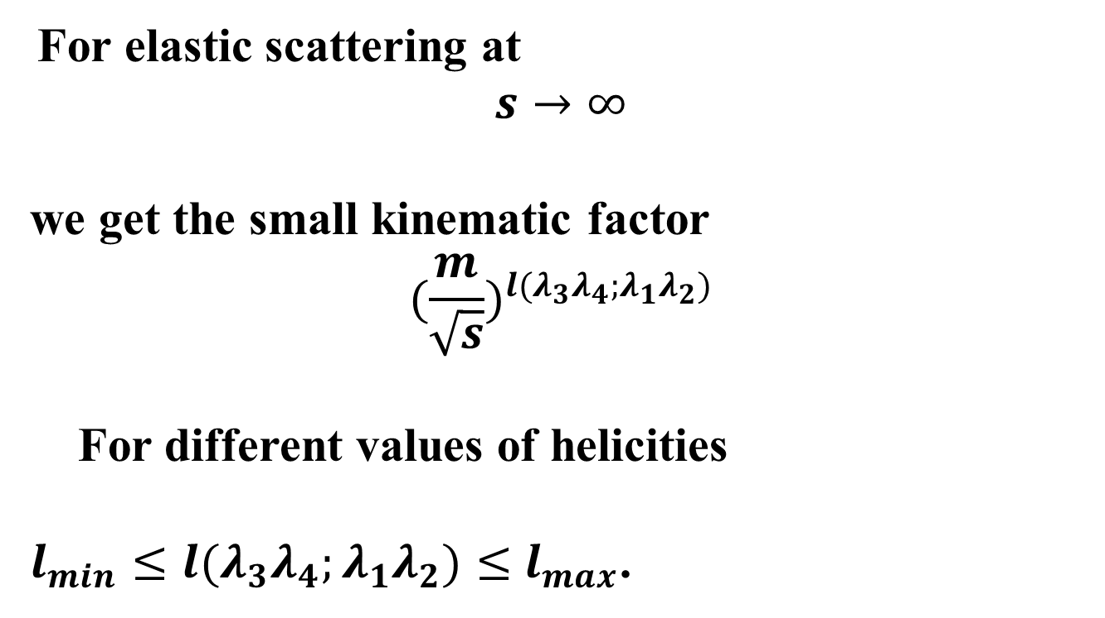
For elastic scattering at $$s→∞$$
we get the small kinematic factor
$${(\frac{m}{\sqrt{s}})}^{{l(λ}_{3}λ_{4};λ_{1}λ_{2})}$$
For different values of helicities
${l_{min}≤l(λ}_{3}λ_{4};λ_{1}λ_{2})≤$ $l_{max}$.

Slide 37
In observables, some of contributions of amplitudes are kinematically increased (such amplitudes will give leading contributions) whereas others are suppressed (and can be neglected in the first approximation).
So we have the
"kinematic hierarchy"
-- the helicity amplitudes are divided into classes giving the leading contribution, the first corrections, second correct ons, and so on.

Slide 38
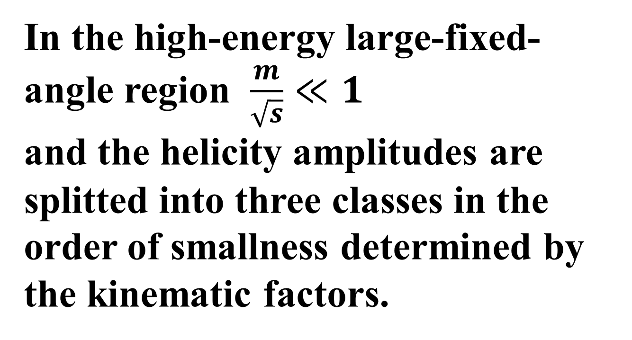
In the high-energy large-fixed-angle region $\frac{m}{\sqrt{s}}≪1$
and the helicity amplitudes are
splitted into three classes in the order of smallness determined by
the kinematic factors.

Slide 39
Taking into account the dominating amplitudes we get for asymmetrie quantity
$A_{nn}$= ${2 Ref}_{\frac{1}{2},−\frac{1}{2}; \frac{1}{2},−\frac{1}{2}}f_{\frac{1}{2},−\frac{1}{2};−\frac{1}{2},\frac{1}{2}}^{∗}$ /{${ [f_{\frac{1}{2},−\frac{1}{2}; \frac{1}{2},−\frac{1}{2}}]}^{2}+{\begin{aligned} \\ [f_{\frac{1}{2},−\frac{1}{2}; −\frac{1}{2},\frac{1}{2}}]\end{aligned}}^{2}\}$ $→$ 1.

Slide 40
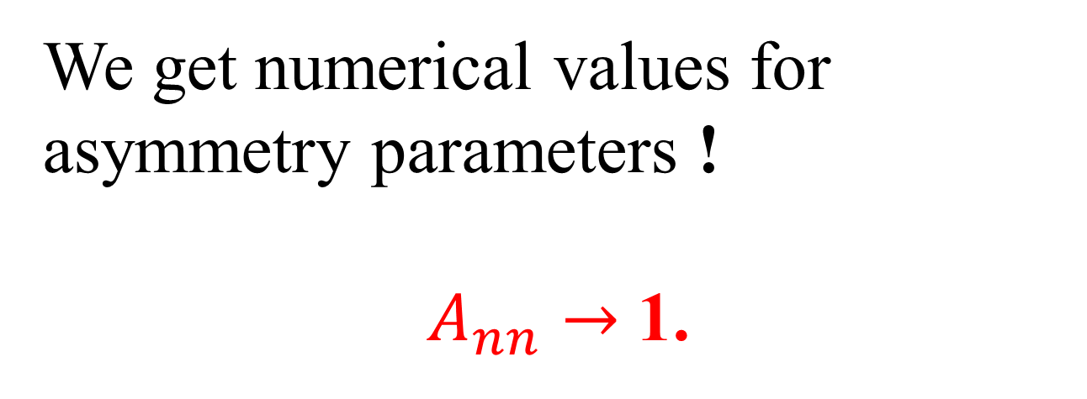
We get numerical values for asymmetry parameters !
$A_{nn}→$ 1.

Slide 41
………
THE END

