Slide 1


Liquid argon veto for the GERDA experiment
Egor Shevchik
For the GERDA collaboration

Slide 2
GERDA setup location

Slide 3
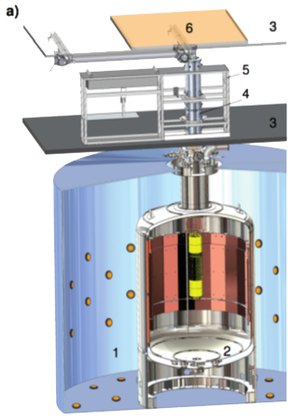
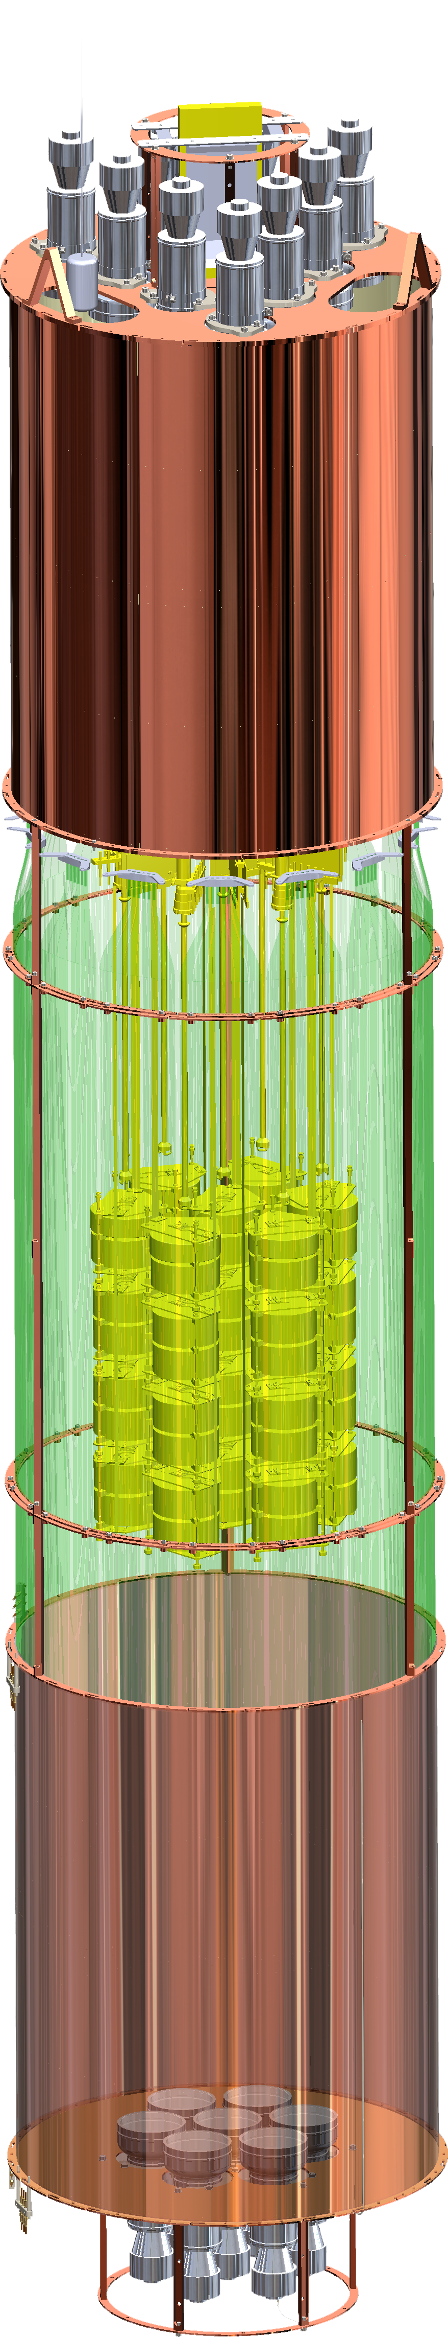
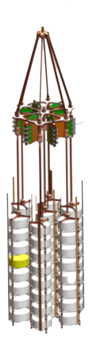
GERDA setup (Phase II)
Plastic scintillator
muon veto
LAr veto instrumentation
Low-background
PMTs
Clean room
Silicon PMs
Low background electronics
Liquid Argon
Cryostat
WLS optical fibers
Ge-detectors
Array
Ultra-pure water
muon Cherenkov veto
Low-background PMTs

Slide 4
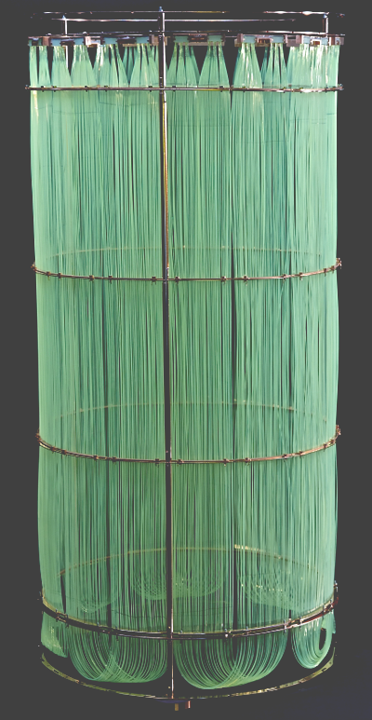
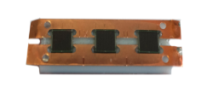

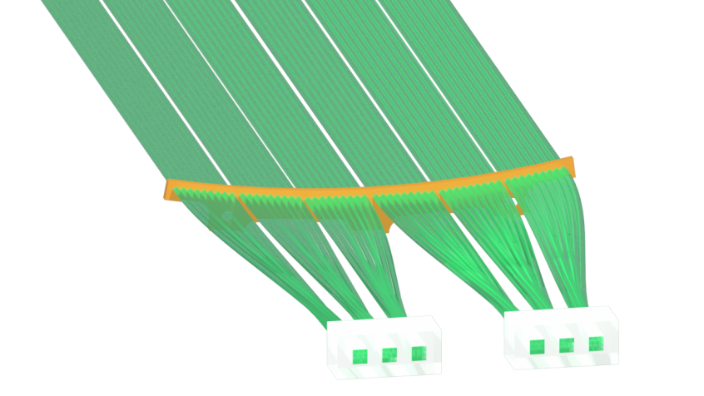
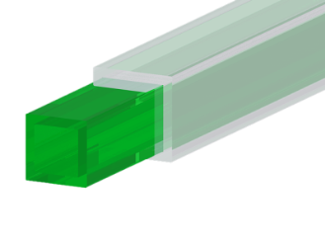
Fiber shroud (old design)
SiPM array
( 3 SiPMs per array)
Silicon PMT
KETEK
WLS optical fibers
SaintGobain BCF-91(M) 1x1 mm, with TPB coating
Fiber shroud with 6 double modules and 3 single modules
Light collection with 54 WLS optical fibers
Double module

Slide 5
Background suppression with LAr veto
● Almost pure 2νββ spectrum after LAr veto cut (600-1300 keV)
● LAr veto cut signal acceptance 97.7(1)%

Slide 6
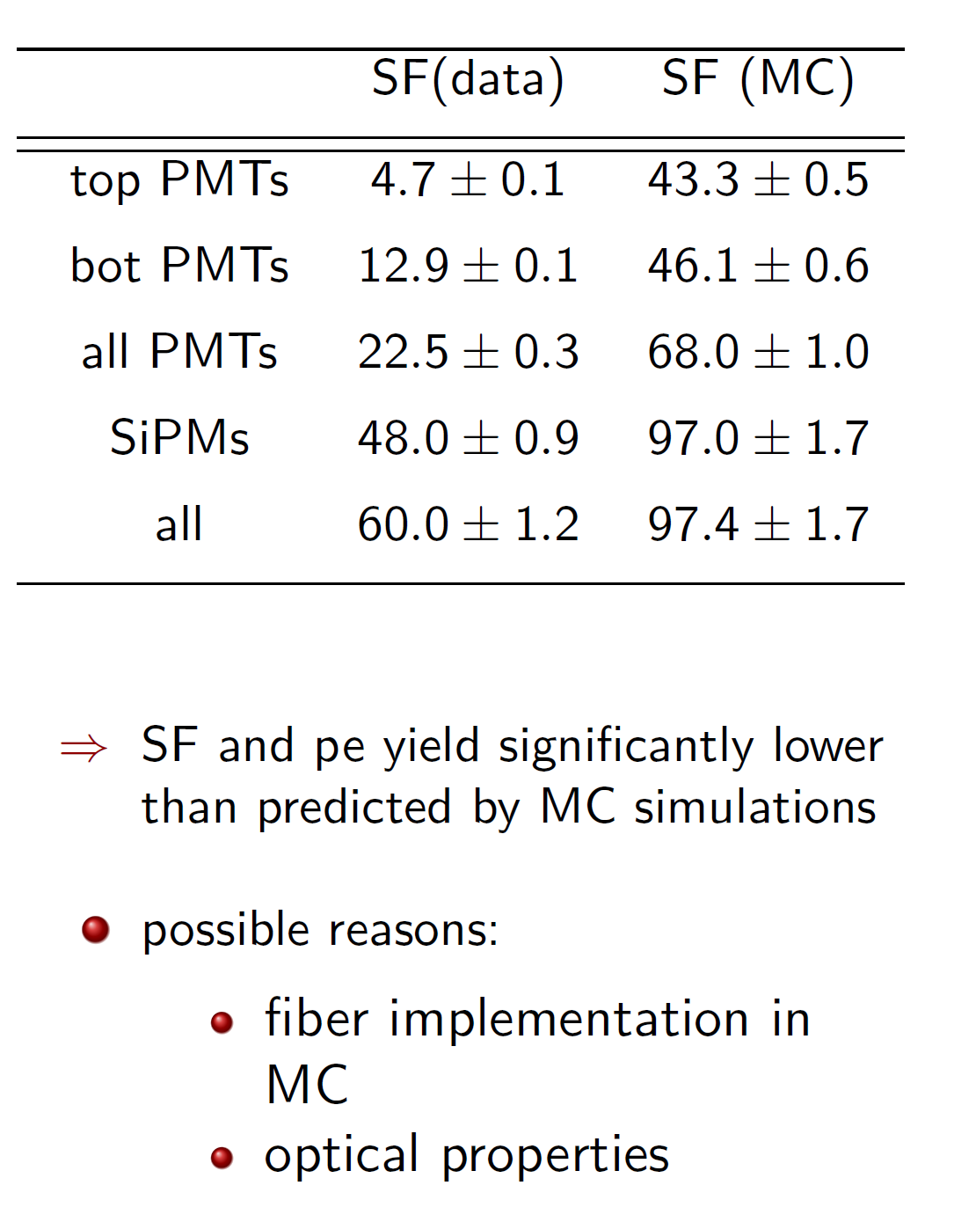
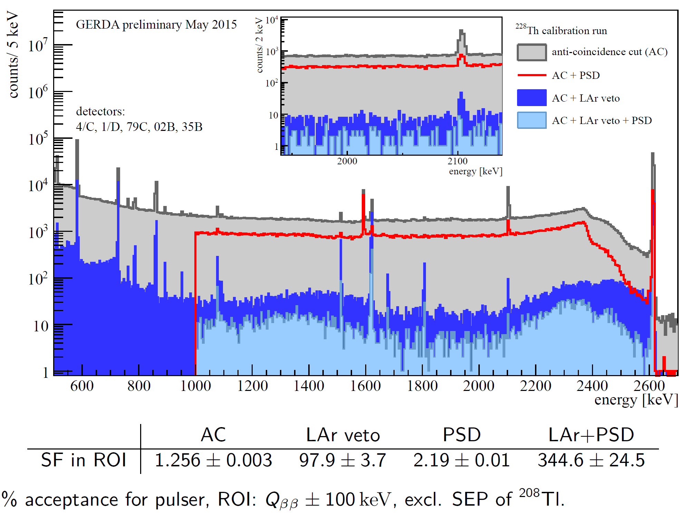
²²⁸Th calibration

Slide 7
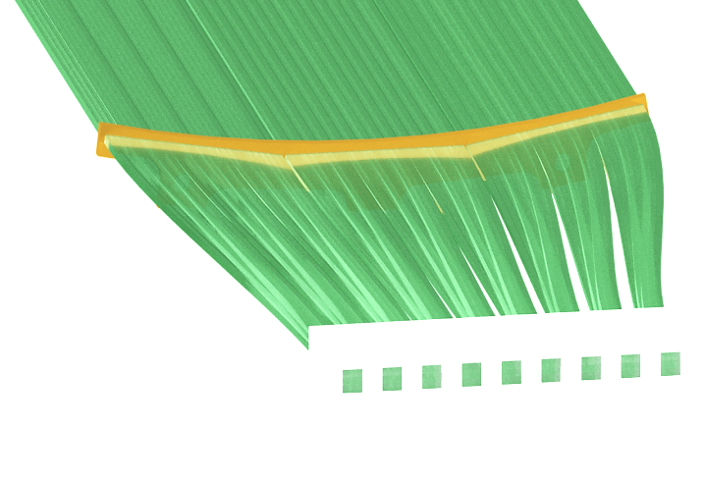
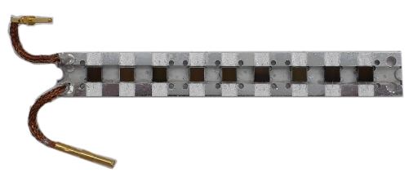
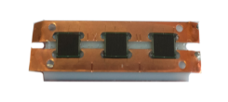
The LAr-veto modules upgrade
WLS optical fibers amount increased from 54 to 81 (per module) for better light collection
Light is collected with 9 SiPMs instead of 6
Using of synthetic quartz for SiPMs placement instead of the acrylic pieces
Copper holders with reduced mass produced with high-purity materials

Slide 8
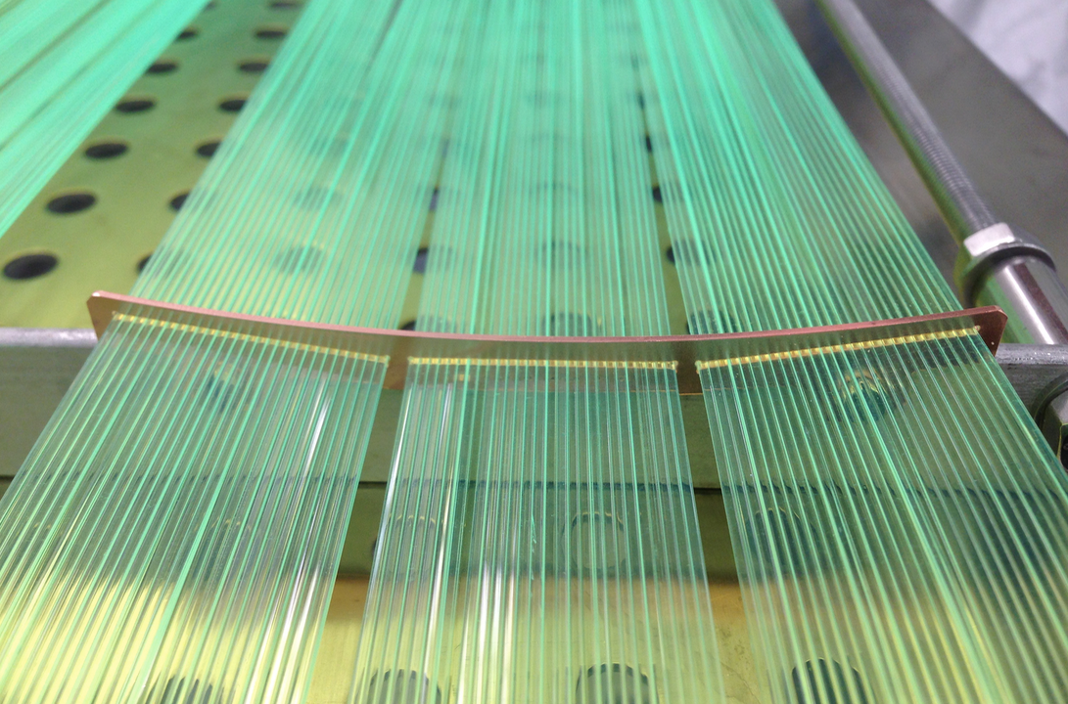
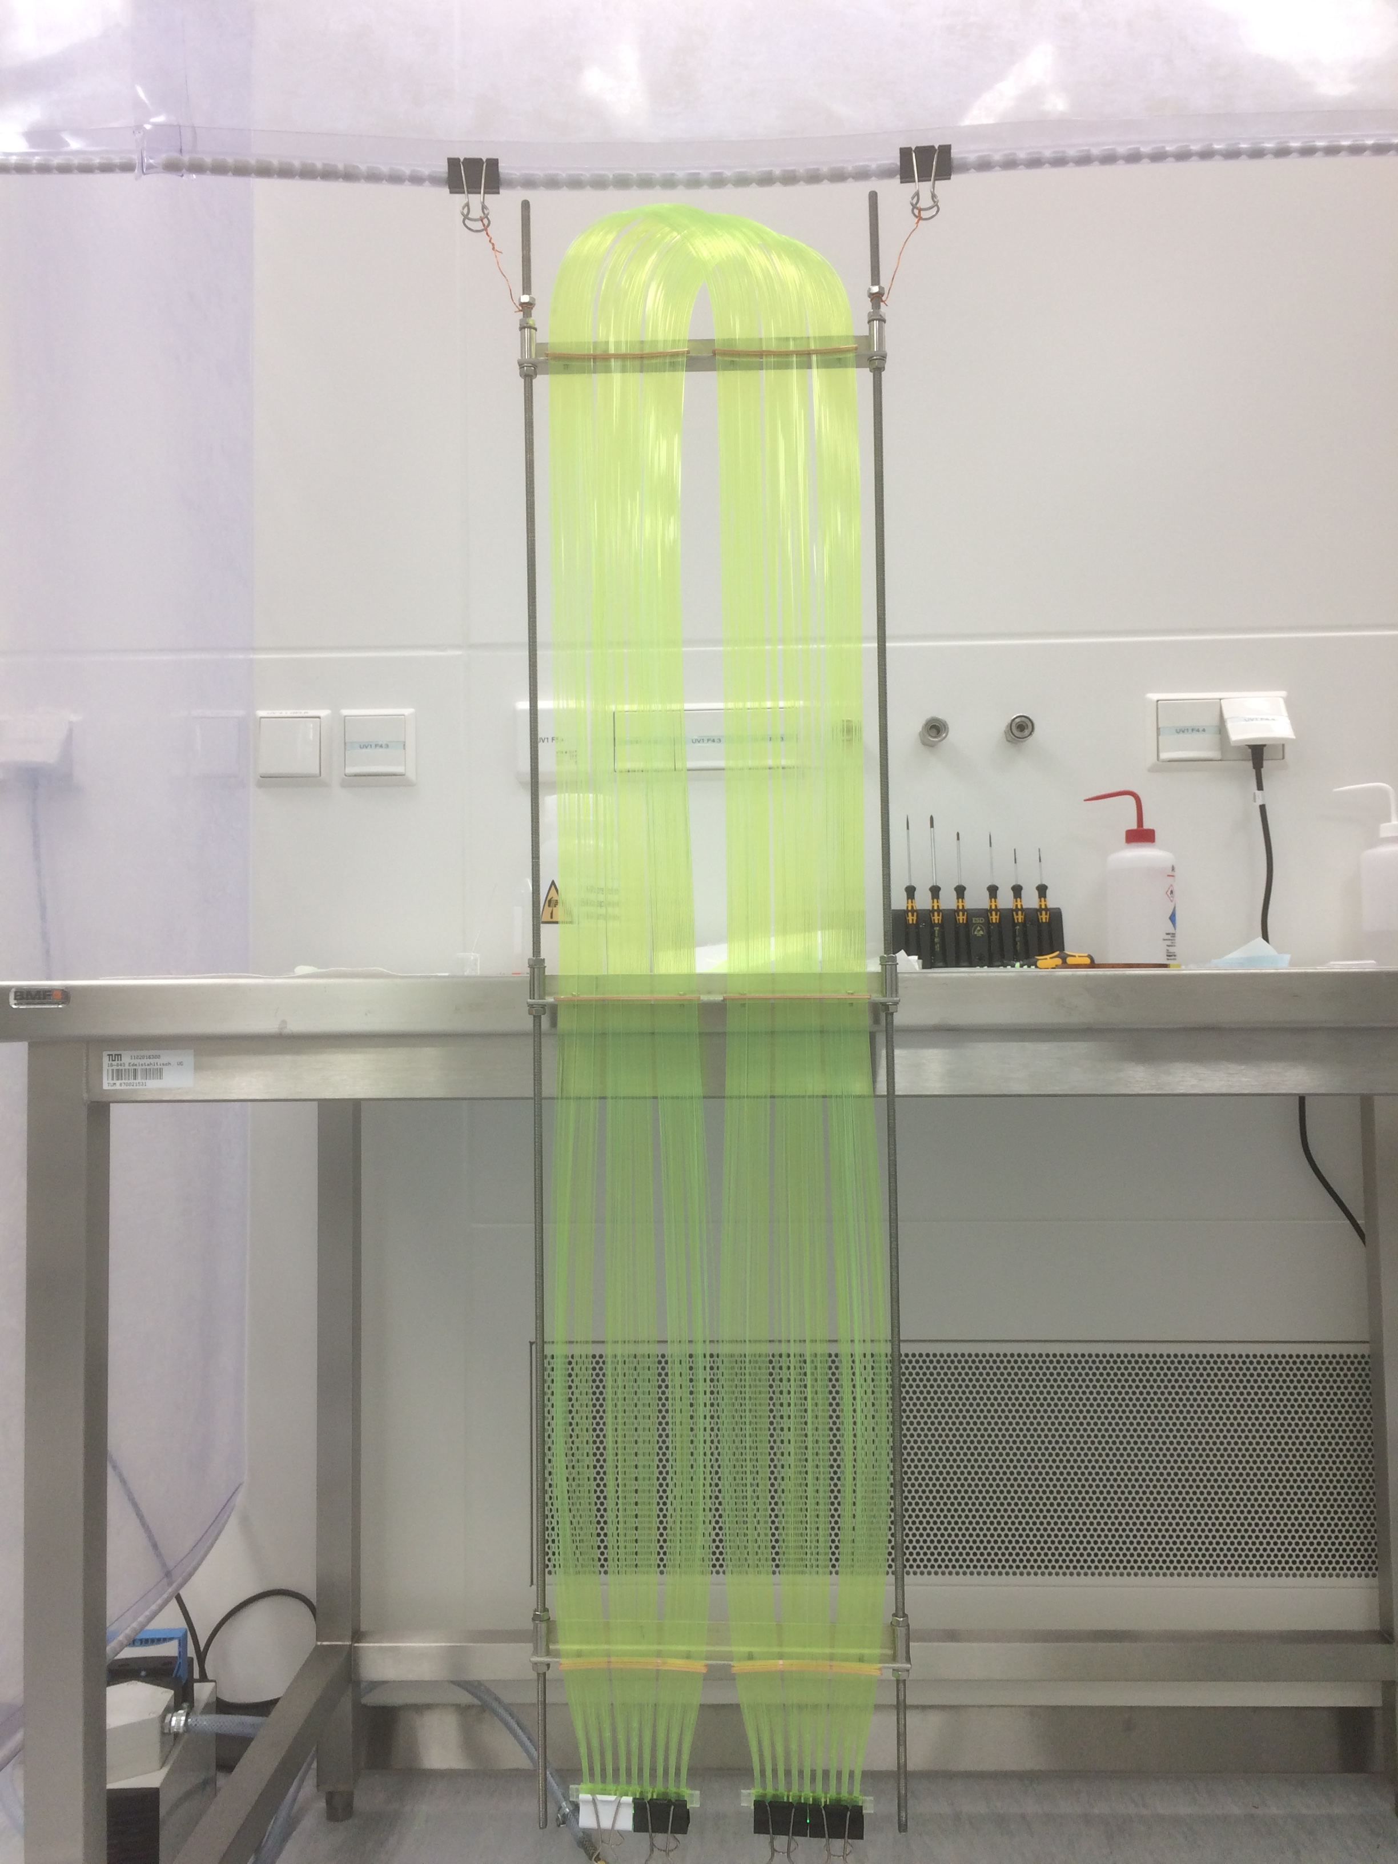
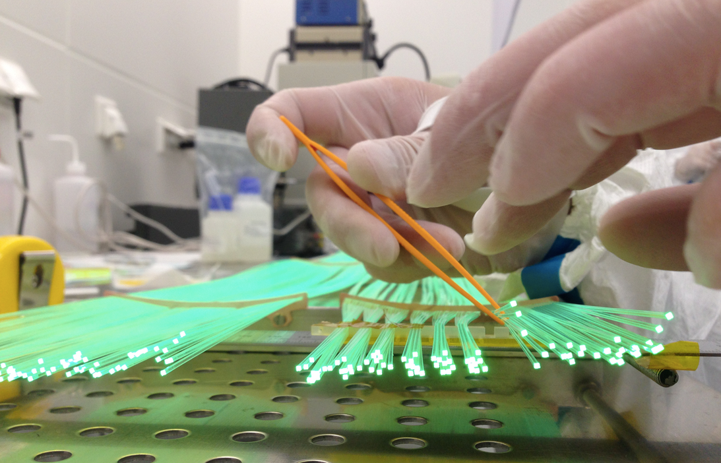
The modules assembling
Produced and installed:
9 double modules
2 single modules
Tests provided:
Etching of quartz pieces
and evaporating of aluminum layers
TPB evaporating at the WLS fibers
Electrical tests of the SiPM arrays

Slide 9
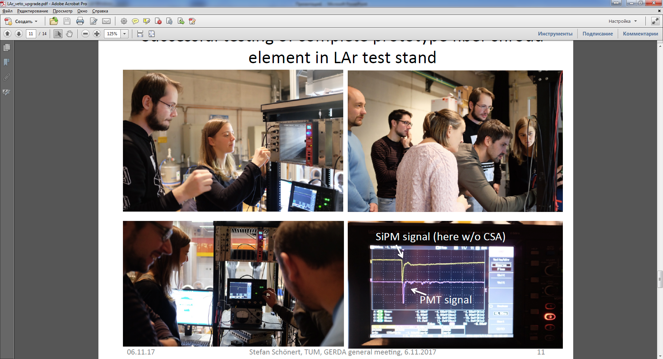
LAr-veto tests
First cryotests of the double module with 9 SiPM array and PMT R11065-20 at TUM liquid argon cryostat (Munich)

Slide 10
LAr-veto installation
Electronics coupling
Background spectra
Th-228 spectra
approx. factor 2 improvement of pe yield!
New shroud in the lock
Bottom view

Slide 11
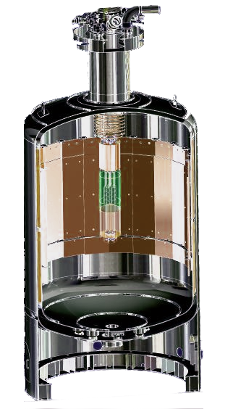
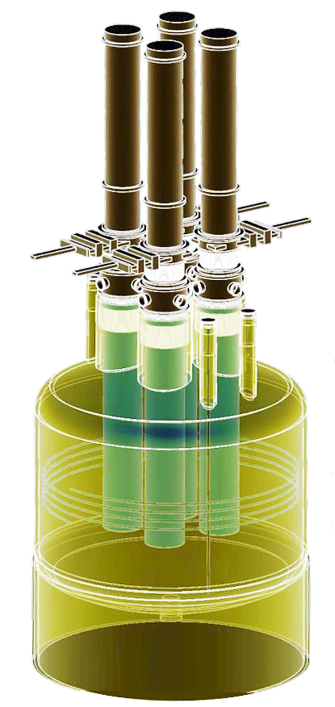
From GERDA to LEGEND
To be done:
The LEGEND collaboration aims to improve the ⁷⁶Ge half-life discovery level to 10²⁷yr (3σ) in its first phase with further improvement to 10²⁸yr in its second phase.
LEGEND (Large Enriched Germanium Experiment for Neutrinoless Double Beta Decay) – This collaboration is the combination of GERDA + Majorana + some other new groups around the globe.
LEGEND 200
First stage:
(up to) 200 kg of HPG inn upgraded GERDA experimental setup
Goal for the BI: 3-5 times better than current GERDA BI
New LAr veto shroud with better Suppression Factor
LEGEND 1000
Second stage:
1000 kg of HPGe
Location to be determined
Goal for the BI:
~30 times better
than current
GERDA BI
New improved LAr veto instrumentation design

Slide 12
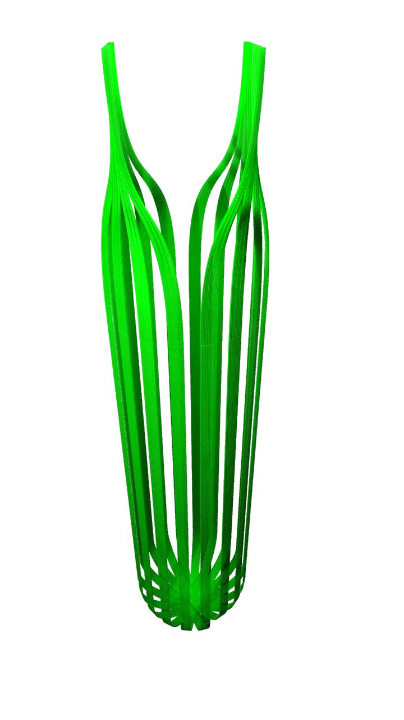
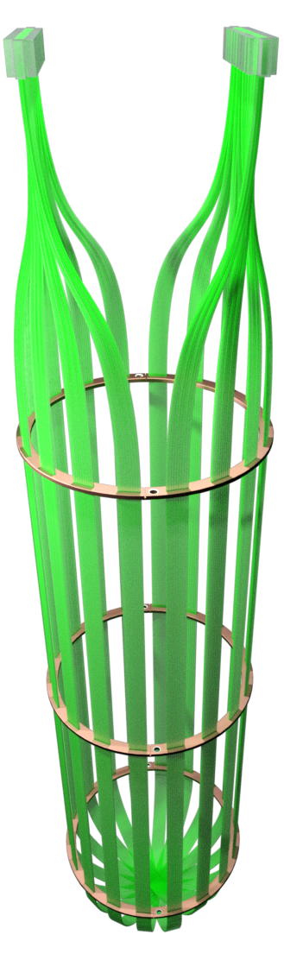
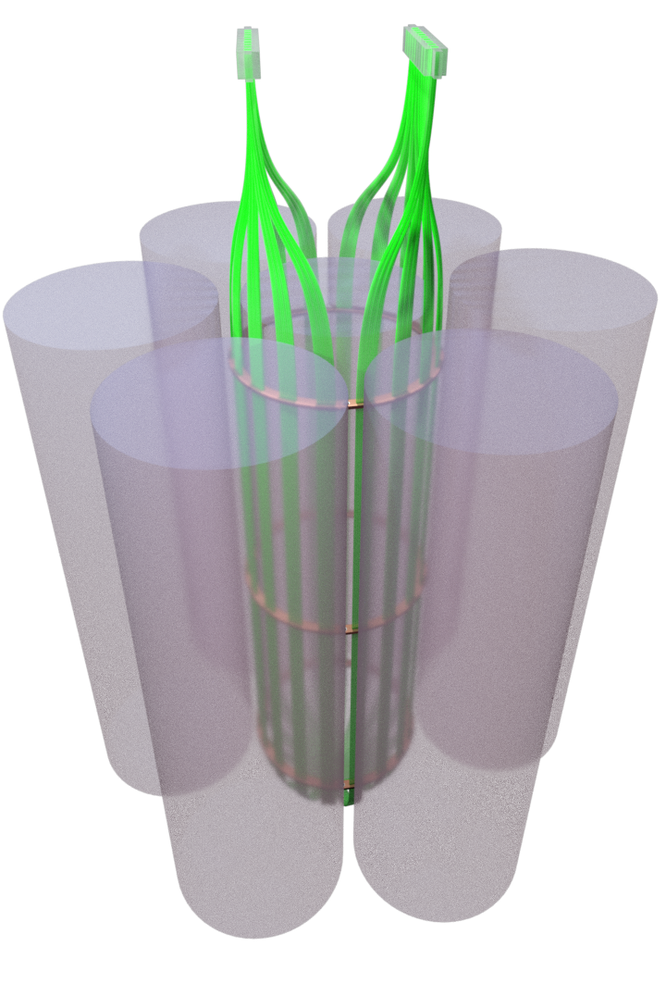
Individual shroud for the central string – first design
Motivation: Replacement of the PMT’s with high background contamination and increasing of light collection (current light collection less then 1%). The way to LEGEND LAr veto technique.

Slide 13
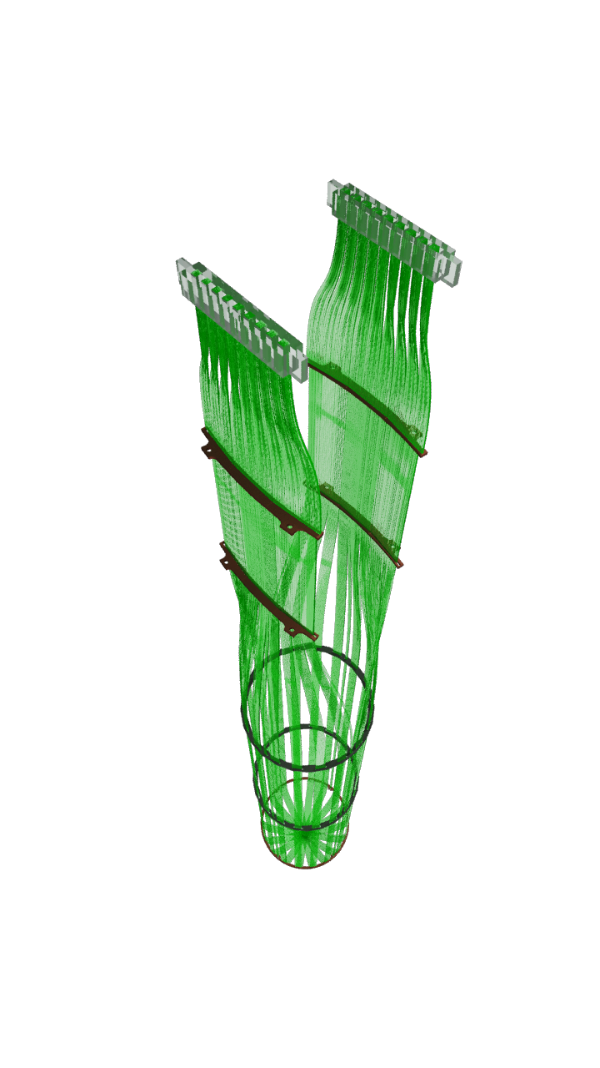
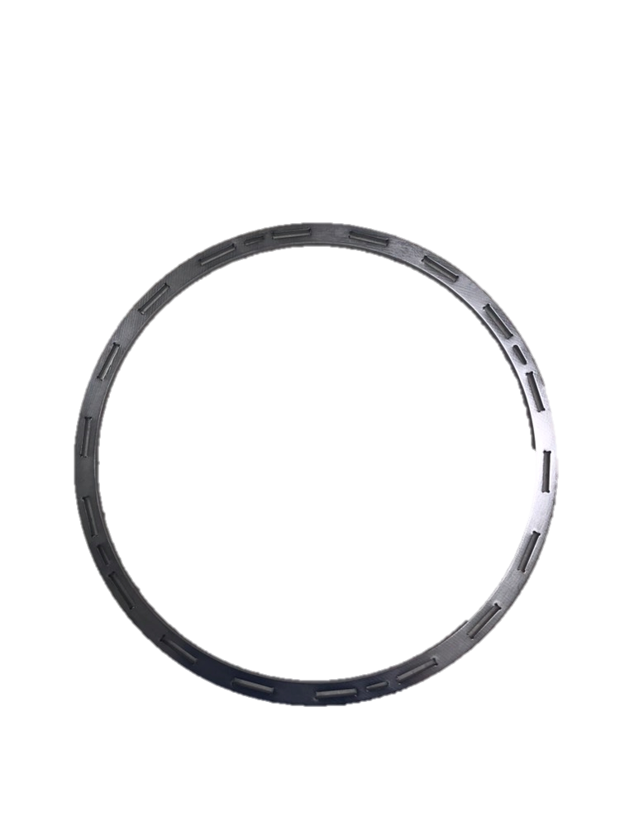
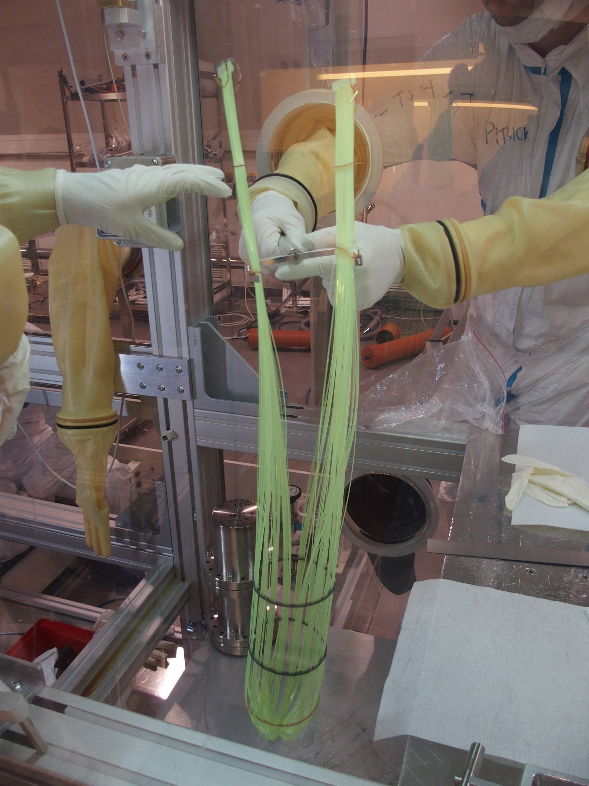
Individual shroud for the central string – final design
Silicon rings with lower background contribution instead of copper ones
Motivation: Replacement of the PMT’s with high background contamination and increasing of light collection (current light collection less then 1%). The way to LEGEND LAr veto technique.

Slide 14
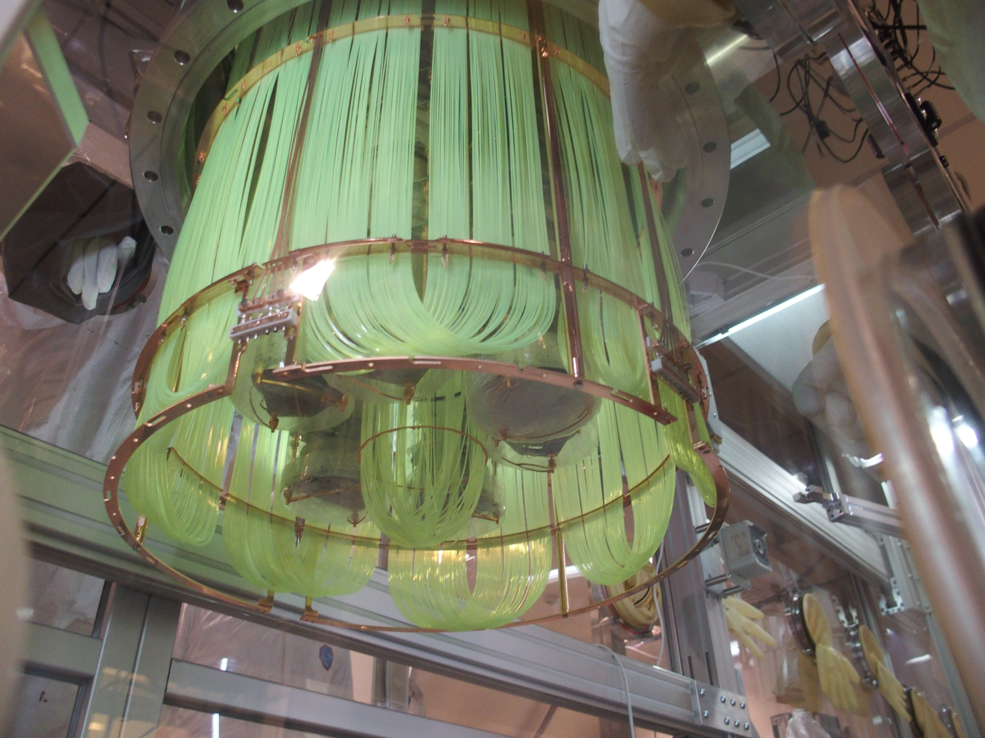
Individual shroud for the central string – installation

Slide 15
Thank you for your attention

Slide 16
Background suppression with PSD
● Both K lines and high energy α events strongly suppressed
● High 0νββ signal efficiency(71.2 ± 4.3)% for Coax and (87.6 ± 2.5)% for BEGe detectors

Slide 17
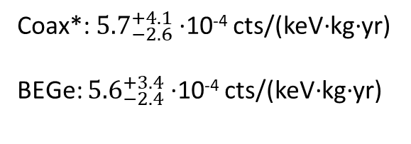
Background index
Coax*: ${5.7}_{−2.6}^{+4.1}$ ∙10⁻⁴ cts/(keV∙kg∙yr)
BEGe: ${5.6}_{−2.4}^{+3.4}$ ∙10⁻⁴ cts/(keV∙kg∙yr)
*Coax: new dataset with improved PSD BEGe: full Phase II dataset

Slide 18
Background index window: 1930-2190 keV, excl. ±5 keV around two
known γ lines and around Q_{ββ}
Coax*: ${5.7}_{−2.6}^{+4.1}$ ∙10⁻⁴ cts/(keV∙kg∙yr)
BEGe: ${5.6}_{−2.4}^{+3.4}$ ∙10⁻⁴ cts/(keV∙kg∙yr)
One new event in the BEGe dataset with energy 2042 keV

Slide 19
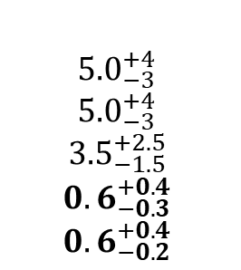
Statistical analysis
● Total exposure 82.4 kg∙yr incl. Phase I
● Combined fit of 7 datasets → flat background + gaussian signal
Dataset
Phase I golden Phase I silver Phase I BEGe Phase I extra Phase II coax-1 Phase II coax-2 Phase II BEGe
Exposure [kg∙yr]
17.9
1.3
2.4
1.9
5.0
23.1
30.8
FWHM
ε
0.57 ± 0.03 0.57 ± 0.03 0.66 ± 0.02 0.58 ± 0.04 0.52 ± 0.04 0.48 ± 0.04 0.60 ± 0.02
BI
[10⁻³ cts/(keV∙kg∙yr)]
11 ± 2
30 ± 10
[keV]
4.3 ± 0.1 4.3 ± 0.1 2.7 ± 0.2 4.2 ± 0.2 3.6 ± 0.1 3.6 ± 0.1 3.0 ± 0.1
$${5.0}_{−3}^{+4}$$
$${5.0}_{−3}^{+4}$$
$${3.5}_{−1.5}^{+2.5}$$
$${0.6}_{−0.3}^{+0.4}$$
$${0.6}_{−0.2}^{+0.4}$$
Limits on half-life
Frequentist analysis
Bayesian analysis
● Best fit → no signal
● T_{1/2} > 0.9∙10²⁶ yr (90% CL)
Best fit → background only
T_{1/2} > 0.8∙10²⁶ yr (90% CI)

